Slide 1
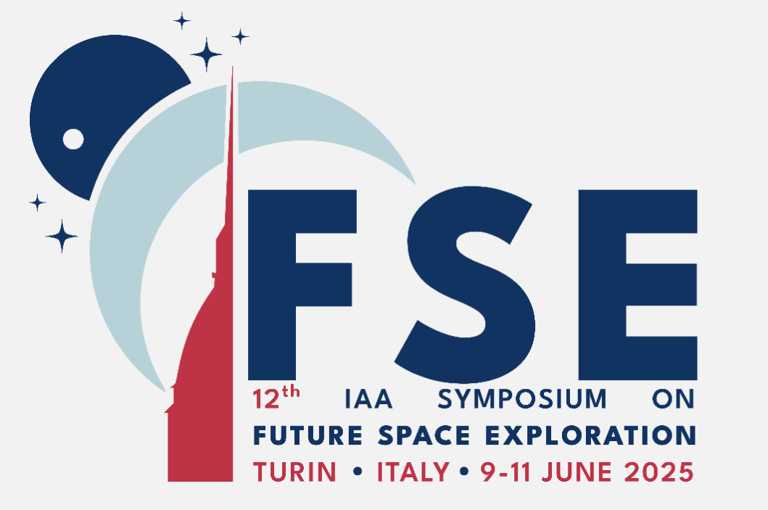
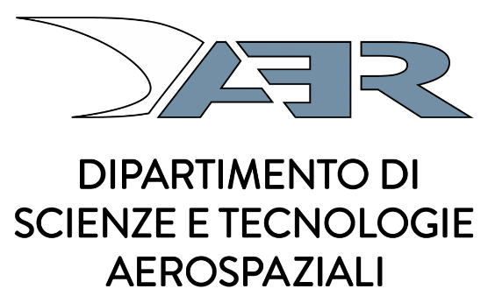

ADVANCING METAL CASTING FOR ISRU:
ADDITIVE MANUFACTURING OF REGOLITH-BASED CERAMIC MOLDS
Maxim Isachenkov^{*a}, Masoud Sadeghiª, Antonio M. Grandeª, Giuseppe Salaª
^{b} Department of Aerospace Science and Technology, Politecnico di Milano, Milano, Italy
* Presenter: maxim.isachenkov@polimi.it
Torino, June 2025

Slide 2
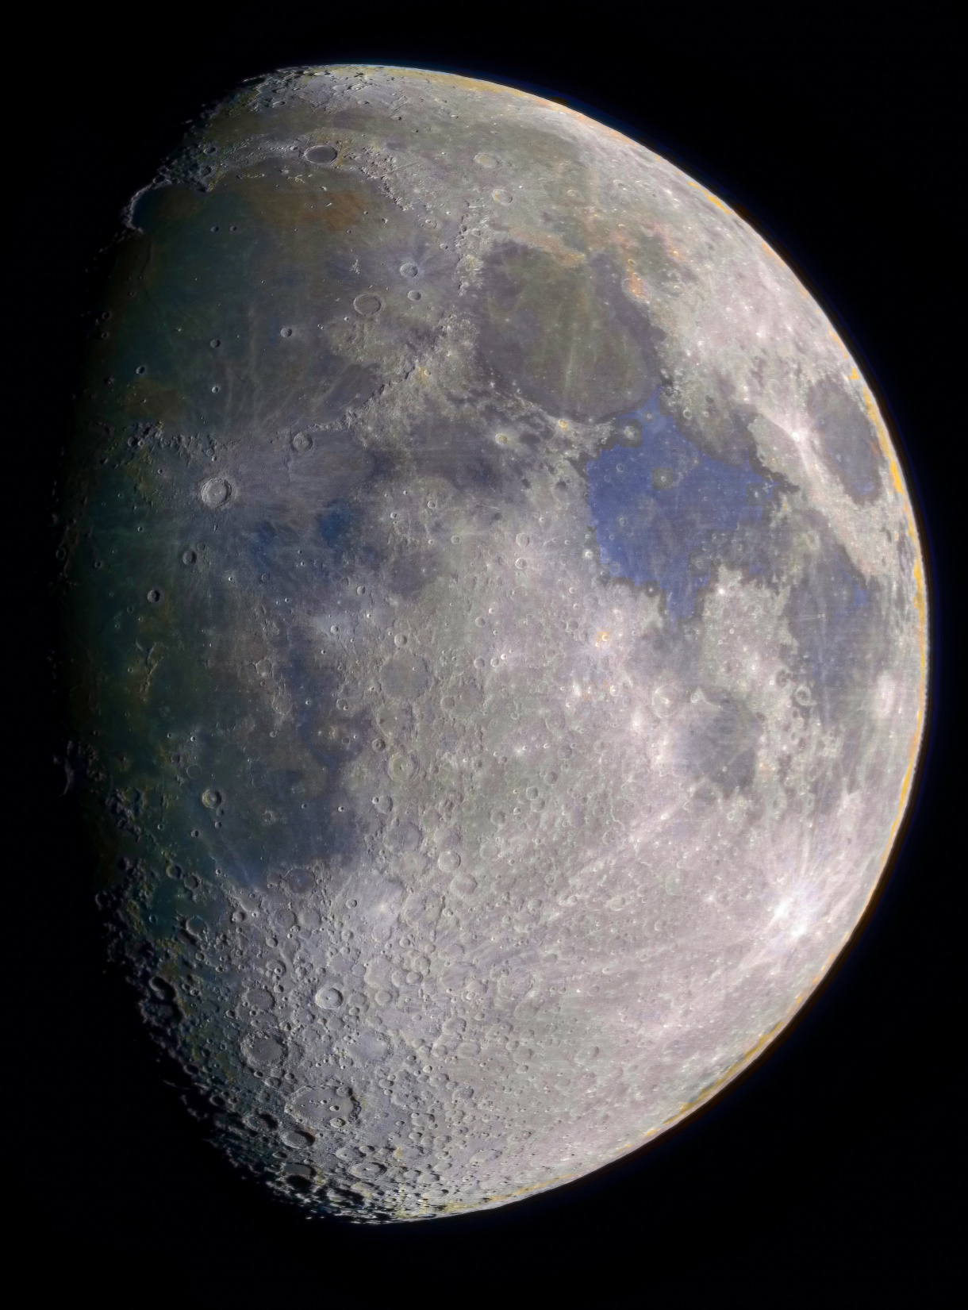

Slide 4
Outline
1. Relevance
2. DLP printing with regolith
3. Applications
4. Rapid-casting
5. Results
6. Outcomes

Slide 5
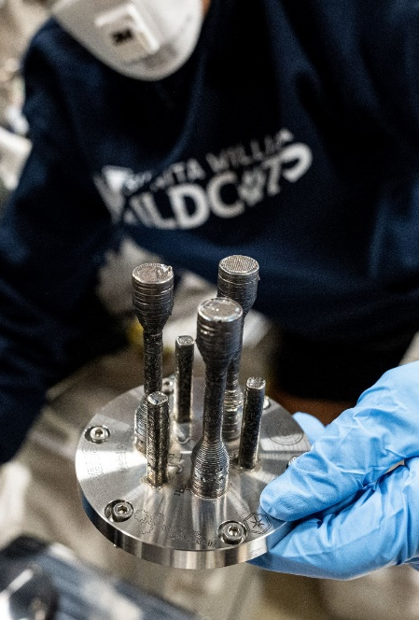
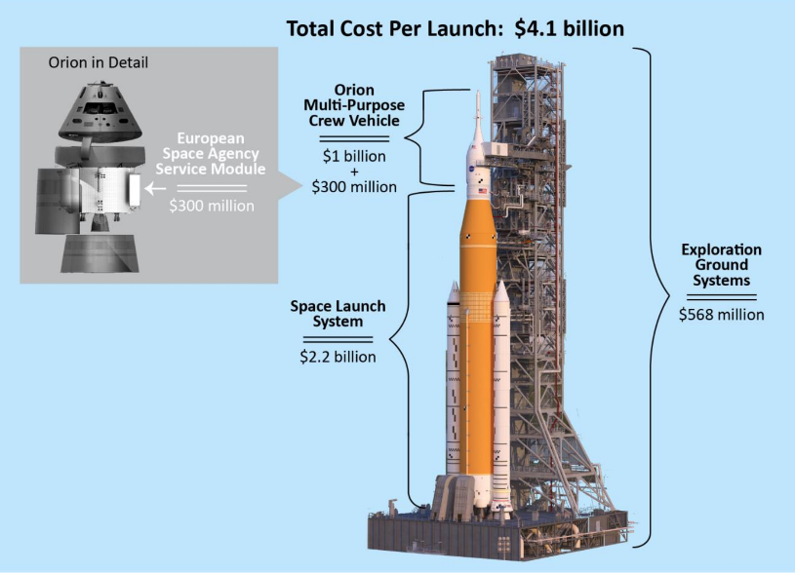
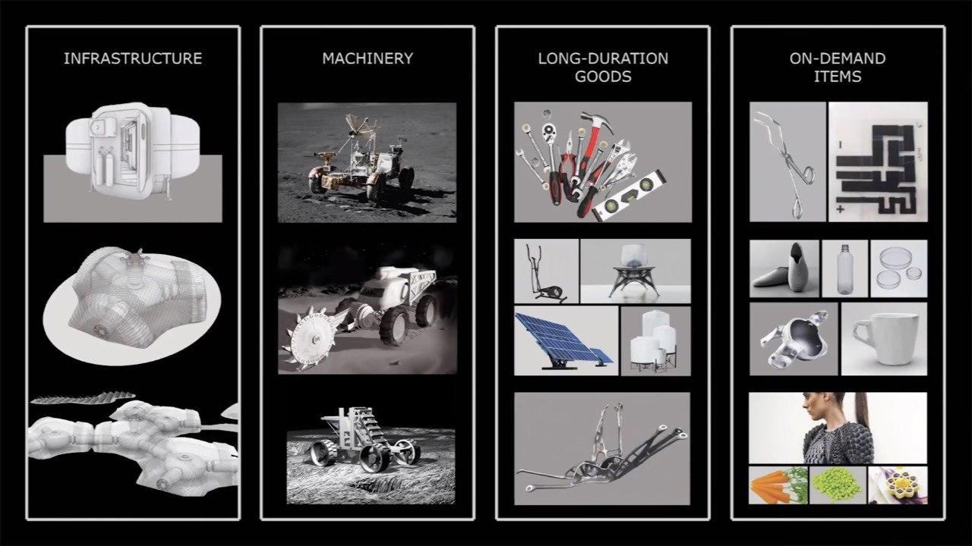
Why do we need AM on the Moon?
© ESA
Returning to the Moon won’t be cheap— every kilogram brought from Earth will count, that’s why we need to utilize in-situ mined resources
Lunar regolith has long been considered the primary stock for In-situ Fabrication and Repair (ISFR) operations in future lunar exploration missions
Using lunar regolith for in-situ additive manufacturing (AM) helps to ensure redundancy and sustainability for the lunar base, by producing a wide range of infrastructure, machinery, instruments and spare parts on-demand [1]
© NASA
[1] Isachenkov, et al. (2023). Technical evaluation of additive manufacturing technologies for in-situ fabrication with lunar regolith. Advances in Space Research, 71(6), 2656–2668. https://doi.org/10.1016/j.asr.2022.07.075
© ESA

Slide 6
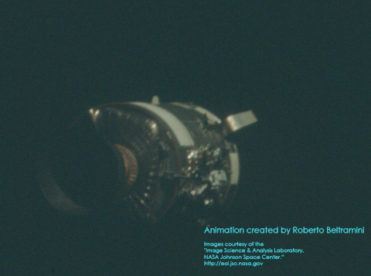
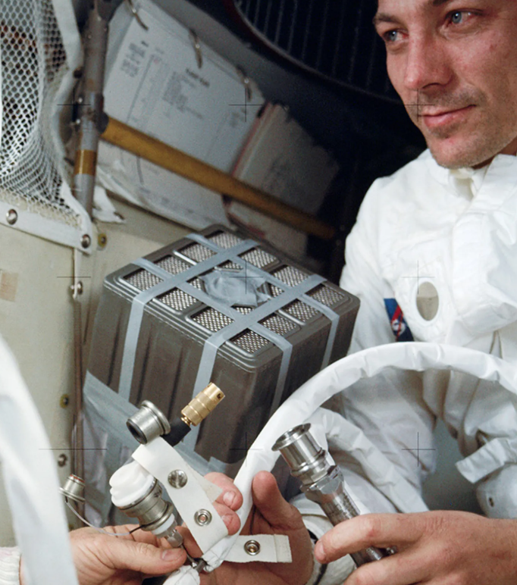
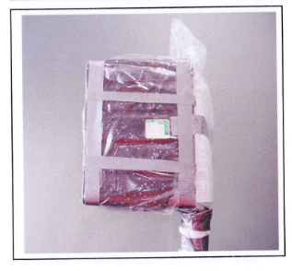
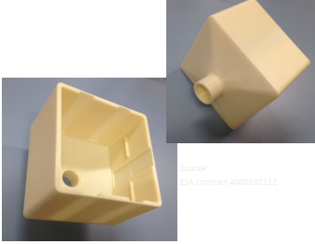
AM for Redundancy
Imagine you're an astronaut, 400,000 km from Earth. Your oxygen generator fails after explosion. What do you do?
*That was actually happened on Apollo-13 mission on its way to the Moon
Apollo-13’s service module damaged after O₂ tank explosion and installation of the improvised CO₂ scrubber
Small-scale AM of precise spare parts and on-demand items
Redundancy and self-sufficiency of the future
Lunar base
Replica of the improvised CO₂ scrubber (left) and modern FDM-printed version of it (right)

Slide 7
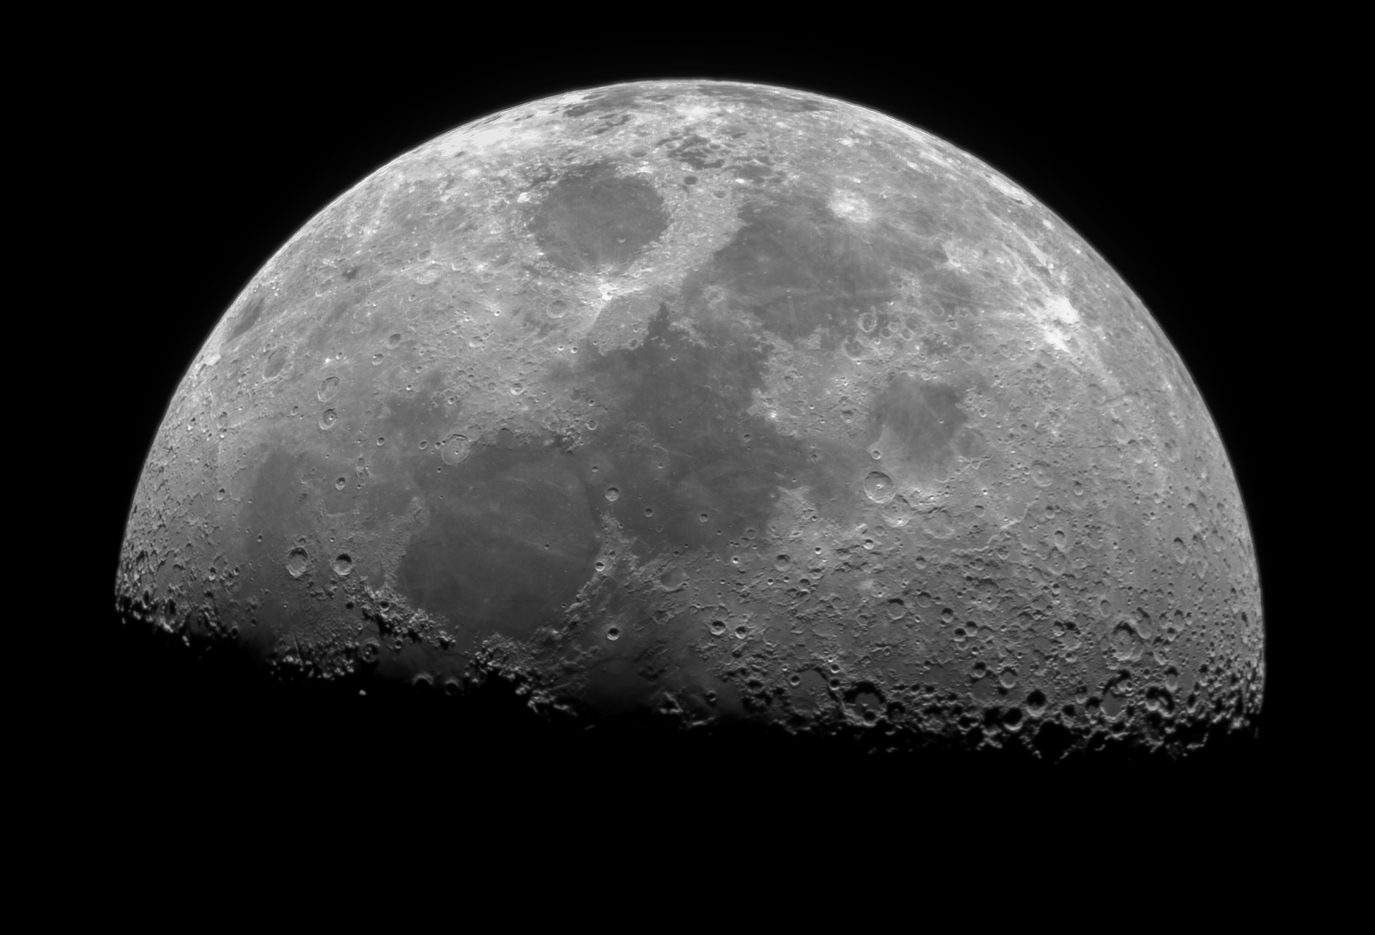
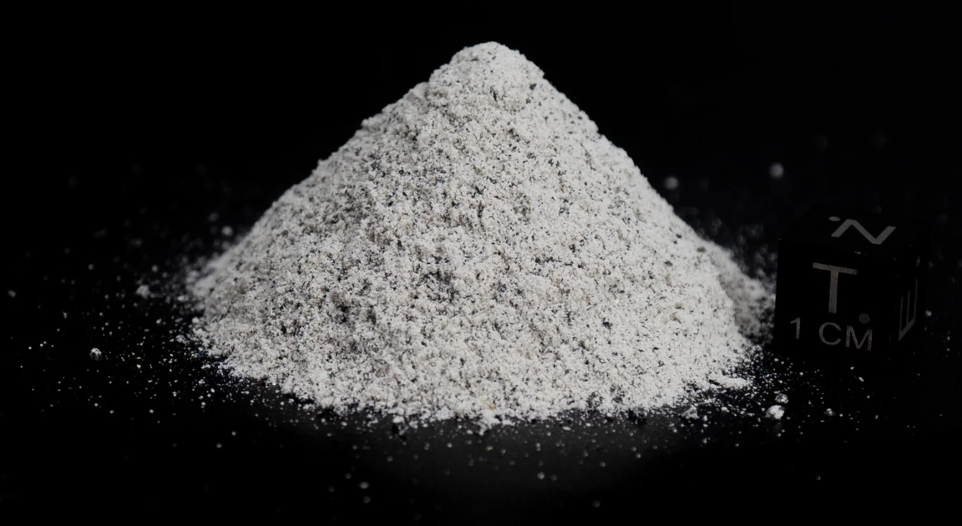
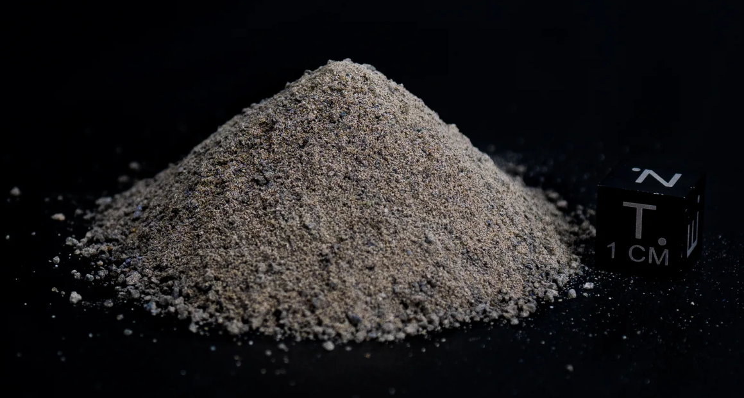
Types of Lunar regolith (LR)
[2]
Highland regolith:
mainly anorthite, rich in aluminum and calcium
Mare regolith: basalts reach in iron and titanium
[2] Isachenkov, M., et al., 2022. Characterization of novel lunar highland and mare simulants for ISRU research applications. Icarus 376, 114873. https://doi.org/10.1016/j.icarus.2021.114873
7

Slide 8
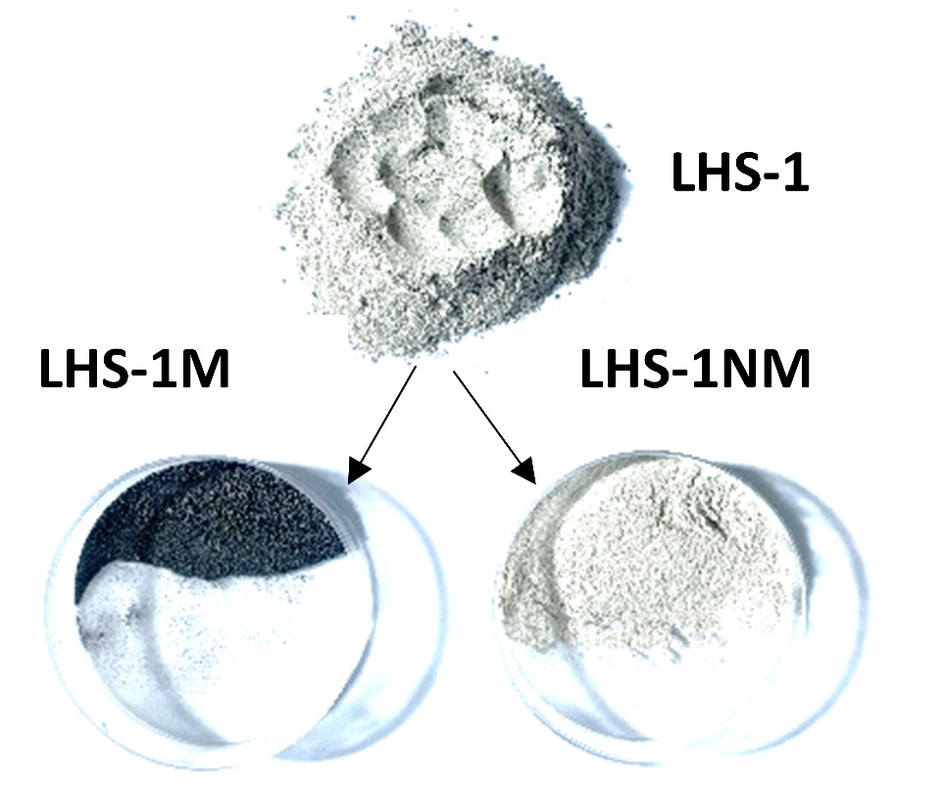
Magnetic beneficiation of LR
Main constituent (75 wt.%) of highland-LR is non-magnetic anorthite
Basalt (composing ⁓25 wt.% of LHS) contains substantial amounts of ferromagnetic iron in different forms and easily attracts to a magnet (LHS-M), leaving us with the desired non-magnetic anorthite (LHS-NM) fraction
The resulting homogeneous NM anorthite fraction is almost a perfect ceramic feedstock
Lunar SP: highland regolith
Magnetic separation
8

Slide 9

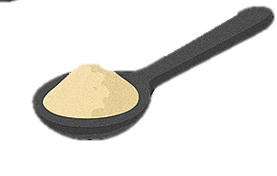


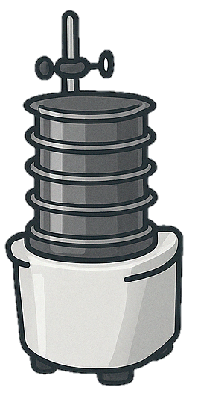
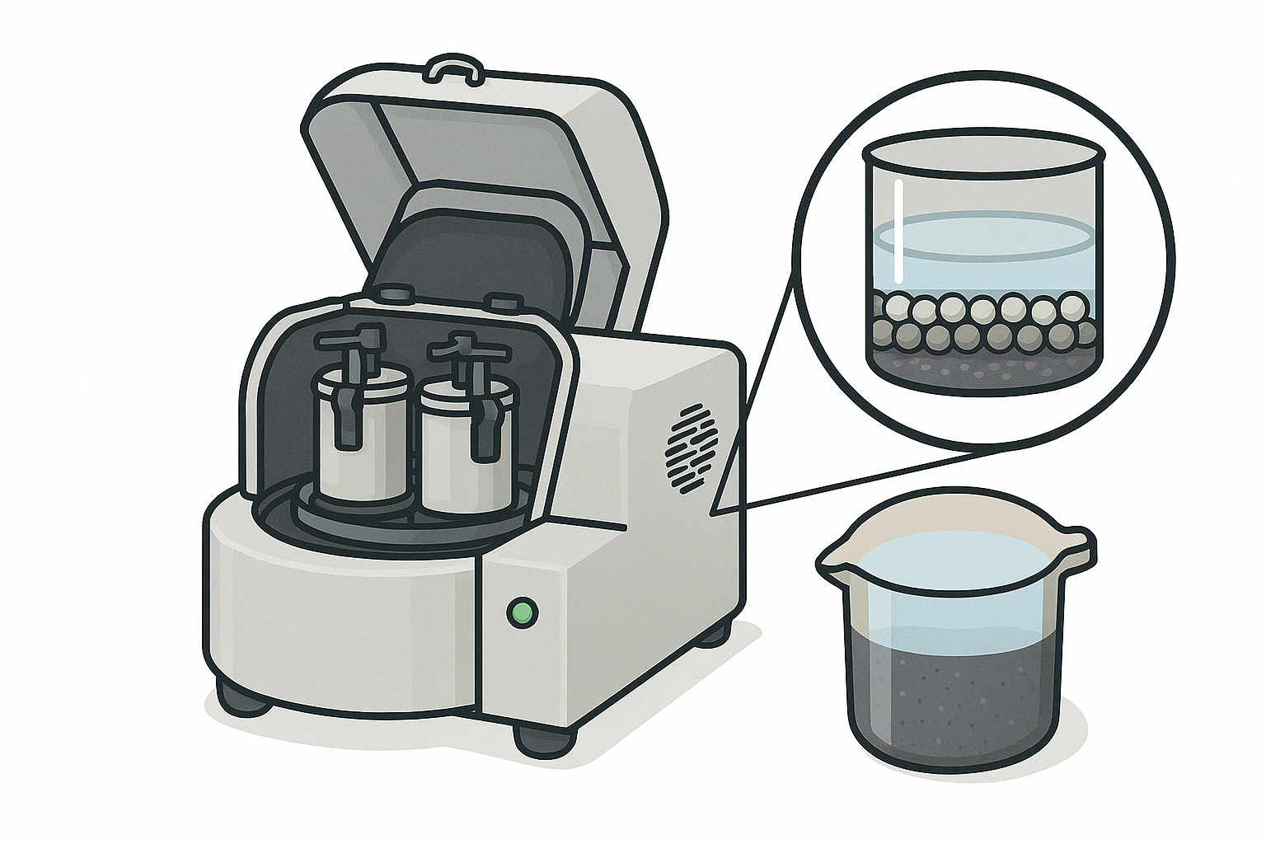



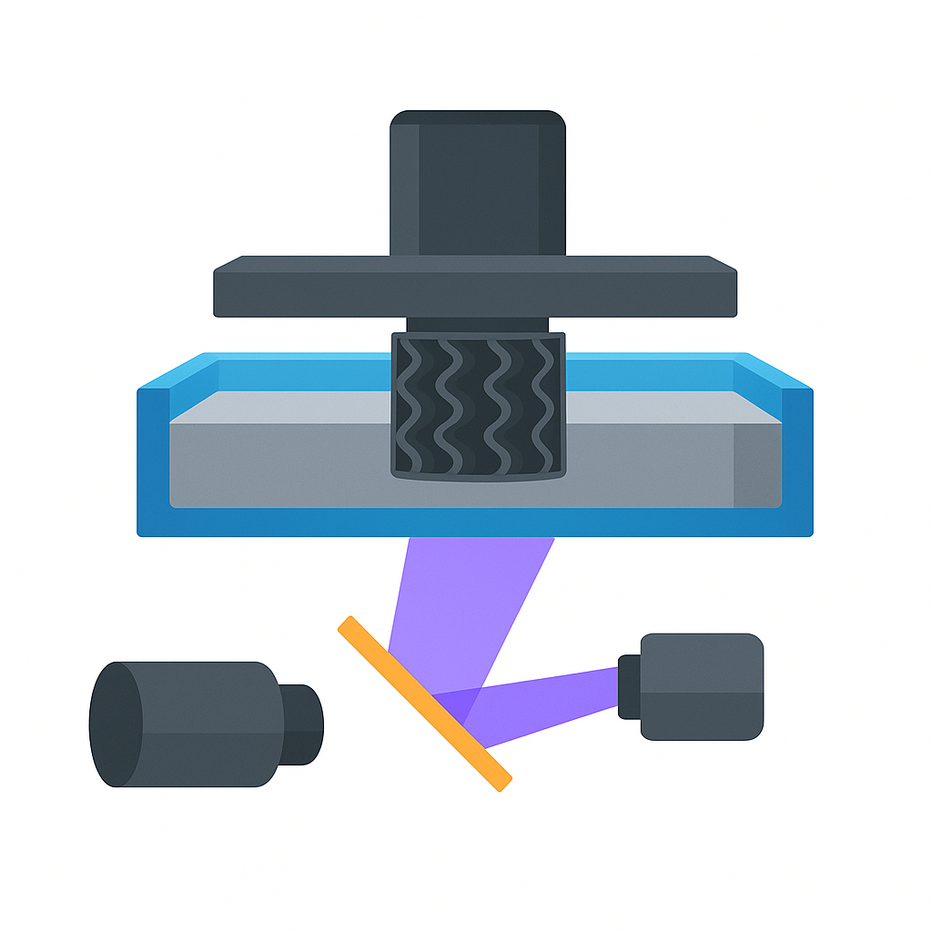
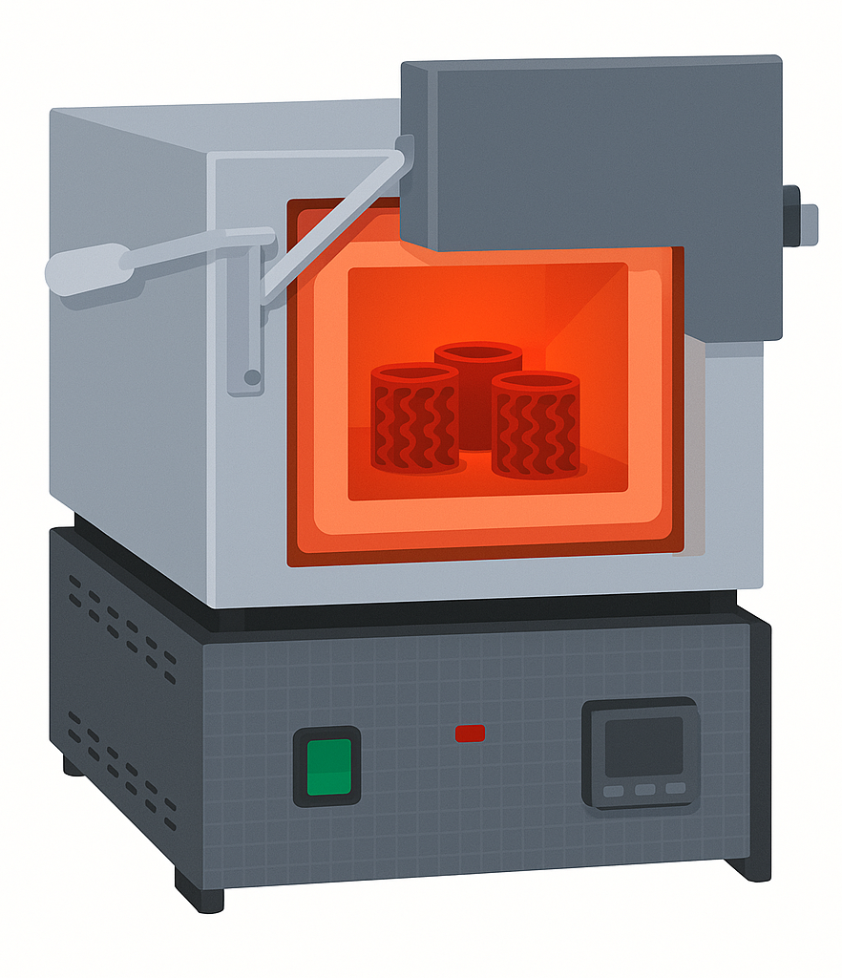
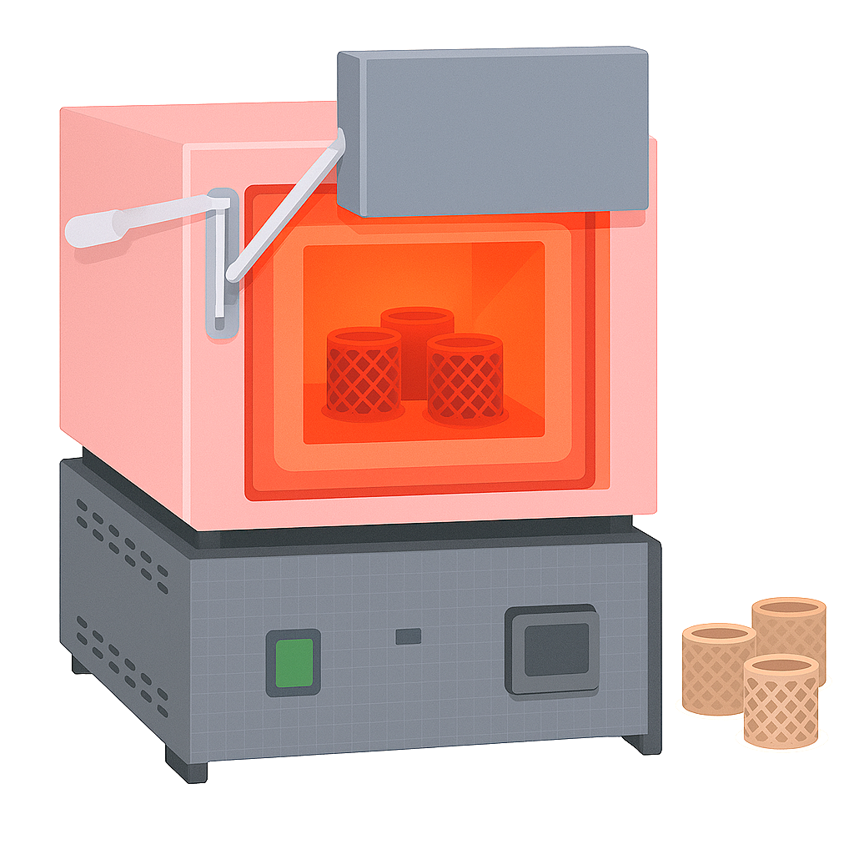
VP-AM with LR layout
TPO
Photocurable resin
30 wt.%
15 min, 140 µm sieve
2h, 250 rpm
D-111
TMPTA
PEG-400
M-fraction
NM-fraction
IPA (1.5:1)
ZrO₂ balls (5:1)
LR <140 µm
Milled LR
70 wt.%
1. Magnetic beneficiation
2. Seiving
3. Ball-milling
Green part
Building platform
LR-containing slurry
Vat
10min, 1200 rpm
Final regolith ceramic parts
UV lamp
6. Sintering
5. DLP-printing (Elegoo Mars 4 DLP)
4. Slurry mixing

Slide 10
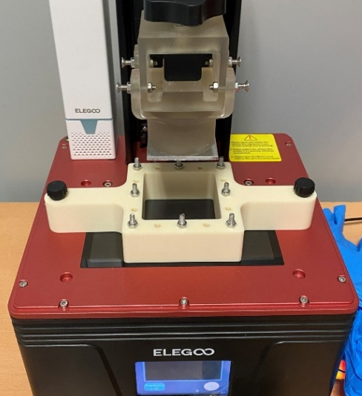
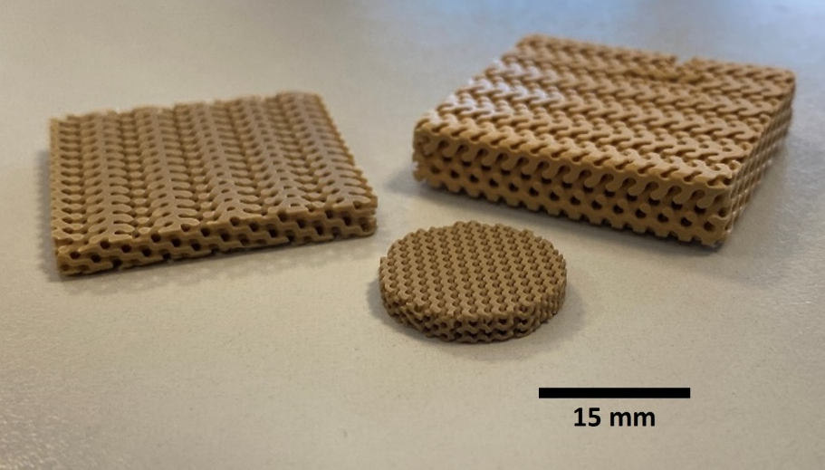
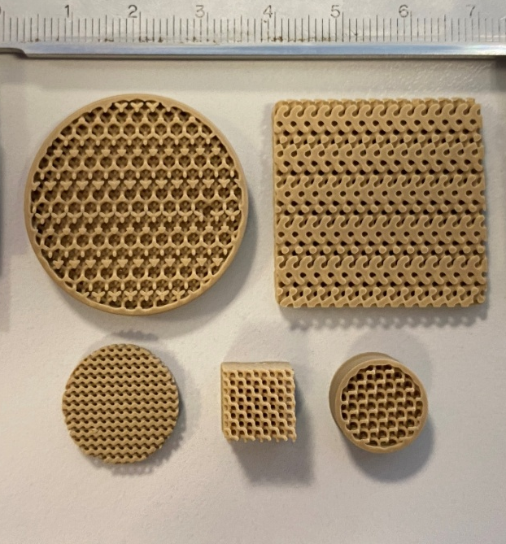
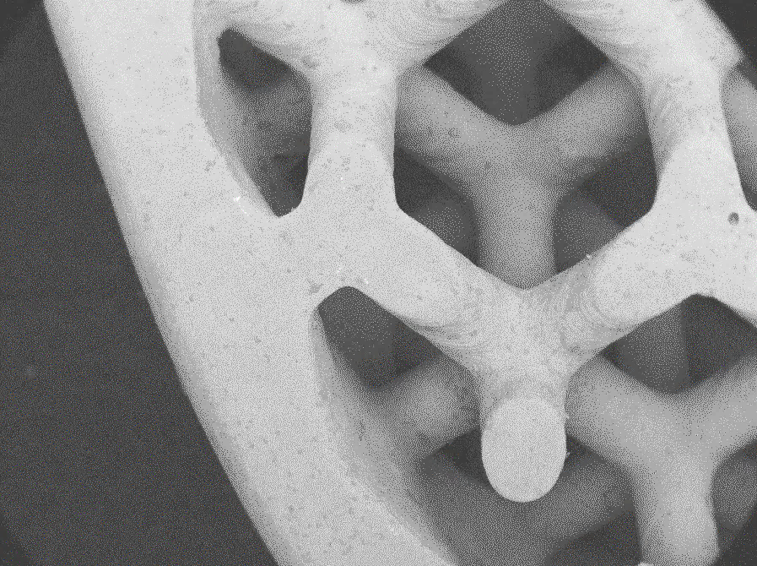
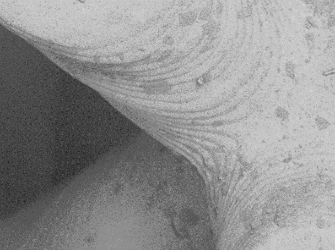
Printed to perform: Functional applications of lunar regolith ceramics
DLP printing of LR can deliver precise, rapid production of various mission-critical components—perfect for small-batch parts
The entire setup (printer, mill, furnace) is compact, crew-maintainable, and habitat-ready
Anorthite-rich LR-derived ceramics are essential where most of the metals fail: high temperatures (up to 1500 °C), thermal cycling, and extreme dimensional stability needs
A
250 µm
A
20 mm
1 mm
10

Slide 11
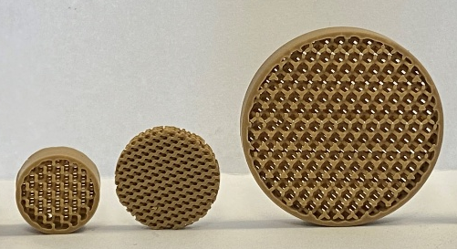
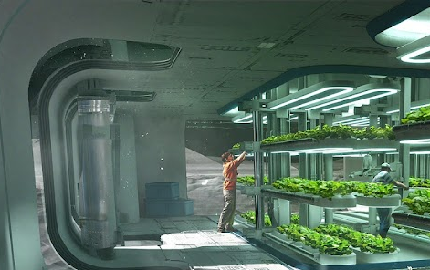
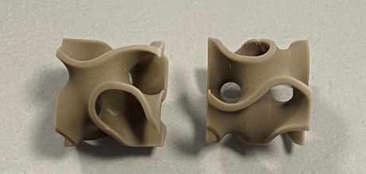
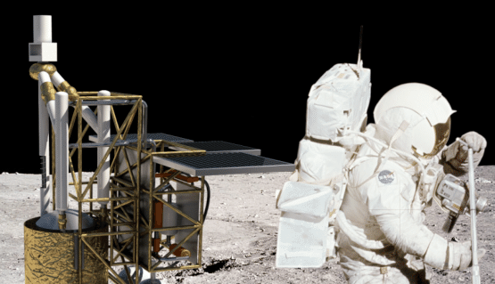
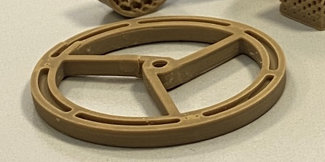
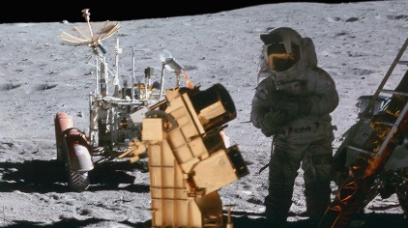
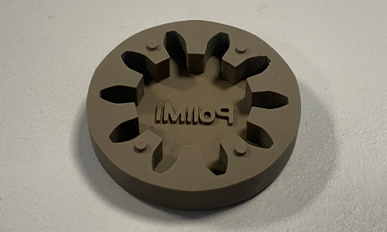
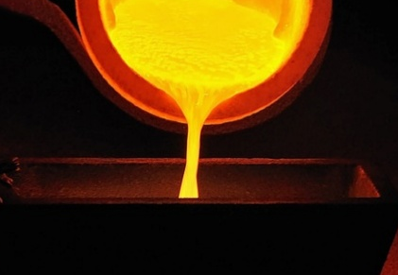
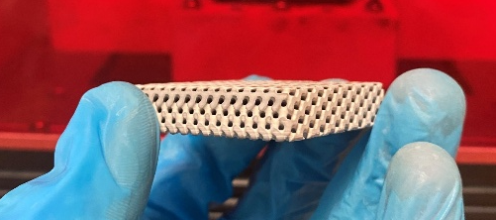
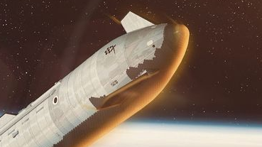
Application | Why Regolith ceramics?
Life support filters | Chemically inert, withstands high temperatures and vacuum; fine porosity control via DLP
Catalysis substrates | High surface area with tunable porosity; excellent thermal shock resistance and high melting T
Optomechanical parts | Low CTE ensures dimensional stability; radiation- and dust-resistant
Metal casting molds | Withstands molten metal (up to 1500°C); low wettability, printable into complex geometries
Thermal shielding | High compressive strength; insulative; printable into custom-fit shields or tiles
11

Slide 12
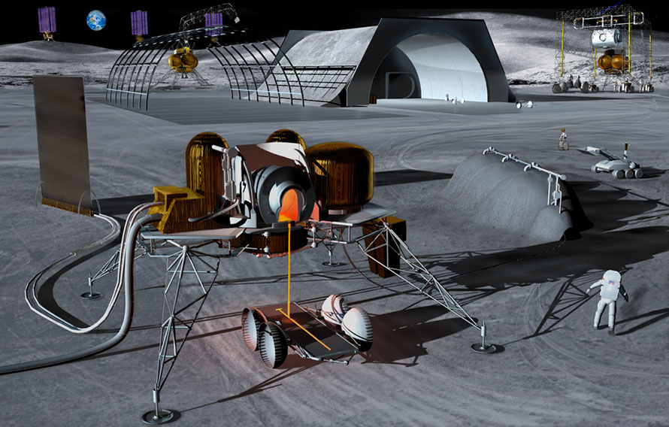
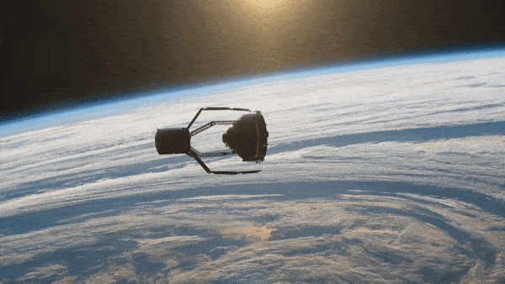
Where to find metals for casting on the Moon?
ISRU Al production
On-orbit recycling
FFC/ Molten salt electrolysis of in-situ excavated regolith with O₂ and Si as the by-products
Old rocket upper stages (up to 2.5 tons of Al in Arian 5’s upper stage) transferred from LEO to the lunar surface
+
In the future: lunar landers and out-of-use hardware on the surface

Slide 13
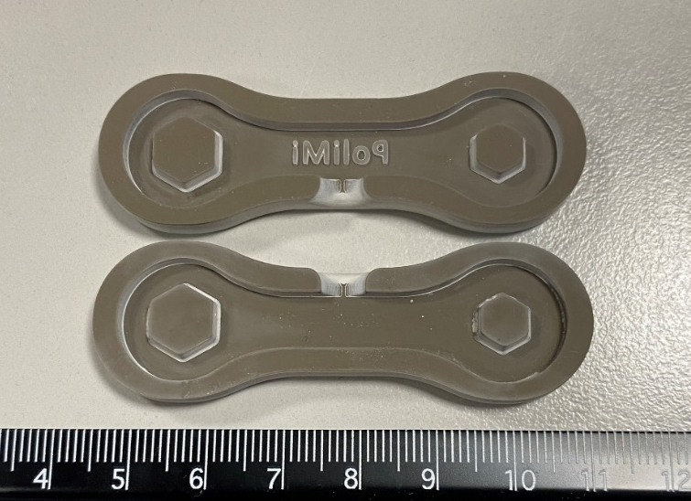
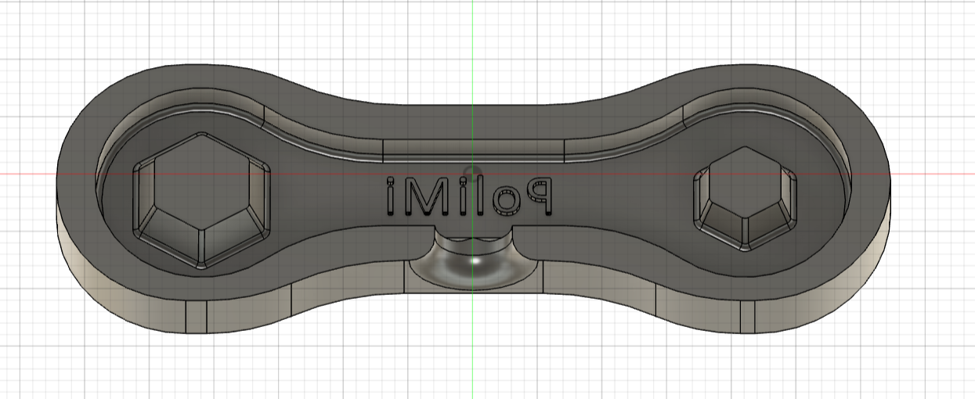
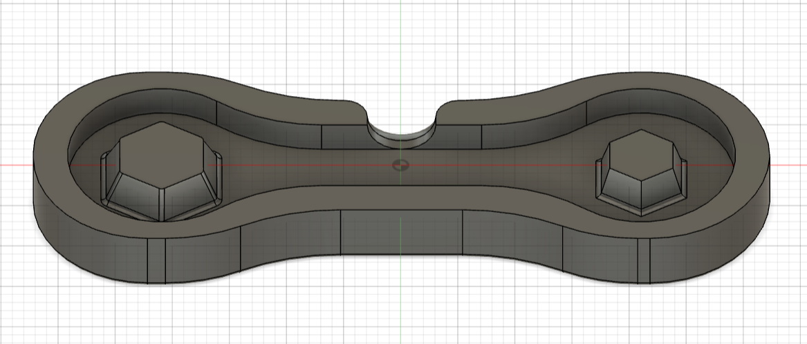
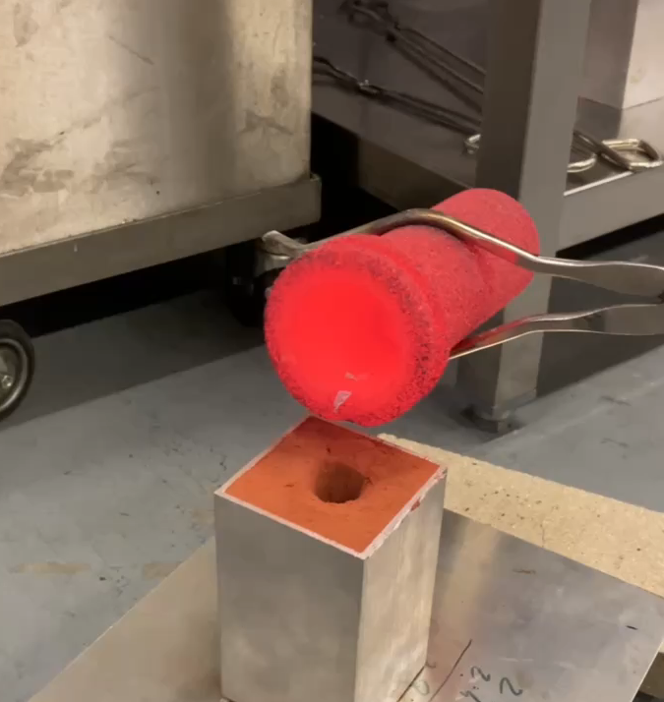
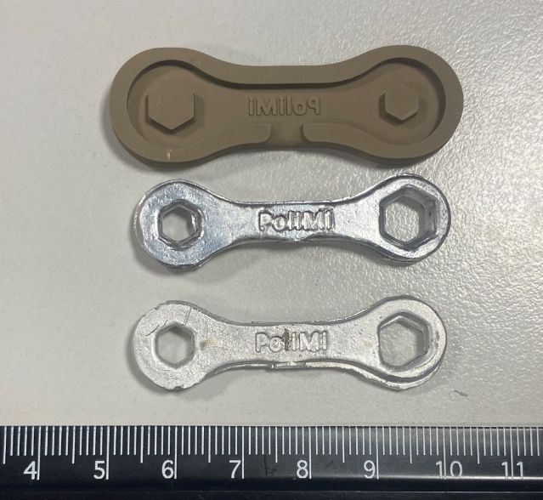
Rapid casting at a glance: from ceramic AM to casted metal parts
In-situ Fabrication of complex metal parts
Casting of mission-critical components, which can’t be produced from LR ceramics itself
Only minimal machining required
Molds with intricate internal features, reducing or eliminating the need for post-processing
Reusable or recyclable molds
Molds can be reused or broken down and reprocessed, supporting circular material flows
Mold CAD
DLP-printed mold
Sintered DLP-printed mold and as-casted Al-parts
13

Slide 14
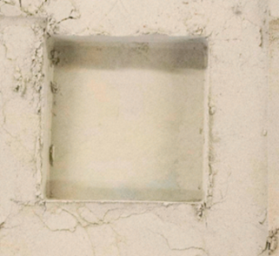
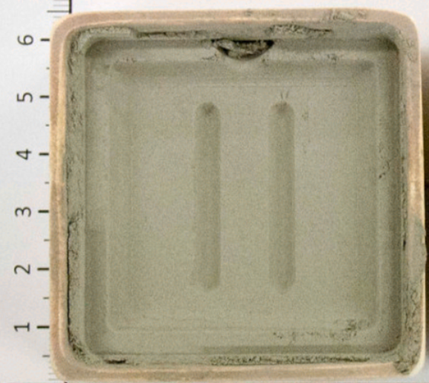
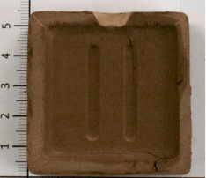
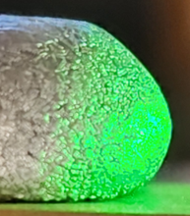
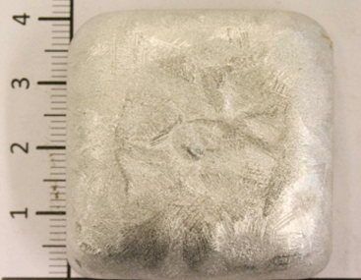
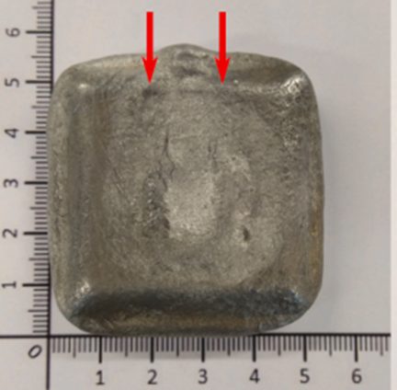
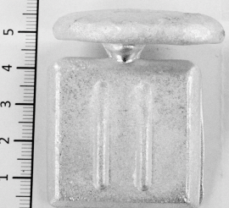

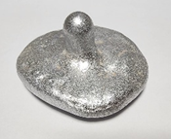
State-of-the-Art: Regolith casting methods
Casting in Compressed Regolith
Casting in Sintered Regolith
Lotus Effect
[1]
[1]
Requires a physical pattern
Impossible to produce complex shapes
Poor mold stability
Complex multi-part mold assembly
Surface repellency ("lotus effect") reduces mold filling
Pattern is still required
Hard to produce complex shapes
Improved mold stability,
Better wetting
[1] Baasch, J., Windisch, L., Koch, F., Linke, S., Stoll, E., & Schilde, C. (2021). Regolith as substitute mold material for aluminum casting on the Moon. Acta Astronautica, 182(January), 1–12. https://doi.org/10.1016/j.actaastro.2021.01.045

Slide 15















Casting Technologies: state of the art
Traditional Sand Casting
Rapid Casting
Pattern Production
[1]
Pattern CAD
3D printing of the Pattern
Silicone Mold
Wax pattern for shell Casting
Direct Rapid Casting
Shell Production
[2]
[1] D. Pal and B. Ravi, 2007, “Rapid tooling route selection and evaluation for sand and investment casting,” Virtual Phys Prototyp, vol. 2, no. 4, pp. 197–207., DOI: 10.1080/17452750701747088
[2] Rodríguez-González, 2020, “Feasibility of Calcium Sulfate Moulds Made by Inkjet 3D Printing for Rapid Casting of Aluminium Alloys,” Metals, 10(6), 802., DOI: 10.3390/met10060802

Slide 16



DLP-printing of shell cylinder regolith ceramics molds
As-printed shell molds
“Green” molds before sintering
 | Wall Thickness
Shell | As Printed | Ceramics
S1 | 2.75 | 2.3
S2 | 2.3 | 1.9
S3 | 1.55 | 1.25
Sintering, 1ºC/min, 1250 ºC, 4h dwell time
Sintered regolith ceramic shell molds

Slide 17






Mold configurations used in our study
1- Petrobond sand mold (traditional baseline)
2- Compressed LHS-1D regolith mold
3- DLP-printed ceramic shell mold
Complete filling but rough surface
Failed filling (didn’t reach cavity)
Excellent surface finish
and precise filling

Slide 18







Casting process with DLP-printed LR ceramic molds
LR ceramic shells
Melt pouring
Flasks after casting
Retrieved molds
Casted Al cylinder
Intact mold

Slide 19




Rapid casting vs traditional casting
LR ceramics
Sand
~25% increase in hardness with shell casting vs. compressed regolith; also higher than sand casting
Near-zero porosity (comparable to sand casting); compressed regolith casting showed 7.87% porosity
Excellent mold filling and significantly smoother surface than even traditional sand casting
Direct 3D printing of the shell (Pattern-less mold production)

Slide 20




Tensile samples preparation and testing
Lathing of casted Al cylinders
Produced tensile specimens
Specimens after tensile test

Slide 21





Wall thickness influence on microstructure
Microstructure of the Al cylinder casted in a 1.9 mm-thick shell
S1
S2
S3
Dendrite microstructure

Slide 22

Wall thickness influence on microhardness and tensile strength
S1
S2
S3
S1
S2
S3

Slide 23







Why is wall thickness so important?
Wall Thickness
Production
Material
Material Consumption
Cooling Rate
Production Time
Dendrites size
Mold
Re-usability
Mechanical
performance

Slide 24






Microstructure and elemental composition of casted parts
OES (Optical Emission Spectroscopy)
quantitative alloy composition analysis
EDS Elemental Mapping
Phase identification and
element distribution in microstructure
Presence of Mg₂Si as the secondary phase
Element | Wt%
Si | 0.992
Mg | 0.902
Fe | 0.413
Cu | 0.080
Mn | 0.858
Zn | 0.147
Al | Bal.
Si- and Mg-rich secondary phase
AA3004
Mg₂Si as eutectic phase
Expected dendritic primary structure

Slide 25


Casting on Earth and on the Moon: ProCAST simulation
1G
1/6G
0.315 s for mold filling
29.82 s for Solidification
0.427 s for mold filling
29.91 s for Solidification

Slide 26





Rapid casting of complex geometries
A
B
C
D
E
A
DLP-printed green part
LR ceramic mold
STL model
As-casted and polished part

Slide 27

Validation of Casting Quality and Properties
Density:
2.705 g/cm³ (97.9% rel. density)
Ultimate Tensile Strength (UTS):
192.1 MPa (89% of 215 MPa for AA3004)
Microhardness (Vickers):
66.2 VHN, (93% of standard 71 VHN)
Surface Roughness:
Ra ≈ 3–6 µm
Overall Performance:
The shell molding method outperformed compressed regolith and sand casting

Slide 28



Outcomes
High-strength complex-shaped ceramic molds can be DLP-printed from beneficiated regolith, helping to increase the redundancy and self-sufficiency of the future lunar outposts
Up to 1500°C operating temperature (compared to 1150°C reachable with original LHS), expanding the possible scope of applications for rapid casting
Mold reusability coming from low wetting, high strength, and good thermal shock resistance
Intricate geometries and good surface finish, minimizing the need for post-processing, thanks to DLP technology
28

Slide 29





Let’s start building our future in Space — one layer of Moon dust at a time!
We are open for any possible collaboration!

