Slide 1




Utilization of additively manufactured lunar regolith ceramics for in-situ fabrication of opto-mechanical parts on the Moon
Kirill A. Potemkin*ª, Maxim Isachenkov^{*b}, Antonio M. Grande^{b}, Diego Scaccabarozziª, Giuseppe Sala^{b}
ª Department of Mechanical Engineering, Politecnico di Milano, Milano, Italy
^{b} Department of Aerospace Science and Technology, Politecnico di Milano, Milano, Italy
* Presenter: maxim.isachenkov@polimi.it
Torino, June 2025

Slide 2
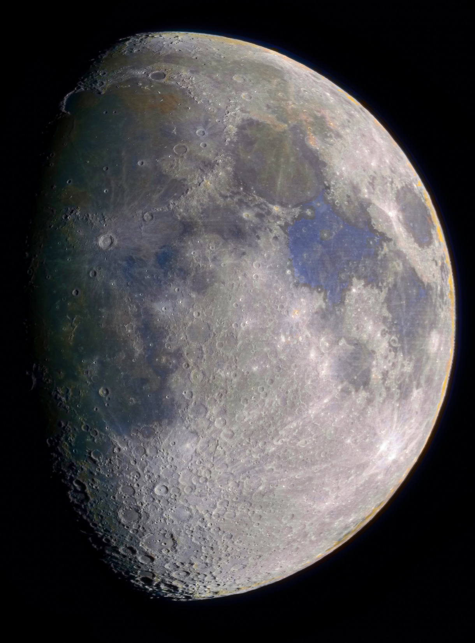

Slide 4
Outline
1. Relevance
2. Regolith as feedstock for DLP
3. Magnetic beneficiation
4. Results
5. Applications
6. Outcomes

Slide 5
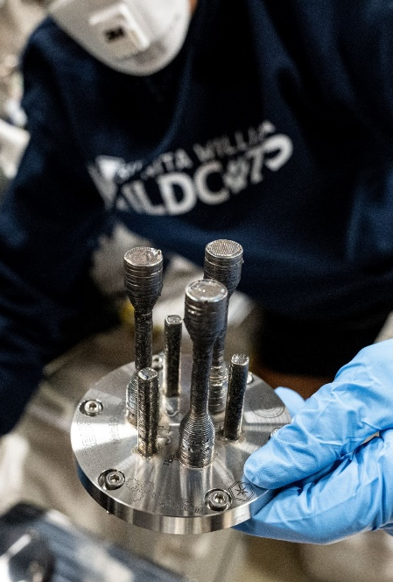
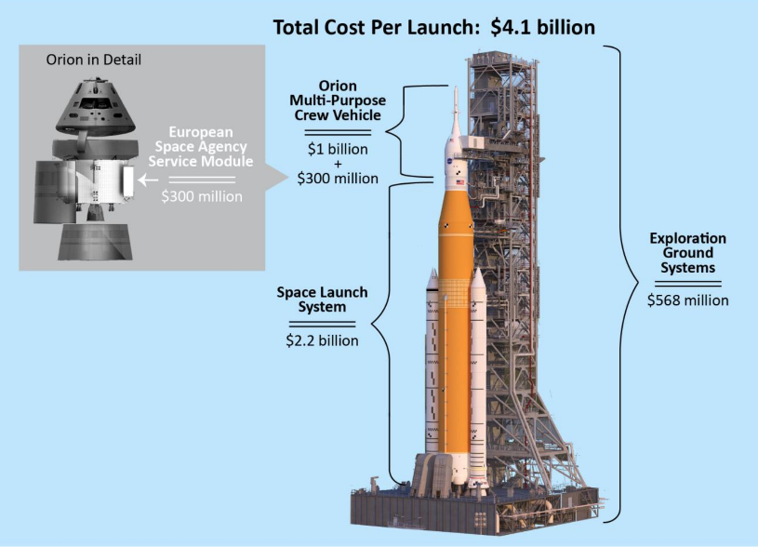
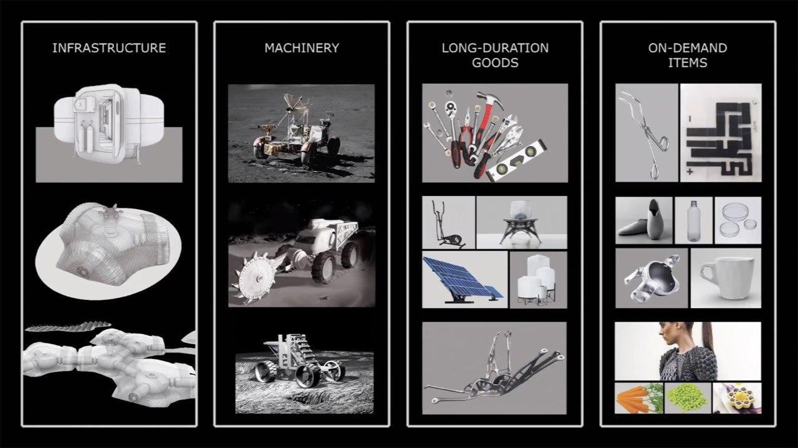
Why do we need AM on the Moon?
© ESA
Returning to the Moon won’t be cheap— every kilogram brought from Earth will count, that’s why we need to utilize in-situ mined resources
Lunar regolith has long been considered the primary stock for In-situ Fabrication and Repair (ISFR) operations in future lunar exploration missions
Using lunar regolith for in-situ additive manufacturing (AM) helps to ensure redundancy and sustainability for the lunar base, by producing a wide range of infrastructure, machinery, instruments and spare parts on-demand [1]
© NASA
[1] Isachenkov, et al. (2023). Technical evaluation of additive manufacturing technologies for in-situ fabrication with lunar regolith. Advances in Space Research, 71(6), 2656–2668. https://doi.org/10.1016/j.asr.2022.07.075
© ESA

Slide 6
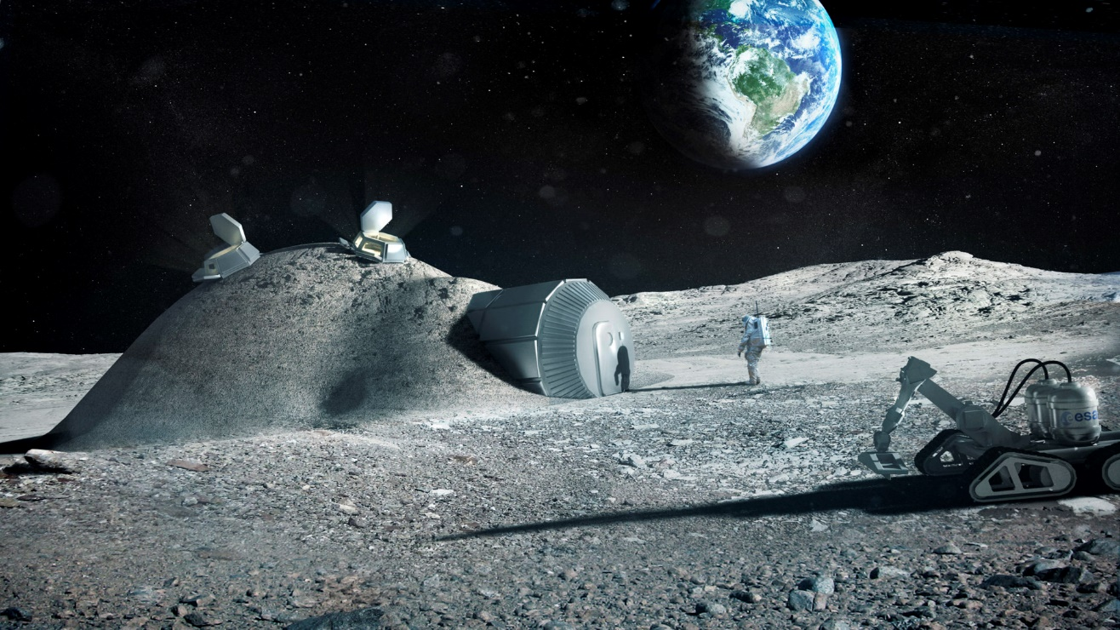
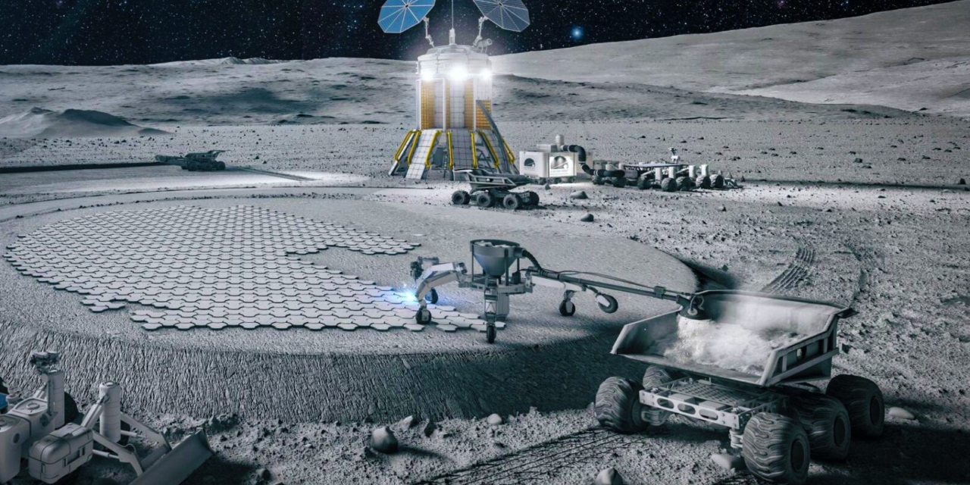
Lunar Infrastructure
Large-scale civil infrastructure
Landing-pads
Blast-walls
Pathways
Habitats’ shielding
Lunar base micrometeorite/radiation shielding and dust mitigation
Huge mass savings
[1]
@ESA
@ICON and SEArch+
[1] Isachenkov, M., et al.. (2023) https://doi.org/10.1016/j.asr.2022.07.075

Slide 7
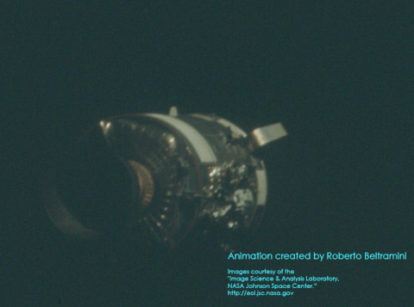
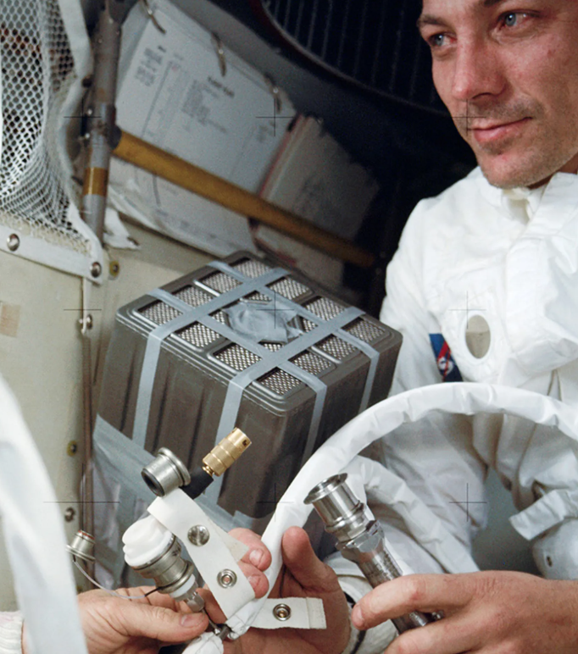
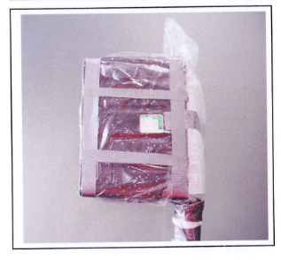
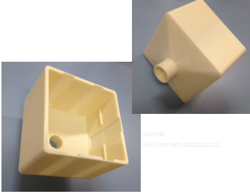
AM for Redundancy
Imagine you're an astronaut, 400,000 km from Earth. Your oxygen generator fails after explosion. What do you do?
*That was actually happened on Apollo-13 mission on its way to the Moon
Apollo-13’s service module damaged after O₂ tank explosion and installation of the improvised CO₂ scrubber
Small-scale AM of precise spare parts and on-demand items
Redundancy and self-sufficiency of the future
Lunar base
Replica of the improvised CO₂ scrubber (left) and modern FDM-printed version of it (right)

Slide 8
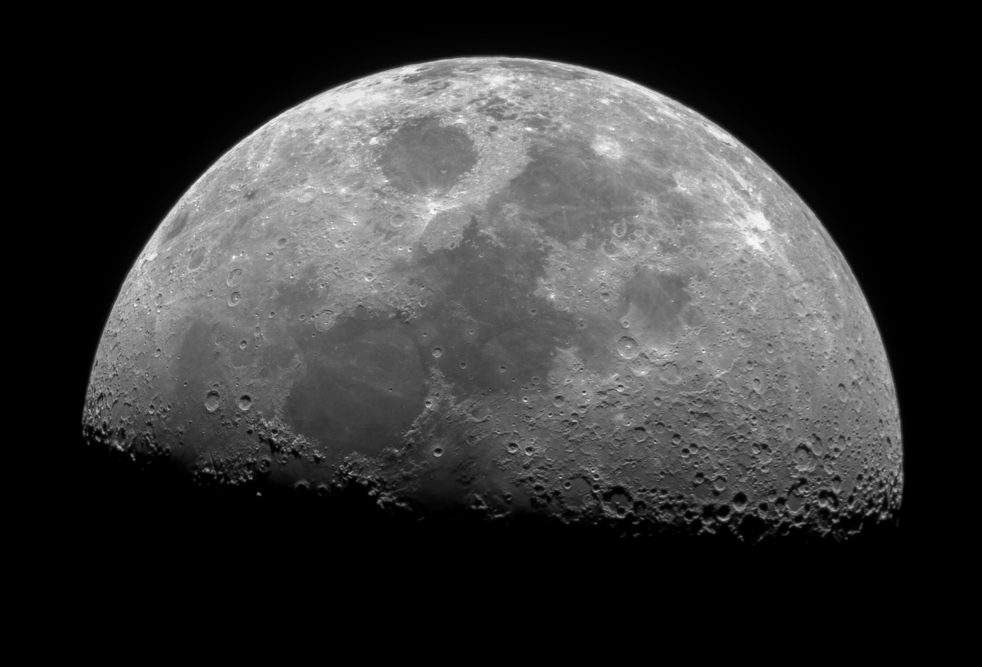
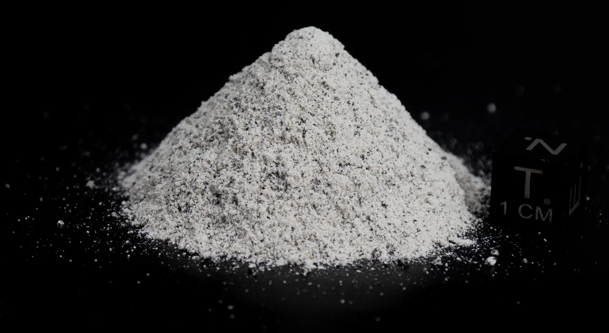
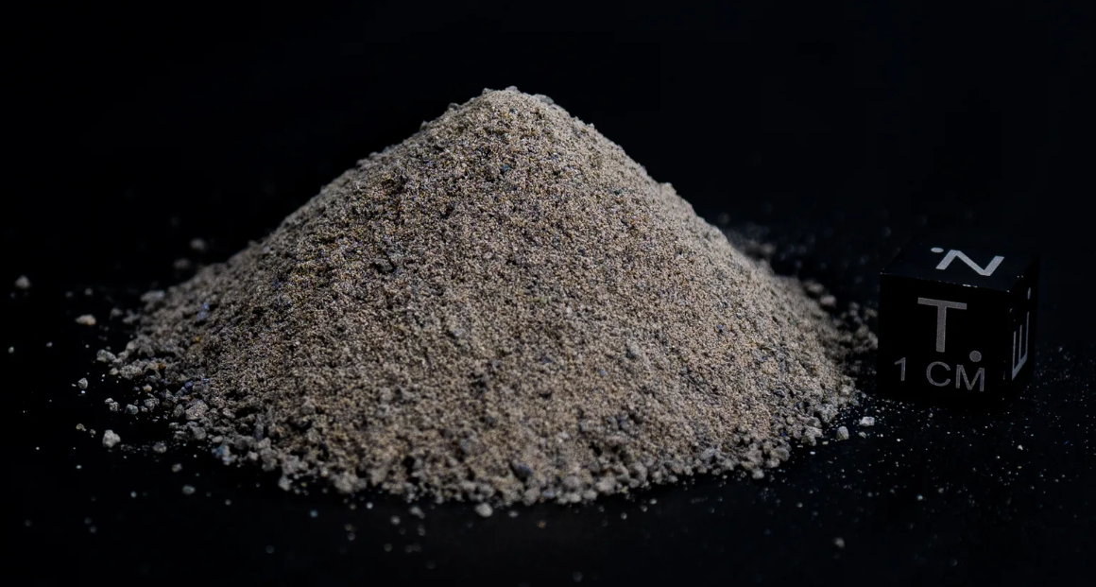
Types of Lunar regolith (LR)
[2]
Highland regolith:
mainly anorthite, rich in aluminum and calcium
Mare regolith: basalts reach in iron and titanium
[2] Isachenkov, M., et al., 2022. Characterization of novel lunar highland and mare simulants for ISRU research applications. Icarus 376, 114873. https://doi.org/10.1016/j.icarus.2021.114873
8

Slide 9
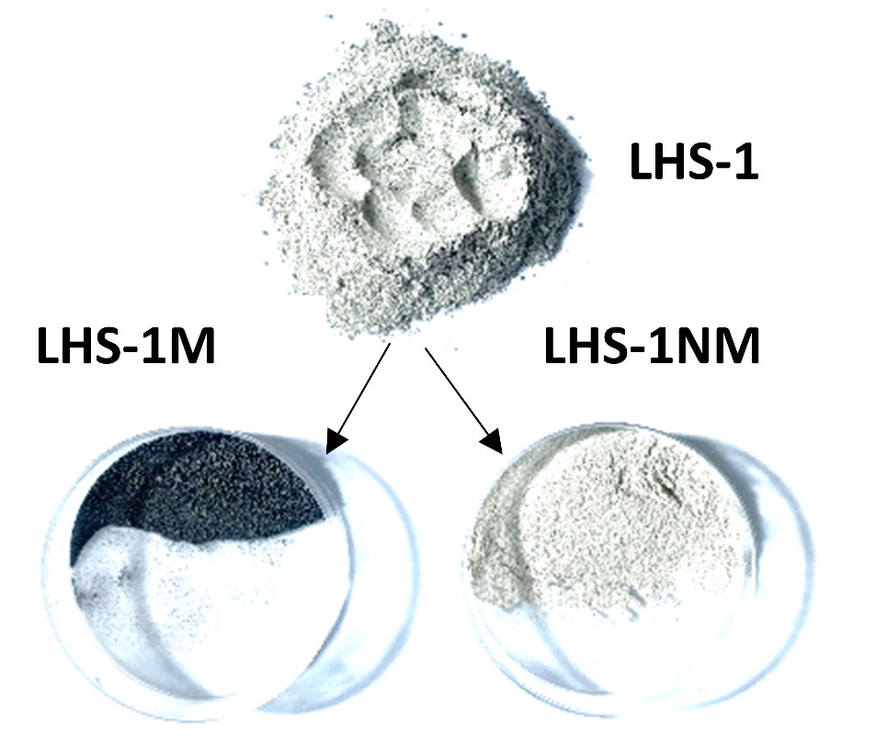
LR magnetic beneficiation
The idea was to refine highland LR composition further, using magnetic beneficiation
Main constituent (75 wt.%) of highland-LR is non-magnetic anorthite
Basalt (composing ⁓25 wt.% of LHS) contains substantial amounts of ferromagnetic iron in different forms and easily attracts to a magnet (LHS-M), leaving us with desired non-magnetic anorthite (LHS-NM) fraction
How will this anorthite enrichment enhance DLP-printing and sintering performance?
Lunar SP: highland regolith
9

Slide 10

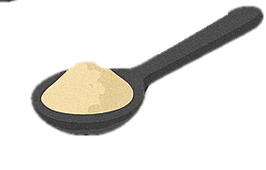


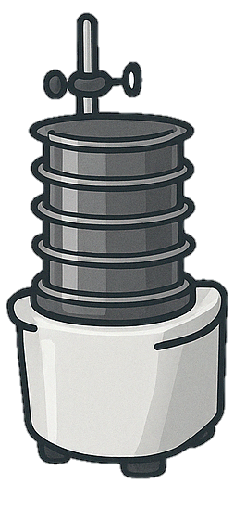
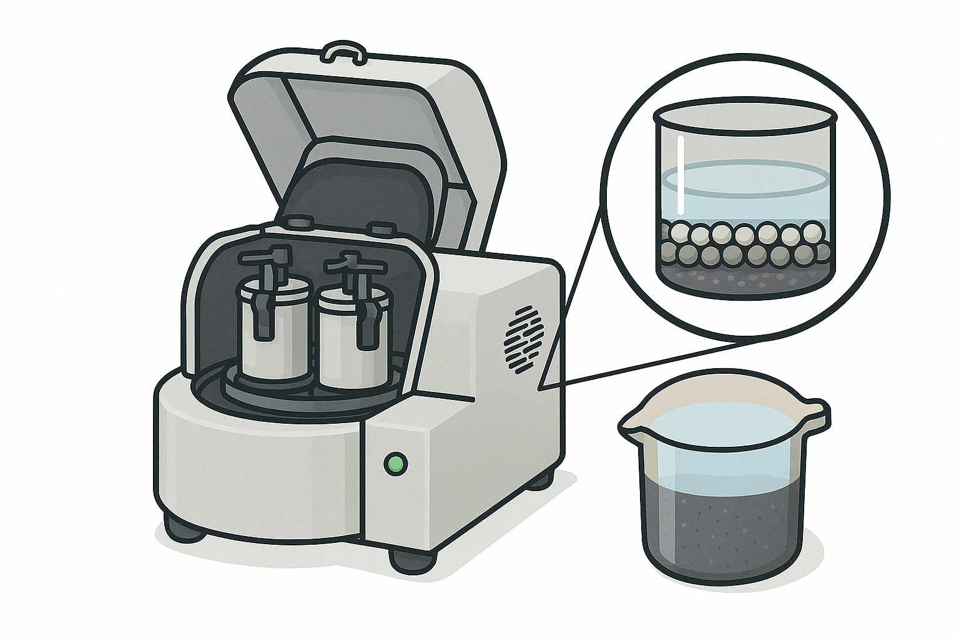



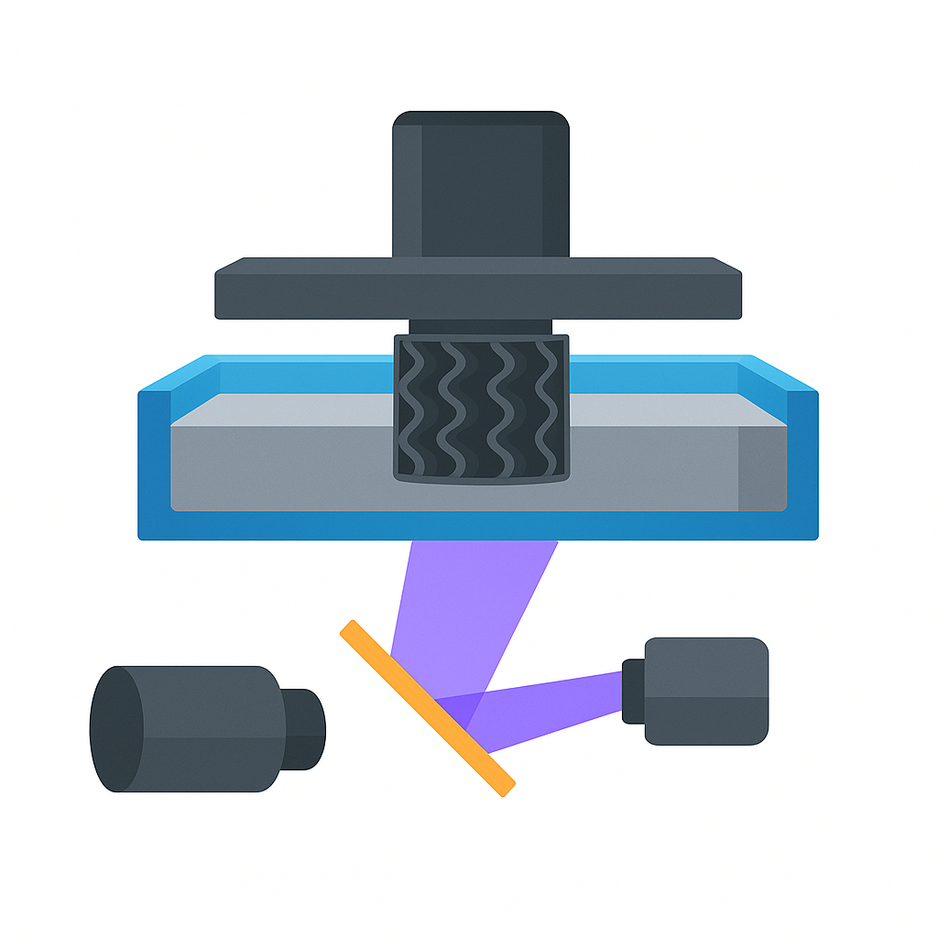
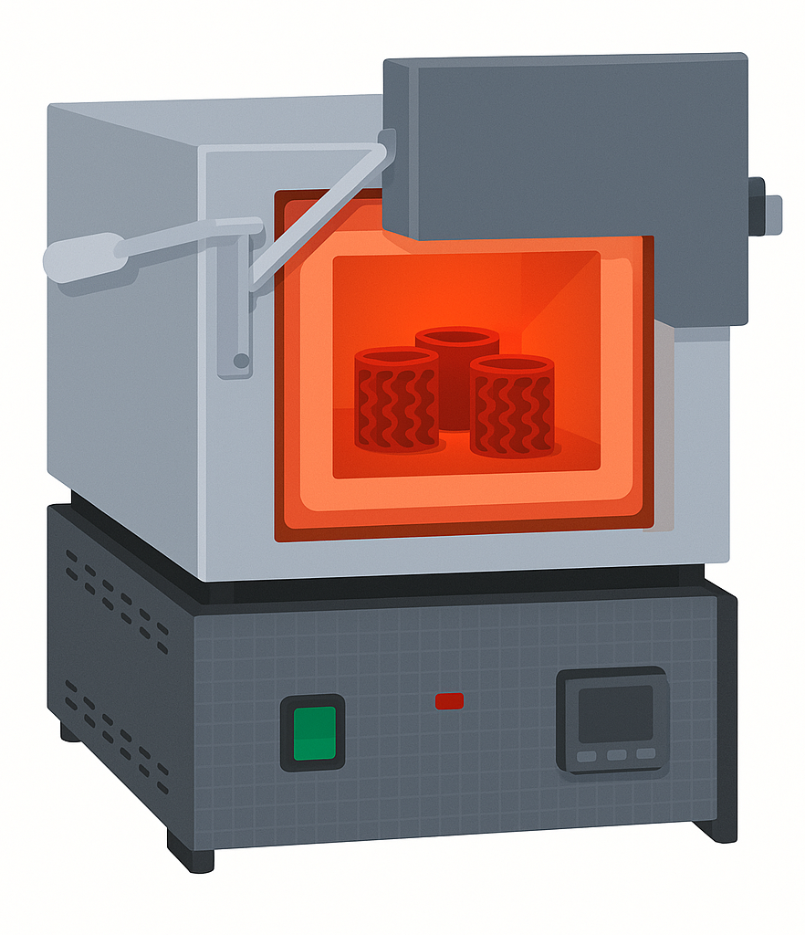
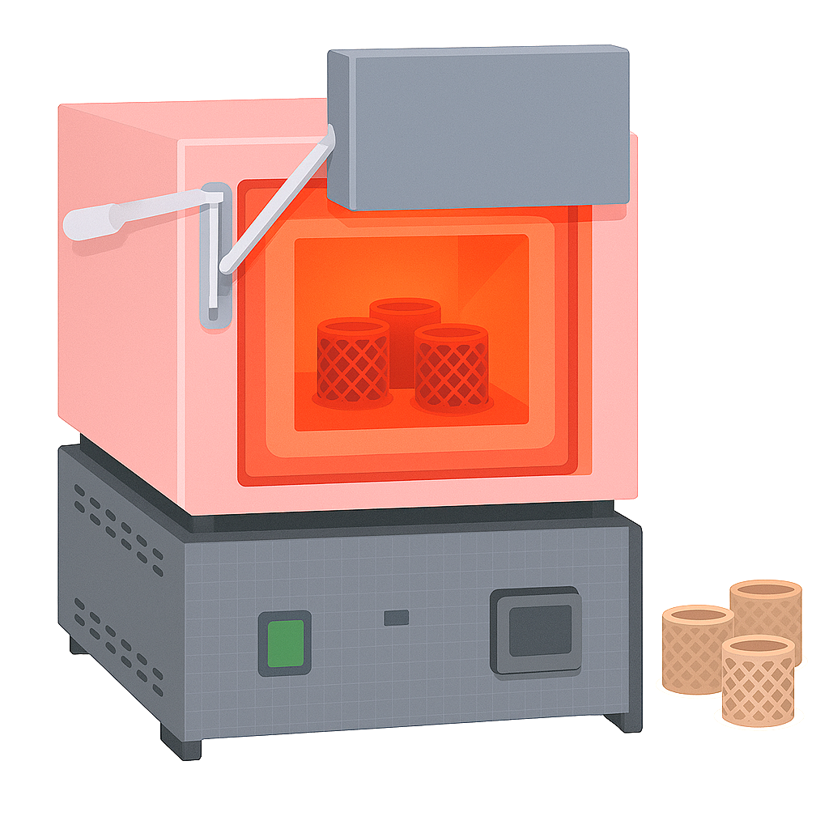
Process layout
TPO
Photocurable resin
30 wt.%
15 min, 140 µm sieve
2h, 250 rpm
D-111
TMPTA
PEG-400
M-fraction
NM-fraction
IPA (1.5:1)
ZrO₂ balls (5:1)
LR <140 µm
Milled LR
70 wt.%
1. Magnetic beneficiation
2. Seiving
3. Ball-milling
Green part
Building platform
LR-containing slurry
Vat
10min, 1200 rpm
Final regolith ceramic parts
UV lamp
6. Sintering
5. DLP-printing (Elegoo Mars 4 DLP)
4. Slurry mixing

Slide 11
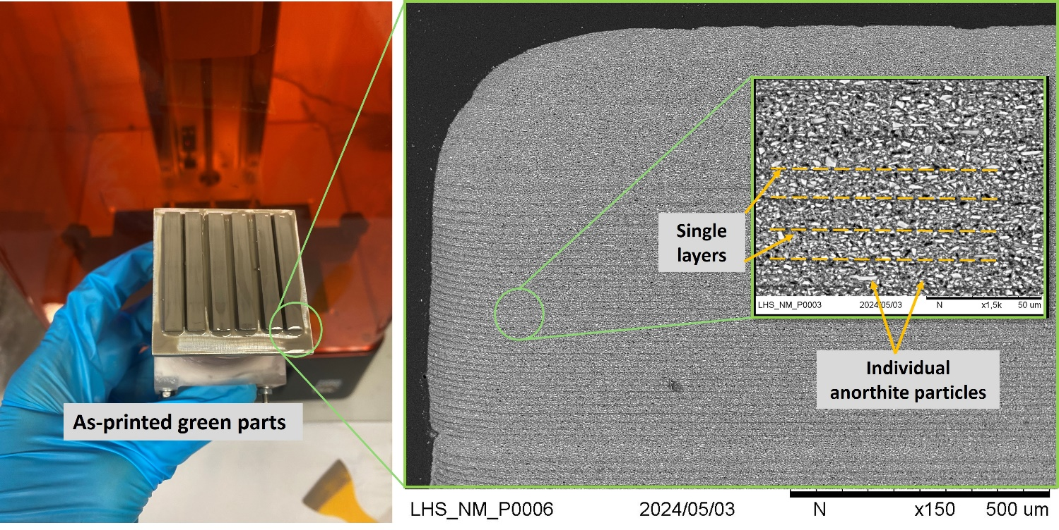
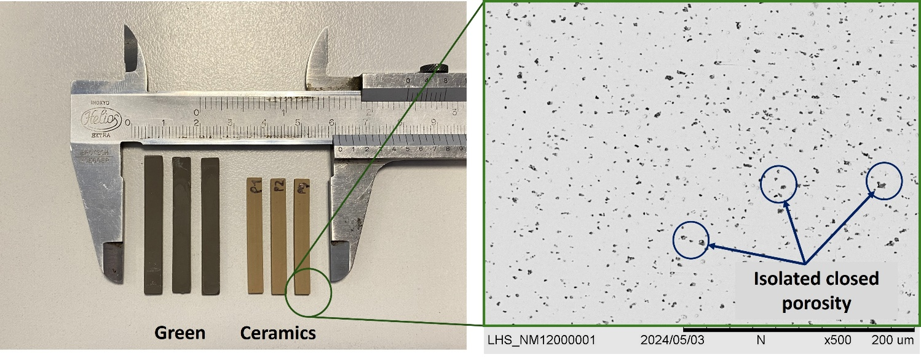
DLP-printing of NM regolith
[4]
After we have determined the optimal basalt content in the slurry, we have 3D-printed first samples from the magnetically beneficiated highland regolith (NM)
Instead of the 60s needed to have a proper inter-layer bonding for the DLP-printing with original highland regolith slurries, it took only 10s to produce properly bonded green parts
With the optimization of the slurry composition, this value can be decreased even further
11

Slide 12
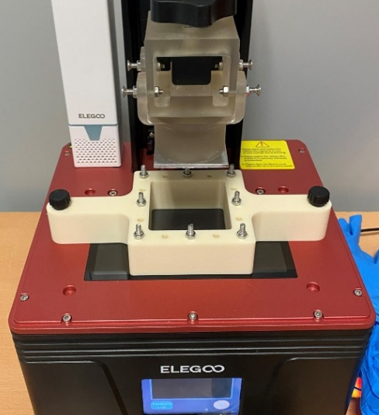
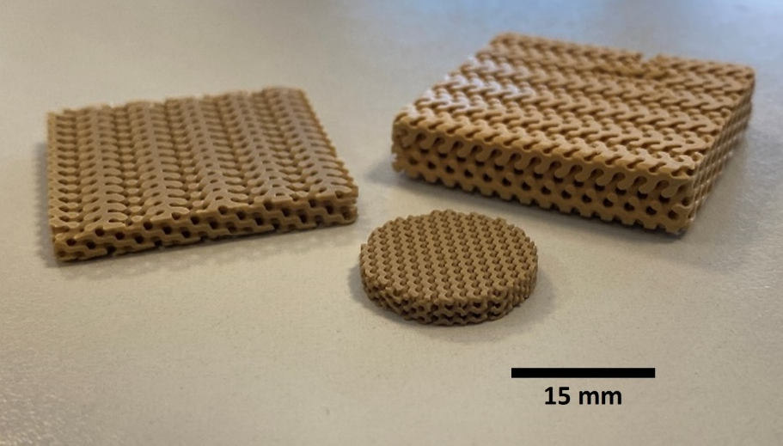
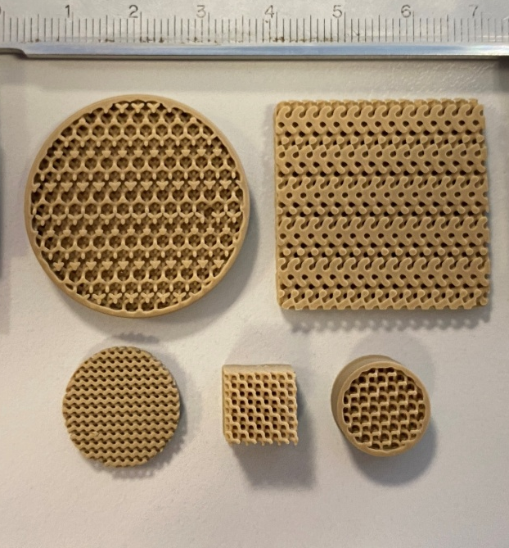
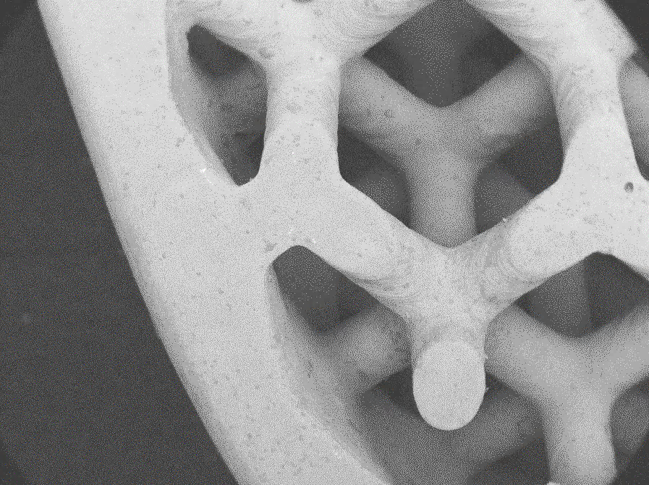
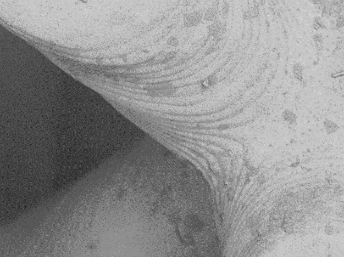
Printed to perform: Functional applications of lunar regolith ceramics
DLP printing of LR can deliver precise, rapid production of various mission-critical components—perfect for small-batch parts
The entire setup (printer, mill, furnace) is compact, crew-maintainable, and habitat-ready
Anorthite-rich LR-derived ceramics are essential where most of the metals fail: high temperatures, thermal cycling, and extreme dimensional stability needs
A
250 µm
A
20 mm
1 mm
12

Slide 13
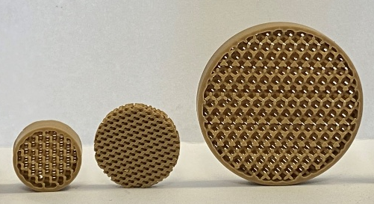

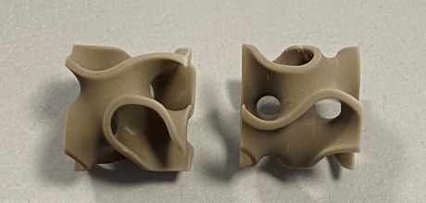
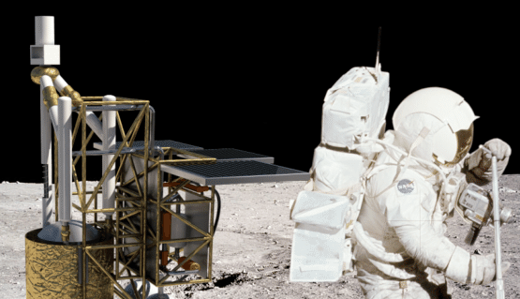
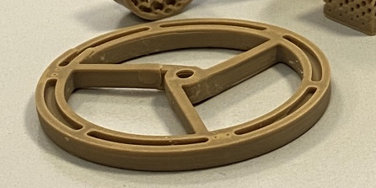
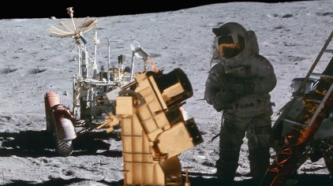
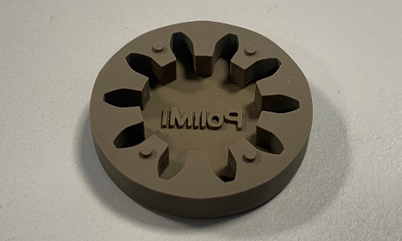
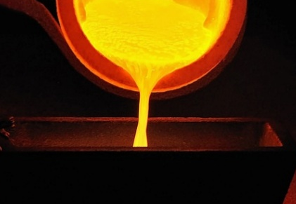
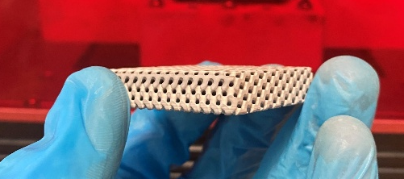
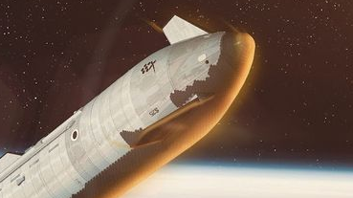
Application | Why Regolith ceramics?
Life support filters | Chemically inert, withstands high temperatures and vacuum; fine porosity control via DLP
Catalysis substrates | High surface area with tunable porosity; excellent thermal shock resistance and high melting T
Optomechanical parts | CTE ensures acceptable dimensional stability; radiation- and dust-resistant
Metal casting molds | Withstands molten metal (up to 1500°C); low wettability, printable into complex geometries
Thermal shielding | High compressive strength; insulative; printable into custom-fit shields or tiles
13

Slide 14
Why regolith can be used for Optomechanical parts?
Property | Unit | Lunar Regolith Ceramic (Sintered) | Invar 36 | Aluminum 7075 | Silicon Carbide (C/SiC®) | ZERODUR® (Class 0) | ULE-glass (Corning)
Density (ρ) | g/cm³ | 2.585 | 8.05 | 2.81 | 3.1 | 2.53 | 2.2
Young's Modulus (E) | GPa | 52.35±9.23 | 141.3 | 71.7 | 410 | 90.3 | 67.6
Specific Stiffness (E/ρ) | 10^6 J/kg | 20.23 | 17.55 | 25.51 | 132.26 | 35.41 | 30.73
Thermal Conductivity (k) | W/m·K | 0.64-0.73 | 10.5 | 130 | 120 | 1.46 | 1.31
CTE, α | 10^−6/∘C | ∼9.5 | 1.2-2.7 | 23.6 | 4.0 | 0.00±0.01 | 0.00±0.03
Ultimate Tensile Strength (σUTS​) | MPa | 8.0±0.89 | 430-810 | 510-540 | 210-370 | 30-100 | 49.8
14

Slide 15
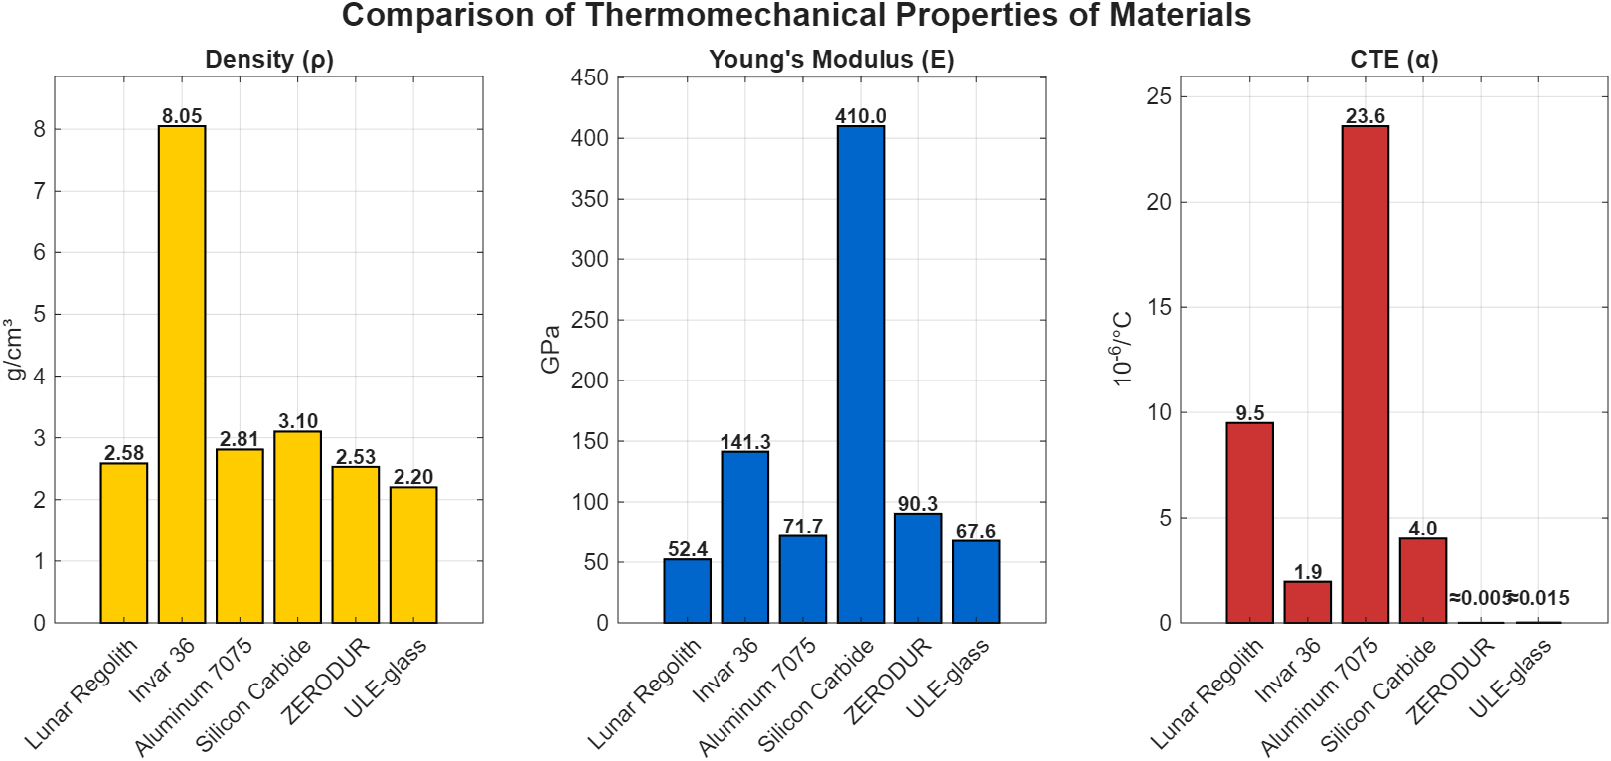
LR face to face
15

Slide 16
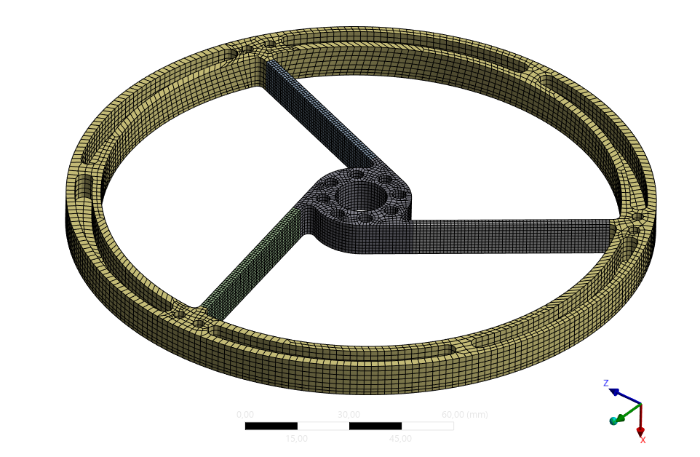
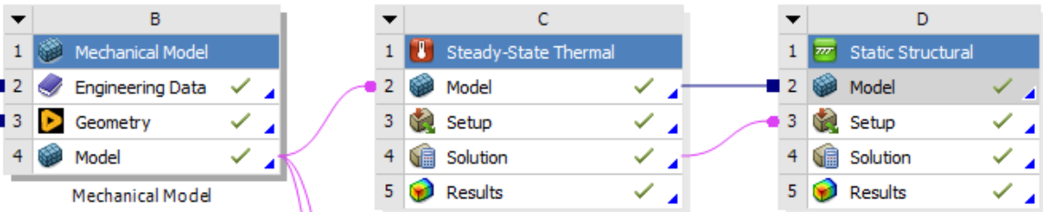
FEM simulation of LR ceramics-based optomechanical part
16

Slide 17
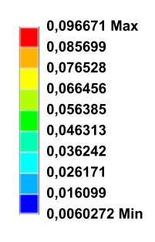
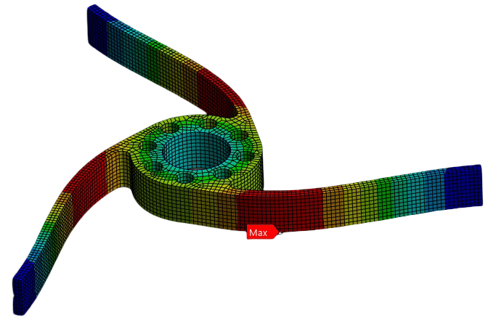
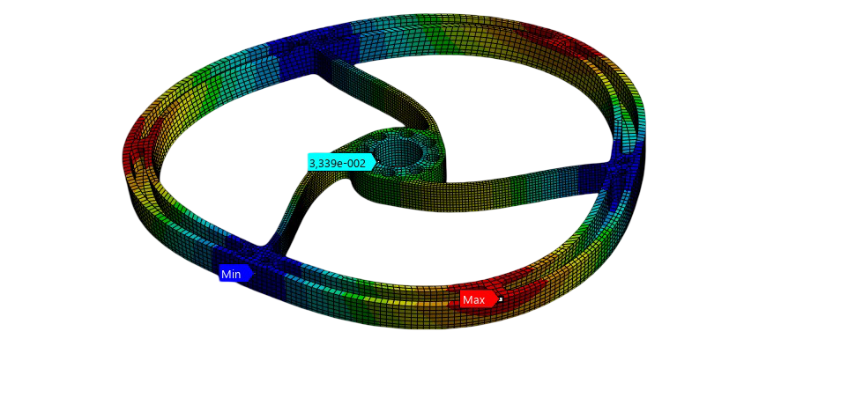
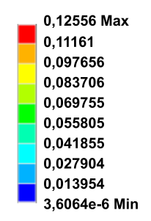
Simulation results
17

Slide 18
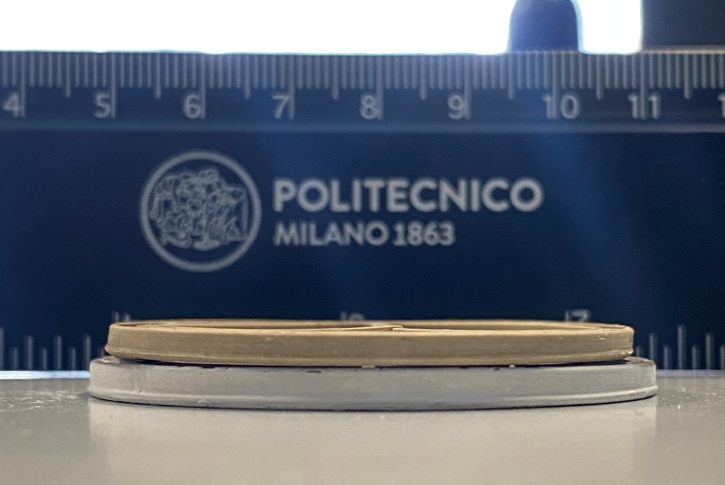
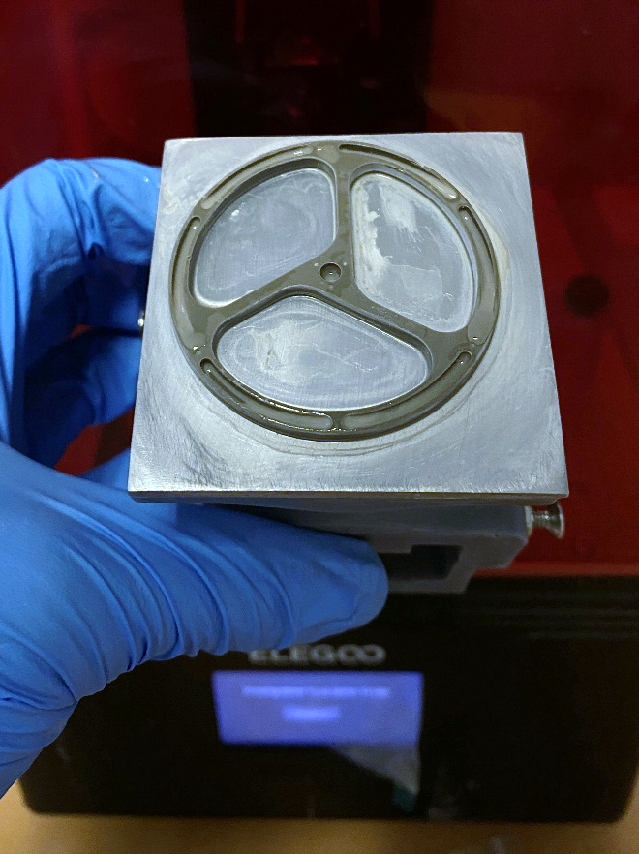
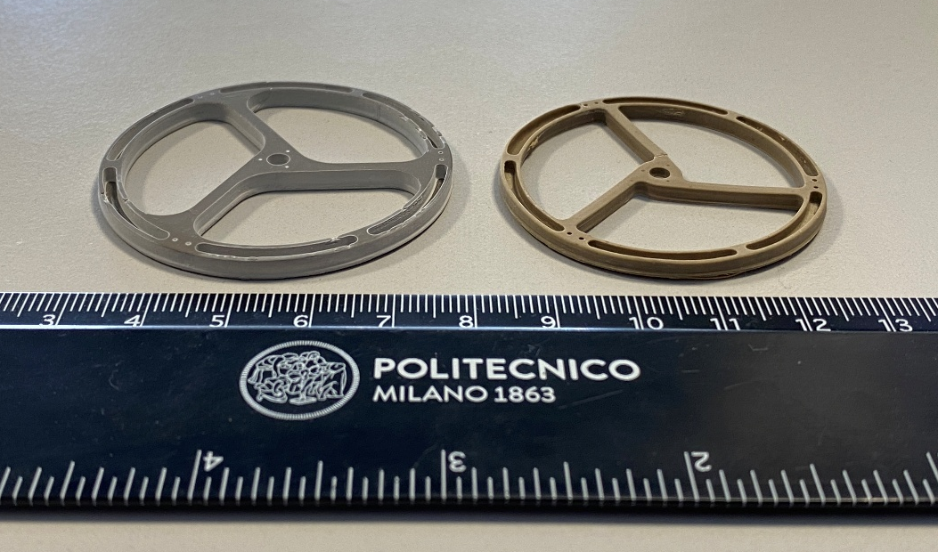
DLP-printing and sintering of prototype spider for secondary mirror
Green part
Sintered ceramic part
Sintering at 1250 ºC x 4h
As-printed spider
18

Slide 19
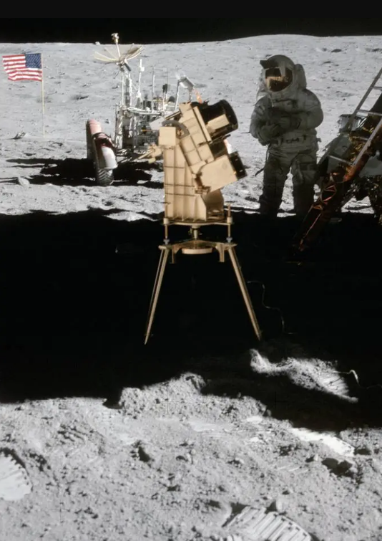



Outcomes
DLP-printed lunar regolith, can be utilized for in-situ manufacturing of opto-mechanical parts, enabling maintenance and repair of optical instruments on the future lunar outpost
Using LR-based ceramics will reduce Earth-launched mass, enhance autonomy, and increase mission redundancy
Simulation results demonstrate that LR-derived ceramics may serve as a substitute material for some particular optomechanical parts, where the extremely low CTE is not needed
Such elements may include secondary mirror spiders, laser diode mounts and some other components for both utility and in some cases scientific optical instruments
First telescope on the lunar surface ©NASA
19

Slide 20
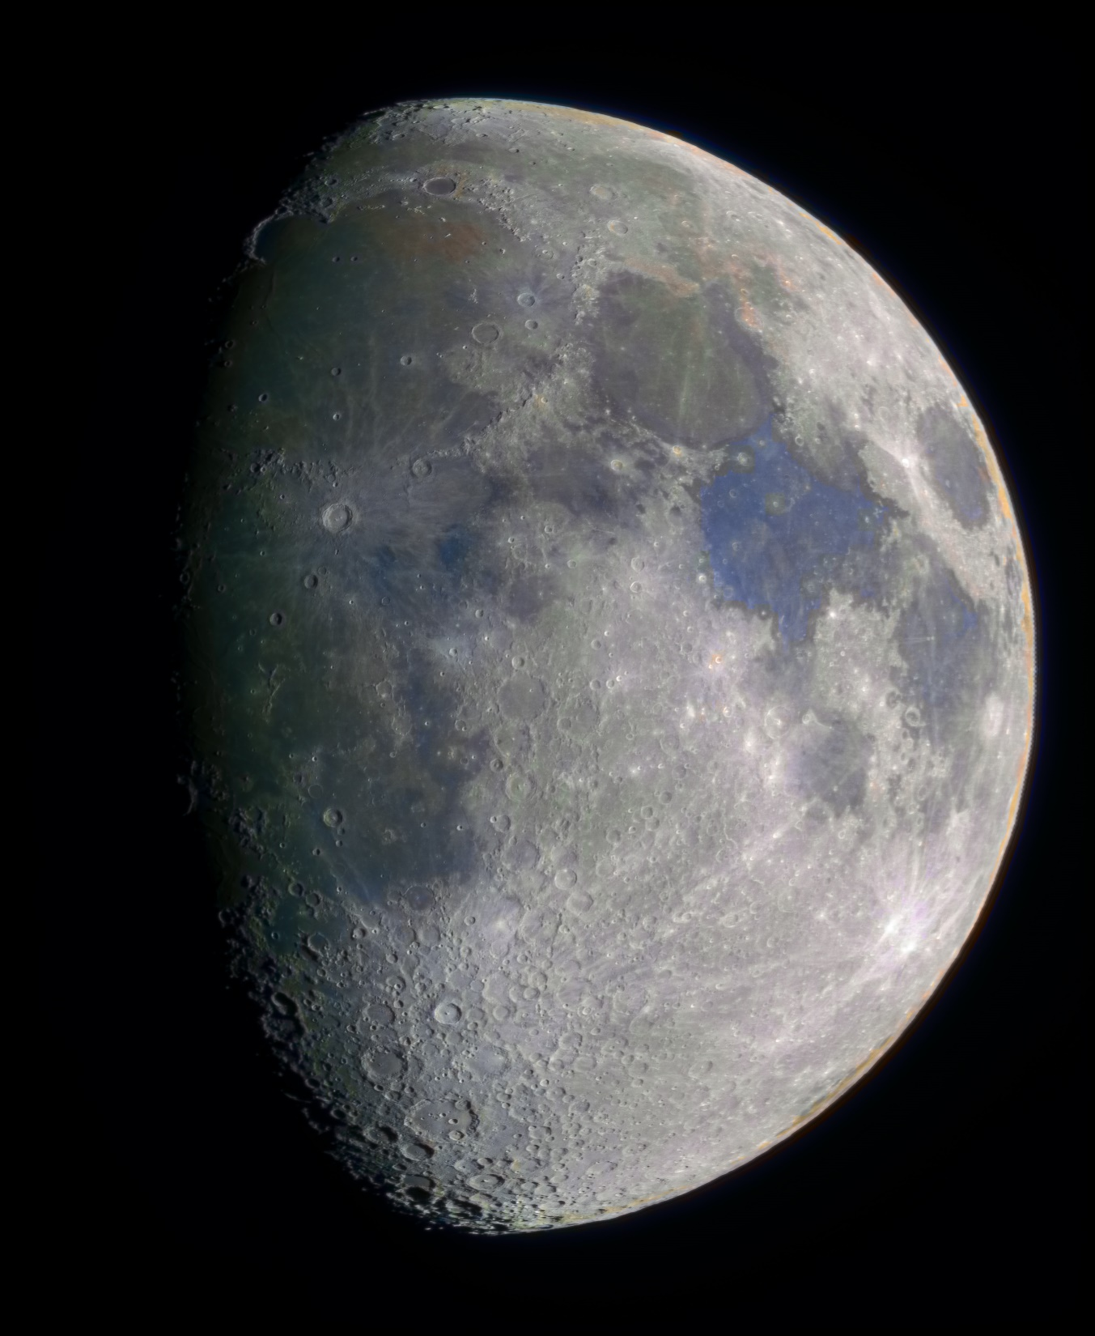




Let’s start building our future in Space— one layer of Moon dust at a time!
We are open for any possible collaboration!

