Slide 1

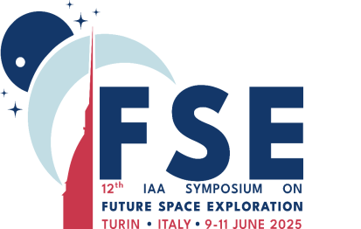
Chronotherapy capabilities to maintain human health in space flights
Galina Yu. Vassilieva, Daria P. Sidorenko, Ivan M. Vasilev, Tatiana N. Agaptseva,
Yuri S. Solomadin, Eugeniy A. Sedov, Boris V. Afonin

Slide 2
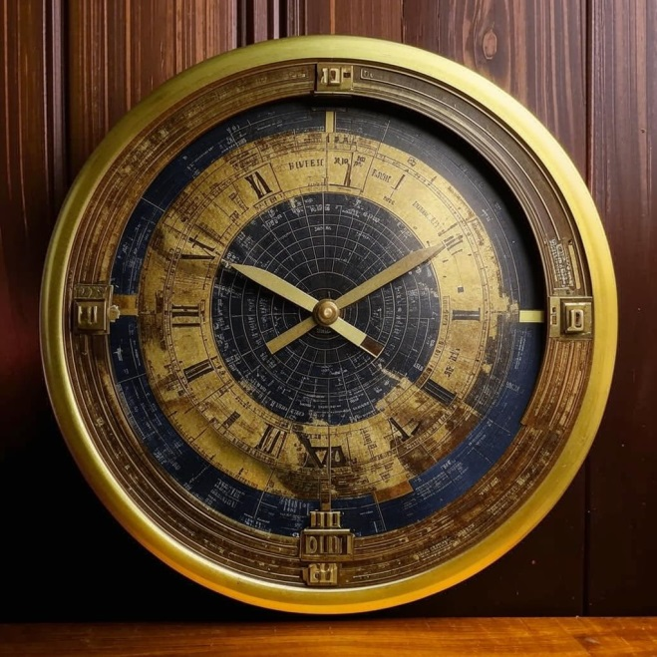
Earth rhythms
Chronobiology is a science that studies the biological rhythms of living organisms and their adaptation to cyclic environmental changes (light, temperature, seasons)

Slide 3

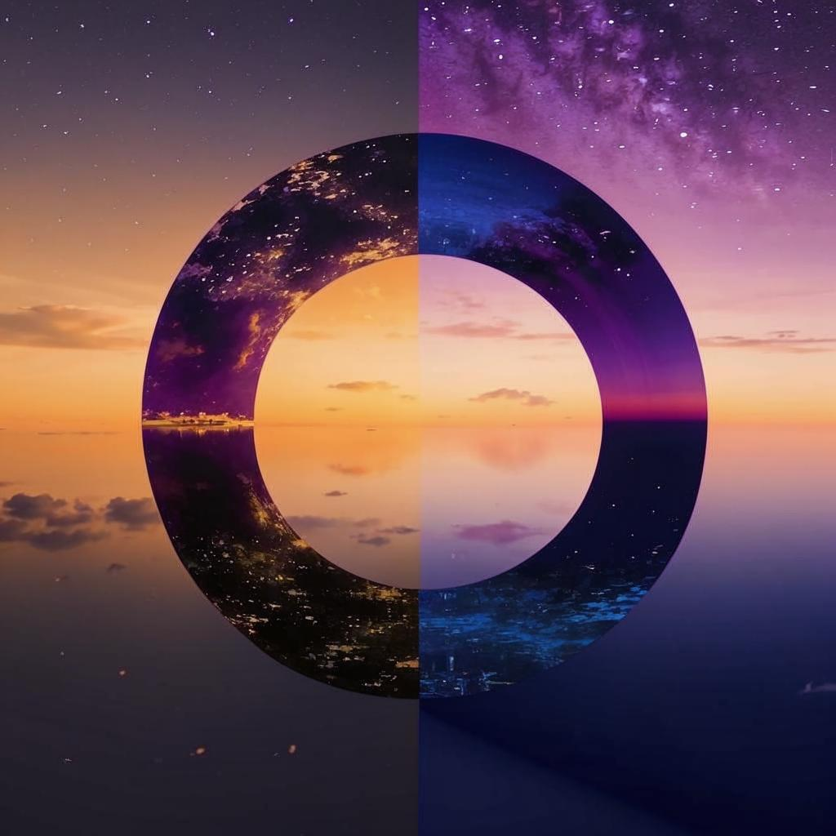
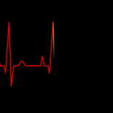
The relevance of the problem of biorhythms
Rhythm type | Period | Examples
Ultradian | From 10⁻³ sec to 20 hours | Molecular-cellular processes, breathing rhythms and heart rate, sleep phases (REM/NREM)
Circadian | ≈24 hours | Sleep-wakefulness, body temperature
Infradian | >28 hours to ≈1 year | Menstrual cycle, seasonal migration, hibernation, molting
“Rhythm is as natural as everything beautiful in the Universe.”
Rabindranath Tagore

Slide 4
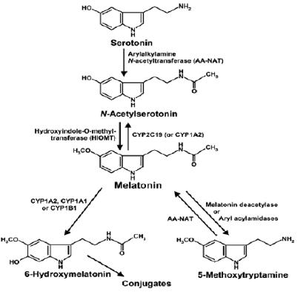
Molecular basis of circadian rhythms regulation
The circadian clock is critical for maintaining physiological homeostasis
Central pacemaker (suprachiasmatic nucleus of the hypothalamus)
Local oscillators in peripheral tissues
Neural signals
Hormonal signals (secretion of melatonin, cortisol, insulin)
Melatonin secretion is simultaneously regulated by the suprachiasmatic nucleus of the hypothalamus, which generates an endogenous circadian rhythm with a period of 23-25 ​​hours, and by an external light-dark rhythm with a period of 24 hours and corrects endogenous rhythms relative to the rhythms of the external environment.

Slide 5
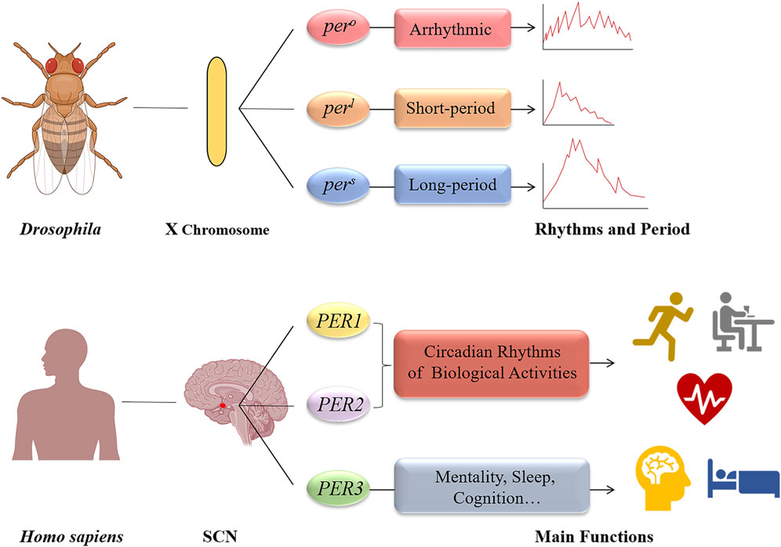
Molecular basis of regulation of circadian rhythms
Kai Chen, Yaohui Wang, Dengxiong Li, Ruicheng Wu, Jie Wang, Wuran Wei, Wei Zhu, Wenhua Xie, Dechao Feng, Yi He Biological clock regulation by the PER gene family: a new perspective on tumor development // Frontiers in Cell and Developmental Biology, May 2024
Provided by periodic clock genes PER1, PER2, PER3

Slide 6
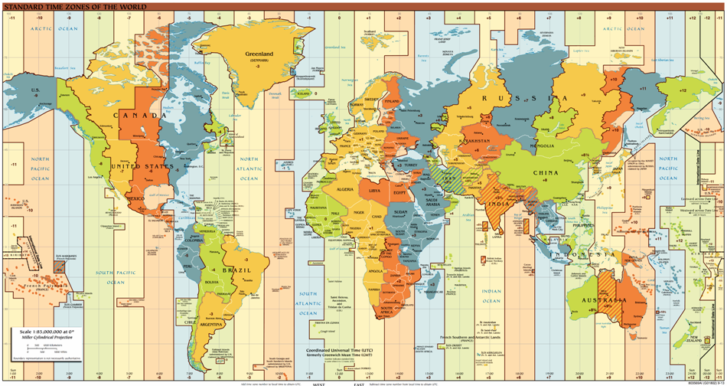
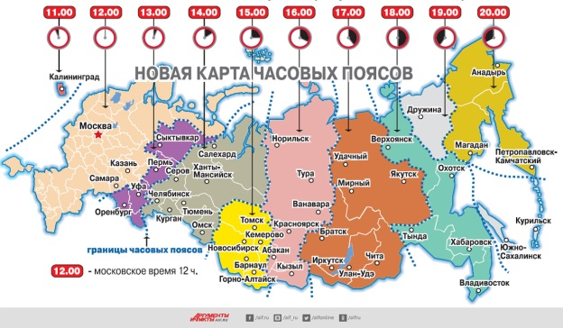

Slide 7
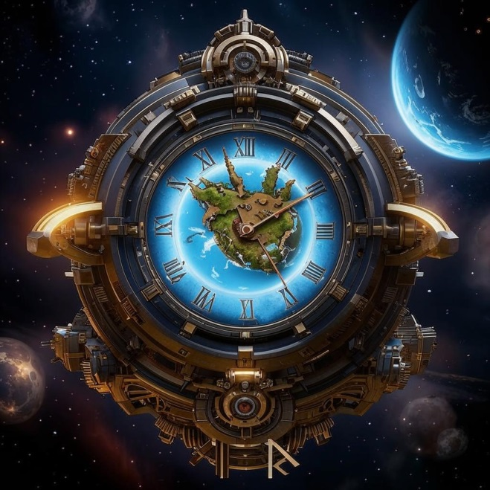
Space rhythms

Slide 8
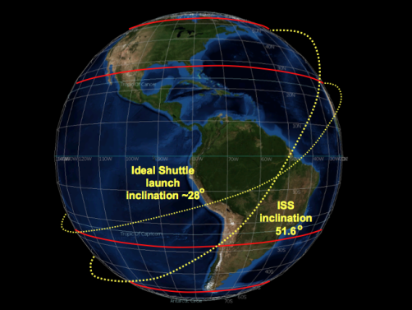
History of the sleep-wake cycle research
.
The first “Vostok“ SV, piloted by Yu.A. Gagarin, made only 1 turn around Earth. The ship moved through an elliptical orbit with a height of perigee 181 km and the height of the apogei 327 km. The inclination of the orbit was 64.95 °, and the orbital period was 89.34 min
The height of the ISS orbit is 408 km above Earth. The speed of movement in orbit is 27700 km/h (7.66 km/s). This allows the station to make complete circle around our planet in 92 minutes ~ 15.652 circles.

Slide 9
HISTORY OF RESEARCH
Work on the study of circadian rhythms in the conditions of space flight (SF) began in the 60s of the last century. One of the first experiments that was conducted on Biosatellite III (W.R. Adey, 1971) convincingly proved a change in the phase angle between the circadian rhythm and the lighting cycle.
However, to date, the chronobiological aspects of the influence on the body of the SF conditions are given insufficient attention. Apparently, this is due to the fact that chronobiology is an accurate science and requires appropriate methodological approaches, which are difficult to directly implement in the SF conditions.

Slide 10
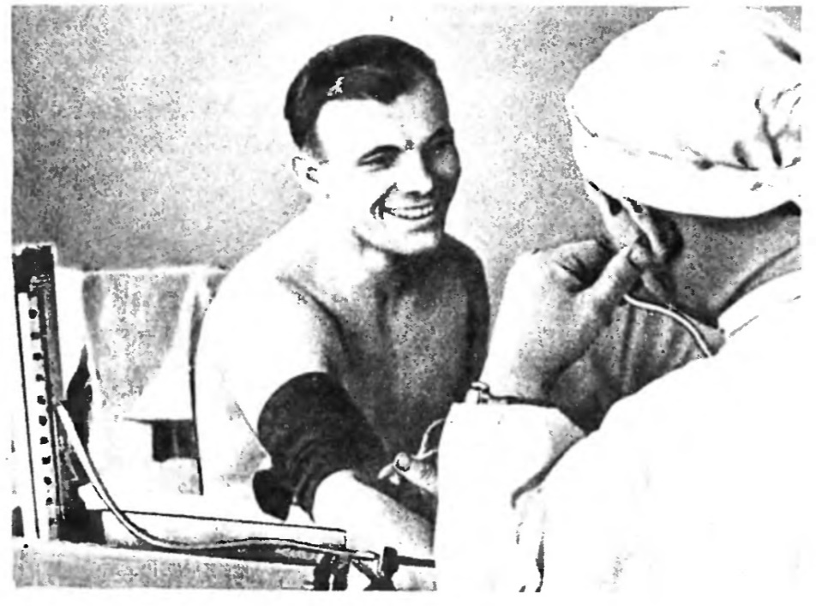
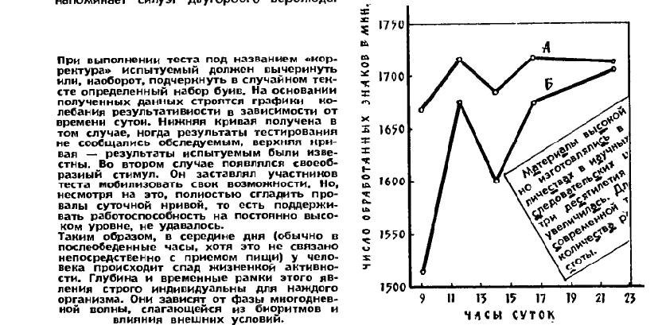
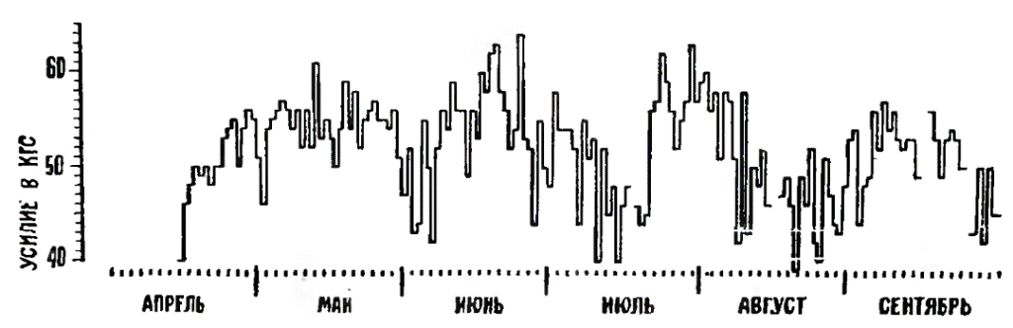
History of research of daily rhythms
В.Макаров. Три ритма //«Наука и жизнь» 1986 г. №1

Slide 11
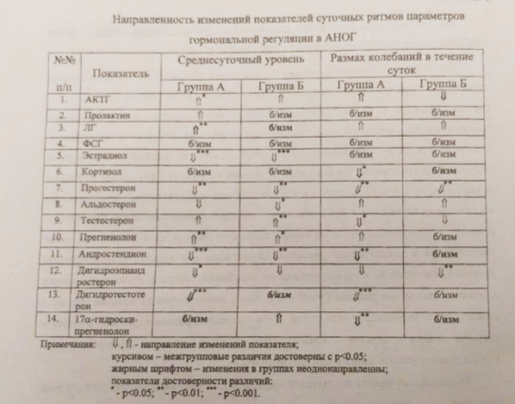
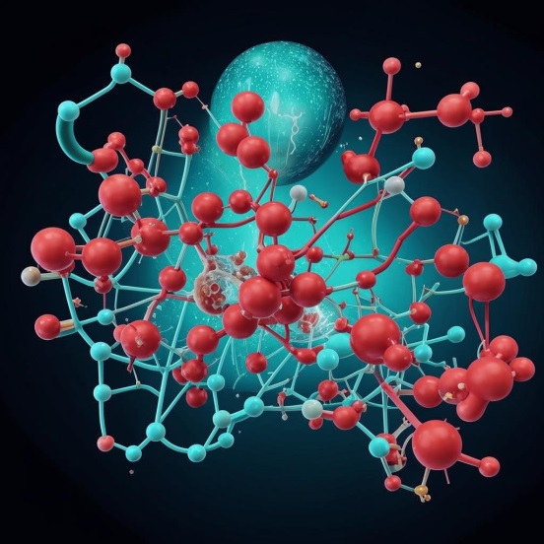
History of research into circadian cycles of hormonal regulation
Modification of the reaction rate was manifested in the main biosynthetic chains leading to the production of cortisol, aldosterone and testosterone, and depended on the use of preventive physical exercises (PE) by the subjects.
I.M. Larina “Patterns of human hormonal systems adaptation to microgravity conditions”, 2000

Slide 12
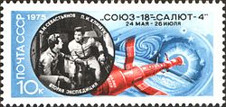
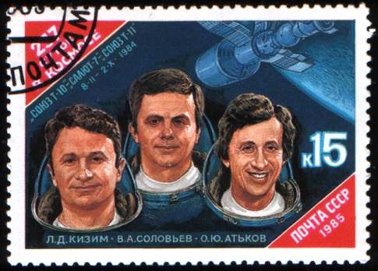
Migrating days
«In the inverted mode, we began to sleep more and more, we shift to the left in relation to sleep, i.e. we are ready to fall asleep - we fall asleep earlier and wake up later. This is phenomenon number one.We began to eat more, but this is due to the fact that the crew began to wake up at night, i.e. they eat even at night...Third. Due to the fact that the mode has changed, the behavioral stereotype has been violated.»
O.G. Gazenko, I.D. Pestov, V.I. Makarov«Humanity and space», 1987
«Tomorrow I have to get up at 12 midnight Moscow time. We can't get used to this routine and we suffer. It's good for flight control and for working with Earth, but it's not suitable for us at all.»
V.I. Sevastyanov,
«Diary above the clouds» (1977)

Slide 13
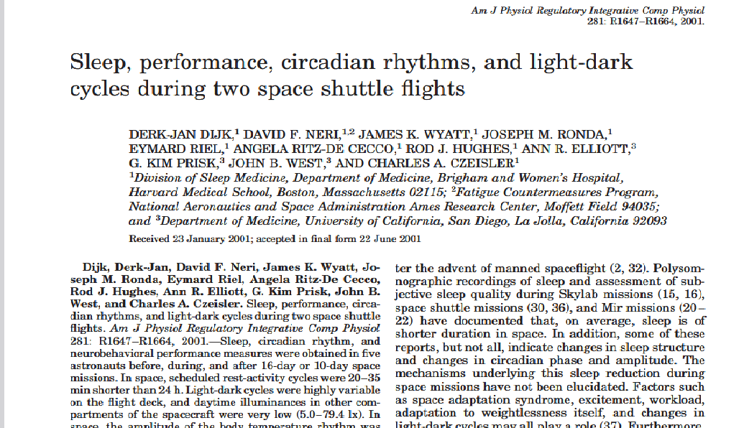
Current state of the problem

Slide 14
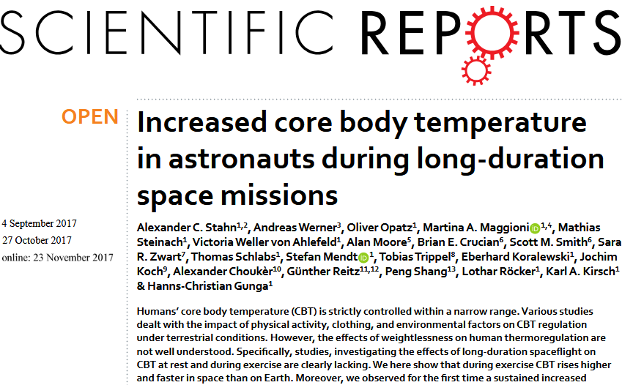
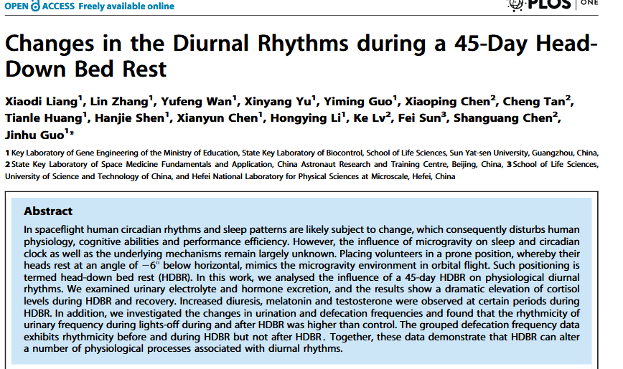
Current state of the problem

Slide 15
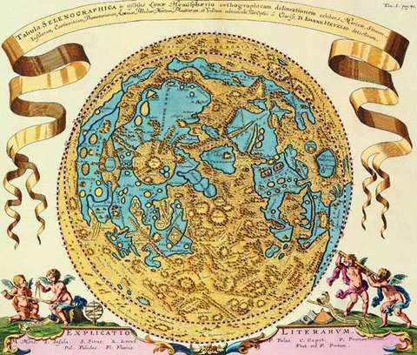
Prospects for the application of chronotherapy principles during manned flights to the Moon

Slide 16
Prospects for the application of chronotherapy principles during manned flights to the Moon
Development of drugs capable of normalizing pathologically altered biological rhythms
Chronokinetics - taking into account the time factor in the pharmacokinetics of drugs;
Chronesthesia - rhythmic changes in sensitivity to drugs;
Chronotherapy includes the following main methodological techniques:
*preventive,
* imitative,
*method of "imposing a rhythm"

Slide 17
Thank you for your attention!
galvassilieva@mail.ru
Спасибо за внимание !

