Slide 1
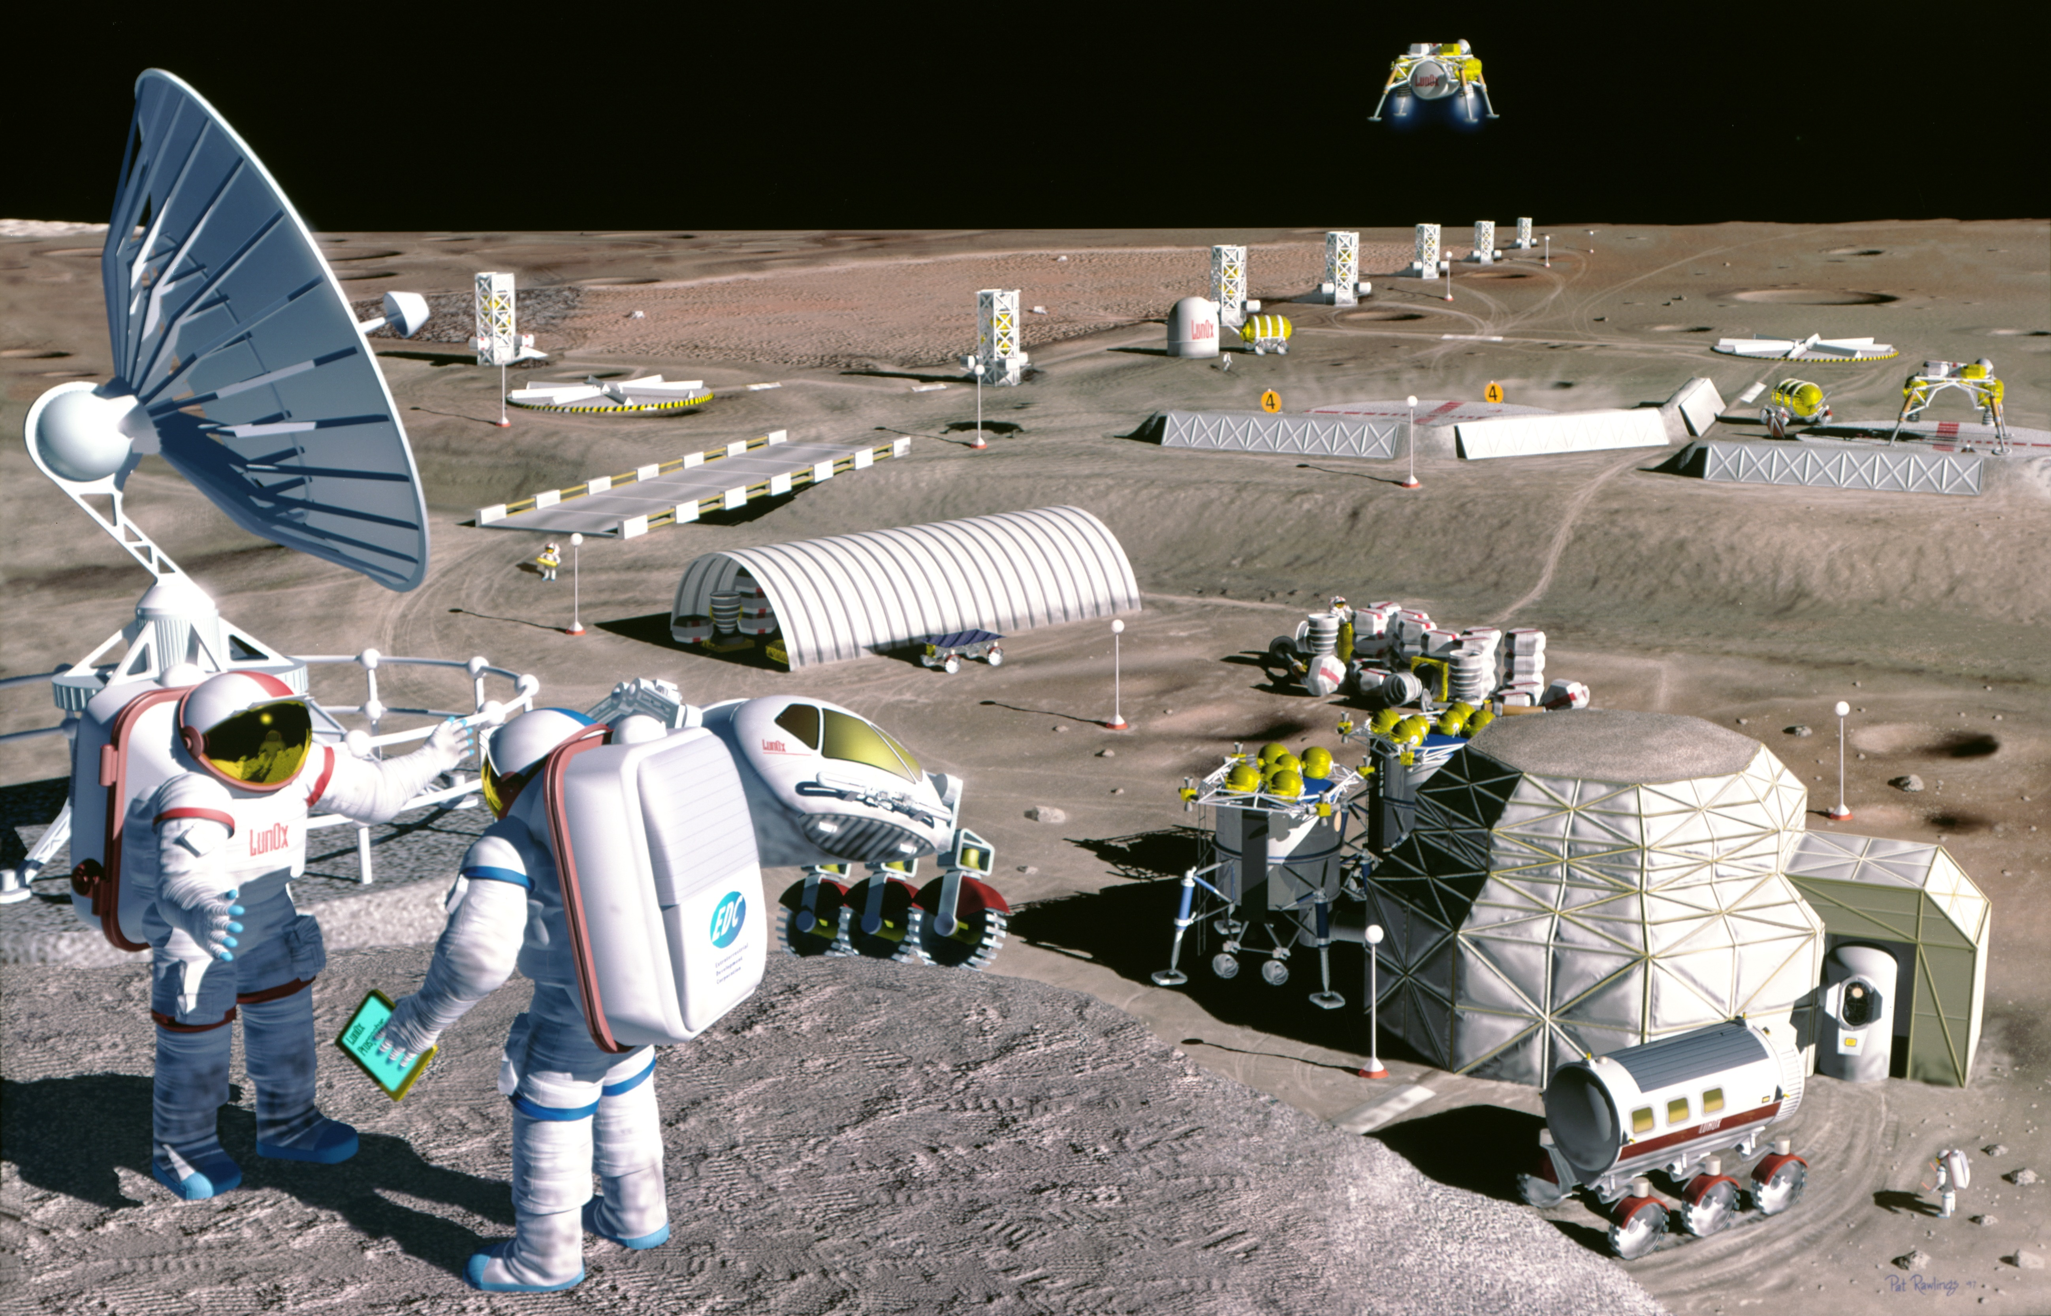

Ground research in the interests of the
international lunar program
Mark S. Belakovskiy, Anna R. Kussmaul, Tatiana N. Agaptseva
Institute of Biomedical Problems of the Russian Academy of Sciences
12th IAA Symposium on Future Space Exploration,
Torino, 9-11 June 2025

Slide 2
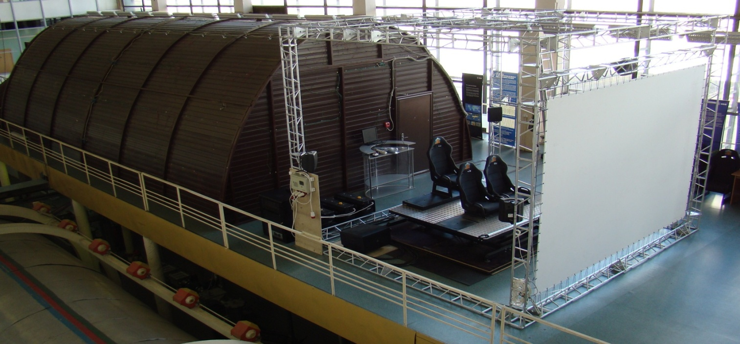
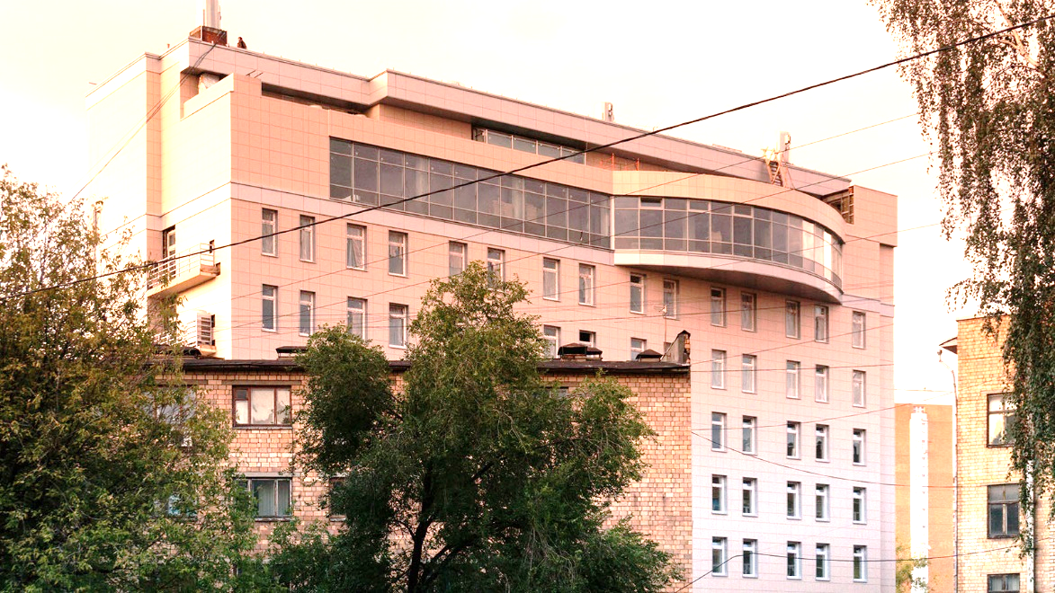
IBMP – more that 60th years of experience in the field of space biology and medicine.
Medical and technical center for development of innovative technologies of space biomedicine in the interests of support of orbital and interplanetary flights
Ground Experimental Facility for isolation studies

Slide 3

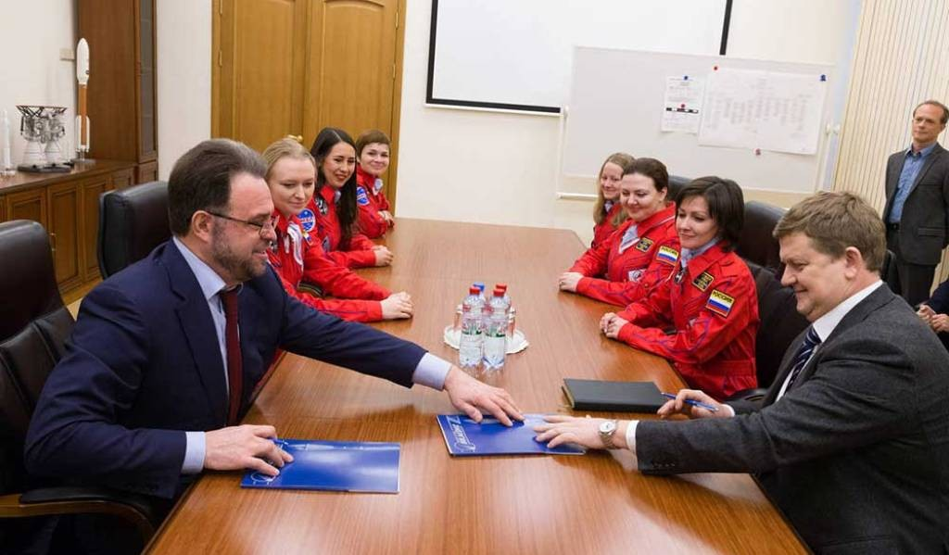
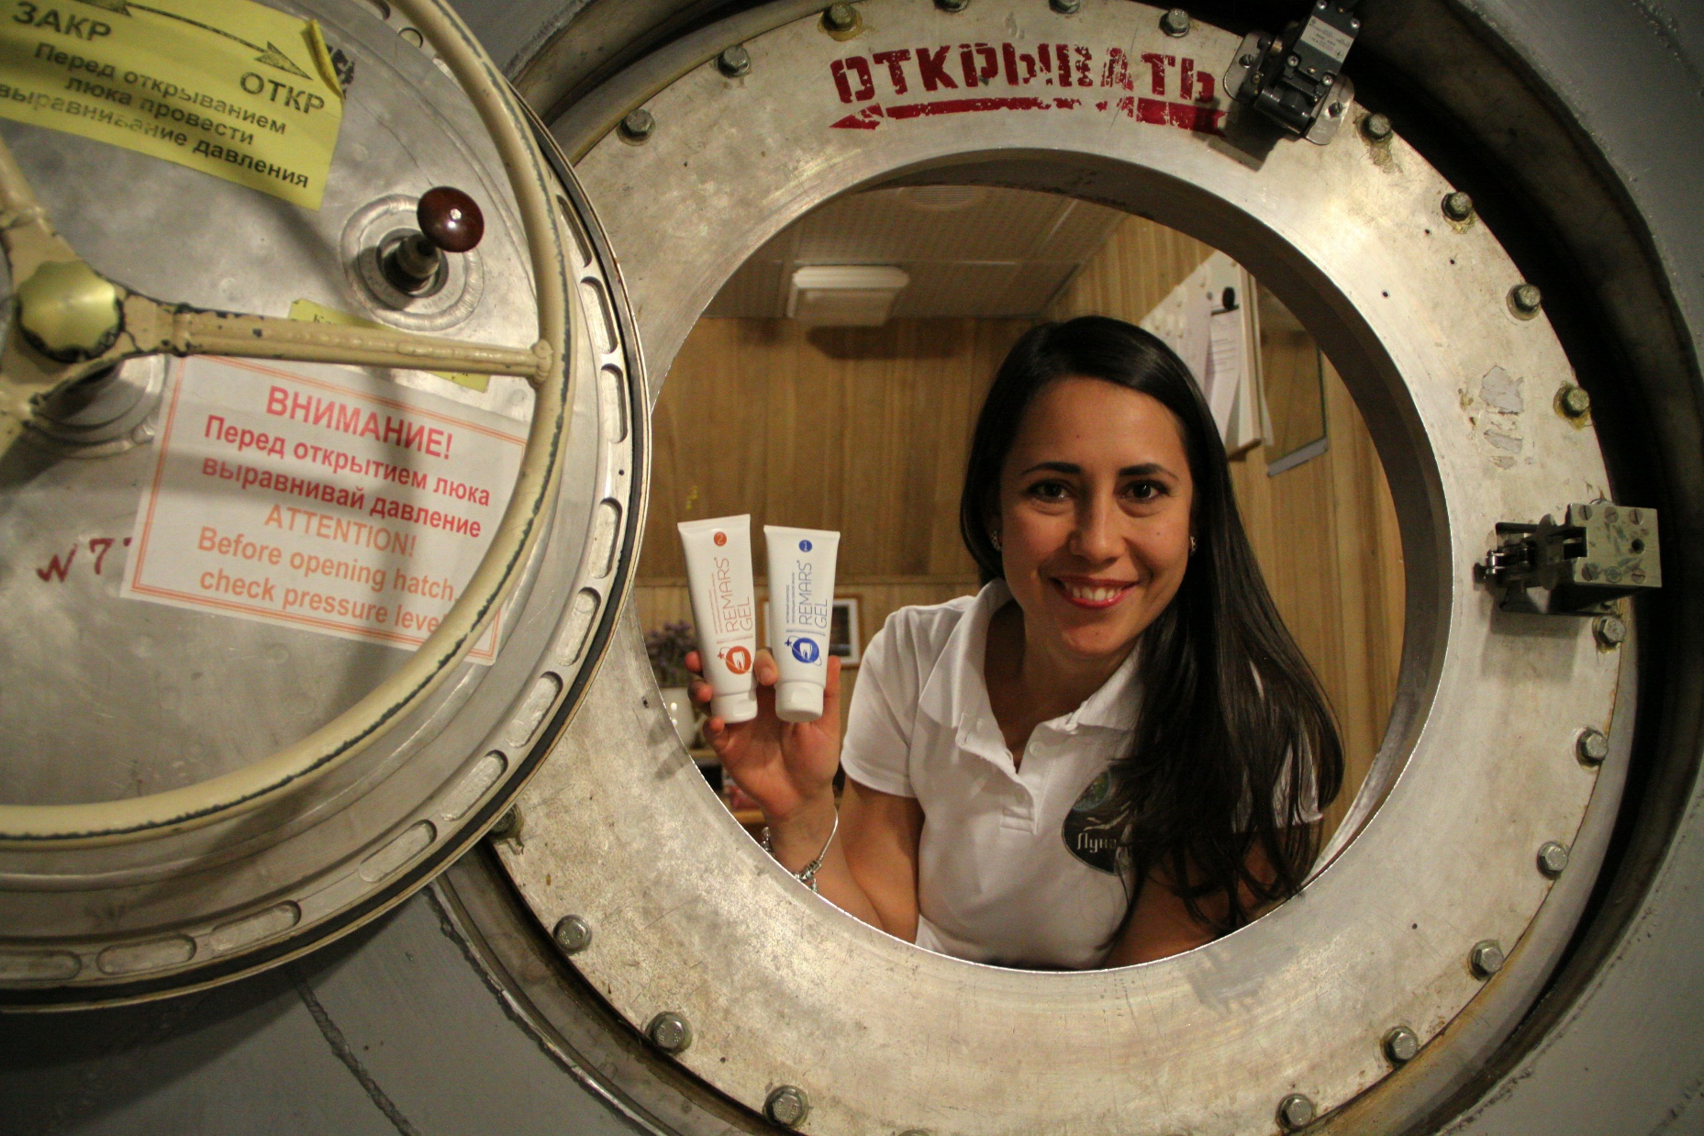
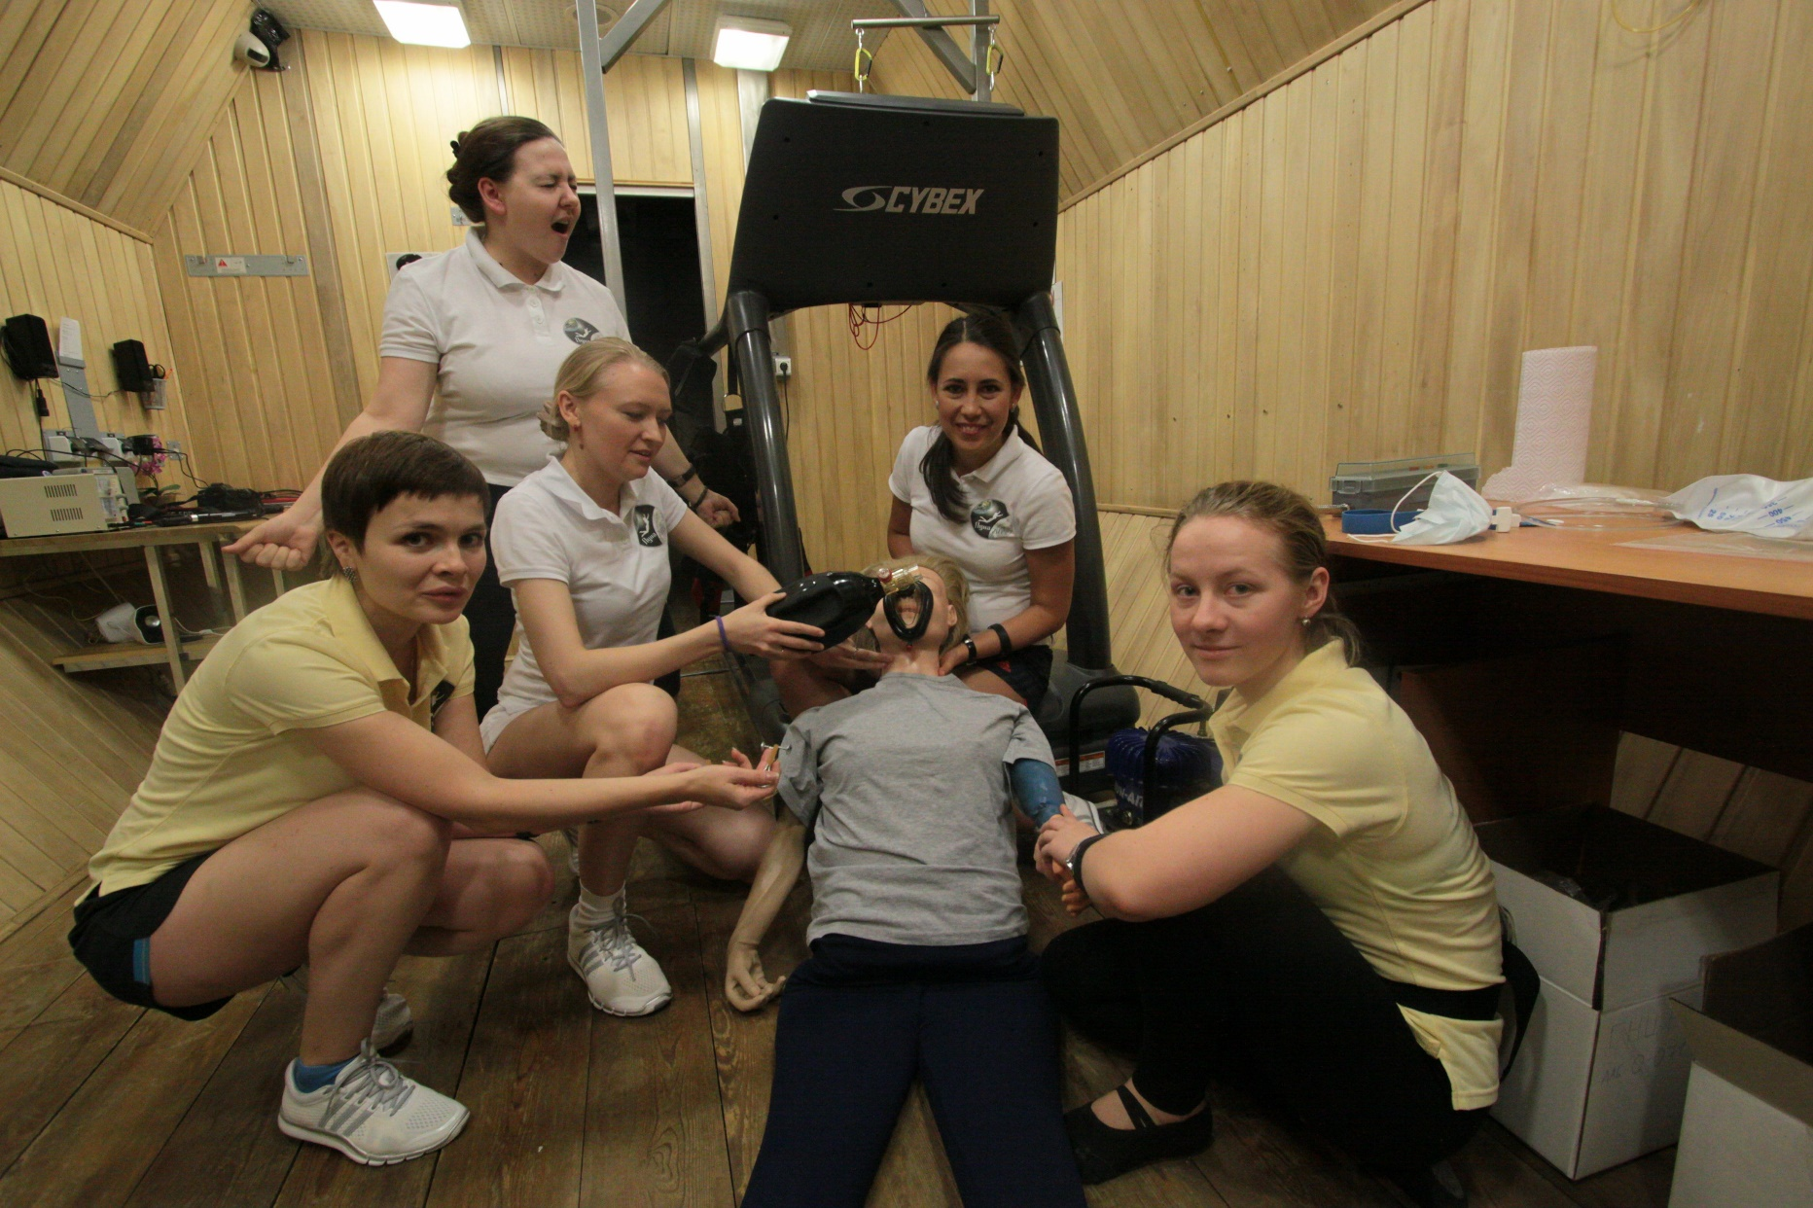
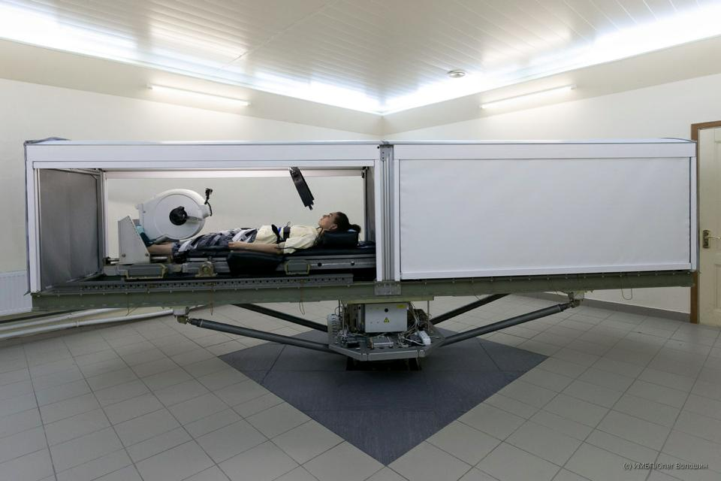
LUNA-2015
Purpose:
study of the mechanisms of the female body adaptation to the conditions of 8-day isolation in a hermetically closed facility, as well as to the effects of "head-pelvis" accelerations during rotation on a short-radius centrifuge (SRC)

Slide 4

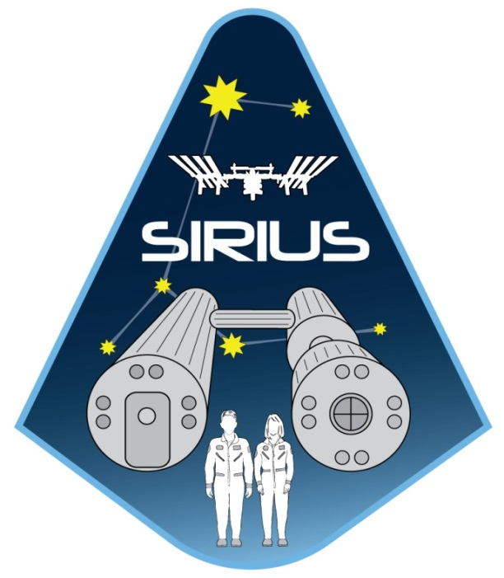

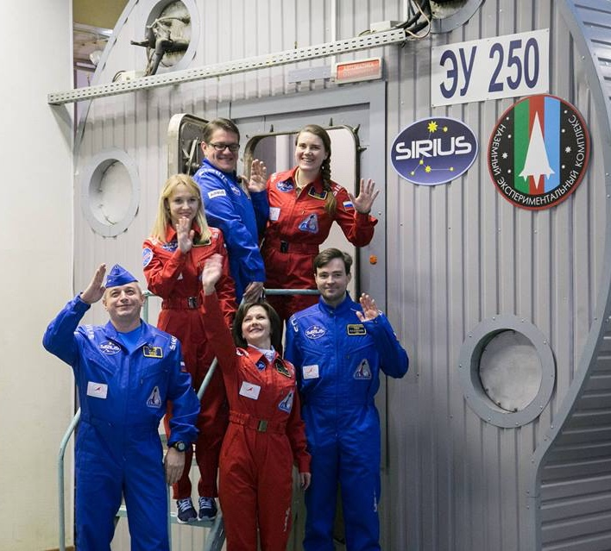
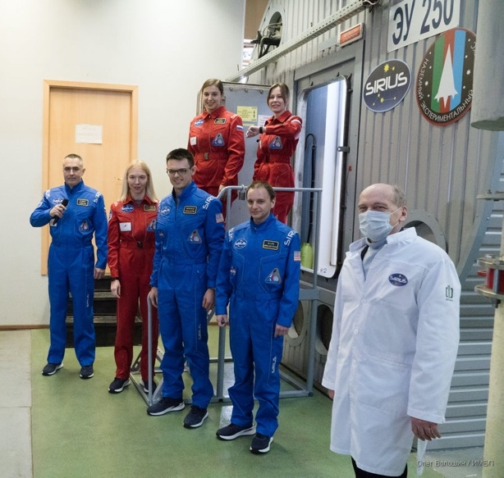
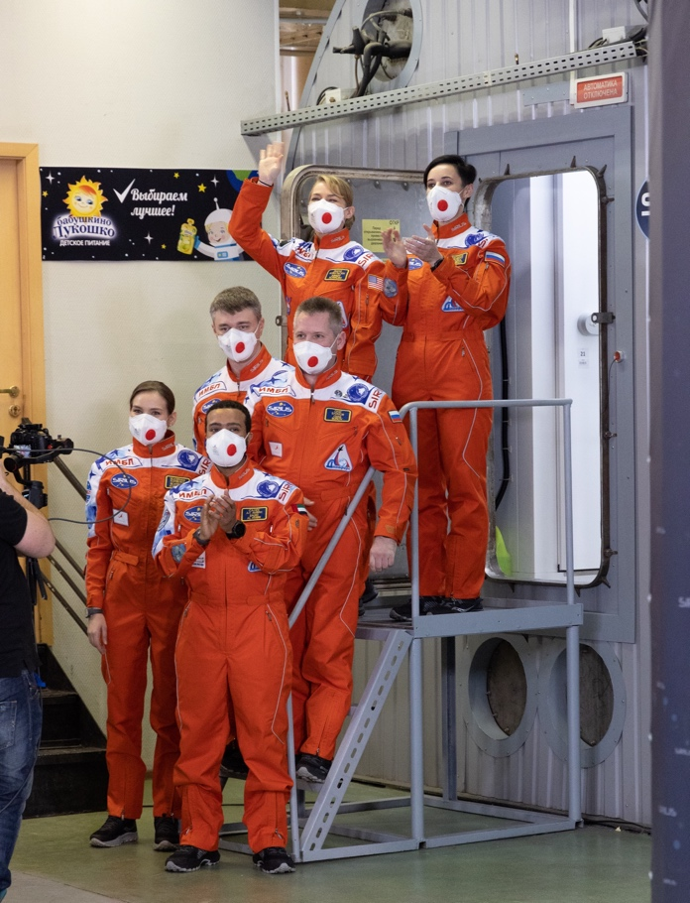
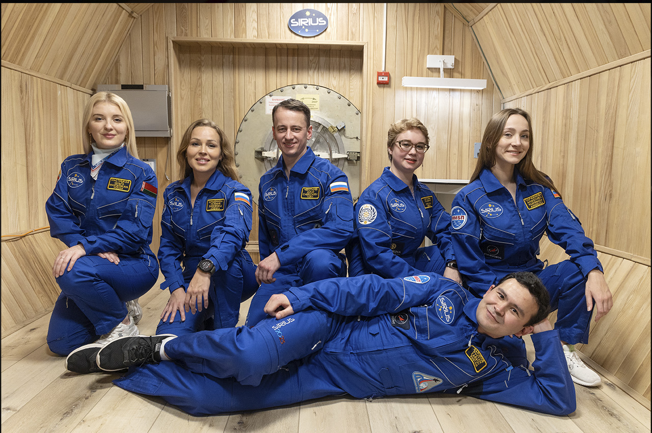
«SIRIUS»
Scientific International Research in Unique Terrestrial Station
2023:
SIRIUS-23 (365 days)
2017:
SIRIUS-17 (17 days)
2019:
SIRIUS-19 (120 days)
2021:
SIRIUS-21 (240 days)
IBMP-NASA HRP partnership with international participation
Objective: to study the effects of isolation and confinement on human psychology, team dynamics, physiology, immunology, microbiology, metabolism to help prepare for long-duration space exploration.
Mixed gender multicultural crews of 6
Lunar missions – transit to/from the Moon, extended orbital phase and surface ops
High crew autonomy, 5-minute communication delay
Emergency situations
Limited resources
Modeling of EVA

Slide 5
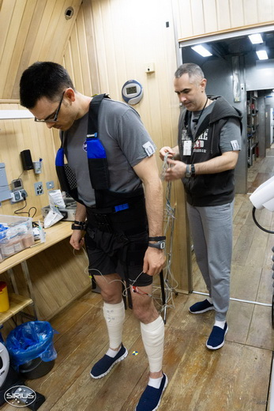
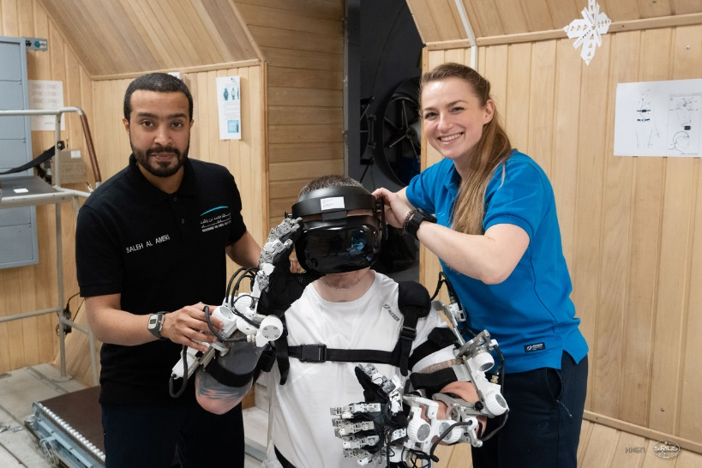
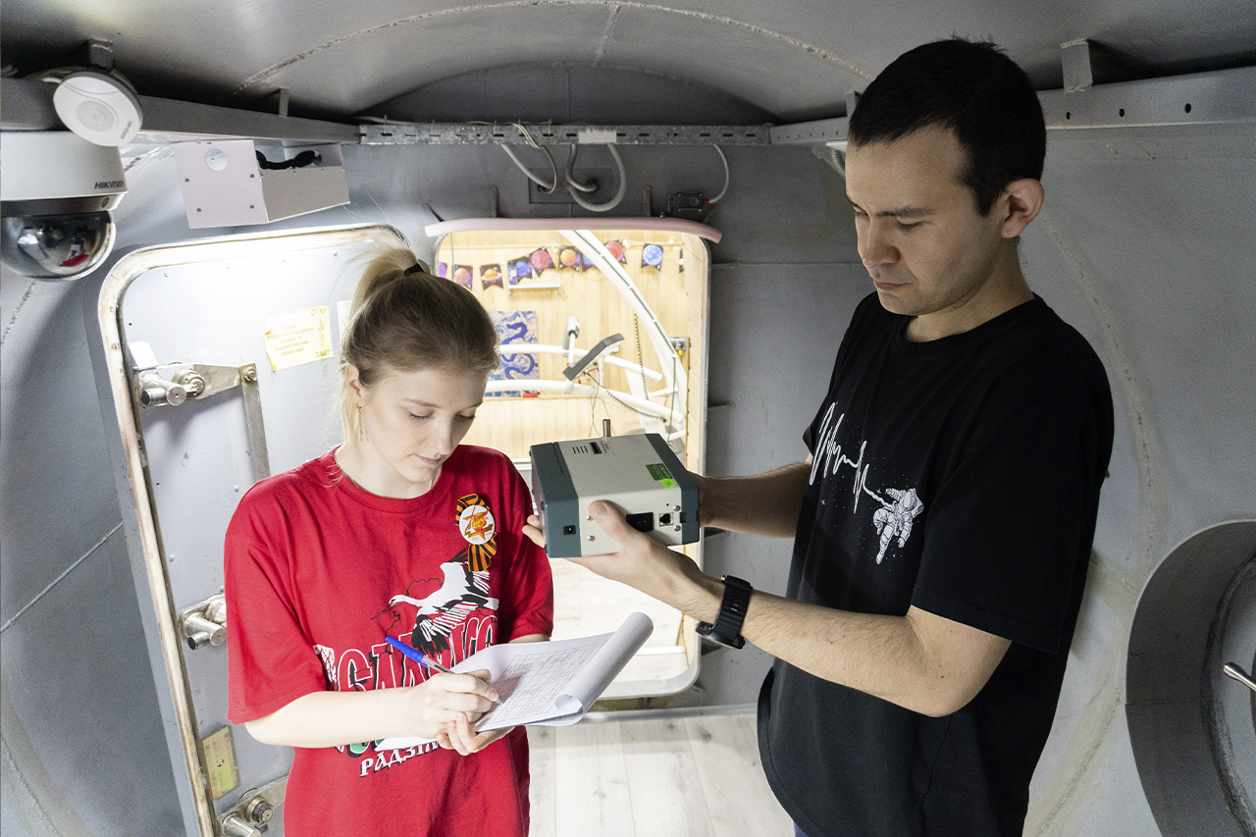
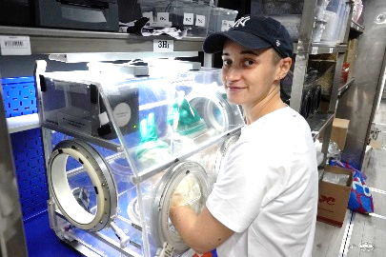
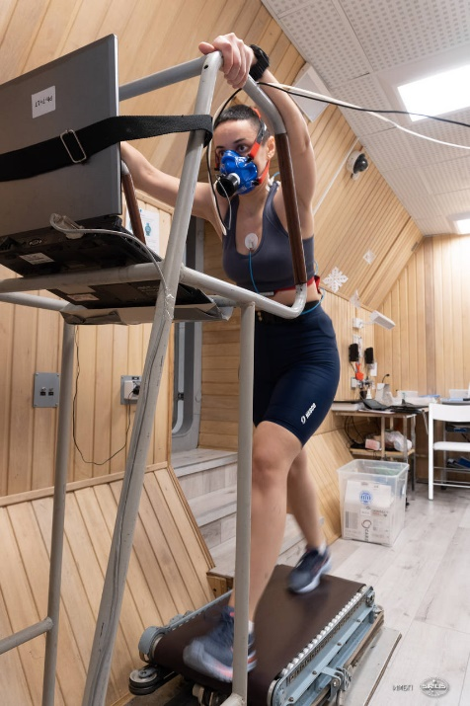
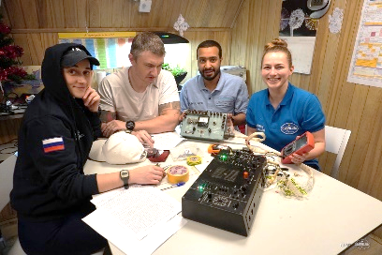
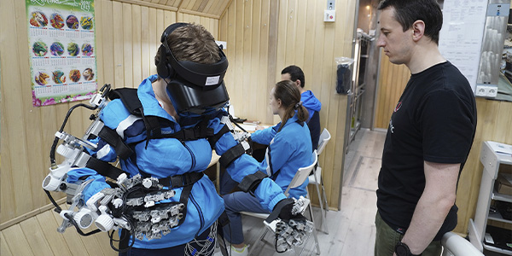
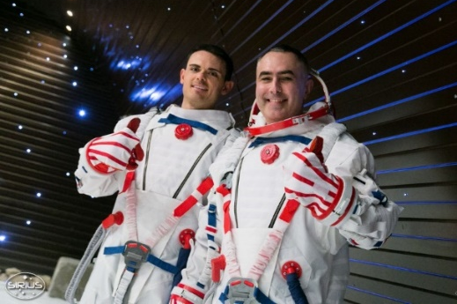
International Cooperation in SIRIUS project

Slide 6

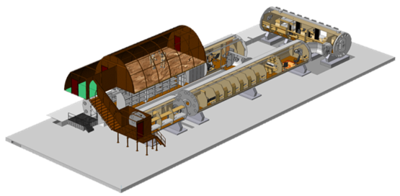
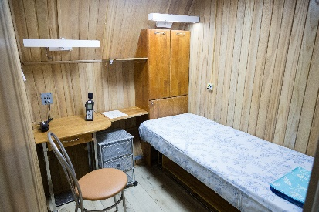

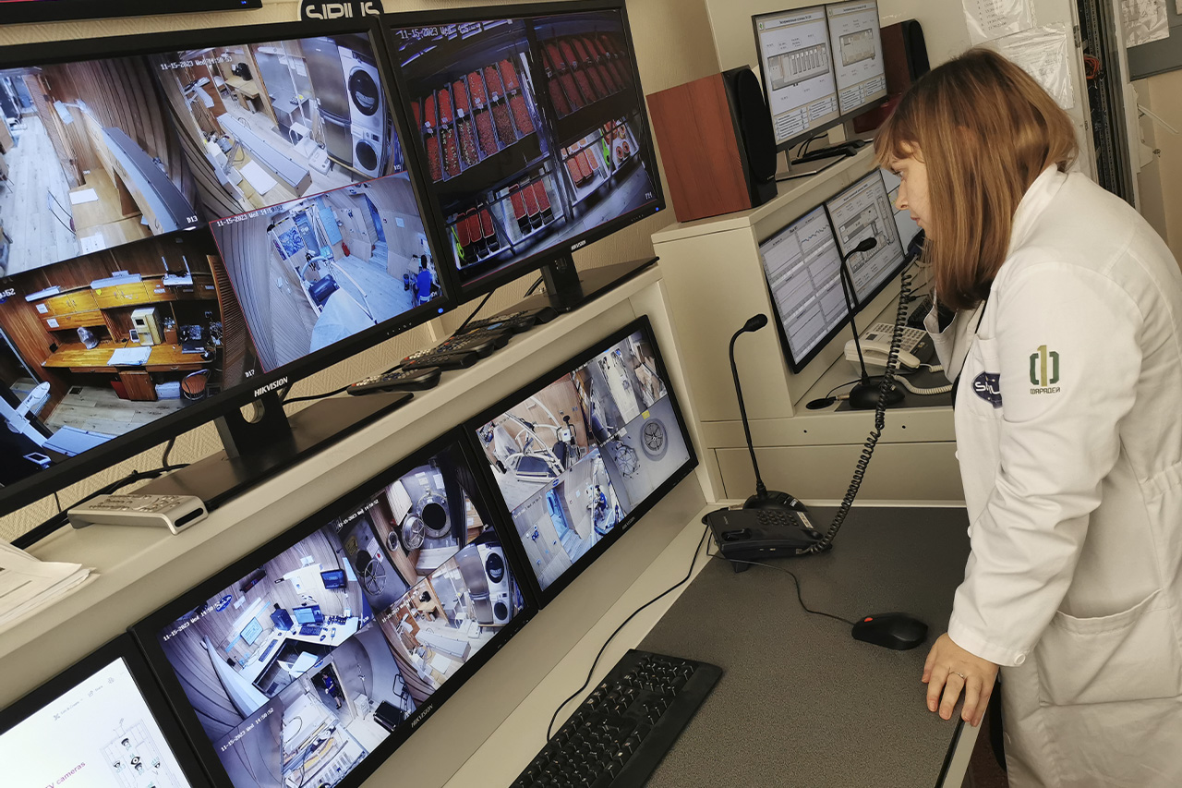

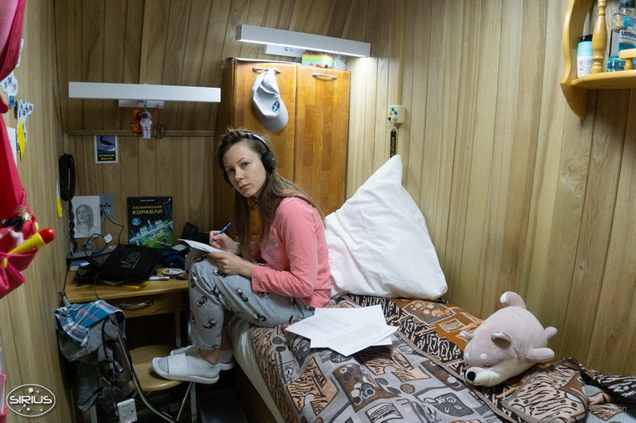

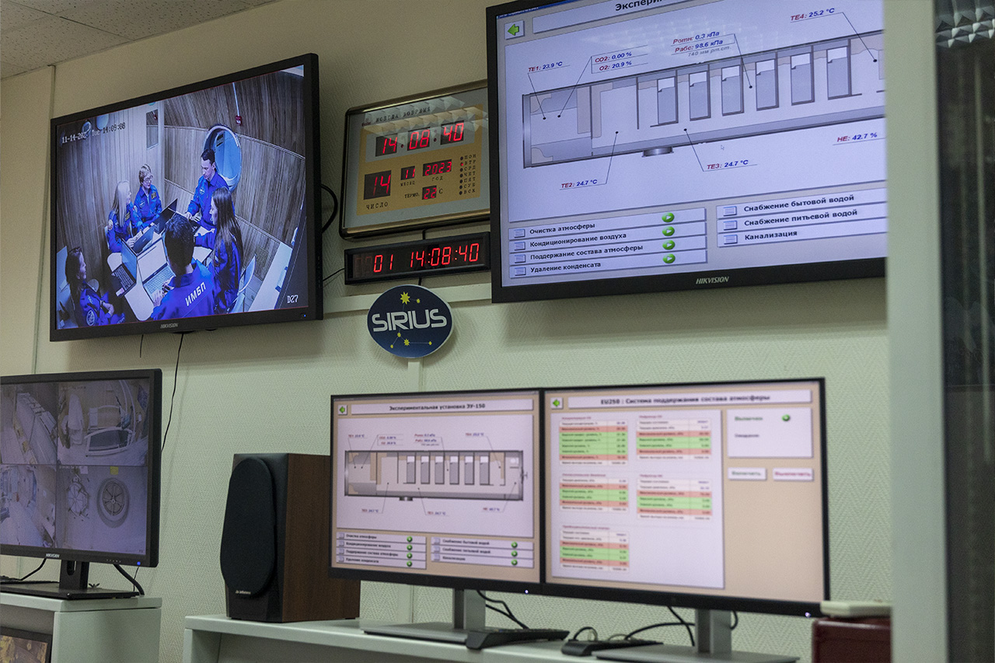
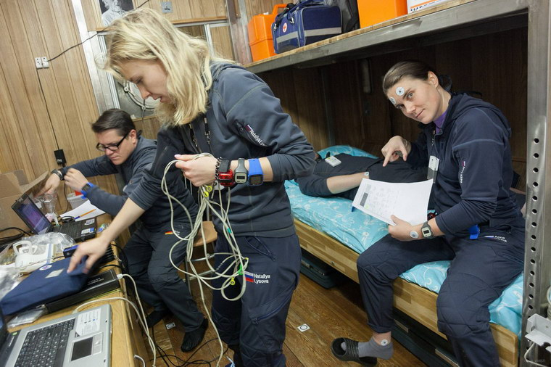

Italian support of the SIRIUS Project

Slide 7
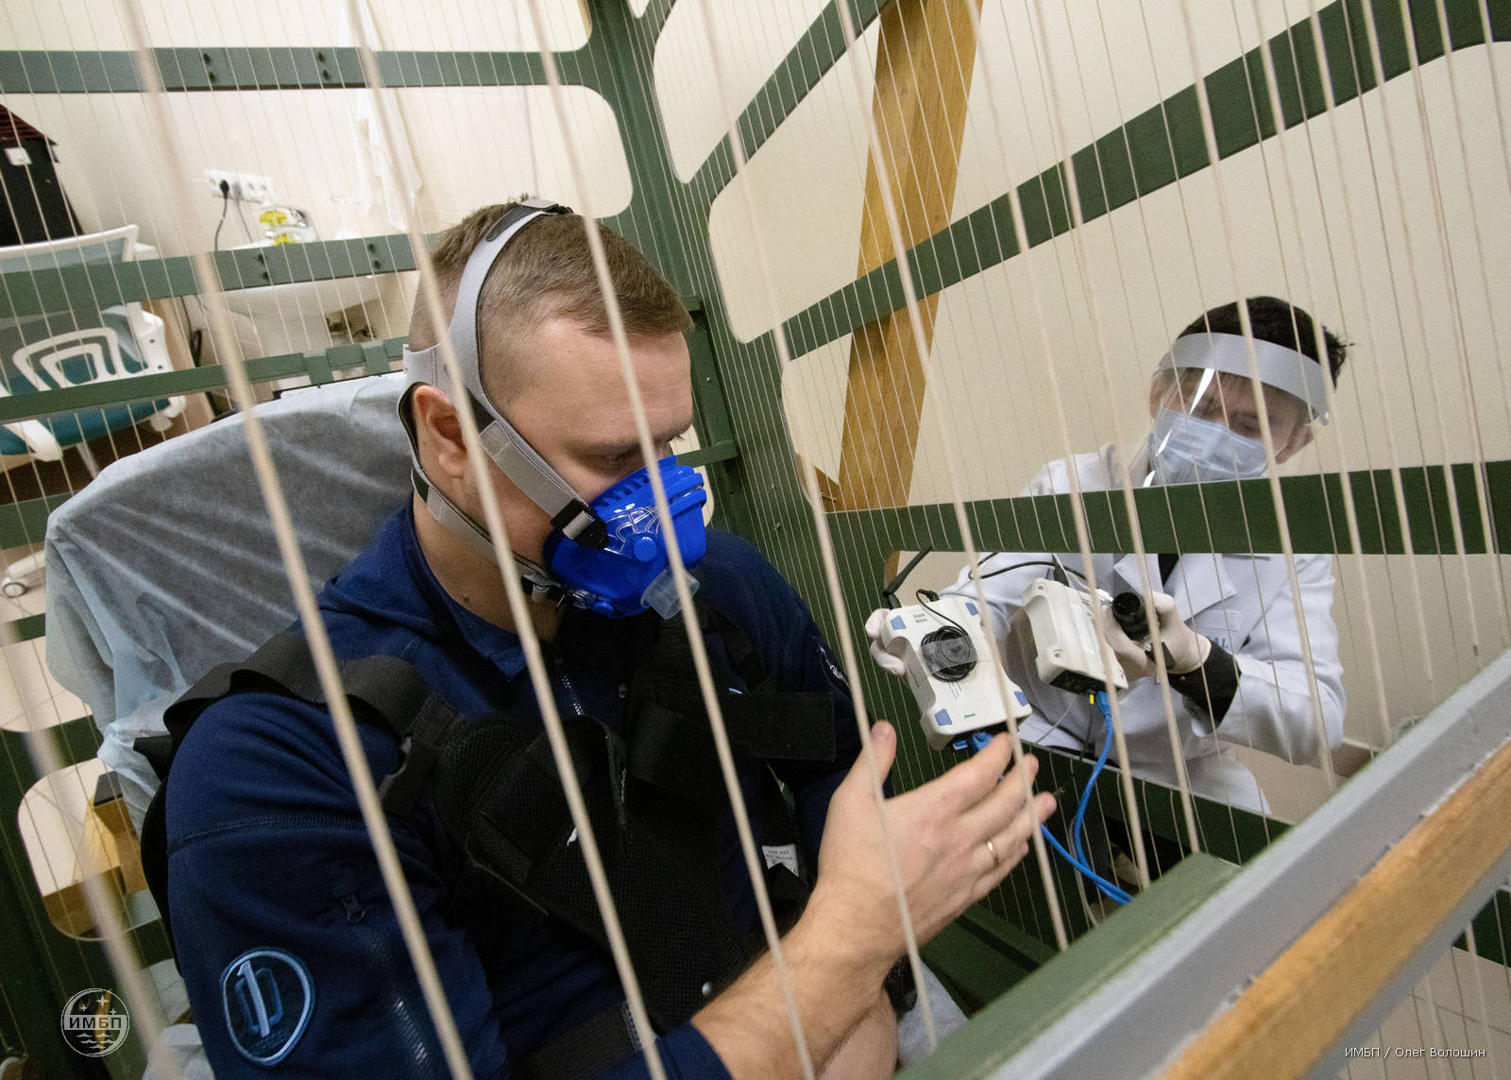
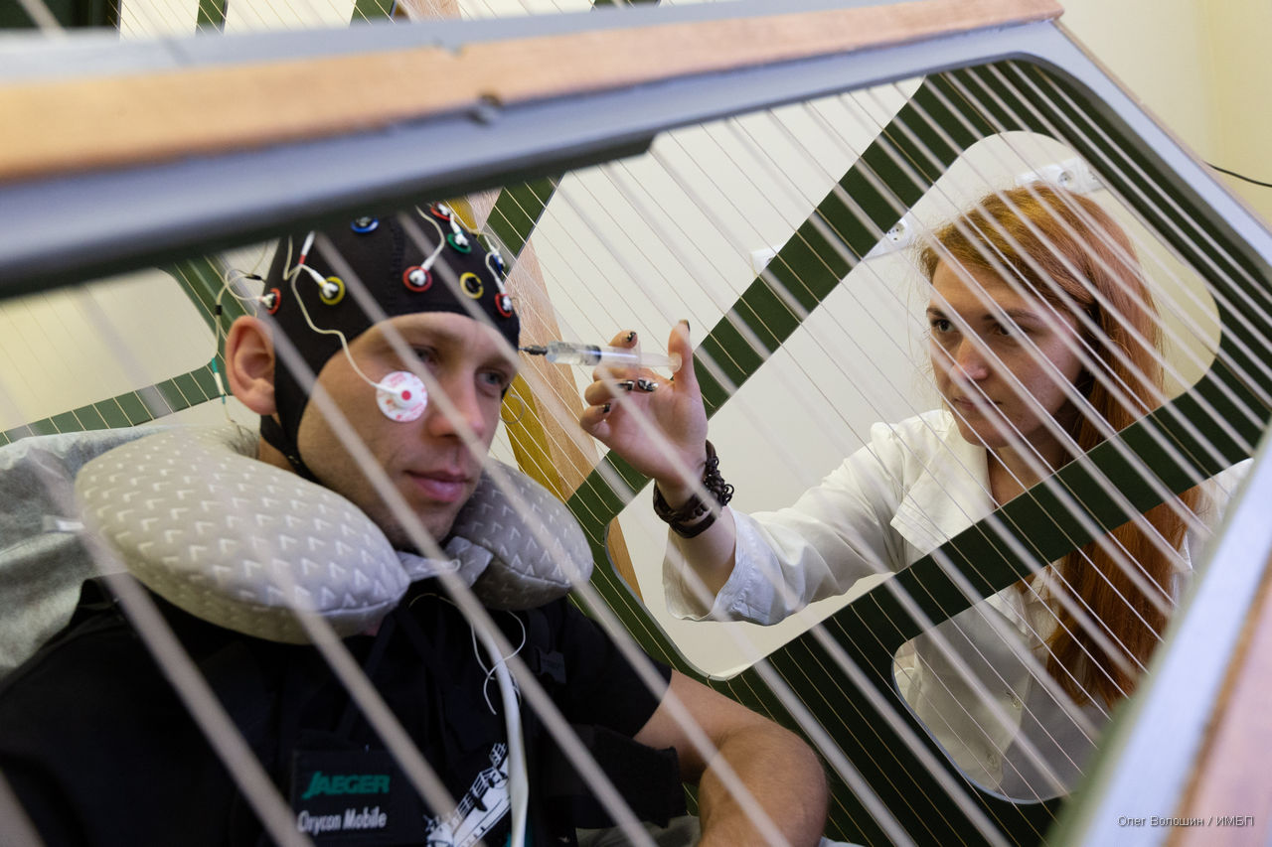
"Arfa" (“Harp”) project, 2020-2021
First stage: 8-hour exposure of a healthy person to a reduced magnetic field.
Second stage: 24-hour exposure, which was divided into 3 periods of 8 hours with a short break.
Third stage: included not only the “placebo” and “exposure” series, but also 3 different degrees of reduction in the magnetic field (350, 650 and 1000 times).

Slide 8
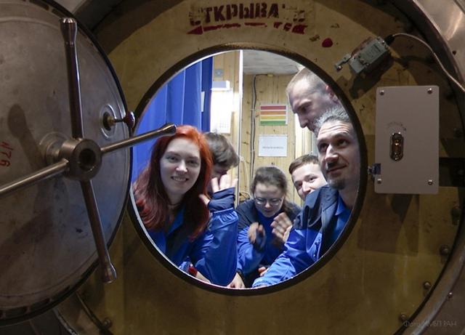
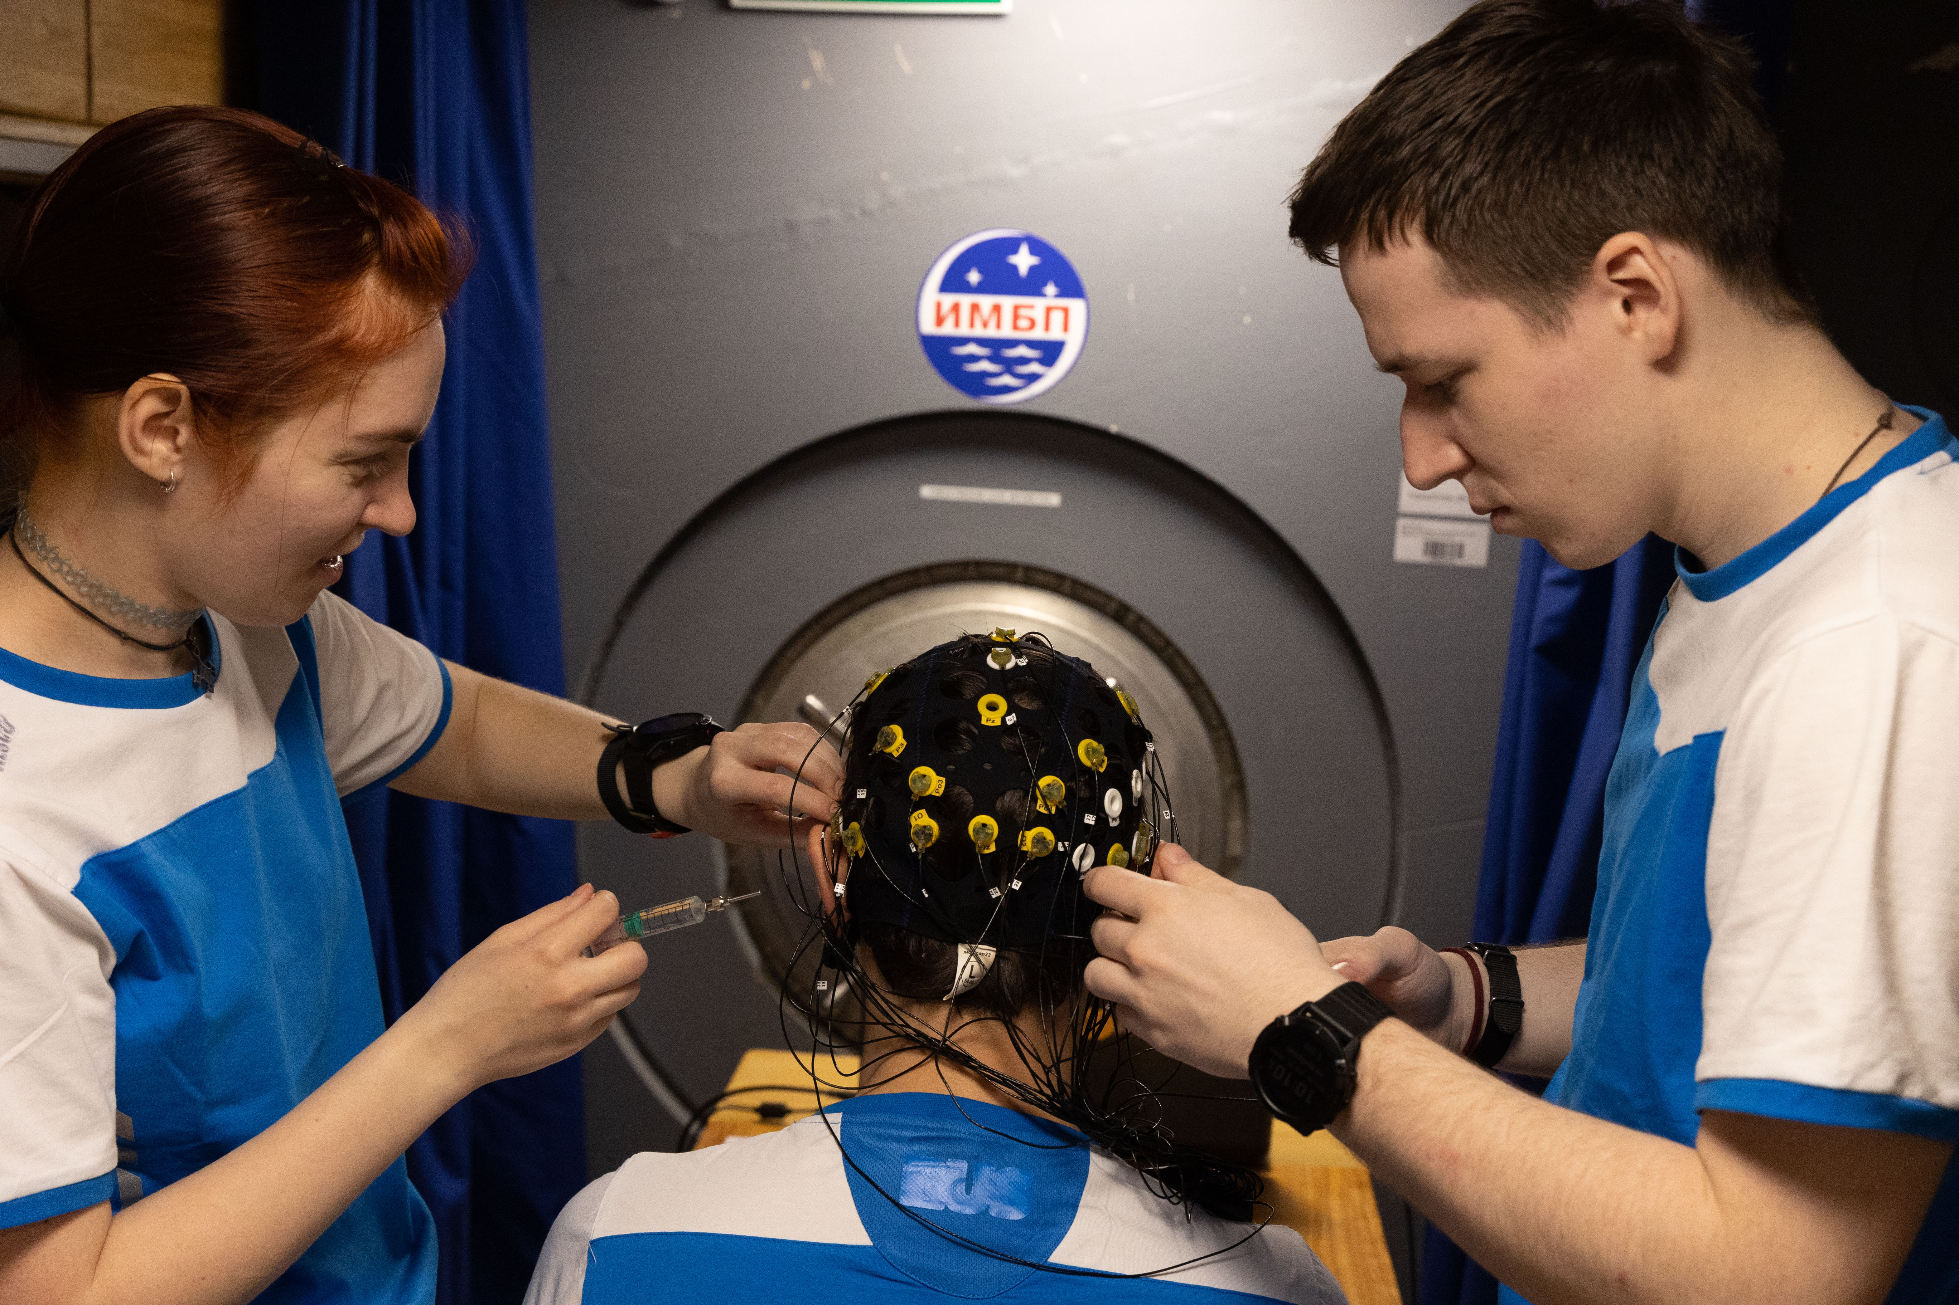
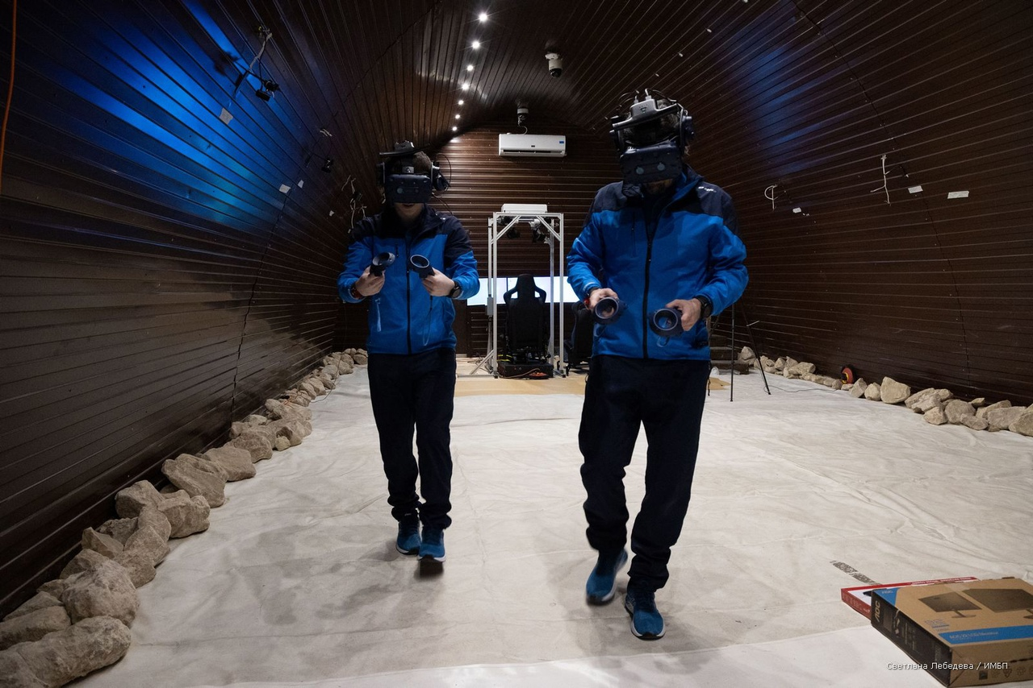
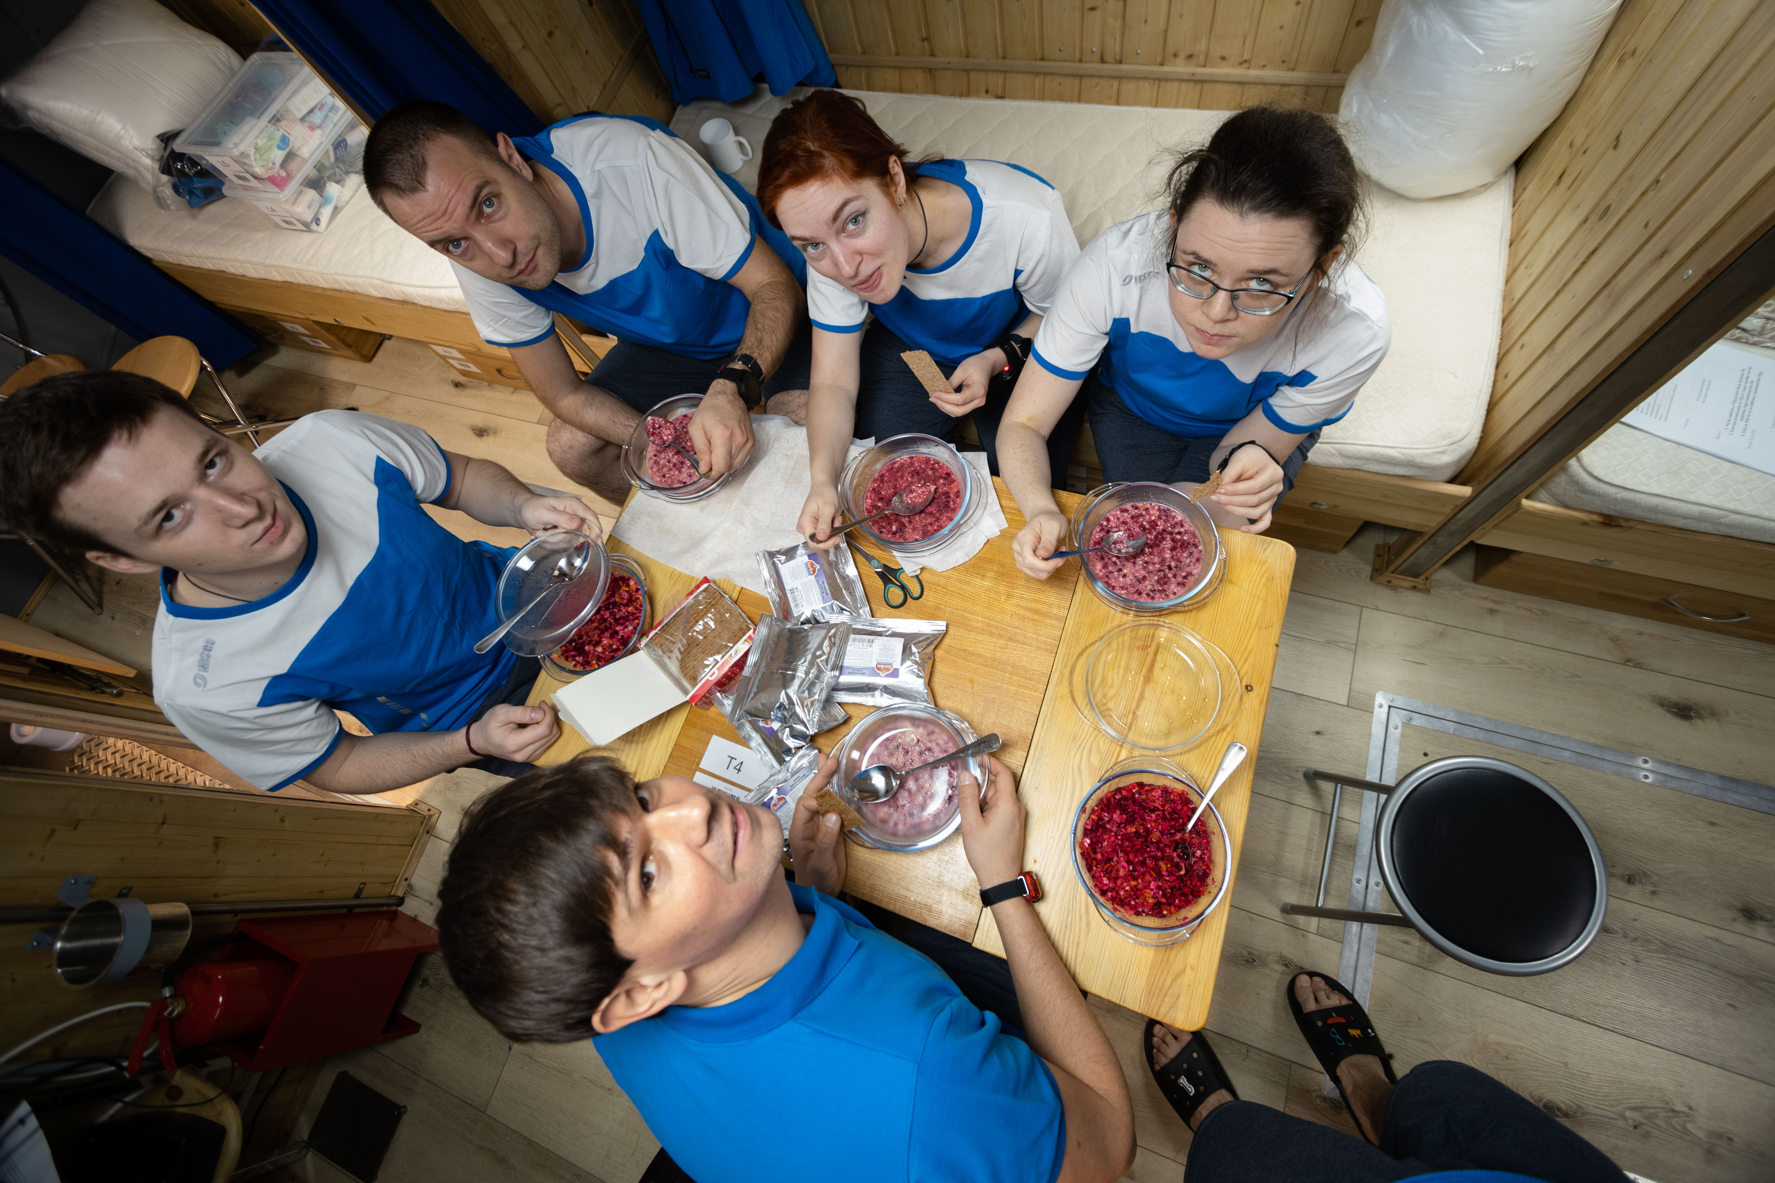
"Eskiz" (“Sketch”) experiment, 2021
The team spent two weeks in a module with an area of ​​only about 8 square meters.
The main objective of the experiment was to study the early period of adaptation of a gender-mixed crew to isolation conditions in a small-volume hermetic facility with an artificial habitat, as well as non-specific effects on the immune system.

Slide 9
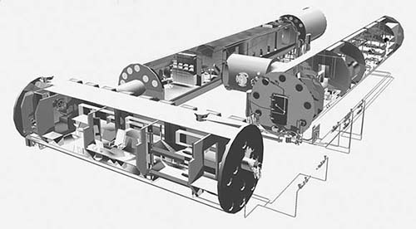
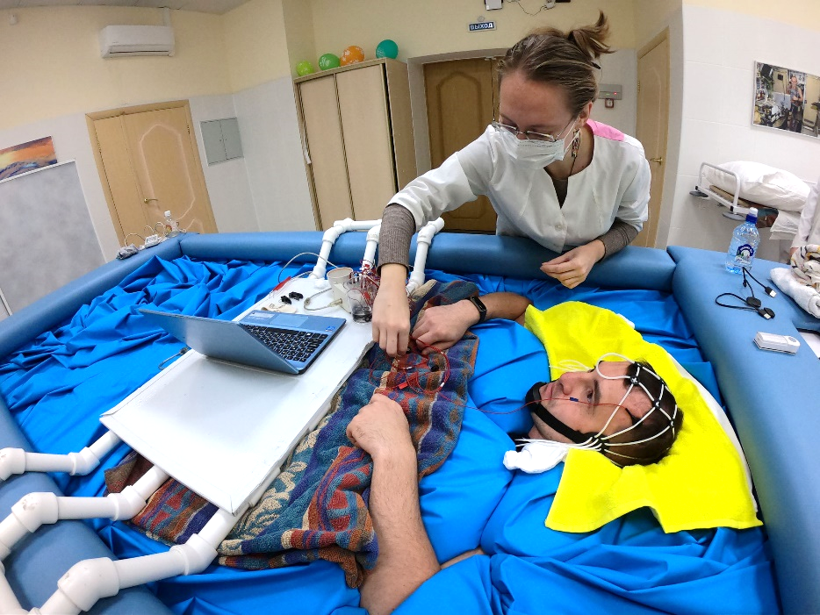
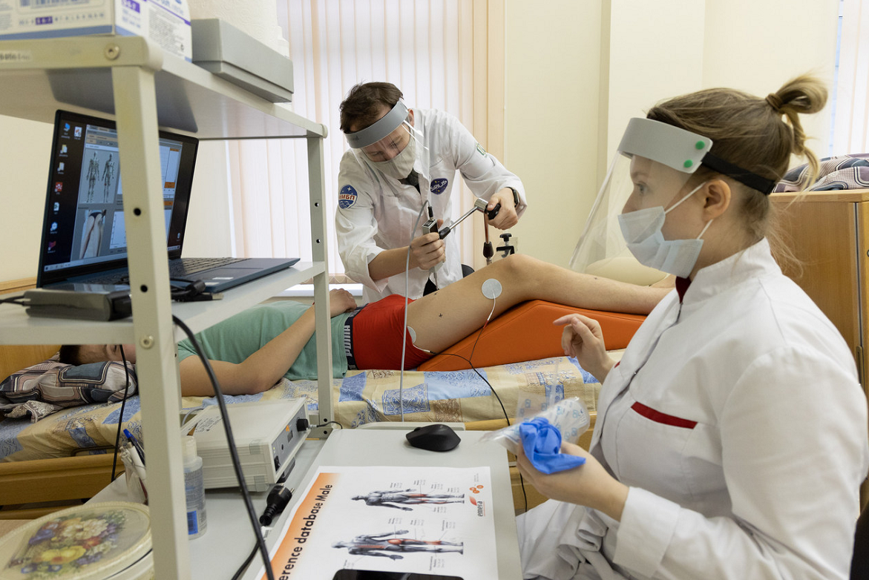
Planned projects
In 2024, a series of 21-day HDT with male subjects using the SRC as a countermeasure was held. We are planning to continue.
4-month isolation experiment in an artificial habitat with a changed gas environment to be launched in July
This and next years: a series of 14-day immersion with and without countermeasures. Super-short immersions (45-60 minutes)

Slide 10
Thank you for your attention!
Contact information: info@imbp.ru

