Slide 1
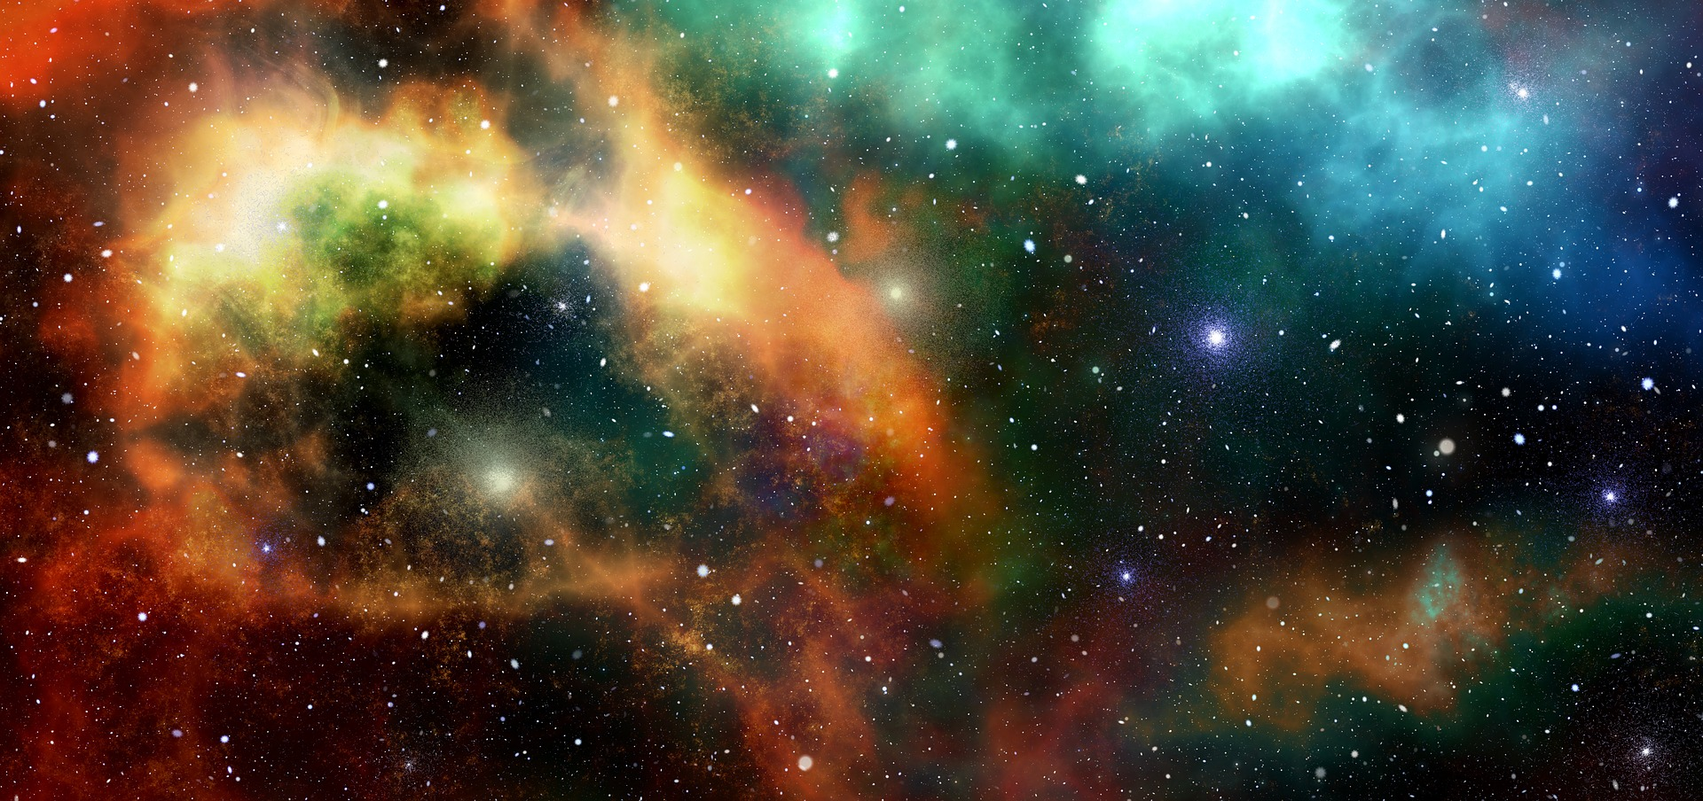


12th IAA Symposium on Future Space Exploration
09-11 June 2025, Torino, Italy
INVESTIGATING THE POTENTIALITY OF LIGHT SPECTRUM IN SPACE FARMING:
A STRAWBERRY CASE STUDY
Nicolò Grasso⁽¹⁾, Franco Lombardi⁽¹⁾, Bruno Mezzetti⁽²⁾
⁽¹⁾Politecnico di Torino, Dipartimento di Ingegneria Gestionale e della Produzione,
Corso Duca degli Abruzzi, 24, Torino (TO)
⁽²⁾Università Politecnica delle Marche, Dipartimento di Scienze Agrarie, Alimentari e Ambientali, ,
Via Ranieri 65, 60131 Ancona (AN)
10/06/2025

Slide 2
INVESTIGATING THE POTENTIALITY OF LIGHT SPECTRUM IN SPACE FARMING: A STRAWBERRY CASE STUDY
BACKGROUND
MATERIALS & METHODS
RESULTS
CONCLUSIONS
END/CONTACT
Overview
Background: indoor farming and space farming
Materials and Methods
Results
Conclusion & Final Remarks
Nicolò Grasso
10/06/2025

Slide 3
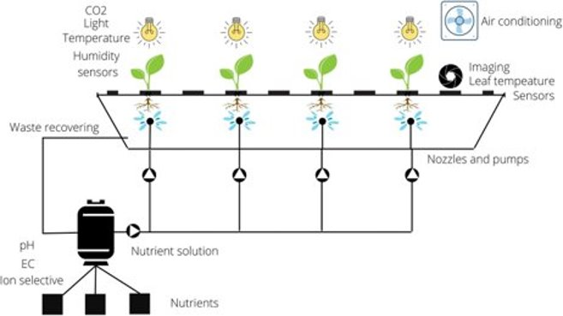
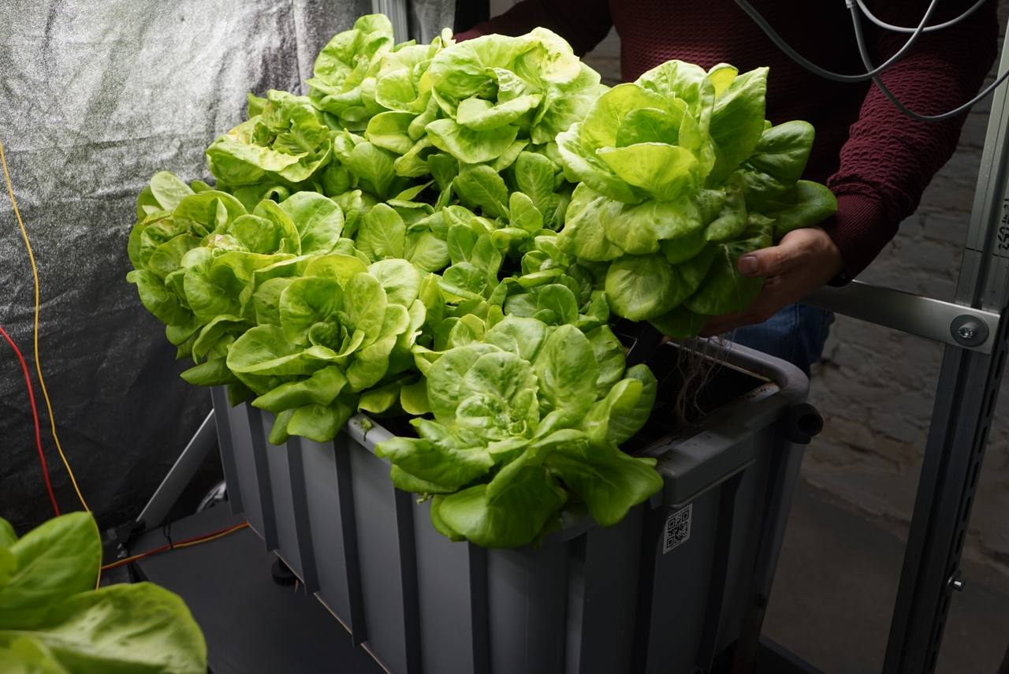
INVESTIGATING THE POTENTIALITY OF LIGHT SPECTRUM IN SPACE FARMING: A STRAWBERRY CASE STUDY
BACKGROUND
MATERIALS & METHODS
RESULTS
CONCLUSIONS
END/CONTACT
Indoor Farming
NO biotic nor abiotic stresses
NO pesticides
Minimum food waste
NO seasonality
MIN water consumption
Stable yield
Predictable Quality
Nicolò Grasso
10/06/2025

Slide 4
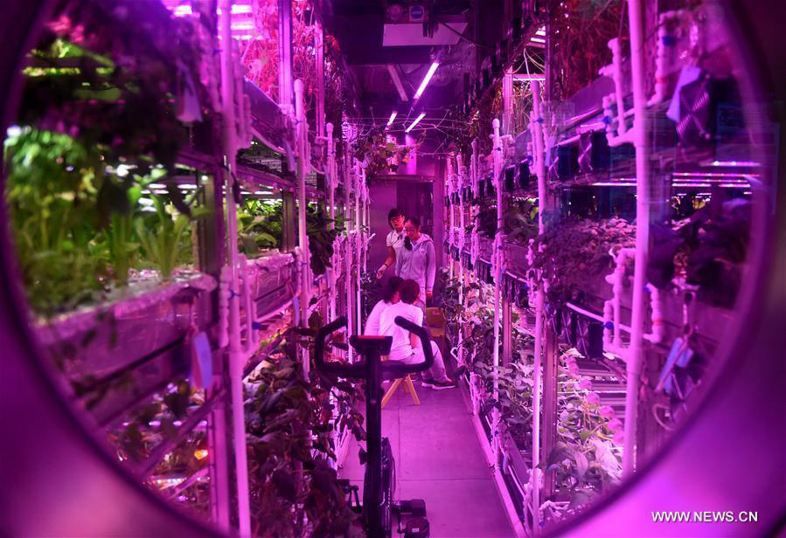
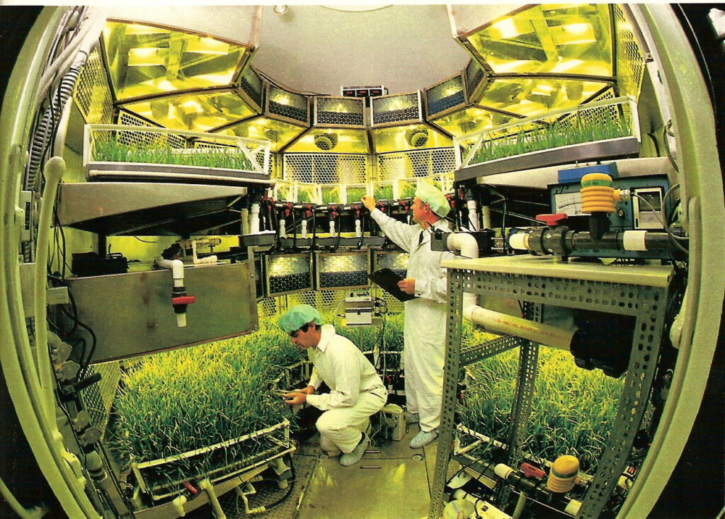
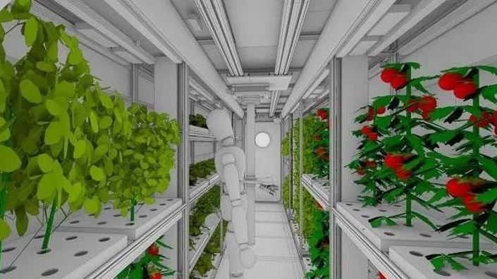
INVESTIGATING THE POTENTIALITY OF LIGHT SPECTRUM IN SPACE FARMING: A STRAWBERRY CASE STUDY
BACKGROUND
MATERIALS & METHODS
RESULTS
CONCLUSIONS
END/CONTACT
Space Farming
Controlled environment
Water recycle
Mass/volume constraints
Integration in BLSS
Nicolò Grasso
10/06/2025

Slide 5
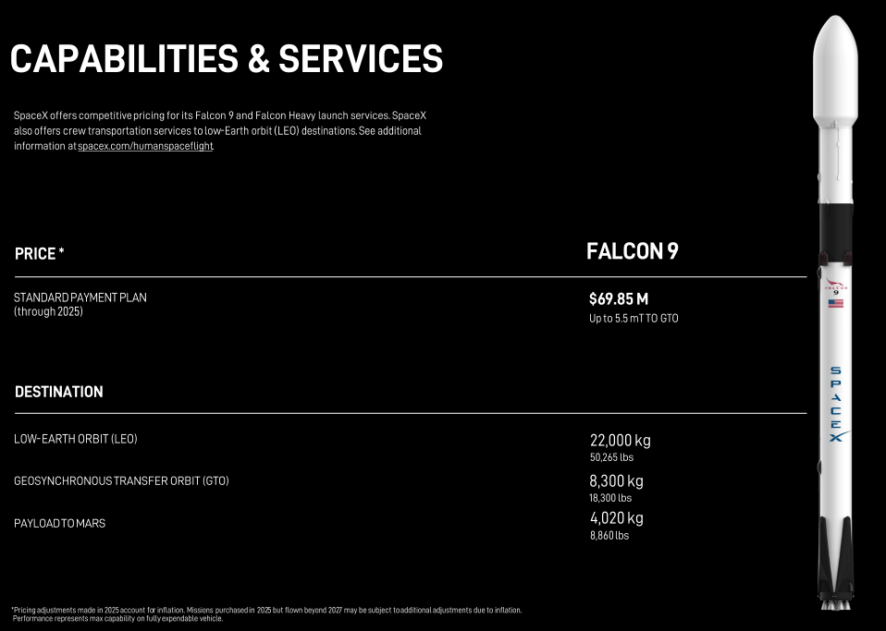
INVESTIGATING THE POTENTIALITY OF LIGHT SPECTRUM IN SPACE FARMING: A STRAWBERRY CASE STUDY
BACKGROUND
MATERIALS & METHODS
RESULTS
CONCLUSIONS
END/CONTACT
Space Farming: why?
800 kg of food per year per person (including packages)
Shipping cost To LEO around $2.4M per person per year
Shipping cost to Mars over $14M per person per year.
Physiological effect of fresh food
Psychological effect of growing plants.
Nicolò Grasso
10/06/2025

Slide 6
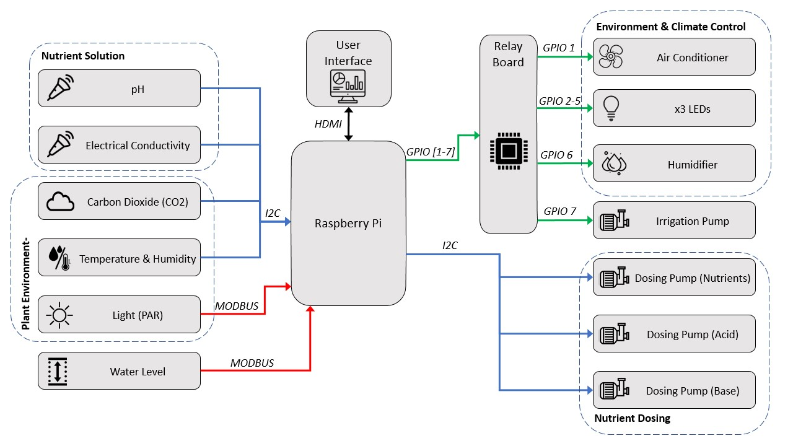
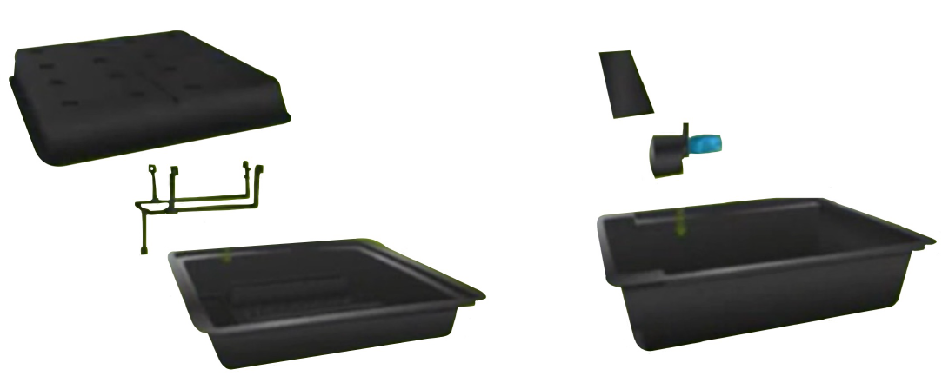
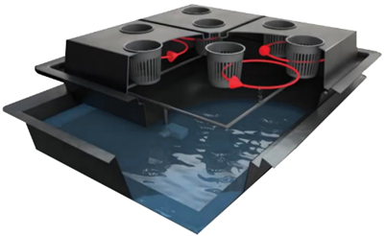
INVESTIGATING THE POTENTIALITY OF LIGHT SPECTRUM IN SPACE FARMING: A STRAWBERRY CASE STUDY
BACKGROUND
MATERIALS & METHODS
RESULTS
CONCLUSIONS
END/CONTACT
Growing Facility
Nicolò Grasso
10/06/2025

Slide 7
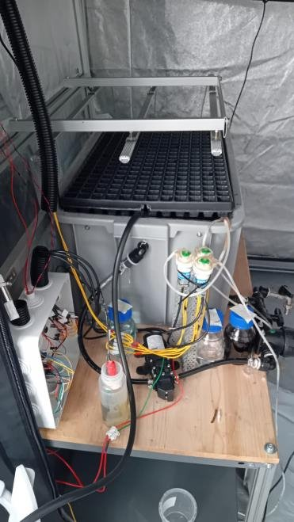
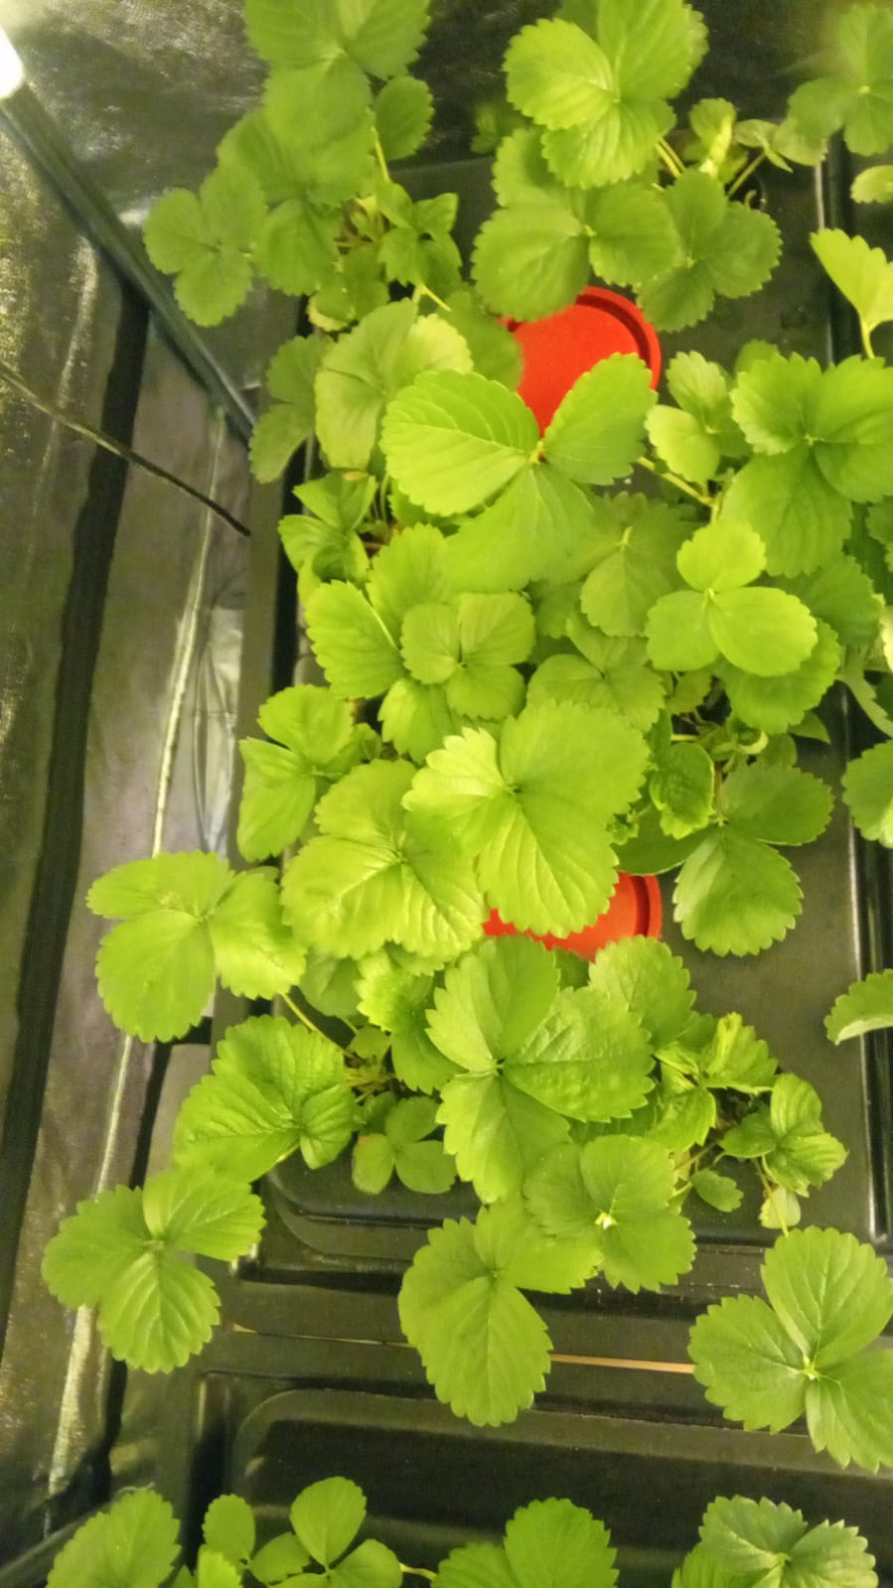
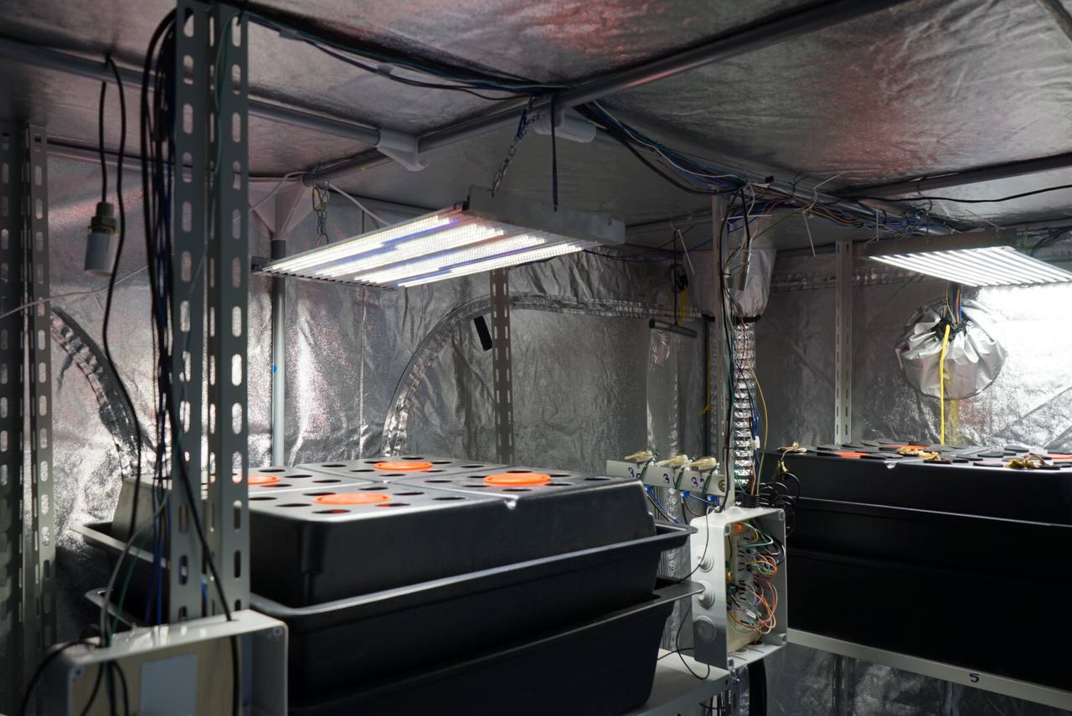
INVESTIGATING THE POTENTIALITY OF LIGHT SPECTRUM IN SPACE FARMING: A STRAWBERRY CASE STUDY
BACKGROUND
MATERIALS & METHODS
RESULTS
CONCLUSIONS
END/CONTACT
Growing Facility
Nicolò Grasso
10/06/2025

Slide 8
INVESTIGATING THE POTENTIALITY OF LIGHT SPECTRUM IN SPACE FARMING: A STRAWBERRY CASE STUDY
BACKGROUND
MATERIALS & METHODS
RESULTS
CONCLUSIONS
END/CONTACT
Plant Growing Condition and Indicators Selection
Control plants: white light
Treated plants: white light + far-red radiation
Productivity:
N° of days to first flower
N° of flowers
N° of days to first fruit
Fruit fresh weight [mg]
Parameter | Value
Temperature | 18°C – 24°C (±1°C)
Humidity | 65% (±10%)
Light intensity | 300 – 350 µmol/m²s
CO₂ Concentration | 420 – 450 ppm
Photoperiod | 16/8 h
pH | 5.8 – 6.5
EC (growth phase) | 1200 µS/cm
EC (flowering phase) | 1400 µS/cm
Quality:
Brix Degree [°B]
Calorie Delivery Efficiency (CDE) [kcal/kW*day]
Nicolò Grasso
10/06/2025

Slide 9
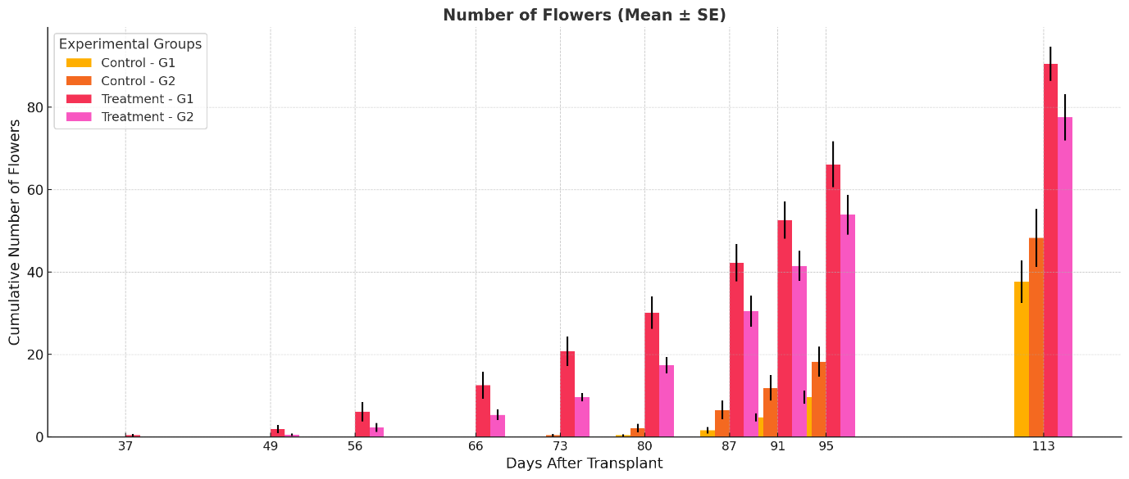
INVESTIGATING THE POTENTIALITY OF LIGHT SPECTRUM IN SPACE FARMING: A STRAWBERRY CASE STUDY
BACKGROUND
MATERIALS & METHODS
RESULTS
CONCLUSIONS
END/CONTACT
Flowering time & Number of flowers
Time to first flower | Control (days) | Treatment (days)
Genotype 1 | 87±5 | 50±6
Genotype 2 | 82±5 | 58±7
Nicolò Grasso
10/06/2025

Slide 10
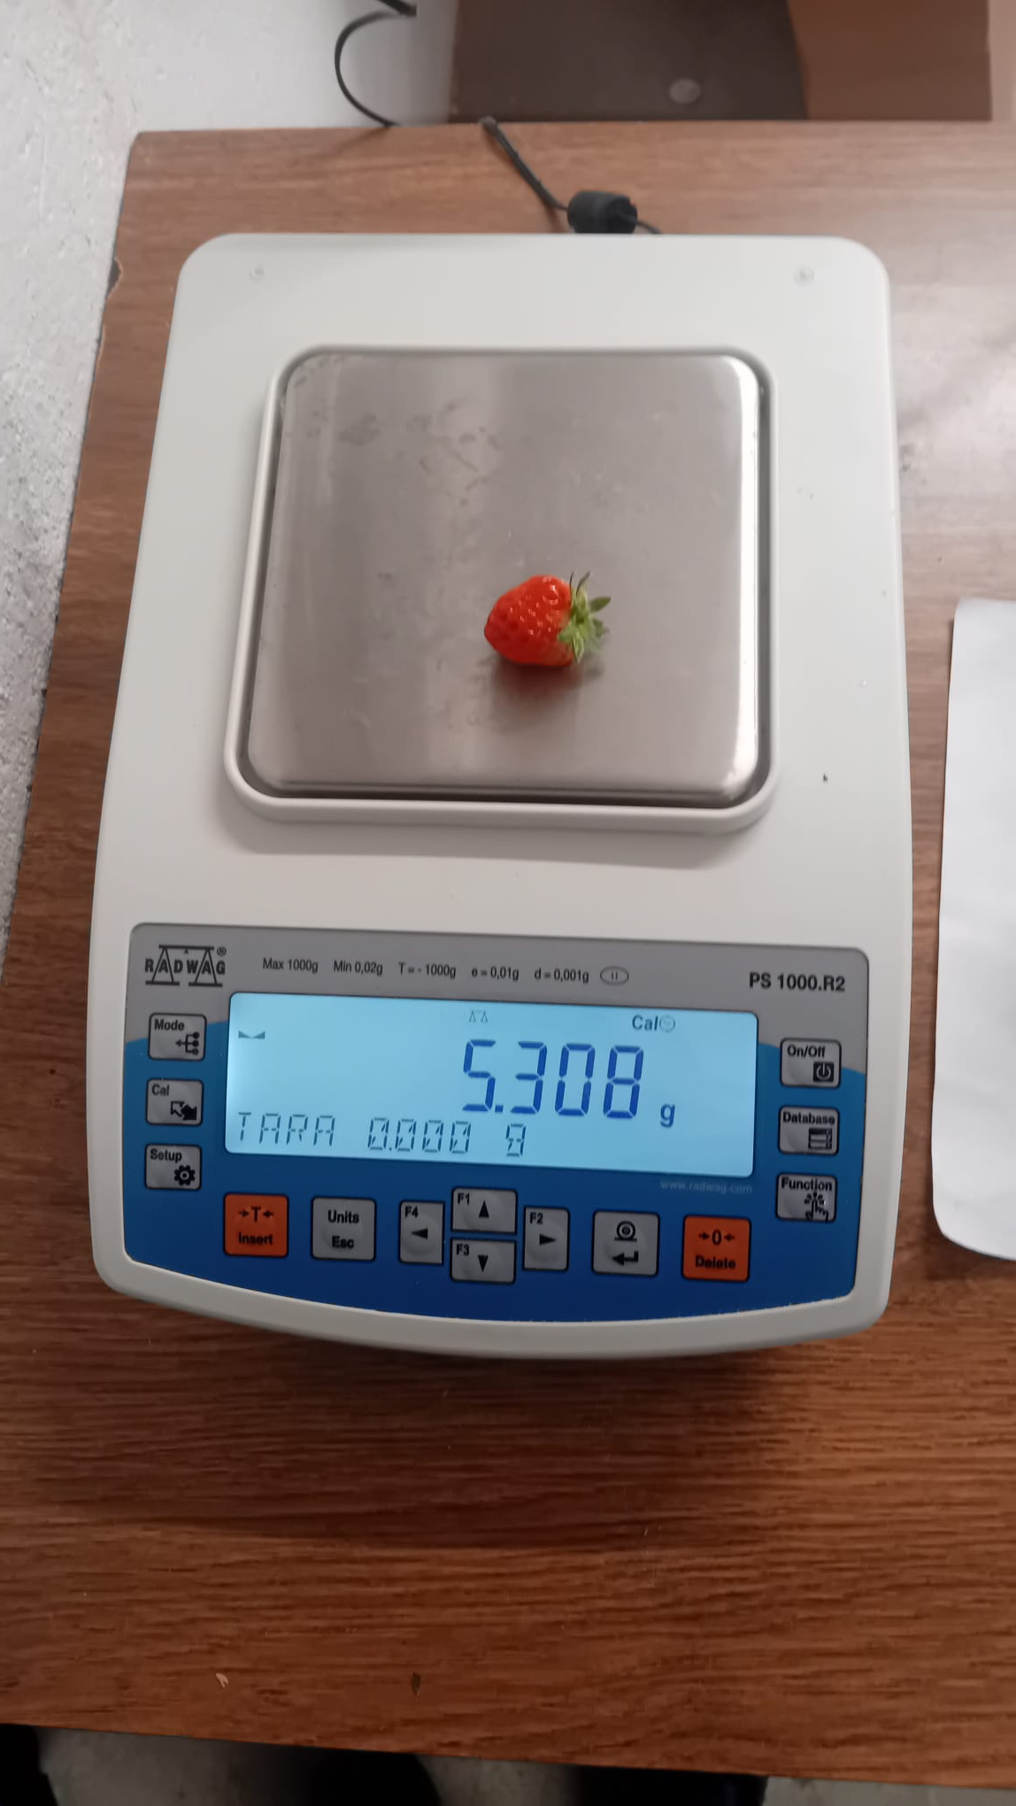
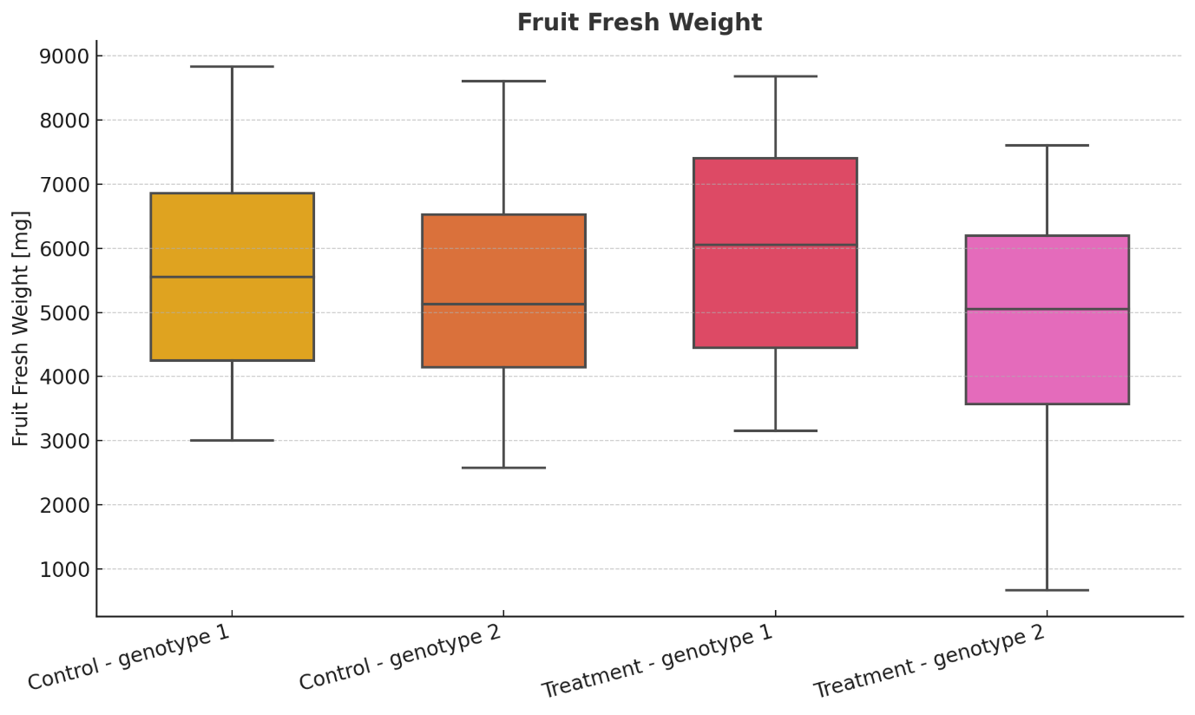
INVESTIGATING THE POTENTIALITY OF LIGHT SPECTRUM IN SPACE FARMING: A STRAWBERRY CASE STUDY
BACKGROUND
MATERIALS & METHODS
RESULTS
CONCLUSIONS
END/CONTACT
Fruit time & Fruit fresh weight
Time to first fruit | Control (days) |  | Treatment (days)
 | dat | daf | dat | daf
Genotype 1 | 130±10 | 43±7 | 114±13 | 63±8
Genotype 2 | 121±10 | 39±6 | 125±14 | 67±7
Nicolò Grasso
10/06/2025

Slide 11
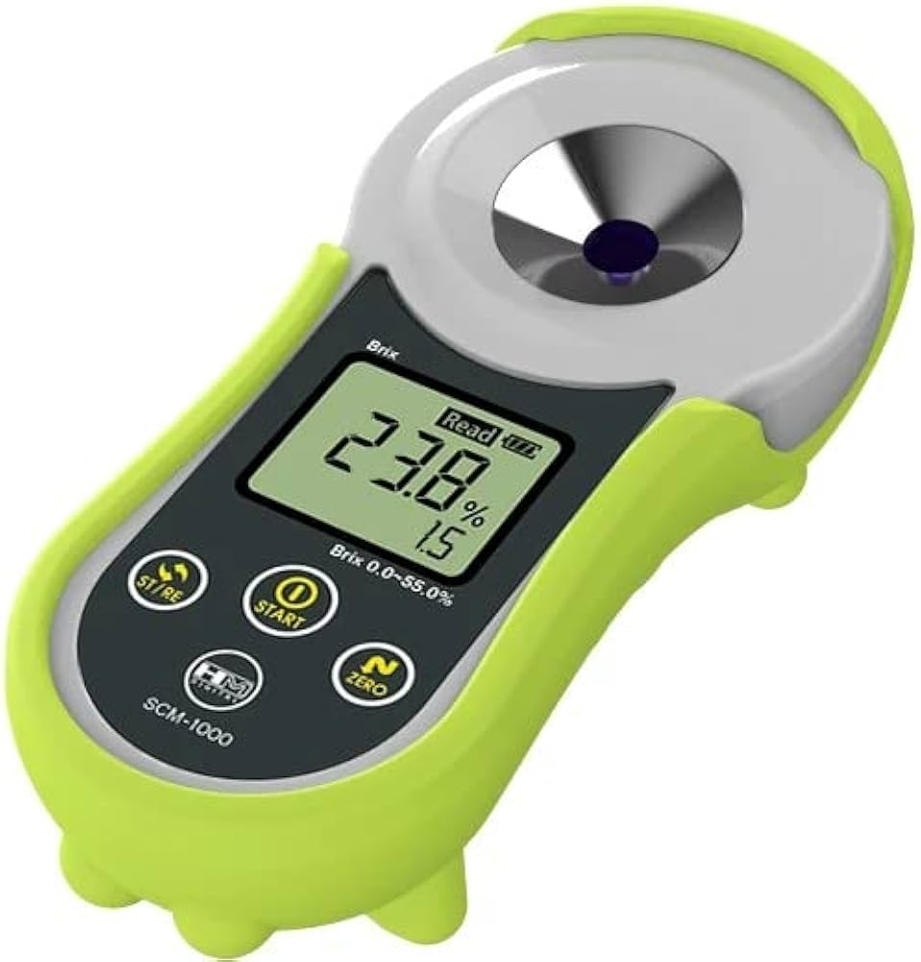
INVESTIGATING THE POTENTIALITY OF LIGHT SPECTRUM IN SPACE FARMING: A STRAWBERRY CASE STUDY
BACKGROUND
MATERIALS & METHODS
RESULTS
CONCLUSIONS
END/CONTACT
Brix degree and CDE
°B | Control (°B) | Treatment (°B)
Genotype 1 | 6.1 | 6.3
CDE | Control (kcal/kW*day) | Treatment (kcal/kW*day)
Genotype 1 | 15.70 | 46.76
Genotype 2 | 19.93 | 30.10
Nicolò Grasso
10/06/2025

Slide 12
INVESTIGATING THE POTENTIALITY OF LIGHT SPECTRUM IN SPACE FARMING: A STRAWBERRY CASE STUDY
BACKGROUND
MATERIALS & METHODS
RESULTS
CONCLUSIONS
END/CONTACT
Far-red radiation had a significant impact on strawberry physiology, even though it was stronger on certain indicators and certain genotypes.
The newly proposed Calorie Delivery Efficiency (CDE) indicator successfully captured combined effects of indicators of different dimensions, proving itself a valuable indicator for space farming related experiments.
CDE is able to gather information coming from every aspect of a space farming food production system, such as crop related aspects (genotype), technological aspects (power consumption) and productivity aspects (harvest time)
Our results demonstrate that both genotype and light treatment jointly influence system efficiency, suggesting the value of CDE as a comparative metric for space farming.
Future study need to better assess radiation effects on strawberry by increasing the number of radiation combinations.
Nicolò Grasso
10/06/2025

Slide 13
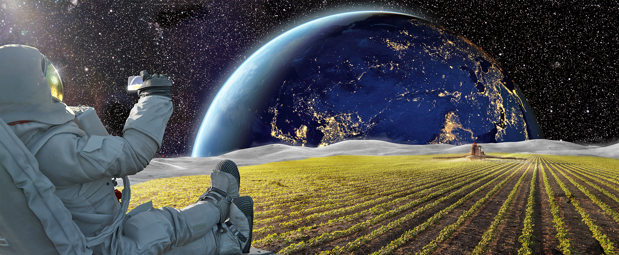
INVESTIGATING THE POTENTIALITY OF LIGHT SPECTRUM IN SPACE FARMING: A STRAWBERRY CASE STUDY
BACKGROUND
MATERIALS & METHODS
RESULTS
CONCLUSIONS
END/CONTACT
Thank you for your attention!
nicolo.grasso@polito.it
Nicolò Grasso
10/06/2025

