Slide 1
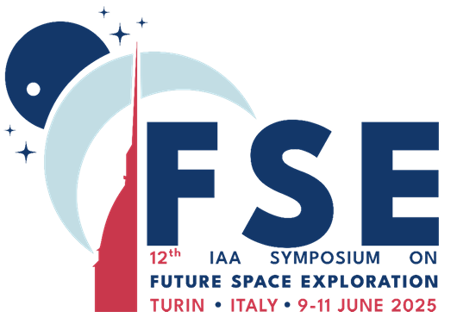


HUMAN ADAPTATIONS TO WEIGHTLESSNESS WITH MOSAIC REPLICATION OF GRAVITY EFFECTS
Elena Fomina
Natalia Senatorova, Anna Burakova, Danil Ivanov
State Scientific Center of Russian Federation - Institute of Biomedical Problems, RAS, Moscow, Russia
12th IAA Symposium on Future Space Exploration

Slide 2
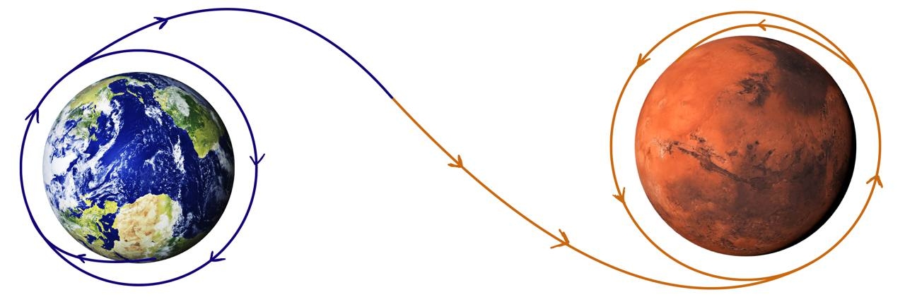
Characteristics of mitigation of hypogravity effects in interplanetary flight
Orbital flight
Interplanetary flight
Level of physical performance must be maintained at all times
Regular communication with specialists on Earth
Cosmonauts have time for adaptation after landing
Level of physical performance should be at peak form before landing.
High physical performance is required immediately after landing
Autonomous flight with automated decision support system in the prevention system
12th IAA Symposium on Future Space Exploration
2

Slide 3
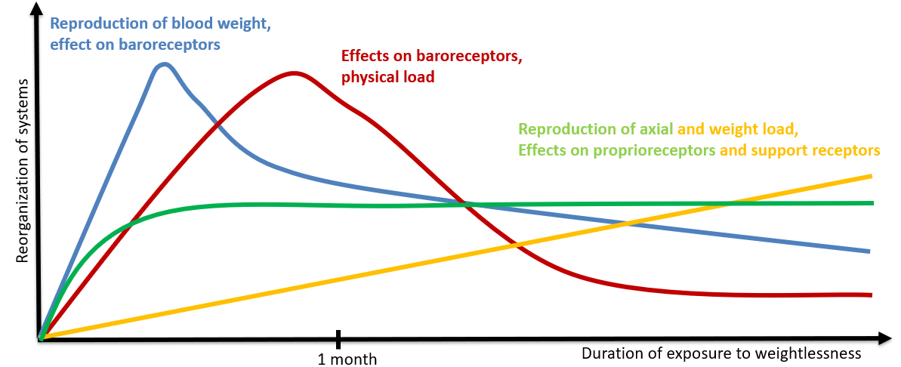
Mosaic replication of gravity effects
Fluid redistribution
Cardiovascular system
Bone tissue and calcium metabolism
Muscular system
12th IAA Symposium on Future Space Exploration
3

Slide 4
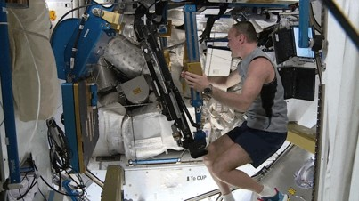
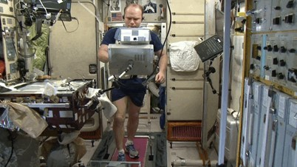
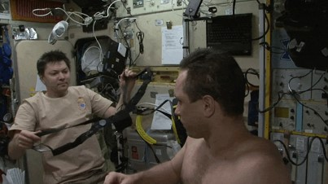
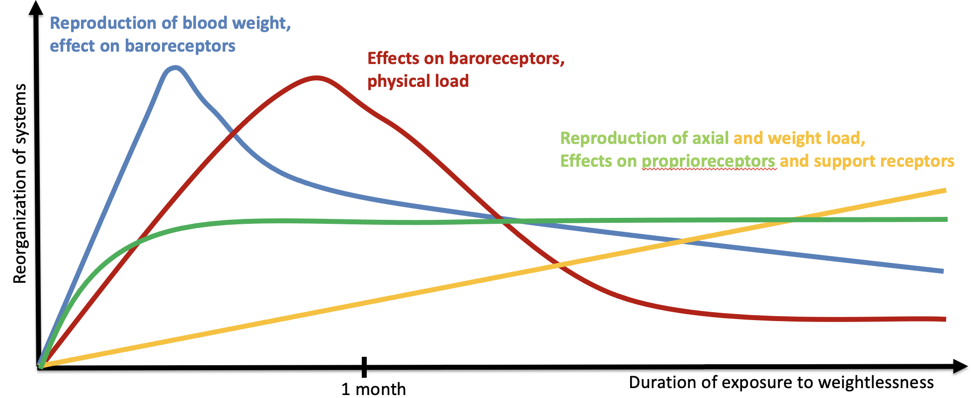
Mosaic replication of gravity effects
Resistive training
Treadmill training
Reproduction of blood weight (LBNP)
Fluid redistribution
Cardiovascular system
Bone tissue and calcium metabolism
Muscular system
12th IAA Symposium on Future Space Exploration
4

Slide 5
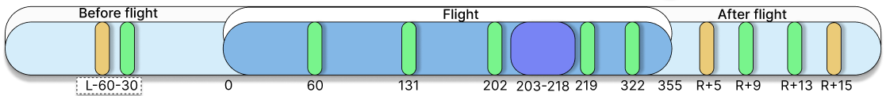
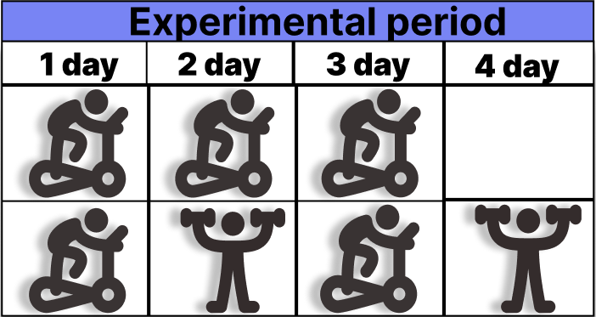
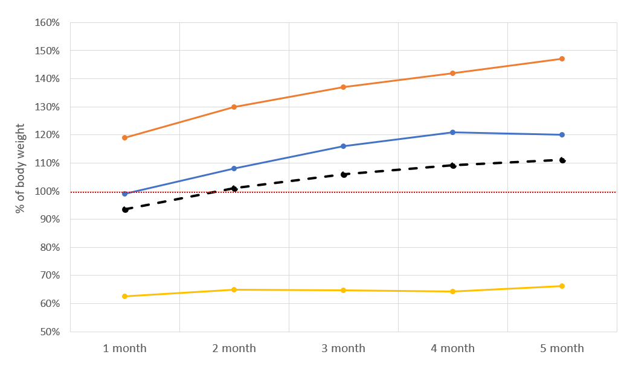
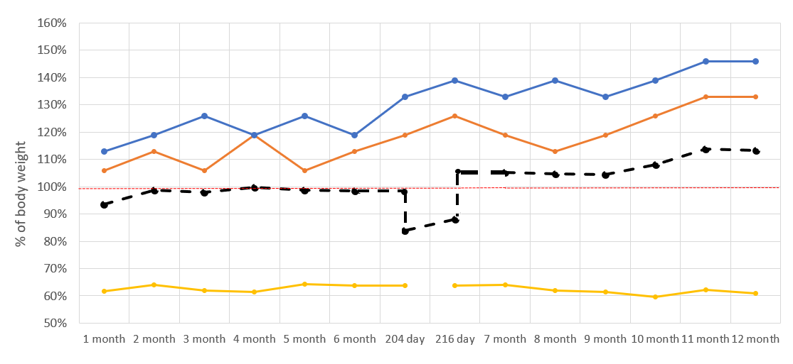
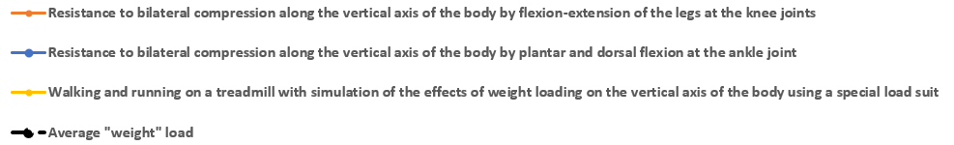
Modulation of adaptation to weightlessness by reproduction of weight loading effects
Simulating the effects of «weight» loading during six-month space missions.
Simulation of the effects of ‘weight’ loading during a one-year space mission with an experimental period
12th IAA Symposium on Future Space Exploration
5

Slide 6
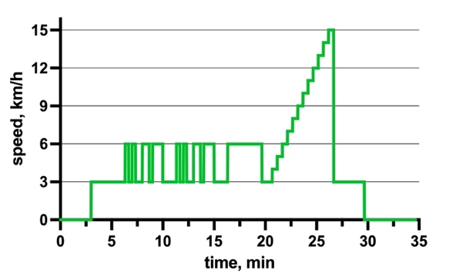
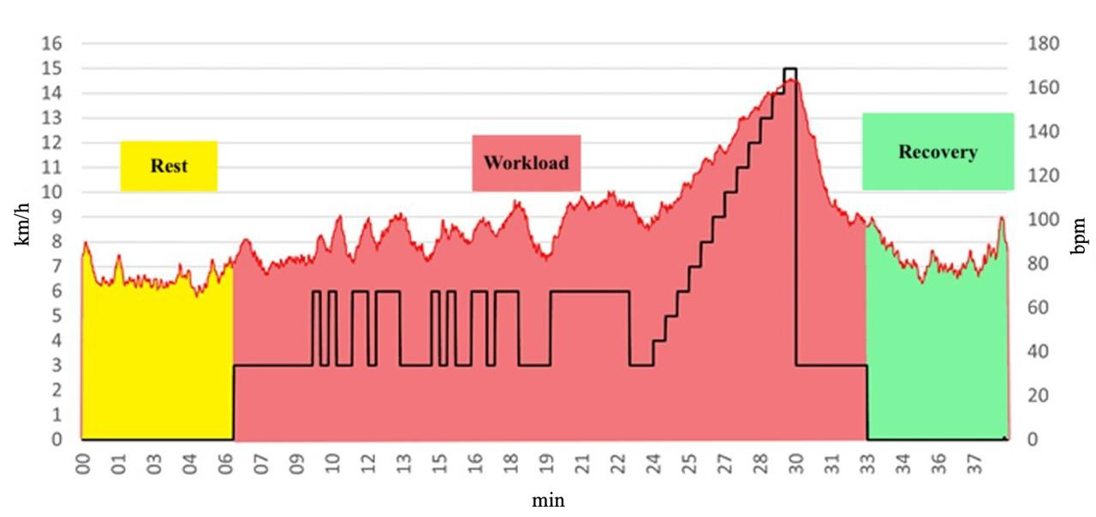
”Individual strategies” test
Recovery pulse sum
Rest pulse sum
Workload pulse sum
Measurements:
Heart rate, pulse sums
Surface electromyogram of leg muslces
Pulse debt= Recovery pulse sum– Rest pulse sum
12th IAA Symposium on Future Space Exploration
6

Slide 7
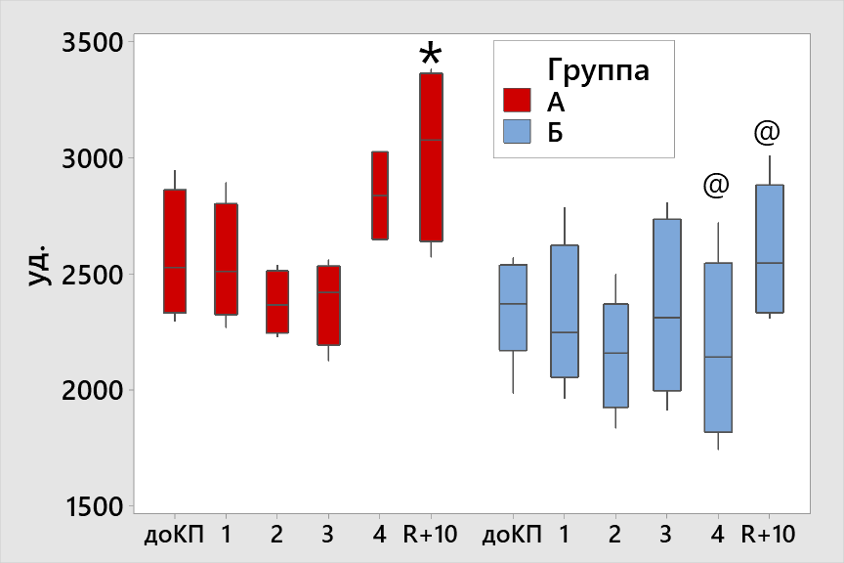
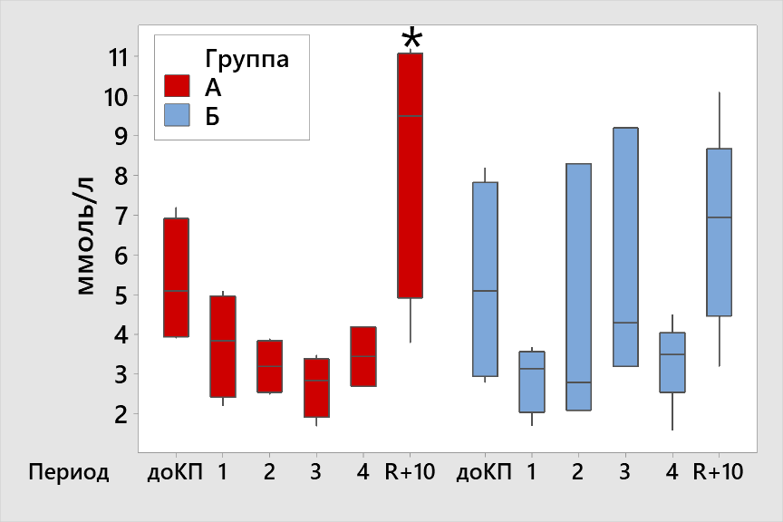
Predicting post-flight performance based on spaceflight test results
Pulse sum of recovery
Capillary blood lactate at the first minute of recovery
Group
A
B
Group
A
B
bpm
Mmol/L
@ p<0.05 - significant difference between groups
* p<0.05 - significant change compared to preflight value
12th IAA Symposium on Future Space Exploration
7

Slide 8
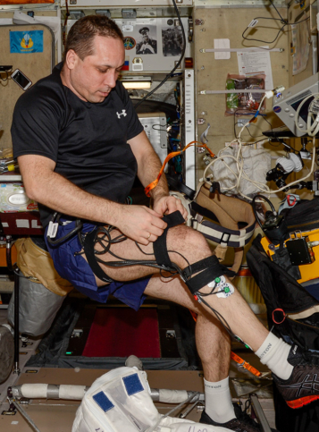
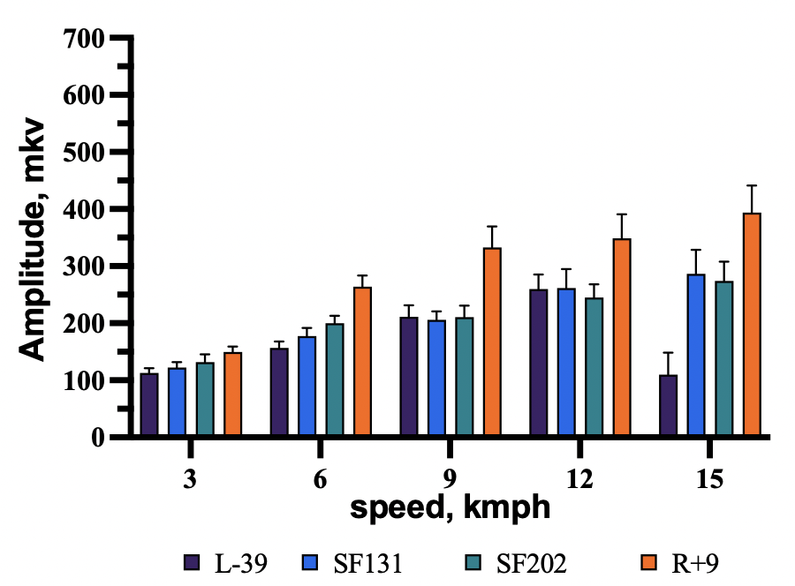
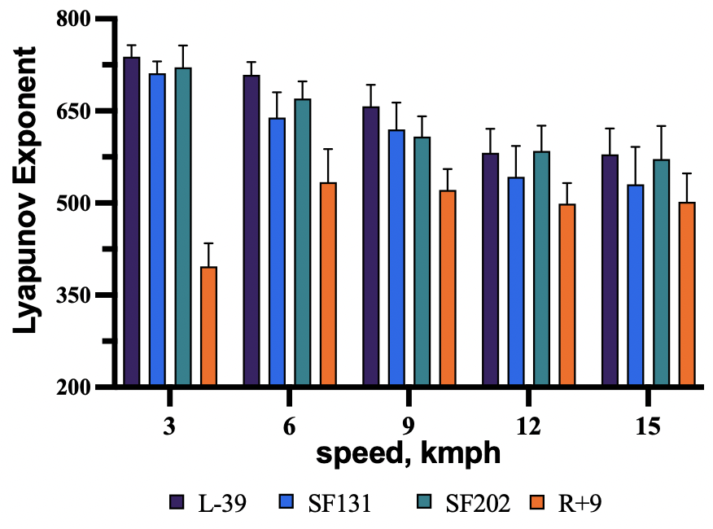
Changes in the parameters of electrical activity of leg muscles in one-year mission
m. Soleus
The value of the Lyapunov exponent reflects how quickly two initially close trajectories separate from each other in phase space, which allows it to be used as a prediction tool for a dynamical system.
A decrease in the Lyapunov exponent indicates a decrease in chaos in the system.
12th IAA Symposium on Future Space Exploration
8

Slide 9
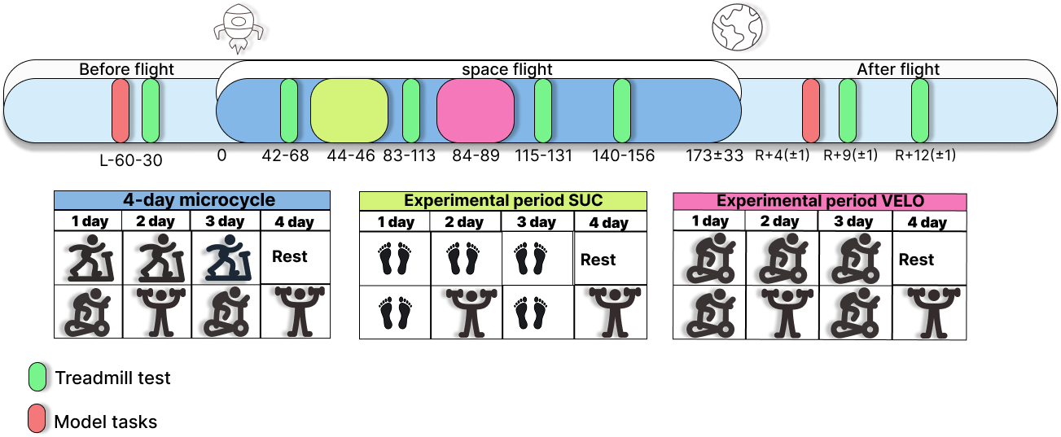
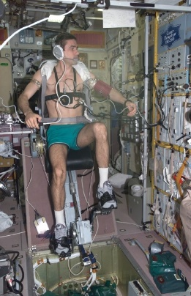
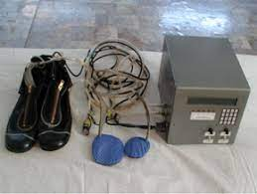
Modulation of long-term adaptation with decreasing magnitude of artificial reproduction of weight-bearing effects
SUC – support unloading compensator
12th IAA Symposium on Future Space Exploration
9

Slide 10
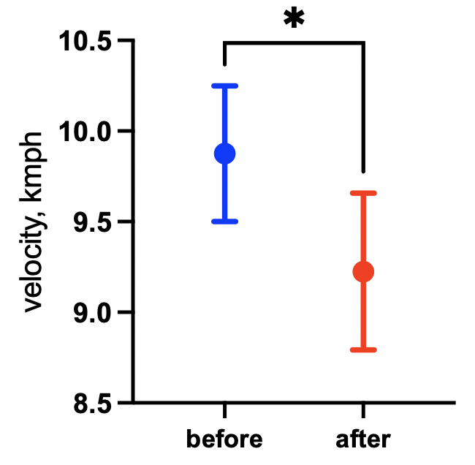
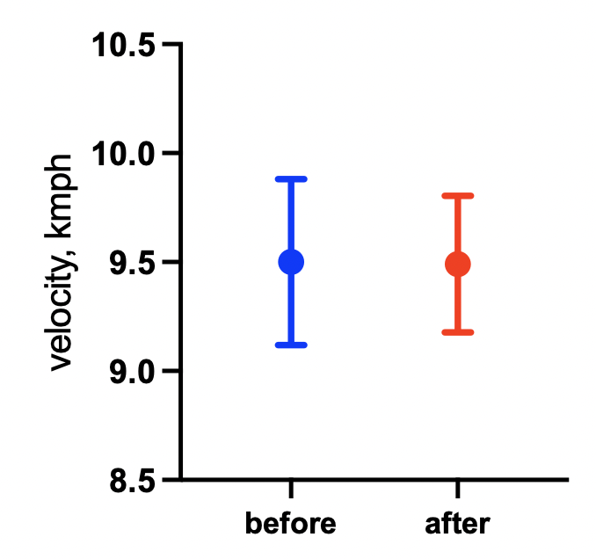
Reducing the magnitude of artificial reproduction of weight load effects
Speed of fast running after a period of load replacement on a treadmill with a support unloading compensator (SUC)
Speed of fast jogging after a period of load replacement on a treadmill with pedaling on the exercise bike (VELO)
P=0,046
MO-3 Locomotor test
12th IAA Symposium on Future Space Exploration
10

Slide 11
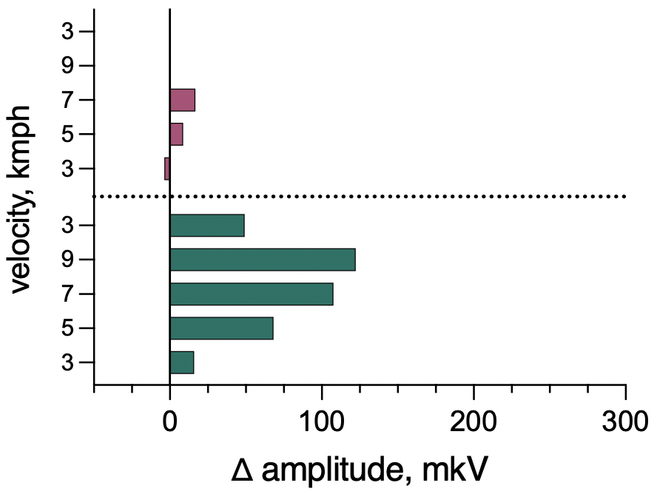
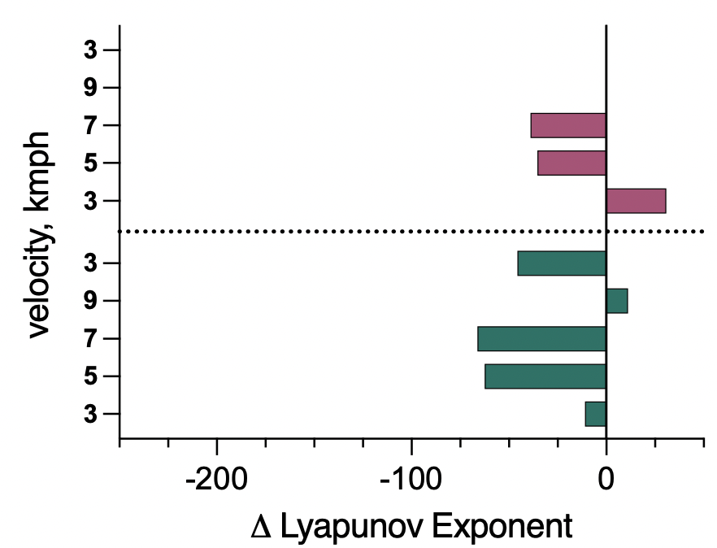
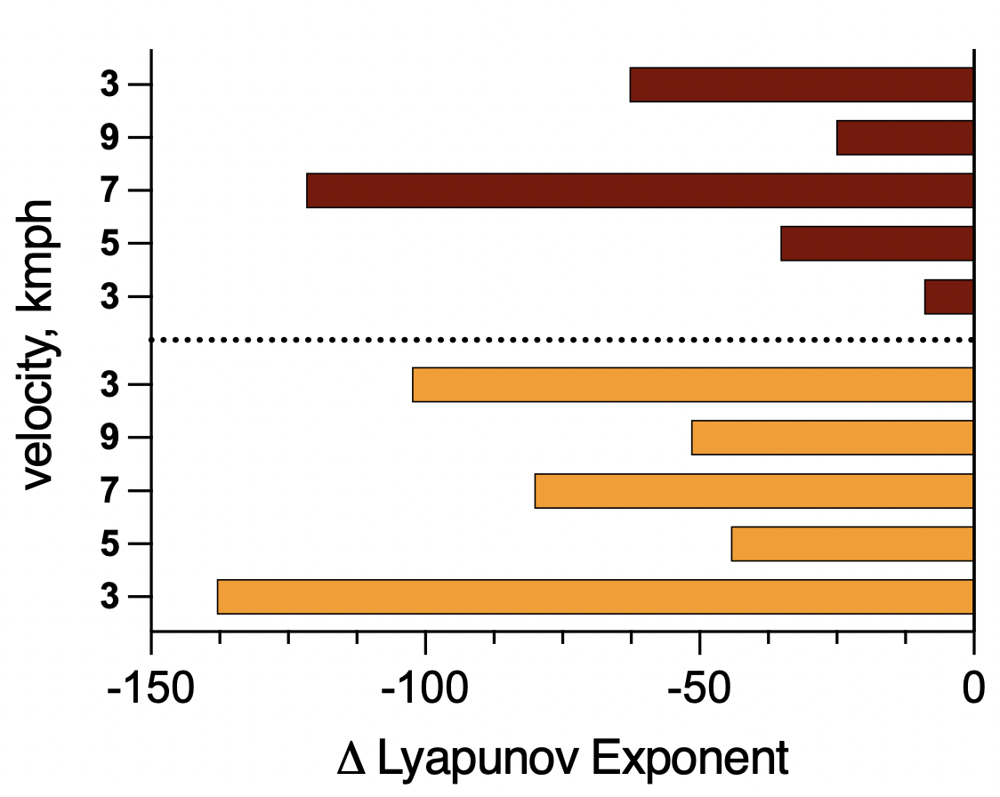
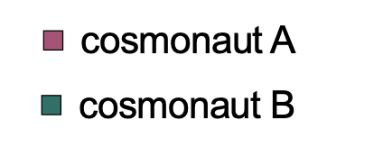
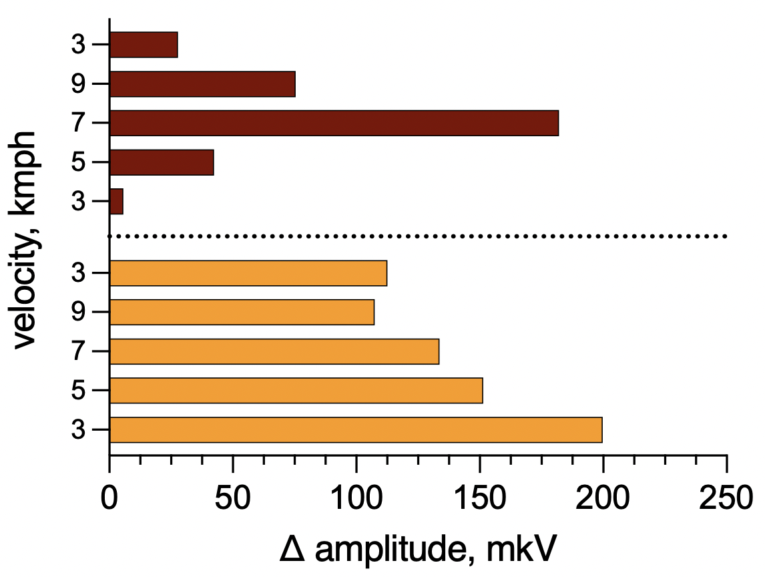
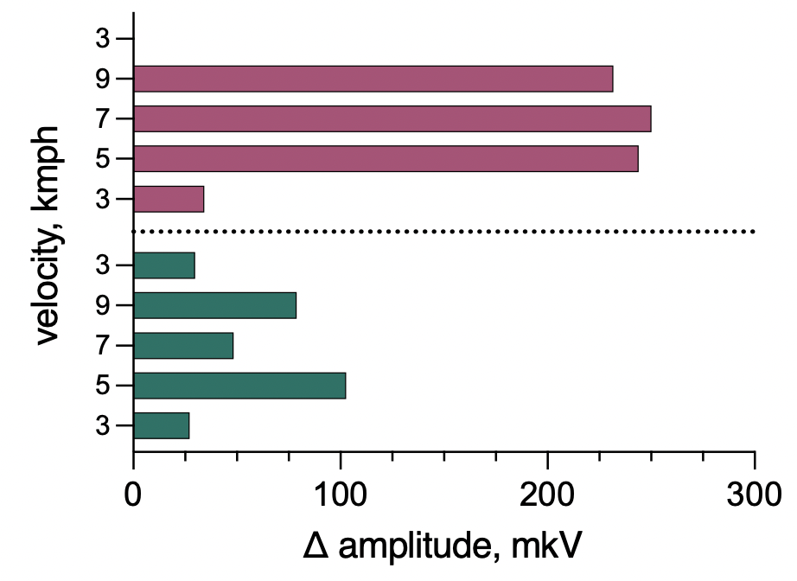
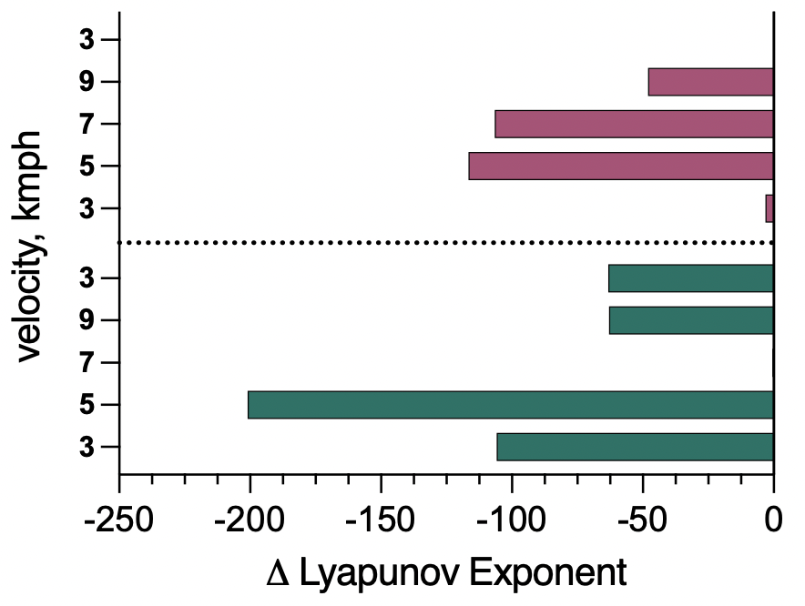
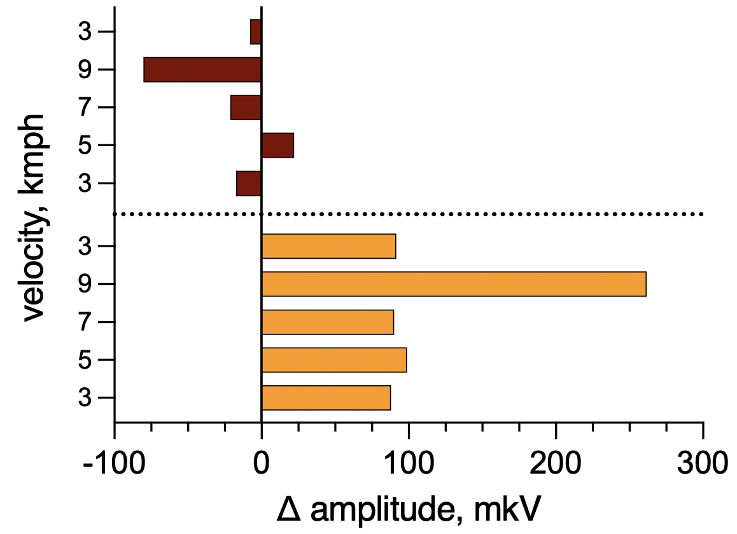
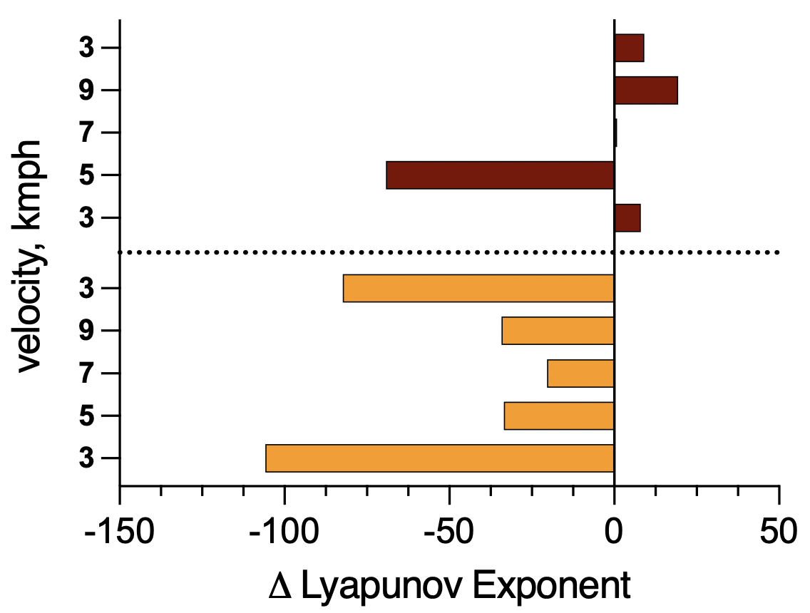
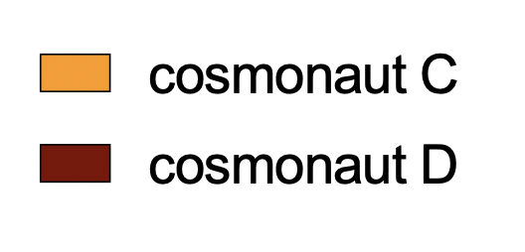
Changes in the parameters of electrical activity of leg muscles after experimental periods
SUC
VELO
m. Soleus
m. Gastrocnemius Lateralis
12th IAA Symposium on Future Space Exploration
11

Slide 12
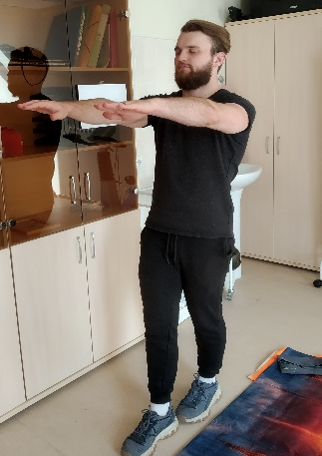
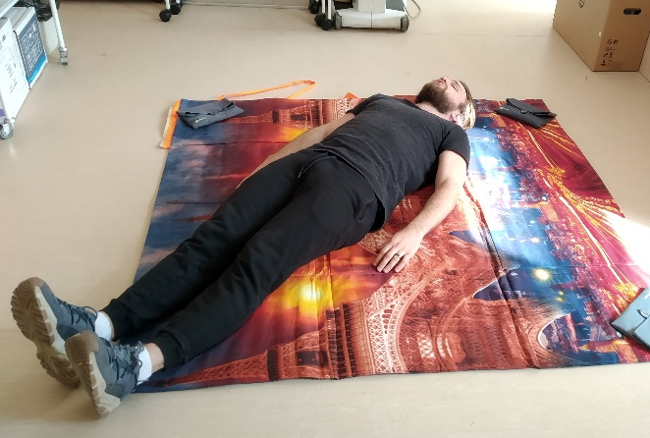
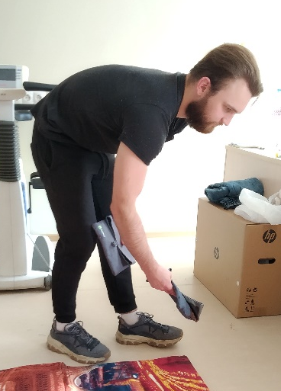
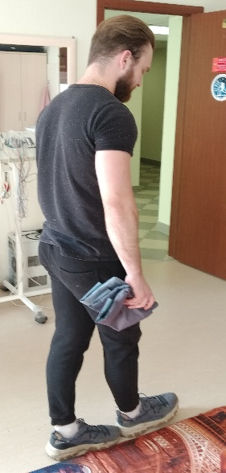
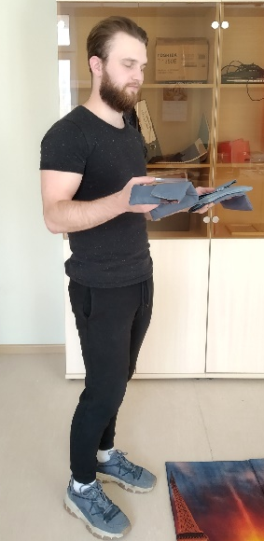
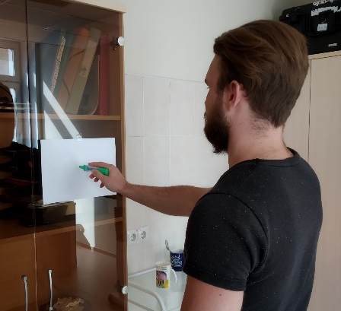
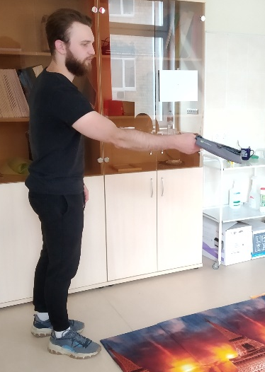
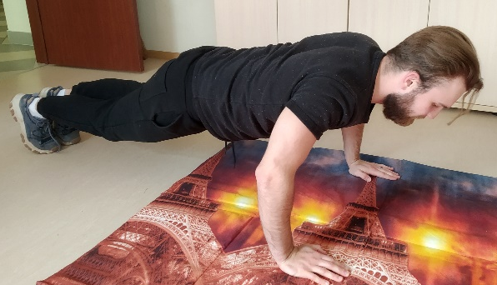
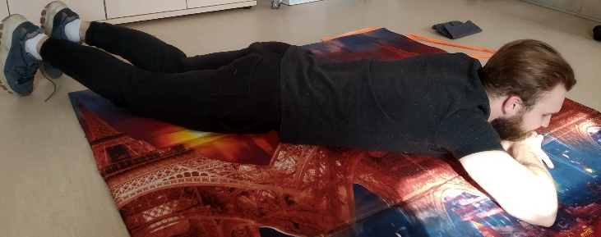
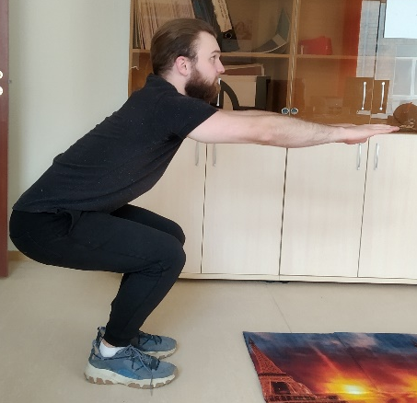
Model tasks – “Express test”
The Express test includes sequential performance of modeling tasks with continuous HR recording:
1
2
3
4
5
6
6
Neurological test
Getting up from the supine
position
Romberg’s test
Collecting samples
7
8
Tandem walk
Subjective evaluation
of the weight
of samples
9
10
Getting up from prone position
Maximum number of push-ups for 10 seconds
Marksmanship evaluation
Maximum number of squats in 10 seconds
12th IAA Symposium on Future Space Exploration

Slide 13
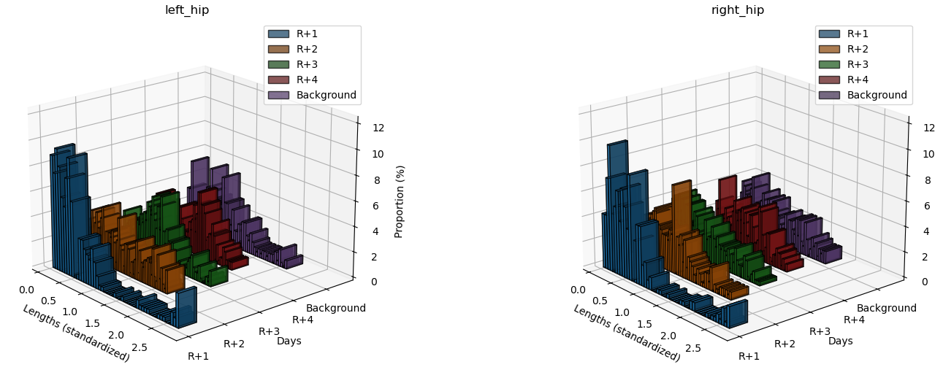
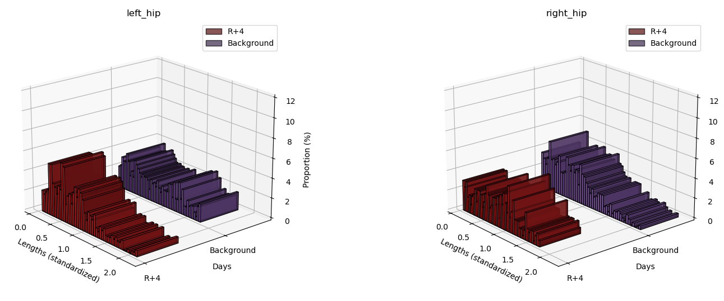
Performance of model tasks during the period of acute readaptation after space flights
Half-year mission
One-year mission
Romberg’s test
12th IAA Symposium on Future Space Exploration

Slide 14
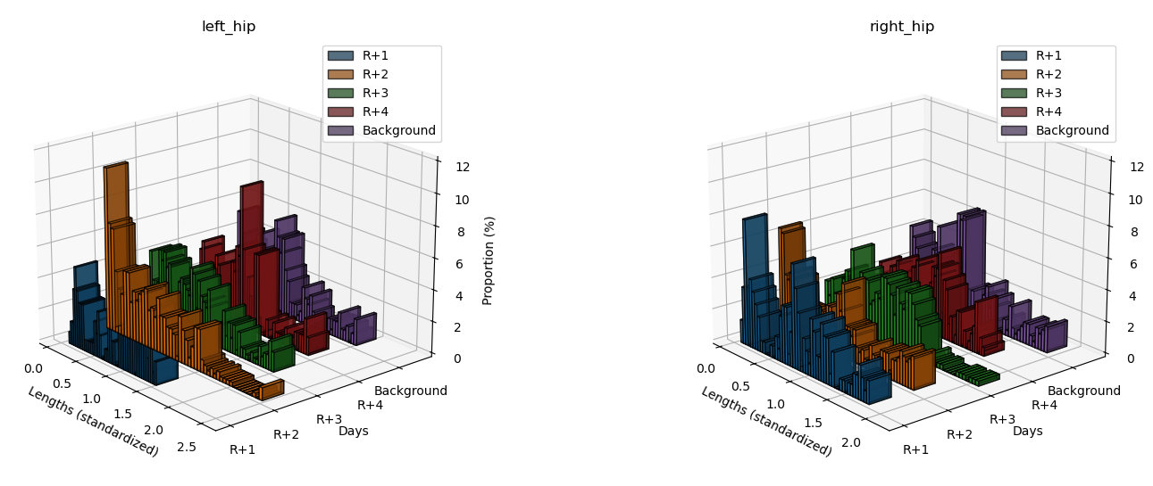
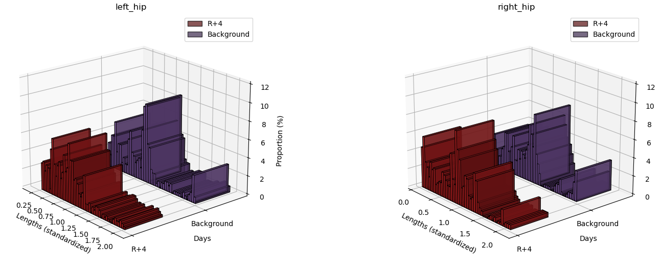
Performance of model tasks during the period of acute readaptation after space flights
Half-year mission
One-year mission
Tandem walk
12th IAA Symposium on Future Space Exploration

Slide 15
Performing model tasks after spaceflights of varying duration and with varying experiences in weightlessness
Dual task: tandem walking and counting backwards with threes (R+3)
Short duration spaceflight
6-month spaceflight
One-year spaceflight
Short,
repeat flight
Short,
the first flight
6-month,
repeat flight
6-month,
the first flight
One-year,
repeat flight
One-year,
the first flight
12th IAA Symposium on Future Space Exploration

Slide 16
Performing model tasks after spaceflights of varying duration and with varying experiences in weightlessness
Subjective assessment of the load weight
One-year spaceflight
Short duration spaceflight
6-month spaceflight
Short,
repeat flight
Short,
the first flight
6-month,
repeat flight
6-month,
the first flight
One-year,
repeat flight
One-year,
the first flight
The smallest load
Average load
The largest load
12th IAA Symposium on Future Space Exploration

Slide 17
Conclusion
Mosaic reproduction of gravity effects in space flight conditions to counteract negative rearrangements of physiological systems allows to provide the necessary level of functional reserves for successful performance of model mission tasks, in particular running and walking in the early postflight period.
Approaches to monitoring the level of functional reserves of gravity-dependent human systems in accordance with the new paradigm of preparation for deep space exploration have been improved.
12th IAA Symposium on Future Space Exploration
17

Slide 18
Thank you for attention!
The work is supported by basic funding from RAS (FMFR-2024-0037).
Address your questions to:
Fomin-fomin@yandex.ru
12th IAA Symposium on Future Space Exploration

