Slide 1




DESIGN OF A 24U-CUBESAT HYBRID ROCKET ENGINE FOR INSERTION IN MARS ORBIT
Daniele Tortorici ^{(a)}, Antonella Ingenito ^{(a)}, Daniele Piazzullo ^{(b)}, Luigi Allocca ^{(b)}, and Alessandro Montanaro ^{(b)}
^{(a)} School of Aerospace Engineering, Sapienza University of Rome, Via Salaria, 851, 00138 Roma, Italy,
^{(b)} Institute of Sciences and Technologies for Sustainable Energy and Mobility (STEMS) of the National Research Council, Via Guglielmo Marconi, 4,80125 Napoli, Italy
12th IAA Symposium on Future Space Exploration, Moon, Mars and beyond:
becoming an Interplanetary Civilization,
09-11 June 2025, Torino, Italy

Slide 2
Goal and outline
Development of a Hybrid Rocket Motor (HRE) for a 24U CubeSat to Achieve Mars Orbit Insertion
Introduction
Mission requirements
Propellants selection
HRE design
Results

Slide 3
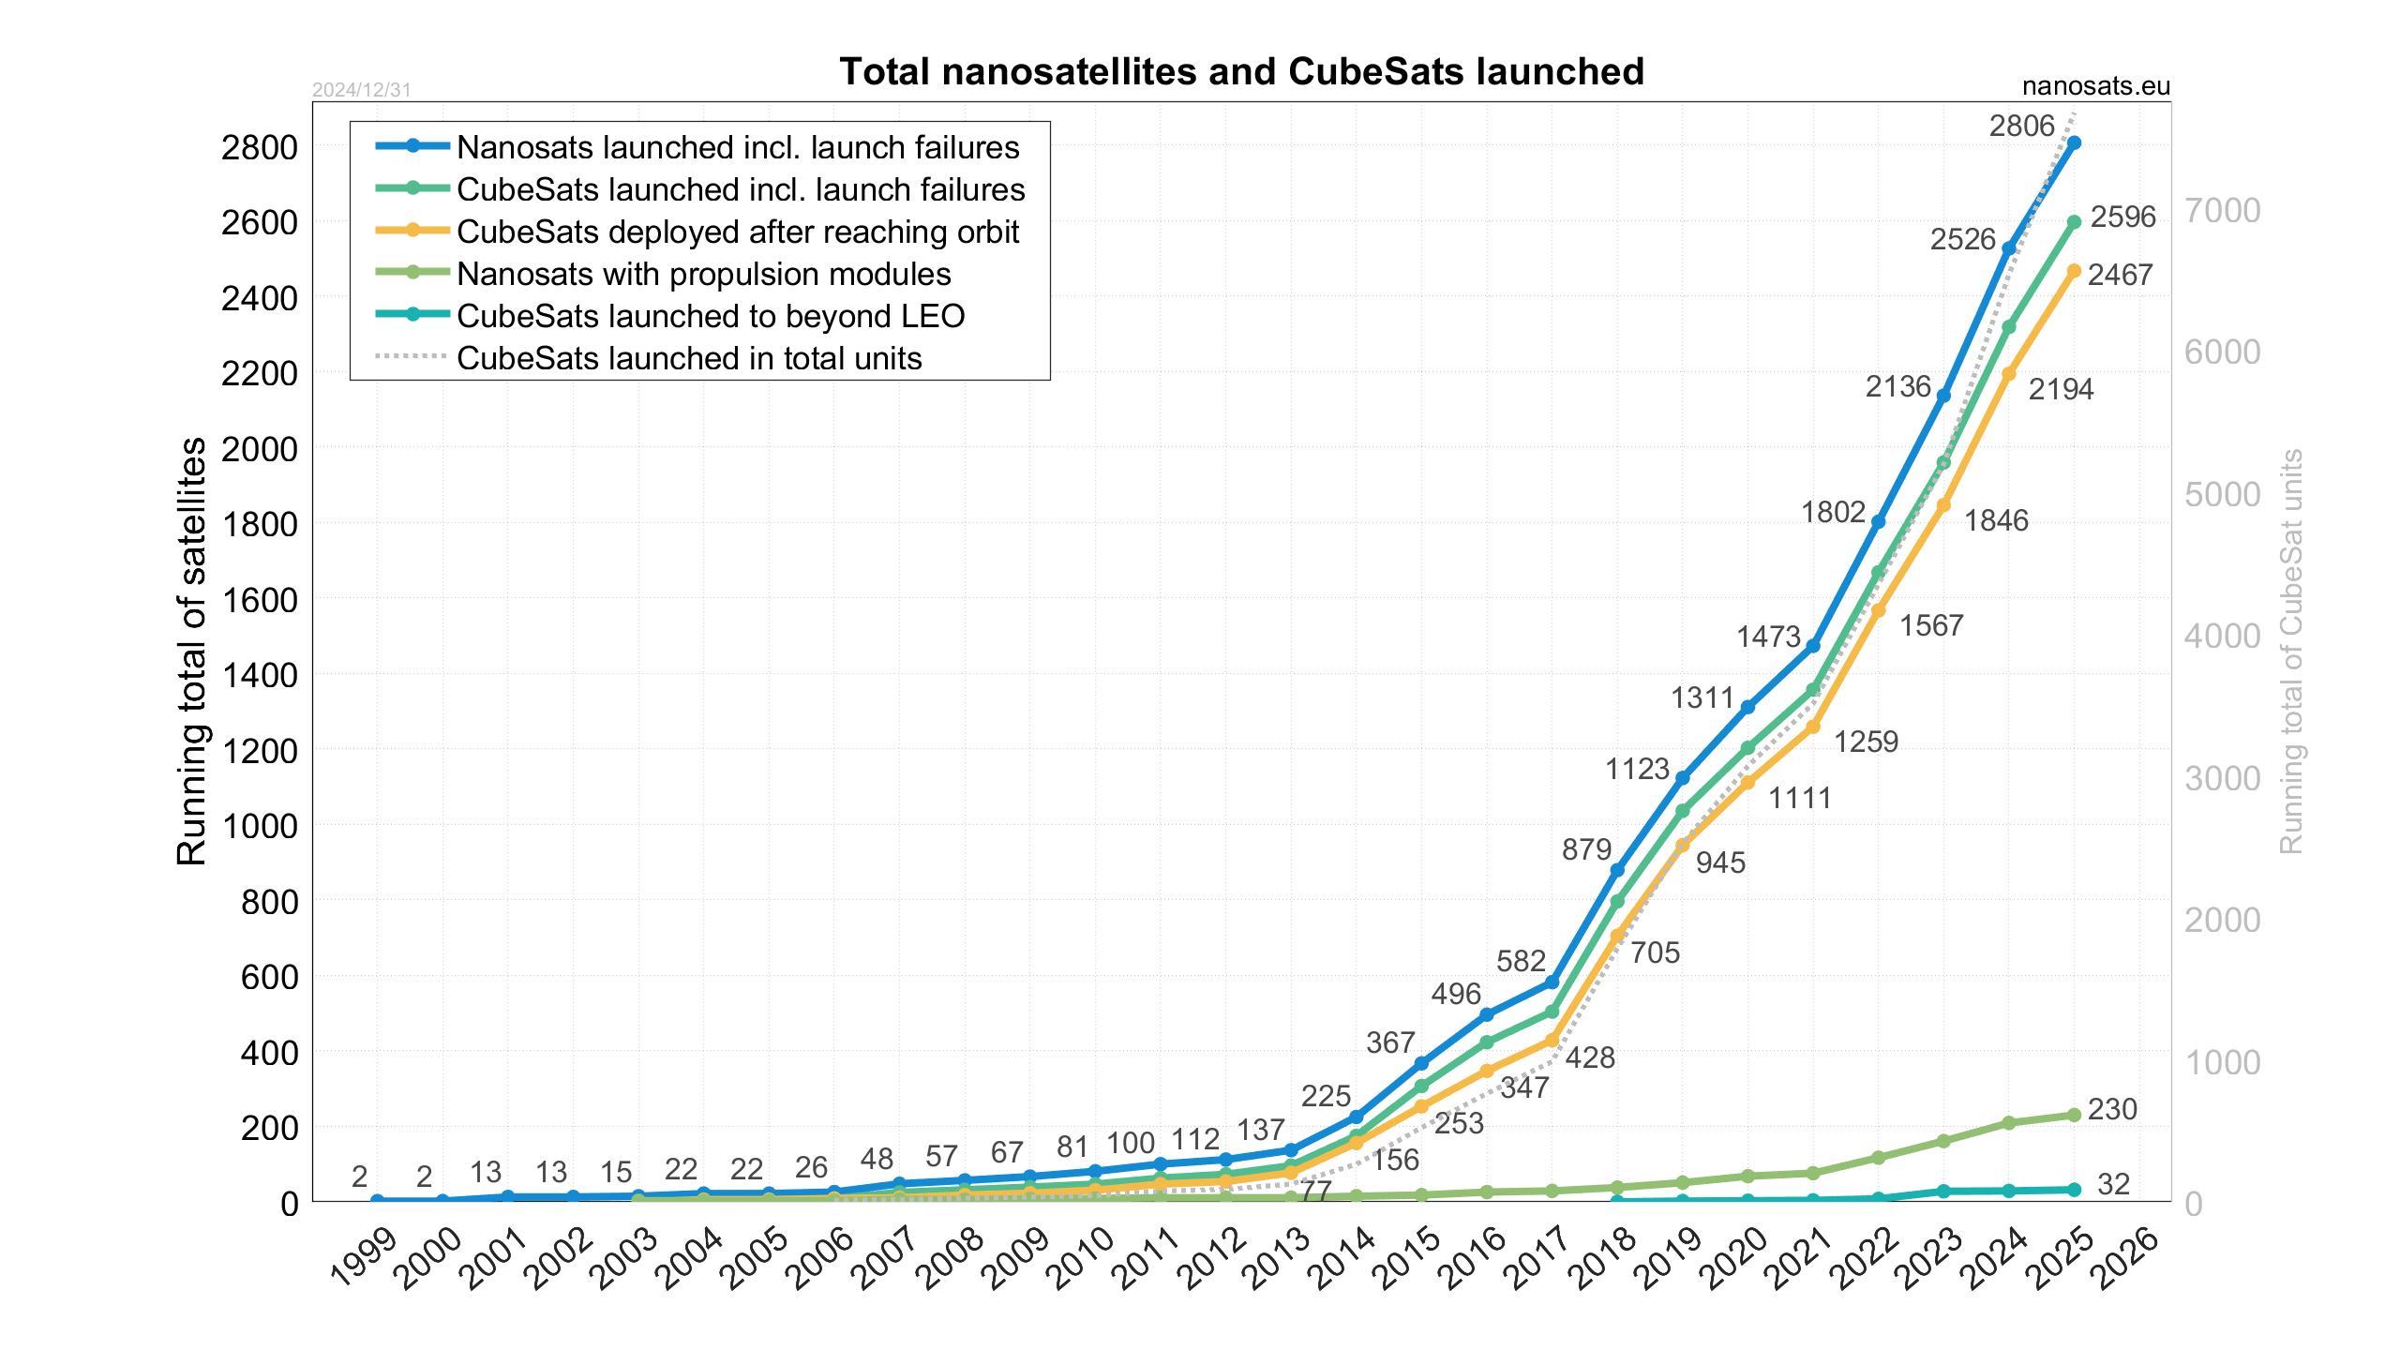
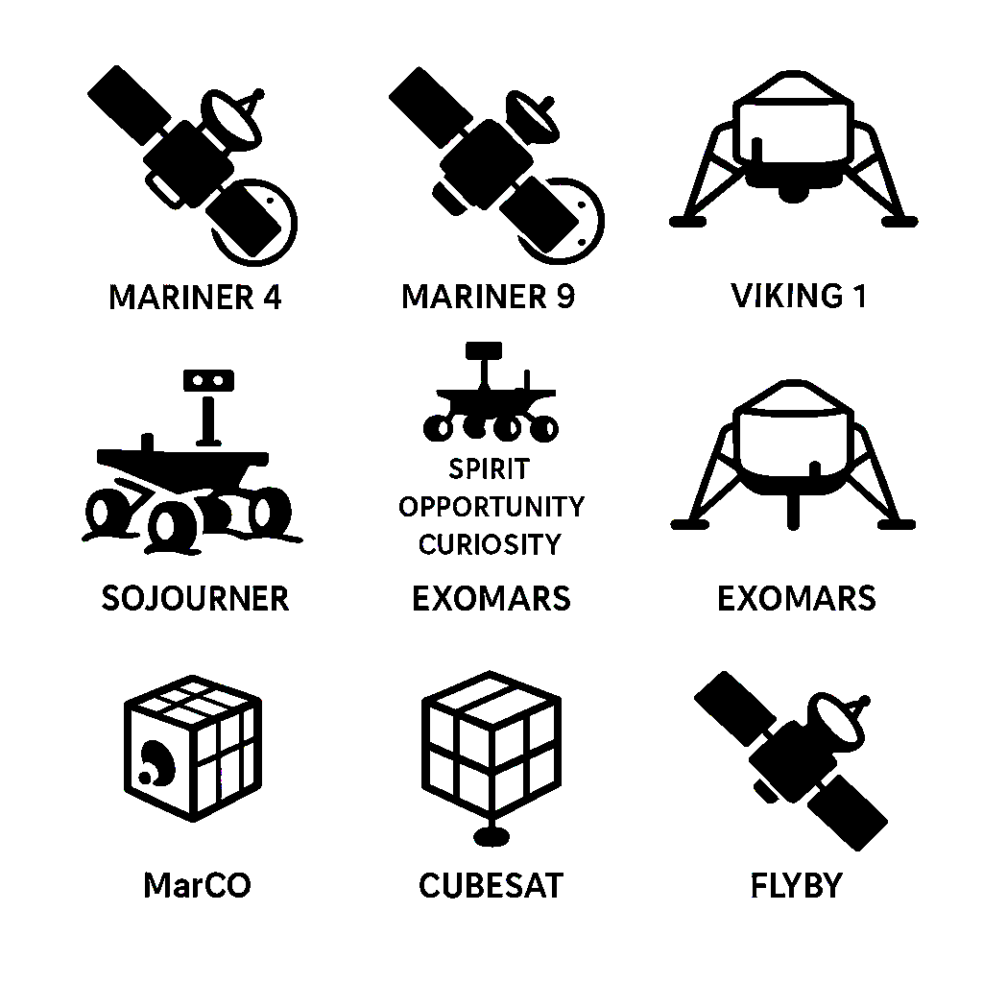
Introduction - Mars exploration and CubeSats
Exploration of Mars
Mariner 4
1965
Flyby mission
Mariner 9
1971
First orbiter
Rovers
Sojourner
1997
Spirit
Opportunity
Curiosity
MarCo
2018
Flyby mission
Future CubeSat missions
Flyby or orbiter

Slide 4
Introduction - Propulsion systems
 | Solid Rocket Motors (SRM) | Liquid Rocket Engines (LRE) | Hybrid Rocket Engines (HRE)
Propellant State | Solid (fuel and oxidizer combined) | Liquid (fuel and oxidizer stored separately) | Solid fuel, liquid oxidizer
Thrust Modulation | Not possible | Possible | Possible
Engine Shutdown | Not possible | Possible | Possible
Safety | High risk (explosive grain) | Safer (separate propellants) | Safer than SRM, risk from oxidizer
Complexity | Low (simple structure) | High (complex feeding/mixing) | Moderate (simpler than LRE)
Specific Impulse | Moderate | High | Lower than LRE, higher than SRM
Handling & Storage | Difficult (explosive risk) | Easier (separate propellants) | Easier than SRM, but requires oxidizer handling
Volumetric Efficiency | High | Low | Moderate
Combustion Stability | Stable | Stable with proper mixing | Can suffer mixture ratio shifts
Regression Rate | High | N/A | Lower than SRM
Failure Risk | Moderate (grain cracks) | High (complex system) | Moderate (mixture ratio variations)

Slide 5
Introduction - Propulsion systems
 | Solid Rocket Motors (SRM) | Liquid Rocket Engines (LRE) | Hybrid Rocket Engines (HRE)
Propellant State | Solid (fuel and oxidizer combined) | Liquid (fuel and oxidizer stored separately) | Solid fuel, liquid oxidizer
Thrust Modulation | Not possible | Possible | Possible
Engine Shutdown | Not possible | Possible | Possible
Safety | High risk (explosive grain) | Safer (separate propellants) | Safer than SRM, risk from oxidizer
Complexity | Low (simple structure) | High (complex feeding/mixing) | Moderate (simpler than LRE)
Specific Impulse | Moderate | High | Lower than LRE, higher than SRM
Handling & Storage | Difficult (explosive risk) | Easier (separate propellants) | Easier than SRM, but requires oxidizer handling
Volumetric Efficiency | High | Low | Moderate
Combustion Stability | Stable | Stable with proper mixing | Can suffer mixture ratio shifts
Regression Rate | High | N/A | Lower than SRM
Failure Risk | Moderate (grain cracks) | High (complex system) | Moderate (mixture ratio variations)

Slide 6
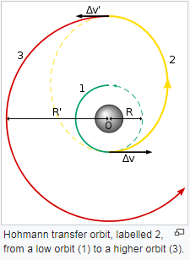
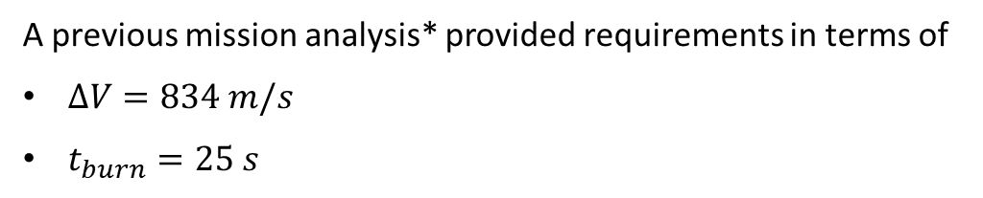
Mission requirements – delta V, tb
Earth's orbit (1) is inner relative to Mars' orbit (3). The Hohmann transfer is the most efficient method for traveling between two orbits in space (2).
This transfer requires a two-impulse maneuver:
The first impulse occurs when departing Earth
The second impulse is applied upon arrival at Mars
A previous mission analysis* provided requirements in terms of
$ΔV=834 m/s$
$t_{burn}=25 s$
*C.D. Renan Ferreira, Antonella Ingenito, Paolo Teofilatto, Mission analysis in the braking effect of a small microsatellite using a hybrid rocket engine to achive a Mars orbit, 2020

Slide 7

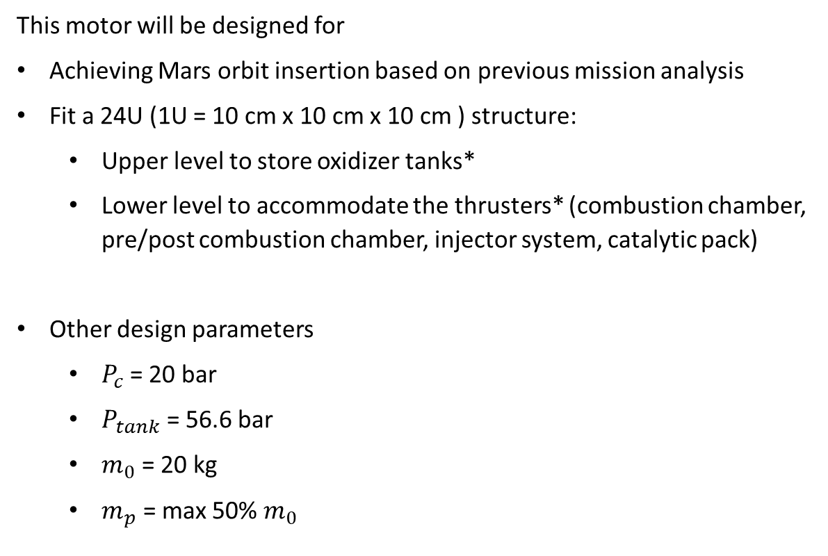
Mission requirements – masses and volumes
This motor will be designed for
Achieving Mars orbit insertion based on previous mission analysis
Fit a 24U (1U = 10 cm x 10 cm x 10 cm ) structure:
  Upper level to store oxidizer tanks*
  Lower level to accommodate the thrusters* (combustion chamber, pre/post combustion chamber, injector system, catalytic pack)
Other design parameters
  $P_{c}$ = 20 bar
  $P_{tank}$ = 56.6 bar
  $m_{0}$ = 20 kg
  $m_{p}$ = max 50% $m_{0}$
*maximum length = 30 cm, maximum diameter depends on number

Slide 8
Propellant selection
Paraffin-based fuels
High regression rate: up to 3-5 times higher than conventional polymer-based fuels like HTPB
Liquefaction behavior: forms a thin molten layer during combustion, improving fuel-oxidizer mixing
Non-toxic: safer to handle compared to other fuel options
Ease of handling: simple to store and process
Cost-Effective: cheap and widely available
Downside: fragile → HTPB addition
Nitrous oxide
Self-Pressurizing liquid: eliminates the need for additional pressurization tank
Relatively high density
Safer handling: less reactive and more stable than oxidizers like LOX or N₂O₄
Simplified system: reduces complexity compared to other oxidizers
Exothermic decomposition: can be used as a propellant for ignition, eliminating the need for extra hardware

Slide 9
Propellant selection: OF ratio
Performance evaluation using NASA's CEA Code based on combustion chamber pressure and propellant properties
At stoichiometric conditions (OF ratio of 9.1), specific impulse reaches the maximum of 282 s
Lower OF ratios result in decreased Isp (e.g., 247 s at OF = 4; 230 s at OF = 2)
Lower Isp requires more propellant to achieve the same ΔV
Fuel-Rich regime benefits: reduces oxidizer mass, leading to a smaller oxidizer tank and lower subsystem weight

Slide 10

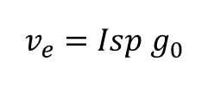

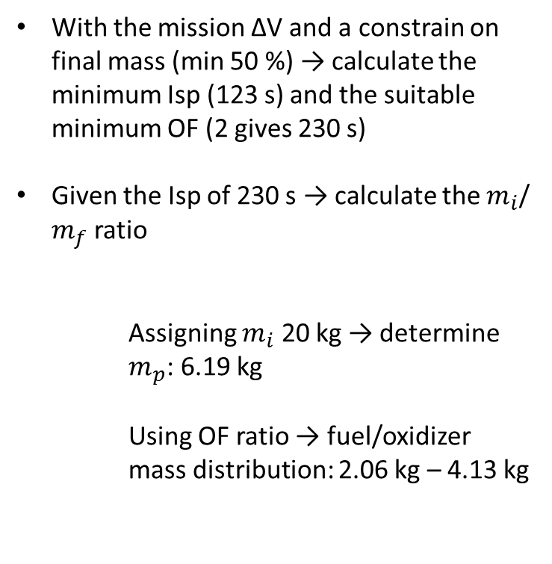


HRE design
$Δv=v_{e}ln(m_{i}/m_{f}$)
With the mission ΔV and a constrain on final mass (min 50 %) → calculate the minimum Isp (123 s) and the suitable minimum OF (2 gives 230 s)
Given the Isp of 230 s → calculate the $m_{i}$/ $m_{f}$ ratio
Assigning $m_{i}$ 20 kg → determine $m_{p}$: 6.19 kg
Using OF ratio → fuel/oxidizer mass distribution: 2.06 kg – 4.13 kg
$$v_{e}=Isp g_{0}$$
A: Oxidizer tank
B: Injectors
C: Pre-combustion chamber
D: Combustion chamber
E: Fuel grain
F: Post-combustion chamber
G: Nozzle
$$m_{p}=m_{i}−m_{f}$$
$$m_{fuel}=m_{p}/(OF+1)$$
$m_{oxidizer}=m_{fuel}$OF

Slide 11
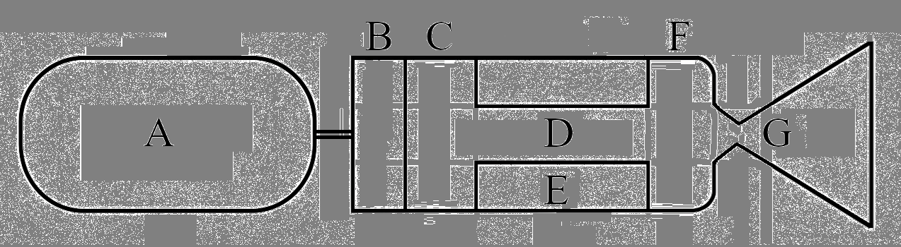
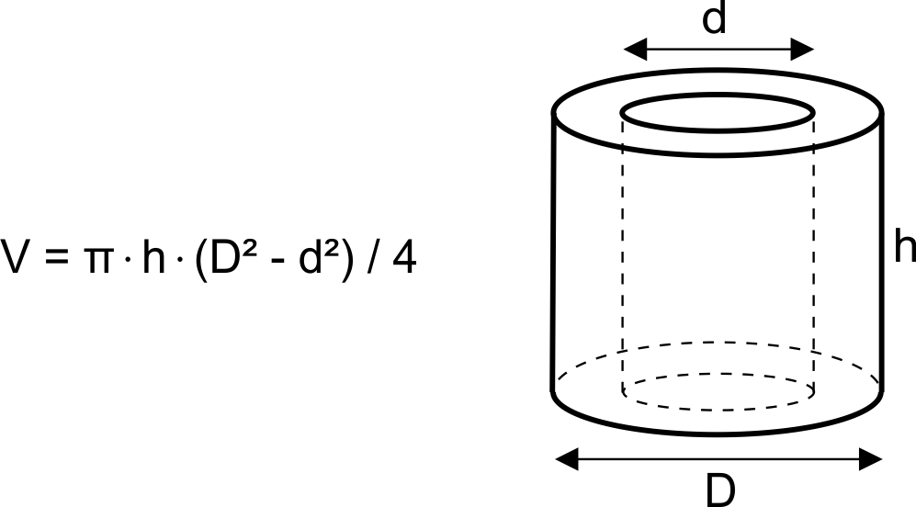


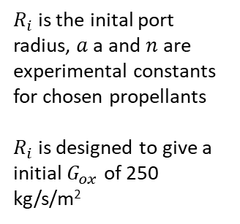
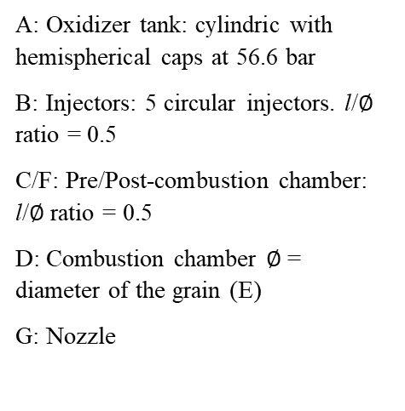



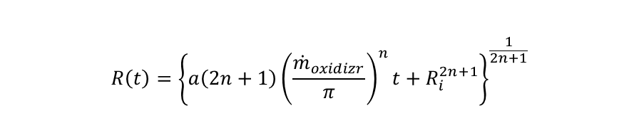



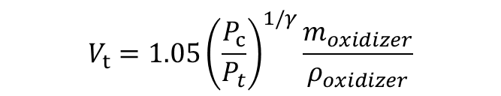

HRE design
$$A_{t}=F/(P_{C}CF)$$
$$A_{e}=A_{t}ε$$
$$L_{convergent}={(R}_{f}−R_{t})tan(45°)$$
$$L_{divergent}={(R}_{e}−R_{t})tan(15°)$$
$$V_{t}={1.05\left(\frac{P_{c}}{P_{t}}\right)}^{1/γ}\frac{m_{oxidizer}}{ρ_{oxidizer}}$$
$${\dot{m}}_{fuel}=\frac{m_{p}}{t_{b}}∙(OF+1)$$
$$V_{fuel}=m_{fuel}/ρ_{fuel}$$
$$R\left(t\right)={\left\{a\left(2n+1\right){\left(\frac{{\dot{m}}_{oxidizr}}{π}\right)}^{n}t+R_{i}^{2n+1}\right\}}^{\frac{1}{2n+1}}$$
A: Oxidizer tank: cylindric with hemispherical caps at 56.6 bar
B: Injectors: 5 circular injectors. l/$∅$ ratio = 0.5
C/F: Pre/Post-combustion chamber: l/$∅$ ratio = 0.5
D: Combustion chamber $∅$= diameter of the grain (E)
G: Nozzle
$$L_{fuel}=V_{fuel}/A_{fuel}$$
$R_{i}$ is the inital port radius, $a$a and $n$ are experimental constants for chosen propellants
$R_{i}$ is designed to give a initial $G_{ox}$ of 250 kg/s/m²
$${\dot{m}}_{oxidizer}={\dot{m}}_{fuel}OF$$
$$A_{injector}=\frac{{\dot{m}}_{oxidizer}/(C_{D}\sqrt{2ρ_{oxidizer}(P_{upstream}−P_{c})}}{n_{injectors}}$$

Slide 12

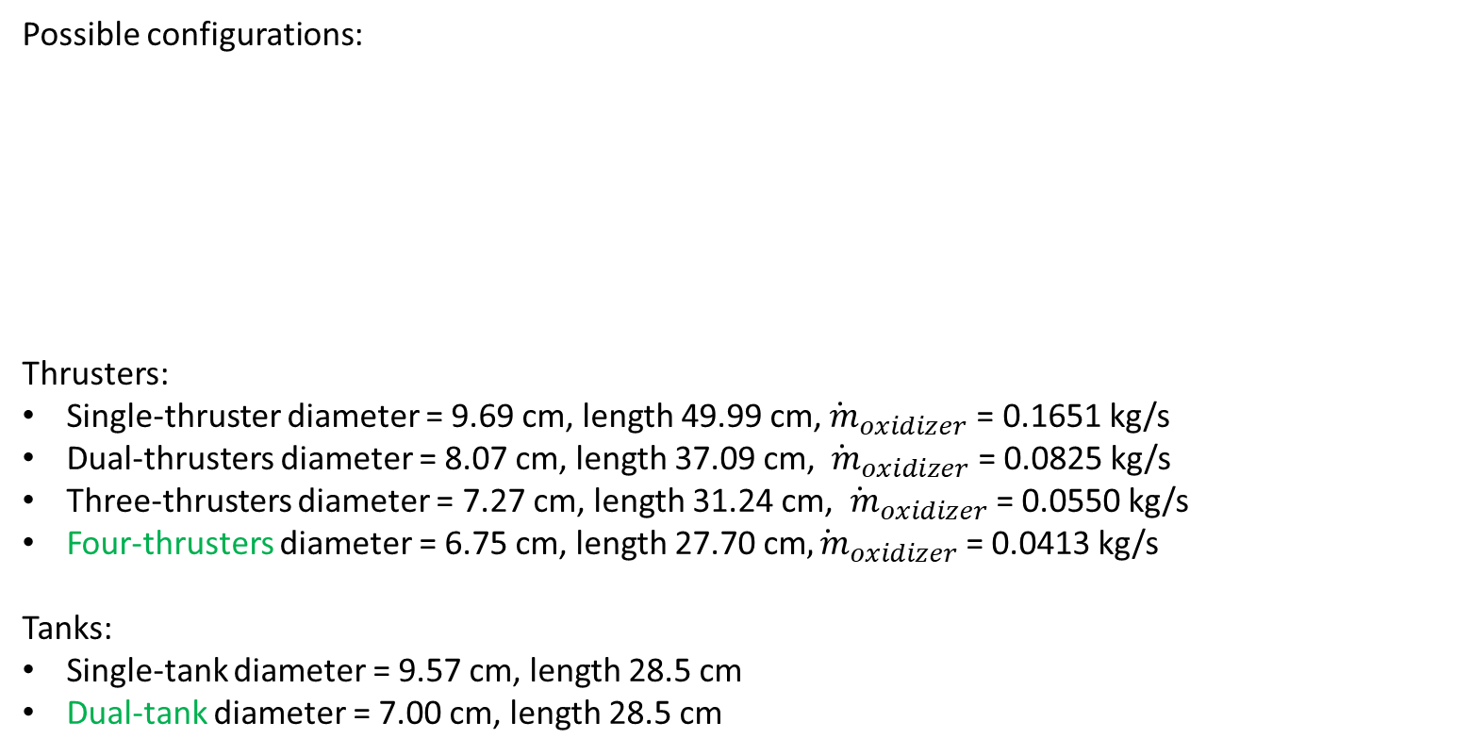
Tanks/thrusters number
Possible configurations:
Thrusters:
Single-thruster diameter = 9.69 cm, length 49.99 cm,${\dot{ m}}_{oxidizer}$= 0.1651 kg/s
Dual-thrusters diameter = 8.07 cm, length 37.09 cm, ${\dot{ m}}_{oxidizer}$= 0.0825 kg/s
Three-thrusters diameter = 7.27 cm, length 31.24 cm, ${\dot{ m}}_{oxidizer}$= 0.0550 kg/s
Four-thrusters diameter = 6.75 cm, length 27.70 cm${\dot{, m}}_{oxidizer}$= 0.0413 kg/s
Tanks:
Single-tank diameter = 9.57 cm, length 28.5 cm
Dual-tank diameter = 7.00 cm, length 28.5 cm
$R_{i}=7.25$ mm
Five circular injectors 0.667 l/min each

Slide 13

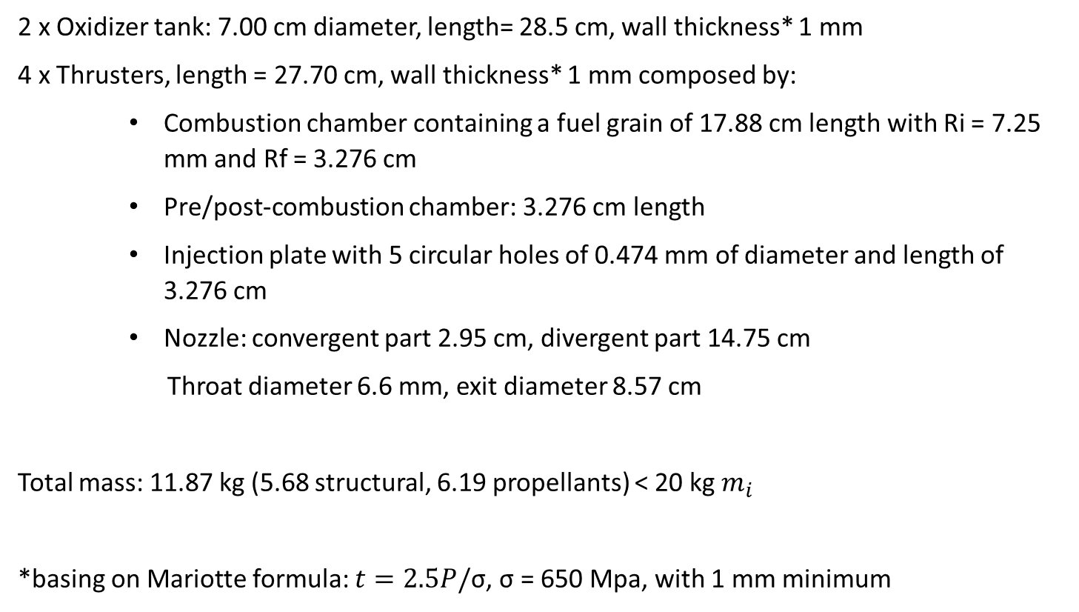
HRE first design results (OF = 2)
2 x Oxidizer tank: 7.00 cm diameter, length= 28.5 cm, wall thickness* 1 mm
4 x Thrusters, length = 27.70 cm, wall thickness* 1 mm composed by:
    Combustion chamber containing a fuel grain of 17.88 cm length with Ri = 7.25 mm and Rf = 3.276 cm
    Pre/post-combustion chamber: 3.276 cm length
    Injection plate with 5 circular holes of 0.474 mm of diameter and length of 3.276 cm
    Nozzle: convergent part 2.95 cm, divergent part 14.75 cm
    Throat diameter 6.6 mm, exit diameter 8.57 cm
Total mass: 11.87 kg (5.68 structural, 6.19 propellants) < 20 kg $m_{i}$
*basing on Mariotte formula: $t=2.5P/$σ, σ = 650 Mpa, with 1 mm minimum

Slide 14
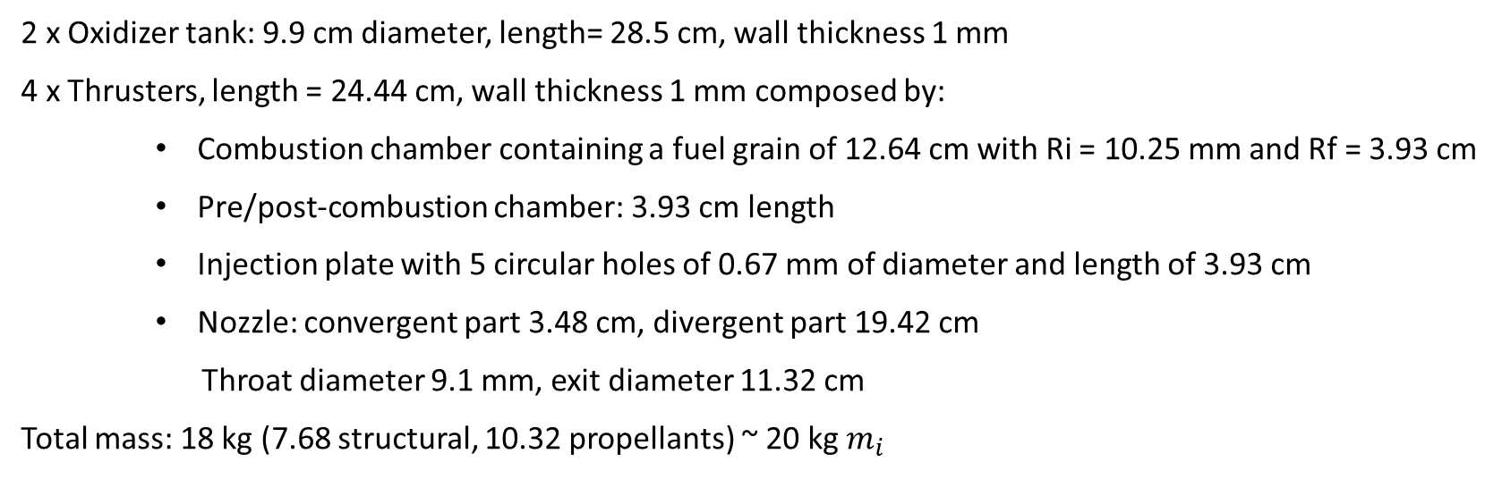
Re-design
Maintain fuel mass, increase oxidizer to reach OF = 4
Utilize HRE’s shutdown capability for orbit insertion
Additional ΔV quantified in 900 m/s
Recalculated mass and volumes fit requirments
Residual propellant enables post-insertion maneuvering
2 x Oxidizer tank: 9.9 cm diameter, length= 28.5 cm, wall thickness 1 mm
4 x Thrusters, length = 24.44 cm, wall thickness 1 mm composed by:
    Combustion chamber containing a fuel grain of 12.64 cm with Ri = 10.25 mm and Rf = 3.93 cm
    Pre/post-combustion chamber: 3.93 cm length
    Injection plate with 5 circular holes of 0.67 mm of diameter and length of 3.93 cm
    Nozzle: convergent part 3.48 cm, divergent part 19.42 cm
    Throat diameter 9.1 mm, exit diameter 11.32 cm
Total mass: 18 kg (7.68 structural, 10.32 propellants) ~ 20 kg $m_{i}$

Slide 15
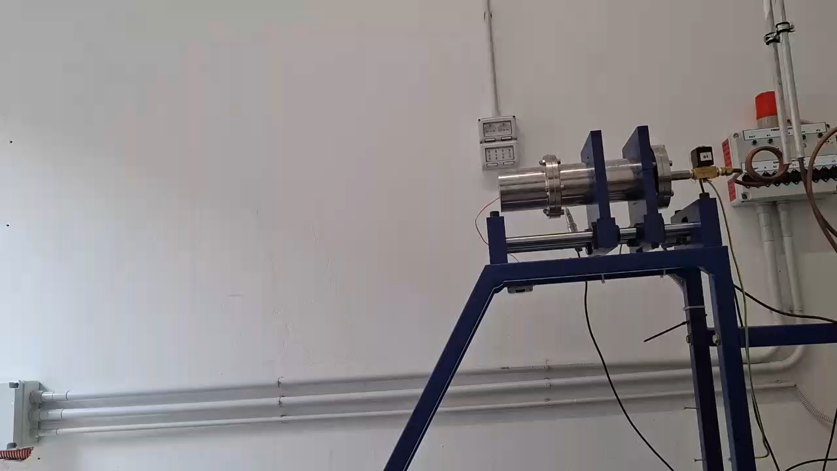
Test bench at Space Propulsion Lab - SIA
Test Facility: Lab-scale static test setup with hybrid rocket motor, oxidizer system, load cell, ignition system, and DAQ system
Oxidizer System: Gaseous Oxygen (GOX) from high-pressure cylinders. Flow controlled using pressure regulators and solenoid valves
Ignition System: Pyrotechnic igniter using solid propellant. Controlled by programmable sequential timer (PT-380) for synchronized ignition and oxidizer injection
Instrumentation & Data Acquisition system :
  GE Druck UNIK5000 transducer to measure pressure and load cell of 50kg to measure thrust
  NI-9237 DAQ module with real-time LABVIEW interface to read the pressure and thrust
Paraffin/GOX 25 seconds burn

Slide 16




Funding and contacts
GREEN FOXFIRE Project funded under the PRIN 2022 Call for Proposals – Director’s Decree No. 104 dated 02-02-2022
antonella.ingenito@uniroma1.it
daniele.tortorici@uniroma1.it
daniele.piazzullo@stems.cnr.it
luigi.allocca@stems.cnr.it
alessandro.montanaro@stems.cnr.it

