Slide 1



THE RAPID RESPONSE FULLY AUTOMATED NEA FOLLOW-UP PROGRAM WITH THE SAAO’S 1-m LESEDI TELESCOPE
By Thobekile Ngwane
MSc Thesis Supervisors: Nicolas Erasmus and Paul Groot

Slide 2
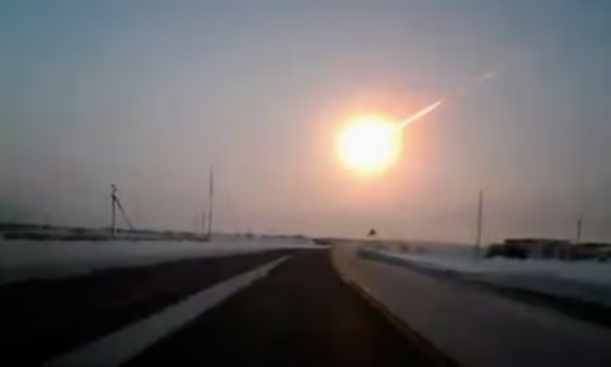
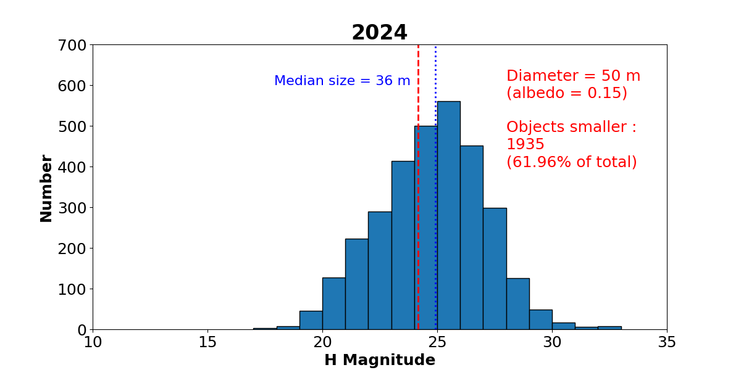
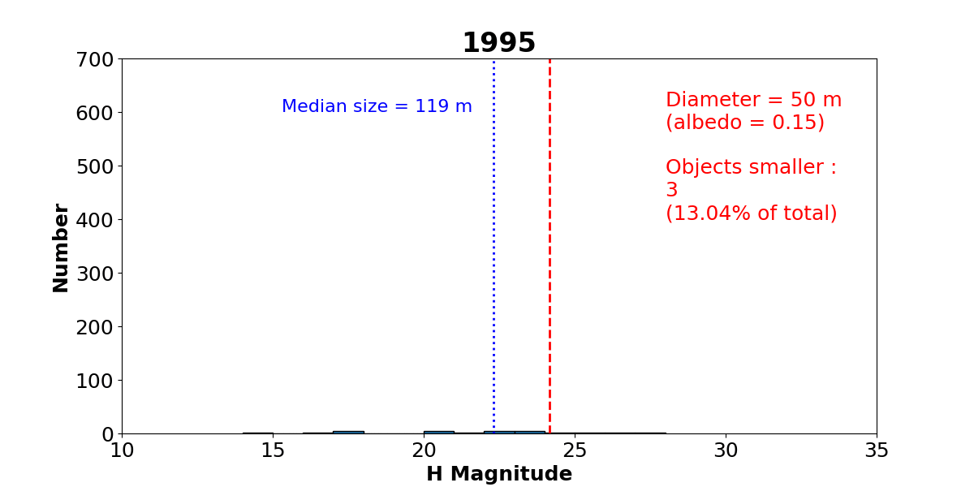
NEAR EARTH ASTEROIDS
38,000 NEAs have been discovered
Small NEAs can still cause significant damage, as shown by the 18-meter Chelyabinsk meteorite in 2013.
Continued research and observation are needed for the small NEA population, as follow-up characterization lags.
Rapid follow-up observations are necessary as small NEAs fade quickly as they move away from Earth.
This project aims to enhance rapid follow-up observation capabilities for newly discovered NEAs using SAAO telescopes.

Slide 3
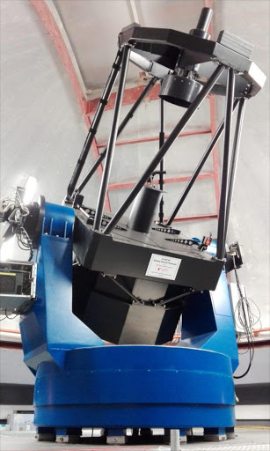
OBSERVATIONS
Using the fully automated and robotic 1-metre telescope called Lesedi with the Mookodi instrument (SDSS filters u, g, r, i, z ) with a 10 x 10 arcminute FOV
Automated "asteroid watchdog" script checks NASAs JPL Scout webpage every 15 minutes for new discoveries.
Detects observable discoveries and sends automated observing requests to SAAO’s Observatory Control System (OCS).
10-minute observation cycle through g, r, i filters, interspersed with clear, with 30s exposures each.
OCS schedules observations for the Lesedi telescope in robotic mode.
Dedicated software on Lesedi retrieves the latest schedule and executes observations.
Systems are in place to notify the PIs when observations are completed.

Slide 4
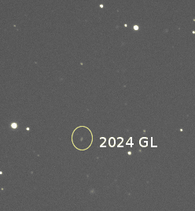
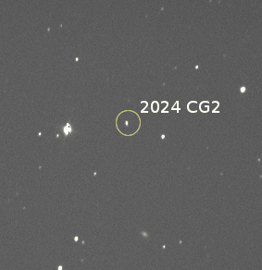
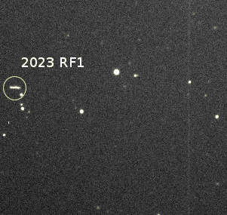
OBSERVATIONS: ASTROMETRY
From unfiltered images, we manually measure astrometry and submit to the Minor Planet Centre (MPC), contributing to the orbit refinement of these NEAs.
2 arcminutes

Slide 5
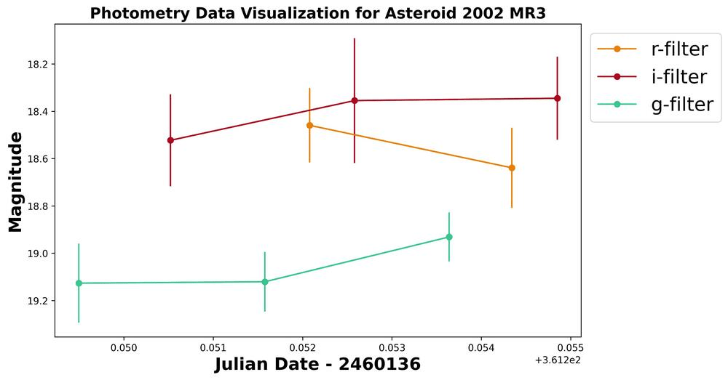
OBSERVATIONS: MULTI-FILTER PHOTOMETRY
Involves the use of the PHOTOMETRYPIPELINE (PP) (Mommert et al., 2017), on each of the filters g, r, and i once asteroid has been designated.
We compute photometric colours from the calibrated g, r, i photometry as shown below

Slide 6
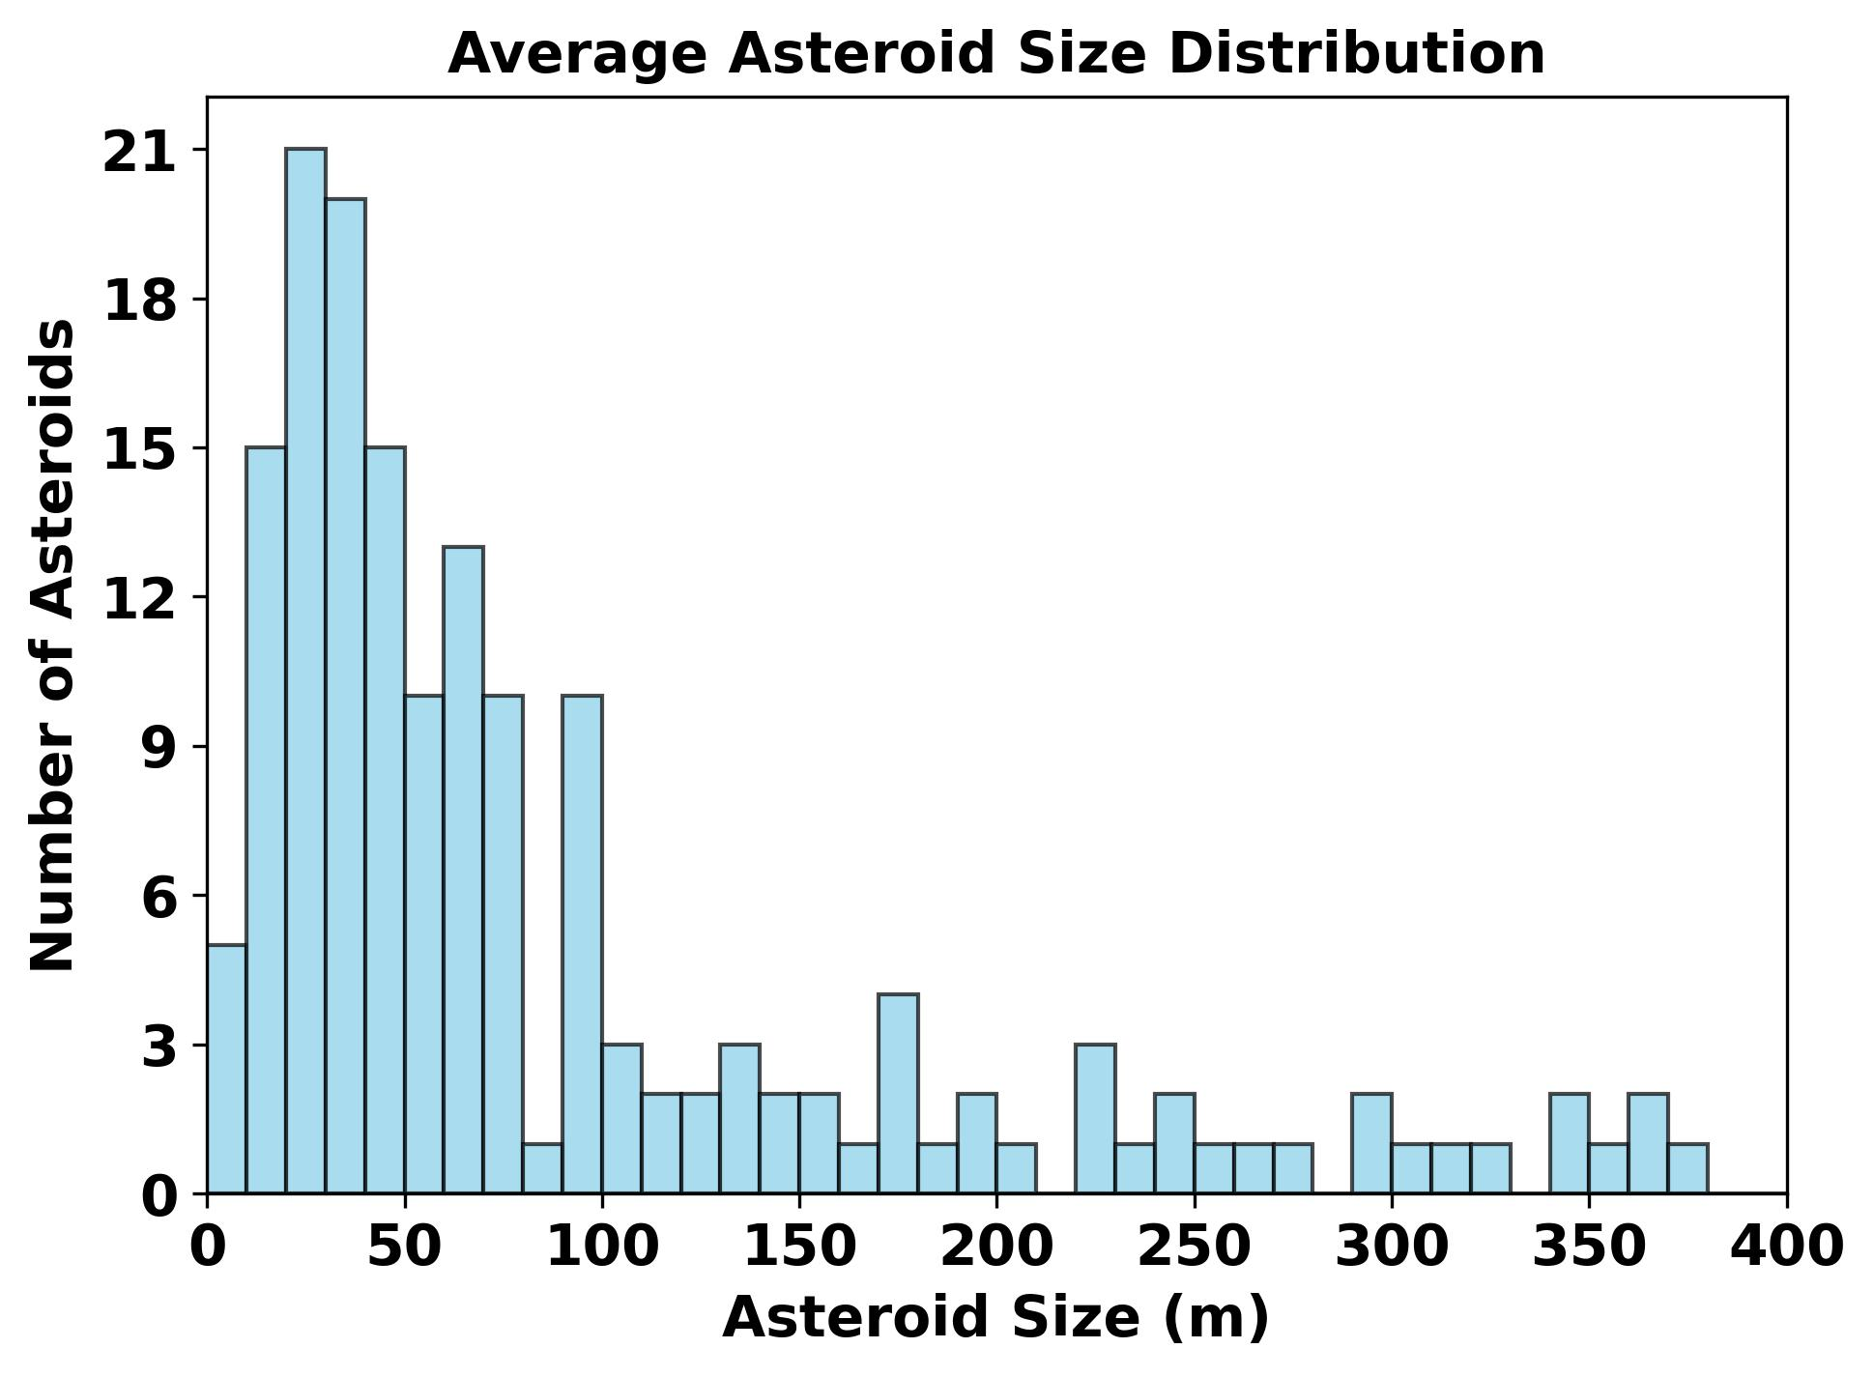
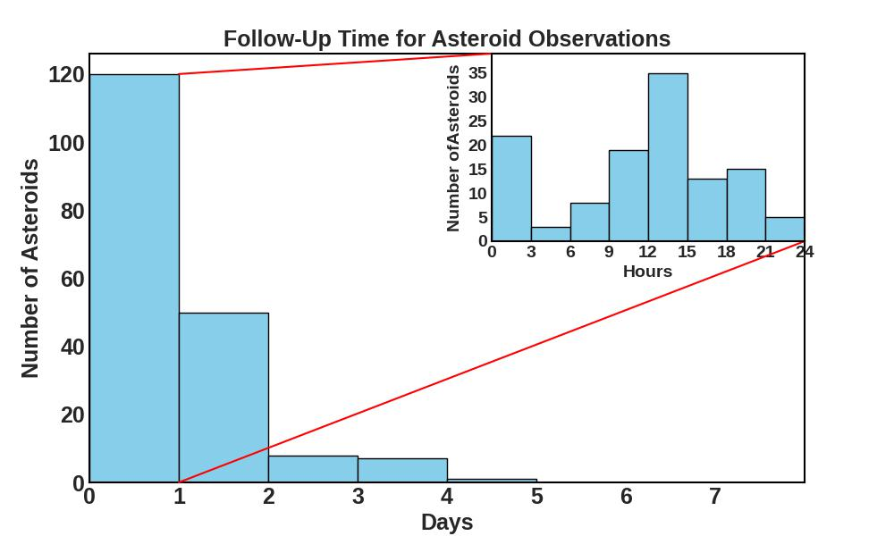
SUMMARY OF OBSERVATIONS
230 successful observations
Majority of our follow up observations are within 1 day after discovery
Faster response time is possible, but we are limited by the reporting of discoveries to the Minor Planet Center (MPC)
≈75% <100m
61% <1 day 10% in < 3 hours
57 Minutes!
2023 QN7

Slide 7
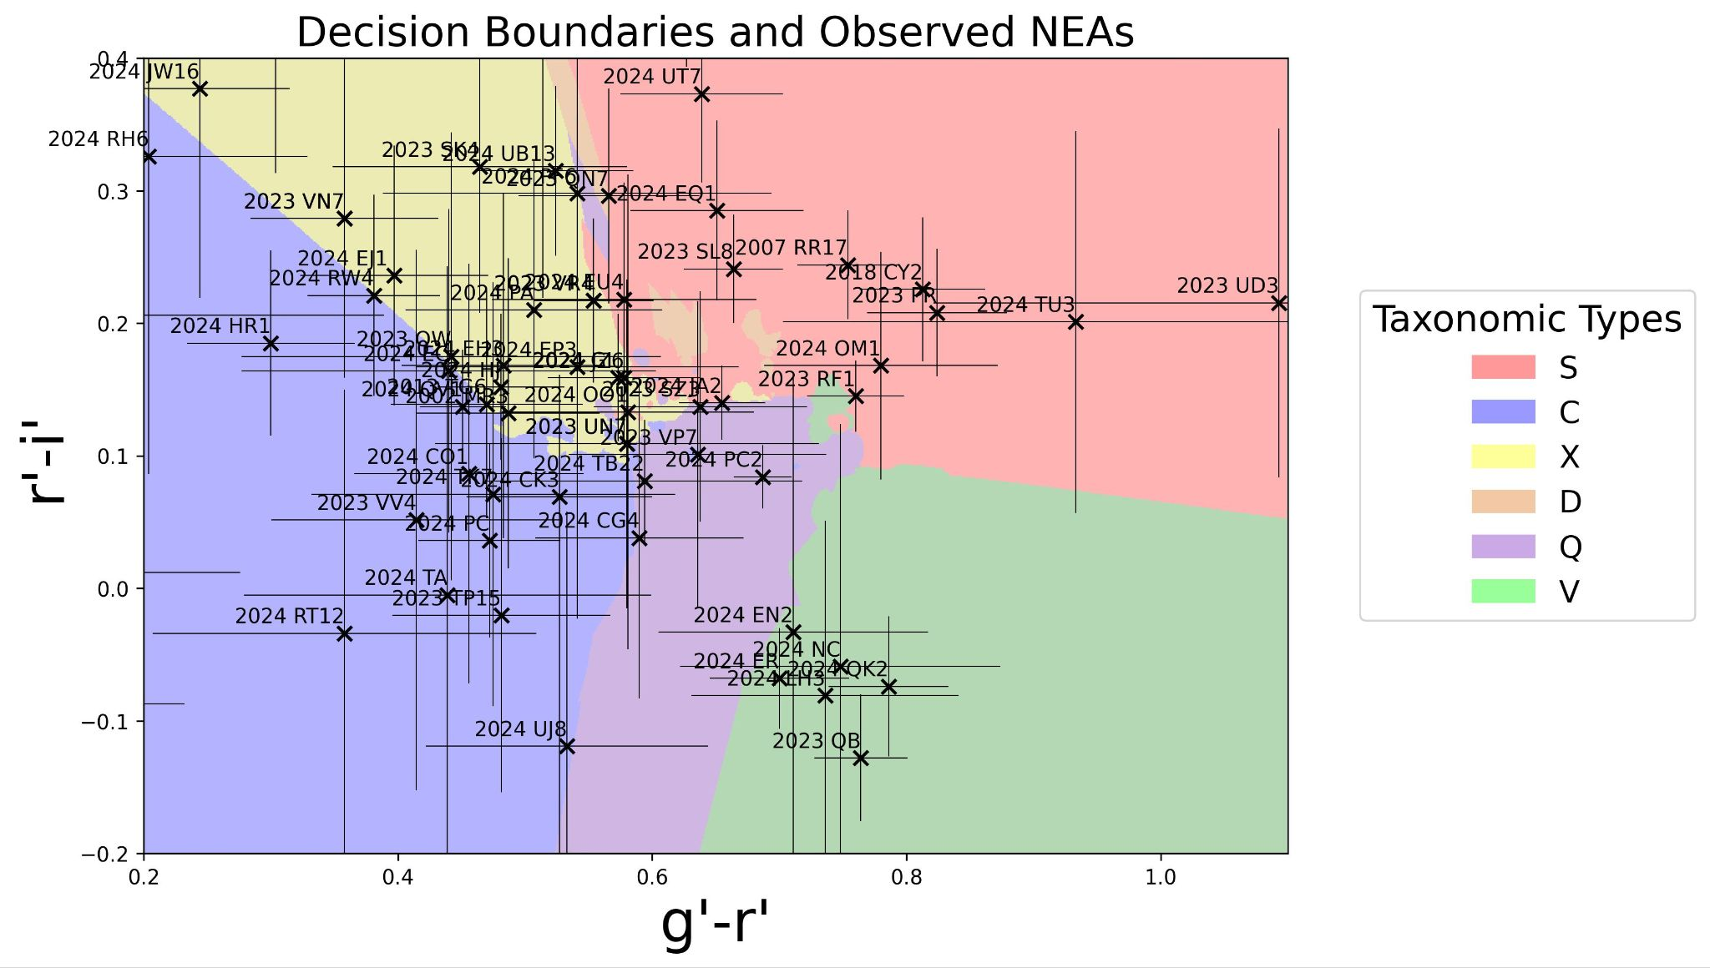
TAXONOMIC CLASSIFICATIONS
Using final calculated g - r and r - i colors to determine taxonomic types.
Decision surface from a trained machine learning algorithm (Petro Janse van Rensburg, 2021 MSc thesis).
Employing the Bus-DeMeo taxonomic scheme.
The trained algorithm was used to generate decision boundaries separating each taxonomic class.
Shown are the color indices of the 73 NEAS superimposed on the decision surface.

Slide 8
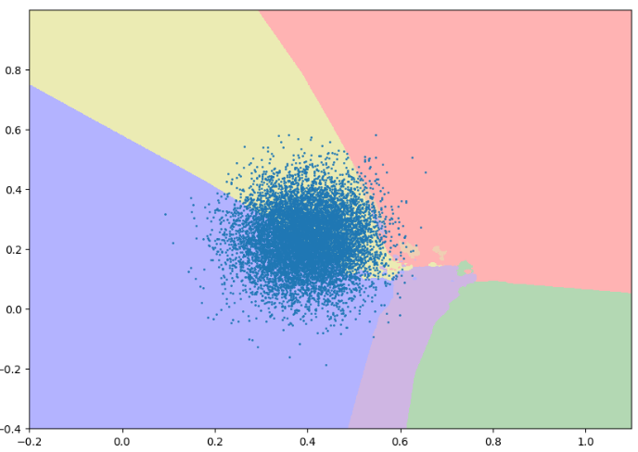
TAXONOMIC CLASSIFICATIONS
To account for this uncertainty, we used a Monte-Carlo approach.
This was done by generating 10 000 random pseudo-colours within the colour uncertainties.
The pseudo-colours were individually classified with the trained ML algorithm and tallied up.
A percentage for each likely classification is returned.
2024 EJ1

Slide 9
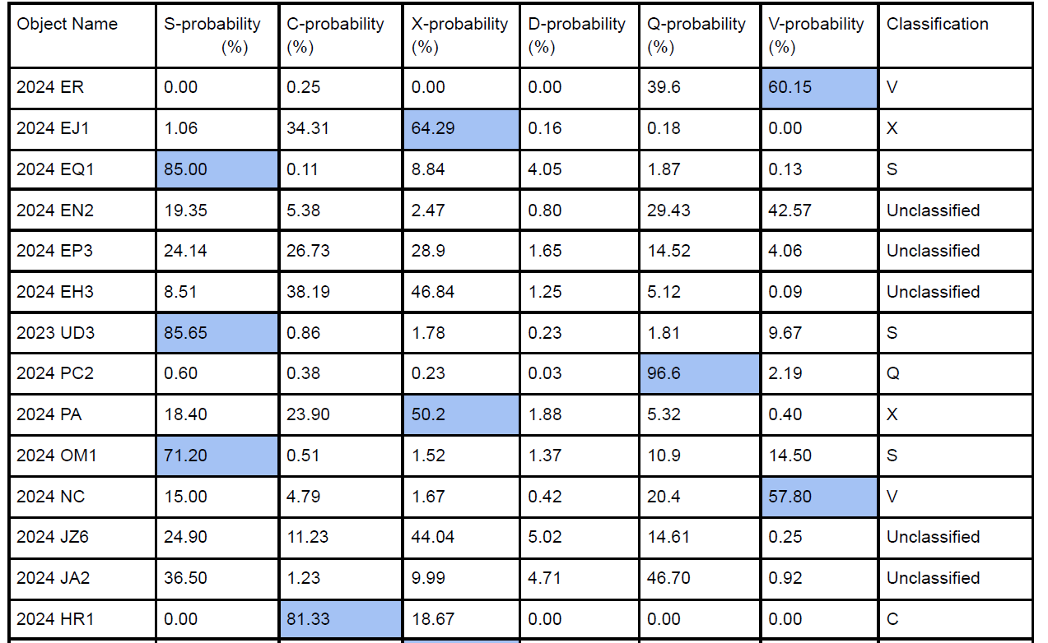
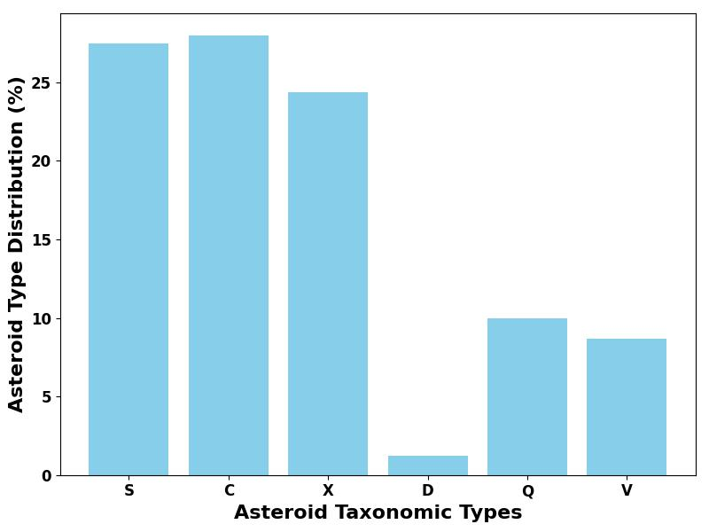
TAXONOMIC CLASSIFICATION
If a target has a taxonomic probability of more than 50% in a specific class, it's assigned that classification.
Excerpt from table containing Asteroid Classification Probabilities Using Training Data

Slide 10
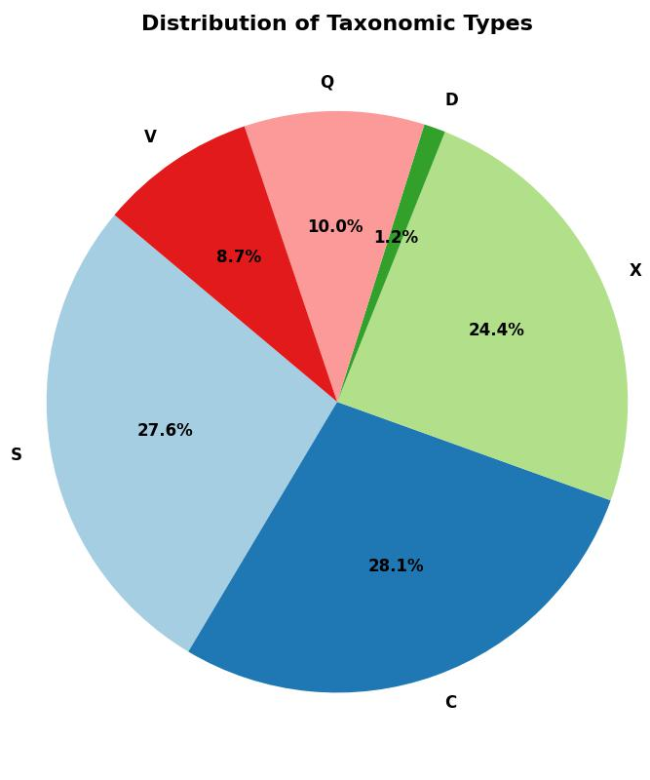
CONCLUSION
Successfully observed 230 NEAs (including 15 PHAs)
Determined taxonomic classifications for some NEAs using machine learning decision boundaries
~75% of observed asteroids are < 100m in diameter and ~61% observed within 1 day of discovery (10% within 3 hours)
Our determined taxonomic distribution somewhat agrees with results from Janse van Rensburg, 2021 MSc thesis, Erasmus et al. (2017) and Mommert et al. (2016)
In the future, we aim to automate the collection of the astrometric measurements and expand the program to make use of larger telescopes eg SALT to observe fainter discoveries(i.e potentially smaller NEAs).
Future work: Automate astrometric measurements and expand observations using larger telescopes (e.g., SALT) to study fainter, potentially smaller NEAs

Slide 11
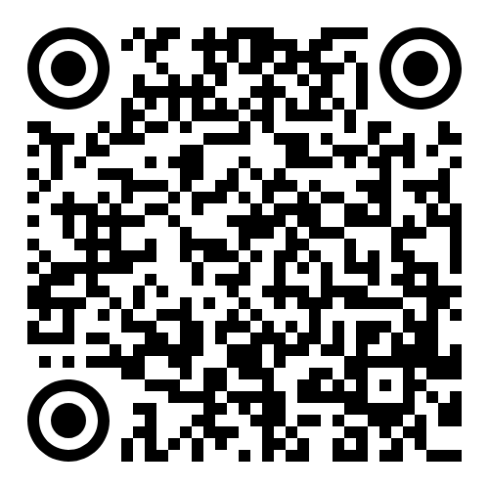
THANK YOU!
thobekilesn@gmail.com

