Slide 1
ESA NEOCC: Impact Assessment of 2024 PDC25
L. Faggioli, M. Fenucci, F. Gianotto, M. Devogèle, M. Micheli, F. Ocaña, J. L. Cano, L. Conversi, R. Moissl
ESA NEO Coordination Centre / Planetary Defence Office
9th IAA Planetary Defence Conference, Stellenbosch – 06/05/2025

Slide 2
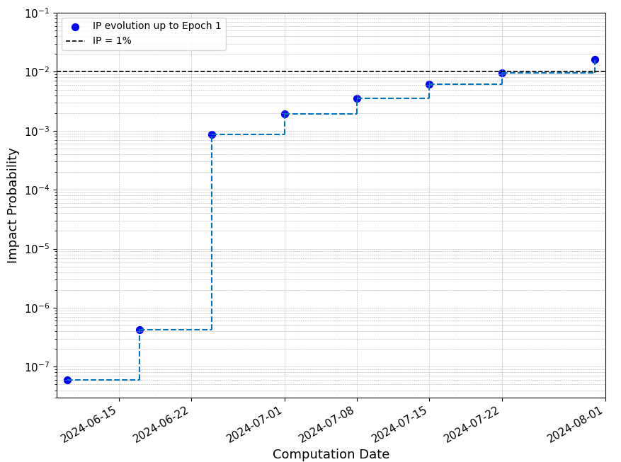
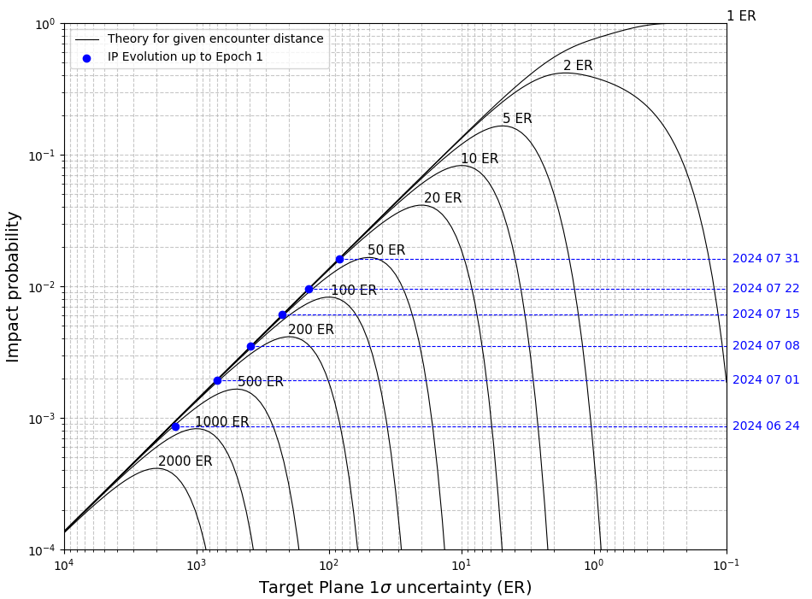
2024 PDC25: Towards Epoch 1
Possible impact on 24 April 2041
TS = 3
TS = 1
Fig. 1. IP evolution computed with Aegis [1] before Epoch 1.
Fig. 2. Theoretical IP vs. TP uncertainty for different Earth encounter distances. Blue points are the values computed by Aegis.
[1] Fenucci et al. (2024). The Aegis orbit determination and impact monitoring system and services of the ESA NEOCC web portal, CMDA 136:58

Slide 3
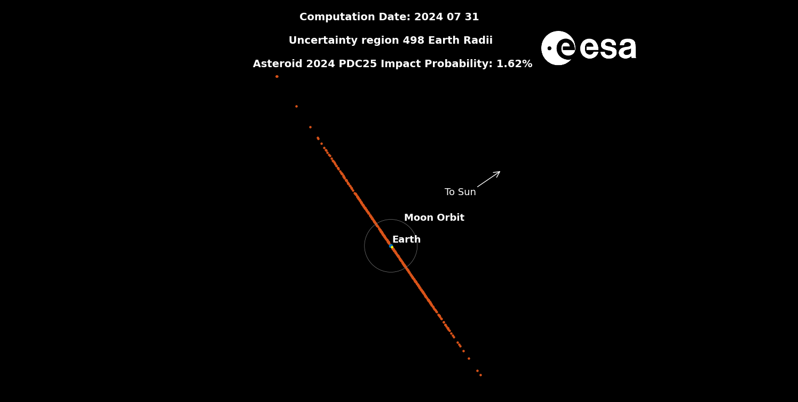
Uncertainty Region in 2041 at Epoch 1

Slide 4
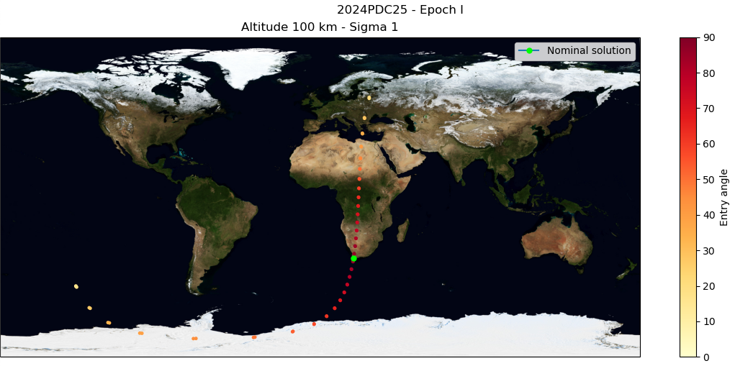
Impact Corridor at Epoch 1

Slide 5
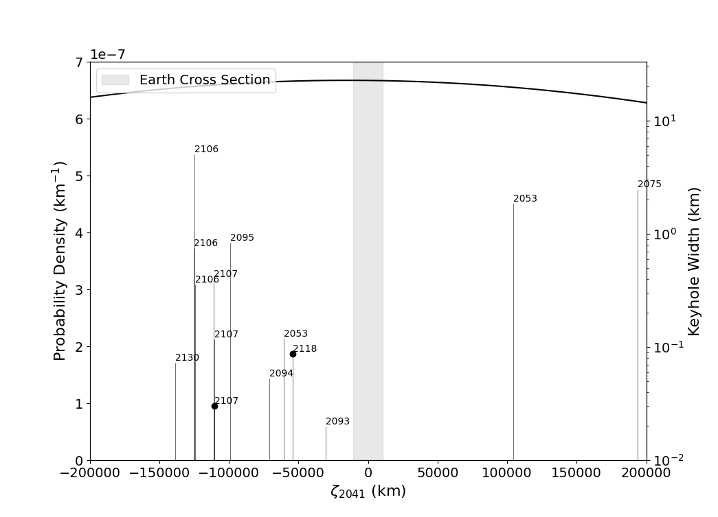
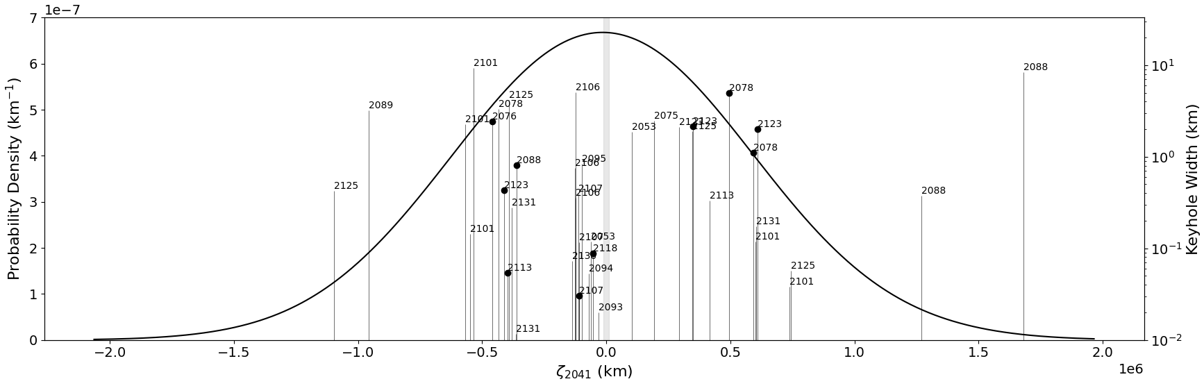
Keyhole Map at Epoch 1
Fig. 3. Keyhole map on the 2041 TP of VIs with IP > 10⁻⁷. Black filled circles are VIs with IP > 10⁻⁶.

Slide 6
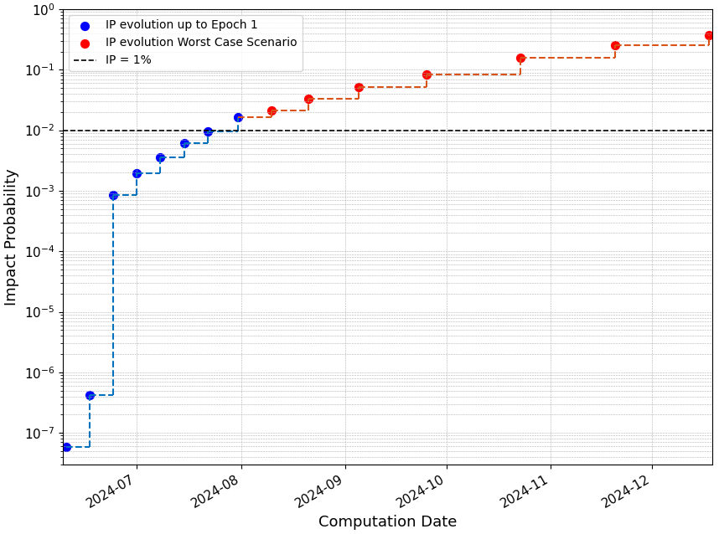
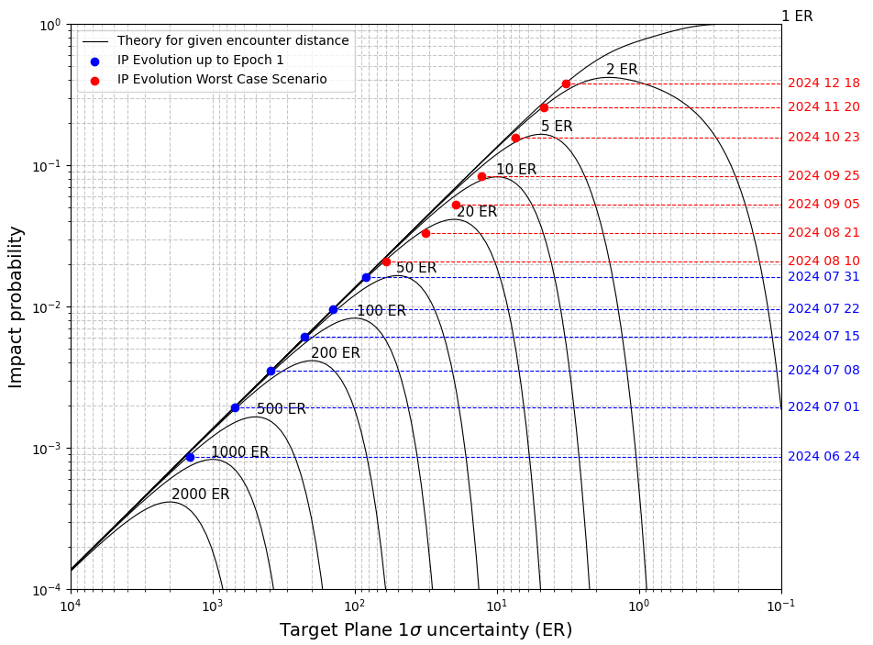
Evolution of the IP: Worst Case Scenario
Simulations up to end Dec. 2024 for impacting object, last visibility chance before PDC 2025.
TS = 3
TS = 1
Fig. 4. IP evolution in the worst case scenario of impacting object (red circles). Blue circles are the IPs up to Epoch 1.
Fig. 5. IP vs TP uncertainty for the worst case scenario (red data). Data up to Epoch 1 are also shown in blue.

Slide 7
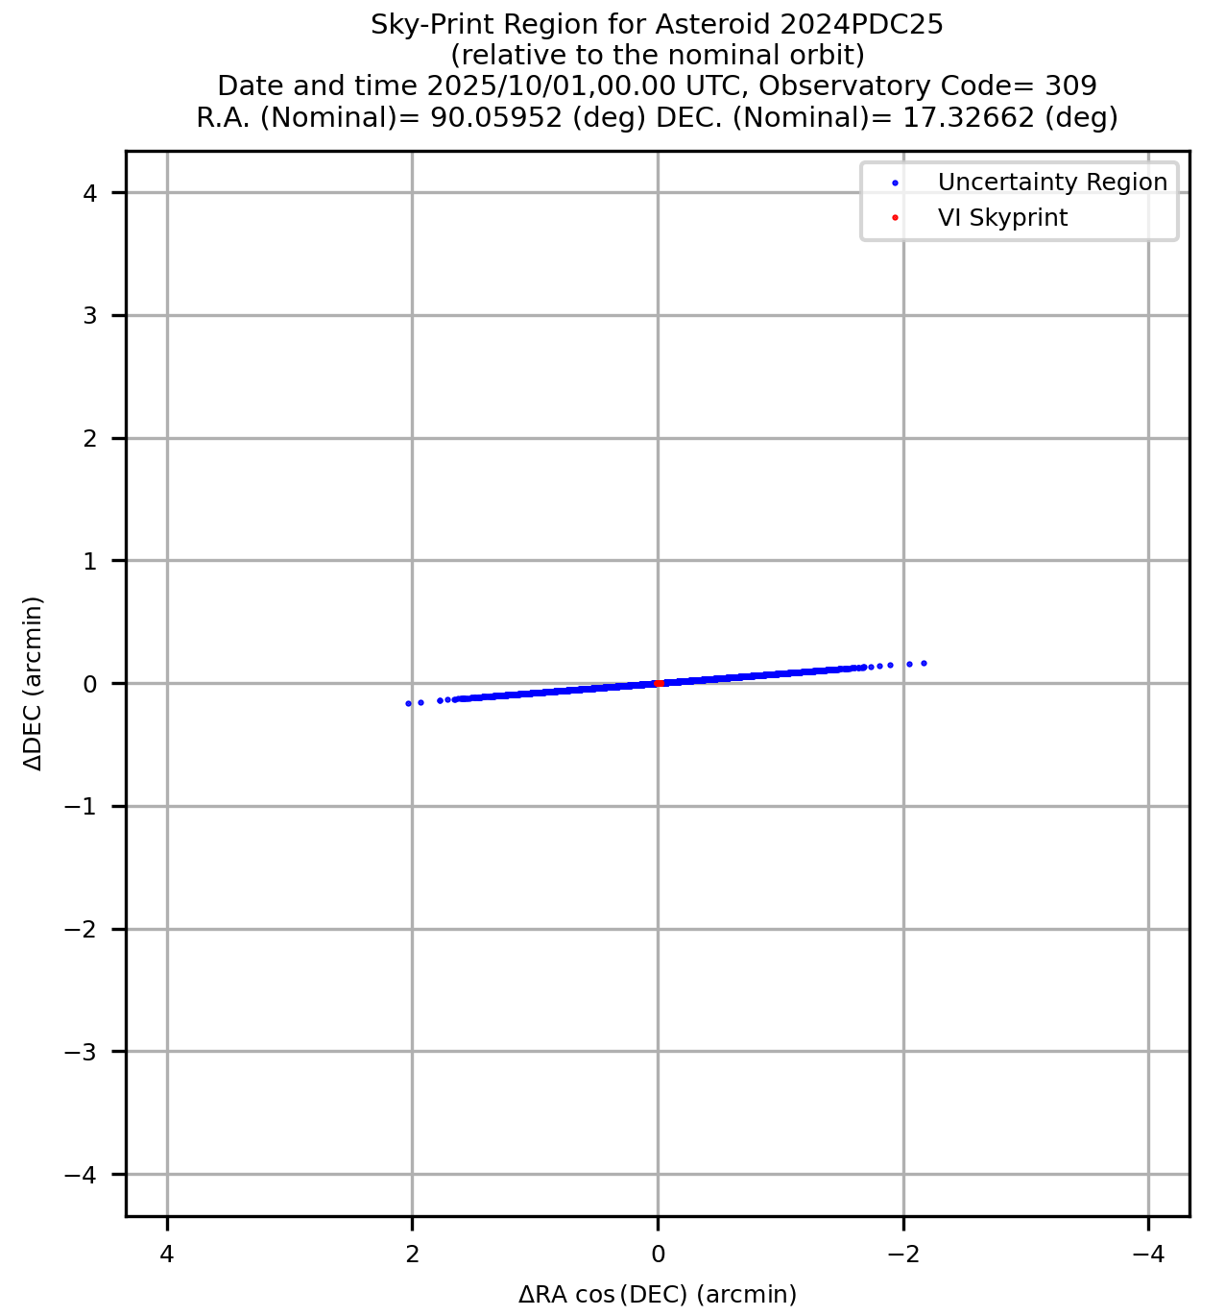
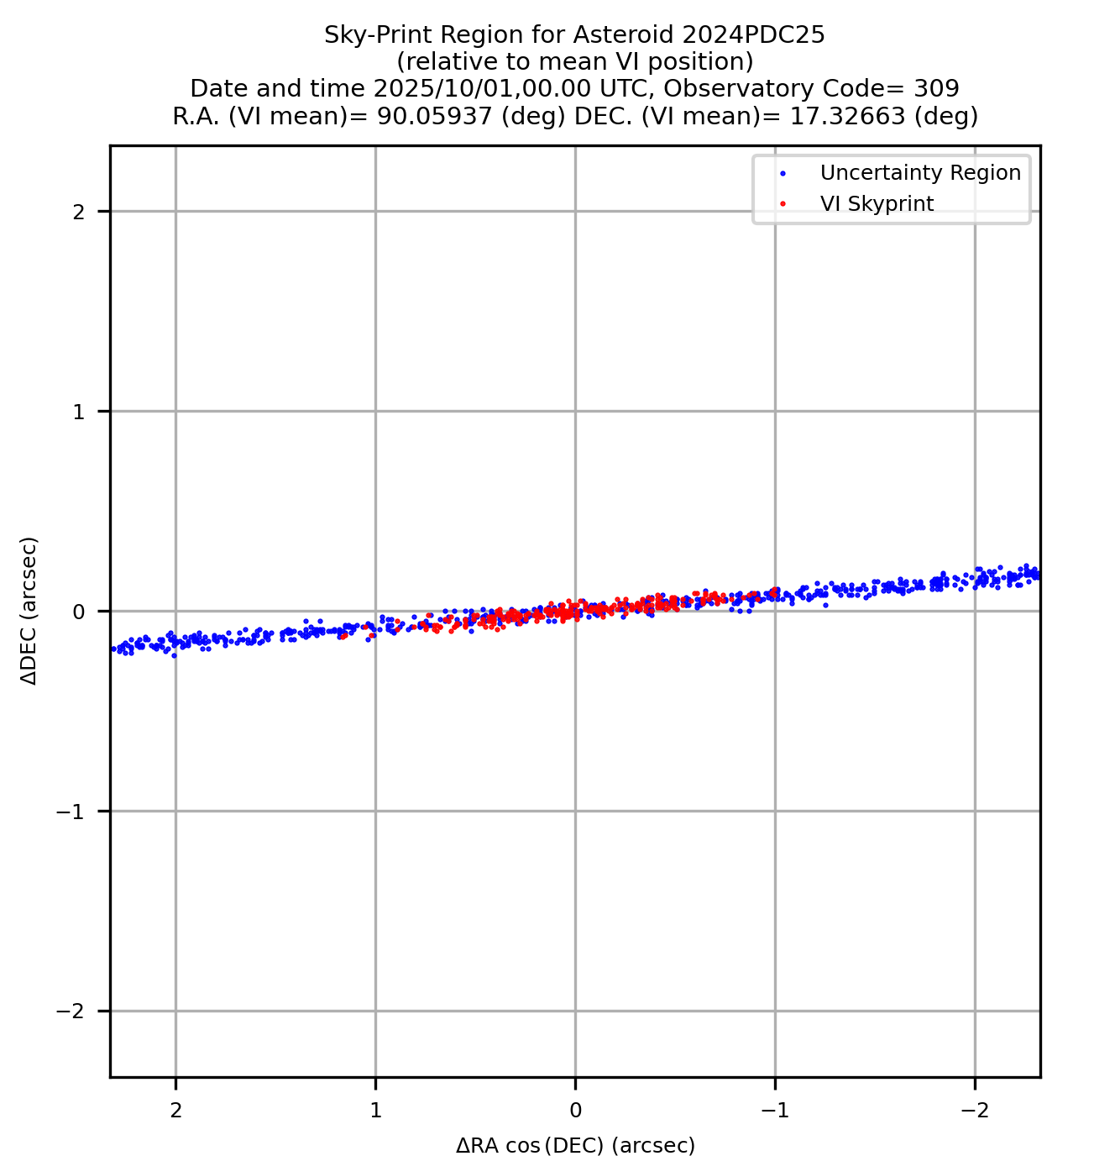
Evolution of the IP: Skyprint prediction
From orbit at Epoch 1:
Object recoverable by VLT in Oct 2025
Uncertainty of ~4 arcmin
VI skyprint of ~2.5 arcsec
VLT astrometric precision: ~0.1 arcsec
Three possibilities for 1 Oct. 2025 recovery:
Inside VI skyprint
  IP = 1
Outside VI skyprint
  IP = 0
Across the border of VI skyprint
  Almost grazing orbit
Fig 6. Uncertainty region of 2024 PDC25 on 1 Oct. 2025, with VI skyprint.

Slide 8
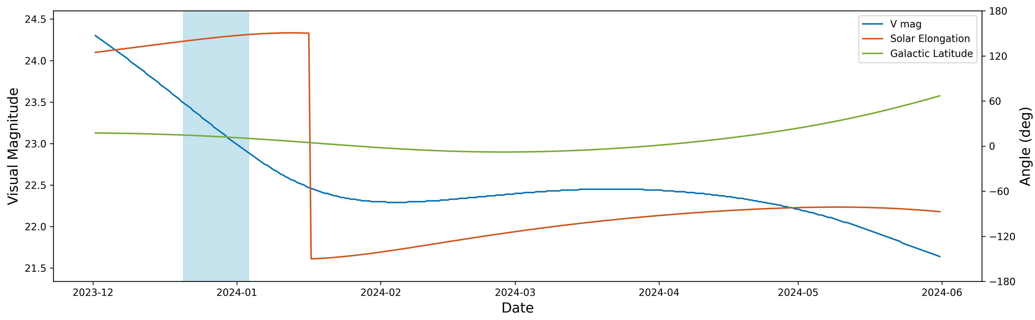
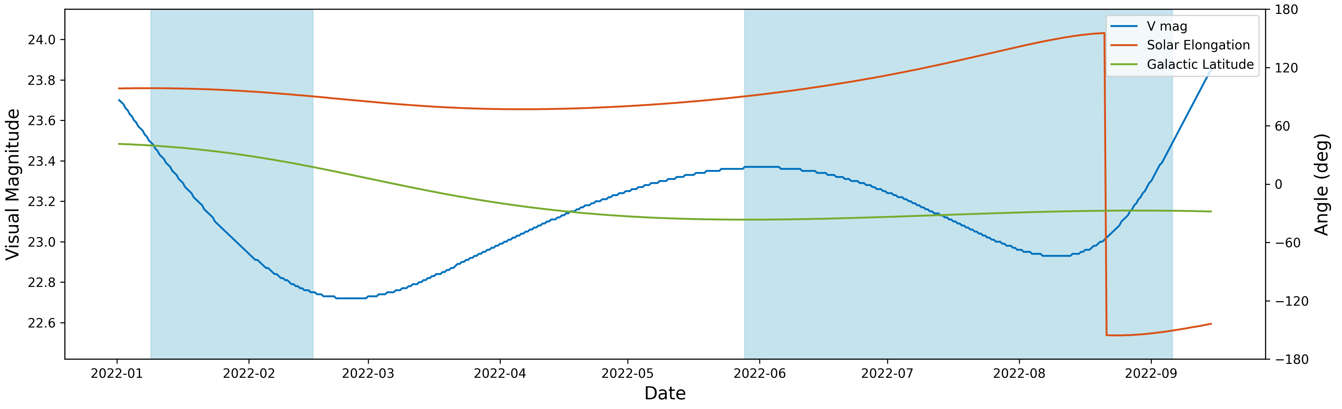
Precoveries search
Visibility conditions for surveys:
V mag < 23.5
Solar elongation > 90 deg
Galactic latitude > 10 deg
Window in 2024:
Low galactic latitudes or low solar elongation
Visibility around Jan. 2024, but not moving in typical survey fields
Window in 2022:
Dimmer than 22.7
No survey pointing at 2024 PDC25
Found DECAM images at correct pointing
Fig 7. Visibility windows (shaded blue areas) of 2024 PDC25 in 2024 (top) and 2022 (bottom).

Slide 9
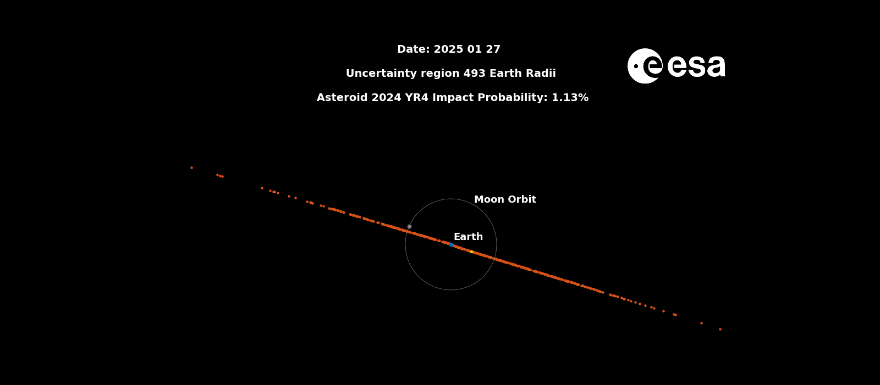
Conclusions
Practice like it’s real, so when it is, you’re already there!
2024 YR4 (Not an exercise)
Thank you!

