Slide 1

3D shape model and spin state of Apophis estimated from the 2012/2013 radar and lightcurve data
¹M. Brozović, ¹L. A. M. Benner, ¹S. P. Naidu, ²P. Pravec, ³C. Magri
¹ Jet Propulsion Laboratory, California Institute of Technology; ²Astronomical Institute, Academy of Sciences of the Czech Republic; ³University of Maine at Farmington
© 2025 California Institute of Technology. Government sponsorship acknowledged.
IAA-PDC-25-03-118
Planetary Defense Conference - May 4-9, 2025

Slide 2
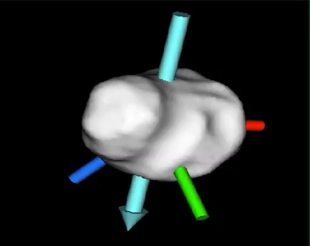
Apophis is elongated object with a tumbling spin state
P_{principal}~30.6 h
P_{long}~11 days
Angular momentum vector
Brozovic et al, 2018
Radar equivalent diameter D=0.34 ± 0.04 km (1σ bounds)

Slide 3
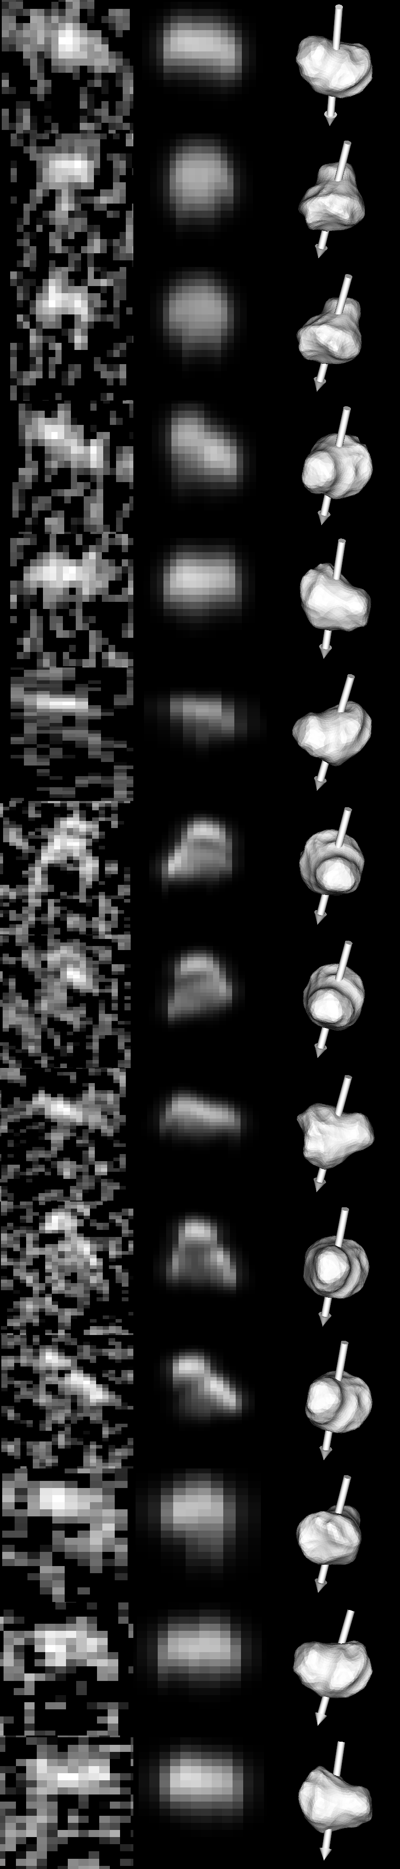
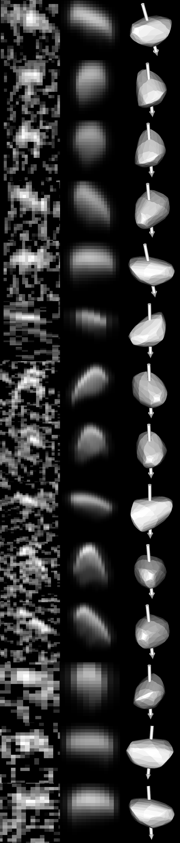
Original radar shape
Shape models and fits to the 2012/2013 radar data
Pravec et al. original
Dec 22
Jan 03a
Jan 03b
Radar model started from lightcurves-derived spin state and only used radar data
Radar data could not constrain the spin state beyond the lightcurves
Radar data have some sensitivity to the object’s size and shape, but the SNRs were low
After 2021, we have more radar and LC data, and we should be able to improve the spin state and to some extent, the shape model
Jan 05
Jan 06
Jan 09
Jan 10a
Jan 10b
Jan 11
Jan 14a
Jan 14b
Jan 16
Feb 18
Feb 20
Obs. Fit. POS
Obs. Fit. POS

Slide 4
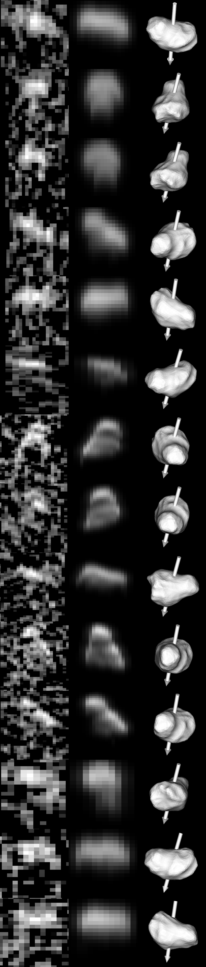
Adjusted radar shape
Step 1: Combine the 2012/2013 radar and LC data
Radar shape model needs an adjustment to the aspect ratio – it needs to be more elongated
The published spin state causes an offset in the fits to the lightcurves
Pravec fit
Radar fit
Three weeks of Apophis lightcurves observed in 2012/2013: 2012-12-23.2, 2012-12-31.1, 2013-01-07.5
Obs. Fit. POS

Slide 5
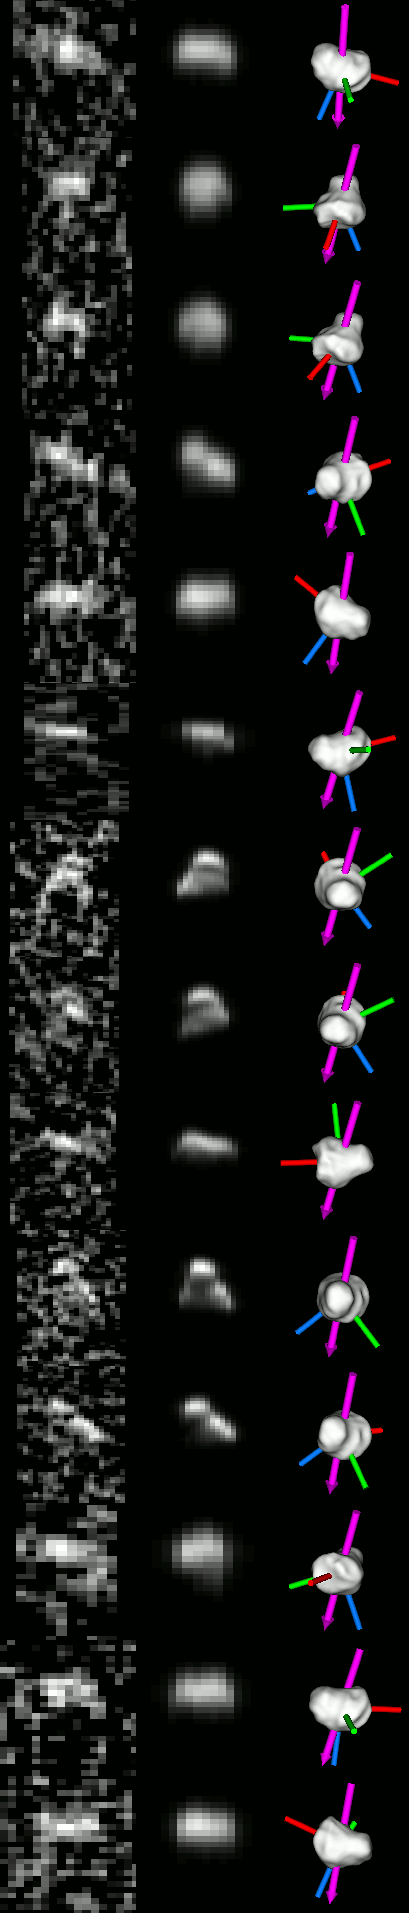
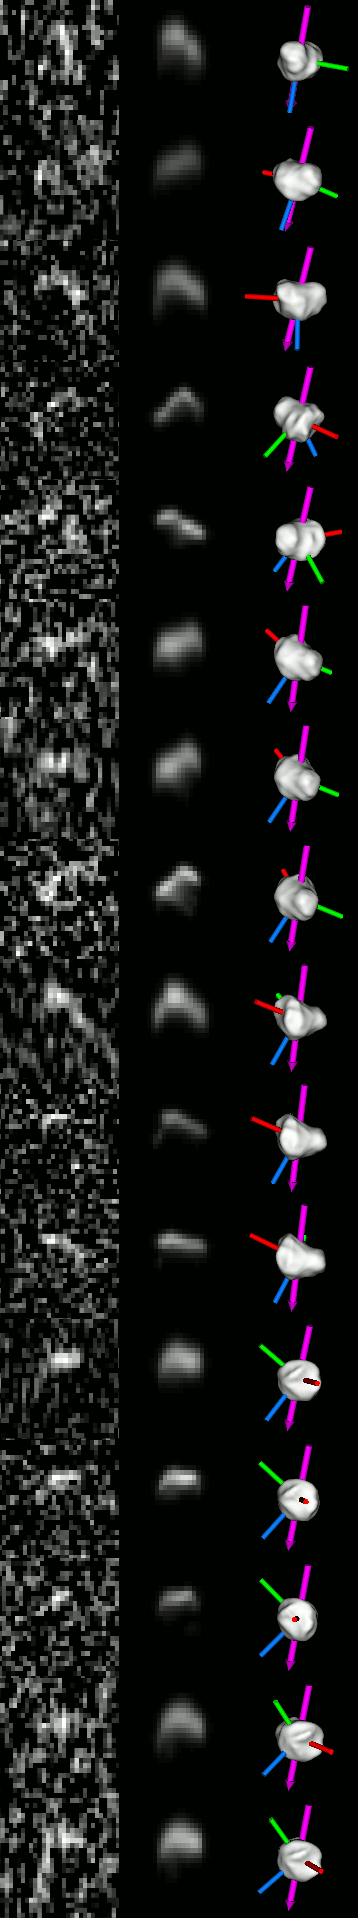
2012-
2013
data
2021
data
Dec 22
Mar 03
Step 2: Connect 2012/2013 and 2021 observations
Jan 03a
Mar 04
Mar 05
Jan 03b
Mar 06
Both radar and optical observers obtained more data
Occultation data obtained at 06:00 UTC Mar 07 2021 confirmed that the spin state needed an update
Orientation of radar echoes in 2021 also showed a mismatch
A preliminary analysis shows that a joint 2012/2013 and 2021 radar solution is possible
… but is it unique?
Jan 05
Mar 07
Jan 06
Mar 08a
Jan 09
Mar 08b
Jan 10a
Mar 08c
Jan 10b
Mar 09a
Jan 11
Mar 09b
Mar 09c
Jan 14a
Mar 10a
Jan 14b
Mar 10b
Jan 16
Mar 10c
Feb 18
Mar 11a
Feb 20
Mar 11b

Slide 6
A matter of shape: Is Apophis a contact binary?

Slide 7
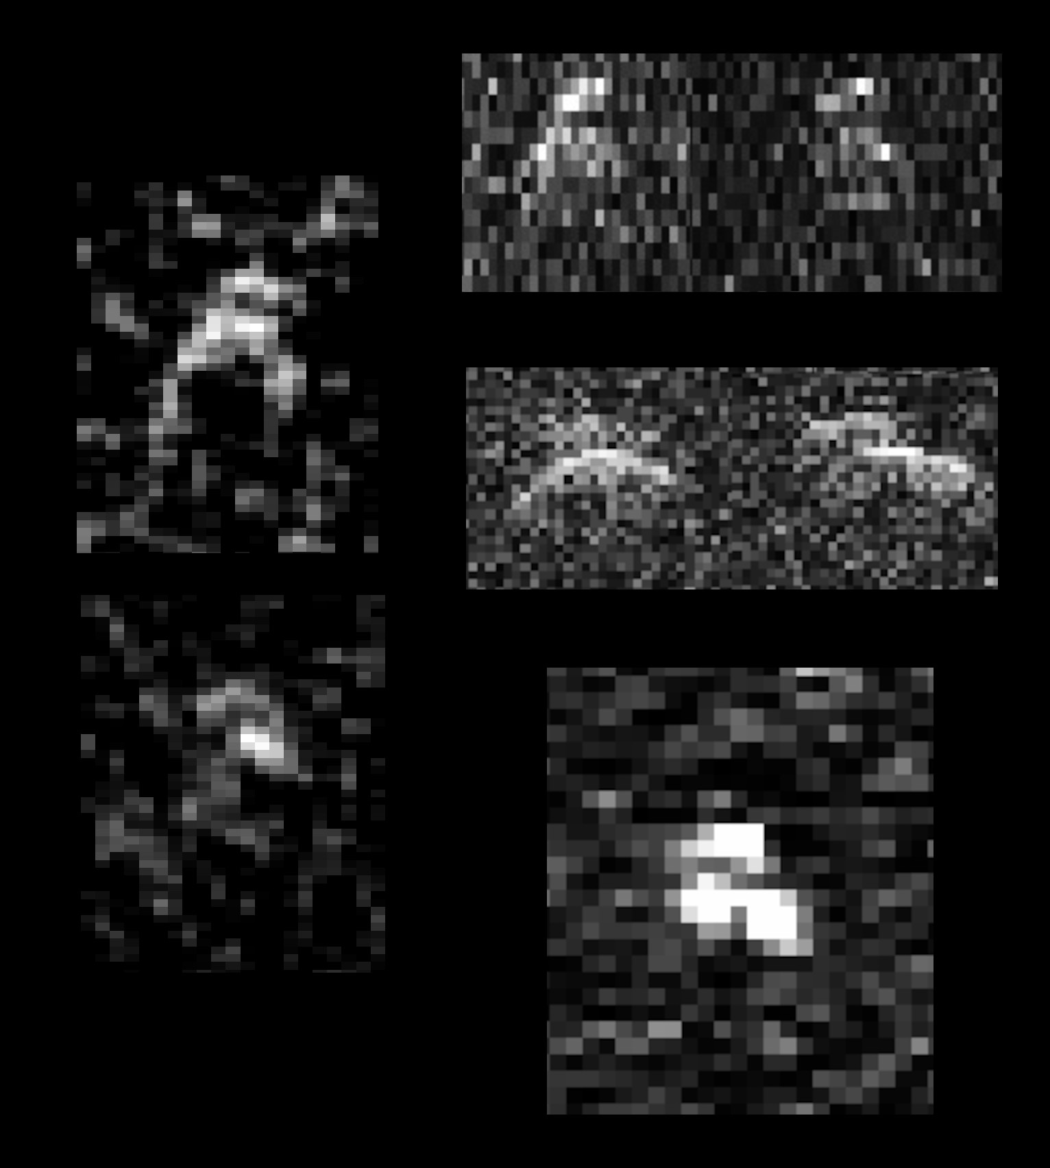
2006 DP14
Apophis
2003 TL4
2017 BW
Jan 10 2013

Slide 8
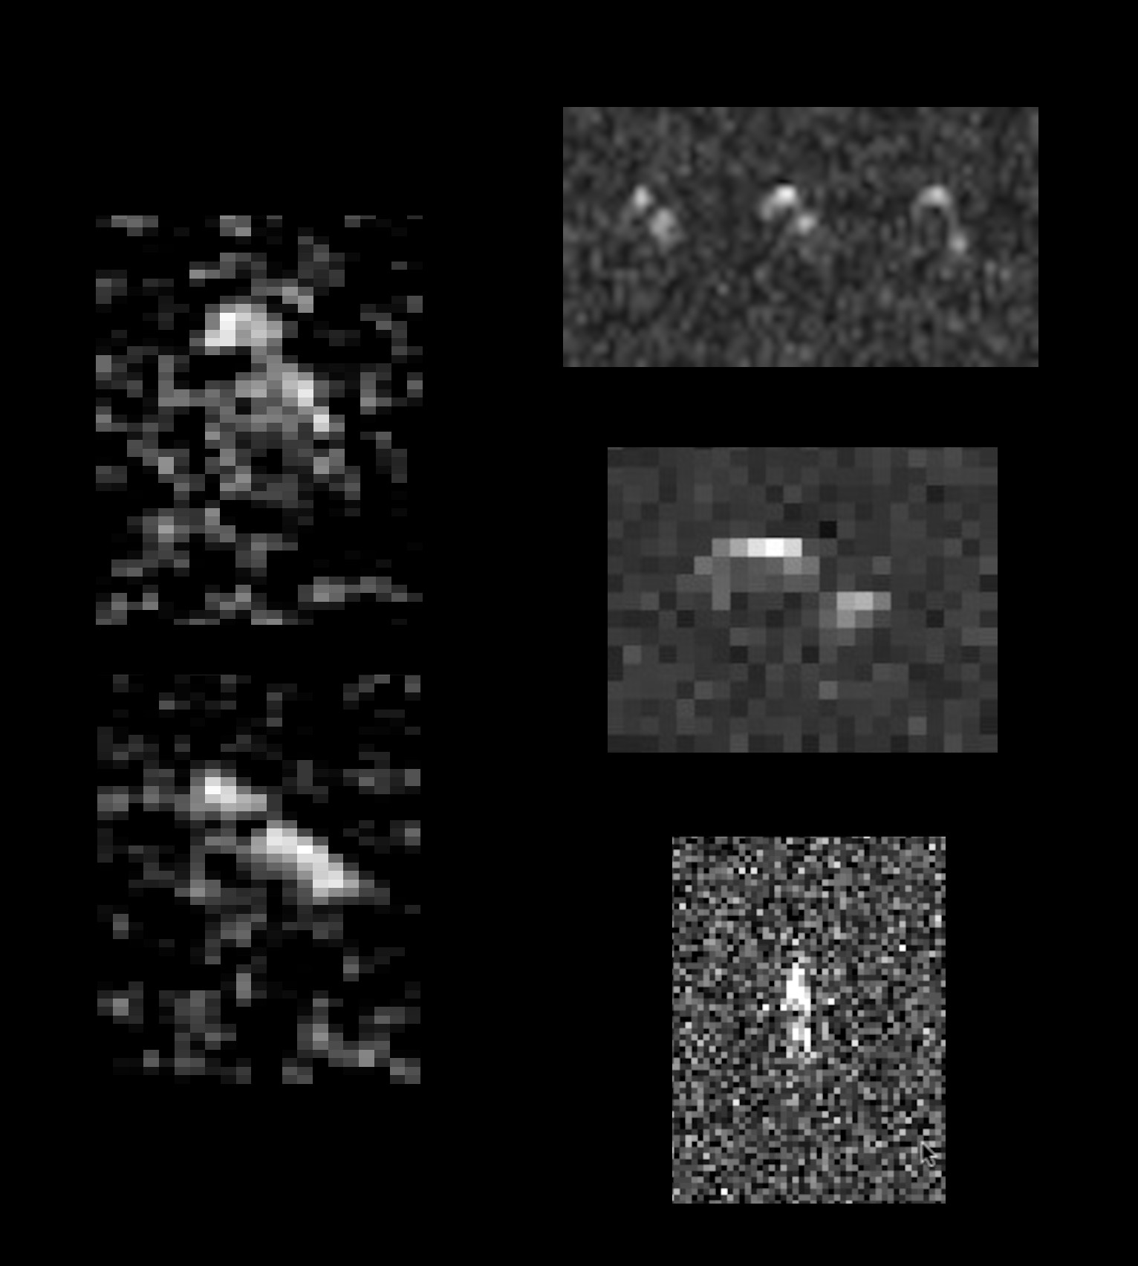
Castalia
Apophis
2010 LE15
2003 AF23
Jan 14 2013

Slide 9
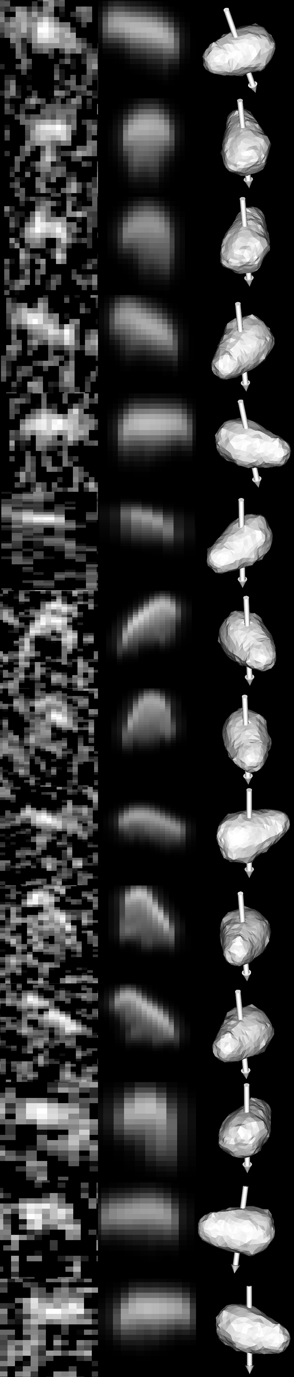
Obs. Fit. POS
How bifurcated is Apophis? Just a tad?
D=0.40 km
Long axis = 0.56 km
p_{v}=0.26
Fits to lightcurves do not reveal the level of bifurcation, but radar images do
Pravec fit
Radar

Slide 10
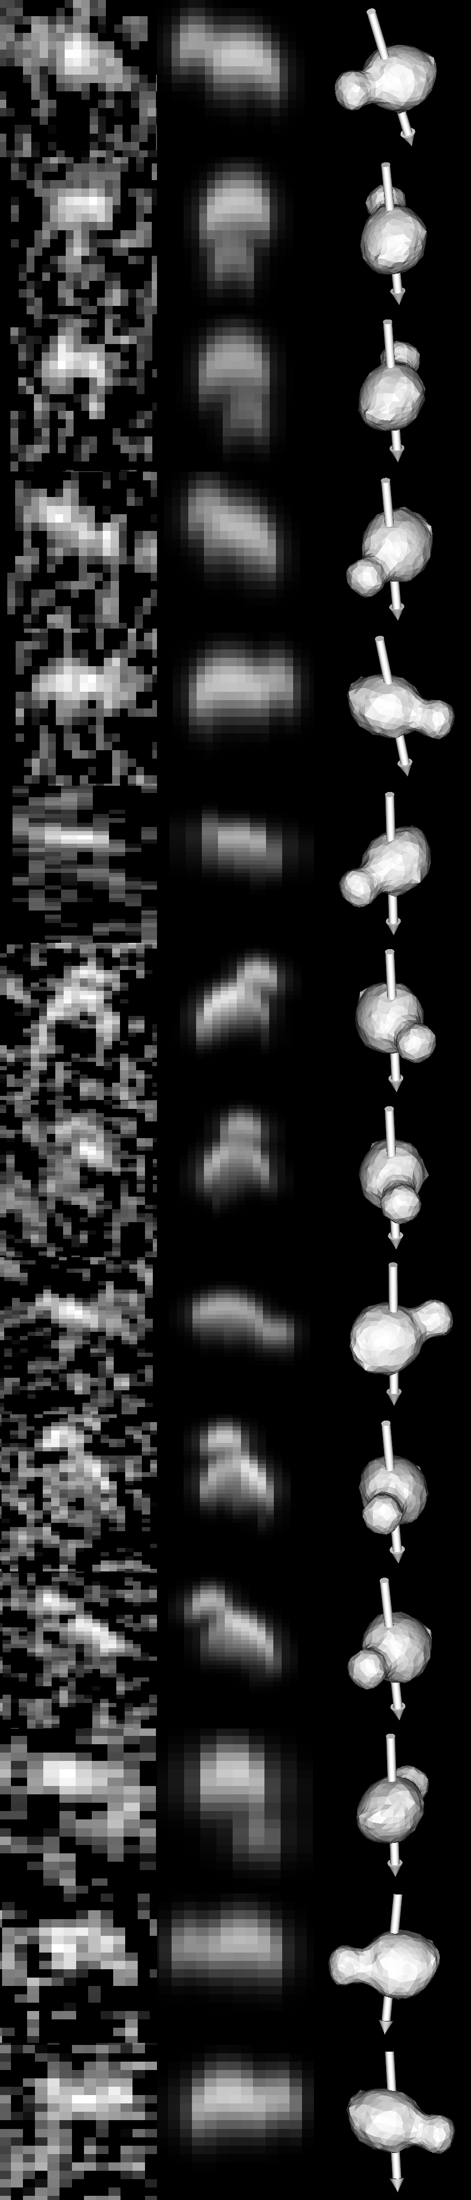
Obs. Fit. POS
How bifurcated is Apophis? Quite a lot?
D=0.33 km
Long axis = 0.5 km
p_{v}=0.37
Lightcurves can be fit with a dramatically different shapes (and sizes) assuming the models keep the same aspect ratios
Pravec fit
Radar

Slide 11
Take home messages
Apophis is (still) bifurcated
Radar shape model published by Brozovic et al 2018 based on 2012/2013 data needs to be updated – we were limited by phase coverage and low SNRs
Joint lightcurves and radar data from 2012/2013 may be sufficient to bridge 9 years of data gap to 2021 apparition
We will need to combine all the data we got to date
It is likely that the updated shape and spin model will still contain considerable uncertainties to predict the 2029 apparition

