Slide 1
Developing a Robust Flyby Reconnaissance Capability for Planetary Defense
Nancy L. Chabot, Justin A. Atchison, Rylie Bull, Andrew S. Rivkin, R. Terik Daly, Ronald-L. Ballouz, Olivier S. Barnouin, Andrew F. Cheng, Carolyn M. Ernst, Angela M. Stickle, Evan J. Smith, Joseph J. Linden, Benjamin F. Villac, Jodi R. Berdis, Dawn M. Graninger, Sarah Hefter
Johns Hopkins University Applied Physics Laboratory

Slide 2
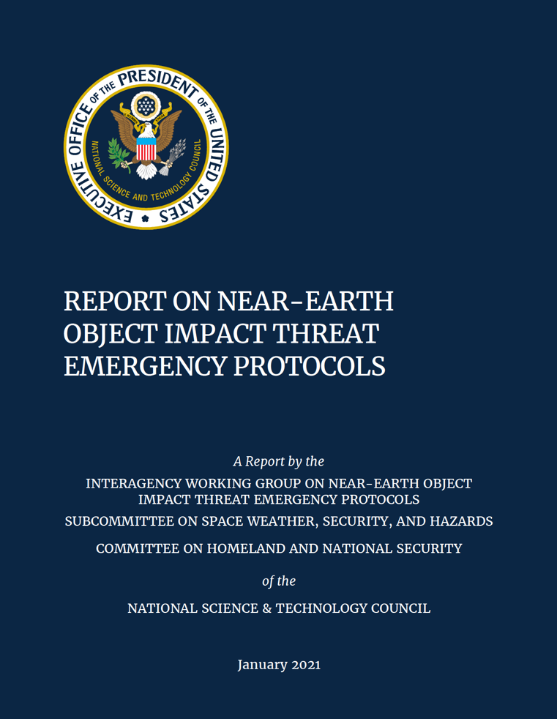
In 2021, the United States adopted protocols that recommended executing a spacecraft reconnaissance mission in any scenario that meets the SMPAG criteria and also has sufficient time to conduct the mission prior to the predicted impact.
“Such a mission can provide information critical to determining whether prevention is necessary and, if so, to enabling its success.”
SMPAG criteria:1. Earth impact is predicted to be within 50 years. 2. Impact probability is assessed to be >1%. 3. Object is determined to be >50 m in size (or H <26 if only brightness data are available).

Slide 3



Developing a spacecraft reconnaissance capability for the most likely impact threat is a necessity
50-m is the smallest to warrant a mission
Earth impact roughly every ~1,000 years
Only ~10% of these NEOs have been found
50-m objects are the smallest NEOs recommended for a space mission under current SMPAG (2017) and U.S. protocols (2021).
50-m objects impact the Earth much more frequently than larger objects, so they are the NEOs most likely to trigger a space-based mission.
Even with NEO Surveyor and Rubin Observatory, ~half of the 50-m NEOs will be left undiscovered. Thus, warning times may be short.

Slide 4

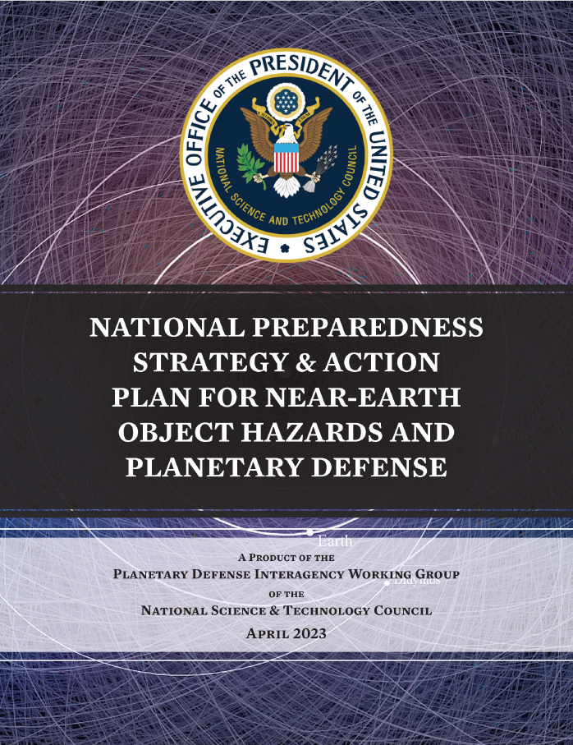
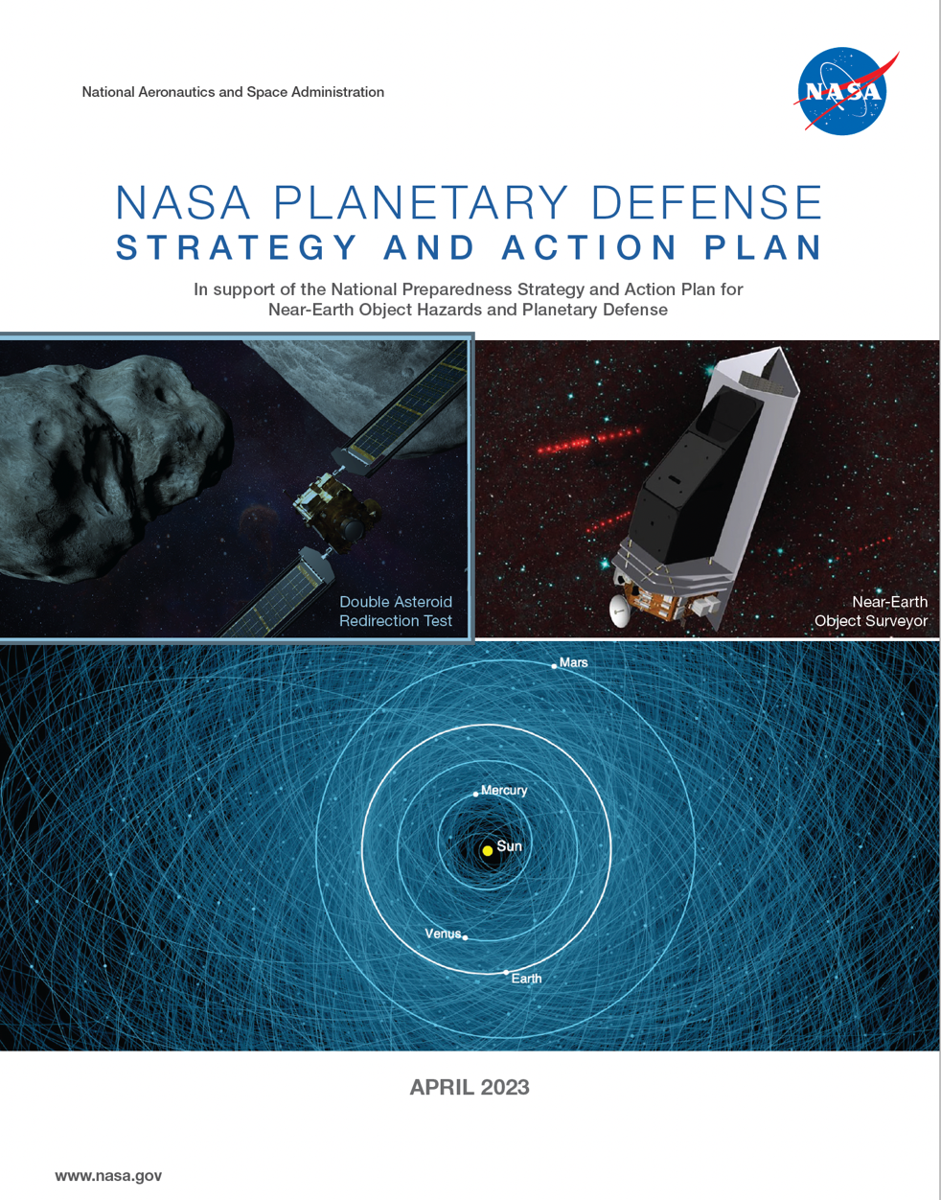
Developing a spacecraft reconnaissance capability for the most likely impact threat is a necessity and a U.S. priority
Recommendation: The next planetary defense demonstration mission should be a rapid-response, flyby reconnaissance mission targeted to a challenging (~50-100-m) NEO
Goal: Develop Technologies for NEO Reconnaissance, Deflection, and Disruption Missions
Short Term Actions: Collaborate on technologies for rapid response, reconnaissance, and characterization of in-space objects. Create plans for the development, testing, and implementation of NEO reconnaissance mission systems.

Slide 5
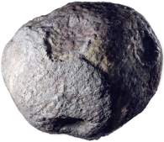
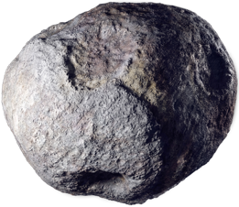






Enable a reconnaissance of >90% of the potential asteroid threat population
1
The darkest timeline
Synthetic Threat Population:
2340 potentially hazardous asteroids (PHA) achieve their minimum Earth distance in the 2030s
You don’t pick the asteroid – the asteroid picks you.

Slide 6
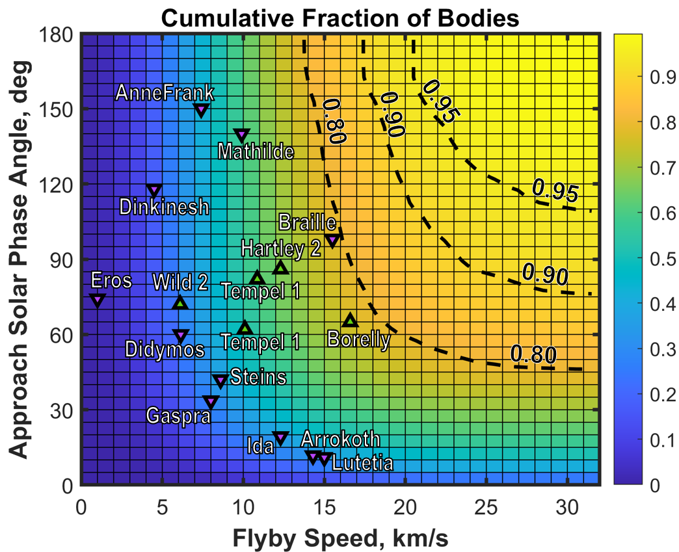
Enable a reconnaissance of >90% of the potential asteroid threat population
1
Ballistic spacecraft trajectories were computed for the synthetic threat population, resulting in millions of possible trajectories.
Flyby conditions that encompass >90%
Max time of flight | 2.5 yrs
Min solar dist. | 0.9 AU
Max solar dist. | 2.0 AU
Max approach solar phase angle | 90 deg
Max flyby speed | 25 km/s
Max launch C3 | 30 km²/s²
You don’t pick the asteroid – the asteroid picks you.
Notes:
Demonstrating this capability for the most challenging conditions shows that it can be applied to ≥90% of the potential asteroid threat population

Slide 7
Demonstrate flyby reconnaissance for a ~50-m NEO
2
The demonstration must test the limits of the performance in a stressing flyby case.
Flyby conditions that encompass >90%
Most flyby encounters won’t be of a half-lit 50-m object at 25 km/s – but if the reconnaissance capability can handle that stressing case, it can be deployed for >90% of the potential asteroid threat population.
Max time of flight | 2.5 yrs
Min solar dist. | 0.9 AU
Max solar dist. | 2.0 AU
Max approach solar phase angle | 90 deg
Max flyby speed | 25 km/s
Max launch C3 | 30 km²/s²
You don’t pick the asteroid – the asteroid picks you.
Notes:
The demonstrated capability could then also be applied to the less challenging case of a larger object, should such a need arise in the future.

Slide 8
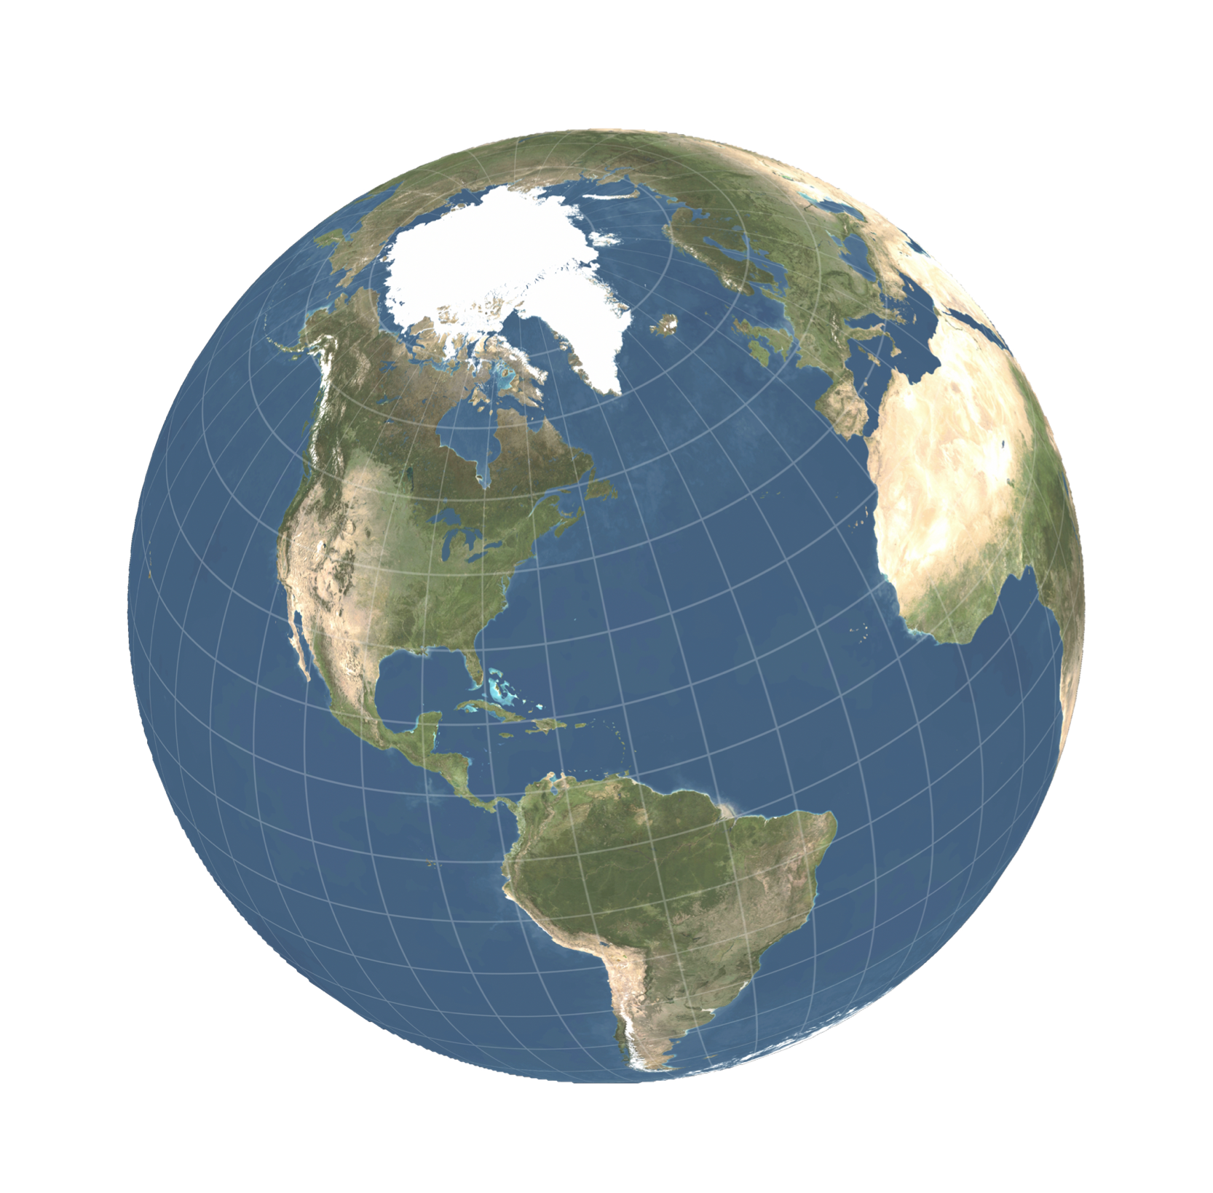
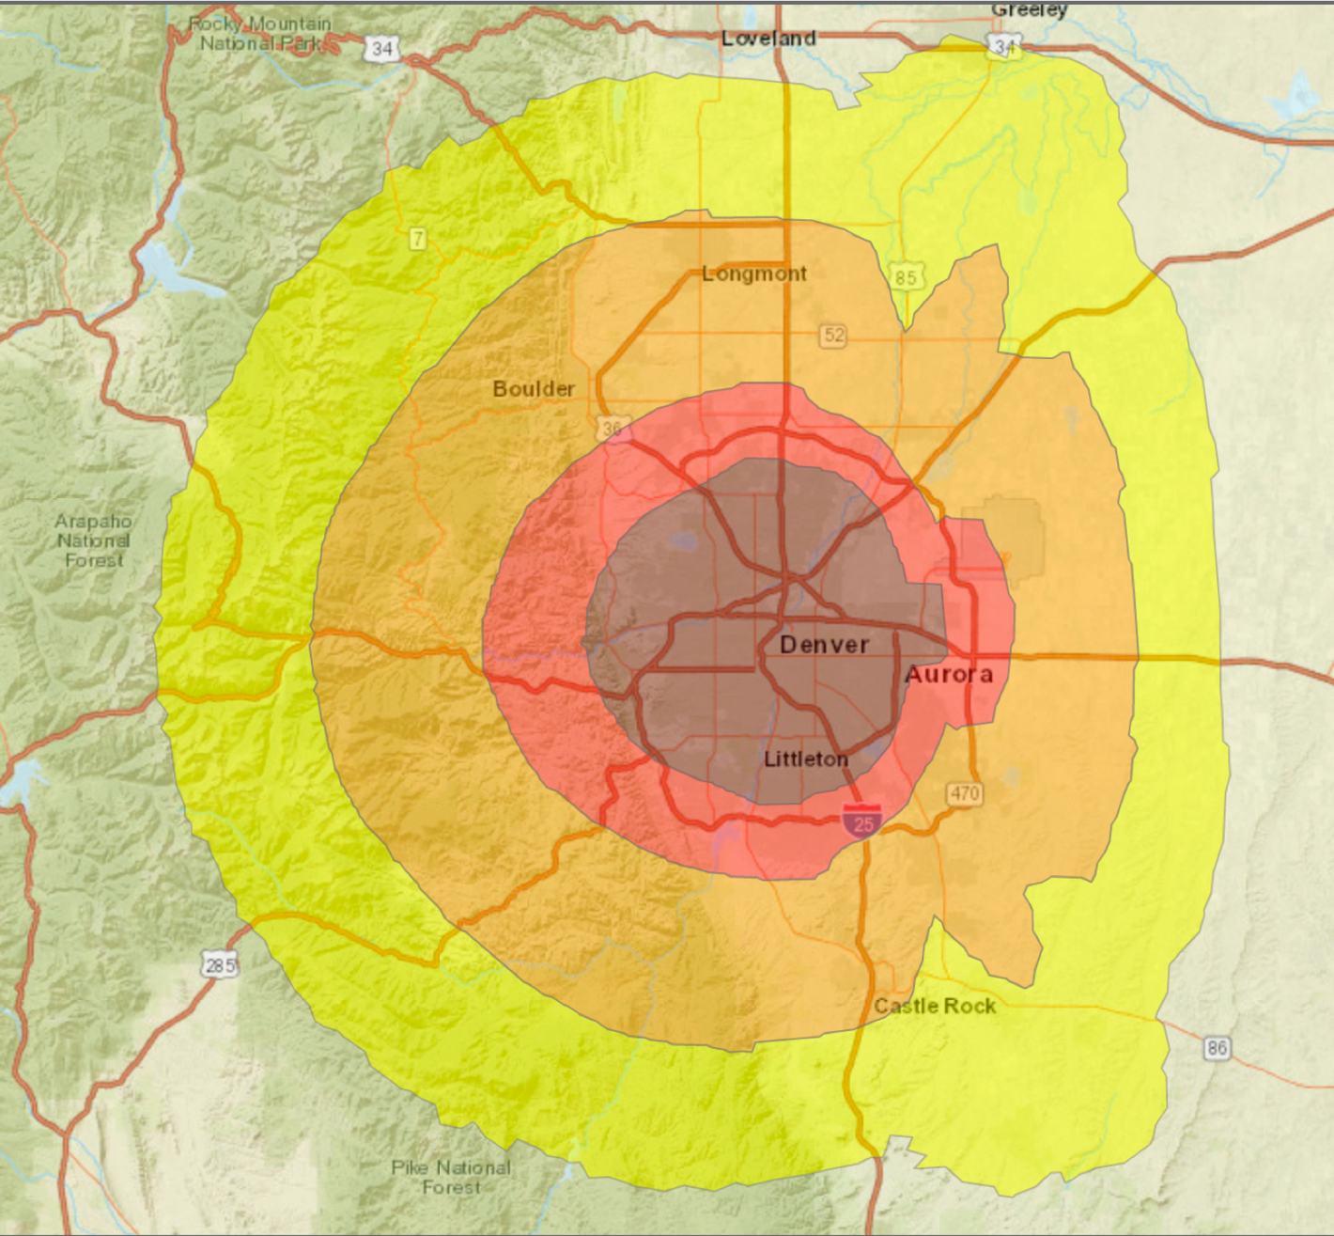
Obtain the information needed to determine if and where the object would impact the Earth
3
Example from Planetary Defense Conference Exercise – 2019
Uncertainty
region
EXERCISE ONLY!
https://cneos.jpl.nasa.gov/pd/cs/pdc19/
EXERCISE ONLY!
With telescopes only, the impact uncertainty region can span the globe
After a flyby, the impact location is known to within ~100 km
Notes:
Left side– Day 2 of exercise – July 2019 is date
Right side – Day 3 of exercise – Dec 30, 2021 – flyby just happened

Slide 9
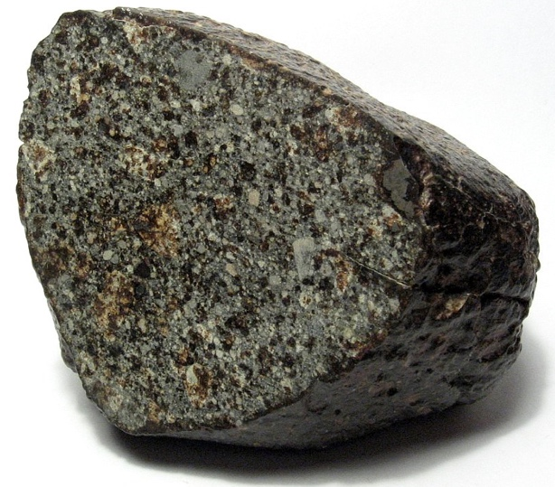
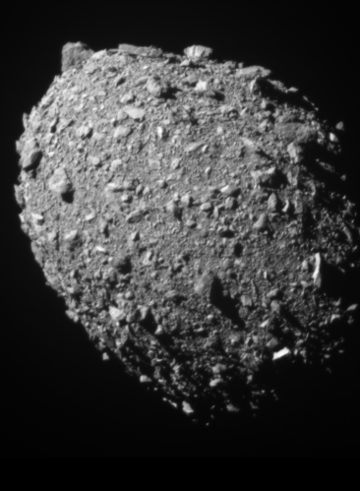


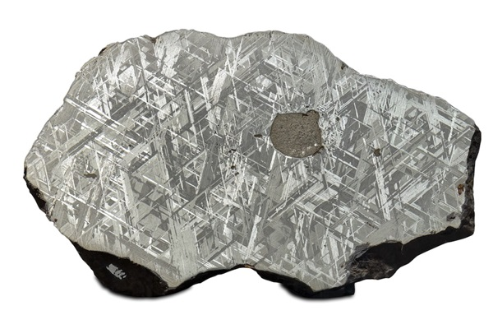

Determine key properties of the asteroid to inform decision makers
4
?
Ordinary chondrite NWA 869
By H. Raab (User:Vesta) - Own work, CC BY-SA 3.0
vs
DART image
of Dimorphos
Cape York iron meteorite
Photo courtesy of Chuck Sutherland
NASA/Johns Hopkins APL
Determine the asteroid’s size
Determine if the asteroid is mostly rocky or metallic
Determine if there is a single object or multiple objects of concern
Determine the asteroid’s surface characteristics

Slide 10
Determine key properties of the asteroid to inform decision makers
4
Asteroid size knowledge
Determine the asteroid’s size
https://cneos.jpl.nasa.gov/pd/cs/

Slide 11

Determine key properties of the asteroid to inform decision makers
4
Asteroid size knowledge
= ±20 m
Determine the asteroid’s size
https://cneos.jpl.nasa.gov/pd/cs/
Flyby imaging greatly reduces the uncertainty in the NEO’s size

Slide 12
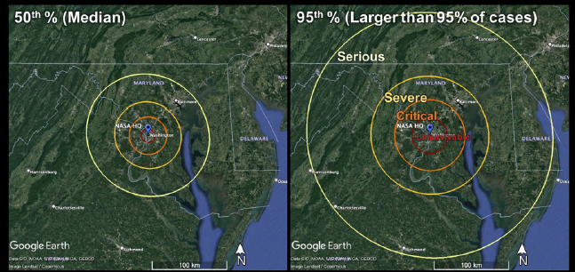
Determine key properties of the asteroid to inform decision makers
4
~3–4 g/cm³
Ordinary chondrite NWA 869
By H. Raab (User:Vesta) - Own work, CC BY-SA 3.0
vs
~7–8 g/cm³
EXERCISE ONLY!
Cape York iron meteorite
Photo courtesy of Chuck Sutherland
From Planetary Defense Tabletop Exercise 4 (2022) – Illustrating the range of potential damage due to uncertainties in the asteroid’s properties.
Determine if the asteroid is mostly rocky or metallic
Without a direct mass measurement, uncertainty in whether the object is rocky or metallic creates large uncertainty in the potential damage

Slide 13
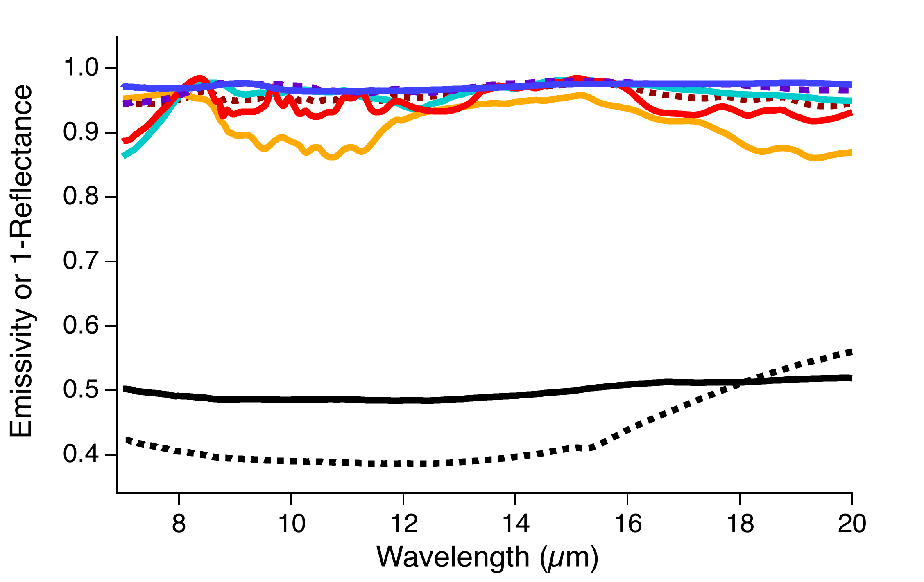
Determine key properties of the asteroid to inform decision makers
4
Thermal IR Spectral Measurements
~3–4 g/cm³
Bennu (Hamilton et al., 2021)
Murchison (CC)
ALH 81001 (eucrite)
EET 90102 (EC)
Norton County (aubrite)
Chelyabinsk (OC)
Ordinary chondrite NWA 869
By H. Raab (User:Vesta) - Own work, CC BY-SA 3.0
Ordinary chondrite NWA 869
By H. Raab (User:Vesta) - Own work, CC BY-SA 3.0
vs
vs
~7–8 g/cm³
Iron powders
<150 µm
<45 µm
(Bramble et al., 2021)
Other spectra from RELAB Database
Cape York iron meteorite
Photo courtesy of Chuck Sutherland
Determine if the asteroid is mostly rocky or metallic
Determine if the asteroid is mostly rocky or metallic
Flyby measurements can distinguish between mostly rocky vs metal-dominated NEOs

Slide 14
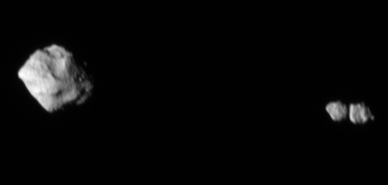
Determine key properties of the asteroid to inform decision makers
4
?
Lucy L’LORRI image
Dinkinesh (790 m)
Selam (220 m each)
Determine if there is a single object or multiple objects of concern
NASA/Goddard/SwRI/Johns Hopkins APL
Flyby imaging can determine the number of objects of concern

Slide 15

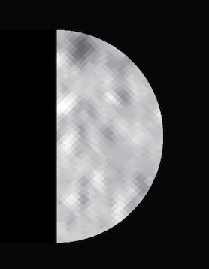
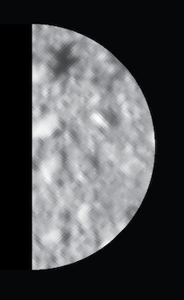
Determine key properties of the asteroid to inform decision makers
4
DART approach images of Dimorphos, cropped to 50-m diameter
DART image
of Dimorphos
NASA/Johns Hopkins APL
2 m/pixel
1 m/pixel
0.5 m/pixel
Determine the asteroid’s surface characteristics
Flyby imaging of ≤0.5 m/pixel can reveal surface features on the scale needed to inform potential mitigation options

Slide 16


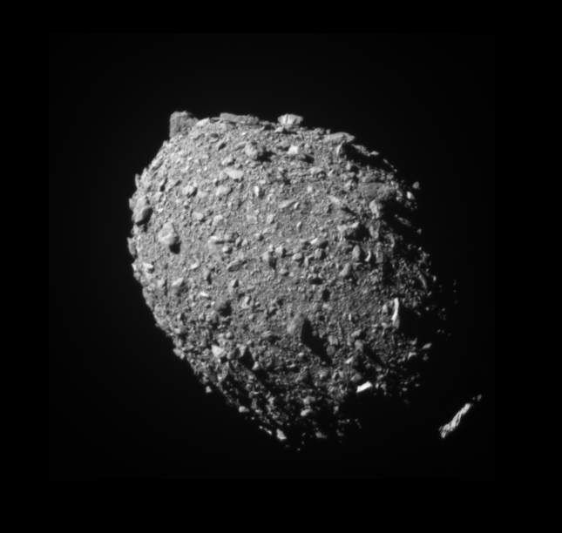
You don’t pick the asteroid – the asteroid picks you.
1
2
3
4
Enable a flyby of >90% of the potential asteroid threat population
Demonstrate flyby reconnaissance for a ~50-m NEO
Obtain the information needed to determine if and where it would impact the Earth
Determine key properties of the asteroid to inform decision makers
A technology demonstration mission is necessary to develop this robust reconnaissance capability and advance planetary defense preparedness.

