Slide 1


IAA-PDC-25-01-83
Retasking In-flight Spacecraft for Rapid Response Reconnaissance in Planetary Defense Exercises
06 May 2025
2025 Planetary Defense Conference; Stellenbosch, Cape Town, South Africa
Session 1: Hypothetical Threat Exercise Technical Session
Rylie Bull*^{1,} Matthew A. Vavrina², Josh Lyzhoft³, Justin Atchison¹, Brent Barbee³
* Corresponding Author – Rylie.Bull@jhuapl.edu
¹ JHU/APL
² a. i. solutions
³ NASA GSFC

Slide 2

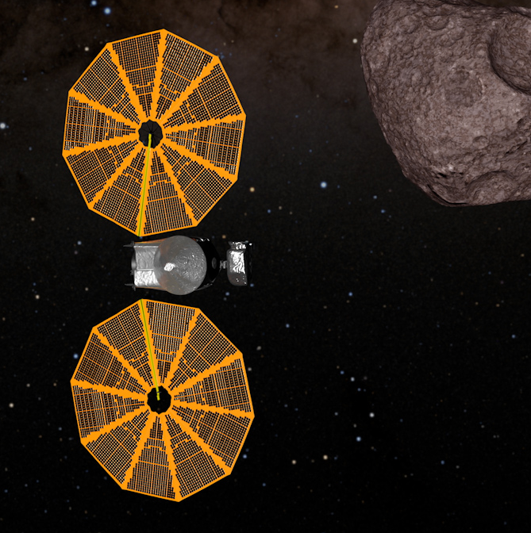
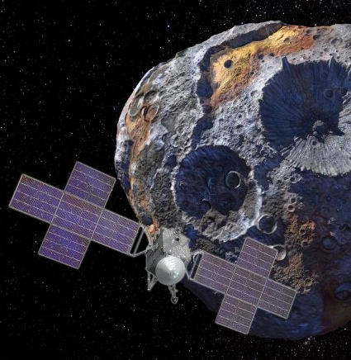
Spacecraft Retasking
Existing spacecraft can potentially survey an asteroid threat sooner than a newly built spacecraft
  Potentially faster than a new-build spacecraft
  Hardware cannot be tailored to the threat and may be beyond design life
In addition to trajectory feasibility, we must assess:
  Does the spacecraft have sufficient propellant?
  How late can the decision to retask be made?
  Is the spacecraft’s hardware suited to the new trajectory?
  Is the spacecraft’s payload suite useful?
For this study, we considered 3 NASA spacecraft:
  OSIRIS-APEX
  Lucy
  Psyche
National Aeronautics and Space Administration (NASA) / Goddard Space Flight Center (GSFC) / University of Arizona / Lockheed Martin
NASA’s Goddard Space Flight Center/Conceptual Image Lab/Adriana Gutierrez
NASA/JPL-Caltech/Arizona State Univ./Space Systems Loral/Peter Rubin

Slide 3
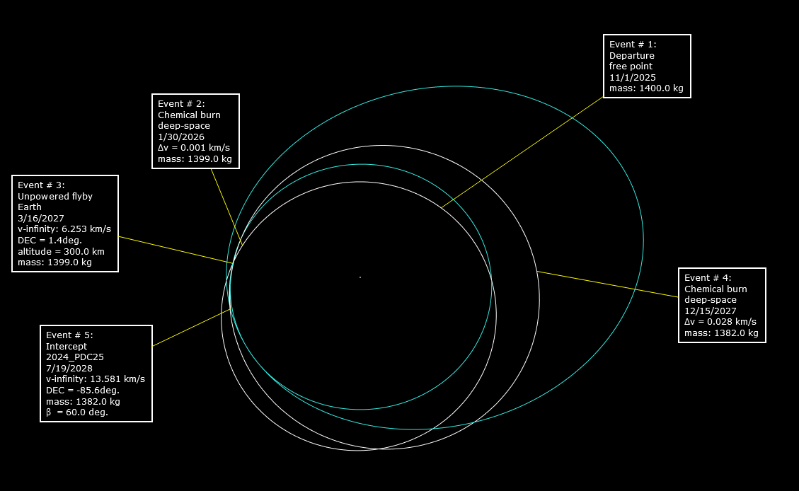
OSIRIS-APEX
Designed for rendezvous and sample return from Bennu.
Extended mission will rendezvous with Apophis shortly after its Earth encounter.
Upcoming Nominal Trajectory Events:
  EGA on 25 Sep 2025
  EGA on 17 Mar 2027
  EGA on 13 Apr 2029
~540 m/s available in Aug 2024
Viable Solution for 2024 PDC25:
  Retarget March 2027 EGA2:
    ~29 m/s in Jan 2026
    Redirect maneuver could be delayed even later
  PHA Flyby Encounter:
    19 Jul 2028
    13.5 km/s
    60 deg approach solar phase angle
    Initial detection 3-4 days out
  Apophis mission is not recoverable in relevant timeframe.
Earth
2024 PDC25

Slide 4
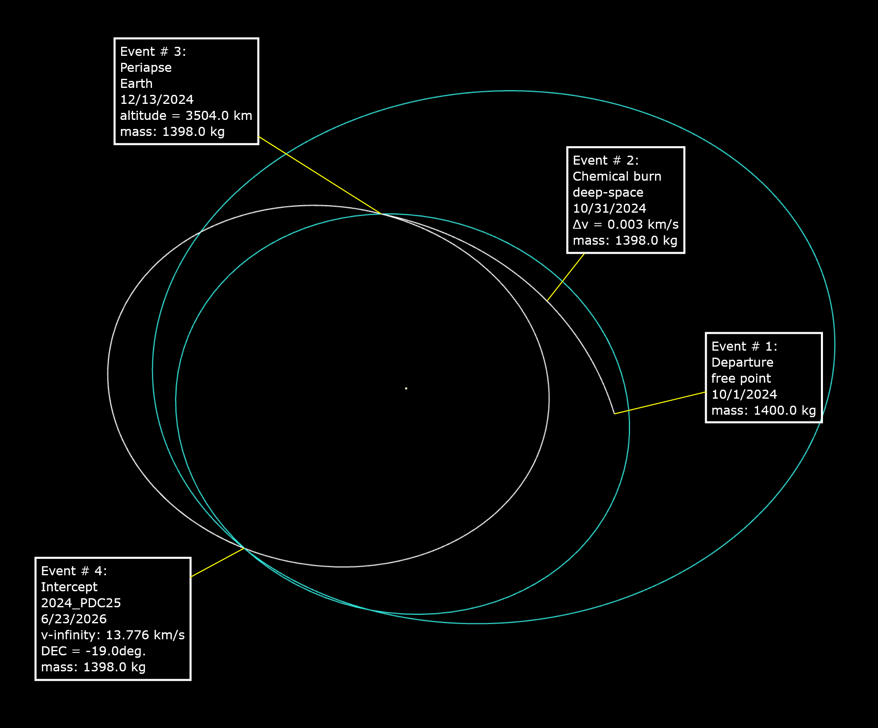
Lucy
Designed for high speed flybys of the Jupiter Trojans
Upcoming Nominal Trajectory Events:
  TCM on 13 Nov 2024
  EGA on 13 Dec 2024
~800-900 m/s available in Aug 2024
Viable Solution for 2024 PDC25:
  Retarget EGA
    3 m/s on 31 Oct 2024 to retarget December EGA, otherwise ballistic
    Very short decision timeline.
  PHA Flyby Encounter:
    23 June 2026
    13.7 km/s
    135 deg approach solar phase angle
    Initial detection 1-2 days out
  The Jupiter Trojan mission is not likely recoverable.
Earth
2024 PDC25

Slide 5
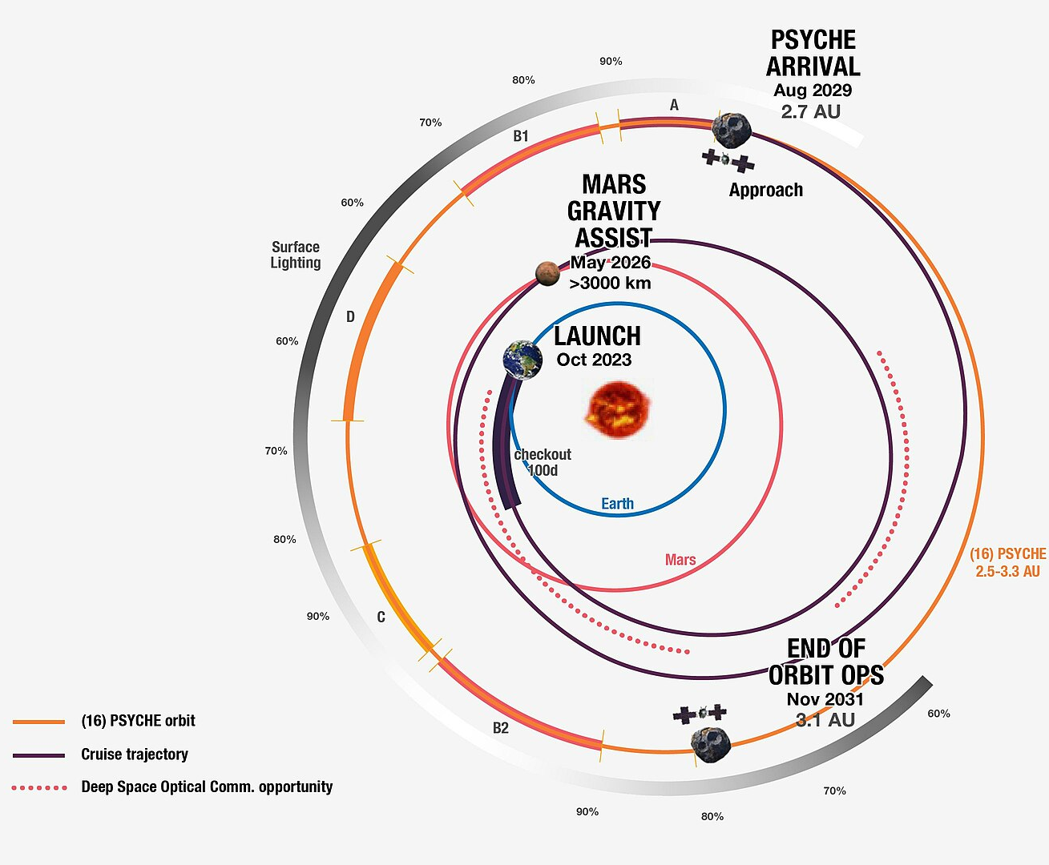
Psyche
Despite having a solar electric propulsion system, we were unable to find a trajectory that redirects Psyche to 2024 PDC25.
Jet Propulsion Laboratory, NASA - https://www.jpl.nasa.gov/images/pia24930-psyches-mission-plan

Slide 6
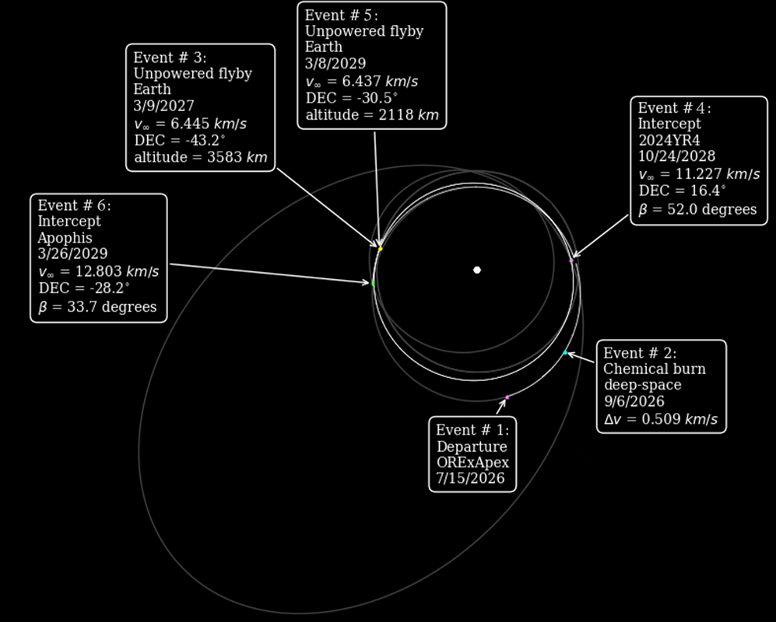
Two Other Scenarios
Interagency Table Top Exercise 5
  OSIRIS-APEX, Lucy, and Psyche could all achieve flybys of the hypothetical asteroid
2024 YR4
  No longer hypothetical
  OSIRIS-APEX could achieve a flyby of 2024 YR4, and still achieve a flyby of Apophis near the Apophis Earth encounter.
OSIRIS-APEX for 2024 YR4

Slide 7
Conclusions
Retasking existing spacecraft is a relevant tool in the rapid reconnaissance toolbox.
  Most useful in a highly constrained timeline
In each case, the spacecraft reached the asteroid via retargeted Earth gravity assists.
Trajectory reachability is a necessary but not sufficient condition for a feasible reconnaissance approach.
  For example, a repurposed rendezvous spacecraft may have limited GNC and measurement capabilities for a high-speed flyby.
Retasking a spacecraft forgoes most, if not all, of its original mission.
Decision-makers would need to weigh these considerations when choosing to retask vs build and launch a dedicated spacecraft.

Slide 9
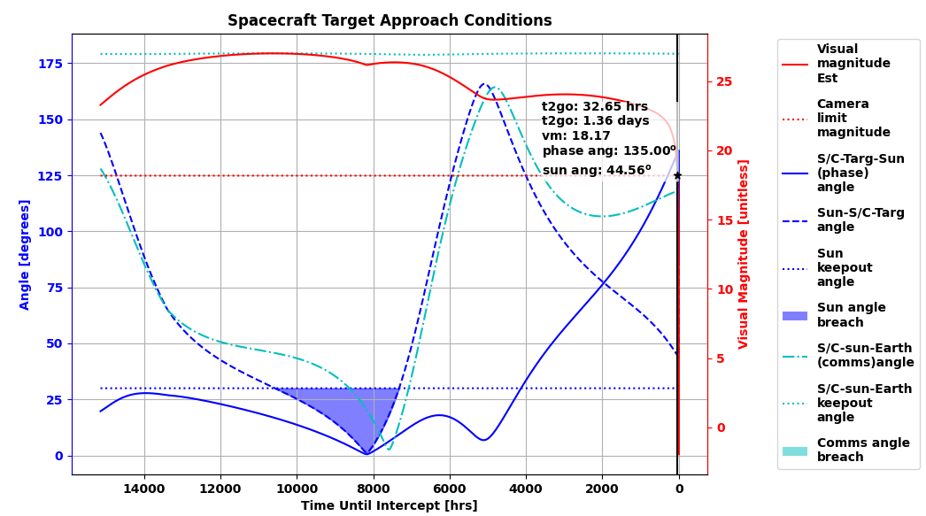
Lucy L’LORRI Expected Performance
75th Percentile Asteroid

Slide 10
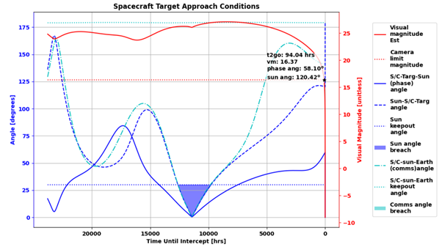
OSIRIS-APEX PolyCam Expected Performance
50th Percentile Asteroid

