Slide 1
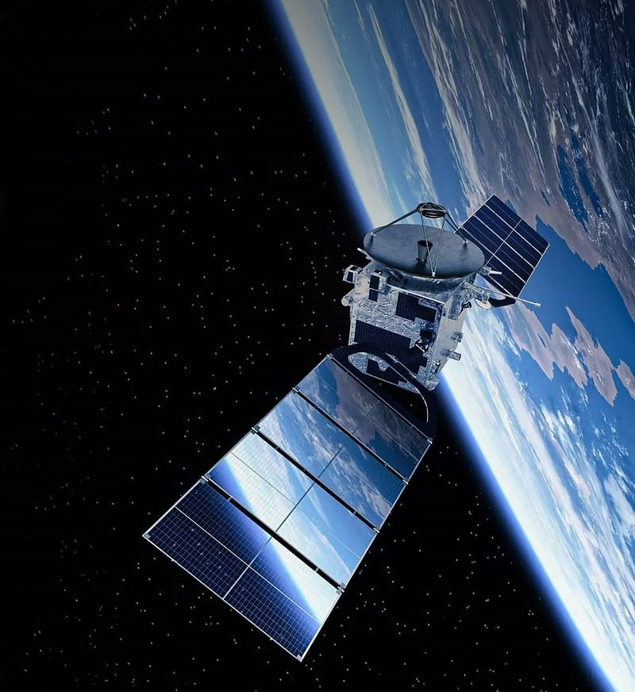

The effect of Apophis on GEO satellites
Dr Marta Ceccaroni m.ceccaroni@cranfield.ac.uk
Miriam Martinez
Nicolo’ Stronati
06/04/2025

Slide 2

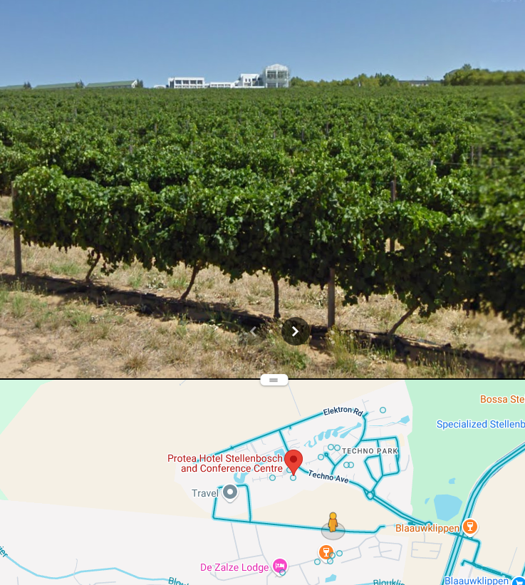
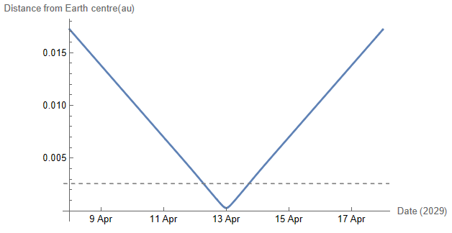
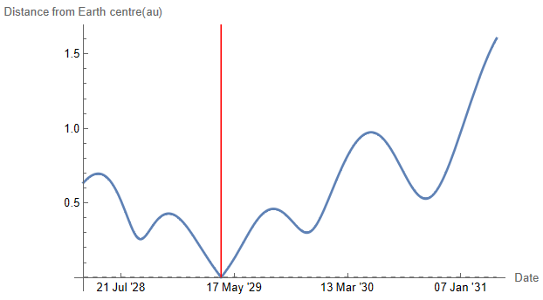
Apophis
You are here
Diameter 375 m
Weight: 1/4 mount Everest
In risk list for > 15 years
Passing by on April 13th 2029, 21:45 UTC
Min possible distance with Earth 37893.14 km
Moon
375 m

Slide 3





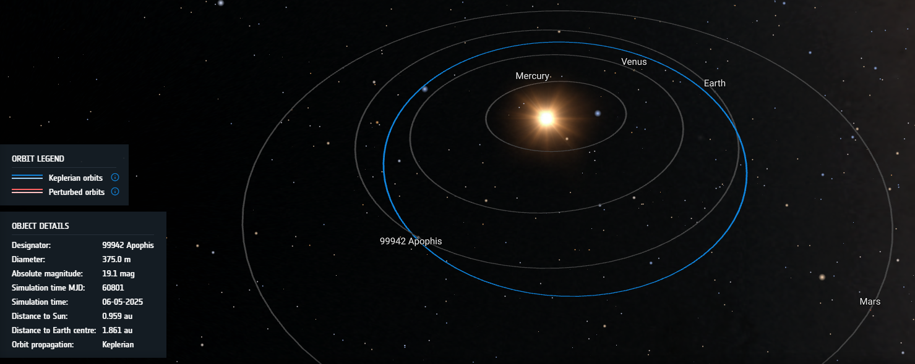
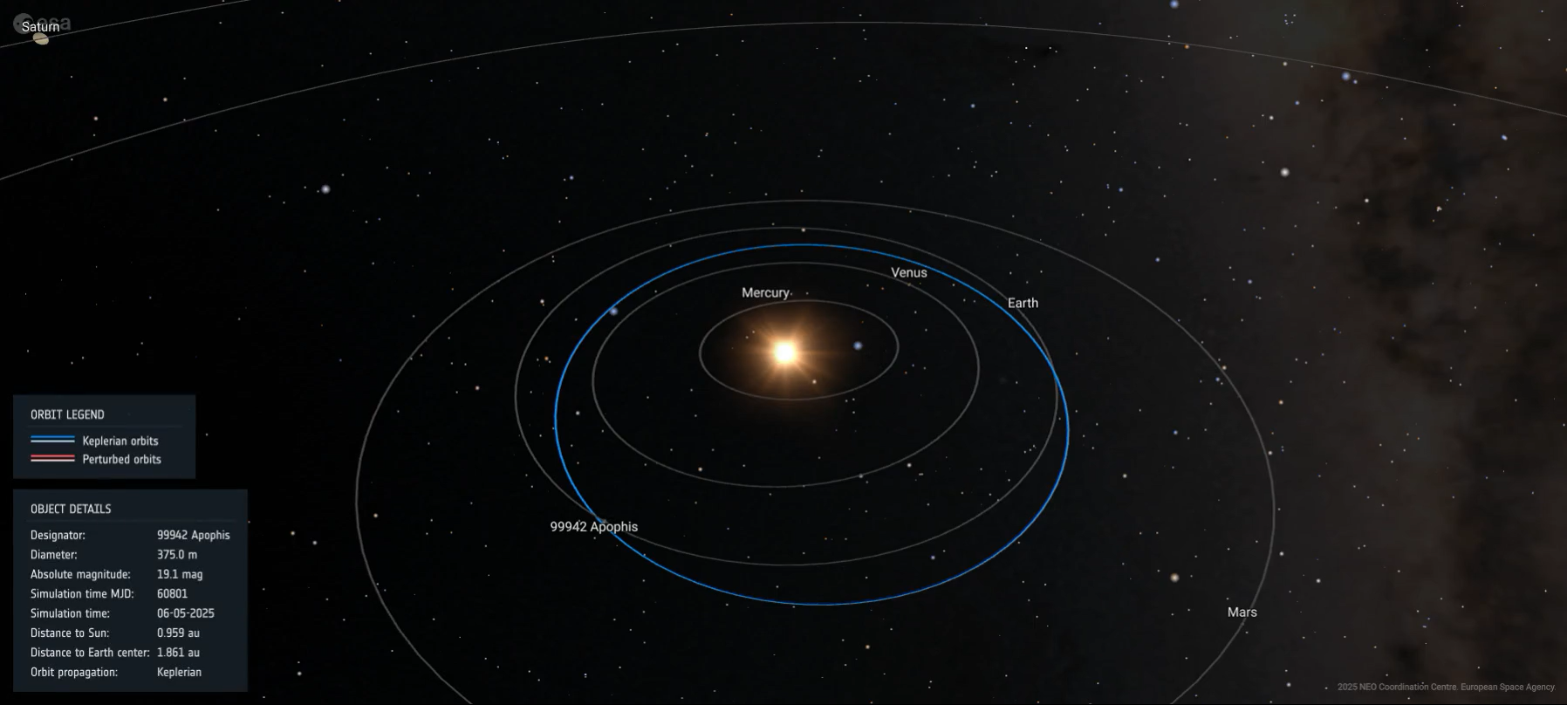
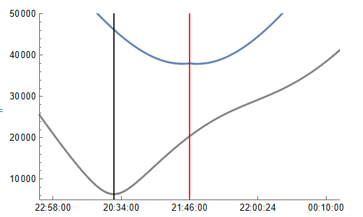
Where is it today?
~ 2 au from Earth
km
Distance from Earth
Distance from GEO
Time
13/14 Apr 2029
NEOCC Orbit Visualisation Tool

Slide 4

What about our satellites?
10 400 active satellites (December 2024)
580 to 800 active satellites in Geostationary Earth Orbit (GEO) (April 2025)
These account for most of the revenue from commercial space services.

Slide 5
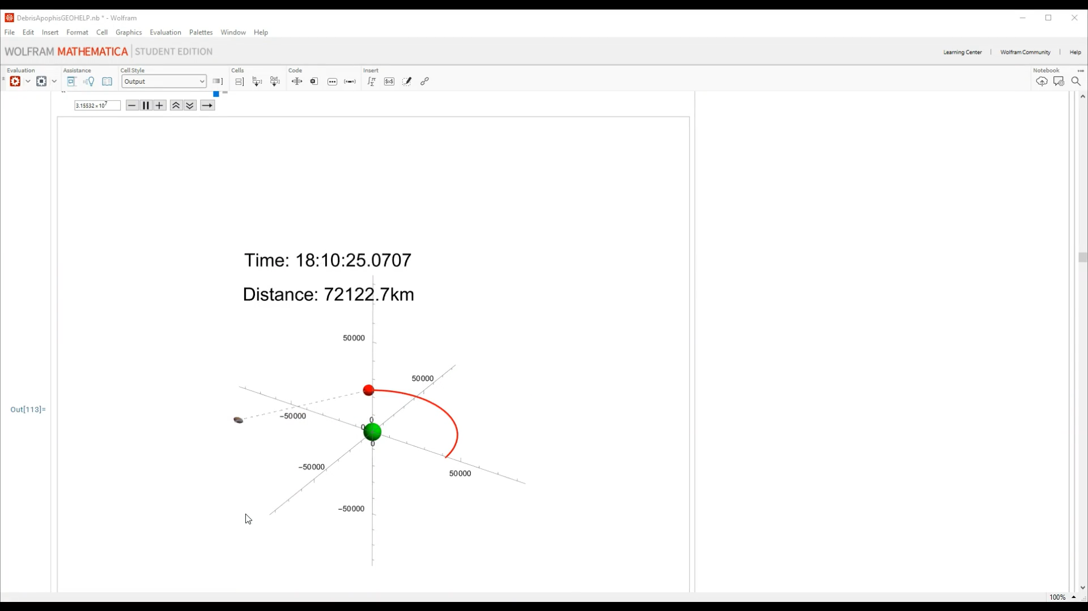
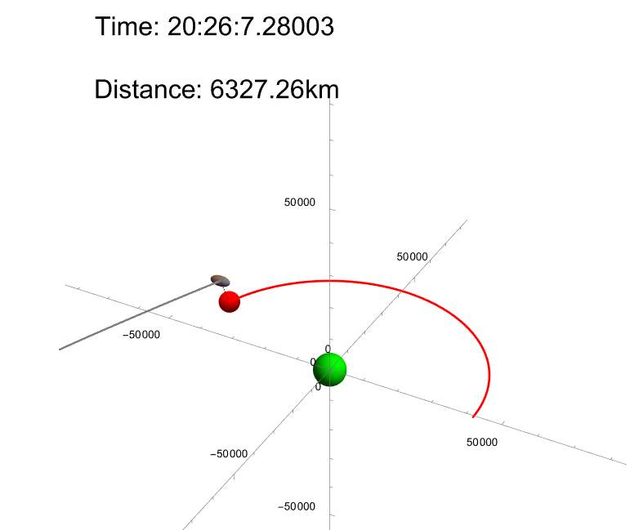
What about our satellites?
GEO: MOID 6327.264 km (20:27:07 UTC)
km
Distance
from Earth
km
Distance from Earth
Distance from GEO
Distance from GEO
Time
Time
13/14 Apr 2029
13/14 Apr 2029

Slide 6
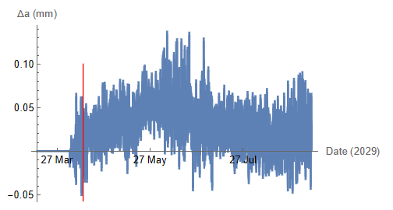
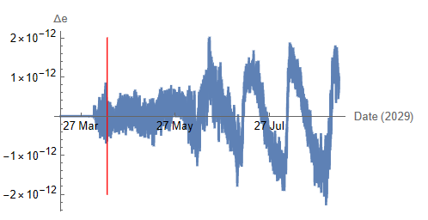
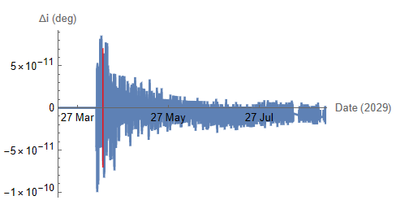
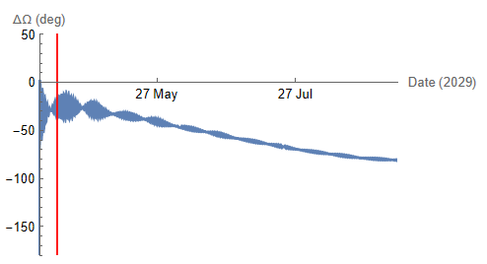
Apophis effect on GEO (Keplerian elements)
Semimajor axis Eccentricity
Inclination RAAN

Slide 7
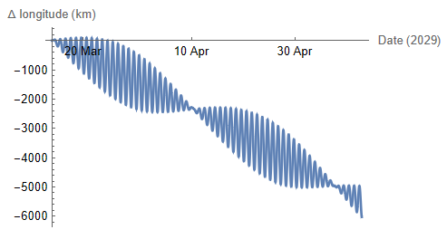
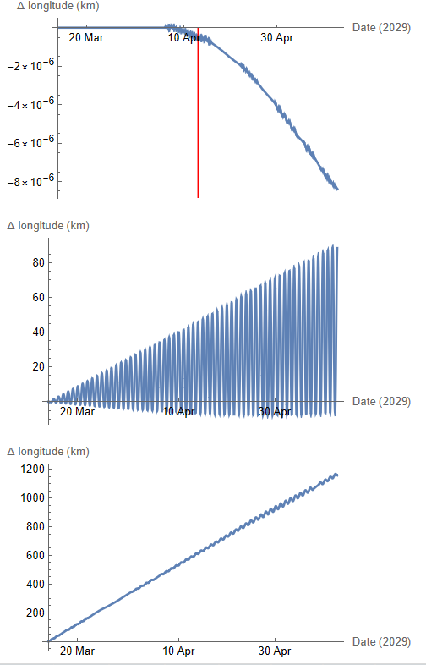

East-West drift (km)
Moon Non-sphericity ($J_{2}$ , $C_{2,2}$, $S_{2,2}$)
SRP Apophis

Slide 8
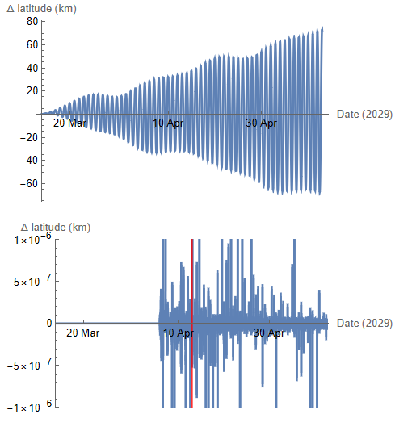
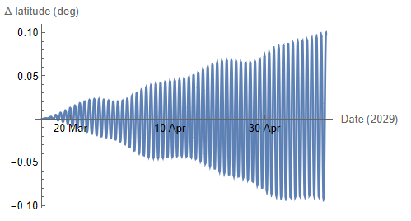
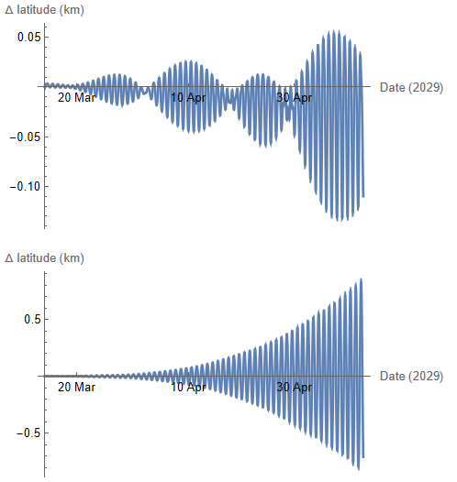
North-South drift
Moon Non-sphericity ($J_{2}$ , $C_{2,2}$, $S_{2,2}$)
SRP Apophis

Slide 9
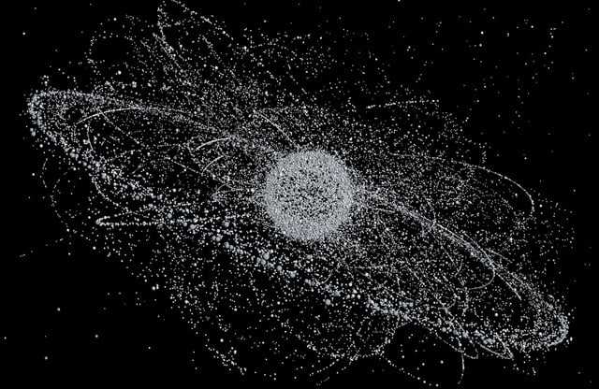
GEO debris
Tracked objects 1 m and above:
>1000
Most classified as “Large”
Estimated untracked objects
10 cm and above: thousands
Every known debris orbiting Earth… 12 yrs ago

Slide 10
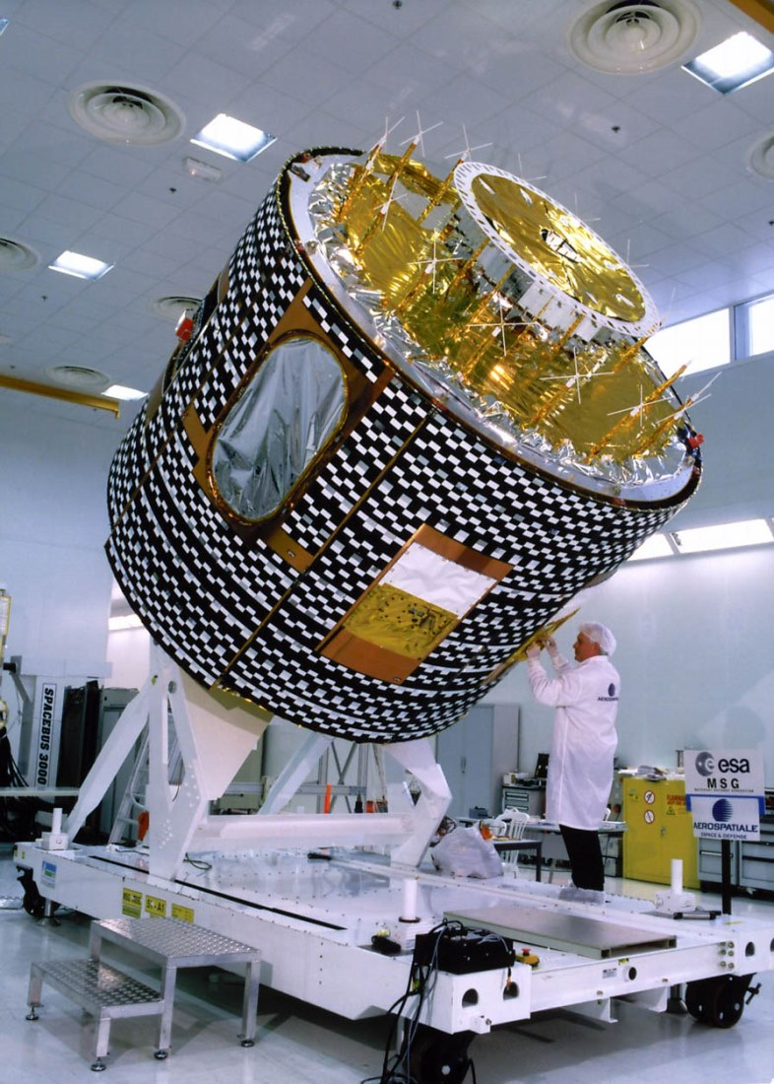
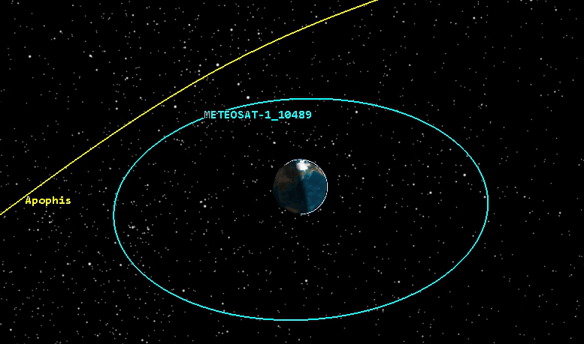
METEOSAT 1 (1977-1984)
Diameter 2.16 m
Height 3.195 m
Mass 282 km

Slide 11
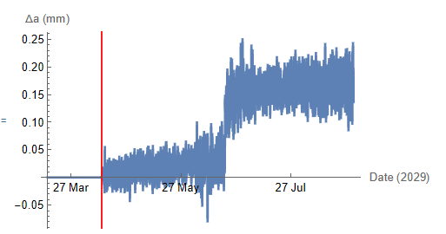
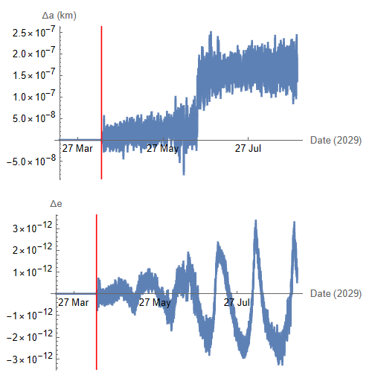
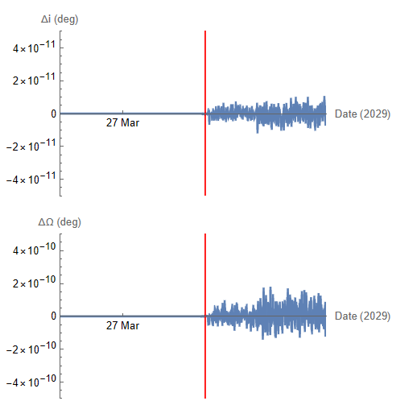
METEOSAT 1 Keplerian elements (uncontrolled orbit)
Semimajor axis Eccentricity
Inclination RAAN

Slide 12
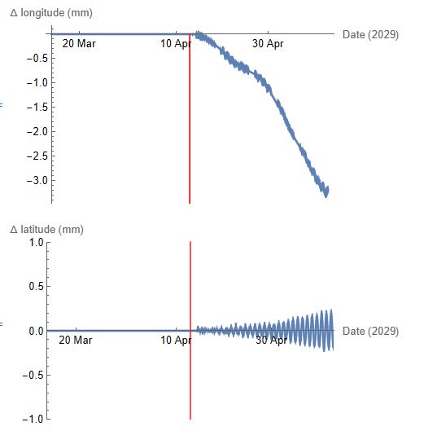
METEOSAT 1 Drift (uncontrolled orbit)
E-W N-S

Slide 13
Close Approach geometry
Geometry and relative velocity change the effects of close approaches
Parallel close approach geometries amplify effects

Slide 14
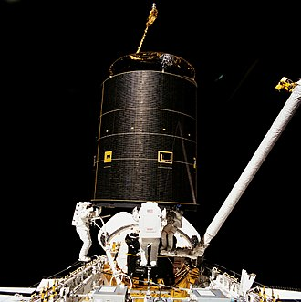
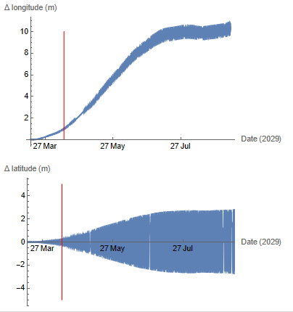
Intelsat 603 (1990- 2015)
Mass 4.2 kg
Height 5.2 m
E-W
N-S

Slide 15

Conclusions
Effects << SRP, non-sphericity, Luni-solar perturbations
Main disturbance on RAAN
Irrelevant $∆$v for station keeping of active satellite
To be taken into account for collision avoidance for peculiar Debris geometries

Slide 16
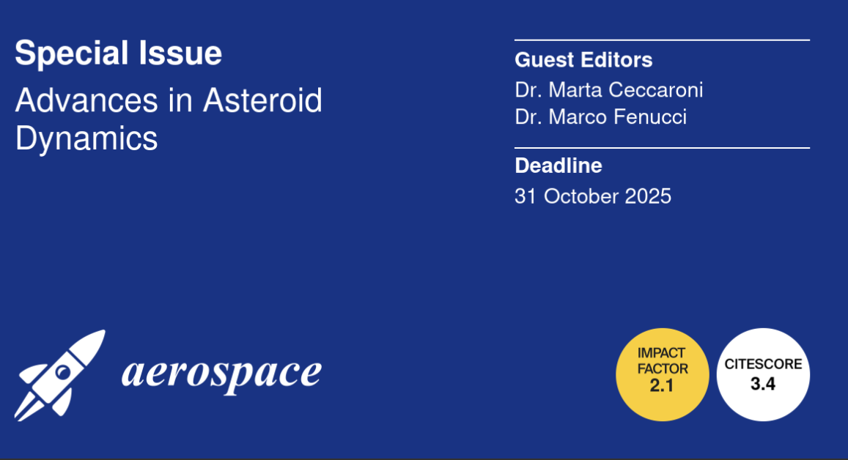
Thank you!

Slide 17
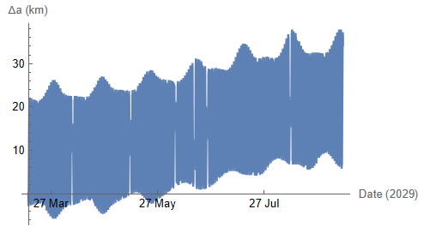
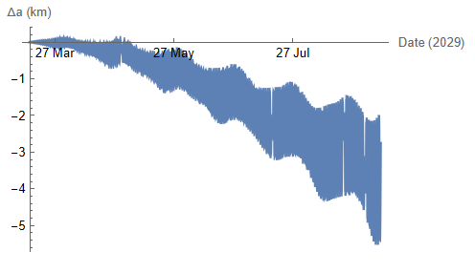
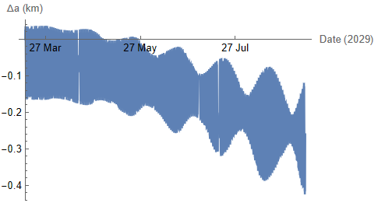

Sun-Earth-S/C VS perturbation (Semimajor axis)
Moon Non-sphericity ($J_{2}$ , $C_{2,2}$, $S_{2,2}$)
SRP Apophis

Slide 18
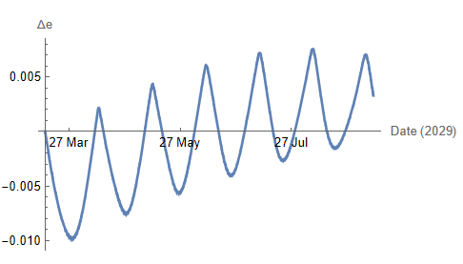
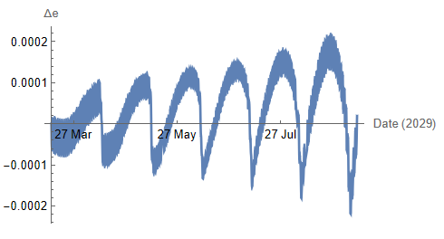
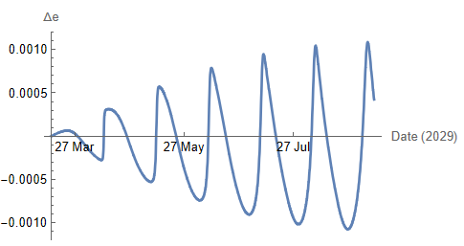
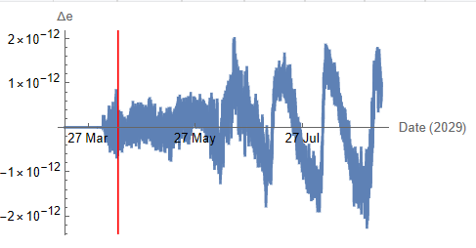
Sun-Earth-S/C VS perturbation (eccentricity)
Moon Non-sphericity ($J_{2}$ , $C_{2,2}$, $S_{2,2}$)
SRP Apophis

Slide 19
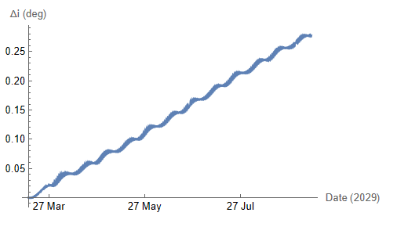
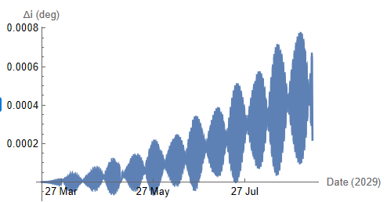
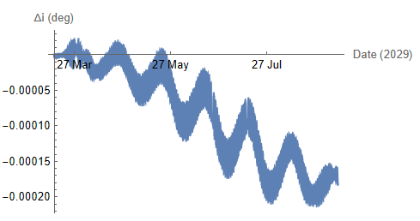
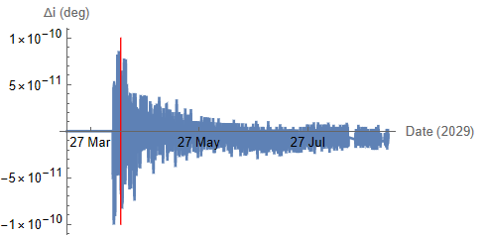
Sun-Earth-S/C VS perturbation (inclination)
Moon Non-sphericity ($J_{2}$ , $C_{2,2}$, $S_{2,2}$)
SRP Apophis

Slide 20
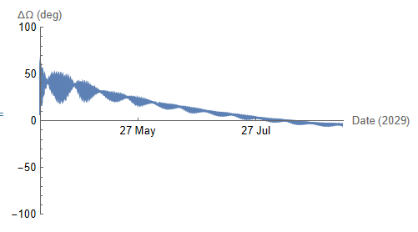
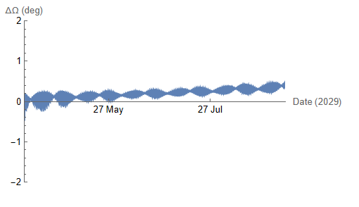
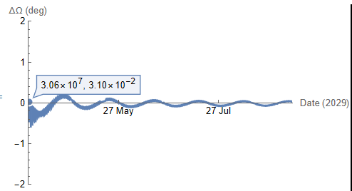
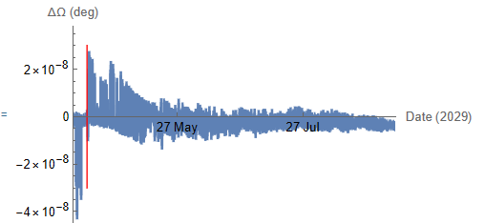
Sun-Earth-S/C VS perturbation (RAAN)
Moon Non-sphericity ($J_{2}$ , $C_{2,2}$, $S_{2,2}$)
SRP Apophis

Slide 21
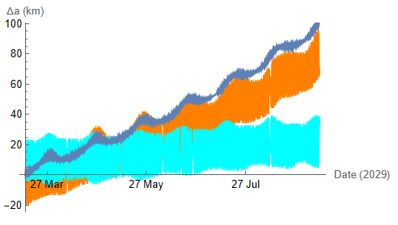
Sun-Earth-S/C VS perturbation (semimajor axis)
Luni-Solar
Luni-Solar
Sun
Moon

Slide 22
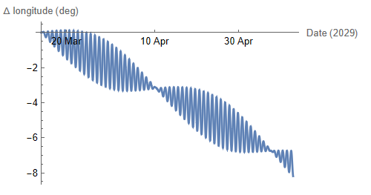
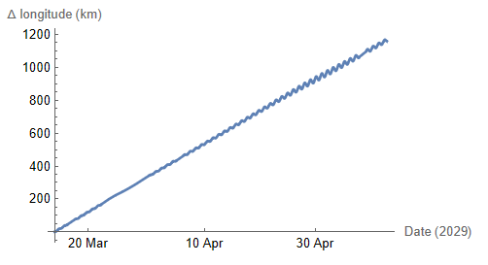
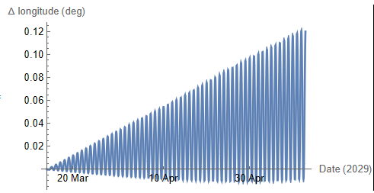
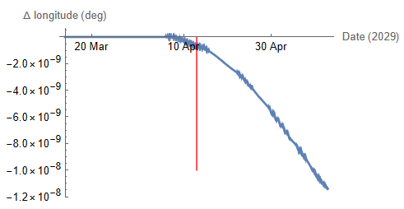
East-West drift
Moon Non-sphericity ($J_{2}$ , $C_{2,2}$, $S_{2,2}$)
SRP Apophis

Slide 23
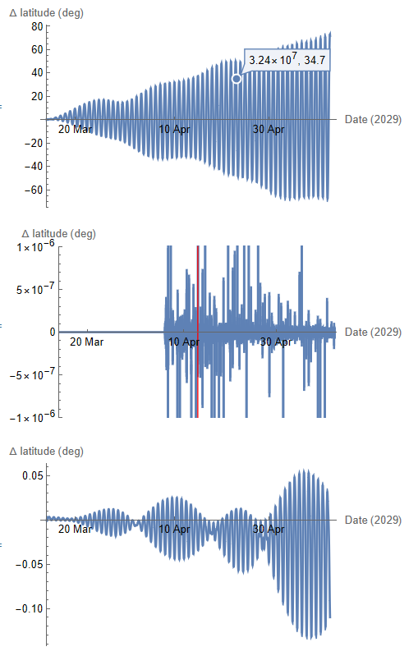
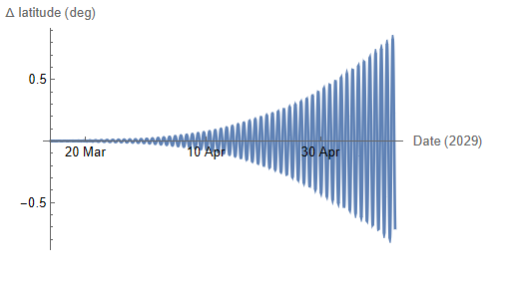
North-South drift (km)
Moon Non-sphericity ($J_{2}$ , $C_{2,2}$, $S_{2,2}$)
SRP Apophis

Slide 24

Inmarsat drift

Slide 25

Intelsat 603 (1990- 2015)
Mass 4.2 kg
Height 5.2 m

