Slide 1
Asteroid-induced climate coupled cascading hazards along an asteroid risk corridor.
T. Titus, D. Robertson, L. Mastin, and L. Morton
This information is preliminary and is subject to revision. It is being provided to meet the need for timely best science. The information is provided on the condition that neither the U.S. Geological Survey nor the U.S. Government shall be held liable for any damages resulting from the authorized or unauthorized use of the information.

Slide 2
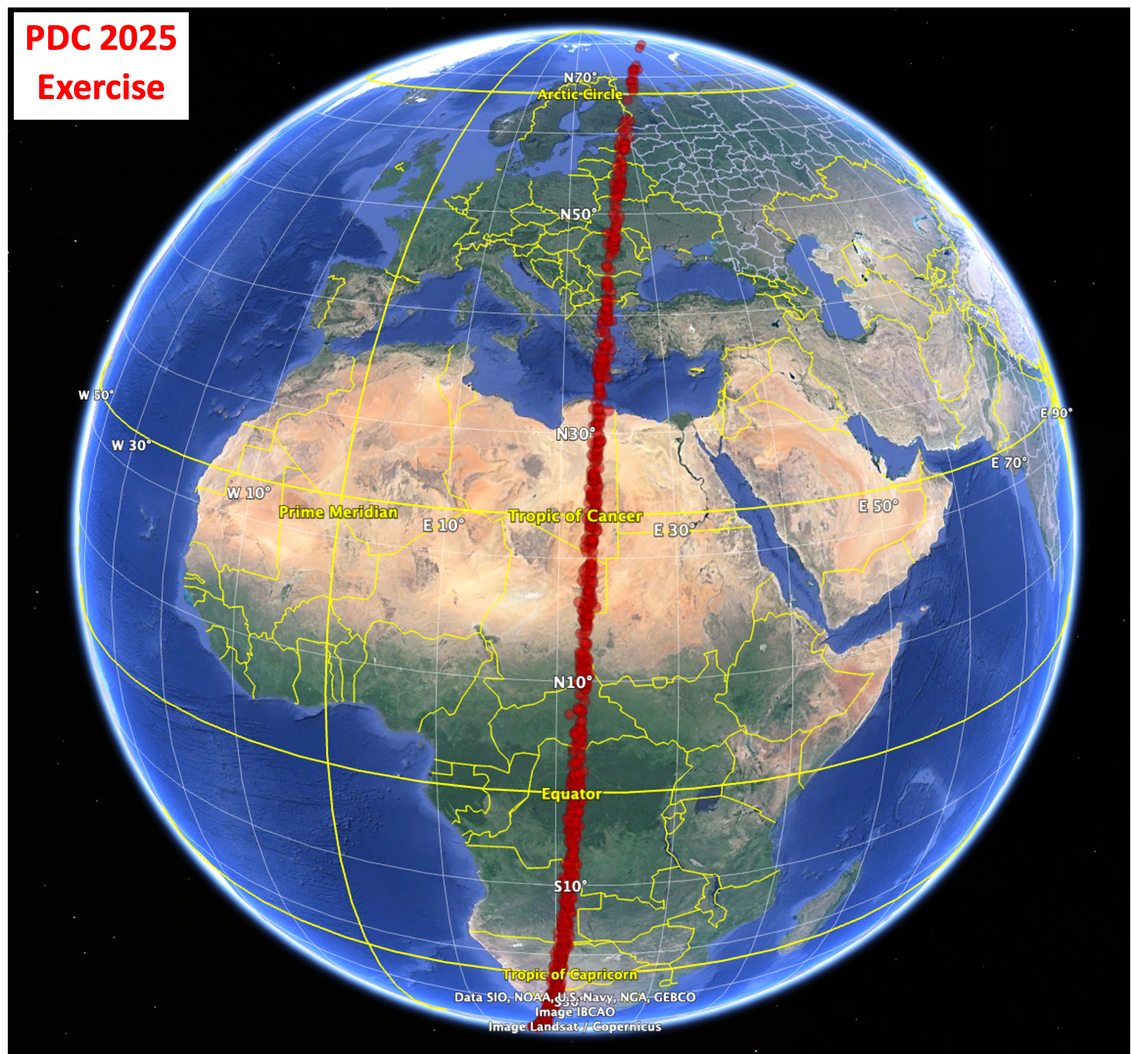
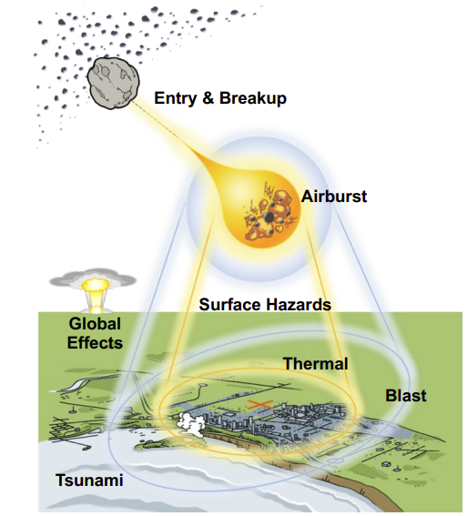
Introduction: Risk corridor and initial effects
Source: Planetary Defense Conference Exercise - 2025
Credit: Modified from Wheeler/ATAP NASA Ames

Slide 3
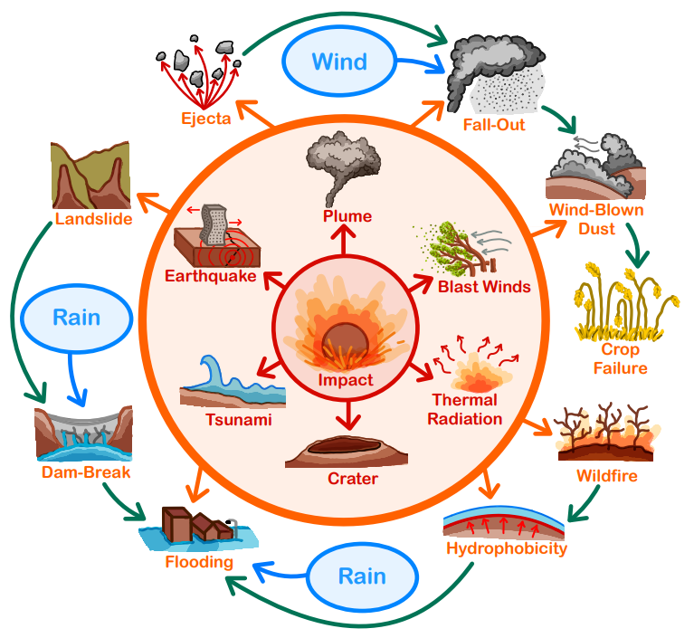
Cascading Hazards: Driven or triggered by a weather event
As if the initial effects aren’t bad enough!
Example of a cascading hazard:
Wildfires → Hydrophobic Soil
Heavy Rains → Excess Runoff
→ Debris Flows + Flooding
Types of cascading hazards to consider:
Downstream (months to years)
Downwind (hours to days)
Credit: Morton+ 2025
Do cascading hazards matter for this size of an event?
Can we evaluate the entire risk corridor?

Slide 4
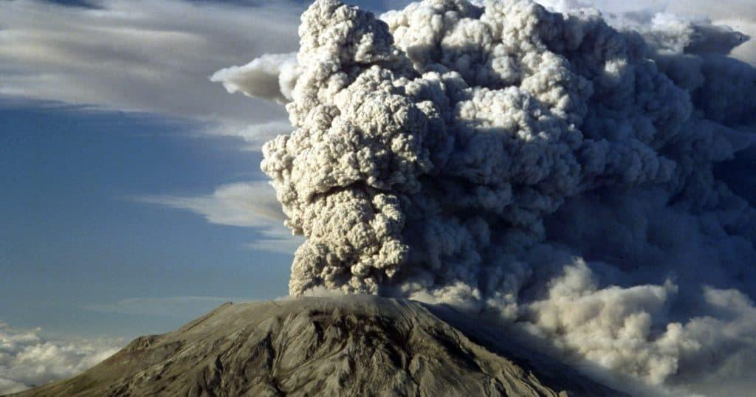
Approach: Use volcanic eruptions as an analog for fallout
Mount St. Helens sends a plume of ash into the air.
Image Credit: Jack Smith/AP
Ash3D: USGS software
Suite of 1760 model runs
Ash3d Volcanic Ash Dispersion Model
Mount St. Helens scaled to event.
USGS Ash3d
8 Lofted mass
10 Years on the same date/time
22 Locations along risk corridor
Notes:
Mount St. Helens Eruption of 1980 with Photos & Video - Historic Mysteries

Slide 5
2 cases considered:
Worst case scenario
99 percentile event
More likely case scenario
(Order of magnitude less lofted mass)
Diameter: 233 m
Mass (Asteroid): 15.4 x 10⁹ kg
Mass lofted: 25 x 10⁹ kg
Fraction lofted: 162%
Incudes impact ejecta plume
Serious damage: 164.9 km
Diameter: 131 m
Mass (Asteroid):
Mass lofted: 2.5 x 10⁹ kg
Fraction lofted: 100%
Serious damage: 80.5 km

Slide 6
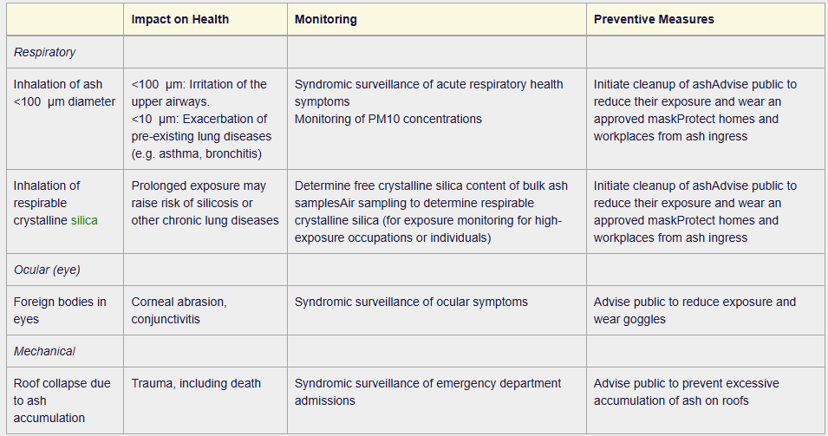
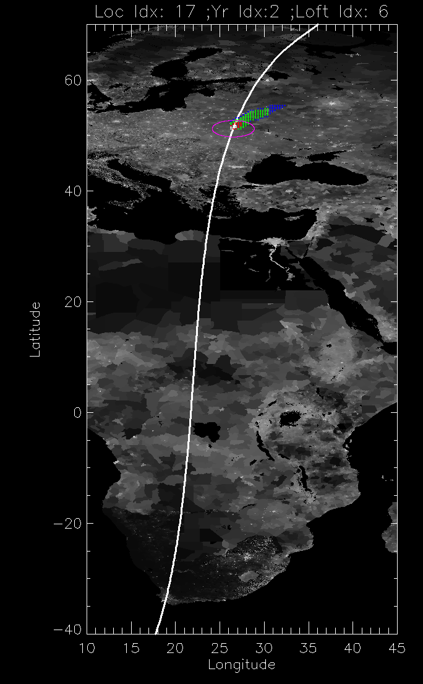
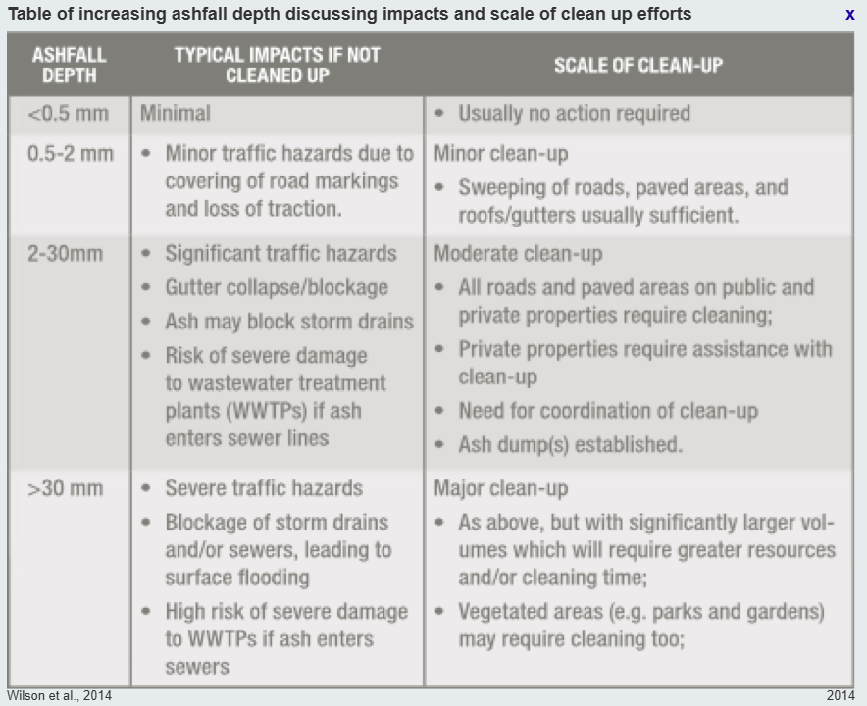
Metrics – Volcano ash deposition threat
Legend for next few slides
Background map: Logarithm of the population with risk corridor identified
Magenta ellipse: radius of the severe damage zone
Blue & Green: Suspension/no cleanup
Red: Suspension & mild cleanup
White (Black in plots): Suspension & moderate cleanup

Slide 7
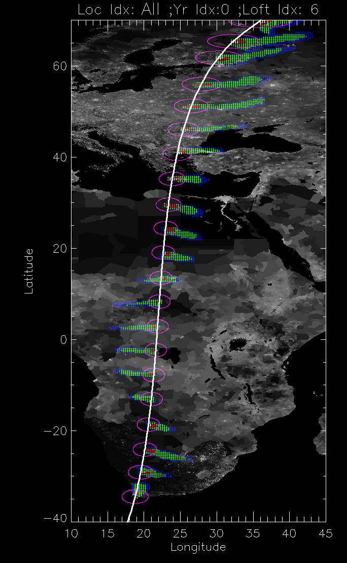
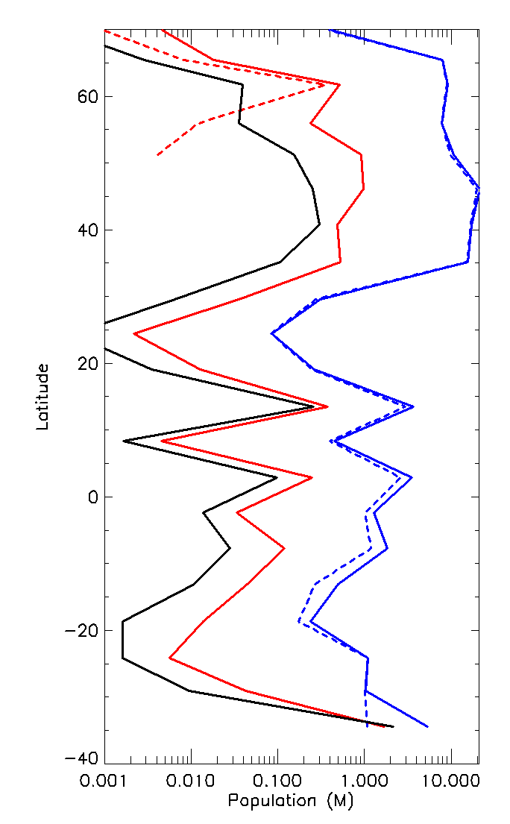
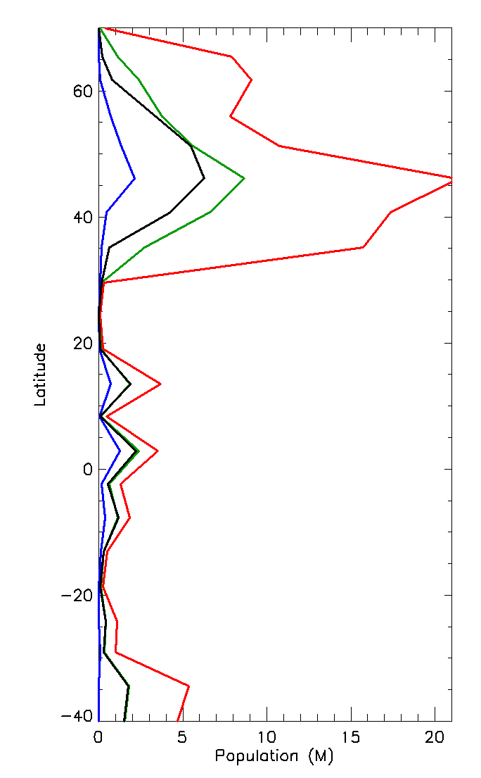
Expected dust fallout from the worse case scenario.
Maximum population exposed
Population stats from outside zone
Dashed lines: Pop Outside Damage Zone
Solid lines: Total Pop
Suspension Hazard
Maximum
Mean
Median
Minimum
Minor Cleanup
Suspension
Moderate Cleanup
Notes:
Worse case scenario. Dashed lines are outside the damage zone

Slide 8
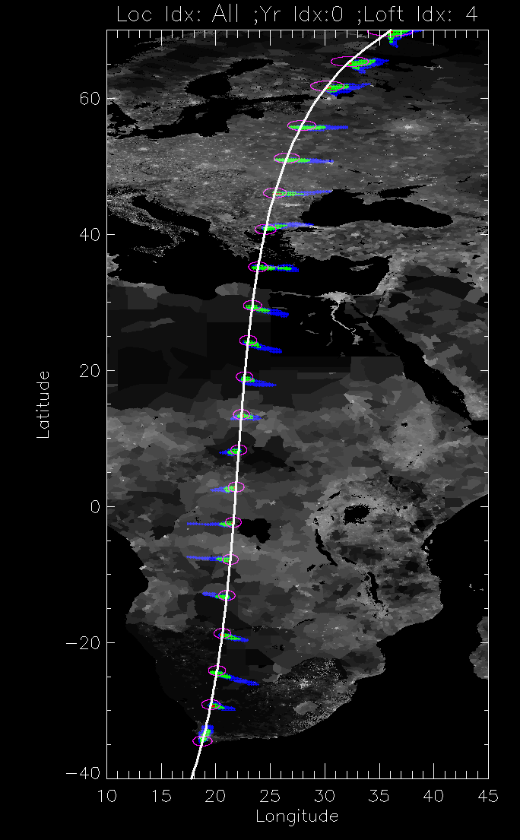
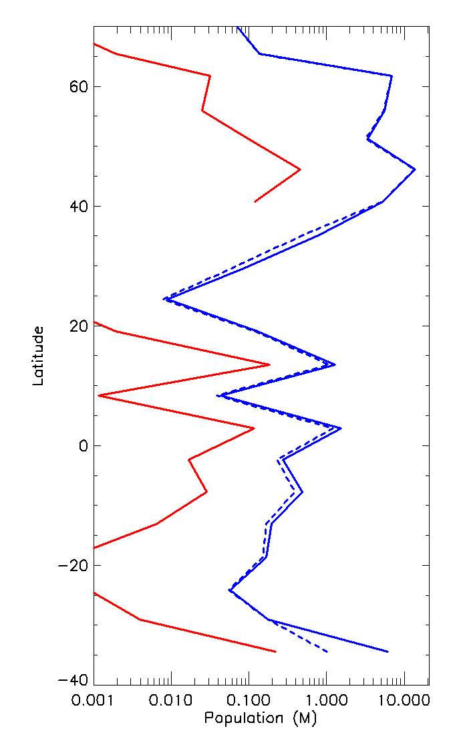
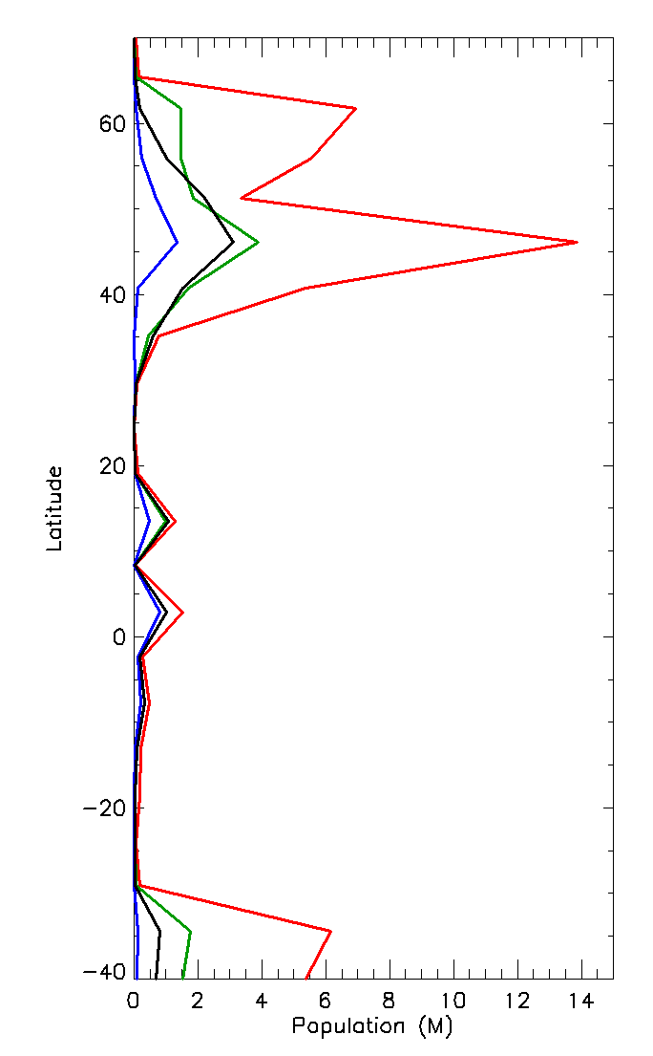
Most likely case for dust fallout
Maximum population exposed
Population stats from outside zone
Dashed lines: Pop Outside Damage Zone
Suspension Hazard
Maximum
Mean
Median
Minimum
Notes:
More likely case scenario.

Slide 9
Summary
Results
Next Steps
Mild and moderate clean-up efforts nearly always contained in serious to unsurvivable damage zones
Outside of the > 1 psi damage zone, respiratory issues, limited visibility.
Extended shelter-in-place and the use of masks
Improve estimates for lofted mass based on asteroid properties and hydrodynamics
Identify “rule of thumb” thresholds for downwind hazards as a function of lofted mass

