Slide 1







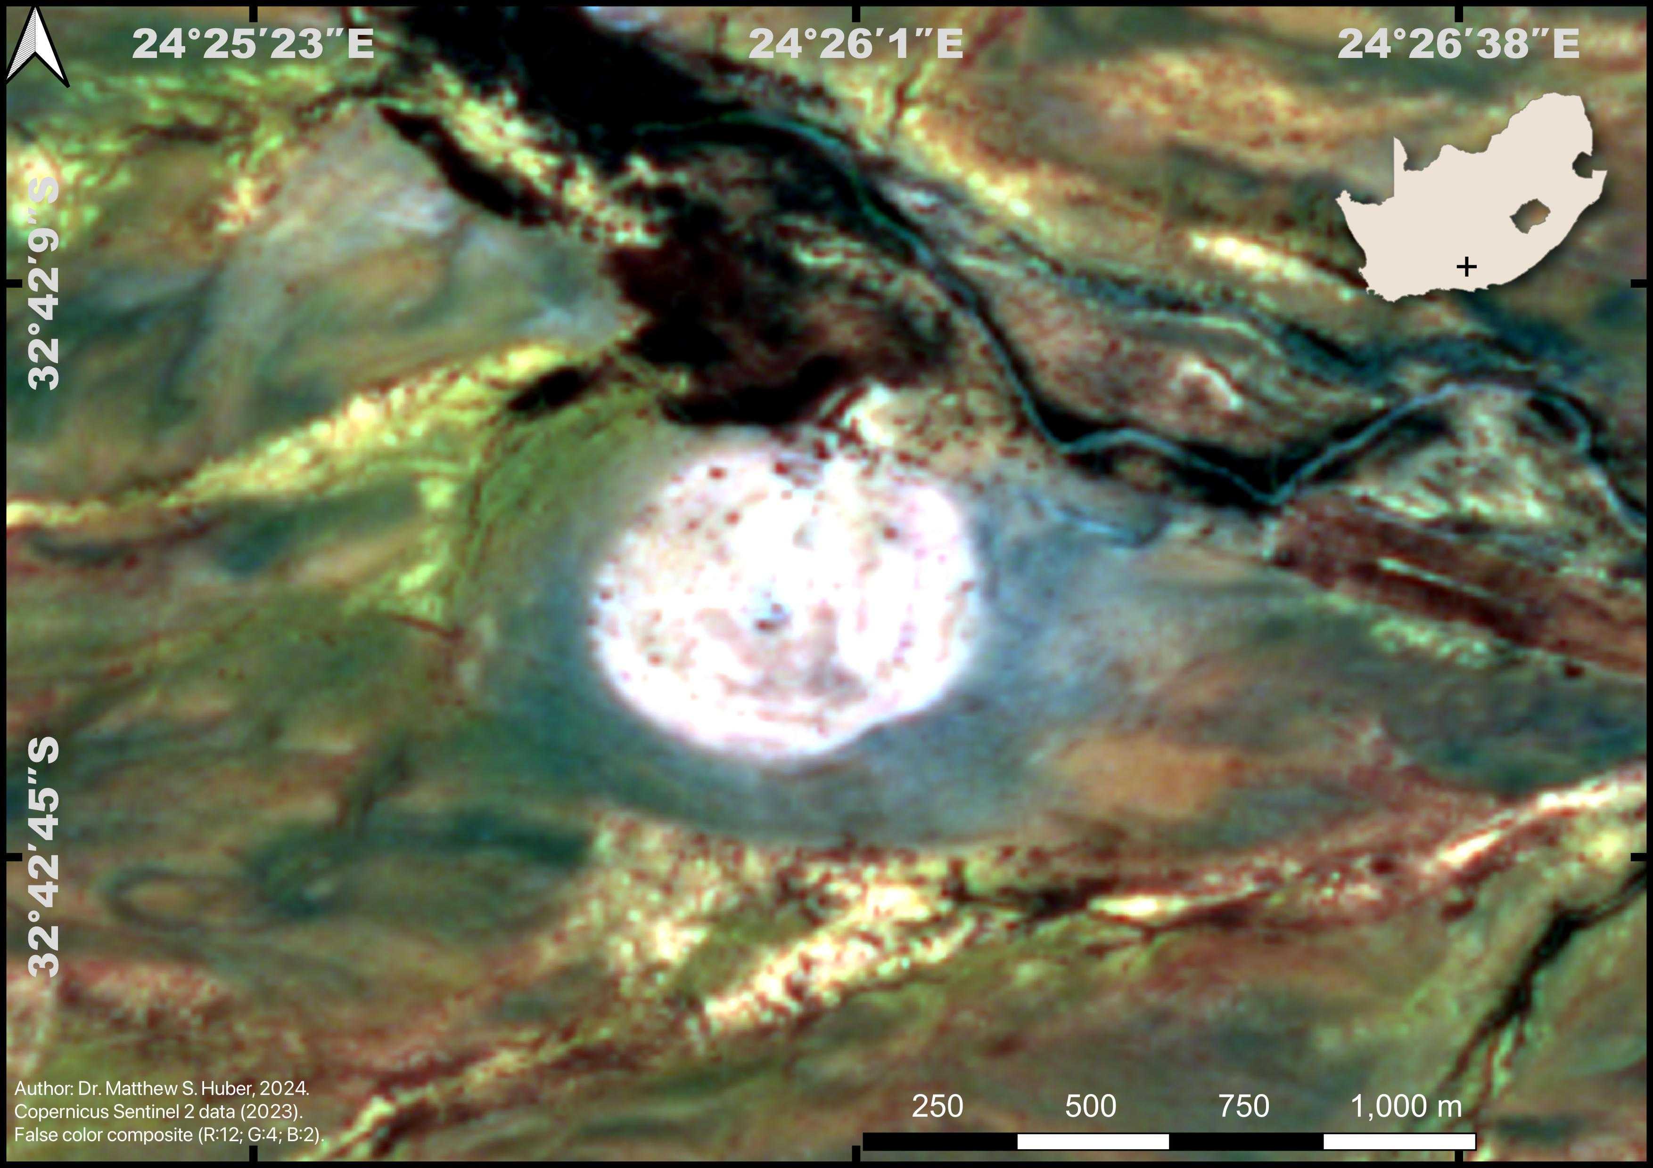
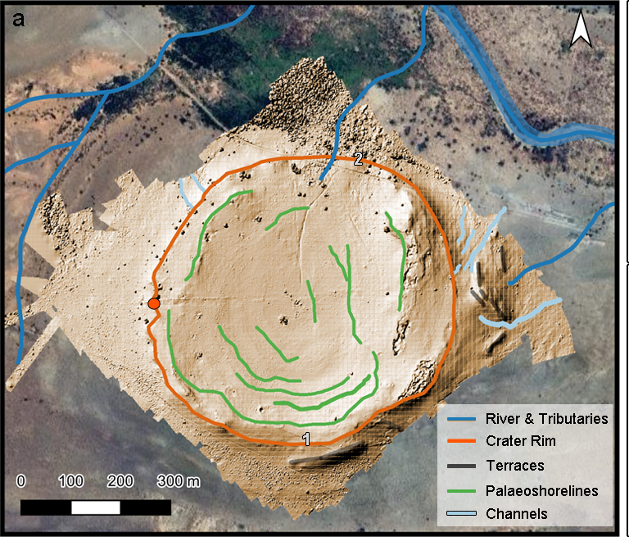
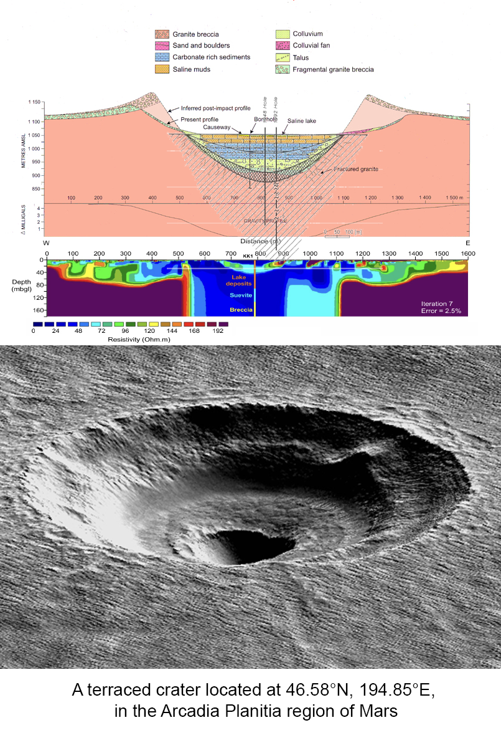
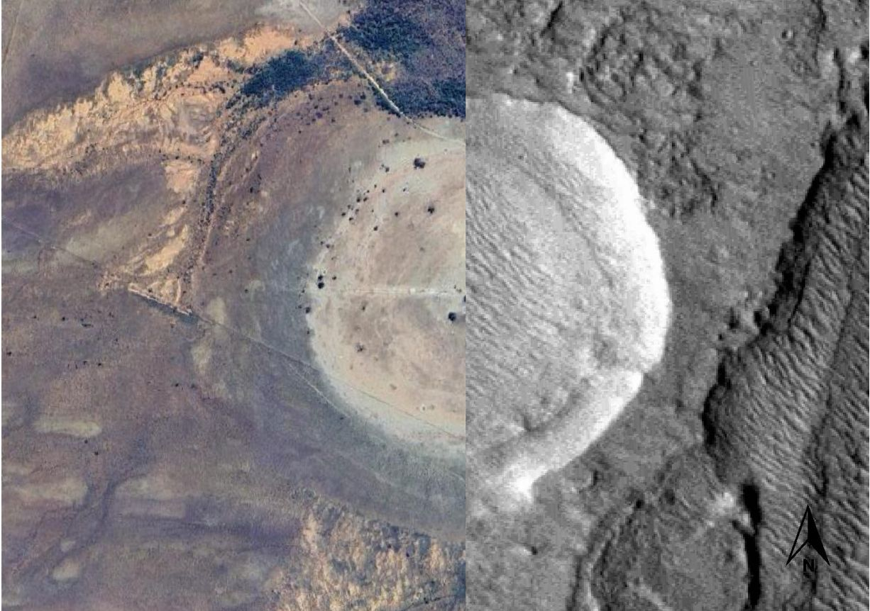
New evaluation of the morphology
of the Kalkkop Crater, South Africa
Matthew S. Huber ⁽¹⁾⁽²⁾, Francois Fourie⁽³⁾, Kelly Kirsten⁽⁴⁾⁽⁵⁾⁽⁶⁾, Jan van der Walt⁽⁷⁾, and Robyn Pickering⁽⁵⁾⁽⁶⁾
⁽¹⁾ Planetary Science Institute, Tucson, AZ, 85719-2395, USA ⁽²⁾ University of KwaZulu Natal, Durban, 54001, South Africa ⁽³⁾ Institute of Groundwater Studies, University of the Free State, Bloemfontein, 9300, South Africa ⁽⁴⁾ School of Energy, Construction and Environment, Coventry University, Coventry, United Kingdom ⁽⁵⁾Department of Geological Sciences, University of Cape Town, Rondebosch, South Africa ⁽⁶⁾ Human Evolution Research Institute (HERI), University of Cape Town, Rondebosch, South Africa ⁽⁷⁾ Geo Electrical Consulting (GEC), 92 Rauch Avenue, Georgeville, Pretoria, South Africa
1
2
The Kalkkop Crater in the Eastern Cape, near Graaff Reinet. The crater has long been considered the smallest of the four South African impact craters. The surface expression of the crater includes the carbonate lake sediments, seen here in white, and the surrounding disturbed sediments that are concealing breccias formed during the disruption of the impact. This image is constructed from Sentinel imagery, using bands 12, 4, and 2 to give a false-color indication of the surface expression of the crater.
A high-resolution DEM of the modern morphology that we acquired through drone imagery allows for a clear picture of the uplift along the edges of the lake sediments, but also shows how the surrounding disturbed sediments are obscured in their modern expression. Earlier workers apparently did not consider the zone around the lake sediments to be significant for understanding the original crater morphology.
3
4
Early reconstructions of the crater based on drilling in the 1940’s (for oil and gas exploration) considered the crater to be simple in morphology, with a basic bowl shape that has since been eroded (Blignault et al., 1948; Haughton et al., 1953). We wanted to test this model and image the subsurface. The core logging suggested that the basement was encountered at a depth of 300 m. Figure after Reimold et al. (1998).
Blignault, J. J. G., Rossouw, P. J., de Villiers, J. and Russell, H. D. 1948. The Geology of the Schoorsteenberg Area, Cape Province. Geological Survey of South Africa, Explanation of Sheet No. 166, 48p. Government Printer, Pretoria.
Haughton, S. H., Blignault, J. J. G., Rossouw, P. J., Spies, J. J. and Zagt, S. 1953. Results of an investigation into the possible presence of oil in Karoo rocks in parts of the Union of South Africa. Geological Survey South Africa Memoir 45, 90-92.
Reimold, W.U., Koeberl, C. and Reddering, J.S., 1998. The 1992 drill core from the Kalkkop impact crater, Eastern Cape Province, South Africa: stratigraphy, petrography, geochemistry and age. Journal of African Earth Sciences, 26(4), pp.573-592.
To understand the subsurface of the crater, we used electrical resistivity tomography (ERT) and audio magnetotelluric (AMT) techniques to get a geophysical understanding of the subsurface. Surprisingly, the morphology of the crater is totally unlike the earlier models. The crater floor is not apparent at the expected 300 m depth, and the area surrounding the central portion of the crater has a peculiar profile, with flanks that are much lower resistivity than the host rocks of the Karoo Supergroup. These features are inconsistent with the simple crater morphology that was proposed earlier, and more likely to be related to a terraced crater morphology.
5
6
The morphology of the Kalkkop Crater is best described as terraced.
The previous estimate of <1 km diameter did not take into account the structural surroundings.
The true diameter of Kalkkop is closer to 1.6 km, making it larger than the Tswaing crater.
The Kalkkop Crater is a potential analogue for Martian terraced craters.
Kalkkop
Martian Terraced
Crater

