Slide 1
Spheral Simulations of the Atmospheric Entry and Energy Deposition of PDC25 Threat Scenario Asteroids
IAA Planetary Defense Conference 2025
Stellenbosch, Cape Town, South Africa
May 5-9, 2025
Evan Bjonnes
Jason M. Pearl, Kathryn M. Kumamoto, J. Mike Owen

Slide 2
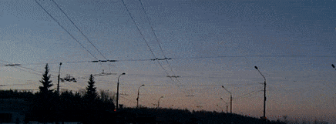
Overview
Atmospheric airbursts can have dire consequences for Earth, from the generated shockwave in the air and from any meteoritic material that strikes the surface
Several factors affect how an incoming asteroid will interact with Earth’s surface and atmosphere:
Incoming angle
Asteroid size
Asteroid material properties
Coherent rock vs rubble pile asteroid
Porosity
Degree of metal content
2013 Chelyabinsk Airburst, from Wikipedia.org

Slide 3
Bolide Parameter Model Space
2025 PDC Hypothetical Asteroid Impact Scenario Epoch 1 Parameters
Physical Property | 5th Percentile | 50th Percentile | 95th Percentile | 100th Percentile
Diameter (m) | 77.09 | 127.05 | 191.17 | 277.84
Bulk Density (g/cm3) | 1.886 | 2.062 | 2.417 | 2.794
Porosity | 0.443 | 0.4 | 0.245 | 0.2
Mass (kg) | 4.5246E+08 | 2.2142E+09 | 8.8424E+09 | 3.1376E+10
Surface Escape Velocity (cm/s) | 3.958 | 6.821 | 11.112 | 17.364
Absolute Magnitude | 22.398 | 21.773 | 21.345 | 21.438
Albedo | 0.326 | 0.214 | 0.14 | 0.061
Taxonomic Type | S | S | S | S

Slide 4
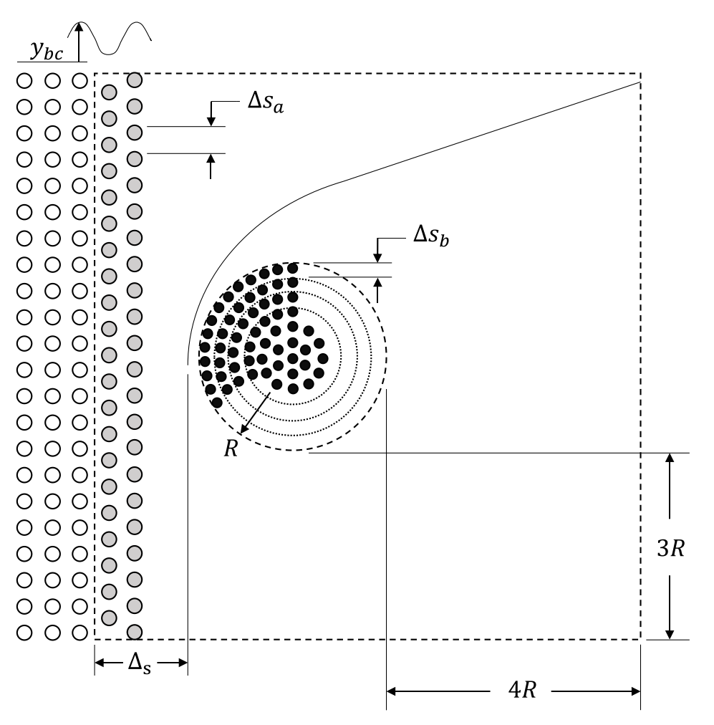
Spheral Model Setup
We use Spheral++, our Lagrangian smooth particle hydrodynamic code with Fluid-Solid Interface SPH (FSISPH) implementation
Model space is set up with designated bolide properties (size, density, strength, etc) and surrounding air particles
As time progresses, Spheral advances air to the right, simulating bolide motion to the left
Incoming air properties (temp, density) calculated according to prescribed atmospheric conditions and entry angle
Model Space
Bolide
“Incoming” Air
Initialized Air
From Pearl et al, 2023

Slide 5
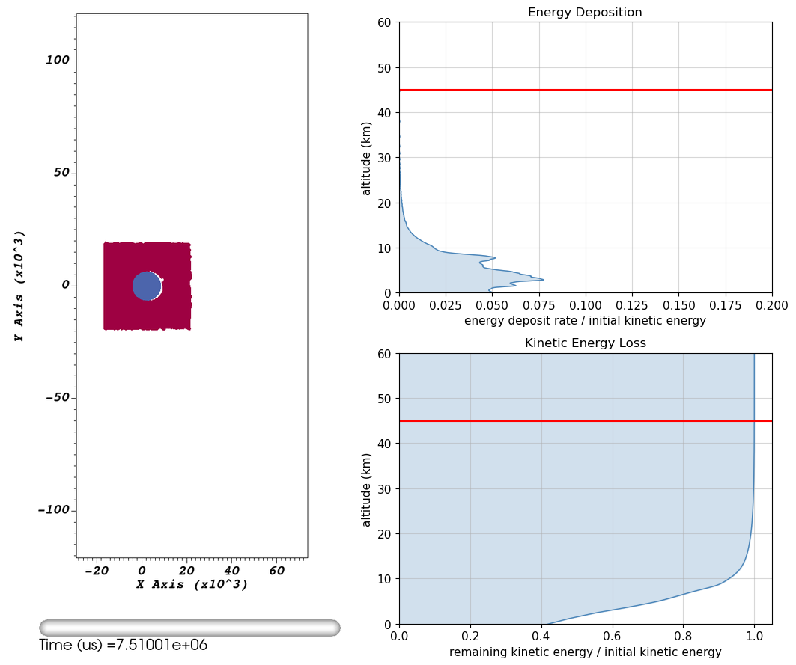
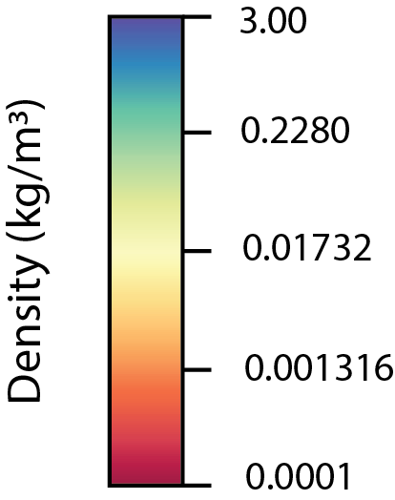
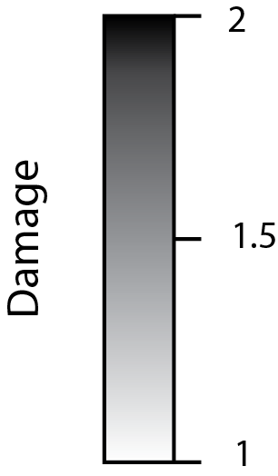
Example Model – 127m Diam, 20° Entry
Midsize,
Longest Traverse
1000
500
0
Distance (m)
-500
-1000
-200
Distance (m)
600

Slide 6
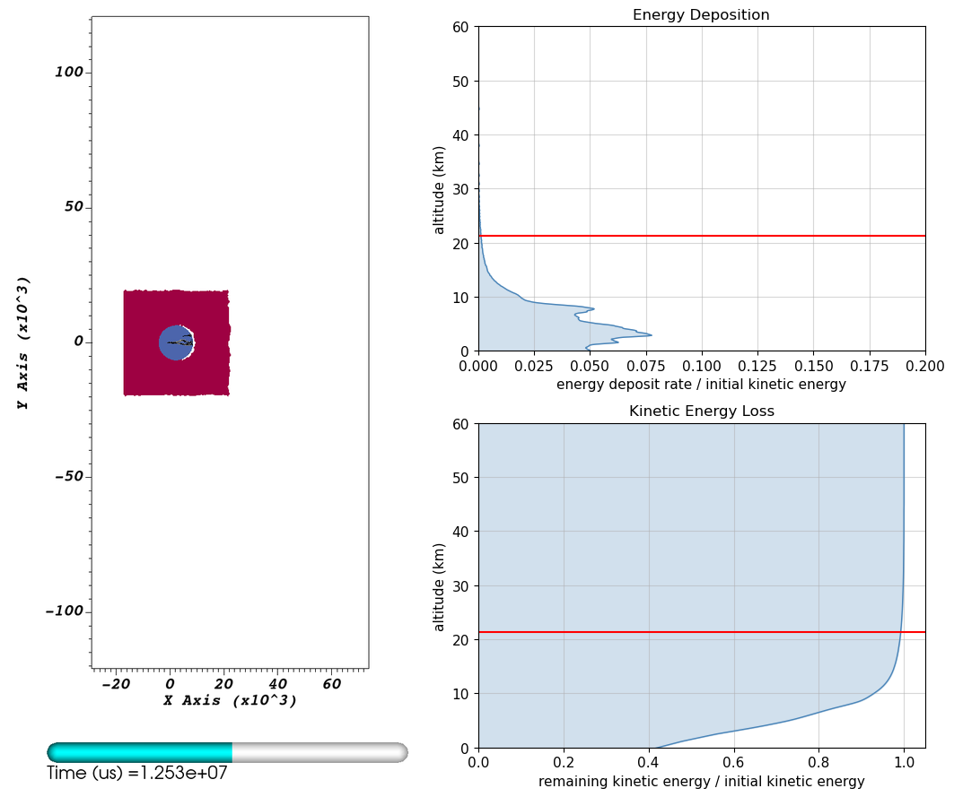
Example Model – 127m Diam, 20° Entry
Midsize,
Longest Traverse
1000
500
0
Distance (m)
-500
-1000
-200
Distance (m)
600

Slide 7
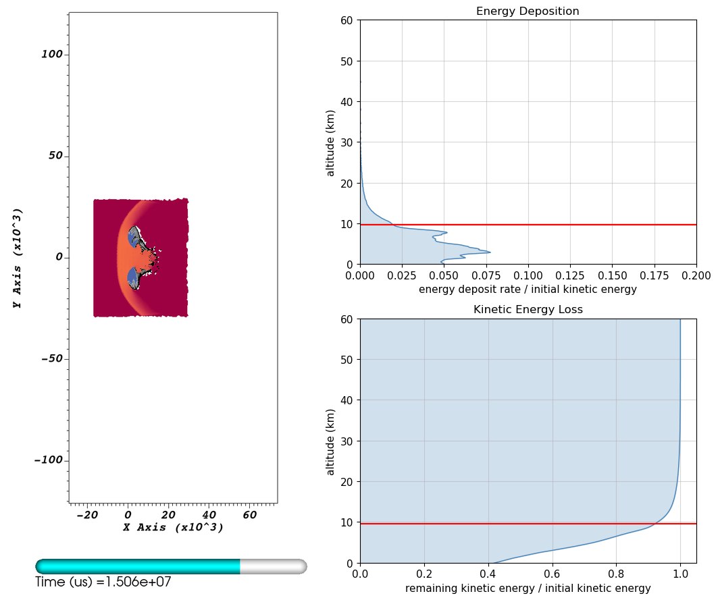
Example Model – 127m Diam, 20° Entry
Midsize,
Longest Traverse
1000
500
0
Distance (m)
-500
-1000
-200
Distance (m)
600

Slide 8
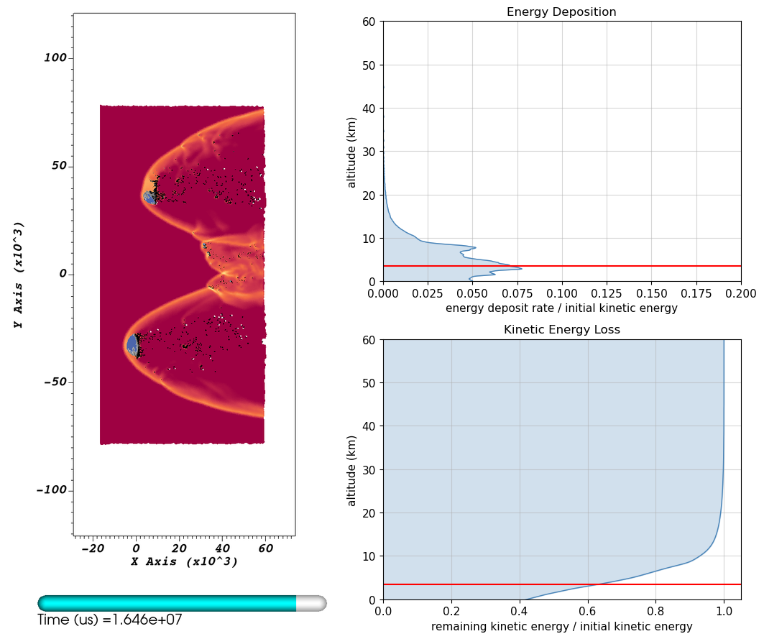
Example Model – 127m Diam, 20° Entry
Midsize,
Longest Traverse
1000
500
0
Distance (m)
-500
-1000
-200
Distance (m)
600

Slide 9
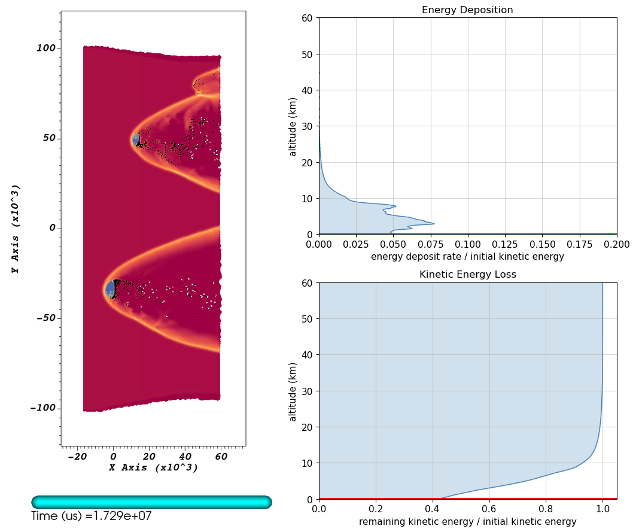
Example Model – 127m Diam, 20° Entry
Midsize,
Longest Traverse
1000
500
0
Distance (m)
-500
-1000
-200
Distance (m)
600

Slide 10
Example Model – 127m Diam, 20° Entry
We performed this analysis for the 4 asteroid sizes and corresponding densities, both with and without material strength, for the three incoming angles.
Midsize,
Longest Traverse
1000
500
0
Distance (m)
-500
-1000
-200
Distance (m)
600

Slide 11
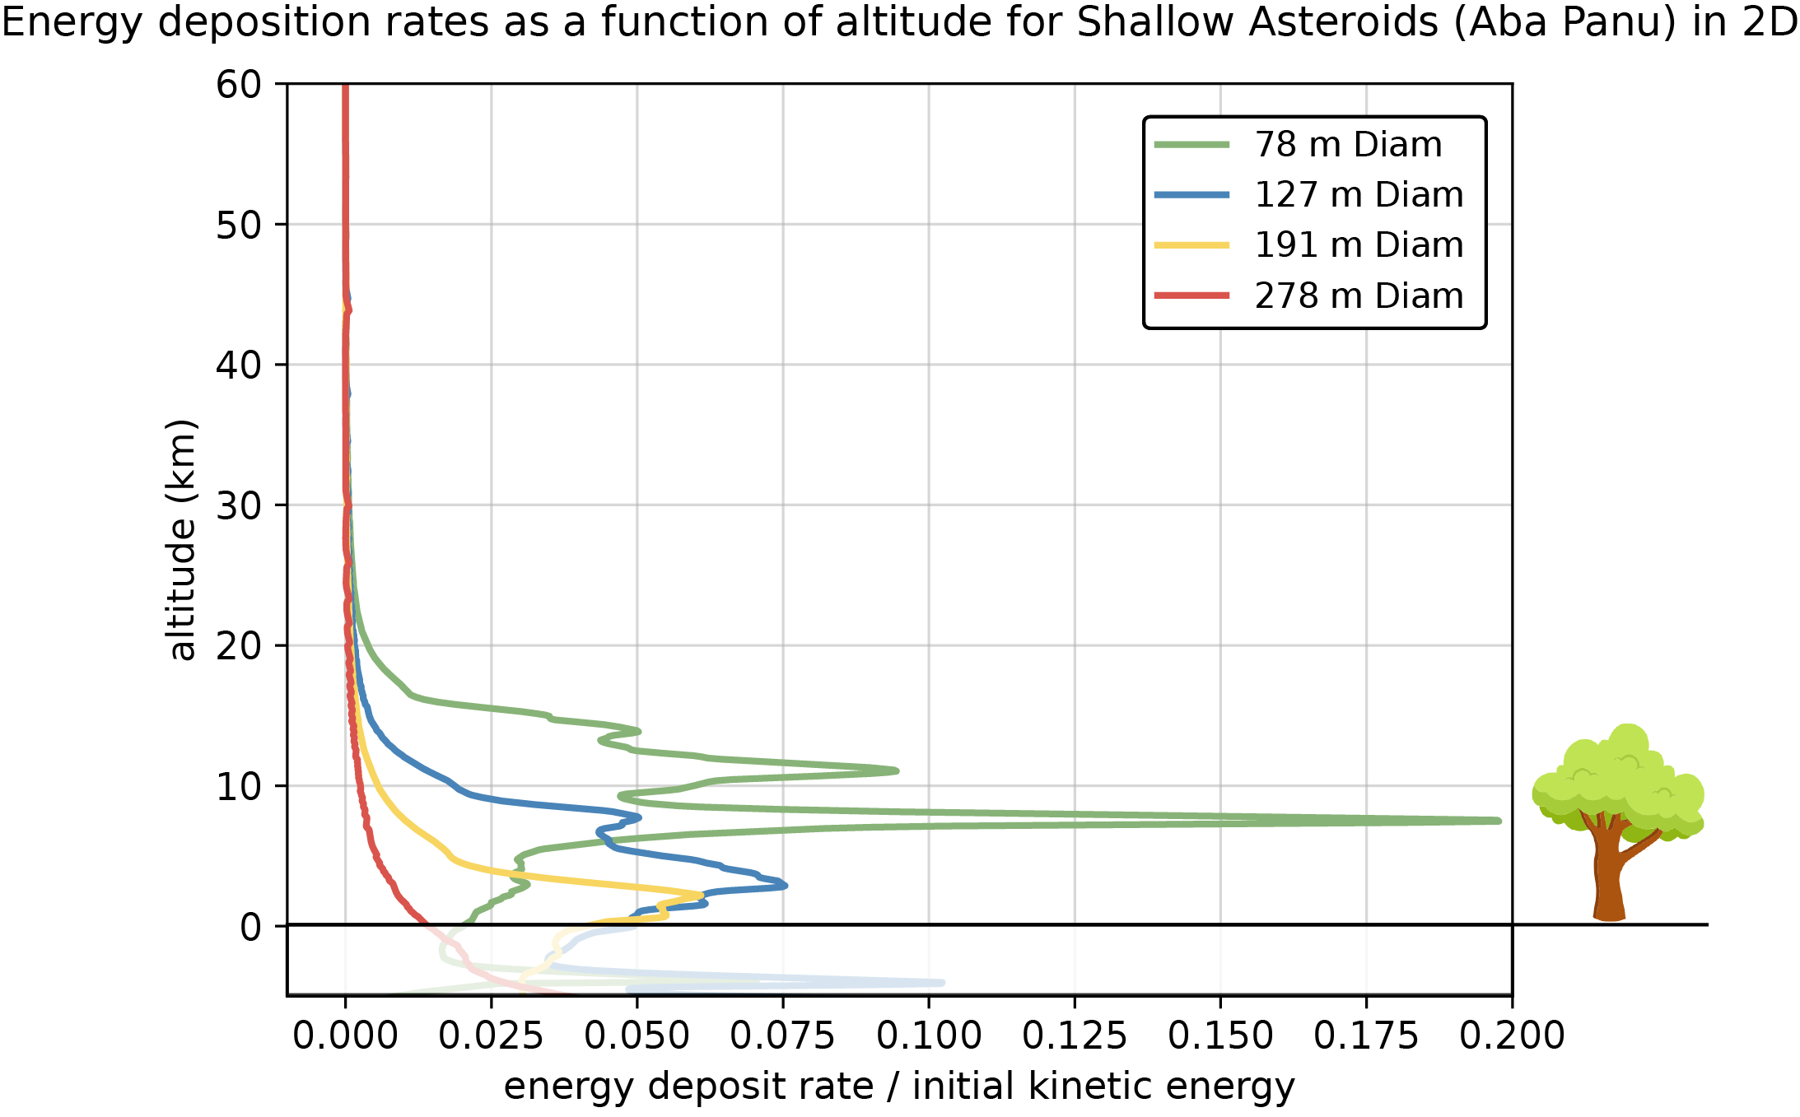
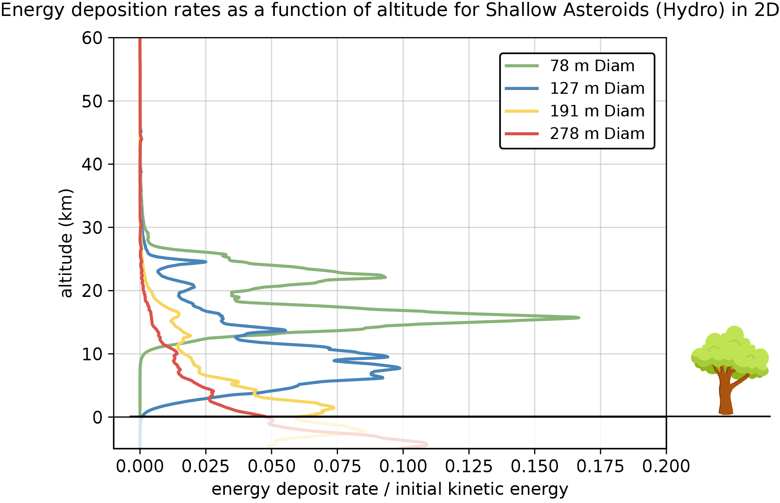
For a Given Entry Angle, Energy Deposition Height Corresponds with Bolide Size
20° Entry
Bolide With Strength
Bolide Without Strength
(tree not to scale)

Slide 12
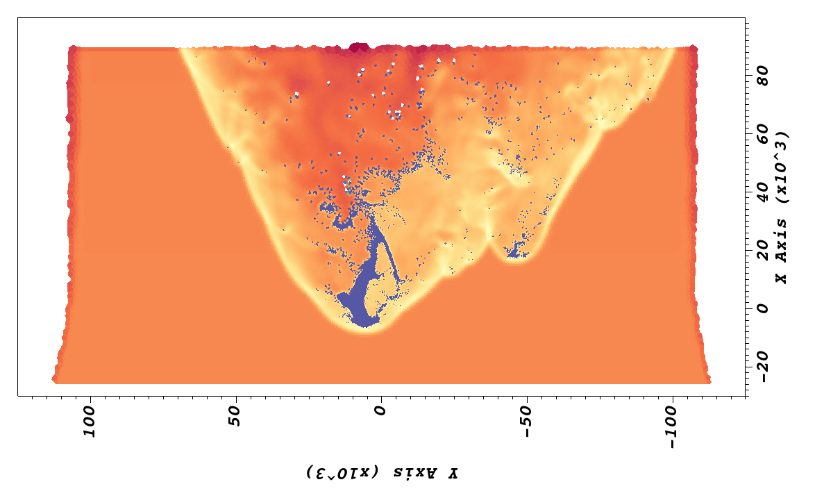
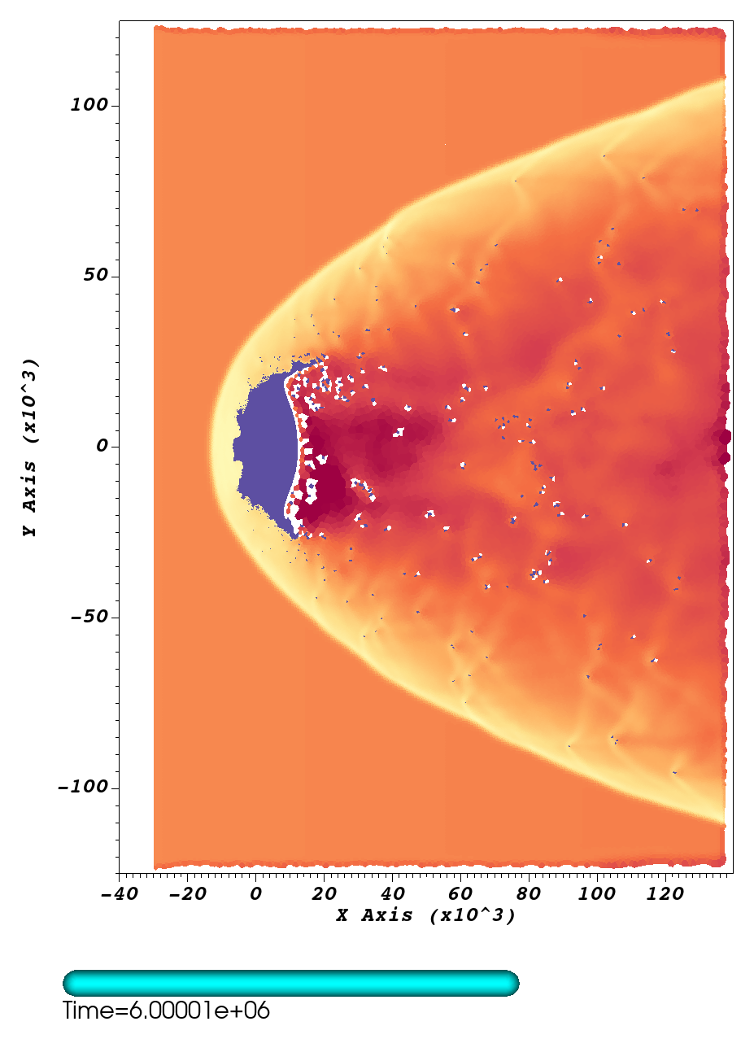
Strength Plays a Pivotal Role in Bolide Evolution
Only one case using a hydrodynamic bolides makes it to the ground “intact” (and that is debatable)
90° Incoming Angle, 278 m Diameter - Hydro
Most Fully Hydro Bolides
1000
800
Elevation (m)
Elevation (m)
Ground
-200
Ground
1000
0
1000
Distance (m)
1000
0
1000
-400
Distance (m)

Slide 13
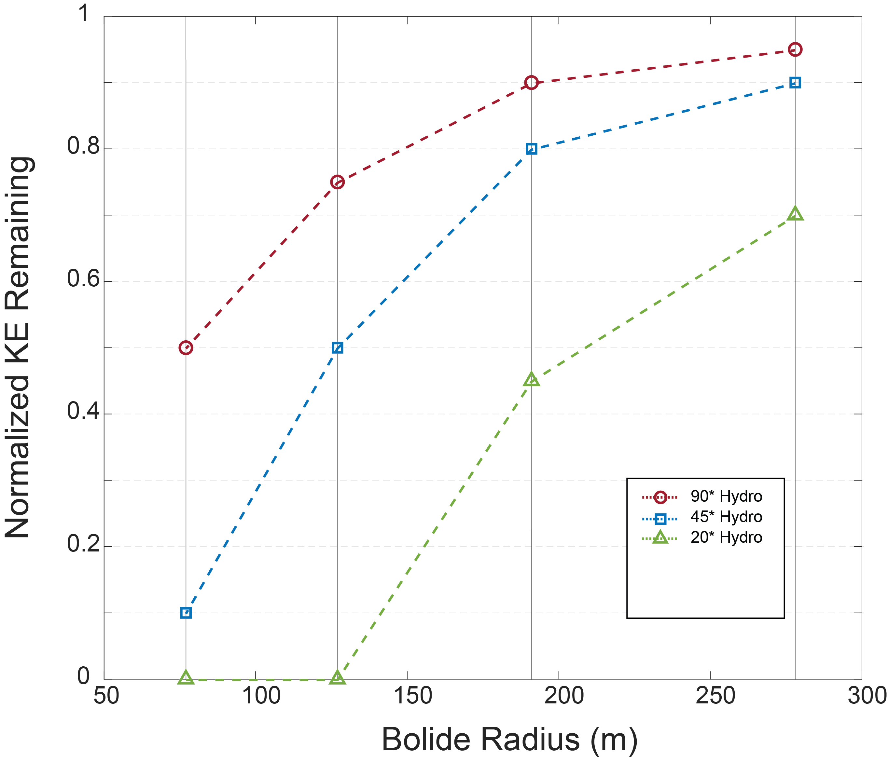
Strength Plays a Pivotal Role in Bolide Evolution
Only one case using a hydrodynamic bolides makes it to the ground “intact” (and that is debatable)

Slide 14
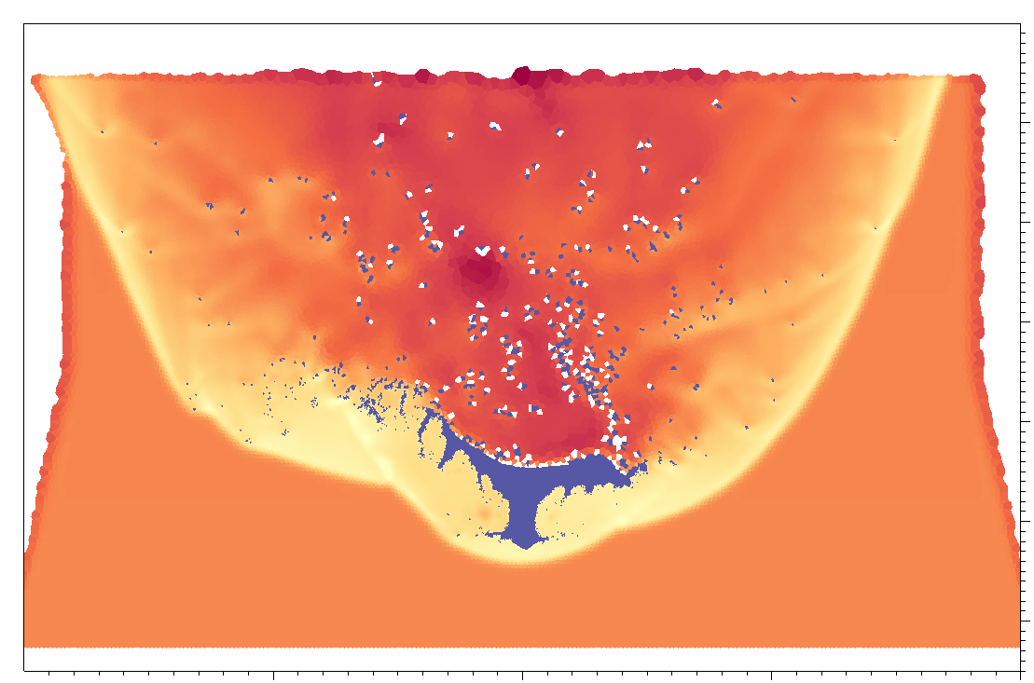
Strength Plays a Pivotal Role in Bolide Evolution
Only one case using a hydrodynamic bolides makes it to the ground “intact” (and that is debatable)

Slide 15
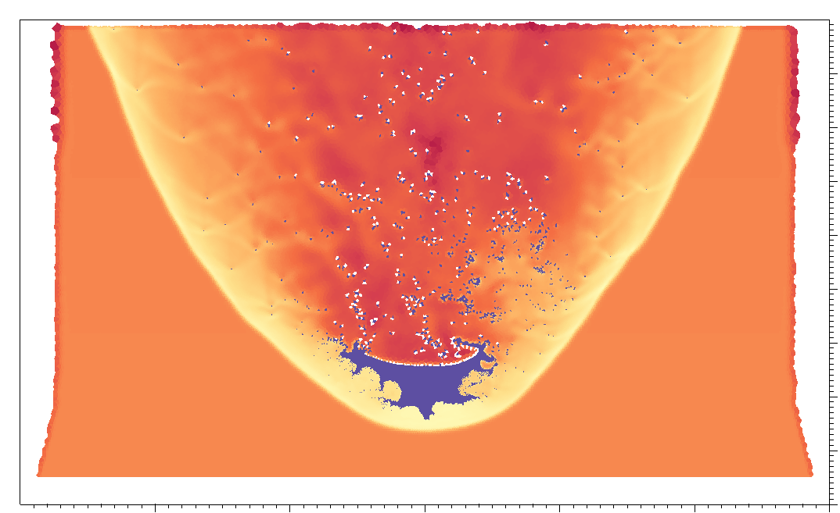
Strength Plays a Pivotal Role in Bolide Evolution
Only one case using a hydrodynamic bolides makes it to the ground “intact” (and that is debatable)

Slide 16
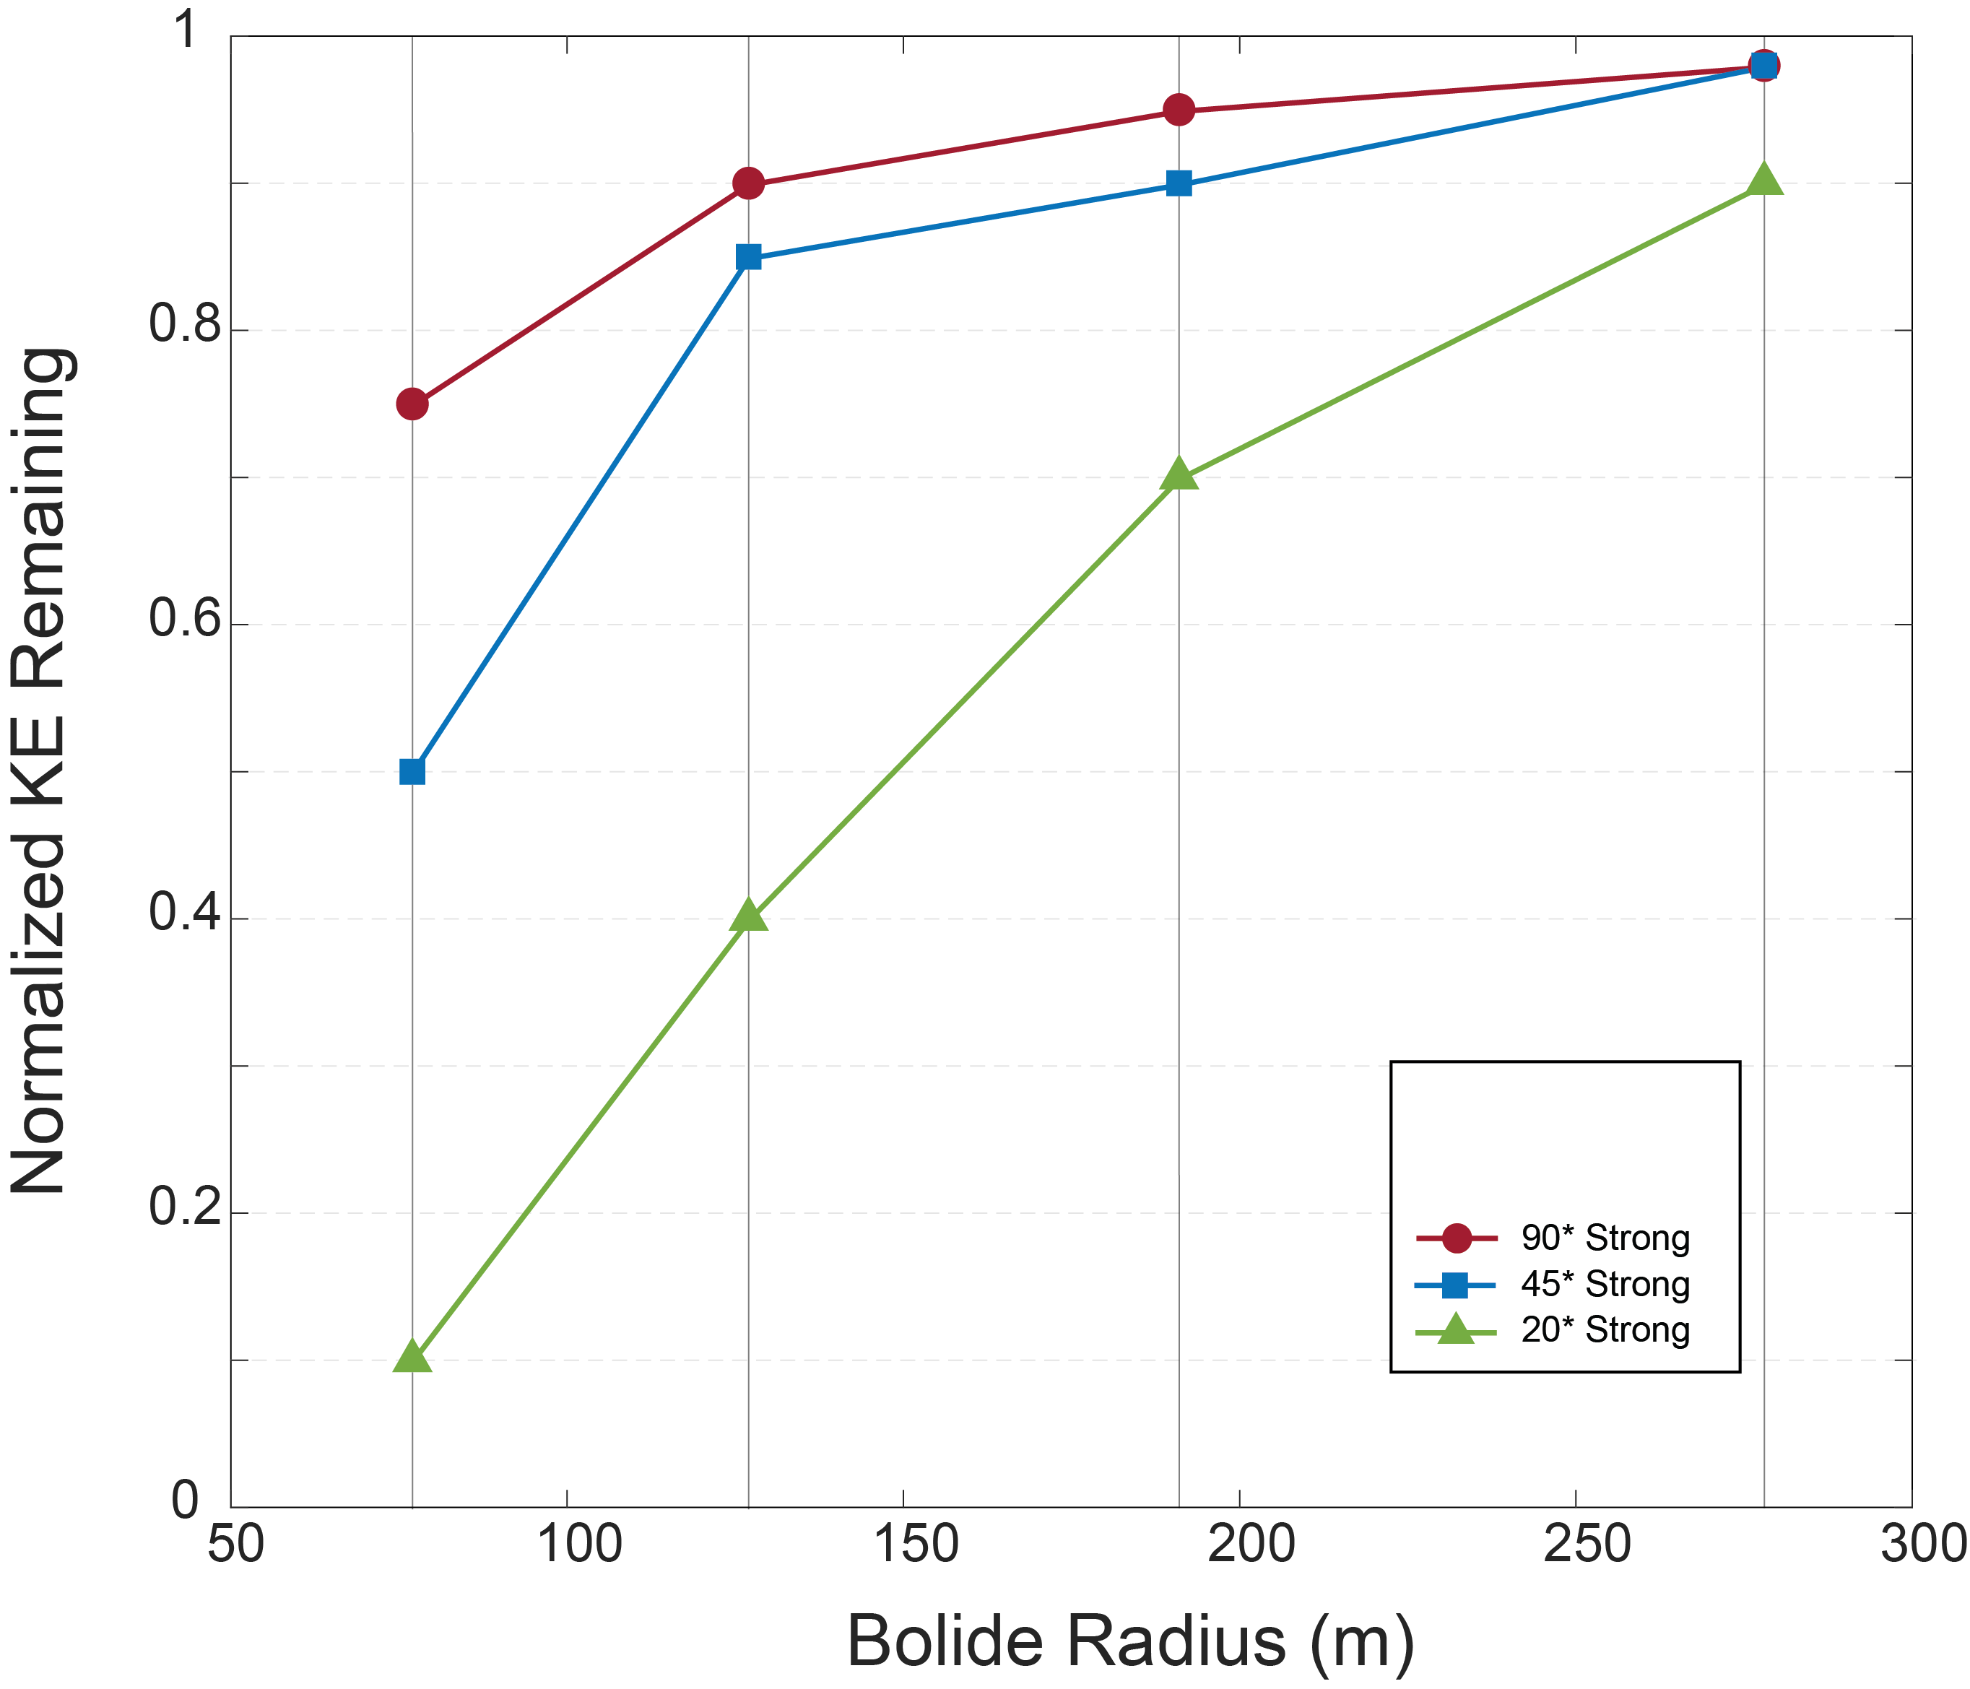
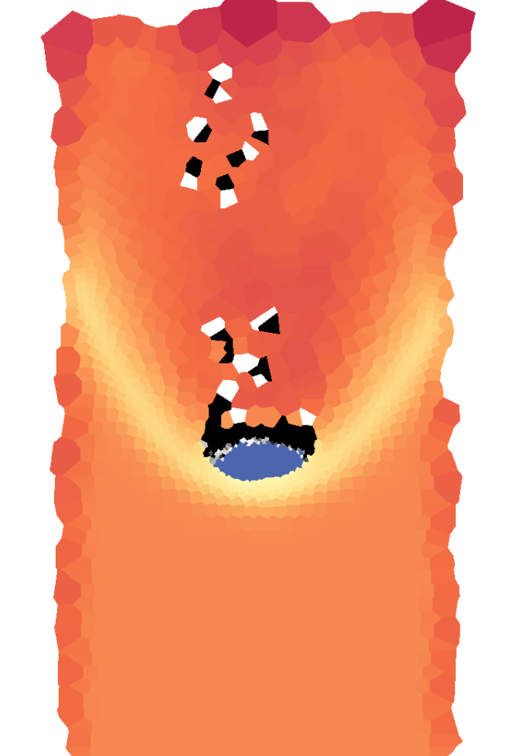
Strength Plays a Pivotal Role in Bolide Evolution
In bolides with strength, all models have portions of intact material reach the surface

Slide 17
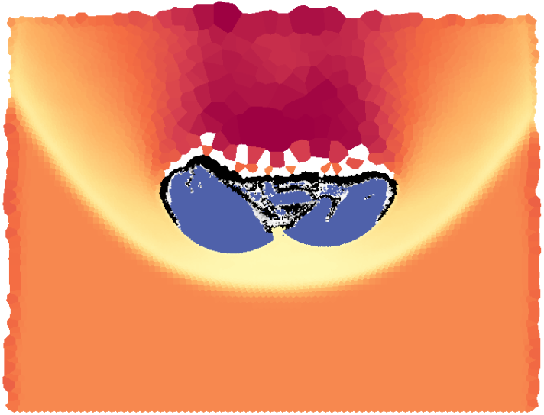
Strength Plays a Pivotal Role in Bolide Evolution
In bolides with strength, all models have portions of intact material reach the surface

Slide 18
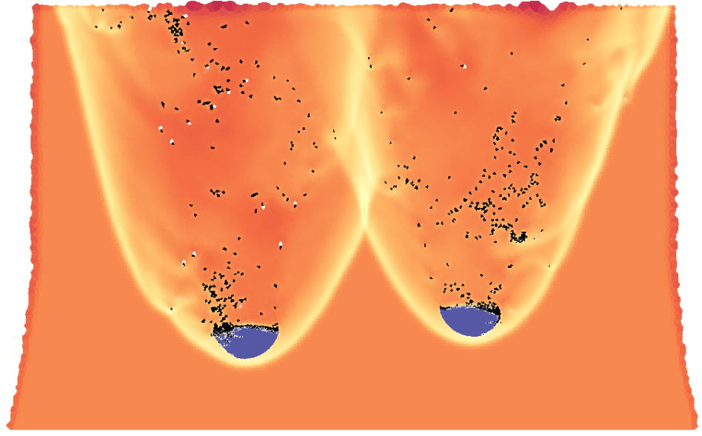
Strength Plays a Pivotal Role in Bolide Evolution
In bolides with strength, all models have portions of intact material reach the surface

Slide 19
Strength Plays a Pivotal Role in Bolide Evolution
In bolides with strength, all models have portions of intact material reach the surface
~250 – 850 m separation

Slide 20
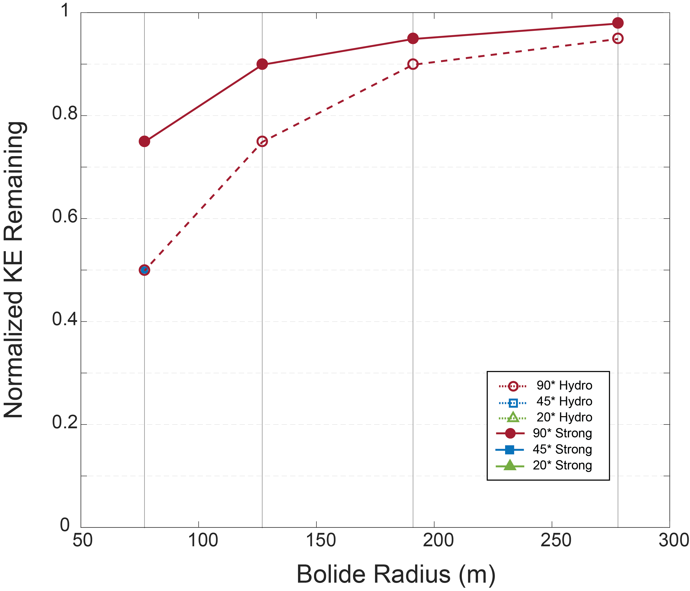
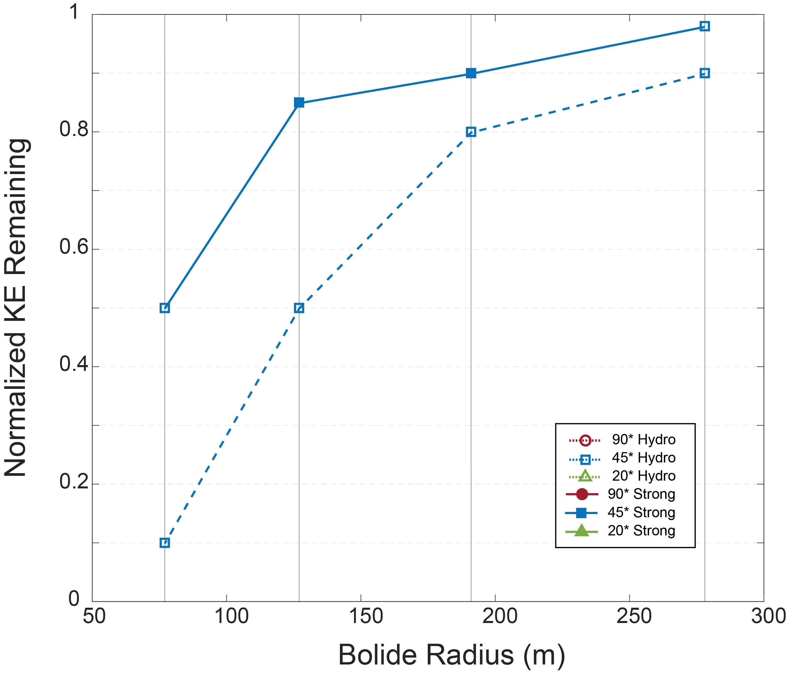
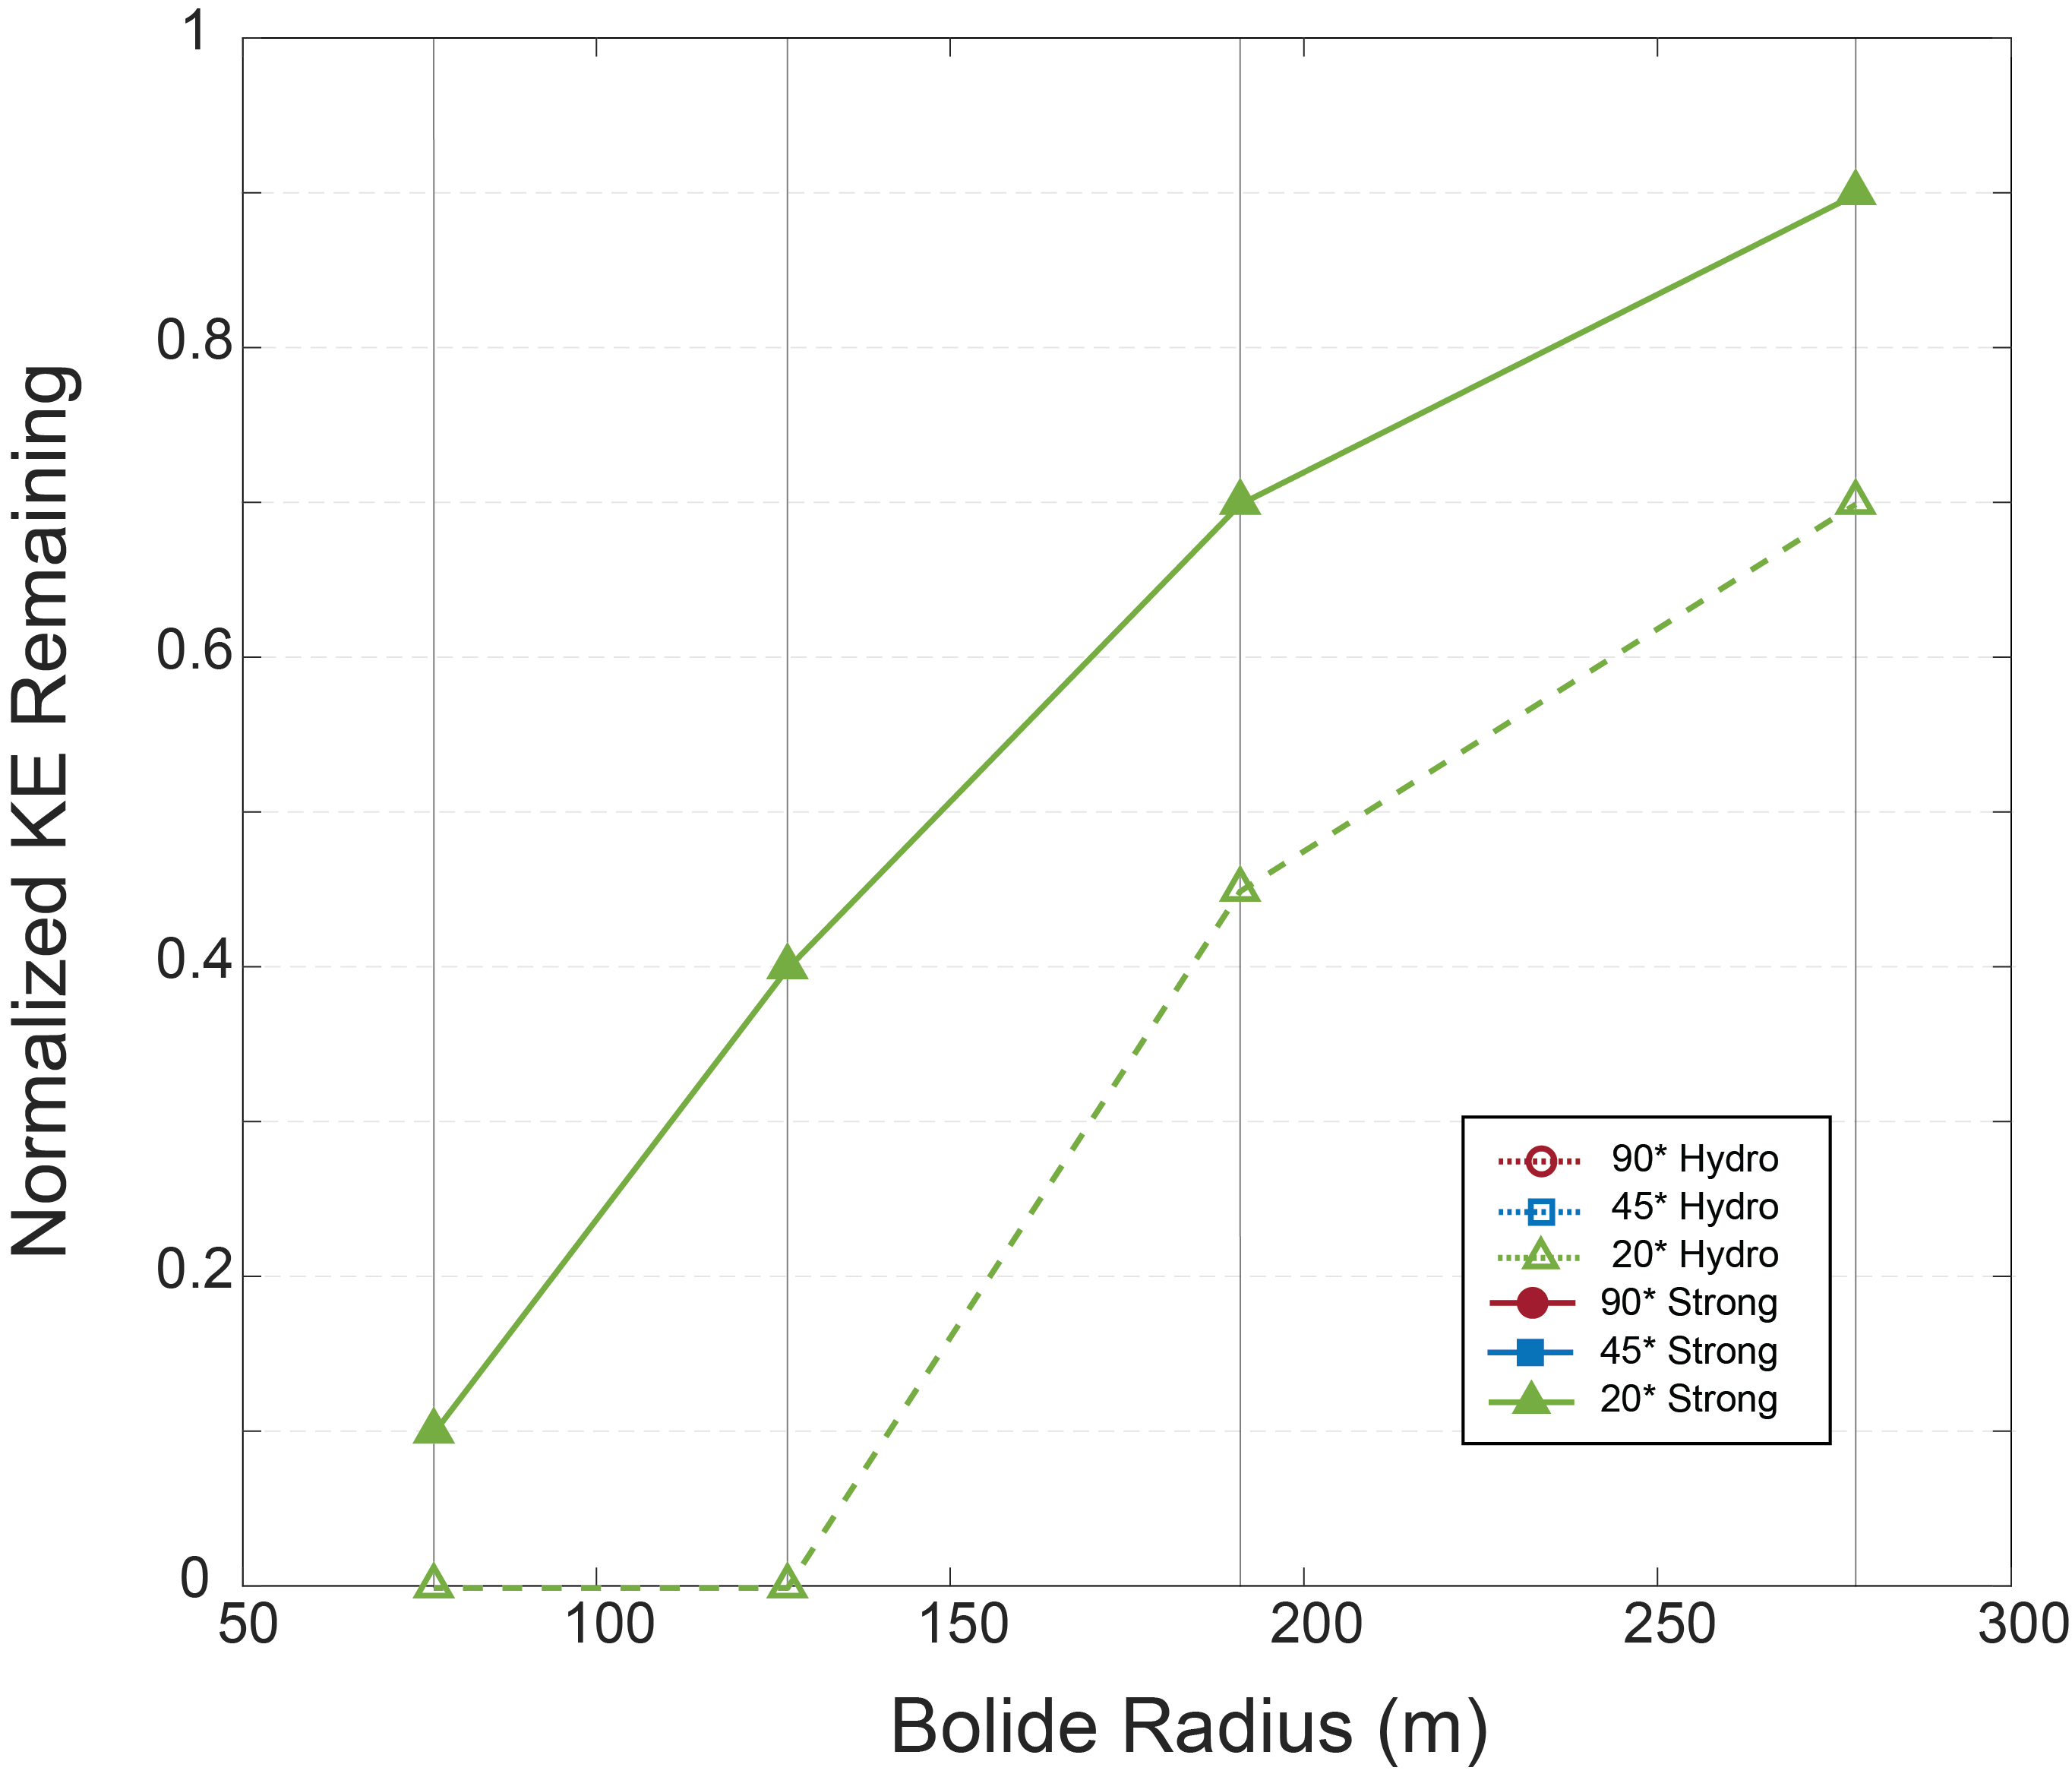
Strength Plays a Pivotal Role in Bolide Evolution
In bolides with strength, all models have portions of intact material reach the surface
90° Entry
45° Entry
20° Entry

Slide 21
Initial Impressions
Material strength plays a huge role in affecting the fate of an incoming asteroid
Asteroids incoming on shallower trajectories have longer transits through the atmosphere and are more likely to become fireballs
Ongoing Work:
Verifying these results with 3D simulations
Using energy deposition curves as inputs for blast wave modeling

Slide 22
Thank you for your attention!

