Slide 1
Leveraging Cislunar Orbits for the Upcoming Apophis Encounter
Planetary Defense Conference
May 9, 2025
Fazle Siddique
Juan Ojeda Romero
Amanda Haapala
Jackson Shannon

Slide 2
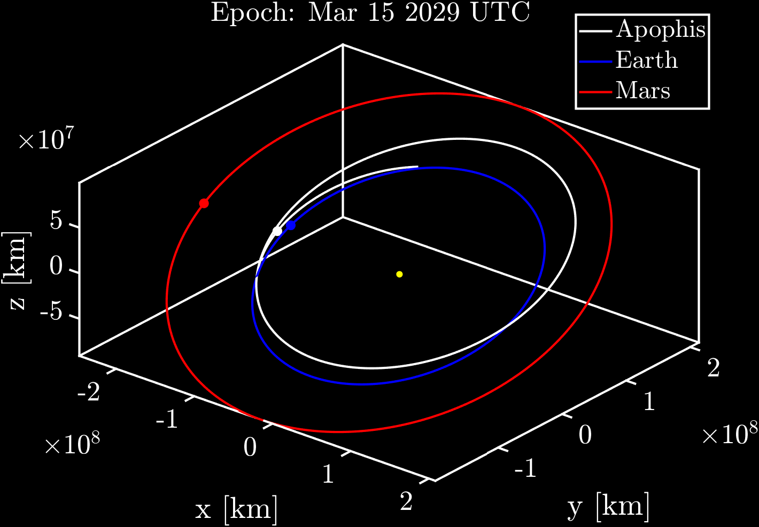
Motivation: Apophis Encounter
Near Earth Object (NEO) 99942 Apophis provides a unique opportunity for an operational Planetary Defense (PD) scenario
Dedicated tracking campaigns helped eliminate any risk of impact during the April 13, 2029 Earth close approach (within 32,000 km altitude)
OSIRIS-APEX mission will rendezvous with Apophis post-flyby
However, Apophis flyby before Earth encounter offers opportunity to characterize asteroid properties
This study examines novel cislunar orbits to flyby Apophis pre-encounter using a low-cost rideshare to the Moon.
Heliocentric J2000 Frame

Slide 3
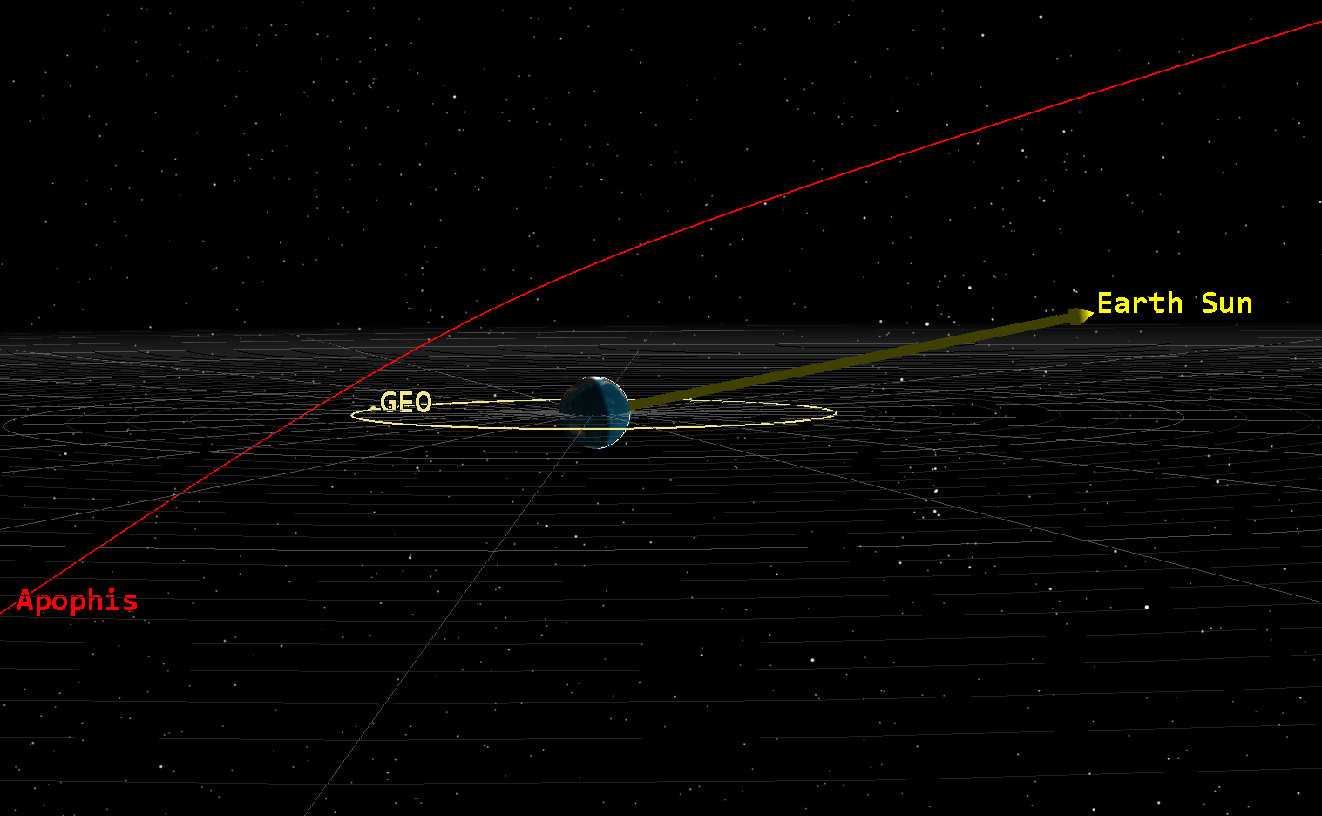
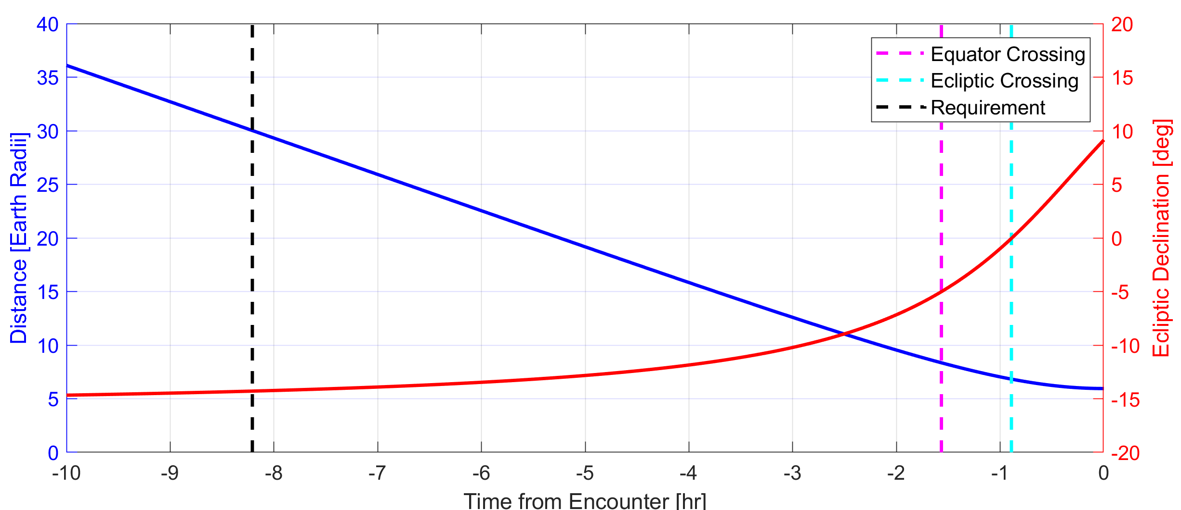
Apophis Encounter Geometry
Science team set 30 Earth radii (R_{e}) as the minimum distance for the flyby
Inside 16 R_{e} surface mobilization of asteroid thought to begin (Binzel et al. 2010)
Must encounter 8+ hours prior to Earth time of closest approach, driving significant out-of-plane size of encounter orbit

Slide 4
Leveraging Cislunar Orbits
Research Objective
Leverage cislunar dynamical structures to construct flyby opportunities to Apophis Identify cislunar staging orbits that intersect incoming Apophis trajectory prior to Earth close approach Construct low-cost mission profiles leveraging cislunar staging orbits for an Apophis flyby opportunity
Mission Scenarios
Transfer to Staging Orbit
Staging Orbit
Rideshare Launch
Lunar Flyby
Apophis Flyby
Direct Transfer to Apophis

Slide 5


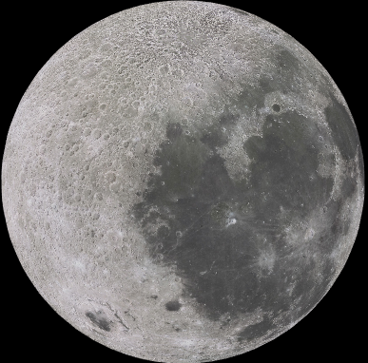


Circular Restricted Three-Body Problem (CRTBP)
Earth-Moon Rotating Frame
L₄
Simplified cislunar (Earth-Moon) dynamics model
Defined in Earth-Moon Rotating Frame
Dynamical structures exist in CRTBP
Five Equilibrium (Lagrange) Points
Periodic Orbits
Quasi-Periodic Orbits
Periodic and quasi-periodic orbits offer long-term staging opportunities
$$\hat{y}$$
B
L₁
L₂
L₃
$$\hat{x}$$
Earth
Moon
L₅
Constant Earth-Moon distance
Fixed Earth and Moon positions in rotating frame

Slide 6
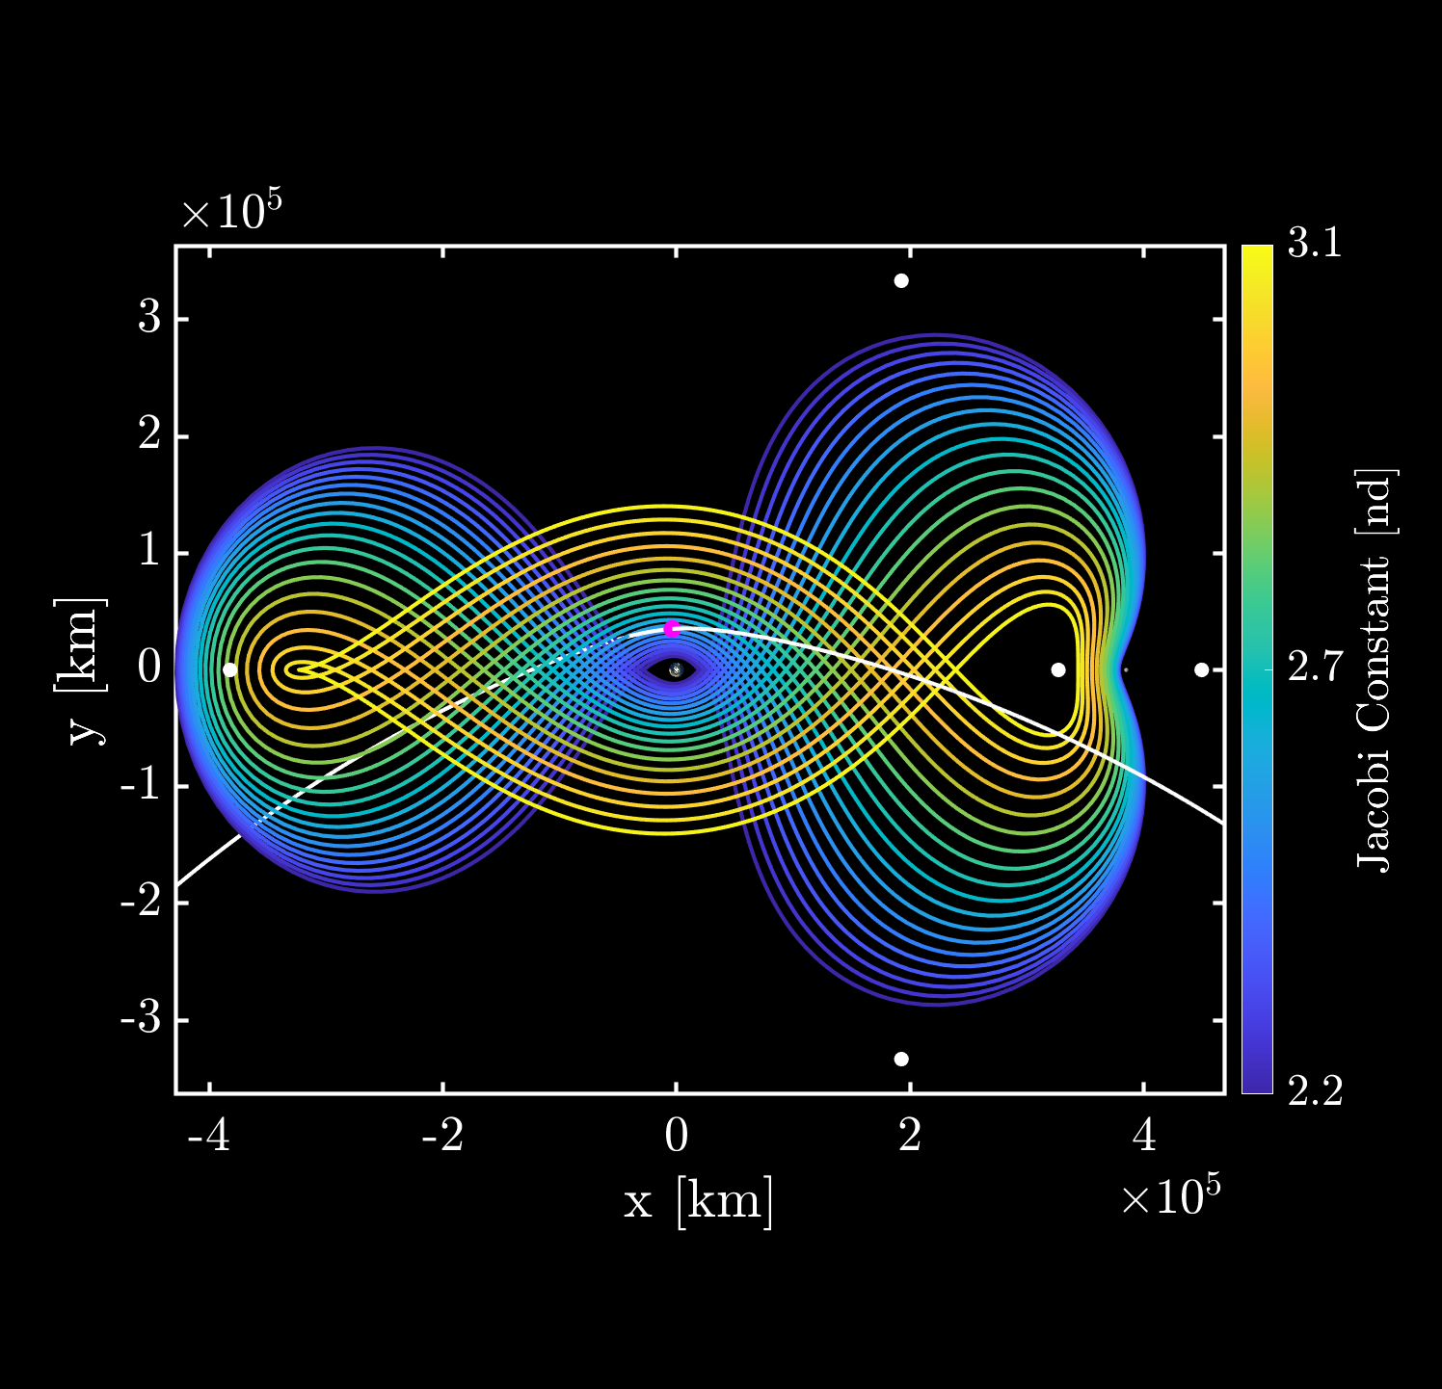
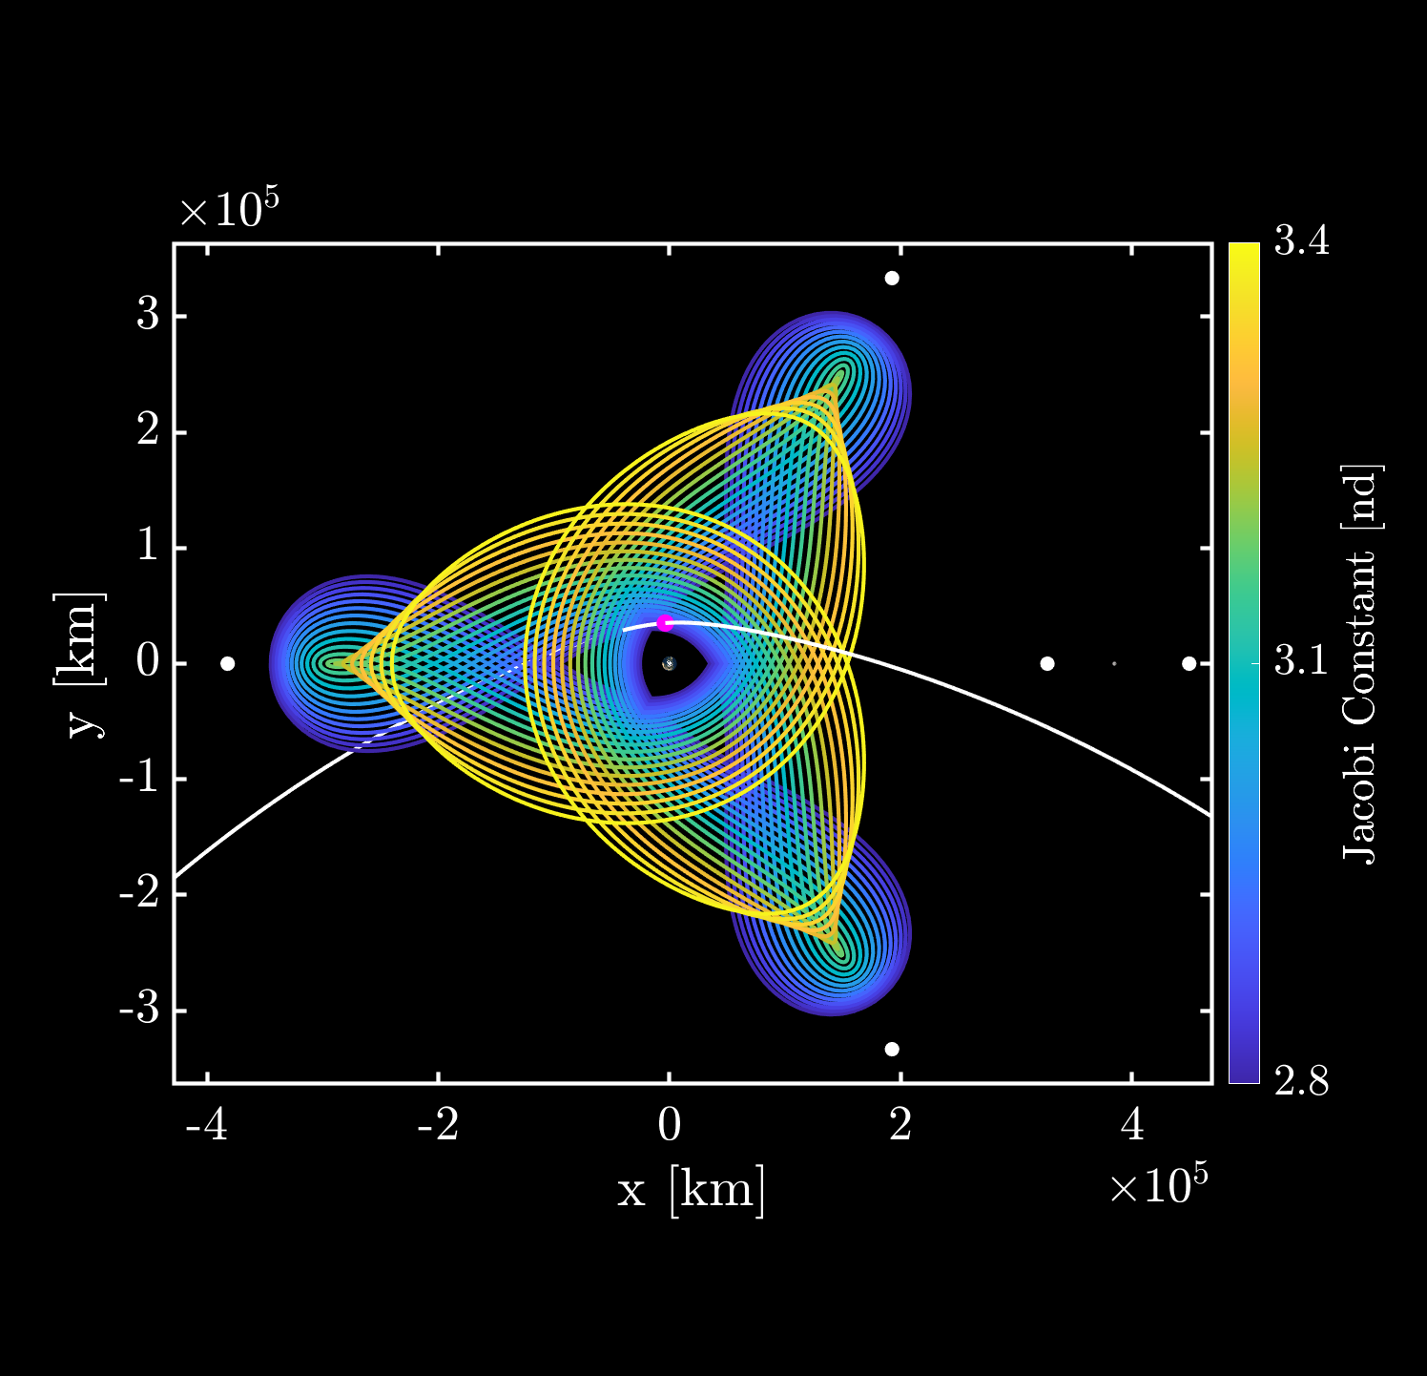
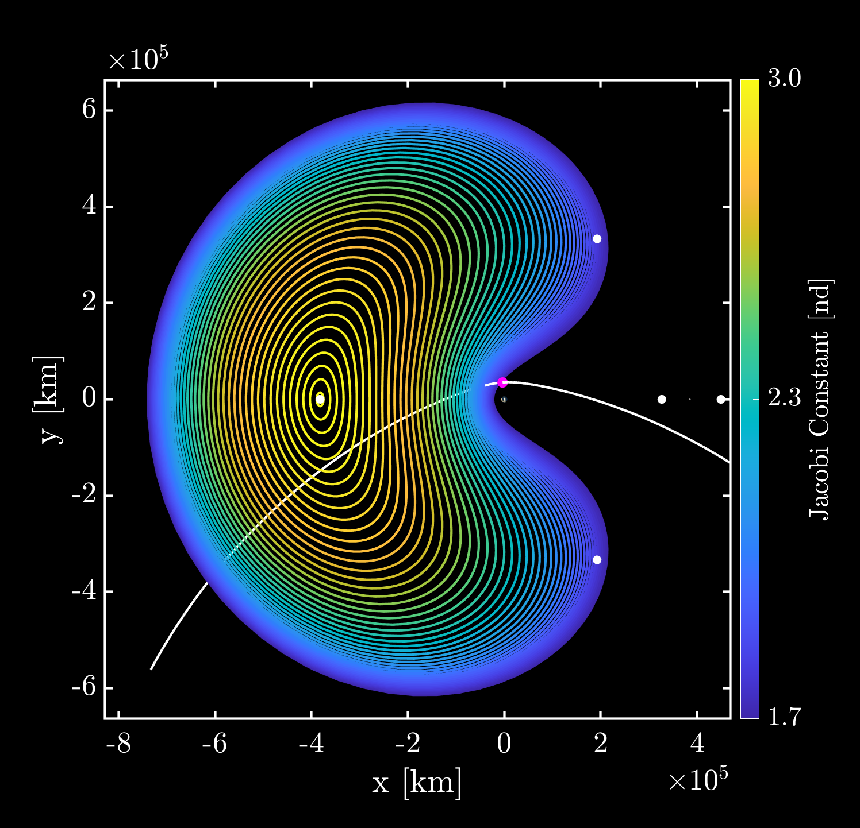
Cislunar Periodic Orbits
Here, CRTBP orbits are used to construct staging trajectories that ballistically approach Apophis before the Earth encounter
Families of cislunar orbits in CRTBP offer staging locations to encounter Apophis:
2:1 Resonant Orbit
3:1 Resonant Orbit
L₃ Lyapunov or Halo orbits
Earth-Moon Rotating Frame
Earth-Centered
2:1 resonant orbit
3:1 resonant orbit
L₃ Lyapunov orbits
L₄
L₄
L₄
L₃
L₃
L₁
L₂
L₁
L₂
L₃
L₁
L₂
Apophis
Apophis
Apophis
L₅
L₅
L₅

Slide 7
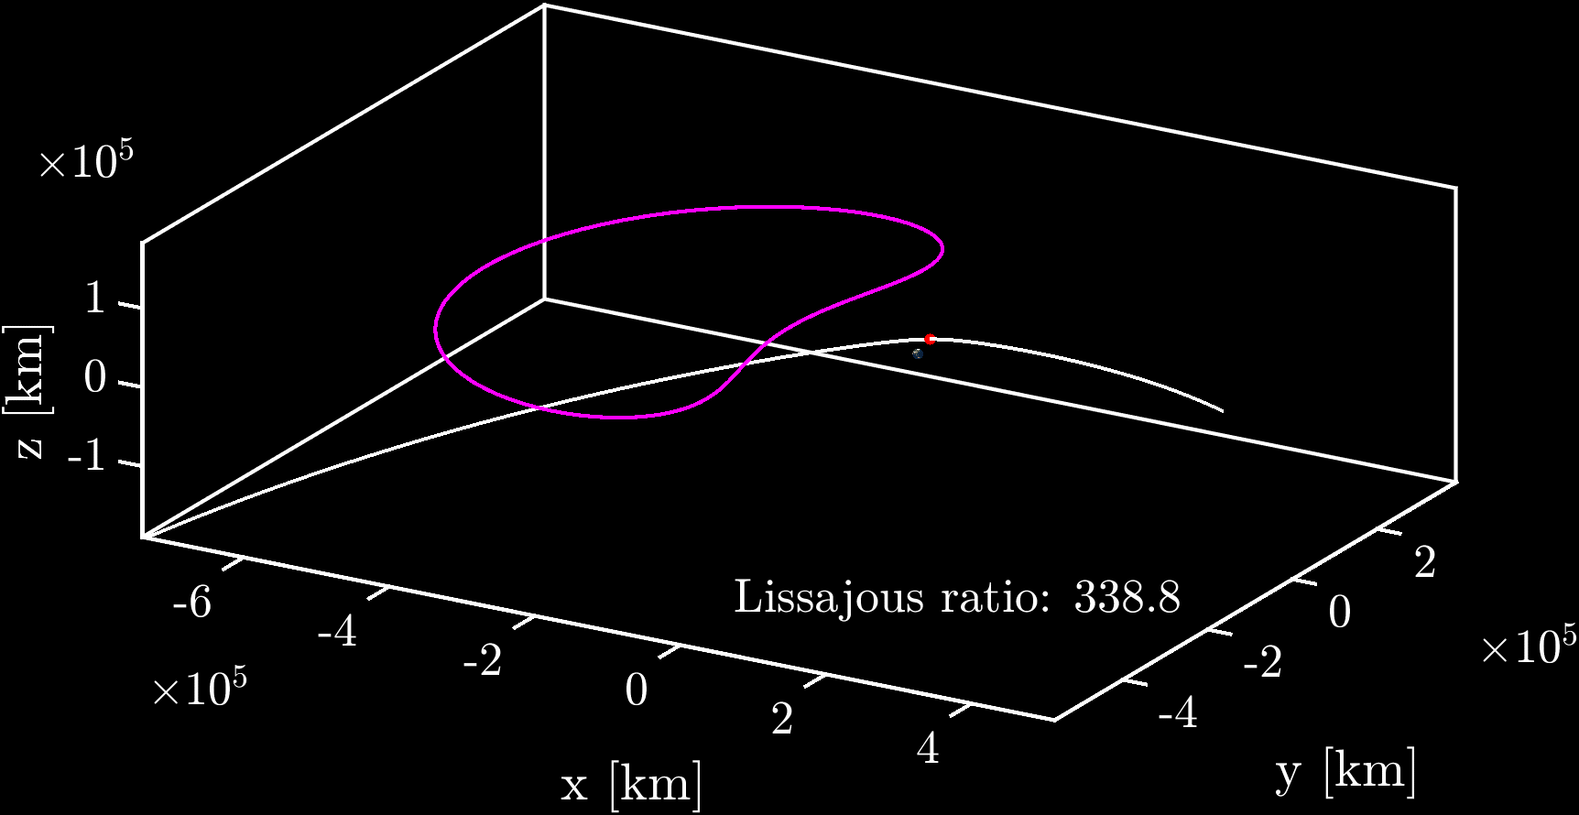
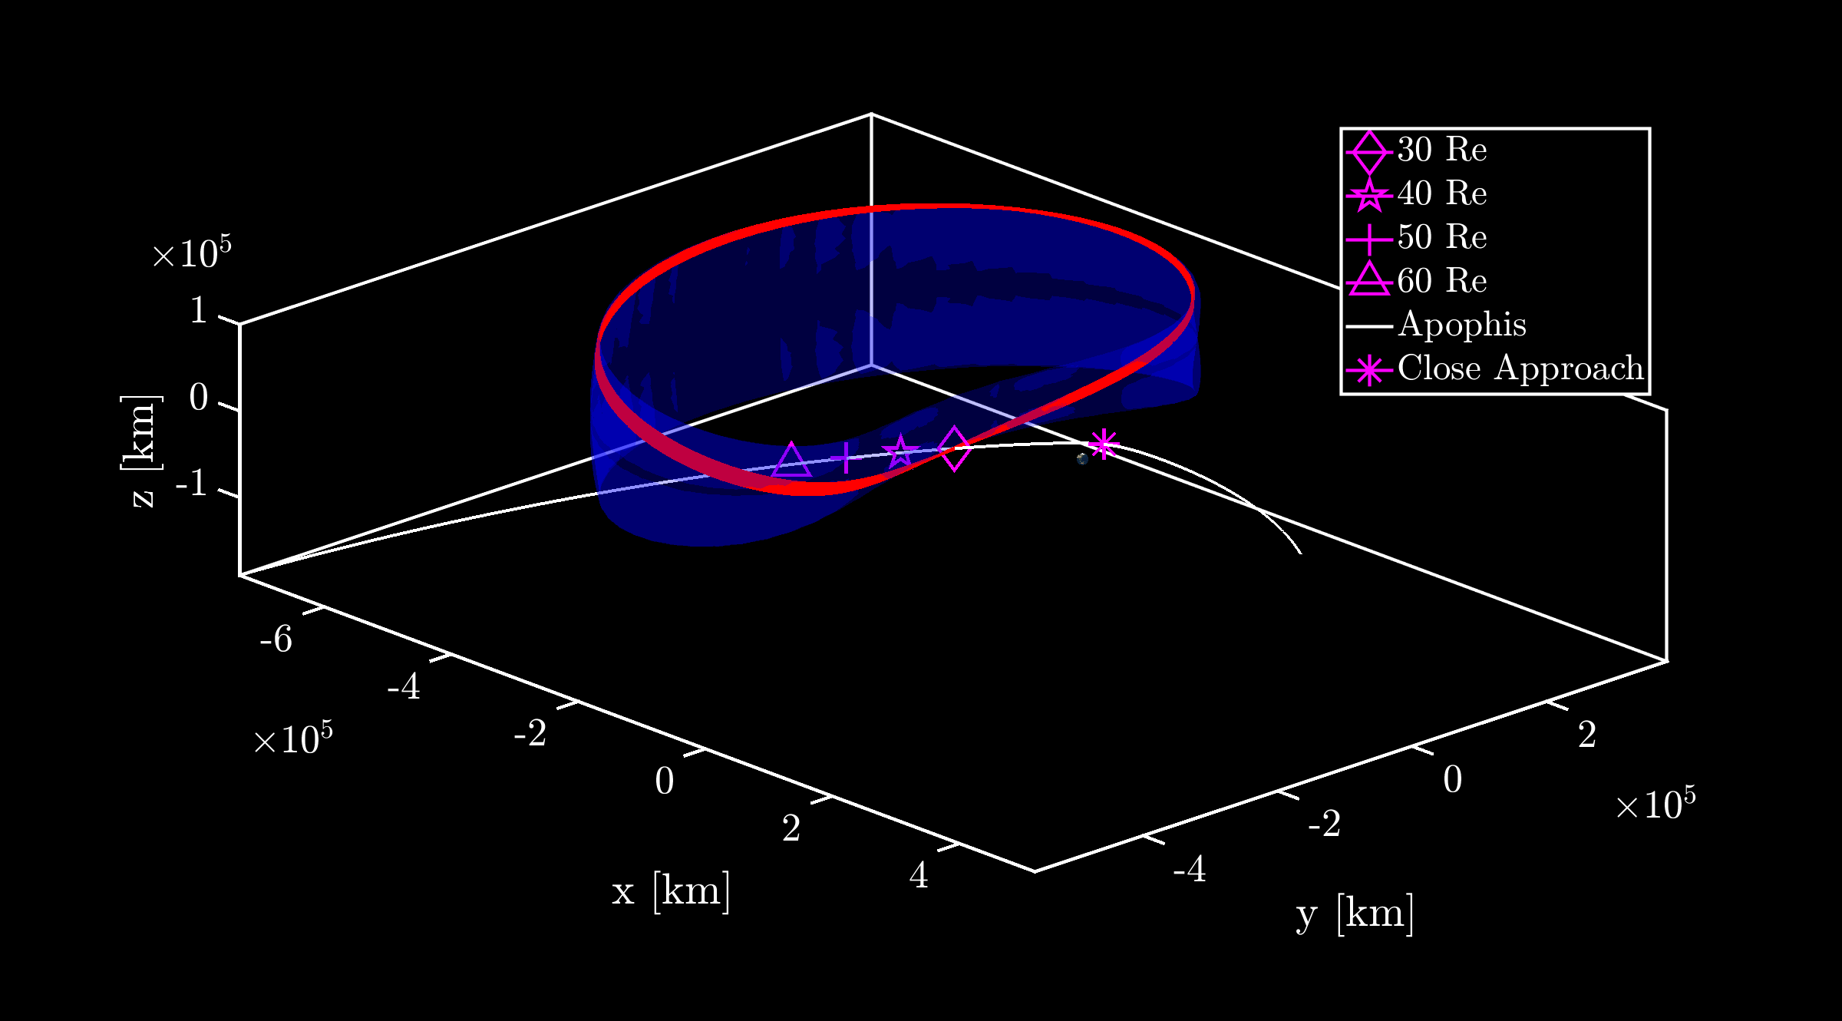
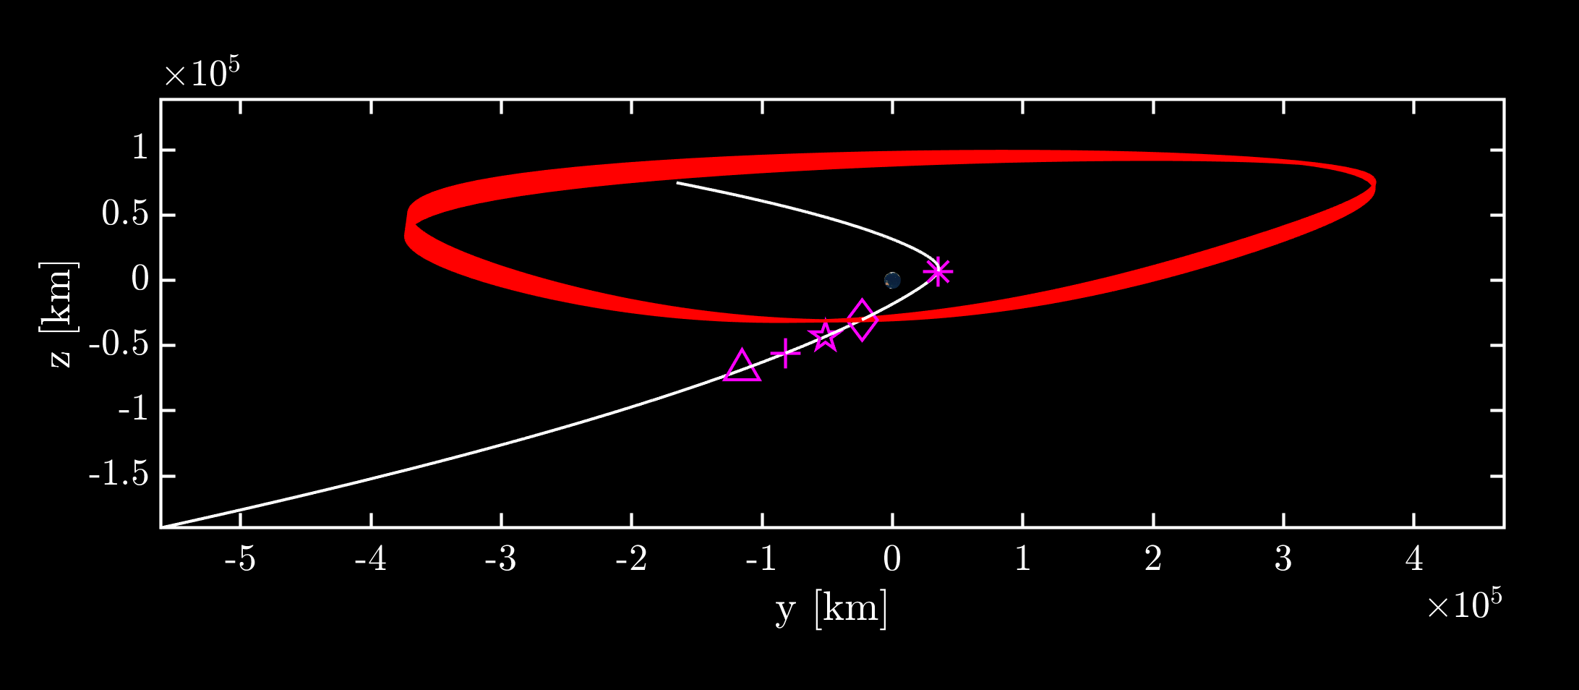
Cislunar Quasi-Periodic Orbits
Family of L₃ Lissajous QPOs
Incoming Apophis trajectory is outside Earth-Moon plane
L₃ Lyapunov orbit family is planar
L₃ halos and Axial families are too ‘big’ and do not intersect Apophis
Alternative option: Lissajous L₃ quasi-periodic orbit family
L₃ Lyapunov
Apophis
Selected 13 month orbit on QPO in red
Out-of-Plane Lissajous orbit intersects Apophis at 30 R_{e} altitude before Earth encounter
Earth-Centered
Earth-Moon Rotating Frame
Apophis
30 R_{e}

Slide 8
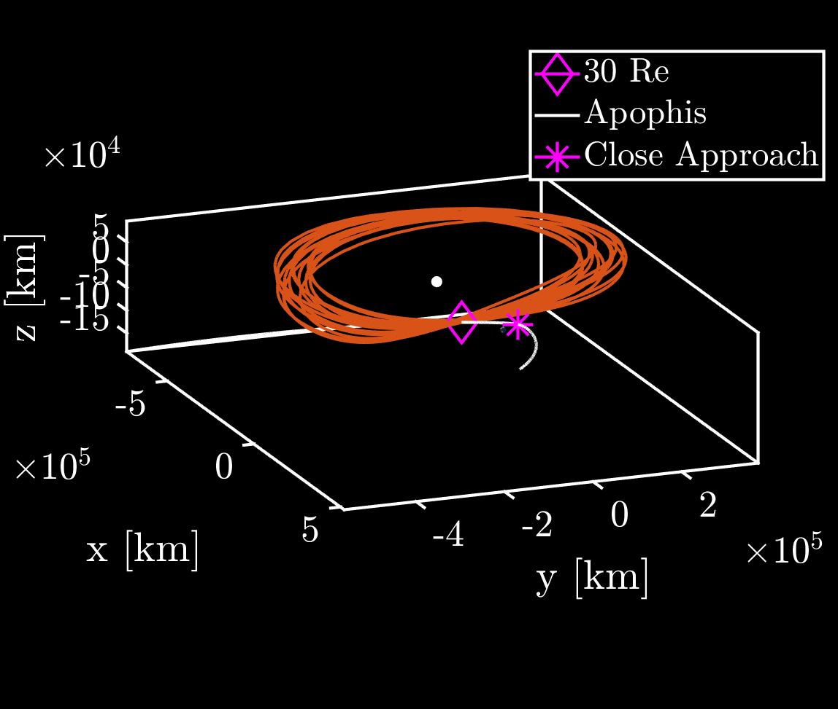
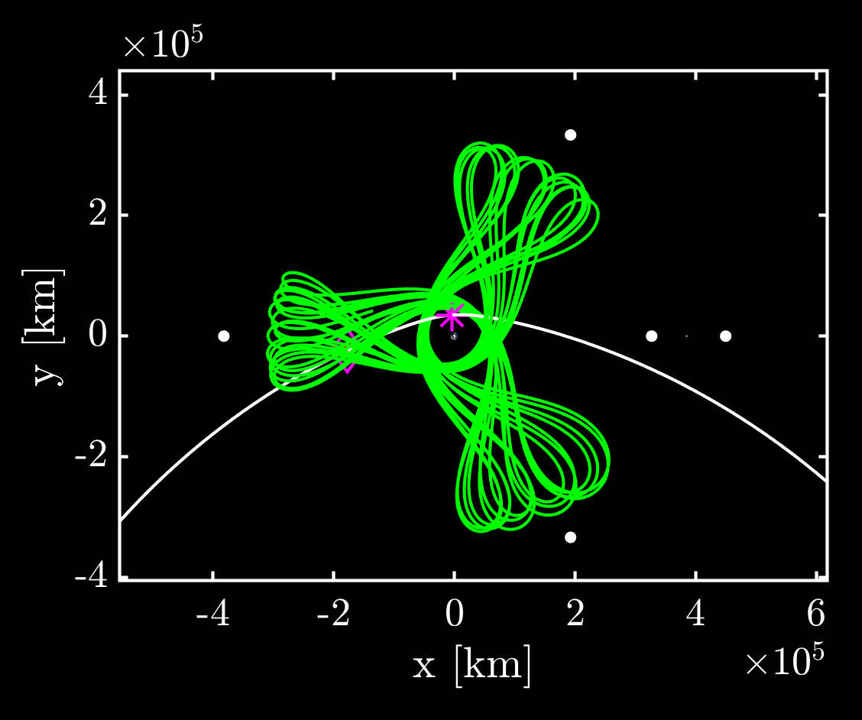
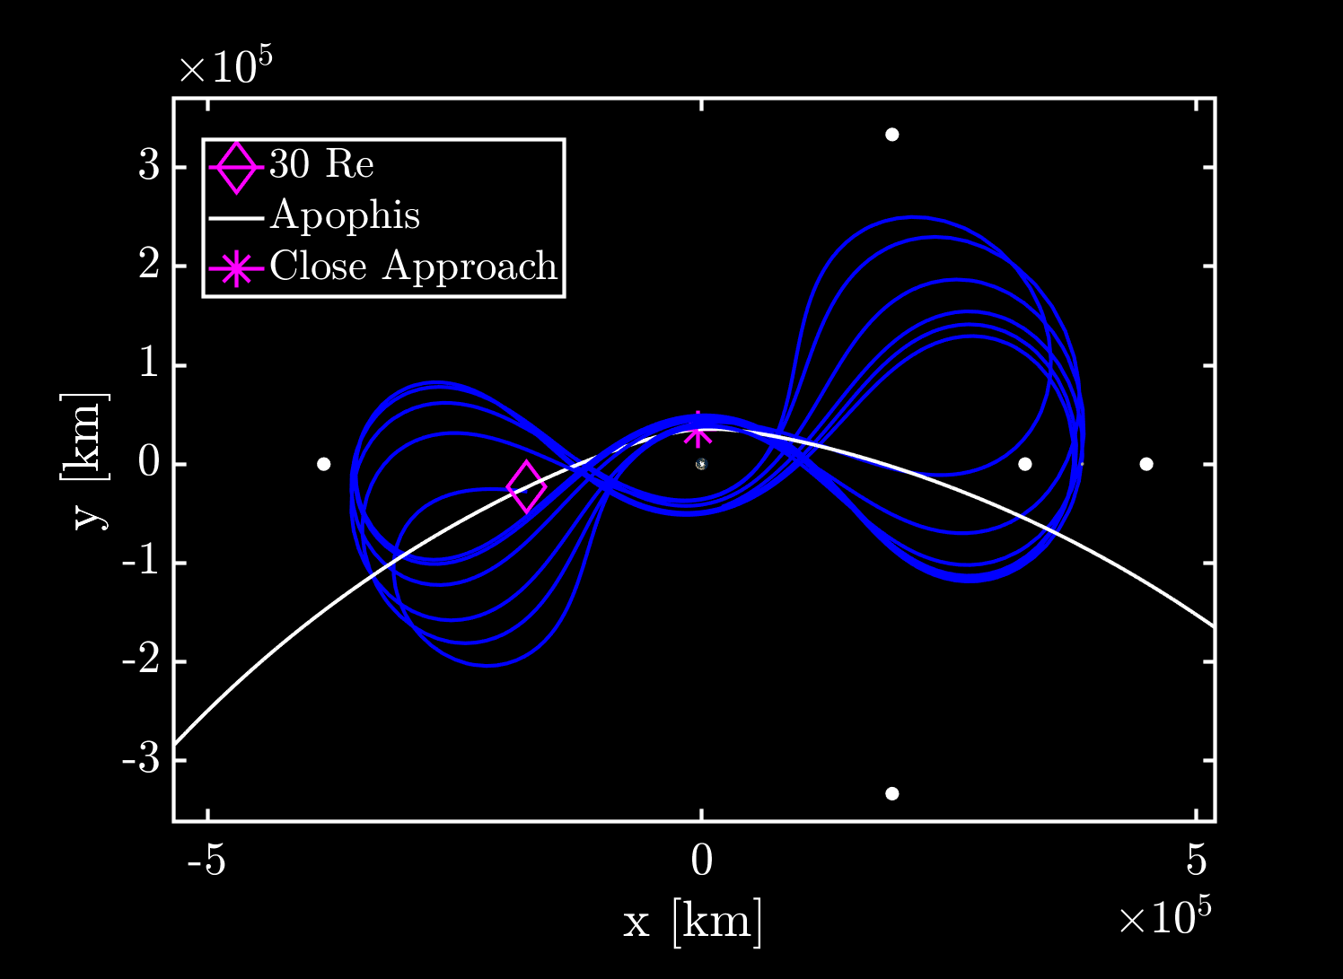
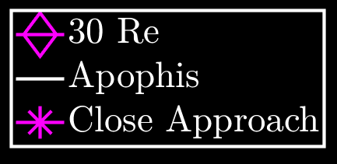
Candidate Staging Orbits
 | Flyby Speed at 30 R_{e} (km/s)
3:1 Resonant Orbit | 5.57
2:1 Resonant Orbit | 5.72
L₃ Lissajous Orbit | 6.78
Cislunar periodic and quasi-periodic structures can be leveraged to construct long-term (many month or year) staging orbits that ballistically intersect Apophis
3:1 Resonant Orbit
2:1 Resonant Orbit
L₃ Lissajous Orbit
L₄
L₄
L₃
L₃
L₁
L₂
L₃
L₁
L₂
L₅
L₅
All high-fidelity (Earth-Moon-Sun) staging orbits have a period of ~28 days

Slide 9
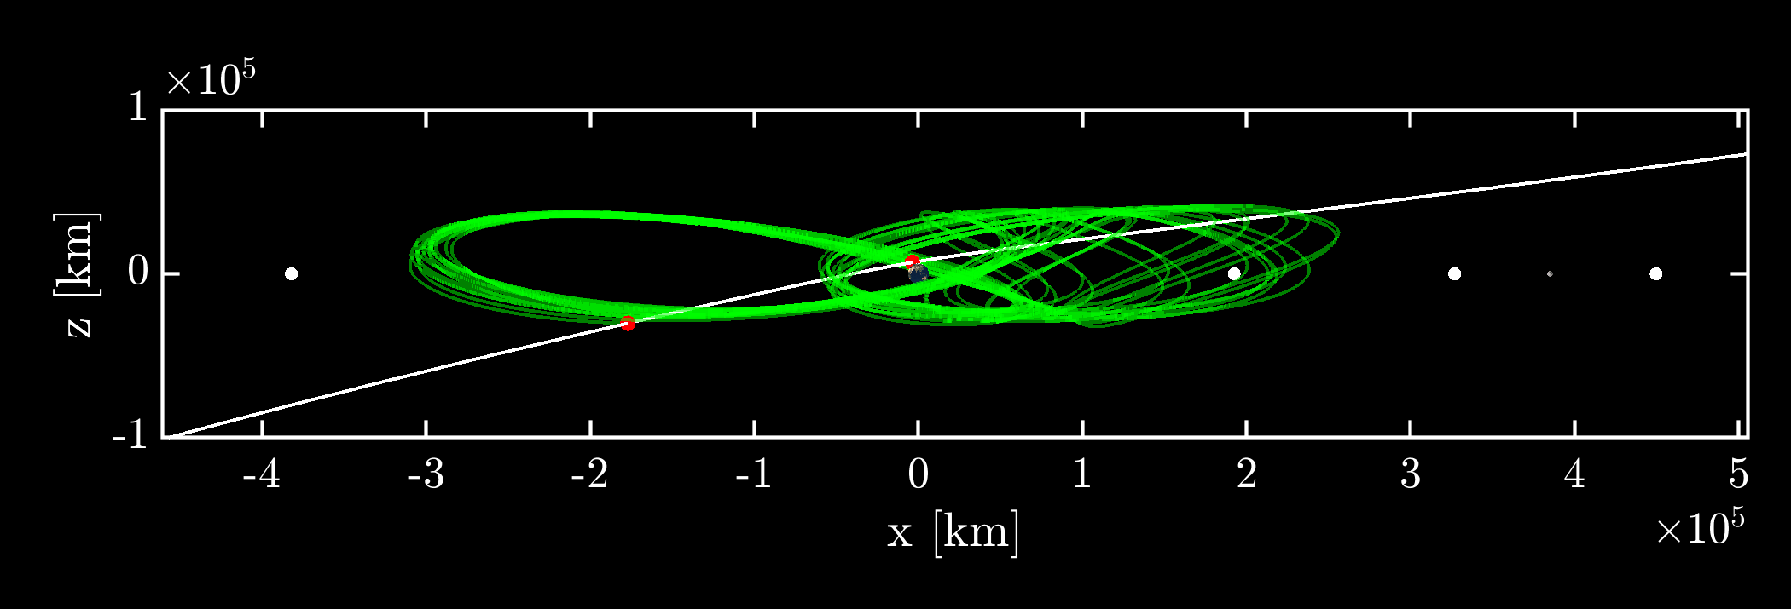
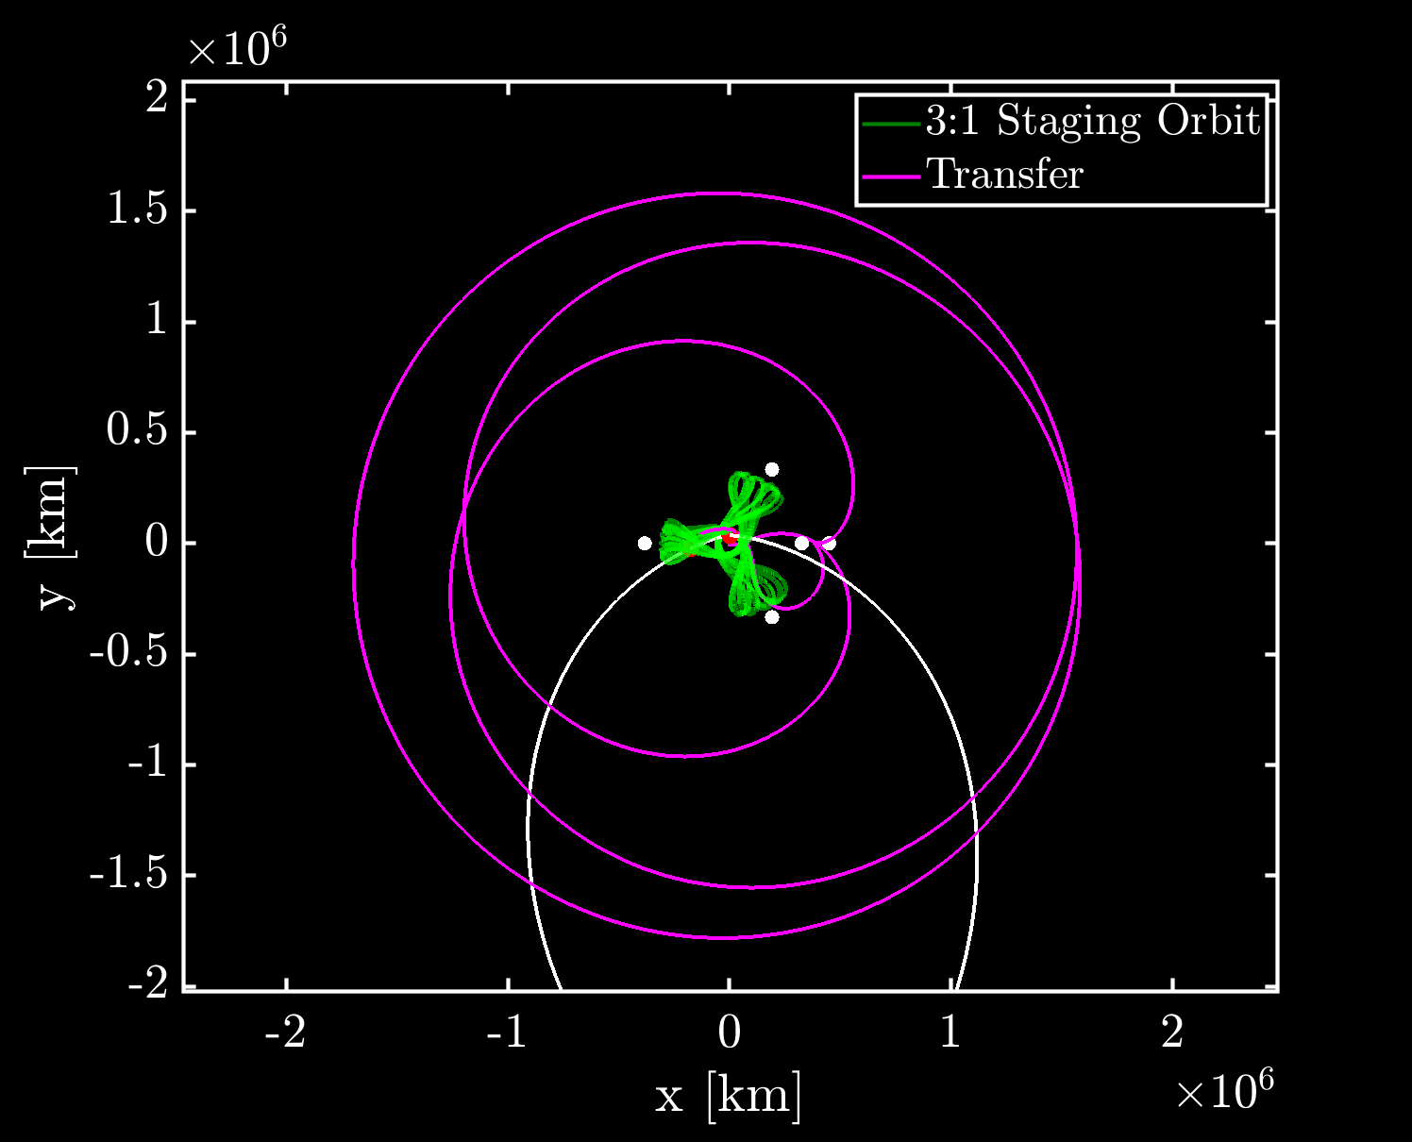
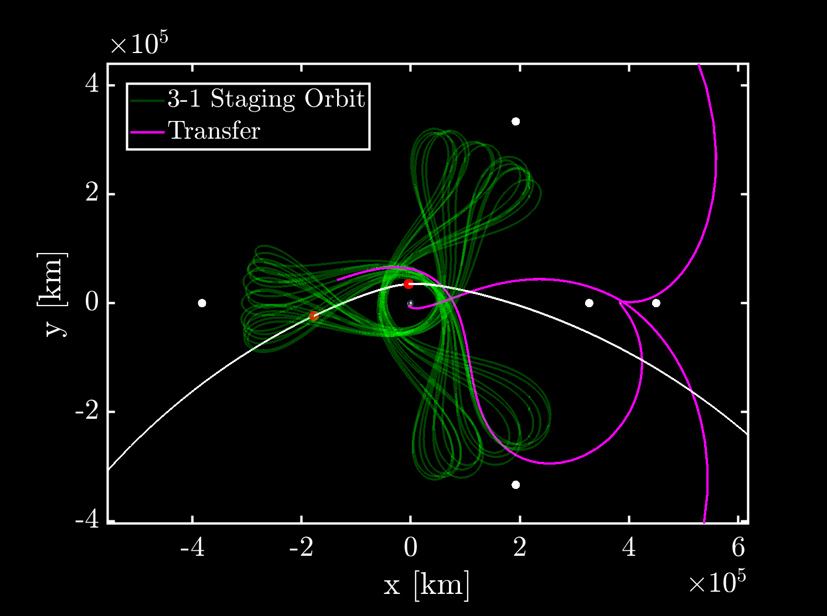
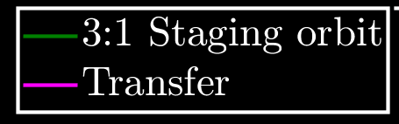
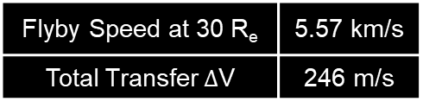
Transfer to Staging Orbit
Transfer launches with a lunar ride-share (e.g., leverage CLPS opportunity) over a year prior to the encounter
Flyby Speed at 30 R_{e} | 5.57 km/s
Total Transfer $Δ$V | 246 m/s
Apophis Flyby
13 month staging orbit
Earth-Centered
Earth-Moon Rotating Frame
L₄
Target 2nd lunar flyby returning to E-M region
Orbit Insertion
L₃
L₁
L₂
Post 1st lunar flyby out of E-M region
104 day Transfer to 3:1 resonant orbit
Apophis Flyby
Apophis
L₅

Slide 10
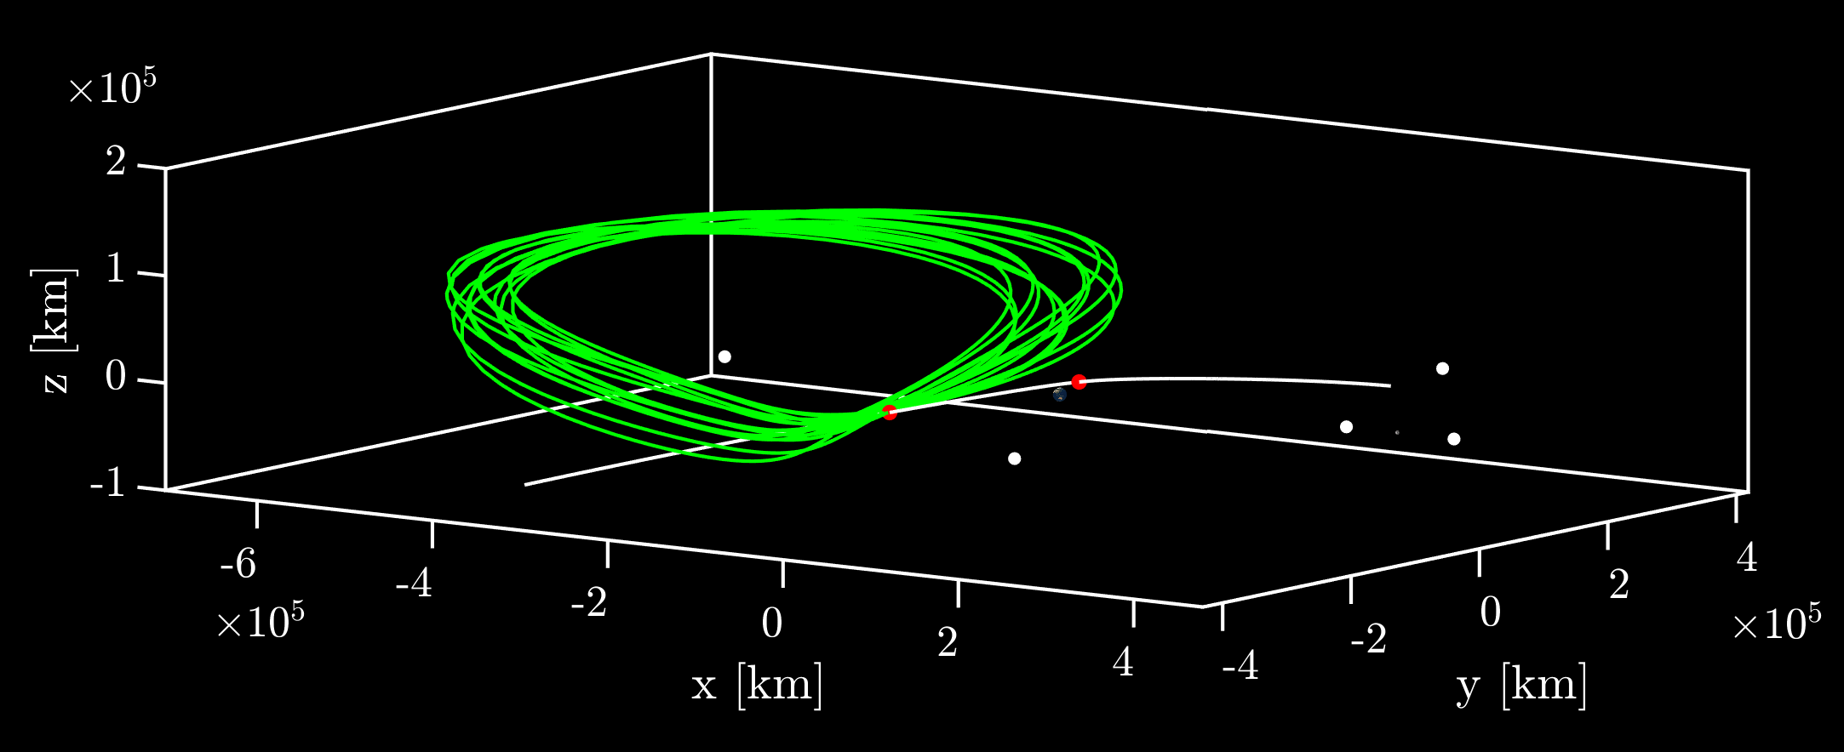
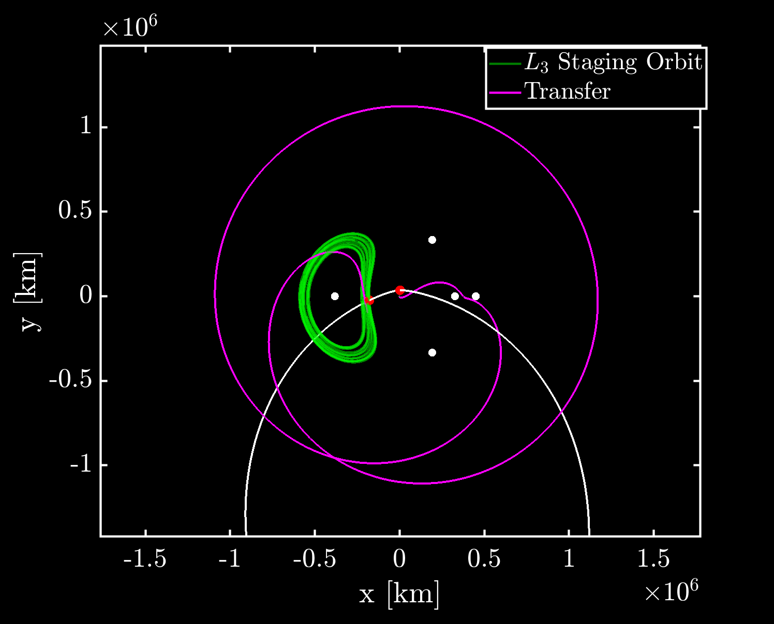
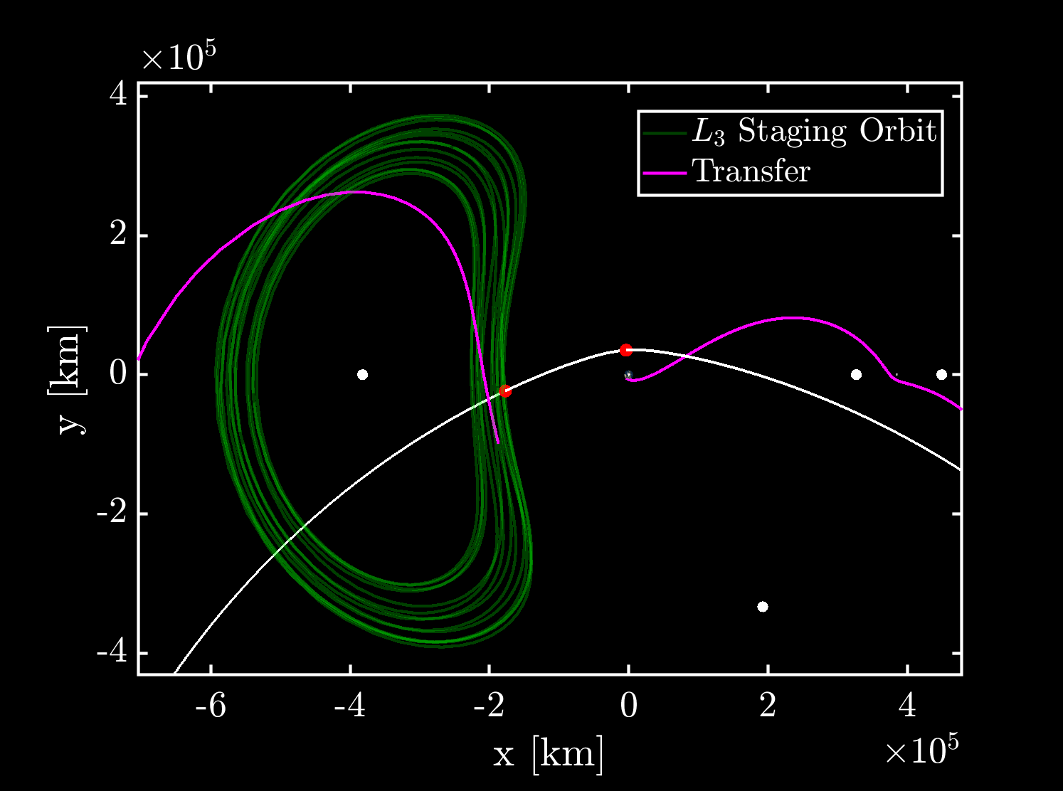
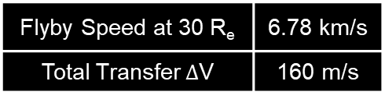
Transfer to Staging Orbit
Transfer launches with a lunar ride-share (e.g., leverage CLPS opportunity) over a year prior to the encounter
L₃
Apophis Flyby
Flyby Speed at 30 R_{e} | 6.78 km/s
Total Transfer $Δ$V | 160 m/s
13 month staging orbit
62 day Transfer To Lissajous
Earth-Centered
Earth-Moon Rotating Frame
Apophis Flyby
L₄
L₃
L₃
L₁
L₂
L₅
Orbit Insertion
Apophis
L₅

Slide 11
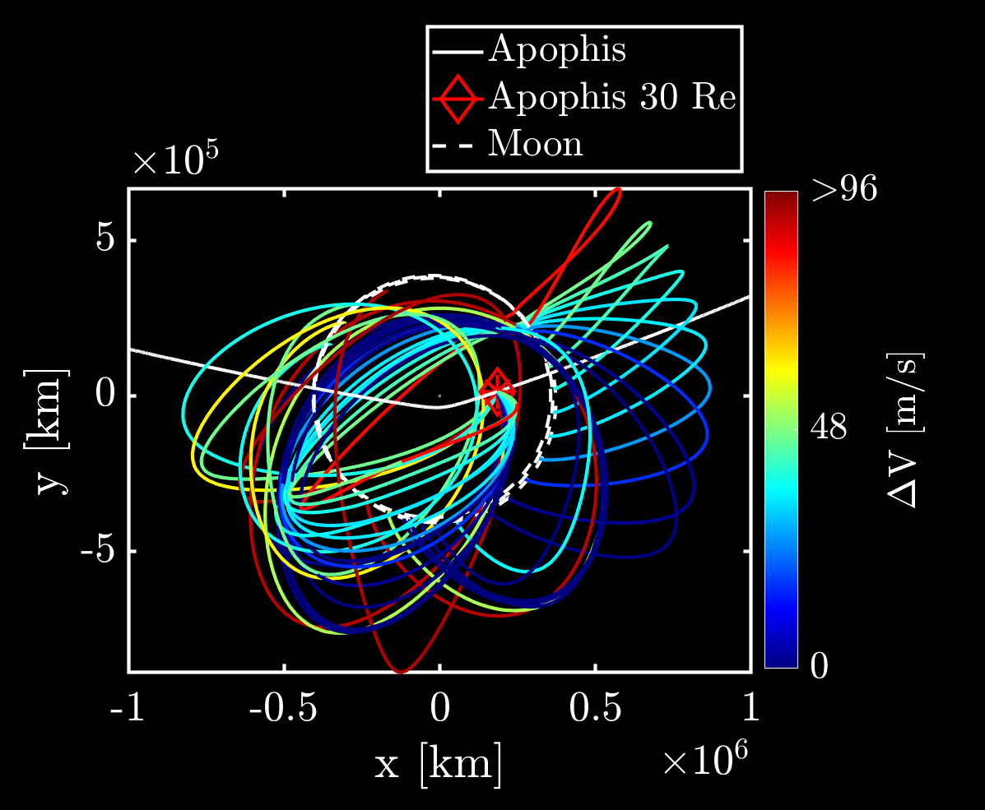
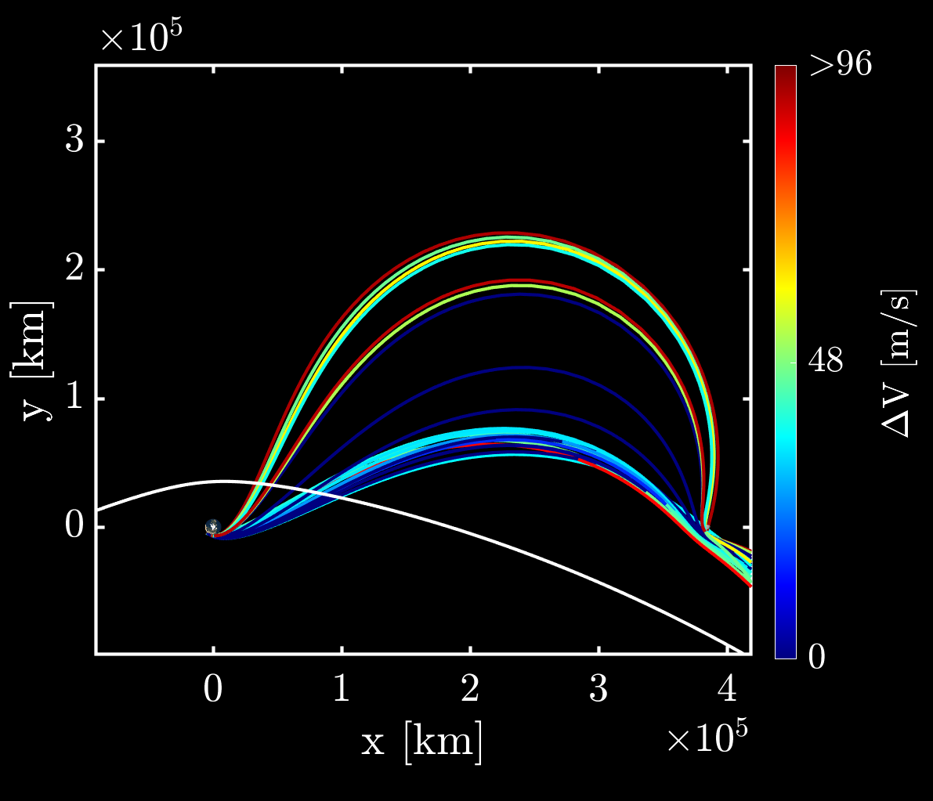
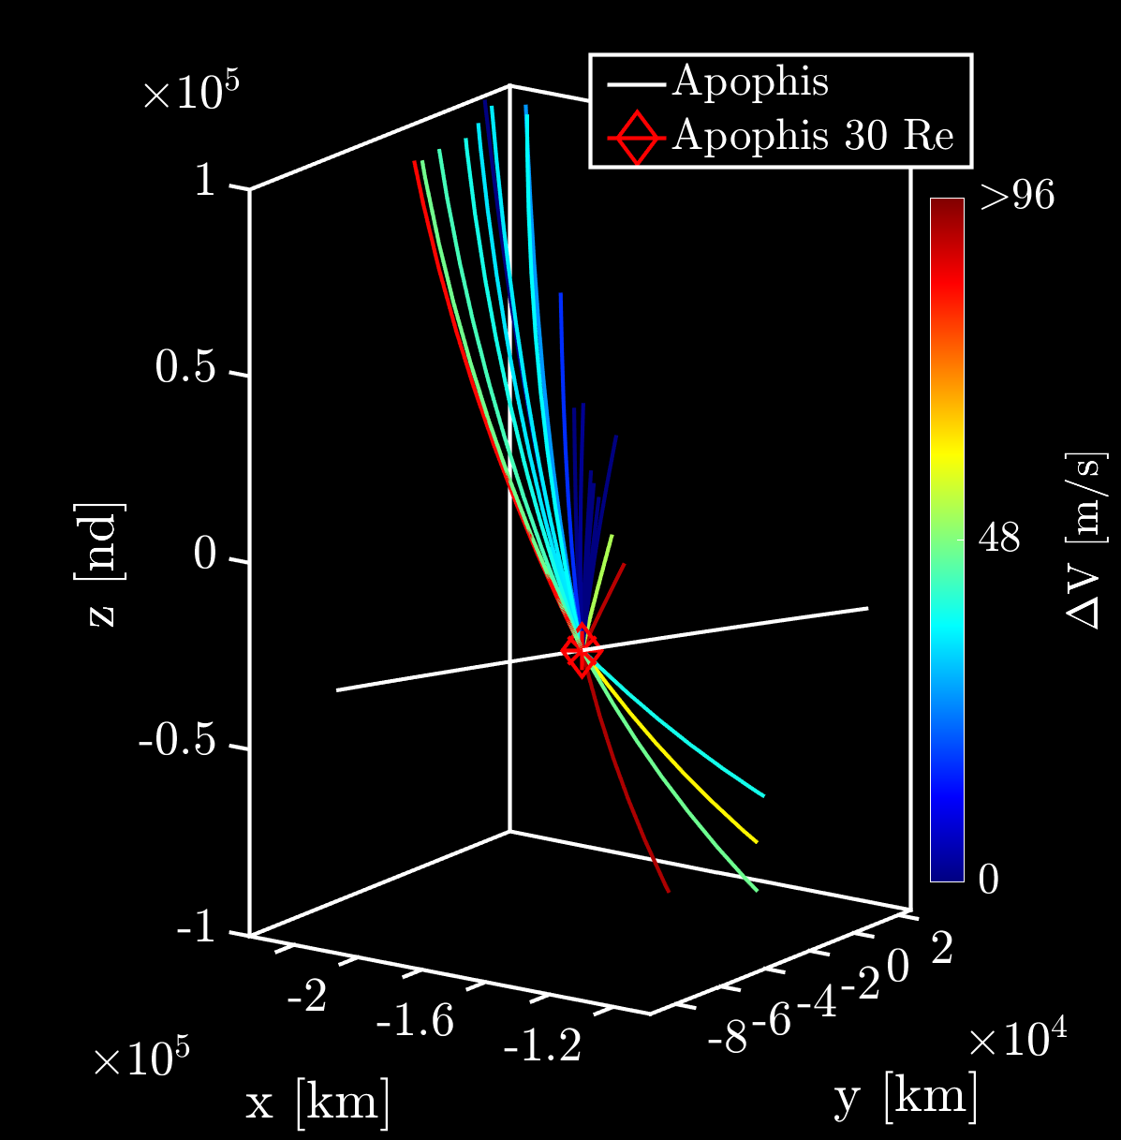
Direct Transfer from Lunar Rideshare
For later launches, we can forgo the staging orbits and leverage 2+ lunar gravity assists to target the Apophis flyby
We evaluated the month of January 2029 to understand the latest options available
Low propellant costs (< 50 m/s) available for half of the launch period
Earth-Centered
Earth-Moon Rotating Frame
Earth-Centered
Sun-Earth Rotating Frame
Earth-Centered
Earth-Moon Rotating Frame
Lunar gravity assist out of Earth-Moon system
Apophis Flyby
Apophis Flyby
Earth
Transfers leverage Sun’s gravity
Transfers perform Apophis flyby at 30R_{e} altitude

Slide 12

Concluding Remarks
Cislunar orbits offer useful staging locations prior to Apophis flyby
Current investigation focused on 3:1 resonant orbit and L₃ Lissajous orbit for >1 year long mission profiles
Direct low-energy (no staging) cislunar transfers are an alternative option with:
Shorter mission transit time-of-flights
Lower propellant mission $Δ$V requirements (<50 m/s)
These mission concepts demonstrate the feasibility of a low-cost and flexible solution that leverages novel cislunar staging orbits to enable future NEO encounters

Slide 13
Questions

