Slide 1

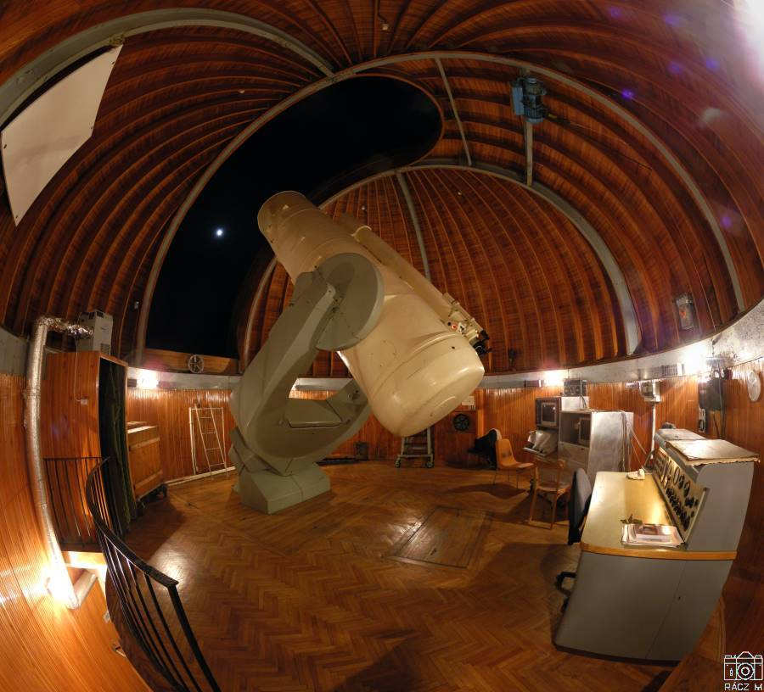
Imminent impactor discoveries from Hungary: recent resuts and lessons learn
László Kiss & Krisztián Sárneczky
Konkoly Observatory, Budapest
PDC 2025 2025.05.07.

Slide 2
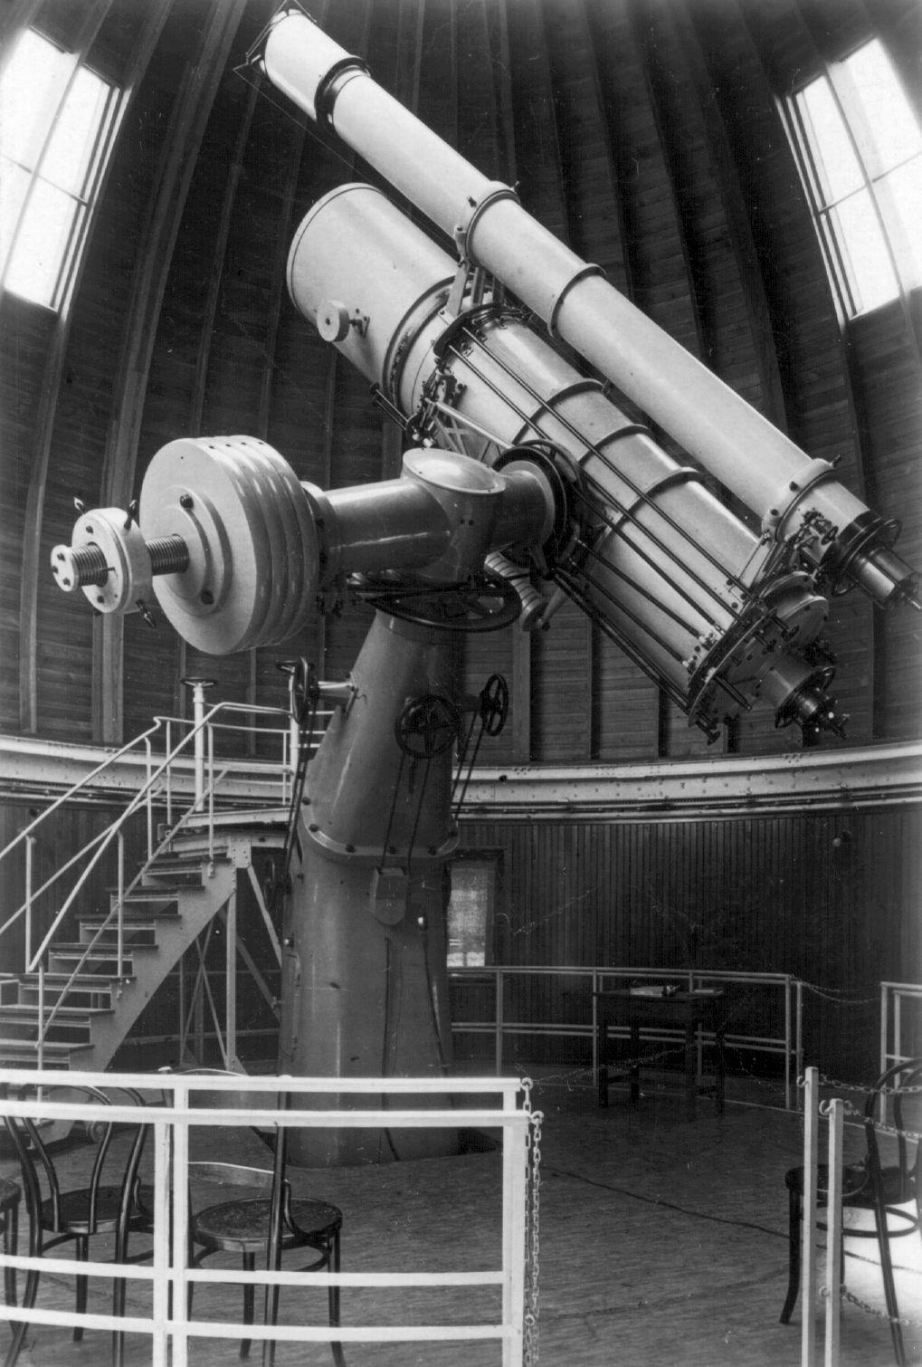
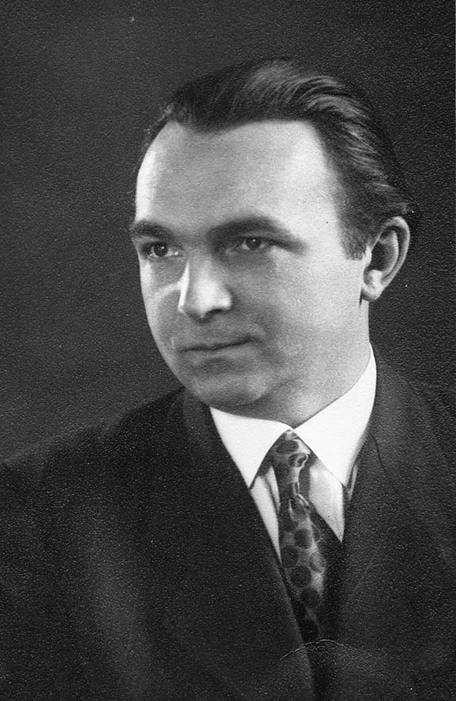
The first Hungarian asteroids
György Kulin
1936-1942
(1436) Salonta
(1441) Bolyai
(1442) Corvina
(1444) Pannonia
(1445) Konkolya
(1452) Hunnia
(1489) Attila
(1513) Mátra
(1538) Detre
(1546) Izsák
(1710) Gothard
(2043) Ortutay
(2058) Roka
(2242) Balaton
(2712) Keaton
(2738) Viracocha
(3019) Kulin
(3380) Awaji
(3427) Szentmártoni
(7317) Cabot
(10258) Sárneczky

Slide 3
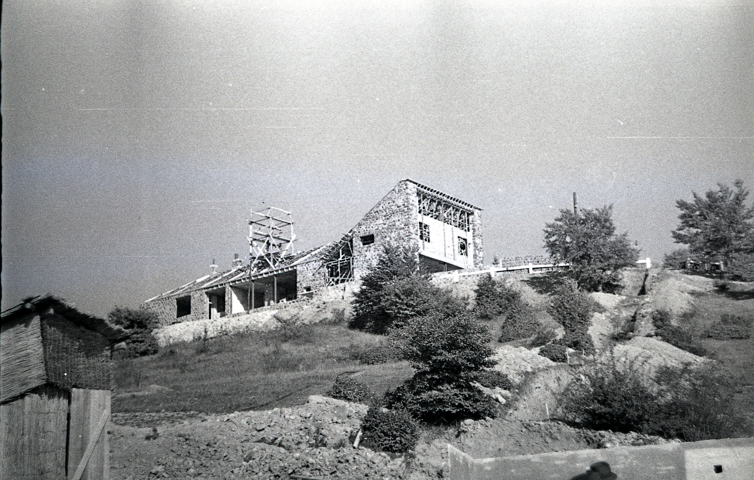
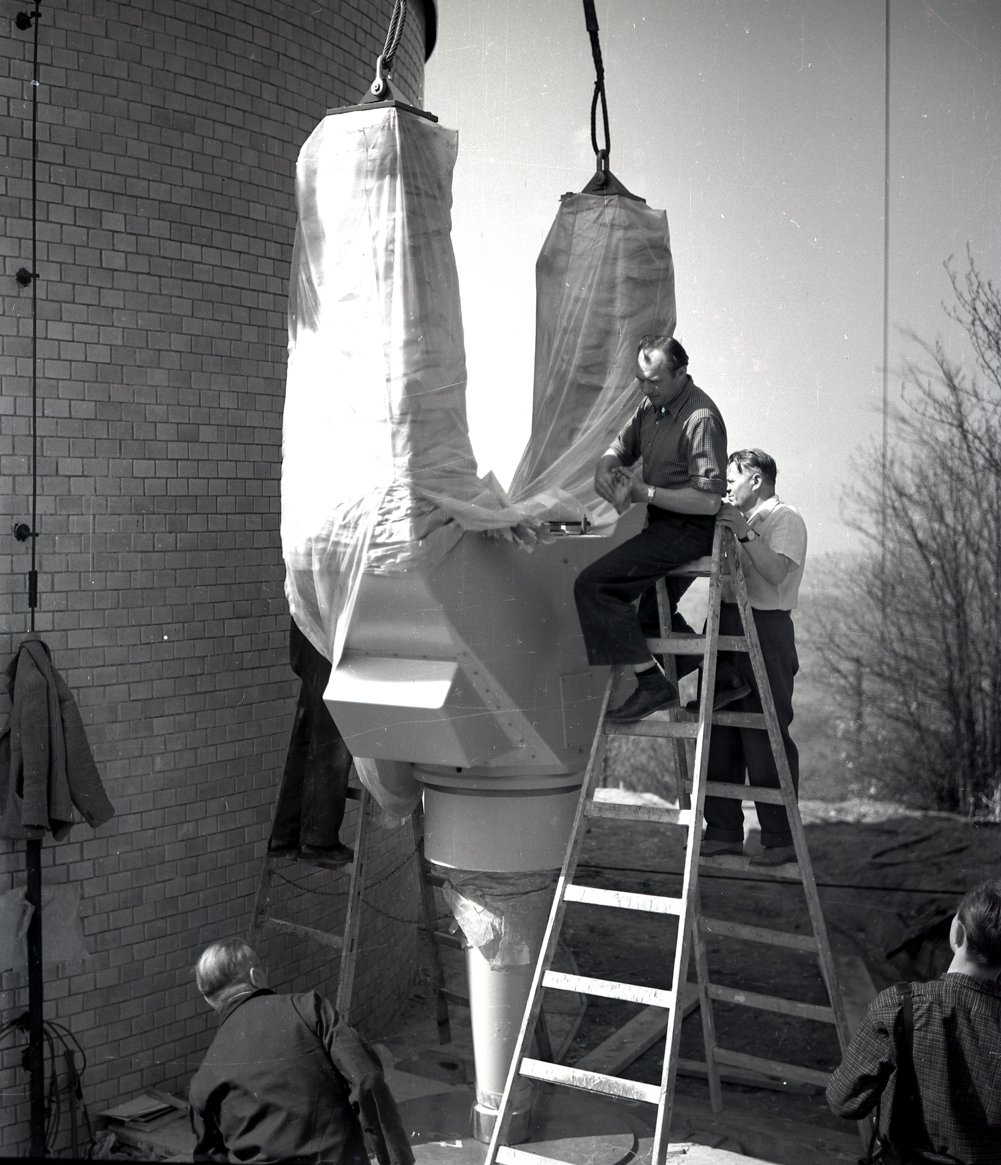
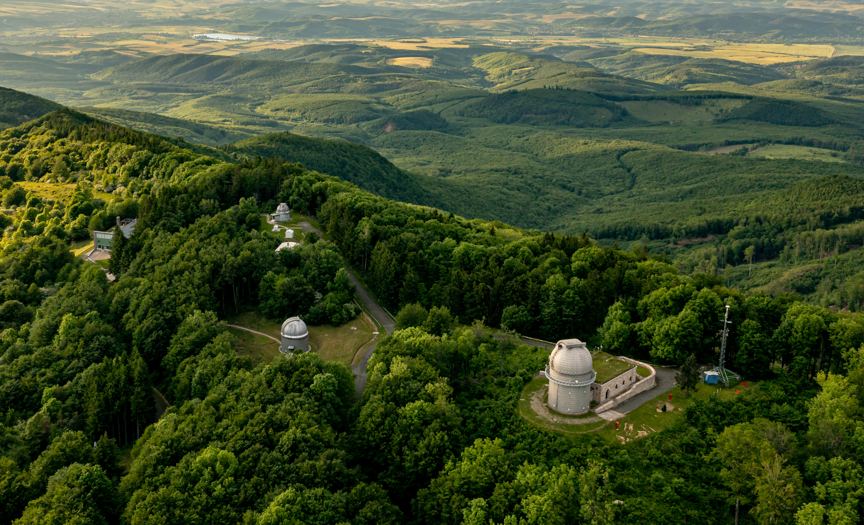
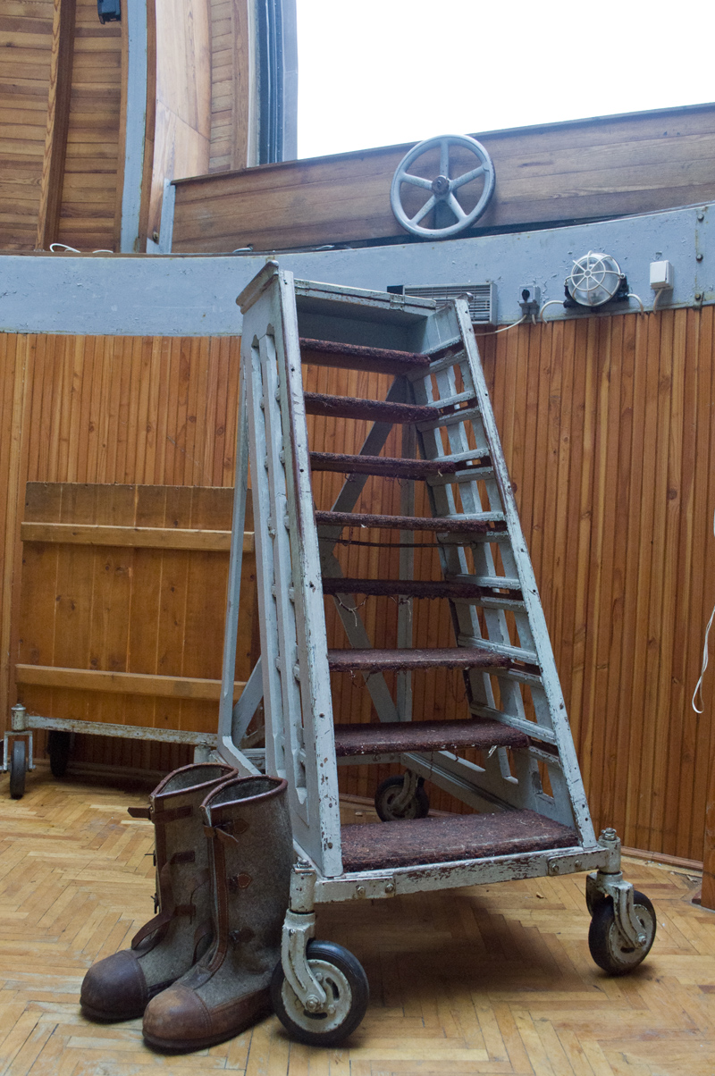
Piszkéstető Mountain Station
1959-1962
60/90/180 Schmidt
Carl Zeiss Jena, 5 deg FOV

Slide 4
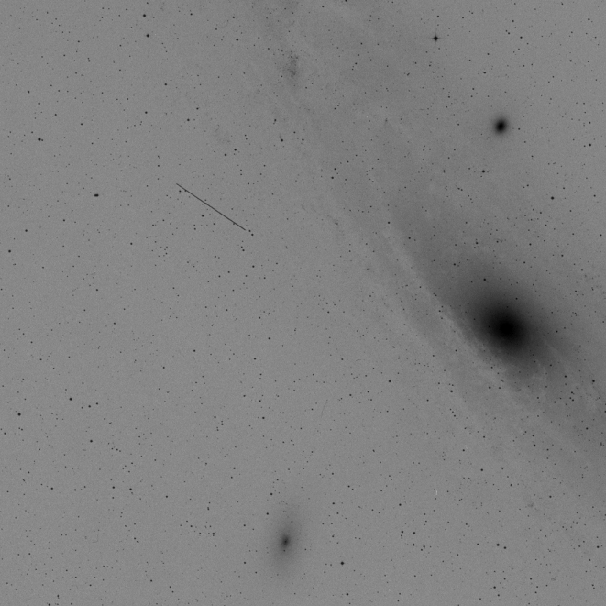
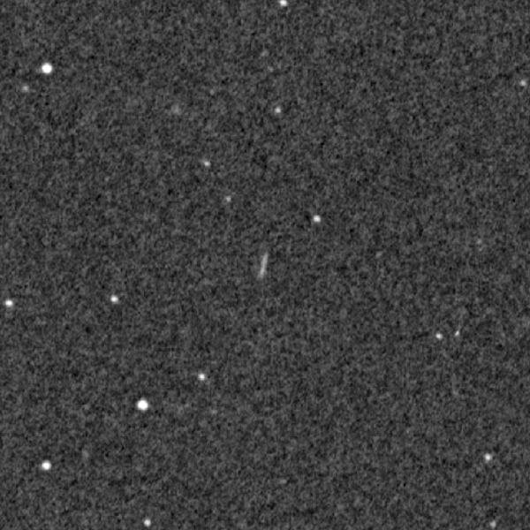
The first Hungarian NEO
(3200) Phaeton
(3103) Eger
1982.01.20.
1974.12.15.

Slide 5
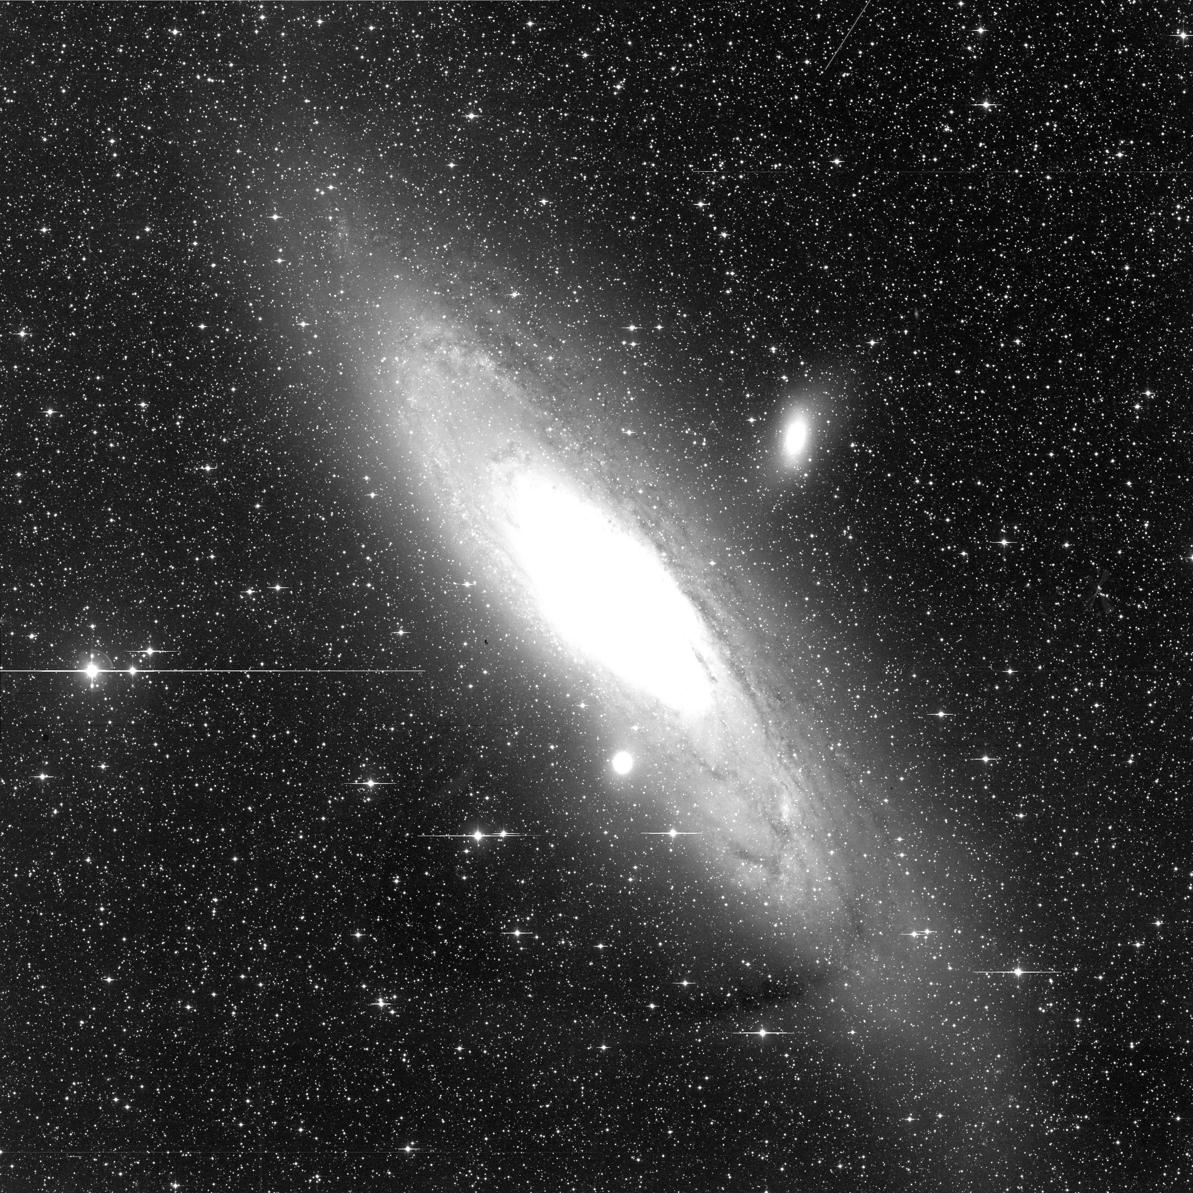
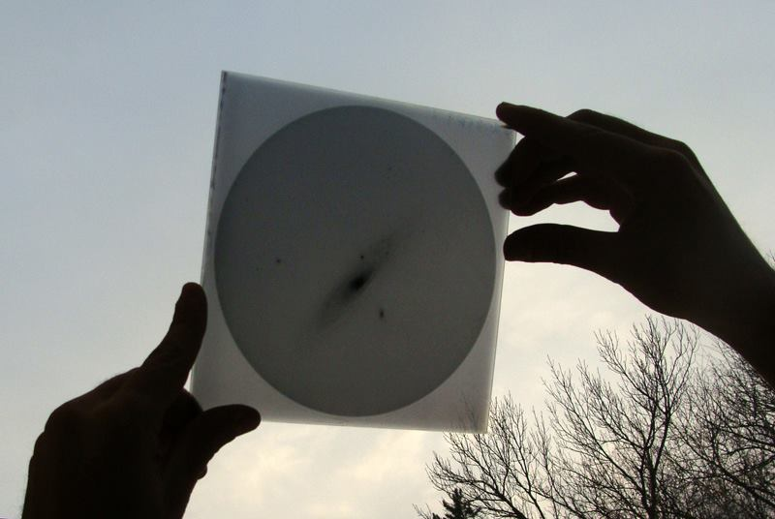
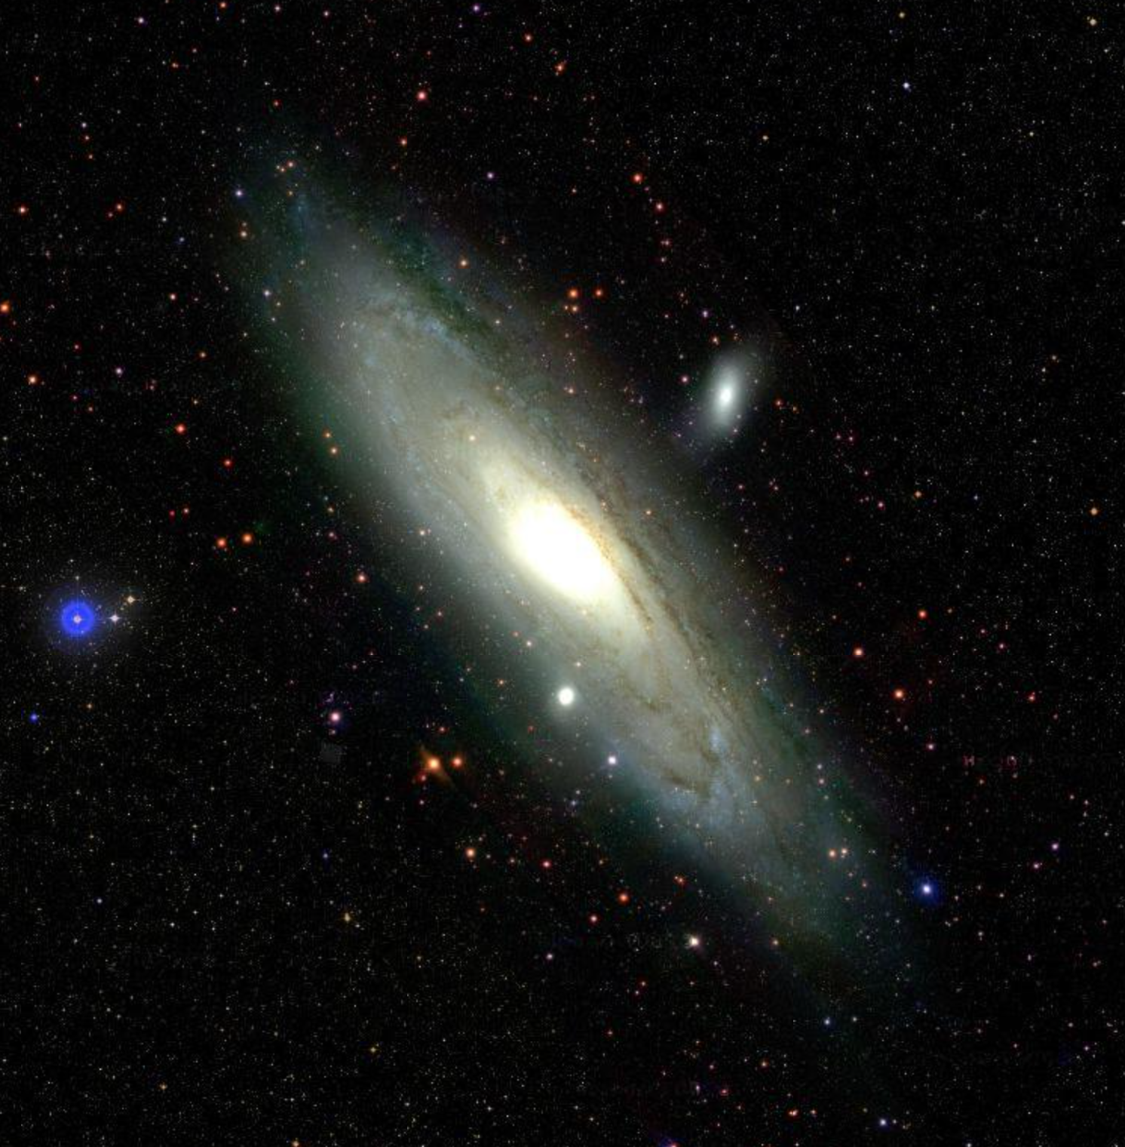
CCD revolution
2020-
277 NEO
1962-1997
1997-2010
1 NEO
2010-2019
7 NEO

Slide 6
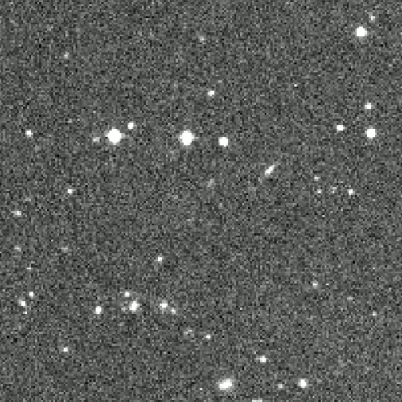
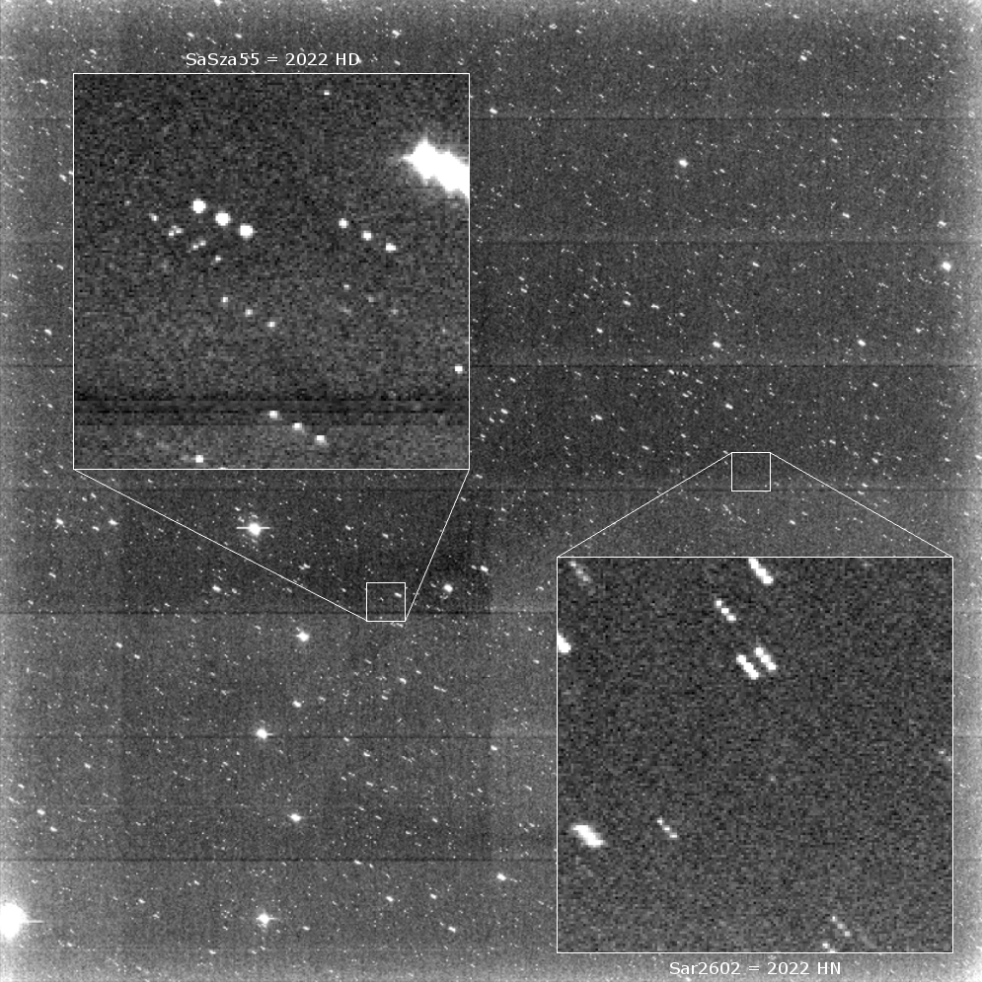
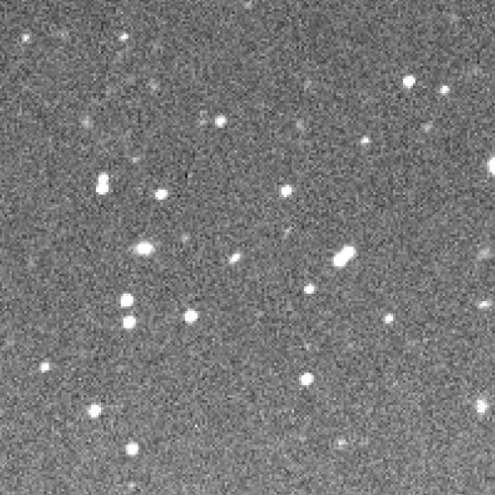
NEO Gallery
2020 VL1, 2020 WH1, 2020 WJ3, 2021 AB4, 2021 BJ3, 2021 CW7, 2021 CW8, 2021 CG9, 2021 DA2, 2021 EA, 2021 EC, 2021 ED, 2021 EX1, 2021 ER3, 2021 FB, 2021 GS6, 2021 JR3, 2021 KG, 2021 PW210, 2021 RB, 2021 RH, 2021 RA1, 2021 RX2, 2021 RK4, 2021 RW4, 2021 RS5, 2021 RA8, 2021 RD10, 2021 RU10, 2021 RL15, 2021 RD239, 2021 TR1, 2021 TQ9, 2021 TU13, 2021 TY14 2021 TC21, 2021 UT, 2021 UF2, 2021 UZ2, 2021 UW3, 2021 UO4, 2021 UT5, 2021 UD6, 2021 UQ7, 2021 UL120, 2021 VX4, 2021 WG, 2021 XM2, 2021 XC4, 2021 XM6, 2021 YR, 2022 AB, 2022 AC, 2022 BJ, 2022 BN, 2022 BS, 2022 CM3, 2022 DV, 2022 EB5, 2022 FD1, 2022 FO1, 2022 FE2, 2022 FT2, 2022 FP3, 2022 FG4, 2022 GV1, 2022, HD, 2022 HM, 2022 HN, 2022 HU3, 2022 MR, 2022 MS, 2022 OG, 2022 OK, 2022 OY78, 2022 QB, 2022 QP6, 2022 QU7, 2022 SF6, 2022 TU1, 2022 US, 2022 UD, 2022 UW1, 2022 UA3, 2022 UU10, 2022 UV10, 2022 UN11, 2022 UE14, 2022 UK16, 2022 UA21, 2022 UK21, 2022 UY21, 2022 UK24, 2022 VD2, 2022 VR2, 2022 WP3, 2022 WR3, 2022 WD4, 2022 WR5, 2022 XL, 2022 YU1, 2022 YR4,2022 YP6, 2022 YQ6, 2022 YS6, 2022 YT6 2023 AB, 2023 AH, 2023 AJ, 2023 AO, 2023 BN1, 2023 BE2, 2023 V2, 2023 BY3, 2023 BJ7, 2023 CO, 2023 CQ, 2023 CR, 2023 CT, 2023 CY, 2023 CJ1, 2023 CN1, 2023 CQ1, 2023 CX1, 2023 CW2, 2023 CB3, 2023 CC3, 2023 CM3, 2023 CS3, 2023 CT3, 2023 DA, 2023 DE, 2023 DR, 2023 EM, 2023 EX, 2023 FD, 2023 FE, 2023 FL, 2023 FT2, 2023 FD3, 2023 FL3, 2023 FT3, 2023 FL4, 2023 GQ, 2023 GS, 2023 HY3, 2023 HO5, 2023 JH, 2023 MO,3 2023 PS, 2023 PA1, 2023 PC1, 2023 PK1, 2023 PL1, 2023 PM1, 2023 PO1, 2023 QY, 2023 QS1, 2023 QK2,2023 QS2, 2023 QT2, 2023 RQ2, 2023 RB5, 2023 RL7, 2023 SL4, 2023 SH7, 2023 SX7, 2023 TA, 2023 TB, 2023 UJ1, 2023 UY1, 2023 VT3, 2023 VP4, 2023 VS4, 2023 VY4, 2023 VN5, 2023 XG, 2023 XU17, 2023 YS, 2023 YY, 2023 YA1, 2023 YR1, 2024 AR2, 2024 AT2, 2024 AV2, 2024 AC3, 2024 AF3, 2024 AG3, 2024 AO3, 2024 AZ3, 2024 AB4, 2024 AC4, 2024 AD4, 2024 BC, 2024 BN, 2024 BX1, 2024 BA3, 2024 CJ1, 2024 CK1, 2024 CR5, 2024 DJ, 2024 EL1, 2034 FO1, 2024 FO3, 2024 GN1, 2024 HF2, 2024 HM2, 2024 HN2, 2024 HX2, 2024 JP17, 2024 JS17, 2024 QF, 2024 QL, 2024 QQ, 2024 QL1, 2024 QM1, 2024 QR1, 2024 QT1, 2024 QV1, 2024 QE2, 2024 RK, 2024 RK1, 2024 RC, 2024 RK3, 2024 RZ4, 2024 SH7, 2024 UE, 2024 UN, 2024 UT2, 2024 UC4, 2024 UE6, 2024 UX10, 2024 UB11, 2024 VL1, 2024 VO1, 2024 VN2, 2024 VF3, 2024 WR4, 2024 XG, 2024 XL, 2024 YV4, 2024 YR6, 2024 YF7, 2024 YH7, 2024 YK7, 2024 YM7, 2024 YG9, 2024 YR9, 2024 YG13, 2025 AO, 2025 CA1 2025 CC1, 2025 DK1, 2025 DL1, 2025 EL, 2025 EW1, 2025 EX1, 2025 EZ1, 2025 EF2, 2025 EH2, 2025 EO2, 2025 FJ, 2025 FN, 2025 FR, 2025 FS, 2025 FO2, 2025 FX6, 2025 GM, 2025 GO, 2025 HE, 2025 HK, 2025 HN, 2025 HS, 2025 HU

Slide 7
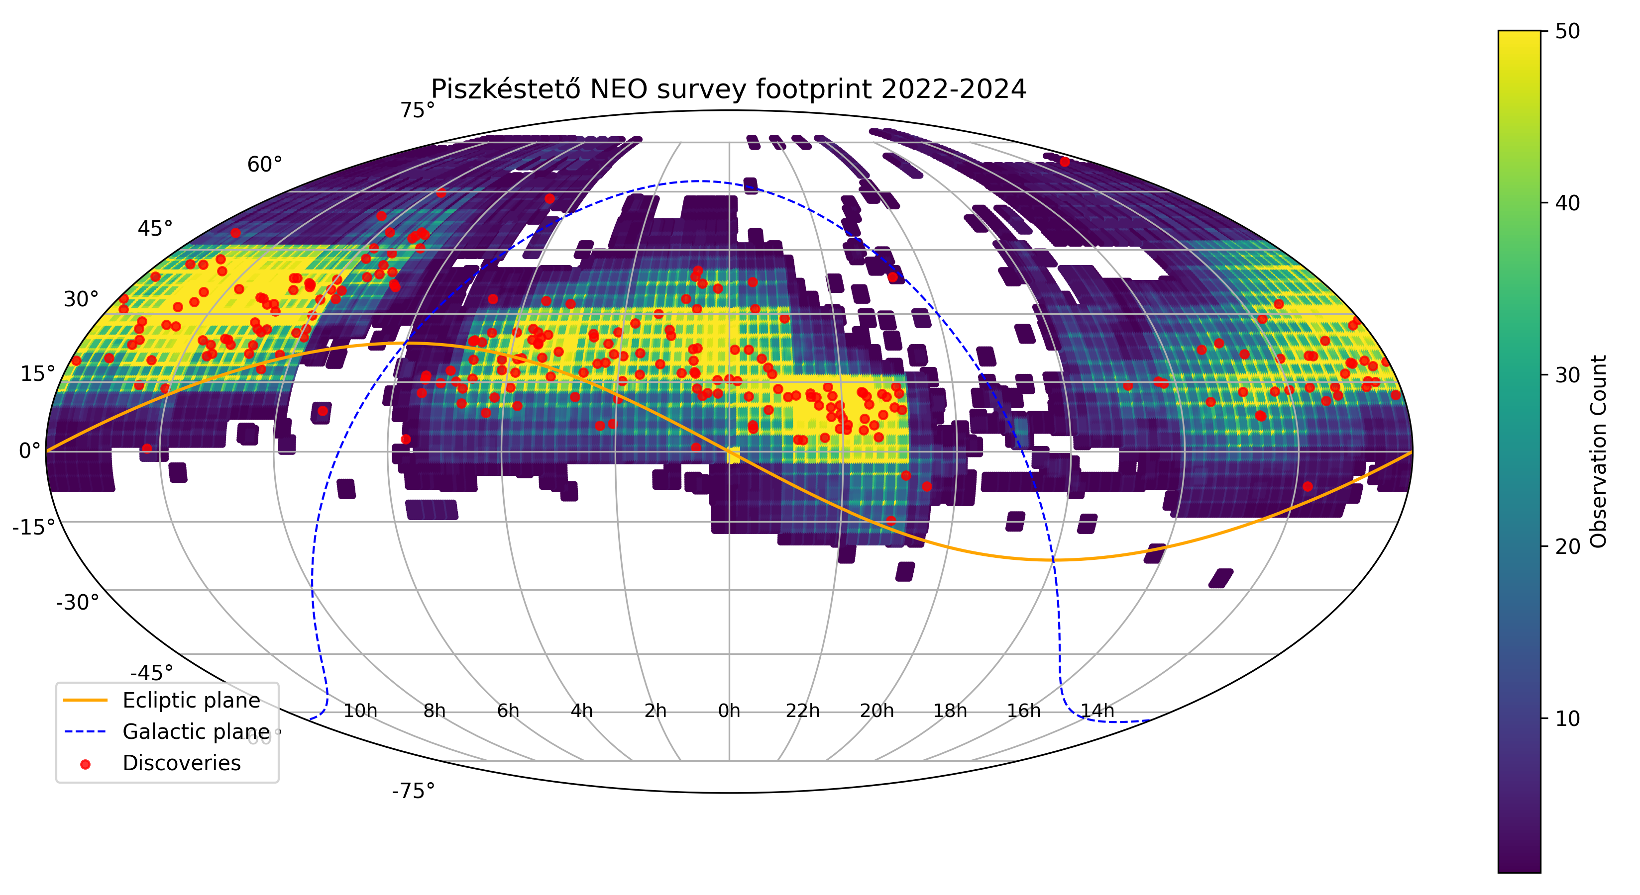
The Piszkéstető NEO Survey footprint and the discoveries between 2022-2024
Telescopes
Mt. Lemmon 3002
Pan-STARRS 2 2422
Pan-STARRS 1 1339
Kitt Peak-Bok 616
Catalina Schmidt 441
Piszkéstető Schmidt 199
Projects
CSS 406
Pan-STARRS 3761
ATLAS 432
Piszkéstető 199

Slide 8
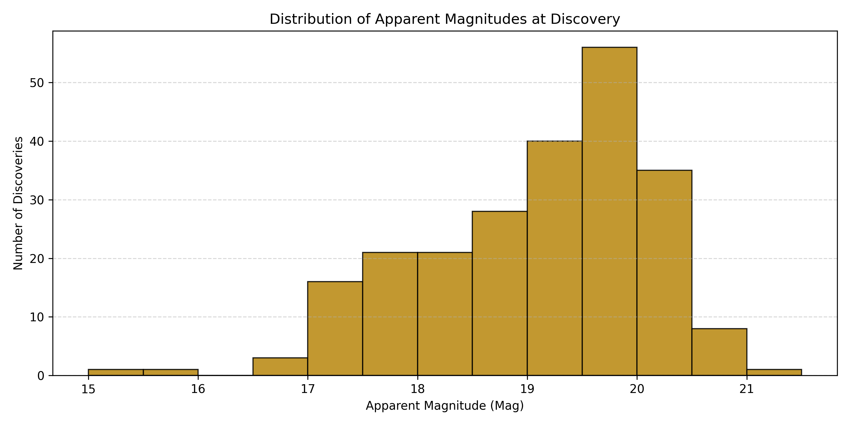
The apparent magnitude distribution of the Piszkéstető NEO’s between 2022-2024

Slide 9
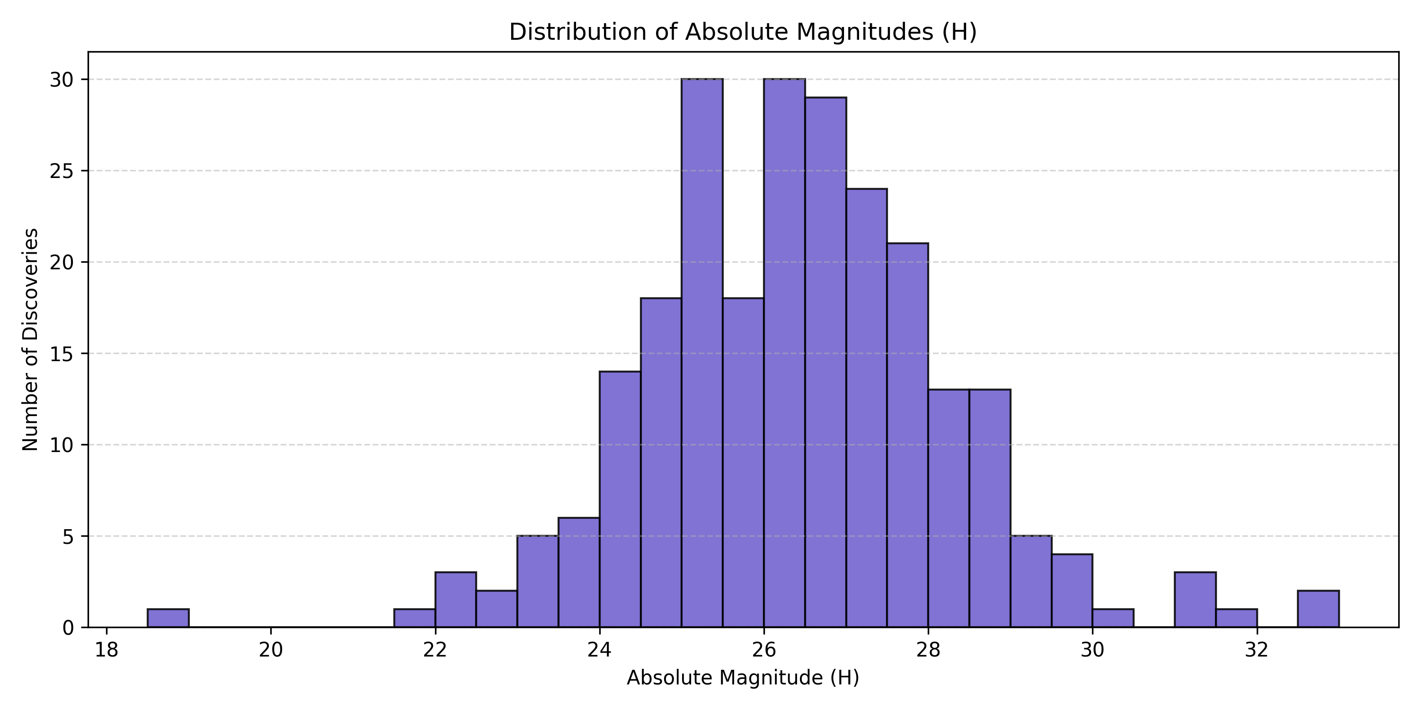
The absolute magnitude distribution of the Piszkéstető NEO’s between 2022-2024

Slide 10
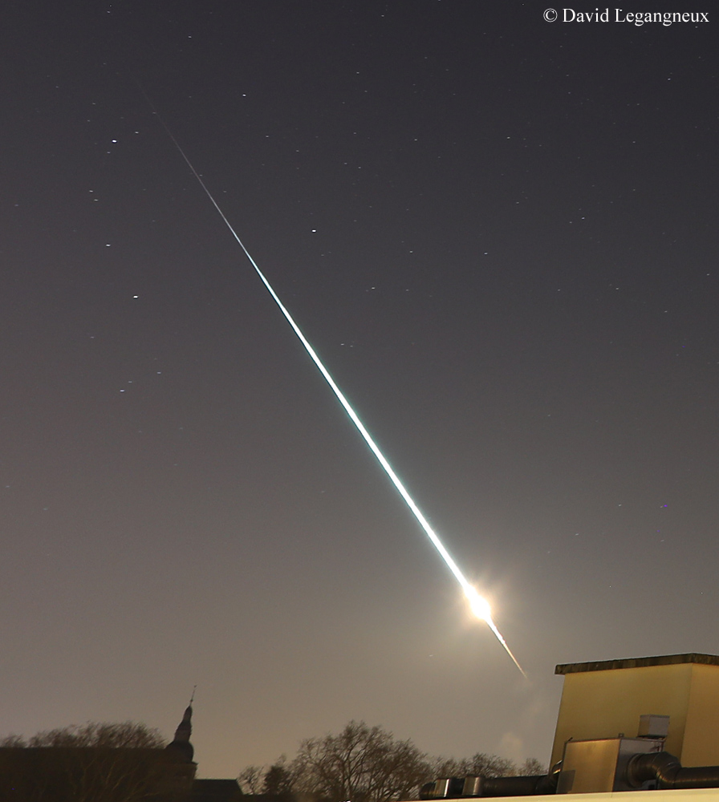
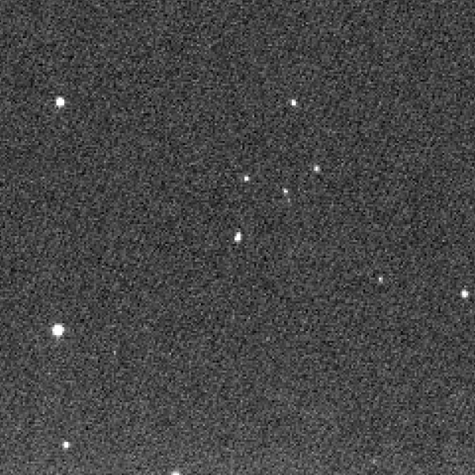
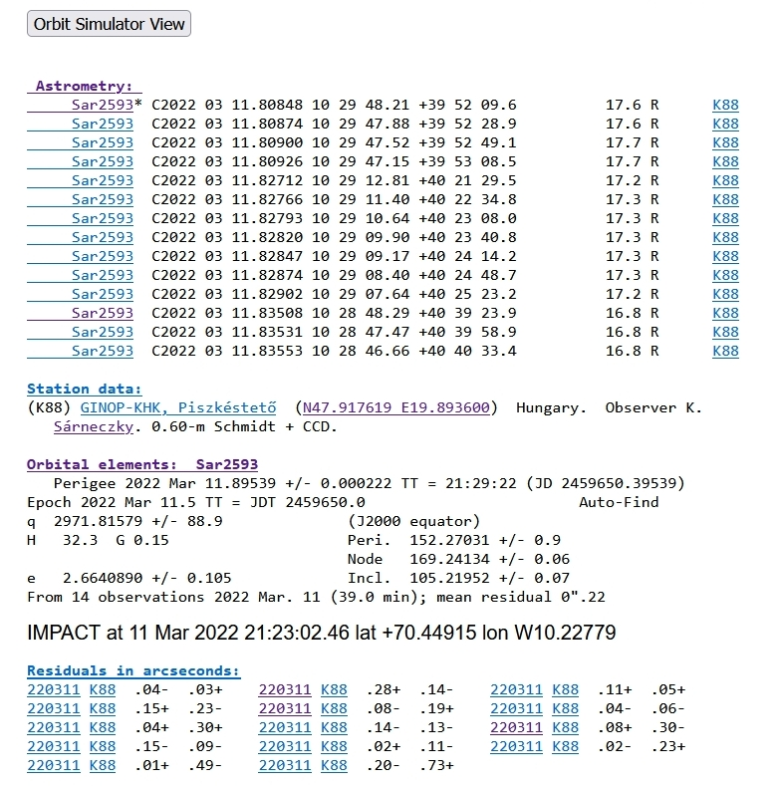
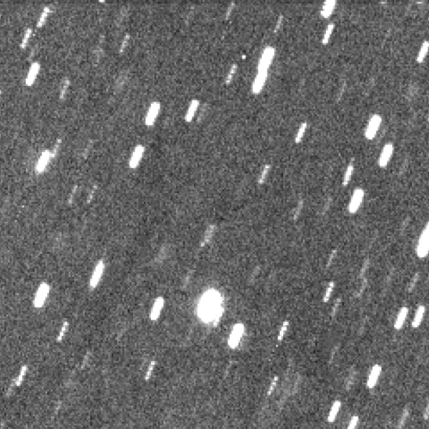
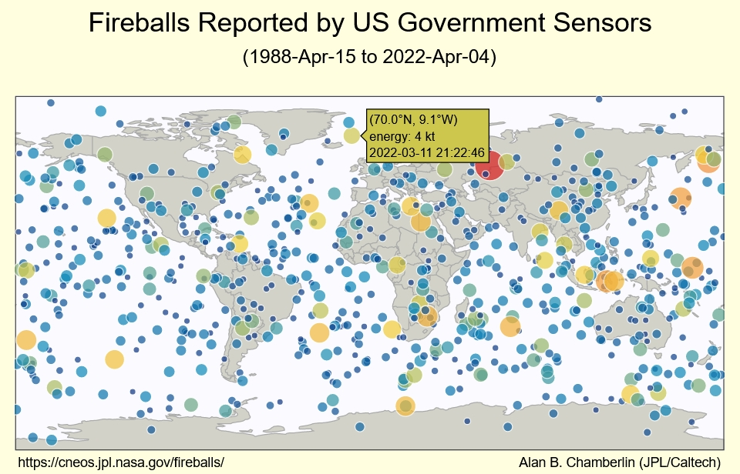
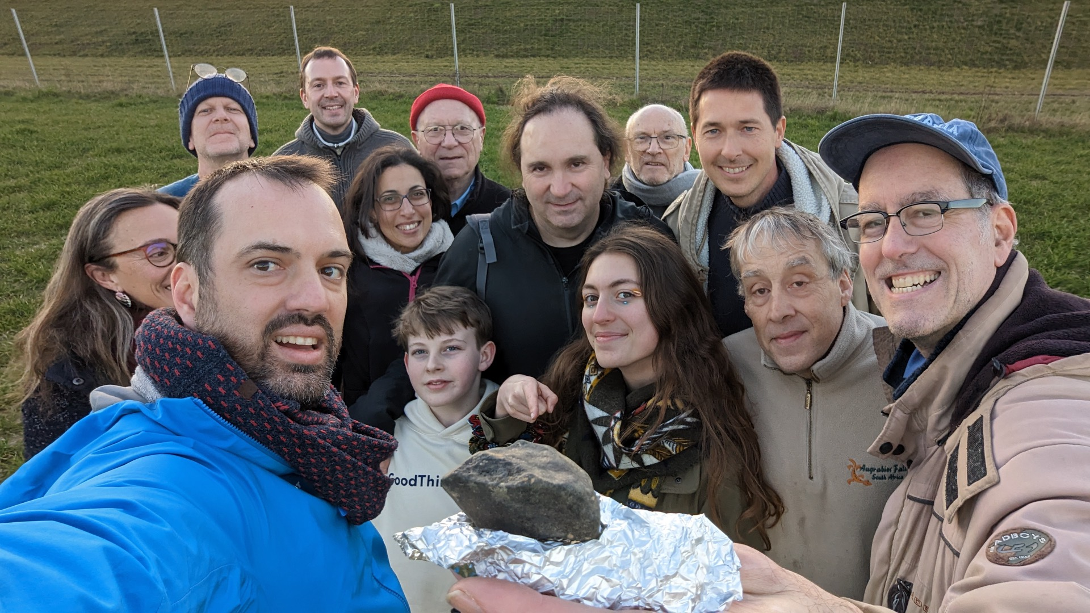
Imminent impactors
2022 EB5
2 hours
2023 CX1
6,7 hours

Slide 11
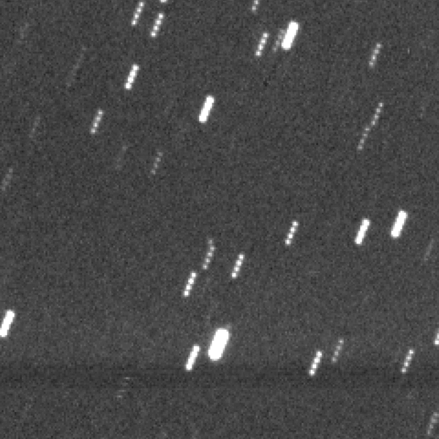
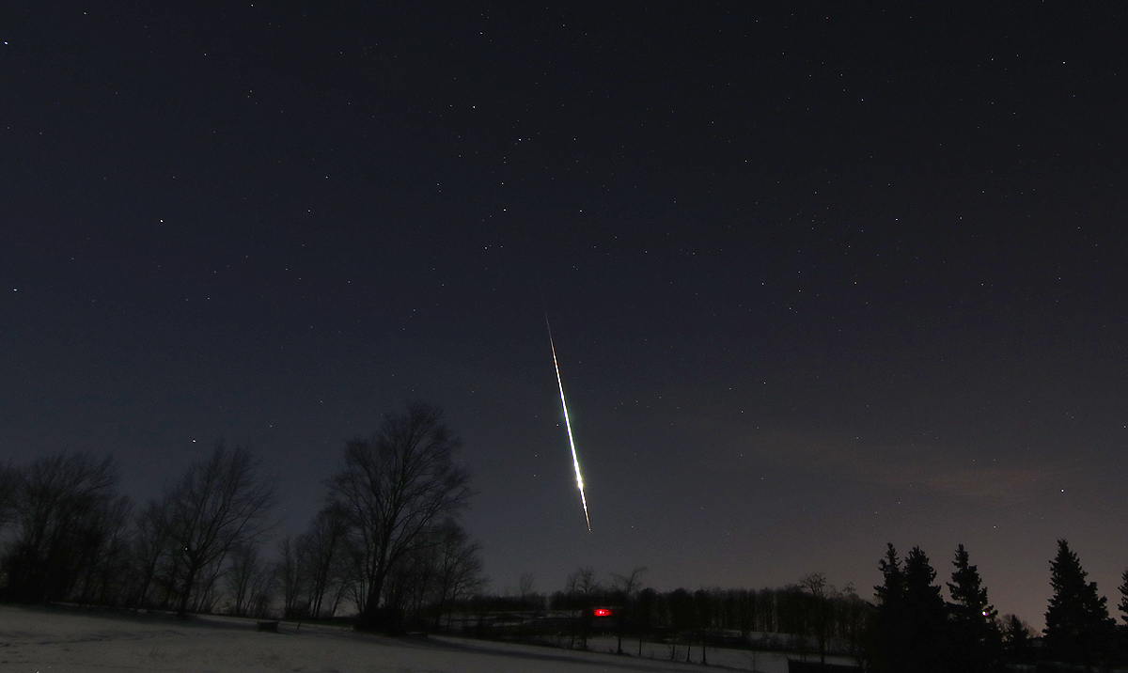
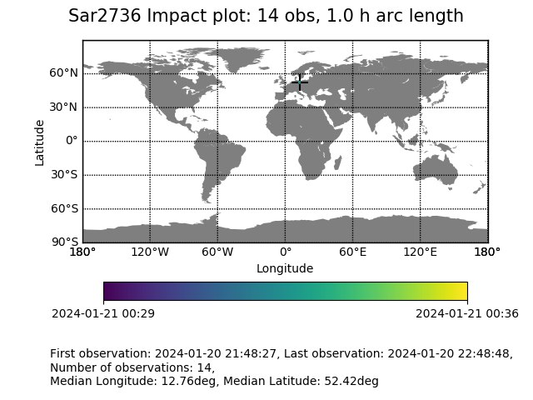
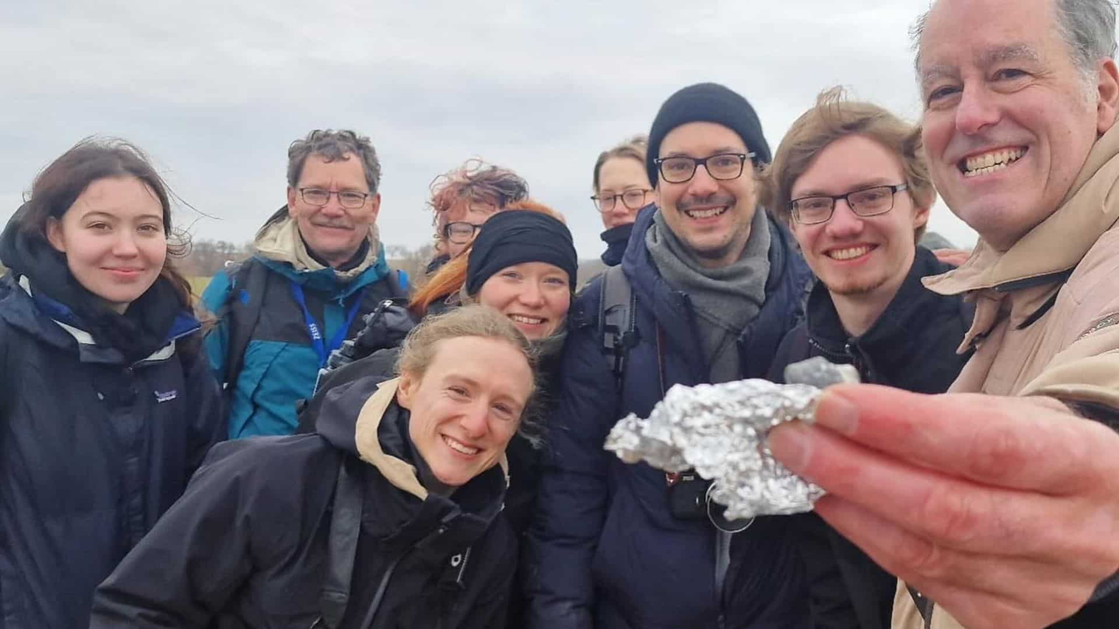
Imminent impactors
  Imminent impactors
  2008 TC3 4 m Mt. Lemmon
  2014 AA 4 m Mt. Lemmon
  2018 LA 3 m Mt. Lemmon
  2019 MO 5 m ATLAS
  2022 EB5 5 m Piszkéstető
  2022 WJ1 1 m Mt. Lemmon
  2023 CX1 1 m Piszkéstető
  2024 BX1 45 cm Piszkéstető
  2024 RW1 1 m Mt. Lemmon
  2024 UQ 1 m ATLAS
  2024 XA1 1 m CSS-Bok
2024 BX1
2,8 hours

