Slide 1
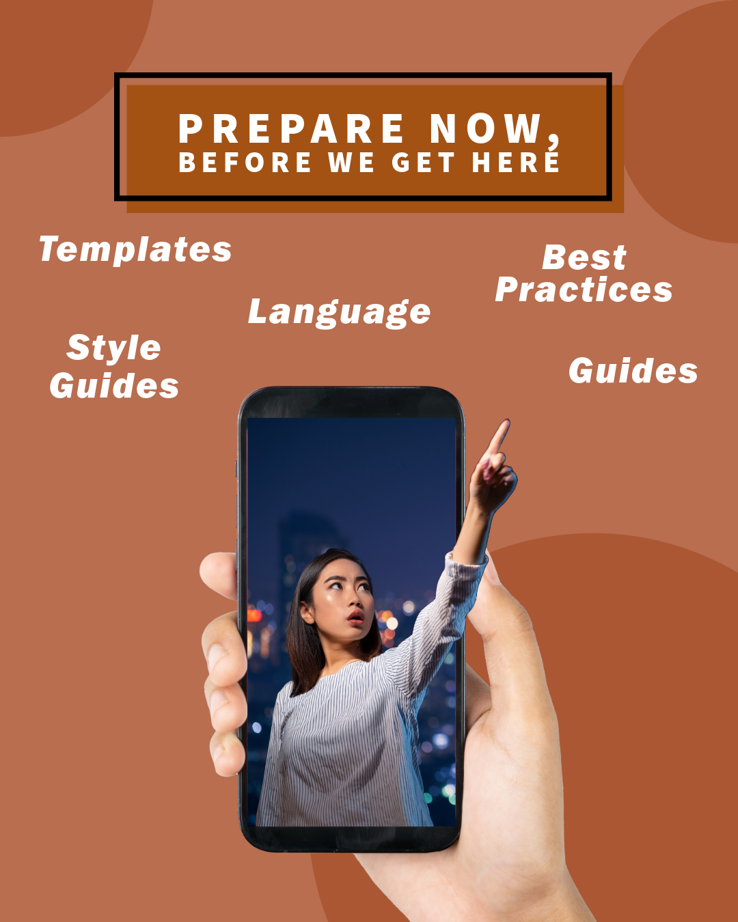
Creating a Communications Kit for Future Asteroid Threats
Dr. Lori Pigue
Dr. Timothy Titus, Dr. Sara McBride
U.S. Geological Survey
Astrogeology Science Center
This information is preliminary and is subject to revision. It is being provided to meet the need for timely best science. The information is provided on the condition that neither the U.S. Geological Survey nor the U.S. Government shall be held liable for any damages resulting from the authorized or unauthorized use of the information.

Slide 2
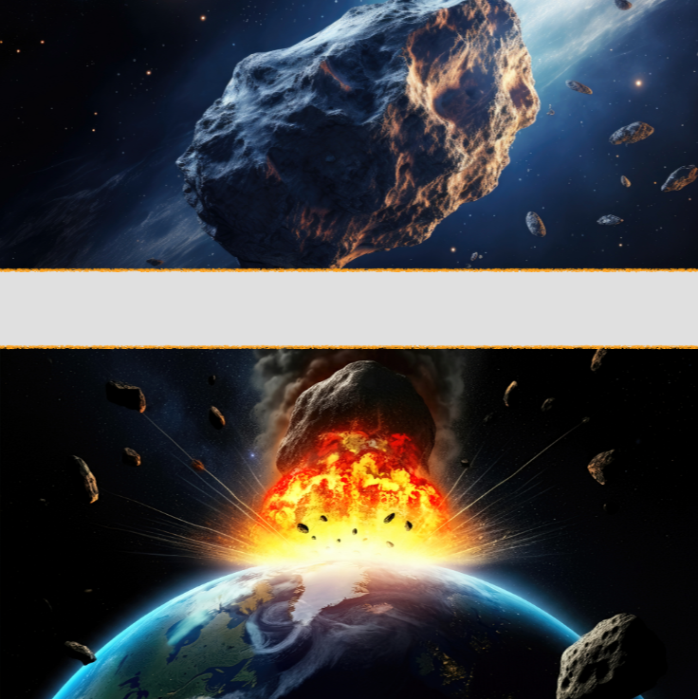
Preliminary Information-Subject to Revision. Not for Citation or Distribution.
The knowledge base for most of the public about asteroid impacts is from Sci-Fi movies and pop culture.
Overdramatized imagery
Unrealistic mission profiles
Misconceptions
Inadequate communications plans
Incorrect content
Chaotic dissemination
The time to plan is now!

Slide 3
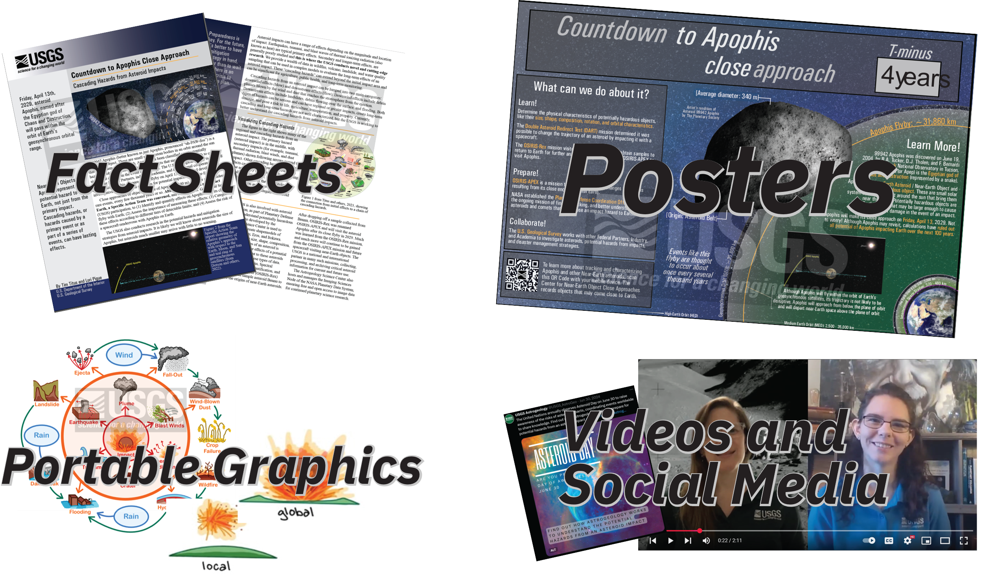
Preliminary Information-Subject to Revision. Not for Citation or Distribution.
U.S. Geological Survey is creating communications products for informal and formal dissemination.
Fact Sheets
Posters
Graphics
Videos
Social Media cards
Outreach materials
Pre-approved template language

Slide 4
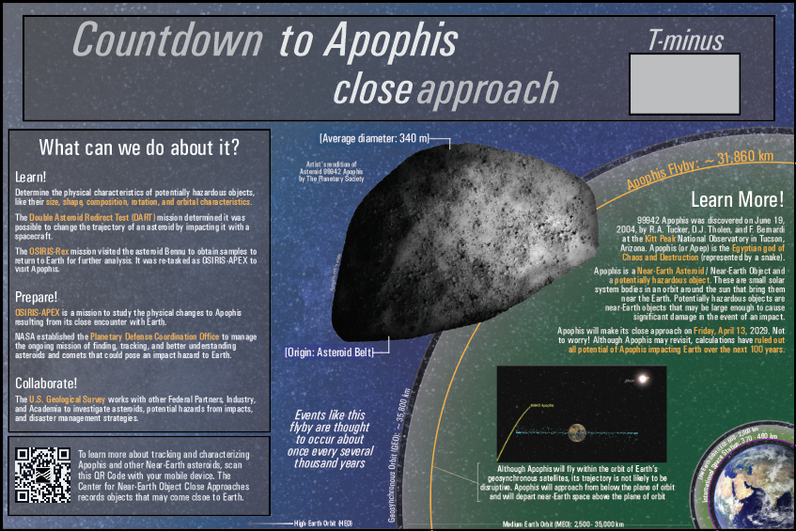
Preliminary Information-Subject to Revision. Not for Citation or Distribution.
Communications products in development now for use during the International Year of Planetary Defense and Apophis Close Approach
Socializing concepts
Many natural hazards have common encounters and are broadly socialized. As populations expand, our exposure to asteroid impacts necessitate increased socialization to the idea that asteroids can impact Earth, and the threat can be mitigated.
High-visibility events
Events like the Apophis close approach and the 2024 YR4 discovery provide opportunities to communicate asteroid threats and activities currently underway in Planetary Defense (especially in detection and mitigation).

Slide 5
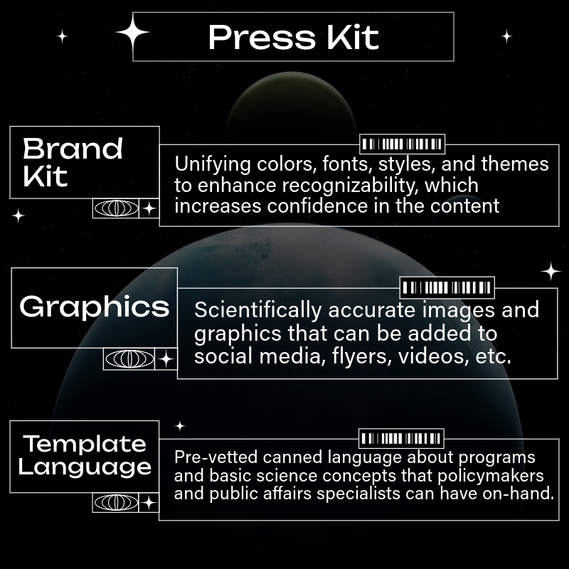
Preliminary Information-Subject to Revision. Not for Citation or Distribution.
USGS is working with FEMA to develop preparedness guidance for public affairs specialists and the public.
Preparedness guidance
Formal guidance on how to react to a variety of asteroid threats is being prepared by FEMA/USGS
Template and Pre-prepared text
Text for social media and public affairs specialists on general background that’s been pre-vetted can reduce the intellectual overload in a crisis
Press Kit
Quickly-deployable text, graphics, and products can be used in an imminent threat

Slide 6
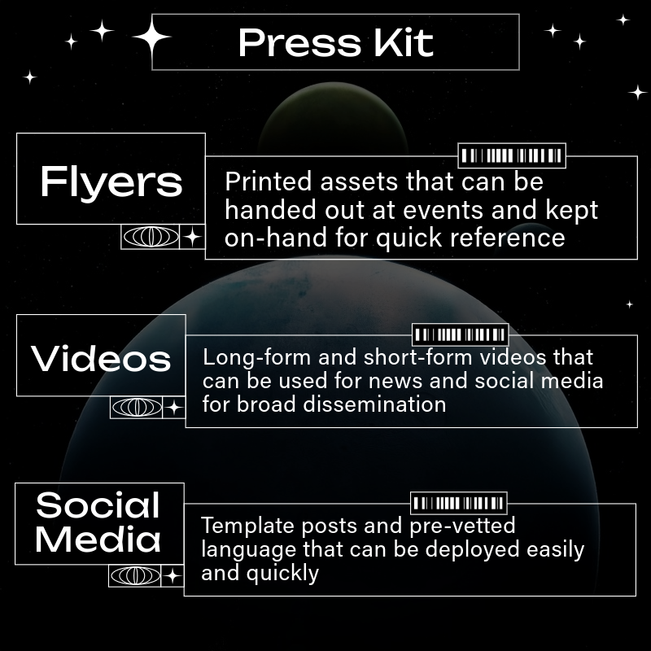
Preliminary Information-Subject to Revision. Not for Citation or Distribution.
USGS is working with FEMA to develop preparedness guidance for public affairs specialists and the public
Pre-designed assets
Print and digital products
Videos and graphics for general concept development
Graphics that have been reviewed by subject matter experts for accuracy
Text that’s been pre-vetted for content and tone
In an emergency situation, time matters ̶ so having materials at the ready can be critical

Slide 7
Preliminary Information-Subject to Revision. Not for Citation or Distribution.
Thorough preparation of a communications plan is the key to effective implementation
Identify the purpose and goals of your activities
Assign a lead, identify Subject Matter Experts (SMEs) and reach out for collaborations
Determine your target announcement date(s) so you can backtrack a timeline and plan milestones
Develop 3 – 5 key messages to maintain consistency in your products
Identify your stakeholders and your intended audiences
Integrate these into an overarching strategy
Products, platforms, events

Slide 8
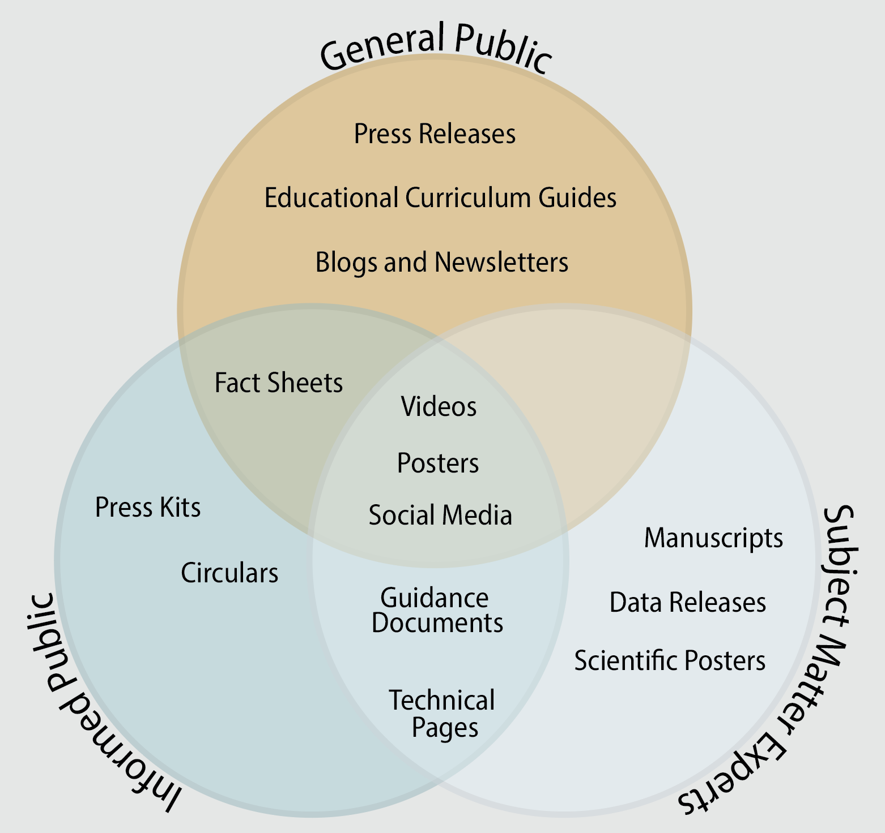
Preliminary Information-Subject to Revision. Not for Citation or Distribution.
Consider your audience – different populations have different needs, levels of understanding, and communication goals
General Public
Anyone who comes across the content: any age, any background, variety of access needs, wide educational levels, many languages, etc.
Informed Public
Already has a general awareness of your topic, or will have a higher educational level. Base level of engagement needs is higher.
Subject Matter Experts
Don’t need as much background, but have different engagement needs (collaboration, enhancement, etc.).

Slide 9
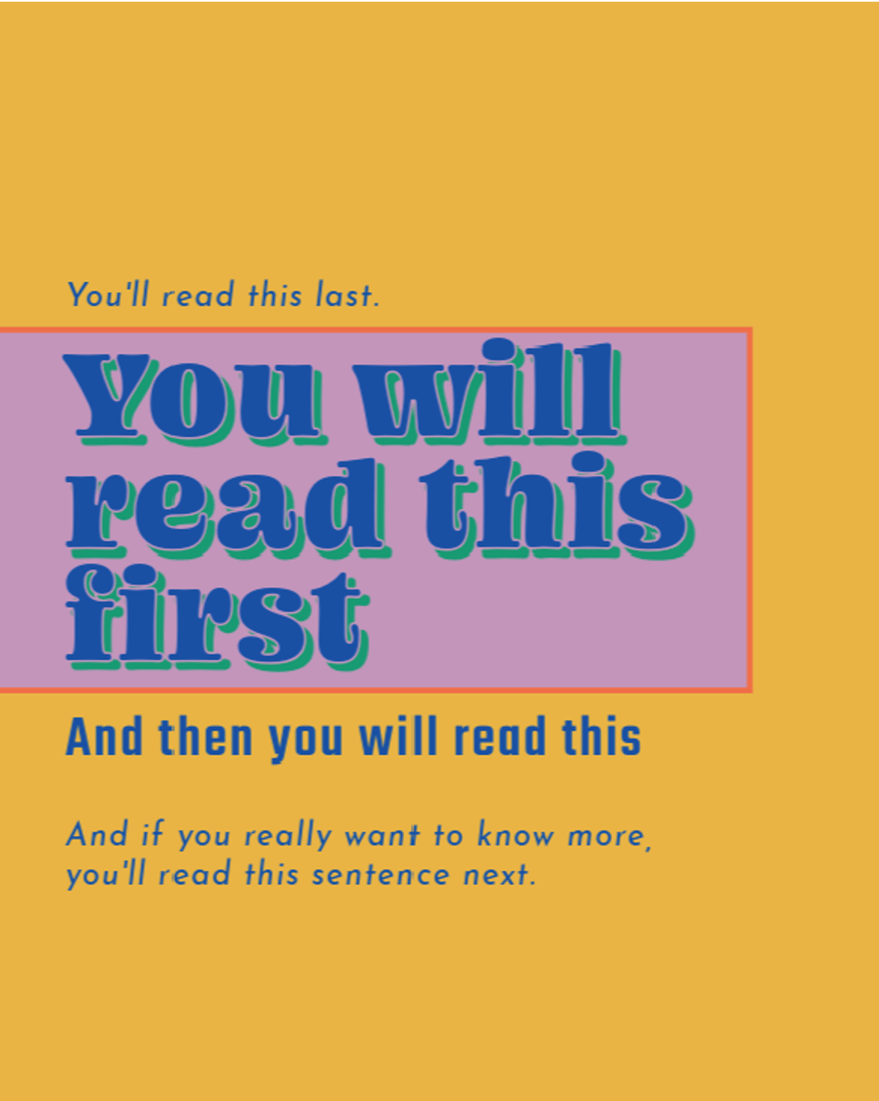
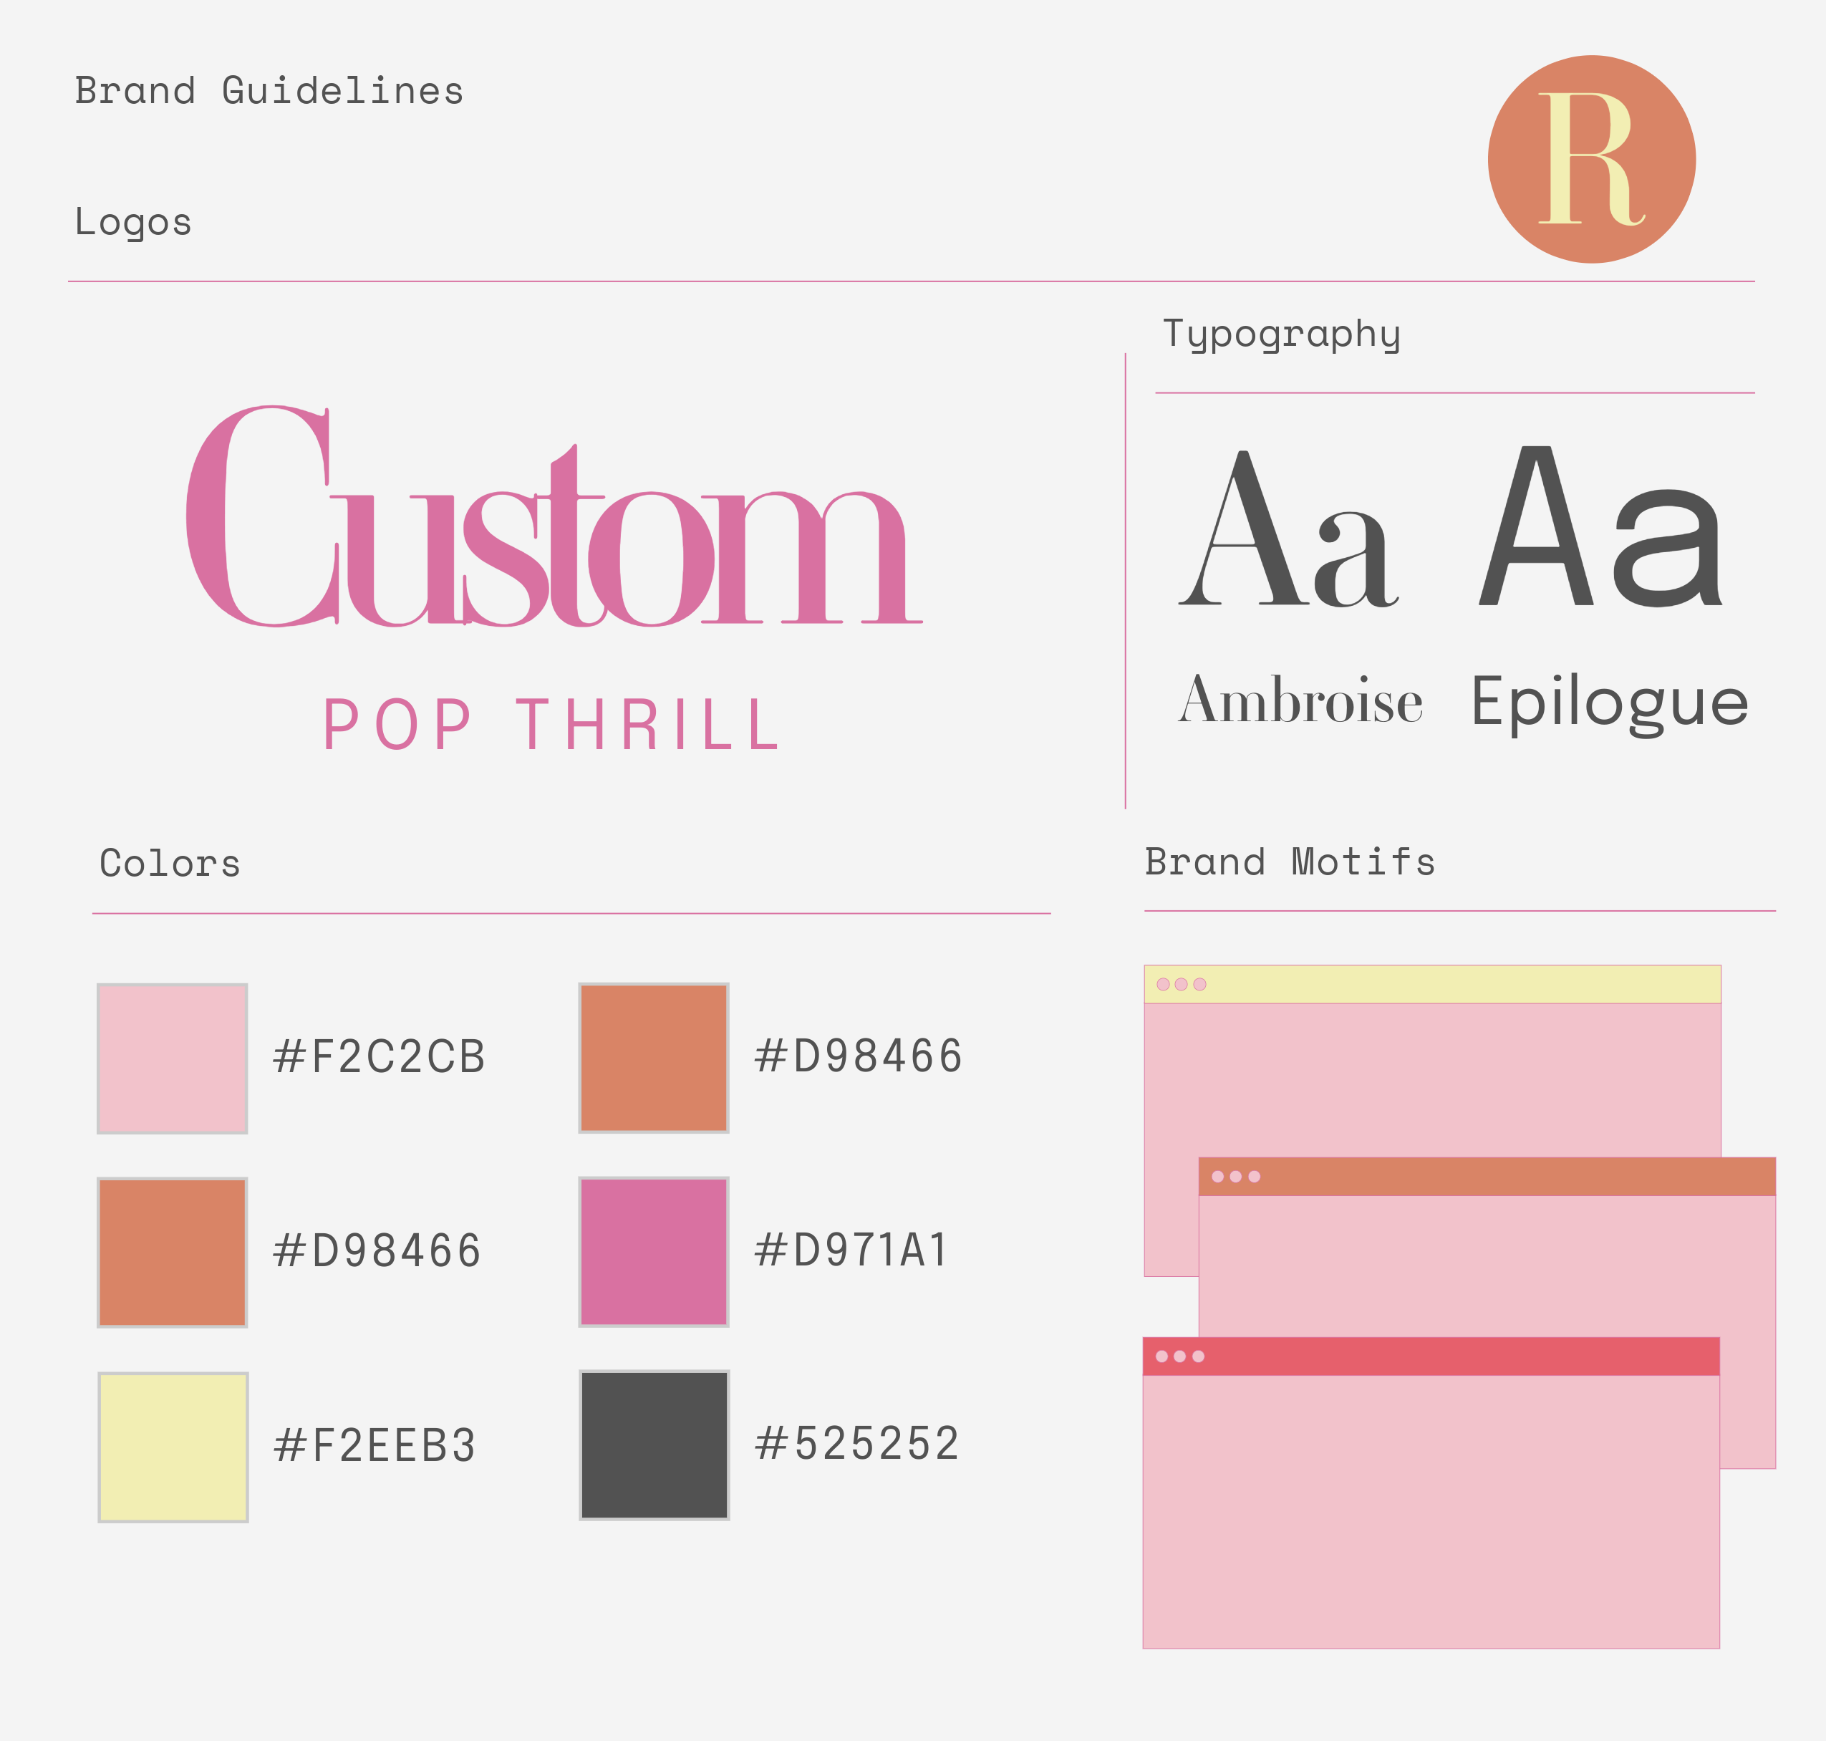
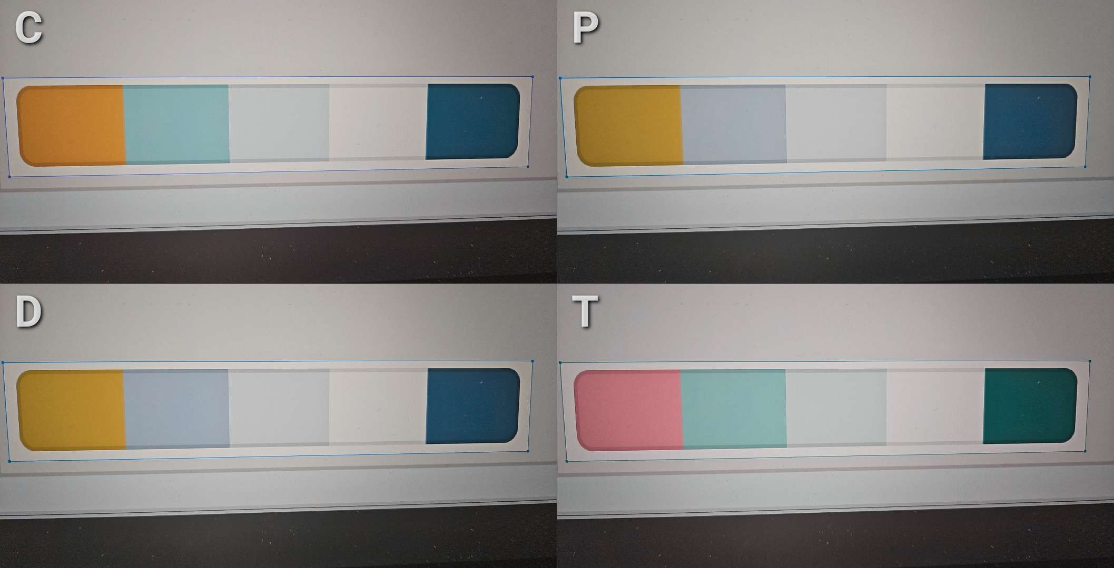
Preliminary Information-Subject to Revision. Not for Citation or Distribution.
Best practices for generating your own communications products
Collaborate!
Consider including other institutions, partners, direct engagement with stakeholders, direct engagement with the public, or getting high-profile communicators involved.
High accessibility
Great color palette that doesn’t exclude parts of your audience with color vision differences
Multiple forms of media – videos, text, graphics
Consider creating a Brand Kit
Consistent fonts, colors, designs, readymade assets
Easily deployable during an imminent threat

Slide 10
Preliminary Information-Subject to Revision. Not for Citation or Distribution.
Thank you!
USGS Astrogeology is open for collaboration!
Insta: @USGS_Astrogeology
Twitter/X: @USGS_AstroGeo
Facebook: USGS Astrogeology
Lori Pigue
USGS Astrogeology Communications Lead
lpigue@usgs.gov

