Slide 1
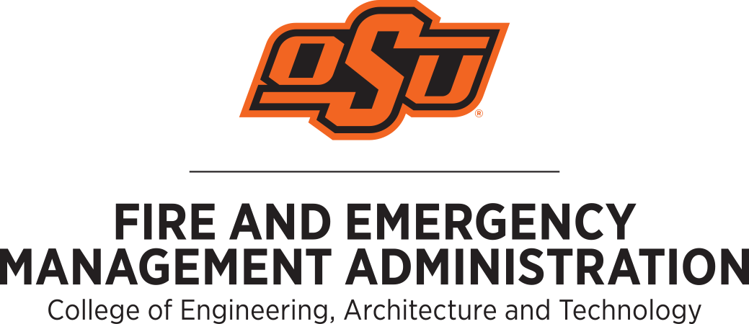
Preparedness Stakeholder Perception of Near-Earth Object Risk:
A Qualitative Doctoral Research Design on Public, Emergency Management, and Expert Perspectives
Lisa Wier¹, and Tony McAleavy¹
Fire and Emergency Management Administration, Oklahoma State University, Stillwater, OK, USA
lisa.wier@okstate.edu IAA-PDC-25-11-116
Oklahoma State University
Introduction
Near-Earth objects (NEOs) are low probability-high consequence hazards with potentially catastrophic extinction-level impacts. The 2013 Chelyabinsk airburst, asteroid 2024 YR₄, and recent technological advancements such as the Double Asteroid Redirect Test have brought planetary defense to the fore. There is, however, limited research that addresses perception of NEO impact risk among the public and prominent stakeholders. Consequently, preparedness initiatives are based on differing understanding of the risks faced which compromises response efficacy. Preparedness begins at the local level and requires a global collaborative effort as the consequences of a NEO impact could overwhelm community lifelines, infrastructure, and local capabilities. Smaller NEOs are far more frequent than one kilometer “global killer” asteroids. Nonetheless, their impacts can be significantly destruction.
How do the general public, emergency managers, and asteroid subject-matter expert/scientific community perceive the risk of a NEO impact?
Expected Results
It is anticipated that the results of this study will identify the differences in NEO impact risk perception of the public, emergency managers, and NEO subject matter experts. Prior research indicates that the public’s understanding of NEO impact risk is markedly different from that of the scientific community. However, little is known about preparedness stakeholder-specific gaps in NEO impact risk perception. Furthermore, it is imperative to survey emergency managers about their knowledge about NEO impact risk, as they are tasked with protecting the public. What information does local emergency managers want to know to increase NEO preparedness for their communities? Should emergency managers be concerned about this type of hazard? The anticipated results will help bridge the gap between scientific experts and localized communities to enhance planetary defense and resilience and improve local policy and practice. Furthermore, this study will contribute to the limited research addressing the risk perception of NEO impacts from the public, emergency managers, and subject-matter experts.
Methodology
The proposed research study is informed by an inductive system of logic, social constructionism philosophy, web-based self-completed questionnaires, semi-structured interviews, and qualitative content analysis methodology. This study will be three-fold:
Members of the public will be snowball sampled to participate in a web-based self-completed questionnaire. This will focus on their knowledge and perception of NEO impact risk, conceptualization of likely impacts and severity of consequences, and the future threat of a global catastrophe.
Local, state, tribal, and federal-level emergency managers in the United States will be snowball sampled for semi-structured qualitative interviews pertaining to their knowledge, understanding and risk perception of likely NEO impacts on their jurisdiction.
Scientists, researchers, and professionals with expertise in NEO impacts and planetary defense at various agencies will be snowball sampled for semi-structured interviews about their risk perception about NEO impacts, future generational threats for global catastrophe, current understanding of public risk perception, and areas for improvement in public communication.
Finally, the resultant data will be analyzed using computer-assisted qualitative content analysis. Content analysis allowed for the identification of emergent themes and patterns through rigorous and iterative investigation of the corpus of data. The progression results in a collection of quotes, codes, categories, and themes that formulate into a posited theory that represents the essence of the data. The resultant emergent themes and tentative theory will illustrate the relationships and gaps about the risk perception about NEO impacts between the three participant groups.
General public
Web-based self-completed questionnaires
Emergency managers
Semi-structured interviews
NEO subject-matter experts
Semi-structured interviews
Selected References
[1] A. J. Haddaji, "Understanding the Social Aspects of an Asteroid Impact Threat from Socio-Anthropological Lessons Learned in Natural Disaster Management," in Legal Aspects of Planetary Defence, I. Marboe Ed. Netherlands: Brill Nijhoff, 2021, ch. 17, pp. 266–285.
[2] N. J. Bailey, G. G. Swinerd, H. G. Lewis, and R. Crowther, "Global Vulnerability to Near-Earth Object Impact," Risk Management, vol. 12, no. 1, pp. 31-53, 2010, doi: 10.1057/rm.2009.16.
[3] E. Bell, A. Bryman, and B. Harley, Business research methods, 5 ed. Oxford, UK: Oxford University Press, 2019.
[4] D. Morrison, C. R. Chapman, D. Steel, and R. P. Binzel, "Impacts and the public: communicating the nature of the impact hazard," in Mitigation of Hazardous Comets and Asteroids, M. J. S. Belton, T. H. Morgan, N. H. Samarasinha, and D. K. Yeomans Eds.: Cambridge University Press, 2004, ch. 16, pp. 353 - 390.
[5] J. C. Reinhardt, X. Chen, W. Liu, P. Manchev, and M. E. Paté-Cornell, "Asteroid Risk Assessment: A Probabilistic Approach," (in en), Risk Analysis, vol. 36, no. 2, pp. 244-261, 2016 2016, doi: 10.1111/risa.12453.
[6] P. Slovic, "Perception of Risk from Asteroid Impact," in Comet/Asteroid Impacts and Human Society: An Interdisciplinary Approach, P. T. Bobrowsky and H. Rickman Eds. Berlin, Heidelberg: Springer Berlin Heidelberg, 2007, pp. 369-382.

