Slide 1


TERP RAPTOR
(Terrapin Engineered Rideshare Probe for Rapid-response Asteroid Apophis Profiling, Tracking, Observing, and Reconnaissance)
Mission Concept Development
9th IAA Planetary Defense Conference
May 6th, 2025
Adrienne Rudolph, Chinthan Prasad, Sean Philips, Kruti Bhingradiya, Rahul Vishnoi, Cameron Storey, Ryan Mahon, Brent W. Barbee, David A. Akin, Mary Bowden, Jarred Young, Paul Bernhardt, Yunghsin Chen, et al.

Slide 2
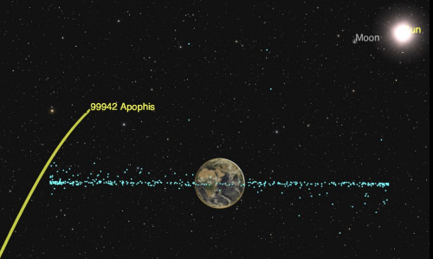
Coming Soon to a Planet Near You…
On Friday April 13th 2029, Earth will dodge a 760 MT bullet.
Apophis is a ~350 meter asteroid that will pass within 31,634 km of Earth’s surface
Naked eye visible across parts of Europe, Africa, & W. Asia
Close proximity to Earth’s gravitational field may notably alter the asteroid’s orbit and stir material on its surface
Who will have eyes on Apophis?
Dotson, J., et al. (2022) Apophis Specific Action Team Report, https://www.lpi.usra.edu/sbag/documents/Apophis_SAT.pdf
Apophis will miss the Earth. Apophis will miss the Earth. Apophis will miss the Earth.

Slide 3
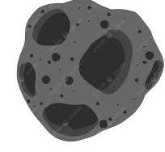

Unique Asteroid Science Opportunities
Questions derived from 2023 Decadal Survey and SBAG Apophis Specific Action Team Report
How has the collisional and dynamical evolution of Apophis affected its surface and structural characteristics?
  Size and shape
  Weathering history
  Relative age of surface craters
How will its close encounter with Earth affect the movement of surface material on Apophis?
  Nature of tidal resurfacing due to close Earth encounter
  Occurrence & triggers of mass wasting events

Slide 4
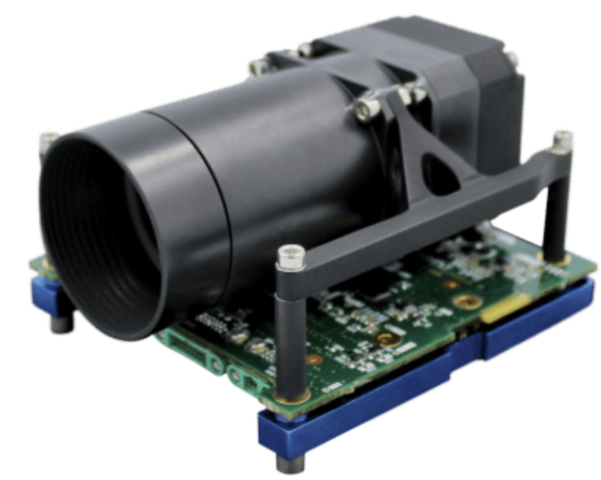
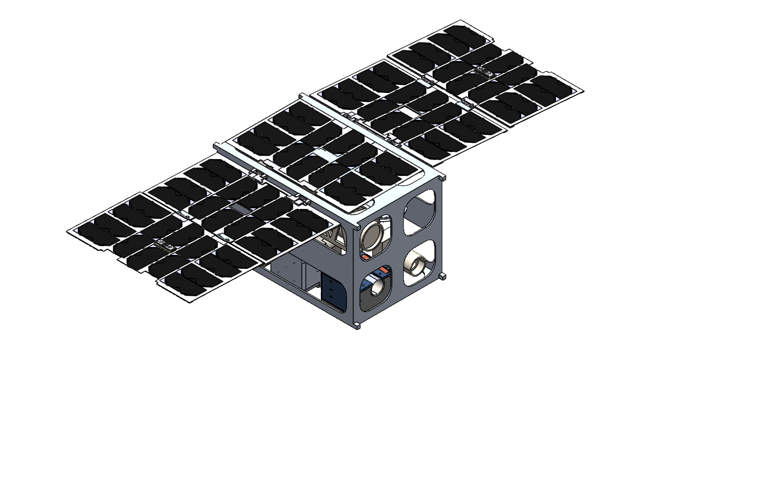
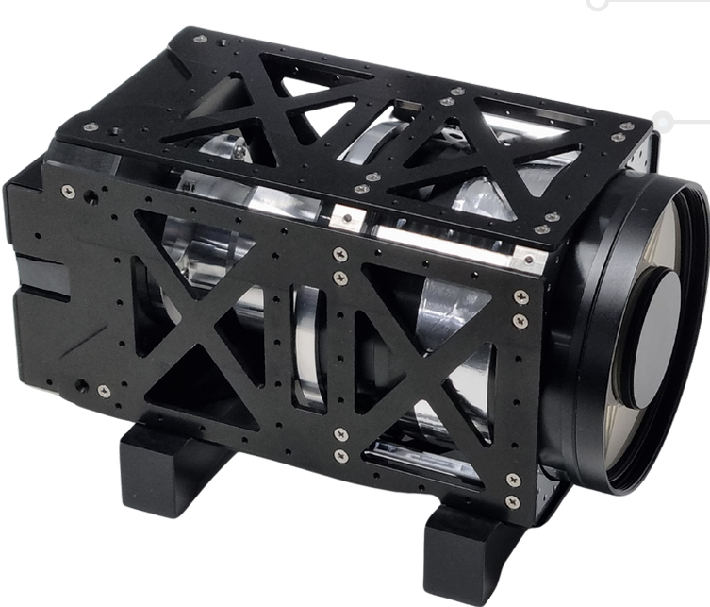
TERP RAPTOR Design
Mass: 20.63 kg
Vol Available: 12U
Vol Used: 9.9U
Power: 66.37W max during orbital maneuvers
Financials
Mission Cost before labor:
~ $3.4 million
Mantis Imager
Optical RGB
0.5m GSD at 15.6 km
60 fps
4° FOV
Nominal cost per image ~20 times less than the historical asteroid flyby missions
Mantis Imager
Rad Tolerance
0.0021 (1/bit*day) given an aluminum shield thickness of 4 mm
Orion 12MP-550
Near-Infrared
0.16m GSD at 15.6 km
100 fps
2° FOV
HF Antenna
HF receiver tuned to 9.6 MHz to capture reflected signals
Sponsored by UAF and NRL
Lifetime: at least 1 year - limited by total ΔV capability (329.8 m/s) and radiation shielding
Orion Imager
Notes:
Our primary goal is to collect imagery of the asteroid during its Earth close approach. TERP RAPTOR is a 12U cubesat designed to accomplish that, using two COTS imagers (visible and near-IR).
The spacecraft should cost around 3.4 million dollars.
We also plan to carry a high-frequency antenna provided by HAARP, to receive reflected signals when they beam energy at the asteroid to investigate its interior.

Slide 5
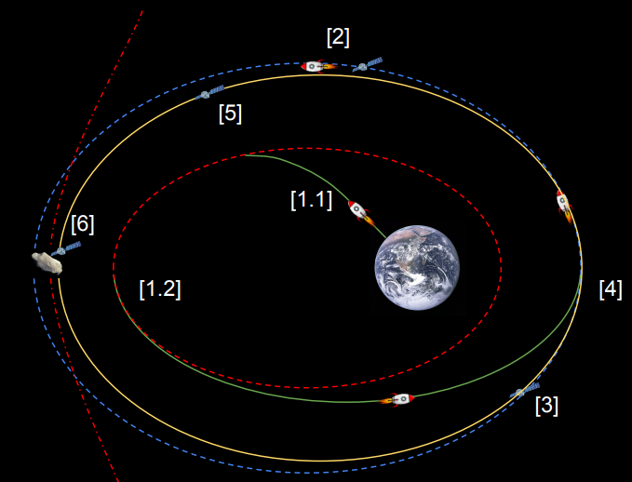
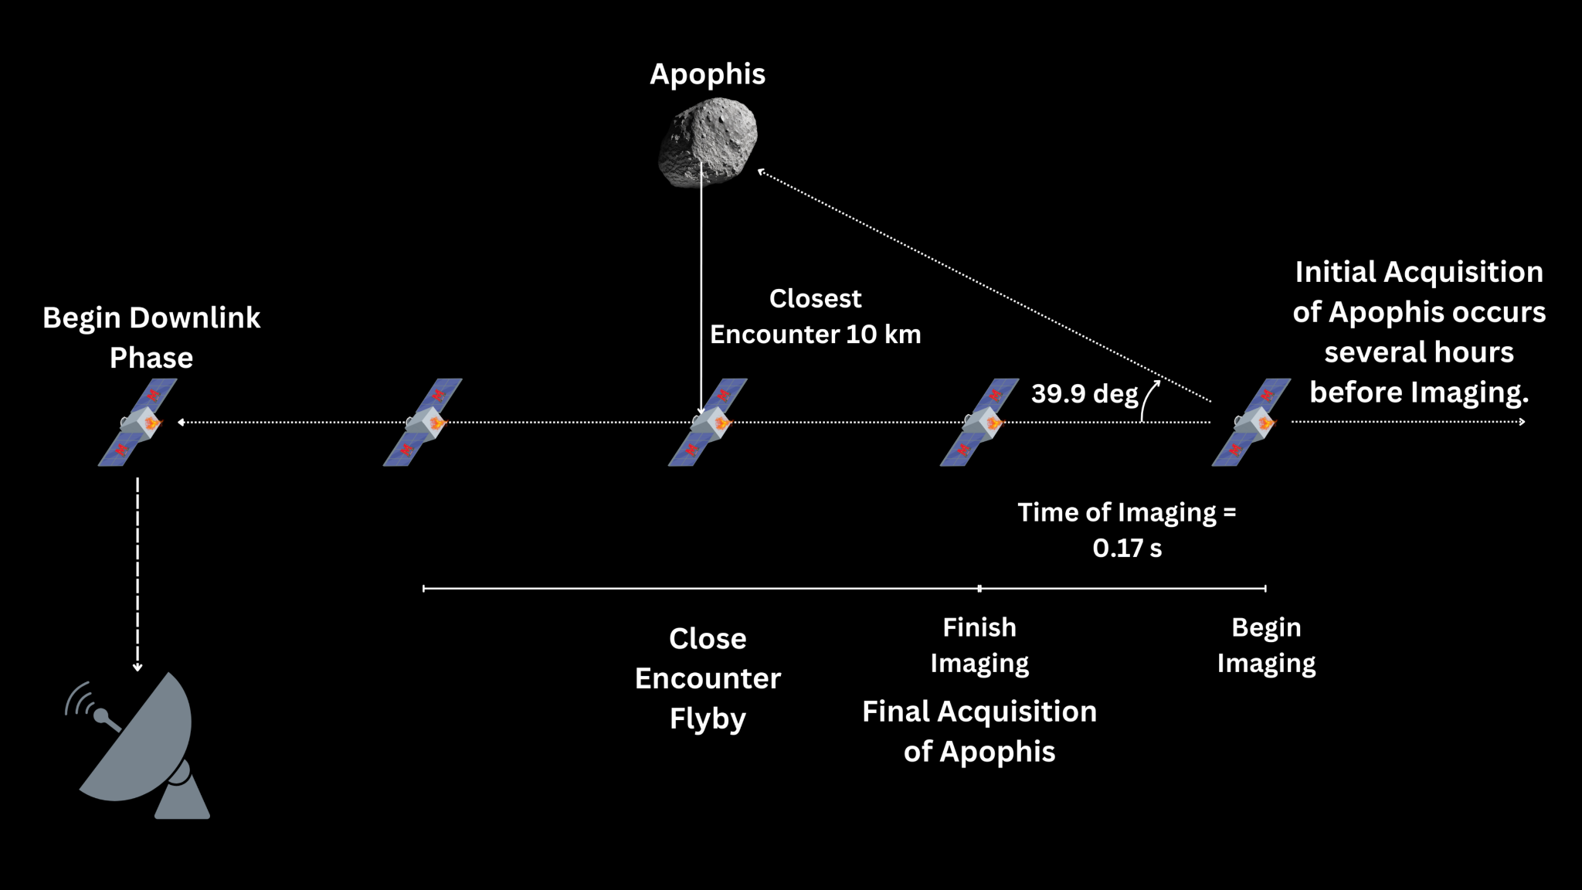
Concept of Operations
Launch and Orbit Insertion
Flyby Operations
1.1 - Launch to Preliminary Orbit
1.2 - Perigee Raising
2 - Deployment
3 - Commissioning
4 - Apogee Lowering
5 - Loiter
6 - Flyby
7 - Downlink
8 - Extended Mission / Decommissioning
Notes:
After a rideshare launch and deployment from the launch vehicle, TERP RAPTOR will undergo commissioning.
We will then maneuver to an Apophis-intercepting orbit and loiter there.
As the asteroid approaches perigee, we will perform final phasing maneuvers to target the asteroid flyby.
We will aim for a close approach distance of 10 km, collecting images throughout the approach and flyby.
Data downlink will be begin as soon as possible after the flyby is complete.

Slide 6


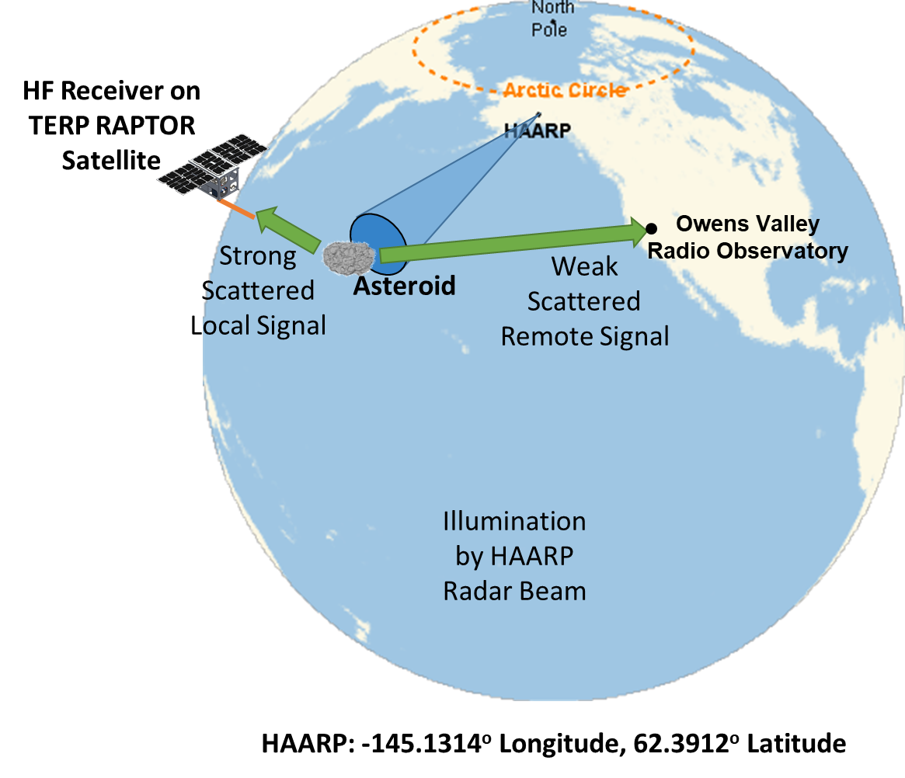
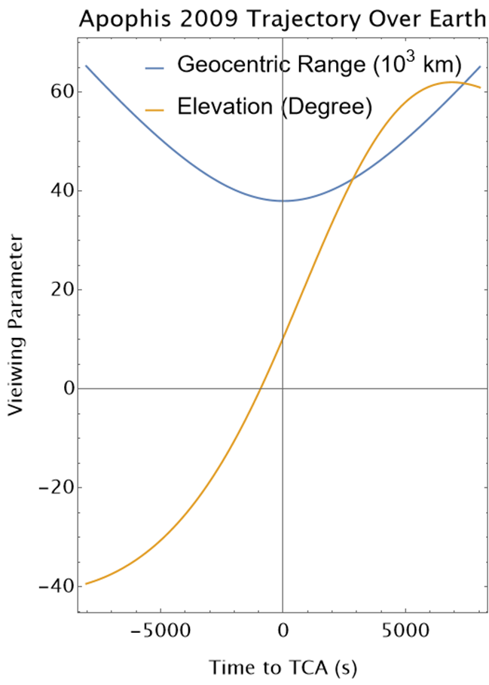
HAARP HF Radar Imaging of Apophis
Apophis 2029 Trajectory Over Earth
Time of day and ionospheric effects have been considered

Slide 7
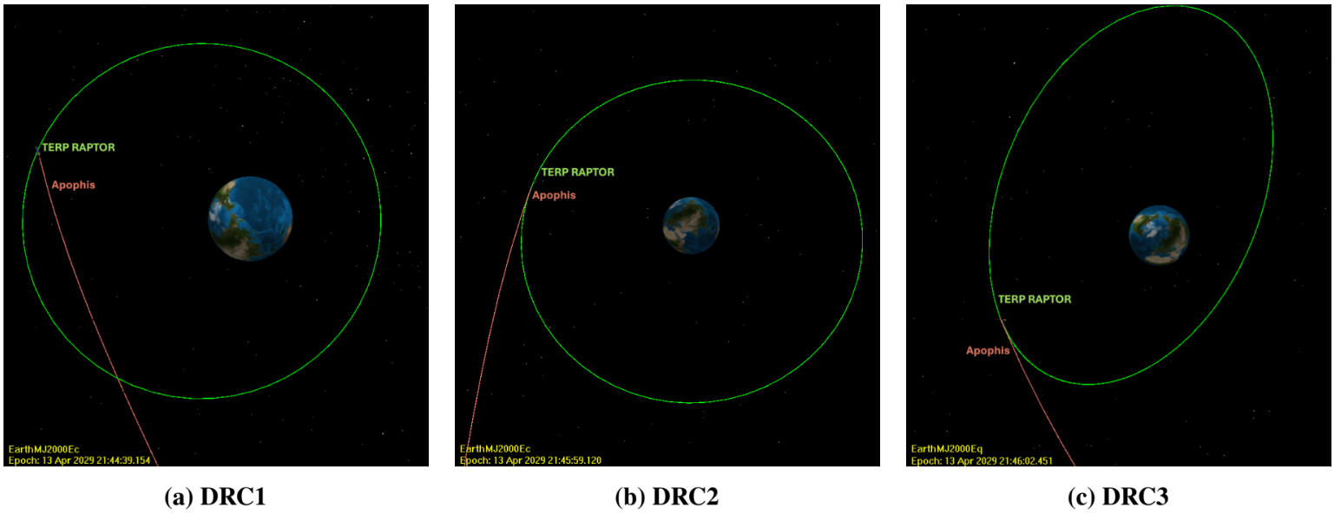
Orbit & Rideshare Considerations
DRC1:
Standard Geosynchronous Transfer Orbit with a ~1700 m/s perigee raise ΔV from the launch vehicle. Total loiter time ~42 hours.
DRC2:
Circular, highly inclined sub-GEO whose plane coincides with Apophis’s flyby hyperbola. Total loiter time ~ 65 hours.
DRC3:
Retrograde, sub-GEO achieved via lunar gravity assist - Would require ~2658 m/s of ΔV from launch vehicle. Total loiter time ~30 days.
DRC = Design Reference Case
Notes:
Standard rideshare offerings (LEO, GTO, GEO) don’t intercept Apophis’s Earth flyby hyperbola.
We’ve assembled example design reference cases for rideshare options.
DRC1 begins with a rideshare launch to a standard GTO, but then requires a substantial perigee boost from the launch vehicle.
DRC2 is a highly inclined near-GEO—the inclination (~39 deg) is much higher than typical.
DRC3 uses a lunar flyby sequence to achieve a retrograde orbit that intercepts Apophis. It offers the slowest Apophis flyby speed but requires substantial Delta-V from the launch provider.
We are continuing to consider other potential rideshare options, such as rideshare to equatorial GEO followed by maneuvering to equatorial super-GEO.

Slide 8
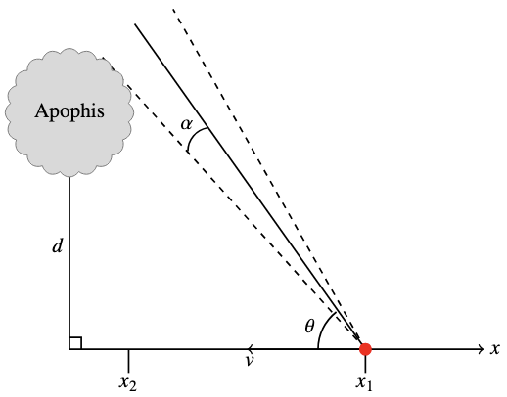
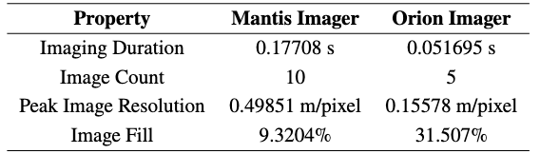
Science Data Collection
Imaging Results for Optimal Fixed Configuration
Required image resolution necessitates flying within ~10km of the asteroid
Required slew rate exceeds spacecraft capabilities
Solution: fixed pointing angle (𝜃) of 39.9º
This configuration optimizes number of images collected (~15), with 0.5 m/pixel resolution, and low cost per image
Barbee, B. W., Rudolph, A., Storey, C., Prasad, C., Bhingradiya, K., Vishnoi, R., Mahon, R., Philips, S., Akin, D., Bowden, M., Young, J., Mission Concept Development for the TERP RAPTOR (Terrapin Engineered Rideshare Probe for Rapid-response Asteroid Apophis Profiling, Tracking, Observing, and Reconnaissance), AIAA SciTech Forum and Exposition, Orlando, FL, January 6-10, 2025
Diagram of Fixed Pointing Angle Case
Notes:
Slewing during the flyby is not feasible given the CubeSat form factor and our imaging resolution capability.
If we want to slew, it requires that our encounter distance be greater than 100 km. -> Image resolution is 1.0 m/pixel at best, but more importantly our image fill goes down to 0.224% of the image (at peak center). This is too small for any meaningful scientific contribution

Slide 9
Ready or Not…
Apophis is coming.
Time is running out to develop missions.
This is a singular opportunity for public engagement, planetary defense, and planetary science - a historic event for in situ investigation of an asteroid in our own backyard.
TERP RAPTOR is in the process of acquiring funds and will be there to bring eyes on Apophis during its close encounter with our planet.
TERP RAPTOR

Slide 10
Questions?
For further inquiries or partnership/funding opportunities, please contact:
Adrienne Rudolph (rudolpa@umd.edu)

Slide 11
Appendices

Slide 12
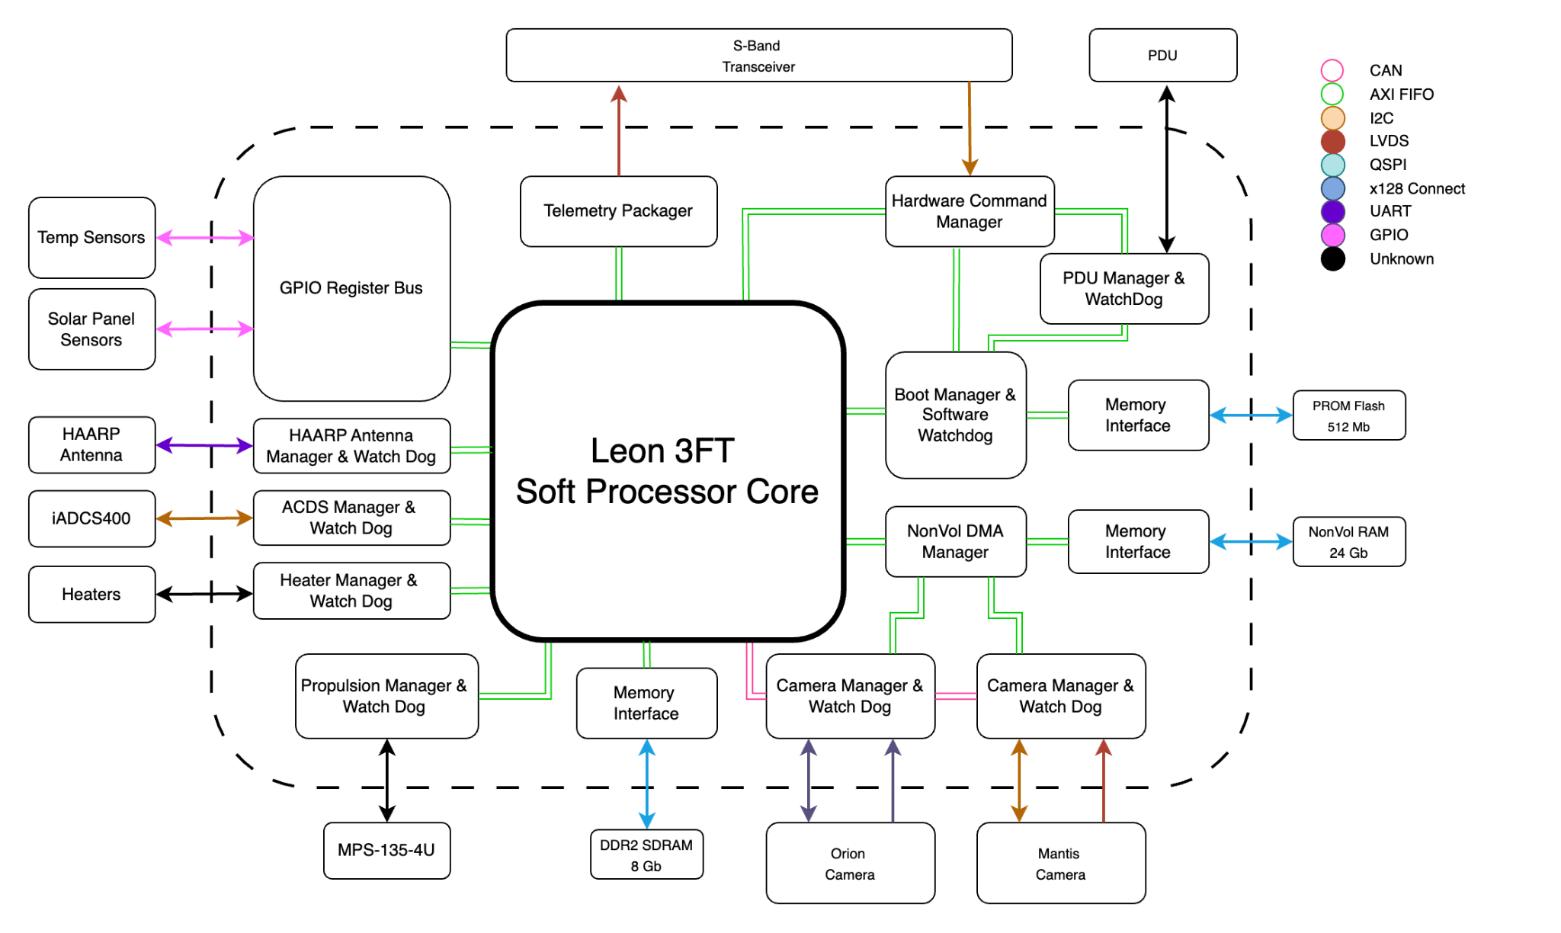
Onboard Computer & Flight Software
Microchip’s RTG4 Field Programmable Gate Array (FPGA) is TERP RAPTOR’s primary flight system.
  High radiation tolerance and proven flight heritage
  Wide array of I/O ports to accommodate COTS components
Flight software runs on a Soft LEON3 fault tolerant core, provided by Gaisler.
Using NASA’s core Flight System (cFS) software.
FPGA Fabric Design

Slide 13
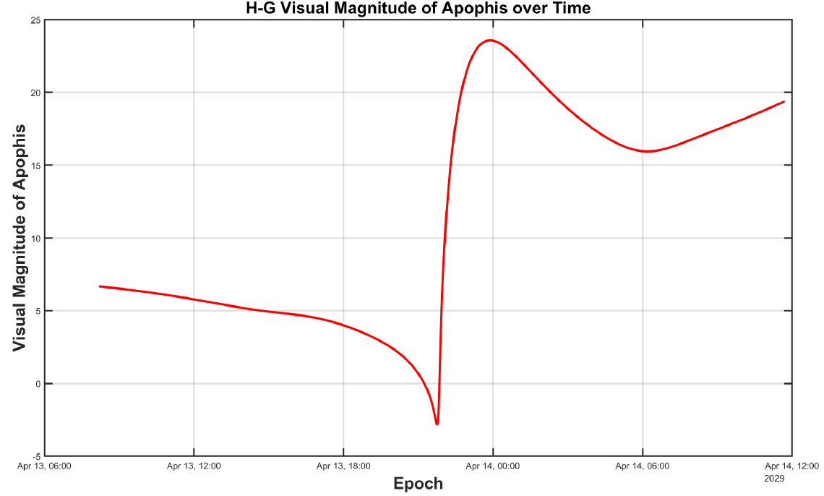
Visual Magnitude of Apophis During TERP RAPTOR Flyby
Solar phase angle is favorable (~20°, decreasing to ~2°) leading up to flyby, and reaches about 83° during flyby - more than half of Apophis is sunlit from TERP RAPTOR’s point of view.
Apophis should be brighter than visual magnitude 7 from TERP RAPTOR’s point of view during the hours leading up to the flyby.
At the short exposure times needed for high frame rates, we estimate the limiting magnitudes of our cameras to be ~6–7.
We should therefore be able to detect Apophis hours before our flyby.

Slide 14
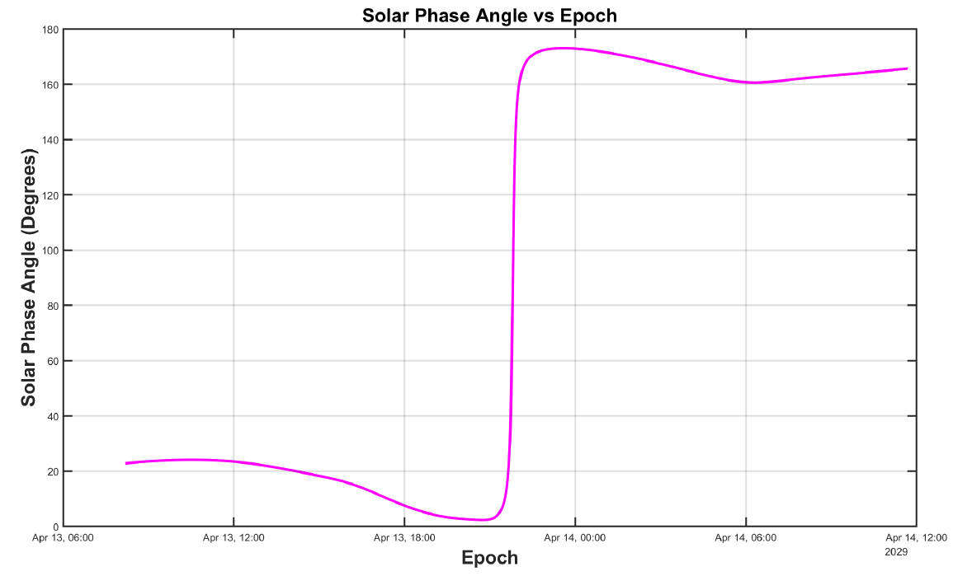
Apophis’s Solar Phase Angle Relative To TERP RAPTOR

Slide 15
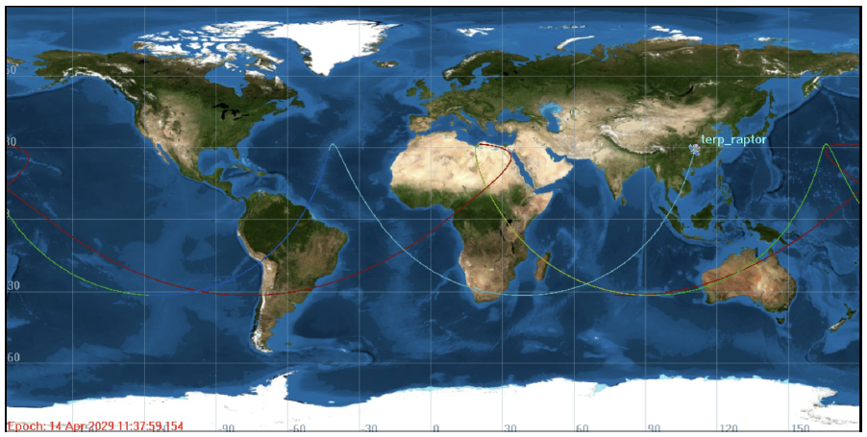
Mission Orbit Ground Track (DRC1)

Slide 16
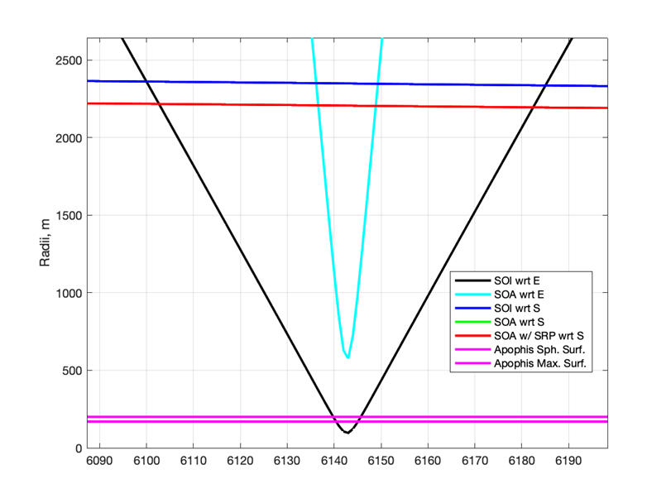
Apophis/Earth Encounter Dynamics
For several minutes surrounding its point of closest approach to Earth, Apophis’s gravitational sphere of influence (SOI) will be smaller than Apophis itself.
  Stable captured orbits around Apophis may not possible during that time.
  May affect operations for any spacecraft that rendezvous with Apophis before the Earth encounter.

Slide 17
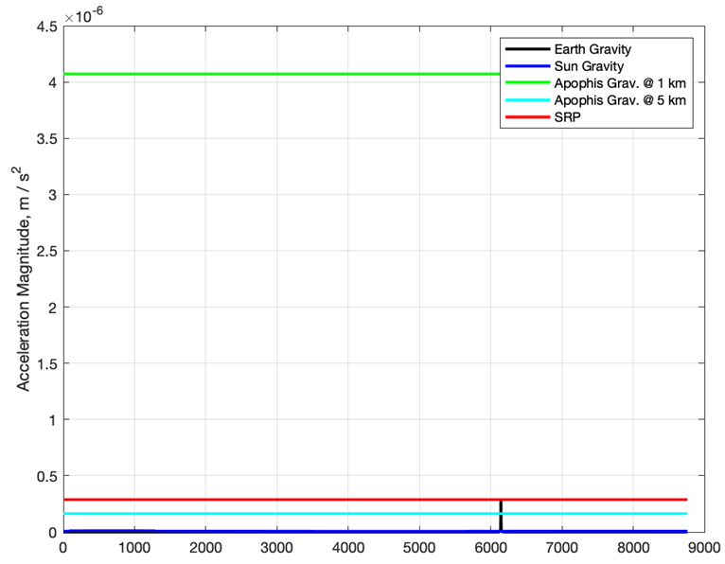
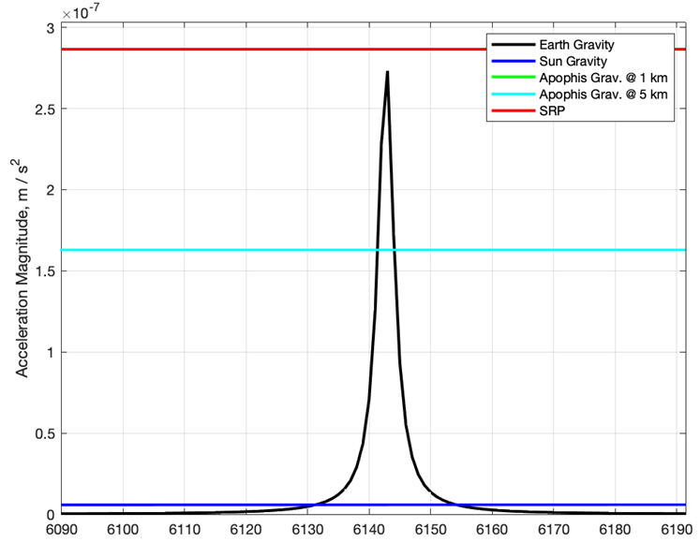
Gravitational Accelerations in Apophis’s Vicinity During Earth Close Approach
Earth’s gravity will briefly dominate over Apophis’s gravity (to within several km of Apophis), and rival solar radiation pressure.

Slide 18
NASEM Decadal Strategy for Planetary Science and Astrobiology 2023-2032
National Academies of Sciences, Engineering, and Medicine. 2023. Origins, Worlds, and Life: A Decadal Strategy for Planetary Science and Astrobiology 2023-2032. Washington, DC: The National Academies Press. https://doi.org/10.17226/26522 .
https://nap.nationalacademies.org/read/26522/chapter/20#483
"Precision observations of Apophis leading up to and through its 2029 close approach to Earth offer a unique opportunity to better understand potential changes in surface morphology, track changes in spin state through close approach, and compare pre- and post-flyby spectra to ascertain if the close passage has disturbed space weathered materials on the asteroid’s surface."
"Apophis’s close approach has also stimulated discussion of visiting the body through either a flyby or rendezvous spacecraft mission. As one example of a flyby mission, the precise prediction of its 2029 trajectory would enable a spacecraft to be placed on an orbit with apogee beyond the GEO belt with only a small ΔV (i.e., velocity change). The spacecraft could be positioned to take observations of the asteroid as it passes by on either its inbound or outbound leg. This type of flyby space mission would not require the observing spacecraft to leave Earth’s gravitational influence. If equipped with an appropriate imaging suite, the craft could observe Apophis under complementary viewing geometries to ground-based observatories and at much higher resolution."
Finding: The Apophis flyby of Earth creates an opportunity to observe a potentially hazardous asteroid via a coordinated ground-based campaign, potentially supplemented via space-based observations from flyby or rendezvous missions.
Recommendation: NASA should study all relevant observing opportunities surrounding the unique Apophis encounter, using both ground and space-based assets. To maximize the scientific and planetary defense return, NASA should develop plans for making the best use of these identified assets during the Apophis encounter and support international cooperation in carrying out these valuable observations.

Slide 19
SBAG Apophis Specific Action Team Report
https://www.lpi.usra.edu/sbag/documents/Apophis_SAT.pdf
"The close encounter of Apophis presents a unique opportunity to observe geophysical processes contemporaneously, rather than infer them after the fact. Multi-band optical-NIR, high spatial resolution maps before and after the Earth encounter would enable the identification of surface features that changed as a result of the encounter. Significant motions of larger rocks (decimeter to meter scale) or regolith displacement could be identified by comparing pre- and post- encounter images. If the surface motion involves motions of smaller rocks, then multi-band images could be used to identify changes in albedo, spectral slope, and/or spectral bands that result from the exposure of fresh, unweathered material. In the case of a clear detection of tidally induced resurfacing, combining the before and after surface morphology with models of the encounter would provide unprecedented insight into this geophysical process, essentially providing a ground-truth observation of the geophysical process of gravitationally induced tidal resurfacing. Even in the case that no resurfacing on Apophis can be identified by comparing before and after high resolution multi-band images, substantial insights will be possible. A lack of identifiable resurfacing, when combined with topological information and the encounter geometry can be used to place lower limits on the surface cohesion."
"The pre- and post- encounter observations required for the contemporaneous investigation of geophysical processes discussed in §6.1 do not necessarily have to be performed by a single spacecraft. Either the pre- or post- or both sets of images could be obtained by a well timed flyby mission. The regions most likely to experience resurfacing have been identified by current models (e.g. Hirabayashi et al. (2021)). When coupled with detailed information about the spin state, a flyby could be timed such that the regions most likely to experience resurfacing would be imaged by the spacecraft, preferably at low phase angle."
"Any detection of motion of surface material would allow real time observations of this geophysical process, resulting in refinements of models and estimates of the strength of cohesion. A non-detection would provide a lower limit on the cohesive strength. Either result would provide significant insights into the role of tidal effects on the resurfacing of asteroids. One or more spacecraft with a high resolution, multi-band optical-NIR imager in close proximity to Apophis before and after the close encounter would be sufficient to make direct observations of this effect. Monitoring during the event would be highly informative, but not required to enable the identification and study of tidally induced resurfacing."

Slide 20
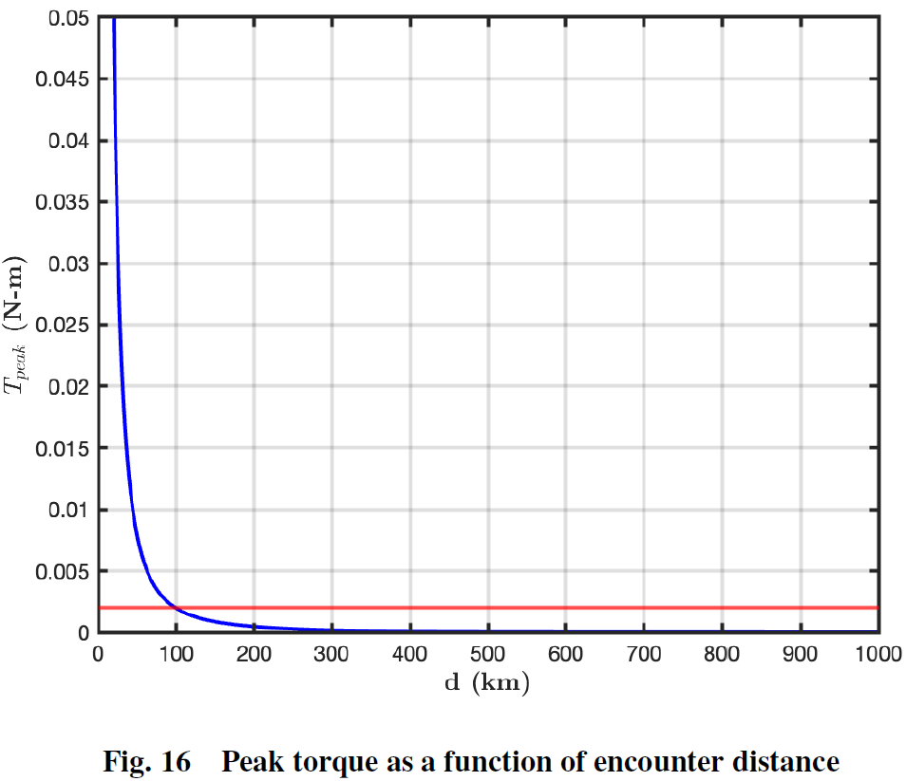
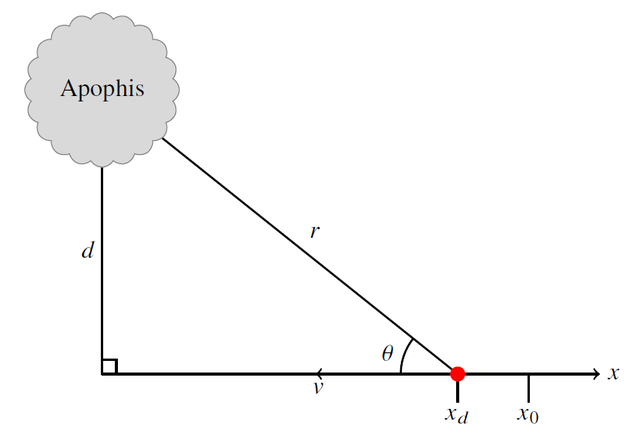
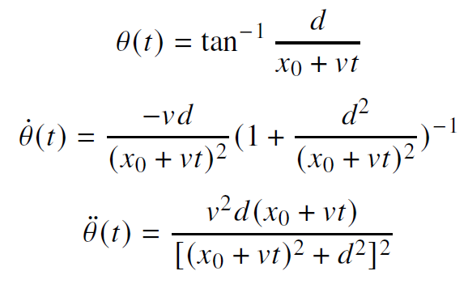
Analysis of Requirements for Slewing to Track the Asteroid During Flyby
Available cubesat ADCS systems can provide at most 2 mN-m of torque for our spacecraft (red line in figure to the left).
With that torque limitation, if we were to continuously slew to track Apophis during the flyby then we could get no closer than 100 km.
However, at 100 km our camera resolution is too low to meet our science requirements. We need to get within about 10 km of the asteroid to have sufficient image resolution.
Thus, we developed a fixed pointing angle strategy for the flyby imaging rather than constant slewing to track the asteroid.

Slide 21
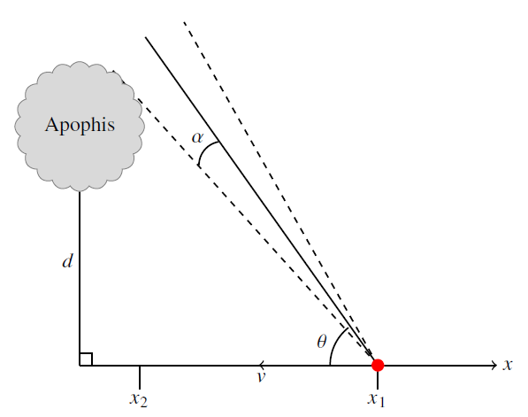
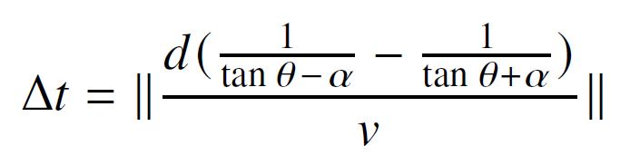
Analysis of Fixed Pointing Angle During Asteroid Flyby (1/2)
The equation above gives the amount of time, Δt, during which the camera FOV (with half-angle ɑ) contains any portion of the asteroid.
For a given imaging duration, Δt, the total number of images can be computed using the camera’s frame rate.
We perform an optimization to determine the closest approach distance, d, and fixed pointing angle, 𝛳, that maximize the number of images collected while respecting constraints.

Slide 22
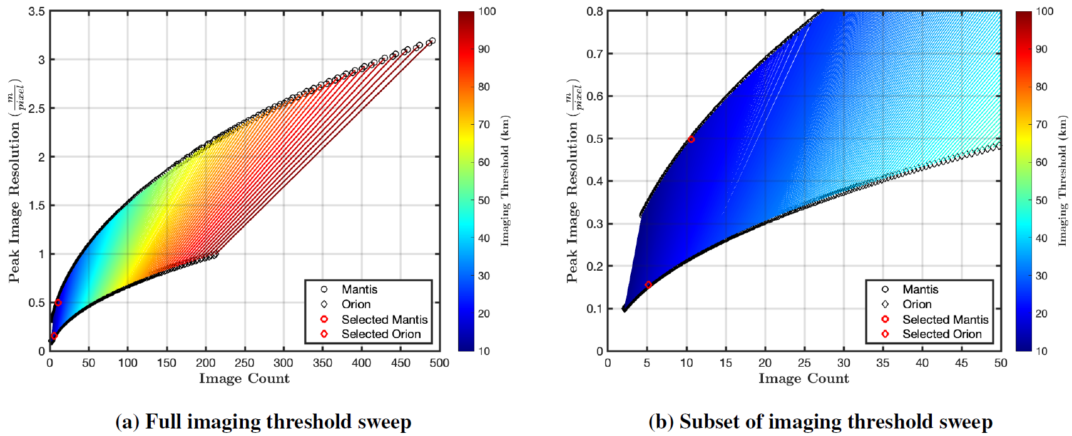
Analysis of Fixed Pointing Angle During Asteroid Flyby (2/2)

Slide 23
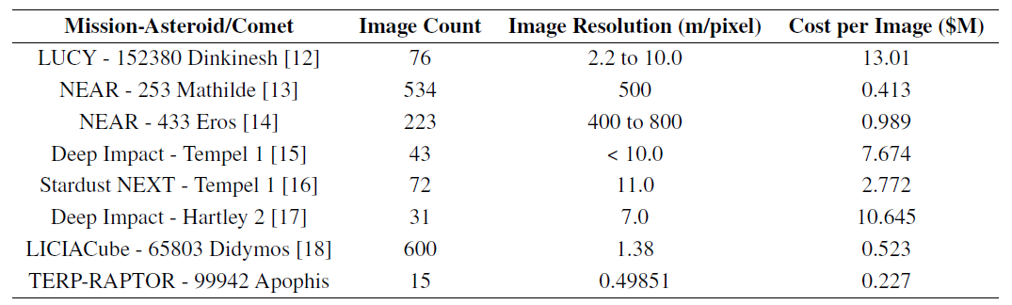
Comparison of Science Data Returns for Asteroid Flyby Missions
Our nominal cost per image is ~20 times less expensive than the historical average for asteroid flyby missions, and with a record-setting 0.5 m/pixel resolution.

Slide 24
Coordination of Multiple Missions
If multiple missions are present at Apophis simultaneously, this would create an unprecedented situation for asteroid missions.
Never before have multiple institutions and nations needed to coordinate the efforts of their multiple spacecraft at an asteroid.
It will be important to prevent collisions or other interference while ensuring that each spacecraft can satisfy mission requirements and achieve mission objectives.
A September 2024 press release from the Committee on Space Research (COSPAR) describes the beginnings of an international coalition calling for coordination of Apophis missions.
  https://cosparhq.cnes.fr/assets/uploads/2024/09/PR_Apophis_COSPAR-2024.pdf
In October 2024, the UN-endorsed Space Mission Planning Advisory Group (SMPAG) discussed a proposal to establish a dedicated SMPAG Asteroid Apophis Coordination Working Group.
  https://www.cosmos.esa.int/web/smpag/
  https://www.cosmos.esa.int/web/smpag/meeting-23-oct-2024-
A detailed proposal and decision from SMPAG about proceeding with the establishment of this Apophis Coordination Working Group are expected at SMPAG’s 24th meeting, scheduled for February 5–6, 2025 in Vienna.

Slide 25
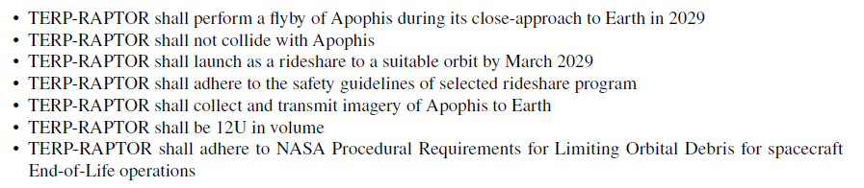
Level 1 Mission Requirements

Slide 26
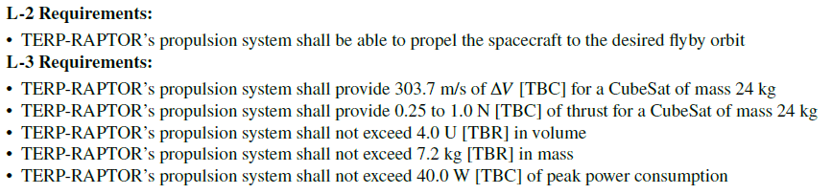
Propulsion System Requirements

Slide 27
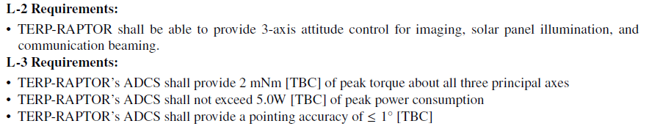
Attitude Determination & Control System Requirements

Slide 28
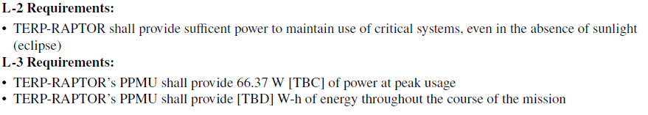
Power System Requirements

Slide 29
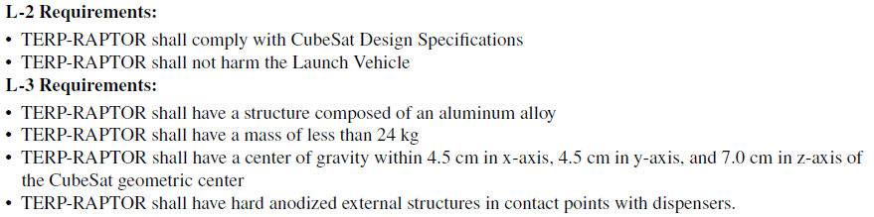
Structure System Requirements

Slide 30
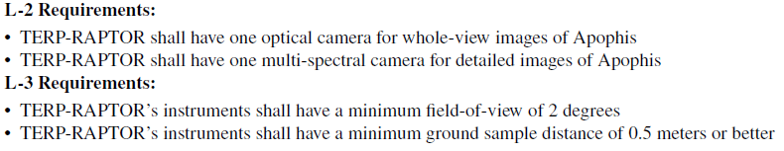
Science Instrument Requirements

Slide 31
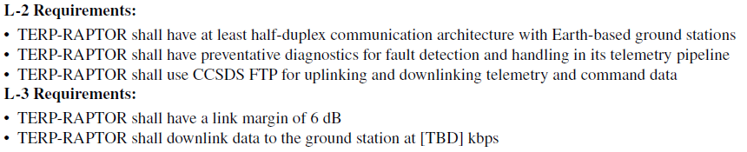
Communications System Requirements

Slide 32
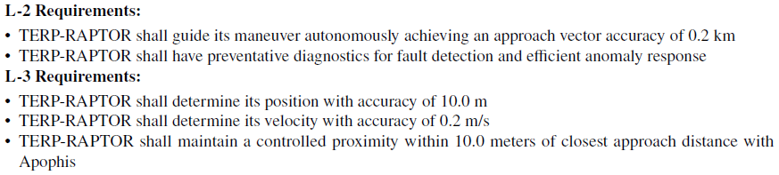
Guidance, Navigation, and Control System Requirements

Slide 33
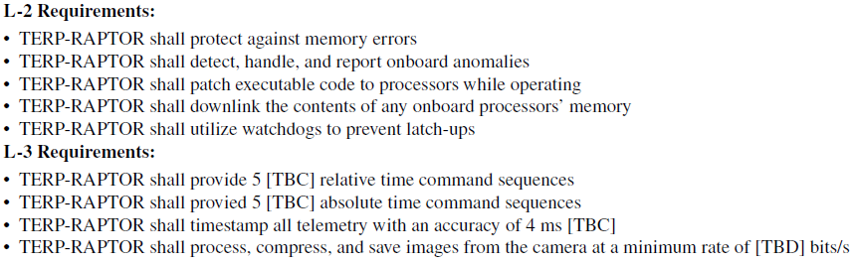
Flight Software System Requirements

Slide 34
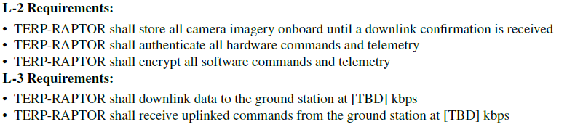
Command and Data Handling System Requirements

Slide 35
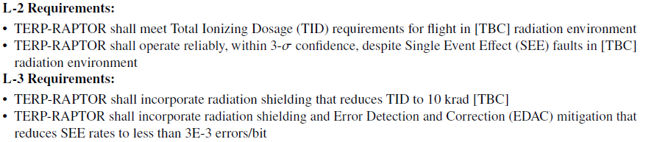
Radiation Protection System Requirements

Slide 36
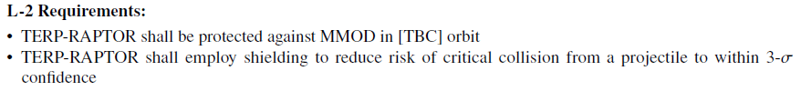
Micrometeoroid and Orbital Debris Protection System Requirements

Slide 37

Spacecraft Charging Protection System Requirements

Slide 38
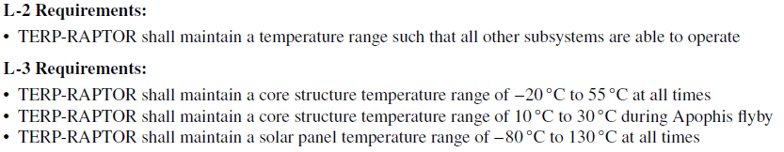
Thermal System Requirements

