Slide 1
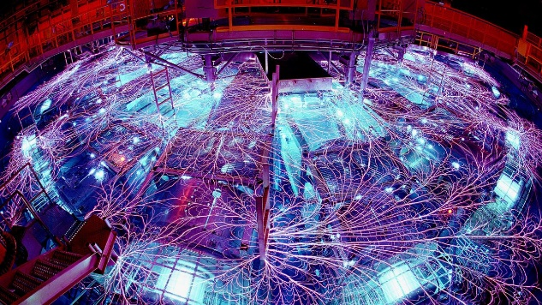
Nuclear Deflection of Kilometer-Scale Asteroids Simulated using Sandia’s Z Machine
SAND2025-03838C
IAA Planetary Defense Conference 2025
Stellenbosch, Cape Town, South Africa, May 5-9, 2025
Nathan W. Moore, Mikhail Mesh, Jason J. Sanchez, Marc-Andre Schaeuble, Chad A. McCoy, Carlos R. Aragon, Kyle R. Cochrane, Michael J. Powell, Kaitlyn Amodeo, and Seth Root

Slide 2
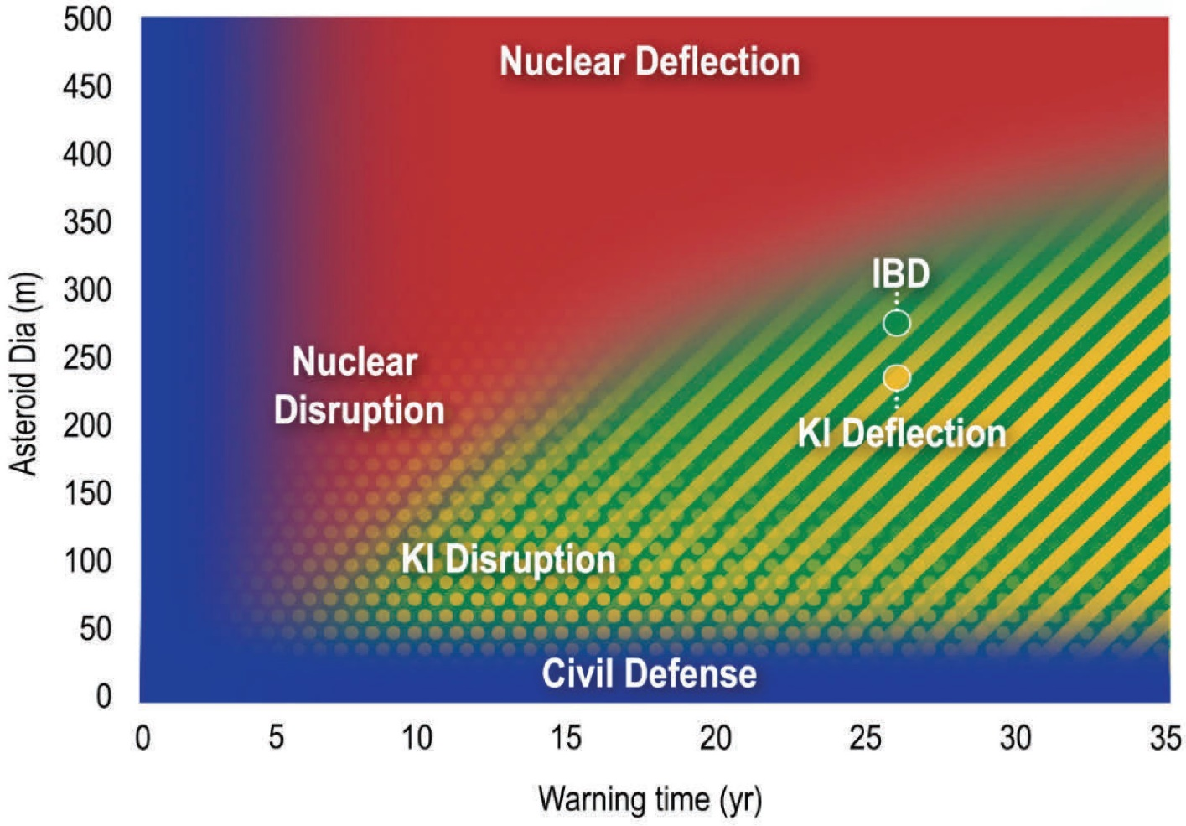
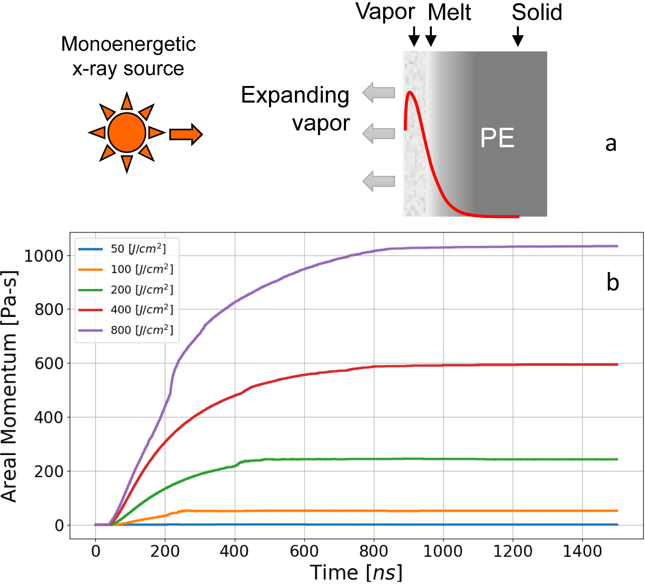
Nuclear (x-ray) deflection: promising for short warning times, yet untested
X-ray
source
X-ray fluence
800 J/cm²
Simulation
ALEGRA simulations
400 J/cm²
200 J/cm²
Origins, Worlds, and Life: A Decadal Strategy for Planetary Science and Astrobiology 2023-2032
100 J/cm²
50 J/cm²
Previous laboratory experiments:
Measured momentum carried by the shock wave
May underrepresent momentum coupled to NEOs
N.W. Moore, et al., J. Appl. Phys. 132, 235901 (2022)

Slide 3
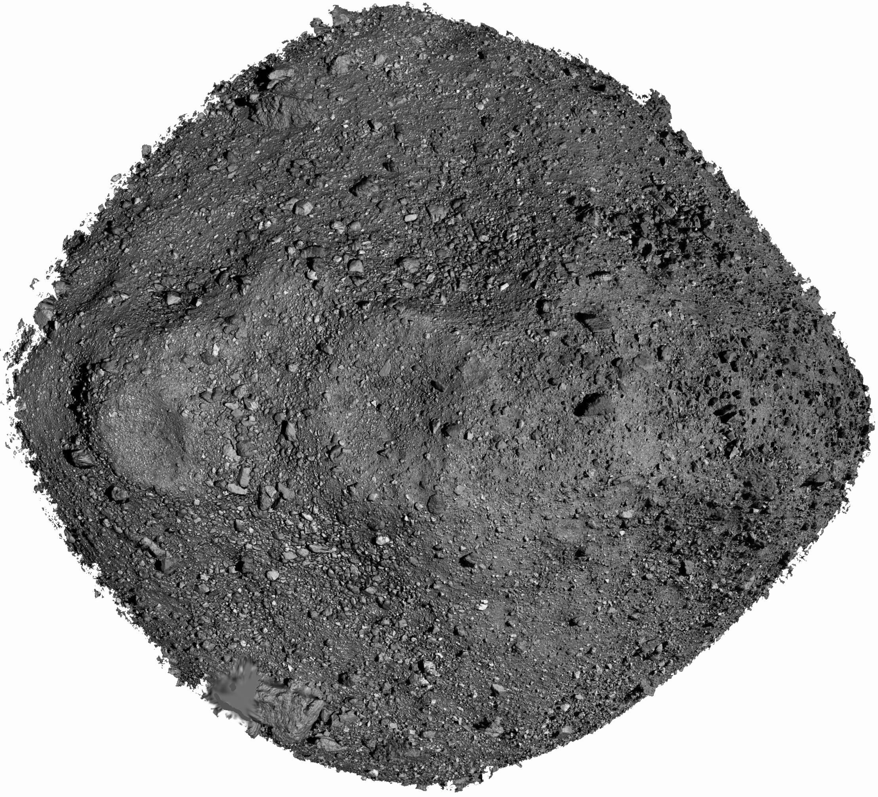
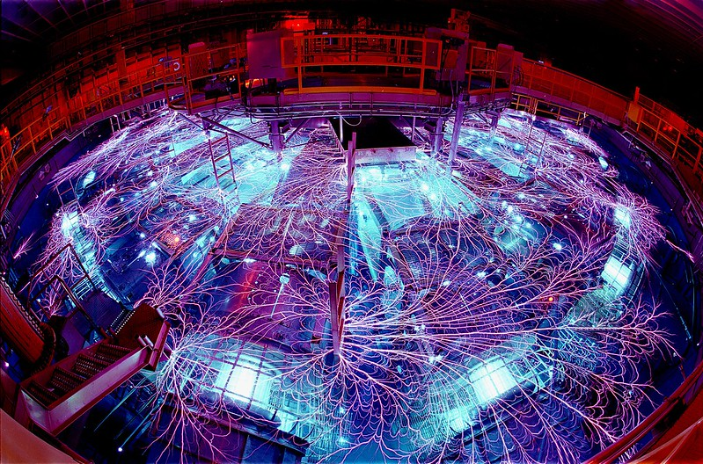

Accurate experimental simulation of x-ray deflection required developing several new methodologies
Pulsed x-ray source with enough energy to vaporize / accelerate mock asteroid
Put mock asteroid into free-fall (within a few nanoseconds!)
Track velocity of mock asteroid during flight (despite plasma background)
70 m/s
Fiberoptic interferometer with plasma trap system
Argon plasma using the Z Pulsed Power Machine
“X-ray scissors”
Image credits:
Sandia National Laboratories
www.vecteezy.com
NASA/Goddard/University of Arizona

Slide 4
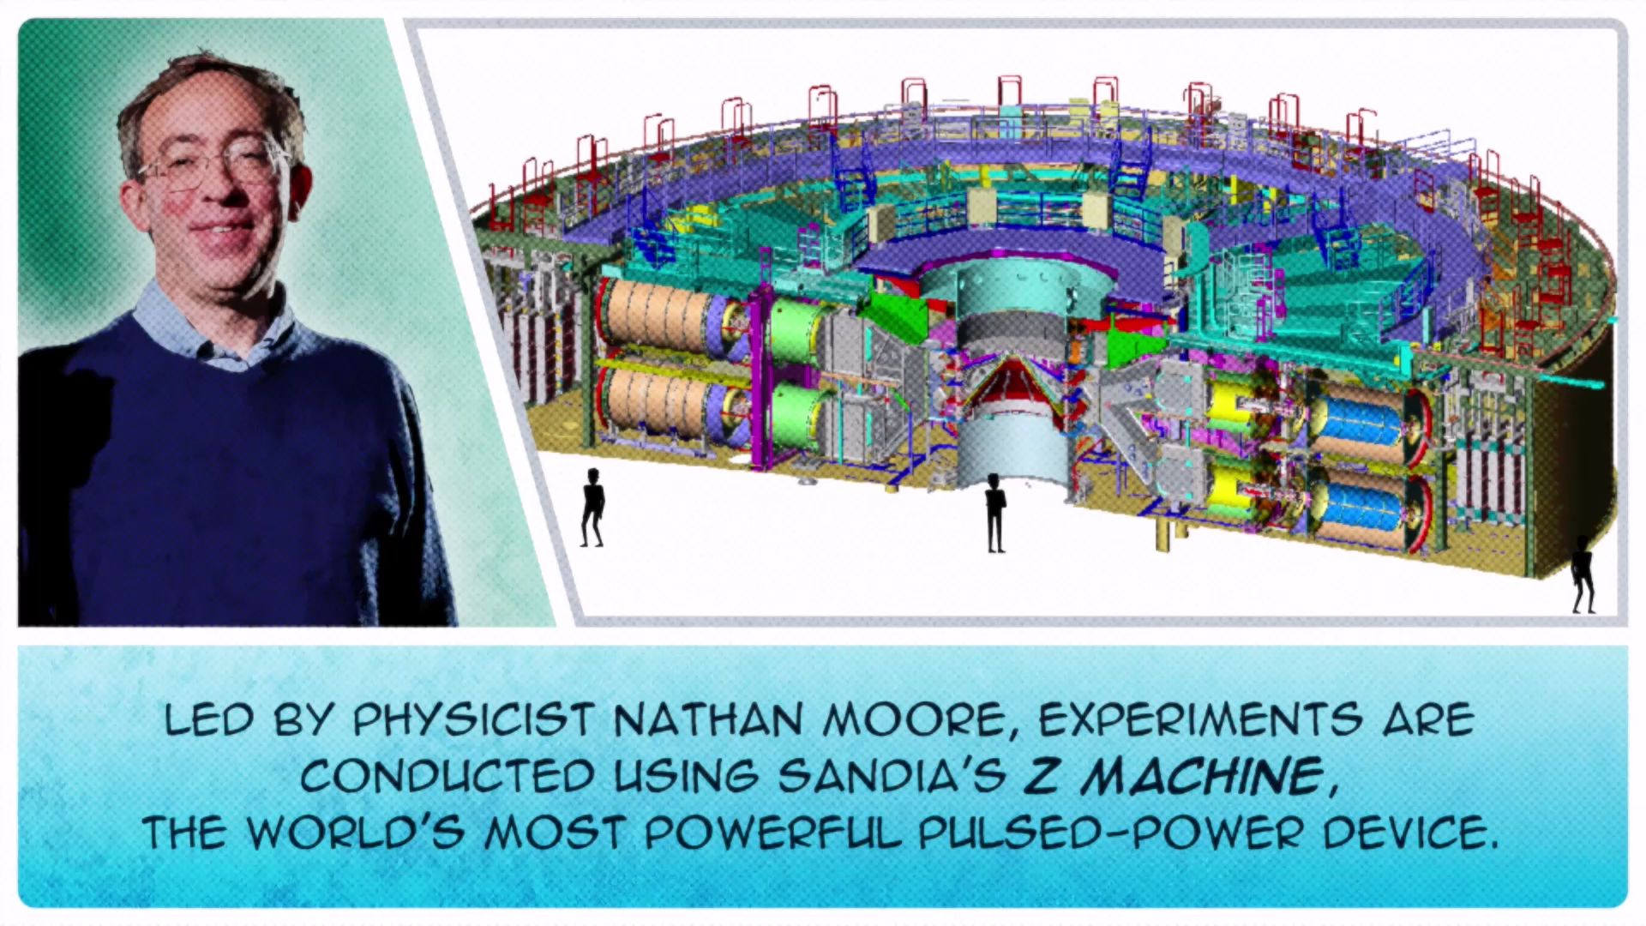
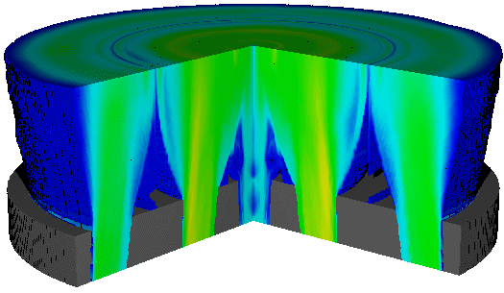
The Z Machine at Sandia produces a megajoule of x-rays
Argon is magnetically compressed to a ~2.5 keV plasma over ~100 ns
8 cm
2 cm
33 m diameter, 8 m high
~ 2 megajoules of electrical energy is released in < 100 ns
→ 15 times the world’s power plant capacity (300 TW)
Bright, reliable x-ray source (~7 ns FWHM)
Nearly monoenergetic (3.4 keV) after filtration

Slide 5
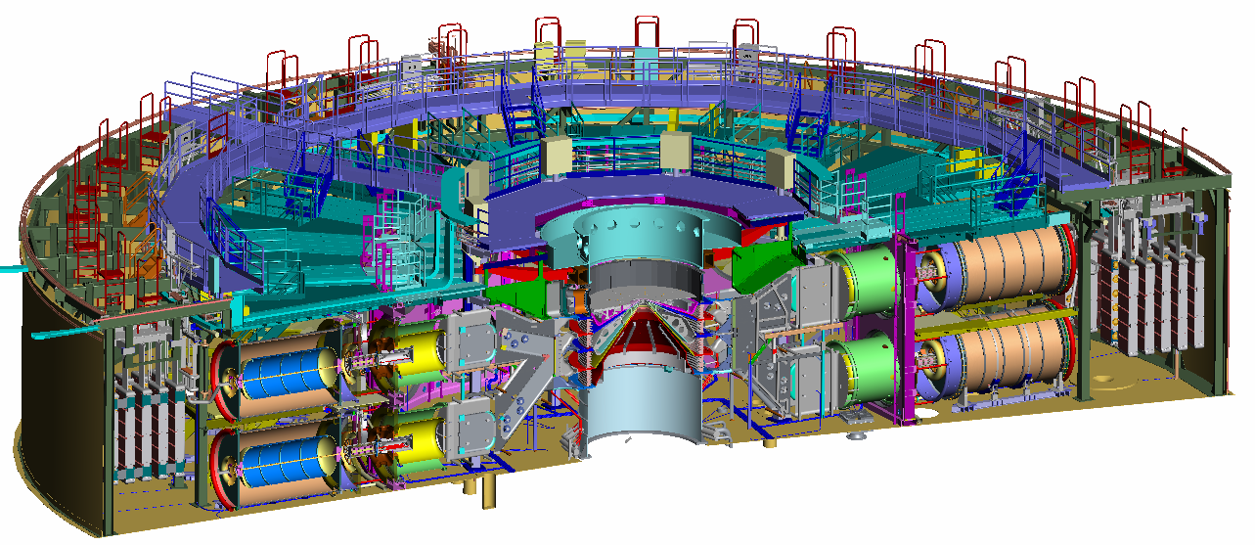
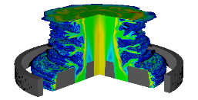
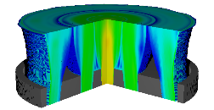
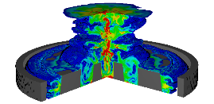
The Z Machine at Sandia produces a megajoule of x-rays
Argon is magnetically compressed to a ~2.5 keV plasma over ~100 ns
8 cm
33 m diameter, 8 m high
~ 2 megajoules of electrical energy is released in < 100 ns
→ 15 times the world’s power plant capacity (300 TW)
Bright, reliable x-ray source (~7 ns FWHM)
Nearly monoenergetic (3.4 keV) after filtration

Slide 6
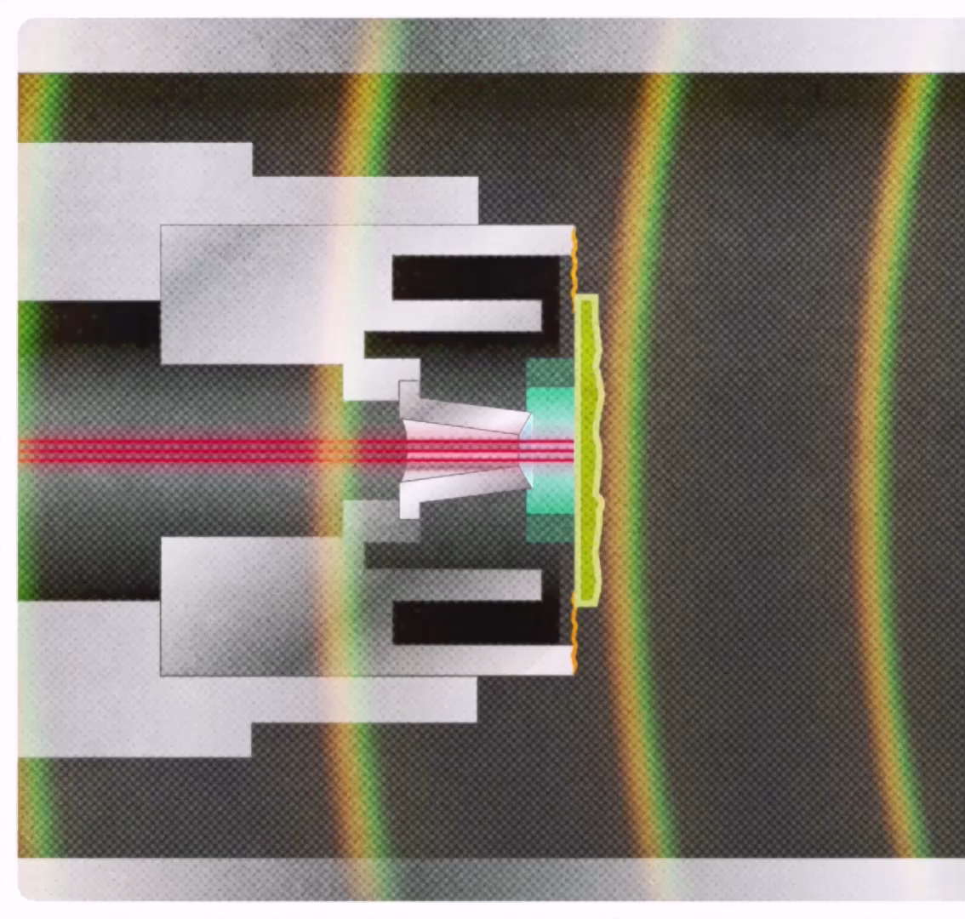
“X-ray scissors” allow release of sample to free space for frictionless acceleration by the blow-off gas
Annular foil support
Al foil (8-13 μm) < 1% of sample mass
Vaporizes 80 ns before shock wave in sample can perturb whole-body motion.
Gravitational fall of sample negligible at < 2 nm
Leaves no effect on sample motion
PDV
beams
Vapor traps and baffle system maintain clear optical path for infrared interferometer beams
Three concentric baffles (aerogel affixed to target is ~2% of moveable mass)
Baffles
Vapor
trap
N.W. Moore, et al., Nature Physics 20, 1833–1839 (2024)

Slide 7

High-fidelity numerical simulation (ALEGRA) predicts ~quasi uniform vapor expansion from front surface
3 mm
Scale: log density, ~3 μs
2D axisymmetric mesh (~10⁶ elements)
Fully-coupled radiation-hydrodynamic simulation with temperature-dependent opacities

Slide 8
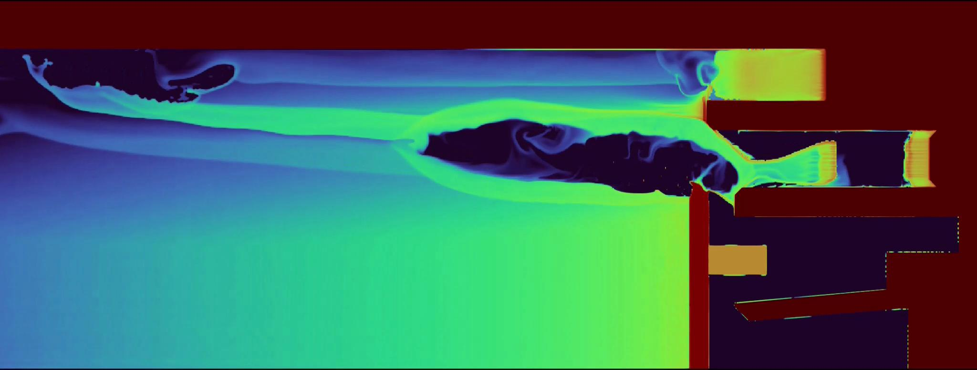
High-fidelity numerical simulation (ALEGRA) predicts ~quasi uniform vapor expansion from front surface
3 mm
Scale: log density, ~3 μs
2D axisymmetric mesh (~10⁶ elements)
Fully-coupled radiation-hydrodynamic simulation with temperature-dependent opacities

Slide 9
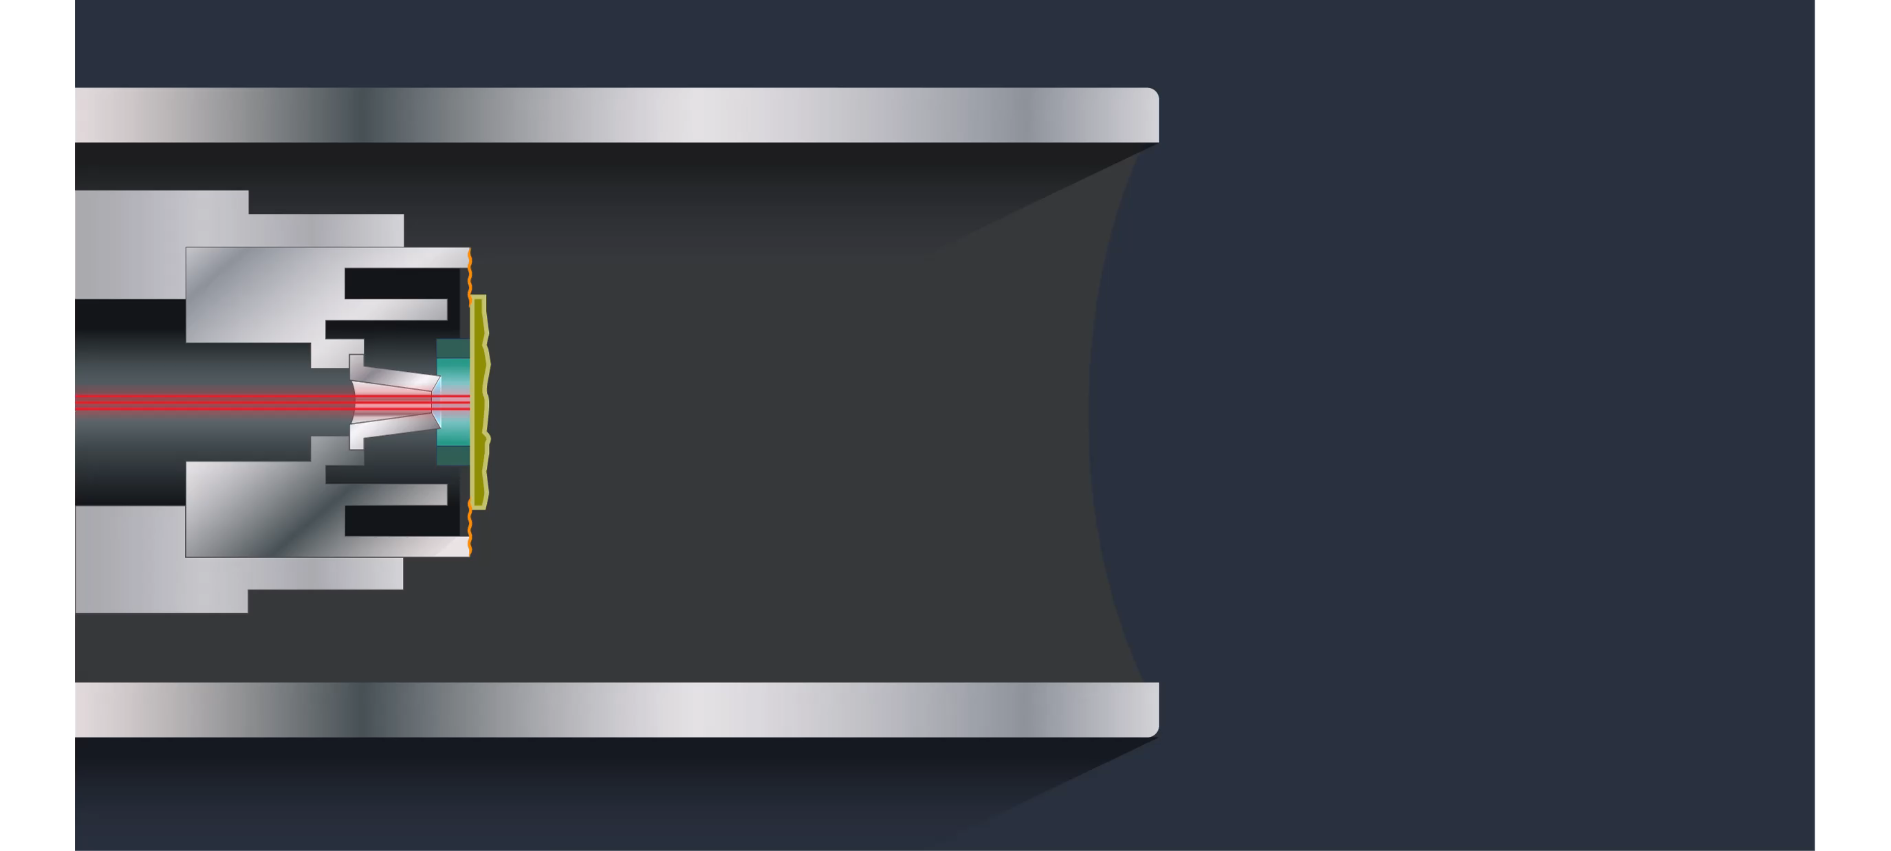
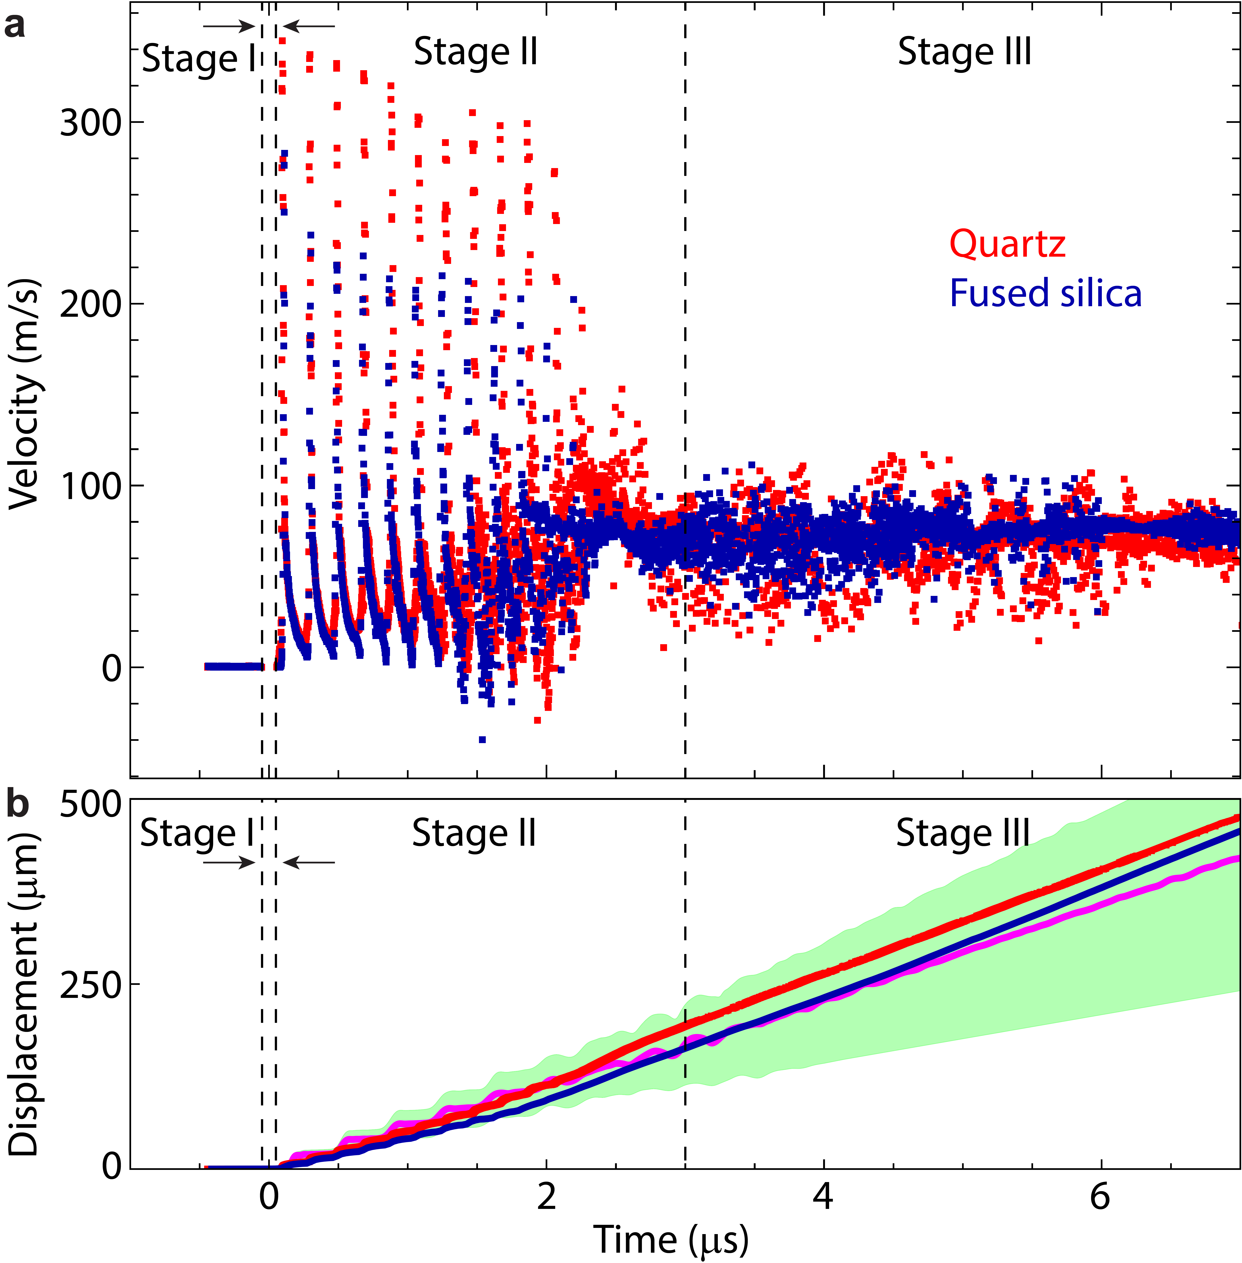
Interferometric measurements show successful release and acceleration of mock asteroids (silica)
1 cm
Three infrared interferometers used to track mock asteroid motion.
Data shows three main stages associated with
Irradiation
Shock wave propagation
Acceleration (>2×10⁷ m/s²) to terminal velocity
Reasonable agreement with simulation
Simulation

Slide 10
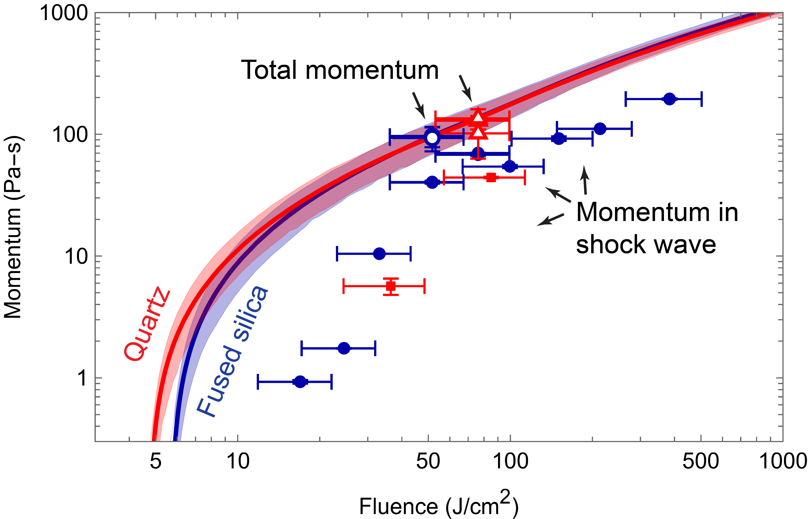
Significantly more momentum transferred when mock asteroid allowed to move freely in vacuum
Mock asteroids of quartz and fused silica gave very similar responses (as expected).
~30–50% more momentum coupled to mock asteroids than carried by the shock
Scaling results to a large silica sphere suggests that ~kilometer-scale asteroids could be deflected using a 1 MT detonation.
MBBAY model modified for silica decomposition
[2]
[1]
[1] Time-integration of in-material stress measured in clamped targets (independent experiments).
[2] Model from N.W. Moore, et al., Nature Physics 20, 1833–1839 (2024)

Slide 11
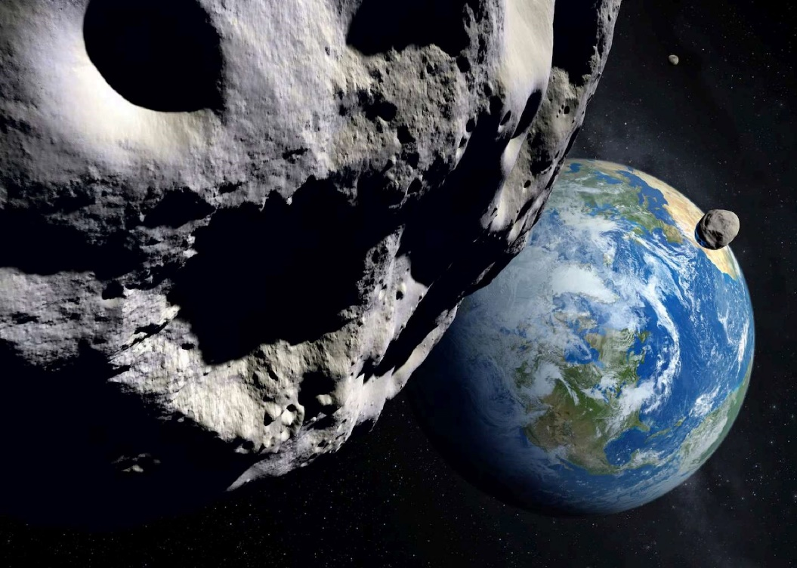
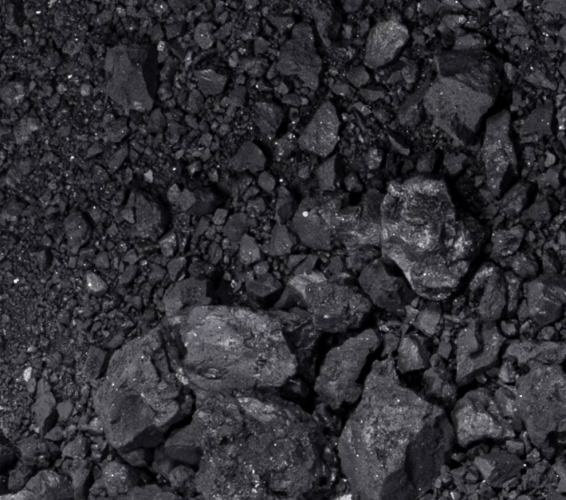
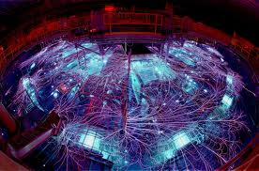
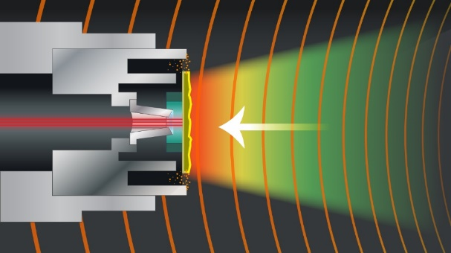
Conclusions
Demonstrated laboratory-based method for studying effectiveness of nuclear (x-ray) deflection of asteroid materials
Provides direct demonstration of deflection concept
Confirmed prediction that momentum coupled to free-floating asteroid is greater than momentum carried by shockwave
Extensible (other minerals, heterogenous, porous, etc.)
Links:
N.W. Moore, et al., Nature Physics (20), 1833–1839 (2024)
https://doi.org/10.1038/s41567-024-02633-7
Press release:
https://www.sandia.gov/labnews/2024/10/03/deflecting-doom-how-sandia-research-could-save-earth-from-asteroids/
Sandia YouTube Channel:
https://www.youtube.com/watch?v=a--_f92O1Nw
Image (top): Science Photo Archive

Slide 12
Backup

Slide 13
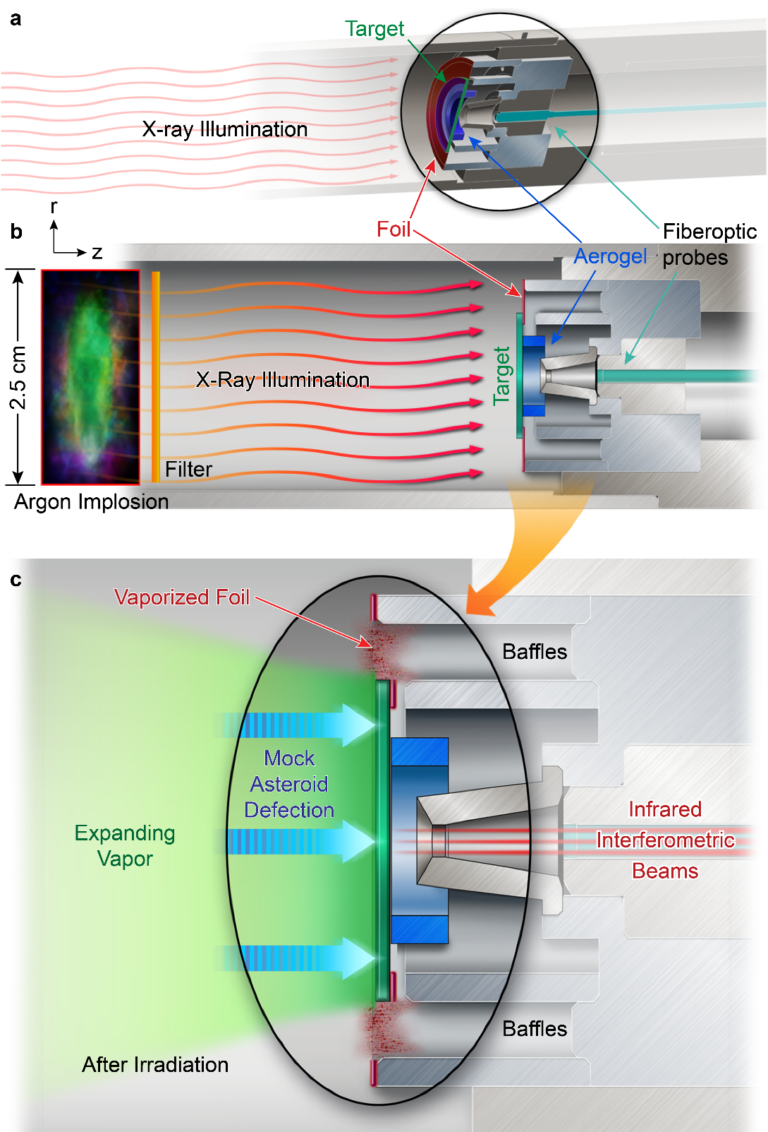
Coupled Momentum for Extraterrestrial Threats (COMET) test fixture
“X-ray scissors” for releasing mock asteroid into free-space
3 focused infrared beams for displacement and tilt
Baffles trap / delay plasma from support foil (includes aerogel baffle)
Density
(kg/m³)
Density
(kg/m³)
Moore et al. (2024), Nature Phys.

Slide 14
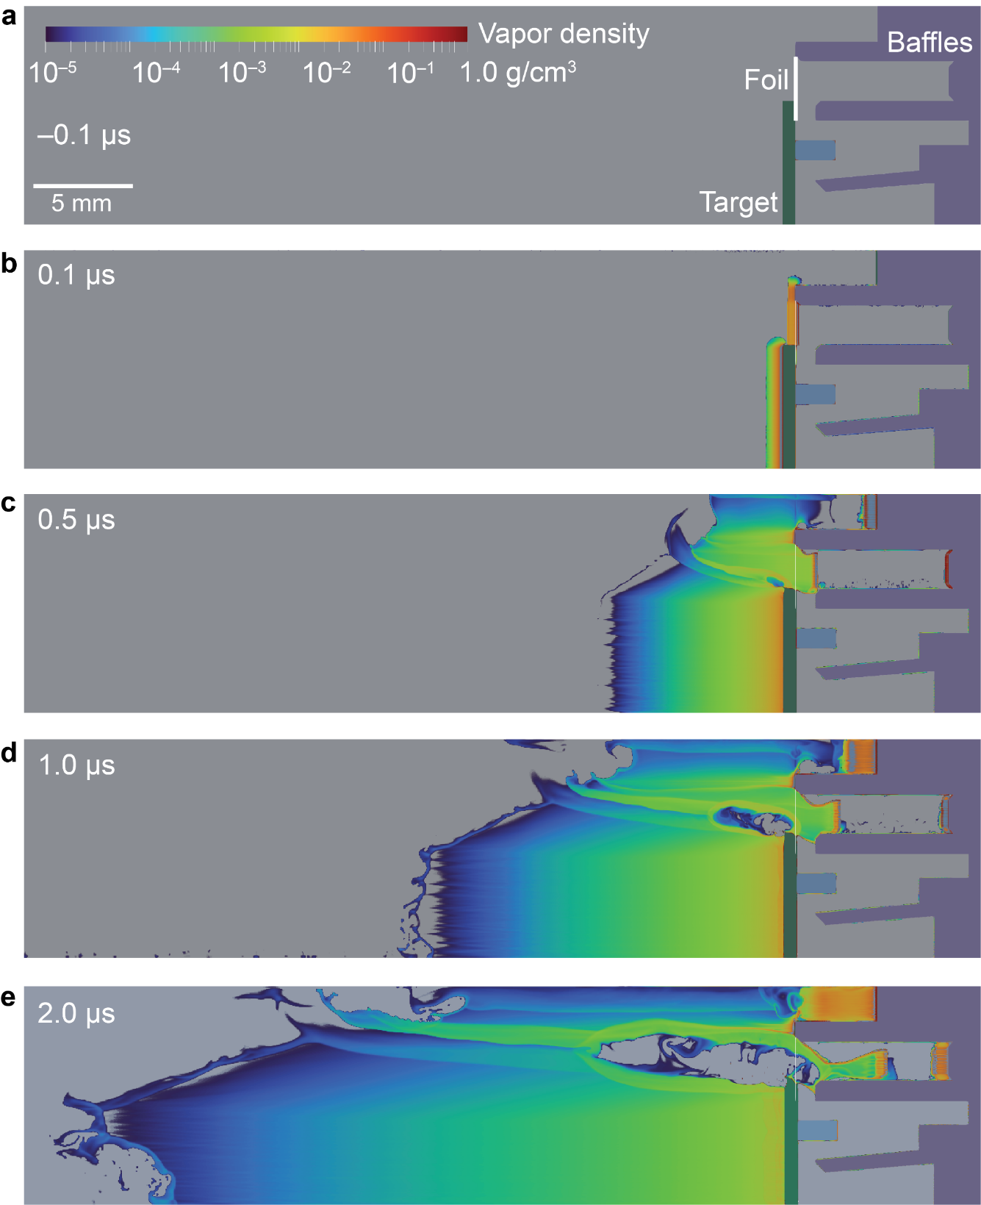
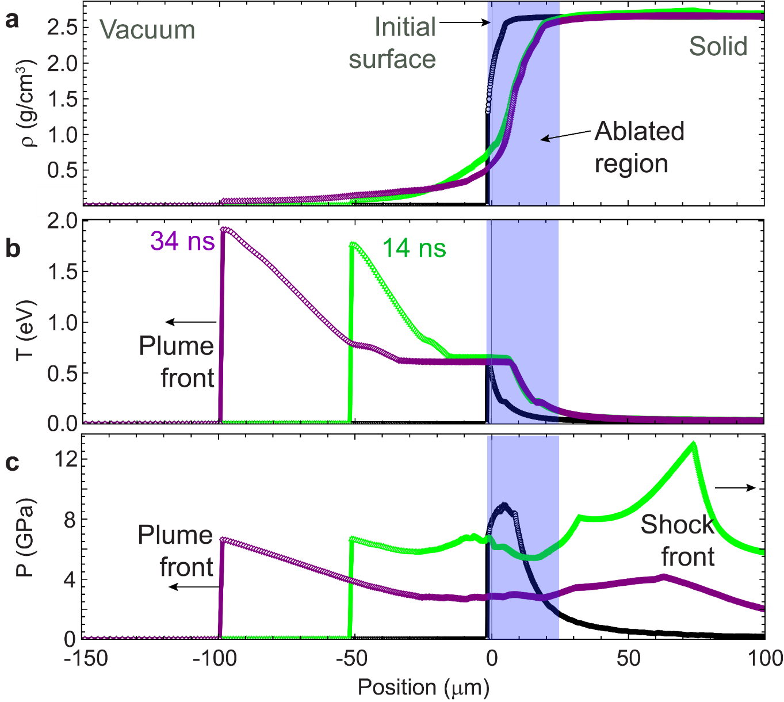
Radiation-hydrodynamic model (ALEGRA) can be used to explore dynamics and EOS trajectory
Moore et al. (2024), Nature Phys.
Moore et al. (2024), Nature Phys.

