Slide 1
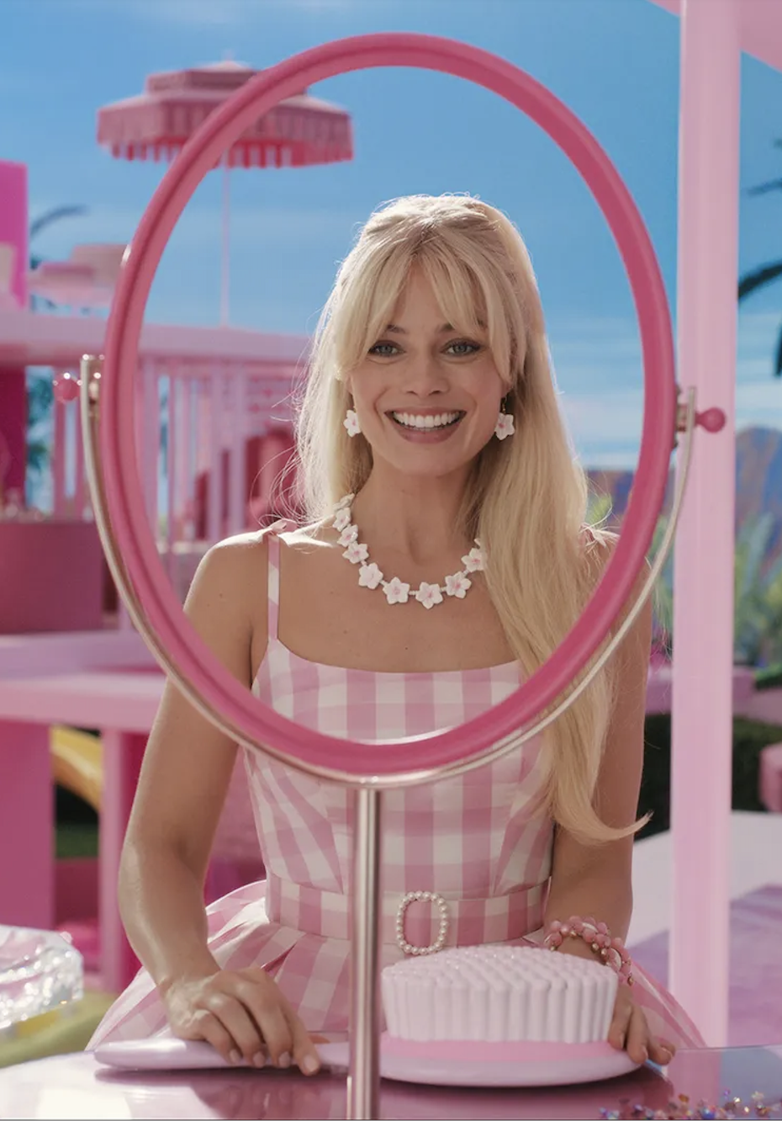
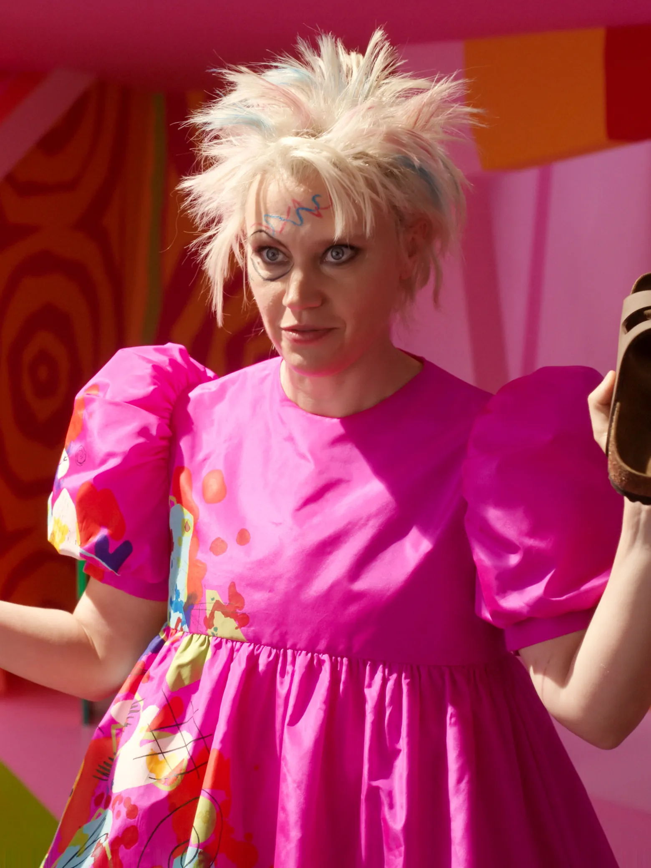
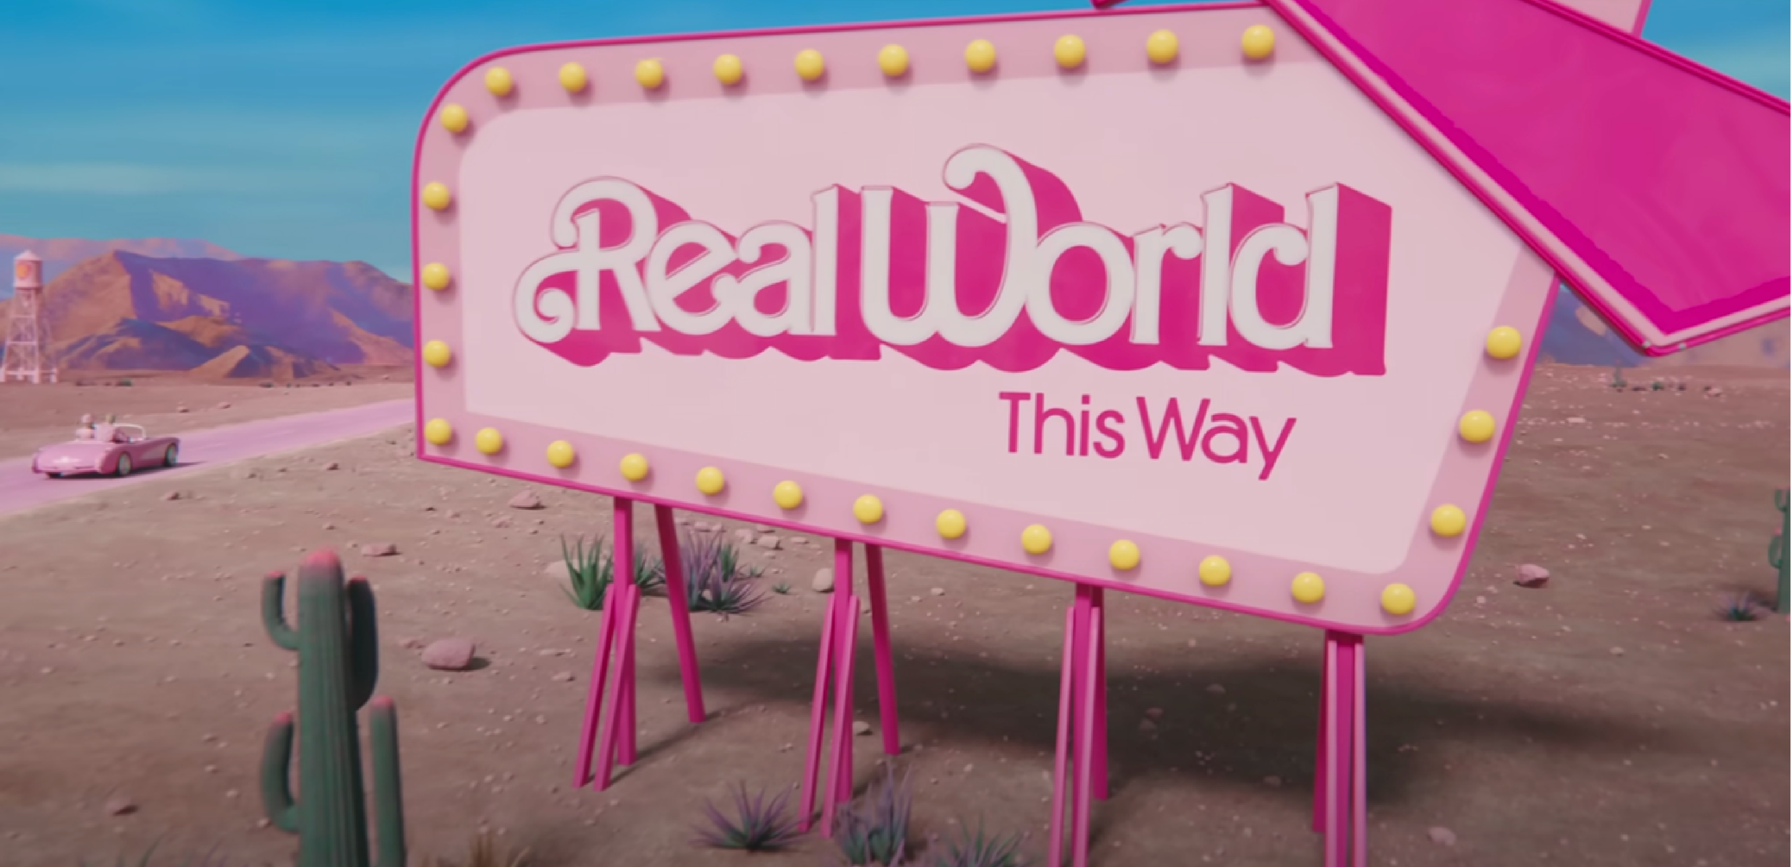
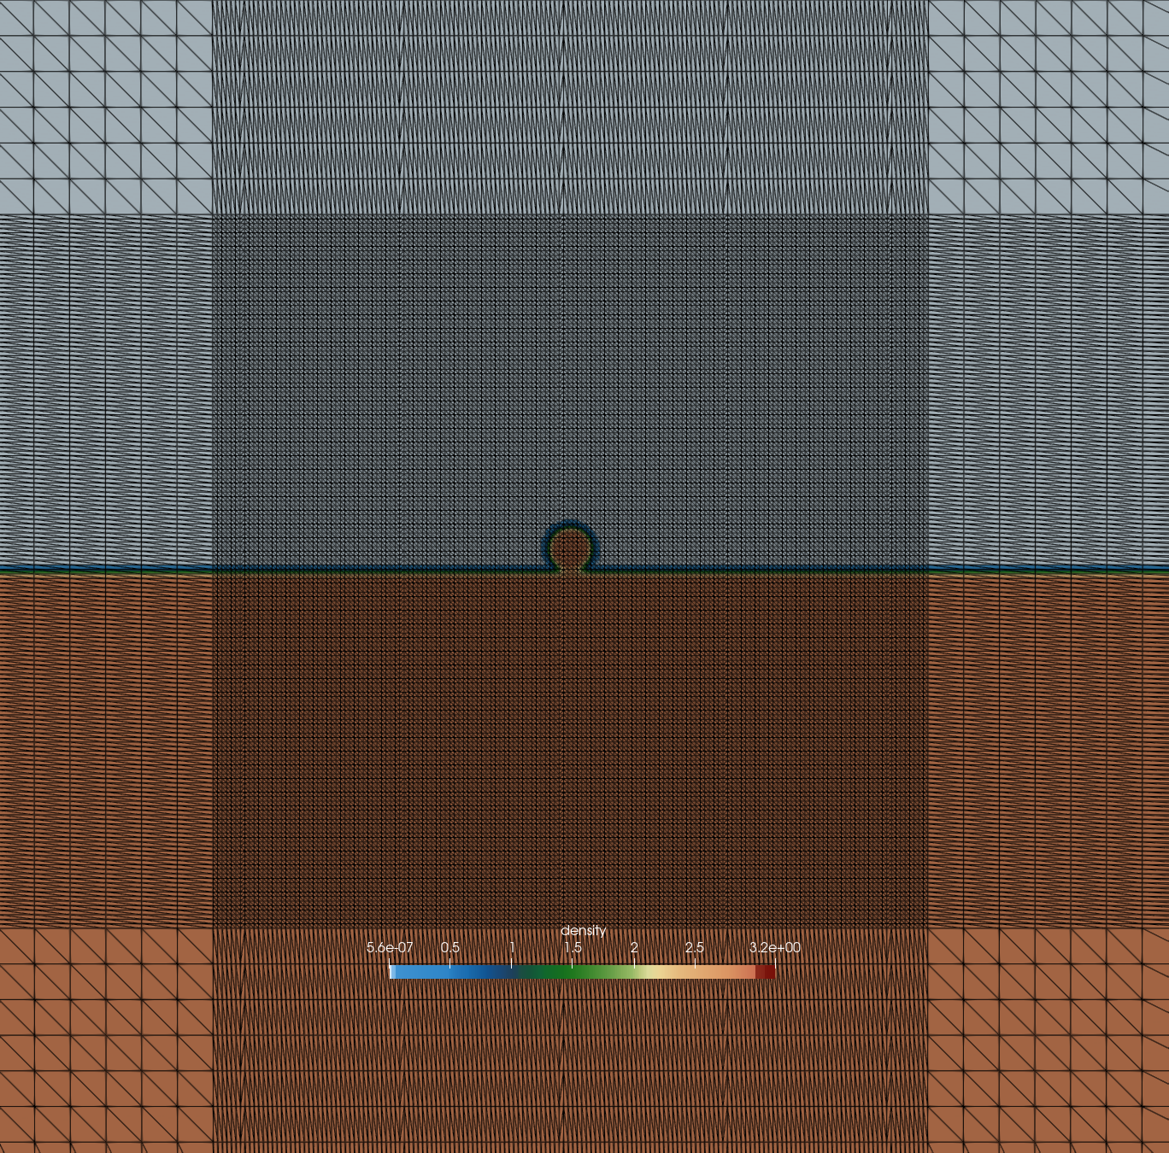
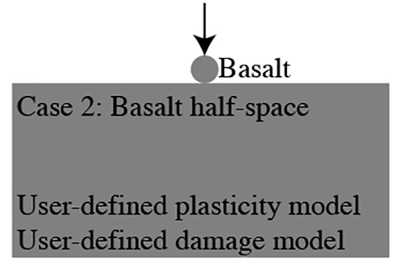
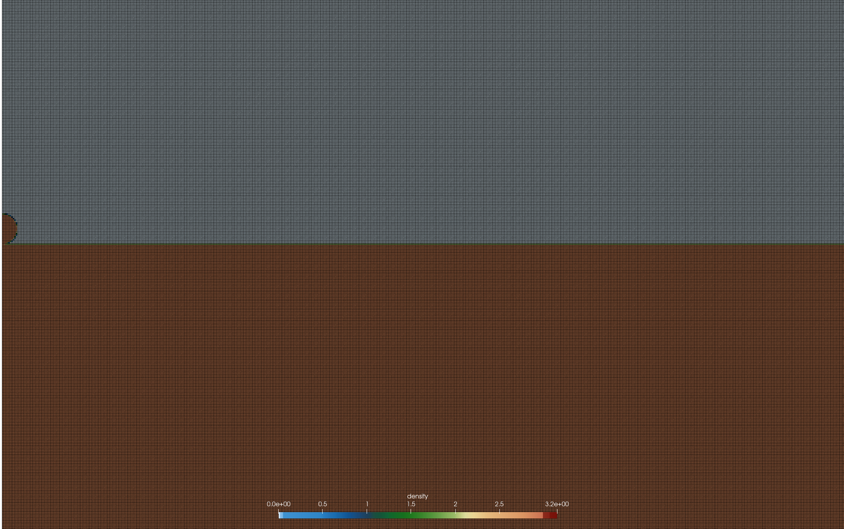
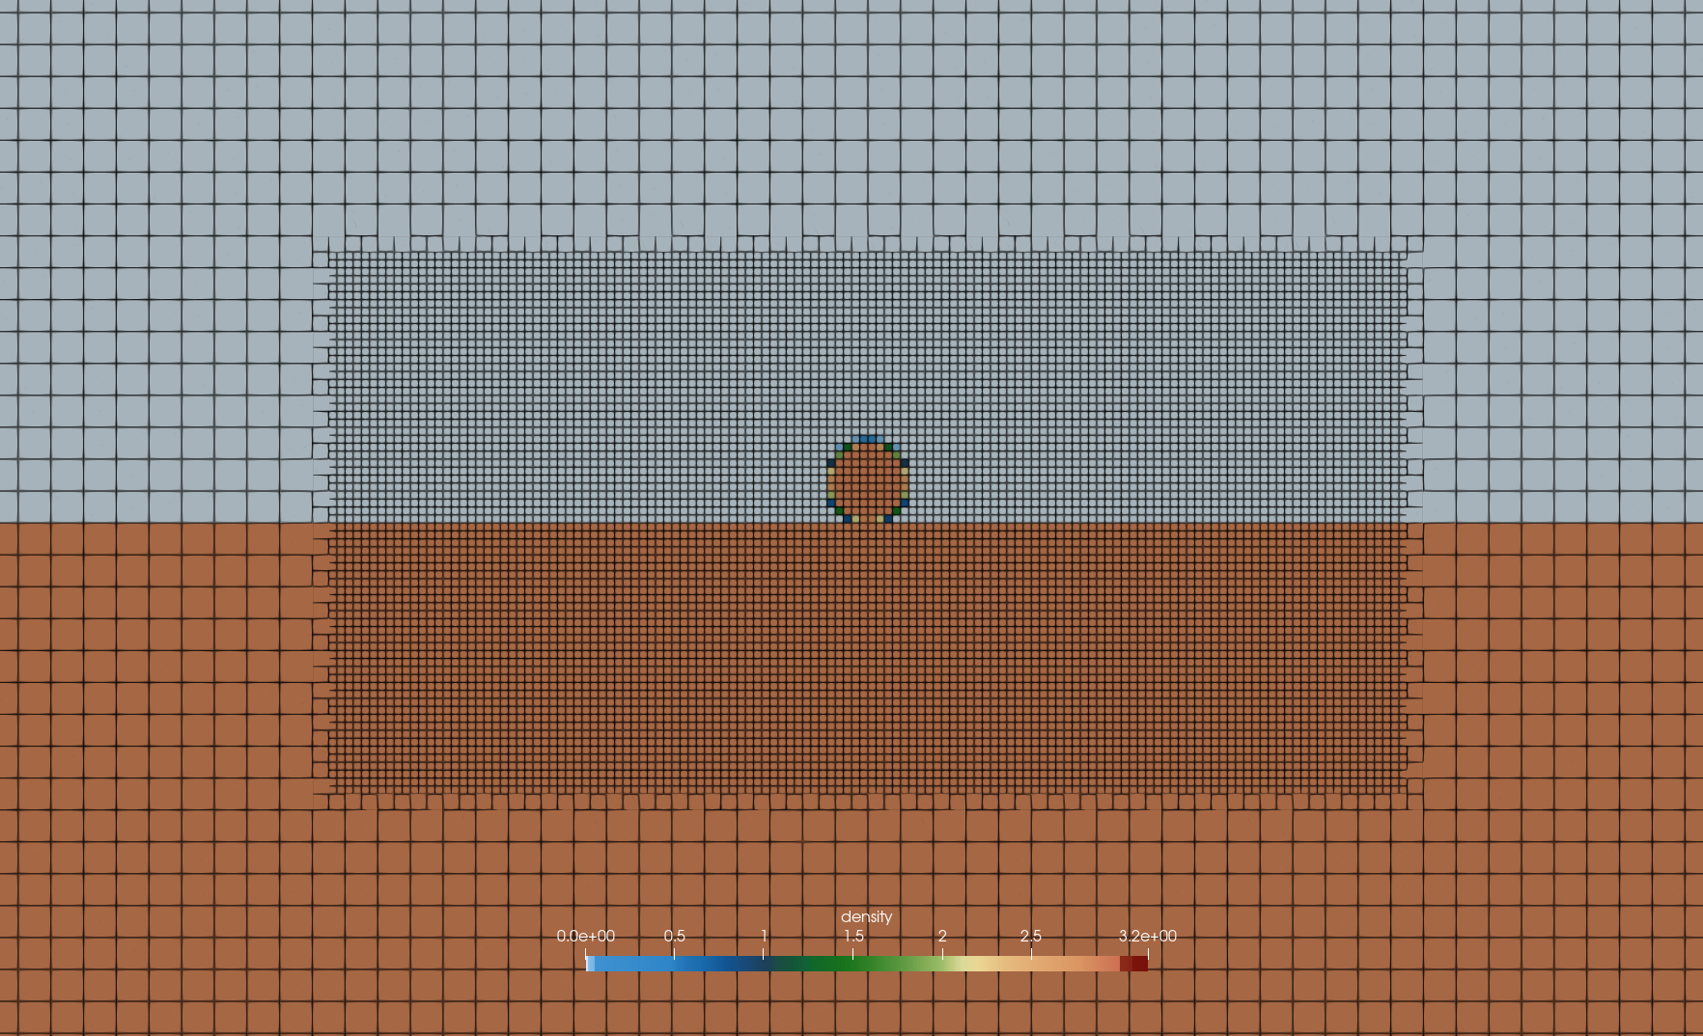
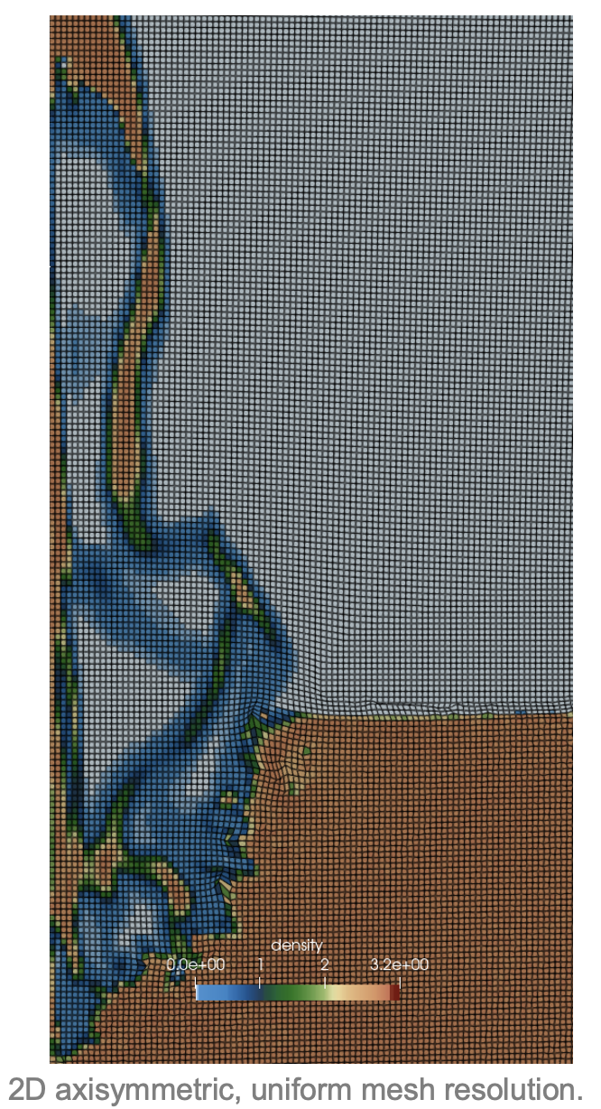
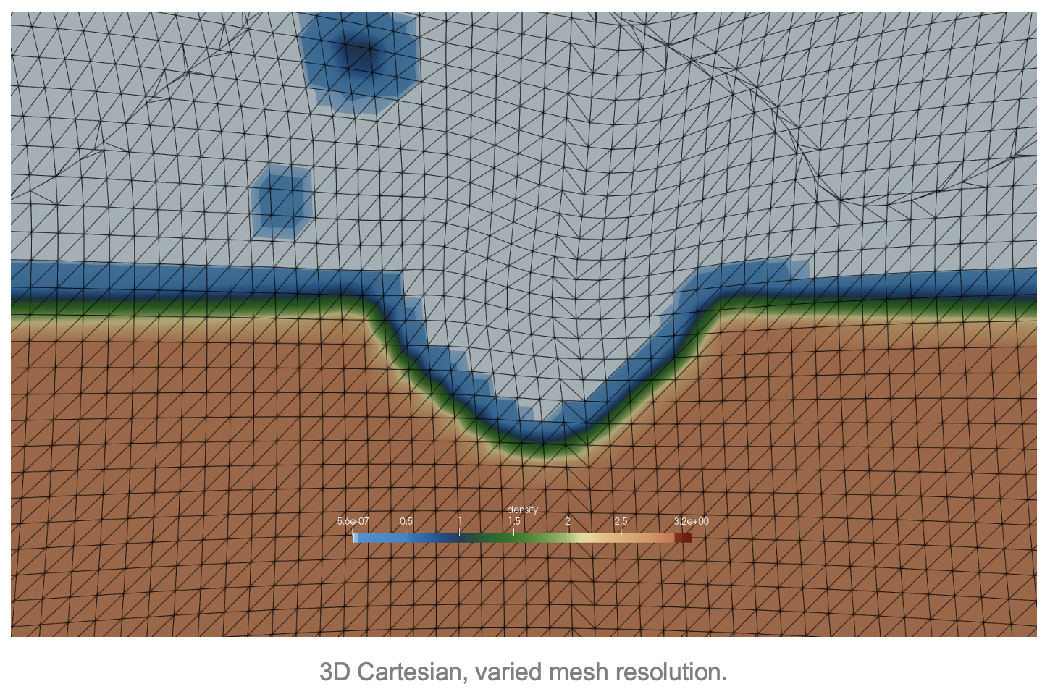
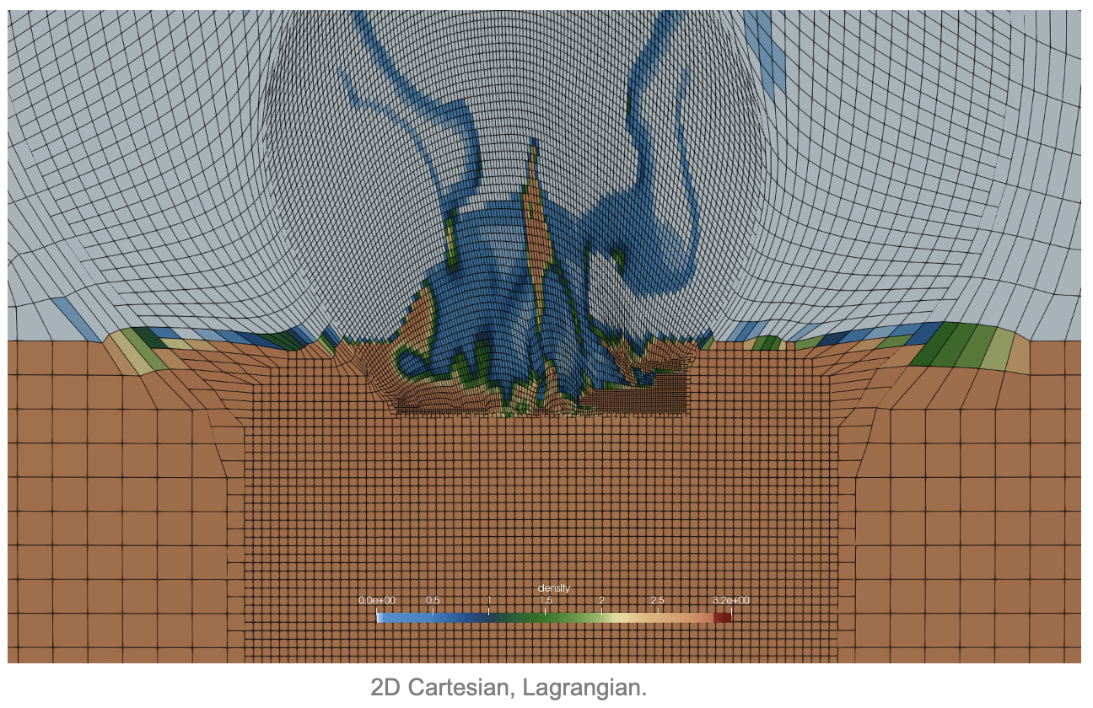
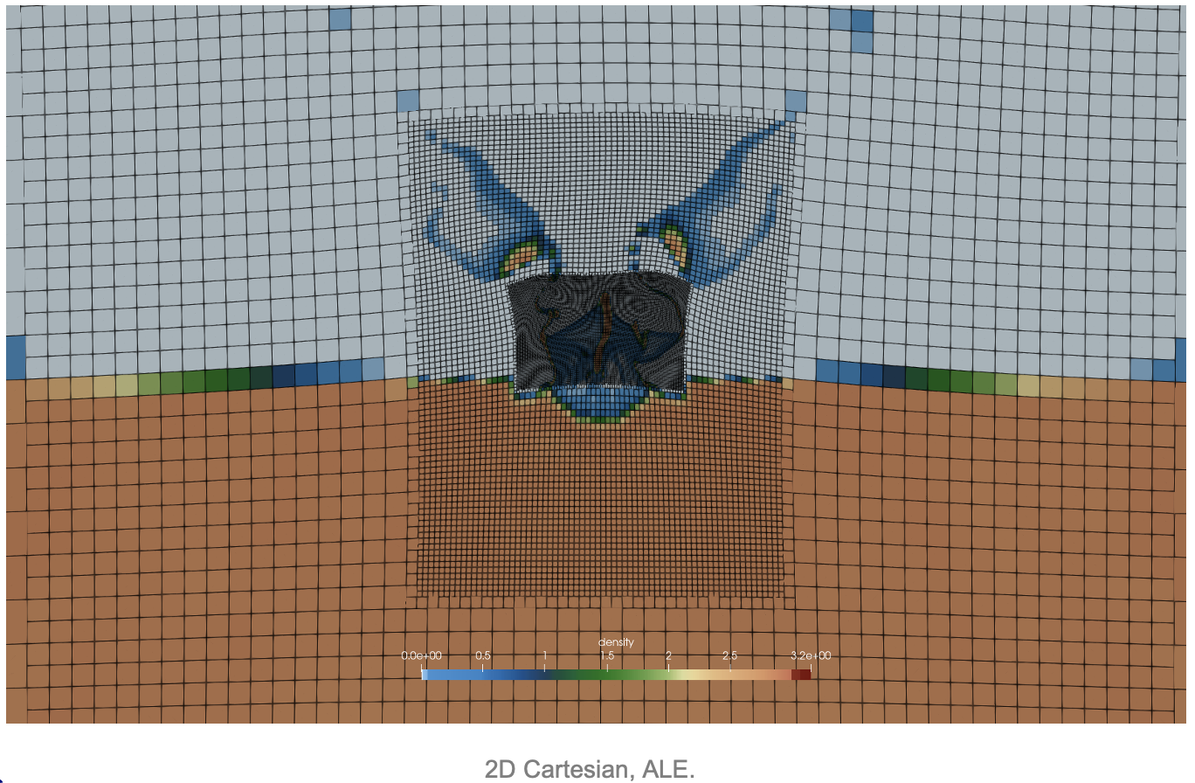
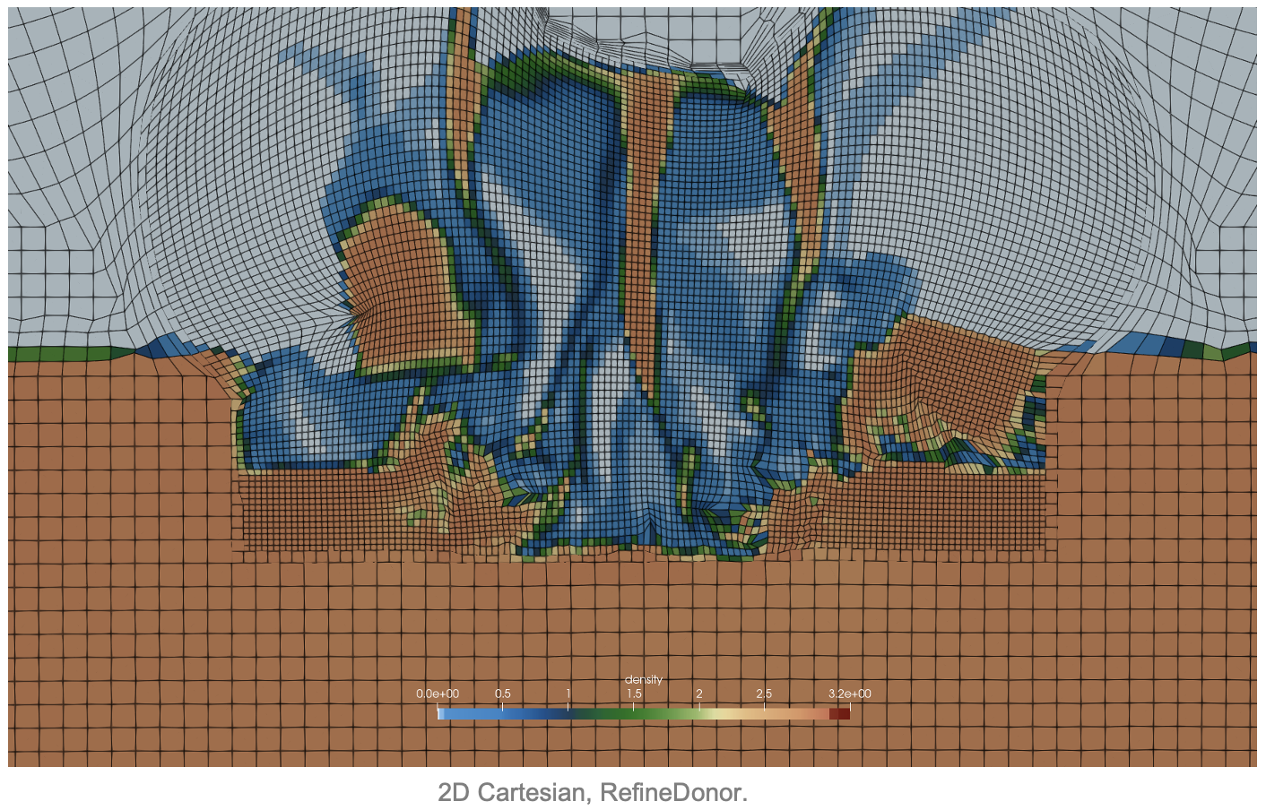
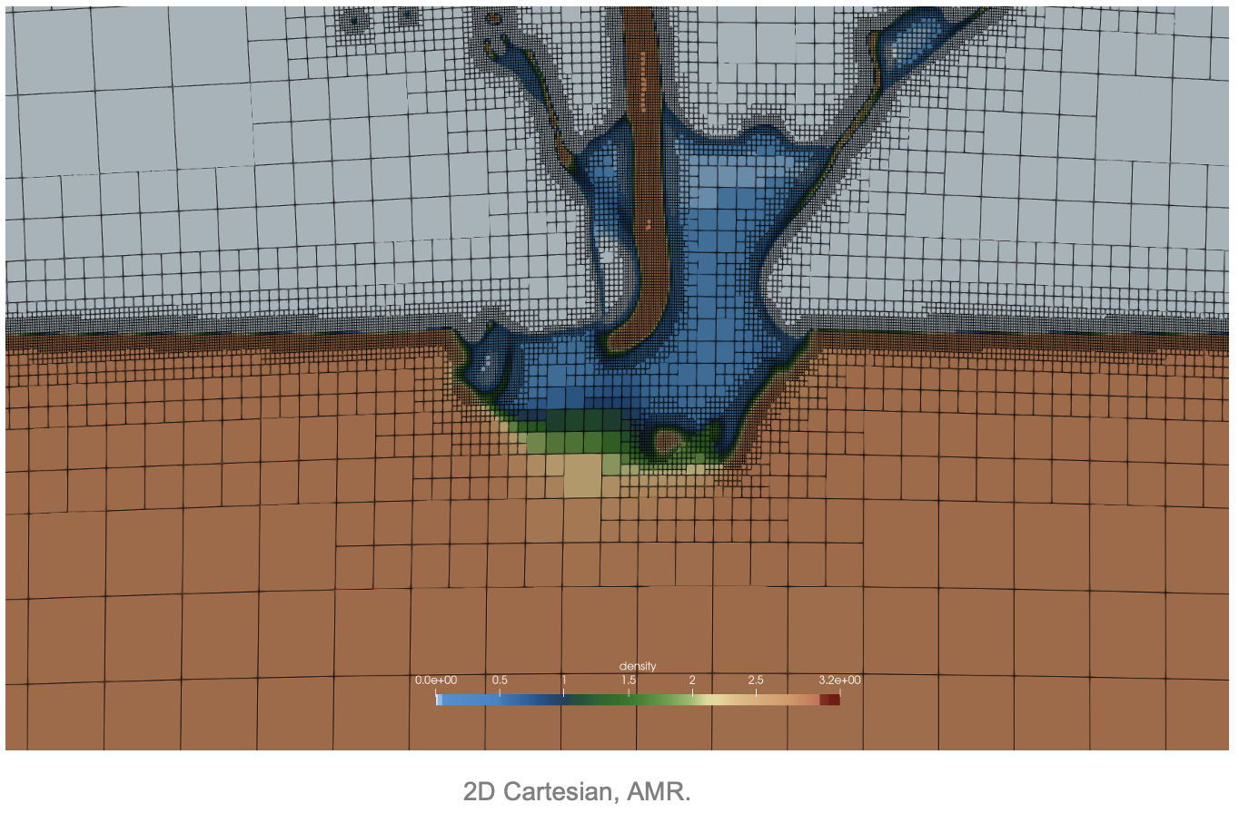
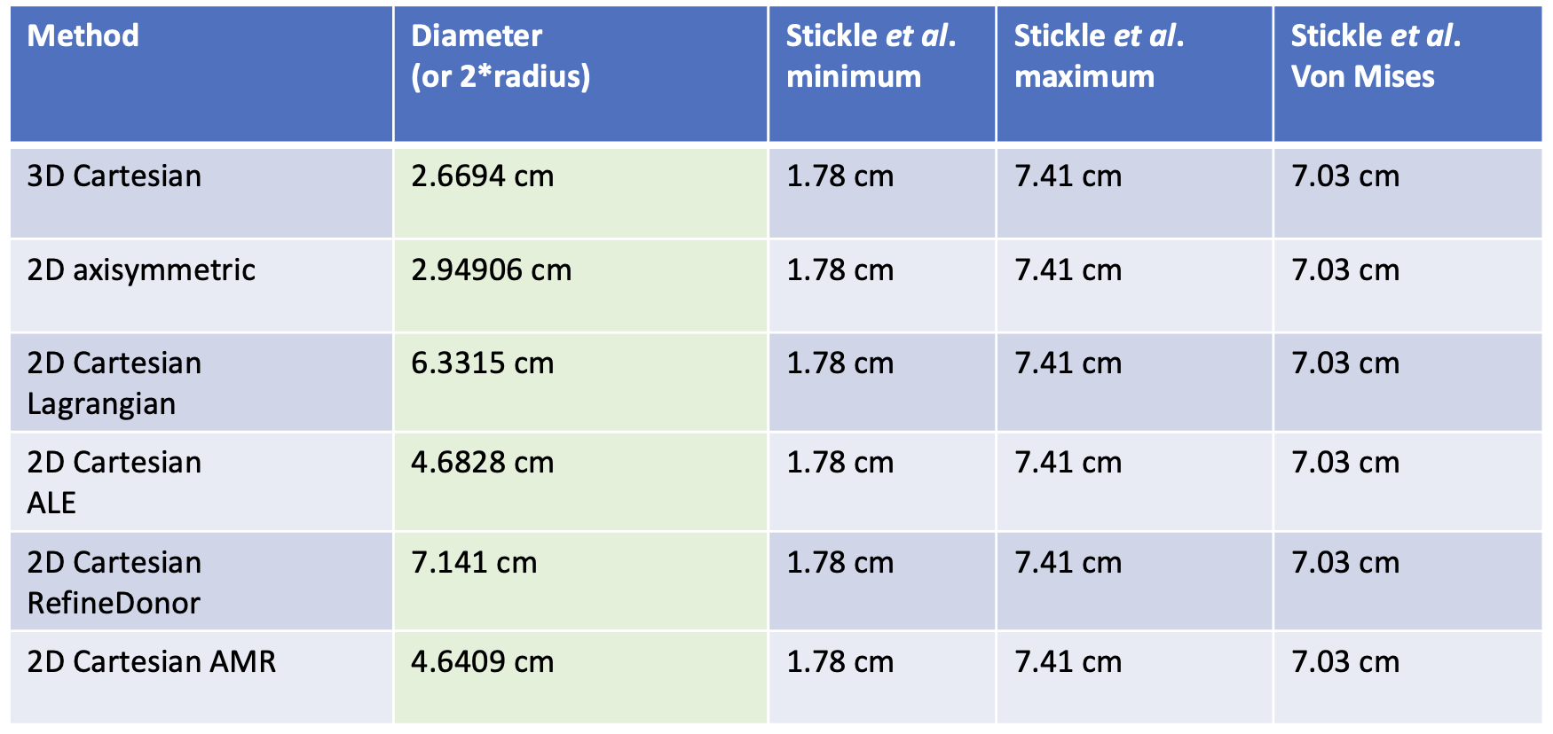
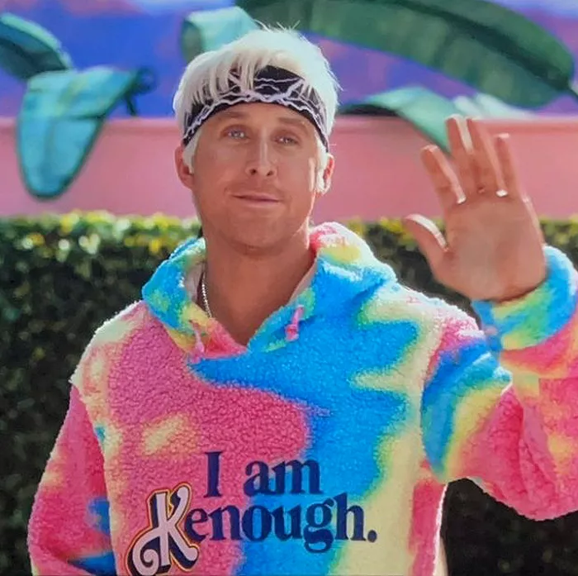
Quantifying Uncertainty in Modeling Choices
for Time-Sensitive Applications
Wendy K. Caldwell, Abigail Hunter, and Catherine S. Plesko
Los Alamos National Laboratory, Los Alamos, N.M., United States
Common Computational VVUQ Approach
Analytic solution
Uniform meshing
Fully converged
mesh resolution
“toy problem”
Real-World Problems Often Require
Unknown solutions
Varied mesh resolution
or AMR
Additional physics
Low computational cost
From Ideal…
Photograph from Warner Bros. Pictures.
Photograph from Warner Bros. Pictures.
3D Cartesian, varied mesh resolution.
Figure from Stickle et al. Icarus 338:113446 (2020).
2D Cartesian, ALE/AMR/Lagrangian/Refine Donor.
…to Real
2D axisymmetric, uniform mesh resolution.
All results within ranges of original study
RefineDonor had the best match to the equivalent strength model in the original study
RefineDonor is the method with the best balance of accuracy and computational efficiency.
Photograph from Warner Bros. Pictures.

