Slide 1
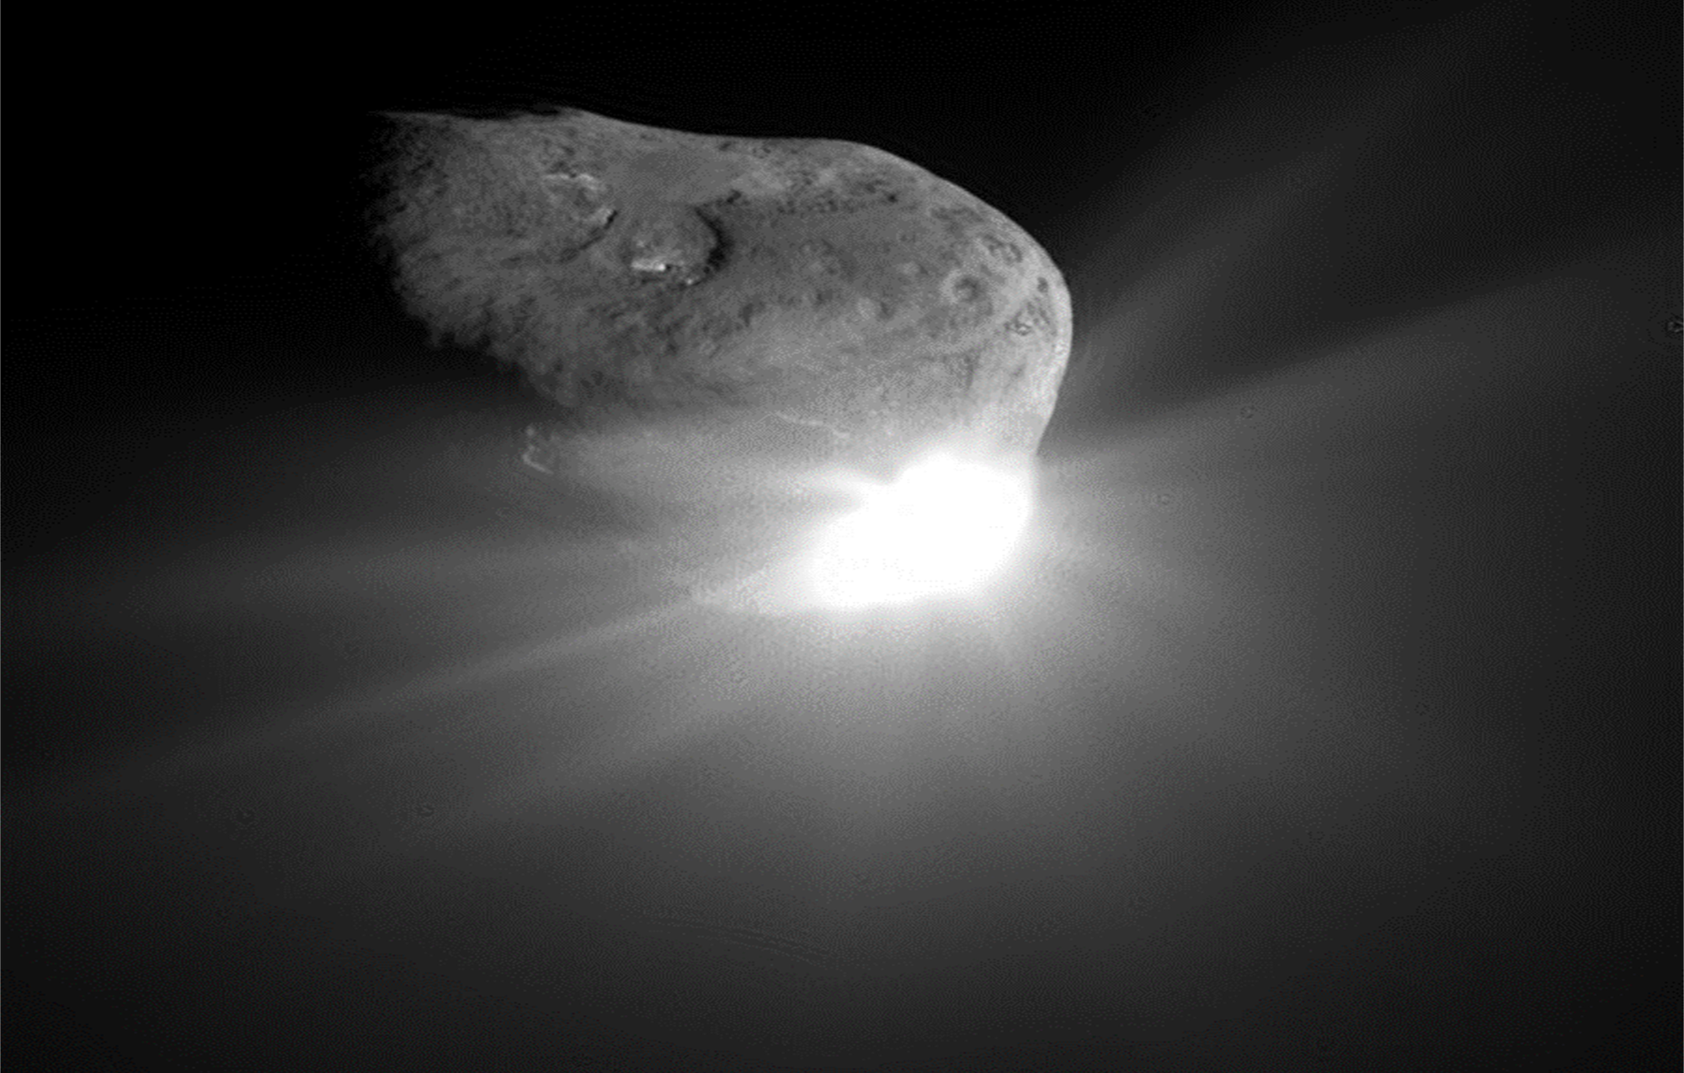
HYPERVELOCITY CRATERING AND DISRUPTION OF THREE L-TYPE ORDINARY CHONDRITES: EFFECTS OF STRENGTH AND POROSITY ON DISRUPTION ENERGY
G. J. Flynn, M. Strait,
D. D. Durda, and R. Macke
NASA Image
Deep Impact at Tempel I

Slide 2
Motivation
Hydrocode modeling the outcome of kinetic impact deflection generally uses the well-established physical properties of terrestrial rocks.
Of particular importance are the momentum transferred in the impact, characterized by the ratio of the change in momentum of the target to the impactor momentum (β) and the specific energy that results in fragmentation (Q*_{F}), since fragmentation could leave a large piece of the asteroid on a collision course.
Asteroids have a wide range of porosity, ranging from near zero to more than 50%.
During an impact, compaction of porous material can help absorb the impact energy, reduce the likelihood of fragmentation, and increase the probability of survival of the body (Holsapple, PSS, 2009).
It is generally assumed that “increasing porosity lowers disruption risk” (Stickle et al., Planet. Sci. J., 2022).
Similarly, it is generally assumed that targets of lower strength require more energy for disruption (Asphaugh, Nature, 1989).
Modeling also indicates that β decreases with increasing target porosity, with several models indicating that be is less than 1.4 for 5 km/s impacts into strong targets with porosity larger than a few percent.

Slide 3
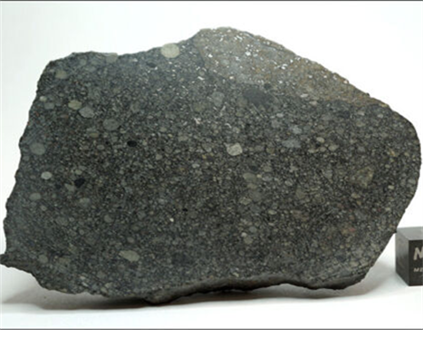
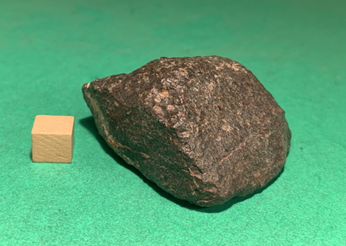
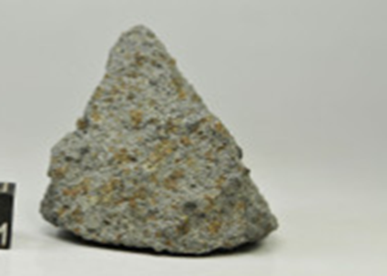
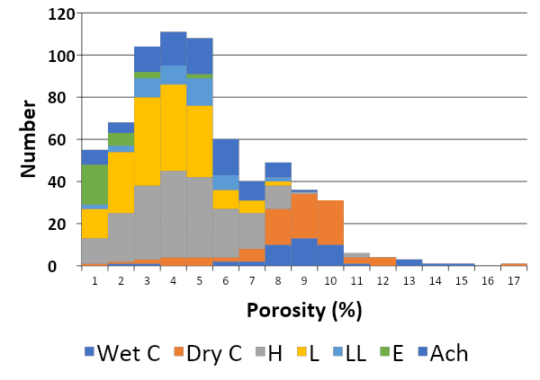
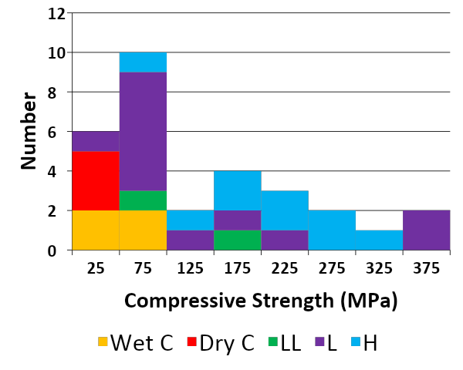
Why Do Experiments on Meteorites?
Meteorites provide a direct sample of the Near-Earth population.
Stone meteorites constitute 95% of meteorite falls, and 95% of the stone meteorites are ordinary chondrites.
“There are no analogues among terrestrial igneous and sedimentary rocks and ores [for the] physical and mechanical properties of the meteorites.” [Slyuta et al. (2008) LPSC XXXIX, Abstract #1056]
Meteorites, which sample their parent asteroids, span most of the porosity, strength, and composition ranges reported for asteroids.
To assess the range of outcomes of natural or human induced collisions with asteroids of known type, we performed a series of hypervelocity cratering and disruption impacts on three L-type ordinary chondrites that span most of the porosity and strength ranges of the meteorites.
Aba Panu (L3) Porosity 3.1%,
Compressive Strength 438 MPa (Cotto-Figuero et al., 51st LPSC, Abstract 2646)
Northwest Africa 869 (L4-6) Porosity 7.8% Compressive Strength 87 MPa
Saratov (L4) Porosity 14.1% in NMNH sample (Macke, 2010)
Compressive Strength: ~0.97 MPa
Aba Panu
NWA 869
Saratov
0 5 10 15 20 25 30 35 40

Slide 4
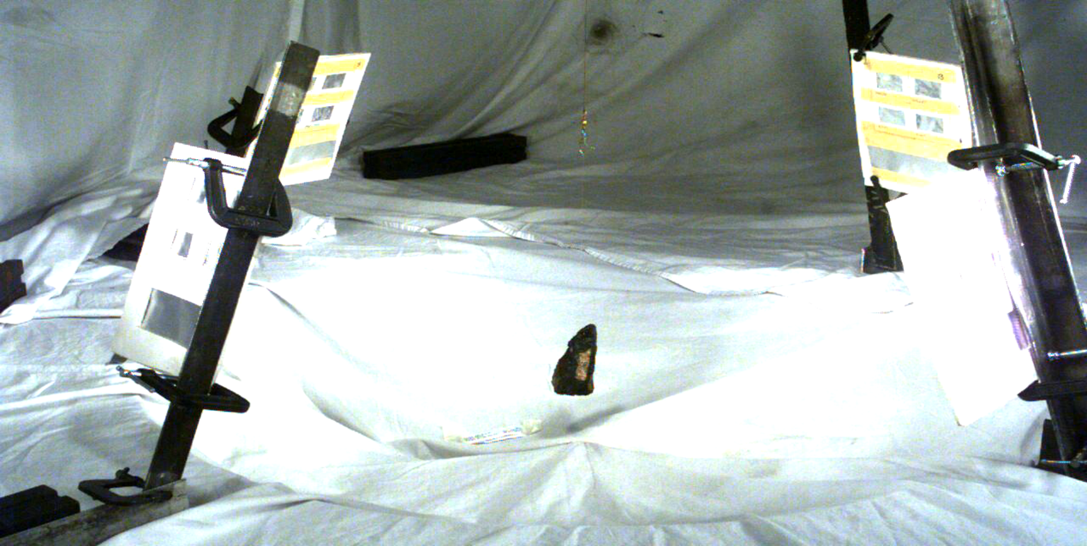
Disruption Measurements
Impact experiments were performed using 1/16, 1/8, or 1/4 inch diameter spherical aluminum projectiles fired at ~5 km/s using the NASA Ames Vertical Gun Range.
The targets were hung on an ~ 2 m long fishing line that did not interfere with the fragmentation.
The chamber was pumped to ~0.5 Torr vacuum.

Slide 5
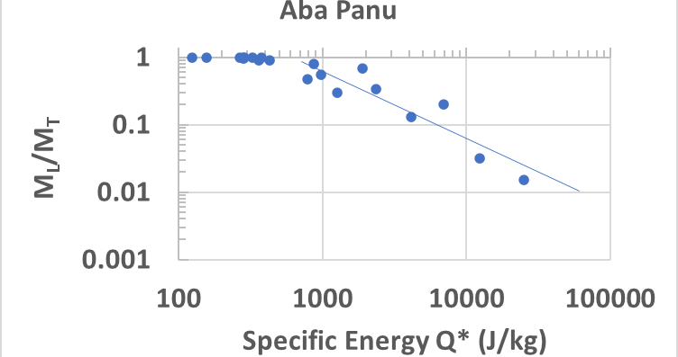
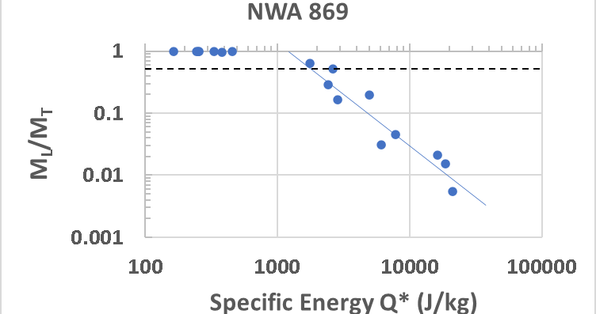
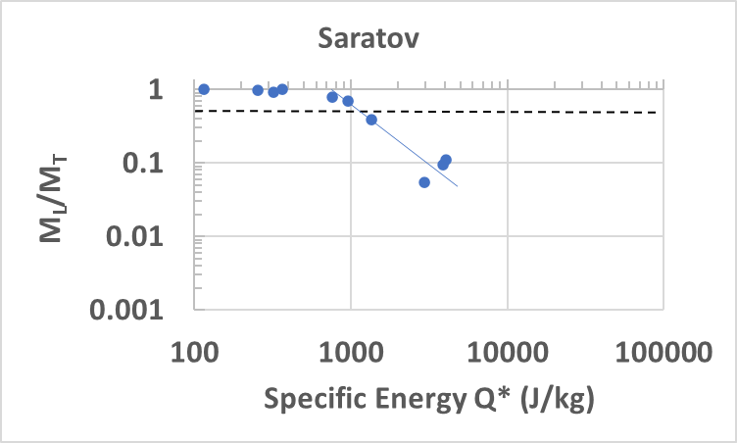
Disruption Results
The fragments from the disruption were recovered, and the mass of the largest fragment was plotted against the energy per unit target mass of the impactor to determine the threshold catastrophic disruption energy, Q*_{C}, the energy that results in the largest fragment having one-half the target mass.
We also determined the energy for the onset of fragmentation by projecting the best fit line back to its intersection with M_{L}/M_{T} = 0.98 (cratering event).
Target Porosity Q*C Q*_{F}
Aba Panu 3.1% 1230 J/kg 680 J/kg
NWA 869 7.8% 1990 J/kg 1320J/kg
Saratov 15.6% 1090 J/kg 660 J/kg

Slide 6
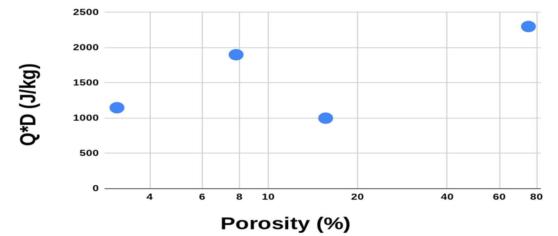
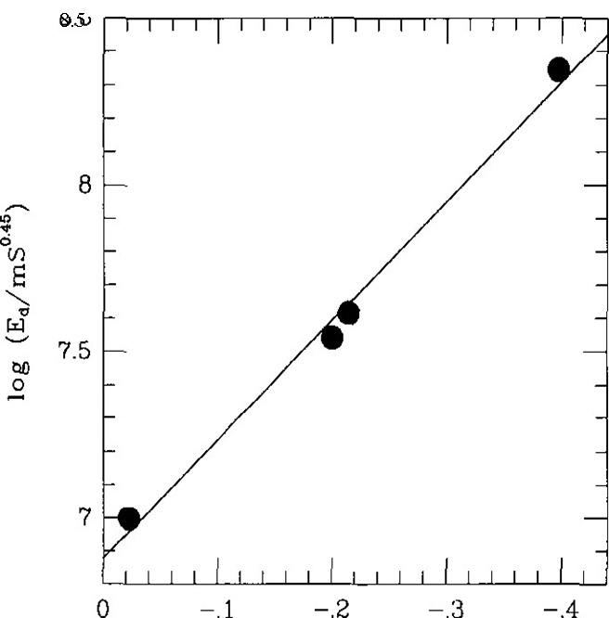
Saratov Results
Saratov has the lowest compressive strength and the highest porosity of any of these three, L-type ordinary chondrites we measured. Based on hydrocode modeling, Saratov was expected to be the most resistant of the three L-type ordinary chondrites to fragmentation or disruption (i.e., have highest Q*_{F} and Q*_{C}). However, Saratov had the lowest Q*_{F} and Q*_{C} of these three meteorites.
Love et al. (Icarus, 1993) faced a similar problem in impacts on sintered glass sphere targets, where two targets with approximately the same porosity but different strengths had different Q*_{C} values.
They noted that early work by D. Gault had indicated Q*_{C} was proportional to the S^{0.45} for rocks he studied, where S is the unconfined compressive strength.
Dividing their Q*_{C} values by indicated a power law behavior of Q*_{C} / S^{0.45} and (1 – porosity).
NWA 869
Aba Panu
Saratov
Q*_{C} (J/kg)
log (1 – P) from Love et al., 1993)

Slide 7
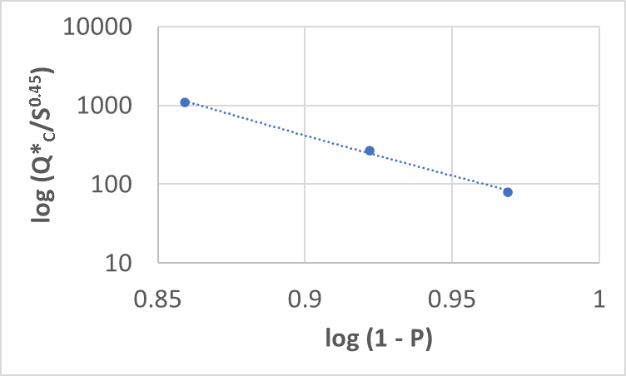
Dependence of Q*_{C} on Strength and Porosity
We tried the same approach used by Love et al. (1993) to separate the effects of porosity and compressive strength.
A plot of Q*_{C}/S^{0.45} vs. (1 – porosity) indicated a power law dependence;
Q*_{C} = 42.25 S^{0.45} (1 – P)^{-21.7}
with Q*_{C} in J/kg for S in MPa
The good fit (R² = 0.99) indicates that, for these three L-type ordinary chondrites, the influences of strengths and porosity on the threshold energy for catastrophic disruption are separable.
The dependence of Q*_{C} on porosity is very strong.

Slide 8
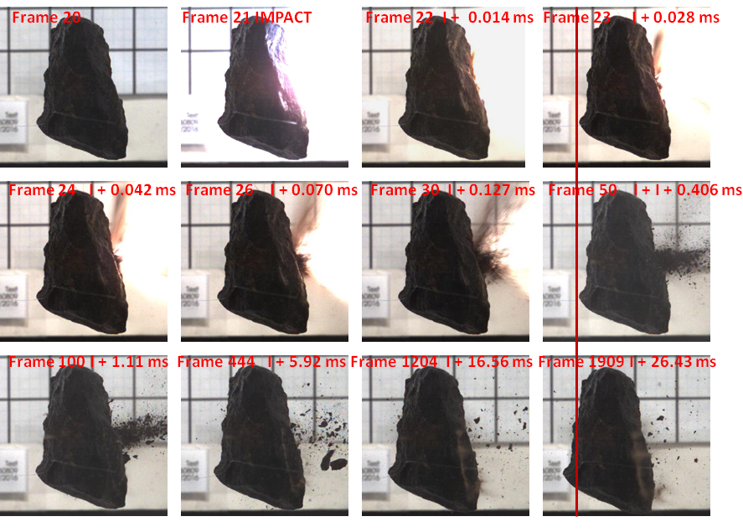
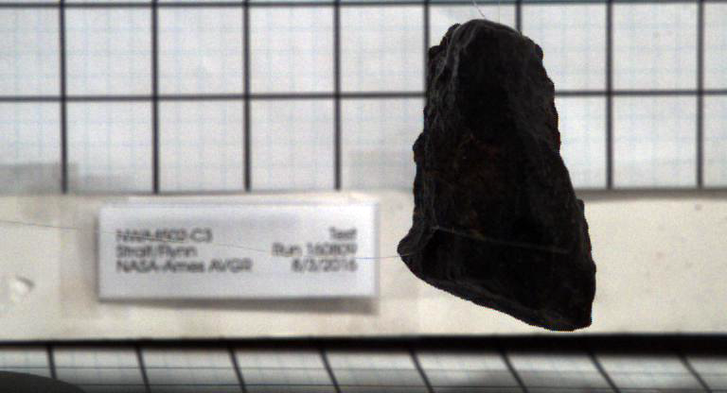
β Measurements
For momentum transfer measurements each target was suspended in front of a grid, and the recoil speed was measured from a sequence of high-speed video images.
xx
₌ momentum acquired by the target
momentum of the impactor

Slide 9
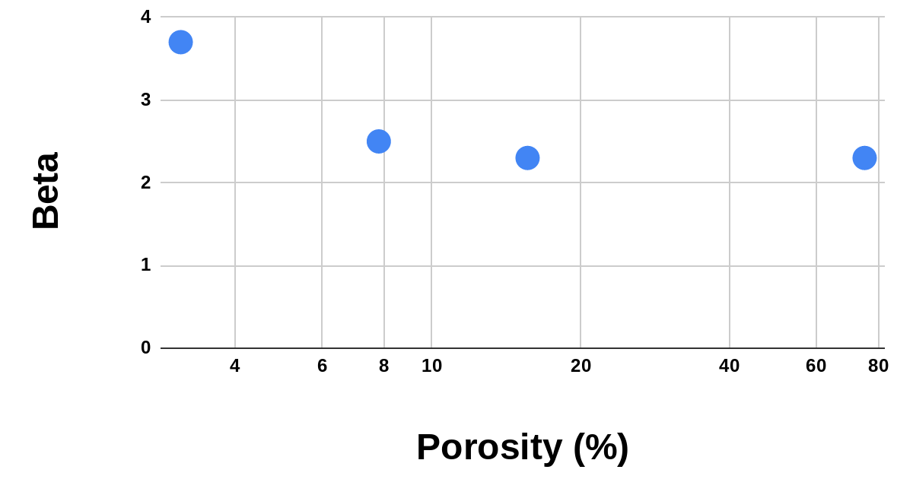
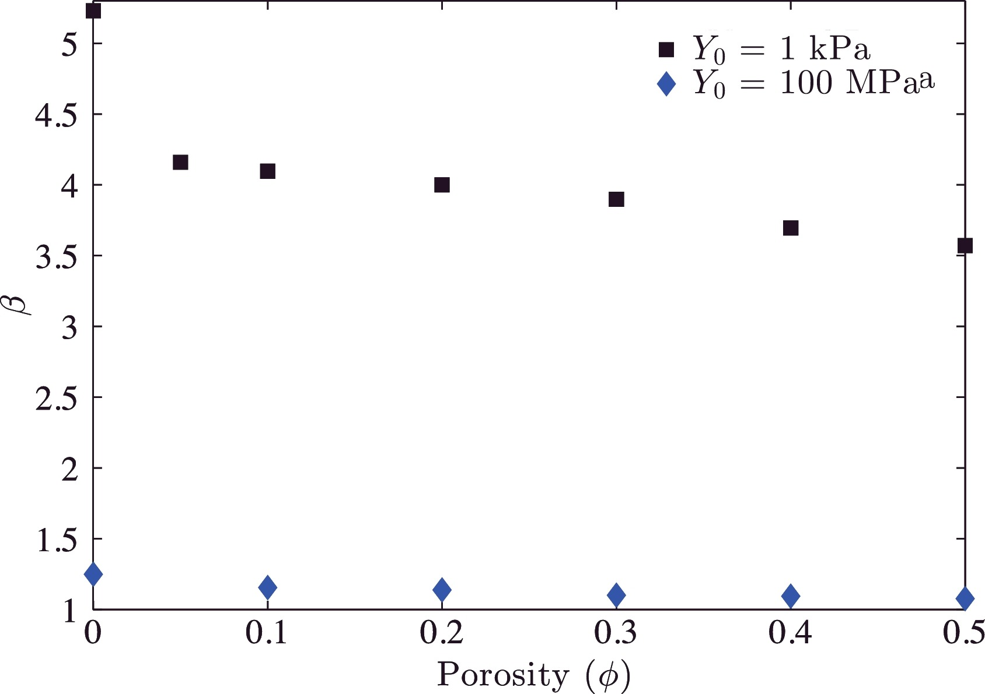
Cratering Results
We measured the momentum transfer, characterized by the parameter β, where: β = momentum acquired by the target
momentum of the impactor
using the recoil speed from a sequence of high-speed video images.
β Results:
Aba Panu β = 3.7
NWA 869 β = 2.5
Saratov β = 2.3
β shows the decrease with increasing porosity
expected from hydrocode modeling.
Aba Panu
NWA 869
Saratov Pumice
From Bruk Syal et al. 2016
very weak targets
Very strong targets
In all cases β is greater than 2, so the momentum gain from crater ejecta exceeds that from projectile capture. Some hydrocode modeling gives β < 1.4 for targets as strong as Aba Panu and NWA 869 (Bruk Syal et al., Icarus 2016).
O Aba Panu
o NWA 869
o Saratov

Slide 10
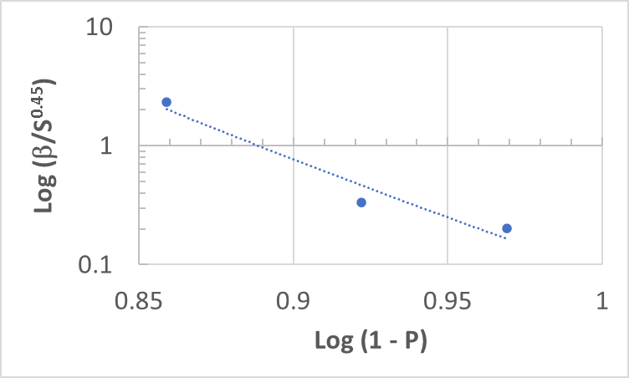
β Dependence on Strength and Porosity
We tried the same approach to β that we employed for Q*_{C}, plotting β/S^{0.45} versus
(1 – porosity).
A plot of β/S^{0.45} vs. (1 – porosity) again indicated a power law dependence;
β = 0.086 S^{0.45} (1 – P)^{-20.8}
with S in MPa
The good fit (R² = 0.99) indicates that, for these three L-type ordinary chondrites, the influences of strengths and porosity on the momentum transfer are separable.
The dependence of β on porosity is very strong.

Slide 11
Limits on Kinetic Impact Deflection
Kinetic impact deflection must avoid disruption which could leave a large fragment on a collision course.
To avoid disruption, the maximum impactor mass (m_{i}) that can be employed for deflection is limited by the requirement that:
½ m_{i} v_{i}² < M_{ast} Q_{F} (Eq. 1)
where M_{ast} is the asteroid mass, v_{i} is the impactor speed, and Q_{F} is the
minimum energy/unit mass that fragmentss the asteroid rather than
cratering it.
This mass limits the maximum momentum transfer:
M_{ast} ΔV_{ast} = β m_{i} v_{i} (Eq. 2)
where ΔV_{ast} is the change in velocity of the asteroid and β is the ratio of the change in momentum of the asteroid to the momentum of the impactor.
Combining the two equations gives the maximum ΔV without disruption:
ΔV_{max} = 2βQ_{F}/v_{i} (Eq. 3)
For a fixed impactor speed the maximum ΔV is proportional to βQ_{F}.

Slide 12
Implications for Kinetic Impact Deflection
We estimate the maximum energy that produces cratering with no
fragmentation from M_{L}/M_{T} = 0.98 on the graphs of Q vs M_{L}/M_{T} .
Combining that impactor energy with our measured β , for our 5 km/s impactor speed the maximum change in velocity without disruption that can be imparted by a single kinetic impactor is:
Target Porosity ΔVMAX
Aba Panu ~3% 1.01 m/s
NWA 869 ~8% 1.32 m/s
Saratov ~15% 0.61 m/s
When corrected for size differences, the maximum change in velocity than can be imparted to the same masses of these L-type ordinary chondrites peaks for the intermediate porosity NWA 869 targets, with the high porosity Saratov targets having a ΔV_{MAX} that is only half that value.

Slide 13
Conclusions
Although it is generally assumed that “increasing porosity lowers disruption risk” (Stickle et al., Planet. Sci. J., 2022), our results indicate that for these 3 L-type ordinary chondrites this effect peaks at porosity ~8%, with the higher porosity Saratov target being easier to disrupt than NWA 869.
β shows the expected decrease with increasing porosity, but β is greater than 2 for each of the three meteorites, somewhat higher than predicted by some hydrocode models.
Our results show a very strong dependence of Q*_{C} and β on porosity, the compressive strength also affects disruption energy, with a dependence of ~S^{0.45} (as suggested by Gault et al. (1972).
For these three L-type ordinary chondrites the effects of strength and porosity on the outcomes of ~5 km/s impacts are separable, with:
Q*_{C} = 42.25 S^{0.45} (1 – P)^{-21.7}
β = 0.086 S^{0.45} (1 – P)^{-20.8}
When corrected for differences in cross-section, these results imply that the maximum change in velocity that can be transferred in a single kinetic impact without disrupting the target is highest for an intermediate porosity NWA 869-like asteroid island a factor of two lower for high porosity, Saratov-like, targets.

