Slide 1
A Mission to Demonstrate Asteroid Mitigation using a Gravity Tractor for Planetary Defense
Ron Ballouz⁽¹⁾, Andrew S. Rivkin⁽¹⁾, Colby C. Merrill⁽²⁾, Rylie Bull⁽¹⁾, Noble Hatten⁽¹⁾, Zachary J. Fletcher⁽¹⁾, Lev Rodovskiy⁽¹⁾, Olivier S. Barnouin⁽¹⁾, Stewart Bushman⁽¹⁾, Justin A. Atchison⁽¹⁾, Brent W. Barbee⁽³⁾,Nancy L. Chabot⁽¹⁾, Andrew F. Cheng⁽¹⁾, R. Terik Daly⁽¹⁾, Carolyn M. Ernst⁽¹⁾, Dawn M. Graninger⁽¹⁾, Edward Lu⁽⁴⁾, Derek C. Richardson⁽⁵⁾, Angela M. Stickle⁽¹⁾, and the Binary Asteroid Gravity Tractor Team.
⁽¹⁾Johns Hopkins University Applied Physics Laboratory
⁽²⁾ Cornell University
⁽³⁾ NASA Goddard Spaceflight Center
⁽⁴⁾ B612 Foundation
⁽⁵⁾University of Maryland, College Park

Slide 2

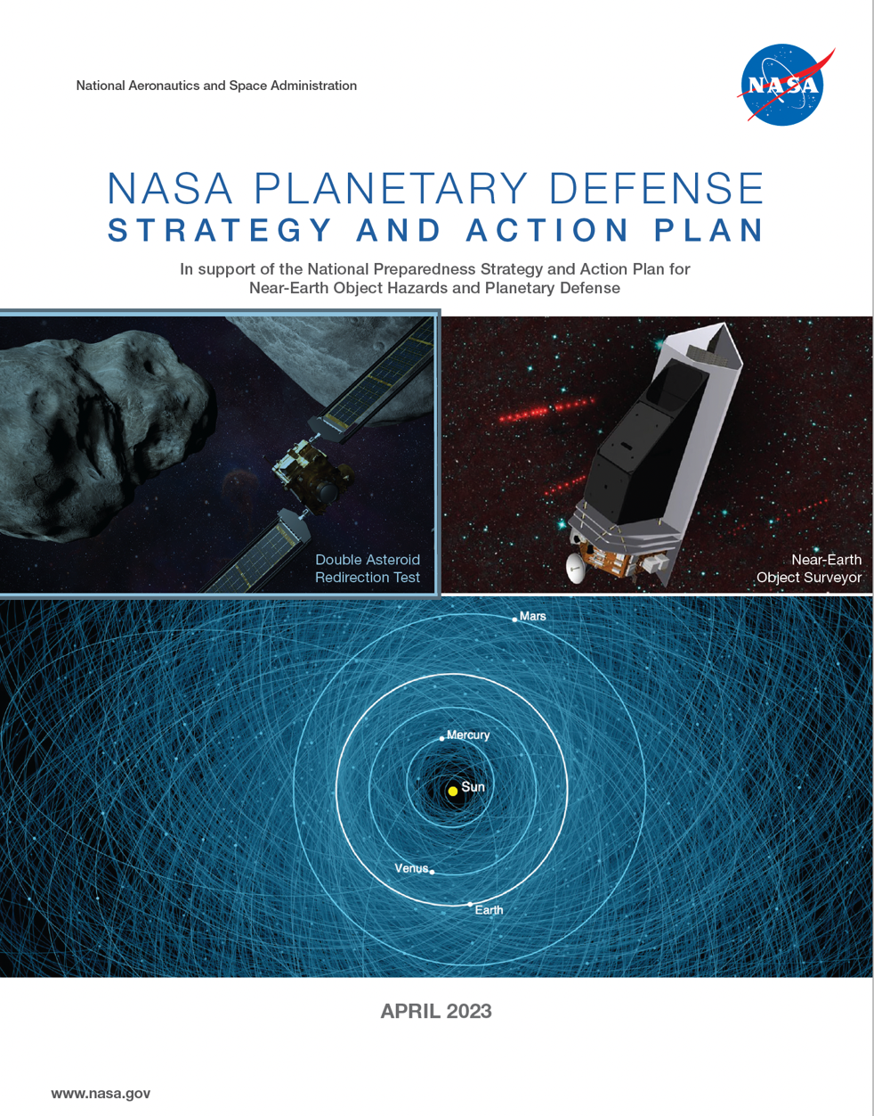
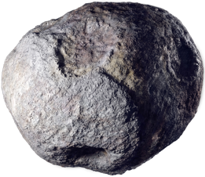

Gravity Tractors: Basics and Motivation
A gravity tractor is a planetary defense mitigation technique that uses the gravity of a spacecraft to slowly deflect an asteroid’s orbit.
Unlike other mitigation methods, benefits from not requiring knowledge of geophysical properties of target or complexities of surface interaction.
Well-suited as a primary mitigation method for 50-100 m asteroids with long warning times, or as a secondary mitigation method following an impulsive technique.
Goal: Develop technologies and designs for NEO deflection and disruption missions
Short Term Actions: Technology assessments should include the most mature in-space concepts—kinetic impactors, gravity tractors, ion beam deflection—as well as less mature NEO impact prevention methods. This action includes preliminary designs for demonstration of a gravity tractor NEO deflection mission campaign.

Slide 3
Binary Gravity Tractor:
A Slow-Push Demonstration Mission for Planetary Defense
modified orbit
We present preliminary designs for a gravity tractor NEO deflection mission demonstration that targets the secondary of an asteroid binary system.
Similar to NASA’s DART mission, this approach benefits from requiring a relatively small deflection to affect an observable change in an asteroid’s orbit.
We developed a metric for GT effectiveness and show that a GT demo is orders of magnitude more effective at a binary system compared to a single asteroid [see poster by Colby Merrill et al.]
original orbit

Slide 4
Binary Gravity Tractor:
A Slow-Push Demonstration Mission for Planetary Defense
modified orbit
We present preliminary designs for a gravity tractor NEO deflection mission demonstration that targets the secondary of an asteroid binary system.
Similar to NASA’s DART mission, this approach benefits from requiring a relatively small deflection to affect an observable change in an asteroid’s orbit.
We developed a metric for GT effectiveness and show that a GT demo is orders of magnitude more effective at a binary system compared to a single asteroid [see poster by Colby Merrill et al.]
We investigated chemical vs. solar-electric propulsion (SEP) for cruise and proximity operations. Find that a mission that exclusively uses chemical thrusters is:
  cost effective
  able to achieve mission requirements
  ready to be implemented for a real operational scenario
original orbit

Slide 5
Target Selection: Mission Design
Considered 14 promising NEA binary targets based on favorability for a Binary Gravity Tractor demonstration [see poster by Colby Merrill et al.]
Launch
  2035 – 2040
  Restricted to ≤ Falcon 9 launch vehicle capability
Maximum cruise of 1000 days (~3 years)
Currently, place no constraints on min/max solar distance (important for systems engineering)
Model assumptions:
  Chemical propulsion, thruster specific impulse, I_{sp} = 315 s (biprop)
  10% propellant mass margin for statistical maneuvers, etc.
  Considered gravity assists: Earth, Mars, and Mars-Earth
  Optimization objective function: maximize post-rendezvous delivered mass.

Slide 6
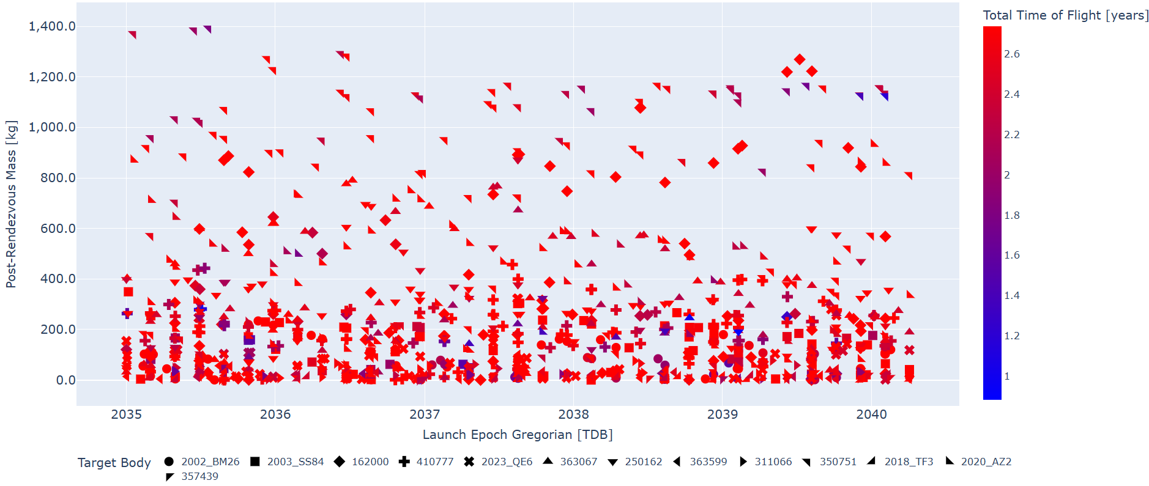
Target Selection: Mission Design
(350751) 2002 AW
(162000) 1990 OS
2020 AZ2

Slide 7
Target Selection: Comparison of 2/3 candidate targets
(162000) 1990 OS
2020 AZ2
S-class
Primary Diameter = 300 m
Secondary Diameter = 50 m
Semi-major axis = 600 m
Orbital period = 21 h
Primary Rotation Period = 2.536 h
Q/S-class
Primary Diameter = 170 m
Secondary Diameter = 90 m
Semi-major axis = 360 m
Orbital period = 22.03 h
Primary Rotation Period = 2.358 h
Drawings of both systems are to scale with one another

Slide 8
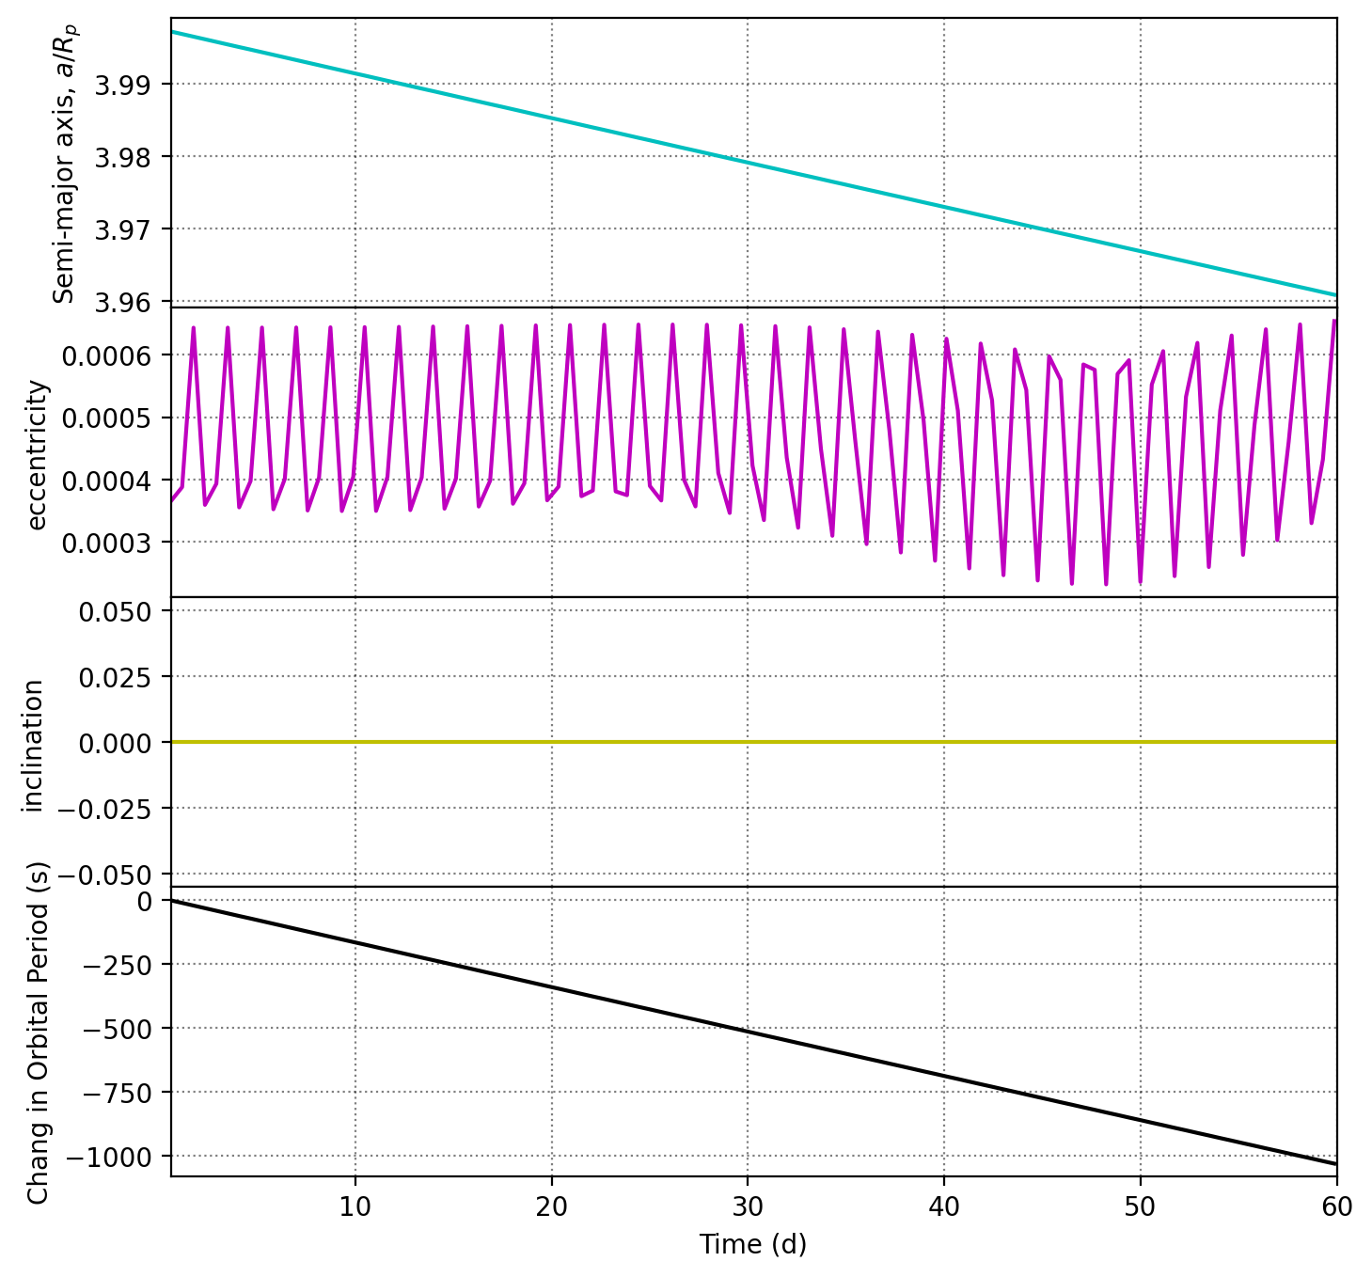
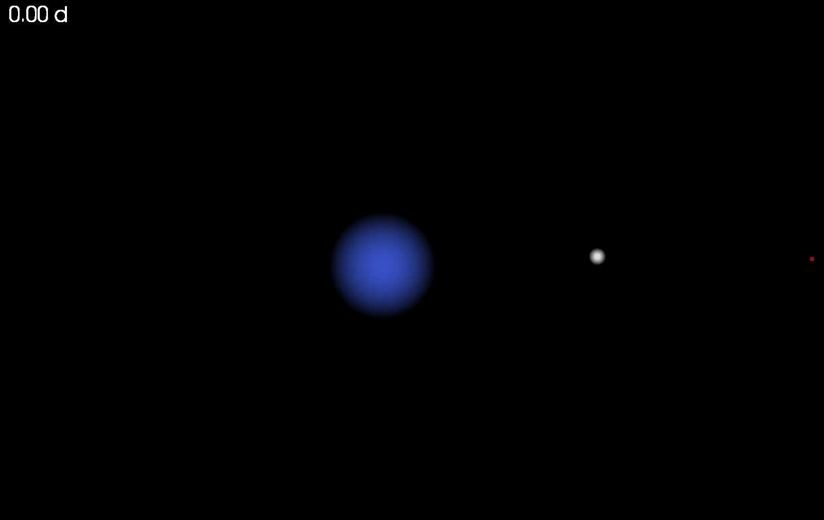
N-body modeling of Gravity Tractor Performance
Define a control scheme for the Binary-GT, based on work by Bocci et al. (2023).
S/C thrusts to:
Counteract mutual gravity from binary components.
Maintain fixed displacement from secondary Center of Mass.
Maintain fixed velocity relative to secondary
Thrust away from secondary if altitude drops below defined threshold.
Additional features (see Colby Merrill’s poster):
Track propellant usage to assess performance
Realistic min and max thrusting magnitudes
Canted thrusting to avoid plume impingement on secondary
Control box (dead-banding within box)
Solar Tides, and non-grav forces (e.g., Solar Radiation Pressure)
System: 1990 OS
White Sphere: Secondary
Red Dot: Gravity Tractor (S/C)

Slide 9
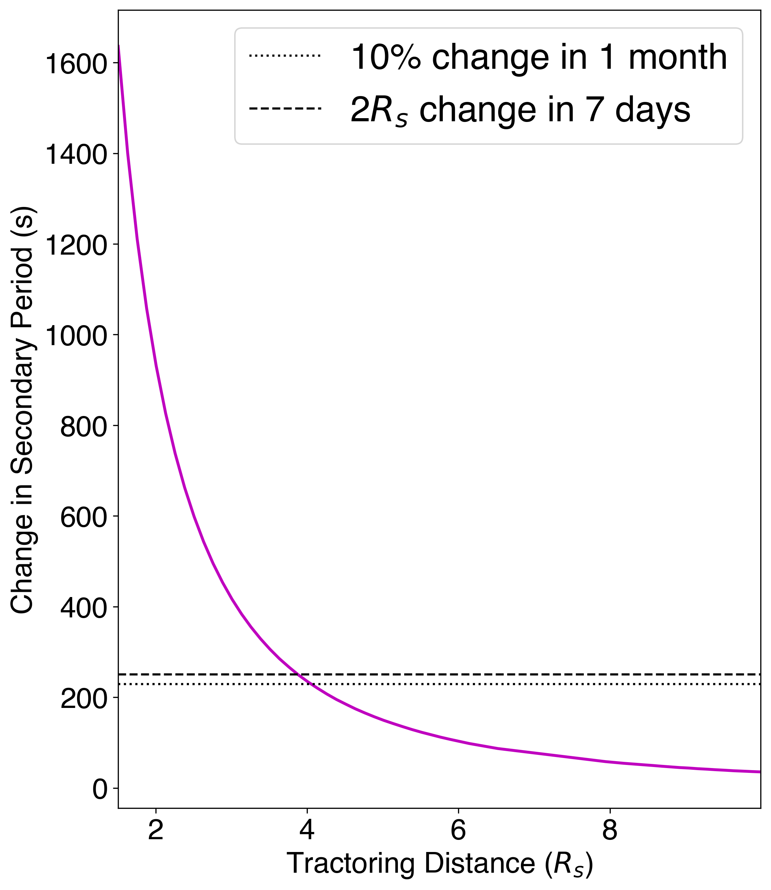
Binary-GT Performance
Evaluated change in binary period after 60 days of tractoring as a function of distance from the secondary [units of secondary radius (R_{s})]
Develop criterion for minimum deflection:
Seven-days after deflection, measure a period change sufficient to amount to a shift of the secondary 1 body diameter (2R_{s}) compared to unperturbed orbit:
250 seconds for 1990 OS.
One month after deflection, this amount to ~10% orbit phase change relative to the unperturbed case:
This was DART’s requirement for Dimorphos
Meeting this minimum deflection requires tractoring at a distance of ~4R_{s} = 200 m.

Slide 10
Binary-GT Mission Requirements
The Gravity Tractor shall rendezvous with the binary system 1990 OS and characterize the diameter of system components to within 1% (TBR).
  Rationale: Rendezvous is required for demonstrating the gravity tractor. Knowledge of system component sizes are needed for executing the slow-push mitigation demonstration.
The Gravity Tractor shall maneuver into position to deflect the secondary member of the 1990 OS system from a distance of 200 m over 60 days to cause a change of at least 250 seconds in the binary orbital period.
  Rationale: This would cause a displacement of the secondary of 1 secondary diameter 7 days after deflection is complete.
The Gravity Tractor shall demonstrate the capability to sustain close proximity operations, within 150 m (TBR), for 30 days (TBR).
  Rationale: operating at this distance would cause a similar magnitude of deflection as the operating parameters defined in 2.
The Gravity Tractor shall characterize the binary orbit with sufficient accuracy by obtaining observations of the 1990 OS system to measure the change in the binary orbital period to within 25 seconds (1σ confidence).
  Rationale: This is 10% of the deflection in 2. and 3.
The project shall measure the efficiency of the Gravity Tractor in changing the orbit of the secondary asteroid (TBR).

Slide 11
Payload and Proximity Operations Timeline
Payload consists of three instruments and high-gain antenna:
Narrow Angle Camera [~0.1 m/pixel at 5-km distance during characterization phase]
Wide Angle Camera [~2 m/pixel at 5-km distance during characterization phase]
Doppler Velocimeter/Laser Rangefinder [~0.5 m precision for closed-loop control during tractoring phase]
Gravity Tractor Phase I
(minimum deflection)
Gravity Tractor Phase II
(close proximity)
Cruise and
Arrival
Binary System Characterization
In Situ Deflection Characterization
In Situ Deflection Characterization
< 3 y
3 months
2 months
<2 months
1 month
<2 months
A slow-push mitigation demonstration mission can achieve all investigation goals in a relatively brief proximity operations timeline (< 1 year).

Slide 13
Preliminary Payload
Narrow Angle Camera
Navigation
Binary system characterization pre- and post-deflection.
~0.1 m/pixel at 5-km distance during characterization phase.
Wide Angle Camera
Navigation
Closed-loop control during tractoring phase
Binary system characterization pre- and post-deflection.
~2 m/pixel at 5-km distance during characterization phase.
Doppler Velocimeter / Laser Range Finder
~0.5 m precision for closed-loop control during tractoring phase
High Gain Antenna:
Radio Science

Slide 14
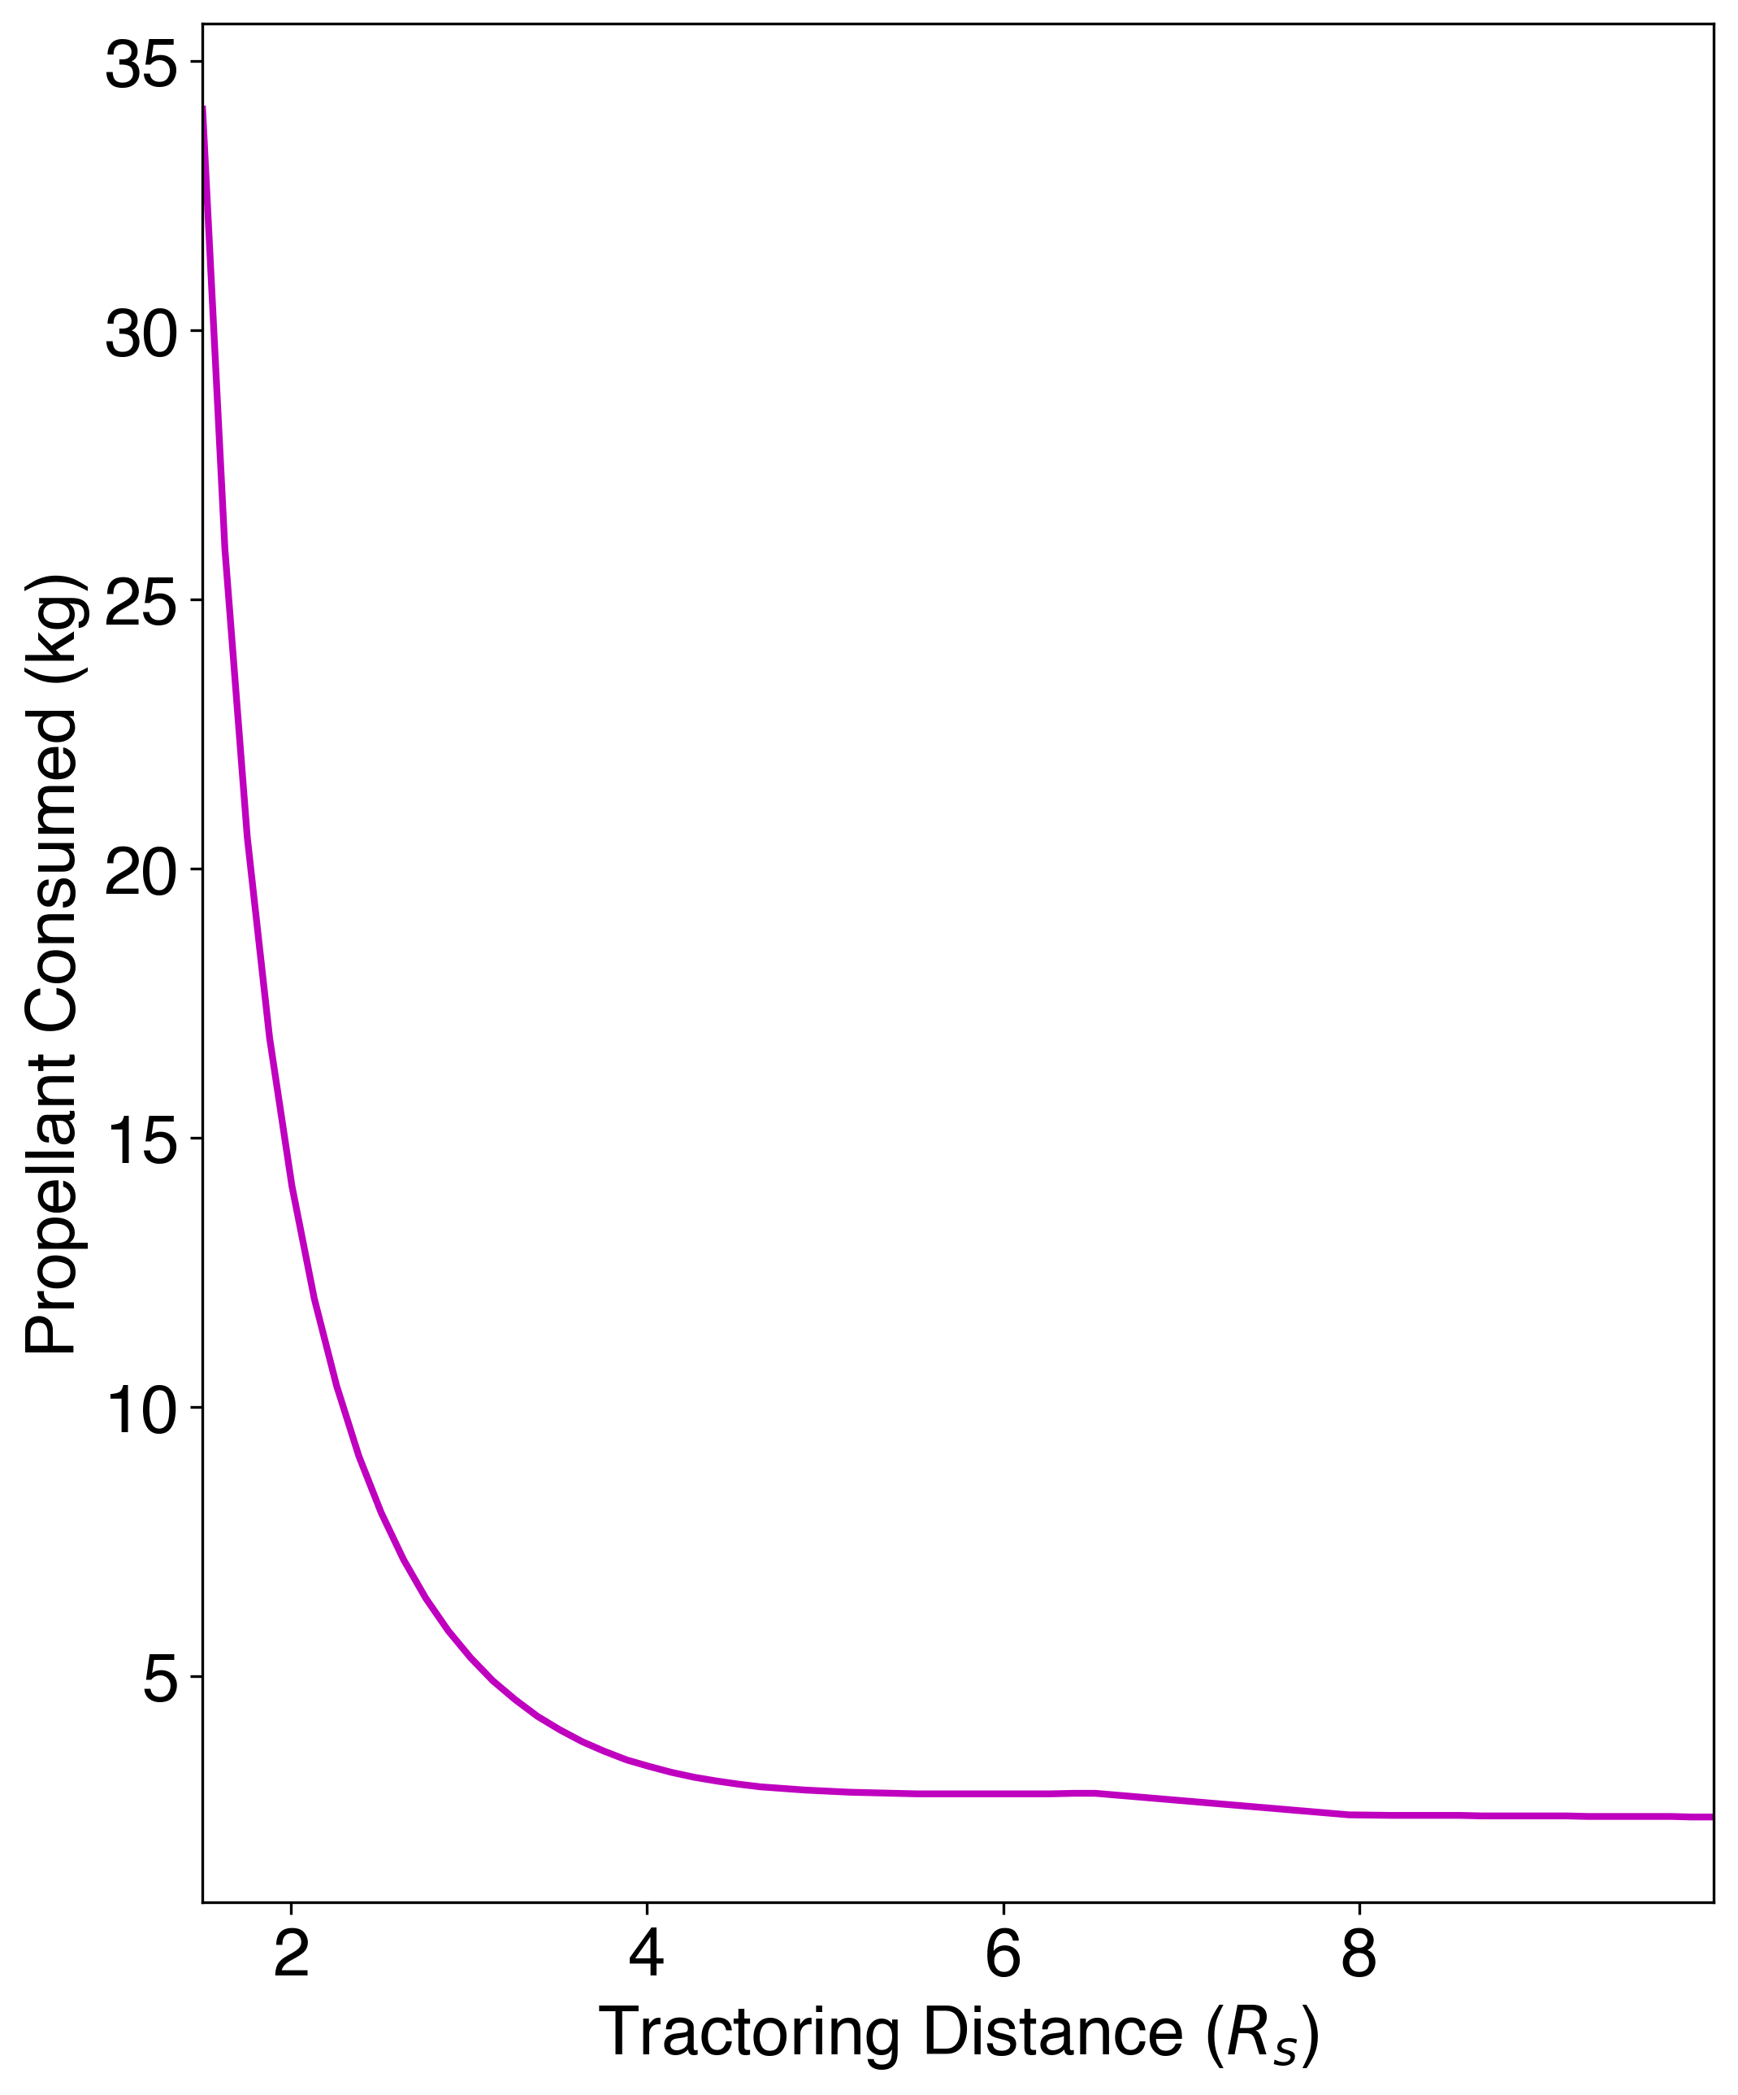
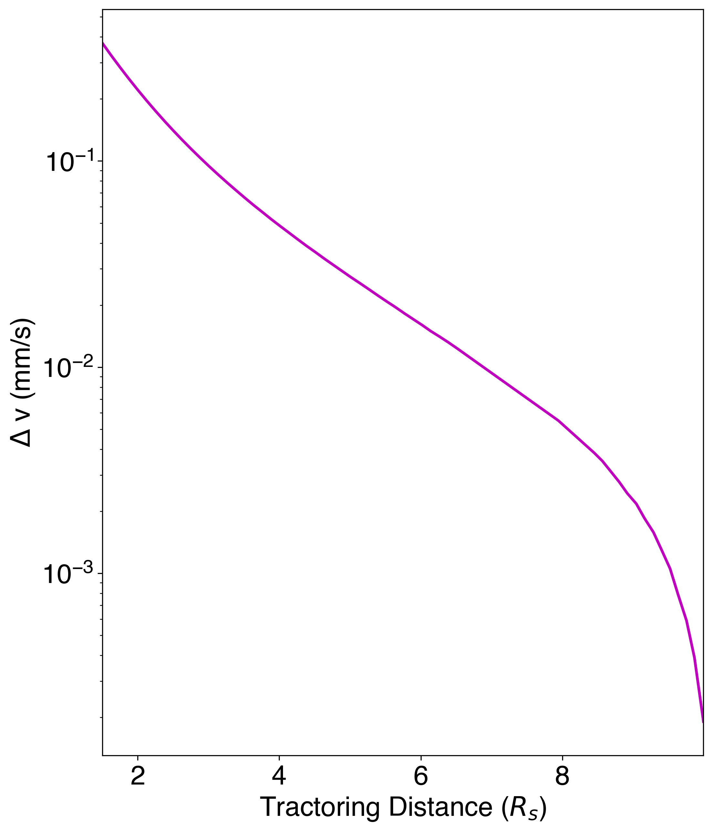
Binary-GT Performance

Slide 15
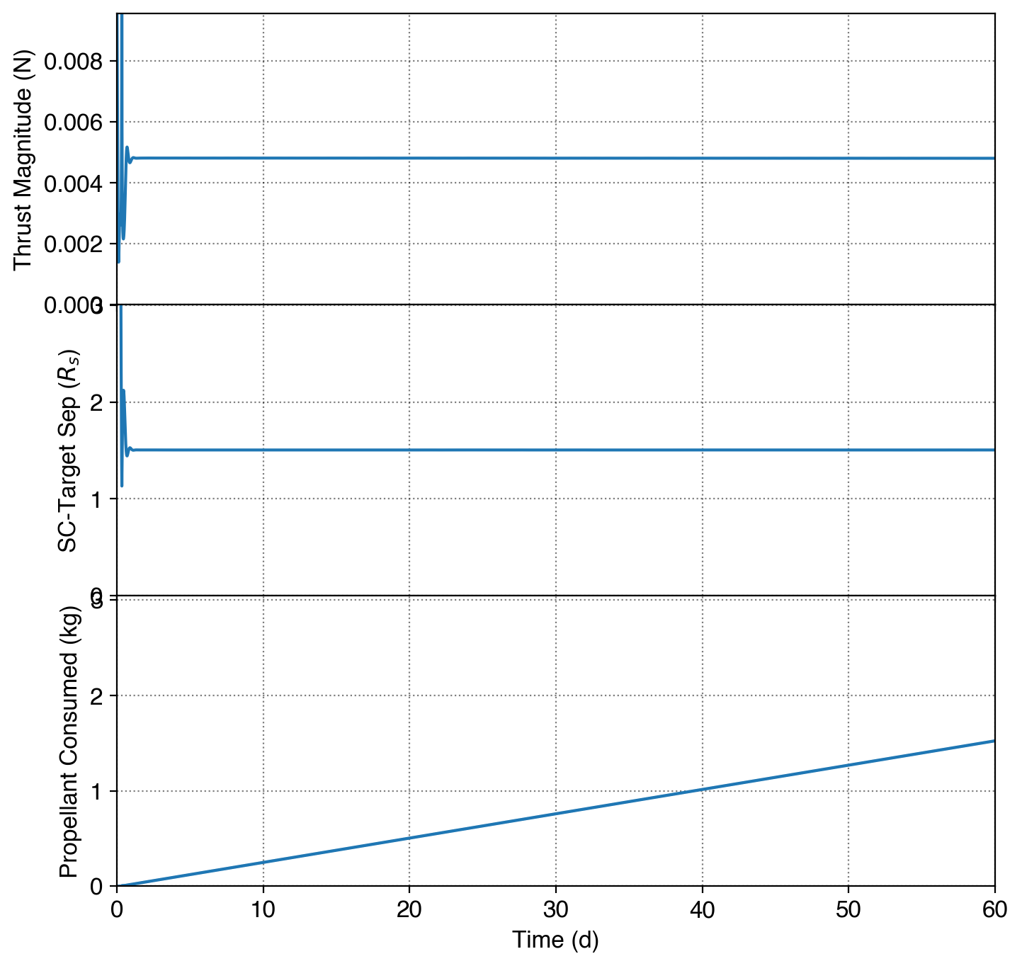
Binary-GT Performance
1990 OS

