Slide 1
Experimental Calibration of X-Ray Energy Deposition Models for Planetary Defense with the OMEGA Laser
Patrick K. King¹, Amanda K. Davis¹, Dawn M. Graninger¹, Mary T. Burkey², Mingsheng Wei³, David A. Burns¹, Michinari Sakai¹, Samuel Slingluff¹, and Steven B. Hancock¹
8 May 2025
The authors would like to acknowledge NASA PDCO for funding this work under NASA ROSES YORPD grant number 80NSSC23K0375.
9th IAA Planetary Defense Conference, 5-9 May 2025
Session 6: Deflection/Disruption Modeling & Testing
Paper IAA-PDC-25-06-72
Part of this work was performed under the auspices of the Department of Energy by Lawrence Livermore National Laboratory under Contract DE-AC52-07NA27344.
LLNL-PRES-2005113
¹Johns Hopkins University Applied Physics Laboratory
11100 Johns Hopkins Road
Laurel, MD 20723
²Lawrence Livermore National Laboratory
7000 East Avenue
Livermore, CA 94550
³University of Rochester Laboratory for Laser Energetics
250 East River Road
Rochester, NY 14623

Slide 2
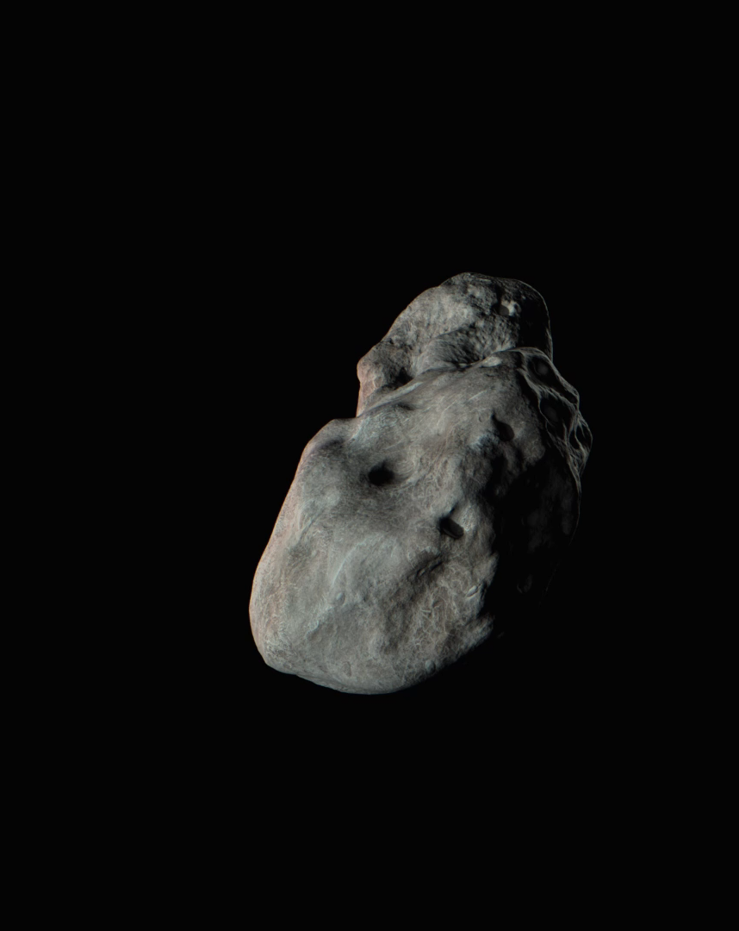
Motivation
Standoff nuclear explosives are capable of deflecting or disrupting asteroids for many planetary defense scenarios.
Most of the output of these devices in deep space are in the form of soft x-rays, which irradiate the target.
Models of this process depend upon understanding the response of typical asteroid materials to x-rays.
Our YORPD grant is intended to provide some experimental calibration to our models by conducting x-ray exposures of representative materials at OMEGA and measuring their effects.
Animation Credit: JHU/APL

Slide 3
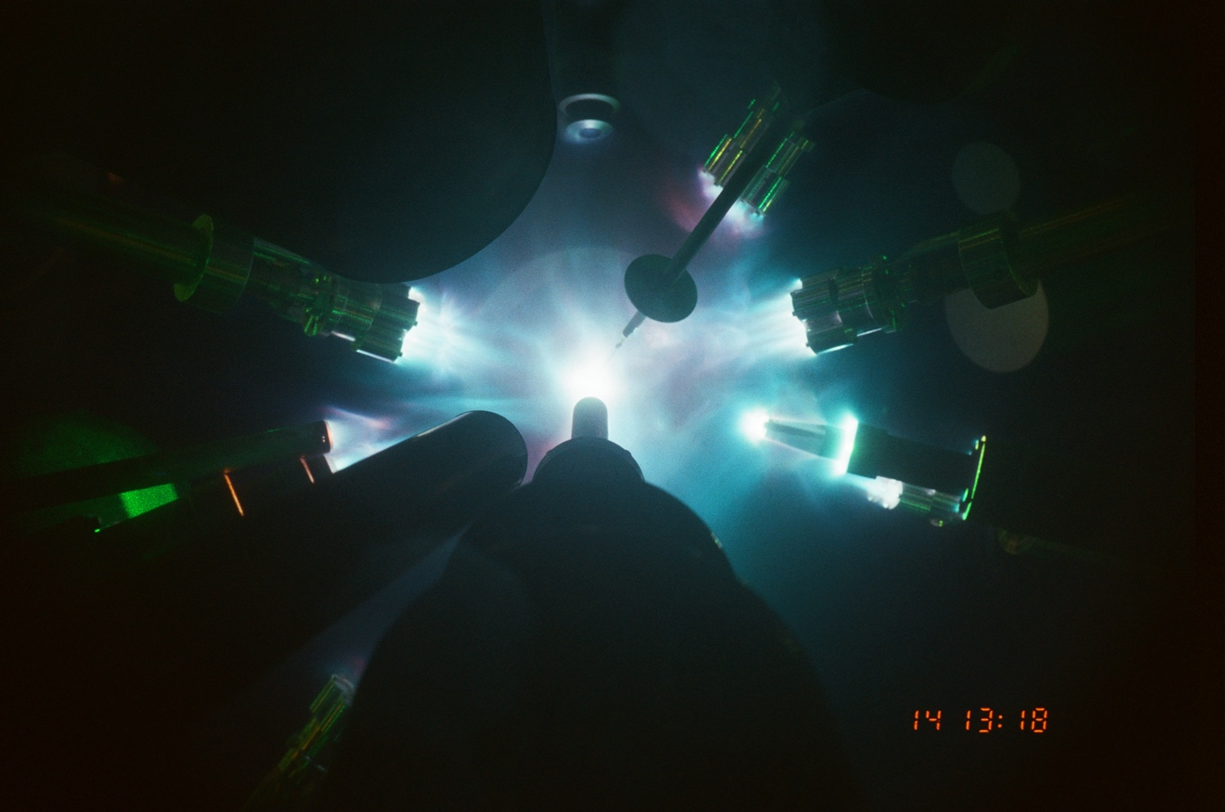
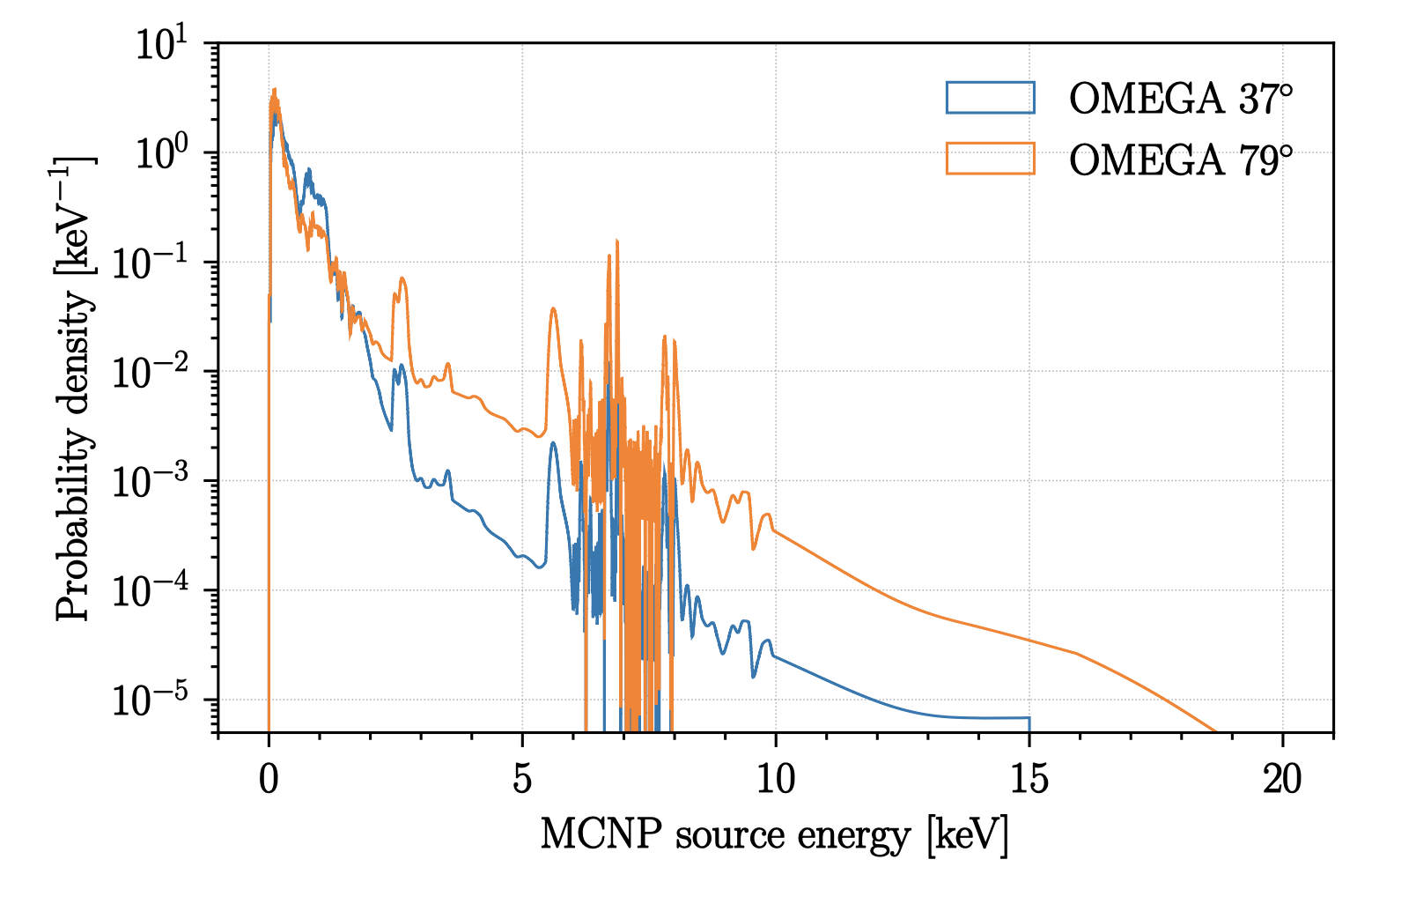
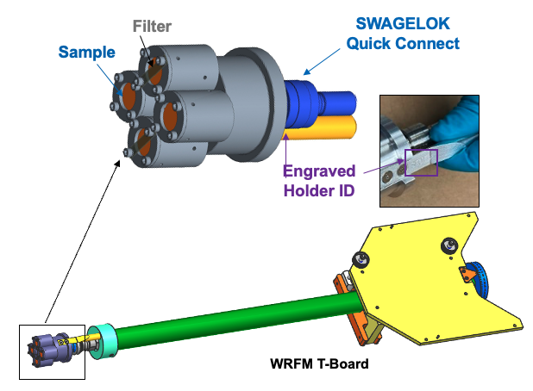
Experiments
X-ray exposures were generated using cavity laser targets on OMEGA-60, which convert laser energy into an x-ray flash.
The cavity targets present a slightly different x-ray spectrum to the samples based on their orientation.
Shot configuration was controlled such that the samples had two possible orientations, allowing controlled study of spectral dependence.
We conducted 12 shots and exposed a combined total of 287 different samples.
Samples were chosen from some control materials, terrestrial rock samples, and H- and L-chondrites (36 of the total.)
Fluence was controlled through standoff; colder spectrum exposures ranged from 1-10 J/cm², and hotter spectrum exposures 0.25-1 J/cm².

Slide 4
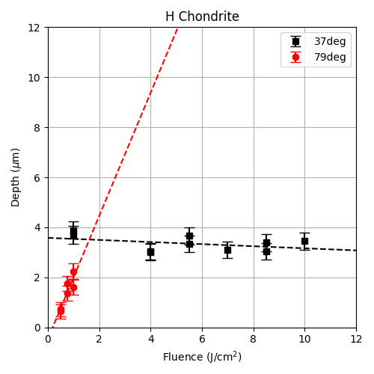
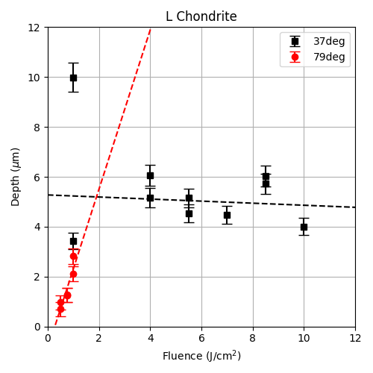
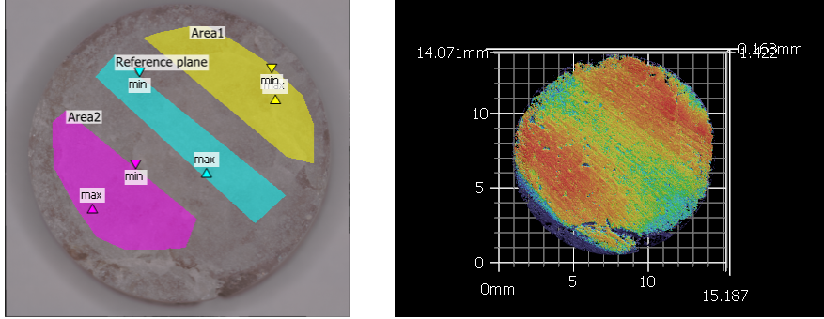
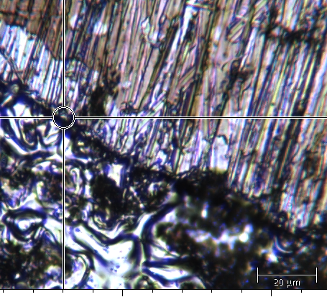
Preliminary Results
Simple mass removal measurements for chondritic meteorites reveal a complex x-ray response.
Exposures with effectively colder spectra (37º) show relatively flat material removal even over a wide range in fluence.
Effectively hotter spectra (79º) at lower fluences demonstrate the expected positive trend of increasing ablation with increasing fluence.
Microscopy and profilometry show complex surface changes.
Metallic control materials show signs of melt and ejecta generation.
Surface swelling, even given expected material removal, renders measurement challenging.
Masked
Optical profilometry reveals significant surface swelling in response to x-rays for several terrestrial samples. Metals show clear evidence of resurfacing and melt processes.
Exposed

Slide 5
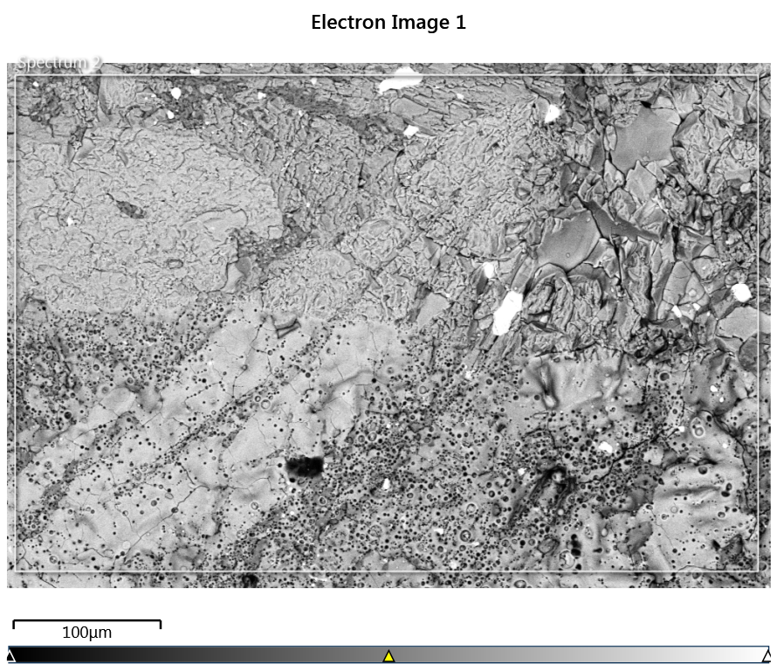
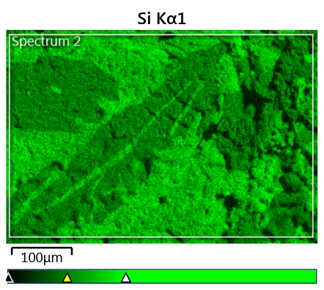
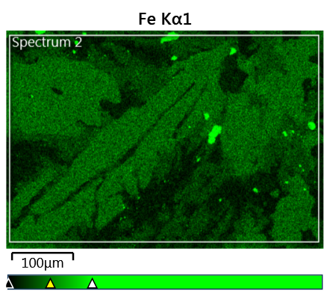
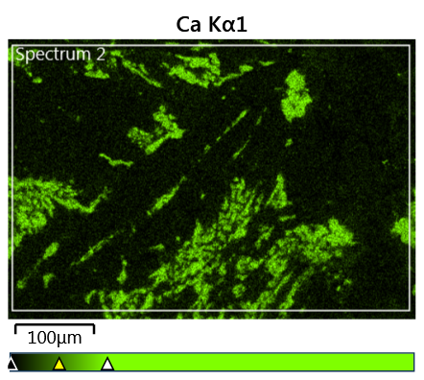
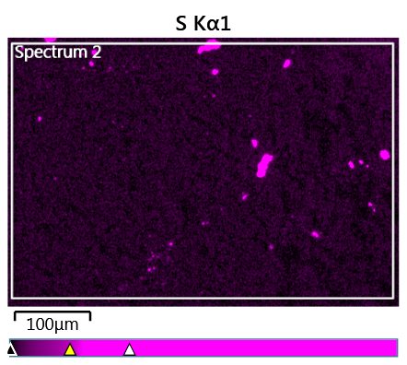
Challenges and Future Directions
Mass differential measurements were robust to apparent surface changes, but for some samples, apparent mass increases from pre-shot were recorded.
Increase may be due to material from the laser target, but investigation is ongoing.
Surface swelling greatly complicates determination of removal from surface changes.
This hints at more complex mineral response than pure removal.
Grain structure and mineral heterogeneity make surface interrogation and interpretation difficult.
Raman spectroscopy to study exposed and unexposed regions is challenging and difficult to interpret.
Heterogenous structure clearly is evident between mineral grains – x-ray response is not homogenized.
We have developed a comprehensive characterization plan (e.g., SEM and more; see right) with more sophisticated measurements to access atomic and chemical compositional differences and density changes.
We are also undertaking concurrent molecular dynamics modeling for deeper insights into the surface processes for individual minerals.

