Slide 1
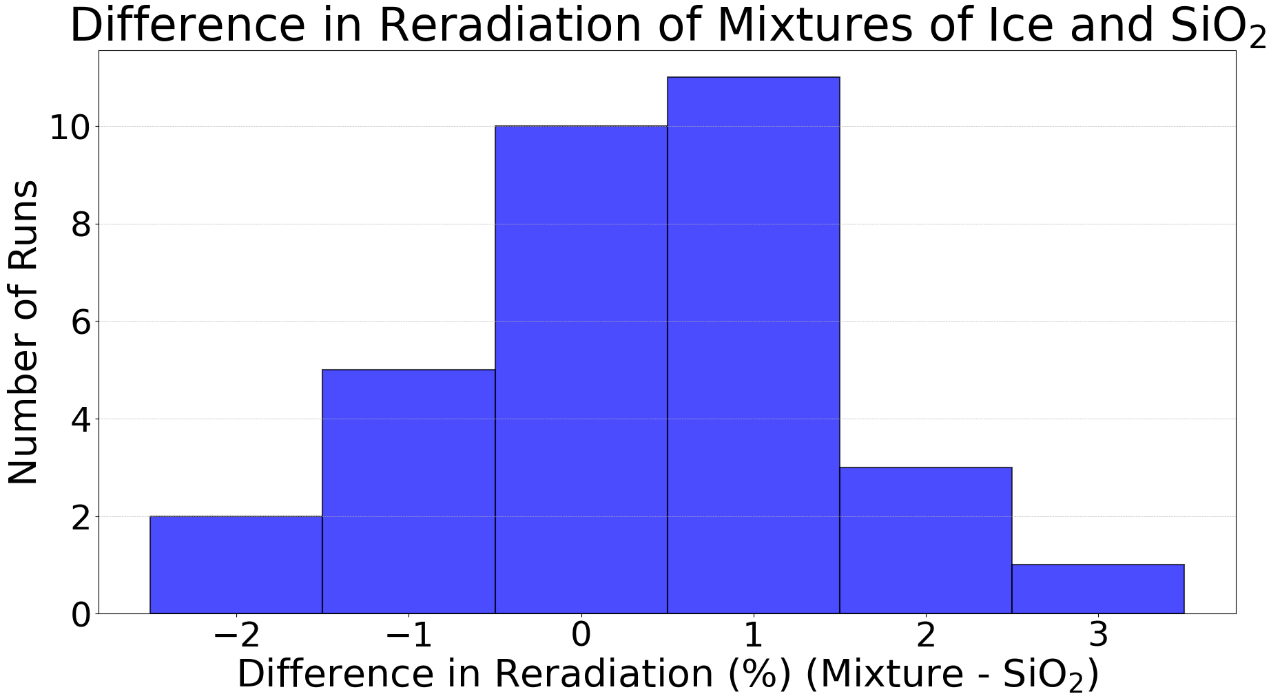
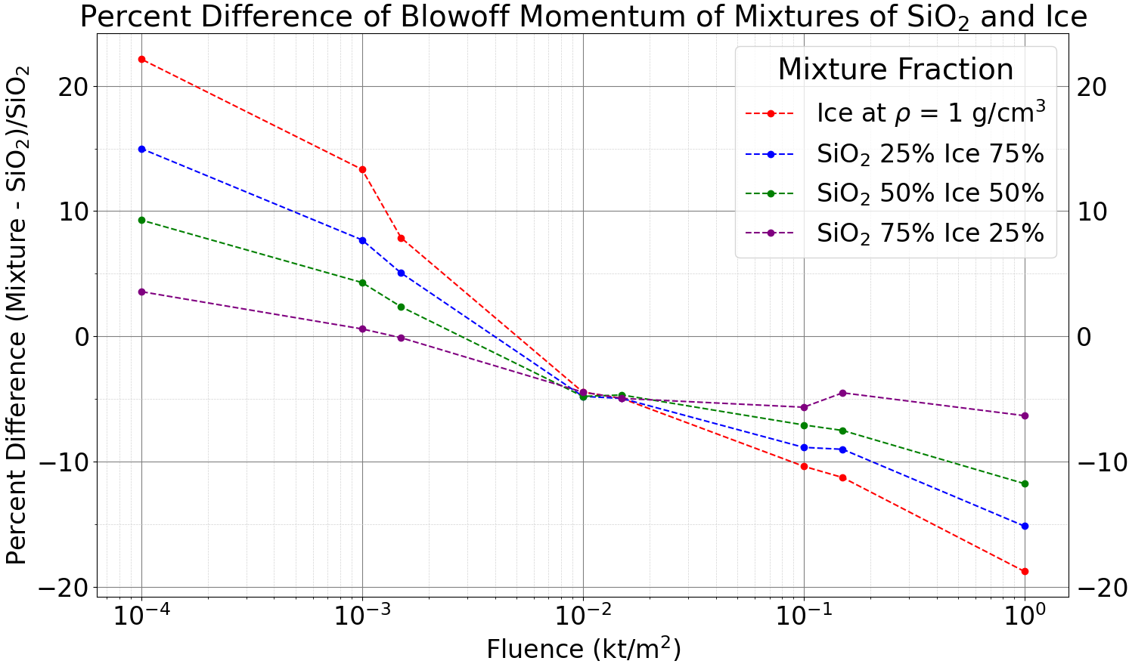
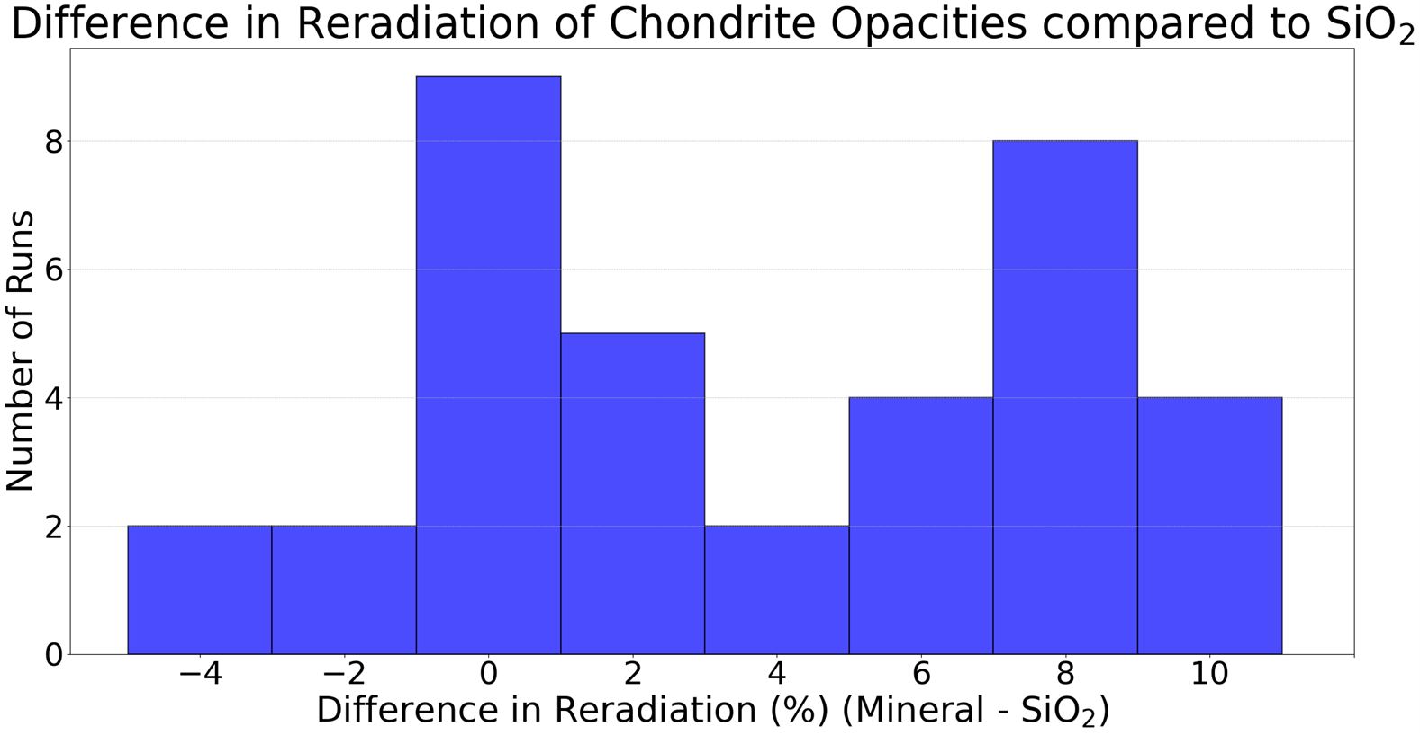
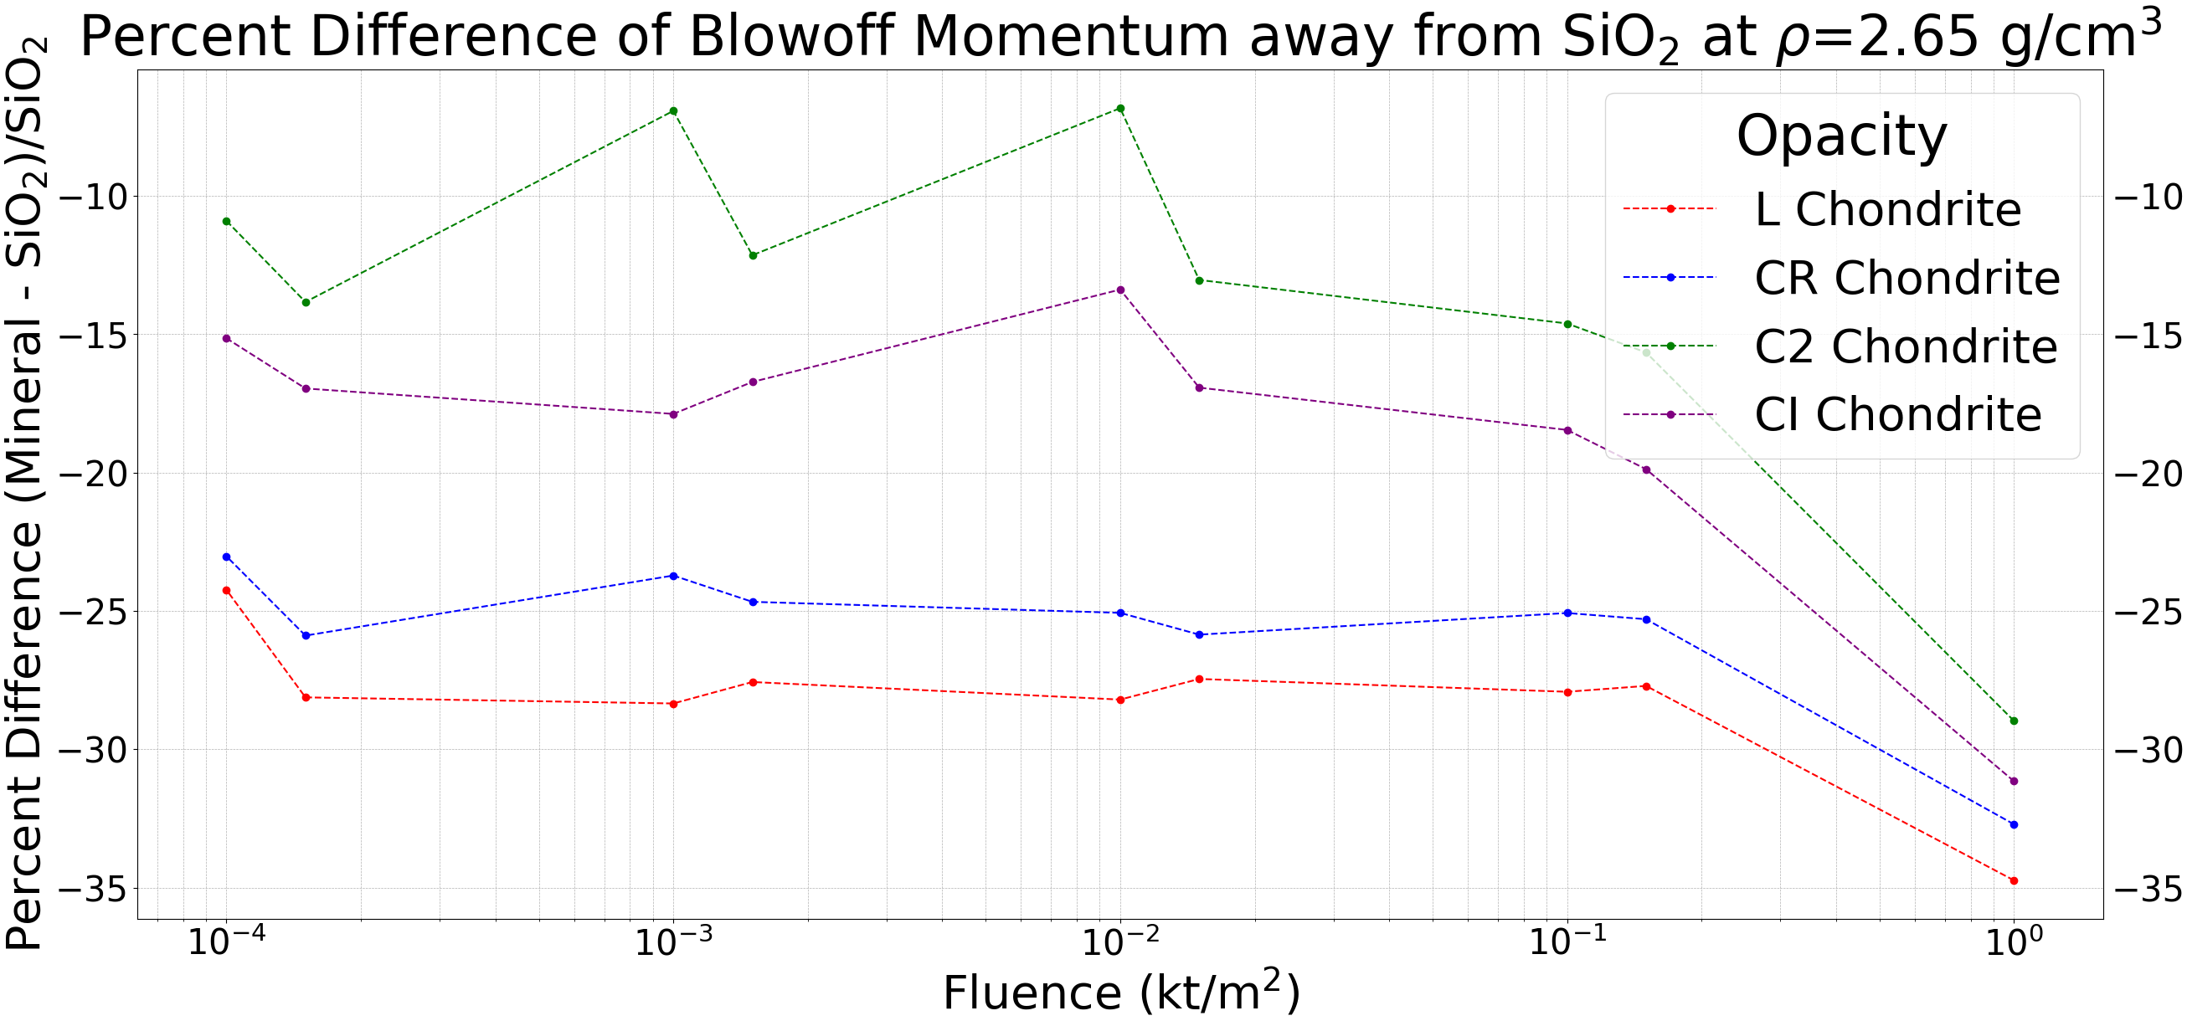
LLNL-POST-2004987
LLNL-POST-2004987
HOW ASTEROID COMPOSITION CHANGES THE EFFECTIVENESS OF NUCLEAR DEFLECTION AND DISRUPTION MISSIONS
T. J. Onyango, M. T. Burkey, N. A. Gentile
Lawrence Livermore National Laboratory, 7000 East Avenue, Livermore, CA 94550-9698, USA
Nuclear deflection is a mitigation strategy for near-Earth objects (NEOs), utilizing x-ray radiation to induce surface ablation causing the NEO to be deflected by Newton’s third law. This study investigated the sensitivity of blowoff momentum and energy reradiation to NEO composition, focusing on variations in opacity and equation of state (EOS). Using the radiation-hydrodynamics code Kull, NEOs composed of CI, L, C2, and CR chondrites exposed to x-rays whose fluences spanned five orders of magnitude were modeled. Results indicated that changing the EOS, through mixtures of SiO₂ and ice, had negligible effects on reradiation fractions and a significant impact on blowoff momentum. Employing realistic opacities left reradiation percentages largely unaffected but significantly decreased blowoff momentum, with chondrites composed of larger percentages of heavier elements leading to lower blowoff momenta. These findings highlight the importance of accurate material properties in deflection calculations.
Introduction
Method
Nuclear deflection is a mitigation strategy that involves sending x-rays to an NEO to heat up its surface enough to cause ablation. The deflection of the remainder of the NEO is directly related to the momentum of the ablated material through Newton’s third law. Two important factors for determining a successful deflection are the blowoff momentum and the fraction of input energy reradiated away, and they are sensitive to the composition of an NEO through its opacity and EOS. This work improves upon previous studies such as Burkey et al.^{[1]} by employing the more complex opacities of CI, L, C2, and CR chondrites, which are types of asteroids^{[2]}, and simulating asteroids containing multiple equations of state. CI chondrite was chosen for its high volatile content and its similarity to the Bennu sample. L chondrite was chosen because to stand in for the Q- and S- type asteroids which are an appreciably portion of the NEA population. It is also representative of 80% of meteorites that reach the ground. CR chondrite was chosen due to its low volatile content which is great for deflection strategies. C2 chondrite has high volatile content, similar to CI chondrite, but its minerology is more evenly distributed compared to the other chondrites.
We simulated NEOs absorbing x-ray radiation from a black body source (of T=2 keV) at fluences spanning 5 orders of magnitude in 1D using Kull^{[3]}. Kull is a mesh-based radiation-hydrodynamics inertial-confinement-fusion code that evolves the system using an implicit Monte Carlo scheme. We examined different NEO compositions by independently changing
Atomic Composition of Sample Asteroids (By Percentage)
 | Mg | Si | O | H | Fe | S | C | N | Ni
CI Chondrite | 13.3 | 8. 7 | 42.8 | 24.1 | 3.8 | 1.8 | 5.4 | 0.1 | 0
L Chondrite | 24.1 | 13.0 | 51.9 | 0 | 5.9 | 2.0 | 0 | 0 | 3.1
C2 Chondrite | 5.6 | 3.4 | 18.9 | 42.5 | 2.8 | 1.2 | 24.9 | 0.7 | 0
CR Chondrite | 19.9 | 11.0 | 49.9 | 7.1 | 6.8 | 1.4 | 2.8 | 0.2 | 0.9
Tab. 1: Table of the atomic composition of various chondrites used to represent realistic asteroid compositions for the purpose of opacity.
the equation of state and opacity of an NEO. The opacities used were based on the atomic compositions of CI, L, C2, and CR chondrites, which are detailed in Tab. 1. Kull can also create an NEO with multiple EOSes mixed into a single zone of its mesh. This model outputs the blowoff momentum and the fraction of energy reradiated. The simulation is carried out to 10 µs after detonation of the NED.
Effects from Changing the EOS
We investigated how changing the EOS changes the blowoff momentum and the amount of energy reradiated away. The EOS of a material is the reference table that determines how the material evolves when there are changes in density and temperature. We simulated the nuclear deflection of asteroids composed of some percentage of SiO₂ and some percentage of ice. The opacities of the two materials was set to CI chondrite to focus on EOS. The percentage of input energy reradiated away increases with fluence as shown in Tab. 2. We can see in Fig. 1 that the percentage of reradiation energy changes negligibly when transitioning from SiO₂ to ice (regardless of fluence). By plotting the difference in blowoff momenta between pure SiO₂ and mixtures of SiO₂ and ice in Fig. 2, a mostly logarithmic relation between the blowoff momenta of a given mixture and pure SiO₂ can be seen.
Reradiation Percentages from mixtures of SiO₂ and Ice (both materials have the opacity of CI Chondrite)
 |  | Fluence
 |  | 10⁻⁴ kt/m² | 10⁻³ kt/m² | 10⁻² kt/m² | 10⁻¹ kt/m² | 10⁰ kt/m²
Mixture Fraction | Ice 100% | 3.4 | 19.8 | 51.5 | 74.5 | 85.2
 | SiO₂ 25%, Ice 75% | 3.2 | 20.6 | 50.3 | 73.4 | 83.4
 | SiO₂ 50%, Ice 50% | 4.1 | 20.3 | 50.7 | 73.7 | 84.3
 | SiO₂ 75%, Ice 25% | 3.9 | 20.1 | 51.0 | 74.0 | 84.6
 | SiO₂ 100% | 3.3 | 19.8 | 51.1 | 72.7 | 82.7
Tab. 2: Table of percentages of energy reradiated from NEO arranged by fluence and the amount of SiO₂ and ice present in the NEO.
Fig. 1: Histogram of differences in the fractions of energy reradiated away of NEOs of pure SiO₂ and mixtures of SiO₂ and ice.
Fig. 2: Plot of percent differences in blowoff momentum of NEOs of pure SiO₂ and mixtures of SiO₂ and ice.
Effects from Changing the Opacity
We investigated how changing the opacity changes the blowoff momentum and amount of energy reradiated away. Opacity is a property that determines how deep light can penetrate a material before it is absorbed. Low opacity means light can travel deeper through a material compared to a material with high opacity. We simulated the nuclear deflection of asteroids with the EOS and density of SiO₂ but the opacity of different minerals found in NEOs. These results are compared to the blowoff momentum and reradiation percentage of an asteroid with the opacity of SiO₂. Chondrites with higher percentages of heavy elements have higher opacities and therefore lower blowoff momenta compared to those with lighter elements and lower opacities.
Reradiation Percentages from SiO₂ with Various Opacities at ρ=2.65 g/cm³
 |  | Fluence
 |  | 10⁻⁴ kt/m² | 10⁻³ kt/m² | 10⁻² kt/m² | 10⁻¹ kt/m² | 10⁰ kt/m²
Opacity | SiO₂ | 3.8 | 20.8 | 44.6 | 67.3 | 74.2
 | CR Chondrite | 3.5 | 21.3 | 53.3 | 74.5 | 82.9
 | C2 Chondrite | 2.3 | 16.5 | 46.0 | 70.9 | 82.0
 | L Chondrite | 3.8 | 22.0 | 54.0 | 75.7 | 83.4
 | CI Chondrite | 3.1 | 19.8 | 49.6 | 72.7 | 82.7
Tab. 3: Table of percentages of energy reradiated from NEO arranged by fluence and the opacity in the NEO.
Fig. 3: Histogram of differences in energy reradiated away from NEOs of various chondrites compared to SiO₂.
Fig. 4: Plot of percent differences in blowoff momentum between SiO₂ asteroids having the opacities of various chondrites and an SiO₂ asteroid with the opacity of SiO₂.
Conclusion
Future Plans
References
We have varied the EOS and opacity and observed the changes in blowoff momentum and reradiation by comparing a simple composition based on SiO₂ to more complex compositions based on chondrites and mixtures with ice. Blowoff momentum was comparably affected by changing the EOS and opacity by as much as 30%. The fraction of energy reradiated away was negligibly affected by changes in the EOS and opacity.
We plan to investigate gradual variations in the EOS while keeping density constant, including combinations of other EOSes. Iron will be included in the study of EOSes. We plan to investigate how changing the source temperature to 1 keV affects optimal mitigation conditions.
[1] Burkey, Mary T., et al. "X-Ray Energy Deposition Model for Simulating Asteroid Response to a Nuclear Planetary Defense Mitigation Mission." The Planetary Science Journal 4.12 (2023): 243.
[2] Britt, D. “Meteorite Mineralogy for Impact Analysis” Private Communications. Circa 2017
[3] Rathkopf, J. A., et al. “Kull: LLNL’s ASCI Inertial Confinement Fusion Simulation Code” Physor (Physics of Reactors) 2000 International Topical Meeting - Advances in Reactor Physics and Mathematics and Computation into the Millennium Jan. 10, 2000
LLNL-POST-2004987
International Academy of Astronautics Planetary Defense Conference (May 5-9) Stellenbosch, South Africa

