Slide 1
Simulating Asteroid Deflection and Disruption Using an X-Ray Energy Deposition Model in SPH
Isaiah Santistevan, Mary Burkey, Mike Owen, Kathryn Kumamoto
IAAA Planetary Defense Conference 2025
Stellenbosch, Cape Town, South Africa, May 5 – 9, 2025

Slide 2
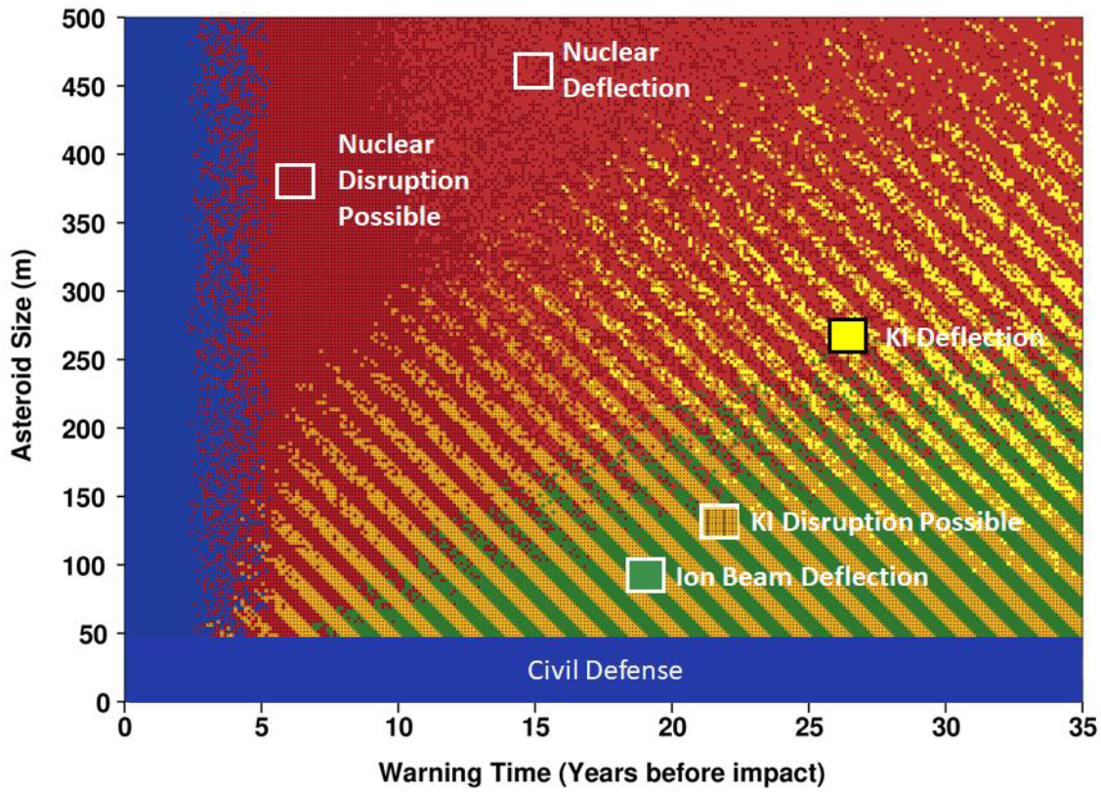

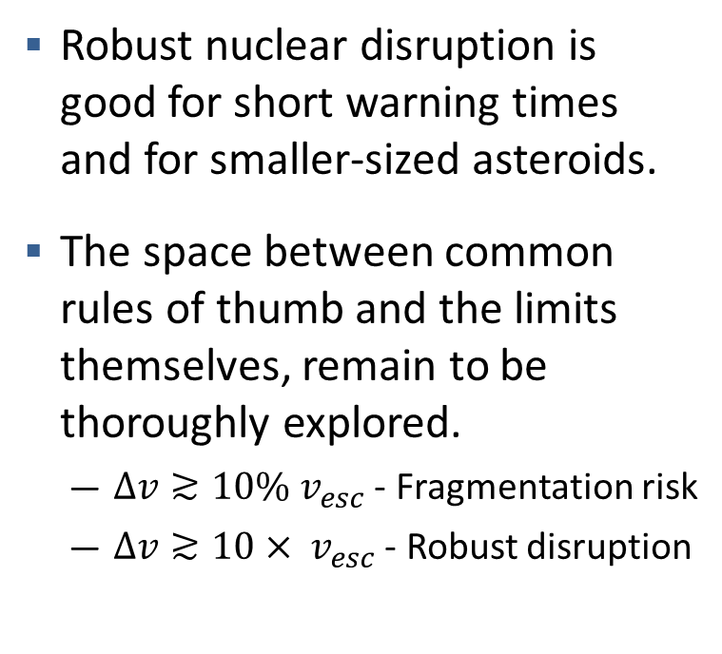
Nuclear mitigation rules of thumb
Robust nuclear disruption is good for short warning times and for smaller-sized asteroids.
The space between common rules of thumb and the limits themselves, remain to be thoroughly explored.
  $Δv≳10\% v_{esc}$ - Fragmentation risk
  $Δv≳10× v_{esc}$ - Robust disruption
Fragmentation
Fragmentation
Frazier et al. 2024

Slide 3
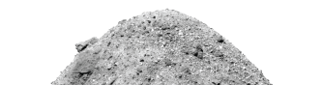
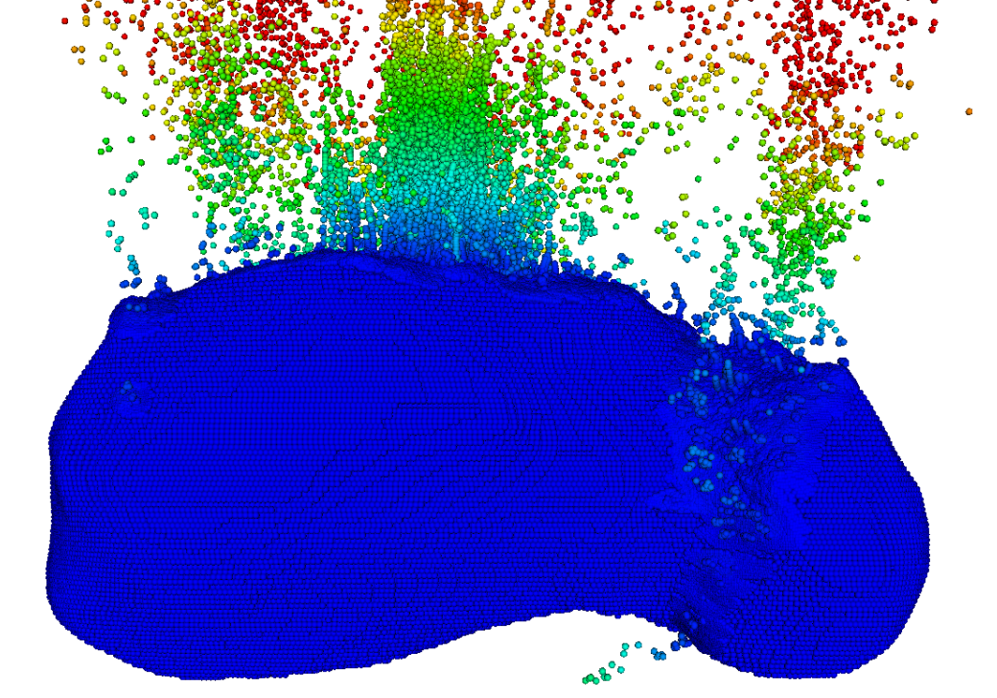
Nuclear mitigation problems require a large dynamic range in simulation resolution.
X-Ray Energy Deposition
Hydrodynamics
X rays illuminate the surface material, causing heating and ionization. Some energy re-radiates away.
Happens at smaller/faster length/timescales compared to motion of ablated material, requires a full rad-hydro simulation.
We use the X-ray energy deposition model from Burkey et al. 2023
Material begins moving and expanding.
We use the Smoothed Particle Hydrodynamics code Spheral to model the material’s strength and damage to better test realistic disruption missions.
  Need sub-cm resolution to model
  Modeling whole asteroid ~ 100s of meters
Image credit: OSIRIS-REx mission

Slide 4
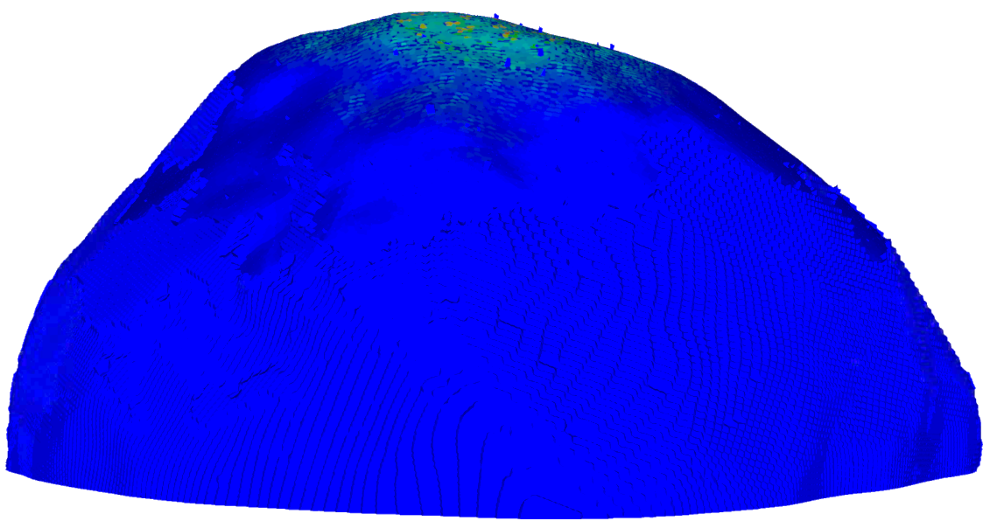



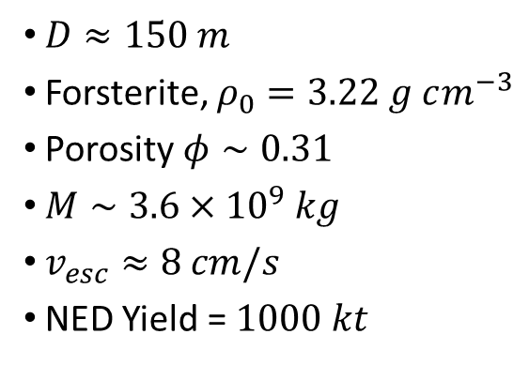
Spheral simulation parameters
PDC Epoch 2 Median Asteroid
$D≈150 m$
Forsterite, $ρ_{0}=3.22 g cm^{−3}$
Porosity $φ∼0.31$
$M∼3.6×{10}^{9} kg$
$v_{esc}≈8 cm/s$
NED Yield = $1000 kt$
Height of burst: 25 m
$≈55 kt$ deposited
Material Properties
Chelyabinsk $≈$ easier to damage
Aba Panu $≈$ harder to damage

Slide 5
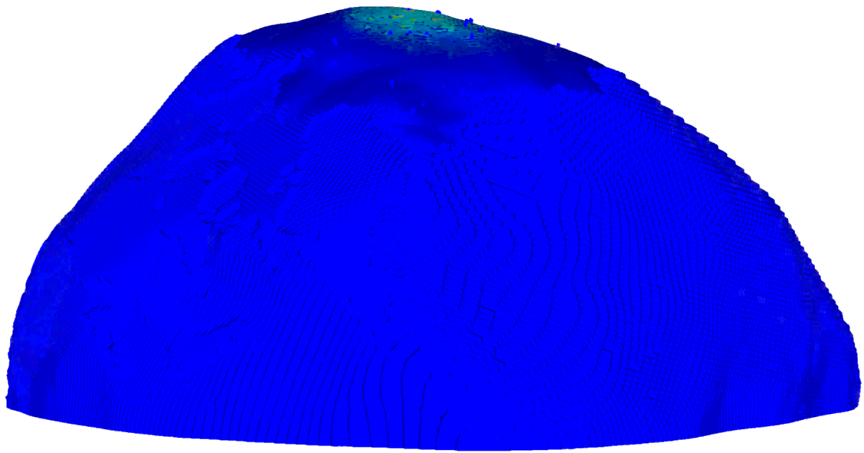

Spheral simulation parameters
PDC Epoch 2 Median Asteroid
$D≈150 m$
Forsterite, $ρ_{0}=3.22 g cm^{−3}$
Porosity $φ∼0.31$
$M∼3.6×{10}^{9} kg$
$v_{esc}≈8 cm/s$
NED Yield = $1000 kt$
Height of burst:
10 m
$≈30 kt$ deposited
Material Properties
Chelyabinsk $≈$ easier to damage

Slide 6
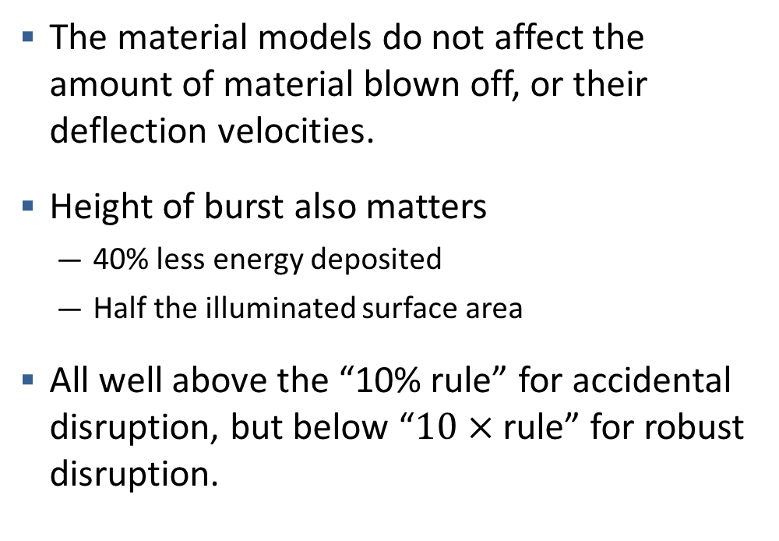
The deflection velocity depends more on HOB than the material model
The material models do not affect the amount of material blown off, or their deflection velocities.
Height of burst also matters
  40% less energy deposited
  Half the illuminated surface area
All well above the “10% rule” for accidental disruption, but below “$10×$ rule” for robust disruption.
Material Model | Height of Burst [m] | Deflection velocity [cm/s] | Deflection velocity / Escape velocity
Aba Panu | 25 | 46.6 | 5.86
Chelyabinsk | 25 | 46.6 | 5.86
Chelyabinsk | 10 | 41.3 | 5.12

Slide 7
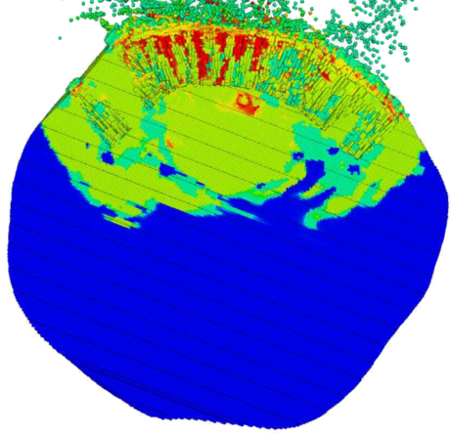
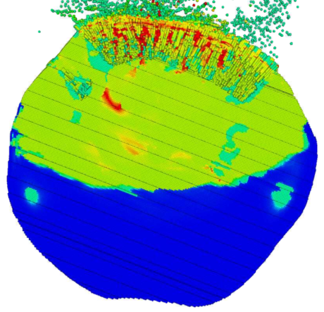
Damage material models result in different rates of damage through the asteroid
Chelyabinsk asteroid model shows much larger damage pattern compared to Aba Panu.
Choice of material model is important for mission planning results.
Aba Panu (25 m)
Chelyabinsk (25 m)
t ~ 34 ms
t ~ 34 ms

Slide 8
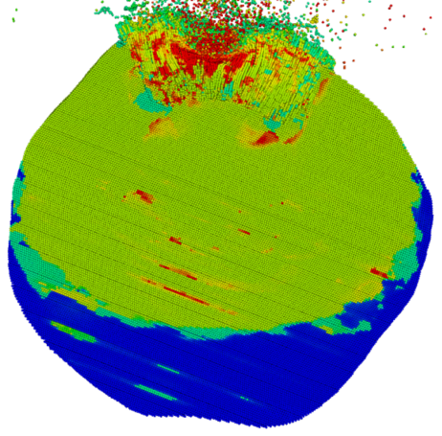
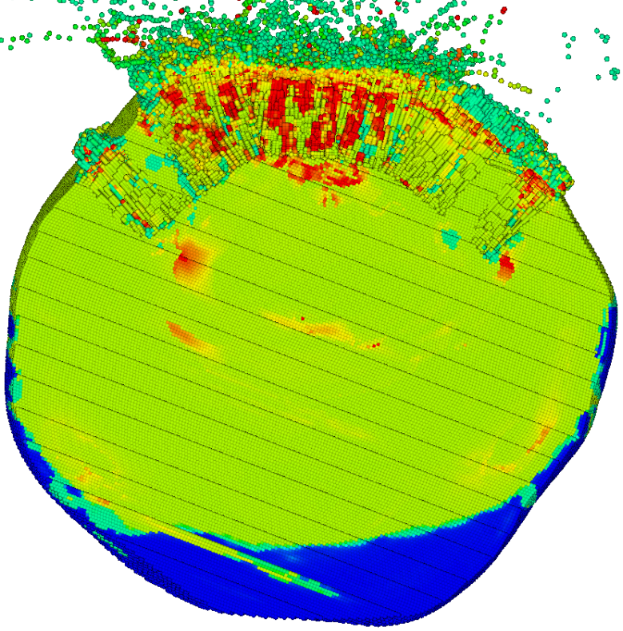
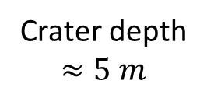
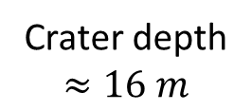
Smaller heights of burst cause comparable damage and induce larger craters
Chelyabinsk (10 m)
Chelyabinsk (25 m)
Crater depth $≈5 m$
Crater depth $≈16 m$
t ~ 68 ms
t ~ 68 ms
Smaller height of burst illuminates less surface area leading to less material damaged compared to larger height of burst at the same time.
See crater size comparisons in Mary Burkey’s poster:
“Probing Nuclear-Initiated Robust Disruption in Mesh-Based Simulations”

Slide 9
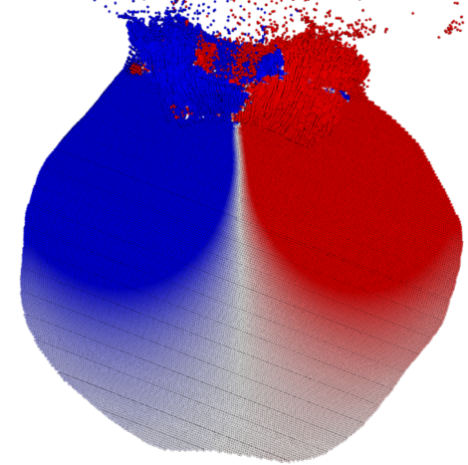
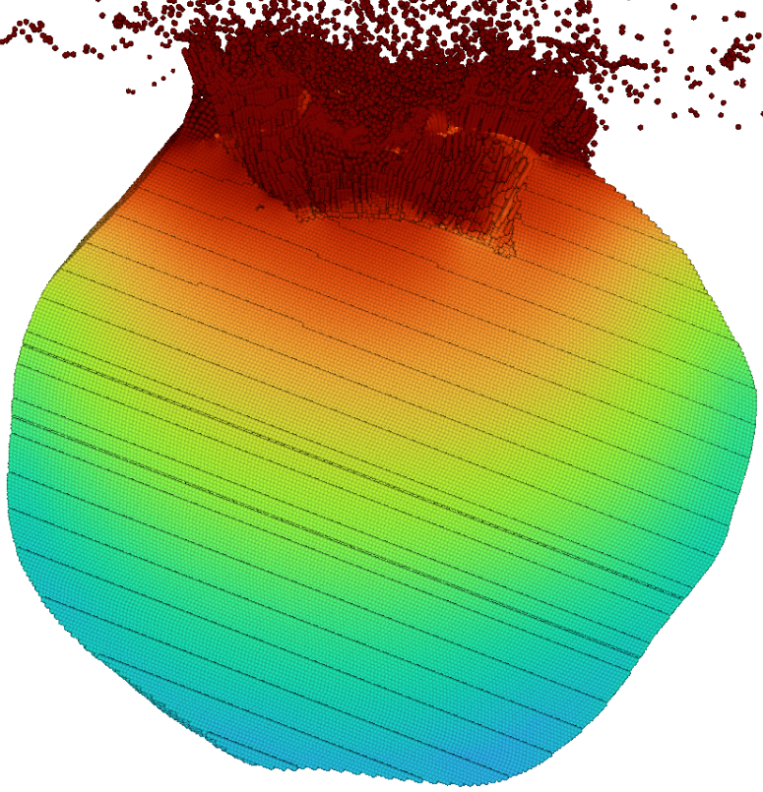
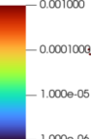
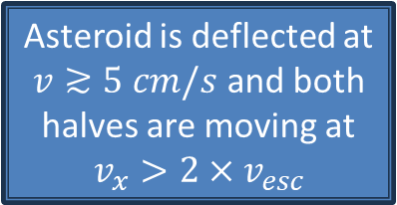

Asteroid material motion strongly suggests that this will undergo nuclear fragmentation
Velocity Magnitude
10 m/s
1 m/s
$$v_{x}≥2×v_{esc}$$
10 cm/s
1 cm/s
Asteroid is deflected at $v≳5 cm/s$ and both halves are moving at $v_{x}>2×v_{esc}$

Slide 10
Summary
Material models matter
  The rate of damage propagation throughout the asteroid differ between the Aba Panu and Chelyabinsk models.
Smaller heights of burst illuminate less surface area which affects the amount of material damaged.
  Still can induce a comparable deflection velocity and induces a larger crater.
Future work:
  Itokawa shape model to later times
  How does disruption depend on: strength parameters, size, porosity, etc.?

Slide 12
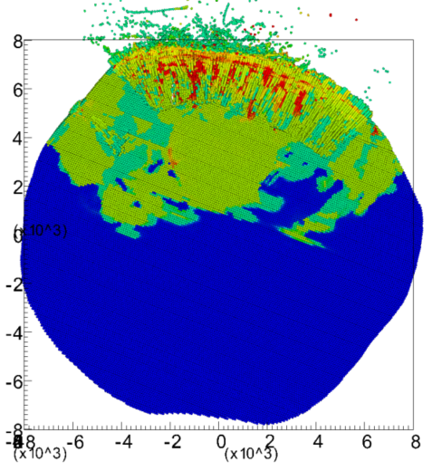
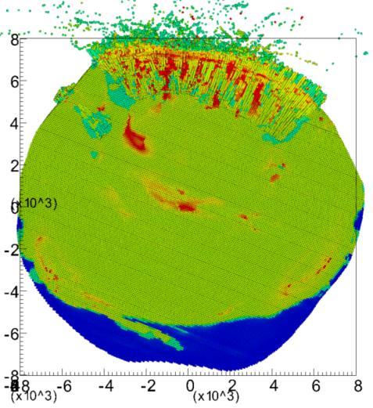
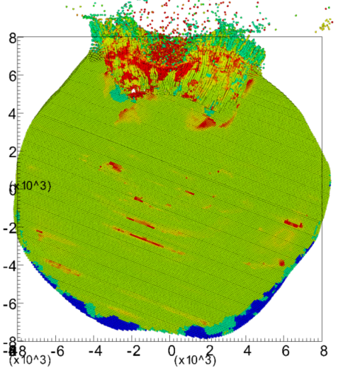
Final damage patterns at the ends of the simulations
Aba Panu (25 m)
Chelyabinsk (25 m)
Chelyabinsk (10 m)
t ~ 34 ms
t ~ 68 ms
t ~ 145 ms

Slide 13
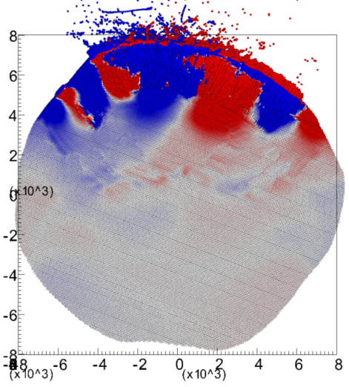
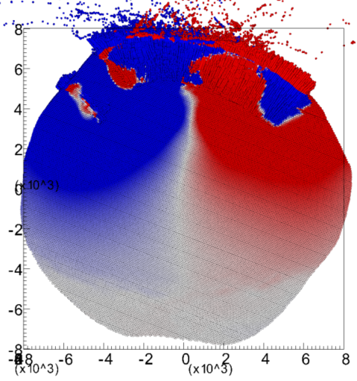
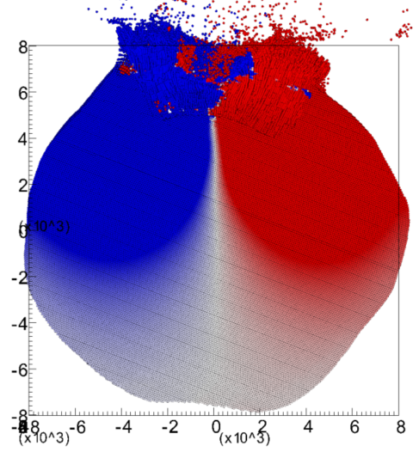
Material motion ($v_{x}$) at final simulation times
Aba Panu (25 m)
Chelyabinsk (25 m)
Chelyabinsk (10 m)
t ~ 34 ms
t ~ 68 ms
t ~ 145 ms

Slide 14

Simulation details
Fixed Parameters
Varied Parameter Combinations
Bennu shape model
Forsterite: $ρ=3.22 g cm^{−3}$
Median Epoch 2 scenario:
  M $∼3.6×{10}^{9}$ kg
  D $≈$ 150 m
  $v_{esc}≈8$ cm/s
  $φ=0.308$
NED Yield = 1000 kt
Intact yield strength = 1 MPa
Damaged yield strength = 1 Pa
Intact shear modulus = 3.15e4 MPa
Poisson’s ratio = 0.3
Aba Panu material model, 25 m HOB
Chelyabinsk material model, 25 m HOB
Chelyabinsk material model, 10 m HOB

