Slide 1
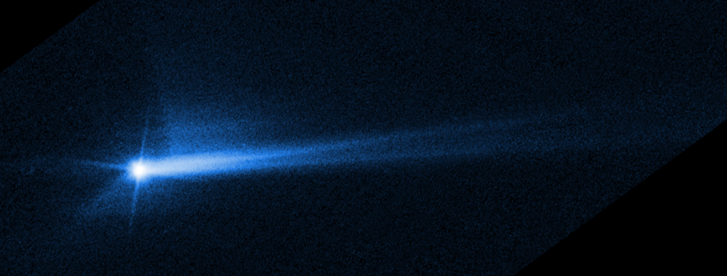
Li et al. 2023
The post-DART heliocentric orbit of Didymos and implications for the effectiveness of the DART impact
Steven R. Chesley, Rahil Makadia, David Herald, Davide Farnocchia, Shantanu P. Naidu, Alexandros Siakas, Damya Souami, Paolo Tanga, Sotirios Tsavdaridis, and Kleomenis Tsiganis

Slide 2
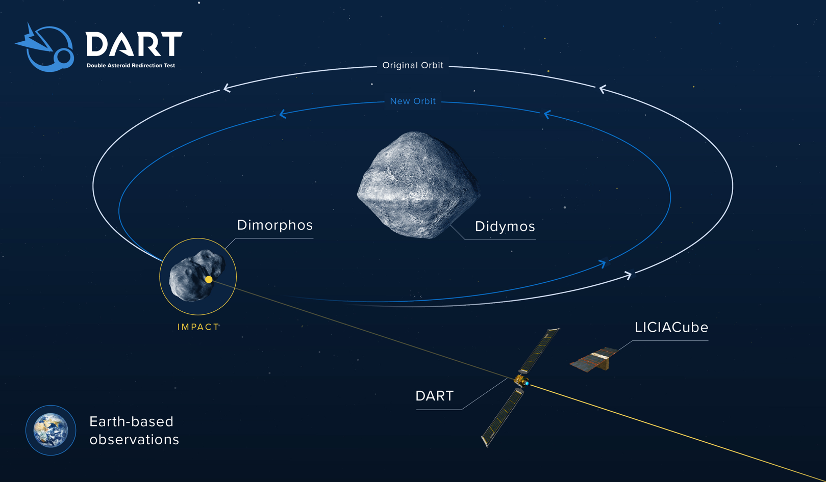
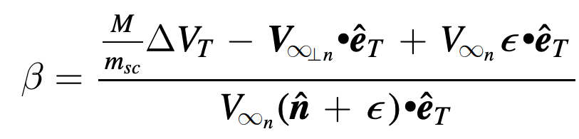
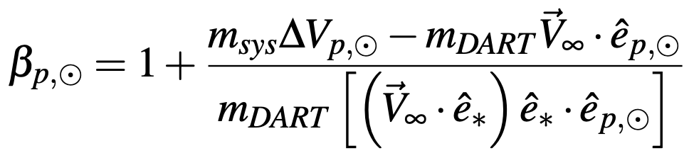

DART and Didymos
The backstory
NASA’s DART spacecraft impacted Dimorphos, the satellite of the Didymos system in Sept. 2022
A key objective was to measure the effects of the impact and the efficiency of the deflection
The efficiency is quantified by the momentum enhancement factor $β=\frac{m_{sc}V_{sc} +{ p}_{ejecta}}{m_{sc}V_{sc}}$ But some care is needed since ejecta and spacecraft momentum vectors may not be aligned. (Statler et al. 2022)

Slide 3
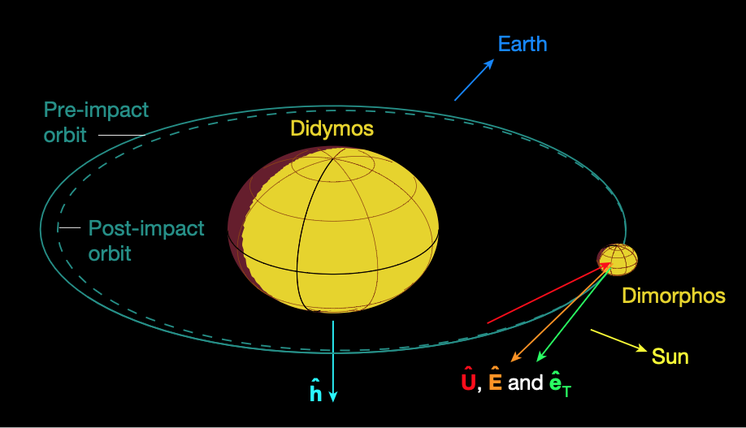
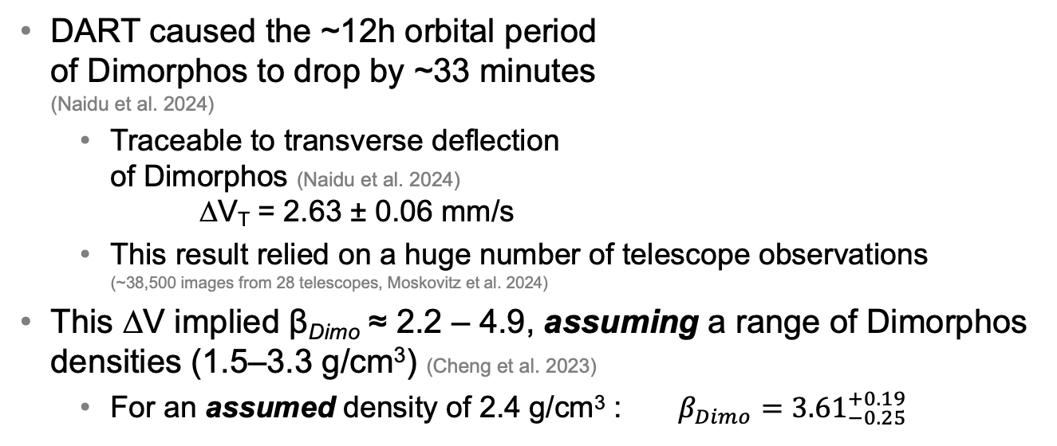
Previous β results from DART
Based on change in Dimorphos orbit
DART caused the ~12h orbital period of Dimorphos to drop by ~33 minutes (Naidu et al. 2024)
Traceable to transverse deflection of Dimorphos (Naidu et al. 2024) ∆V_{T} = 2.63 ± 0.06 mm/s
This result relied on a huge number of telescope observations (~38,500 images from 28 telescopes, Moskovitz et al. 2024)
This ∆V implied β_{Dimo} ≈ 2.2 – 4.9, assuming a range of Dimorphos densities (1.5–3.3 g/cm³) (Cheng et al. 2023)
For an assumed density of 2.4 g/cm³ : $β_{Dimo}={3.61}_{−0.25}^{+0.19}$
Cheng et al. 2023

Slide 4
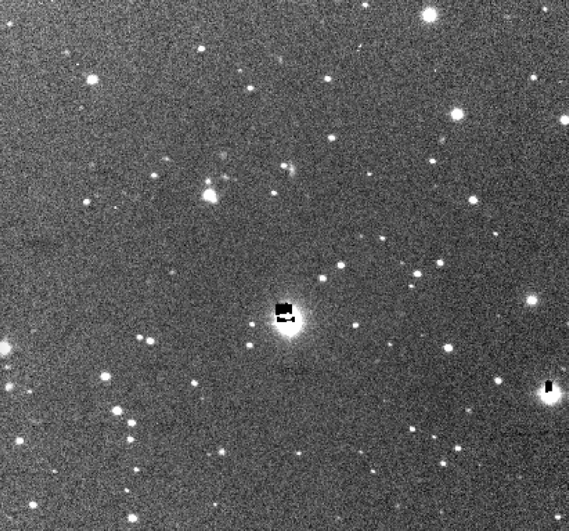
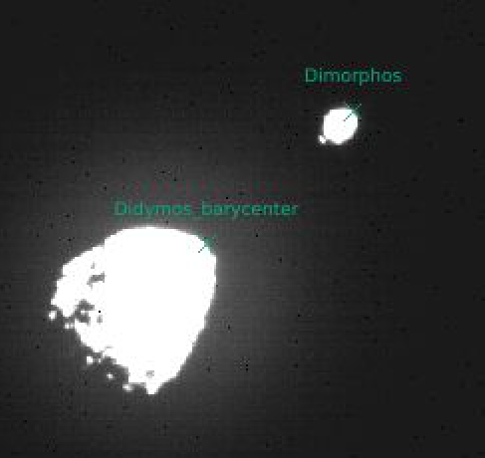
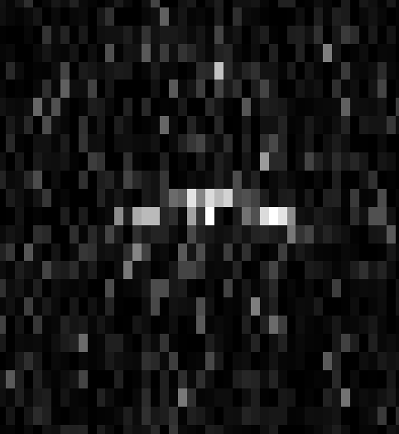
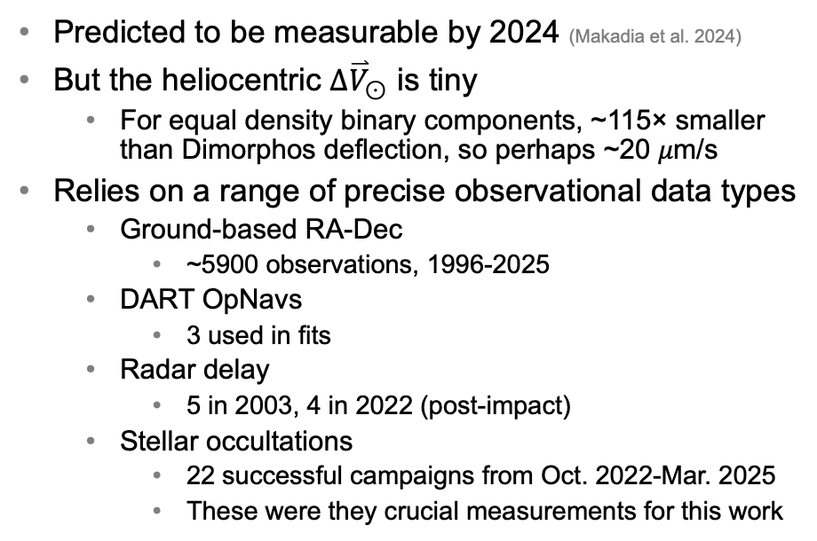
The heliocentric deflection
An alternate approach to measuring β
Predicted to be measurable by 2024 (Makadia et al. 2024)
But the heliocentric ${∆\overset{⃑}{V}}_{⊙}$ is tiny
For equal density binary components, ~115× smaller than Dimorphos deflection, so perhaps ~20 𝜇m/s
Relies on a range of precise observational data types
Ground-based RA-Dec
~5900 observations, 1996-2025
DART OpNavs
3 used in fits
Radar delay
5 in 2003, 4 in 2022 (post-impact)
Stellar occultations
22 successful campaigns from Oct. 2022-Mar. 2025
These were they crucial measurements for this work

Slide 5
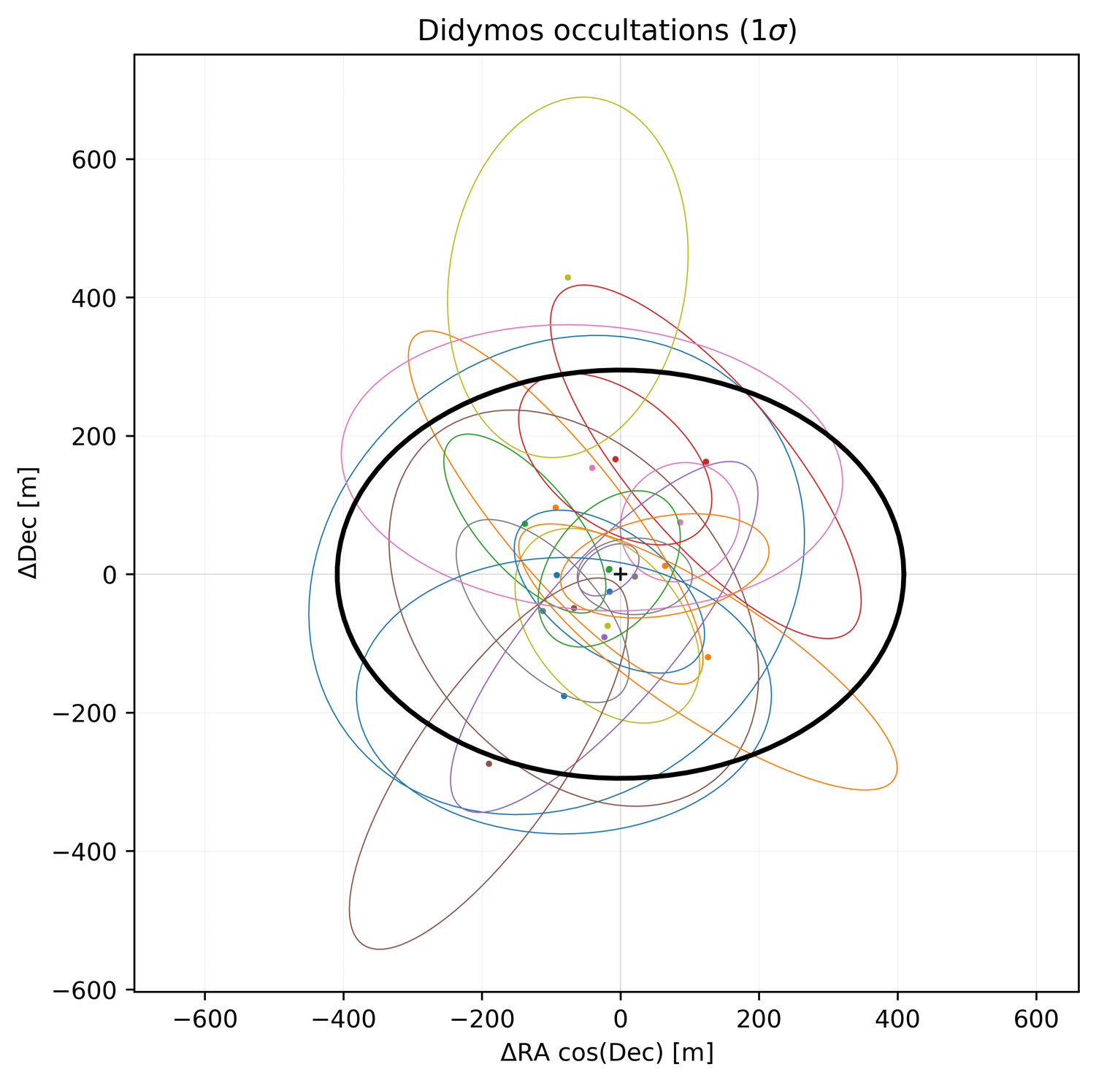
Didymos Occultations
22 total occultations (including 2 rejected outliers)
Around ⅓ are sub-milliarcsecond precision
Most precise is 0.1 mas(!)
Figure of Didymos
Contributing Observers
A. Asai
E. Barbotin
J. Broughton
N. Carlson
A. Cazaux
S. Cikota
K. Cobble
F. Colas
J. Dauvergne
R. Dunford
D. Dunham
J. Dunham
J. Flores
D. Gault
K. Getrost
K. Guhl
J. Hanus
T. Hayamizu
D. Herald
K. Hosoi
M. Ida
R. Jones
K. Kitazaki
G. Langin
A. Leroy
B. Lott
G. Lyzenga
P. Maley
N. Manago
A. Manna
J. Moore
Y. Nakamura
T. Nemoto
H. Noda
R. Nolthenius
S. Preston
L. Rousselot
M. Sanchez
M. Skrutskie
S. Sposetti
M. Takimoto
R. Trank
R. Venable
H. Watanabe
F. Weber
B. Whitehurst
H. Yamamura
M. Yamashita
H. Yoshihara

Slide 6
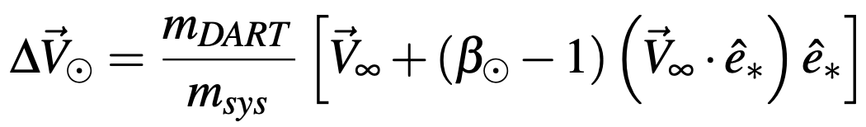
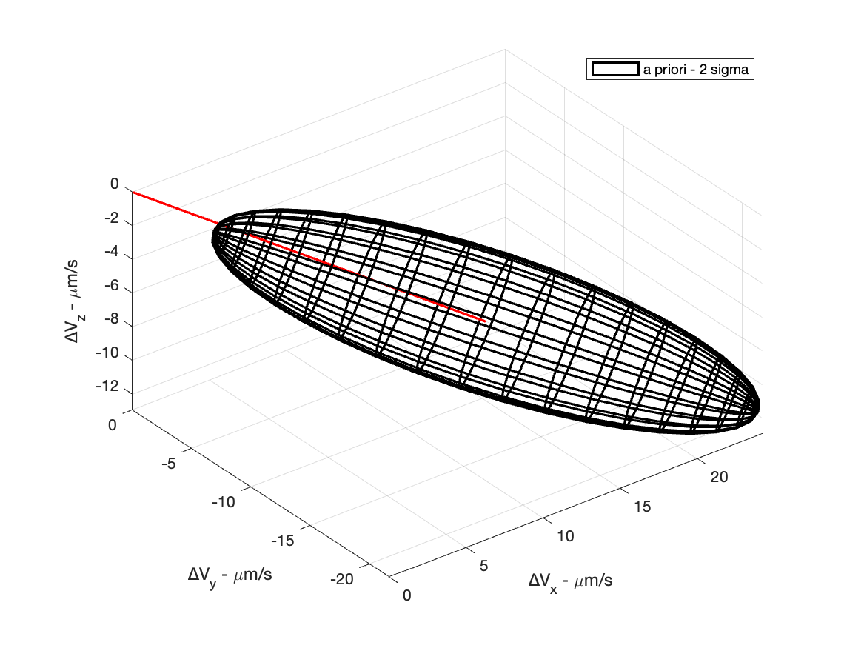
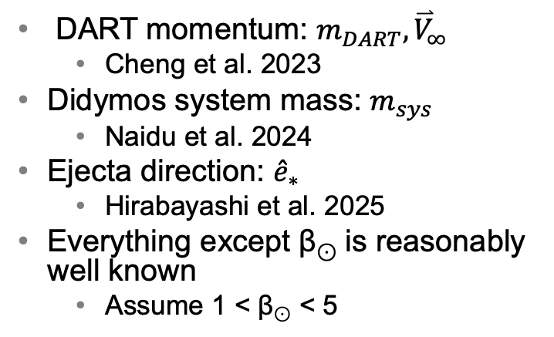
Estimate ${∆\overset{⃑}{V}}_{⊙}$
First, apply a priori constraint from independent sources
DART momentum: $m_{DART}{,\overset{⃑}{V}}_{∞}$
Cheng et al. 2023
Didymos system mass: $m_{sys}$
Naidu et al. 2024
Ejecta direction: ${\hat{e}}_{∗}$
Hirabayashi et al. 2025
Everything except β⊙ is reasonably well known
Assume 1 < β⊙ < 5
β⊙≈1
β⊙≈2
β⊙≈3
β⊙≈4
β⊙≈5

Slide 7
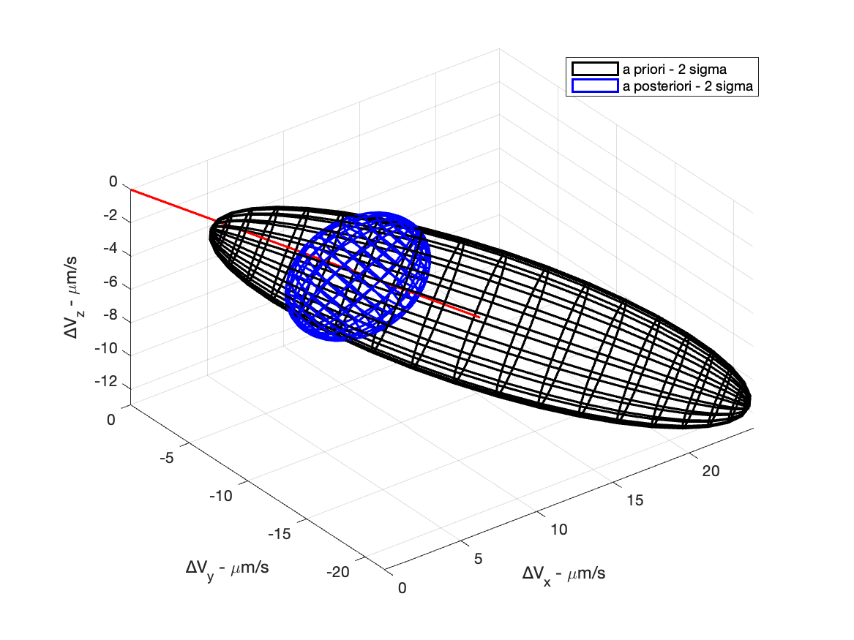
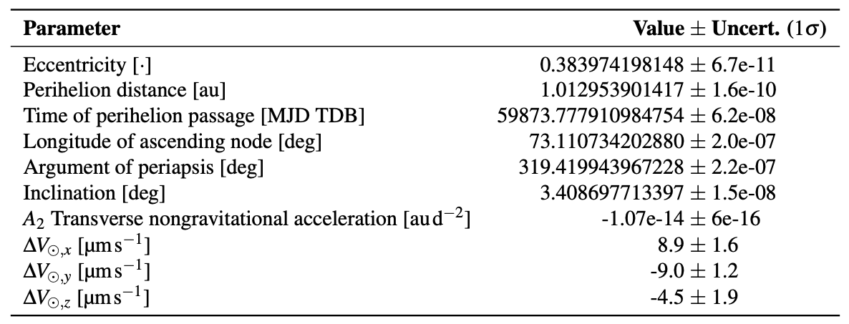
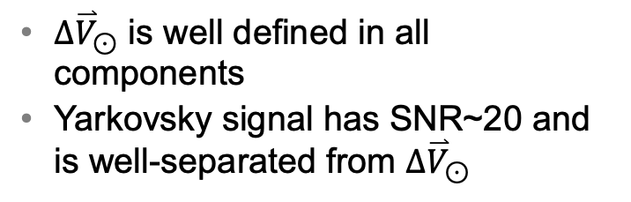
Estimate ${∆\overset{⃑}{V}}_{⊙}$
Next, estimate the orbit and ${∆\overset{⃑}{V}}_{⊙}$ (& Yarkovsky effect)
${∆\overset{⃑}{V}}_{⊙}$ is well defined in all components
Yarkovsky signal has SNR~20 and is well-separated from ${∆\overset{⃑}{V}}_{⊙}$
β⊙≈1
β⊙≈2
β⊙≈3
β⊙≈4
β⊙≈5

Slide 8
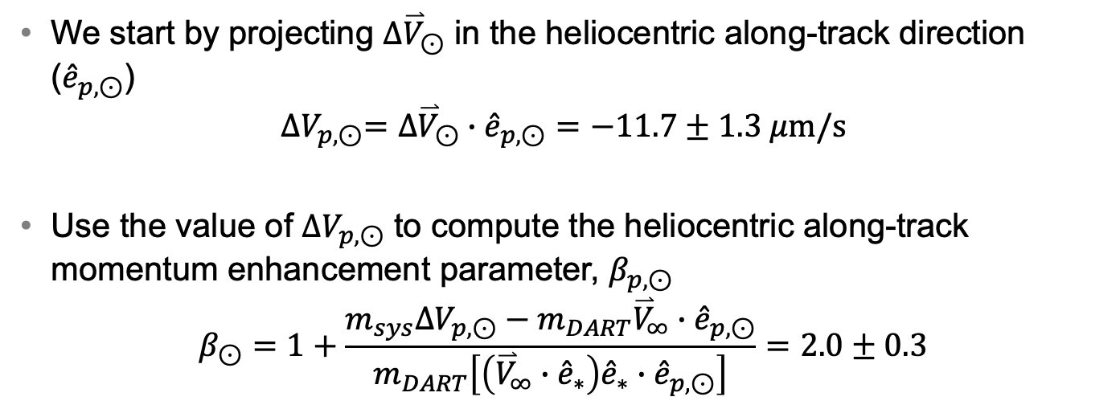
We can now calculate β
We start by projecting ${∆\overset{⃑}{V}}_{⊙}$ in the heliocentric along-track direction (${\hat{e}}_{p,⊙}$)
$${{∆V}_{p,⊙}=∆\overset{⃑}{V}}_{⊙}∙{\hat{e}}_{p,⊙}=−11.7±1.3 μ\text{m}\text{/}\text{s}$$
Use the value of ${∆V}_{p,⊙}$ to compute the heliocentric along-track momentum enhancement parameter, $β_{p,⊙}$
$$β_{⊙}=1+\frac{m_{sys}{∆V}_{p,⊙}−m_{DART}{\overset{⃑}{V}}_{∞}∙{\hat{e}}_{p,⊙}}{m_{DART}\left[\left({\overset{⃑}{V}}_{∞}∙{\hat{e}}_{∗}\right){\hat{e}}_{∗}∙{\hat{e}}_{p,⊙}\right]}=2.0±0.3$$

Slide 9
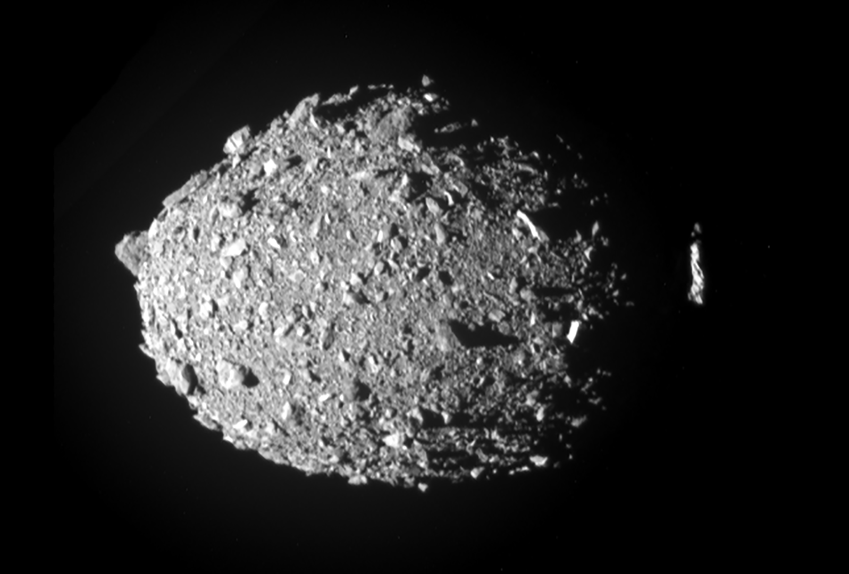
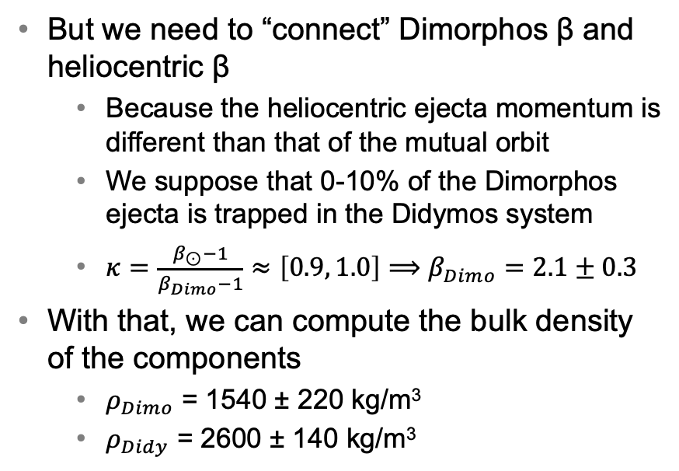
Why is β so much lower?
Because Dimorphos has (relatively) low bulk density
But we need to “connect” Dimorphos β and heliocentric β
Because the heliocentric ejecta momentum is different than that of the mutual orbit
We suppose that 0-10% of the Dimorphos ejecta is trapped in the Didymos system
$κ=\frac{β_{⊙}−1}{β_{Dimo}−1}≈\left[0.9, 1.0\right]⟹β_{Dimo}=2.1±0.3$
With that, we can compute the bulk density of the components
$ρ_{Dimo}$ = 1540 ± 220 kg/m³
$ρ_{Didy}$ = 2600 ± 140 kg/m³

Slide 10
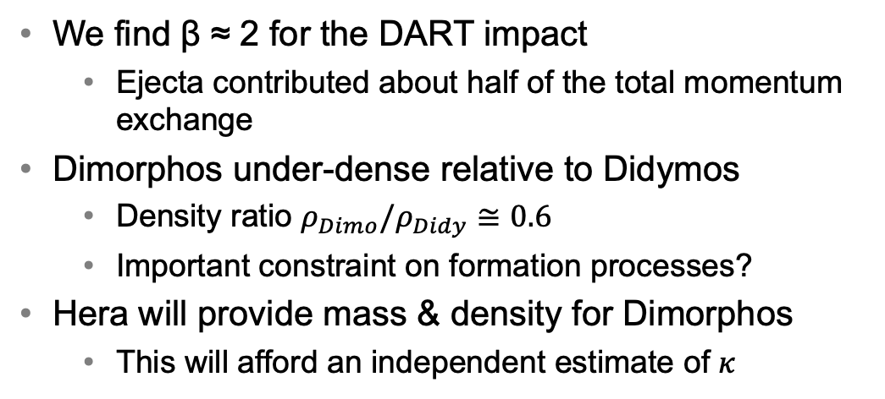
Concluding remarks
We find β ≈ 2 for the DART impact
Ejecta contributed about half of the total momentum exchange
Dimorphos under-dense relative to Didymos
Density ratio $ρ_{Dimo}/ρ_{Didy}≅0.6$
Important constraint on formation processes?
Hera will provide mass & density for Dimorphos
This will afford an independent estimate of $κ$

