Slide 1
Options and Uncertainties for Nuclear Mitigation in the 2025 Hypothetical Asteroid Threat Exercise Scenario
Catherine S. Plesko, Stephen A. Becker, Mark B. Boslough, Wendy K. Caldwell, Megan L. Harwell
May 2025
LA-UR-25-24025

Slide 2
The Delta V Criteria: Shifting Technical Risk
The velocity threshold criteria were intended to be simple and conservative:
For a uniform impulse from ablation of the burst-facing surface:
If delta v < 0.1 v_{esc}, the object is very unlikely to disrupt.
If delta v > 10 v_{esc}, the object is very likely to strongly disrupt.
A lot of previous work has assumed a high-speed trajectory, not rendezvous
Limited control of height of burst
Proximal operations have a high-risk of premature impact
The hypothetical threat object size range and orbit make it difficult to adhere to the delta V heuristics for stand-off bursts
Up to a dozen impulses required in some cases
This scenario allows rendezvous, which make proximal operations viable
Surface bursts couple much more energy to the target
Energy deposition is highly localized

Slide 3

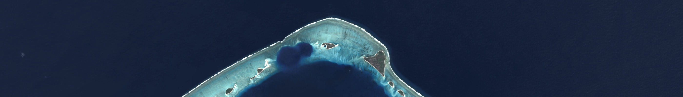
Hypothesis: A Single 1 MT Burst in Close Proximity Could Strongly Disrupt the Hypothetical Threat Object.
2024 PDC is of comparable size, mass to the PDC 2011 conference venue, if substantially weaker.
A 1 MT surface burst on Earth makes a transient crater of a size comparable to the threat object.
300-500 m diameter
50-100 m depth
Glasstone and Dolan, pp. 253-257
A 1 MT surface burst on the threat object is not expected to make a smaller crater.
lower surface gravity, no air,
expected to be weaker than the rock under load used above.
Koa crater on Eniwetok Atoll is a potential near neighbor
Top: Romanian Palace of Parliament, courtesy Wikipedia
Bottom: : Landsat image of Eniwetok Atoll, showing some of the craters Glasstone and Dolan’s model was derived from. (NASA/USGS)

Slide 4
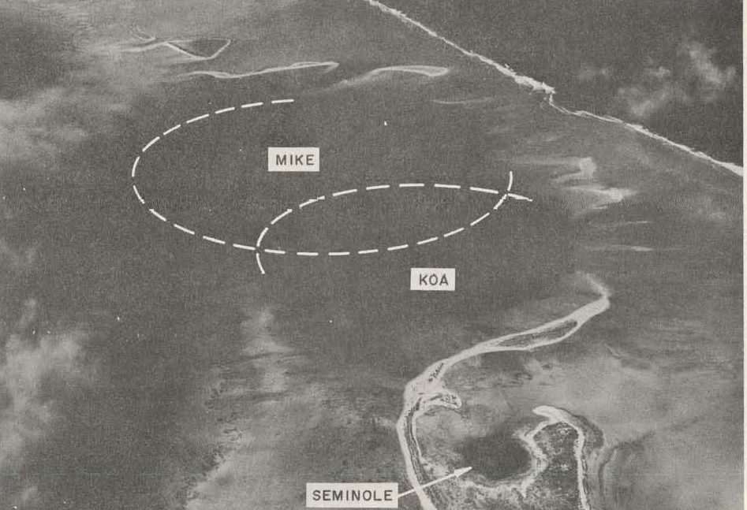
The Koa Crater in the Eniwetok Atoll is a Potential Near Neighbor
Described in “Nuclear Cratering Experience at the Pacific Proving Grounds” (UCRL-12172)
Yield = 1.3 MT
Final crater diameter: 1.1 km
Transient crater diameter 400-500 m
Excavation depth: 41 m
Extensive studies of the crater were done by the USGS PEACE Program in the 1980’s. (USGS Open-File Report 86-419 & etc. )
Top: Landsat image of Eniwetok Atoll, showing the Mike and Koa craters. (NASA/USGS)
Bottom: Frontispiece, UCRL-12172

Slide 5
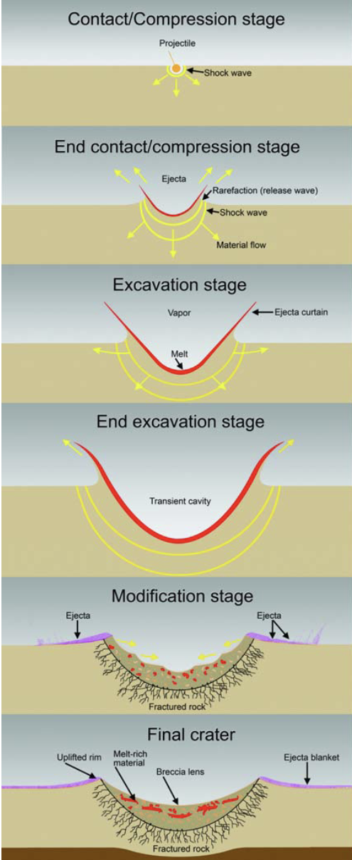
The Amount of Material Displaced in a Strong Disruption Should be Predicted to be at Least that of a Similarly Sized Transient Crater.
The transient crater is that which exists at the end of the excavation stage on Earth.
Third frame from the bottom
It is deeper and narrower than the final crater.
Over geologic time on Earth, the transient crater slumps, becoming wider and shallower.
The modification process does not apply to our scenario, so we use the transient crater, not the final crater.
We propose these dimensions as a lower bound.
We hypothesize that if the device is big enough to move at least that much material on Earth, it should do so in space.
Image by B. French and D. Kring, LPI

Slide 6
Glasstone and Dolan Scaled Crater Predictions Suggest Disruption of 2024 PDC by a Near-Surface Burst is Possible.
Transient crater dimensions for Y = 1 kt are experimentally determined
Dimensions can be scaled to other yields
d(Y) = d(1kt)*Y^1/3
Scaled predictions validated against experiments
Cube root scaling example:
Scaled DOB = DOB/Y^1/3 = 0/1000^1/3 = 0
30 m < D(1kt, HOB=0) < 50 m
300 < D(1kt)*1000^1/3 < 500 m
Predicted transient crater D > D threat object
lower surface gravity,
target expected to be weaker
Right: Glasstone and Dolan (1977) p. 255, Fig. 6.72 a
Notes:
Note- even for 10-100kt, crater diameter is ~ threat object size.
FIXME ADD CRATER GRAPHIC

Slide 7
Mitigation Outcome Requirements Used in This Work
A community standard definition may be beneficial
The initial target parameters should over-predict the difficulty of disruption
No remaining fragment should be larger than Tunguska
We use d = 30 m, the lower end of Tunguska diameter predictions
Q*_{m} vs Q*_{D}
Energy required to mitigate to our preferred specifications
Energy required to disrupt so that the largest fragment is 50% of initial
Fragments should be left with sufficient velocity to miss Earth
Not well-posed
Solar wind effects on smaller particles
What amount of disrupted mass at what size distribution is tolerable?

Slide 8

Cautious Simplification Through a Steel Man Argument
A rhetorical technique to address the strongest form of an argument.
We believe 2024 PDC to be structurally weaker than solid SAE 304 stainless steel.
We can model 2024 PDC as solid steel, which has well-known constitutive properties.
If a steel target disrupts, we believe the attempt would likely also disrupt 2024 PDC.
Right: A steel man argument envisioned as a graphic novel character. Image generated by the author using DALL-E by OpenAI on 4.3.2025

Slide 9

Steel vs. S-type Asteroid: 2-3 Orders of Magnitude Stronger
 | Yield | Tensile | Shear
S-type | 0.2-5 MPa | < 10 MPa | < 10 MPa
SAE 304 | 294 MPa | 200 Mpa | 370 MPa
We don’t know the internal properties of 2024 PDC, or most asteroids, very well.
The disruption threshold is dependent on these properties
Specific cases that involve gravity regime cratering may be less sensitive to target strength
These cases involve high energies
Right: A steel man argument envisioned as a graphic novel character. Image generated by the author using DALL-E by OpenAI on 4.21.2025
Notes:
Tensile and shear values for Tuff, Yield taken from ATAP aerodynamic strength predictions

Slide 10
The Pagosa Hydrocode
Pagosa is a 1-3D Eulerian finite difference code
Fixed mesh (non-AMR)
Used to study high-velocity impacts and high explosives phenomena.
Weseloh et al. (2010)
Verification and validation for crater modeling by Heberling et al. (2017)
Was tested in the Stickle et al. (2019) code benchmarking study prior to DART.
Notes:
The second multi-physics code that we use is PAGOSA,
an Eulerian finite difference hydrocode.
PAGOSA uses different numerical methods than FLAG,
And was originally developed by Wayne Weseloh and co-authors
to study high-velocity impacts and high explosives experiments.
PAGOSA was validated for modeling hypervelocity impacts into geologic materials
by Tamra Heberling in 2017,
and again for the DART code benchmarking study in 2019.

Slide 11
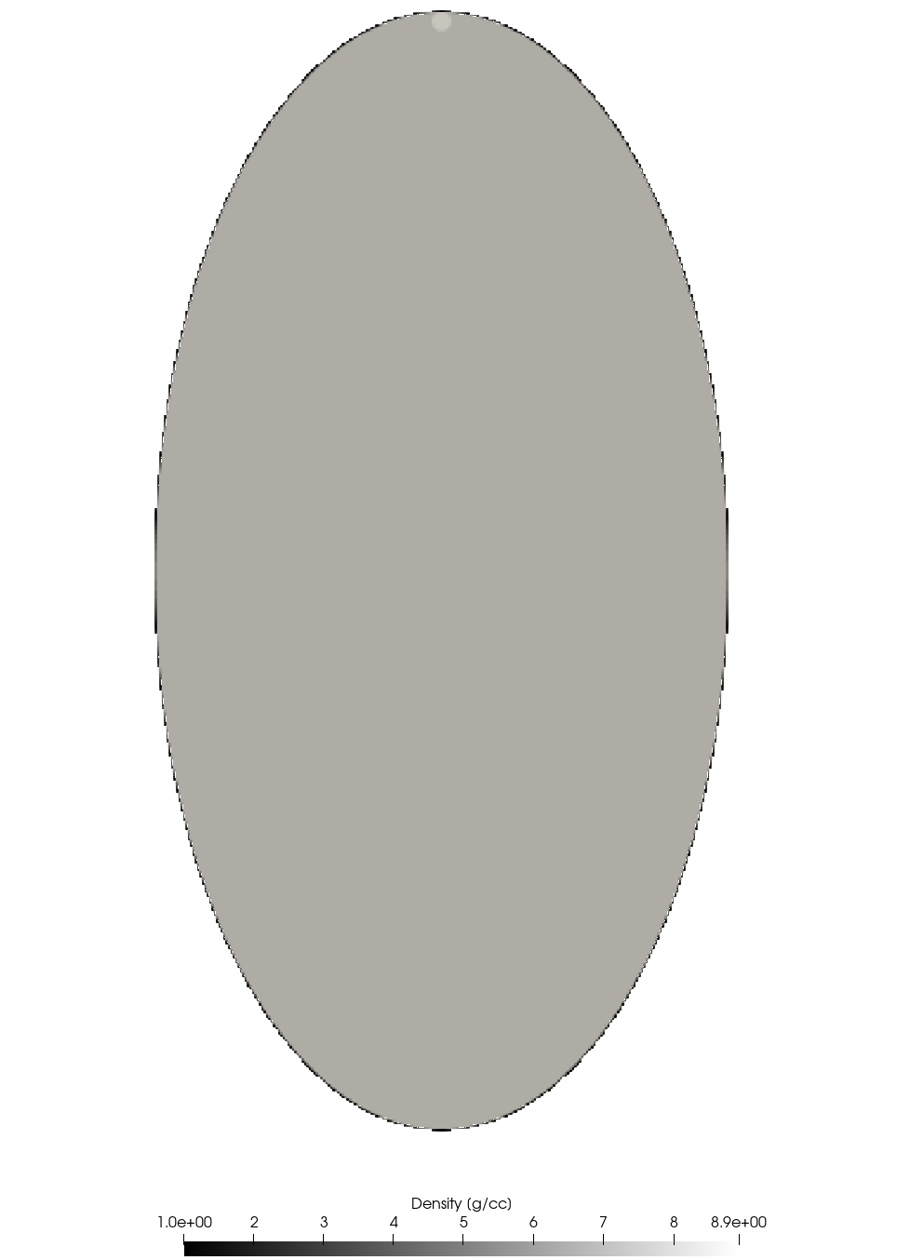
2024 PDC Epoch 2 Steel Man Model Input
Pagosa:
Hydrodynamics only, no x-rays.
dx = 50 cm fixed mesh
2d-axisymmetric
Energy pill has variable internal energy sourced into a copper sphere:
d = 2 m, Mie-Gruenisen Copper EOS
1 ton TNT < Y < 500 kt TNT
At the surface along the long axis, partially buried
Threat object
95th percentile ellipsoid (121m x 124 m x 236 m)
Homogeneous Sesame EOS 4272
Preston-Tonks-Wallace strength
Yield stress: 0.002944 Mbar
Johnson-Cook damage
spall stress: 0.05861 Mbar
Pagosa model at t=0

Slide 12
2024 PDC Epoch 2 Steel Man Model Results
Yield (kt) | Disrupted ? | Q*_{D} Achieved? | dV > 100 cm/s ? | Energy Imparted
500 | Yes, t < 0.4 s | Yes, t < 0.2 s | Yes, t < 0.1 s | 170 kt deposited, ~50 kt does work on solids
200 | TBD | TBD | TBD | 60 kt deposited, ~ 30 kt does work on solids
100 | TBD | TBD | TBD | 30 kt
10 | No | No | No | 3.7 kt
1 | No | No | No | 0.55 kt
0.001 | No | No | No | ~10 lbs TNT

Slide 13
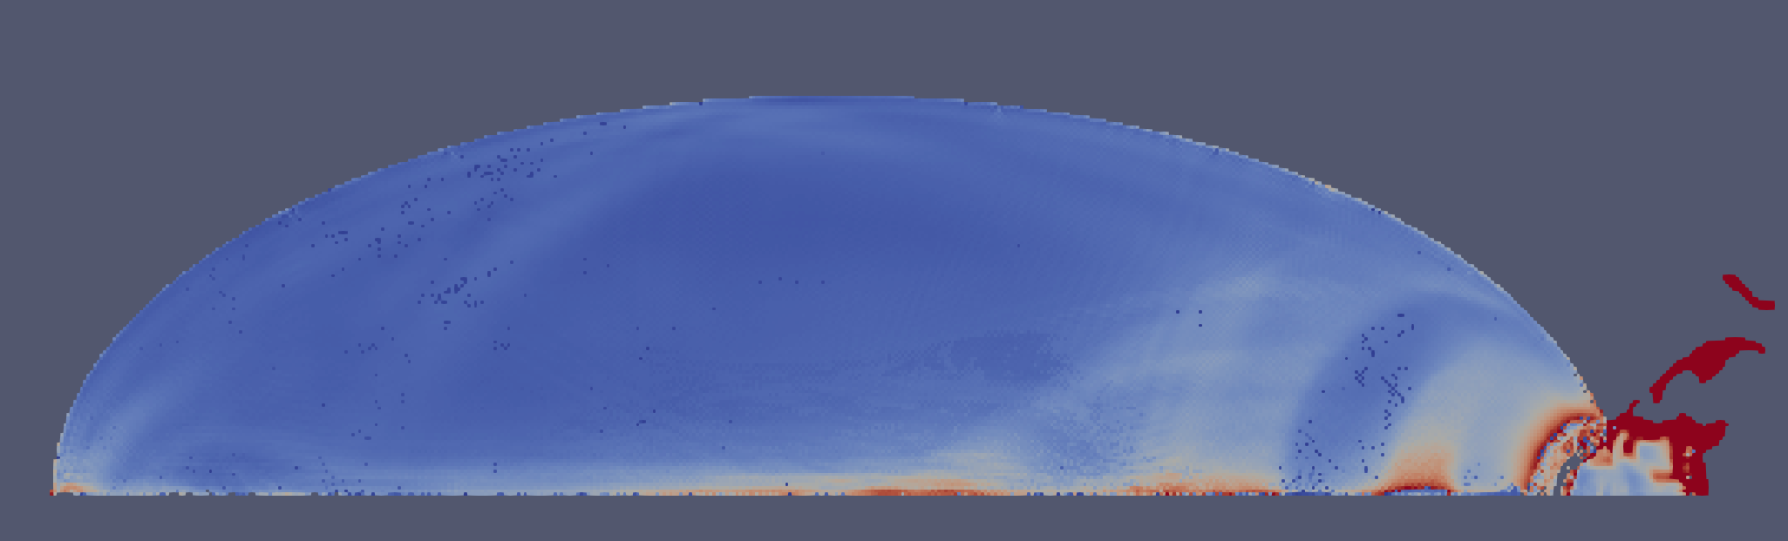
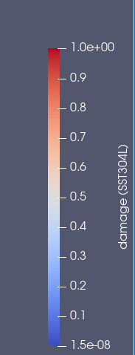
2024 PDC Epoch 2 Steel Man Model Results: Non-Disruption Cases
Yield (kt) | First shock crossing | Time shock attenuated to -pfail < P < yld str., -0.05861 < P < 0.002 Mbar | Damage at time of attenuation
10 | t = 0.0383 s | t > 0.07 s | TBD
1 | t = 0.0387 s | t = 0.0676 | minimal
0.001 | t = 0.0412 s | t = 0.0412 | minimal
Notes:
1 kt case shown, colored by damage

Slide 14
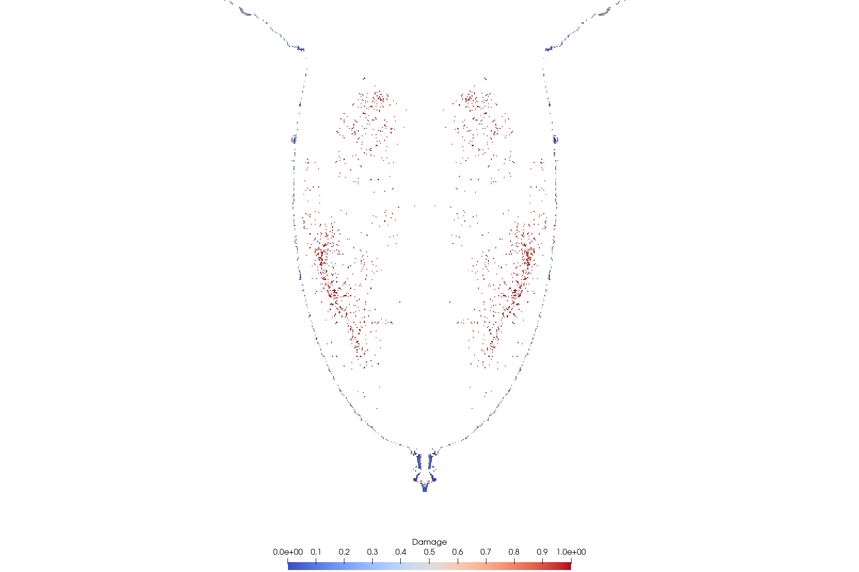
2024 PDC Epoch 2 Steel Man Model Results
A single 500 kt – 1 Mt contact burst appears sufficient to strongly disrupt a steel object of the same volume as the 95th percentile case of 2024 PDC.
It should be sufficient to disrupt any instantiation of 2024 PDC.
Parameter studies are ongoing to constrain a lower bound estimate of the energy required to mitigate, for completeness, does not drive mission design.
Contiguous portions of the steel target subject to the 500 kt blast with damage < 1 are meter-scale or smaller at late time.

Slide 15

2024 PDC Epoch 2 Geologic Model Input
Pagosa:
Hydrodynamics only, no x-rays.
dx = 50 cm fixed mesh
2d-axisymmetric
Energy pill is 500 kt internal energy sourced into a copper sphere
d = 2 m
Mie-Gruenisen EOS
At the surface along the long axis, partially buried
Threat object
95th percentile case
SESAME Nevada Alluvium EOS
Porosity implicit in the EOS to include PdV work.
Kospall strength model, cohesion ~ yield strength.
Homogeneous material.
Right: The 2024 PDC hypothetical threat object envisioned as a graphic novel character, contemplating a Steel Man action figure. Image generated by the author using DALL-E by OpenAI on 4.21.2025

Slide 16
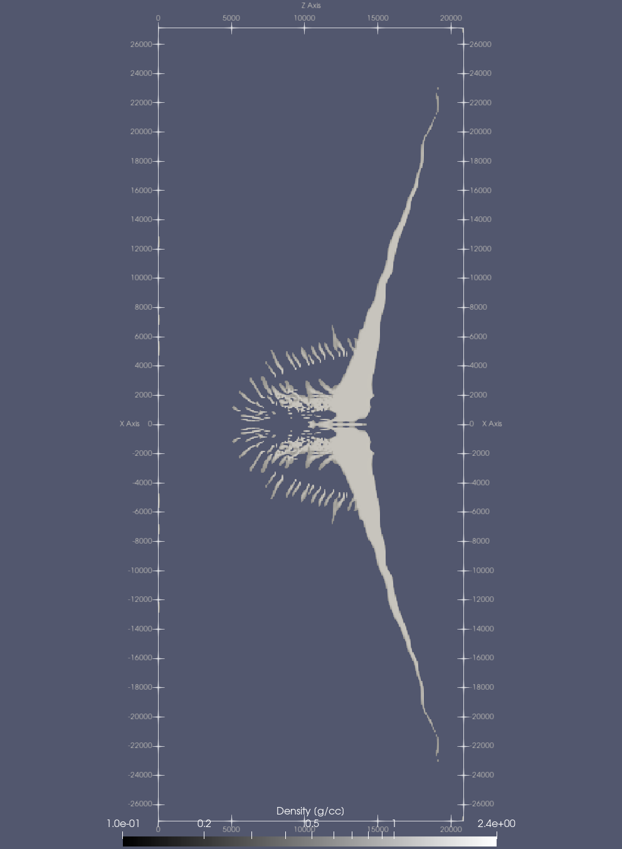
2024 PDC Epoch 2 Geologic Model Results
As expected from the steel man models, all cases strongly disrupt.
95th percentile case model suggests strong disruption by t = 1.0 s
One Tunguska-sized contiguous piece
Craters made by explosions this size are in the gravity regime.
May be less sensitive to details of target strength.
Right: Hydrodynamics simulation of a 500 kt energy pill tangent to the 95th percentile threat object.

Slide 17
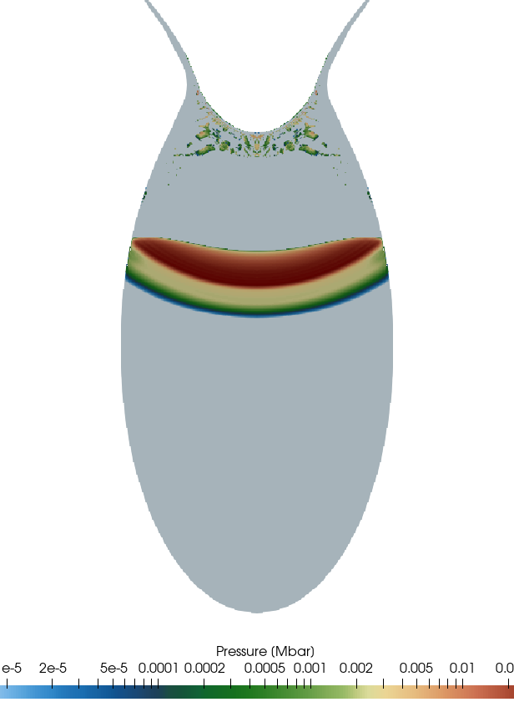
Potential Applications
Disruptions are insensitive to:
B-plane direction
perihelion timing
As a main option:
2032-2039, per Barbee et al. (this meeting)
Reserve options (upon main option failure)
Post Northward IBD: 2034-2039
Post Southward IBD: 2035-2039
Post Southward Partial IBD: 2035-2039
Post KI Backup Dates: 2037-2039
Right: A cross-section of a shock wave traveling through a disrupting steel target. Pagosa 500 kt steel simulation at t=0.01 sec.

Slide 18
Remaining Questions
Mission options for contact binaries
2+ devices placed carefully?
Time required for dispersal of decameter scale fragments
A specific consensus definition of mitigation outcome requirements
based on expected ground effects?
Right: A cross-section of a disrupting steel target, colored by damage, thresholded to D< 1. Pagosa 500 kt steel simulation.

