Slide 1
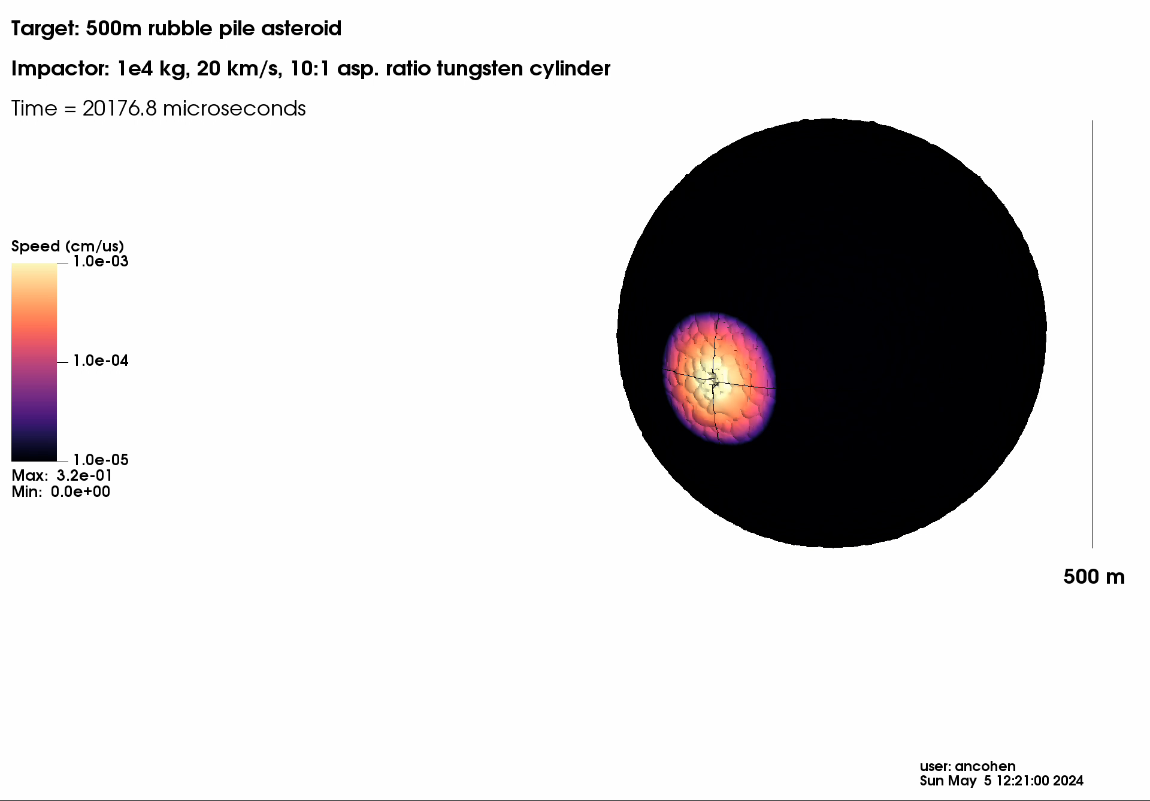



Pulverize It (PI): Intentional Robust Disruption (IRD) for Multi-modal Planetary Defense
Brin Bailey
brittanybailey@ucsb.edu
9th IAA Planetary Defense Conference
8 May 2025
Notes:
Hi, my name is Brin Bailey and I’m from the UC Santa Barbara Deepspace Group. Thank you so much for giving me the opportunity to talk to you today about “Pulverize It,” which is our multi-modal planetary defense study, currently in Phase II of NASA’s Innovative Advanced Concepts program.

Slide 2
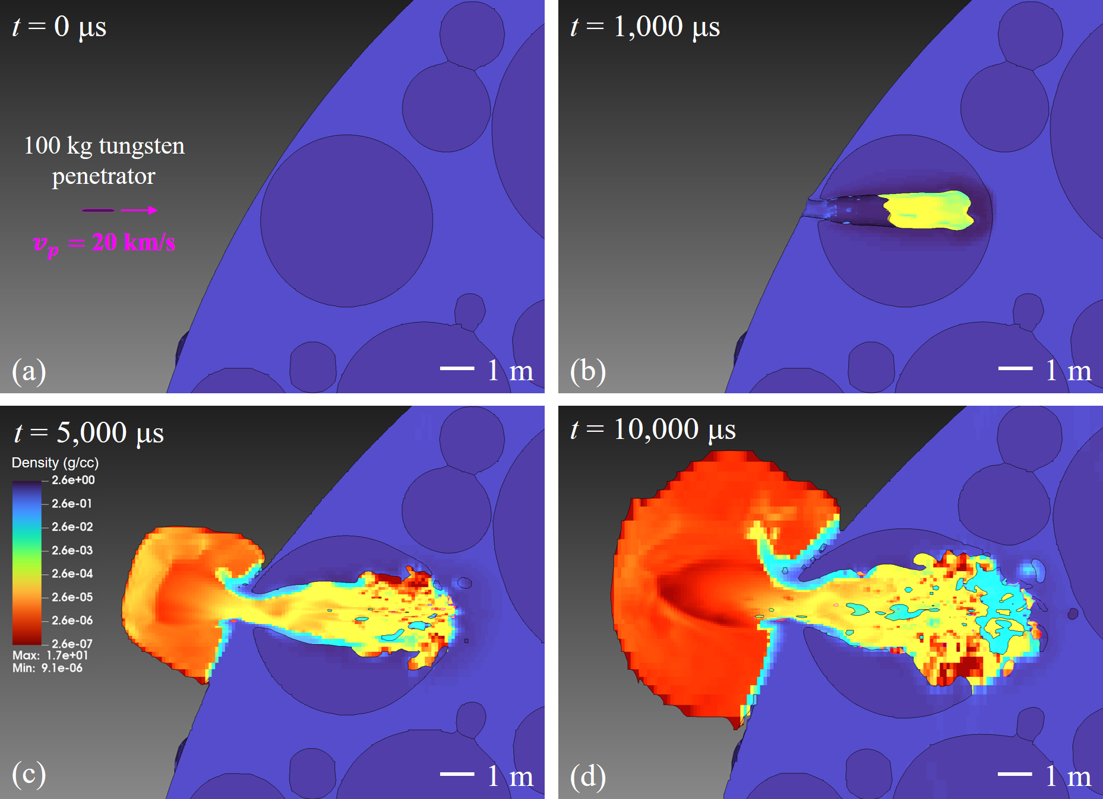
Pulverize It (PI or $π$): why it works
IAA-PDC-25-06-231
Hypervelocity penetrator induces a strong shockwave that pulverizes material
  Can use multiple penetrators for very large/strong threats
Impactor vaporizes itself and target material
  Acts as a gas-expansion engine for complete disassembly
In intentional robust disruption (IRD), target is blown apart into a fragment cloud → threat is mitigated
Notes:
1.
We propose Pulverize It, or PI, as a supplementary planetary defense approach to bolster our response to potential threats
Rather than using momentum transfer as in deflection, PI works by imparting energy transfer to a threat.
PI's approach, in essence, is to penetrate an incoming asteroid with high-density, hypervelocity kinetic impactors, which, in the case of intentional robust disruption, would enter the asteroid and break it apart into many small fragments
2.

Slide 3
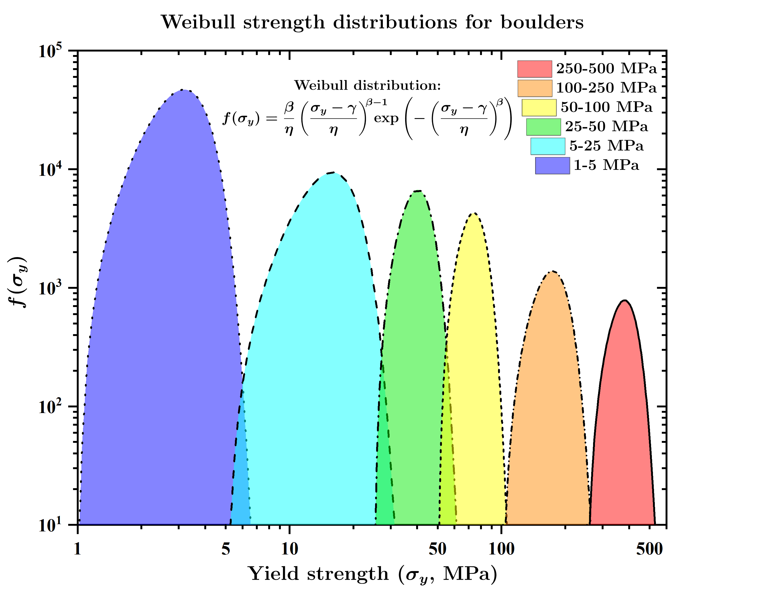
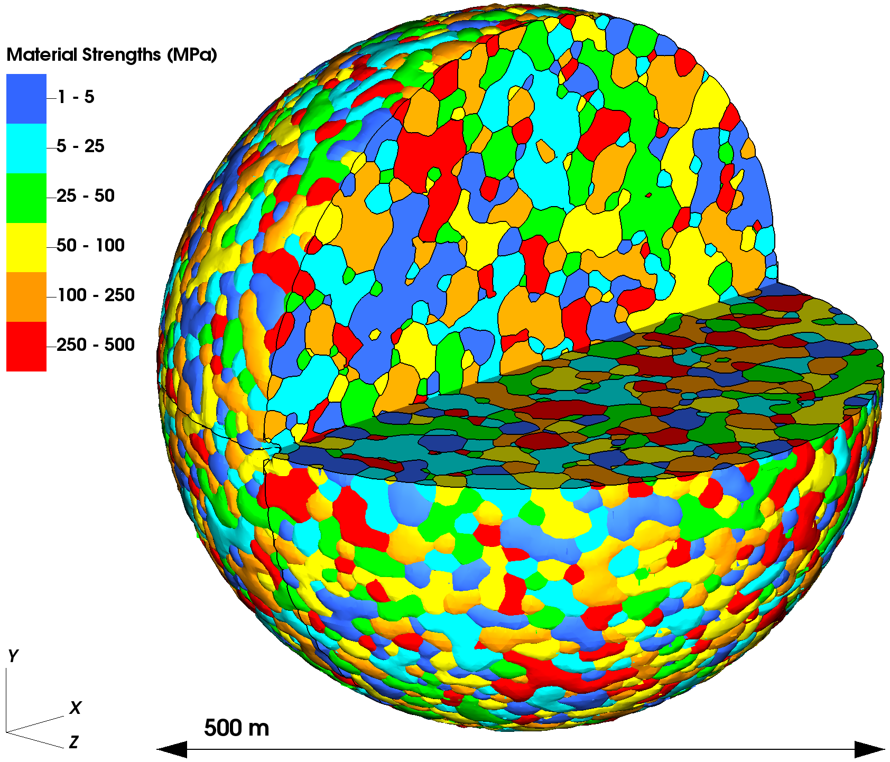
Hypervelocity impact simulations
IAA-PDC-25-06-231
Two-phase LEOS granite tabular equation of state used for asteroid materials, with density 2.6 g/cm³, porosity 40-50%
Baseline projectile is a 10:1 aspect ratio tungsten cylinder arriving in the reference frame of the target at 20 km/s
Complex boulder distribution set inside weak (~25 Pa) binder material [3]
Weibull distribution allows for realistic simulation of fracture dynamics
[3] Sánchez, P. and Scheeres, D.J. (2014), https://doi.org/10.1111/maps.12293
Notes:
Our hypervelocity impact simulations are run using Lawrence Livermore National Laboratory’s ALE3D code, using two-phase tabular equations of state for our asteroid materials, and implementing a porous crush model
We model a complex boulder distribution set inside a weak binder material to simulate a rubble-pile type asteroid
And we use a Weibull distribution of yield strengths to simulate realistic fracture dynamics within the asteroid material.
Our baseline projectile is a 10:1 aspect ratio tungsten cylinder, 1 meter in length, which arrives in the asteroid reference frame generally around 20 km/s.

Slide 4
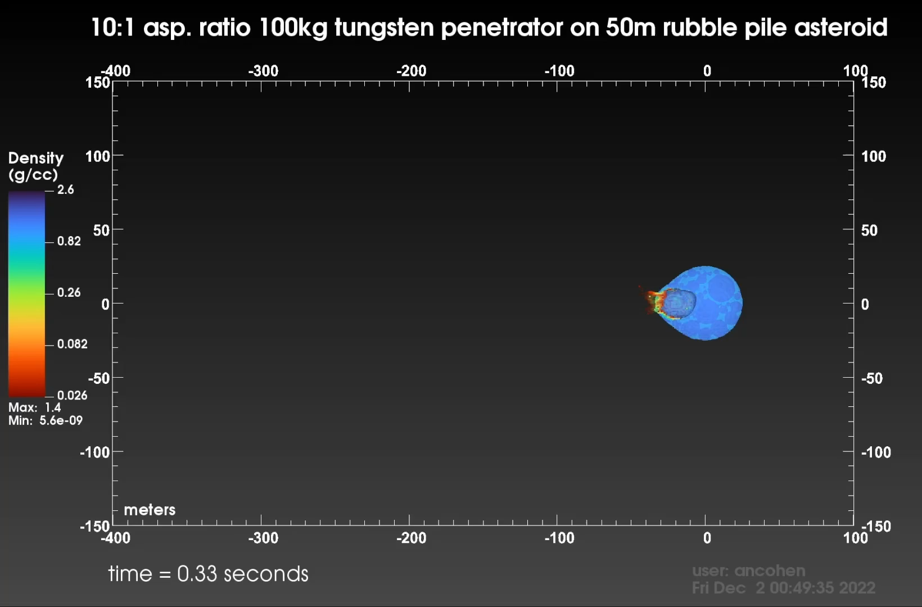
Notes:
Here we have a simulation showing the time evolution of the intentional robust disruption of a 50m rubble pile asteroid into a distribution of fragments after the impact of a single 100 kg tungsten penetrator at 20 km/s
Of note is that the high-speed vaporized ejecta exhausting through the entrance cavity at early times induces a transient thrust force comparable to that of a heavy lift vehicle for about 1/10th of a second

Slide 5
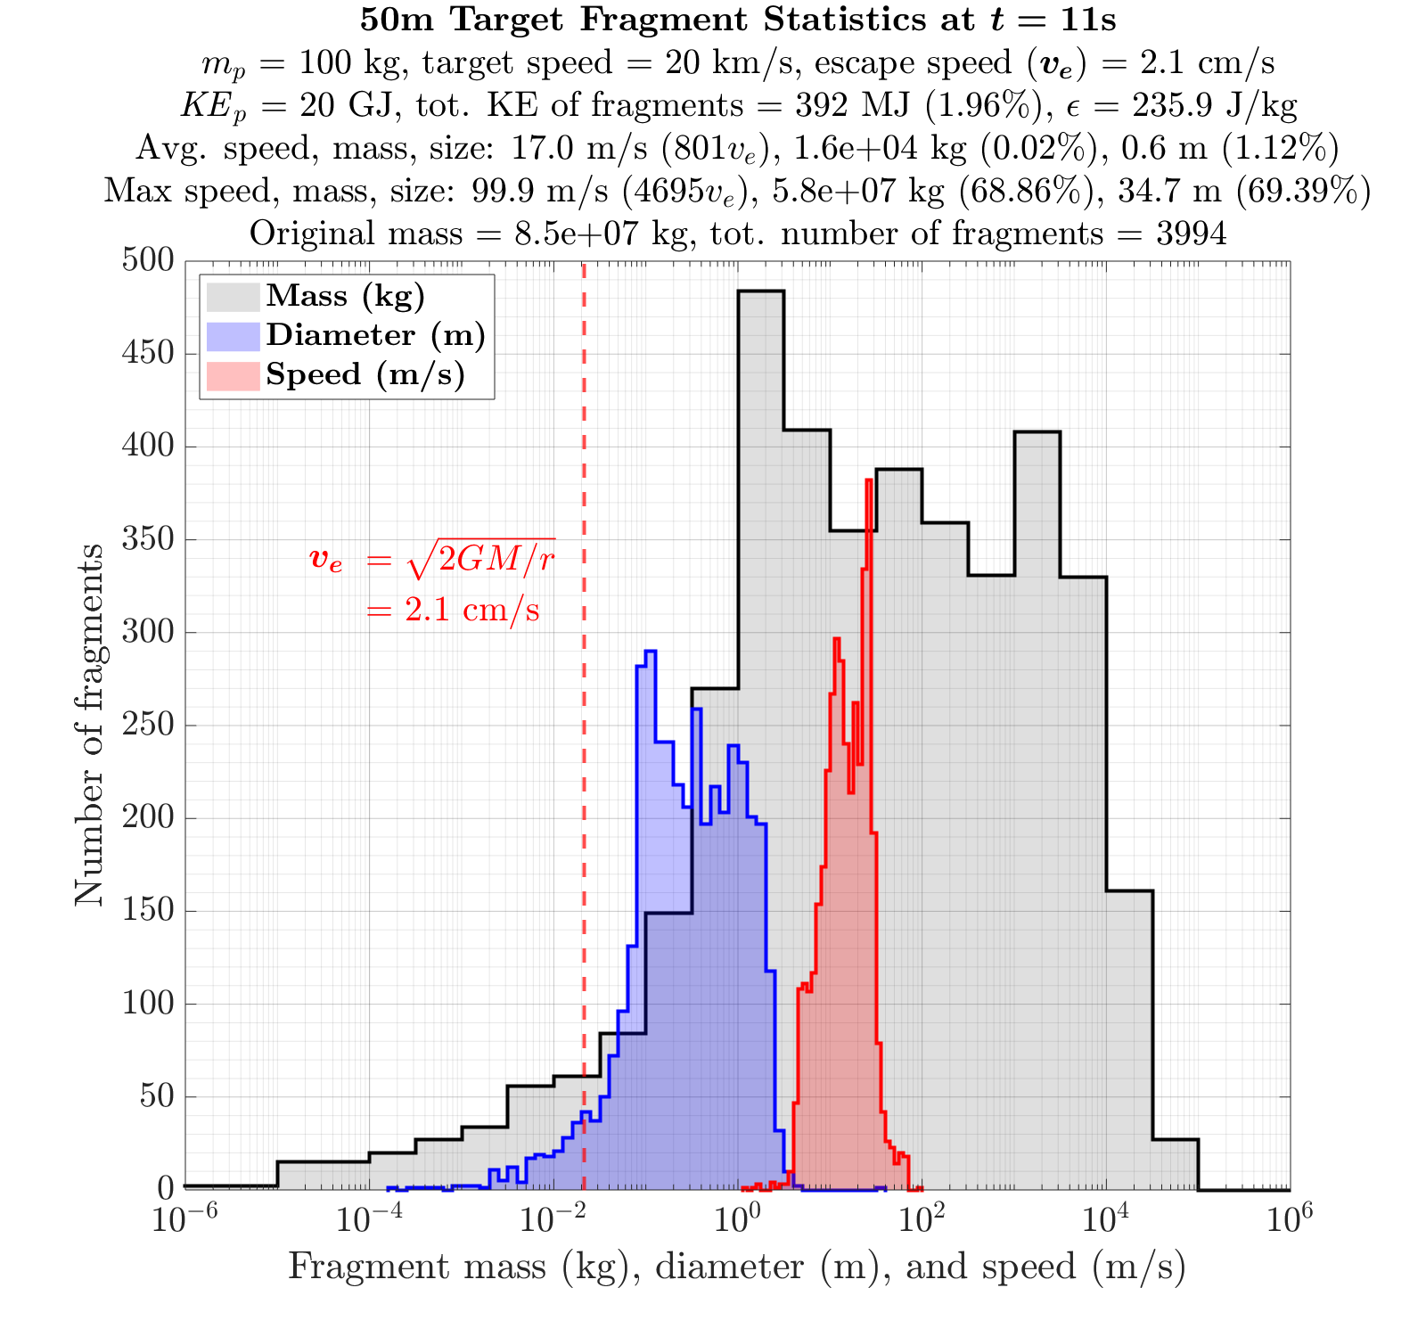
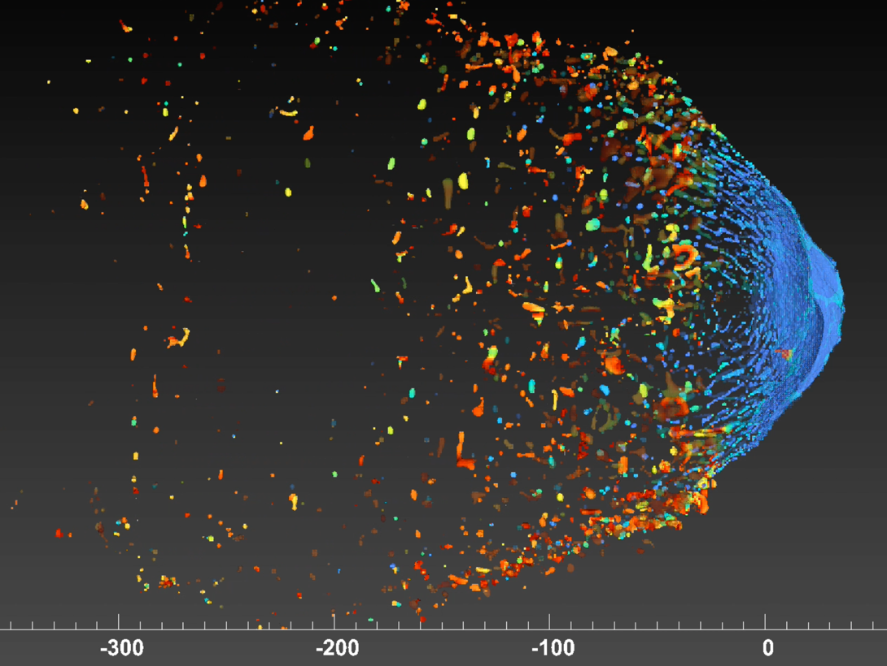
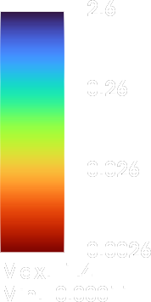

50m rubble pile asteroid – single 100kg 10:1 asp. ratio 20km/s tungsten penetrator – t=11s
Shows catastrophic disruption and near complete volumetric material failure
Results suggest single 100kg penetrator is sufficient to mitigate 50m bolide – scale to 100m, 8x100kg should suffice.
25x100kg penetrators in single Falcon 9 can achieve C₃ > 0 (escape), which can act as a single-launcher, passive-penetrator solution for threats in the 20m – 150m range.
Specific impact energy
$$ε=\frac{1}{2}m_{p}v_{p}^{2}∕m_{t}$$
Density (g/cc)
meters
Notes:
A brief analysis of the fragment statistics after impact shows that the average velocity of the fragments, shown by the red histogram, is far above the escape speed of the original parent asteroid, shown by the vertical dashed red line, which tells us that the fragments will not gravitationally recombine
These results suggest that a single 100 kg penetrator is sufficient to mitigate a 50m body, with the use of additional penetrators showing similar results on larger objects
This means that payload capacities of pre-existing launch vehicles, such as a Space X Falcon 9 or NASA SLS, can be used to provide a single-launcher solution for objects in the 20-150m diameter range

Slide 6

IAA-PDC-25-06-231
500m rubble pile asteroid
Impactor: 10 metric tons, 20 km/s, 10:1 asp. ratio tungsten cylinder (e.g., SpaceX Falcon Heavy, NASA SLS)
Notes:
This final impact simulation showcases the extended multi-modal nature of PI, in that, not only do we enable the complete disruption of objects, but the method is also capable of enhanced deflection of objects, by ejecting large quantities of material off the surface for enhanced momentum transfer.
This simulation shows a 500m target being deflected by a 10 metric-ton impactor at 20 km/s.
In this case, we observe an estimated momentum enhancement factor, or beta, of greater than 50, meaning that the impact transferred over 50 times more momentum than the inelastic collision with the penetrator alone (if the impact had produced no ejecta at all)
And again, this payload could be supplied with a single launcher, such as a SpaceX Falcon Heavy or NASA SLS, using preexisting technology that could be reserved for at-the-ready capability

Slide 7
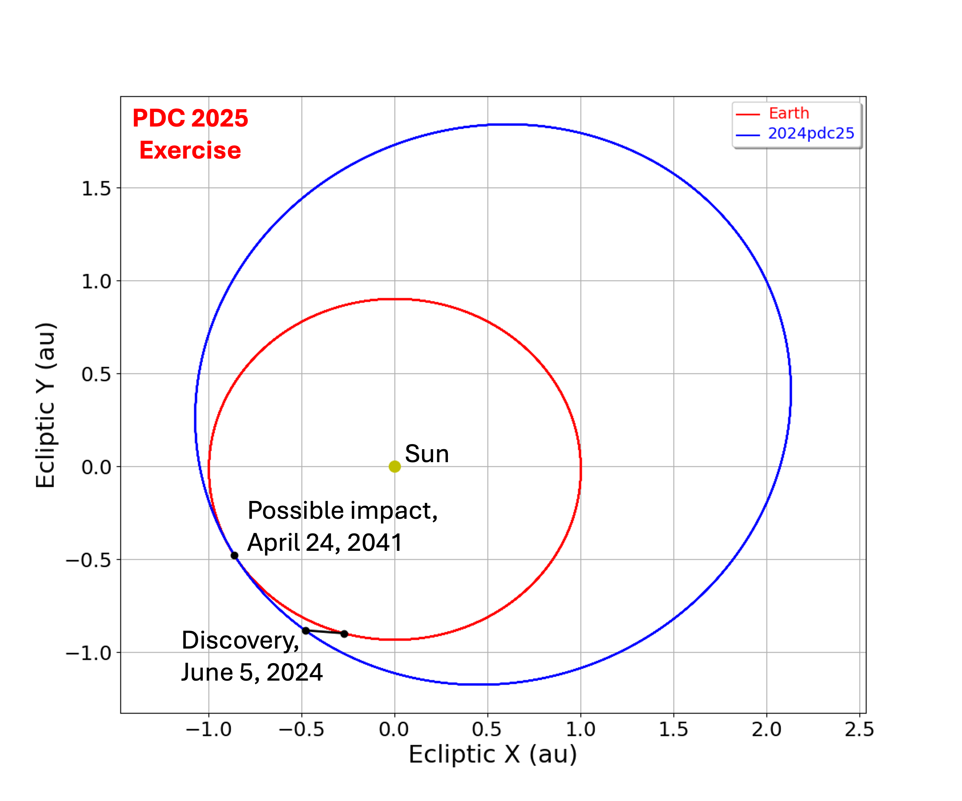
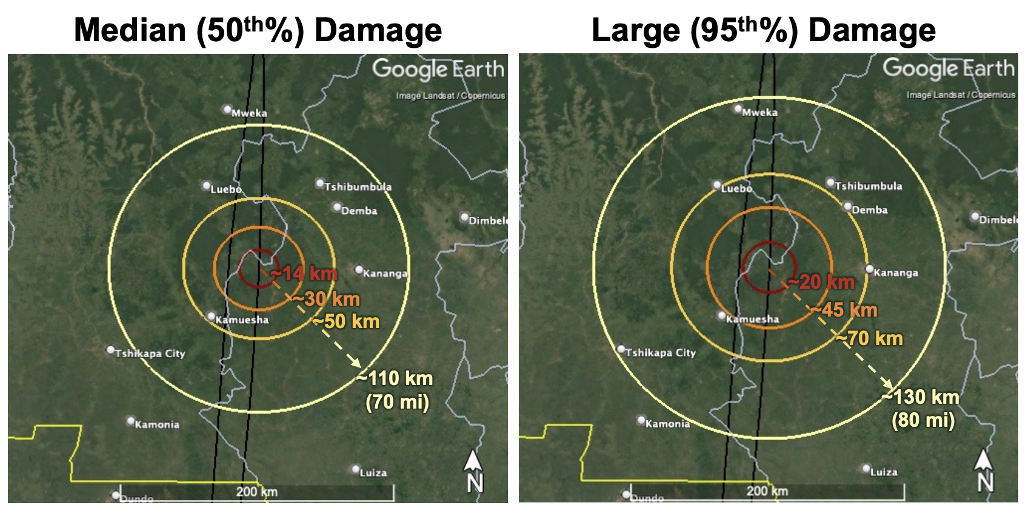
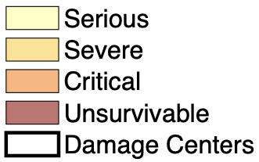
2024 PDC25
IAA-PDC-25-06-231
Large, long-warning threats
Hypothetical: 2024 PDC25 (~140 – 160 m)
Est. impact energy of 63 – 105 Mt
Discovered ~17 years before initial 1.6% impact probability
Asteroid and impact properties well-constrained ~13 years before 100% impact probability
Serious regional damage, out to ~100 – 120 km or further
[2] Wheeler et al, https://cneos.jpl.nasa.gov/pd/cs/pdc25
Notes:
1.
In this meeting’s hypothetical asteroid impact scenario, we meet 2024 PDC25 and are tasked with creating a future in which it doesn’t hit us.
With a discovery date 17 years ahead of Earth impact, there’s ample time to consider our fate, though we’d like to act as quickly as possible.
And with an estimated diameter between 140 to 160 m, and density ranging from 1.6 – 2.7 g/cc, PI could be used in either of its extended warning modes--for intentional robust disruption or enhanced deflection--to mitigate the threat of otherwise potential regional devastation.
This would be achievable with a single preexisting launcher, with the added benefit of requiring less mass off the launch pad AND enabling faster response than traditional deflection.
It would seem plausible that the four years between Epochs 1 and 2 could provide enough time for rapid development of PI, leading to operational status by the time the asteroid’s characteristics are fully constrained.
2

Slide 8
IAA-PDC-25-06-231
To play devil’s advocate…
What if we don’t have 17 years of warning time?
Notes:
To play devil’s advocate, though…
- What if a situation arose where we DON’T have extended warning?

Slide 9

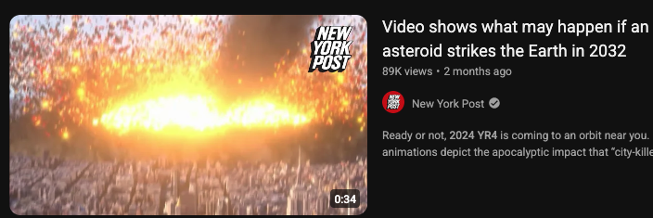
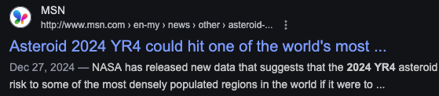
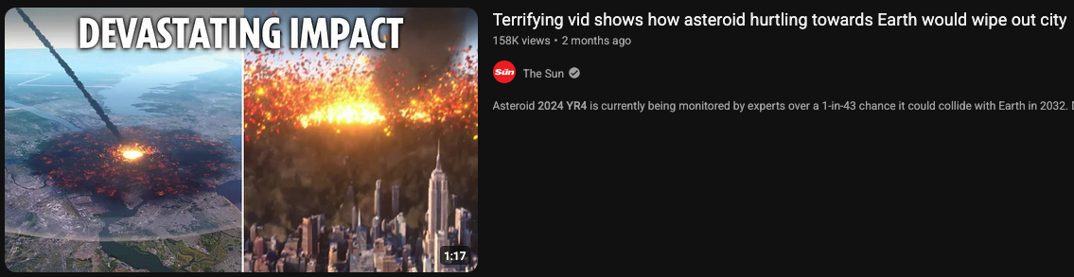
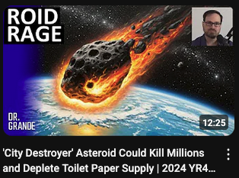
To play devil’s advocate…
What if we don’t have 17 years of warning time?
What if we had another 2024 YR4 situation on our hands, but its impact probability didn’t drop to zero?
?
Notes:
1.
What if…we did stumble into a short-warning discovery of an incoming object, similar to asteroid 2024 YR4’s recent close approach, but a non-zero impact probability were to persist? It’s not uncommon for small bodies to be discovered close to or after a close approach, particularly when coming from the direction of the sun.
And you and I know that these threats can be dealt with, but much of the general population might not.
*ANIMATIONS*
In the unlikely, but not impossible, event that we are faced with relatively short warning of an impact, what preventative measures could we develop? Other than *ANIMATION* stocking up on toilet paper, for some reason…

Slide 10
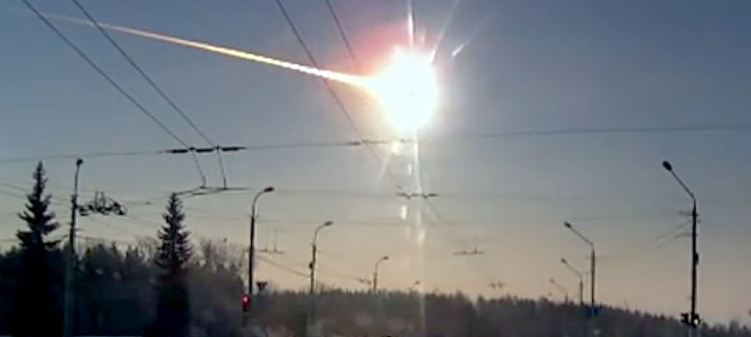
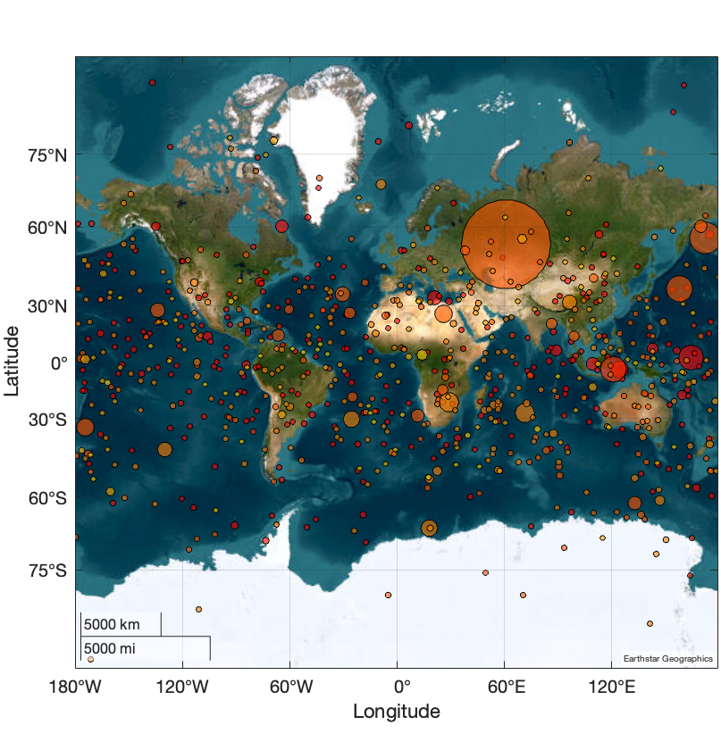
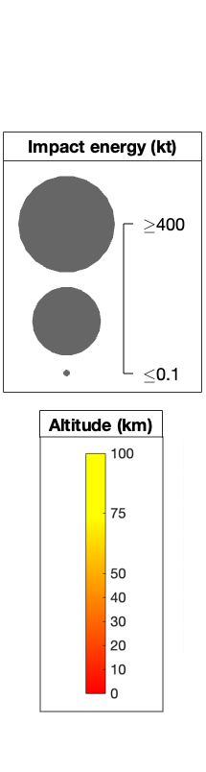
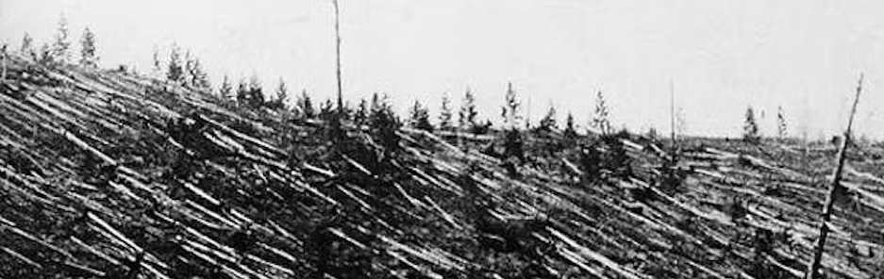
What is needed?
Small, short-warning threats
Fireballs reported by US Government sensors
April 1988–March 2023
Image: Youtube/Tuvix72
Chelyabinsk, 2013 (18 m)
Est. impact energy of 500 ± 100 kt
Damage out to 120 km
Impact interval: 50–100 years
Image: Leonid Kulik
Tunguska, 1908 (~40–50 m?)
Est. impact energy of 3–15 Mt
Damage spanning 2000 km²
Impact interval: 300–500 years (3–5 Mt) to 800–1800 years (10–15 Mt)
[1] Alan B. Chamberlin (JPL/Caltech), https://cneos.jpl.nasa.gov/fireballs/
Notes:
1.
In practice, we’ve seen that kinetic impact is a tried-and-true method, as the DART mission showed us in a tremendous breakthrough for planetary defense.
Though, presently, deflection is the ONLY method which has been reliably put into practice.
And in a real mitigation scenario, a deflection mission hinges largely on time: an object's discovery must give us enough time to design and launch a mission to deflect it relatively far ahead of its impact-- which is on the scale of years, if not decades.
3. Motivation (transition to next slide)
As such, current PD strategies are not necessarily well-equipped to combat a wide range of possible threats, particularly in the short-warning regime where there is little to no time before impact

Slide 11
What is needed?
Small, short-warning threats
Fireballs reported by US Government sensors
April 1988–March 2023
Image: Youtube/Tuvix72
What is needed?
Fail-safe mitigation strategy for short-warning, “worst-case” scenarios
Chelyabinsk, 2013 (18 m)
Est. impact energy of 500 ± 100 kt
Damage out to 120 km
Impact interval: 50-100 years
Image: Leonid Kulik
Tunguska, 1908 (~40-50 m?)
Est. impact energy of 3-15 Mt
Damage spanning 2000 km²
Impact interval: 300-500 years (3-5 Mt) to 800-1800 years (10-15 Mt)
[1] Alan B. Chamberlin (JPL/Caltech), https://cneos.jpl.nasa.gov/fireballs/
Notes:
1.
So, what would we need to remedy these issues? Well,
1. We could append an existing strategy or introduce a new one with the capacity to mitigate short-warning threats, in the event that an object is detected with little time before impact. A failsafe for a sort of “worst-case” scenario.
To achieve this, we would need:
2.

Slide 12
What is needed?
Small, short-warning threats
Fireballs reported by US Government sensors
April 1988–March 2023
Image: Youtube/Tuvix72
What is needed?
Fail-safe mitigation strategy for short-warning, “worst-case” scenarios
Rapid, at-the-ready capability
Chelyabinsk, 2013 (18 m)
Est. impact energy of 500 ± 100 kt
Damage out to 120 km
Impact interval: 50-100 years
Image: Leonid Kulik
Tunguska, 1908 (~40-50 m?)
Est. impact energy of 3-15 Mt
Damage spanning 2000 km²
Impact interval: 300-500 years (3-5 Mt) to 800-1800 years (10-15 Mt)
[1] Alan B. Chamberlin (JPL/Caltech), https://cneos.jpl.nasa.gov/fireballs/
Notes:
An operation with rapid, at-the-ready capability, which ideally relies on pre-existing technologies, such as launch vehicles and bases
Realistically then, in a scenario where every second counts: the less moving parts we have, the better. Decreased complexity translates to a decreased likelihood for error. Then,

Slide 13
What is needed?
Small, short-warning threats
Fireballs reported by US Government sensors
April 1988–March 2023
Image: Youtube/Tuvix72
What is needed?
Fail-safe mitigation strategy for short-warning, “worst-case” scenarios
Rapid, at-the-ready capability
Single-launcher solution
Chelyabinsk, 2013 (18 m)
Est. impact energy of 500 ± 100 kt
Damage out to 120 km
Impact interval: 50-100 years
Image: Leonid Kulik
Tunguska, 1908 (~40-50 m?)
Est. impact energy of 3-15 Mt
Damage spanning 2000 km²
Impact interval: 300-500 years (3-5 Mt) to 800-1800 years (10-15 Mt)
[1] Alan B. Chamberlin (JPL/Caltech), https://cneos.jpl.nasa.gov/fireballs/
Notes:
A single-launcher solution, which requires only one vehicle for mitigation of smaller-end objects, would be ideal.
In summary then,

Slide 14
What is needed?
Small, short-warning threats
Fireballs reported by US Government sensors
April 1988–March 2023
Image: Youtube/Tuvix72
What is needed?
Fail-safe mitigation strategy for short-warning, “worst-case” scenarios
Rapid, at-the-ready capability
Single-launcher solution
Simple, highly effective methodology
Chelyabinsk, 2013 (18 m)
Est. impact energy of 500 ± 100 kt
Damage out to 120 km
Impact interval: 50-100 years
Image: Leonid Kulik
Tunguska, 1908 (~40-50 m?)
Est. impact energy of 3-15 Mt
Damage spanning 2000 km²
Impact interval: 300-500 years (3-5 Mt) to 800-1800 years (10-15 Mt)
[1] Alan B. Chamberlin (JPL/Caltech), https://cneos.jpl.nasa.gov/fireballs/
Notes:
We desire a method that is simple in execution and highly effective in practice.

Slide 15
What is needed?
Large, long-warning threats
What is ideal?
Multi-modal mitigation strategy
  Small, short-warning, “worst-case” threats
  Large, long-warning, regional threats
Rapid, at-the-ready capability
Single-launcher solution
Simple, highly effective methodology
Hypothetical: 2024 PDC25 (~150–160 m)
Est. impact energy of 63–105 Mt
Discovered 17 years before initial ~1.6% impact probability
Asteroid and impact properties well-constrained 13 years before 100% impact probability
Serious regional damage, out to ~100–120 km or further
[2] Wheeler et al, https://cneos.jpl.nasa.gov/pd/cs/pdc25
Notes:
The question becomes: Can we append existing planetary defense technologies with a new approach that relies on a relatively simple, reusable infrastructure, that can provide reasonable mitigation of a wide variety of threats, including those in the long- AND short-warning regimes?

Slide 16
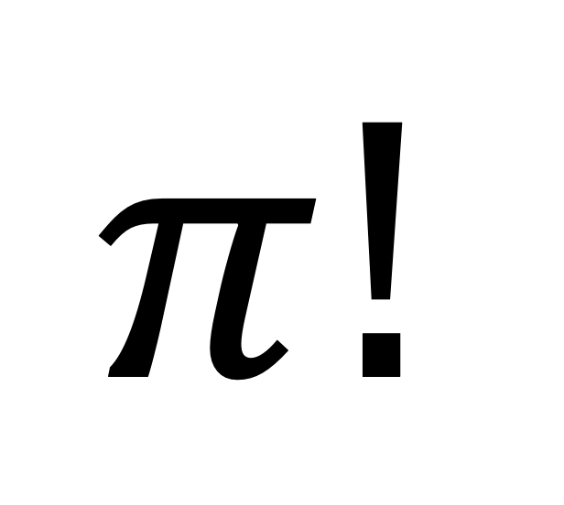
What is needed?
Large, long-warning threats
$$π!$$
What is ideal?
Multi-modal mitigation strategy
  Small, short-warning, “worst-case” threats
  Large, long-warning, regional threats
Rapid, at-the-ready capability
Single-launcher solution
Simple, highly effective methodology
Hypothetical: 2024 PDC25 (~150–160 m)
Est. impact energy of 63–105 Mt
Discovered 17 years before initial ~1.6% impact probability
Asteroid and impact properties well-constrained 13 years before 100% impact probability
Serious regional damage, out to ~100–120 km or further
[2] Wheeler et al, https://cneos.jpl.nasa.gov/pd/cs/pdc25
Notes:
Well, we think so!

Slide 17
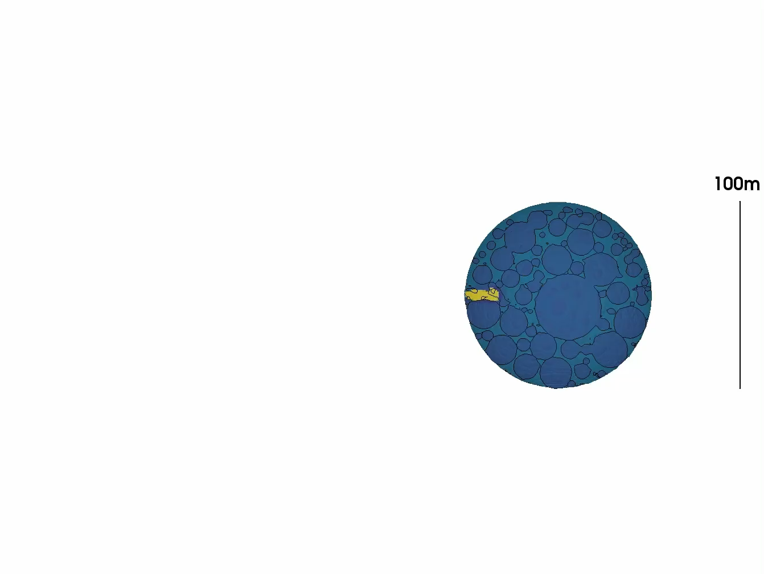
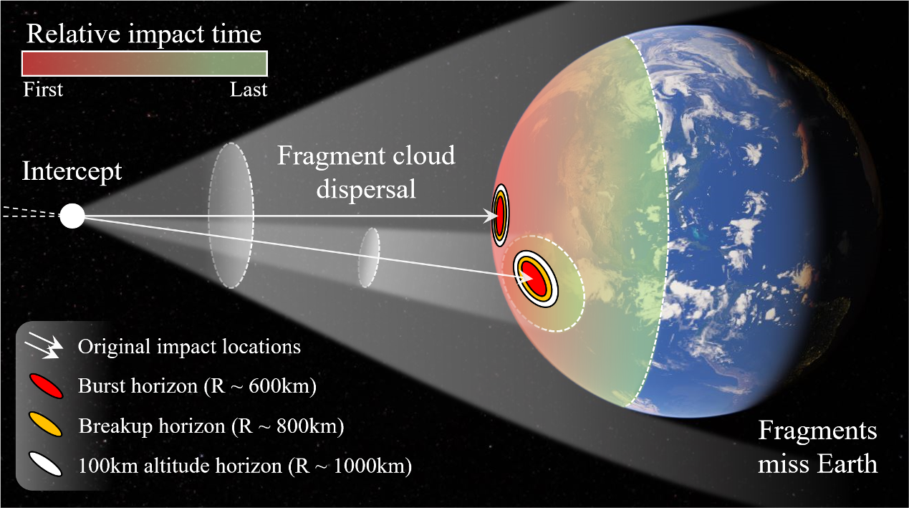
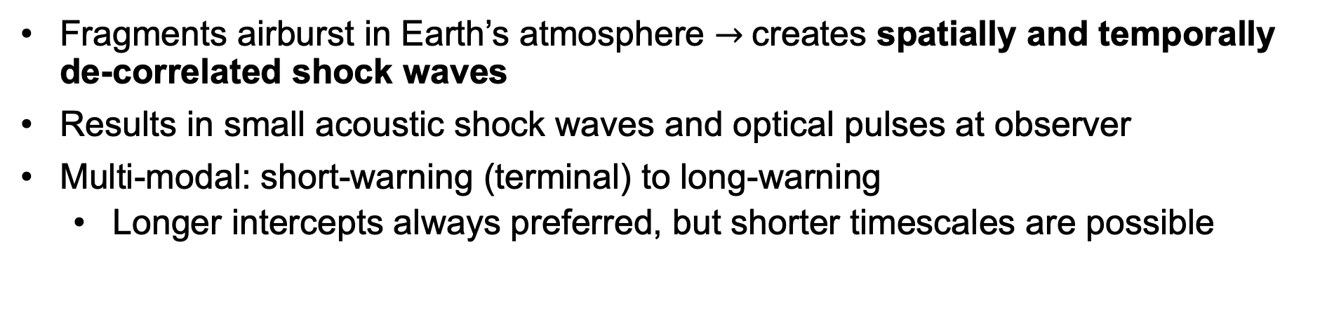
Short-warning mode: fragmentation distributes energy
IAA-PDC-25-06-231
Fragments airburst in Earth’s atmosphere $→$creates spatially and temporally de-correlated shock waves
Results in small acoustic shock waves and optical pulses at observer
Multi-modal: short-warning (terminal) to long-warning
  Longer intercepts always preferred, but shorter timescales are possible
100 m rubble-pile asteroid
2500 kg penetrator (Falcon 9) at 20 km/s
Notes:
1. Introducing PI
PI fills all these boxes and represents a versatile, multi-modal approach that could be used in a wide variety of scenarios, spanning warning time and threat size
In longer-warning scenarios, where an impact is months or years away, the fragments can miss Earth entirely, completely removing the threat.
Depending on an asteroid’s size and speed, a short-warning mitigation scenario, or "terminal" scenario, could be feasible. The fragment cloud would then enter Earth’s atmosphere, where it would disperse the energy of the original asteroid into optical flashes and de-correlated shock waves of acceptably low magnitude.

Slide 18
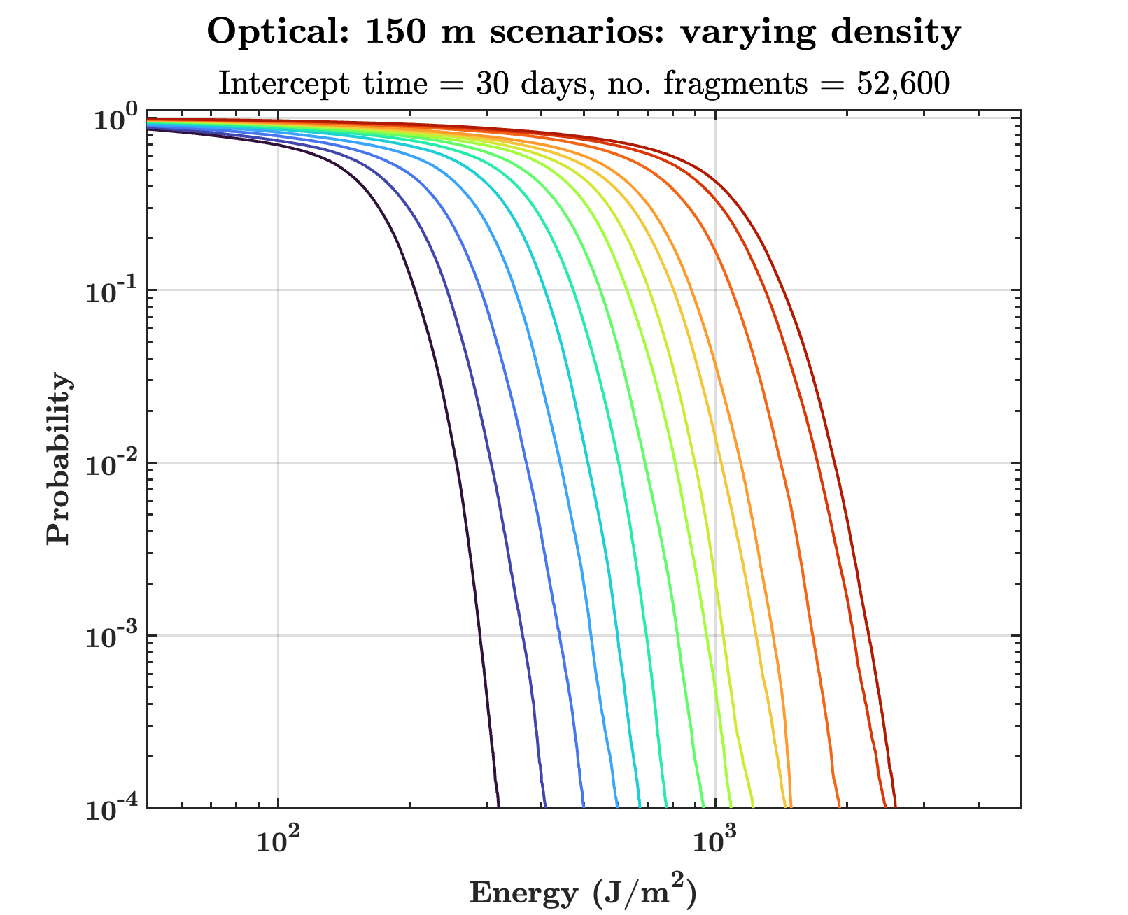
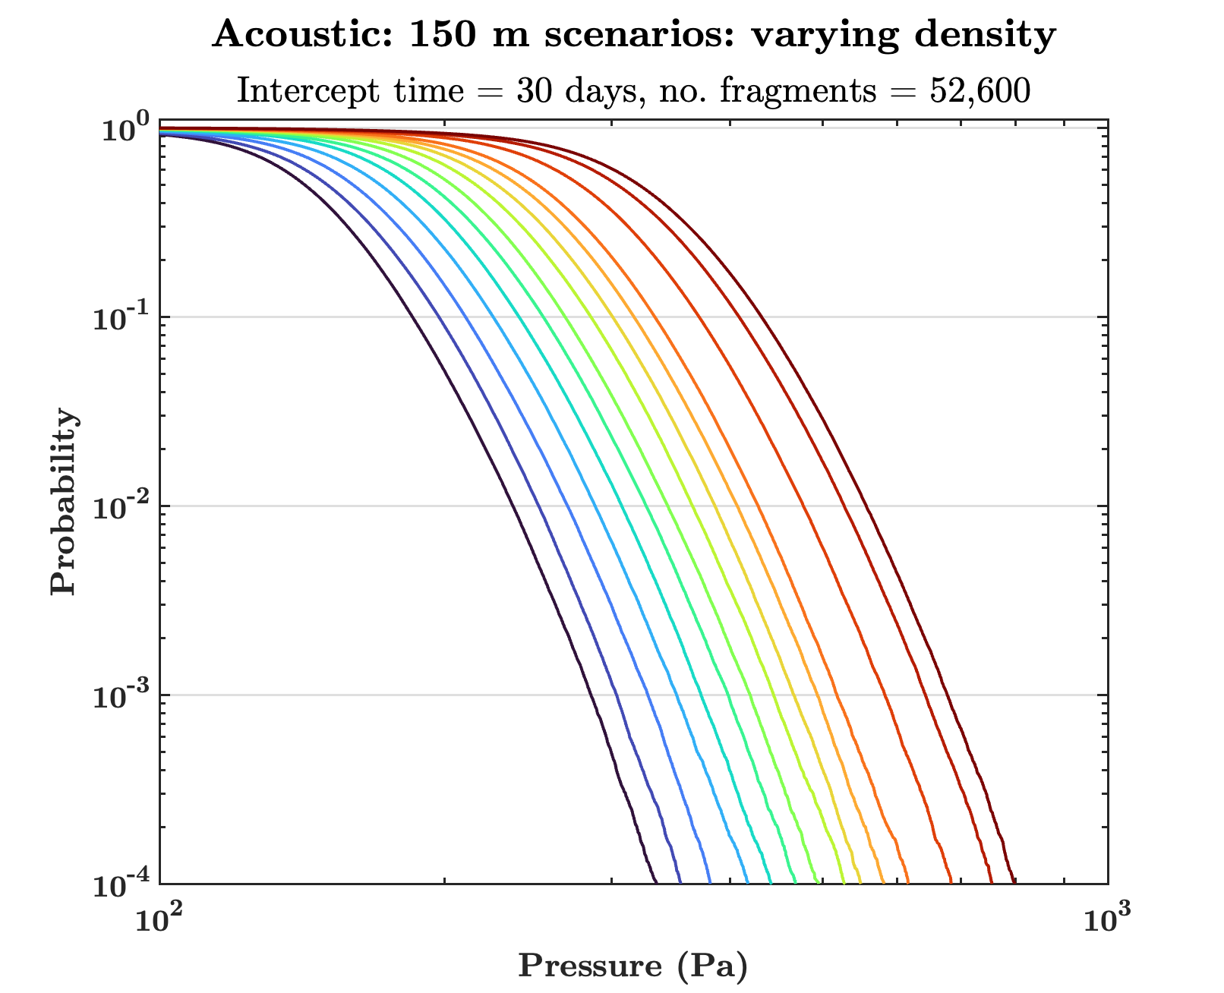
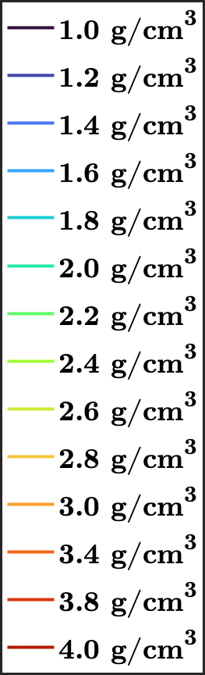
Ground effects of 2024 PDC25: 150 m estimate
IAA-PDC-25-06-231
v_{exo} = 13.725 km/s, entry angle = 69°
No. fragments = 52,600, avg. fragment size = 4.00 m
Intercept time = 30 days prior to impact
Varying average density
Optical
Acoustic
Notes:
1.
And– although we don’t recommend it– we find that even terminal mitigation of our hypothetical asteroid would yield optical and acoustic effects with acceptably low damage as experienced on the ground.
These plots show the cumulative distribution functions of the optical energy and acoustic over-pressure in an extreme scenario in which we intercept a 150 m asteroid just 30 days before Earth impact. The various colors dictate different average densities spanning 2024 PDC25’s estimated density range.
This is an extremely conservative example – it is highly improbable that an object of this size would be discovered late enough to necessitate a terminal mitigation effort.
Increasing the intercept time by just several months would be enough to spread the fragment cloud wider than Earth’s diameter, leading to no ground effects at all.
But, we simulate these extreme cases here to show that it would be possible.

Slide 19



Conclusion
IAA-PDC-25-06-231
brittanybailey@ucsb.edu
Effective multi-modal planetary defense method for a wide range of threat scenarios (20 – 1000 m diameter)
  First PD strategy for short-warning threats
  Much faster response time and much less launch mass than other methods
Path towards a single-launcher solution with at-the-ready capability
  Goal: PI becomes synergistic with existing mitigation strategies (such as deflection), which may be logistically favorable in some threat scenarios (particularly those with especially long warning times)
Website and recent papers
UCSB Deepspace Group
PI project page
March 2025 publication in
The Astrophysical Journal
August 2024 publication in
Acta Astronautica
www.deepspace.ucsb.edu
doi:10.3847/1538-4357/adb289
doi:10.1016/j.actaastro.2024.05.002
Notes:
To conclude, PI represents an effective, multi-modal method for planetary defense that could prove useful in a wide range of threat scenarios, spanning both asteroid size and warning time
Represents the first PD strategy that is capable for use against short-warning threats
It allows for a logical roadmap towards a robust planetary defense system, creating a single-launcher solution with at-the-ready capability
I have linked here some of our recent papers
Thank you so much for your attention, and I would be happy to take any questions.

