Slide 1

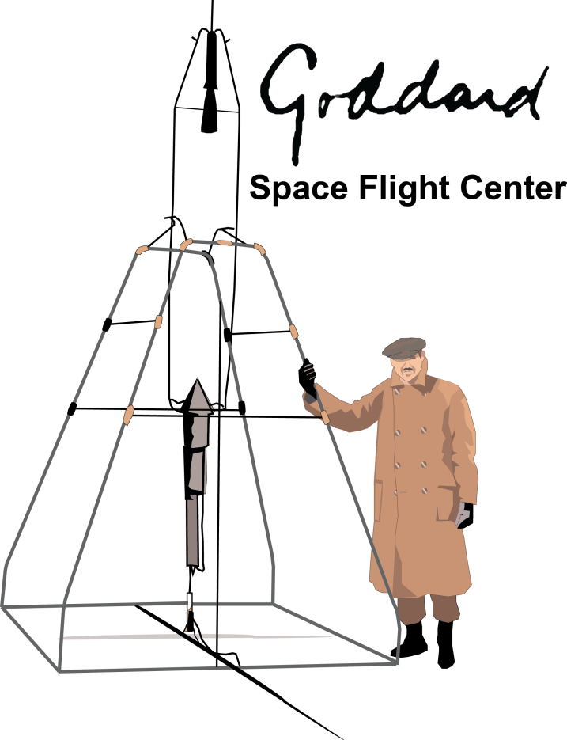
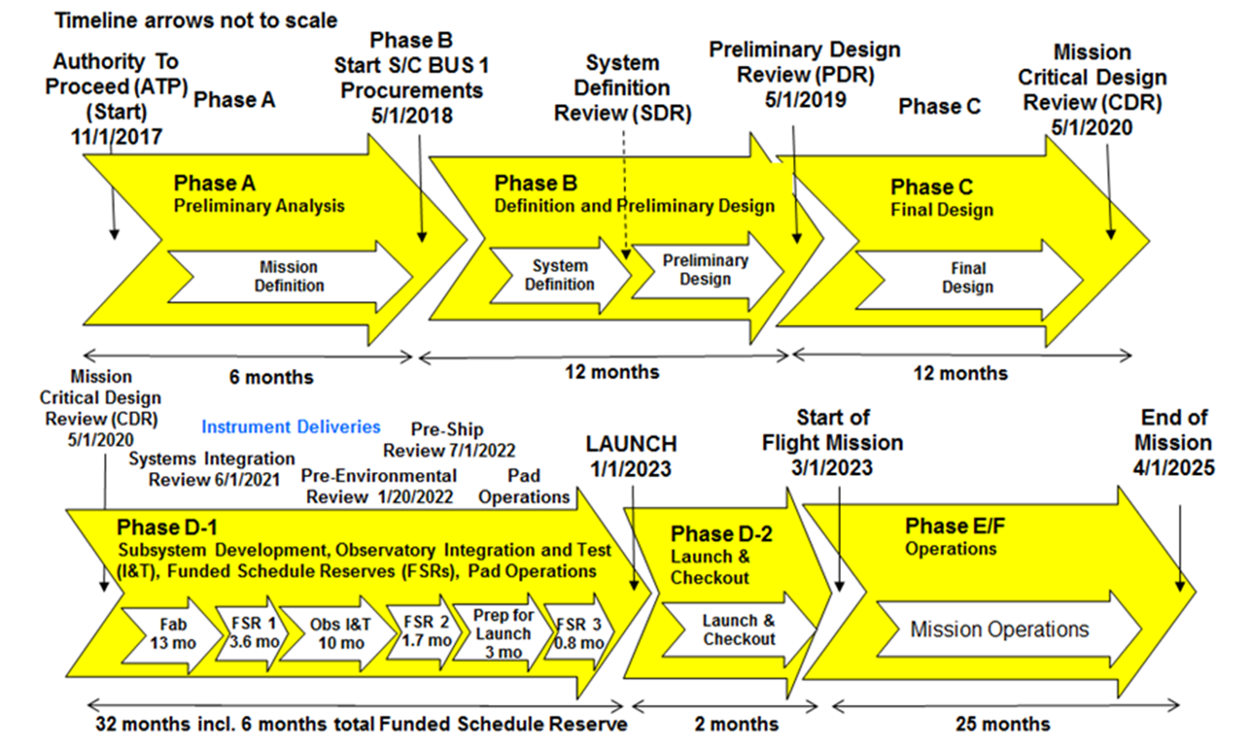

RAPID RESPONSE TO AN IMMINENT THREAT.
Joseph A. Nuth IIIª, Brent W. Barbee^{b} and Joshua R. Lyzhoft^{b}
ªNASA’s Goddard Space Flight Center, Solar System Exploration Division, Code 690, Greenbelt MD 20771, USA 301-286-9467
^{b}NASA’s Goddard Space Flight Center, Navigation and Mission Design Branch, Code 595, Greenbelt MD 20771 USA, 301-286-1837
With the upcoming launch of NEO Surveyor and new Survey Telescopes coming online, we can now find most threats. What should be the next high priority for Planetary Defense?
Designing, Building, Testing and Launching Spacecraft
NASA, ESA, JAXA and other space agencies have developed rules and standard practices to increase the probability of Mission Success.
Shown below is a typical timeline for a Planetary Science Mission that DOES NOT include the preliminary studies to set the Objectives, or the Instrument Specifications required to meet these objectives.
Using standard procedures, it could take more than 5 years from the time we receive the authority to proceed until a spacecraft is launched.
Short Warning Time Threats are the Stressing Case for Planetary Defense
Asteroid 2024 YR4 was discovered in December 2024 and rose to more than a 3% probability of impacting the Earth in 2032 before additional observations more precisely defined its orbit and retired the threat.
Comet Siding Spring, a long period comet discovered on Jan. 3, 2013, dropped into the inner solar system from the celestial pole, just missed Mars on October 19, 2014, and could easily have targeted Earth.
If either of these threats had progressed to the point of requiring a reconnaissance or mitigation spacecraft mission, the probability of success would have been low, as very little time was available to design, build, test and launch a new spacecraft.
Recommendations to Reduce Reaction Time
Build a simple reconnaissance spacecraft and put it into storage (with periodic testing). This could document the threat’s orbit, shape, spin axis and rotation rate to enable the most effective mitigation mission (and can determine if mitigation is actually required).
Build a mitigation spacecraft that could be either a Kinetic Impactor or carry a Nuclear Explosive Device and put the spacecraft into storage (with periodic testing). This could quickly be adapted to appropriately respond to a threat.
Build duplicate spacecraft to mitigate against possible launch failures.
Building high reliability spacecraft can be done prior to need, on a “normal” schedule, using established protocols for reviews & testing, thus maximizing the probability that flaws, and design errors will be detected prior to launch.
Stored spacecraft can be launched within a year or less, reducing reaction time to launch reconnaissance or mitigation missions by at least four years.
Periodically replace stored spacecraft to avoid obsolescence.
Release “old” spacecraft to the scientific community through the standard AO process for new, low-cost missions.
.
.
Launching within 6 Months of Authority to Proceed
The basic Mission Requirements for a reconnaissance mission do not depend on the specific asteroid or cometary threat.
Mission Requirements for a Kinetic Impactor or Nuclear Explosive Device mitigation mission only generically depend on the threat: the KI mass could be modularly adjusted by adding or removing ballast, and the NED device can be chosen to provide sufficient yield to encompass the uncertainty in the asteroid’s properties
Therefore, we can design and build generic reconnaissance and mitigation spacecraft before any specific threat is identified.
While these generic “quick-launch” spacecraft can respond to short warning time threats, they can also be used as the basis to respond to longer timescale impact threats.
How do we justify the expense for an impact threat response system that we hope to never use?
Safety systems are ubiquitous in modern society. The expense for these systems is typically a tiny fraction of the cost of the protected asset.
Fire suppression systems are required in public buildings.
Hard hats and other protective gear is mandatory at industrial facilities or construction sites.
Lifeboats are standard equipment on cruise ships.
What is the replacement cost for a village, town, city, nation, continent, civilization, or even the unsterilized surface of the Earth?
We only need a single response system to protect everything and everyone on our planet.
The cost of the recommended Planetary Defense system as a fraction of the value of the protected asset (the Earth) is trivial.
We know an impact is coming. The only questions are “When?” and “Will we be prepared?”
I told you we needed a Planetary Defense system!

