Slide 1



Ion-Beam Deflection Missions for the
2024 PDC25 Scenario
Paul Chodas¹, John Brophy¹, Matt Vavrina² and Brent Barbee²
⁽¹⁾ Jet Propulsion Laboratory, California Institute of Technology
⁽²⁾ NASA Goddard Space Flight Center
9th IAA Planetary Defense Conference,
Stellenbosch, Cape Town, S. Africa, May 5-9, 2025
© 2025 California Institute of Technology. Government sponsorship acknowledged.

Slide 2
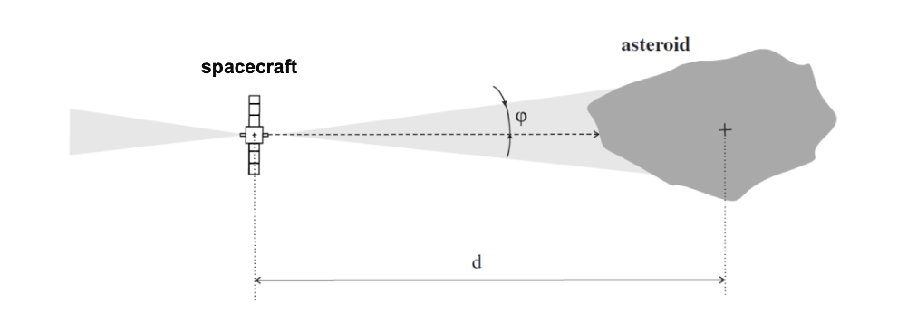
Ion-Beam Deflection (IBD) - Overall Concept
Rendezvous with a high-power SEP spacecraft & a large amount of xenon.
Hover 3-4 diameters away from the asteroid.
Continuously fire opposing ion thrusters, one beam directed at the asteroid.
Momentum of the impinging ions is transferred to the asteroid.
Over time, a considerable amount of momentum can be imparted to the asteroid without the possibility of disrupting it.

Slide 3
Ion-Beam Deflection - Advantages
IBD can deflect an asteroid trajectory in either direction
An IBD spacecraft can be positioned to optimize the deflection
IBD is highly predictable: its effectiveness does not depend on asteroid physical properties other than mass
  IBD spacecraft design is largely independent of asteroid physical properties
IBD does not require a separate rendezvous recon mission or an observer mission to monitor deflection progress
IBD effectiveness can be amplified via multiple spacecraft operating in parallel

Slide 4
Ion-Beam Deflection - Campaign Strategy
At Epoch 1 we recommended developing 1-2 modest 22kW IBD spacecraft
At Epoch 2 we analyzed two higher power IBD spacecraft models:
  46kW Purpose-Built IBD spacecraft modeled on the NASA Asteroid Redirect Robotic Mission (ARRM), modified with 3 pairs of NEXT-C thrusters gridded for low beam divergence (~5 degrees)
  Repurposed 60kW Gateway PPE IBD spacecraft with 7 thrusters total (3x AEPS & 4x BHT-6000) [Not discussed here: see paper for discussion of that option]
Large amount of extra propellant for deflection, e.g. 2000-5000 kg
Launches in the April 2029 -- April 2030 timeframe
  Development time would be only 4.5 - 5.5 years, which could be challenging

Slide 5
Rendezvous Trajectories for 46-kW IBD Spacecraft
Case | Launch Date | Arrival Date | Time of Flight [years] | Launch Mass [kg] | Delivered Mass to Asteroid [kg] | Xenon for Trajectory from Earth to Asteroid [kg] | Estimated Xenon for IBD ops [kg] | Total Estimated Xenon [kg] | Flyby sequence
Early1 | 2029-04-25 | 2032-04-27 | 3.01 | 10295 | 8863 | 1432 | 5199 | 6631 | Direct
Early2 | 2029-06-02 | 2032-06-04 | 3.01 | 9235 | 7855 | 1380 | 4191 | 5571 | Direct
Primary | 2029-10-03 | 2032-07-06 | 2.76 | 7399 | 5867 | 1532 | 2203 | 3735 | VGA
Backup | 2030-04-10 | 2032-10-01 | 2.48 | 6949 | 6239 | 710 | 2575 | 3285 | direct
Falcon Heavy Expendable launch vehicle
Choose missions that arrive before the Nov 2032 perihelion
IBD missions with later launches are possible but not considered here because deflection effectiveness would be reduced by ~40% and the number of required spacecraft would nearly double

Slide 6
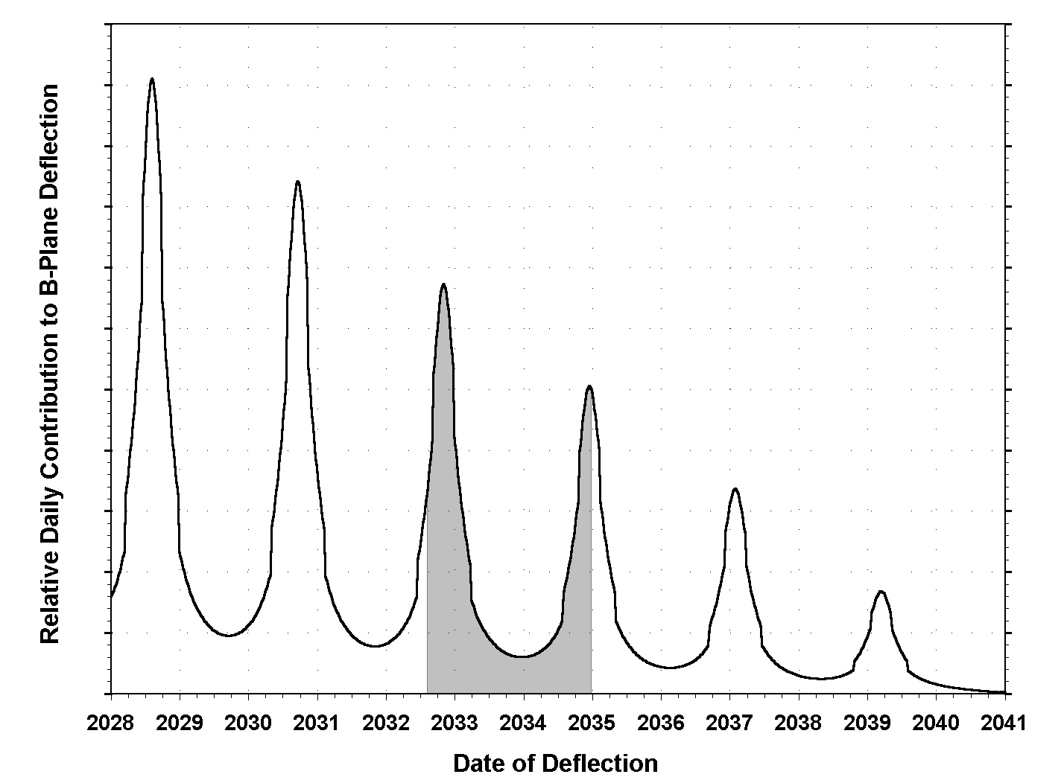
Ion-Beam Deflection Efficiency vs. Time for 46kW Spacecraft
Plot shows relative daily contribution to p-plane deflection as a function of time
Peak contributions occur at perihelia, when both power levels and deflection leverage maximize
This spacecraft design has enough power to continue deflections all the way around the orbit
The total b-plane deflection is the integral under the curve over the deflection arcs: e.g. the area of the shaded region
2032 Perihelion
2034 Perihelion
2037 Perihelion

Slide 7
Ion-Beam Deflection Simulations - Outline of Results
Simulations run for 3 different deflection goals:
  Northward off the Earth
  Southward off the Earth
  Southward Partial Deflection
Each simulation calculates the IBD mission’s deflection capability, the number of IBD spacecraft and the completion dates
Deflection thrusting arcs are optimized for early completion.
Results presented for 3 realizations of the asteroid:
Low Mass, 50th %tile Mass, and High Mass

Slide 8

2024 PDC25: Three Deflection Goals at Epoch 2
Northward Deflection:
7370 km
Partial Southward Deflection:
5046 km
Full Southward Deflection:
15352 km
Impact
Region
Partial Deflection Target
Earth image unrolled into B-plane

Slide 9
46kW IBD Spacecraft: Results for Northward Deflection
Mission: | Early1 | Early2 | Primary | Backup
Launch | 4/25/2029 (5.5 mo. earlier) | 6/2/2029 (4.2 mo. earlier) | 10/3/2029 | 4/10/2030 (6.2 mo. later)
Arrival | 4/27/2032 | 6/4/2032 | 7/6/2032 | 10/1/2032
Asteroid Mass %ile: | Required Number of Launches & Completion Dates:
Low | 1 Mar 2034 | 1 Jun 2034 | 1 Aug 2034 | 1 Dec 2034
50th | 1 Oct 2036 | 1 Nov 2036 | 2 Jun 2034 | 2 Dec 2034
High | 2 Feb 2035 | 2 Mar 2035 | 2 Apr 2035 | 2 Dec 2036
Deflection begins
1 month after arrival
1 or 2 IB spacecraft could successfully deflect northwards

Slide 10
46kW IBD Spacecraft: Results for Southward Deflection
Mission: | Early1 | Early2 | Primary | Backup
Launch | 4/25/2029 (5.5 mo. earlier) | 6/2/2029 (4.2 mo. earlier) | 10/3/2029 | 4/10/2030 (6.2 mo. later)
Arrival | 4/27/2032 | 6/4/2032 | 7/6/2032 | 10/1/2032
Asteroid Mass %ile: | Required Number of Launches & Completion Dates:
Low | 1 Feb 2037 | 1 Mar 2037 | 2 Sep 2034 | 2 Jan 2035
50th | 2 Dec 2036 | 2 Jan 2037 | 3 Dec 2034 | 3 Jul 2035
High | 3 Mar 2037 | 3 Apr 2037 | 4 Jul 2035 | 4 Jan 2037
Deflection begins
1 month after arrival
2-4 IB spacecraft would be needed to successfully deflect southwards

Slide 11
46kW IBD Spacecraft: Results for Partial Southward Deflection
Mission: | Early1 | Early2 | Primary | Backup
Launch | 4/25/2029 (5.5 mo. earlier) | 6/2/2029 (4.2 mo. earlier) | 10/3/2029 | 4/10/2030 (6.2 mo. later)
Arrival | 4/27/2032 | 6/4/2032 | 7/6/2032 | 10/1/2032
Asteroid Mass %ile: | Required Number of Launches & Completion Dates:
Low | 1 Jan 2033 | 1 Feb 2033 | 1 Mar 2033 | 1 Aug 2034
50th | 1 Nov 2034 | 1 Dec 2034 | 1 Dec 2034 | 1 Jun 2035
High | 1 Feb 2037 | 1 Mar 2037 | 2 Sep 2034 | 2 Jan 2035
Deflection begins
1 month after arrival
A single early-
launch IB spacecraft can achieve a partial southward deflection
In the top 10% of the cases by mass, another spacecraft is required to reach the target

Slide 12
IBD for 2024 PDC25: Summary
A single 46kW IBD spacecraft could achieve the partial southward deflection as long as it is launched early in 2029
If launched later in 2029, another IBD spacecraft would be needed to reach the partial deflection target if the asteroid was in the top 10% by mass
Deflecting northward off the Earth would likely require 2-3 IBD spacecraft.
Deflecting southward off the Earth would likely require 3-4 IBD spacecraft.

