Slide 1
THE INFLUENCE OF MICRO- VS MACROPOROSITY IN THE DEFLECTION OF RUBBLE-PILE ASTEROIDS
International Academy of Astronautics
Planetary Defense Conference
Stellenbosch, Cape Town, South Africa
May 5 – 9, 2025
S. E. Wiggins, J. M. Owen, K. M. Kumamoto, J. M. Pearl, C. D. Raskin
Lawrence Livermore National Laboratory

Slide 2
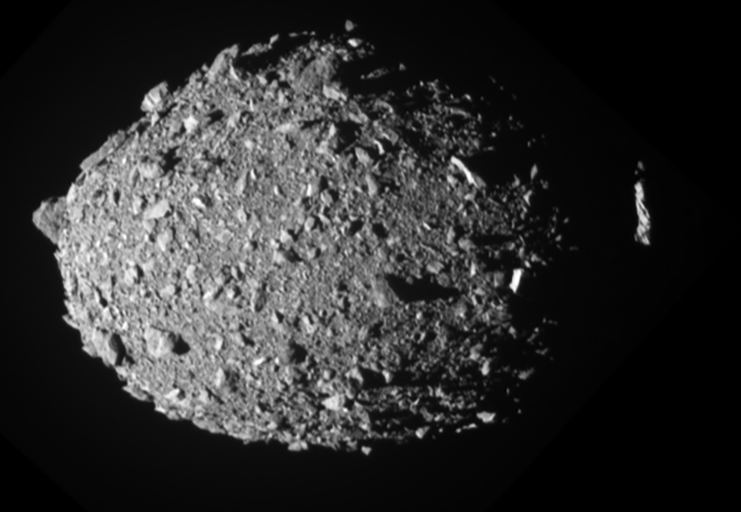
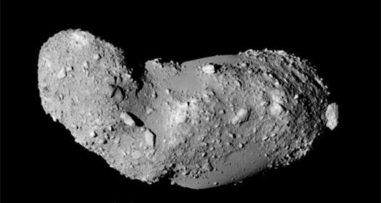
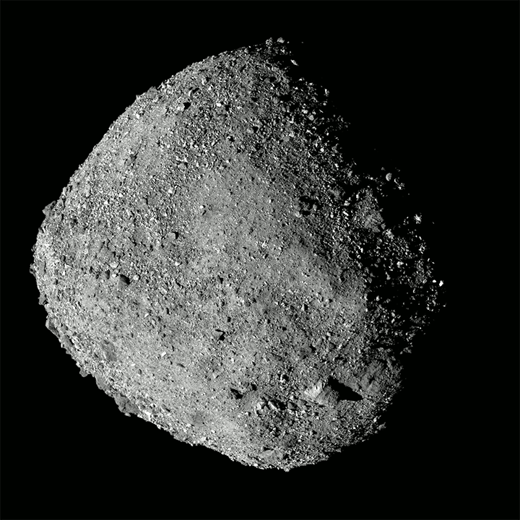
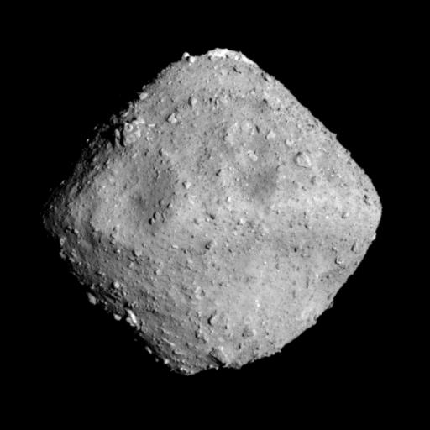
The Majority of Hazardous Asteroids Have a Rubble-Pile Structure
Itokawa Credit: JAXA
Bennu
Ryugu
Dimorphos Credit: NASA/Johns Hopkins APL
Credit: JAXA, University of Tokyo & collaborators
Credit: NASA/Goddard/Univ. of Arizona
It is widely known that pore space has a significant influence on the cratering process, including in the formation of ejecta.
Porosity therefore has a significant influence on how to deflect threatening asteroids.
Normally we model asteroid deflections using a uniform, unresolved implicit porosity.
How does the inclusion of explicit, resolved pore spaces change the creation of ejecta, and therefore the change in momentum of an asteroid that we want to deflect?

Slide 3
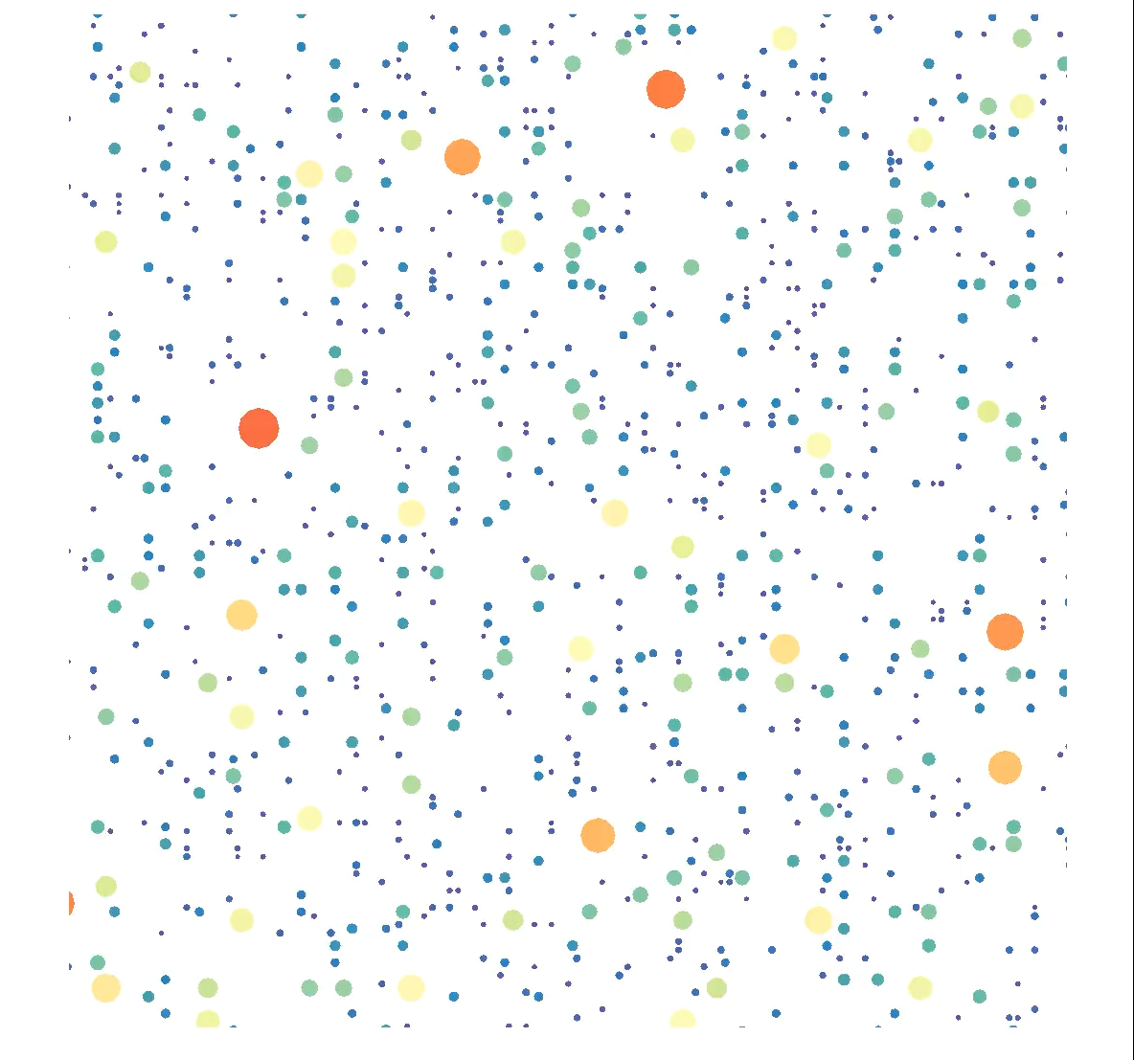
How We Form Rubble Piles
We begin by using the Discrete Element Method (DEM) to generate particles sized according to a size frequency distribution, in this case a Weibull distribution.
We then let these DEM particles accumulate via a gravitational potential of our desired shape.

Slide 4
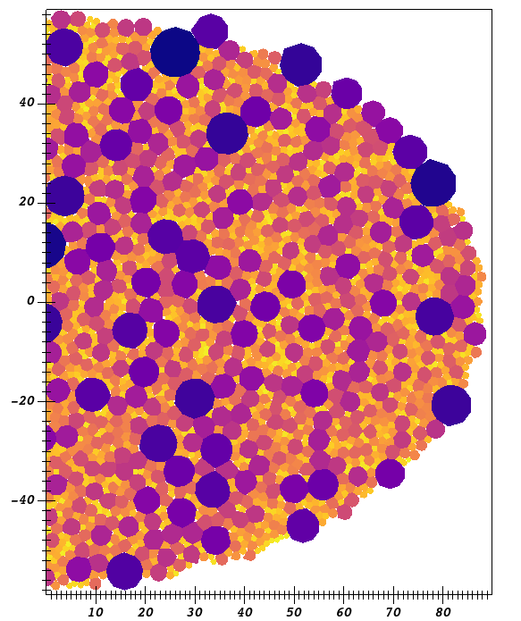
From DEM to SPH
We use a weighted Voronoi tessellation of DEM particle positions and expand the Voronoi cells until we are left with virtually no space left between boulders.
The Voronoi diagram is weighted by boulder radius to preserve the size distribution.
Since we are limiting our Voronoi to planar facets instead of curved, there are small gaps that remain between boulders.

Slide 5
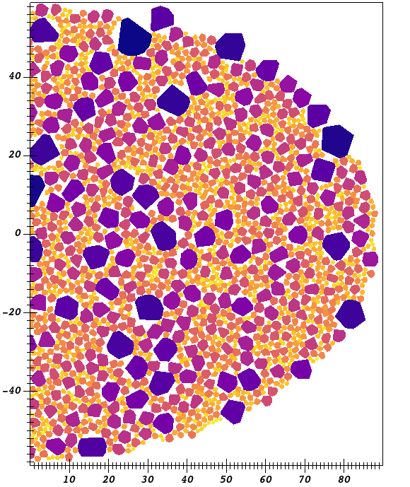
From DEM to SPH
We use a weighted Voronoi tessellation of DEM particle positions and expand the Voronoi cells until we are left with virtually no space left between boulders.
The Voronoi diagram is weighted by boulder radius to preserve the size distribution.
Since we are limiting our Voronoi to planar facets instead of curved, there are small gaps that remain between boulders.
To create explicitly resolved porosity each boulder gets clipped randomly from their furthest vertices, which shrinks each shape by the same percentage to create the desired overall void fraction.

Slide 6
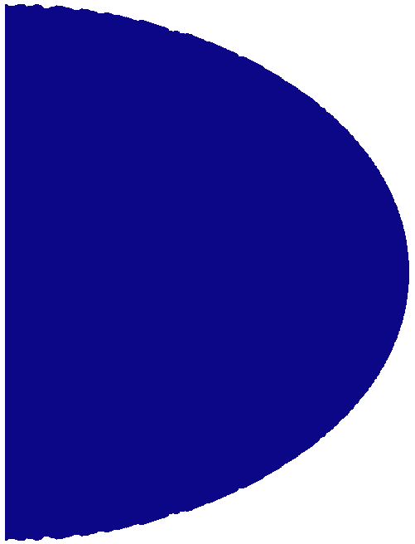
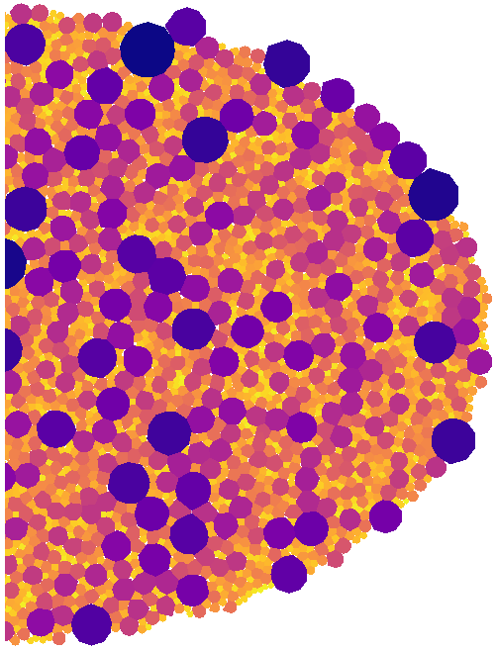

Different Porosity Distribution Initializations
There are 3 initial setup geometries we use for the rest of this talk. Each one has different internal interface structures, and therefore different ways to have porosity distributed.
Monolith
Fractured Monolith
Macroporous Body

Slide 7

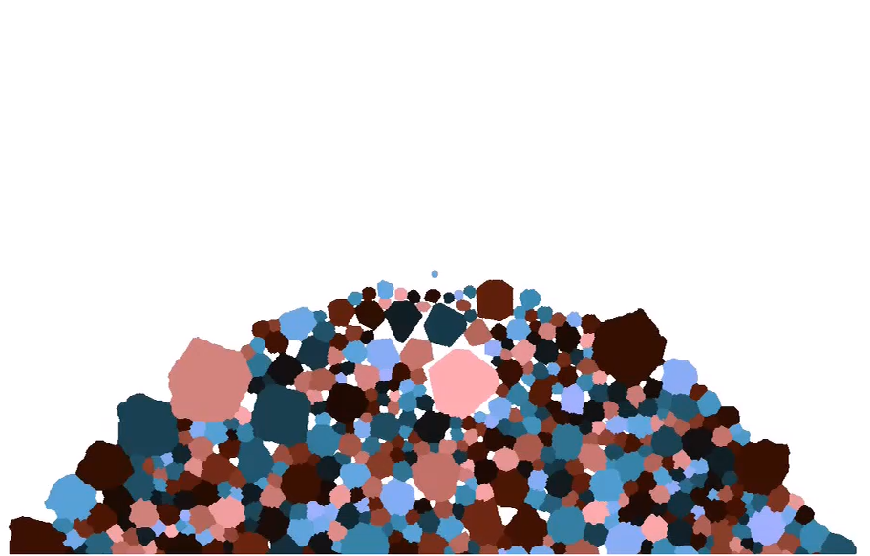
Pure Implicit Porosity vs Pure Explicit Porosity
Monolith
40% Implicit Porosity
Colored by Damage
Macroporous Body
40% Explicit Porosity
Colored by Damage

Slide 8
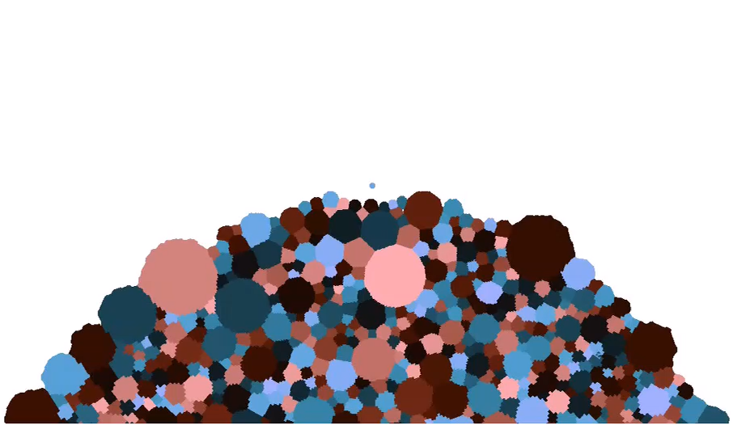
Monolith VS “Fractured Monolith”
Monolith
40% Implicit Porosity
Colored by Damage
Fractured Monolith
40% Implicit Porosity
Colored by Damage

Slide 9
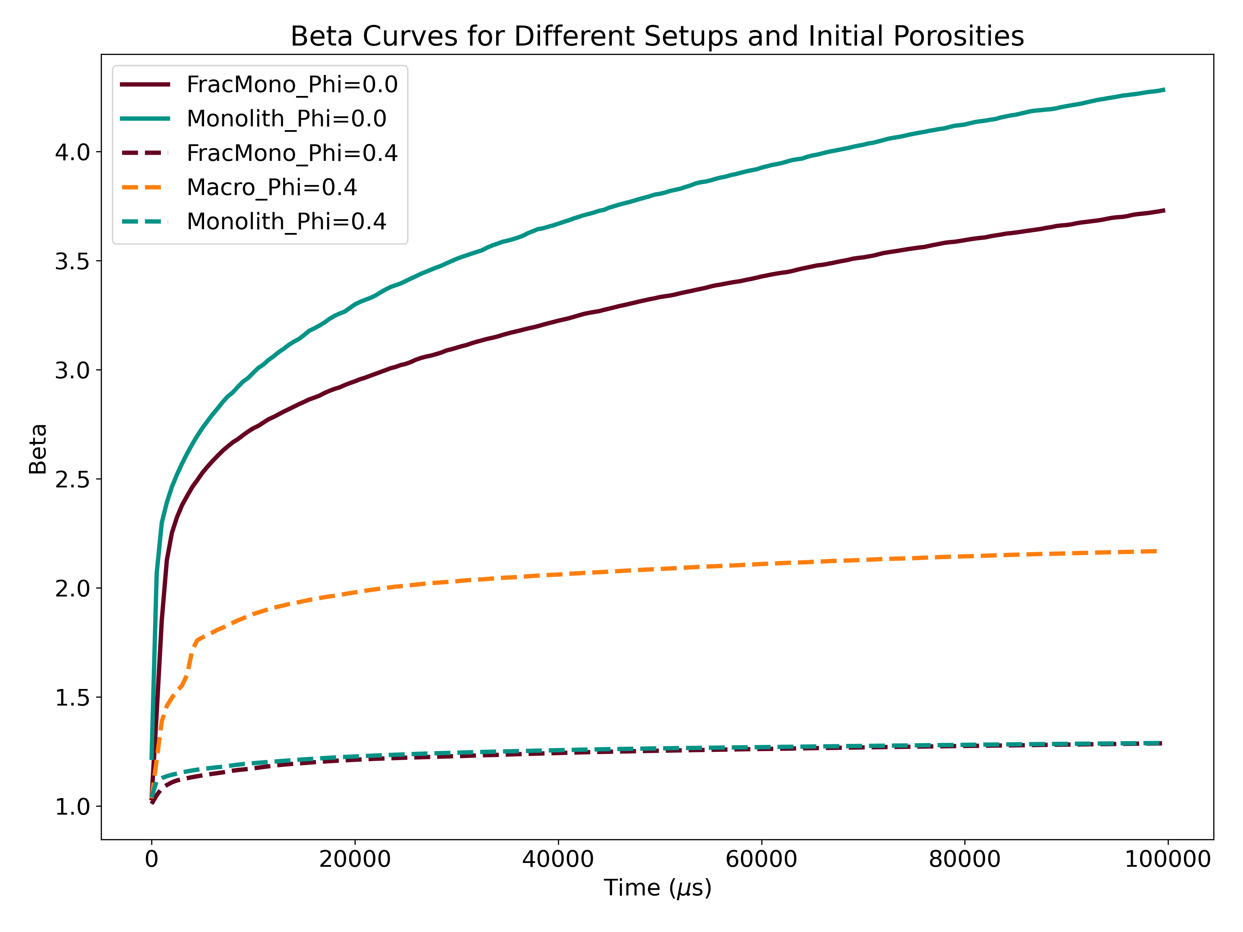
Beta Depends Heavily on the Porosity Distribution

Slide 10
Conclusions
The addition of porosity, no matter the implementation, reduces β.
We found that the inclusion of fracture surfaces reduces coupling between material, thus further reducing β.
The inclusion of explicit porosity does not reduce β as much as we anticipated, with macroporous bodies having higher β than simulations with the equivalent bulk density via implicit porosity.
These results are all early in the impact cratering process, and these β values are likely to change over longer run times.
These results are 2D, and therefore not to be interpreted quantitatively!
However, we do expect that in general these trends will hold in 3D.

Slide 11
This work was performed under the auspices of the U.S. Department of Energy by Lawrence Livermore National Laboratory under Contract DE-AC52-07NA27344.
Disclaimer
This document was prepared as an account of work sponsored by an agency of the United States government. Neither the United States government nor Lawrence Livermore National Security, LLC, nor any of their employees makes any warranty, expressed or implied, or assumes any legal liability or responsibility for the accuracy, completeness, or usefulness of any information, apparatus, product, or process disclosed, or represents that its use would not infringe privately owned rights. Reference herein to any specific commercial product, process, or service by trade name, trademark, manufacturer, or otherwise does not necessarily constitute or imply its endorsement, recommendation, or favoring by the United States government or Lawrence Livermore National Security, LLC. The views and opinions of authors expressed herein do not necessarily state or reflect those of the United States government or Lawrence Livermore National Security, LLC, and shall not be used for advertising or product endorsement purposes.

