Slide 1
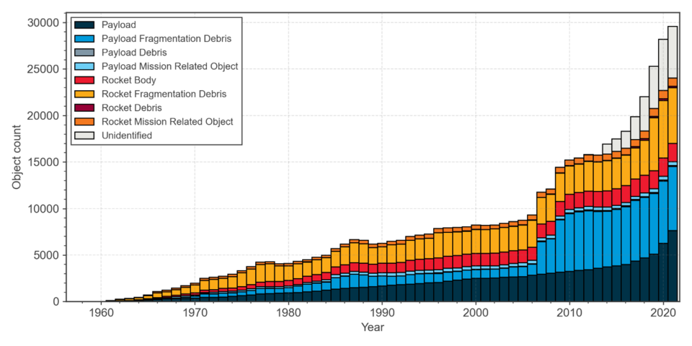
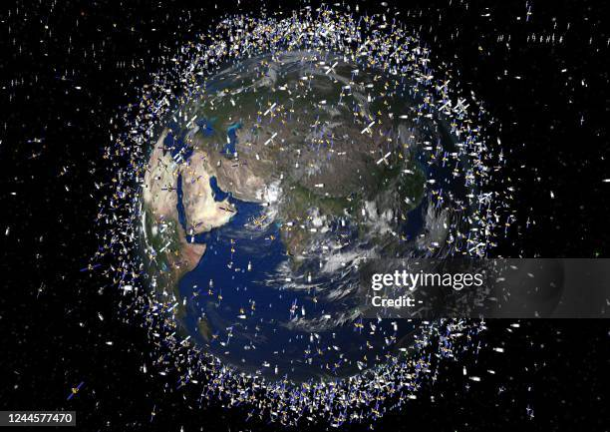
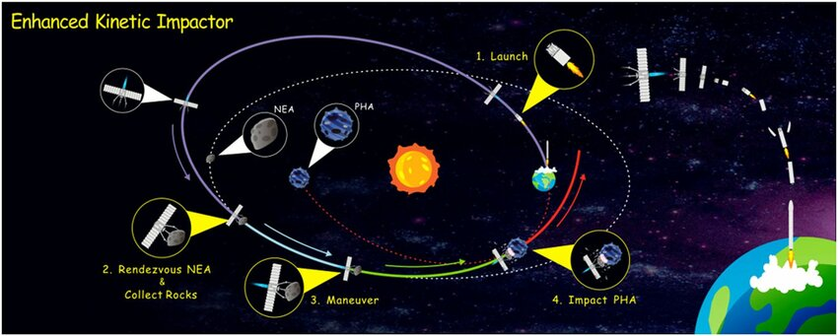
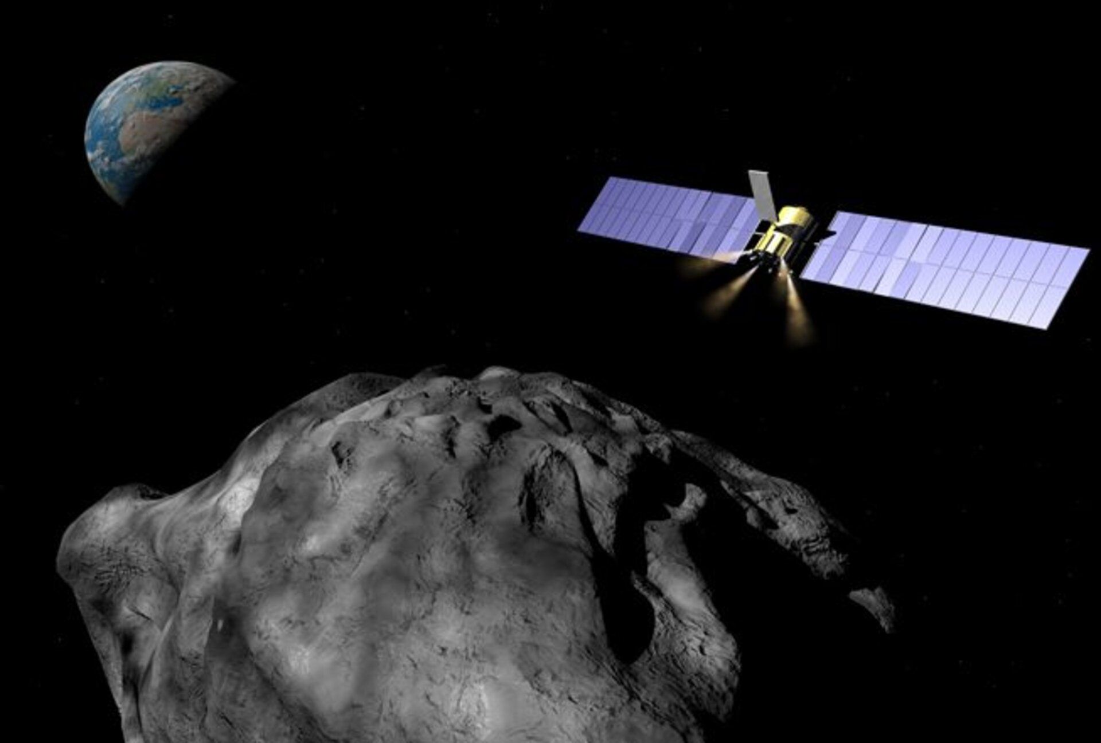
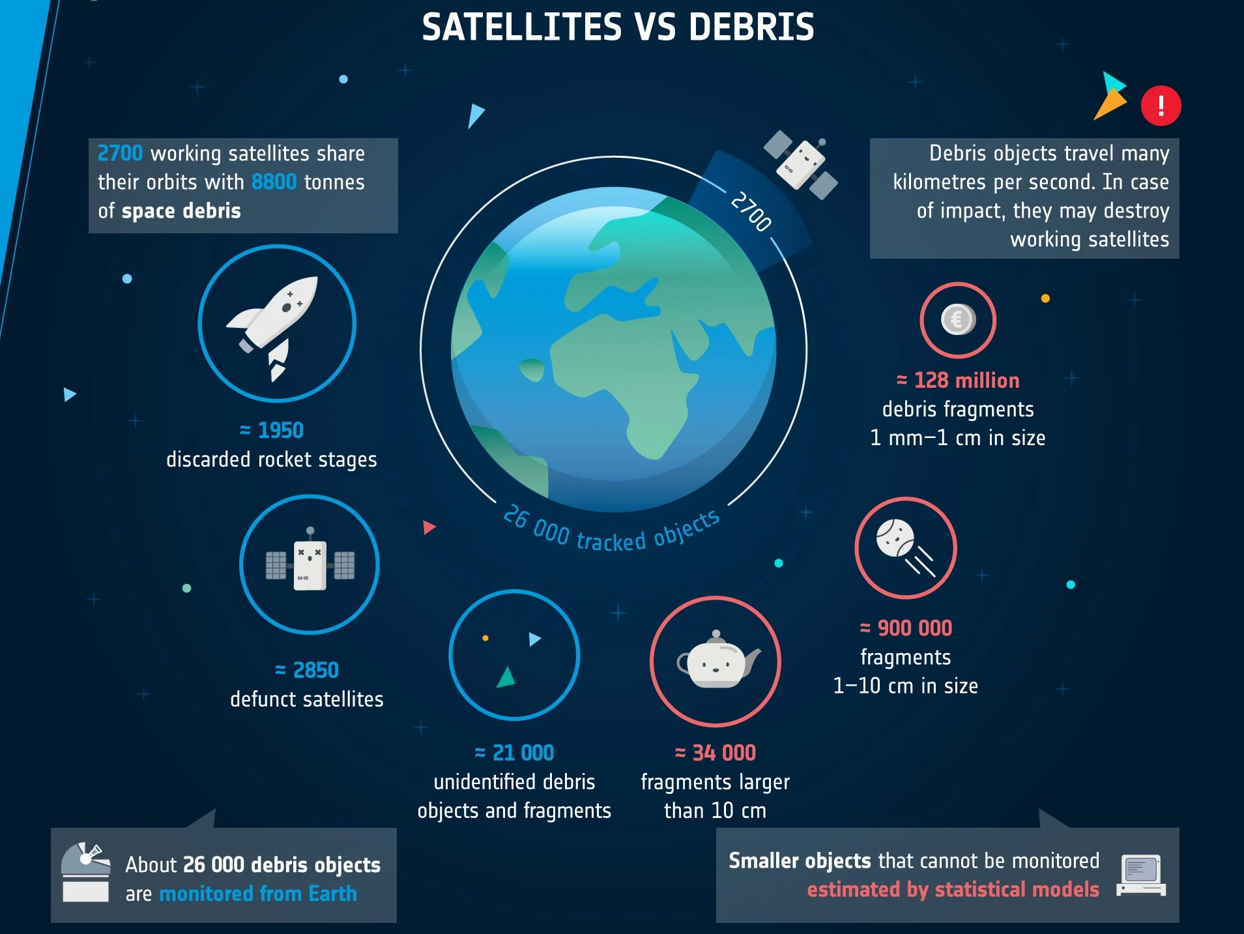
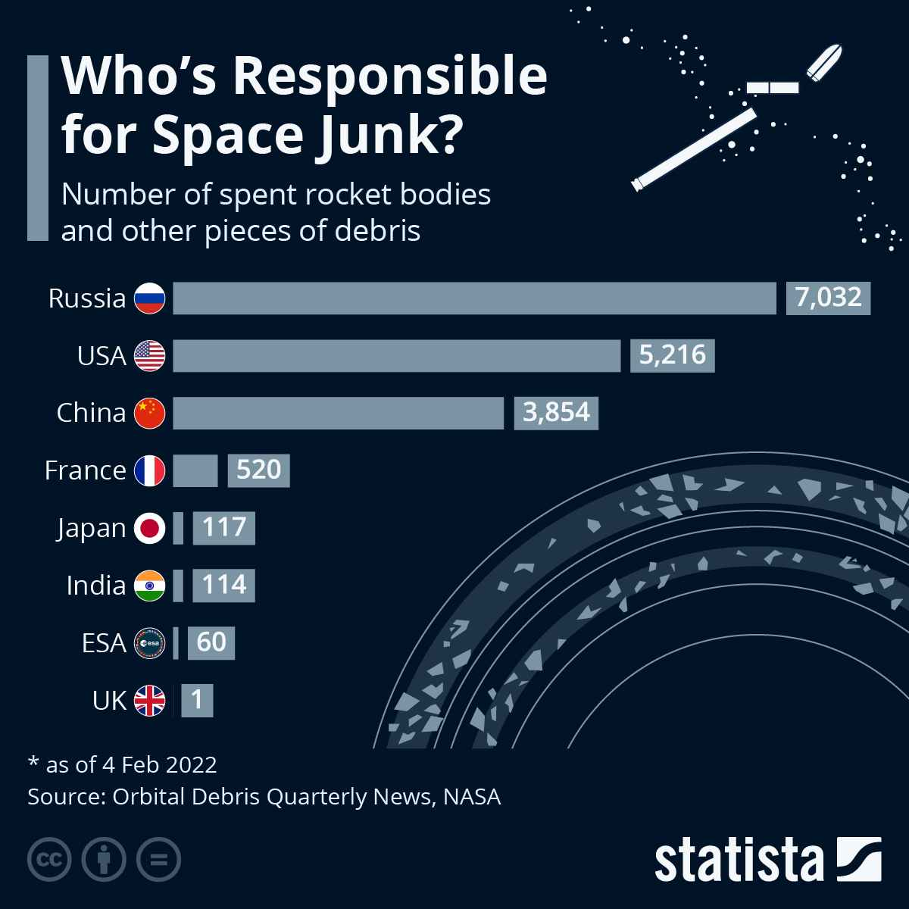
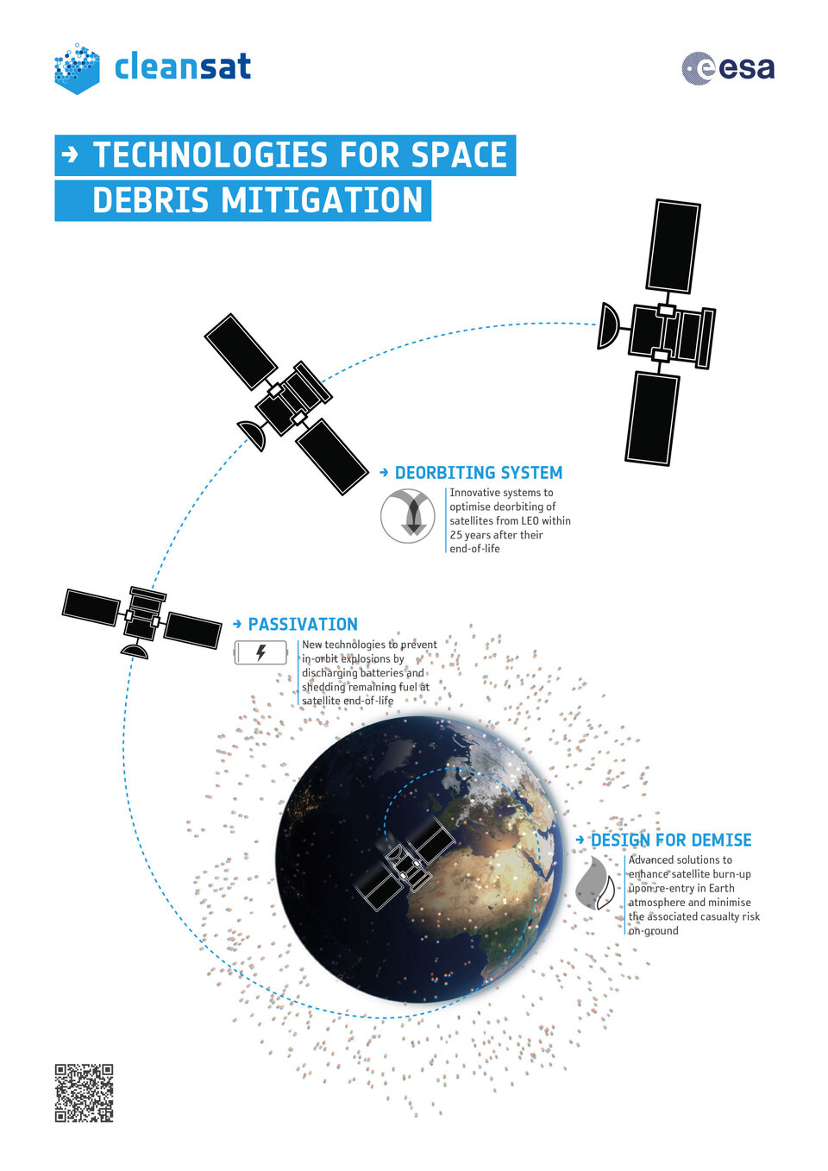
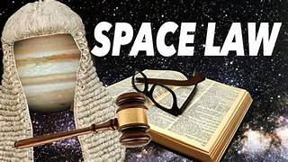
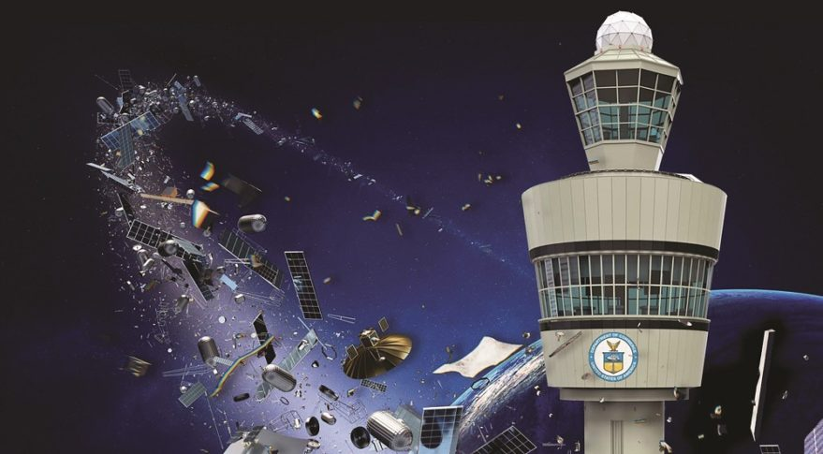


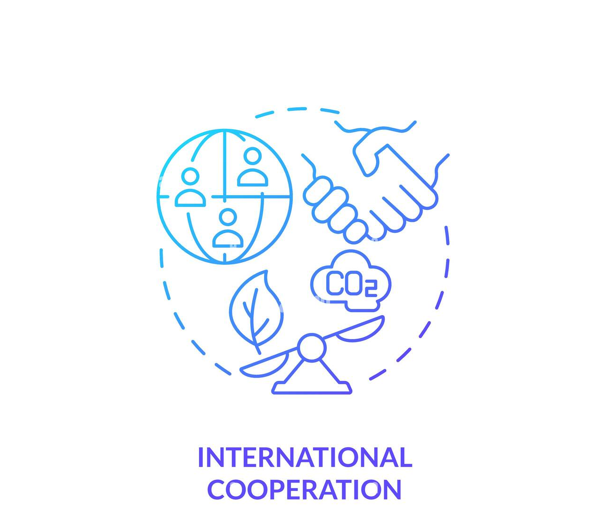

SPACE DEBRIS AND CONSEQUENCES OF PLANETARY DEFENSE OPERATION
Seenu Tiwari,
National Law Institute University, Bhopal (INDIA)
Objective:
Planetary Defense is crucial to protect Earth from asteroid impacts.
Planetary Defence Methods: Kinetic Impactors, Nuclear Deflection, Gravity Tractors.
Issue: Methods may generate space debris, which poses a risk to future space operations.
What is Space Debris?
Defunct satellites, rocket stages, asteroid fragments and more.
Over 34,000 pieces larger than 10 cm in orbit (ESA).
Impact on Space Operations:
Risk to satellites, spacecraft and missions.
Growth of debris increases collision risks, costs and damage to infrastructure.
Planetary Defense Methods & Risks of Space Debris:
Kinetic Impactors
Impact: Deflects asteroids by collision.
Risk: Creates debris from asteroid surface and fragments.
Nuclear Deflection
Impact: Alters asteroid’s trajectory with nuclear explosion.
Risk: Fragments asteroid into smaller pieces, adding to space debris.
Gravity Tractors
Impact: Uses gravitational pull to nudge asteroid.
Risk: Less debris but still poses collision risks with existing junk.
Environmental Risks:
Space debris threatens the long-term habitability of Low Earth Orbit (LEO).
Small debris can damage spacecraft traveling at high velocities.
Legal Ramifications:
Outer Space Treaty (1967) and Liability Convention (1972) hold countries accountable for space debris.
International cooperation is essential to prevent liability disputes.
Advanced Modelling and Simulation:
Predict debris generation and optimize planetary defence methods.
Debris Removal Technologies:
Robotic arms, lasers, or electrodynamic tethers for de-orbiting debris.
International Cooperation & Space Traffic Management:
Global collaboration on space traffic systems to avoid collisions.
Non-Destructive Methods (Gravity Tractors):
Minimize debris generation by prioritizing gentler deflection techniques.
Environmental & Legal Implications
Mitigation Strategies:
The risk of space debris from planetary defence must be minimized to preserve space sustainability.
Global collaboration and responsible planning are essential for ensuring Earth’s protection and safe space operations.
Conclusion:
References :
European Space Agency (ESA) data.
Outer Space Treaty (1967) and Liability Convention (1972).
Relevant planetary defence research papers and space agencies.

