Slide 1
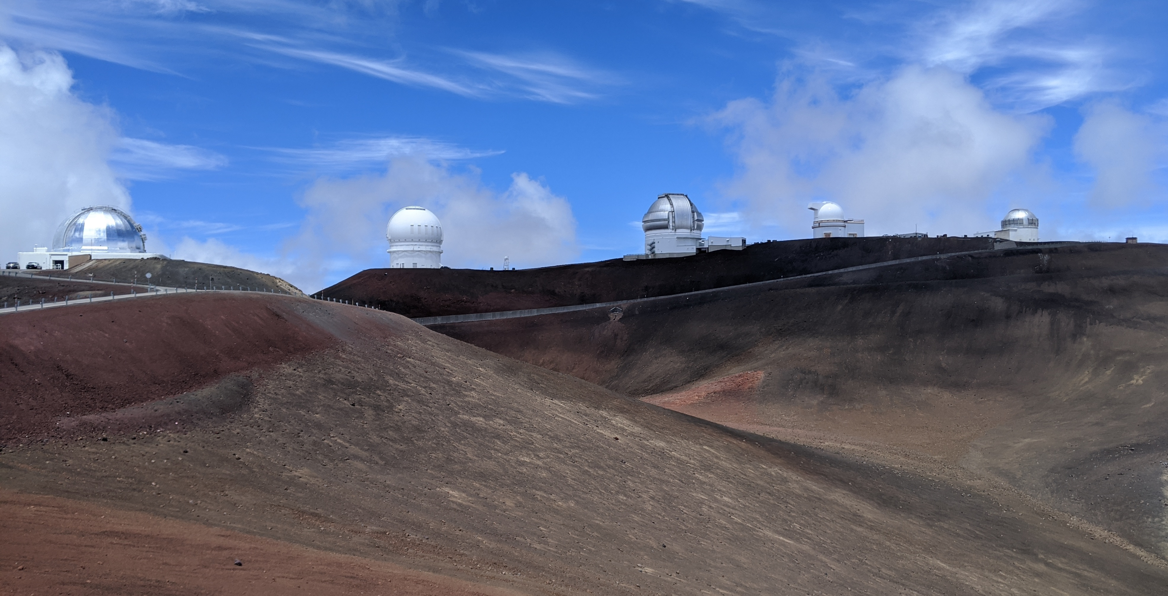
Near-Future Plans for IAWN Apophis Observing Campaigns
Dr. James M. Bauer
V. Reddy, C. Thomas, M.S. Kelley, D. Farnocchia, E. Warner, T. Farnham
Apophis T-4 Years
6 May 2025

Slide 2
IAWN: Overview
The International Asteroid Warning Network (IAWN) is a world-wide planetary defense collaboration of organizations and individual astronomers recommended by United Nations resolution who collectively work to detect, monitor, and characterize potentially hazardous asteroids and Near-Earth Objects. We currently have 71 IAWN signatories from 29 countries.
IAWN conducts campaigns to test the operational readiness of the global coalition of observers, modelers, and decision makers to assess a potential NEO impact hazard. Since 2017, we have conducted six IAWN campaigns focused on discovery, characterization, hazard modeling and astrometric timing involving 100s of scientists from around the world.
Lessons learned from these exercises have been contributed to to peer-reviewed publications and the success of global efforts on 2024 YR4.

Slide 3
IAWN: Overview
Campaign Window | Target | Focus | Participation
March 2017-Sept. 2018 | 2012 TC4 | Astrometry, Characterization, Hazard Modeling | 69 participants from 14 countries
Feb. 2019-March. 2021 | 1999 KW4 (66391 Moshup) | Characterization, Hazard Modeling | 70+ participants from 13 countries
Oct. 2020-April 2022 | 99942 Apophis | Astrometry, Characterization, Hazard Modeling | 103 participants from 19 countries
Oct. 2021-Dec. 2021 | 2019 XS | Timing | 71 MPC Codes
Oct. 2022-Feb. 2023 | 2005 LW3 | Timing | 82 MPC Codes
March 2023 | 2023 DZ2 | Characterization | 33 participants from 12 countries

Slide 4
IAWN Apophis Campaign
Three opportunities to observe Apophis
  2027 Apparition: 2027 February to April
  2028 Apparition: 2027 December to 2028 June
  2029 Apparition: 2029 January to April (Close Approach)
The organizational structure for these efforts
  NASA HQ POC: Dr. Kelly Fast
  IAWN Campaign Coordinator: Dr. Vishnu Reddy
  Observations Working Group Lead: Dr. Cristina Thomas
*Orbit shown is pre-encounter

Slide 5
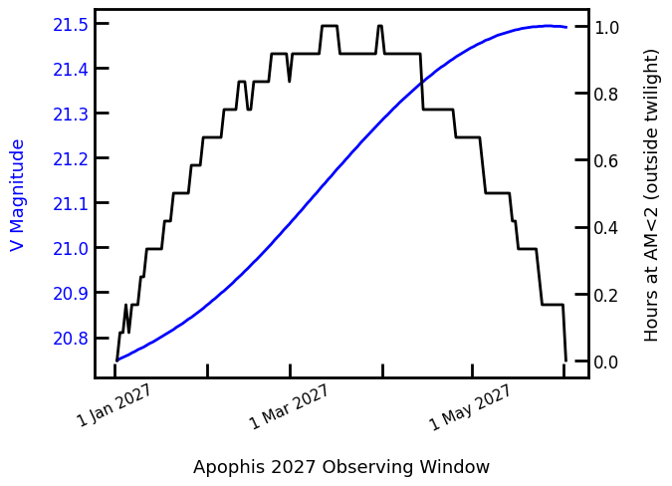
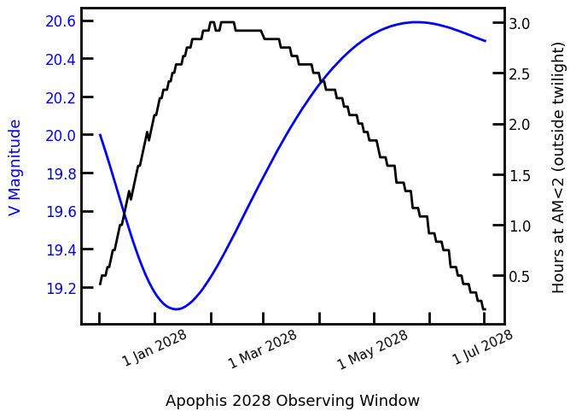
IAWN Campaign Overview:
2027 & 2028
Observations focused on physical characterization.
Opportunities are restricted to large ground-based and space-based telescopes due to limiting magnitude and observing geometry. Focused science goals (lightcurves, visible spectra).
IAWN will be coordinating these telescope focused observing efforts. Observers will self organize but will be supported by IAWN when they apply for telescope time. Scientific results from these efforts will be published independently by respective PIs with some coordination from IAWN.

Slide 6
IAWN Campaign Overview:
2027 & 2028
2027: Likely lightcurves only. Not much time outside of twilight, but long sequences are not necessary. Low northern declinations, equatorial.
2028: Brighter = Lightcurves and visible spectroscopy. Longer blocks of time outside of twilight. Moves from southern to northern declinations, fairly equatorial.

Slide 7
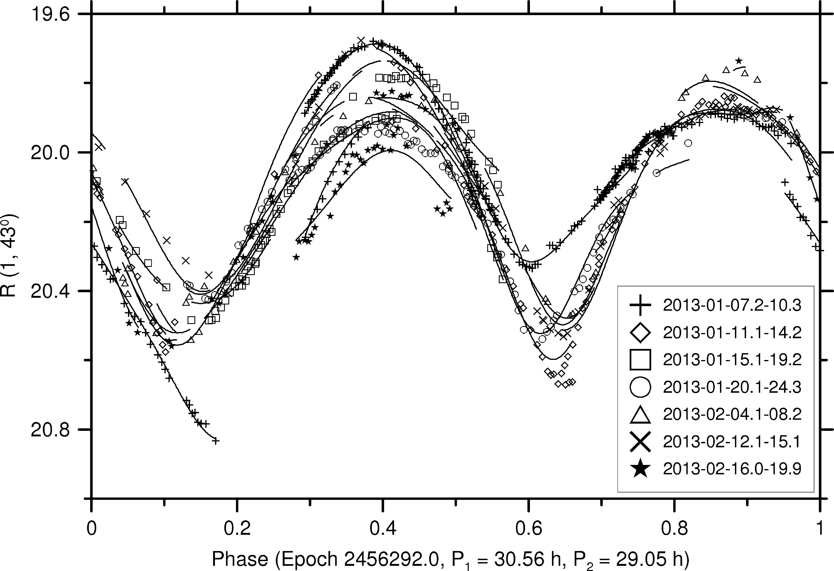
Rotation State is the Key Focus in 2027 & 2028
Observations from 2012-2013 show that Apophis is in non-principal axis rotation. It rotates slowly with a main period of 30.56 ± 0.01 hr.
To observe this object we would need a specific observing strategy. From Pravec et al. (T-5 meeting): “a sampling of one lightcurve data point per 2 hours is sufficient”.
A coordinated effort will get the best analysis possible of Apophis’ rotation state.
Pravec et al. (2014)

Slide 8
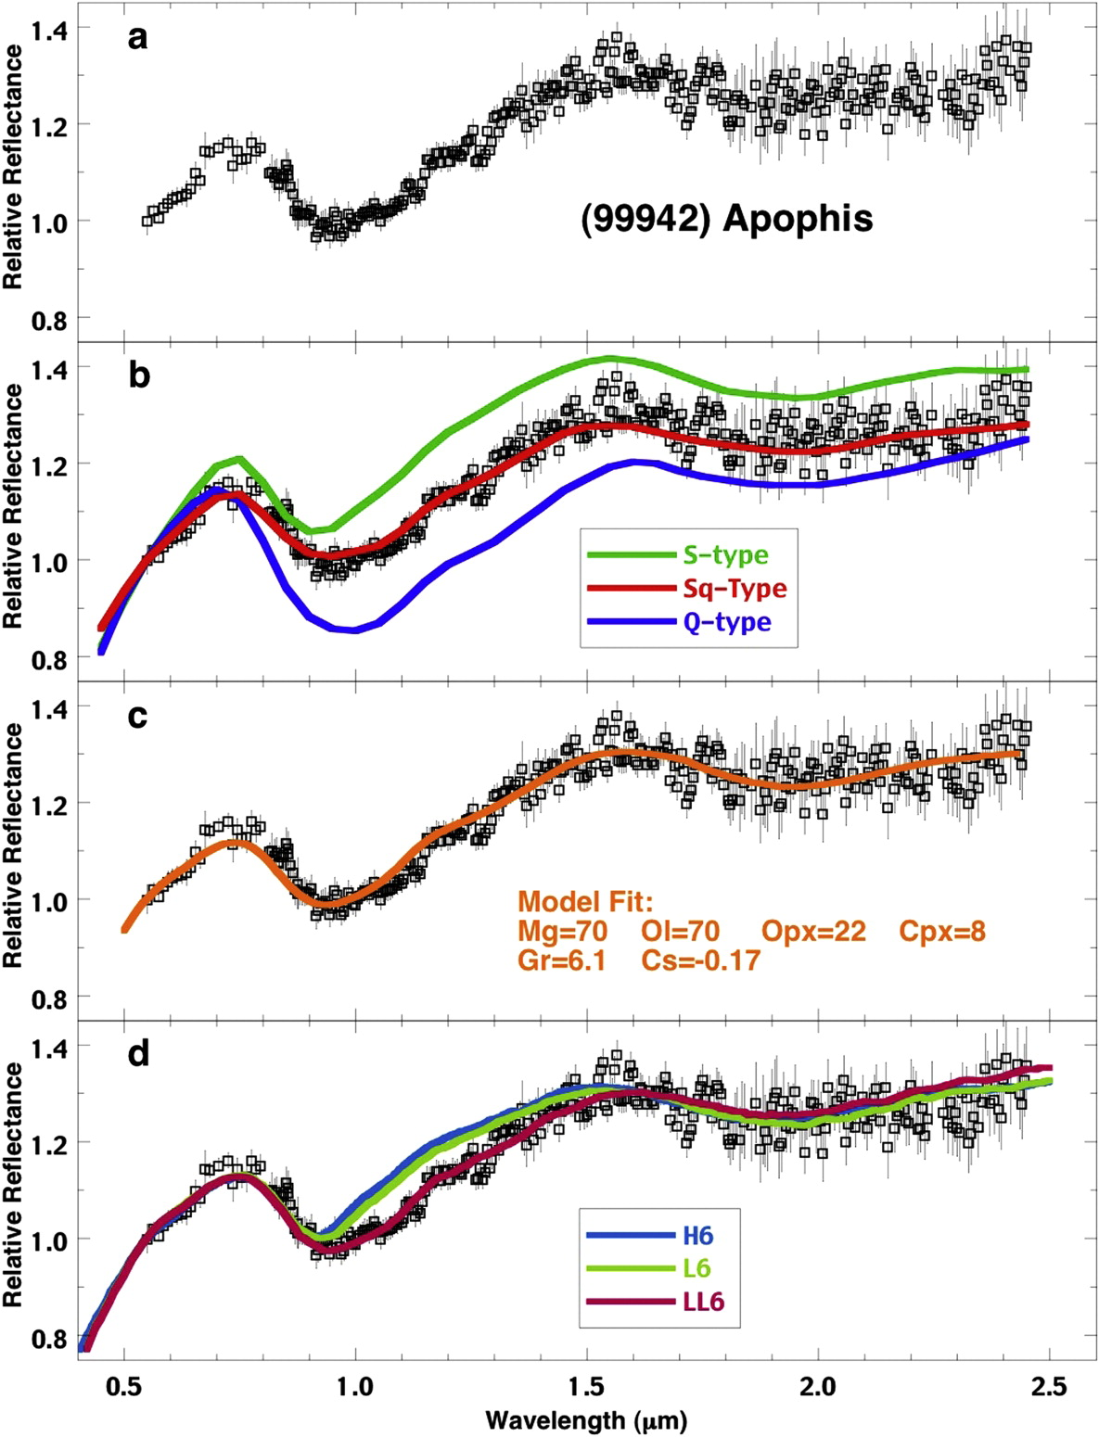
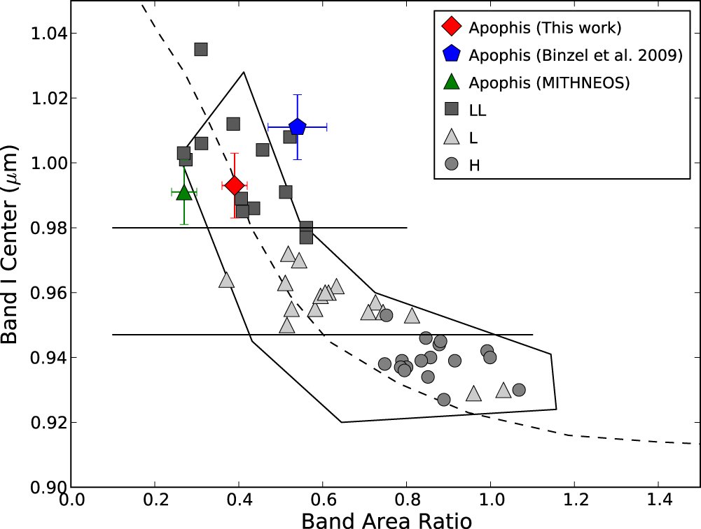
Spectroscopy & Composition
Binzel et al. (2009) reported that the Apophis is an Sq-type that “most closely resembles LL ordinary chondrite meteorites”.
Reddy et al. (2018)
Reddy et al. (2018) use additional spectra and complementary techniques to also determine Apophis to be an LL chondrite. They identify the ν₆ resonance as the most likely source region.
Binzel et al. (2009)

Slide 9
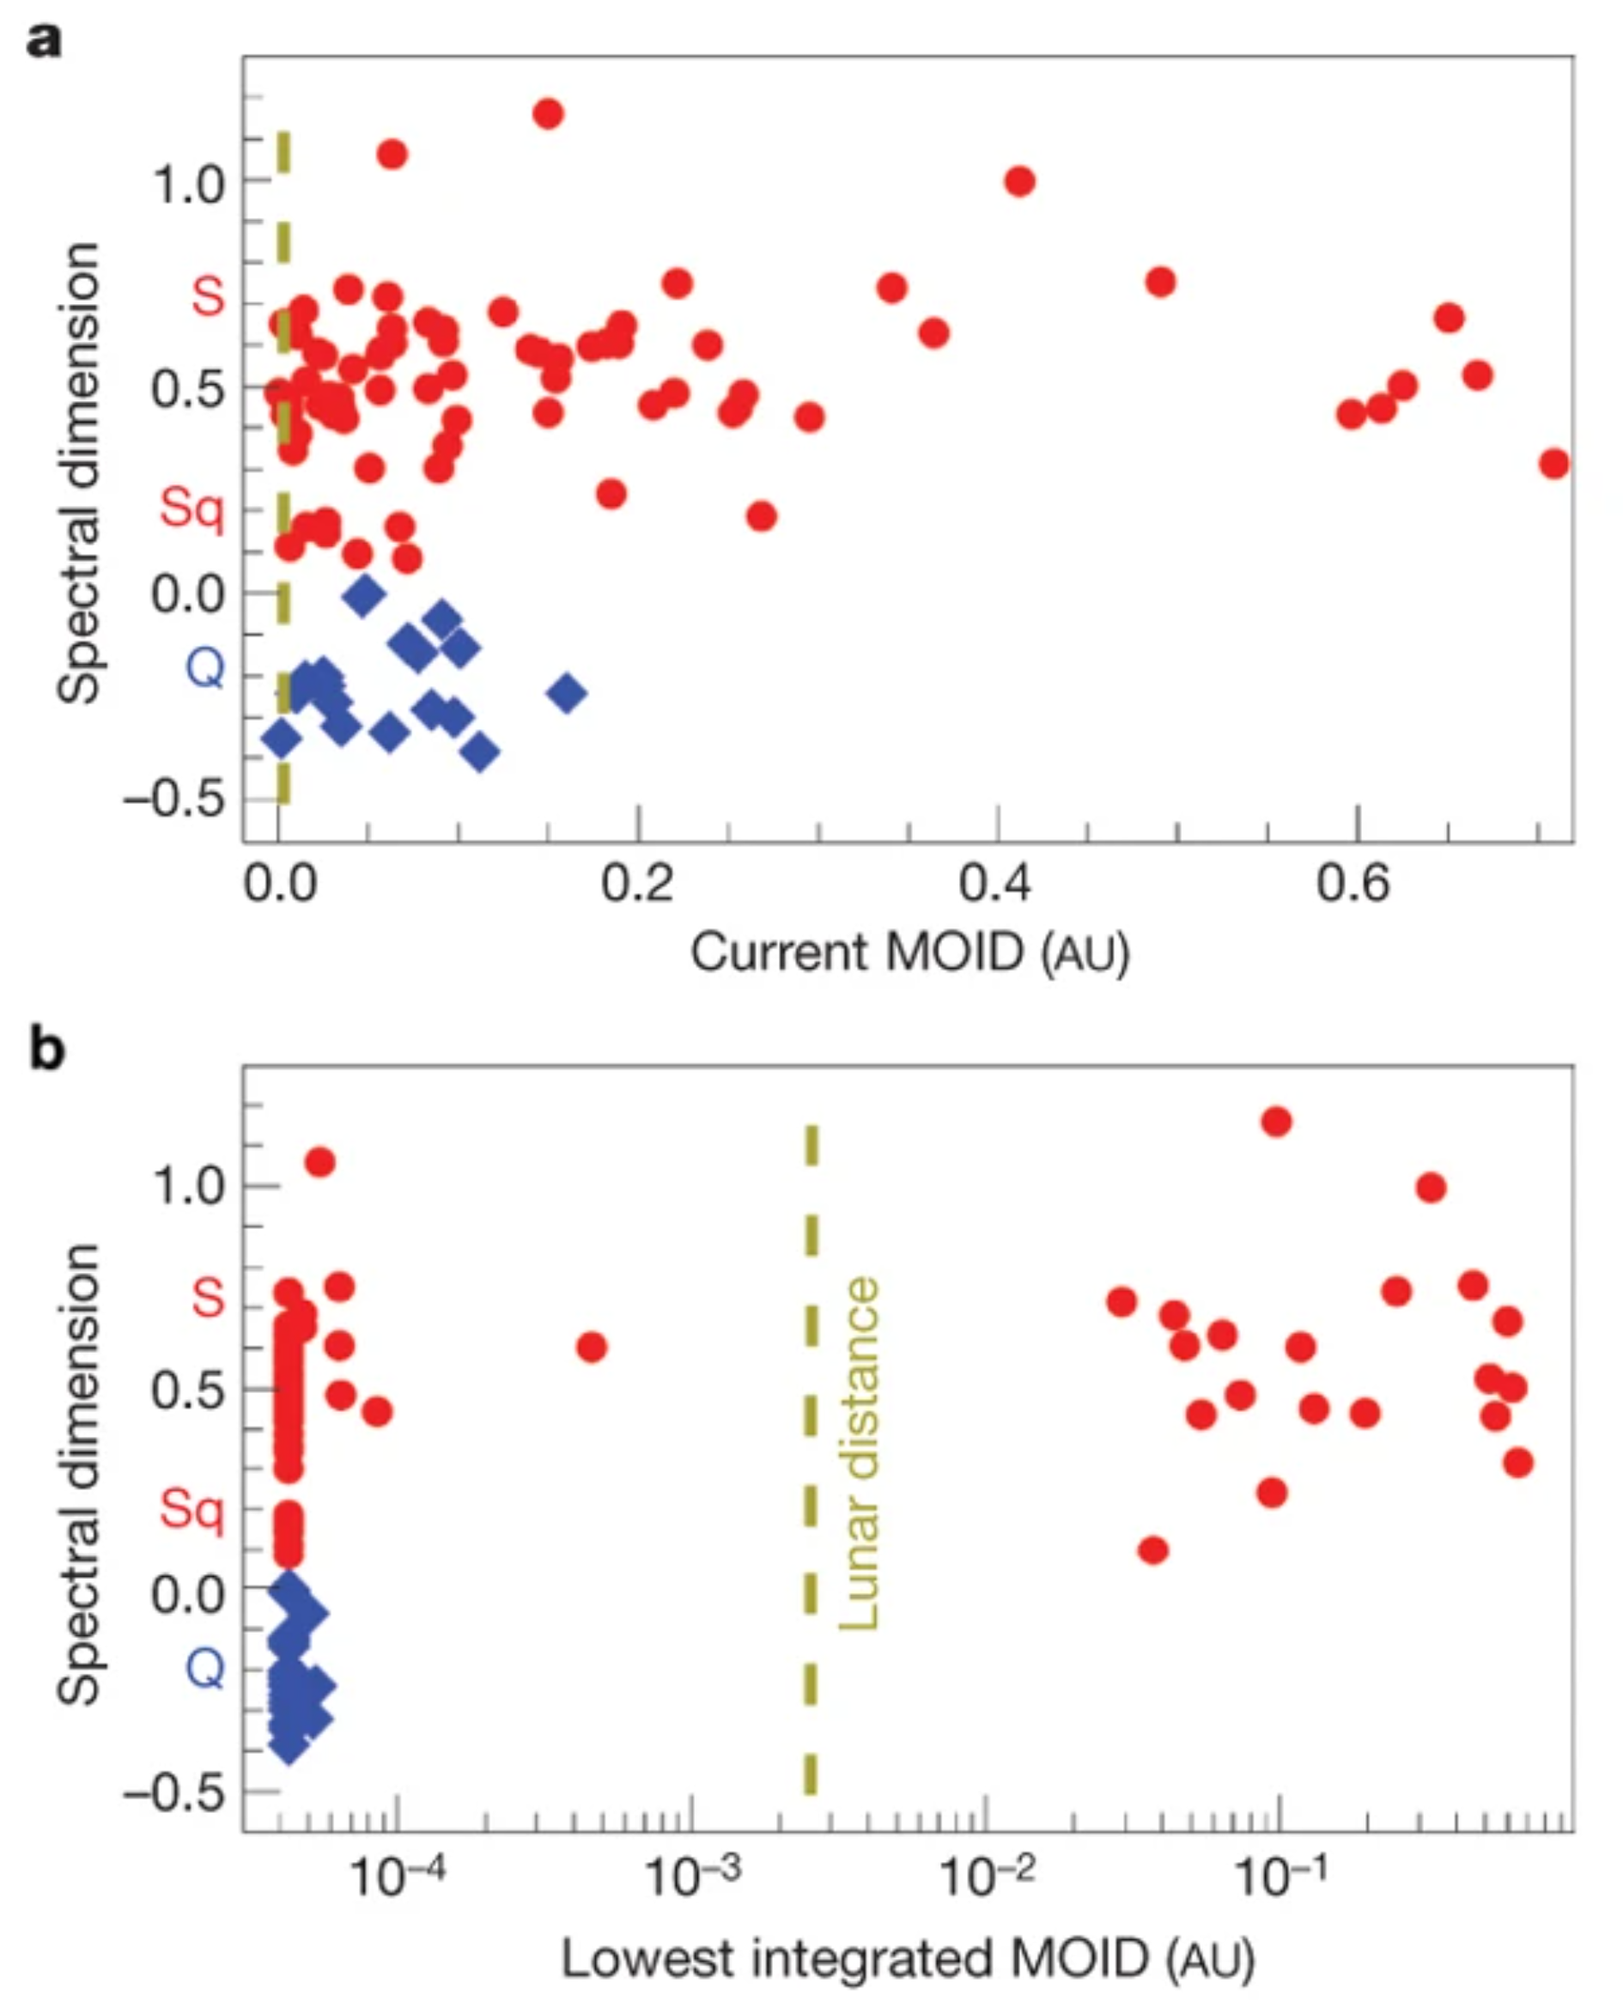
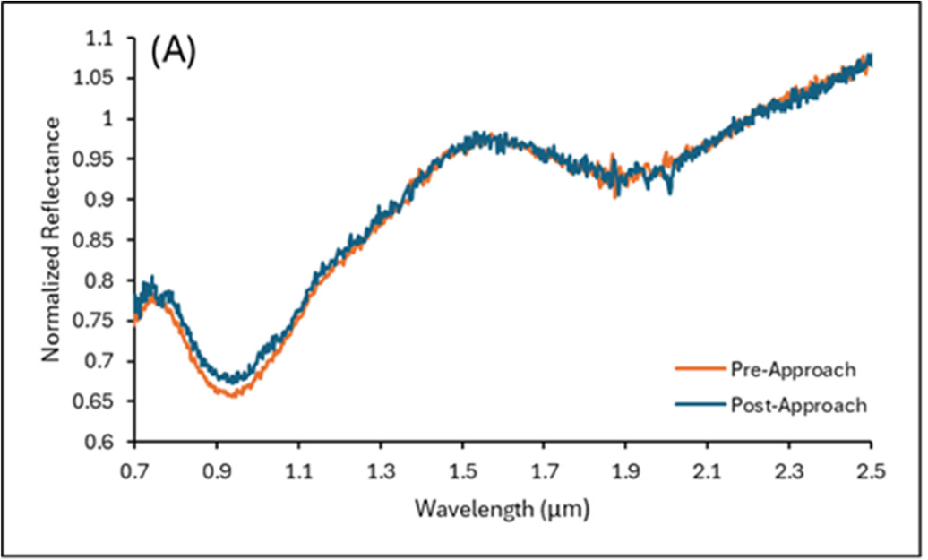
Spectroscopy & Space Weathering
Binzel et al. (2010) showed a correlation between MOID and spectral slope suggesting tidal stress can lead to asteroid resurfacing.
McGraw et al. (2024) observed 2024 MK before and after its Earth close approach (0.76 LD). IRTF SpeX data show no significant change.
pre-approach ⍺=13.4°, post-approach ⍺=22.9°

Slide 10
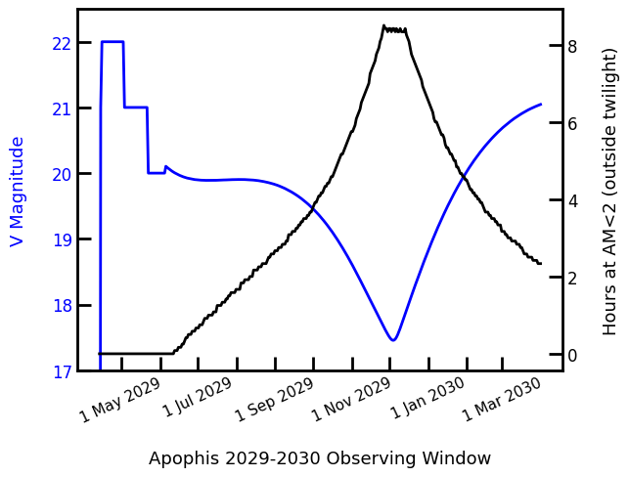
Apophis with Hubble
HST observations can be made at elongation > 55° from the Sun, tracking limited to < 5 arcsec/sec
Pre-encounter
  2027 Jan 24 – May 24
  2027 Nov 24 – 2028 Jul 15
  2028 Oct 17 – encounter
Post-encounter
  Window opens June 16
Notes:
2029 June 16, V=19.9, 01:41:20 +18:36:14

Slide 11
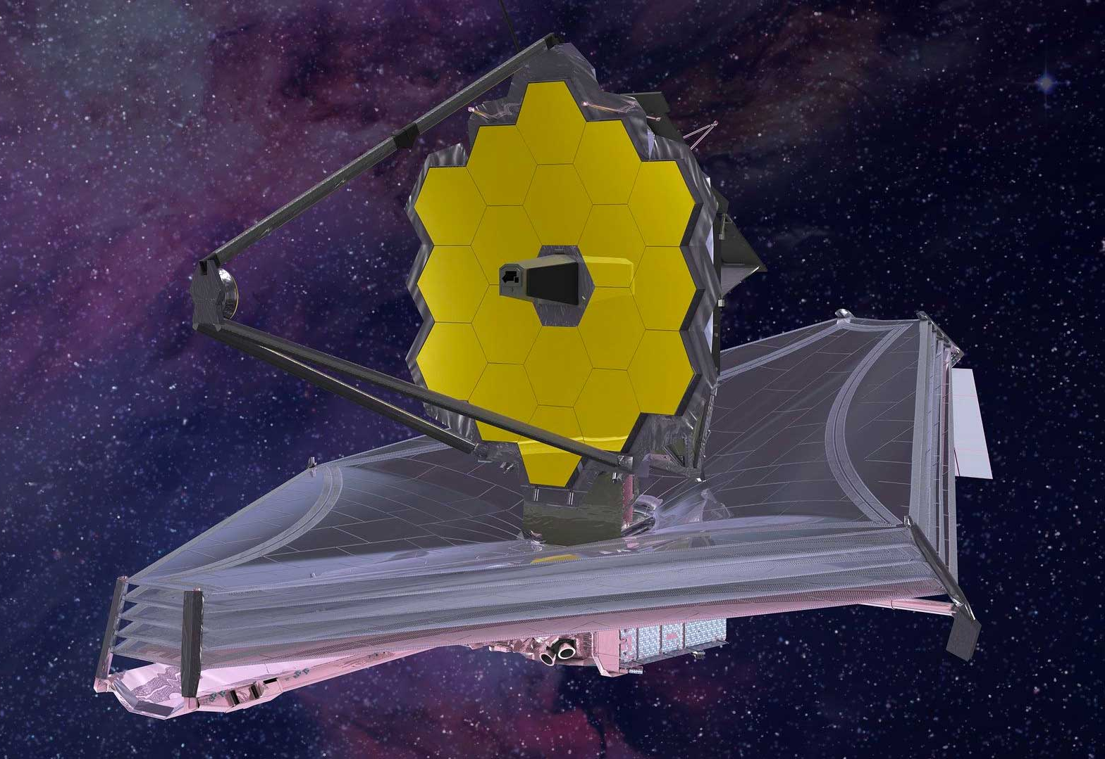
Apophis with JWST
JWST’s solar elongation requirement is 85-135°
Observation windows are:
  2028 18 January – 21 March
  2028 17 December – 2029 17 March
  2029 6 September – 7 November
Non-sidereal rates remain within the JWST limits in all parts of the observing windows.
  At these rates, guide stars for tracking will need to be changed approximately hourly.
  Acquisition of a new guide star and target reacquisition take non-negligible amounts of time.

Slide 12
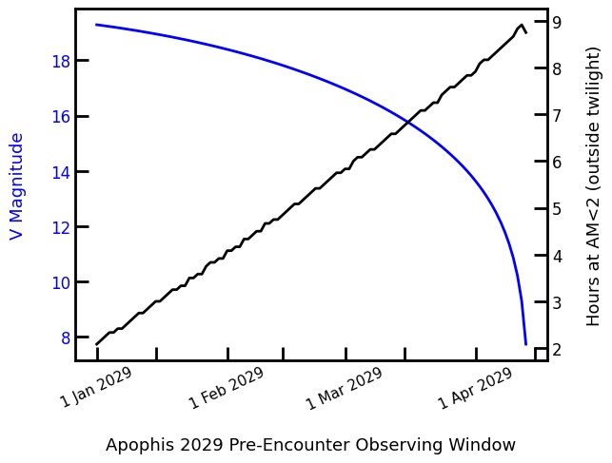
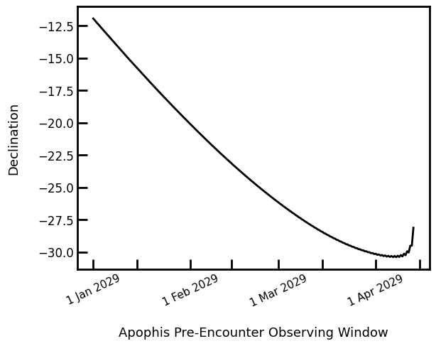
IAWN Campaign Overview: 2029
Close Approach will be primary focus for traditional IAWN efforts
Exploring campaign focus options in coordination with all stakeholders.
Preliminary suggested options for IAWN 2029 campaign themes include:
  Traditional IAWN campaign assuming Apophis is a newly discovered NEA. This would be similar to our 2021 campaign.
  IAWN campaign focused on science with large ground-based and space-based telescopes. This would be similar to Pre-2029 apparition efforts.
  IAWN campaign focused mostly on small telescopes (<1 meter aperture). Aligned towards International Year of Planetary Defense.
We welcome better coordination with PDC exercises if there is one planned around Apophis and inputs from spacecraft rendezvous missions planned for Apophis.

Slide 13
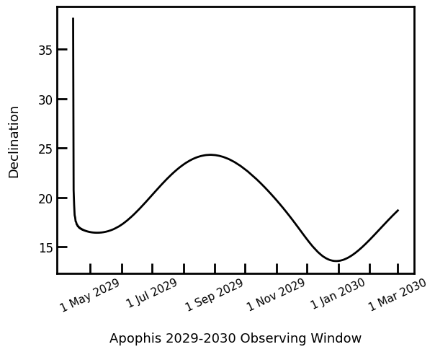
IAWN Campaign Overview: 2029
Close Approach will be primary focus for traditional IAWN efforts
Exploring campaign focus options in coordination with all stakeholders.
Preliminary suggested options for IAWN 2029 campaign themes include:
  Traditional IAWN campaign assuming Apophis is a newly discovered NEA. This would be similar to our 2021 campaign.
  IAWN campaign focused on science with large ground-based and space-based telescopes. This would be similar to Pre-2029 apparition efforts.
  IAWN campaign focused mostly on small telescopes (<1 meter aperture). Aligned towards International Year of Planetary Defense.
We welcome better coordination with PDC exercises if there is one planned around Apophis and inputs from spacecraft rendezvous missions planned for Apophis.

Slide 14
Backup Slides

Slide 15
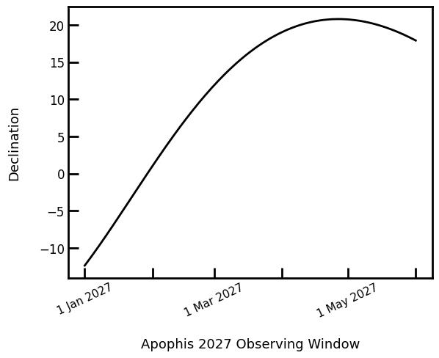
2027 February - April
Airmass calculations for Observatory Code 568 (Mauna Kea).

Slide 16
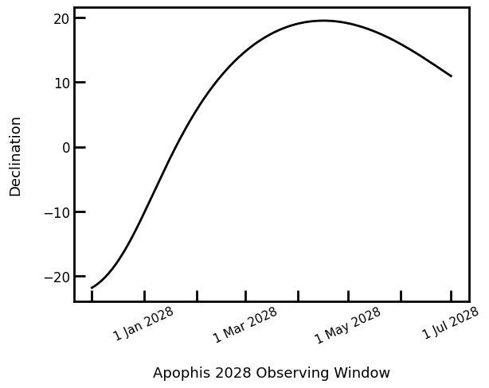
2027 December – 2028 June
Airmass calculations for Observatory Code 568 (Mauna Kea).

Slide 17
2029 Pre-Encounter
Airmass calculations for Observatory Code 304 (Las Campanas).

Slide 18
2029 Pre-Encounter
Light curves and visible + near-infrared spectroscopy possible.
Radar from mid-March to mid-May (Brozovic et al. 2018).

