Slide 1
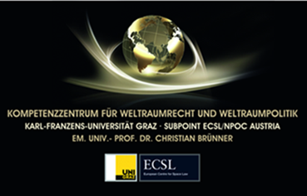

IAA-PDC-25-09-261
ON THE LEGALITY OF ANY OTHER NUCLEAR EXPLOSION
Hannes Mayer
Competence Centre for Space Law and Policy; Austrian Center for Intelligence, Propaganda and Security Studies; University of Graz

Slide 2
Asteroid impact mitigation techniques
Kinetic impactor: A spacecraft (the impactor) crashes into an asteroid at very high velocity. The momentum is transferred to the NEO and changes its trajectory slightly.
Gravity tractor: A spacecraft is hovering near a NEO using the small gravitational attraction between the two to alter the pair’s centre of gravity, affecting the asteroid’s course.
Blast deflection: That technique is employing a nuclear explosive near the asteroid causing its outer layers to evaporate thereby acting like rocket fuel and thereby altering the asteroid’s trajectory.(4)
Destruction of the NEO through a nuclear or conventional explosion.(5)
Other methods: e.g. employing lasers to boil off materiel from the asteroid’s surface; alternatively using large lenses to concentrate the sun’s energy onto an asteroid.(6)
Which method to employ may depend on the circumstances, such as the time to prepare a certain measure to counter the threat.
Especially when faced with large objects and only little warning time, the nuclear option might be the only feasible one.(7)

Slide 3
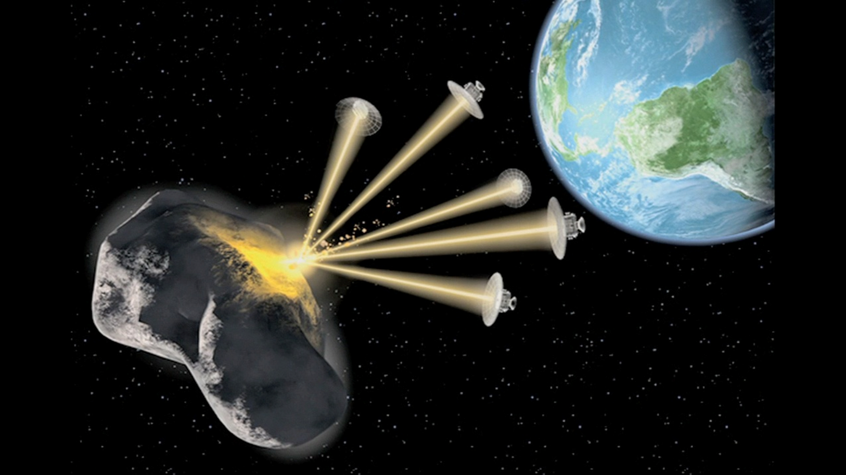
Legal Questions concerning Nuclear Planetary Defence Measures
Would the employment of nuclear warheads against NEOs violate Art.IV OST?
Would the employment of nuclear warheads against NEOs violate Art.I §1 lit a PTBT?
Could a nuclear warhead that is employed against a NEO be considered a weapon of mass destruction?

Slide 4
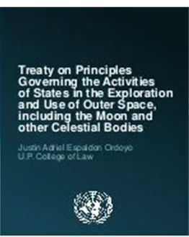
Would the employment of nuclear warheads against NEOs violate Art.IV OST?
A nuclear explosive device for planetary defence is not necessarily placed in orbit or installed in outer space
Could a nuclear warhead that is employed against a NEO be considered a weapon of mass destruction?
  The device is not used to cause mass destruction against humans or human-made installations.
Not every explosive device is a weapon
  Several examples where explosive are used for non-violent, non-military purposes

Slide 5

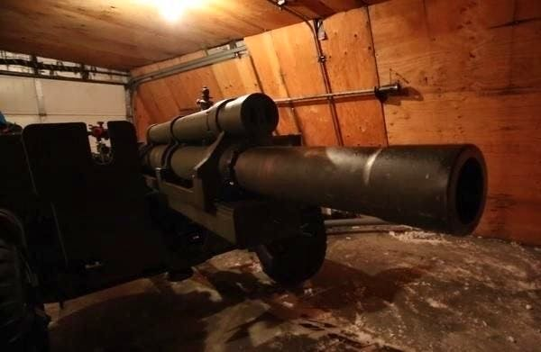
Not every explosive device is a weapon
a number of cases where explosives are used for peaceful and specifically non-military purposes such as mining, construction of tunnels
also very specifically to defuse threats from natural phenomena (for example avalanches)
  Airborne deployment
  Using artillery pieces

Slide 6
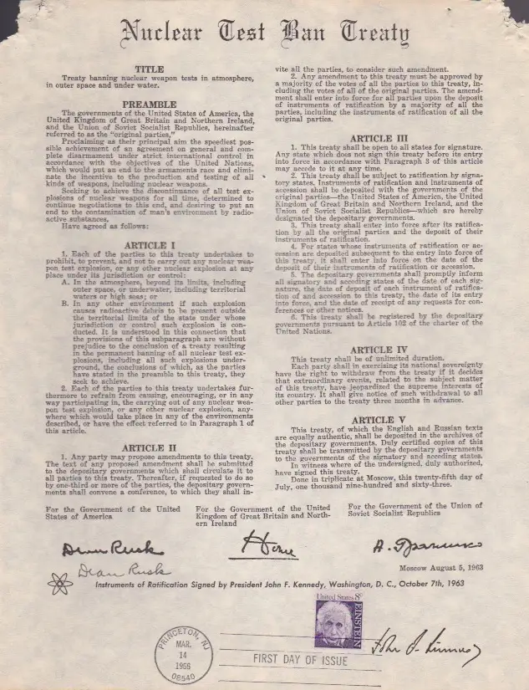
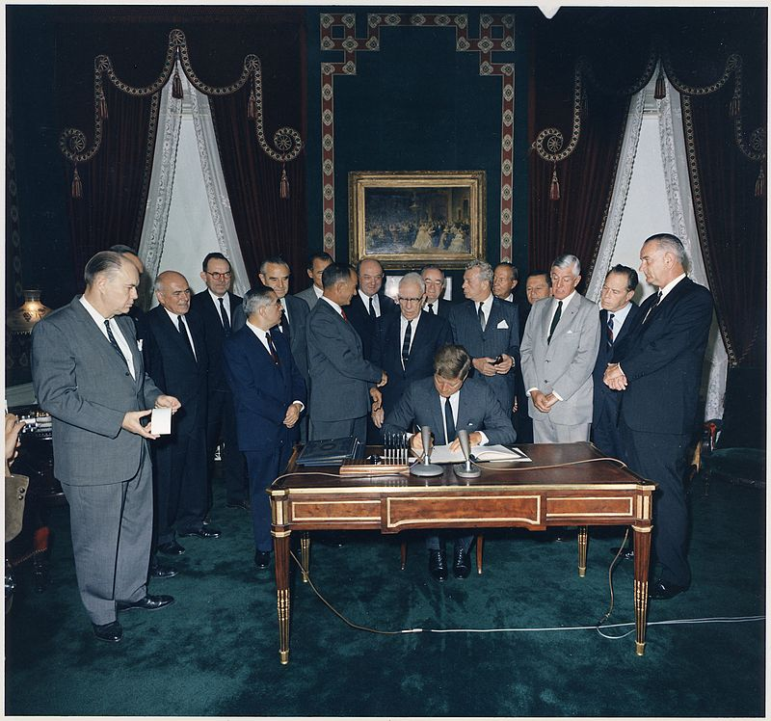
Would the employment of nuclear warheads against NEOs violate Art.I §1 lit a PTBT?
PTBT deals with nuclear testing not with operational NEO intercept missions
Not a weapon
some concern due to the phrase “any other nuclear explosion”

Slide 7
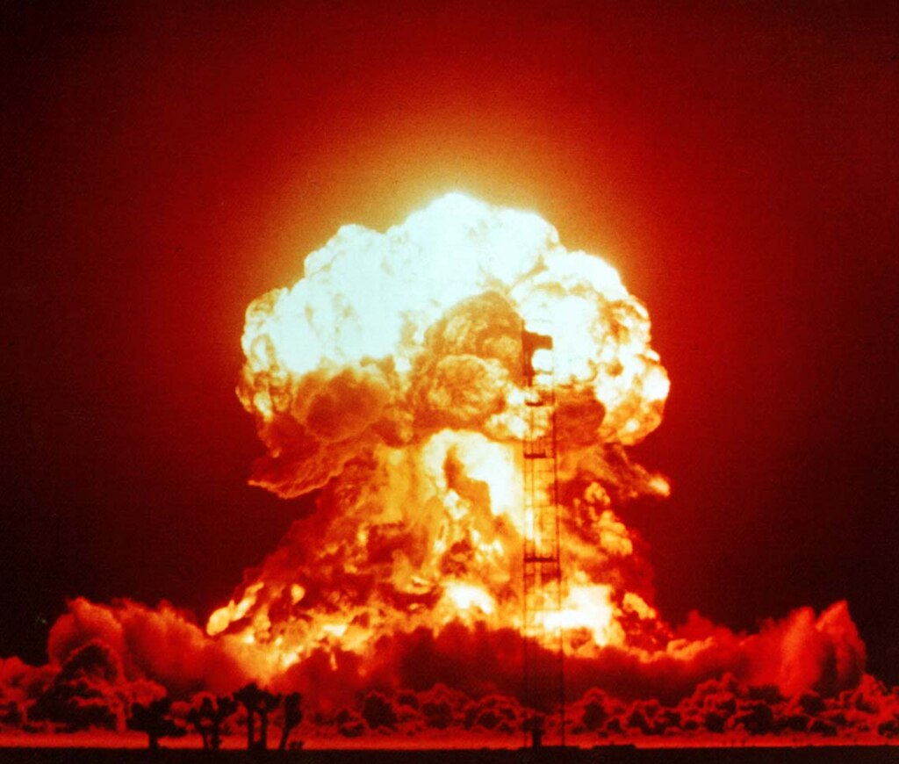
Any other nuclear explosion
Not just weapons tests?
the intention behind this was mainly included in the text because of verification issues and the problem of cross-border fall-out
  Cross-border fallout probably not applicable in border-less space
  Not under jurisdiction of any state (Green)
Art 32 VCLT
CTBT not in force

Slide 8
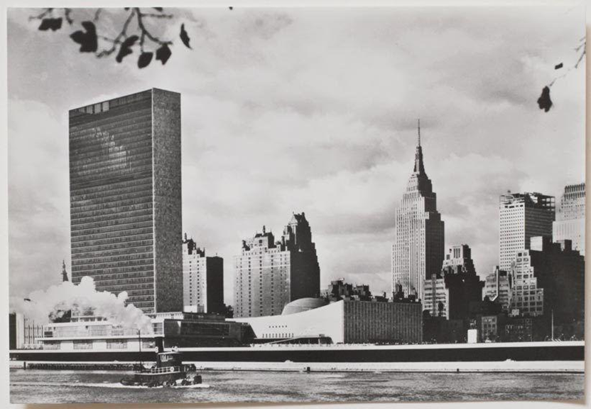
Any other nuclear explosion?
Art 32 VCLT
  a result which is manifestly absurd or unreasonable?
Mitigate the question of any other nuclear explosions
  UNSC Resolution
  Set up a specific legal regime – „Planetary Defence Covenant“
  Do what needs to be done??

Slide 9

Thank you for your attention!
Hannes Mayer
Competence Centre for Space Law and Space Policy
ACIPSS
University of Graz
hannes.mayer@uni-graz.at
https://www.facebook.com/hannes.mayer.5494/
https://www.linkedin.com/in/hannes-mayer-0500541

