Slide 1

Trajectory and CubeSat Mission Design for Plasma Physics Observations during the 2029 Apophis Flyby
Lucas Barbero Sánchez
Contact: lucasbarberosanchez@gmail.com
9th IAA Planetary Defense Conference – Student Competition

Slide 2
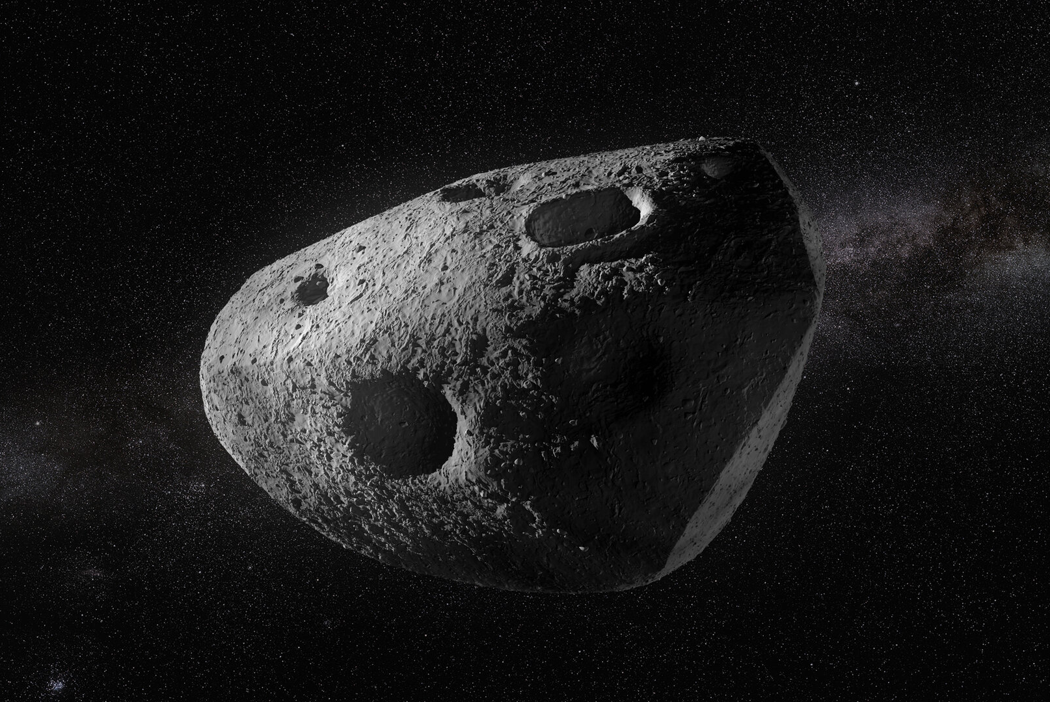
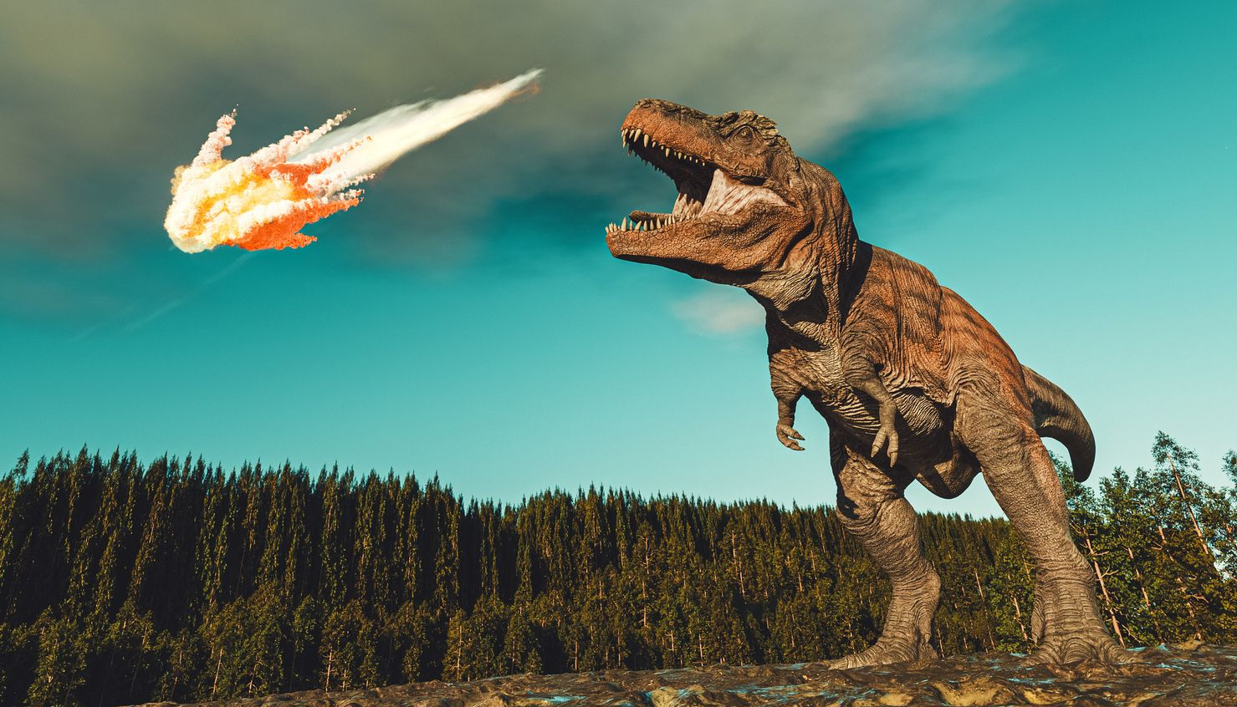
Motivation and Challenges
Apophis (99942)
A unique case for plasma physics observations!
Magnetosphere
Ring current
Illustration Source: ESA
Outer radiation belt
Apophis Characteristics
Size: ~ 400 m wide!
Retrograde flyby with respect to Earth
Closest Approach: 38 000 km (closer than GEO satellites!)
Velocity at closest approach: 7.42 km/s (VERY fast!)
Key challenge: intercepting Apophis
Do we need rapid space mission development?
Ask dinosaurs!
Yes!
9th IAA Planetary Defense Conference – Student Competition

Slide 3
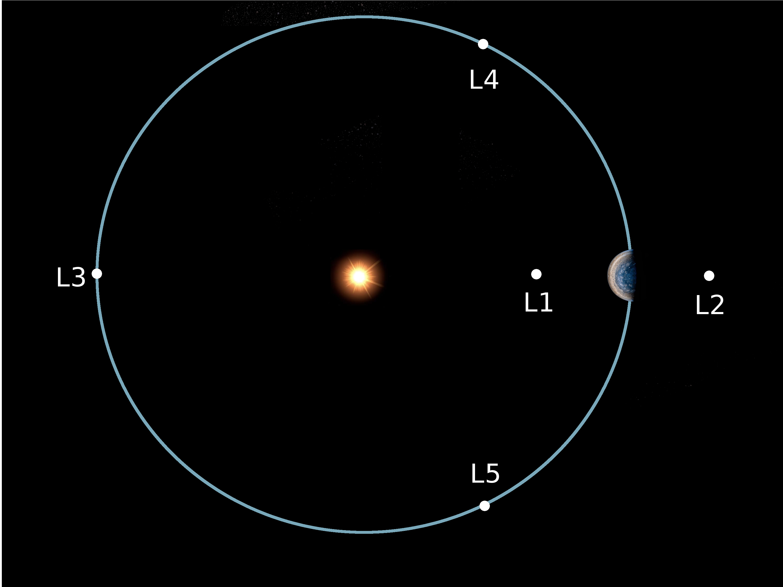
Dynamics and Lagrange Points
Gravity Model: the Sun-Earth CR3BP
Primary Bodies
Tertiary Body
Sun
Earth
Onuris Spacecraft
What are Lagrange Points?
Equilibrium points where the gravitational and centrifugal forces are balanced!
Why are they interesting?
Because periodic orbits exist around them!
[not to scale]
Illustration Source: NASA
9th IAA Planetary Defense Conference – Student Competition

Slide 4
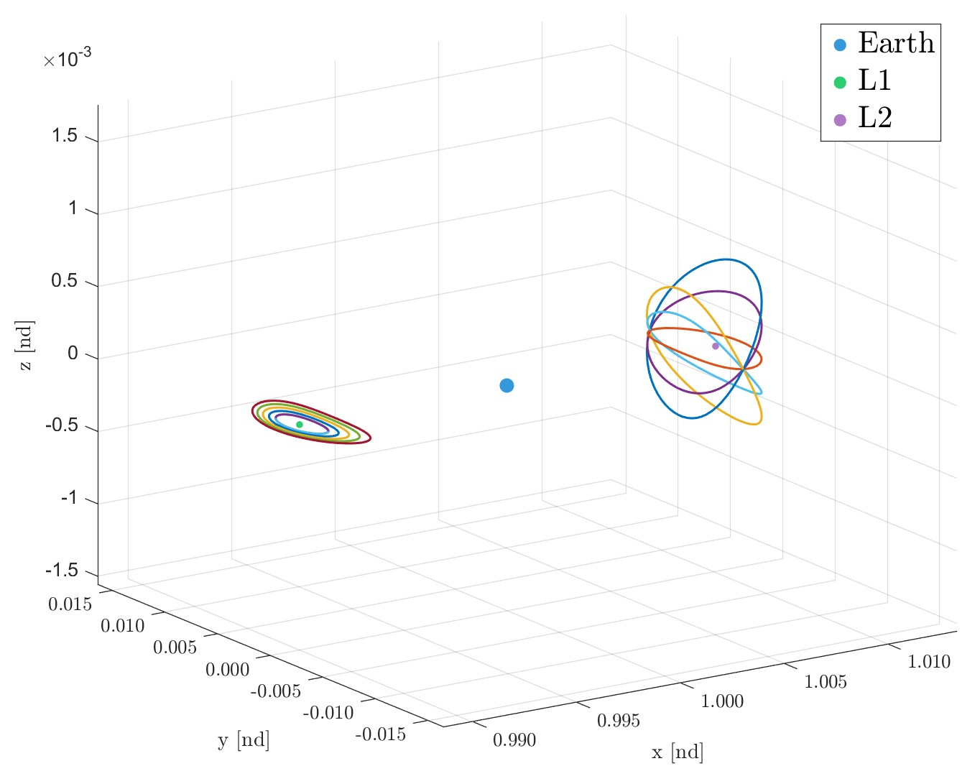
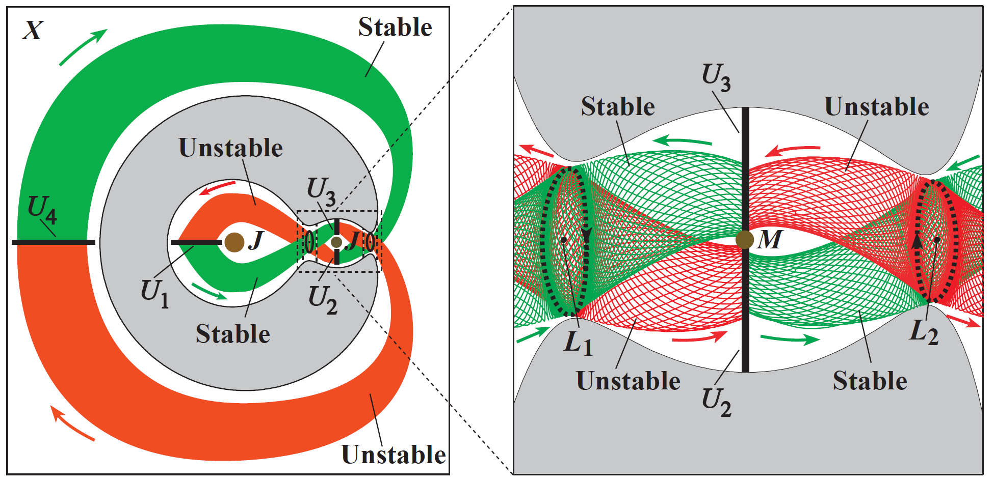
Periodic Orbits and Invariant Manifolds
Graph from G. Gómez, W.S. Koon, M.W. Lo, J.E. Marsden, J. Masdemont, and S.D. Ross, Invariant Manifolds, the Spatial Three-Body Problem, and Space Mission Design
Unstable invariant manifolds associated with periodic orbits around L₁ offer interception opportunities!
Lyapunov (planar) and Halo orbits around L₁ and L₂, respectively.
9th IAA Planetary Defense Conference – Student Competition

Slide 5
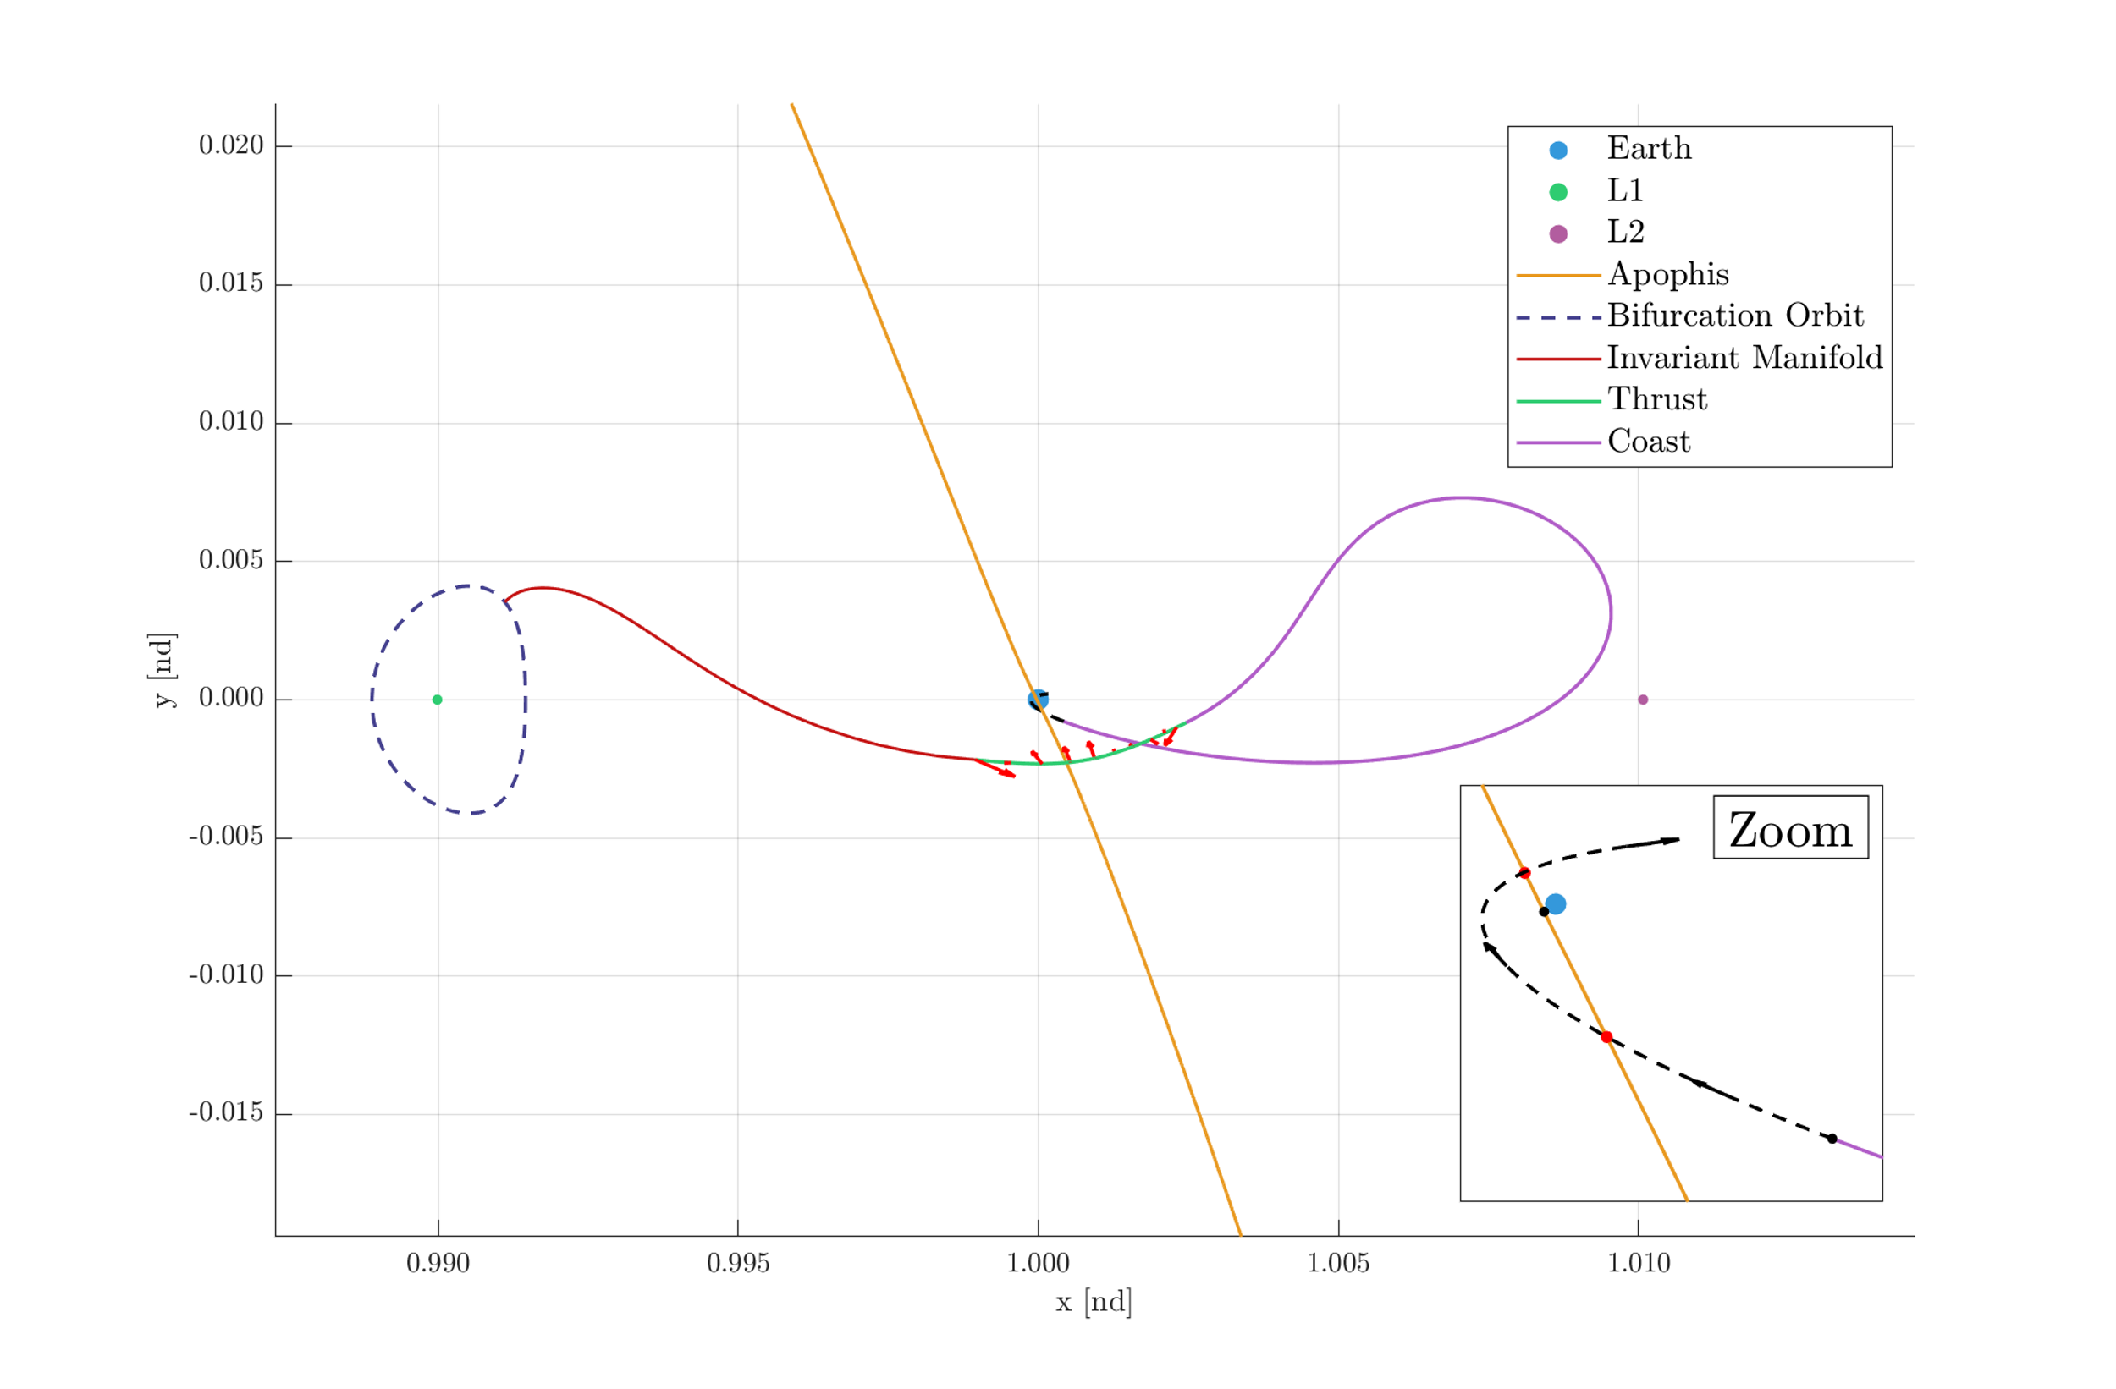
Trajectory Concept
Invariant Manifold Free Fall
Thrust Phase
Coast Phase
Interception

Slide 6
Results, failures and improvements
Onuris Transfer Characteristics
Total transfer time: 160.8 days
∆V cost: 1.17 km/s
Low-thrust propulsion system (1 mN)
Onuris mass: 15 kg (assumed constant)
Targeting Apophis at closest approach became difficult!
Final segment of Onuris' transfer
The multi-impulse low-thrust algorithm struggled to achieve Apophis interception.
Near Earth, a transition to the Earth-Moon CR3BP or higher-fidelity models is needed.
Over 3 km/s relative velocity allows measurements but requires precise interception.
9th IAA Planetary Defense Conference – Student Competition

Slide 7
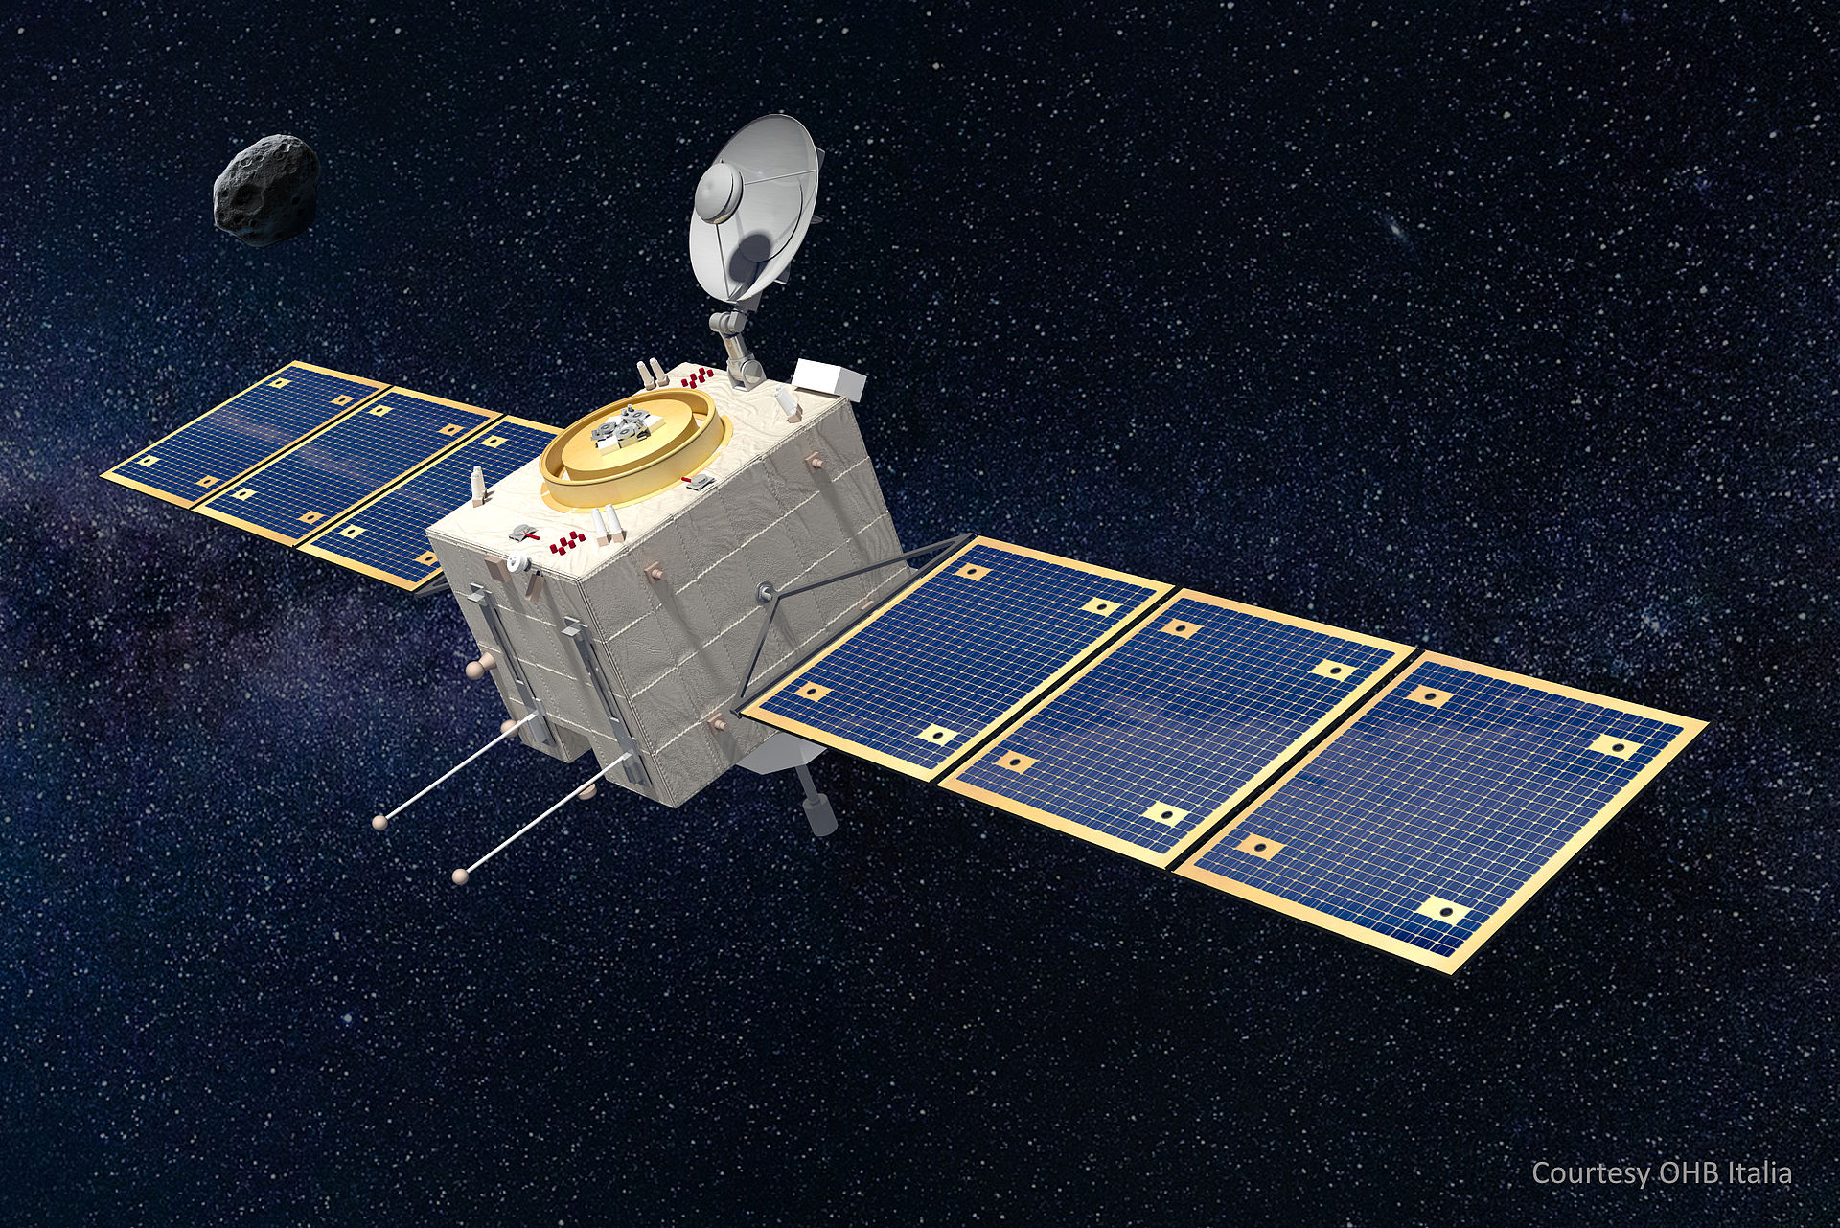
Planetary Defense Applications
Trajectory Scheme
Inspiration
Invariant Manifold Free Fall
Thrust Phase
Coast Phase
Interception
ESA’s Comet Interceptor mission will wait near L₂ for an opportunity to intercept a comet.
Illustration Source: OHB Sweden
Scheme applied to Planetary Defense
A large platform orbiting around L₁ could deploy small spacecraft for rapid interception missions against hazardous asteroids.
9th IAA Planetary Defense Conference – Student Competition

Slide 8


Thank you for your time!
lucasbarberosanchez@gmail.com

