Slide 1



The Effect of Irregular Constituent Particle Shape and Internal Structure on the Anticipated Physical Outcomes of the Apophis 2029 Close Encounter
Joseph V. DeMartini, Adriana Daca, Derek C. Richardson, Ronald, L. Ballouz, and Naomi Murdoch
Joe DeMartini (UMD)
4/28/2025

Slide 2
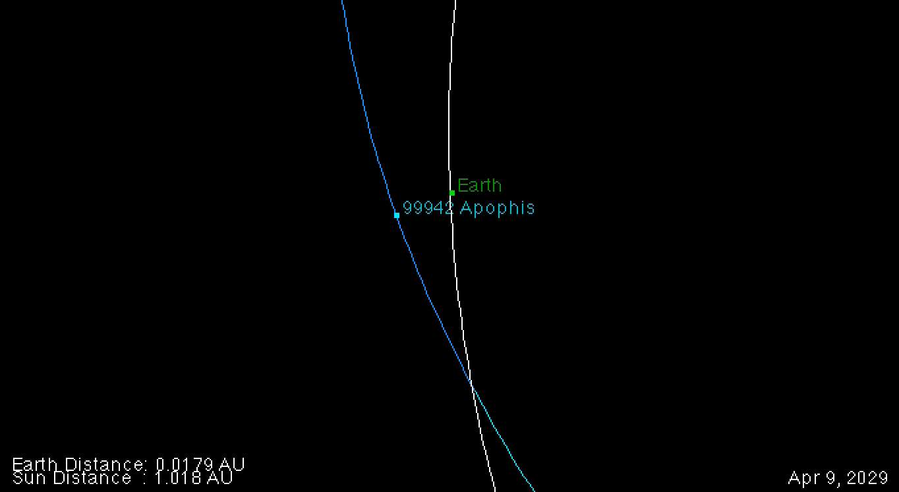
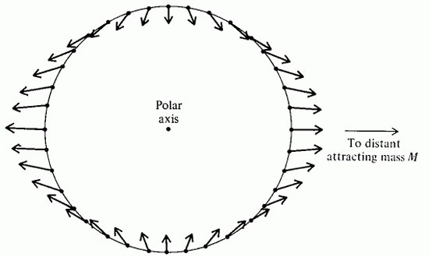
Motivation
Tidal Encounter:
Earth’s tidal forces act on Apophis regolith
Source: NASA JPL
Source: aerospaceweb.org
Joe DeMartini (UMD)
4/28/2025

Slide 3
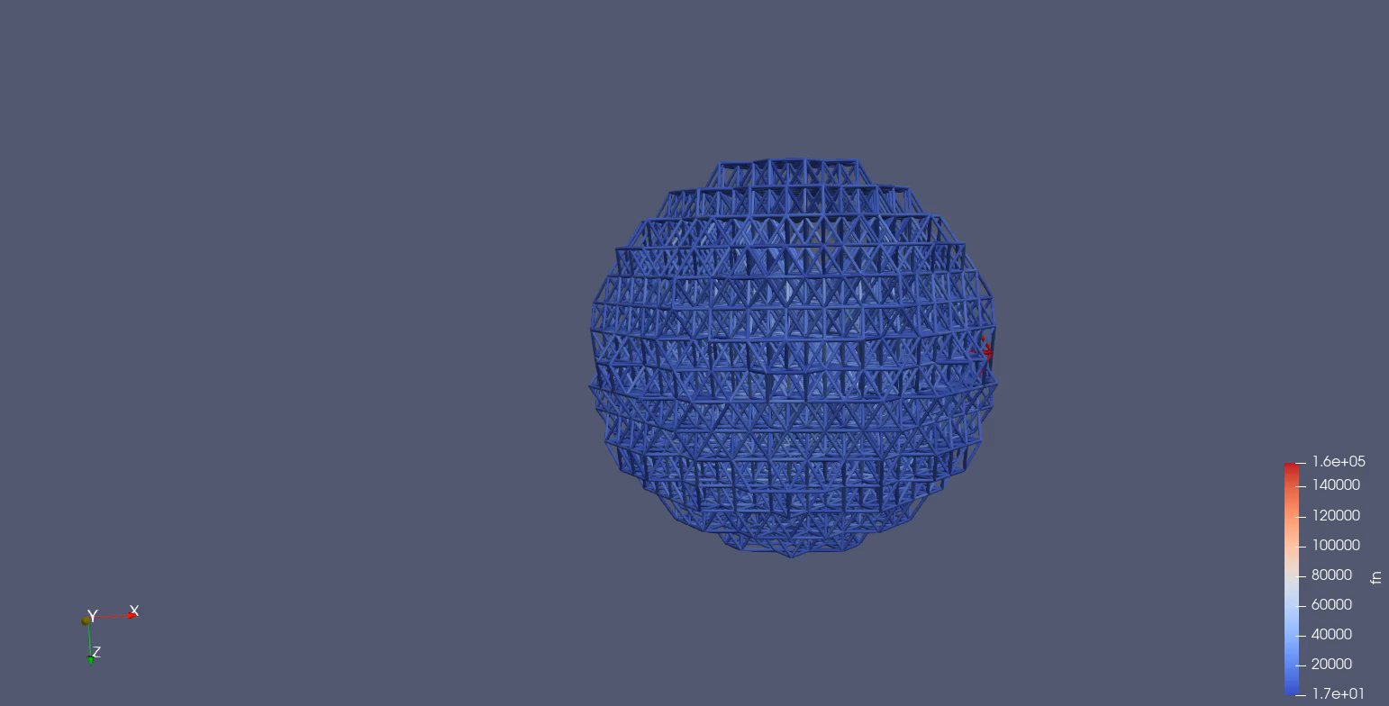
Motivation
Impact simulation
DeMartini et. al, in prep
Tidal Encounter:
Earth’s tidal forces act on Apophis regolith
Bulk shape change?
Change in rotational state?
Measurable seismic signal(s)?
Quaking?
Put attention-grabbing movies on this slide? One for each of the last 3 bullets
Joe DeMartini (UMD)
4/28/2025

Slide 4
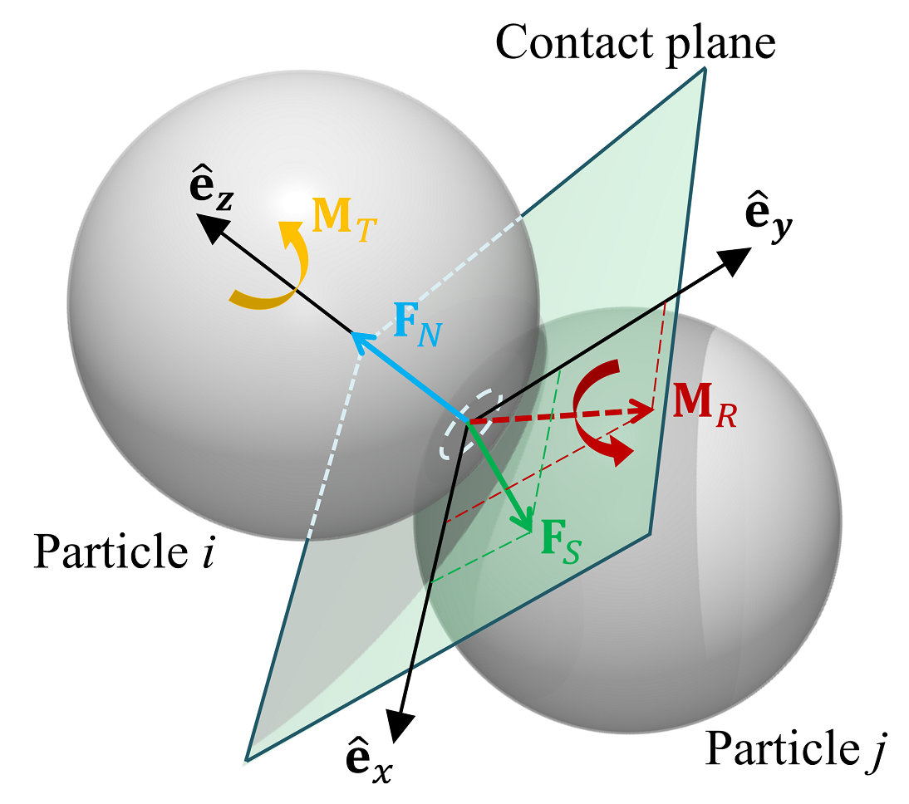
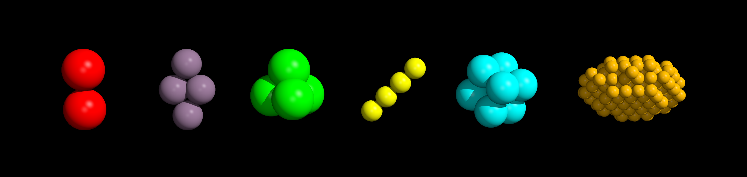
Numerical Approach - pkdgrav
Soft-sphere DEM contact; Zhang et al. 2017
Parallel, N-body Gravity tree code
Calculate mutual gravity between spherical particles
Soft-Sphere Discrete Element Method
Contact forces
Restoring (Hooke) spring force
Energy damping + rolling, twisting, sliding friction
Irregular particle shapes
pkdgrav’s glued-sphere “aggregates”
Symmetric Aggregates; Marohnic et al. 2023
Joe DeMartini (UMD)
4/28/2025
Notes:
Small timesteps necessary to see full spring oscillation
parallelization bc we’re just computing forces constantly (not tracking collision events like HSDEM)
1 Mpa = fairly large kn for pkdgrav (similar to that measured for 67P/CG)

Slide 5
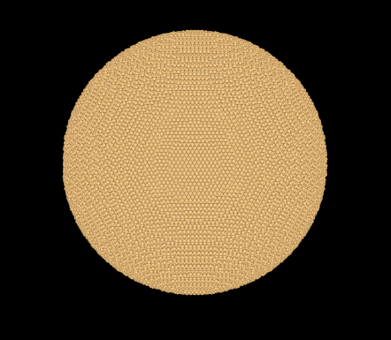
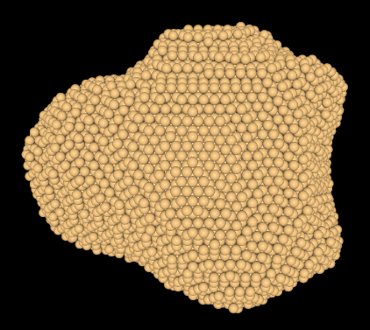
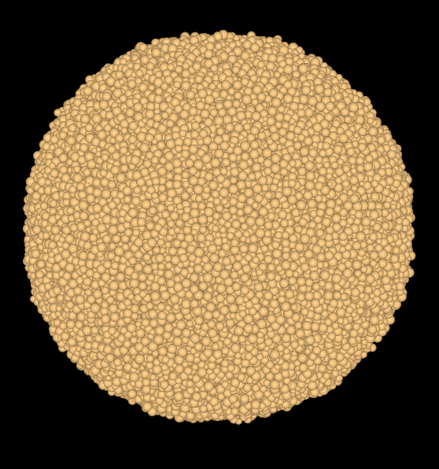
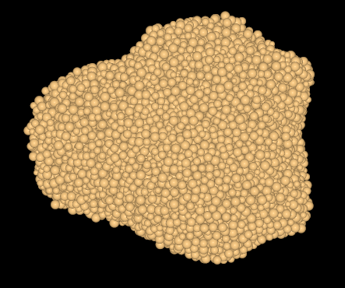
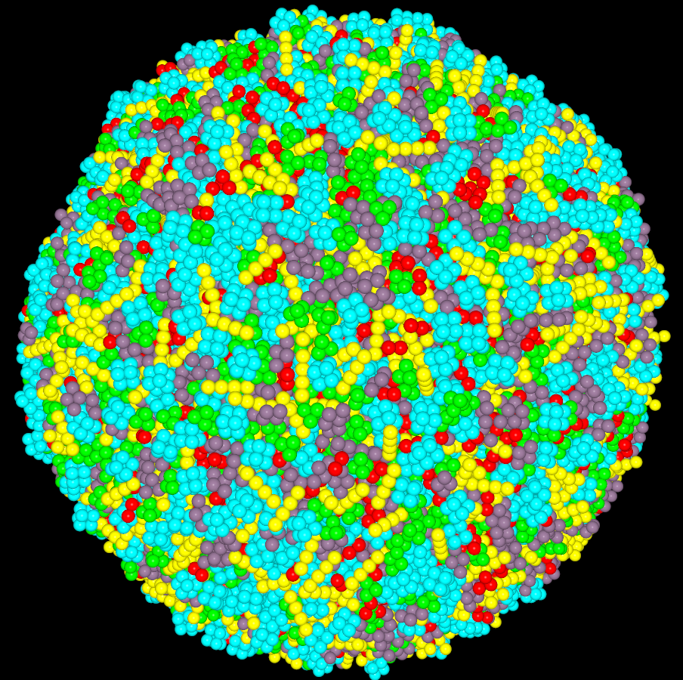
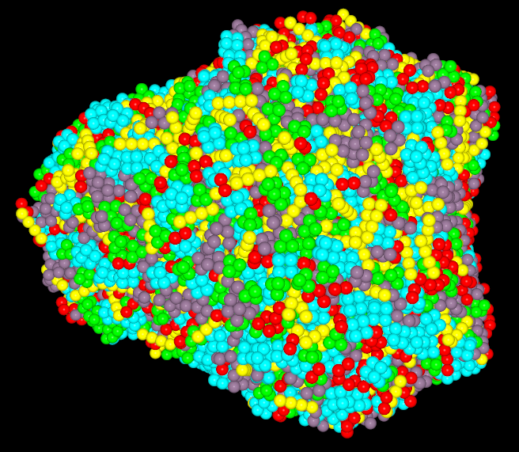

Simulation Setup
DeMartini et. al, 2019
HCP (dense)
Spherical array of particles
Mixed Aggs $ρ_{sph}=$ 3.9 g/cc
Mixed Aggs $ρ_{bulk}=$ $\sim$1.8 g/cc
$R_{sph,agg}=5$ m
$R_{HCP}=9.17$ m
$R_{RPP}=[3.3, 10]$ m, $α$ = -3
Carve shape model (~400 m)
Brozović et al. (2018)
Settle in free space
Bulk rotation period = 30.56 hr; Pravec et al. (2014)
Rotate about intermediate axis
RPP (fluffy)
DeMartini et. al, in prep
Mixed Aggregates (Even fluffier!)
Joe DeMartini (UMD)
4/28/2025

Slide 6
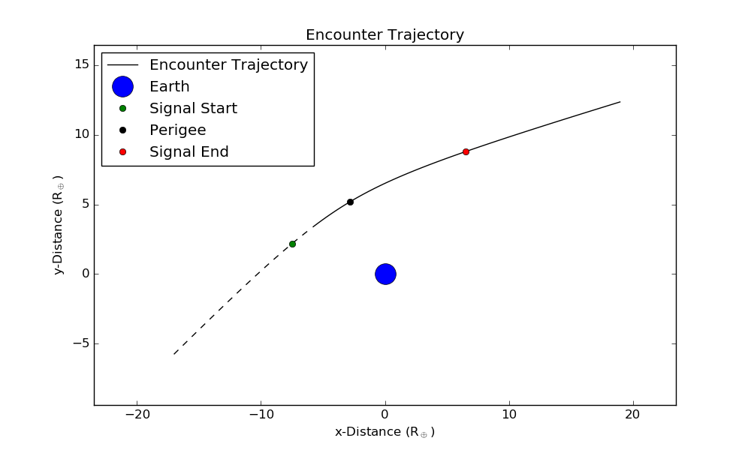
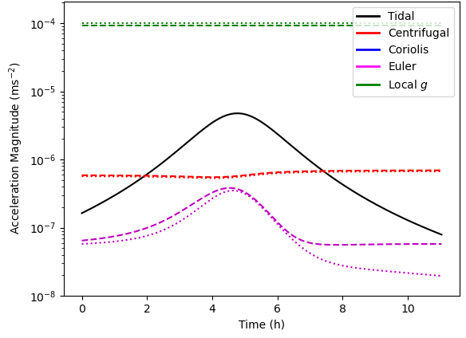
Encounter Details
Apophis COM frame
New sims: Orbit in x-y plane
6 hours significant tidal influence
DeMartini et. al, 2019
Joe DeMartini (UMD)
4/28/2025
Notes:
Clarify coordinate system for trajectory plot. Explain that we rotate so that the encounter occurs in the x-y plane

Slide 7
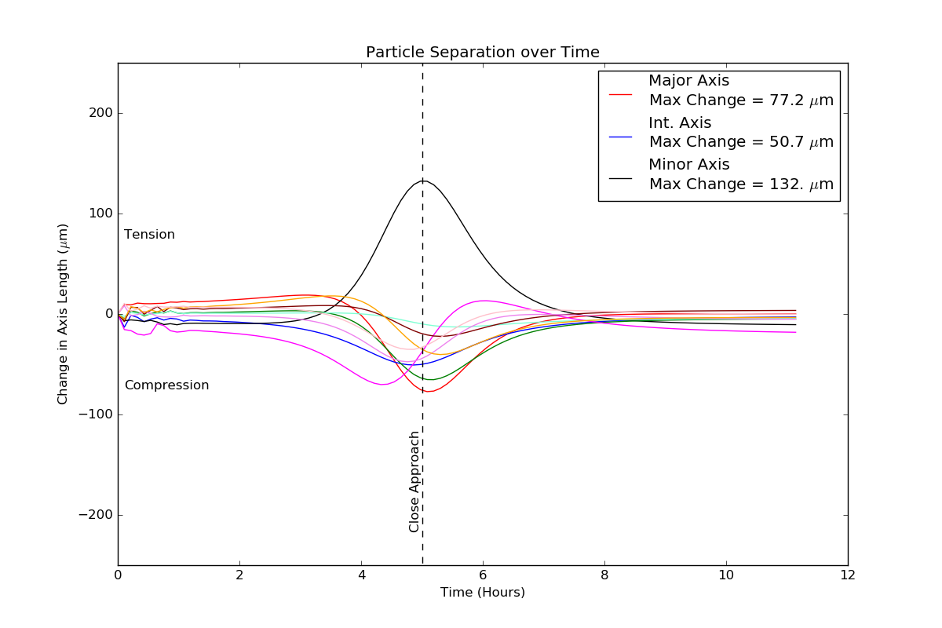
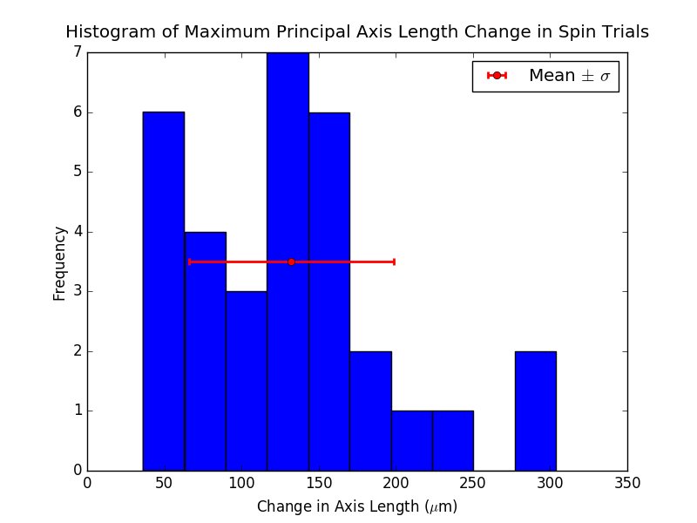

Axis Length Changes – HCP
Tension
Compression
Close Approach
Time (Hours)
(Hours)
DeMartini et. al, 2019
Encounter orientation can alter deformation by $\sim$1 order of magnitude
Joe DeMartini (UMD)
4/28/2025

Slide 8
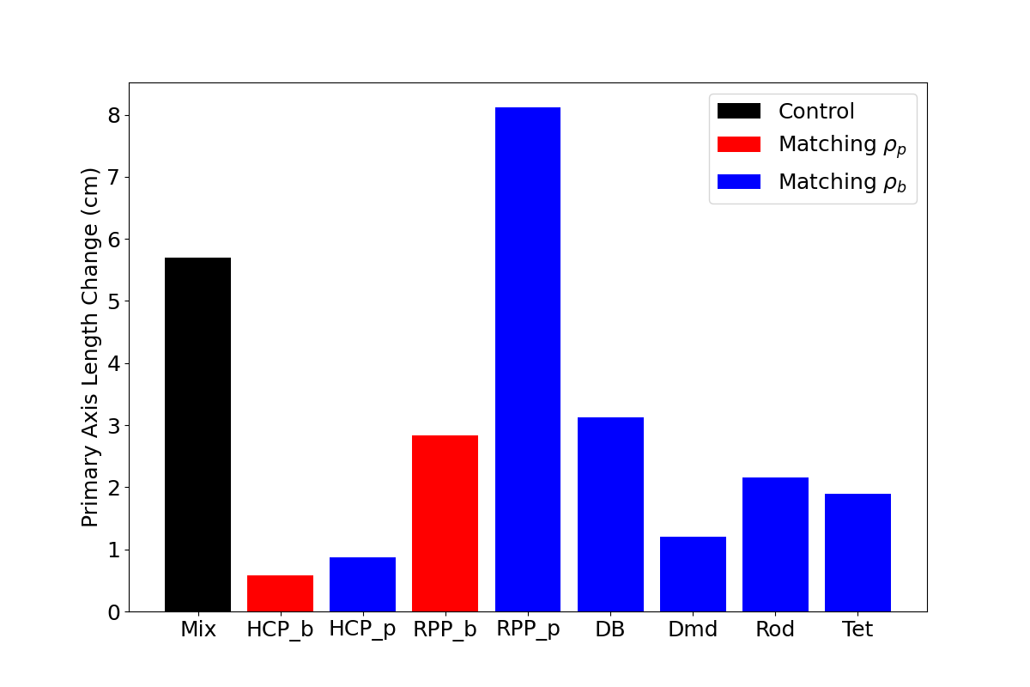
Axis Length Changes – Comparison
DeMartini et. al, in prep
Increased porosity from mixed particle shapes/sizes increases deformation
Joe DeMartini (UMD)
4/28/2025

Slide 9
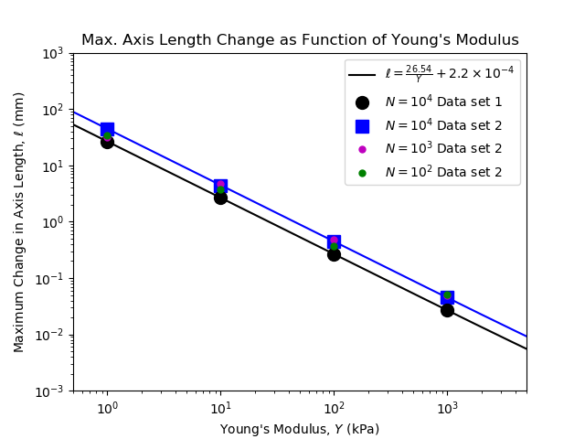
Axis Length Changes – Comparison
DeMartini et. al, 2019
Figure: Comparison of max axis length change for different constituents
(smaller)
DeMartini et. al, in prep
Effective Young’s Modulus (new models): $\sim 10$ kPa
True strain magnitudes will depend on Young’s Modulus
Joe DeMartini (UMD)
4/28/2025

Slide 10
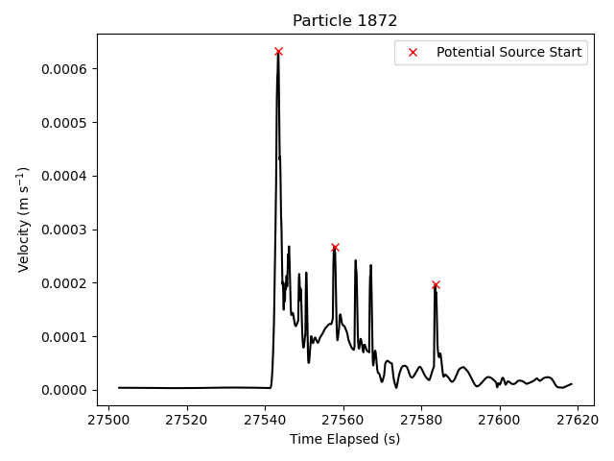
Seismic Source Analysis: Source Identification (RPP, higher resolution)
Identify Sources:
Particle velocity magnitude profiles
Min. prominence = 1.9e-4 m/s
Max. width = 100 samples (3.8 sec)
Minimum interval = 5 s
Simple numerical derivative for accelerations
DeMartini et. al, in prep
Joe DeMartini (UMD)
4/28/2025

Slide 11
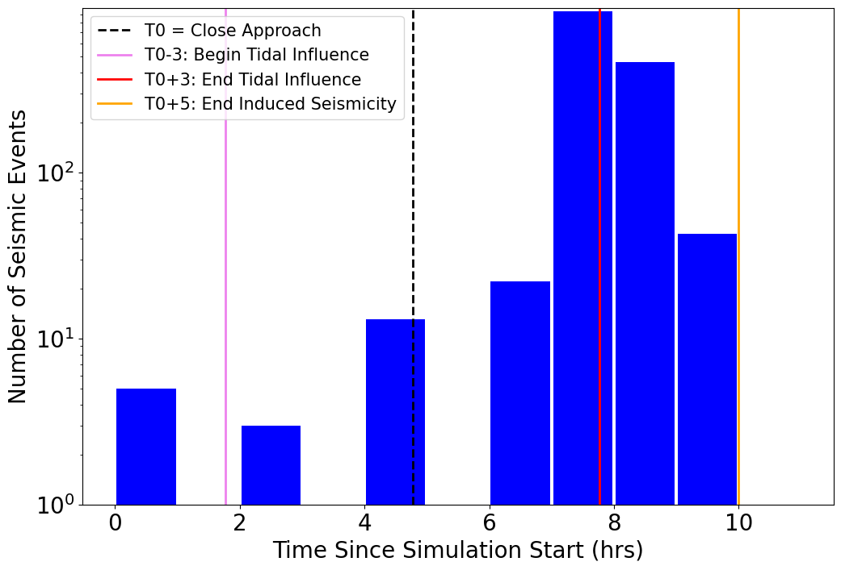
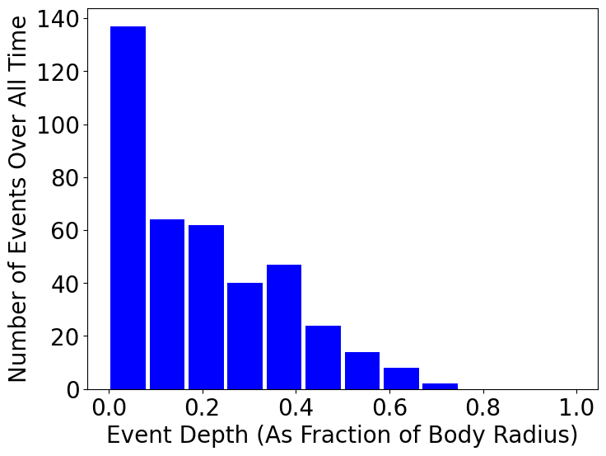
Seismic Source Analysis: Depth and Timing
DeMartini et. al, in prep
Figure: Source timing
Figure: Source depth
Most sources occur at the end of the period of strong tidal influence,
and at shallow depths (< 30 m)
Joe DeMartini (UMD)
4/28/2025

Slide 12
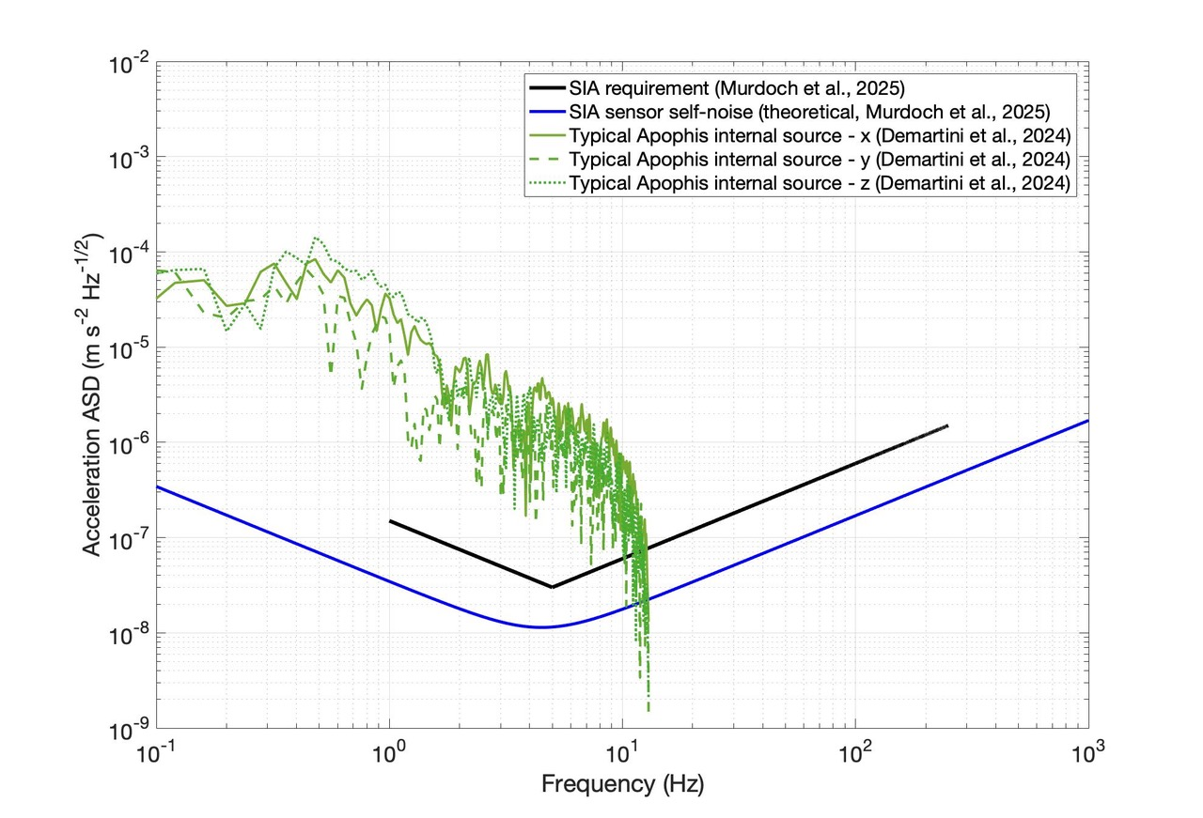
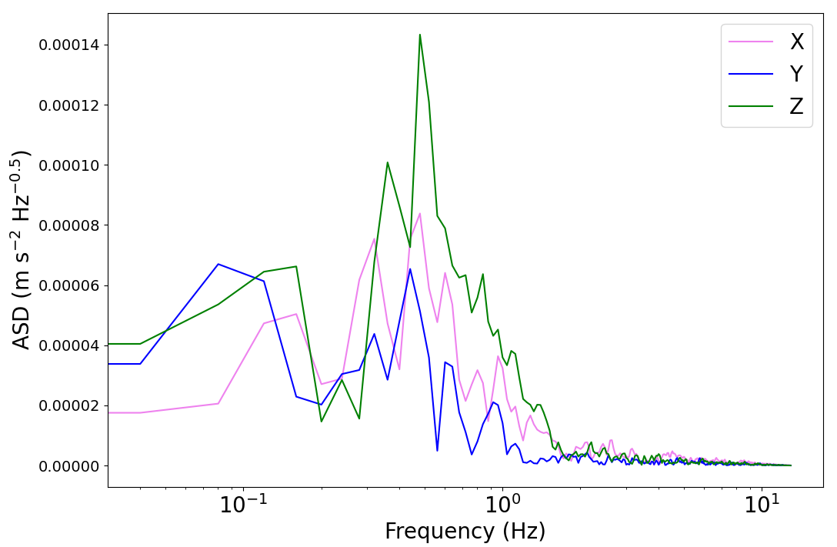
Seismic Source Analysis: Frequency Content
DeMartini et. al, in prep
Peak frequencies between 0.5 – 1 Hz
Peak Acceleration Amplitudes < 1e-3 m s⁻²
Joe DeMartini (UMD)
4/28/2025

Slide 13
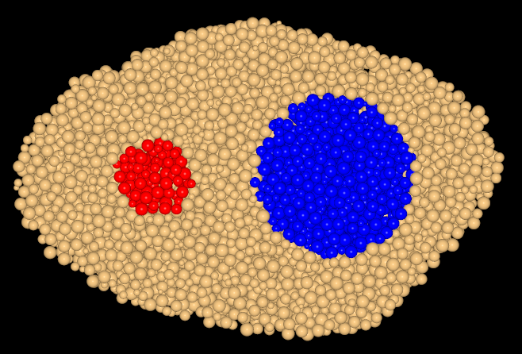
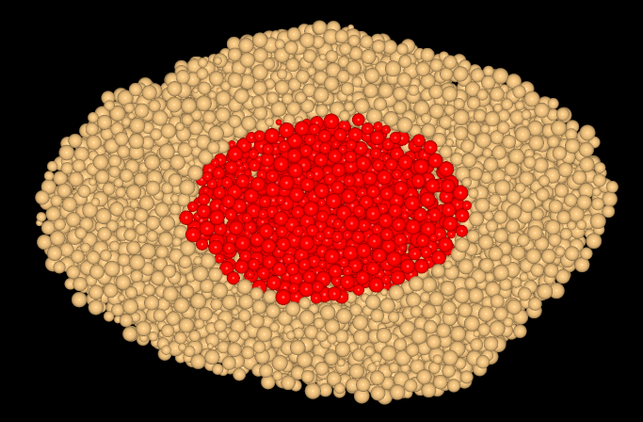
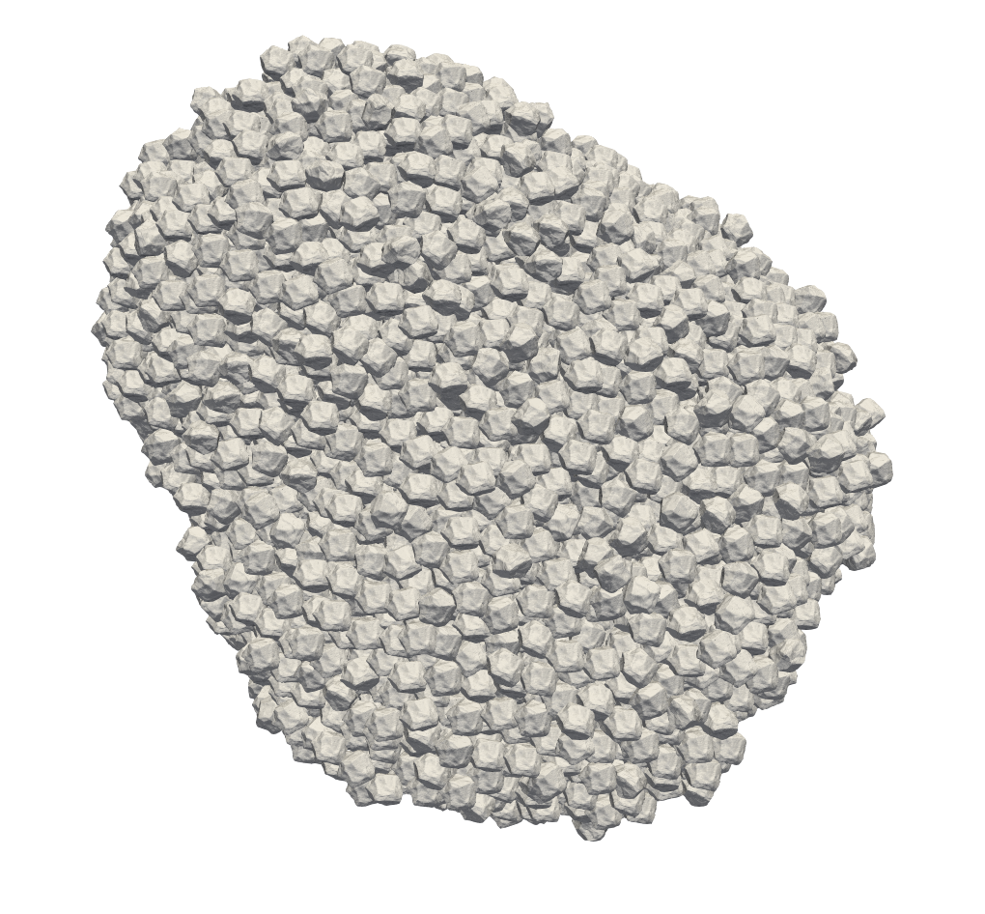
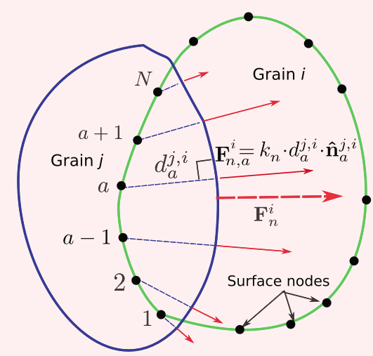
Ongoing Work
Varying internal structures:
Single core
Contact binary
Seismology w/ irregular shapes
Level Set DEM
See poster by Adriana Daca (Abstract #138)
Figure: Nereus w/ diff interiors
OR collapsed aggs w/ diff interiors
Figure: Adriana’s level set stuff
Level-Set Apophis; Daca et al., this conference
Level-Set DEM contact; Feldfogel et al., 2023
Joe DeMartini (UMD)
4/28/2025
Notes:
Easier to deform if Contact Binary, more difficult w/ a single competent core

Slide 14
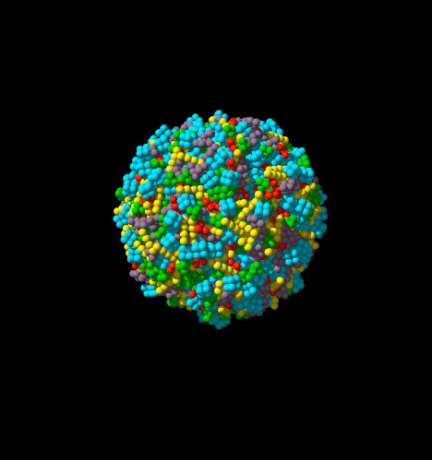

Conclusions
Encounter orientation determines change in rotational state
Deformation will be primarily elastic
Constraining material parameters will determine magnitude
Likely to generate shallow “quakes” or “faults” at the end of the tidal influence
Measurable with current technology!
More realistic constituent shape/packing increases expected deformation by $\sim 10$x
Joe DeMartini (UMD)
4/28/2025

Slide 15
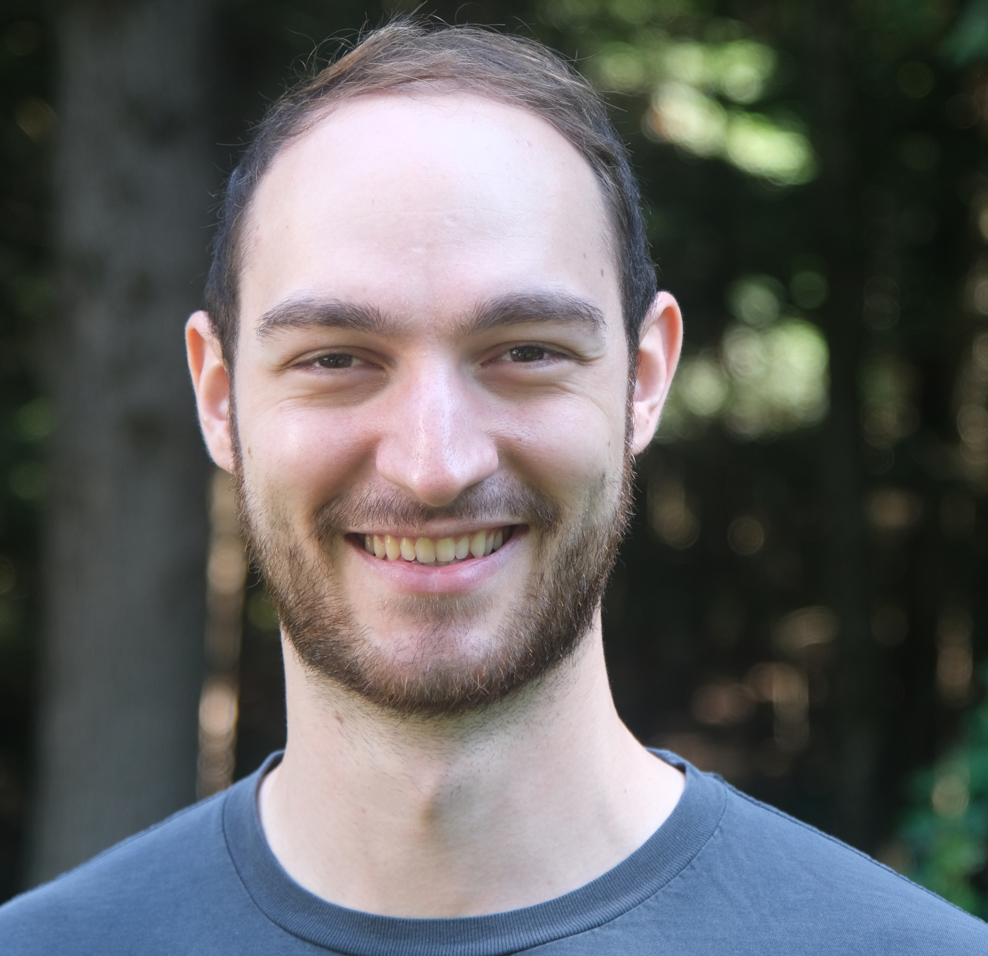
Thank you!
Contact me!
Joe DeMartini (he/him/his)
7th Year Ph.D Candidate
University of Maryland, College Park
jdema@umd.edu
Joe DeMartini (UMD)
4/28/2025

