Slide 1


Look Before You Leap: Approaches for Rapid Response of NEOS
Benjamin Donitz¹, Joseph Lazio¹, Jim Bell² (Presenting), Julie Castillo-Rogez, Carol Raymond¹, Declan Mages¹, Paul Chodas¹, Darryl Z. Seligman³, Karen Meech⁴, Paul Abell⁵, Naoya Ozaki⁶, Mike Brown⁷, Hajime Yano⁸
2025 Planetary Defense Conference
Cape Town, South Africa; May 8, 2025
¹Jet Propulsion Laboratory, California Institute of Technology; ²School of Earth and Space Exploration, Arizona State University; ³Department of Physics and Astronomy, Michigan State University; ⁴Institute of Astronomy, University of Hawaii; ⁵Johnson Space Center; ⁶Department of Spacecraft Engineering, Institute of Space and Astronautical Science, Japanese Aerospace Exploration Agency; ⁷Division of Geological and Planetary Sciences, California Institute of Technology; ⁸Department of Interdisciplinary Space Science, Institute of Space and Astronautical Science, Japanese Exploration Agency

Slide 2
Keck Institute for Space Studies
October 24-28, 2023

Slide 3
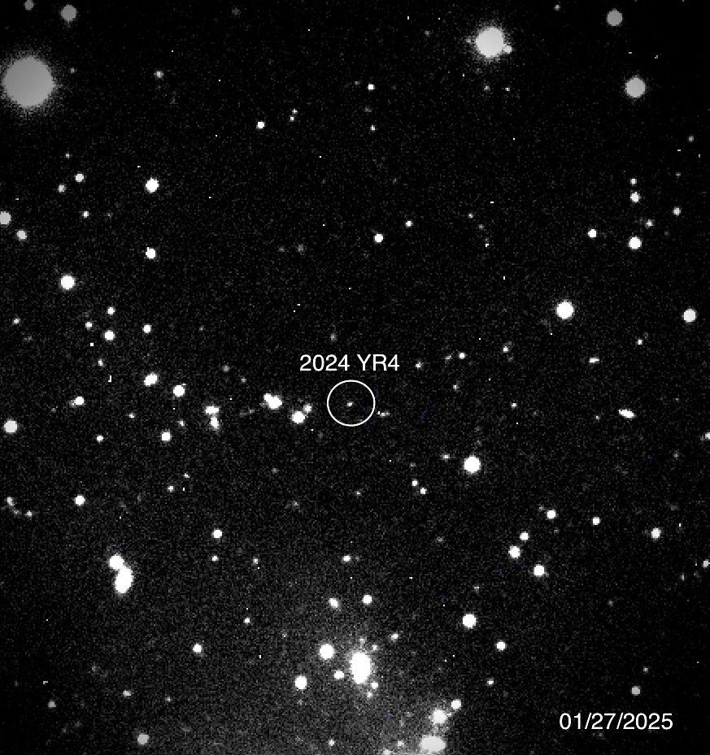
Driving Need for Rapid Response
We will continue to discover potentially hazardous asteroids with increased observation and with next generation observatories like NEO Surveyor and Vera Rubin Telescope
Remote observation is not always sufficient to address three key questions:
Will an object impact a populated area?
Does the object have sufficient mass to warrant a mitigation?
What is the most effective mitigation approach?

Slide 4
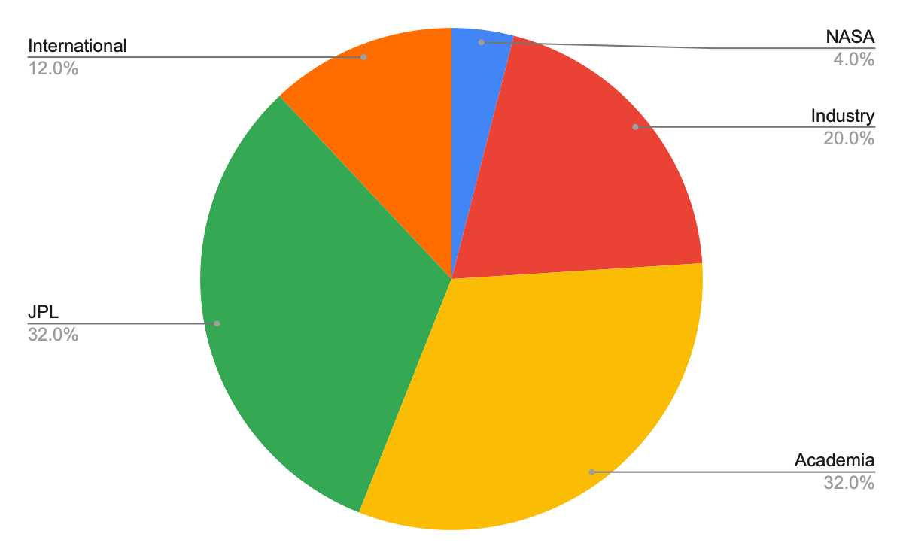
Keck Institute for Space Studies (KISS) Workshop Participants
25 participants from 13 institutions across 3 countries and 8 US states
Study Leads:
Benjamin Donitz (JPL)
Jim Bell (ASU)
Mike Brown (Caltech)

Slide 5
Workshop Participants
Paul Abell, NASA Johnson Space Center | Anne Marinan, Jet Propulsion Laboratory
Coralie Adam, KinetX Aerospace | Joseph Masiero, California Institute of Technology
Oketa Basha, Arizona State University | Karen McConnell, Blue Canyon Technologies
Jim Bell*, Arizona State University | Karen Meech, University of Hawaii
Mike Brown*, California Institute of Technology | Daniel Miller, Massachusetts Institute of Technology
Julie Castillo-Rogez, Jet Propulsion Laboratory | Erica Molnar-Bufanda, University of Hawaii
Paul Chodas, Jet Propulsion Laboratory | Derek Nelson, KinteX Aerospace
Benjamin Donitz*, Jet Propulsion Laboratory | Naoya Ozaki, Japanese Aerospace Exploration Agency
Sonia Hernandez, Continuum Space Systems | Carol Raymond, Jet Propulsion Laboratory
Geraint Jones, University College London | Darryl Z. Seligman, Cornell University
Joseph Lazio, Jet Propulsion Laboratory | Matthew Shaw, Lockheed Martin
Declan Mages, Jet Propulsion Laboratory | Hajime Yano, Japanese Aerospace Exploration Agency
*Study Lead | Walid Majid, Jet Propulsion Laboratory

Slide 6
Pseudo-Science Traceability Matrix for Planetary Defense
Goal | Objective | Measurement | Instrument | Example | Mass/Power Estimate
Improve the assessment of the likelihood of an impact event | Reduce the predicted position uncertainty in the b-plane of the potential impact to less than 0.1 times (TBC) the capture radius | Orbit | On-board radio | IRIS (MarCO), UST-Lite | N/A (Part of spacecraft subsystem)
 |  |  | OpNav Imager | mAPIC* (JPL, demo) | 16 kg / 18 W (avg)
Improve the assessment of the consequence of an impact event | Reduce the uncertainty in mass to less than a factor of 5 (TBC) | Mass/gravity | Gravity probes (low TRL) | OpGrav/SIMMEE (APL, demo) | 16.5 kg / NA
 |  | Diameter | Thermal Imager | TIR (JAXA, Hayabusa 2) | 3.3 kg / 18 W (avg)
 |  |  | Visible imager | mAPIC* (JPL, demo) | 16 kg / 18 W (avg)
Inform the optimal mitigation approach, if needed (Not part of threshold mission) | Determine whether the object is a binary system | Target images | Visible imager | mAPIC* (JPL, demo) | 6 kg / 13 W (max)
 | Determine the bulk composition of the target object | Surface composition | Multispectral imager
 | Determine the interior structure of the object including porosity and density distribution | Subsurface topology | Mono-static radar | JuRa (ASI, Hera Juventas) | 1.3 kg / 5 W (RF)
*Multiuse instrument for OpNav and science

Slide 7
Rapid Response Development Timeline
Phase 1: Discovery and Confirmation
Phase 2: Preparation and Launch
Phase 3: Operations
Discovery
Confirmation
Launch
Flyby
Does this target meet our criteria for a mission?
Build spacecraft (?), prepare trajectory, obtain licenses, etc
Autonomous operations and fast flyby

Slide 8
Improving Rapid Response Development Timeline
Phase 1: Discovery and Confirmation
Phase 2: Preparation and Launch
Phase 3: Operations
Discovery
Confirmation
Launch
Flyby
Does this target meet our criteria for a mission?
Build s/c (?), prepare traj., obtain licenses, etc
Autonomous operations and fast flyby
Define clear thresholds to trigger a rapid response mission. For example, likelihood of impact and likelihood of the ground providing sufficient information | Develop a responsive, adaptable mission architecture that can be deployed within TBD months of confirmation | Physics-driven. Optimize launch periods to minimize time between launch and flyby

Slide 9
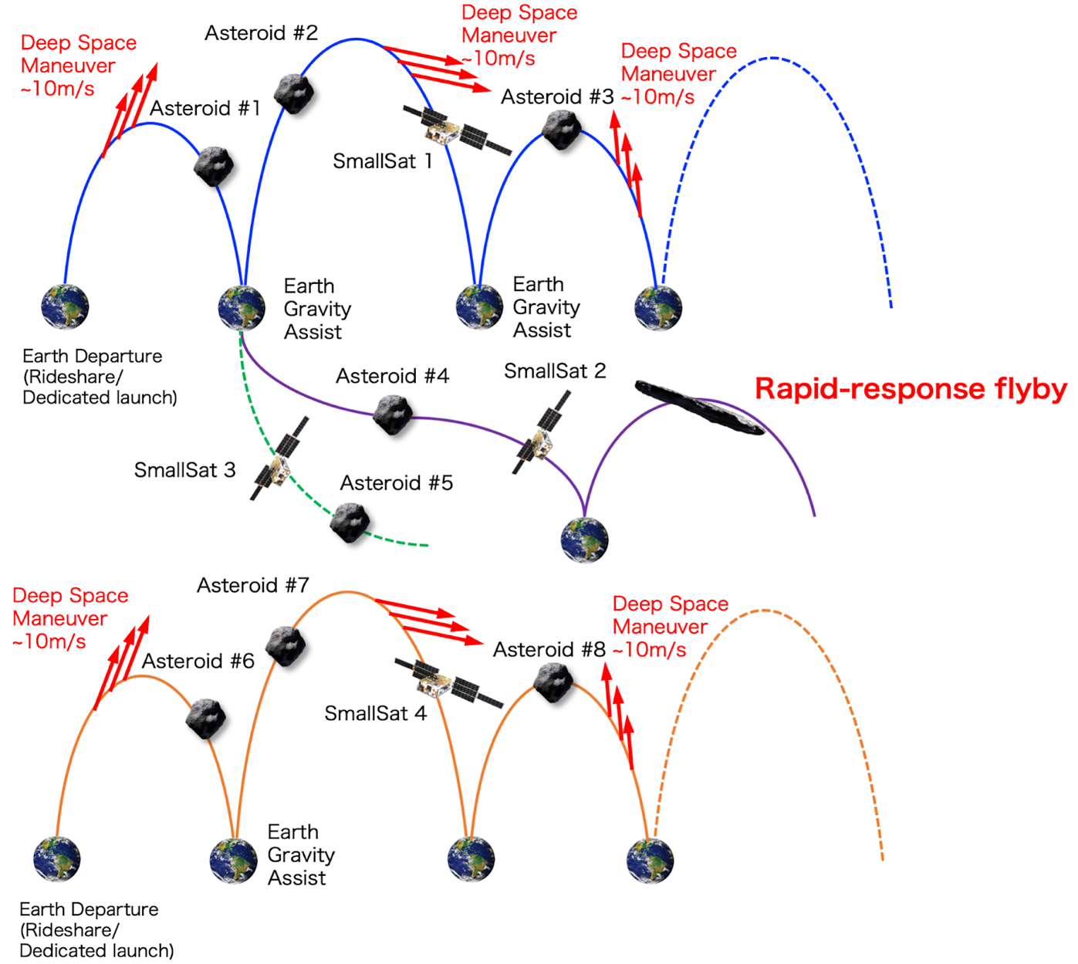
Space Storage Architecture for Rapid Response
Commercial small satellite industry is making it cheaper and more feasible to operate large constellations
Takes advantage of unique mission designs, such as an Earth resonant orbit (pictured right)
Very short response time enabled by asset already being on-orbit
Supplementary science opportunity
Space-stored spacecraft can be on-target very shortly after detection and rideshare minimizes the cost of deploying a large constellation to loitering orbits
From N. Ozaki

Slide 10
Ground Storage Architecture for Rapid Response
Commercial spacecraft partners are making batch-built low-cost spacecraft more feasible
On-going DoD activities related to tactical and responsive launch are driving down the time required to integrate onto a commercial small launch vehicle
Pre-established agreements with regulatory bodies can reduce the time associated with licenses and regulation
Ground-stored spacecraft can be tailored to the target, maximizing payload mass and keeping cost low by putting delta-V on the launch vehicle rather than on the spacecraft
Final Int.
Functional Test
Nav Analysis
Activities
LV Procurement
LV Int.
Launch!
LV Analysis
FCC, FAA, DSN, other licenses
Time

Slide 11
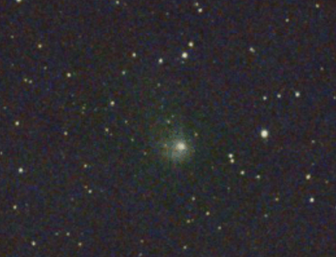
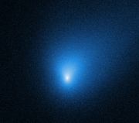
Feed Forward Applications
Architectures and approaches developed for planetary defense rapid response also directly feed forward to science targets like interstellar objects and long period comets
Paradigm is similar: a fleeting object is discovered and to explore, rapid response is necessary
Comet C/2017 K2
Response required: 5 years
ISO 2I/2019 Borisov
Response required: < 1 year

Slide 12
Rapid Response Mission Demonstration
Mission Definition
Derive Level 1 requirements for rapid response (e.g. response time required, target parameters, cost cap, top level objectives)
Develop a rapid response capability that includes plans for a flight system, space delivery plan, and an assessment for time to respond
Identify any technology or capability gaps required for rapid response
The capability should be target-agnostic
Ready to initiate Rapid Response Mission Definition!
Capability Assessment
Provide a simulated rapid response target and enact the mission plan defined in Mission Definition phase
Assess the time and effectiveness to respond
Perform the assessment a second time (ideally, depending on cost) and assess the cost delta; the recurring cost should be relatively low

Slide 13
Next Steps
Population study to determine bounding mission design requirements including response time, launch energies, min/max distances from the sun for response trajectories
Architecture studies to determine approaches and costs to be capable of responding to 90% (TBC) of all potential impactors
Learn more: https://kiss.caltech.edu/final_reports/Rapid_Response_final_report.pdf
100%
Mission/Program Cost
% Impactors Accessible

