Slide 1
Novel Reutilization of the European Service Module in Service of Planetary Defense
Lorraine Fesq, Carol Raymond, Jennifer Scully, James Keane, Dave Bearden
Jet Propulsion Laboratory/California Institute of Technology
Stephan Ulamec, DLR, Linder Höhe
Jean-Baptiste Vincent, Matthias Grott, DLR Institute of Planetary Research
Christian J. Renggli, Norbert Krupp, Thorsten Kleine, Max Planck Institute for Solar System Research
Matthias Winter, Airbus Defence and Space GmbH
Robert Luther, Museum für Naturkunde – Leibniz-Institute for Evolution and Biodiversity Science
Kai Wünnemann, Museum für Naturkunde and Freie Universität Berlin, Institute of Geological Sciences, Planetary Sciences and Remote Sensing
William Bottke, Southwest Research Institute, Department of Space Studies
© 2025 California Institute of Technology.
Government sponsorship acknowledged.
Planetary Defense Conference
Cape Town, South Africa, April 5-9, 2025

Slide 2
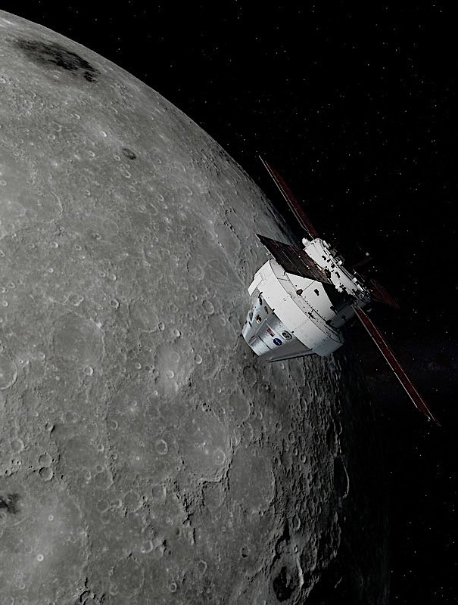
Concept
Artemis’ European Service Module returns to Earth with escape velocity
Nearly a complete Spacecraft (some functions missing)
Significant remaining fuel
Hardware built for longer life duration (210 days)
Unpressurized cargo support (ESM capability: ~380kg)
By leveraging the remaining propulsive capabilities, post separation, the ESM has the potential to provide a near term method, at a reduced cost, to achieve science return across an array of mission types

Slide 3
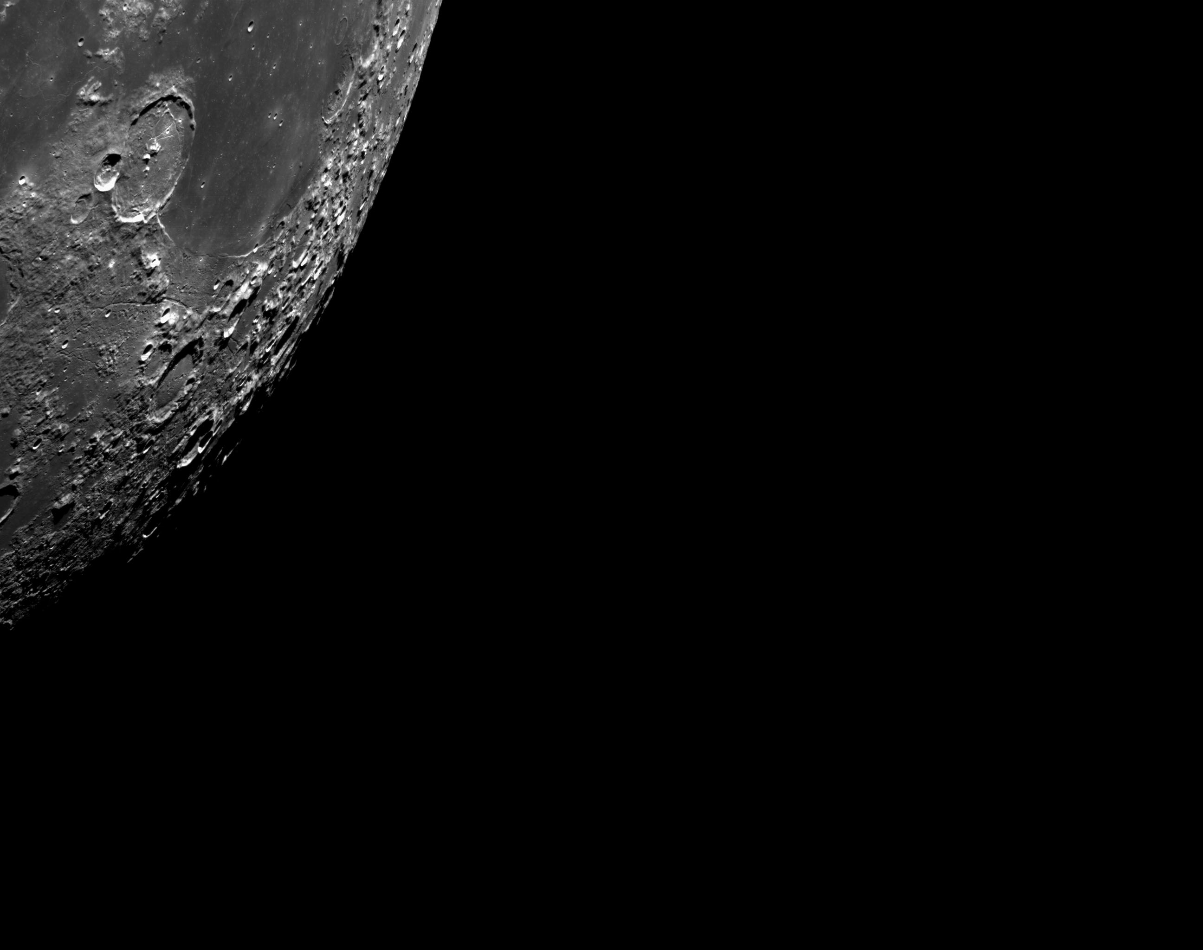
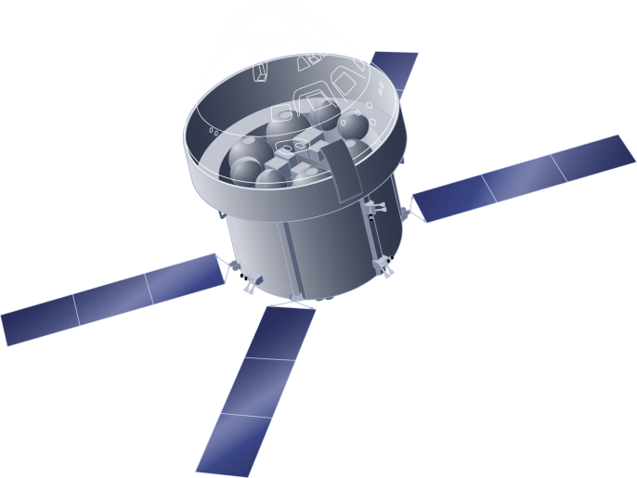

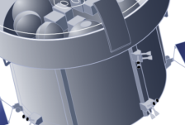



Orion ESM
ORION ESM
CREW MODULE
Propulsion (1 x 26.7 kN main engine, 8 x 490 N auxiliary engines)
Attitude Control (24 x 220 N RCS thrusters, 8 sun sensors)
Power Generation, Conditioning and Distribution (11.2 kW)
Thermal Control (heaters, cooling loop, radiators)
Payload Support (up to ~380 kg with power and data interface)
Consumables (~8600 kg of propellant, 90 kg of oxygen, 30 kg of nitrogen, 240 litres of water)
19 m
CREW MODULE ADAPTER
4 m
7 m
EUROPEAN SERVICE MODULE

Slide 4
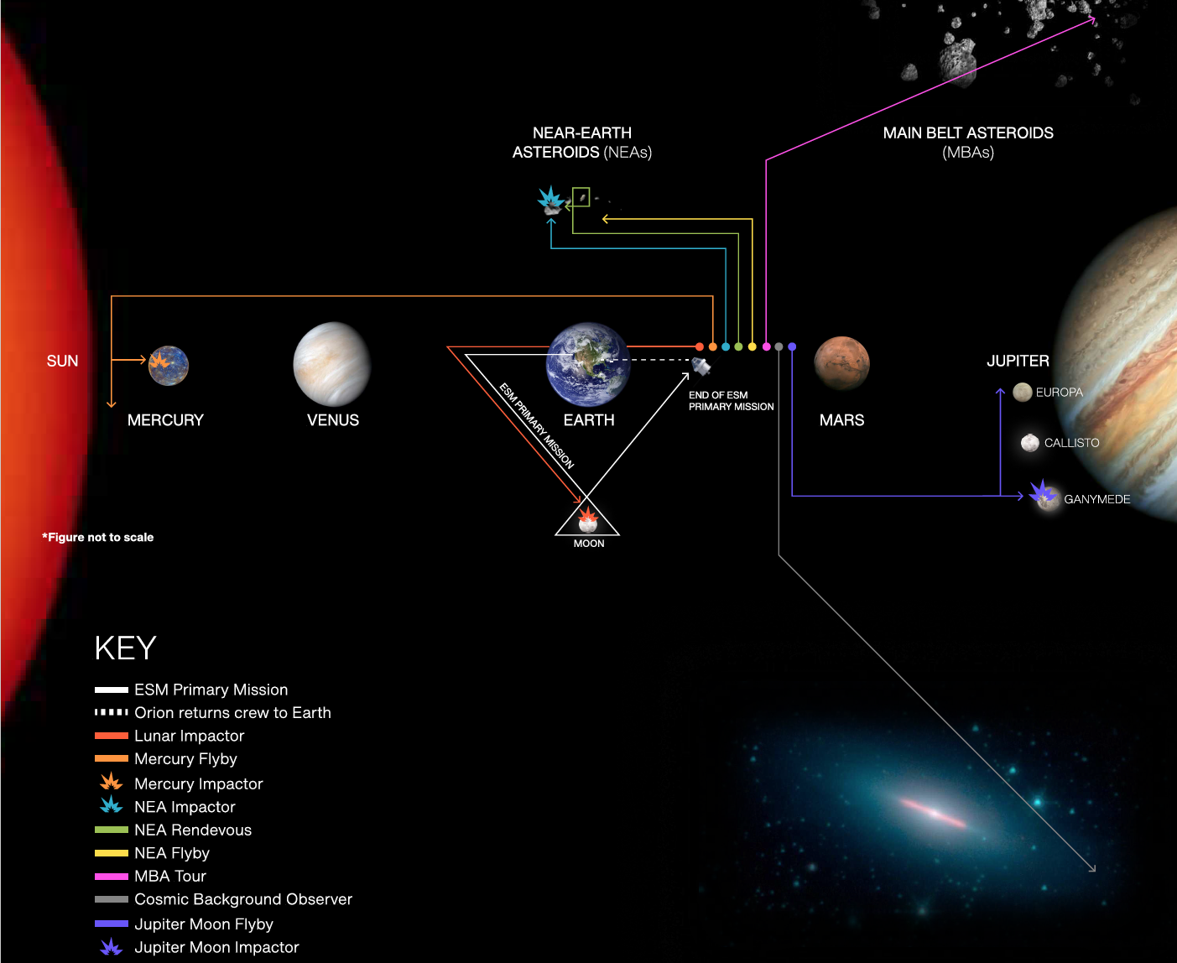
ESM extended mission concepts
JPL hosted a scientific workshop in summer 2024, with US and European participants, to discuss potential ESM extended mission targets
Pre-Decisional Information – For Planning and Discussion Purposes Only. © 2024 California Institute of Technology. Government sponsorship acknowledged.

Slide 5
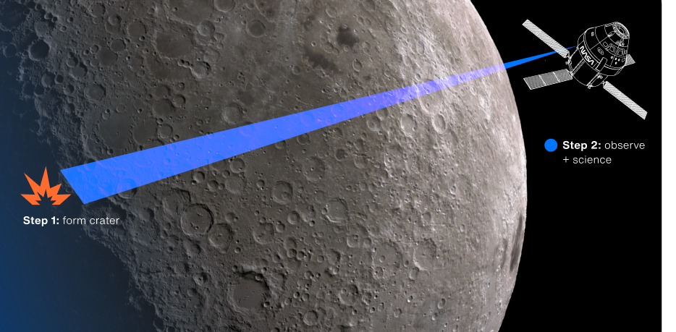
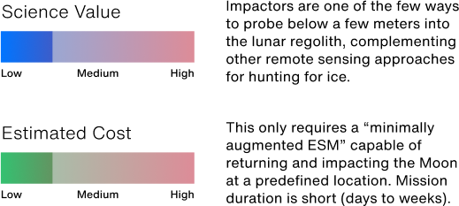
Lunar ice impactor
Send ESM back to the Moon for a targeted impact experiment to enable active seismology and probe the lunar interior
ESM has sufficient remaining propellant to return to the moon for an impact
ESM has 2x the mass of LCROSS
Creation of a fresh impact crater in the Artemis exploration zone could provide an exciting target for crewed exploration
The plume could be observed from Earth or from other spacecraft
Pre-Decisional Information – For Planning and Discussion Purposes Only. © 2024 California Institute of Technology. Government sponsorship acknowledged. The cost information contained in this document is of a budgetary and planning nature and is intended for informational purposes only. It does not constitute a commitment on the part of JPL and/or Caltech.

Slide 6
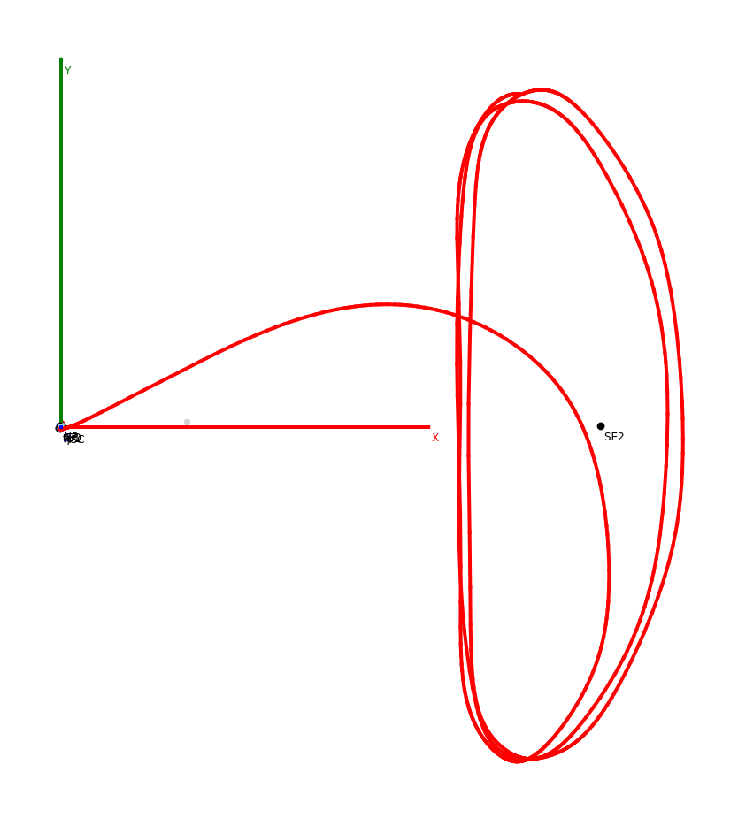
Staging Orbit Analysis
Place the ESM into a staging orbit to use later, either to impact the moon, or when a small body is identified for investigation or deflection
△V ~15-32 m/s, depending on the epoch, to put the ESM in a staging orbit. If phasing loops around Earth is required, +25 m/s per orbit.
Sun-Earth L1/L2 Halo orbit is an ideal staging orbit where we can take advantage of the orbit instability (i.e., easier to get into and out of the orbit)
Targeting the Moon: △V + ~60 m/s
Conclusion: ESM has sufficient remaining propellant to be placed into a staging orbit until a target is identified
Moon’s Orbit (approx.)
Earth
Sun-Earth-L2
Example Case:
CM/SM Separation: 04-JUL-2031
Perigee Raise Mnvr.: 71 m/s (SEP+6.5 min.)
TCM: 15 m/s at SEP+21.8 min.
Halo Arrival: Fall 2031
C3 at L2: -0.676 km²/s²

Slide 7
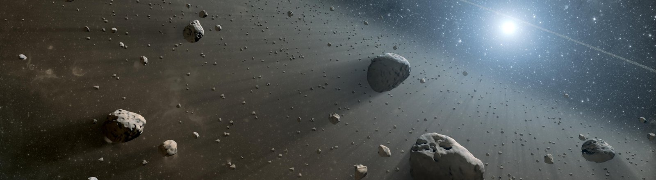
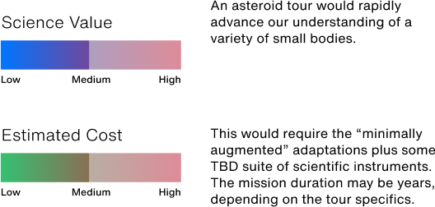
Asteroid tour
There are many diverse, unexplored classes of near-Earth and main belt asteroids => some are associated with water (e.g., 24 Themis), others with metals (e.g., 216 Kleopatra), and others are impact hazards
ESM has sufficient remaining propellant to reach hundreds of potential NEO targets and even rendezvous with some, leading to the potential to rapidly accelerate our understanding of these worlds
Pre-Decisional Information – For Planning and Discussion Purposes Only. © 2024 California Institute of Technology. Government sponsorship acknowledged. The cost information contained in this document is of a budgetary and planning nature and is intended for informational purposes only. It does not constitute a commitment on the part of JPL and/or Caltech.

Slide 8
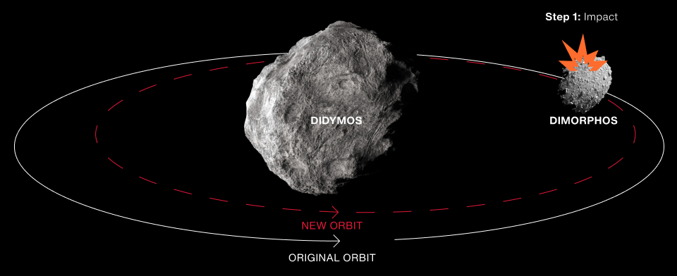
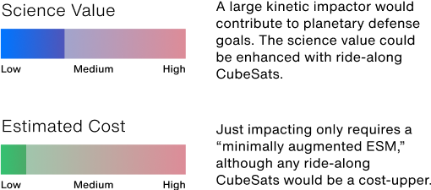
Asteroid Impactor
Send ESM to impact a suitable Near Earth Asteroid (NEA) to demonstrate a kinetic impact
ESM has a dry mass 7x larger than DART
Impacting an NEA alone is not sufficient, unless you also have the ability to observe the effects of the impact
Need to evaluate the ramifications for a larger kinetic impact test for planetary defense
Pre-Decisional Information – For Planning and Discussion Purposes Only. © 2024 California Institute of Technology. Government sponsorship acknowledged. The cost information contained in this document is of a budgetary and planning nature and is intended for informational purposes only. It does not constitute a commitment on the part of JPL and/or Caltech.

Slide 9
Trajectory Option Summary
ESM has sufficient remaining propellant to return to the moon, to escape the Earth-Moon system, to put into a staging orbit, and reach potentially hundreds of NEO targets
Initial Perigee Raise Maneuver
(raise perigee to
120 km alt.)
71 m/s
Sun-Earth L1/L2
Staging Orbit
15-32 m/s
Moon Target
Additional ~60 m/s
Apogee Maneuver in Earth Orbit (raise perigee to
120 km alt.)
~25 m/s
per Earth Orbit
Service Module Separation
NEOs
Additional ~80 m/s for C3 = 1 km²/s² without targeting (+31 m/s for C3 = 2 km²/s² )
Moon Target
Additional
60-250 m/s
NEOs
Very limited in targeting NEO. Phasing will be an issue.

Slide 10
Conclusions
ESM opens new opportunities for low-cost missions
Augmented missions could include asteroid impactors with CubeSats, sample return missions, asteroid landers, and seismicity studies.
Although the ESM has the potential to deliver additional scientific value beyond its current scope, the scientific value added will have to be weighed against programmatic considerations and carefully analyzed within the ESM's programmatic framework and its stakeholders.
The ESM will have propulsive capabilities post Crew Module separation that offer the possibilities to achieve tantalizing science and planetary defense objectives at a lower-cost

Slide 11
Backup

Slide 12
Workshop Participants
Airbus Defence and Space GmbH
– Head of moon programs: Ralf Zimmermann
– Lead Systems Engineer for European Service Module:
Matthias Winter
– Lead Campaign Manager - Moon Exploration: Thomas Schrage
• Germany/Deutsches Zentrum für Luft- und Raumfahrt (DLR)
– Programm and Project Management for Human Spaceflight:
Sophie Bielawski
– Planetary Scientist, Robert Luther
– Planetary Scientist, Kai Wünnemann
– Planetary Scientist, Matthias Grott
– Planetary Scientist, Stephan Ulamec
– Planetary Scientist, Jean-Baptiste Vincent
– Planetary Scientist, Thorsten Kleine
– Planetary Scientist, Norbert Krupp
– Planetary Scientist, Christian Renggli
US/JPL
– Planetary Science Program Office Program Scientist: Carol Raymond
– Program Area Manager, Small Bodies and Planetary
Defense: Lorraine Fesq
– Planetary Scientist, Bill Bottke
– Planetary Scientist, Paul Byrne
– Planetary Scientist, Simone Marchi
– Planetary Scientist, James Tuttle Keane
– Planetary Scientist, Jennifer Scully
– Heliophysics Scientist: Jamie Jasinski
– Astrophysics Scientist: Eric Huff
– Astrophysics Scientist: Raissa Estrela
– Scientist, formerly Earth Science Program Office: Sabrina
Feldman
• JPL A-Team
– Workshop Facilitator: Alfred Nash
– Workshop Assistant: Ashley Davies
– Trajectory Designer, Reza Karimi

Slide 13
Follow-on Activities Participants
European Space Agency
Project Coordination Manager - Orion-ESM Program: Philippe Berthe
???: Sara Pavesi
Airbus Defence and Space GmbH
Head of moon programs: Ralf Zimmermann
Lead Systems Engineer for European Service Module: Matthias Winter
???, Xavier VO Quang Tue
Germany/Deutsches Zentrum für Luft- und Raumfahrt (DLR)
Programm and Project Management for Human Spaceflight: Sophie Bielawski
???, Manuel Metz
Orion-ESM Engineering Team Lead, Antonio Preden
US/NASA JSC
Orion Mission Evaluation Room Manager, Aaron Cannon
Orion Systems Engineering and Integration Deputy Lead, Patrick Morris
US/JPL
Planetary Science Program Office Program Scientist: Carol Raymond
Program Area Manager, Small Bodies and Planetary Defense: Lorraine Fesq
Planetary Scientist, James Tuttle Keane
Planetary Scientist, Jennifer Scully
Strategic Planner, Ryan Fiorentino
Mission Design, Try Lam and Min-Kun Chung
Manager - Office of Strategic Integration, Dave Bearden

Slide 14
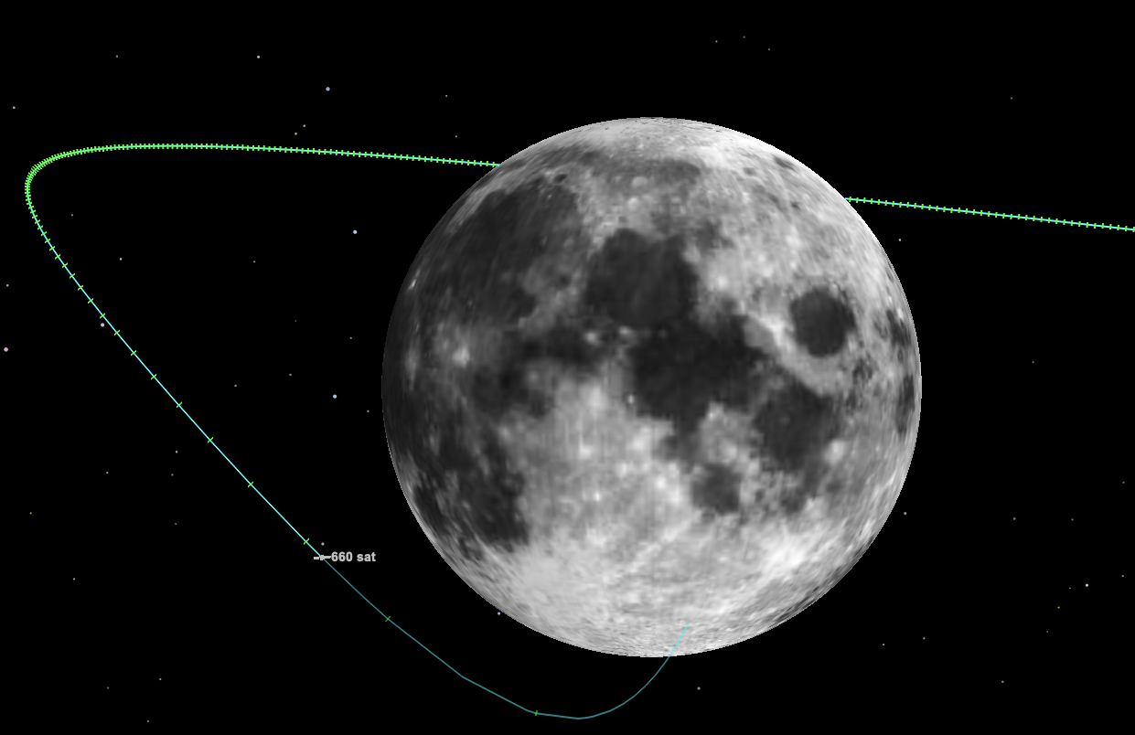
Analyses – Case 1: Return to the Moon
Returning to the moon after the periapsis raise maneuver require propulsive maneuver(s)
For a direct (no-flyby) case, the △V ~60-250 m/s, depends on the epoch and phasing
A more structured approach would be to place it into a ‘staging orbit’ before targeting the moon [more on this later]
Conclusion: ESM has sufficient remaining propellant to return to the moon for an impact
Example Case:
CM/SM Separation: 04-JUL-2031
Perigee Raise Mnvr.: 71 m/s (SEP+6.5 min.)
TCM: 60 m/s on 09-JUL-2031
Lunar Impact: 27-JUL-2031
Impact Target:
Speed: 2.7 km/s
Latitude: -51 deg
Longitude: 32 deg

Slide 15
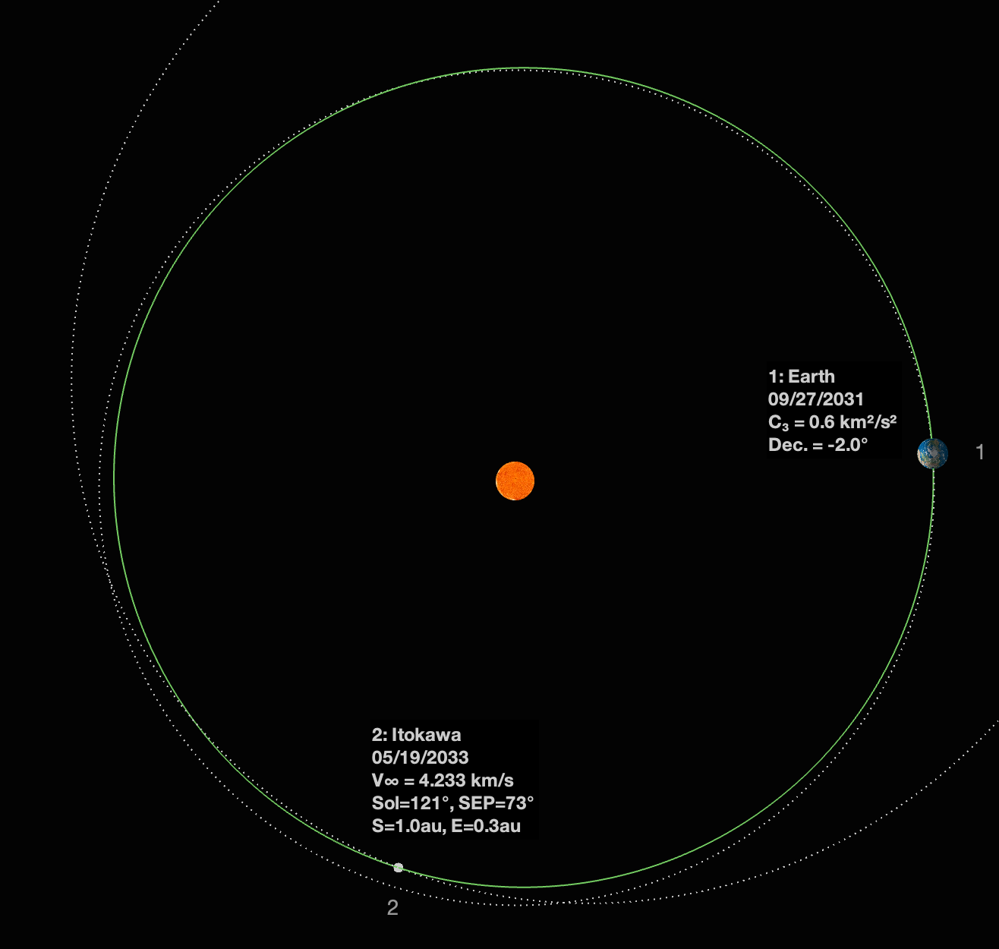
Analyses – Case 3: Asteroid Targeting
Hundreds of NEO targets are reachable for C3 < 2 km²/s². Conservative since C3 between 2-6 km²/s² are reachable depending on available ESM propellant.
3439 NEO target list based on reachable set
△V ~= +80 m/s to C3 = 1 km²/s² from Halo staging orbit, +31 m/s to increase to C3 = 2 km²/s²
Conclusion: ESM has sufficient remaining propellant to reach hundreds of potential NEO targets, and rendezvous with some if flight time was relaxed.
Example Case: To Itokawa
Escape Earth: SEP-2031
Flyby Itokawa: MAY 2033
Total △V ~ 170 m/s (perigee raise, staging insertion, and escape)

