Slide 1
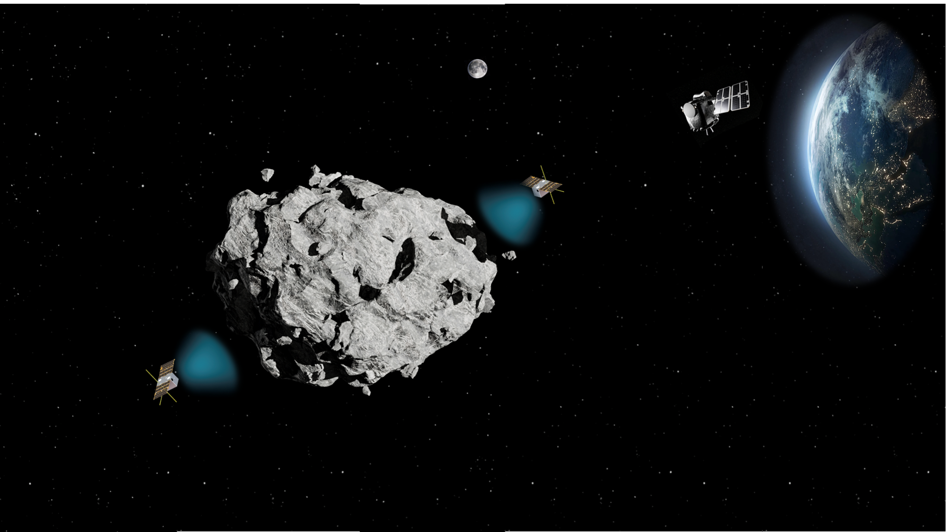





IAA Planetary Defense Conference 2025
Stellenbosch, Cape Town, South Africa, 5-9 May 2025
Apophis 2029:
Advancing Planetary Science & Planetary Defense with the Caltech Mission
Adriana Daca, Masatoshi Hirabayashi, Yaeji Kim, Joseph DeMartini, and the Caltech Mission Team
© 2025 California Institute of Technology.

Slide 2
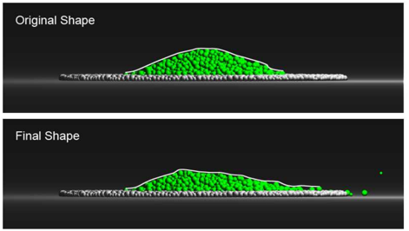
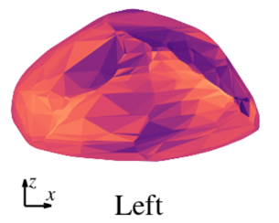

Characterizing Apophis
Schematic diagram of possible interior structures for small asteroid (Asphaug+ 1999)
Goals: | Objectives: | Key Measurements:
Understand the interior structure of a rubble pile asteroid, and implications for its formation, evolution, and response to a mitigation attempt | Determine the shape, bulk density, and bulk porosity of Apophis to constrain its interior structure and mechanical properties. | Global shape and gravity models
 | Determine the internal block size distribution, composition, porosity, and geometric arrangement | Monostatic and bistatic radar observations
Understand how close planetary flybys affect asteroids, to understand how asteroids are resurfaced and respond to impulsive events (like deflection attempts) | Determine cohesive strength by observing material movement on the surface of Apophis during the Earth flyby | Images of the surface of Apophis before and after the Earth encounter
 | Determine how the spin-state of Apophis changes during the Earth flyby | Measurements of Apophis’s spin state before and after the Earth encounter
 | Put asteroids into human context by taking simultaneous resolved images of the Earth and Apophis | Images of Apophis during the Earth encounter
Simulations of regolith pile shapes on Apophis before and after the Earth encounter (Yu+ 2014)
Predicted changes in Apophis’s surface slope during the Earth encounter (Valvano+ 2021)
Model of surface stresses on Apophis during the Earth encounter (Hirabayashi+ 2021)
Pre-decisional Information – For Planning and Discussion Purposes Only
Notes:
The first overarching goal for this mission is to understand the interior structure of a rubble pile asteroid, and implications for its formation, evolution, and response to a deflection attempt.
we want to determine the shape, bulk density and bulk porosity of apophis. This will help constrain its interior structure and mechanical properties. We would also like to determine the internal block size distribution, composition, porosity, and geometric arrangement of blocks and voids.
The second goal is to understand how close planetary flybys affect asteroids - including resurfacing and implications for response to a deflection attempt.
Observing material movement during ECA will help us constrain the cohesive strength. We also want to observe spin state changes as a result of ECA, and take a cool photo of apophis with earth in the background, which will be great for public outreach.

Slide 3
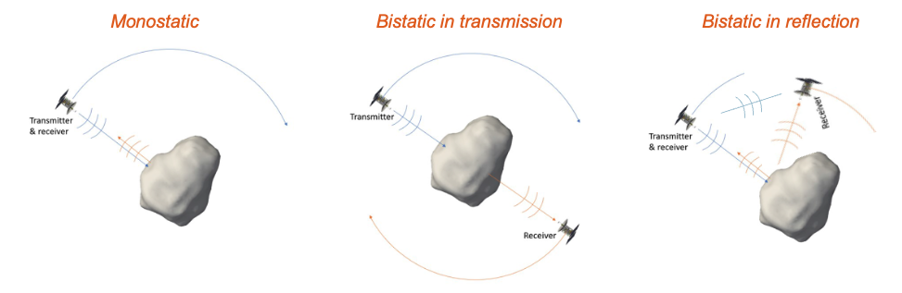
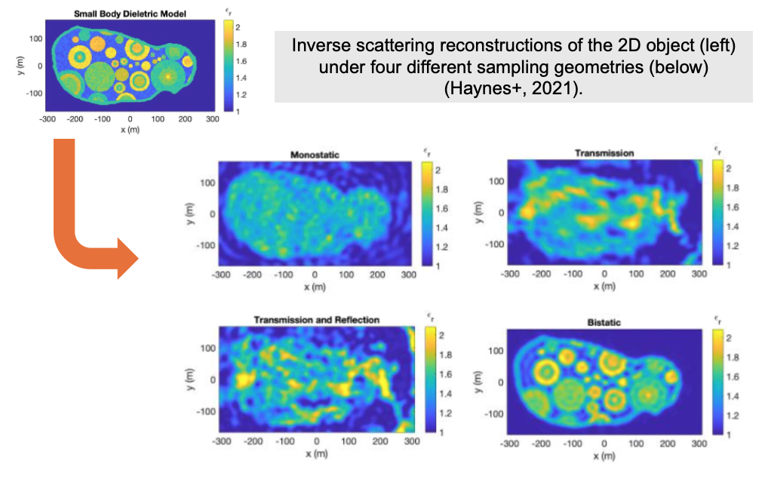
Interior Characterization
The low frequency radar will use simultaneous reflection and transmission measurements to characterize the interior heterogeneity by creating 3D volumetric images of radar backscatter and with time-of-flight measurements through the asteroid.
Requirements:
Interior block and void size distributions at >= 10 m.
Global average permittivity to constrain bulk porosity.
Degree of material heterogeneity at hectometer scales.
If bilobed, determine whether the lobes are different.
Radar modes implemented by the Caltech Mission to Apophis.
Image credit: Alain Hérique and Mark Haynes.
Pre-decisional Information – For Planning and Discussion Purposes Only
3
Notes:
- The 2 CubeSats will perform both monostatic and bistatic radar to map the interior of Apophis.
For radar science, we have 4 main objectives:
We want to assess the block and void size distribution for blocks or voids larger than 10 m
We want to constrain bulk porosity by estimating the global average permittivity.
We want to assess the heterogeneity on the scale of hundreds of meters
We want to determine the structure of the lobes, if it’s bilobed.
we can also compare data between ground-based and in-situ observations from our mission and others.
Scattered fields are simulated for four acquisition geometries: 1) full monostatic reflection (all possible reflection measurements), 2) transmission only, 3) transmission and reflection, and 4) full bistatic (all possible combinations of source/receiver data are collected).

Slide 4
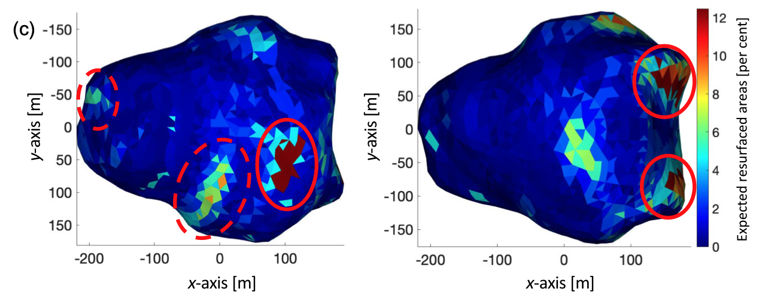
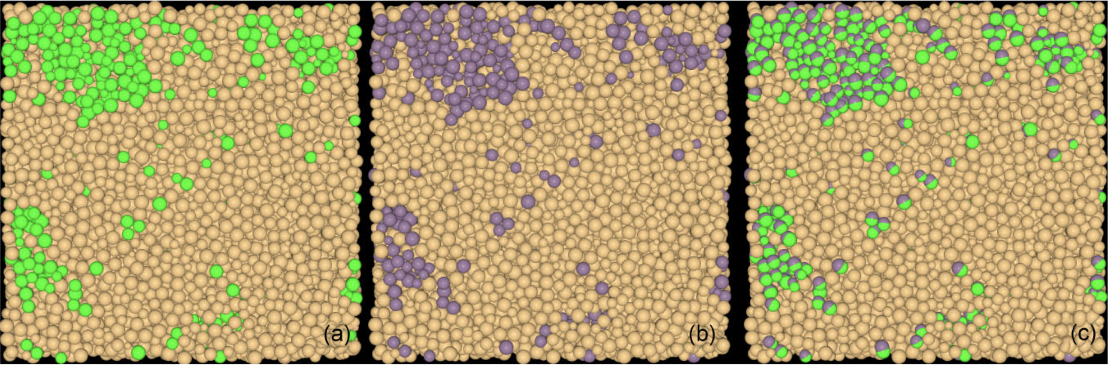
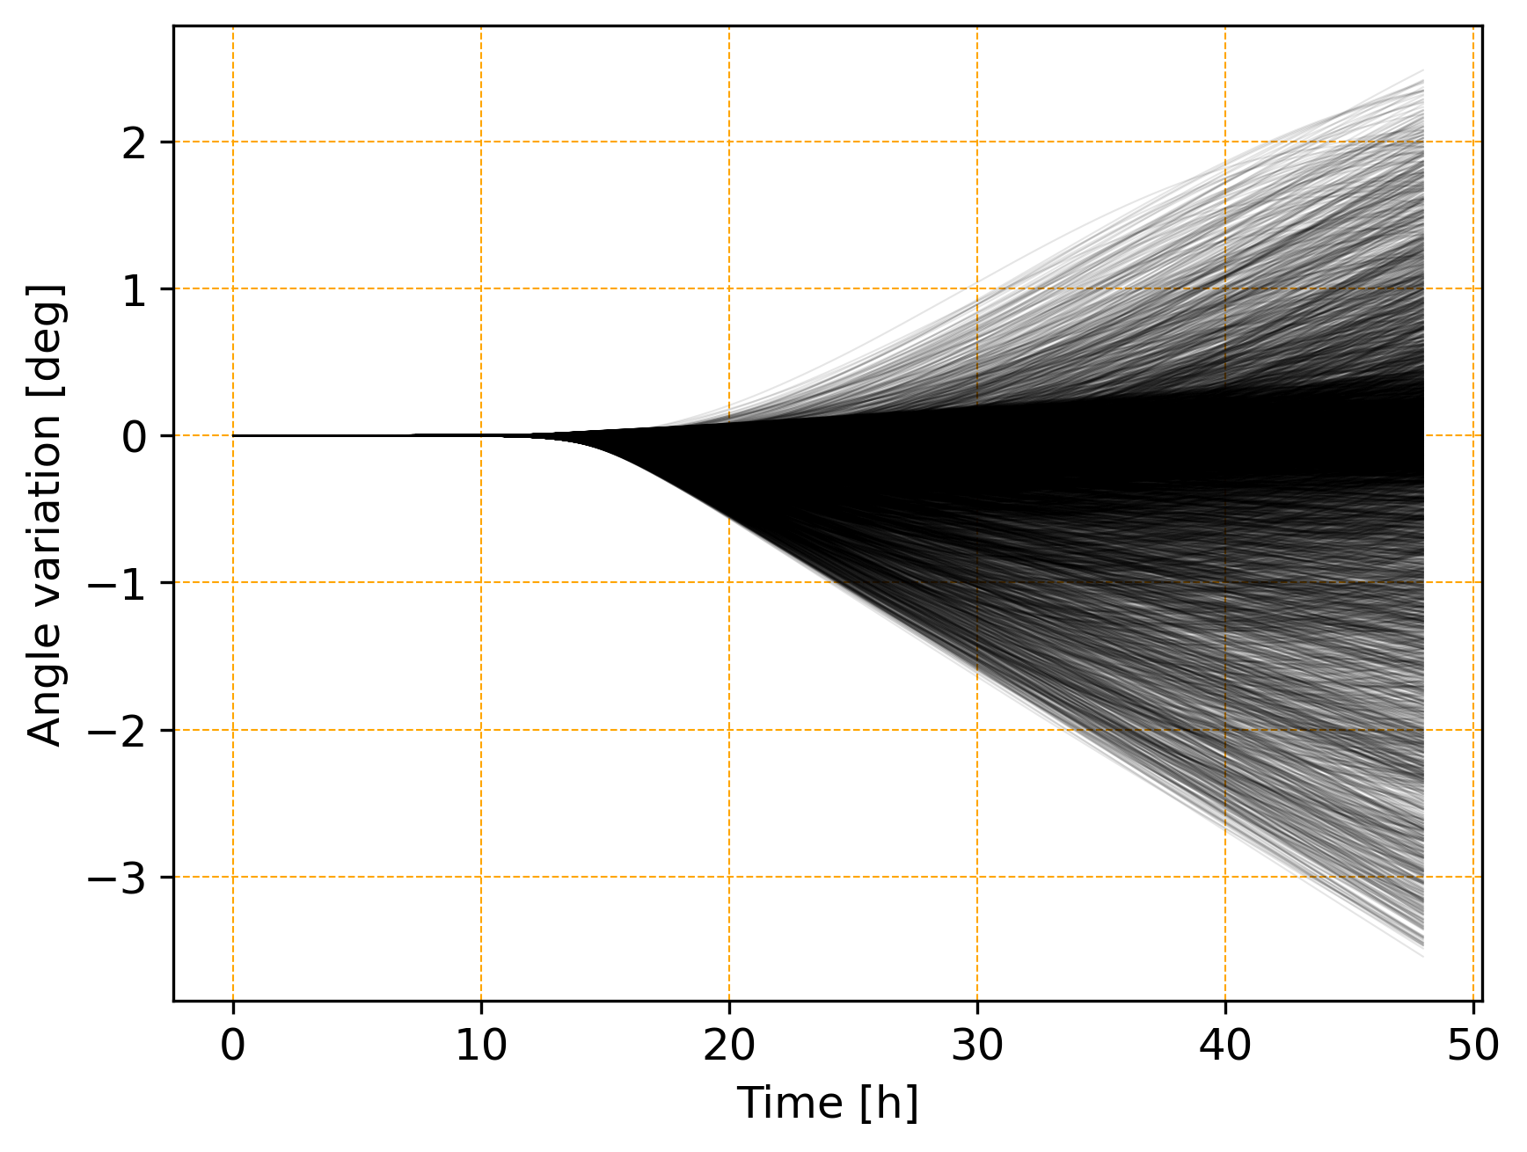
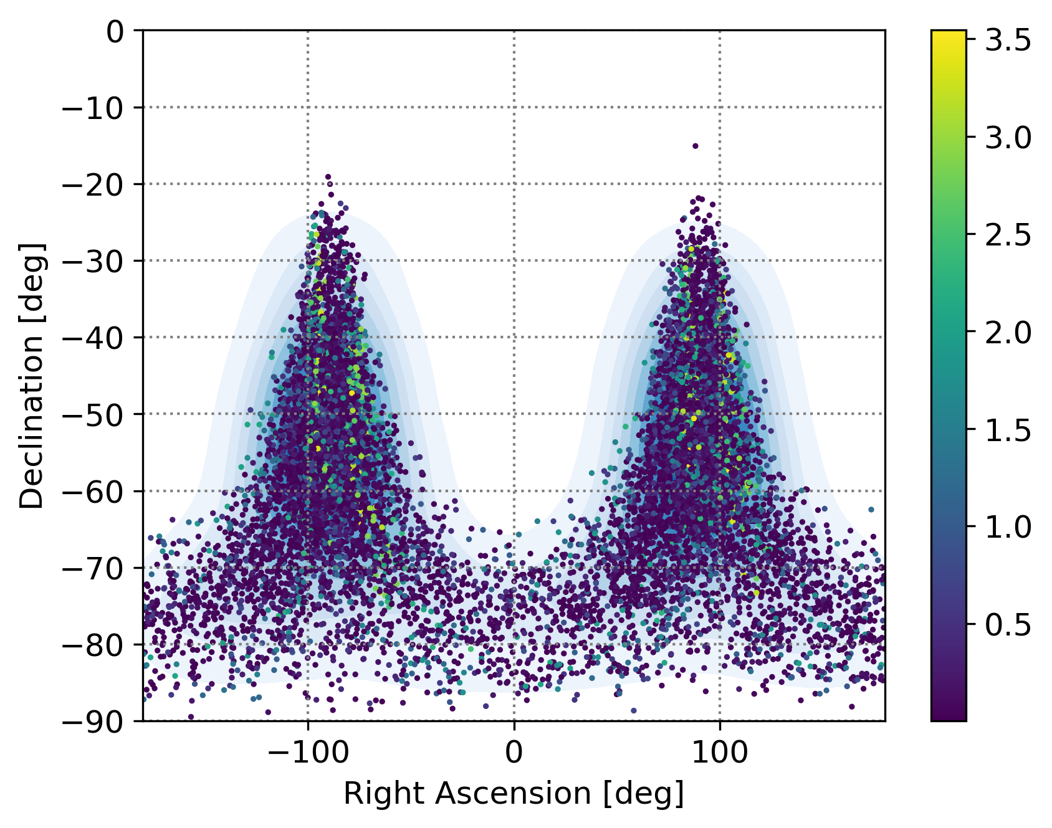
Change Detection
Local resurfacing may occur when grain piles reach angle of repose due to changing gravity vector and spin change during Earth Closest Approach (ECA) (Yu+ 2014; DeMartini+, 2019; Valvano+, 2022; Kim+, 2023)
Small deformations may cause spin changes beyond those expected in the rigid body case, providing additional constraints on internal structure (Hirabayashi 2025, in prep.)
Requirements:
Detailed shape and morphology before and after ECA, with height accuracy of 0.5 m
Albedo and spectral slope (400-1000 nm) at ~10 cm/px
Spin-state changes during the Earth flyby
Tidal resurfacing for different encounter orientations (Kim+ 2023)
Example of surface grain motion (green to purple) (Kim+ 2023)
ECA
35h after ECA
Rotation evolution along max principal axis (deviation from rigid body case, E=10kPa). Left: with time, Right: projected onto spin axis orientation distribution (Hirabayashi 2025, in prep.)
Pre-decisional Information – For Planning and Discussion Purposes Only
Notes:
The main thing we want to accomplish with surface imagery is detection of changes to the surface due to Earth’s tidal forces.
Multiple studies have predicted that local resurfacing may occur when grain piles reach their angle of repose due to spin changes and the gravity vector changing during ECA
We aim to obtain a detailed shape model before and after ECA with a height accuracy of half a meter.
We’ll also obtain albedo and spectral slope information in the range of 400-1000 nm at a resolution of 10 cm/pixel , so we’ll be able to detect any albedo or color changes as a result of fresh, non-space-weathered material being uncovered by resurfacing.
We will also observe spin-state changes during the Earth flyby.

Slide 5
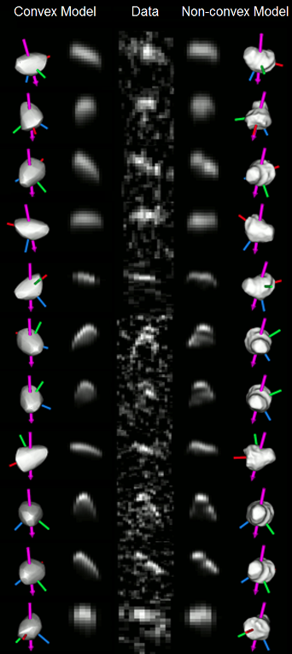
Apophis spin state from radar data
Interior structure, bulk density and bulk porosity
The mass distribution and interior structure of Apophis is poorly known. Interior structure models using radar, gravity and inferences from rotation state changes will reveal the state of the interior and any changes resulting from the close flyby
Requirements:
Mass to derive bulk density and bulk porosity
Higher-order (deg 4) gravity field to determine mass distribution
Global shape with height accuracy of 0.5 m
Spin-state changes during the Earth flyby
Brozović et al. (2018)
Pre-decisional Information – For Planning and Discussion Purposes Only
5
Notes:
The mass distribution & interior structure of apophis is currently unknown.
We’ll be able to learn about the state of the interior and any changes resulting from the close flyby with interior structure models that use gravity data, radar observations, and inferences from rotation state changes
We aim to determine the mass, which will allow us to derive the bulk density and porosity of the body.
Higher order gravity field measurements will allow us to determine how its mass is distributed
And again, we’ll measure spin state changes during earth flyby

Slide 6
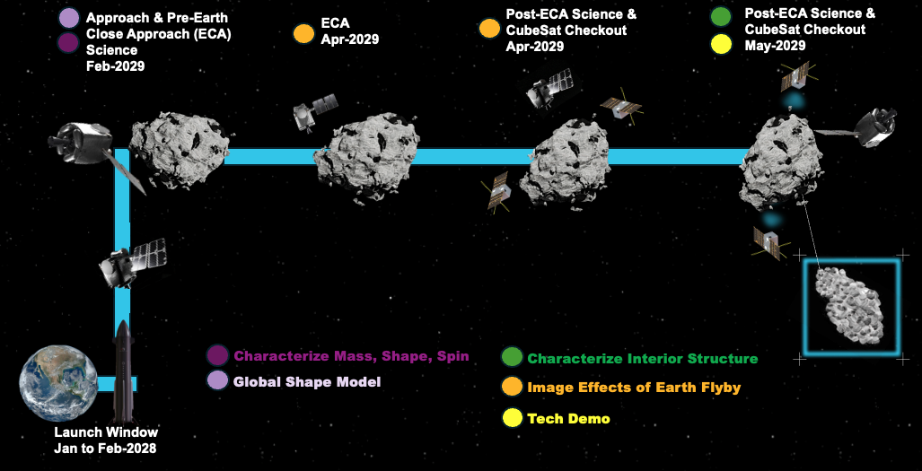
Connections to Planetary Defense
Opportunity to test how current state-of-the-art planetary science techniques can provide data to inform decision-making for PD
Rendezvous with Apophis ~2 months before ECA
  Limited period to observe Apophis before ECA
  Demonstrating asteroid characterization in a time-limited manner can tie into future efforts to establish fast reconnaissance mission concepts
Pre-decisional Information – For Planning and Discussion Purposes Only

Slide 7
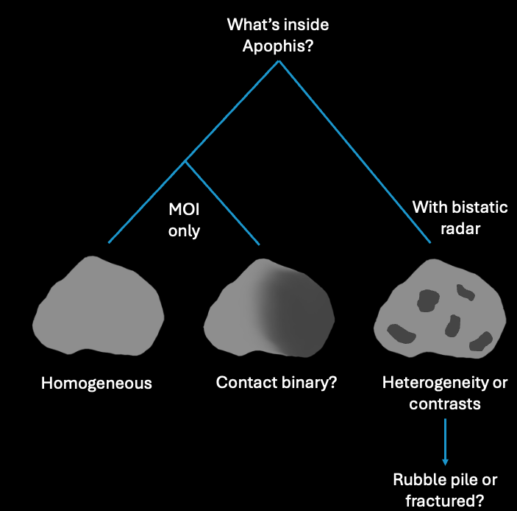
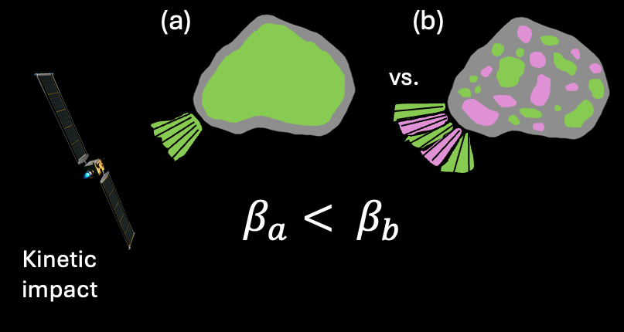
Connections to Planetary Defense
Key parameters for planetary defense identified by the NEO WARP Working Group (2024).
Parameter | Why is this important for PD? | Current knowledge | Caltech Mission contribution
Mass | Size of terminal event and design of mitigation approaches | Poorly known. Estimates range from 2 – 6.2 x 10¹⁰ kg (Binzel+, 2009; Müller+, 2014) | Accurate mass estimate and distribution of mass (moments of inertia)
Orbit | Timing and location of terminal event, informs post-mitigation assessments | Well known (Lee+, 2022) | Track changes to orbit and spin state due to ECA
Composition | Controls size and behavior of terminal event and efficiency of the planned mitigation approach including β | Surface composition: Sq type (Reddy et al., 2018) | Bistatic radar measurements to estimate internal composition
Strength | Relates to deflection efficiency and β | Unknown | Infer strength from interior structure, boulder shapes, and surface material movement due to ECA
Bistatic radar improves knowledge of interior structure.
(Adaptation of a drawing by James Keane.)
β is larger for rubble pile asteroids. (Adaptation of a drawing by James Keane.)
Pre-decisional Information – For Planning and Discussion Purposes Only

Slide 8
Summary and Future Work
An understanding of both surface and interior properties of potentially hazardous objects is critical for planetary defense purposes
Caltech is leading a first-of-a-kind mission that aims to characterize the interior structure and surface conditions of Apophis
Here, we discussed current knowledge of Apophis and how predictions of its interior structure and reaction to Earth’s tidal forces flow down to mission requirements
Check out my poster, #138
  Apophis 2029: Synergy between Numerical Models and Radar Tomography Data from the Caltech Mission
Review paper coming soon!
  Apophis modeling and data, focusing on knowns, unknowns, current science knowledge gaps, and how Caltech’s mission would fill those gaps
Pre-decisional Information – For Planning and Discussion Purposes Only

Slide 9



Slide 10
References
Asphaug, Erik, et al. "Disruption of kilometre-sized asteroids by energetic collisions." Nature 393.6684 (1998): 437-440.
Binzel, Richard P., et al. "Spectral properties and composition of potentially hazardous Asteroid (99942) Apophis." Icarus 200.2 (2009): 480-485.
Brozović, Marina, et al. "Goldstone and Arecibo radar observations of (99942) Apophis in 2012–2013." Icarus 300 (2018): 115-128.
DeMartini, Joseph V., et al. "Using a discrete element method to investigate seismic response and spin change of 99942 Apophis during its 2029 tidal encounter with Earth." Icarus 328 (2019): 93-103.
Haynes, Mark, et al. "Small body radar inverse scattering in monostatic and bistatic geometries." Lunar and Planetary Science Conference. Vol. 2548. 2021.
Hirabayashi, M., Y. Kim, and M. Brozović. "Finite element modeling to characterize the stress evolution in asteroid (99942) Apophis during the 2029 Earth encounter." Icarus 365 (2021): 114493.
Kim, Yaeji, et al. "Tidal resurfacing model for (99942) Apophis during the 2029 close approach with Earth." Monthly Notices of the Royal Astronomical Society 520.3 (2023): 3405-3415.
Lee, H-J., et al. "Refinement of the convex shape model and tumbling spin state of (99942) Apophis using the 2020–2021 apparition data." Astronomy & Astrophysics 661 (2022): L3.
Müller, T. G., et al. "Thermal infrared observations of asteroid (99942) Apophis with Herschel." Astronomy & Astrophysics 566 (2014): A22.
Reddy, Vishnu, et al. "Surface composition of (99942) Apophis." The Astronomical Journal 155.3 (2018): 140.
The NEO WARP Working Group. 2024, in The 31st Meeting of the NASA Small Bodies Assessment Group (SBAG)
Valvano, Giulia, et al. "APOPHIS–effects of the 2029 Earth’s encounter on the surface and nearby dynamics." Monthly Notices of the Royal Astronomical Society 510.1 (2022): 95-109.
Yu, Yang, et al. "Numerical predictions of surface effects during the 2029 close approach of asteroid 99942 Apophis." Icarus 242 (2014): 82-96.

