Slide 1



A 2025 Update to the Asteroid Mitigation Response Plot
P.W. Chodas¹, M.T. Burkey² and K.M. Kumamoto²
⁽¹⁾ Jet Propulsion Laboratory, California Institute of Technology
⁽²⁾ Lawrence Livermore National Laboratory
9th IAA Planetary Defense Conference,
Stellenbosch, Cape Town, S. Africa, May 5-9, 2025
© 2025 California Institute of Technology. Government sponsorship acknowledged.
Part of this work prepared by LLNL under Contract DE-AC52-07NA27344. LLNL-PRES-2005085.
.

Slide 2
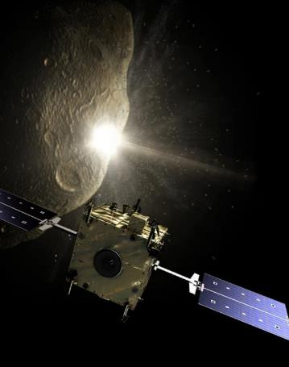
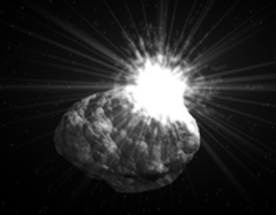
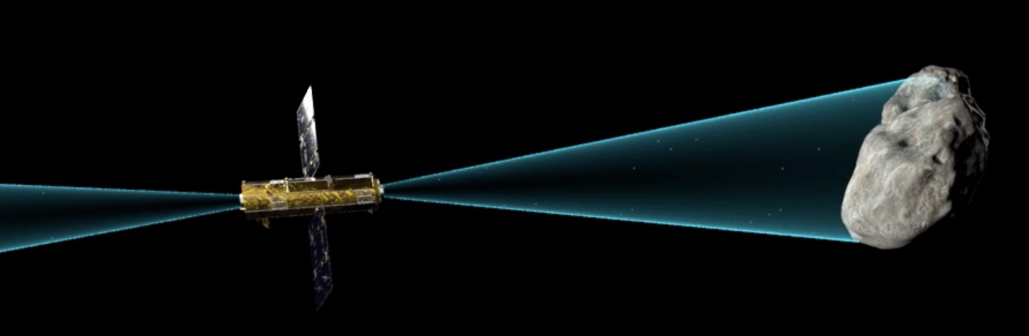
Comparing Planetary Defense Techniques
Kinetic Impactor (KI)
Nuclear Standoff Detonation
Momentum transfer from vaporization of ablated material
Momentum transfer enhanced by recoil from ejecta
Ion-Beam Deflection (IBD)
Momentum transfer from absorption of high-velocity xenon exhaust ions
IBD graphic from APL Tabletop Exercise #5, NED graphic: Peter A Wilkins (November 2005), KI graphic: https://www.esa.int/ESA_Multimedia/Images/2008/01/Don_Quijote_mission

Slide 3
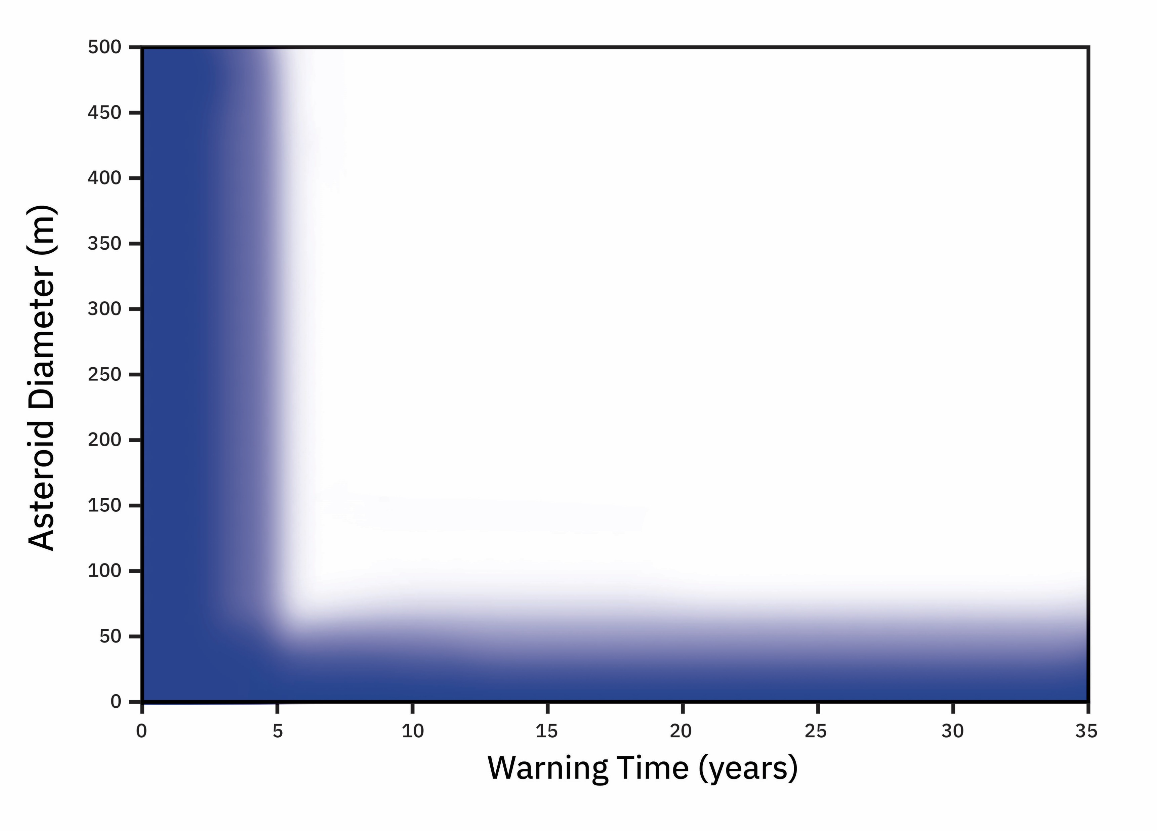
Mapping Out Where Mitigation Techniques Are Effective
Objective: Using realistic orbital simulations, map out where each technique could successfully move an asteroid trajectory off the Earth
Main Assumptions:
  Density: 2 g/cm³, spherical asteroids
  15 typical impactor orbits with realistic mapping of deflection ∆Vs
  to impact b-plane
  Near-worst-case impact location
  Single mission on a Falcon Heavy,
  single-impulse deflection
  2 years to develop the spacecraft
  Ballistic KI trajectories via Lambert
  1-3-year cruise for rendezvous
What mitigation technique could we use?
Inadequate time to mitigate
“Civil defense” for small asteroid impacts

Slide 4
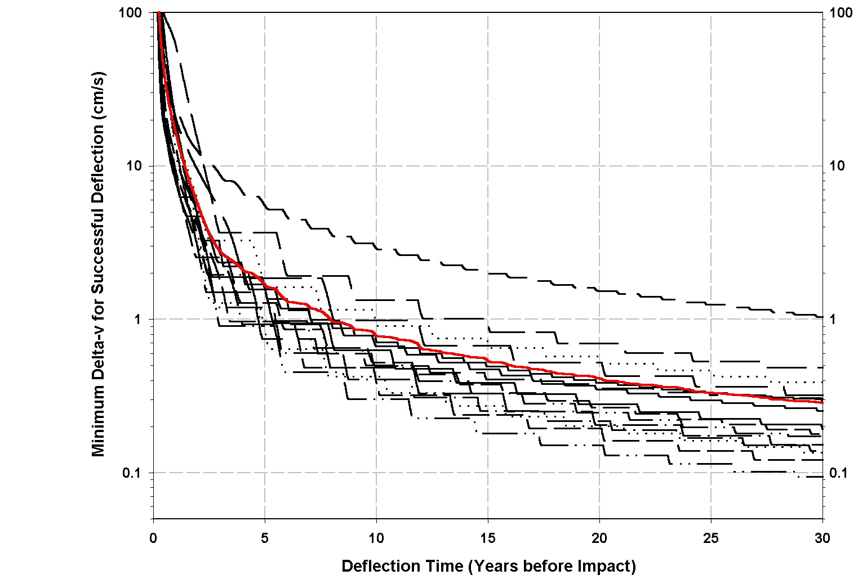
Typical ΔVs to Successfully Deflect Worst-Case Impact Location
Plot shows deflection ∆V required for 15 typical impactors, as a function of deflection time
The earlier the deflection, the smaller the required ∆V
The required ∆V’s vary by an order of magnitude
Red line is the average deflection
Typical required ΔV 10 years before impact: ~8 mm/s

Slide 5
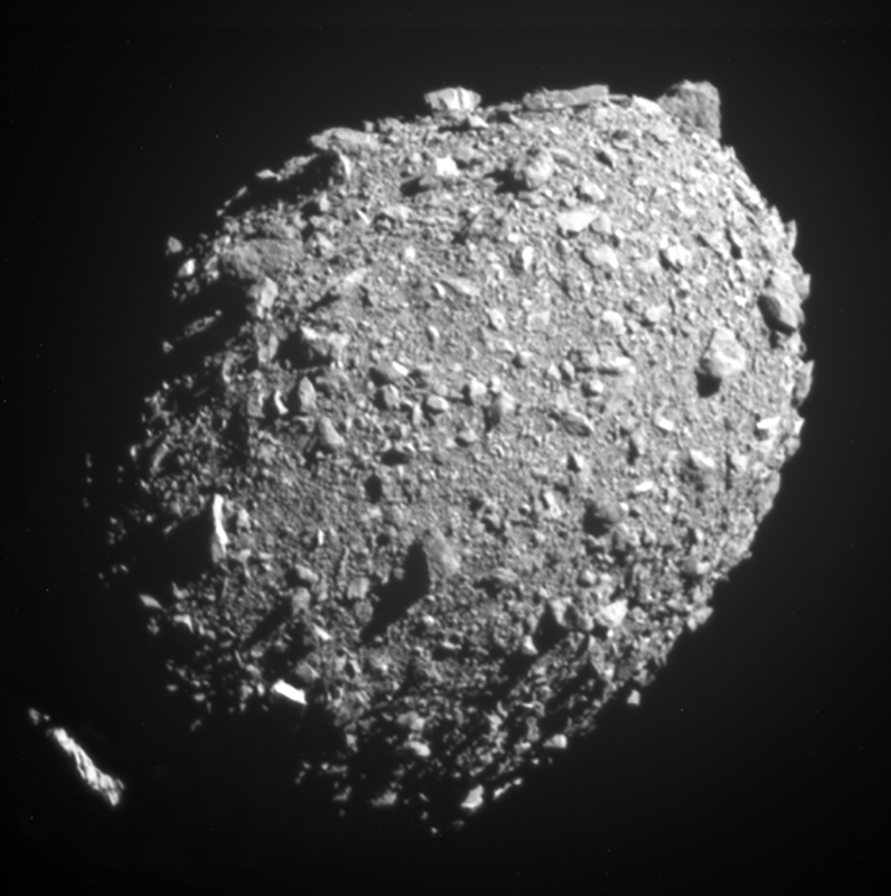
Fragmentation: A Possible Outcome for Impulsive Deflection
Simulations show that if the ΔV applied to an asteroid is too large, it might fragment or “disrupt”
Fragmentation is an undesirable outcome because the fragments will likely have unpredictable sizes and velocities
Rule of thumb 1: Fragmentation might occur if imparted ΔV exceeds 10% of the surface escape velocity
  ΔV imparted by DART was ~4% of Dimorphos’s escape velocity
Simulations also show that if an impulsive deflection ΔV is extremely large, an asteroid will likely disassemble into very small pieces that disperse with large velocities
Rule of thumb 2: Robust disruption, i.e., disintegration into very small and fast-moving pieces, will likely occur if the imparted ΔV exceeds 10 times the surface escape velocity
Dimorphos
~150 m
ΔV imparted to Dimorphos by DART: ~2.7 mm/s

Slide 6
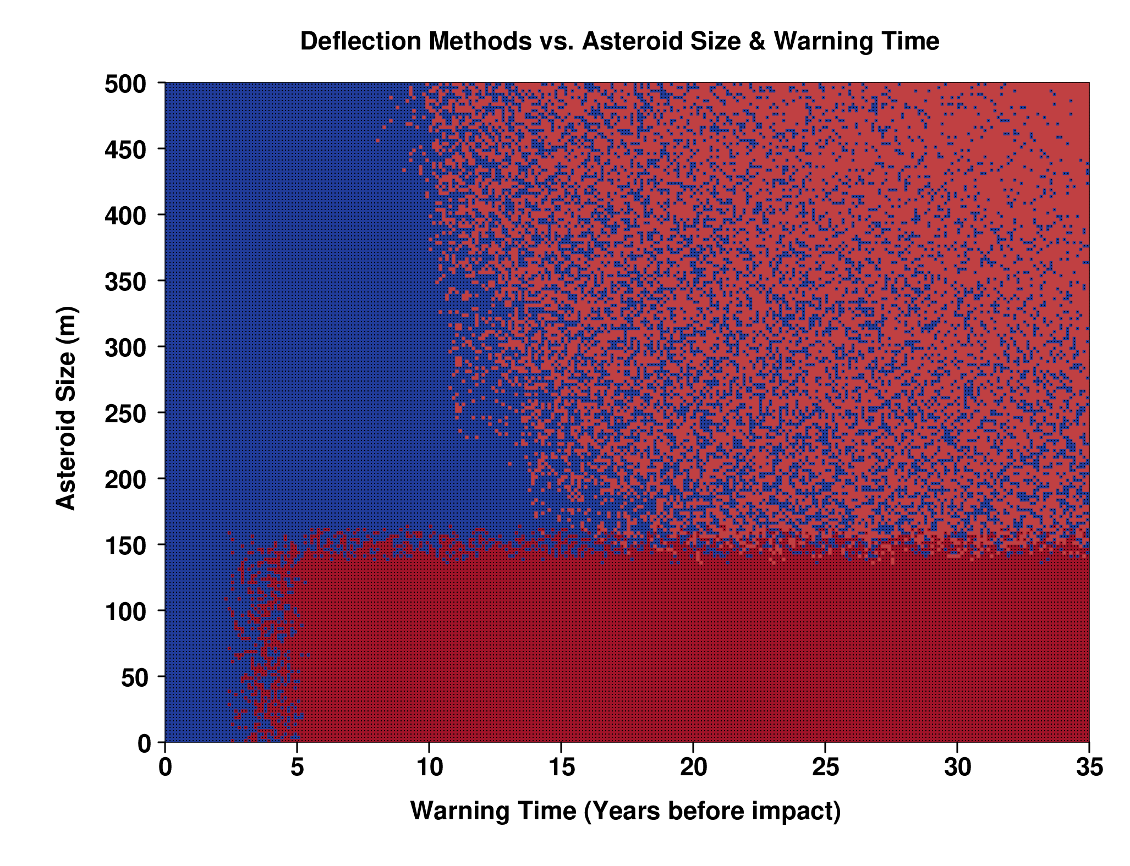
Effectiveness of Nuclear Deflection
Density of dots ≡ likelihood of being effective
Assumptions:
Rendezvous mission
Single Nuclear Explosive Device (NED)
Unintended fragmentation is possible or likely for short warnings or small-to-moderate asteroid sizes
Upper bound on Nuclear Robust Disruption (NRD) is reasonable but notional
Red boxed region: fragmentation likely for a single impulse, but a spacecraft with multiple, sequential NEDs might be effective
Nuclear Deflection
Nuclear Robust Disruption (NRD)
Civil defense

Slide 7
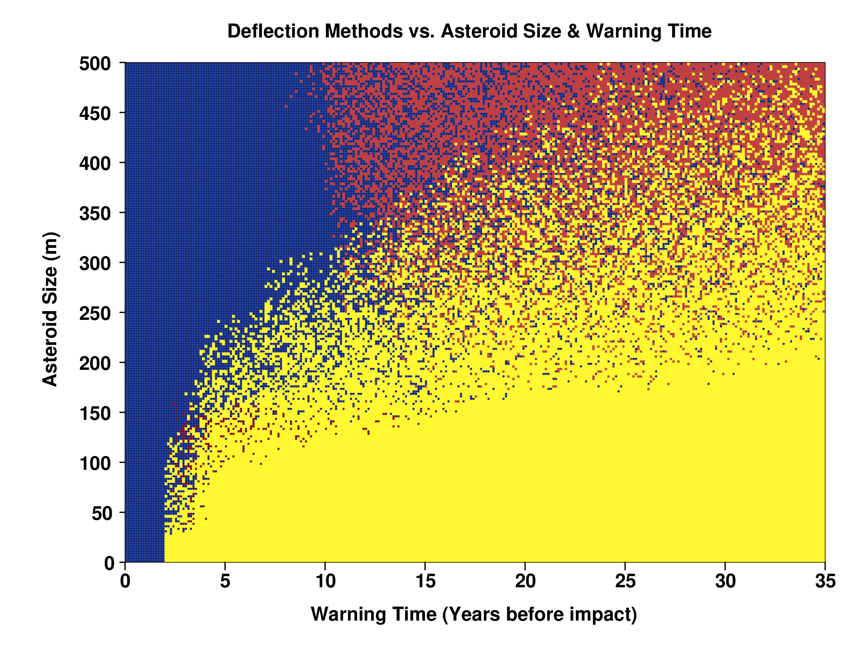
Effectiveness of Kinetic Impactor Deflection
Density of dots ≡ likelihood of being effective
Nuclear Deflection
Assumptions:
Max spacecraft mass
Optimized spacecraft trajectories
ΔV from physics-based momentum exchange
𝛽 = 2.0
KI would be very effective if we could ignore the possibility of fragmentation
KI Deflection
Civil defense

Slide 8
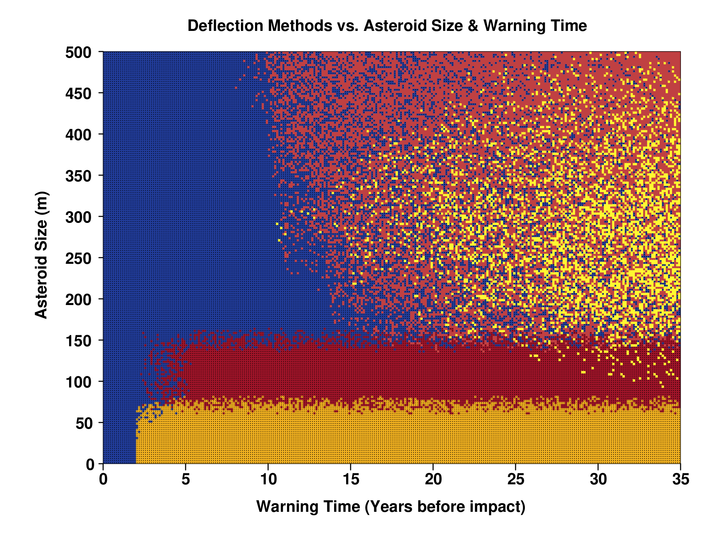
KI Deflection May Produce Unintended Fragmentation
Density of dots ≡ likelihood of being effective
Nuclear Deflection
Assume 𝛽 is largely unpredictable within the range 2 - 5
∆Vs could be 2.5 times larger than required
Asteroids have to be large enough that they don’t fragment at 𝛽 = 5
For a wide range of worst-case scenarios, a single KI deflection could cause fragmentation
  KI could still be effective if it is split into multiple mini-deflections
KI Robust Disruption is effective for asteroids smaller than ~80m
KI Deflection
Nuclear Robust Disruption
KI Robust Disruption
Civil defense

Slide 9
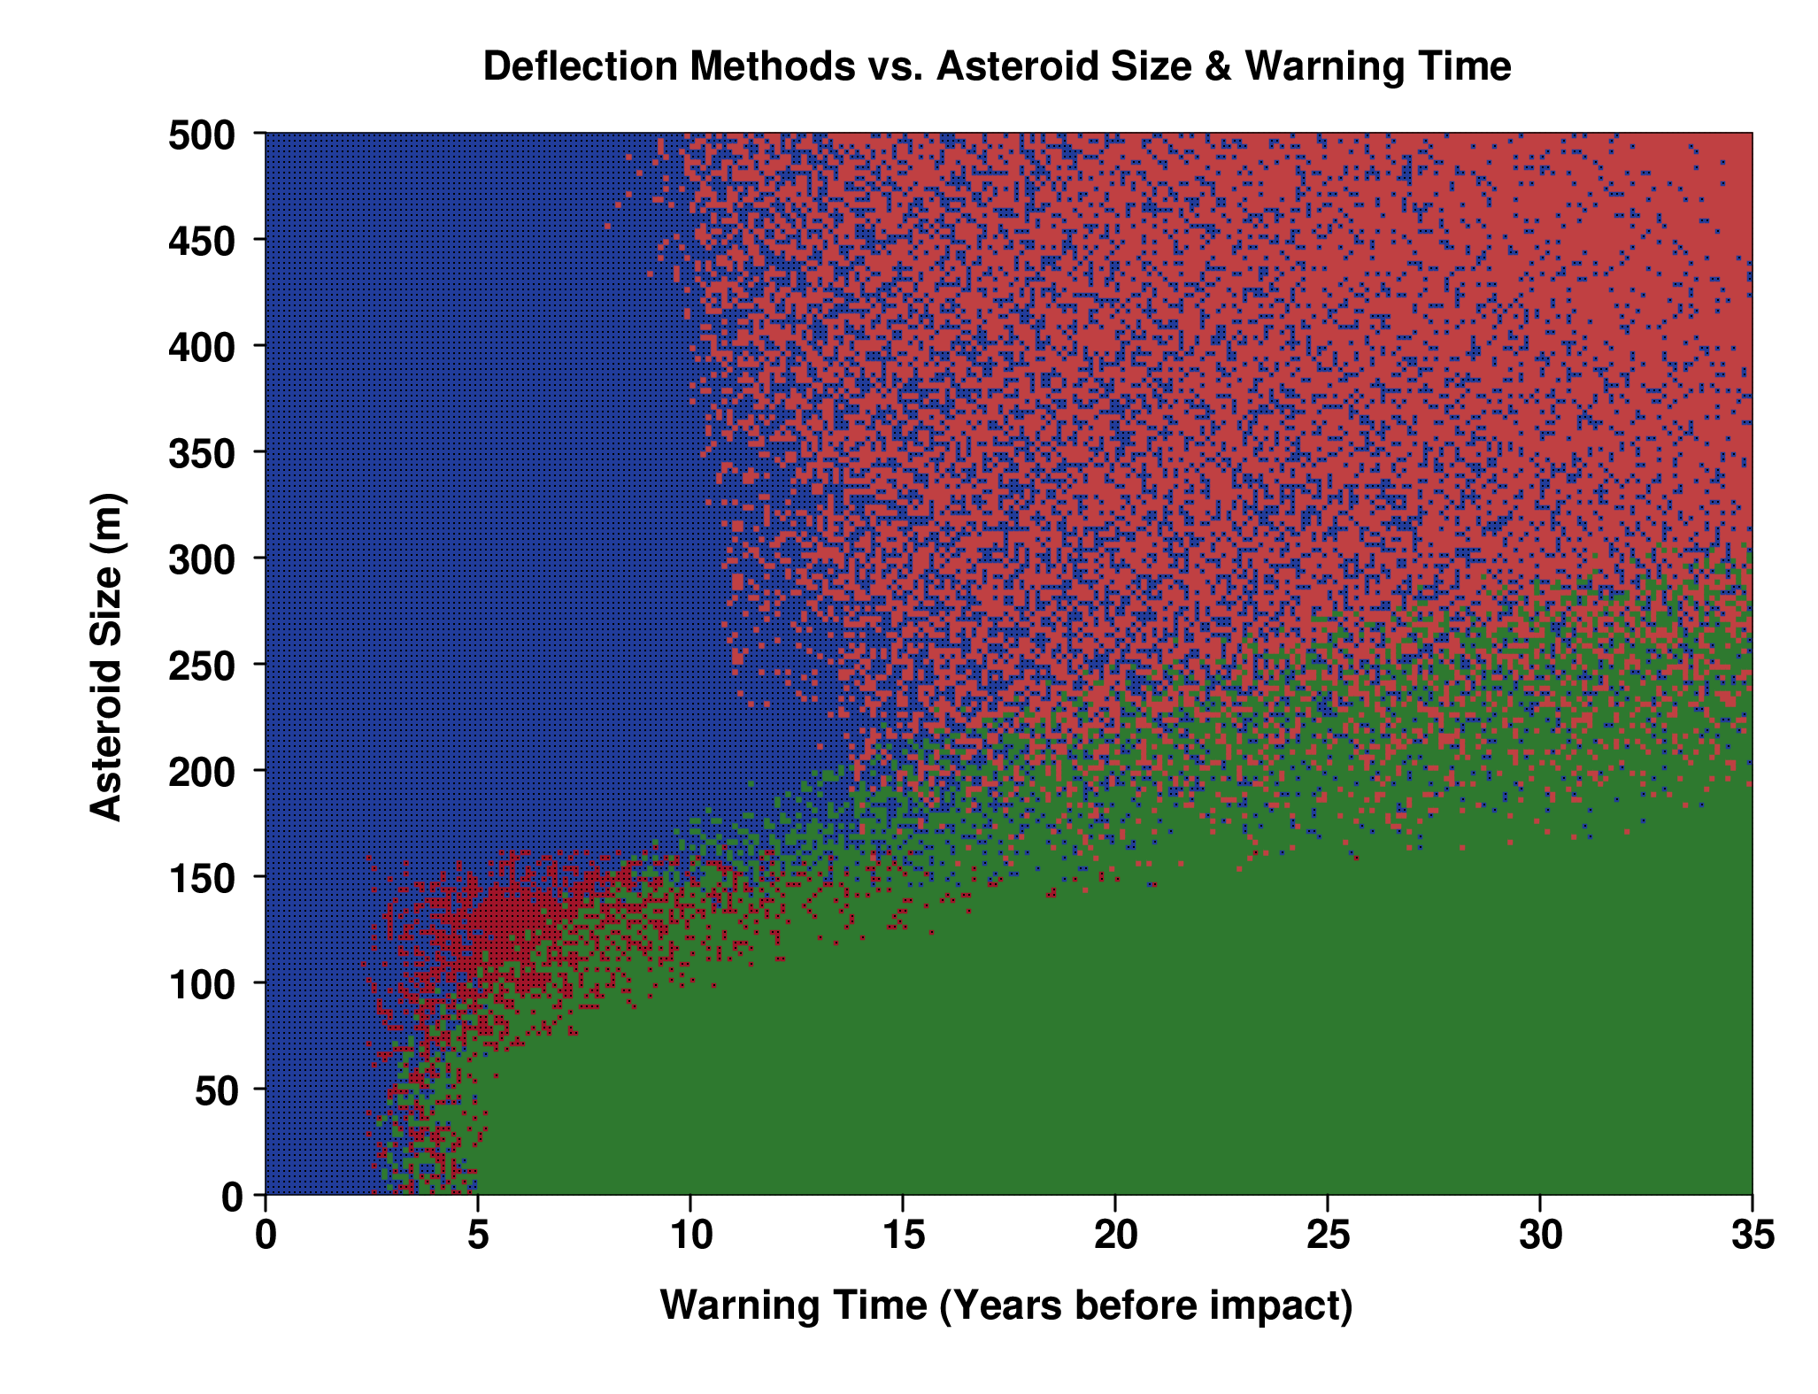
Effectiveness of Ion Beam Deflection (IBD)
Density of dots ≡ likelihood of being effective
Assumptions:
60kW SEP spacecraft,
2 NEXIS thrusters,
2000-3000 kg of xenon for deflection
Spacecraft stationed ~4 asteroid diameters away and 95% of one beam intersects the asteroid
Deflection thrusting optimized and continues until propellant runs out
No risk of fragmentation for IBD
Nuclear Deflection
Ion-Beam Deflection
Civil defense

Slide 10
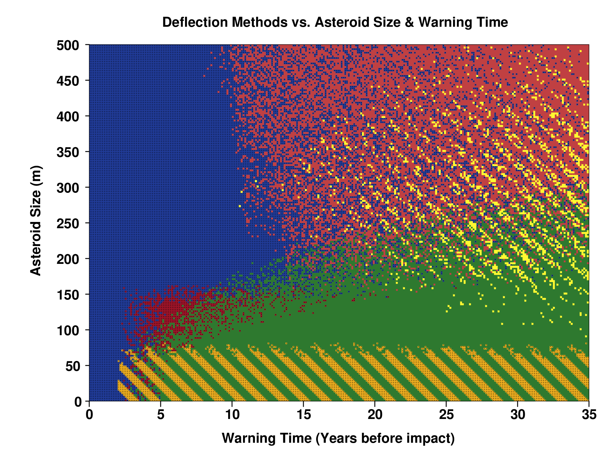
Comparing Effectiveness of All 3 PD Techniques
Density of dots ≡ likelihood of being effective
Unintended fragmentation is a major limiting factor for single impulse deflections
  Splitting into multiple smaller deflections can offset this limitation, but adds complexity
Robust disruption is effective up to ~80m for KI, ~150m for NRD
IBD is effective for smaller asteroids (<150-200m) and longer warning times (> 7-10 yrs), and avoids the risk of fragmentation
IBD can be scaled up to larger asteroids
Nuclear Deflection
KI Deflection
NRD
Ion-Beam Deflection
KI Robust Disruption
Civil defense

