Slide 1
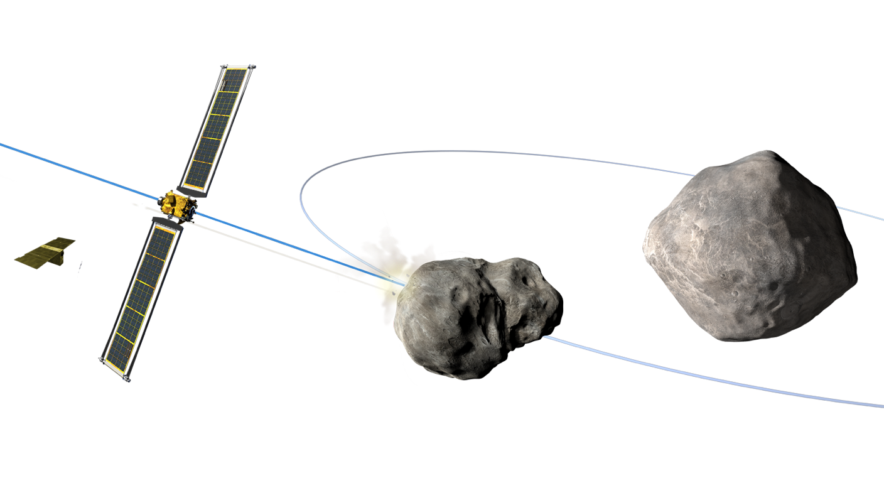
Design Constraints for Asteroid Deflection Campaigns based on Delta-V Estimation Timelines
2025 Planetary Defense Conference | 5-9 May 2025, Stellenbosch, Cape Town, South Africa
Rahil Makadia¹, Davide Farnocchia², Brent W. Barbee³, Siegfried Eggl¹
¹University of Illinois at Urbana-Champaign
²Jet Propulsion Laboratory, California Institute of Technology
³NASA Goddard Space Flight Center
8 May 2025

Slide 2
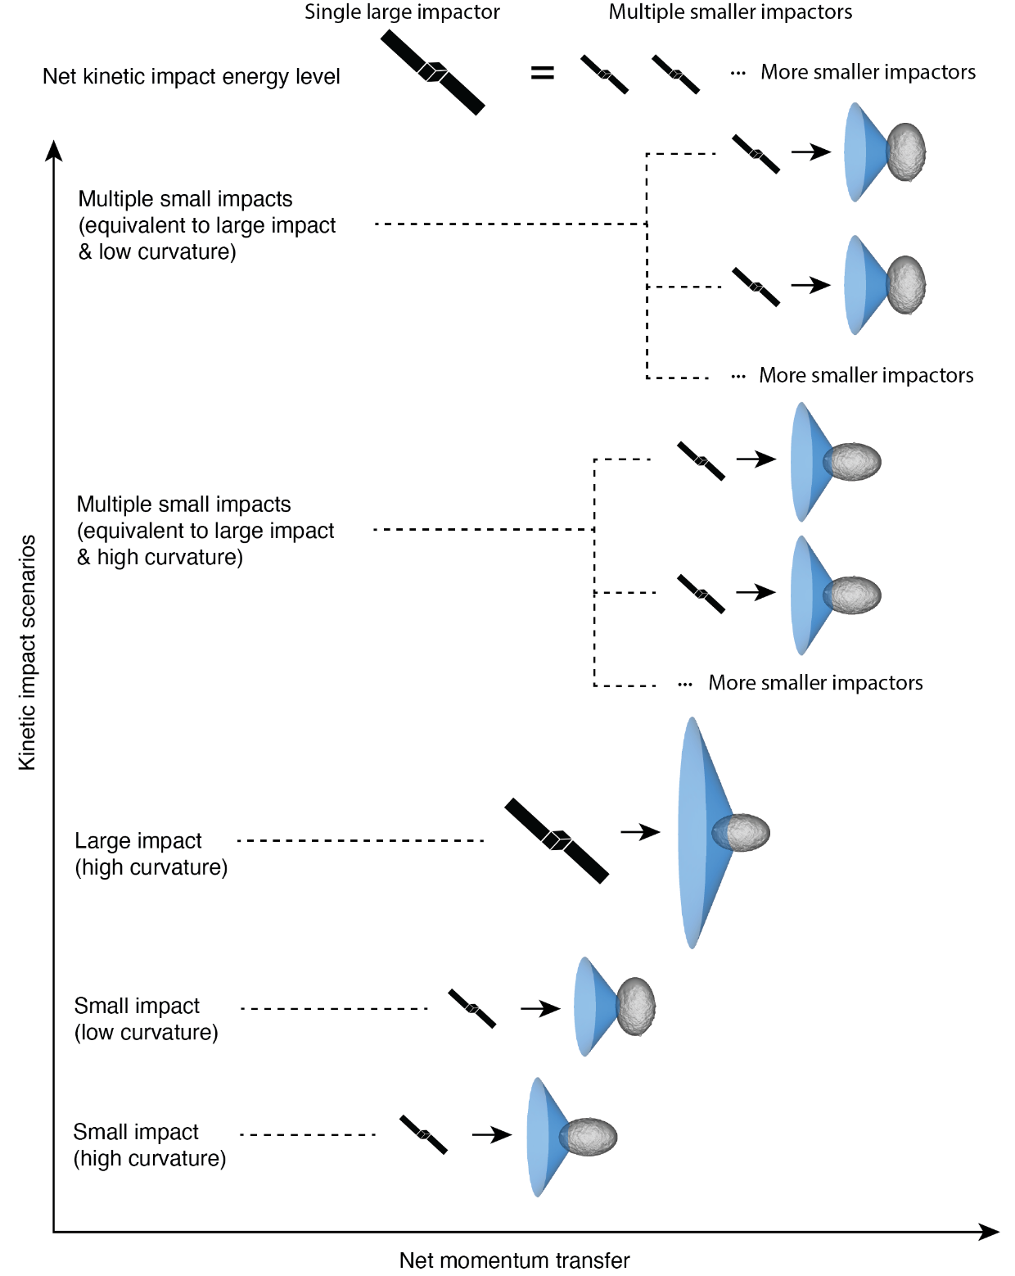
Asteroid Deflection Strategies
Kinetic impacts are a proven method of deflecting asteroids
  But we run the risk of disruption when implementing KI missions
  Target curvature also affects their efficiency
Multiple KI campaigns are a proposed solution
However, we need to understand the deflection estimation constraints in such a scenario
Credit: Hirabayashi et al. (2025)

Slide 3
Multiple KI Campaign Setup
First deflection of 2024 PDC₂₅ on 15 December 2034
  Around the perihelion pass
Rendezvous spacecraft around asteroid before and after each KI mission
Use pseudo-range and pseudo-optical ΔDOR measurements of target asteroid
Parameter | Value
Number of KI spacecraft | 3
Recon. spacecraft residence time | 30 days
Pre-deflection ConOps time | 1 day
Post-deflection ConOps time | 7 days
Deflection interval (ΔV span) | varies
Pseudo-measurement span | 7 days

Slide 4

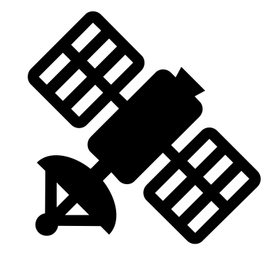
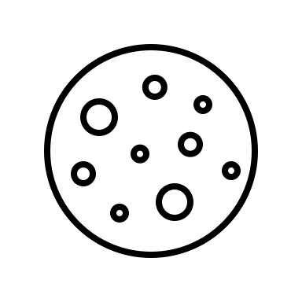
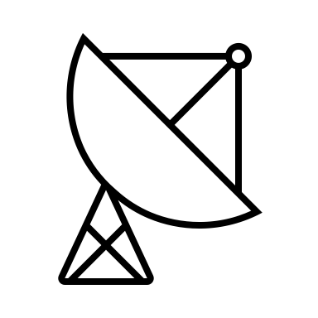
Derived Target Asteroid Astrometry
Ground-Spacecraft Navigation Data
  Range, ΔDOR data
Spacecraft-Asteroid Navigation Data
  Optical Navigation (OpNav) images
Ground-Asteroid pseudo-measurements
  Pseudo-range points (~2 meters)
  Pseudo-optical ΔDOR measurements
  (~1 nanoradian)

Slide 5
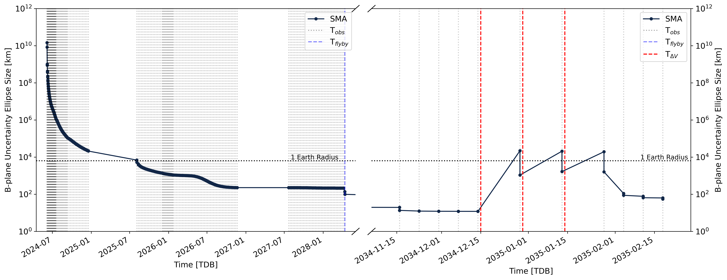
15-day Deflection Interval Results

Slide 6
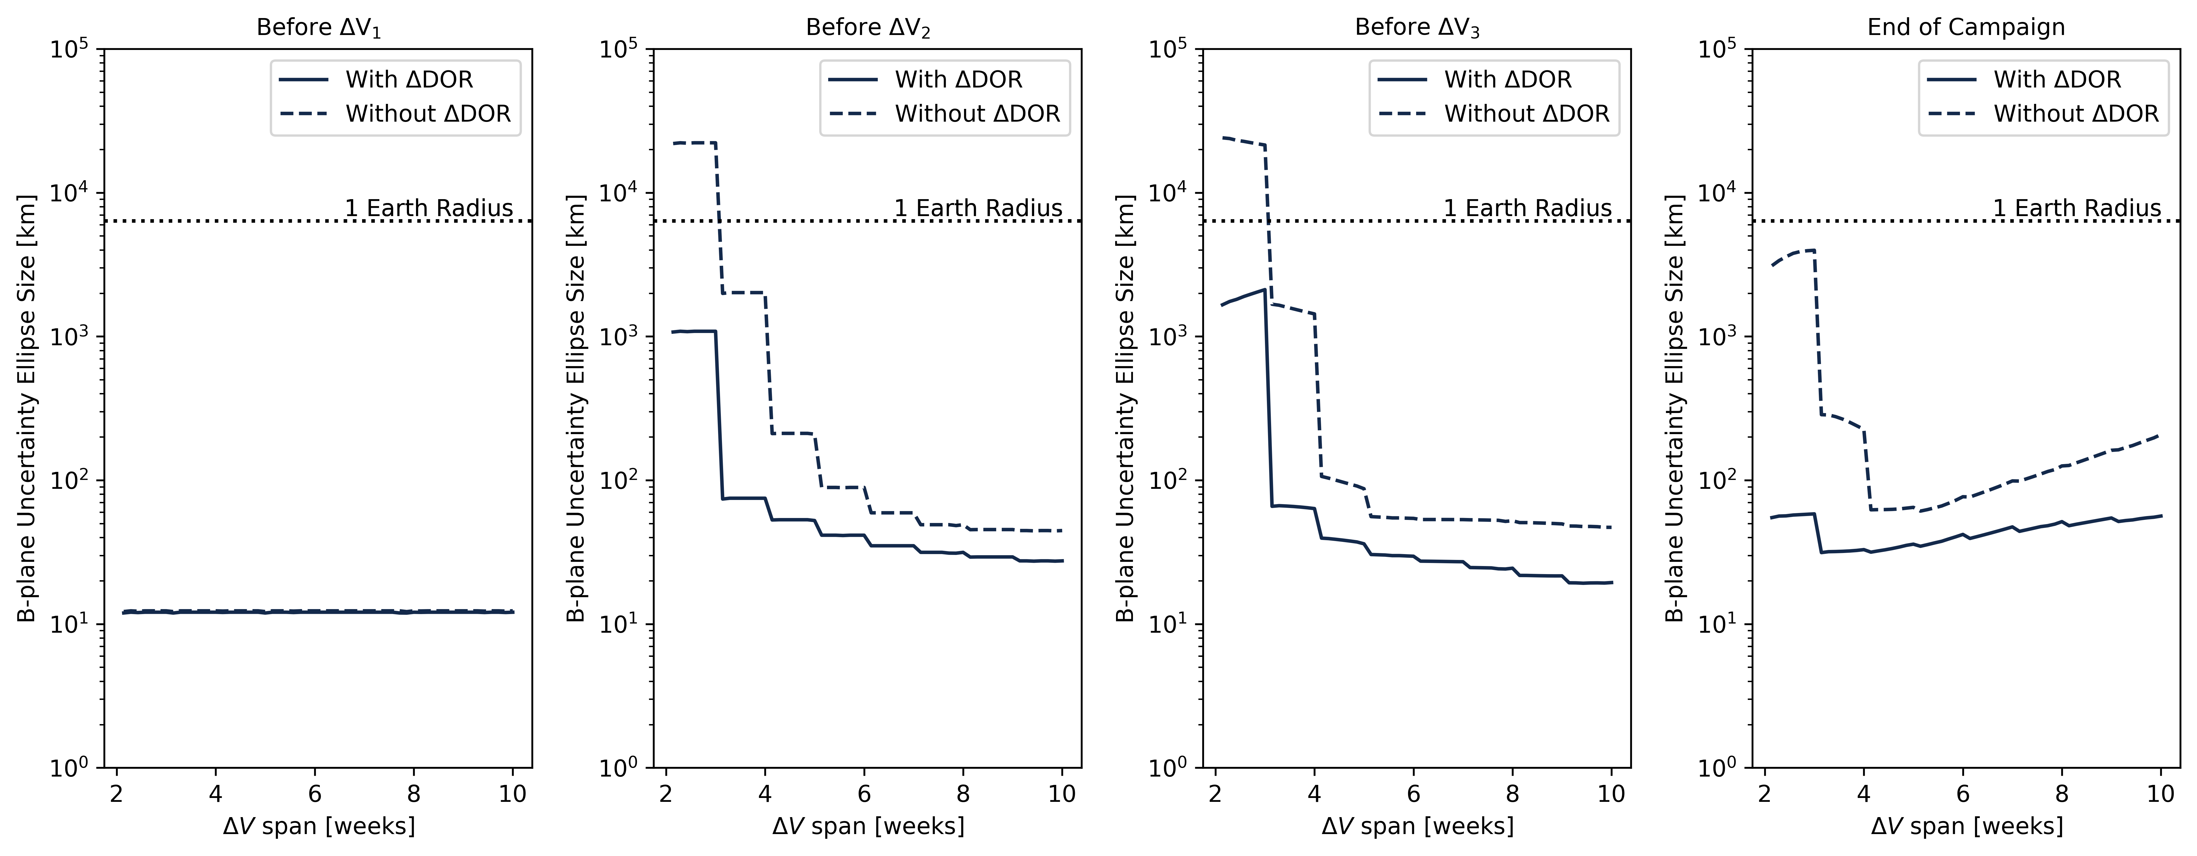
Deflection Interval Sweep Results

Slide 7
Conclusions
Multiple kinetic impacts are a viable strategy to avoid unintentional fragmentation of the target asteroid, but bring their own set of operational constraints
A minimum span of around 2 weeks is necessary to preserve decision-making ability in between impacts
  Made possible by using pseudo-optical ΔDOR measurements of the target asteroid
  Without pseudo-optical ΔDOR measurements, we need at least 3 weeks for 2024 PDC₂₅

Slide 8
Questions?
Feel free to reach out at makadia2@illinois.edu
R.M. acknowledges funding from a NASA Space Technology Graduate Research Opportunities (NSTGRO) award, NASA contract No. 80NSSC22K1173.

