Slide 1

Education, Outreach and Heritage on a global scale
Dr Edward Gomez, Las Cumbres Observatory
IAU Division C - President

Slide 2



Division C – Education, Outreach and Heritage
~3000 members
(1/4 of IAU total members)
5 Commissions
Working Groups
IAU Division C – Education, Outreach, and Heritage
Dr Edward Gomez, Las Cumbres Observatory
Notes:
Division WG for Star Names & Key Initiatives in Eduction, Outreach and Development and Inter-Division WG on Solar Eclipses (with Div E)

Slide 3
Division C – Education, Outreach and Heritage
Working groups on various of pertinent topics
6 Commissions
Many members from other academic disciplines
Annual PhD prize
Interdivision commissions and working groups
Support themes in IAU symposia
~3000 members
(1/4 of IAU total members)
5 Commissions
IAU Division C – Education, Outreach, and Heritage
Dr Edward Gomez, Las Cumbres Observatory

Slide 4
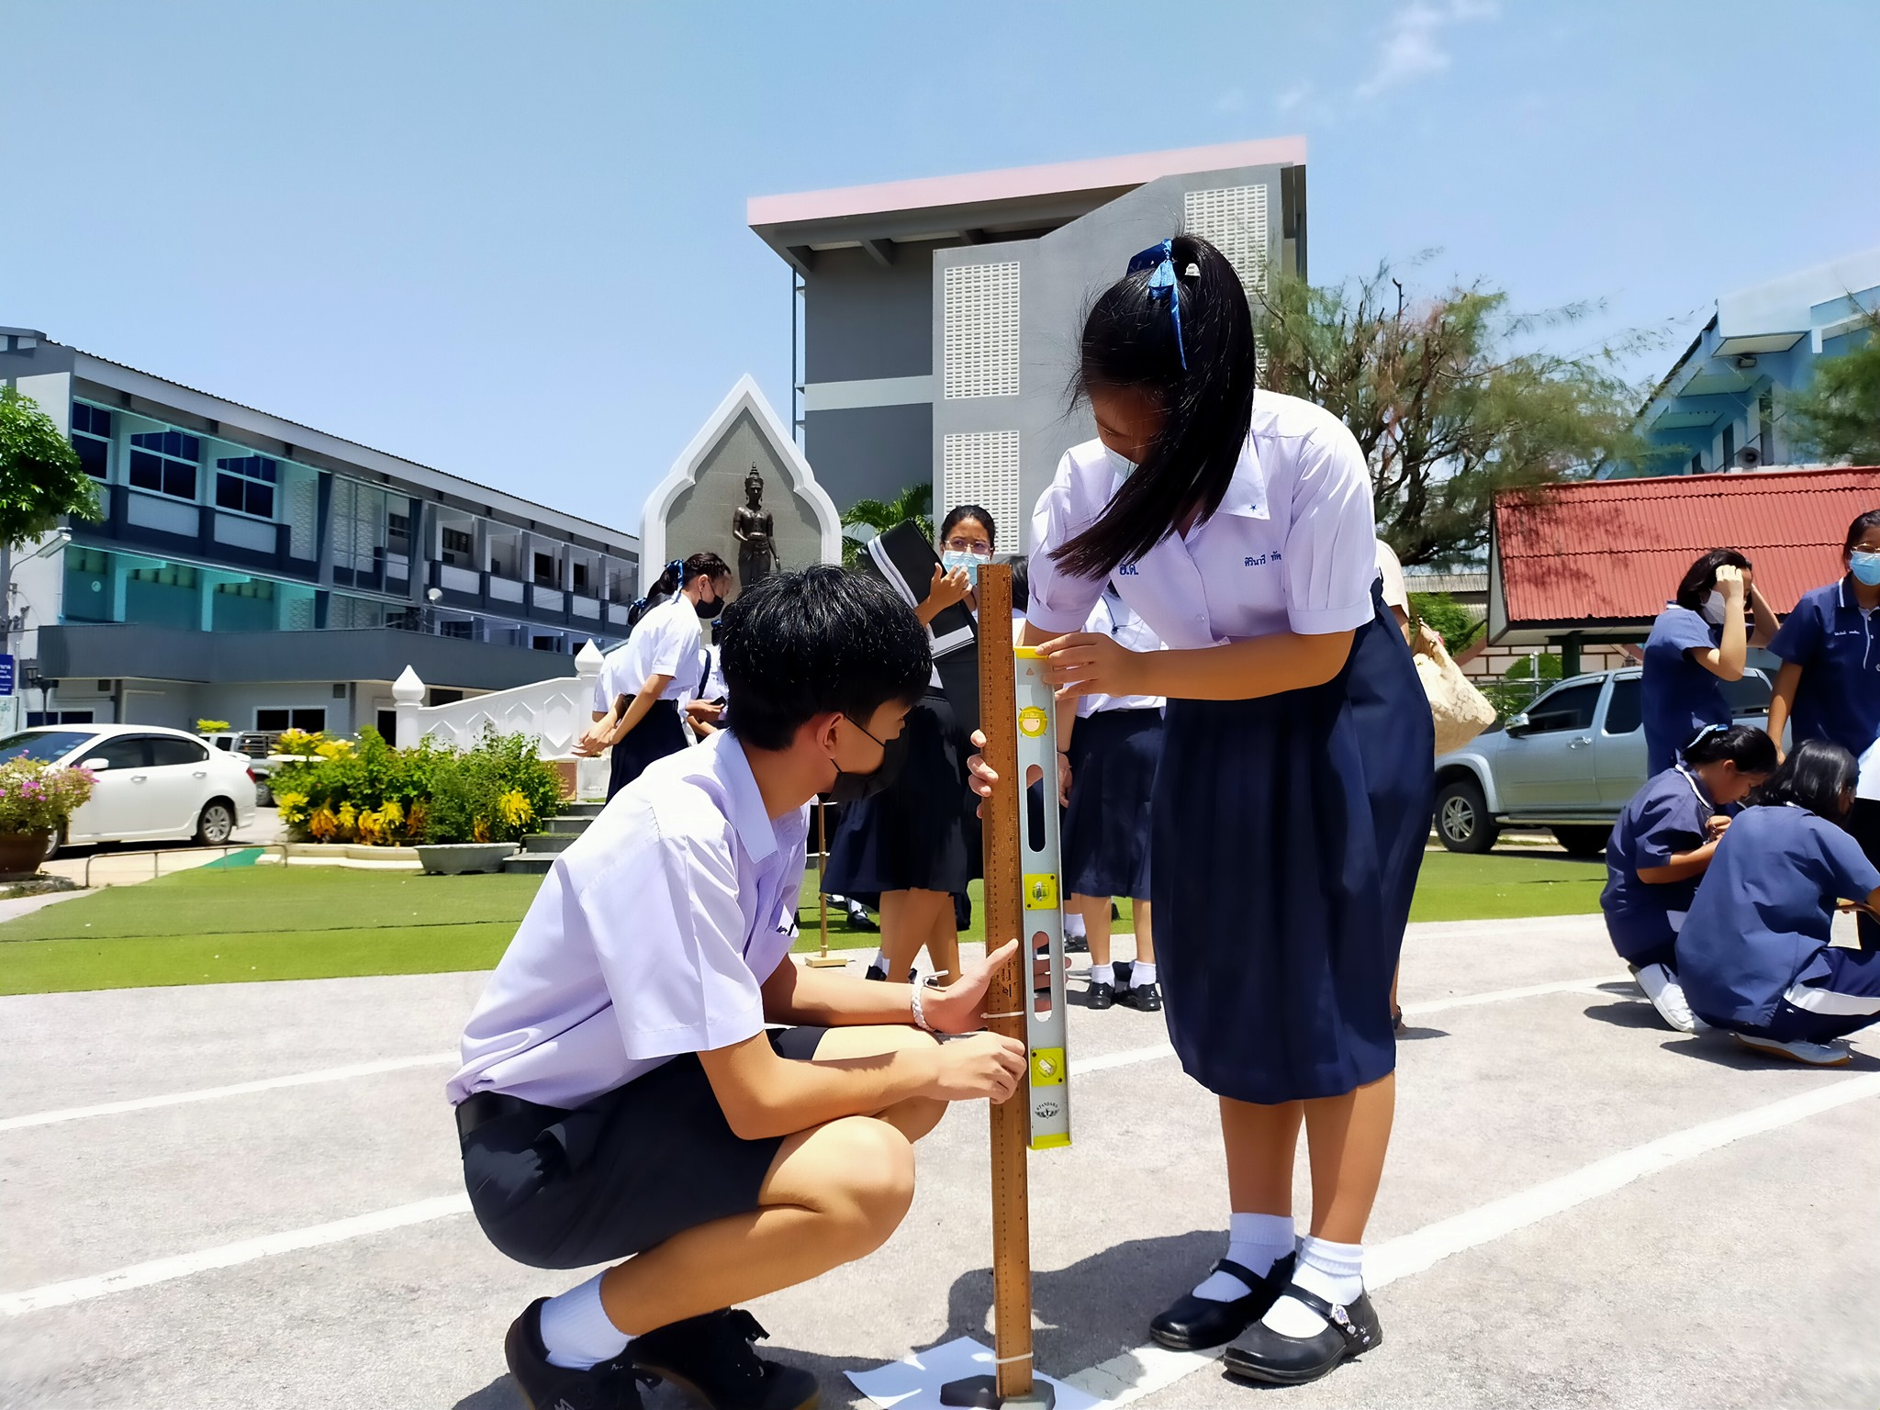
Commission C1 – Astronomy education & Development
Commission President: Aniket Sule
International Olympiad in Astronomy and Astrophysics
Astronomy education research and methods: Conference and journal
Astronomy Day in Schools
Education and training in Astrobiology*
IAU Division C – Education, Outreach, and Heritage
Dr Edward Gomez, Las Cumbres Observatory

Slide 5
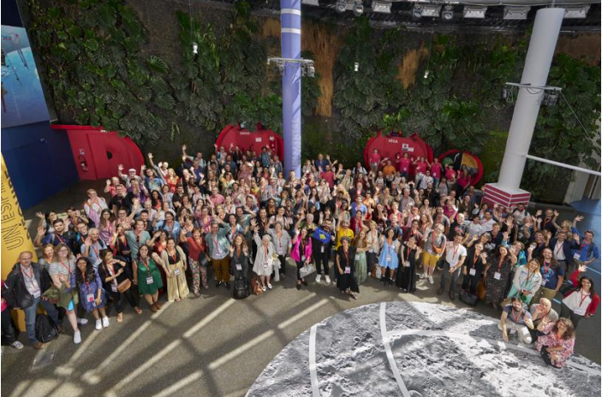
Commission C2 – Communicating Astronomy with the public
Commission President: Sylvie D.Vauclair
Communicating Astronomy with the Public – biennial conference
June 2024, Toulouse – “Astronomy Communication in a Hybrid World”
CAP Journal – Publishes scholarly articles and best practices on science communication
IAU Division C – Education, Outreach, and Heritage
Dr Edward Gomez, Las Cumbres Observatory

Slide 6
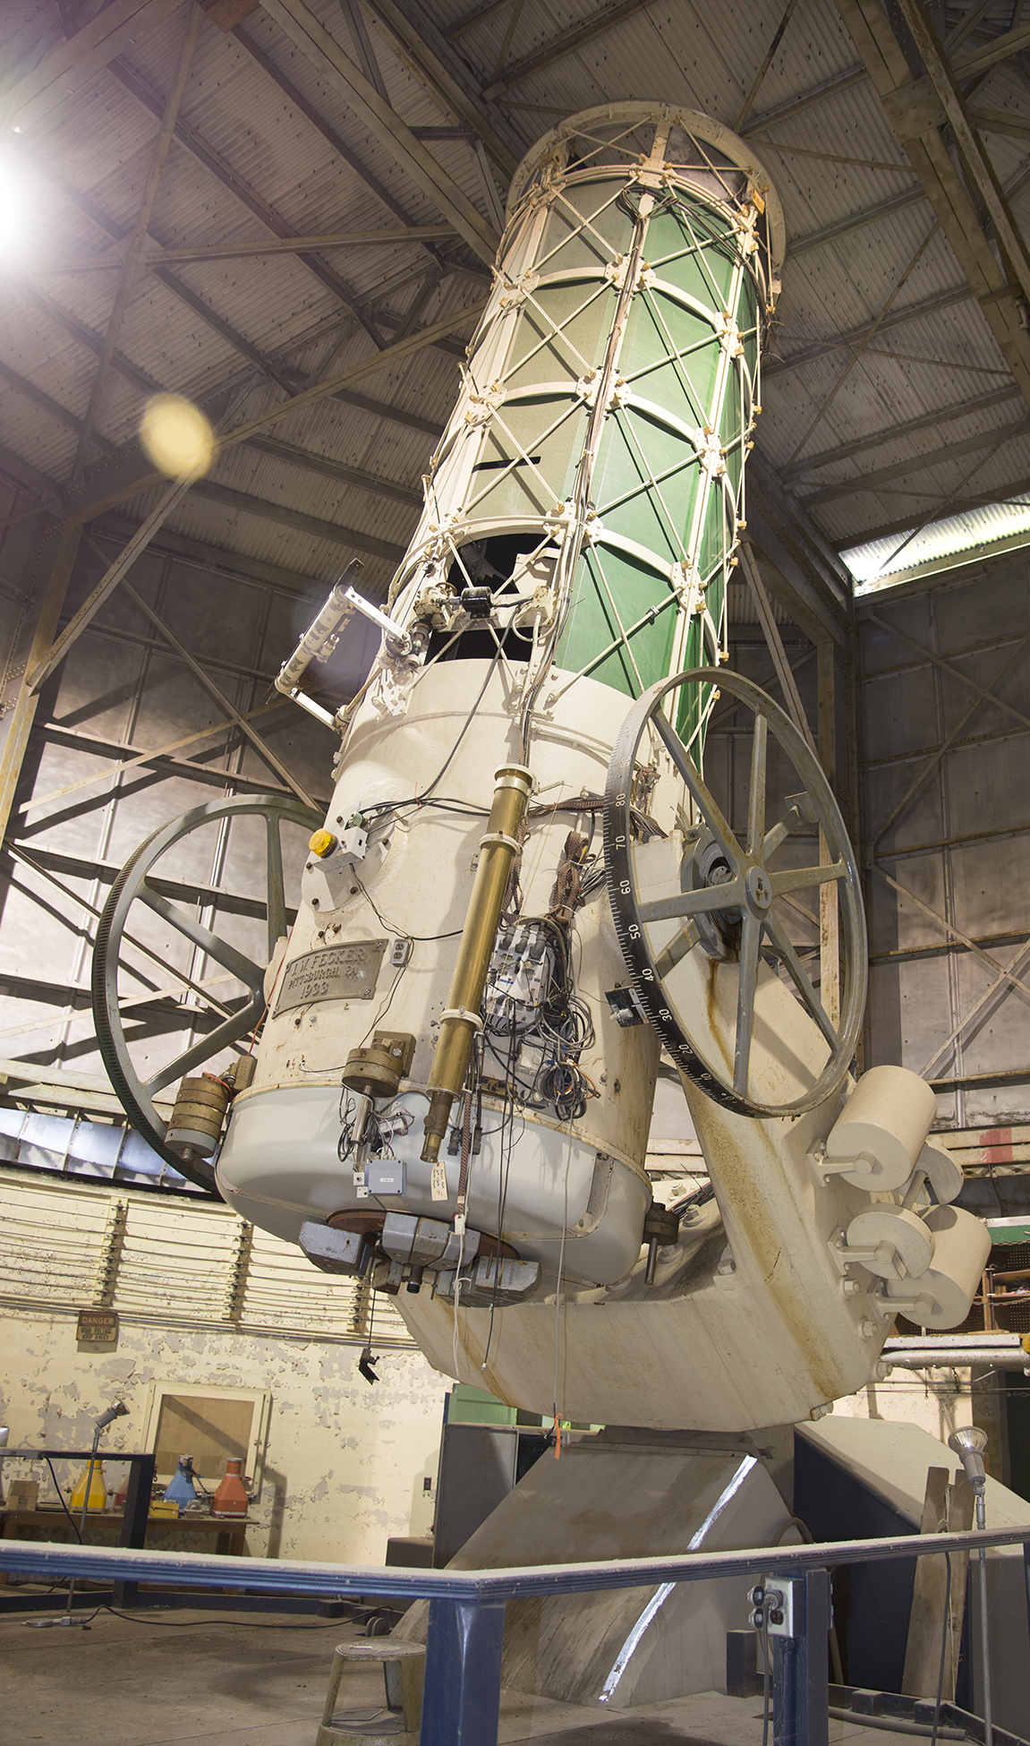
Commission C3 – History of Astronomy
Commission President: Sara Schechner
Encourages all aspects of research and publication in the History of Astronomy and Astrophysics.
Organizes special focus meetings, book projects.
Disseminates criteria for identifying and preserving historical astronomical instruments, records, and structures so that they will continue to be available for astronomical and historical research, teaching, and outreach.
Liaises with the International Union of History and Philosophy of Science and Technology to lead the Inter-Union Commission for History of Astronomy.
IAU Division C – Education, Outreach, and Heritage
Dr Edward Gomez, Las Cumbres Observatory

Slide 7

Commission C4 – World Heritage & Astronomy
Commission President: Michael Burton
UNESCO World Heritage United Nations Educational, Scientific & Cultural Organisation
Heritage is our legacy from the past, what we live with today, and what we pass on to future generations. Our cultural and natural heritage are both irreplaceable sources of life and inspiration.
What makes the concept of World Heritage exceptional is its universal application. World Heritage sites belong to all the peoples of the world, irrespective of the territory on which they are located.
Nominated by country in which located, then examined by experts, decided by vote of the members.
IAU Division C – Education, Outreach, and Heritage
Dr Edward Gomez, Las Cumbres Observatory
www.unesco.org

Slide 8
Commission C4 – World Heritage & Astronomy
Recent UNESCO Designations associated with Astronomy
2021 in Fuzhuo, China
Chankillo Astronomical Complex – Peru
Paseo del Prado & El Retiro, Madrid – Spain
2023 Riyadh, Saudi Arabia
Talayotic Menorca – Balearic Islands, Spain
Eise Eisinga Planetarium – Franeker, Netherlands
Astronomical Observatories of Kazan Federal University – Tatarstan, Russia
Hopewell Ceremonial Earthworks – Ohio, USA
2025 Placed on the UNESCO Tentative List of Ireland
The Astronomical Observatories of Ireland (Armagh, Birr, Dunsink)
IAU Division C – Education, Outreach, and Heritage
Dr Edward Gomez, Las Cumbres Observatory

Slide 9
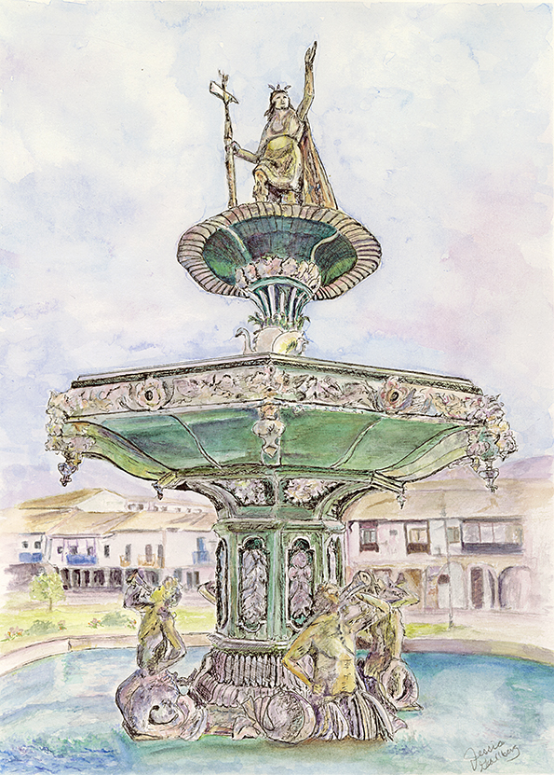
Commission C5 - Cultural Astronomy
Commission President: Steve Gullberg
Cultural Astronomy has matured as a distinct field of research and is represented by a commission of the IAU where it continues the advancement of archaeoastronomy, ethnoastronomy, and other astronomy in culture.
The commission supports efforts within the IAU.
IAU Division C – Education, Outreach, and Heritage
Dr Edward Gomez, Las Cumbres Observatory

Slide 10
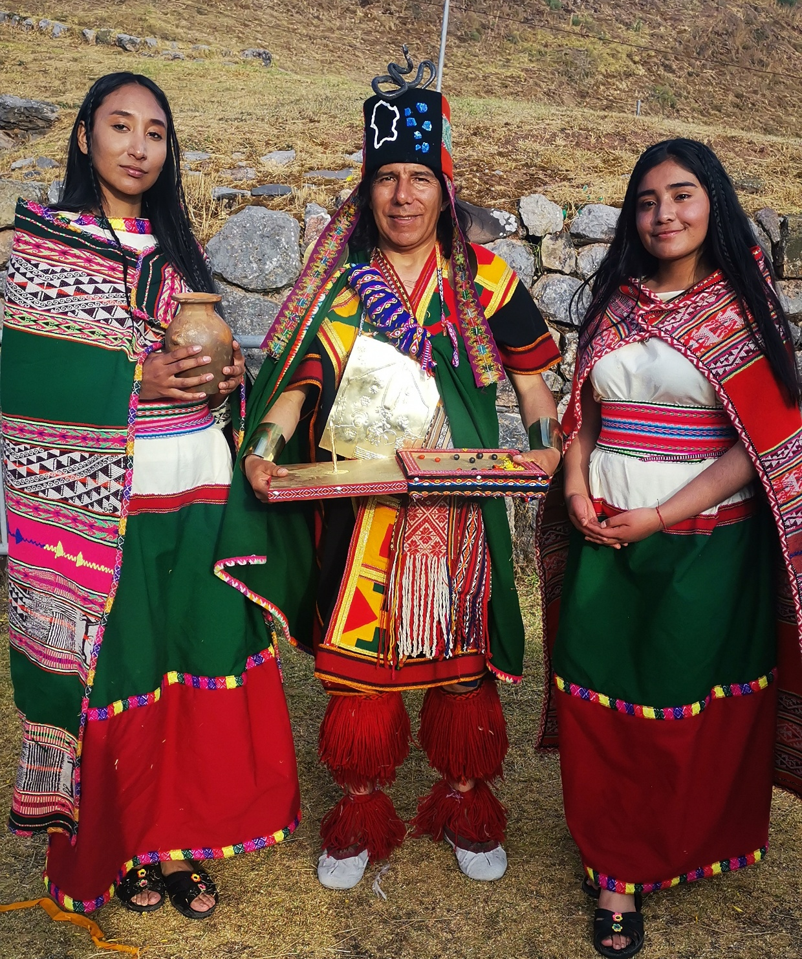
Activities
Archaeoastronomy – continued research and understanding of the astronomy of ancient cultures
Ethnoastronomy – continued research and understanding of Indigenous astronomy
Contemporary Cultural Astronomy - pursue exploration of astronomy in such as contemporary literature, art, poetry, music, and films.
Culturally Sensitive Sites - help astronomers to become better aware of Indigenous sensitivities where observatories have been built upon or are planned for sacred lands. Also help new development to be more in this regard.
Astronomical Heritage in Danger – identify sites needing protection and promote their preservation
Cultural Astronomy of Developing Nations - increase the understanding of how astronomy has been used in cultures within developing nations where such has not yet been fully explored
IAU Division C – Education, Outreach, and Heritage
Dr Edward Gomez, Las Cumbres Observatory

Slide 11
For more information
https://iau.org/DivisionC/
egomez@lco.global
IAU Division C – Education, Outreach, and Heritage
Dr Edward Gomez, Las Cumbres Observatory

