Slide 1
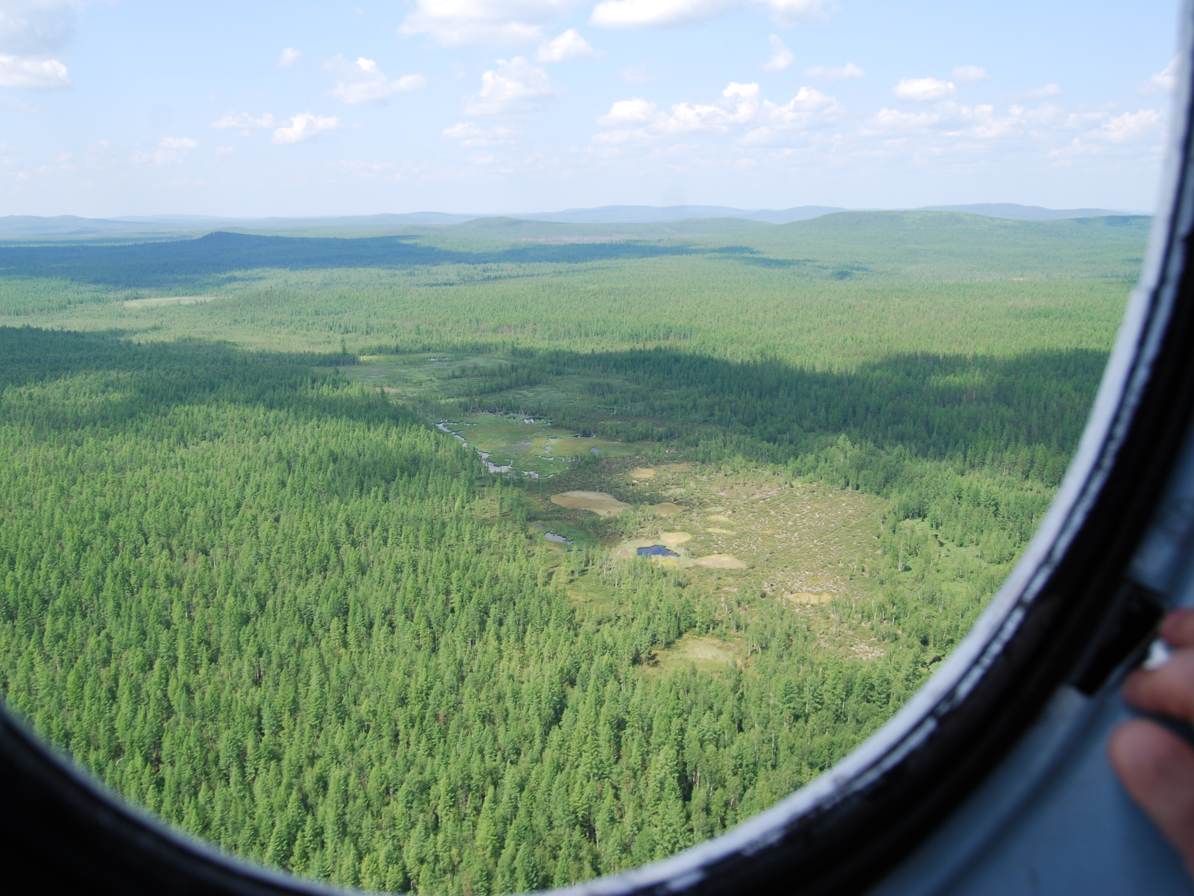
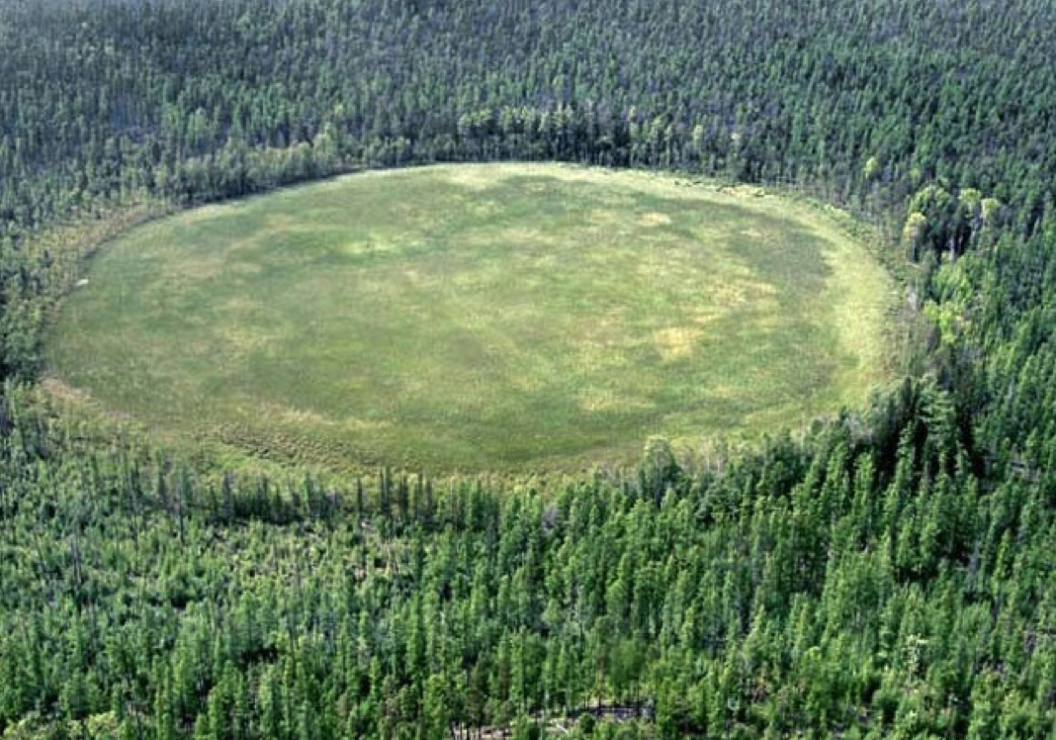
Preventing and Correcting Spread of Misinformation about NEOs, Impacts, Airbursts, and Planetary Defense
Mark Boslough¹, Peter Brown², Andy Bruno³, Paul Chodas⁴, Gareth Collins⁵, Tyrone Daulton⁶, Alan Harris⁷, Christian Koeberl⁸, Ania Losiak⁹, David Morrison¹⁰, Olga Popova¹¹, Darrel Robertson¹², Elizabeth A. Silber¹³, and Matthias van Ginneken¹⁴
¹Los Alamos National Laboratory, ²U. of Western Ontario,. ³Indiana U. Bloomington, USA, ⁴Jet Propulsion Laboratory, ⁵Imperial College London, ⁶Washington U. in St. Louis, ⁷Jet Propulsion Laboratory (retired), ⁸U. of Vienna, ⁹Institute of Geological Sciences, Polish Academy of Sciences, ¹⁰NASA (retired), ¹¹Institute of Geosphere Dynamics, ¹²NASA Ames Research Center, ¹³Sandia National Laboratories, ¹⁴U. of Kent
Tunguska
Not Tunguska
IAA Planetary Defense Conference, 5-9 May 2025, Stellenbosch, Cape Town, South Africa
LANL work was supported by the US Department of Energy through the Los Alamos National Laboratory. Los Alamos National Laboratory is operated by Triad National Security, LLC, for the National Nuclear Security Administration of U.S. Department of Energy (Contract No. 89233218CNA000001).
Notes:
Two parts to this talk: 1) Rapid response. 2) Sustained response.

Slide 2
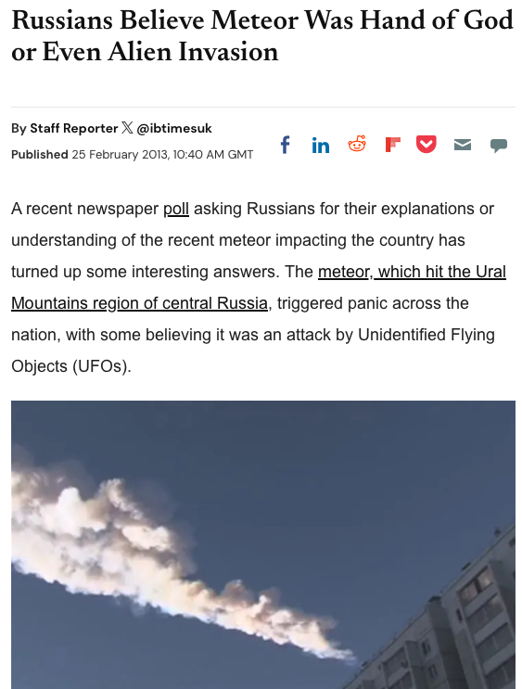
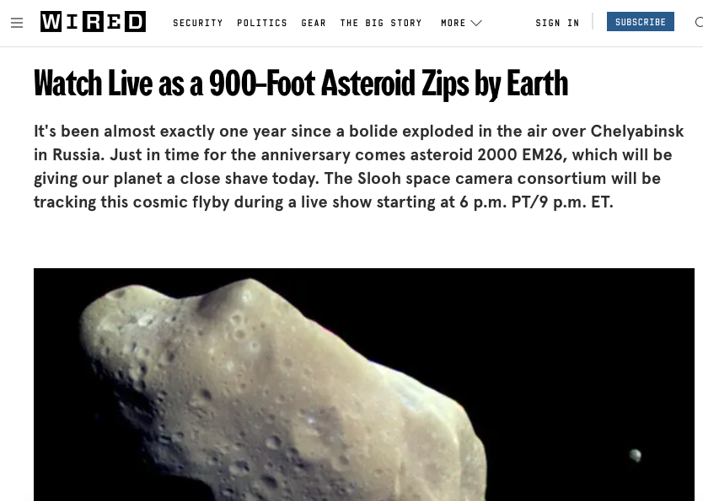
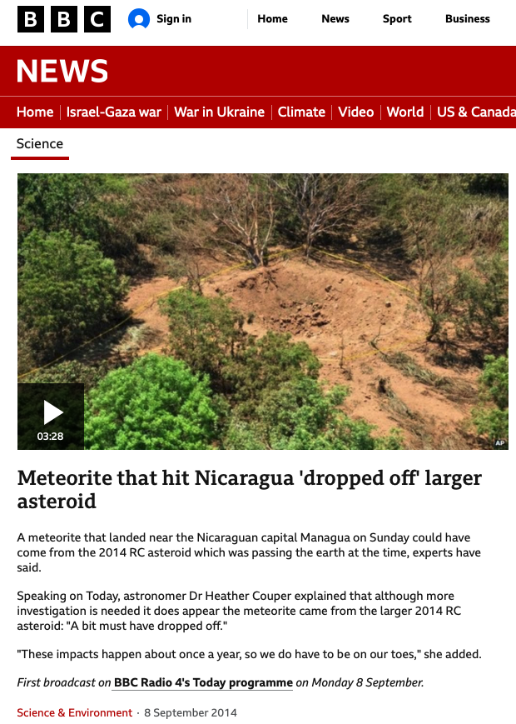
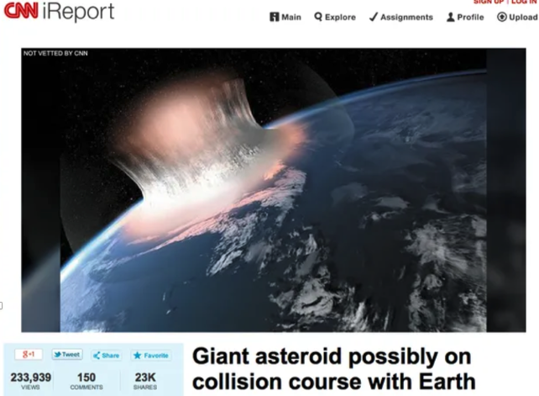
Distributed (non-centralized) rapid response: case studies (2013-2014)
Chelyabinsk
Slooh non-event
CNN hoax
The Beast
Nicaragua crater

Slide 3
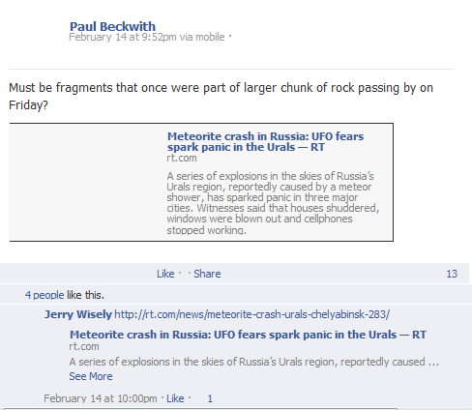
Distributed (non-centralized) rapid response: case studies (2013-2014)
Chelyabinsk
Slooh non-event
CNN hoax
The Beast
Nicaragua crater
I learned from Facebook
Just after 9:52 pm Feb. 14
(about 1.5 hours after event)
“According to unconfirmed reports, the meteorite was intercepted by an air defense unit at the Urzhumka settlement near Chelyabinsk.”
“The regional Emergency Ministry said the phenomenon was a meteorite shower, but locals have speculated that it was a military fighter jet crash or a missile explosion.”
“It is believed that the incident may be connected to asteroid 2012 DA14, which measures 45 to 95 meters in diameter and will be passing by Earth tonight at around 19:25 GMT at the record close range of 27,000 kilometers.”

Slide 4
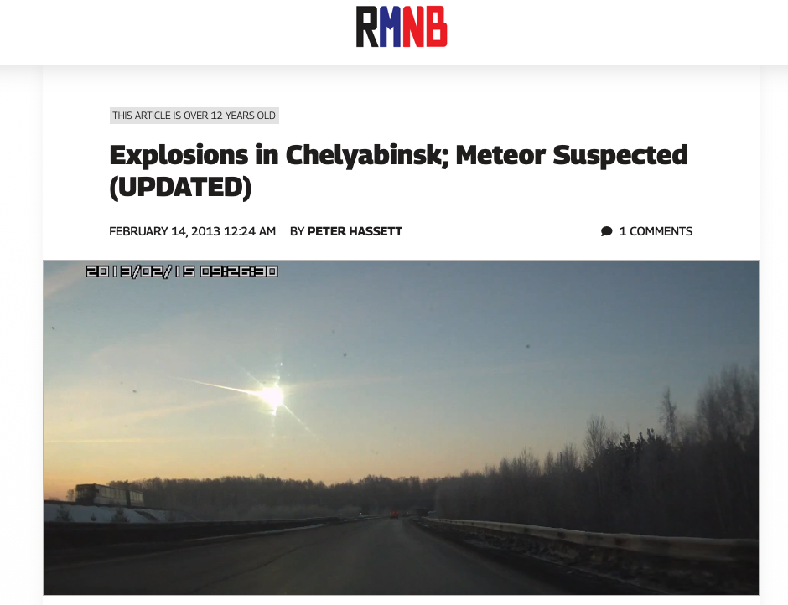
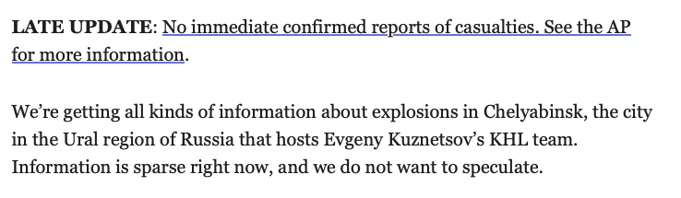
Distributed (non-centralized) rapid response: case studies (2013-2014)
Chelyabinsk
Slooh non-event
CNN hoax
The Beast
Nicaragua crater

Slide 5
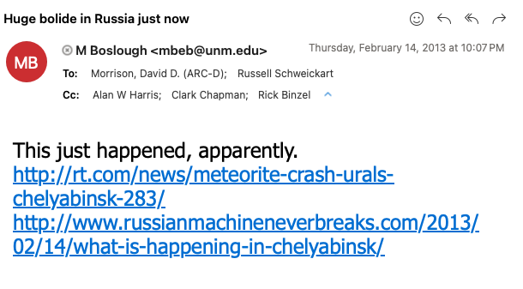
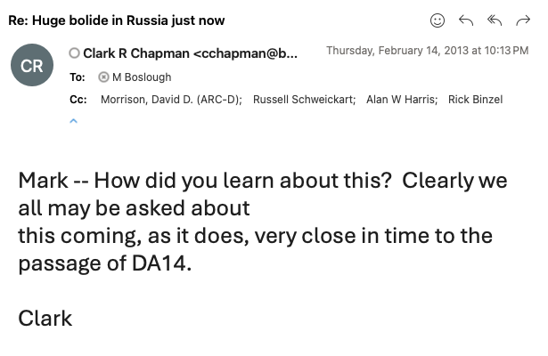
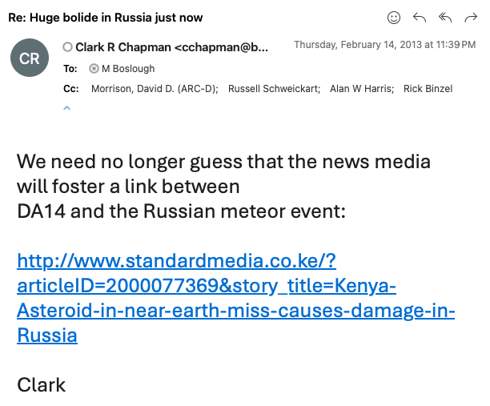
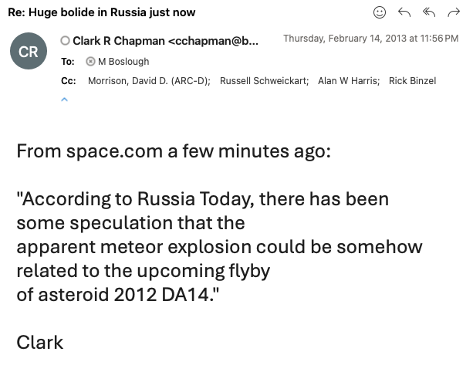
Distributed (non-centralized) rapid response: case studies (2013-2014)
Chelyabinsk
Slooh non-event
CNN hoax
The Beast
Nicaragua crater

Slide 6
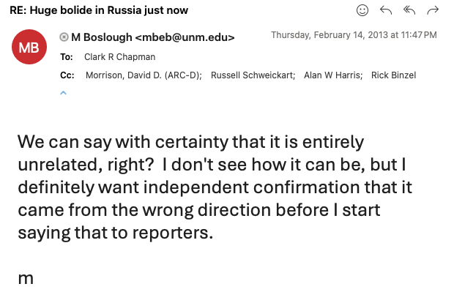
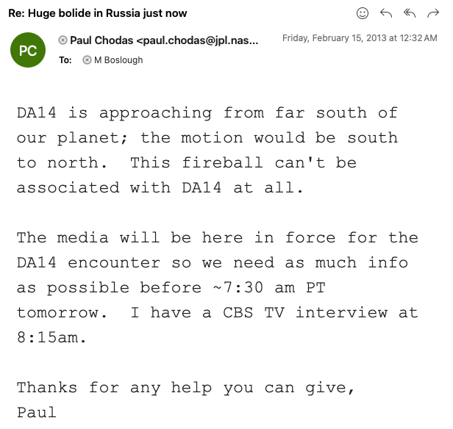
Distributed (non-centralized) rapid response: case studies (2013-2014)
Chelyabinsk
Slooh non-event
CNN hoax
The Beast
Nicaragua crater

Slide 7
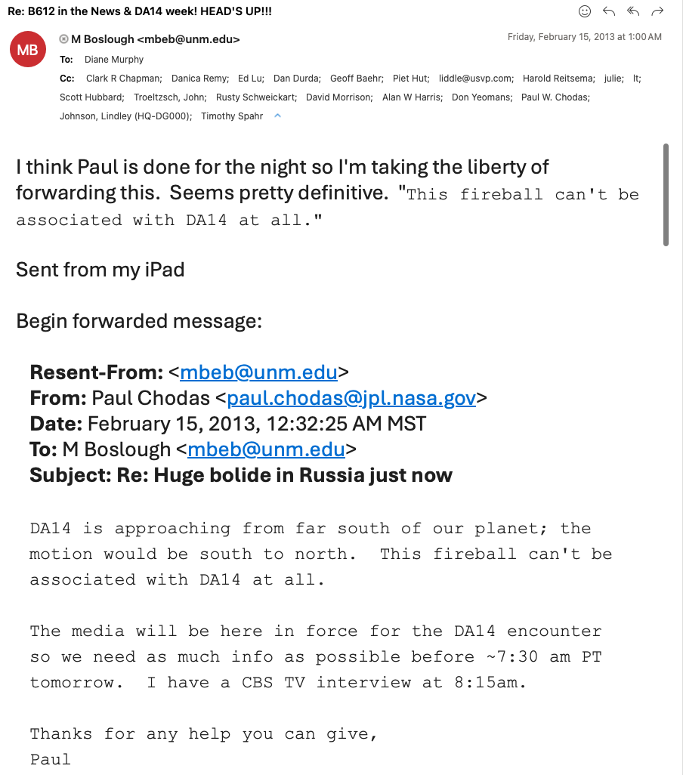
Distributed (non-centralized) rapid response: case studies (2013-2014)
Chelyabinsk
Slooh non-event
CNN hoax
The Beast
Nicaragua crater
“This fireball can’t be associated with DA14 at all.” -Paul Chodas (~4 hours after event)
Lesson Learned:
Value of rapid, distributed means of communication among subject matter experts across all time zones.

Slide 8
Distributed (non-centralized) rapid response: case studies (2013-2014)
Chelyabinsk
Slooh non-event
CNN hoax
The Beast
Nicaragua crater

Slide 9
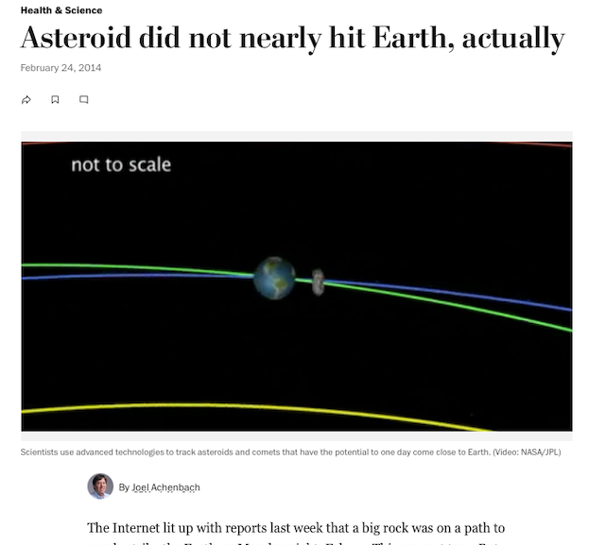
Distributed (non-centralized) rapid response: case studies (2013-2014)
Chelyabinsk
Slooh non-event
CNN hoax
The Beast
Nicaragua crater
Lesson Learned:
Value of subject matter experts reaching out to journalists.

Slide 10
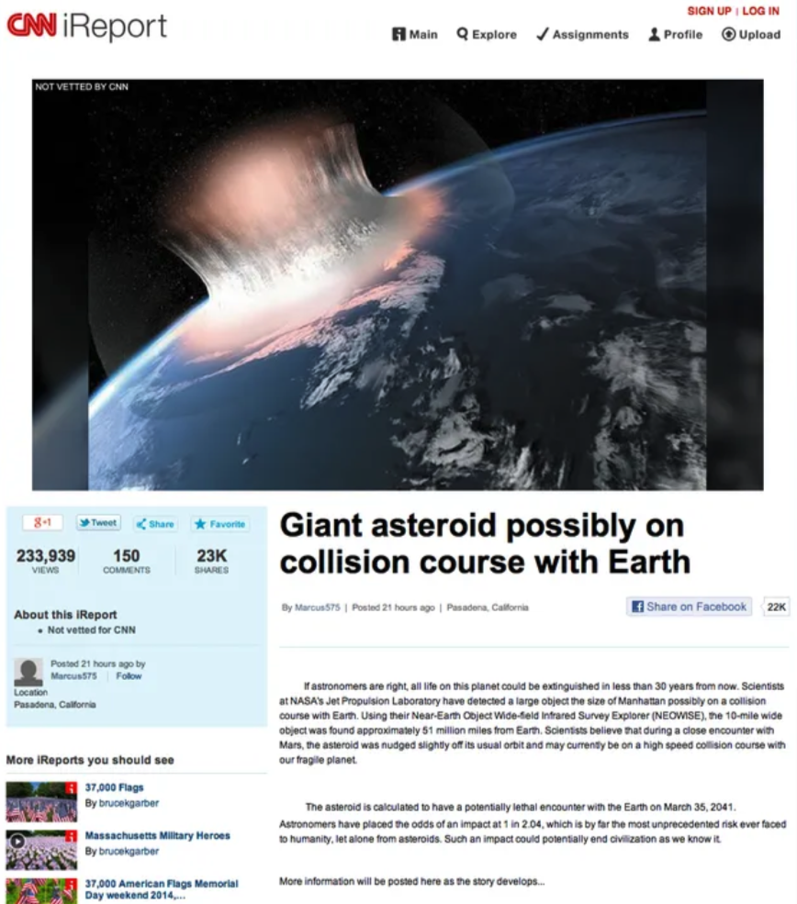
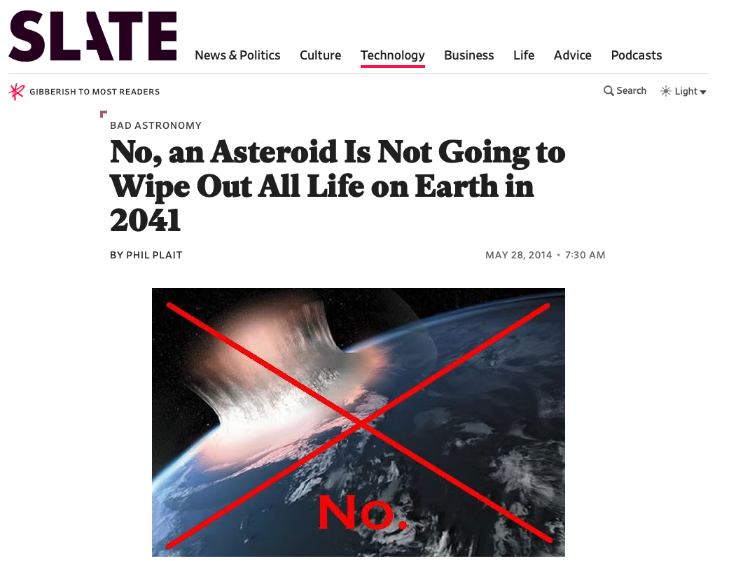
Distributed (non-centralized) rapid response: case studies (2013-2014)
Chelyabinsk
Slooh non-event
CNN hoax
The Beast
Nicaragua crater

Slide 11
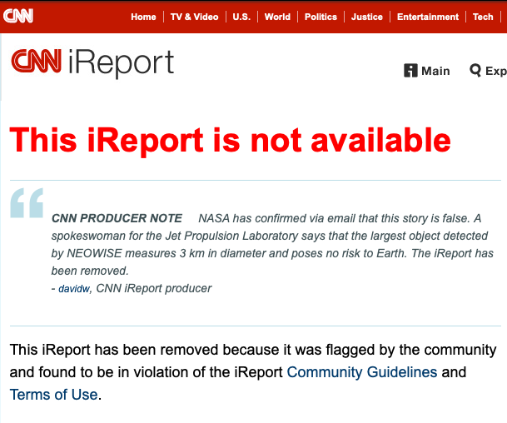
Distributed (non-centralized) rapid response: case studies (2013-2014)
Chelyabinsk
Slooh non-event
CNN hoax
The Beast
Nicaragua crater
Lesson Learned:
Value of scientists who blog and are active on social media.

Slide 12
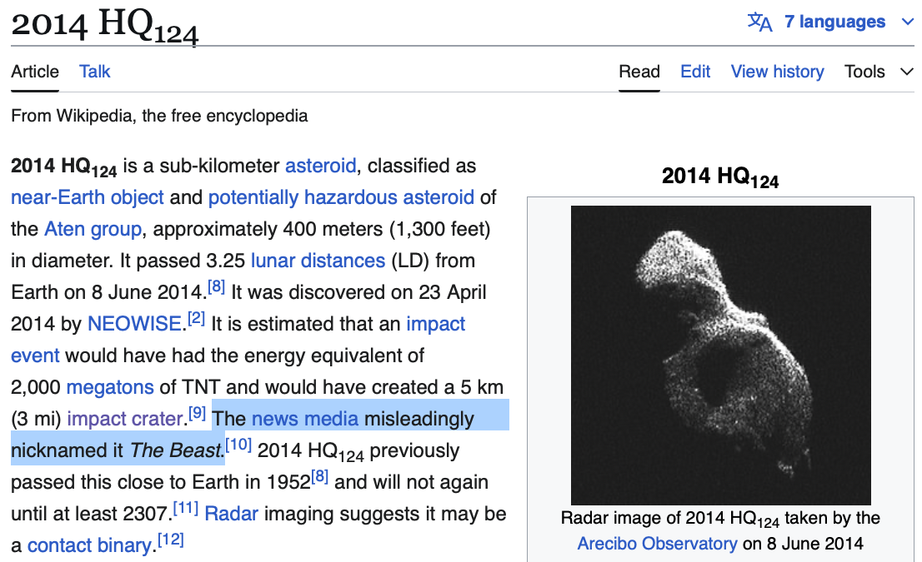
Distributed (non-centralized) rapid response: case studies (2013-2014)
Chelyabinsk
Slooh non-event
CNN hoax
The Beast
Nicaragua crater

Slide 13
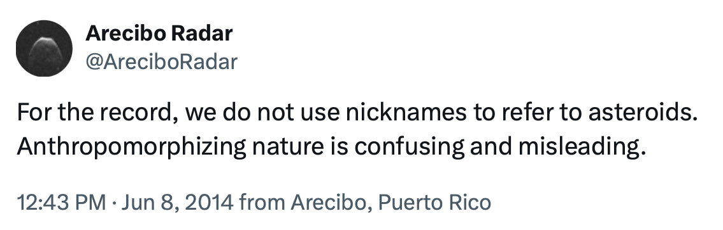
Distributed (non-centralized) rapid response: case studies (2013-2014)
Chelyabinsk
Slooh non-event
CNN hoax
The Beast
Nicaragua crater
Lesson Learned:
Value of institutions using social media.

Slide 14
Distributed (non-centralized) rapid response: case studies (2013-2014)
Chelyabinsk
Slooh non-event
CNN hoax
The Beast
Nicaragua crater

Slide 15
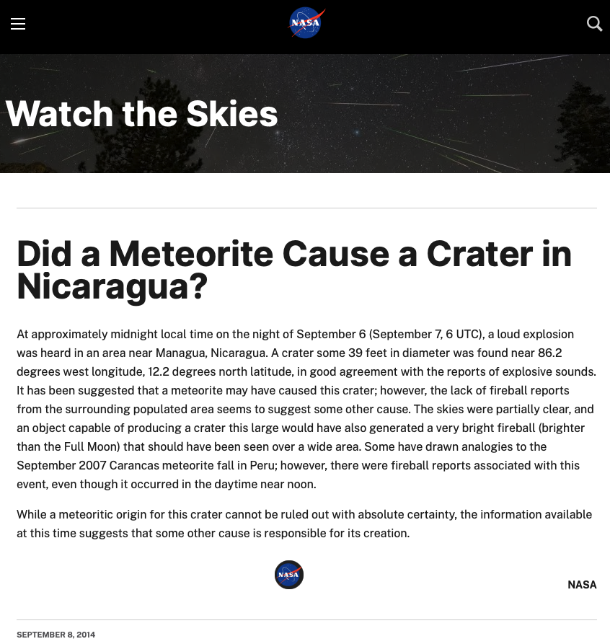
Distributed (non-centralized) rapid response: case studies (2013-2014)
Chelyabinsk
Slooh non-event
CNN hoax
The Beast
Nicaragua crater
“While a meteoritic origin for the crater cannot be ruled out with absolute certainty, the information available at this time suggests that some other cause is responsible for its creation.” -NASA
Lesson Learned:
Value of rapid response by institutions to questionable news stories.

Slide 16
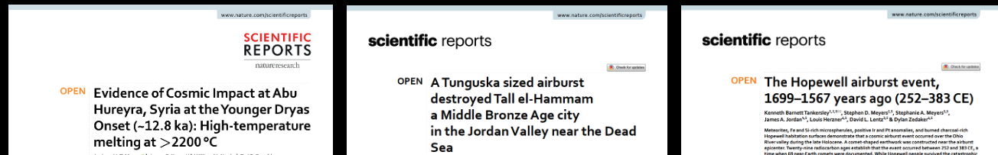
Meme laundering playbook: 5 stages of science misinformation
Step 1: Questionable peer review
Step 2: Aggressive promotion
Step 3: Clickbait science media
Step 4: Clickbait general media
Step 5: Pop culture and public acceptance
3 case studies
Moore et al, 2020
Bunch et al, 2021
Tankersley et al, 2022

Slide 17
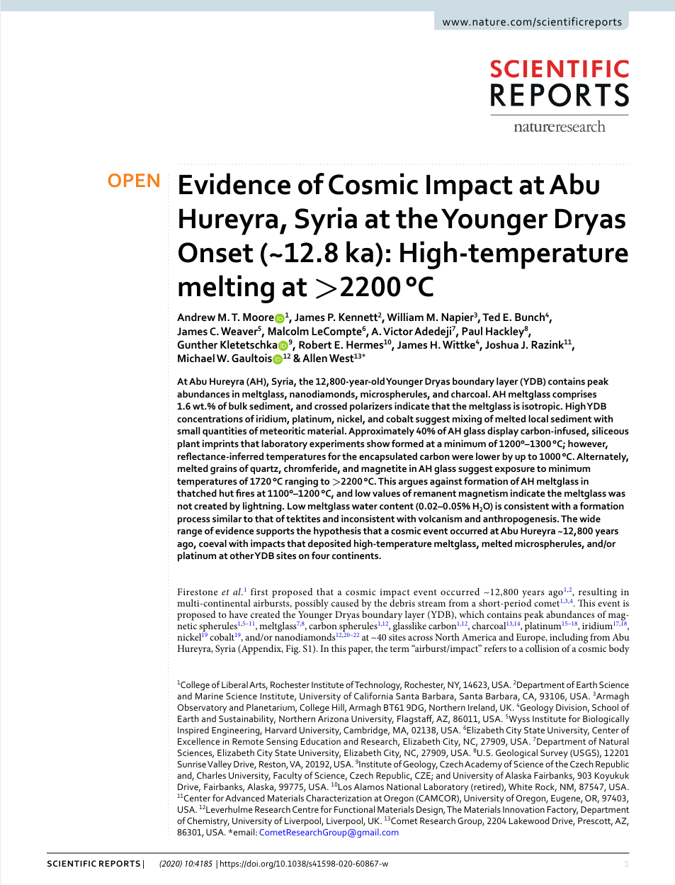
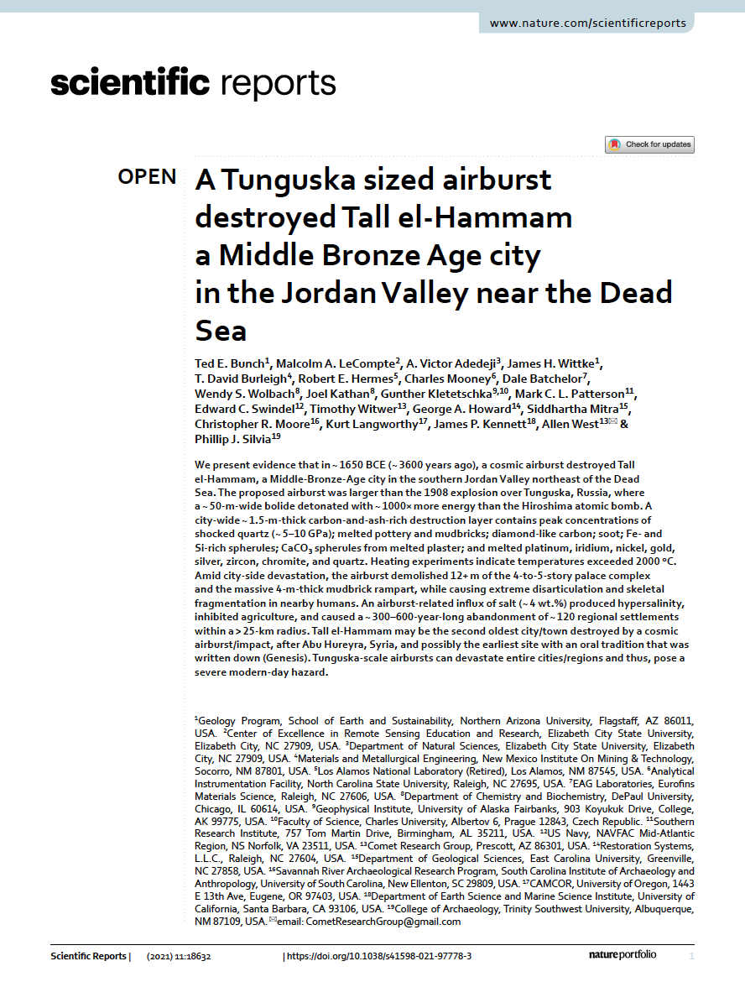
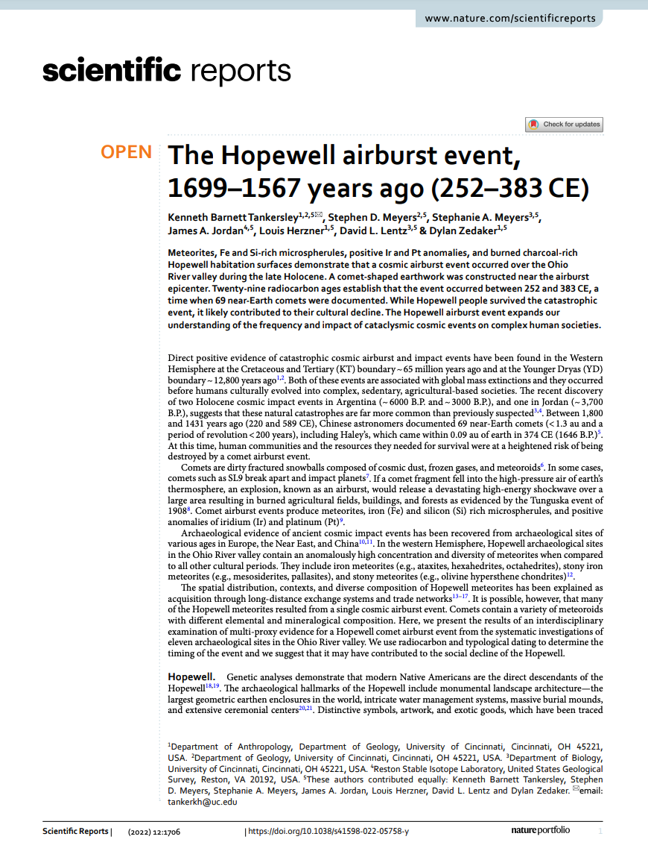
Meme laundering playbook: The 5 stages of science misinformation
Step 1: Questionable peer review
Moore et al, 2020
Bunch et al, 2021
Tankersley et al, 2022
Notes:
17
17

Slide 18
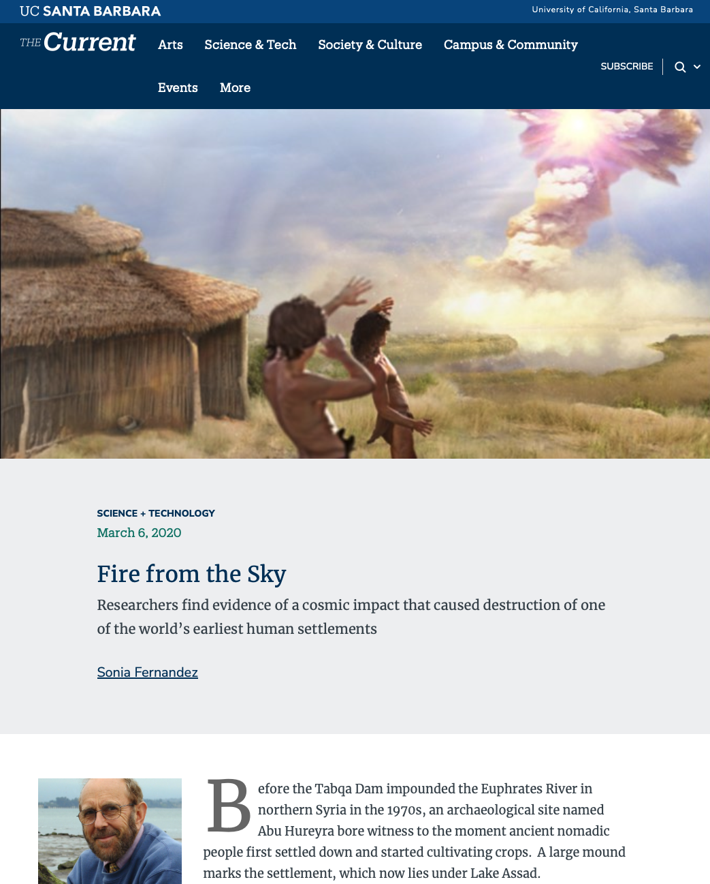
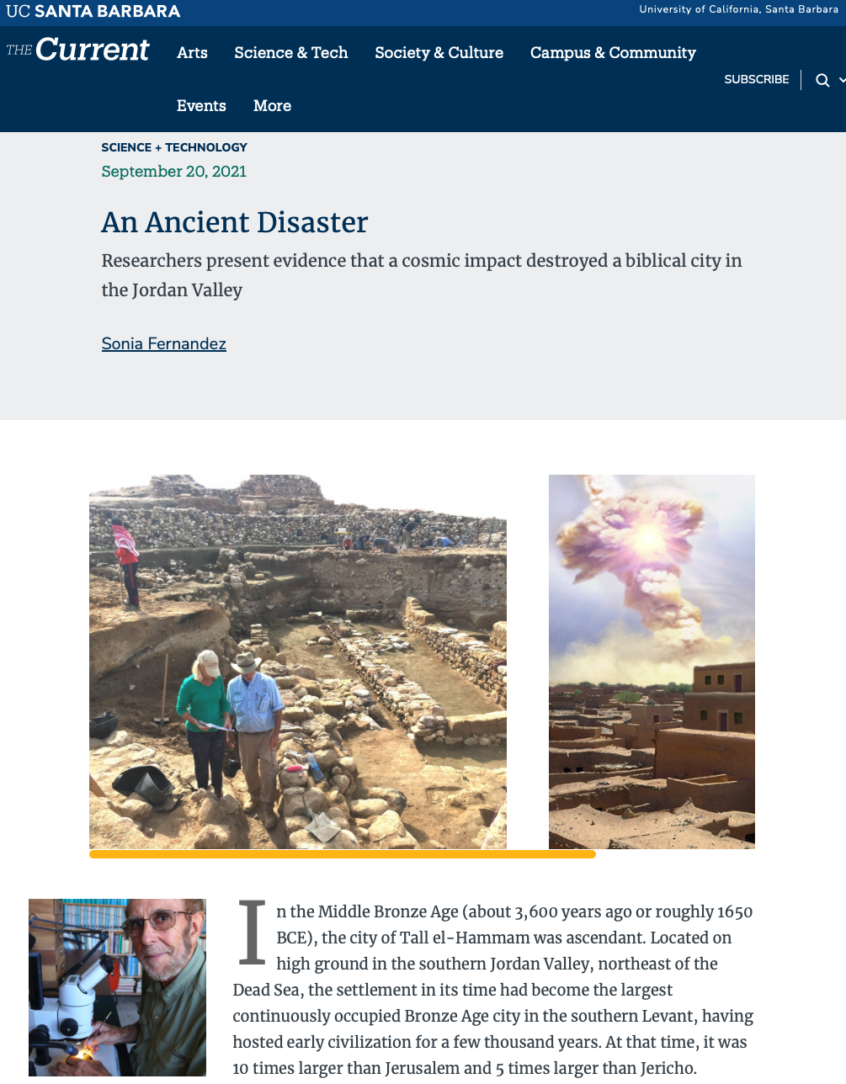
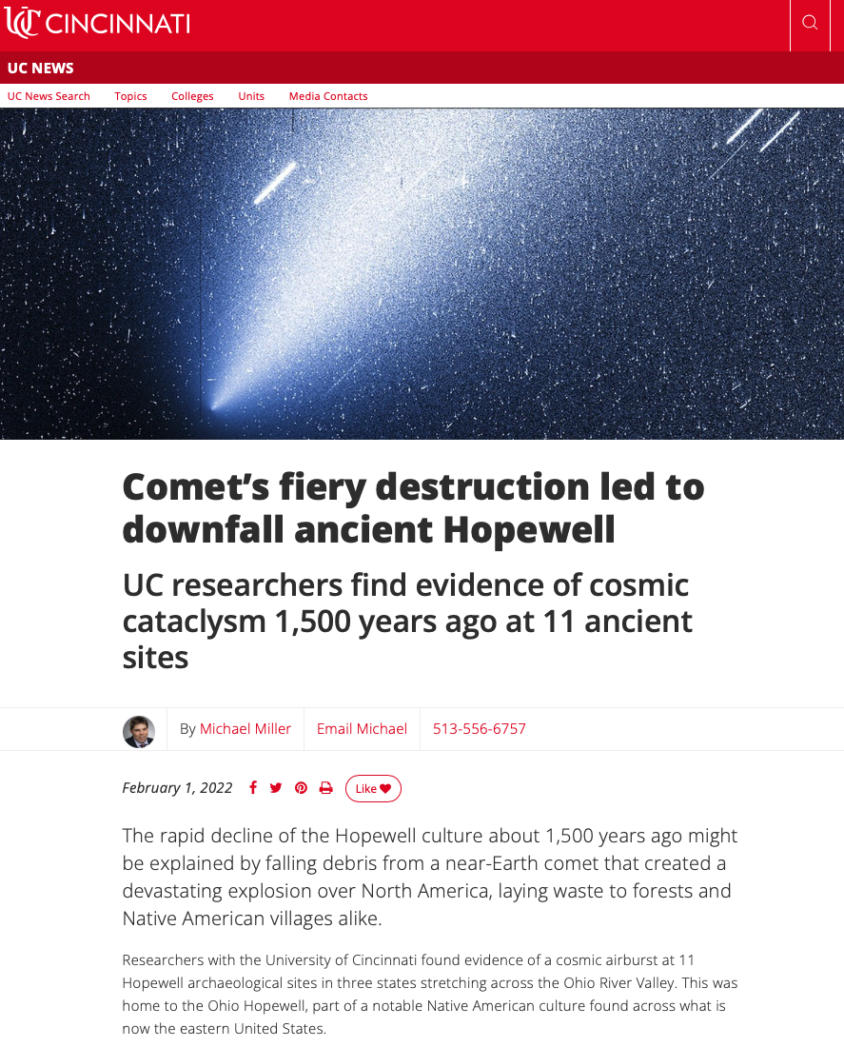
Meme laundering playbook: The 5 stages of science misinformation
Step 2: Aggressive promotion
Moore et al, 2020
Bunch et al, 2021
Tankersley et al, 2022
Notes:
18
18

Slide 19
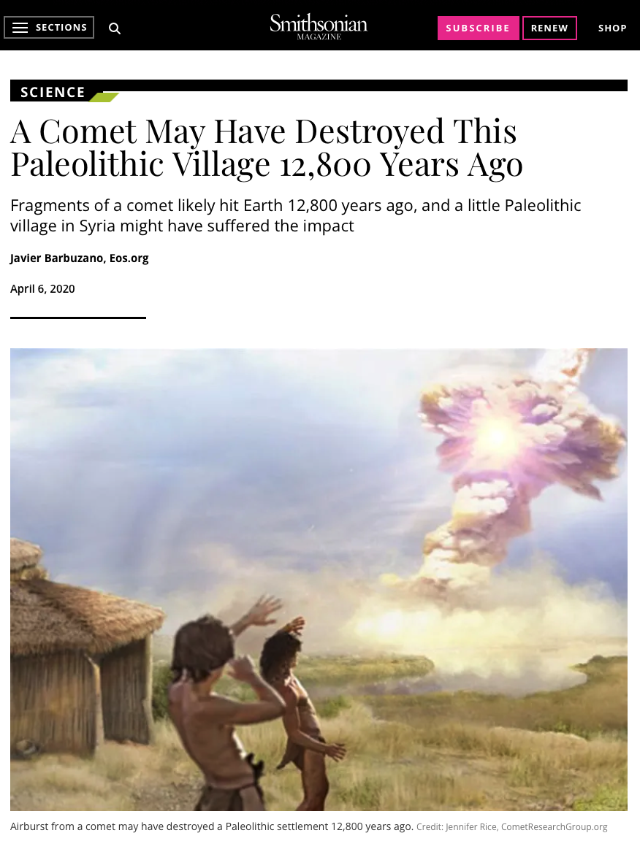
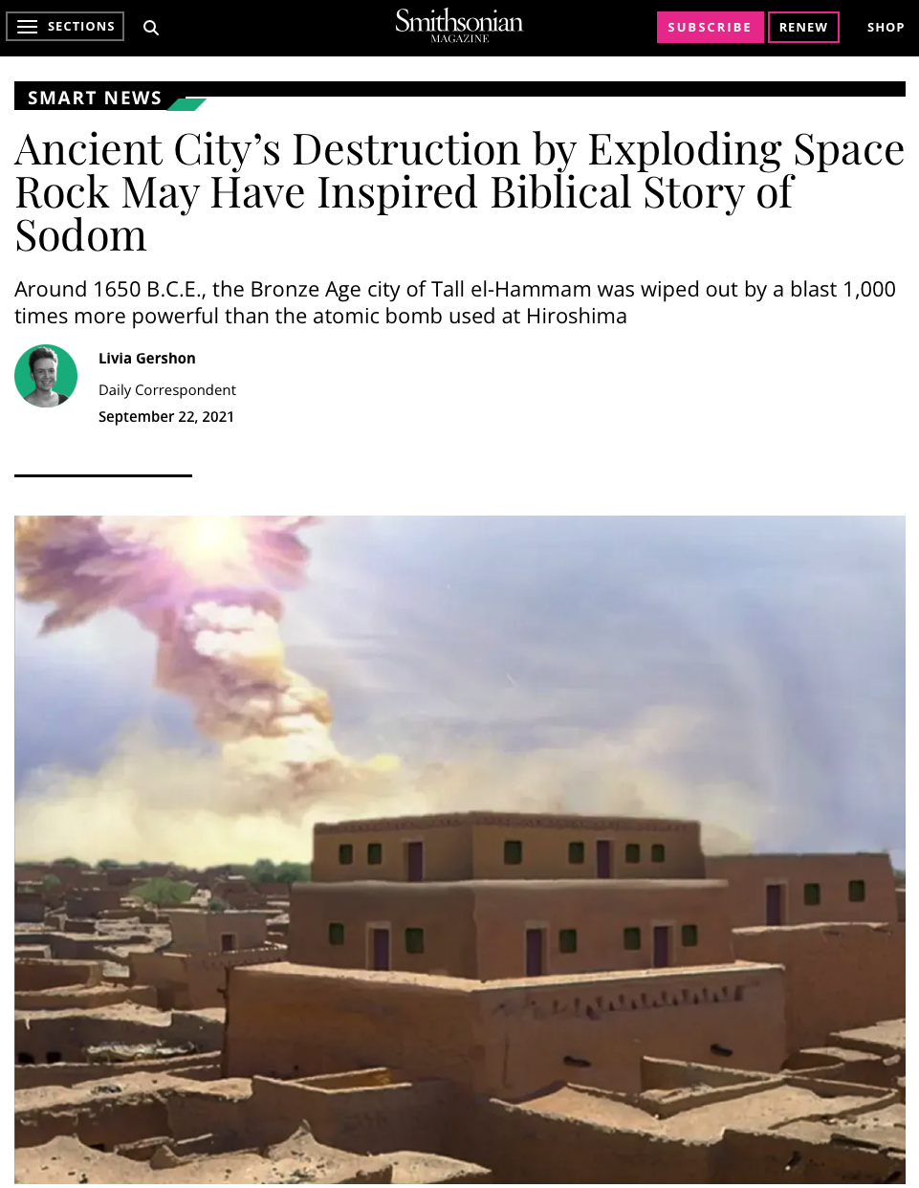
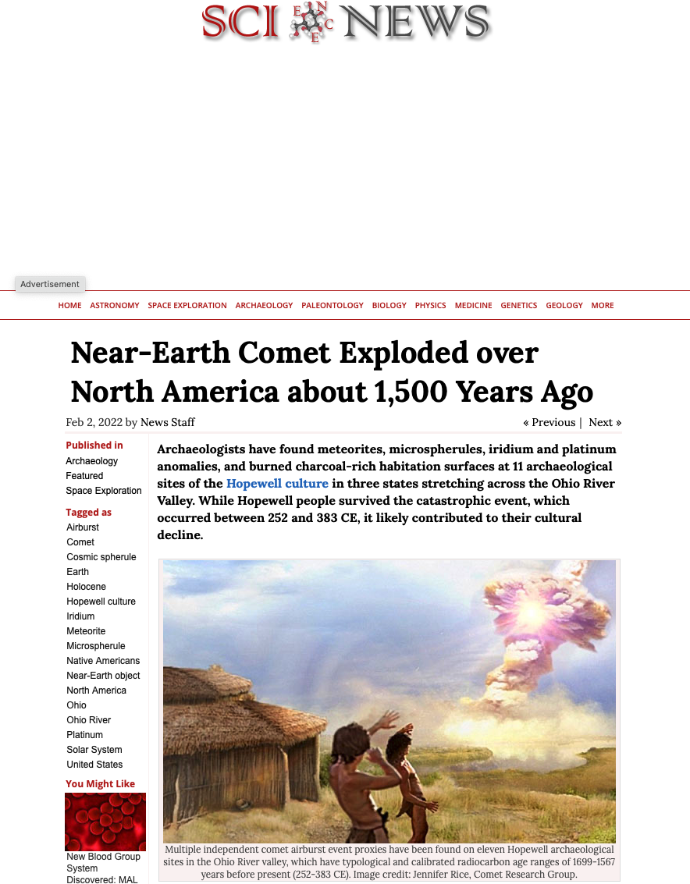
Meme laundering playbook: The 5 stages of science misinformation
Step 3: Clickbait science media
Moore et al, 2020
Bunch et al, 2021
Tankersley et al, 2022
Notes:
19
19

Slide 20
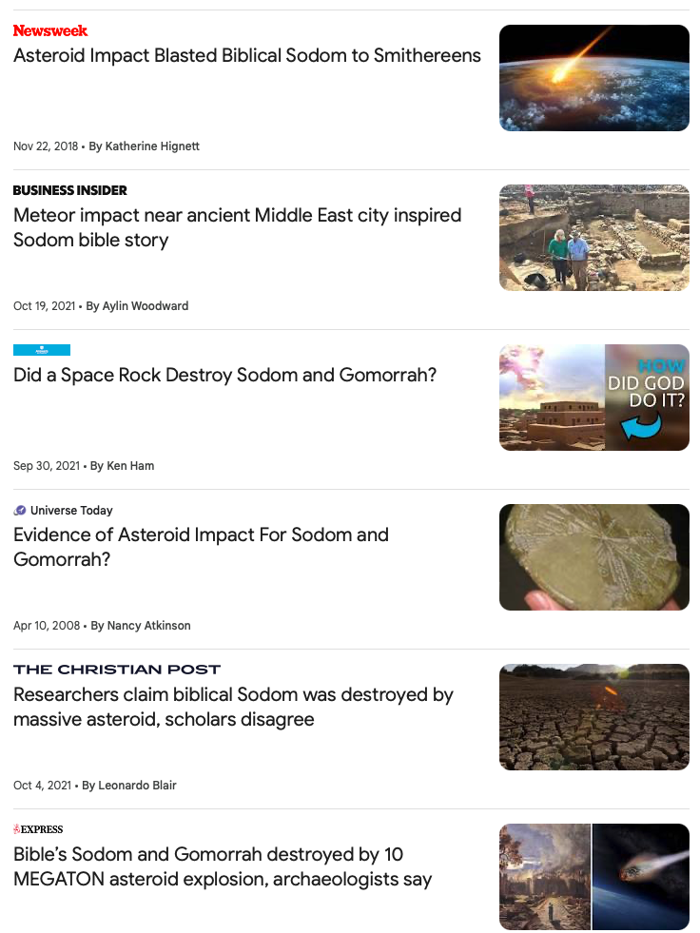
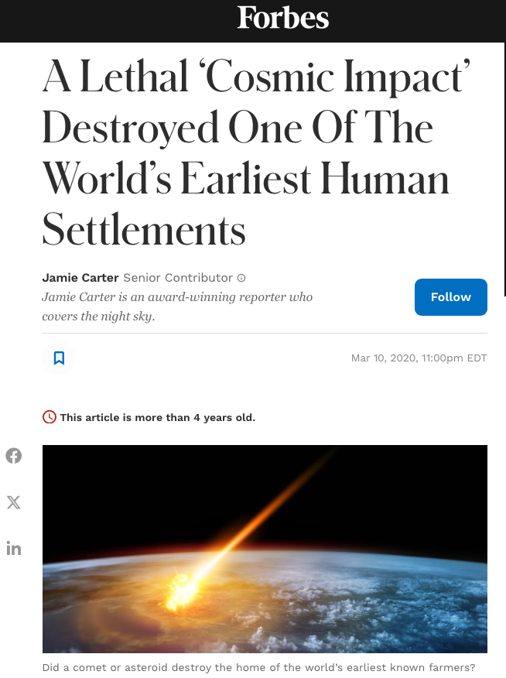
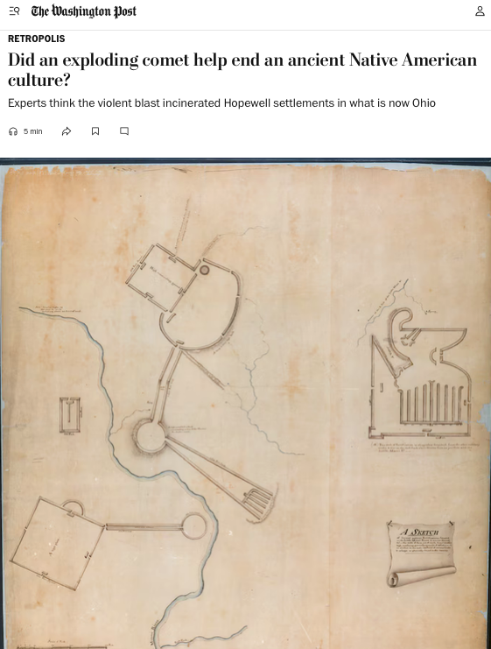
Meme laundering playbook: The 5 stages of science misinformation
Step 4: Clickbait general media
Moore et al, 2020
Bunch et al, 2021
Tankersley et al, 2022
Notes:
20
20

Slide 21
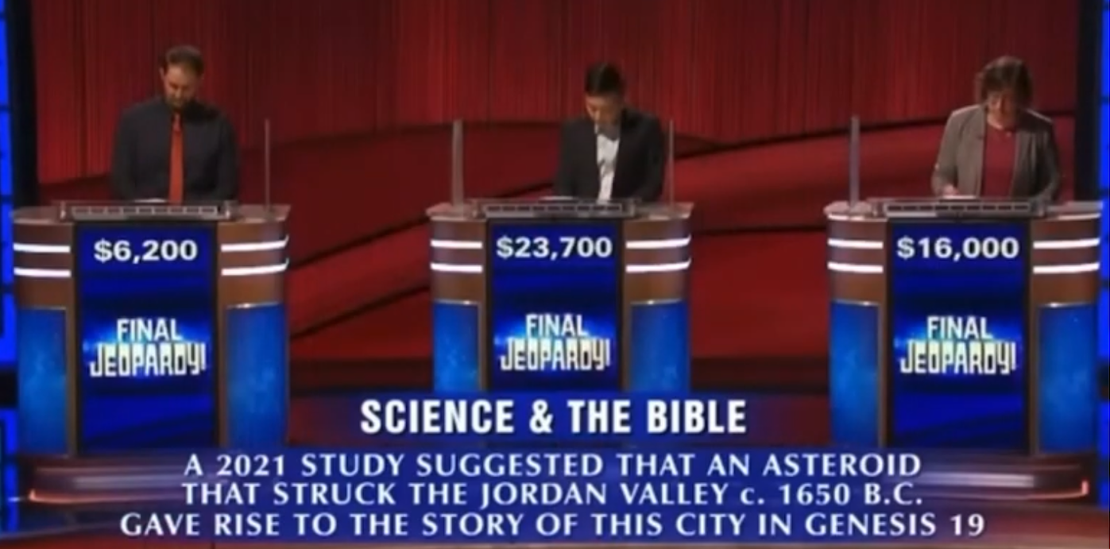
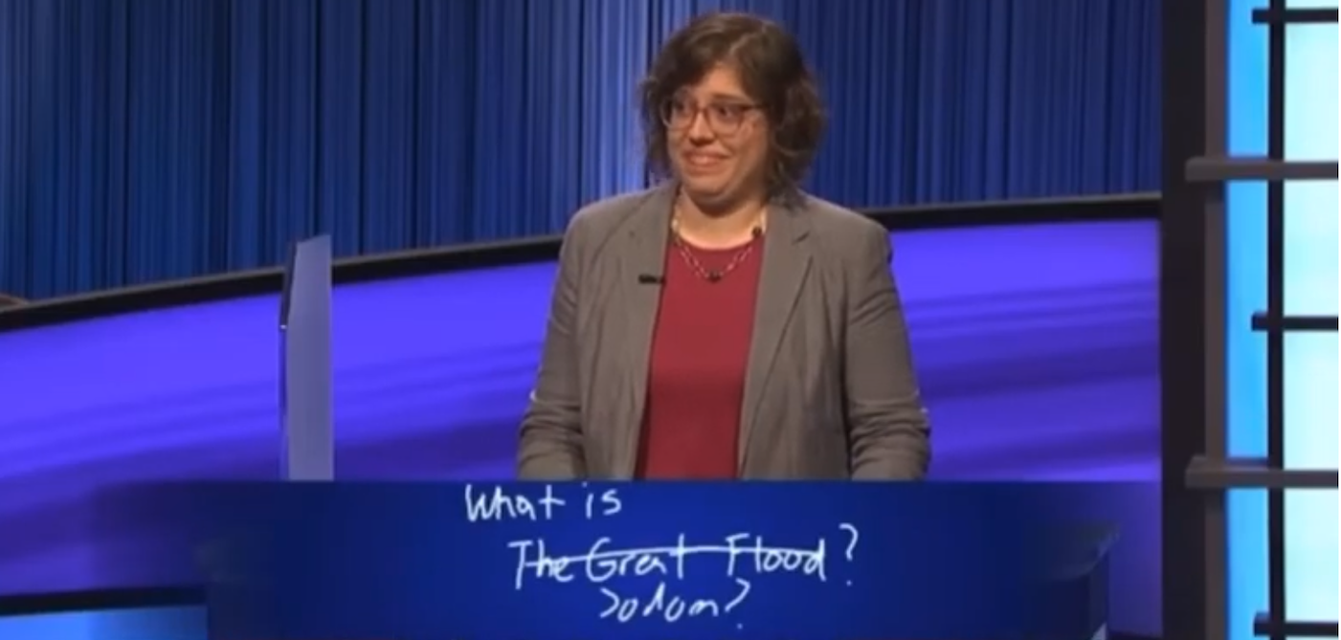
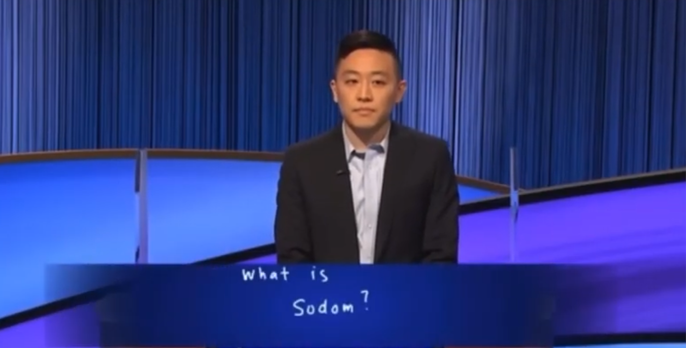
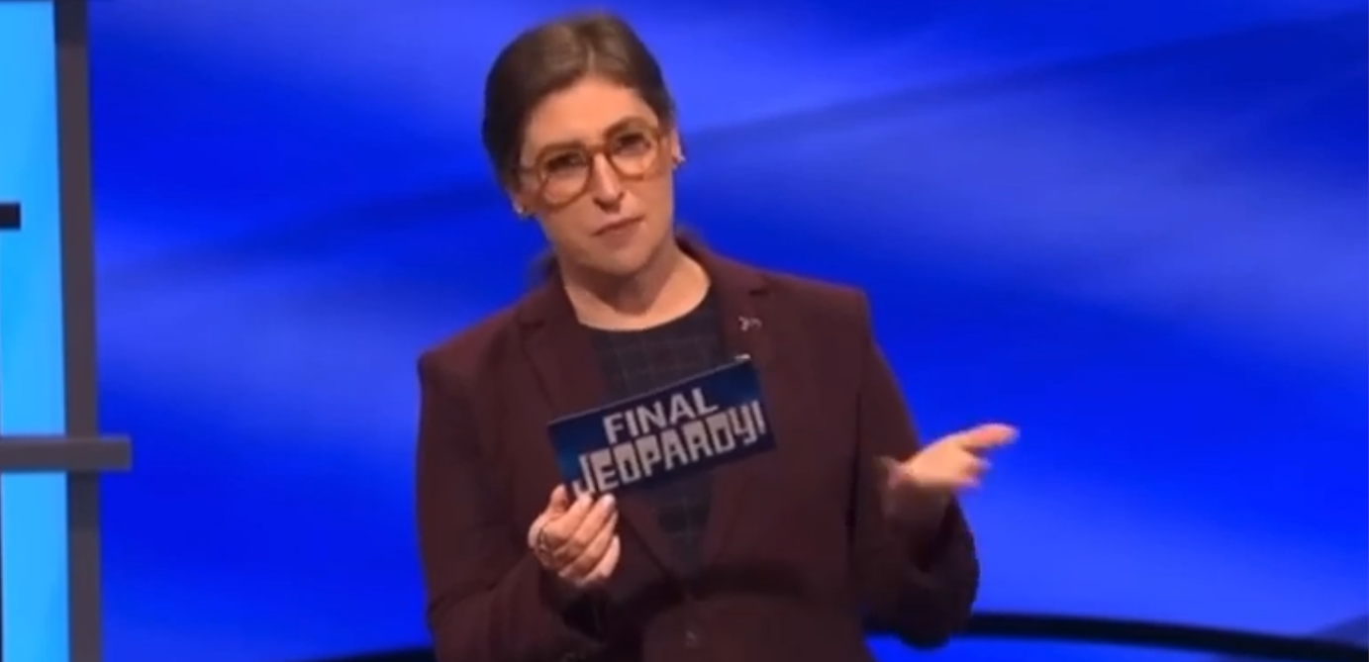
Meme laundering playbook: The 5 stages of science misinformation
Step 5: Pop culture and public acceptance
“That is correct. Stones and fire fell from the sky just as fire and brimstone destroyed the wicked city of Sodom.”
Notes:
21
21

Slide 22
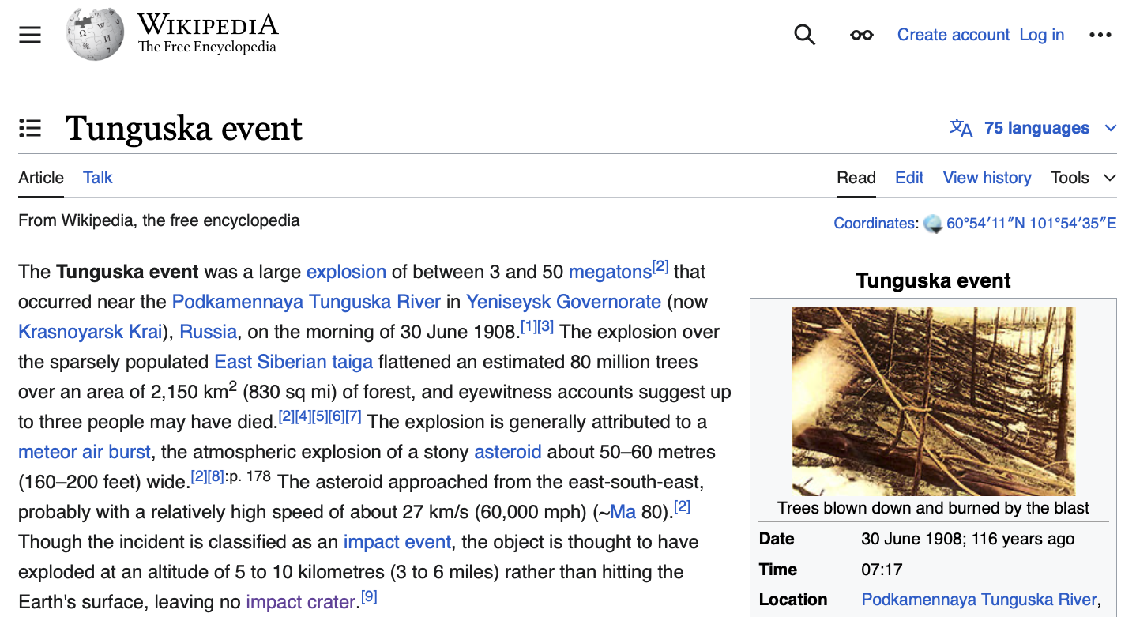
Myths and misinformation propagate
Notes:
22
22

Slide 23
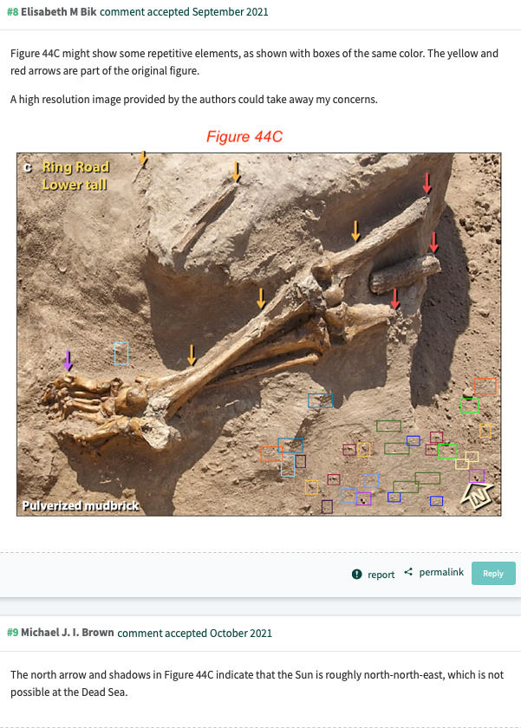
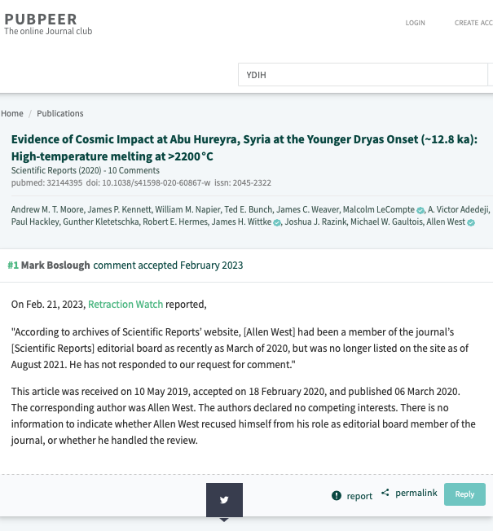
Neutralizing published myths and misinformation: Post-publication review
Moore et al, 2020
Bunch et al, 2021
Tankersley et al, 2022
Notes:
23
23

Slide 24
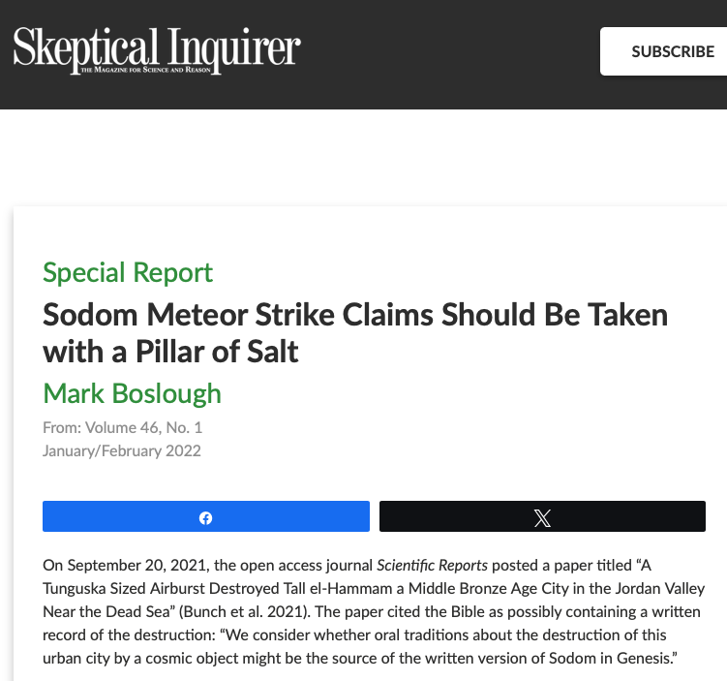
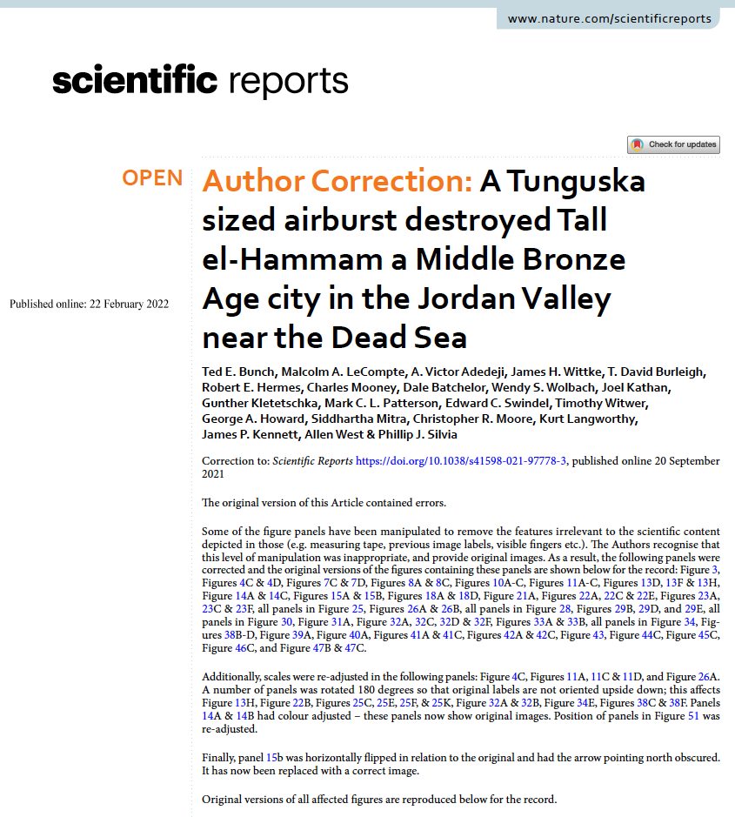
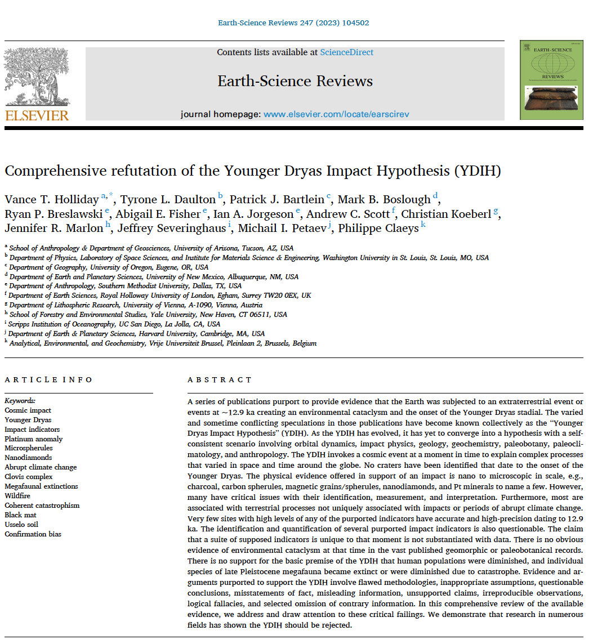
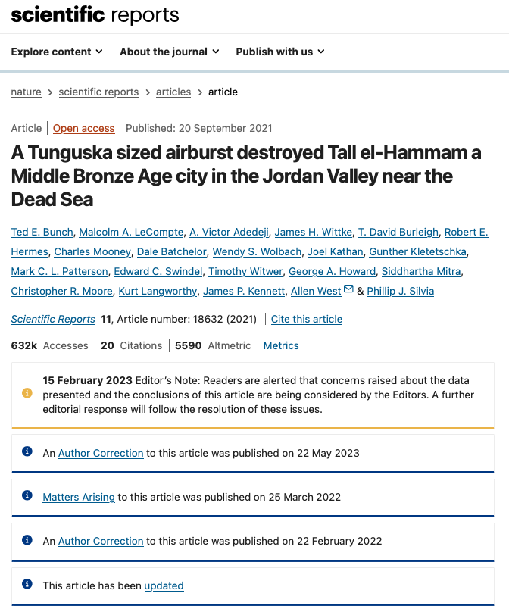
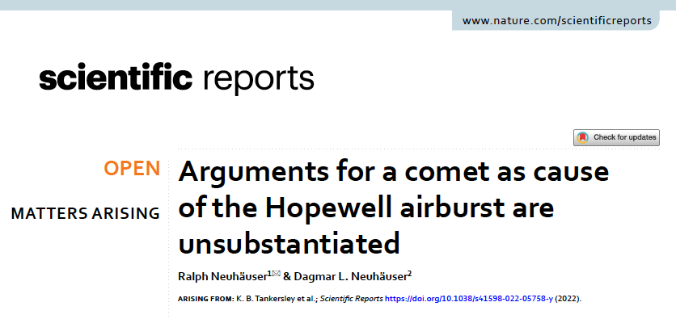
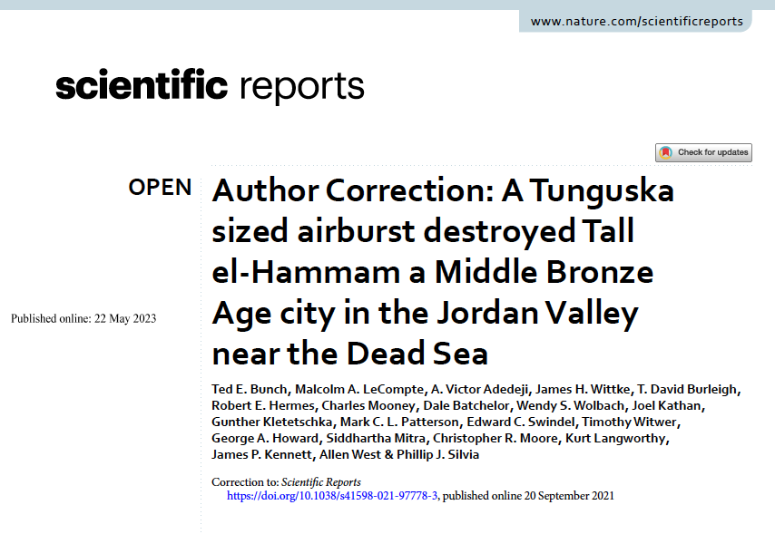
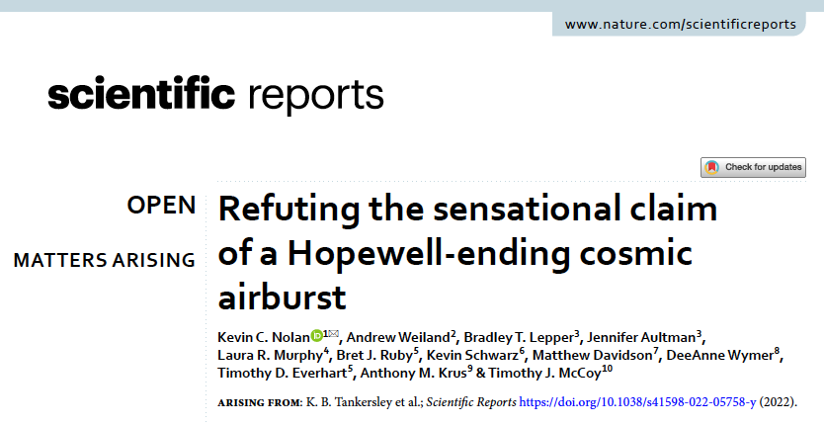

Neutralizing published myths and misinformation: Corrections & Retractions
Moore et al, 2020
Bunch et al, 2021
Tankersley et al, 2022
Notes:
24
24

Slide 25
Neutralizing published myths and misinformation: Corrections & Retractions
RETRACTED ARTICLE
RETRACTED ARTICLE
Moore et al, 2020
Bunch et al, 2021
Tankersley et al, 2022
Notes:
25
25

Slide 26
Myths and misrepresentations: What can you do?
Do not repeat them. Check primary sources if you are unsure.
Post-publication review. Get a PubPeer account and post comments.
Review PubPeer for comments on suspect papers.
Publish comments on papers that contain misinformation. Ask for corrections.
Publish articles in non-technical literature. Wikipedia uses these sources.
Become a Wikipedia editor. Wikipedia needs subject matter experts.
Notes:
26
26

