Slide 1
Hypothetical Asteroid
Impact Exercise
Panel 1b: Acting on results from an
information-gathering space mission
Point of Contact: Terik Daly
terik.daly@jhuapl.edu

Slide 2




Panel Objectives
Awareness Raising
International Views
Decision Making
Perception
Raise awareness about the nature of asteroid threats and challenges related to preparing for an effective international response
Hear international viewpoints about asteroid impact threats and potential ways of responding to them
Discuss ways of communicating with decision makers about a potential asteroid impact and options for responding to it
Expand perspectives of planetary defense specialists about how non-specialists perceive asteroid impact threats

Slide 3




Meet the Presenters
Kelly Fast
Nancy Chabot
Lorien Wheeler
Detlef Koschny
NASA Headquarters & International Asteroid Warning Network
Johns Hopkins University Applied Physics Laboratory
NASA Ames Asteroid Threat Assessment Project
Technical University of Munich & Space Mission Planning Advisory Group

Slide 4
It is now April 2028.
13 years until a definite Earth impact
October 2024
SMPAG makes recommendations
September 2027
Flyby reconnaissance
mission launches
Potential impact
24 April 2041
100
Reconnaissance spacecraft flies by
asteroid
April 2028
IAWN issues
notification
1 August 2024
Earth impact becomes certain
September 2025

Slide 5
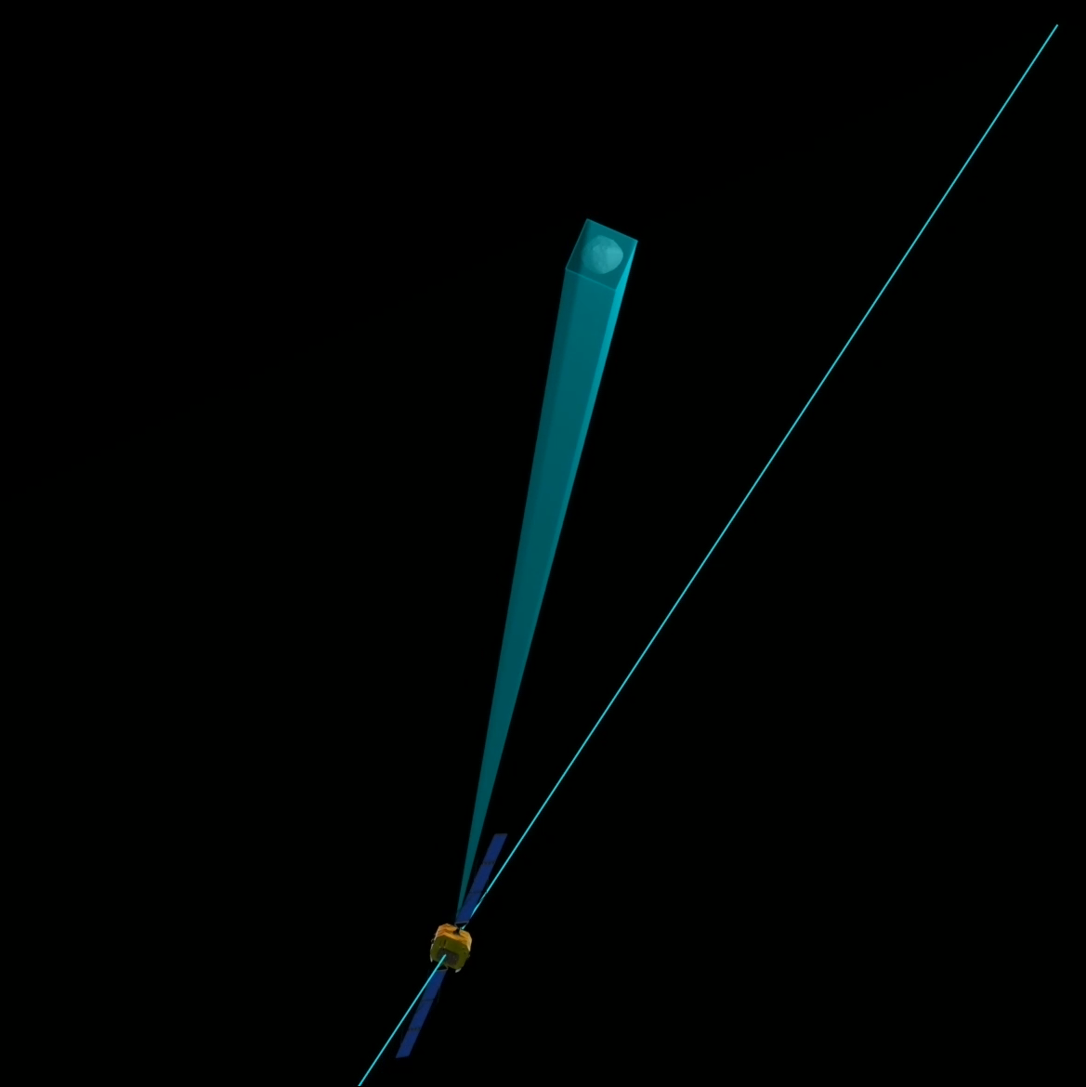
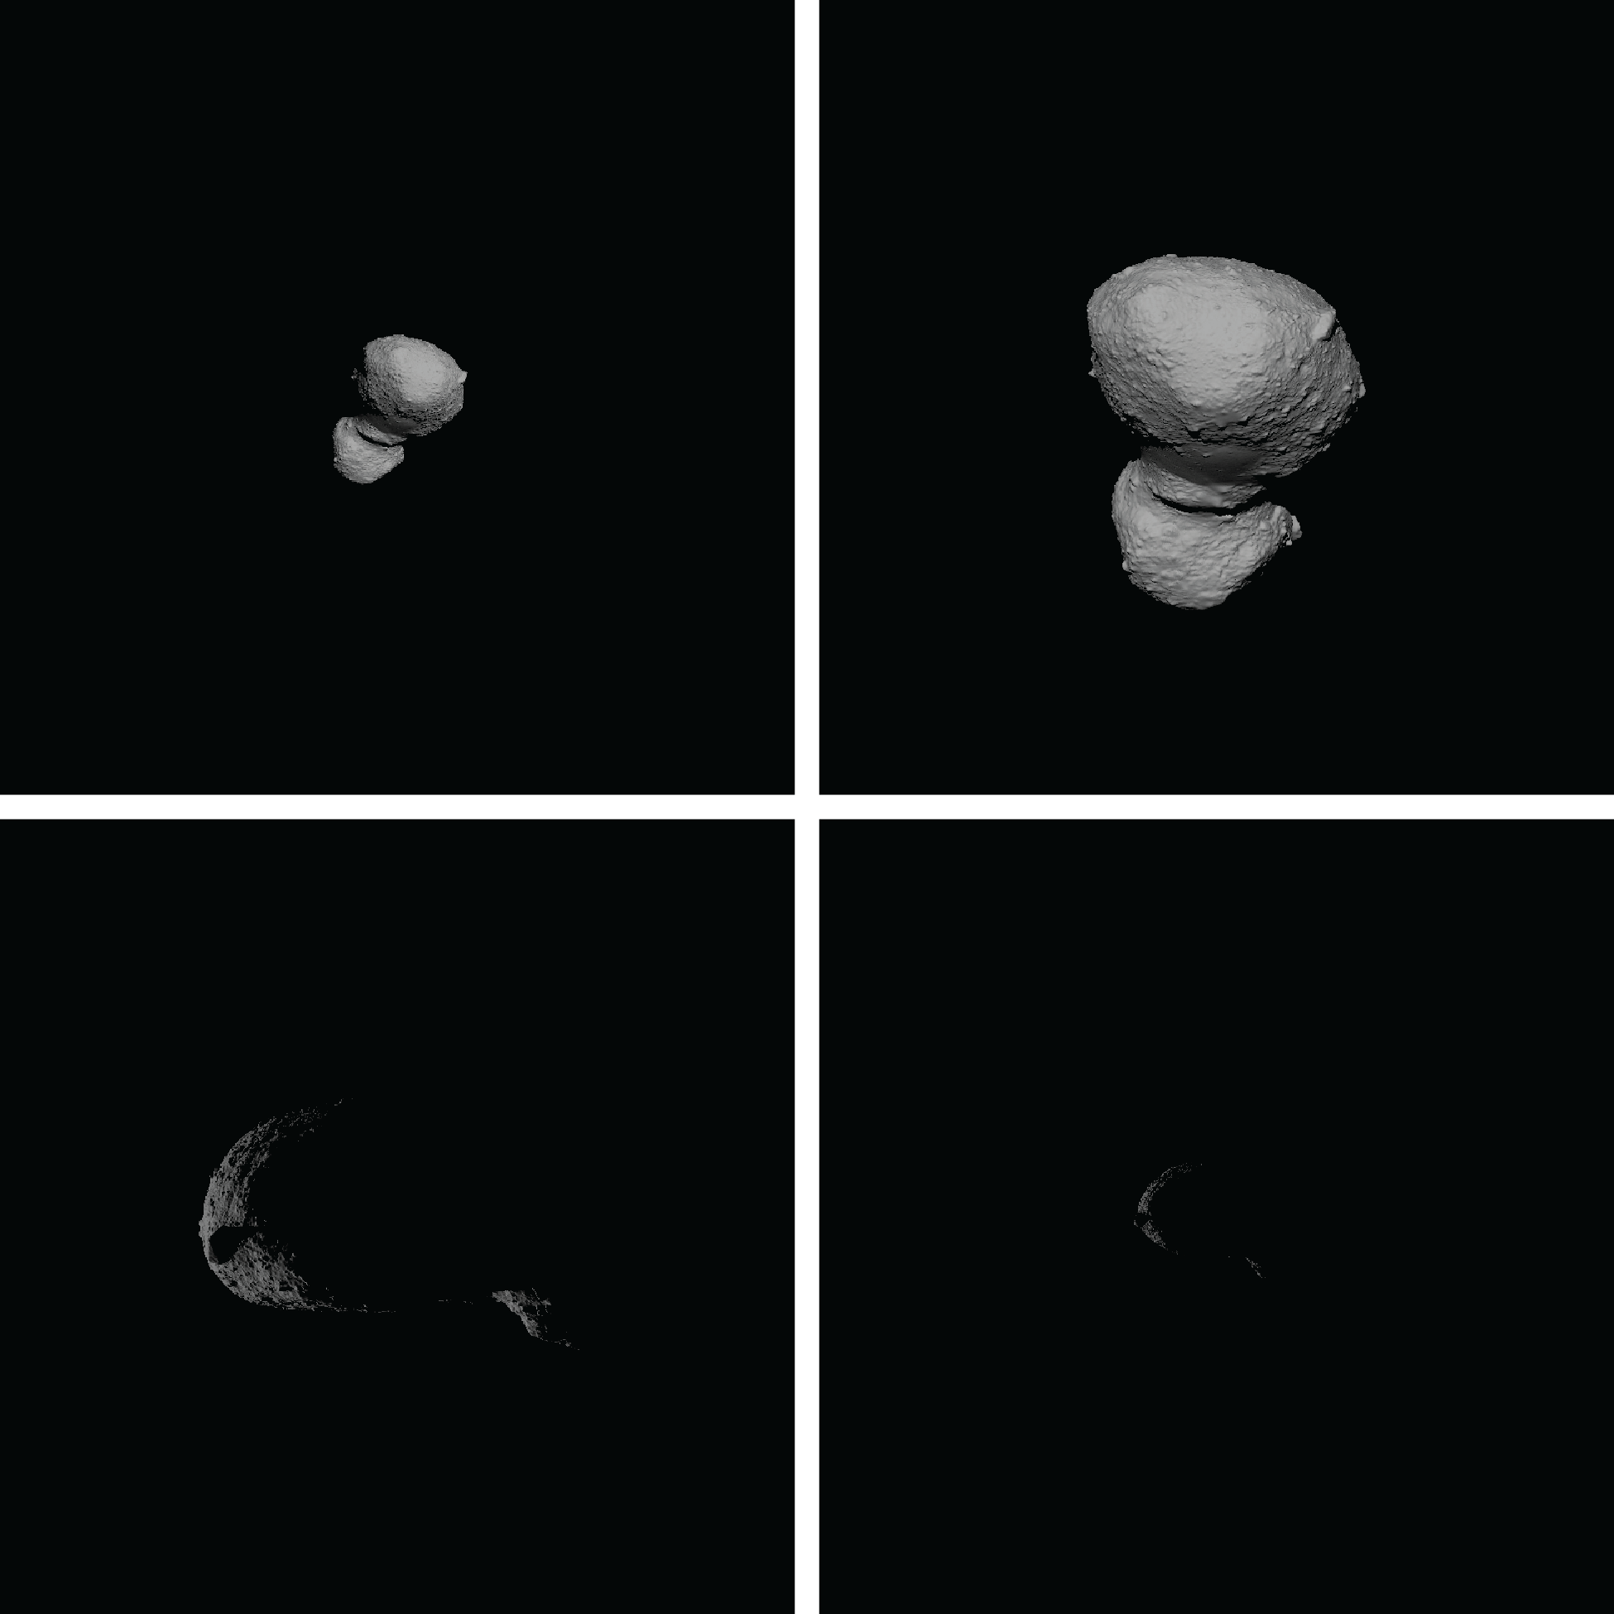
The international community implemented a fast flyby mission
Key uncertainties reduced to improve plans for Earth impact prevention missions & disaster management
Simulated flyby
observations
Simulated images from flyby

Slide 6

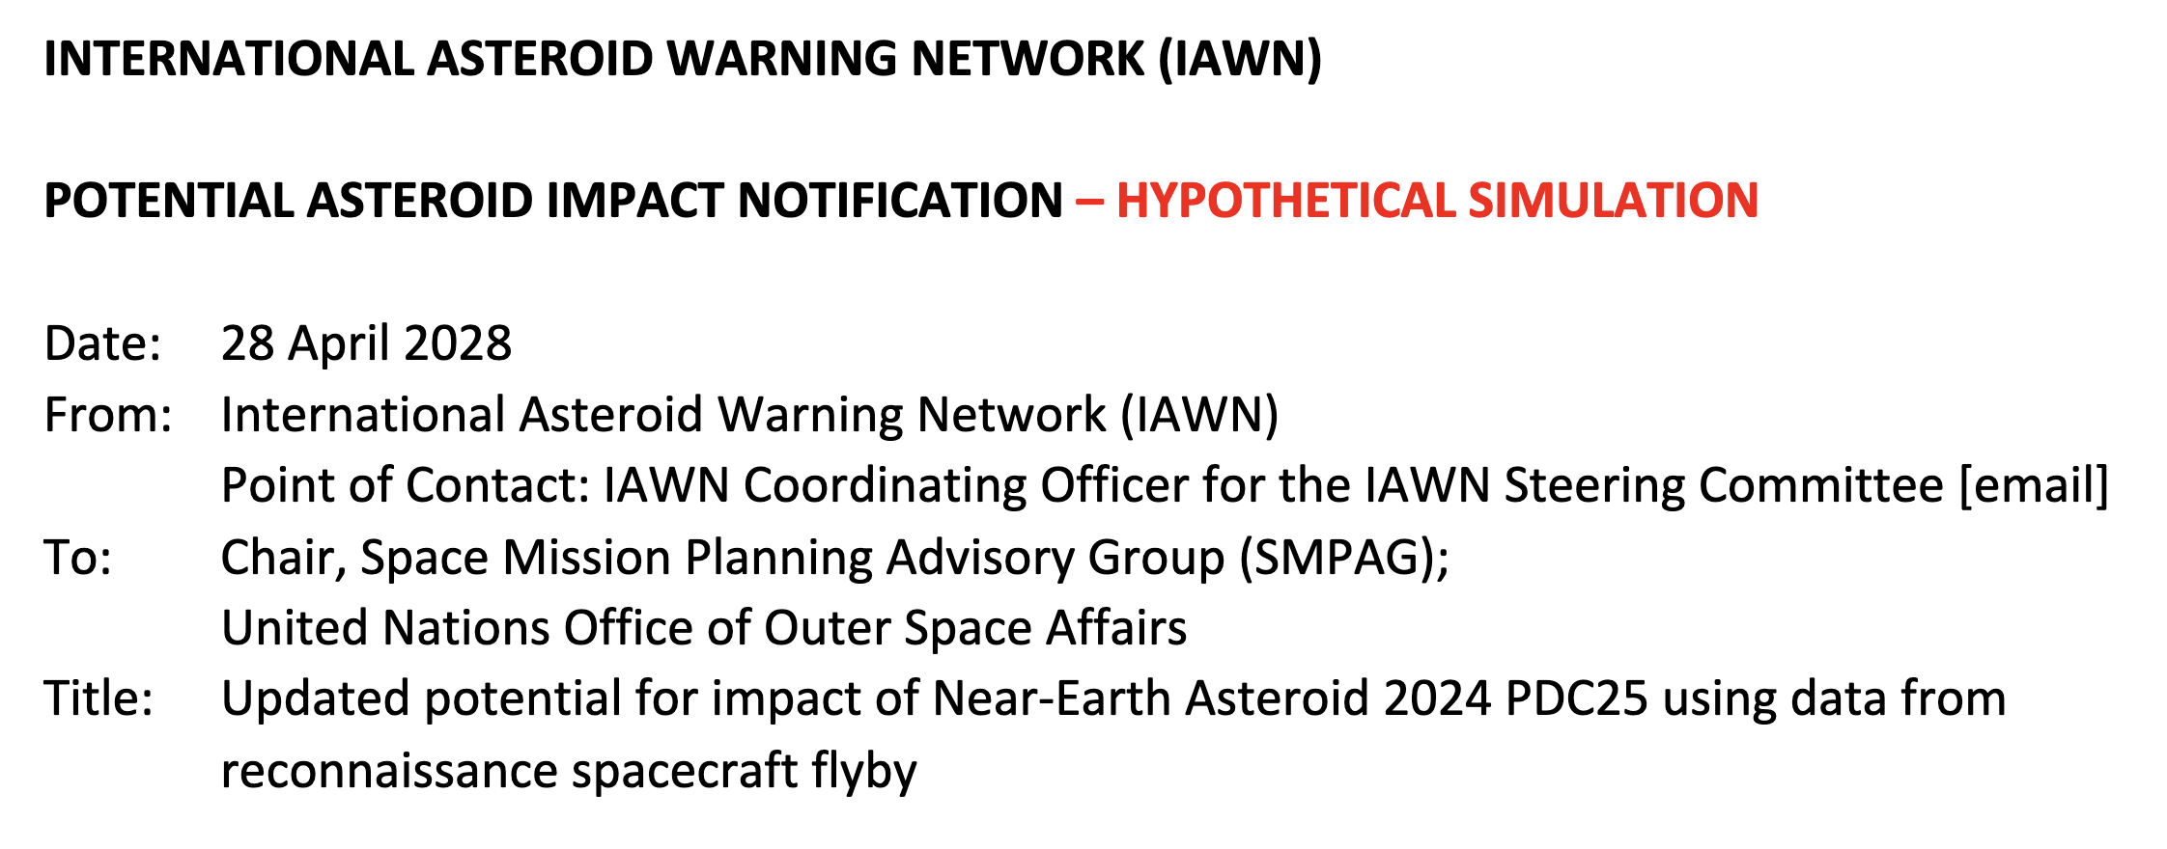
It is April 2028.
13 years until a definite Earth impact
Potential impact
24 April 2041

Slide 7
EXERCISE EXERCISE EXERCISE
Simulated Impact Threat Scenario:
Update After Flyby Reconnaissance
Notification by IAWN
Kelly Fast, NASA
IAWN Coordinating Officer
9th IAA Planetary Defense Conference
Scenario date: April 2028
EXERCISE EXERCISE EXERCISE

Slide 8
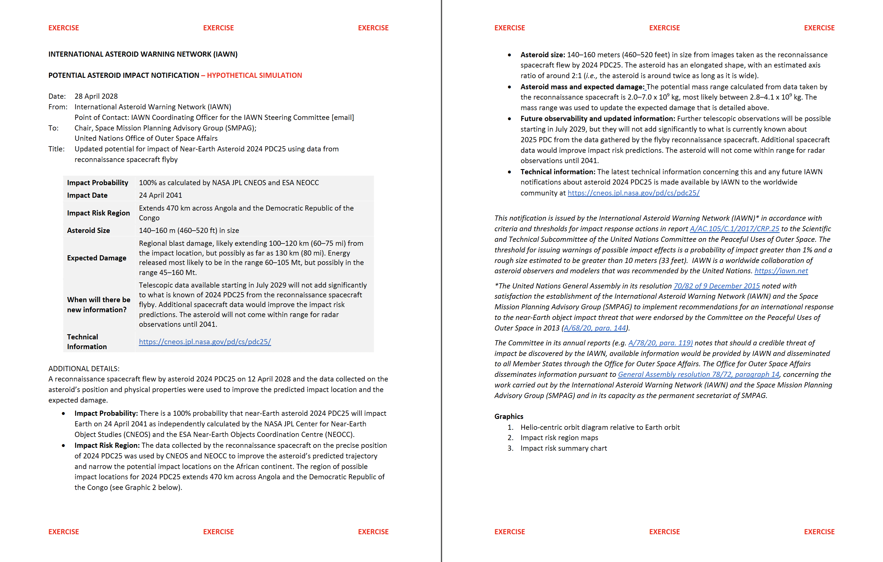
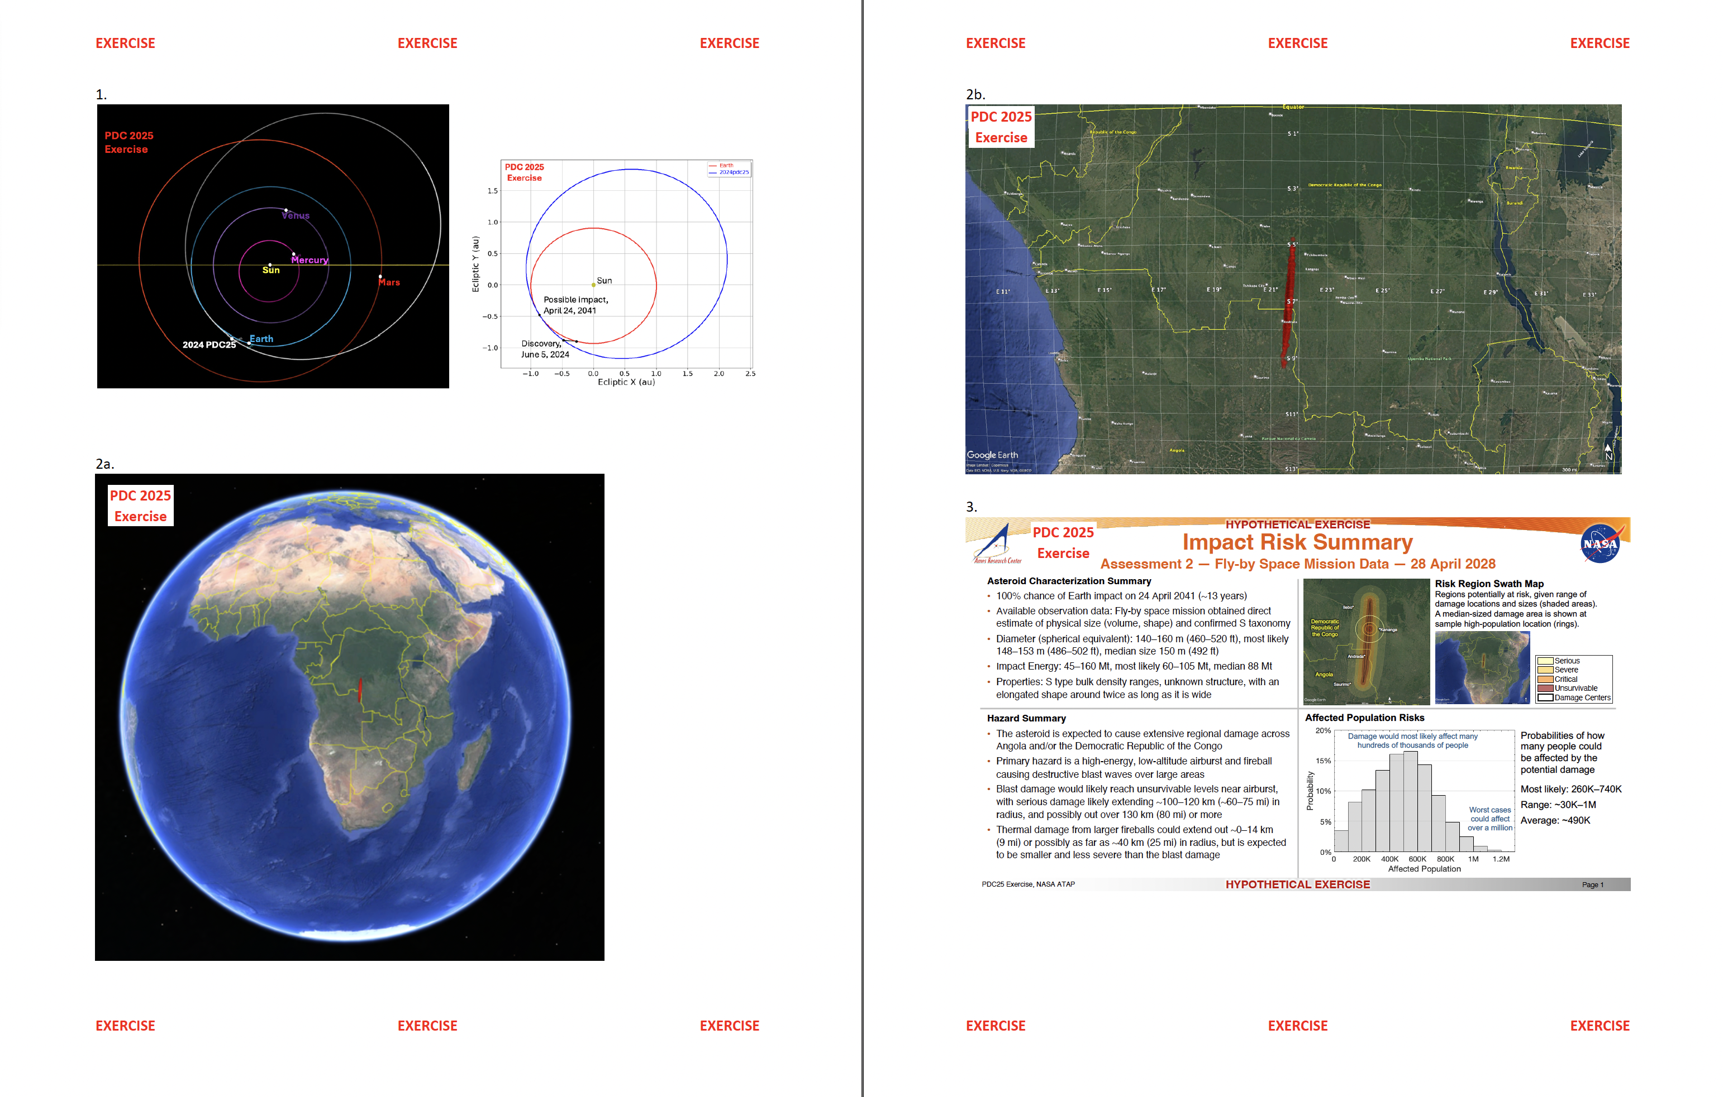
EXERCISE EXERCISE EXERCISE
Updated IAWN Notification
Notification shared with UNOOSA and SMPAG
EXERCISE EXERCISE EXERCISE
8
Notes:
Rationale: Impact probabilities greater than 1 per cent are rare yet warrant awareness of possible effects. Most objects greater than 10 meters in size could have some effects (air blast and pieces) that could reach the Earth’s surface. IAWN is compelled to warn populations if bodies will have effects that reach the ground. Setting threshold at 1 per cent is a compromise between not being overly alarmist and not warning too late for necessary action to be initiated. It is a probability figure that individuals and governments can comprehend. An alert such as this demonstrates that the IAWN is functioning. Further, it ensures the flow of communications from IAWN to the public and the United Nations.

Slide 9
EXERCISE EXERCISE EXERCISE
IAWN Notification: Key Points
Impact Probability | 100% as calculated by NASA JPL CNEOS and ESA NEOCC
Impact Date | 24 April 2041
Impact Risk Corridor | Extends 470 km across Angola and the Democratic Republic of the Congo
Asteroid Size | 140–160 m (460–520 ft) in size
Expected Damage Level If Impact Occurs | Regional blast damage, likely extending 100–120 km (60–75 mi) from the impact location, but possibly as far as 130 km (80 mi). Energy released most likely to be in the range 60–105 Mt, but possibly in the range 45–160 Mt.
When Will New Information Be Available? | Telescopic data available starting in July 2029 will not add significantly to what is known of 2024 PDC25 from the reconnaissance spacecraft flyby. Additional spacecraft data would improve the impact risk predictions. The asteroid will not come within range for radar observations until 2041.
Technical Information | https://cneos.jpl.nasa.gov/pd/cs/pdc25/
EXERCISE EXERCISE EXERCISE
9

Slide 10
Information Gathered by Flyby Mission
Nancy Chabot
Johns Hopkins University Applied Physics Laboratory

Slide 11
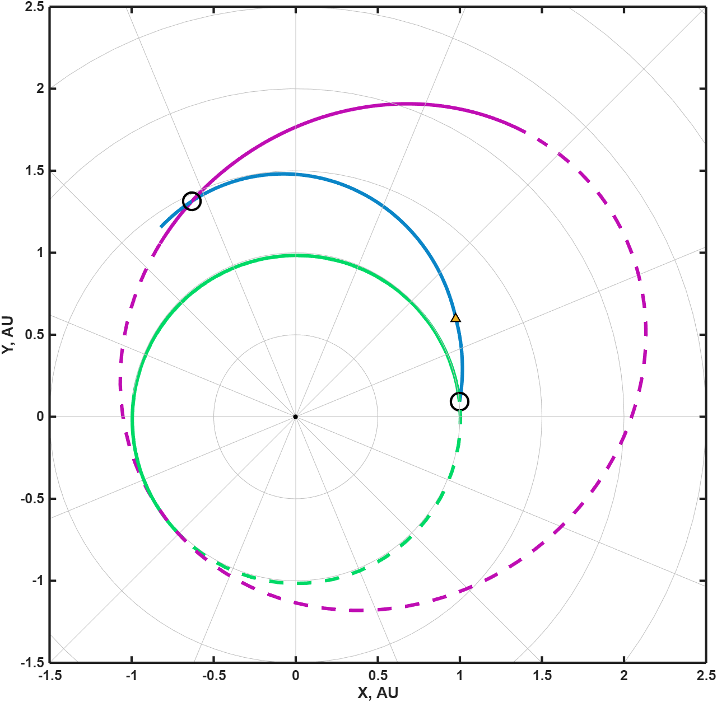
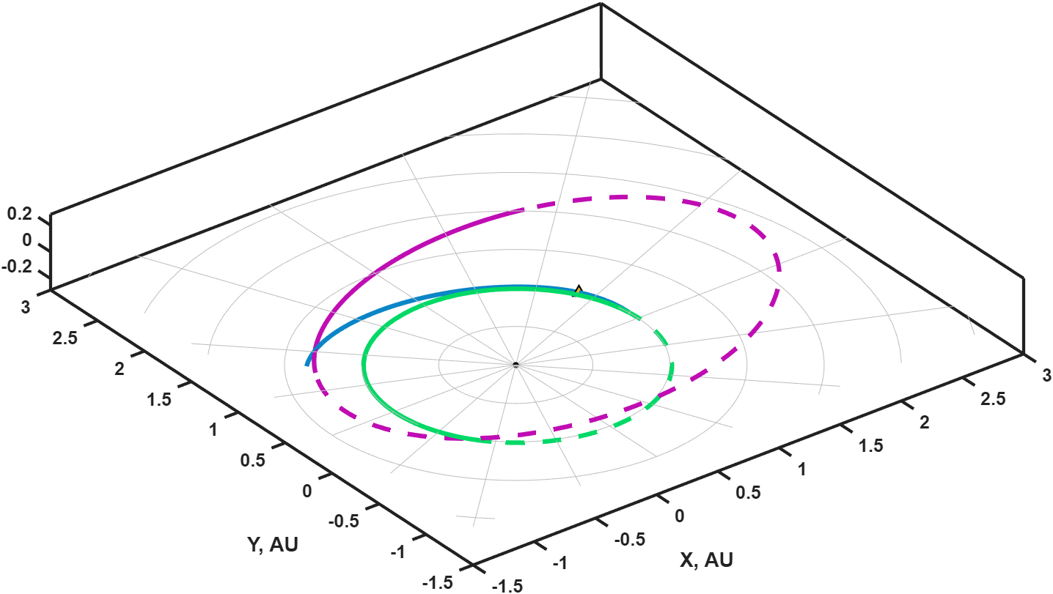
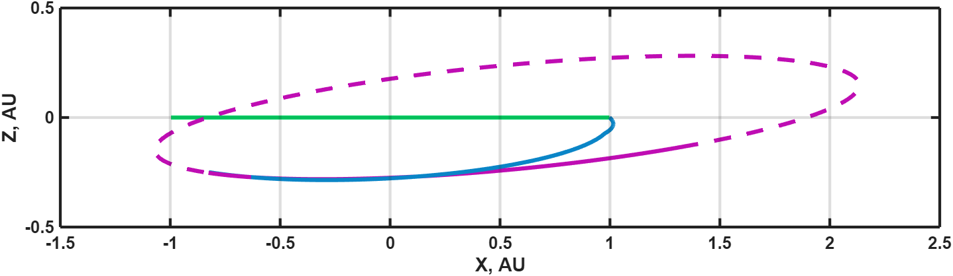
Flyby Details
Launch: 29 September 2027
  Falcon Heavy
  2 km/s of on-board propellant
Flyby: 12 April 2028
  Flyby speed: 8 km/s
  Approach solar phase angle: 30°
  Close approach distance: 100 km
  Solar distance: 1.48 AU
  Earth distance: 1.75 AU
2024 PDC25
flyby
spacecraft
Earth
deep space maneuver
launch

Slide 12
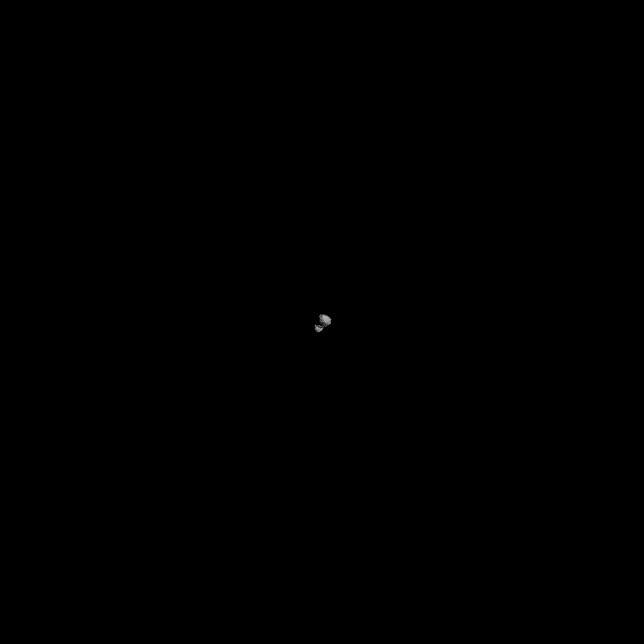
Flyby Mission Data
Flyby Imaging Acquired
Approach to 23 s: NAC images
2 s prior: WAC image
2 s after: WAC image
Departure after 23 s: NAC images
Narrow Angle Camera (NAC) imager like DART DRACO
(FOV 0.29°), from 6 minutes to 23 seconds prior to closest approach (2905 km to 209 km; 50 cm pixel scale at 209 km)

Slide 13
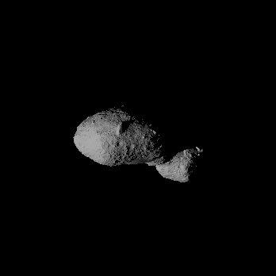
Flyby Mission Data
Flyby Imaging Acquired
Approach to 23 s: NAC images
2 s prior: WAC image
2 s after: WAC image
Departure after 23 s: NAC images
Wide Angle Camera (WAC) imager like OSIRIS-REx PolyCam (FOV 0.79°), at 2 seconds prior to closest approach (100 km, pixel scale 135 cm)

Slide 14
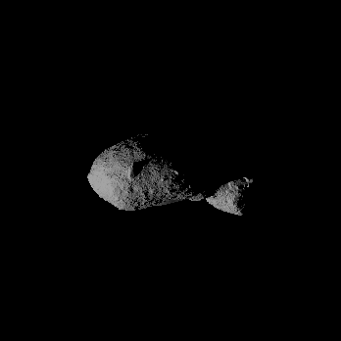
Flyby Mission Data
Flyby Imaging Acquired
Approach to 23 s: NAC images
2 s prior: WAC image
2 s after: WAC image
Departure after 23 s: NAC images
Wide Angle Camera (WAC) imager like OSIRIS-REx PolyCam (FOV 0.79°), at 2 seconds after closest approach (100 km, pixel scale 135 cm)

Slide 15
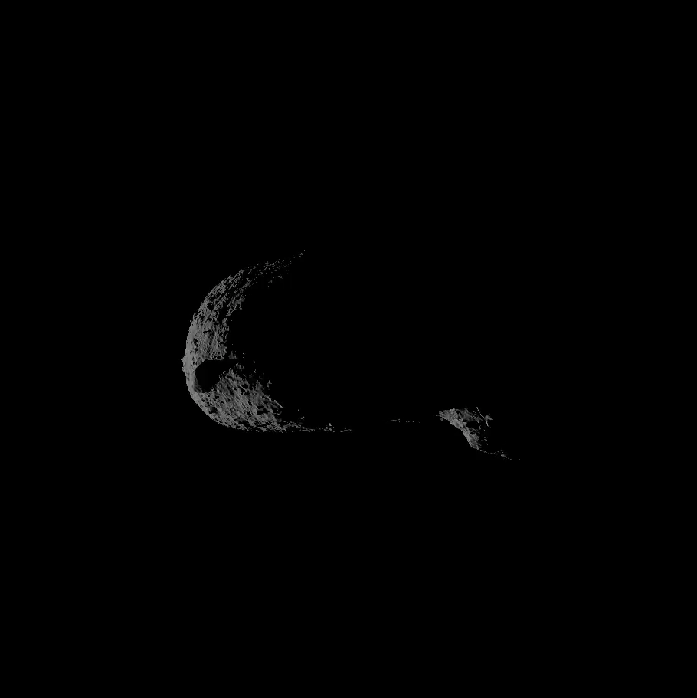
Flyby Mission Data
Flyby Imaging Acquired
Approach to 23 s: NAC images
2 s prior: WAC image
2 s after: WAC image
Departure after 23 s: NAC images
Asteroid Properties
Rotation period: 3 hrs.
Thermal inertia: 200 ± 20 (SI units)
Spin axis: RA, Dec (253°, 74°) ± 3°
Taxonomy: S-type
Yarkovsky semimajor axis drift:
586 ± 195 m/yr
Narrow Angle Camera (NAC) imager like DART DRACO
(FOV 0.29°), from 23 seconds to 6 minutes after closest approach (209 km to 2905 km; 50 cm pixel scale at 209 km)

Slide 16
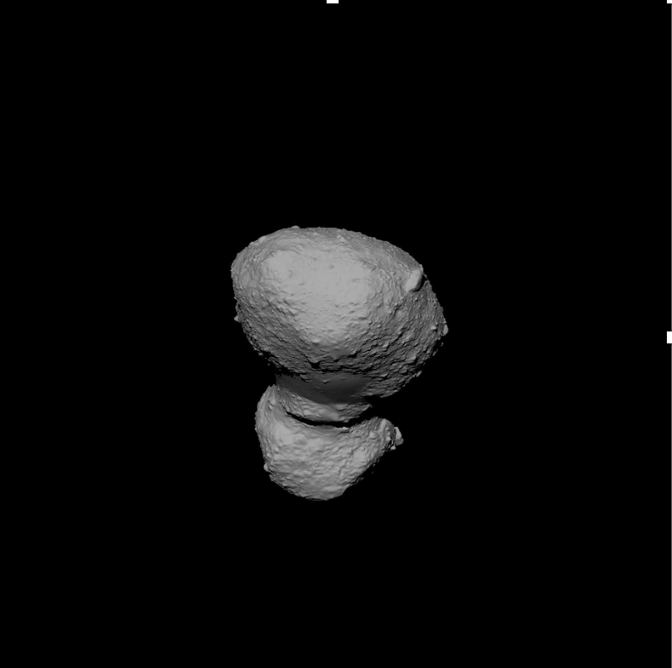
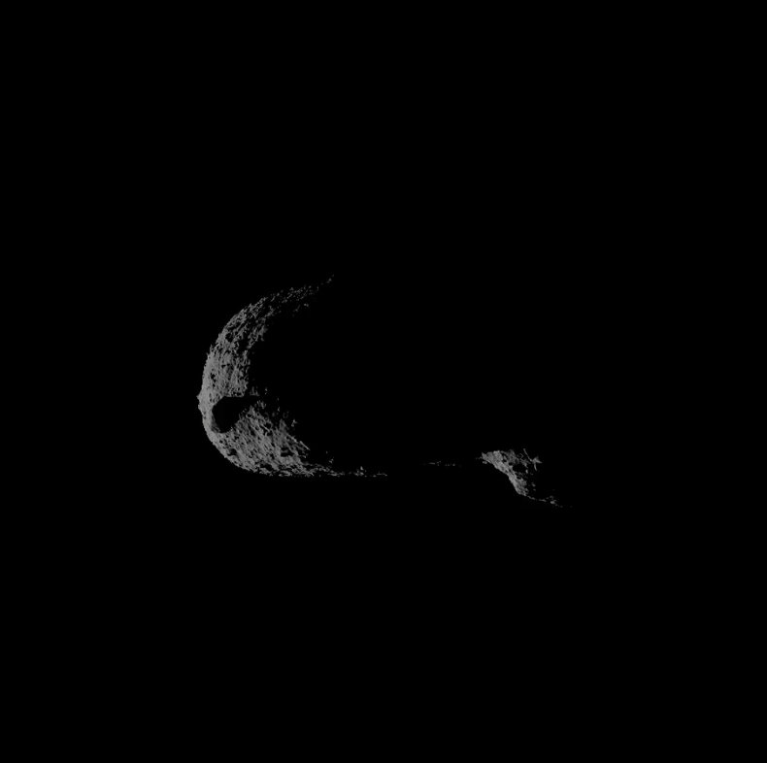
Flyby Mission Results
Multiple imaging geometries constrain the asteroid’s size, shape, and surface characteristics.
Size: 150 m ± 2.5 m (1σ) effective spherical diameter
Shape: two-lobed, ~240 m long by ~120 m wide by ~120 m high
NAC -23 s
WAC -2 s
WAC +2 s
NAC +23 s

Slide 17
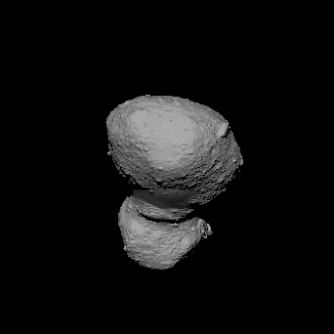
Flyby Mission Results
Multiple imaging geometries constrain the asteroid’s size, shape, and surface characteristics.
Size: 150 m ± 2.5 m (1σ) effective spherical diameter
Shape: two-lobed, ~240 m long by ~120 m wide by ~120 m high
Surface: boulder-covered, rocky
S-type surface
NAC -23 s 50 cm pixel scale

Slide 18
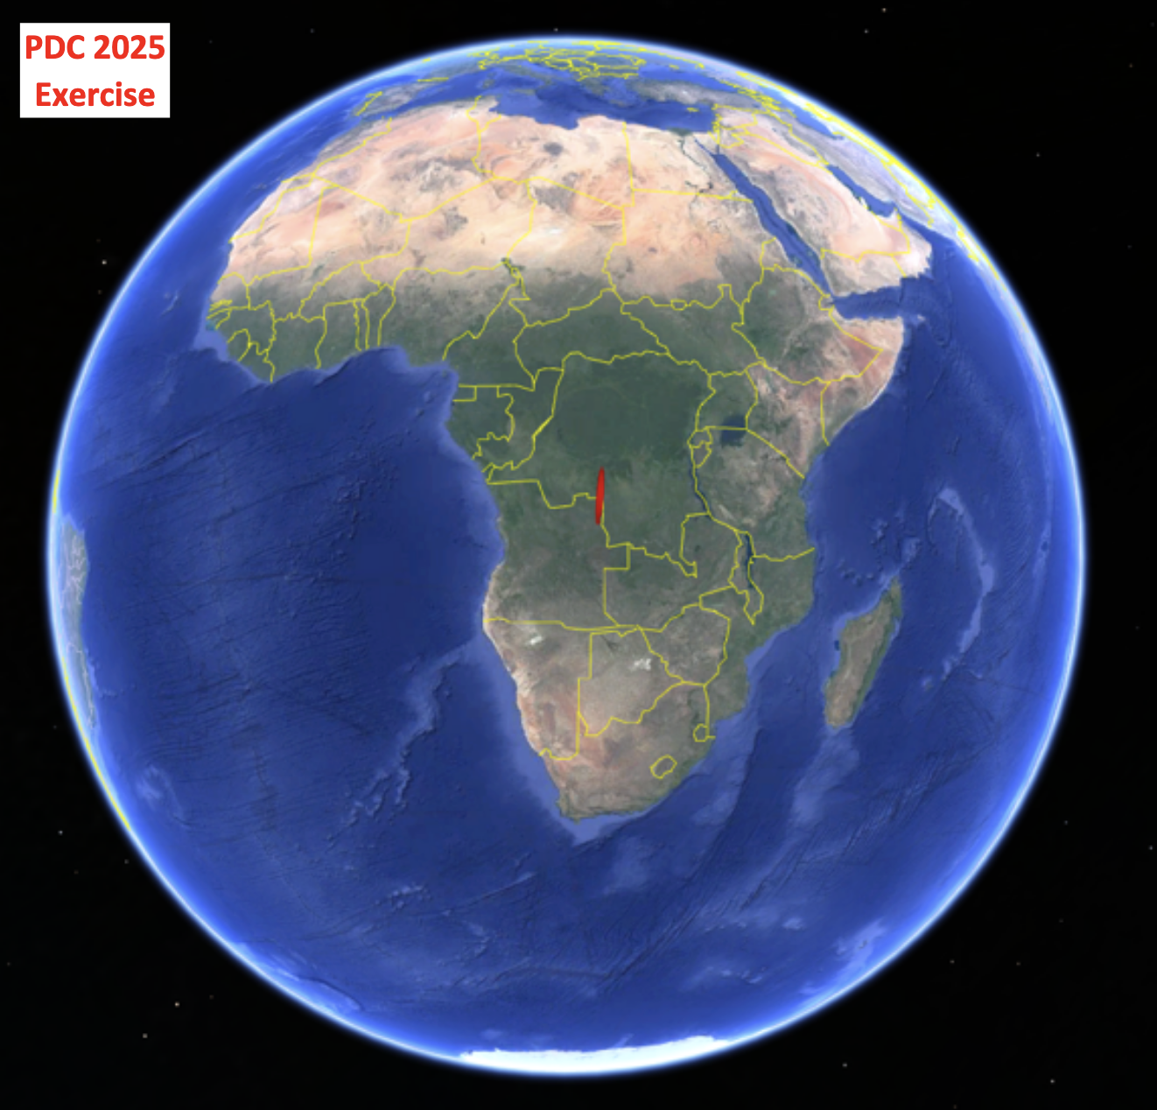
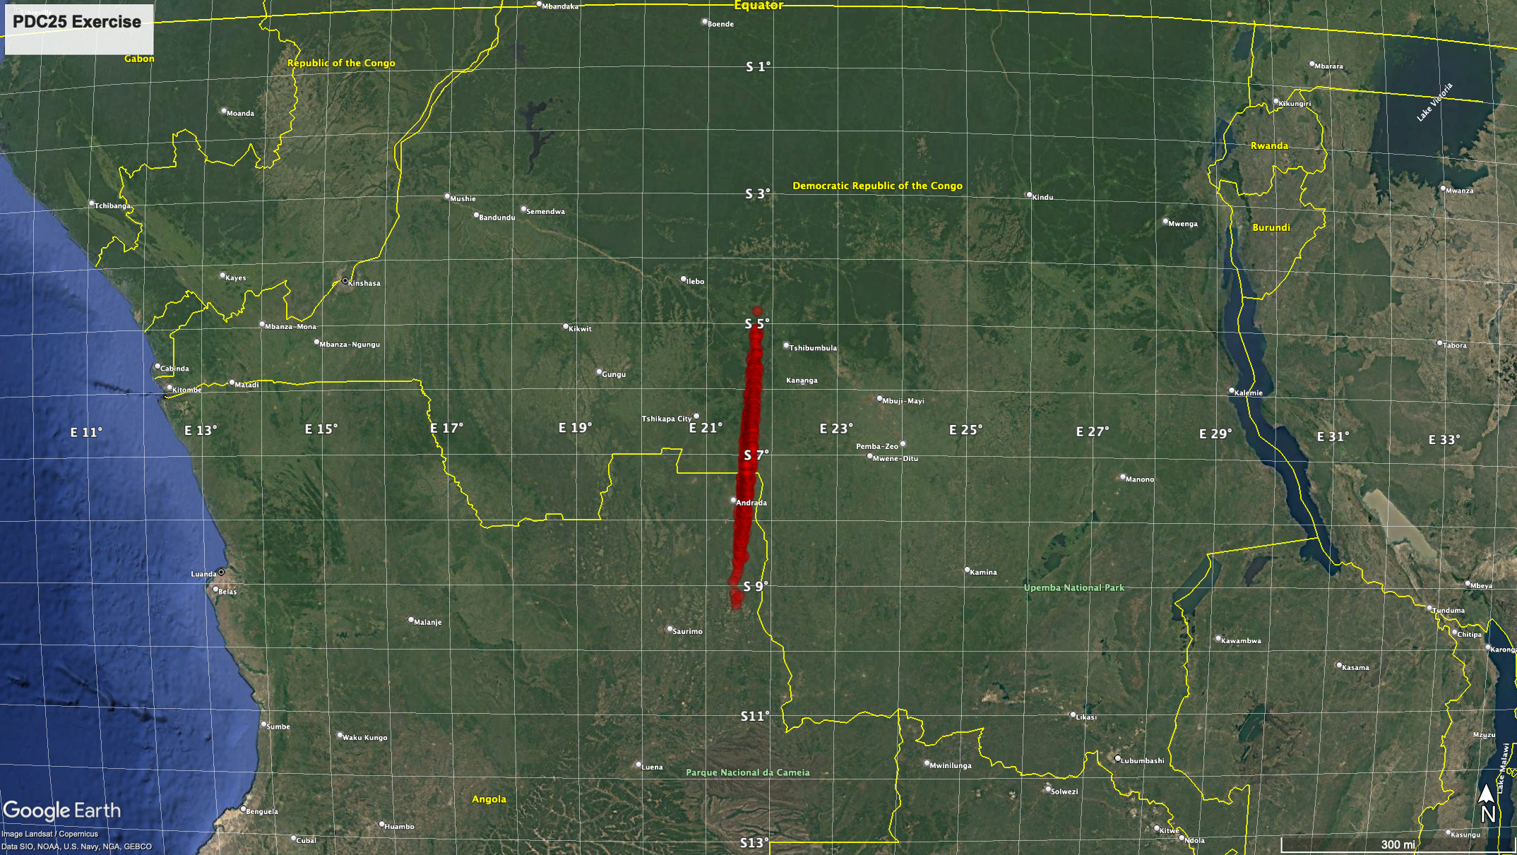
Flyby Mission Results
Orbital tracking from the flyby, together with ground-based astrometry, constrain the region of possible impact to a
470-km corridor that crosses the border between Angola & the Democratic Republic of the Congo.

Slide 19
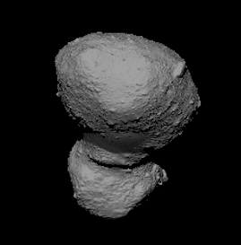
Flyby Mission Results
Impact Location
Asteroid Size
Asteroid Characteristics
Impact corridor spans 470 km, crossing Angola and the Democratic Republic of the Congo
150 m ± 2.5 m (1σ) effective spherical diameter
Two-lobed shape (~240 m long, ~120 m wide, ~120 m high). Rocky, boulder-covered S-type surface.

Slide 20
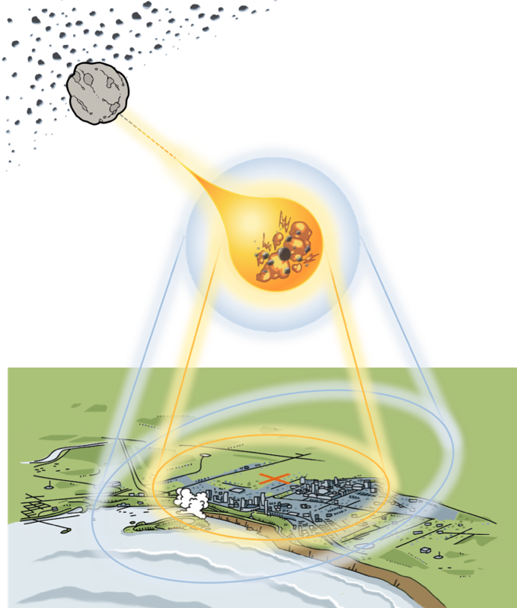
Updated Impact Risk Assessment
Lorien Wheeler
Asteroid Threat Assessment Project
NASA Ames Research Center

Slide 21
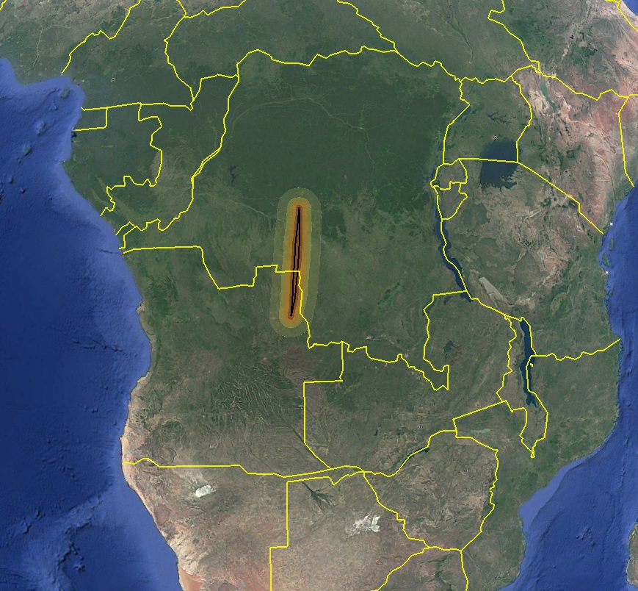
Impact Hazard Summary
April 2028: 100% chance of Earth impact by an asteroid ~150 m in diameter with ~45–160 Mt of energy
100% chance of damage to populated regions among possible impact locations
Primary hazard is a destructive blast wave from a high-energy, low-altitude airburst
Damage severities could reach unsurvivable levels near airburst
Serious damage (causing structural damage, shattered windows) is likely to span multiple cities and provinces
Risk region swath map: Regions potentially at risk, given range of damage locations and sizes (shaded areas).
Median-sized damage
is shown at a sample location (rings).
Impact would cause extensive blast damage across a large region
in Angola and/or DRC, potentially affecting ~30K–1M people
Notes:
Overview of the main types of hazards and how many people could be affected

Slide 22
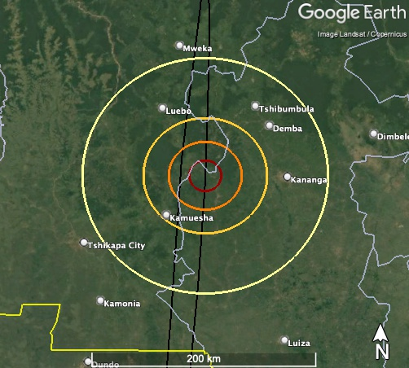
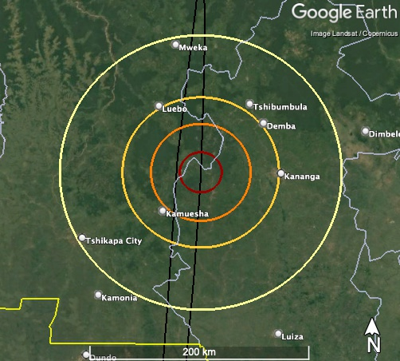
Potential Ground Damage Sizes & Severities
Example near Kananga, DRC
Damage areas would most likely extend over ~100 km
(>60 miles) in radius
Large damage areas could extend out over ~130 km
(~80 miles) or more in radius
Damage severities could reach unsurvivable levels near the blast, extending to larger areas of structural damage, fires, and shattered windows
Damage Level Description
Serious | Windows shatter, some structure damage
Severe | Widespread structure damage
Critical | Residential structures collapse
Unsurvivable | Devastation, structures flattened or burned
~14 km
~20 km
~30 km
~45 km
~50 km
~70 km
~110 km
(70 mi)
~130 km
(80 mi)
Median (50th%) Damage
Large (95th%) Damage
Notes:
Epoch 2 stats:
Damage severities remain similar to initial assessment… could reach unsurvivable levels near airburst, extending to larger areas of structural damage, fires, and shattered windows
Outer serious damage areas are most likely between ~100–120 km (~60–75 miles) in radius
(median ~110 km, 70 mi)
Large damage areas could extend out over ~130 km or so
(~80 miles) or more in radius
(99th% is 130 km, max modeled is 140 km)

Slide 23
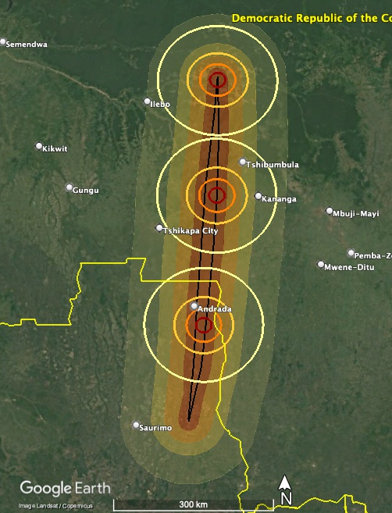
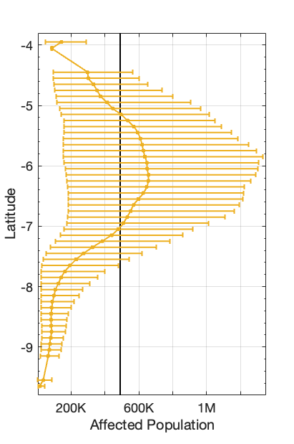
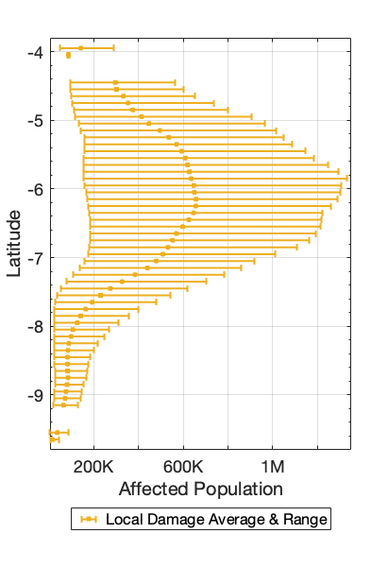
Affected Population Ranges by Location
Affected population ranges for potential damage sizes along impact locations
Large damage could affect hundreds-of-thousands to over 1 million people
Median
damage sizes
Democratic Republic of the Congo
Average damage could affect tens-of-thousands to
~700 thousand people
Angola
Smaller damage could affect several thousands to
~200 thousand people
Swath avg.
Notes:
Average ranges: ~17K – 657K
Min ranges: ~5K – 190K
Max ranges: ~45K – 1.3M

Slide 24
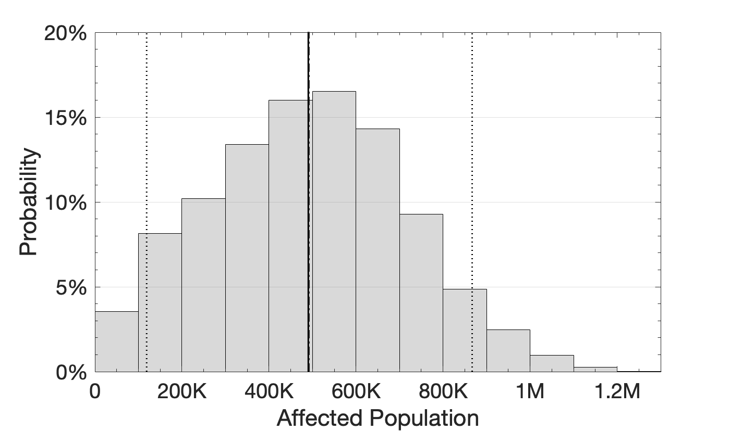
Affected Population Risks
Damage probabilities among modeled impact sizes and locations; Earth impact probability is 100%
Average~500K
Likelihood of the impact affecting
at least this many people
5th%
95th%
>30K
~100%
>100K
96%
>500K
48%
>800K
9%
>1M
~1%
Damage likely to affect
many hundreds-of-thousands
Worst cases could affect over a million
Damage likely to affect ~250K–750K people and potentially over 1M people
~500K people affected on average
Most likely range
~1%
100% chance of large damage to populated regions

Slide 25
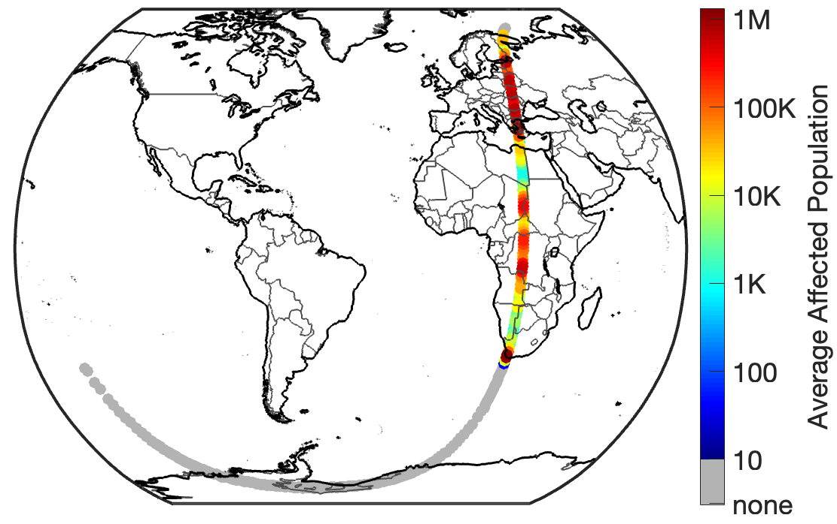
Population Risks for Asteroid Deflection
Gradual deflection of the asteroid changes the number and location of people at risk of damage if Earth impact should occur
Average affected population along deflection corridor
Deflecting the asteroid northward would cross ~85% of population within the corridor (~80M–120M people)
Northward Deflection
Impact Region
Deflecting the asteroid southward would cross ~15% of population within the corridor (~15M–25M people)
Southward Deflection
No direct population damage estimated
Notes:
Populations potentially at risk along the corridor over which mitigation missions could move the asteroid during a deflection away from Earth (Assessment for SMPAG)
Northward deflection crosses longer span of high-population regions across Africa and Europe
Southward deflection crosses a shorter populated span (but crosses highest-population Cape Town region) before reaching unpopulated ocean/Antarctic regions
There are roughly 6 times more people living along the northward corridor than along the southward corridor
~85% of the population within the corridor is northward, ~15% is southward
~80M–120M people living Northward
~15M–25M people living Southward

Slide 26
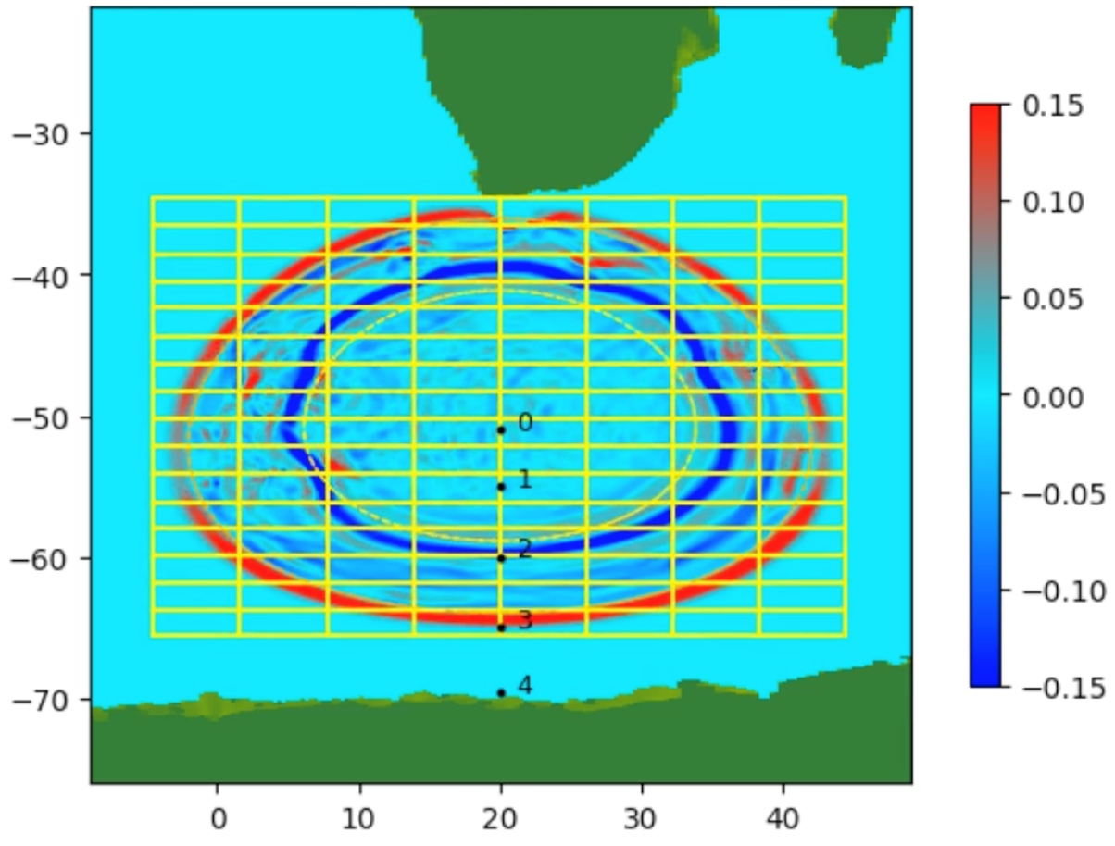
Tsunami Risk from Deflection into the Southern Ocean
No direct population damage or significant tsunami expected for impacts into the Southern Ocean along most of the ocean-crossing deflection corridor
Average affected population along deflection corridor
High-fidelity simulation of tsunami from largest asteroid size deflected into mid-ocean shows waves too small to cause substantial damage
Northward Deflection
Impact Region
S. Africa
Southward Deflection
No direct population damage estimated
Wave height (m)
Consequences of more direct impact on Antarctic ice sheets uncertain
Antarctica
M. Aftosmis, NASA/ARC ATAP team
Notes:
Northward deflection crosses longer span of high-population regions across Africa and Europe
Southward deflection crosses a shorter populated span (but crosses highest-population Cape Town region) before reaching unpopulated ocean/Antarctic regions
There are roughly 6 times more people living along the northward corridor than along the southward corridor
~85% of the population within the corridor is northward, ~15% is southward
~80M–120M people living Northward
~15M–25M people living Southward

Slide 28
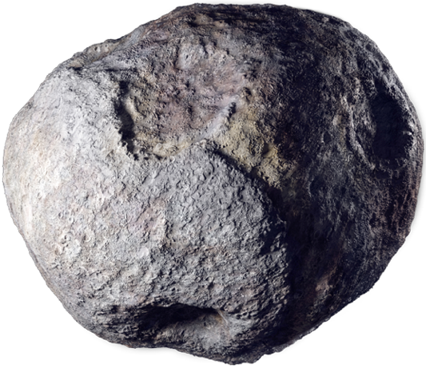

Asteroid Size Knowledge
Potential impact
24 April 2041
August 2024
50 m
280 m
April 2028 (post flyby)
140–160 m

Slide 29
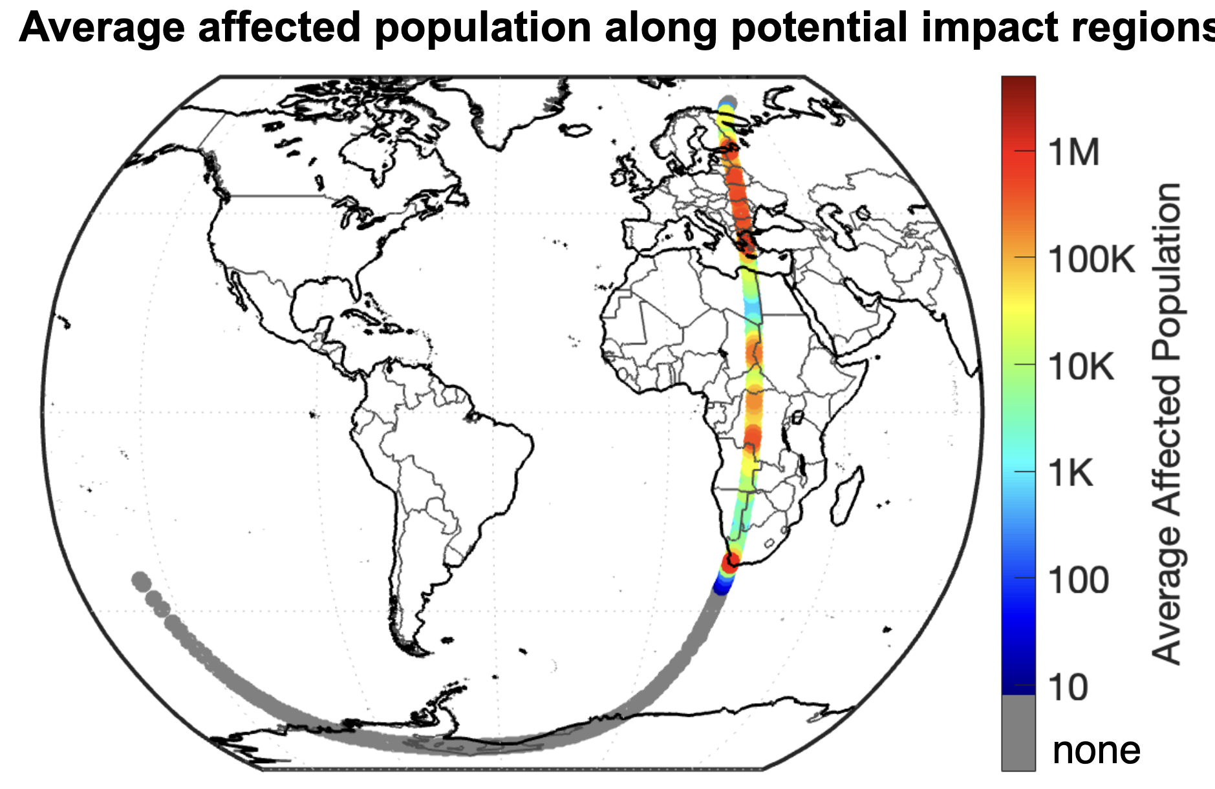
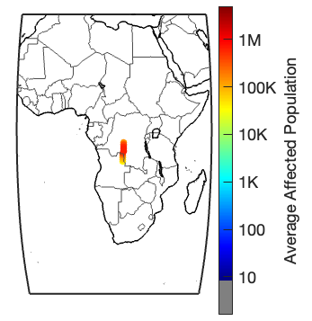
Average Affected Population
Potential impact
24 April 2041
August 2024 (1.6% chance of impact)
Small chance of damage; large uncertainties
April 2028 (post flyby, impact assured)
Certain damage to populated regions

Slide 30
It is now April 2028.
13 years to definite Earth impact
October 2024
SMPAG makes recommendations
September 2027
Flyby reconnaissance
mission launches
Potential impact
24 April 2041
100%
Reconnaissance spacecraft
flies past asteroid
IAWN issues
notification
1 August 2024
Earth impact becomes certain
September 2025
IAWN issues an update
April 2028
SMPAG meets to review space mission options in light of new information

Slide 31
Recommendations for Further
Space Mission Options
Detlef Koschny
Chair, Space Mission Planning Advisory Group
(SMPAG)
9th IAA Planetary Defense Conference
Scenario date: April 2028

Slide 32
Recommendations to Prevent Earth Impact
1 |  | Deflection direction Decide whether the deflection will be northward or southward.
2 |  | Deflection amount (southward only) If southward deflection is selected, decide whether a partial deflection option is considered safe/acceptable, then decide whether partial deflection or total deflection will be the mission goal.
3 |  | Deflection method Select a deflection mission type—kinetic impact (KI), ion beam deflection (IBD), or nuclear explosive device (NED)—complete its development, and deploy it.
Juan’s slides do not include the sentence about multiple factors to consider, etc. so I haven’t included that here in the text (or in the BRAIN slide), but I trust that Detlef will make the point nonetheless.

Slide 33


Asteroid Deflection Options Flowchart
LEGEND
Number of launches/
spacecraft required*
Black icon = minimum required
Total spacecraft mass
(6,000 kg increments)
Gray icon =
may be needed
IBD
Northward
NED
Deflection direction
KI
DART
Total
IBD
NED
Deflection amount
Southward
KI + IBD
IBD: ion beam deflection
NED: nuclear explosive device
KI: kinetic impactor
Partial
IBD
NED

Slide 35
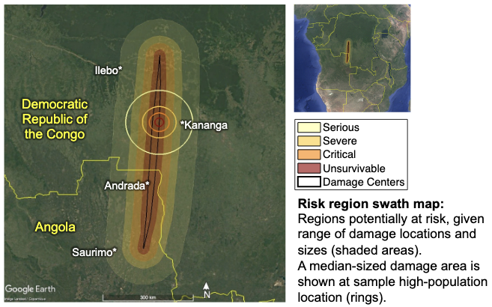
EXERCISE EXERCISE EXERCISE
It is April 2028.
13 years until a definite Earth impact
Potential impact
24 April 2041
Affected people
Asteroid properties
>30K
~100%
>100K
96%
>500K
48%
>800K
9%
>1M
1.3%
Size: 140–160 m, most likely 148–153 m
Composition: Rocky
Impact risk corridor
SMPAG Recommendations
Deflection
direction
Partial or total deflection
Earth impact prevention method

Slide 36
Participant Discussion
What did you learn during the panel?
What in the panelists’ comments aligned with your expectations? What surprised you?
Did your perspective on planetary defense change in any way after listening to the panelists? If so, how?
What are the implications of the panelists’ comments for your own work?
What concrete actions could be taken to make progress on the issues raised by the panelists?
If you could ask the panelists to elaborate on one specific point, what would it be?

Slide 37
Share Your Perspectives
Which factor do you think decision makers should prioritize when weighing deflection options?
  Minimizing the number of people potentially placed in harm’s way along the deflection corridor
  Maximizing the chance of preventing an Earth impact by moving the asteroid a shorter distance
  Choosing a method that has been demonstrated to deflect an asteroid in a flight test

