Slide 1
Hypothetical Asteroid Impact Exercise
Panel 1a: Notification of asteroid impact threat and early preparedness
Point of Contact: Terik Daly
terik.daly@jhuapl.edu

Slide 2




Panel Objectives
Awareness Raising
International Views
Decision Making
Perception
Raise awareness about the nature of asteroid threats and challenges related to preparing for an effective international response
Hear international viewpoints about asteroid impact threats and potential ways of responding to them
Discuss ways of communicating with decision makers about a potential asteroid impact and options for responding to it
Expand perspectives of planetary defense specialists about how non-specialists perceive asteroid impact threats

Slide 3




Meet the Presenters
Kelly Fast
Davide Farnocchia
Lorien Wheeler
Detlef Koschny
NASA Headquarters & International Asteroid Warning Network
NASA JPL Center for Near-Earth Object Studies
NASA Ames Asteroid Threat Assessment Project
Technical University of Munich & Space Mission Planning Advisory Group on behalf of ESA

Slide 4

EXERCISE EXERCISE EXERCISE
It is 1 August 2024.

Slide 5
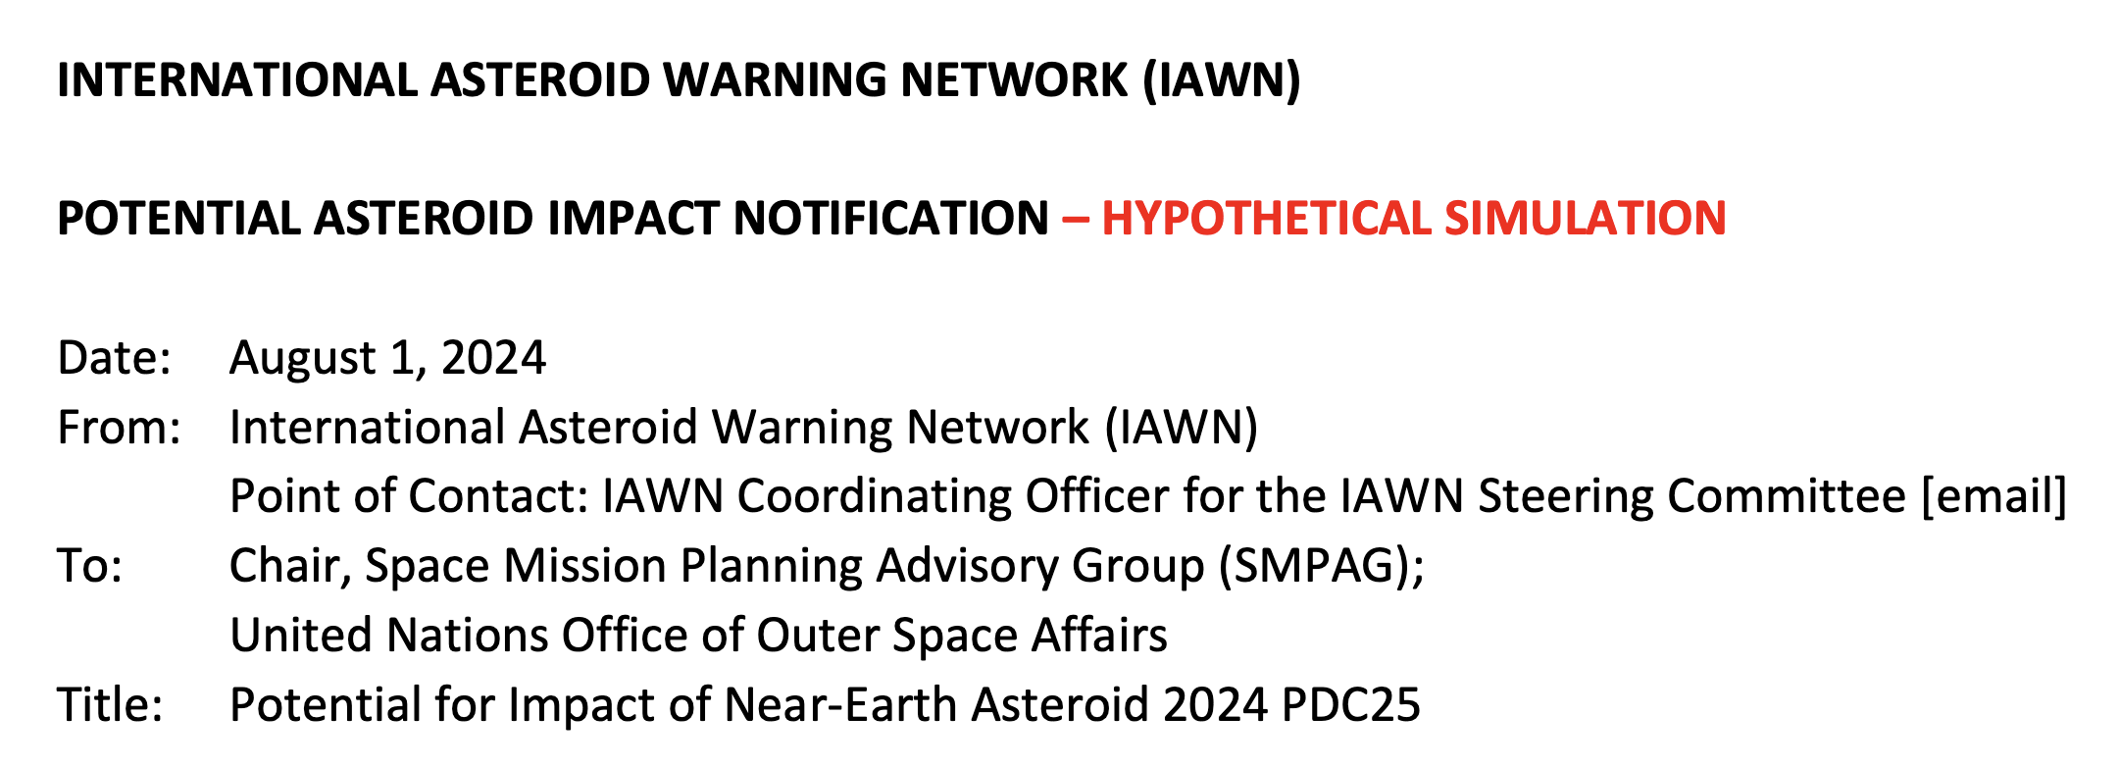
It is 1 August 2024.

Slide 6
EXERCISE EXERCISE EXERCISE
Simulated Impact Threat Scenario
Notification by the International Asteroid Warning Network
(IAWN)
Kelly Fast, NASA
IAWN Coordinating Officer
9th IAA Planetary Defense Conference
Scenario date: 1 August 2024
EXERCISE EXERCISE EXERCISE

Slide 7
EXERCISE EXERCISE EXERCISE
The International Asteroid Warning Network (IAWN)
A worldwide collaboration recommended by the United Nations to detect, track, and physically characterize near-Earth objects
Signatories include scientific institutions, observatories, and independent astronomers involved in asteroid observations, orbit computation, and modeling
IAWN’s goal is to provide the most accurate and up-to-date information available on the impact potential and effects
Currently 69 signatories from over 28 countries
EXERCISE EXERCISE EXERCISE
7

Slide 8
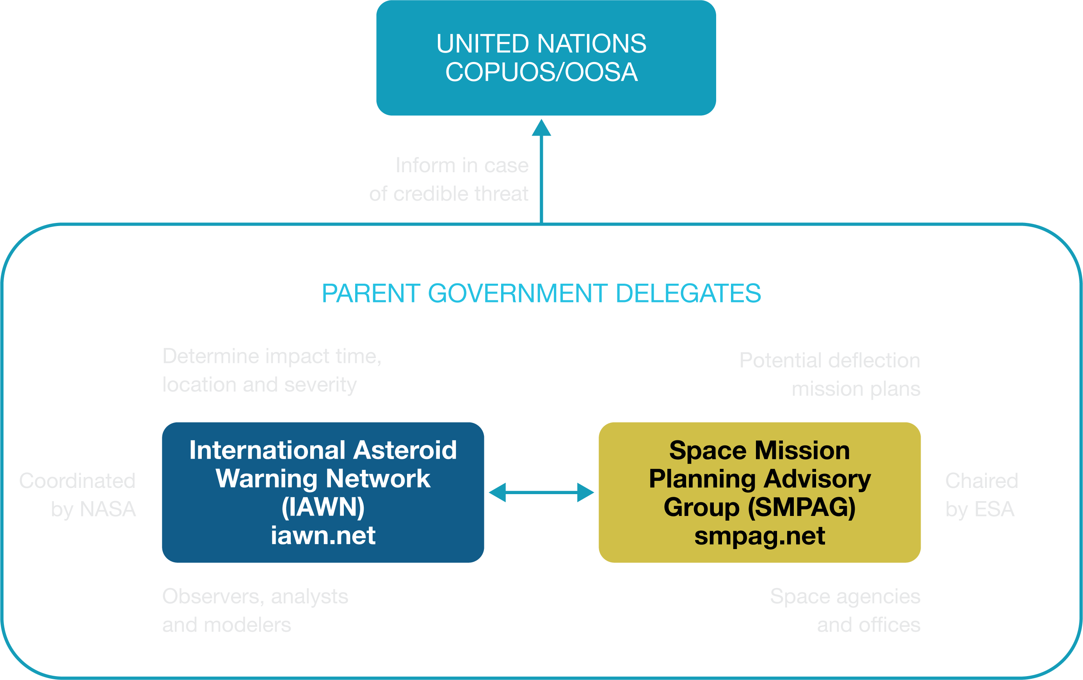
EXERCISE EXERCISE EXERCISE
Overview for NEO Threat Response
EXERCISE EXERCISE EXERCISE
8

Slide 9
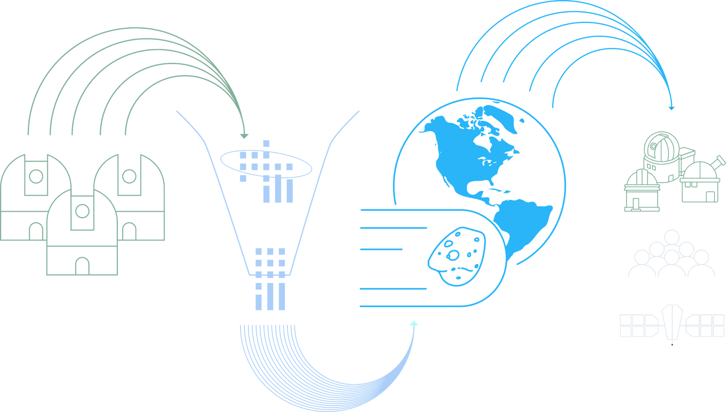
EXERCISE EXERCISE EXERCISE
NEO Observations to Impact Predictions
Minor Planet Center
Provides identification, designation, and initial orbit computation
Information made available to the public and to support follow-on observations by Earth-based and space-based facilities
NEO position measurements from observatories worldwide
ESA NEOCC
NASA CNEOS
Provide independent calculations of NEO orbits and potential impact information
NEOCC – Near-Earth Object Coordination Centre
CNEOS – Center for Near Earth Object Studies
EXERCISE EXERCISE EXERCISE
9

Slide 10
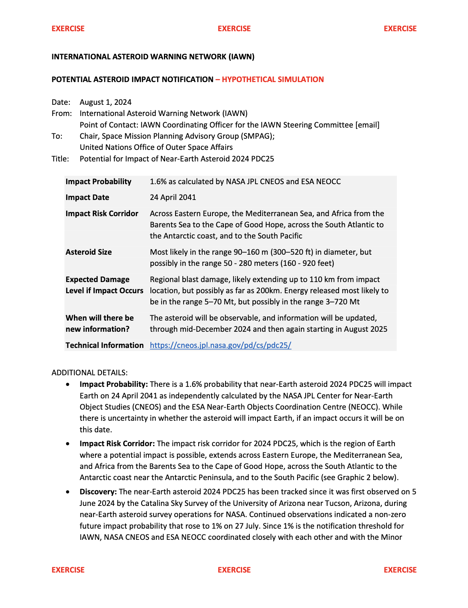
EXERCISE EXERCISE EXERCISE
IAWN Notification
IAWN shall warn of predicted impacts exceeding a probability of 1% for all objects characterized to be greater than 10 meters in size* and notify:
Chair, Space Mission Planning Advisory Group (SMPAG)
United Nations Office for Outer Space Affairs (UNOOSA)
UNOOSA will notify UN Member States
IAWN signatories will also notify and work with their own governments according to their own national policies, as applicable.
* Roughly equivalent to an absolute magnitude of 28 if only brightness data can be collected
EXERCISE EXERCISE EXERCISE
10
Notes:
Rationale: Impact probabilities greater than 1 per cent are rare yet warrant awareness of possible effects. Most objects greater than 10 meters in size could have some effects (air blast and pieces) that could reach the Earth’s surface. IAWN is compelled to warn populations if bodies will have effects that reach the ground. Setting threshold at 1 per cent is a compromise between not being overly alarmist and not warning too late for necessary action to be initiated. It is a probability figure that individuals and governments can comprehend. An alert such as this demonstrates that the IAWN is functioning. Further, it ensures the flow of communications from IAWN to the public and the United Nations.

Slide 11
EXERCISE EXERCISE EXERCISE
IAWN Notification: Key Points
Impact Probability | 1.6% as calculated by NASA JPL CNEOS and ESA NEOCC
Impact Date | 24 April 2041
Impact Risk Corridor | Across Eastern Europe, the Mediterranean Sea, and Africa from the Barents Sea to the Cape of Good Hope, across the South Atlantic to the Antarctic coast, and to the South Pacific
Asteroid Size | Most likely in the range 90–160 m (300–520 ft) in diameter, but possibly in the range 50–280 meters (160–920 feet)
Expected Damage Level If Impact Occurs | Regional blast damage, likely extending up to 110 km from impact location, but possibly as far as 200km. Energy released most likely to be in the range 5–70 Mt, but possibly in the range 3–720 Mt
When Will New Information Be Available? | The asteroid will be observable, and information will be updated, through mid-December 2024 and then again starting in August 2025
Technical Information | https://cneos.jpl.nasa.gov/pd/cs/pdc25/
EXERCISE EXERCISE EXERCISE
11

Slide 12
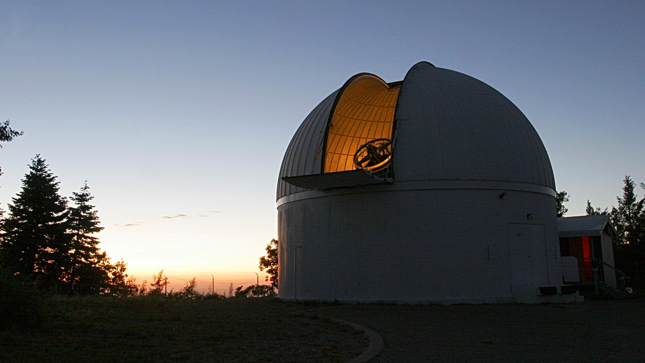
Current Knowledge from Telescopic Observations
Davide Farnocchia
Center for Near-Earth Object Studies NASA Jet Propulsion Laboratory

Slide 13
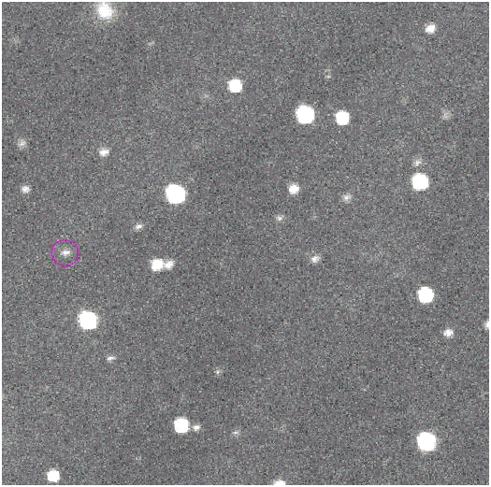
Discovery of asteroid 2024 PDC25
Discovery observations of 2008 TC3
Credit: Catalina Sky Survey
Asteroid 2024 PDC25 was discovered on June 6, 2024 by the NASA-funded Catalina Sky Survey.
Announced by the Minor Planet Center on June 7, 2024.

Slide 14
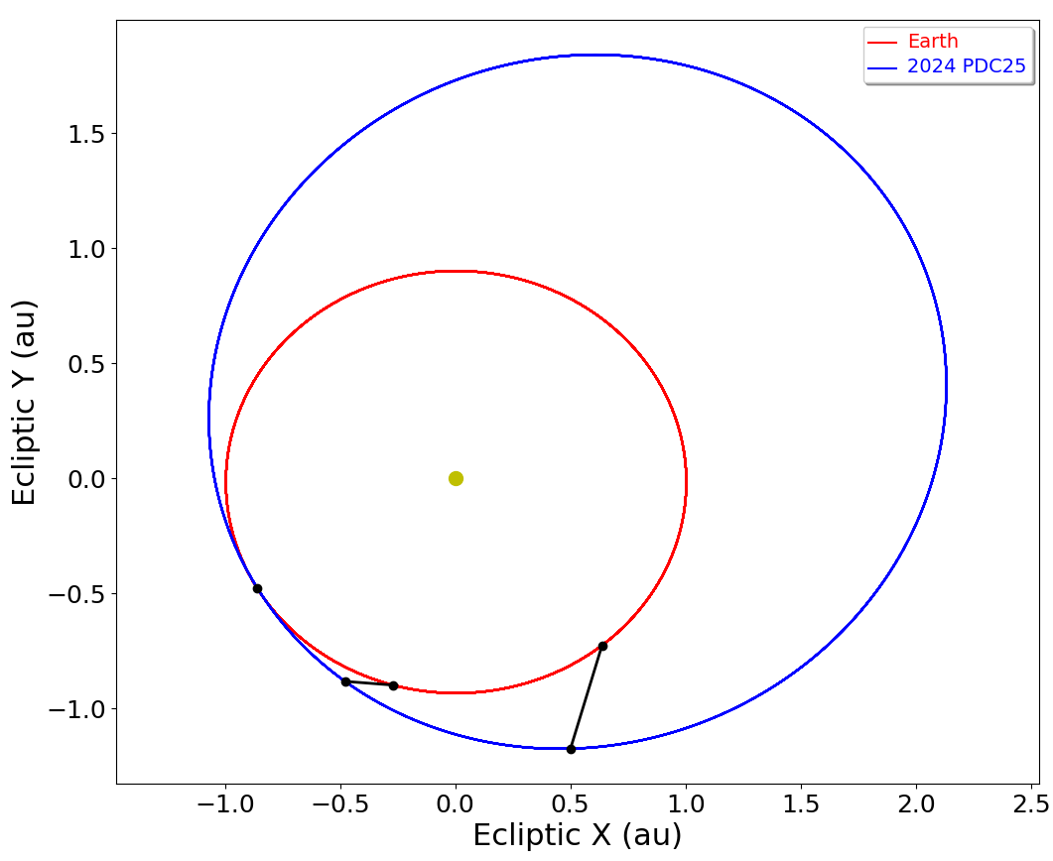
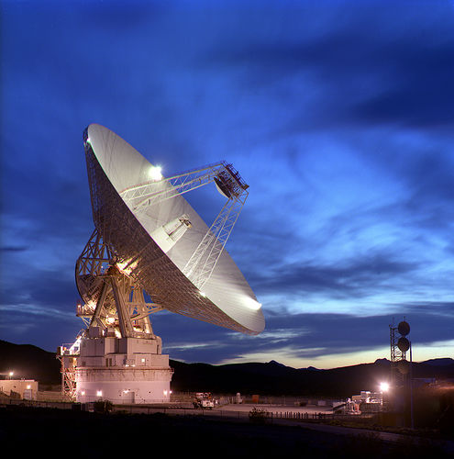
Orbit and tracking of asteroid 2024 PDC25
2024 PDC25 is on 1.0 au × 2.3 au orbit, with an inclination of 11° and an orbit period of 2.1 years.
2024 PDC25 has been tracked by optical telescopes since discovery. It will be observable until mid-December 2024 and again starting in August 2025.
2024 PDC25’s orbit
Earth’s orbit
Sun
Possible impact April 24, 2041
Radar observations are not possible until 2041.
Discovery June 5, 2024
August 1, 2024

Slide 15
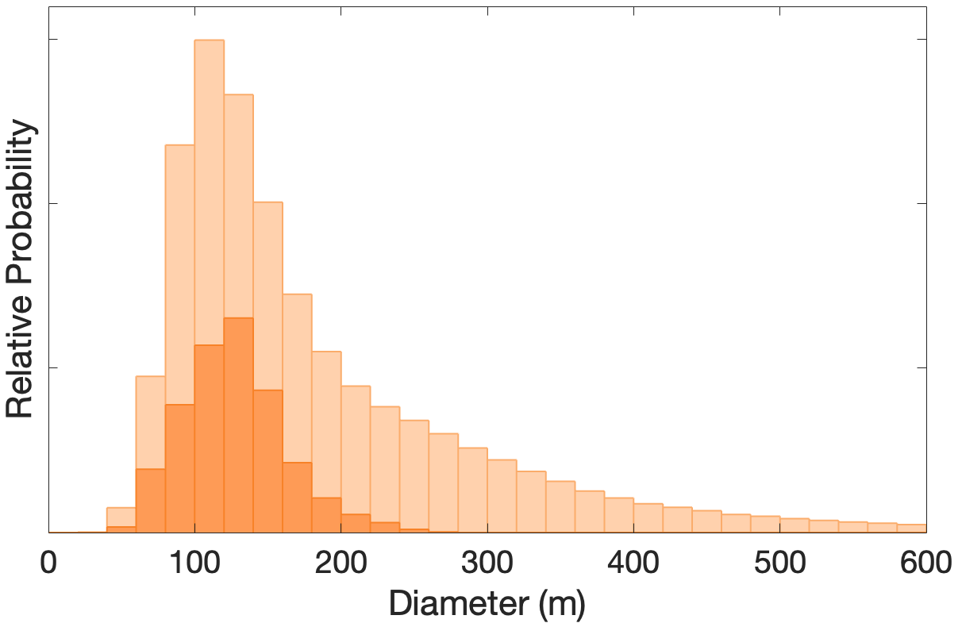
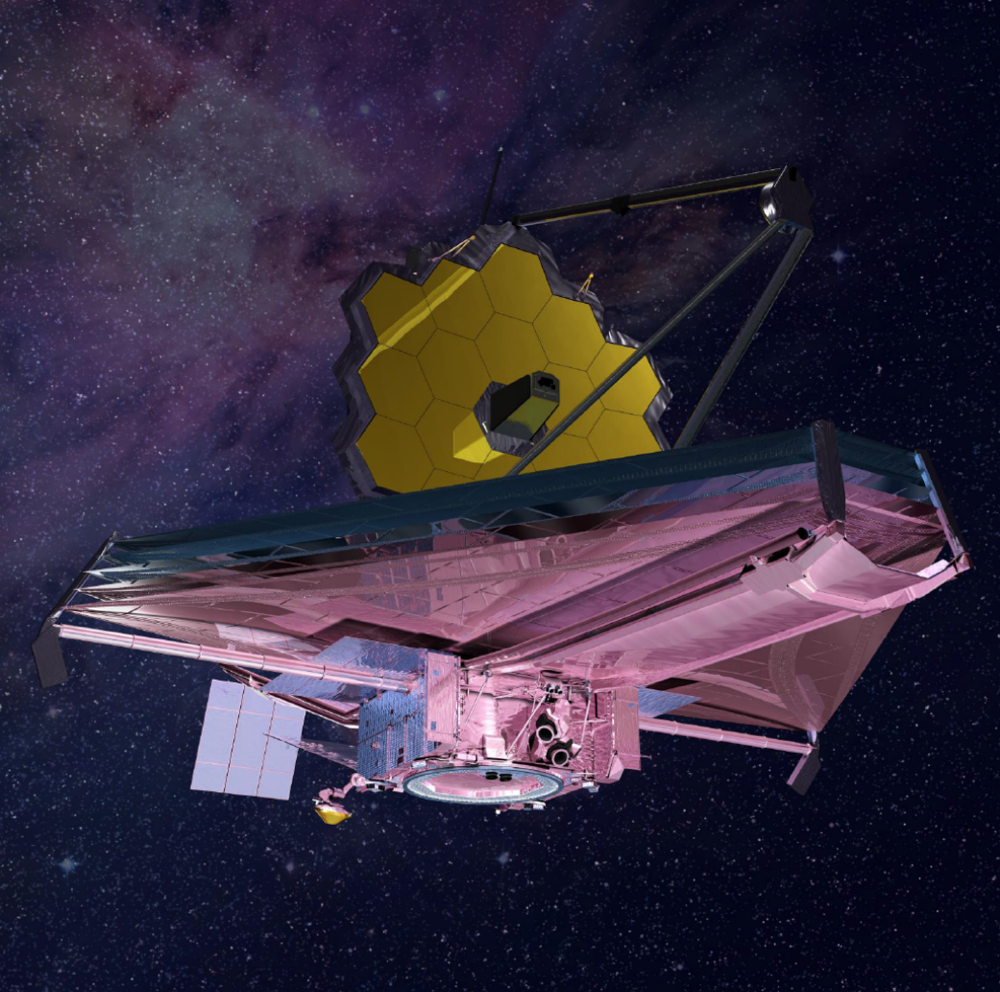
Physical properties of asteroid 2024 PDC25
Spectral and infrared observations from the James Webb Space Telescope provide key constraints
2024 PDC25 is an S-type (stony) asteroid.
Diameter most likely between 90–160 m, but possibly in the range 50–280 m.
Impact energy most likely to be in the range 5–70 Mt, but possibly in the range 3–720 Mt.
Size based on brightness measurements alone
Size including JWST observations

Slide 16
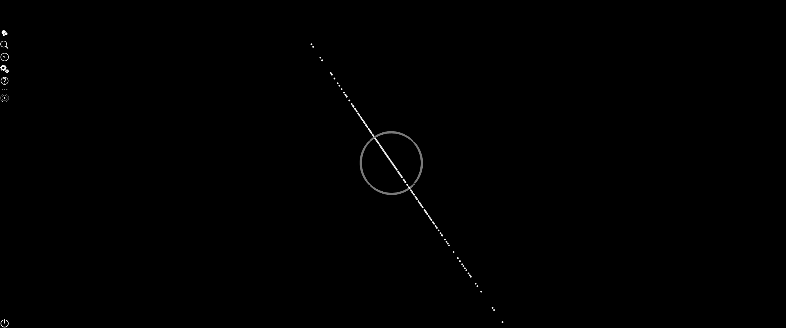
Potential impact of 2024 PDC25
Positional uncertainty of 2024 PDC25 in 2041
Currently, 1.6% probability of Earth impact in April 2041
2024 PDC25 will make a close approach to Earth in April 2041, and there is a 1.6% probability of impact.
Based on the current orbit uncertainty, the position of 2024 PDC25 in 2041 can only be predicted to within ±1.7 million km (4.3 lunar distances).
Based on asteroid population estimates, objects of the size of 2024 PDC25 impact the Earth every 35,000 years or so, on average.
On the Torino Impact Hazard Scale (0 to 10), this potential impact currently has a rating of 3. Only Apophis in 2004 reached a higher level on the Torino Scale.
As the asteroid is tracked over the coming months, the position uncertainty in 2041 will shrink, and the impact probability will change.
Earth
Moon’s orbit

Slide 17
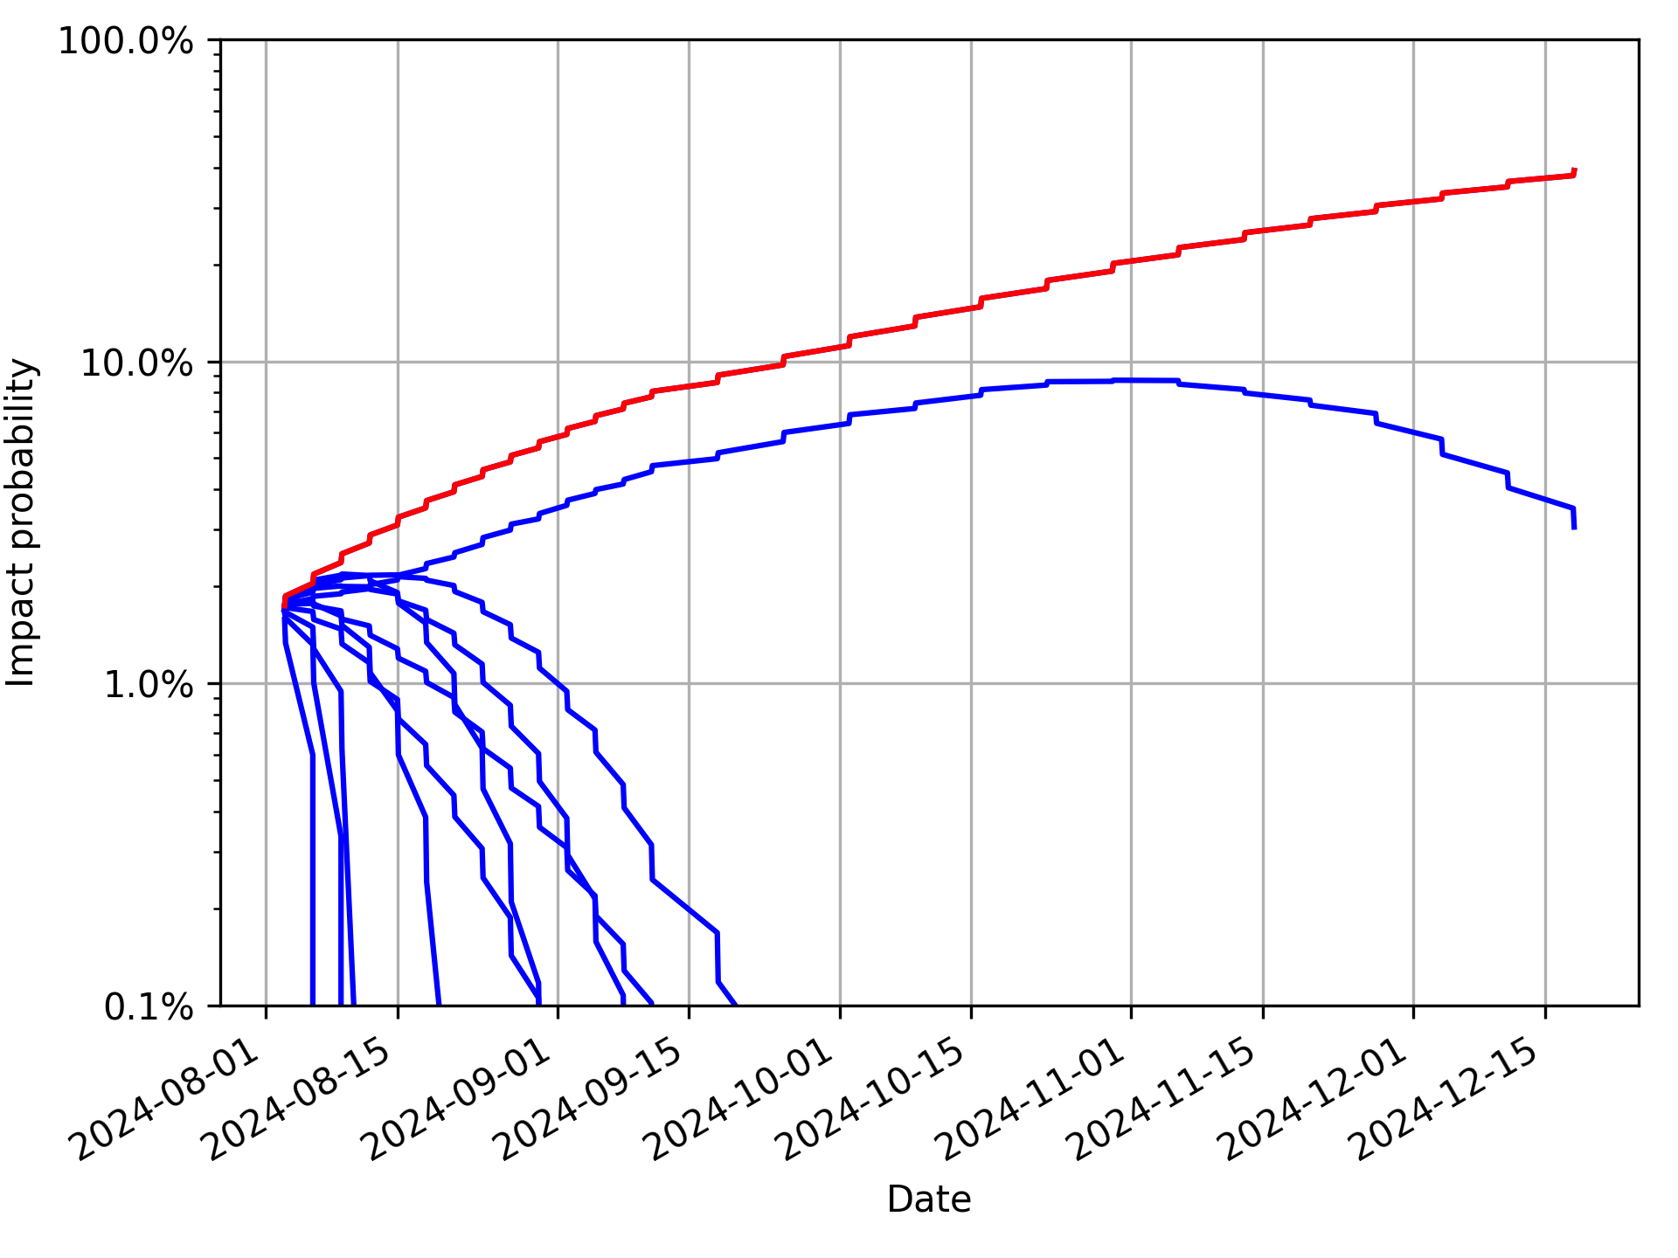
Expected evolution of asteroid impact probability
Impact probability will evolve as asteroid observations continue until mid-December 2024
7% chance that the impact probability will be >10%
Worst case
5% chance that the impact probability will be 1% to 10%
Other possible cases of impact probability evolution
88% chance that the impact probability will be < 1%

Slide 18
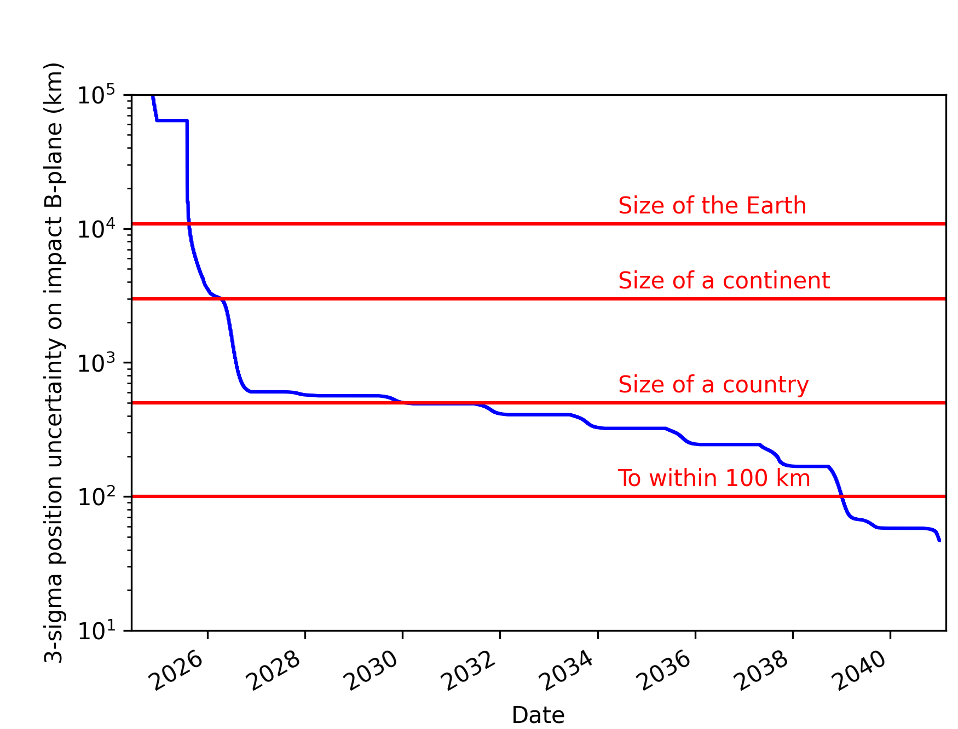
Expected evolution of asteroid location knowledge
From Earth-based observations
If 2024 PDC25 is on an impact trajectory, we cannot yet predict the impact location.
We can predict the accuracy of the impact location knowledge.
Without a space mission, we won’t know the impact location to within 100 km until 2039.
The soonest the impact probability could reach 100% is September 2025.
A reconnaissance mission would enable us to accurately predict the impact location much earlier.

Slide 19
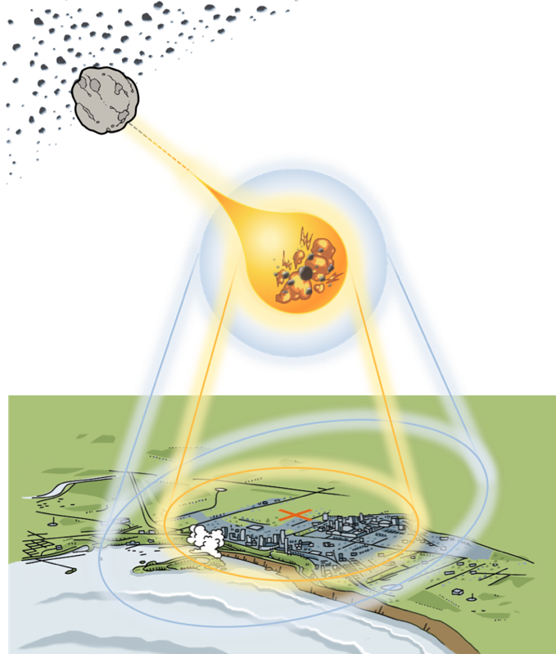
Impact Risk Assessment
Lorien Wheeler
Asteroid Threat Assessment Project NASA Ames Research Center

Slide 20
Asteroid Impact Hazards
Asteroids can cause damage by exploding in the atmosphere or by impacting Earth’s surface
Potential hazards include destructive blast waves, thermal fireballs, or tsunamis
Damage depends on asteroid properties, atmospheric entry, and impact location
Entry and Breakup
Airburst or Surface Impact
Surface Hazards
Local Ground Damage
Thermal
Blast
Tsunami

Slide 21
Asteroid Impact Hazards
?
?
Asteroids can cause damage by exploding in the atmosphere or by impacting Earth’s surface
Potential hazards include destructive blast waves, thermal fireballs, or tsunamis
Damage depends on asteroid properties, atmospheric entry, and impact location
Entry and Breakup
Airburst or Surface Impact
?
Surface Hazards
Local Ground Damage
Properties and impact location of asteroid 2024 PDC25 are uncertain, so the potential damage is highly uncertain
?
Thermal
Blast
Tsunami

Slide 22
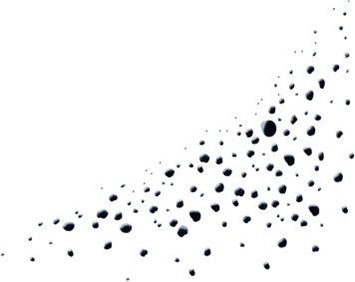
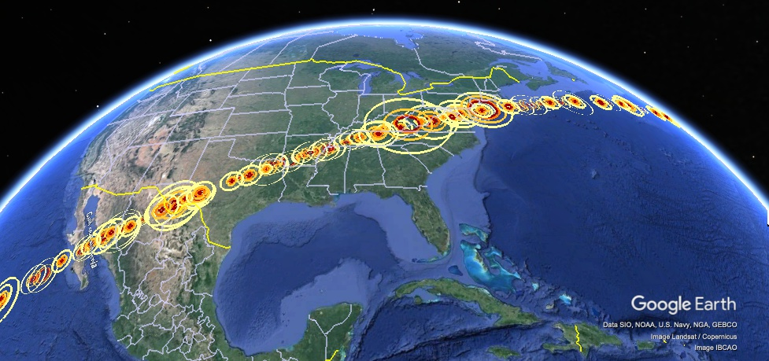
Impact Risk Assessment
Models millions of cases to evaluate range & likelihood of potential damage, given uncertainties

Slide 23
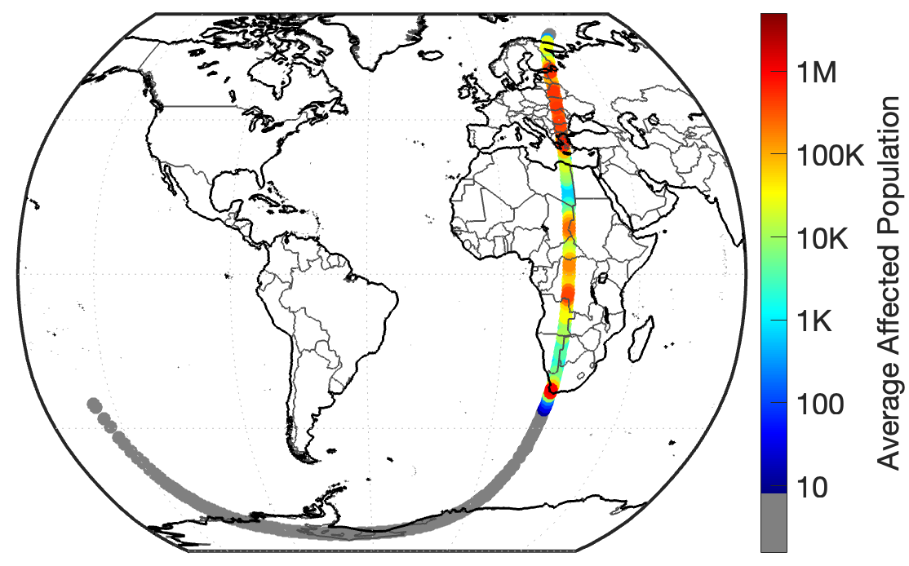
What are the damage risks if the asteroid 2024 PDC25 hits Earth?
August 2024: 1.6% chance of Earth impact by an asteroid 50–280 m in diameter with 3–720 Mt of energy
Moon’s orbit
Earth
Positional uncertainty of asteroid in 2041
none
If Earth impact occurs, there is a ~50/50 chance of damage to populated areas
Notes:
First to transition from Davide’s briefing, I’ll show this snapshot connecting the full orbital uncertainty region to the portion impacting earth.
Emphasize that there is currently only a 1.6% chance of earth impact by an asteroid in this size that, and that we are now going to be looking at the potential damage and risk among those potential earth impacting cases.

Slide 24
Impact Hazard Summary
August 2024: 1.6% chance of Earth impact by an asteroid 50–280 m in diameter with 3–720 Mt of energy
Primary hazard is a destructive blast wave from a high-energy, low-altitude airburst
Blast damage could span multiple cities or larger provinces, potentially affecting thousands to millions of people
Significant tsunami are unlikely, but the largest impacts near coasts could cause inundation damage
none
If Earth impact occurs, there is a ~50/50 chance of damage to populated areas
Notes:
Overview of the main types of hazards and how many people could be affected

Slide 25
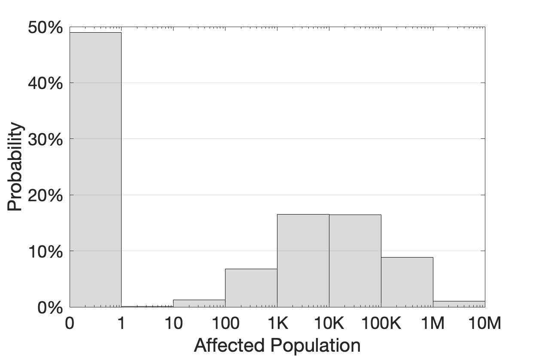
Affected Population Risks
Damage probabilities if Earth impact occurs; Earth impact probability is currently 1.6%
49%
Average~50K
Likelihood of the impact affecting at least this many people if Earth impact occurs
Likely no damage from impacts over ocean or Antarctic
0
49%
>1K
43%
>10K
26%
>100K
10%
>1M
1%
Large damage from impacts over land
Impacts over land would likely affect 1K–100K people, potentially up to ~5M people
~50K people affected on average
17%
17%
7%
9%
1%
If Earth impact occurs, chances of no damage or large damage are both likely
Notes:
Then we’ll look that the overall probabilities of how many people might be affected if the asteroid hits earth. Overall, chances of no population damage or large population damage are both likely, with a
~50K people affected on average if Earth impact occurs
~51% chance of damage to populated regions among Earth-impacting cases.
Impacts over land likely to affect at least 1K–100K people
Worst cases could affect up to 5M people.
Likely no population significantly affected by remote impacts over ocean or Antarctic

Slide 26
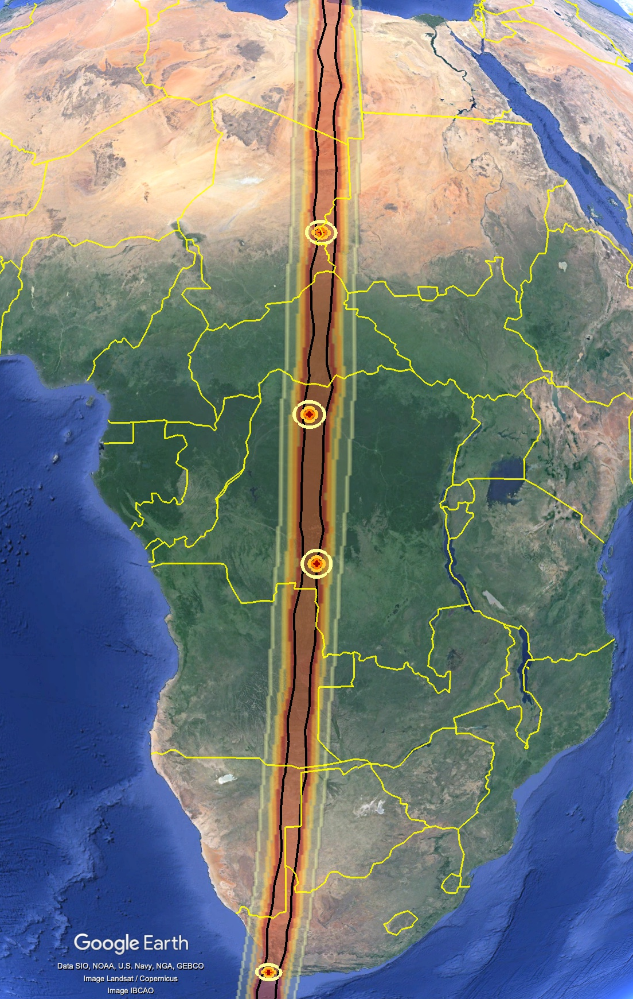
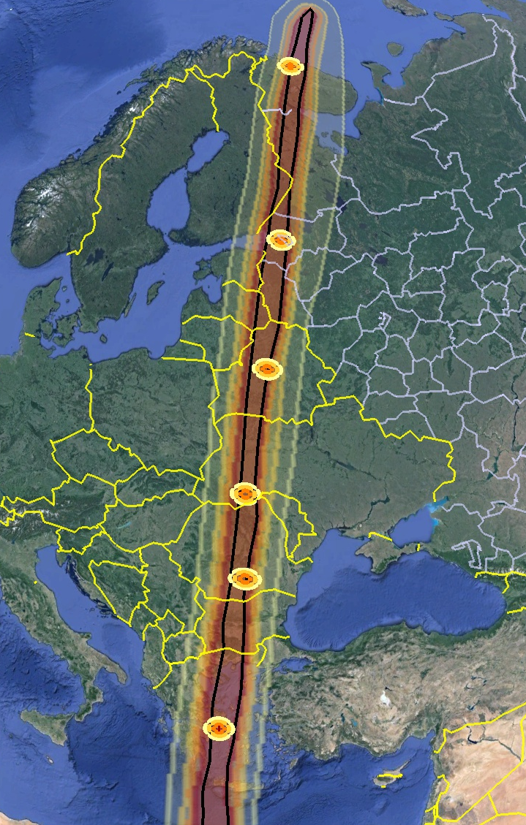
Ground Damage Risk Swath
Regions potentially at risk to ground damage given ranges of damage sizes and locations
Areas potentially at risk to blast damage span a ~500-km-wide swath from South Africa to the Barents Sea, crossing Africa, the Mediterranean, and Eastern Europe
Murmansk
Impact Corridor
St. Petersburg
Al Junaynah
Median damage sizes
Minsk
Lisala
Chernivtsi
Bucharest
Damage risk swath shows extent of regions potentially at risk to ground damage, given ranges of potential damage locations and sizes
Black border shows range of potential airburst/impact locations
Rings show median damage sizes at sample locations
Kananga
Athens
Cape Town

Slide 27
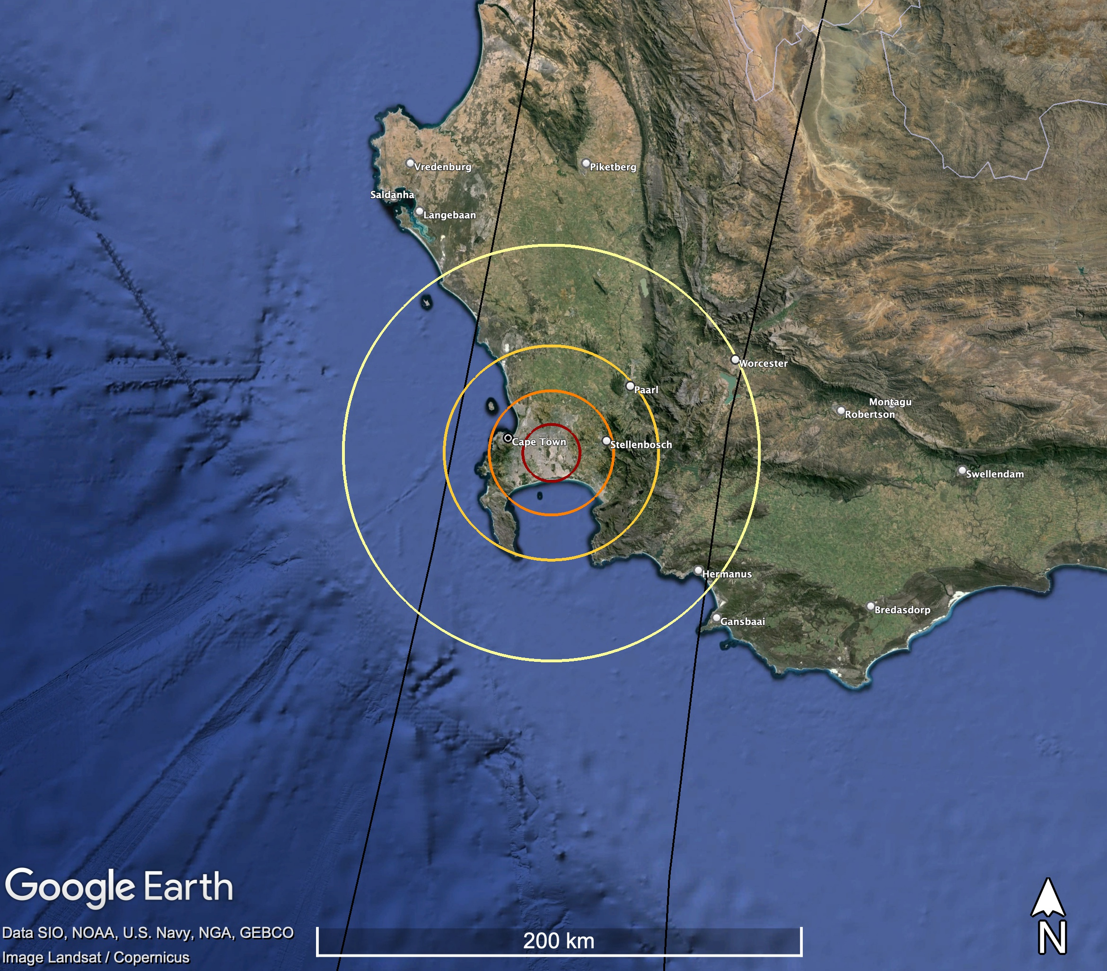
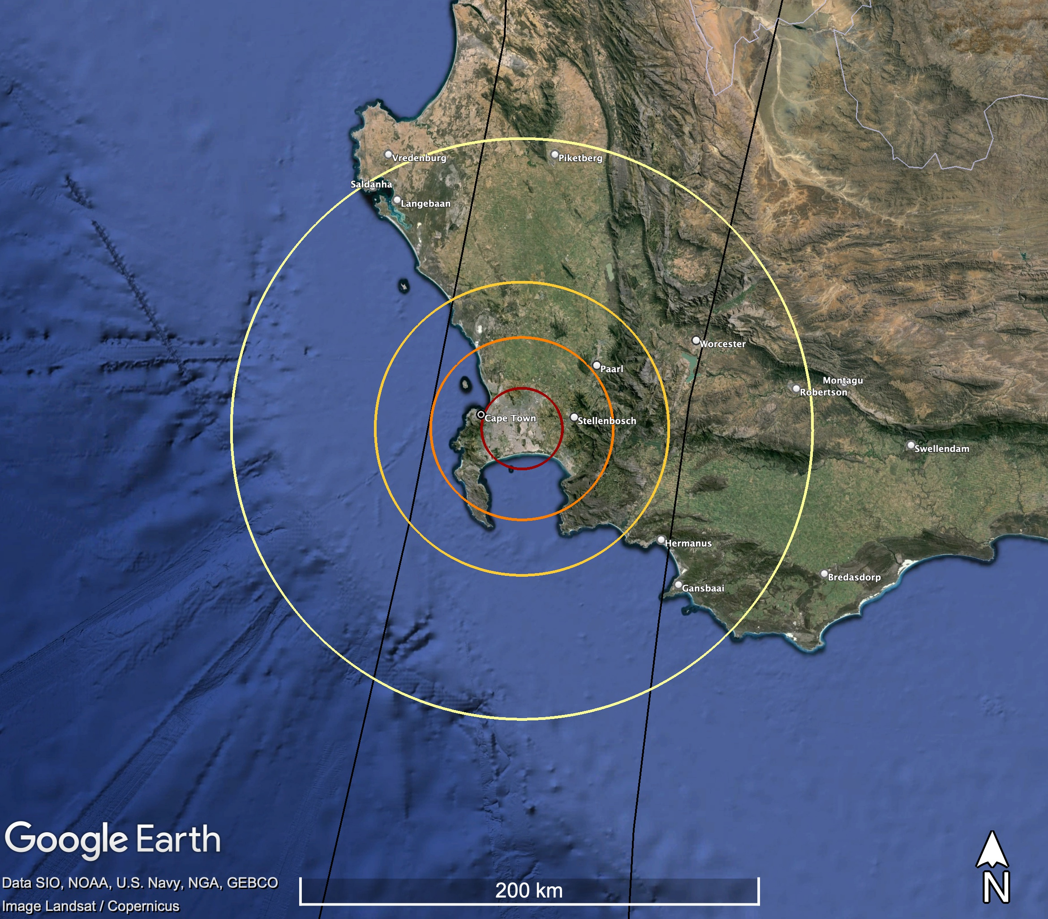
Potential Ground Damage Sizes & Severities
Example over Cape Town, South Africa
Likely damage sizes could span multiple metropolitan areas or counties
Large damage sizes could span multiple provinces or states
Damage severities could reach unsurvivable levels near the blast, extending to larger areas of structural damage, fires, and shattered windows
~130 km (80 mi)
~80 km (50 mi)
Damage Level Description
Serious | Windows shatter, some structure damage
Severe | Widespread structure damage
Critical | Residential structures collapse
Unsurvivable | Devastation, structures flattened or burned
~60 km (40 mi)
~40 km (25 mi)
Cape Town
~12 km (7 mi)
Cape Town
~20 km (12 mi)
Median (50th%) Damage
Large (95th%) Damage
Notes:
Epoch 1 damage section stats:
Damage severities could reach unsurvivable levels near airburst, extending to larger areas of structural damage, fires, and shattered windows
Outer serious damage areas are most likely between ~40–110 km (~25–70 miles) in radius (median ~80 km, 50 mi)
Large damage areas could extend out over ~130 km or so (~120 miles) or more in radius
(99th% is 160 km, max modeled is 240 km)

Slide 29
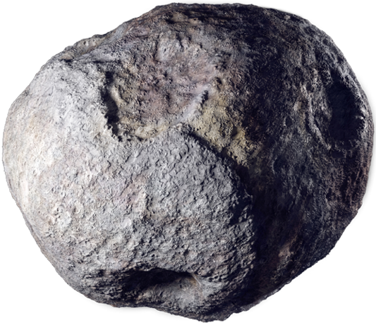
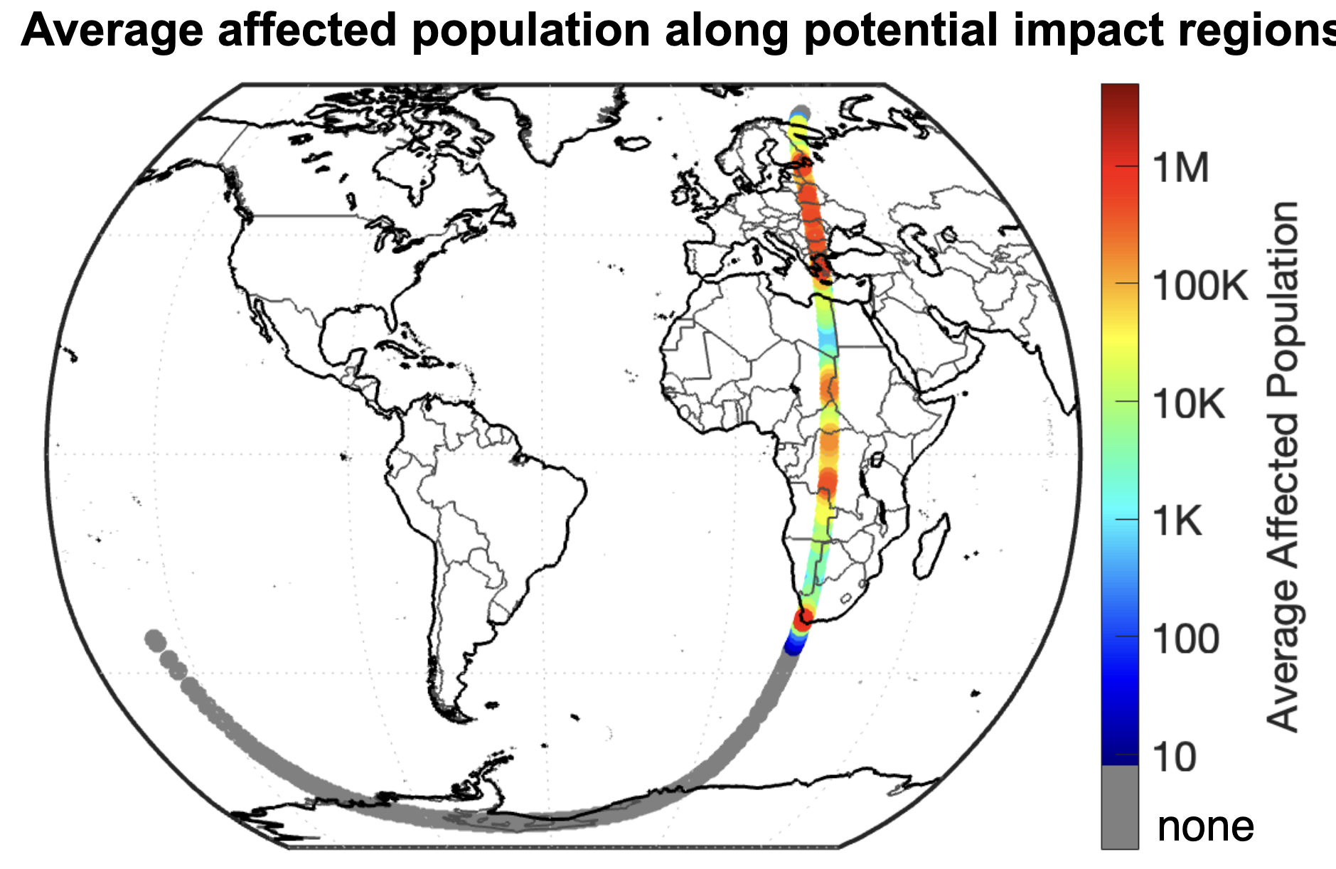

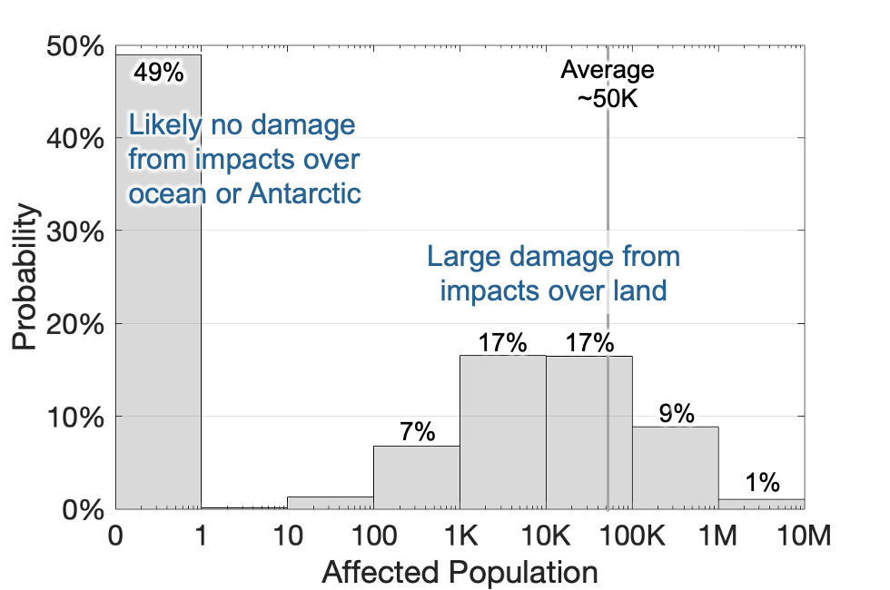
EXERCISE EXERCISE EXERCISE
Today is 1 August 2024.
1.6% probability of Earth impact in ~17 years
Potential impact
24 April 2041
Average affected population along potential impact regions
Possible asteroid sizes (m)
50
Most likely size: 90–160
280
Rocky composition
Damage probabilities if Earth impact occurs

Slide 30

EXERCISE EXERCISE EXERCISE
It is now October 2024.
16.5 years until potential impact
Potential impact
24 April 2041
IAWN notification
1 August 2024

Slide 31
EXERCISE EXERCISE EXERCISE
It is now October 2024.
16.5 years until potential impact
Potential impact
24 April 2041
IAWN notification
1 August 2024

Slide 32
EXERCISE EXERCISE EXERCISE
The impact probability is now 18%. There is an 82% chance the probability of Earth impact will be >1% when observations end in December.
August 2024
IAWN issues notification about potential impactor
29 October 2024
SMPAG shares recommendations
August to October 2024
Delegates of the UN-endorsed Space Mission Planning Advisory Group (SMPAG) meet virtually on a recurring basis to assess space mission options
10 & 11 October 2024
SMPAG meets in Milan, Italy
EXERCISE EXERCISE EXERCISE

Slide 33
Recommendations for Space Mission Options
Detlef Koschny
Chair, Space Mission Planning Advisory Group
(SMPAG)
9th IAA Planetary Defense Conference
Scenario date: 29 October 2024

Slide 34




















Space Mission Planning Advisory Group
Endorsed by the UN Committee on the Peaceful Uses of Outer Space in 2013
FFG (Austria)
BELSPO (Belgium)
CSA (Canada)
CNSA (China)
Czech Republic
ESA
CNES (France)
DLR (Germany)
ISA (Israel)
ASI (Italy)
JAXA (Japan)
KASI (Korea)
AEM (Mexico)
+ Observer or
ex-officio status:
ASE, COSPAR, ESO, IAA, IAU, IAWN, SWF, UNOOSA
SUPARCO (Pakistan)
ROSA (Romania)
ROSCOSMOS (Russia)
SSAU (Ukraine)
UK Space Agency (UK)
NASA (USA)
SMPAG members as of January 2024

Slide 35
Excerpts from Terms of Reference
“The purpose of the SMPAG is to prepare for an international response to a NEO impact threat through the exchange of information, development of options for collaborative research and mission opportunities, and NEO threat mitigation planning activities.”
Reference: SMPAG Terms of Reference, https://www.cosmos.esa.int/web/smpag/terms_of_reference_v2

Slide 36
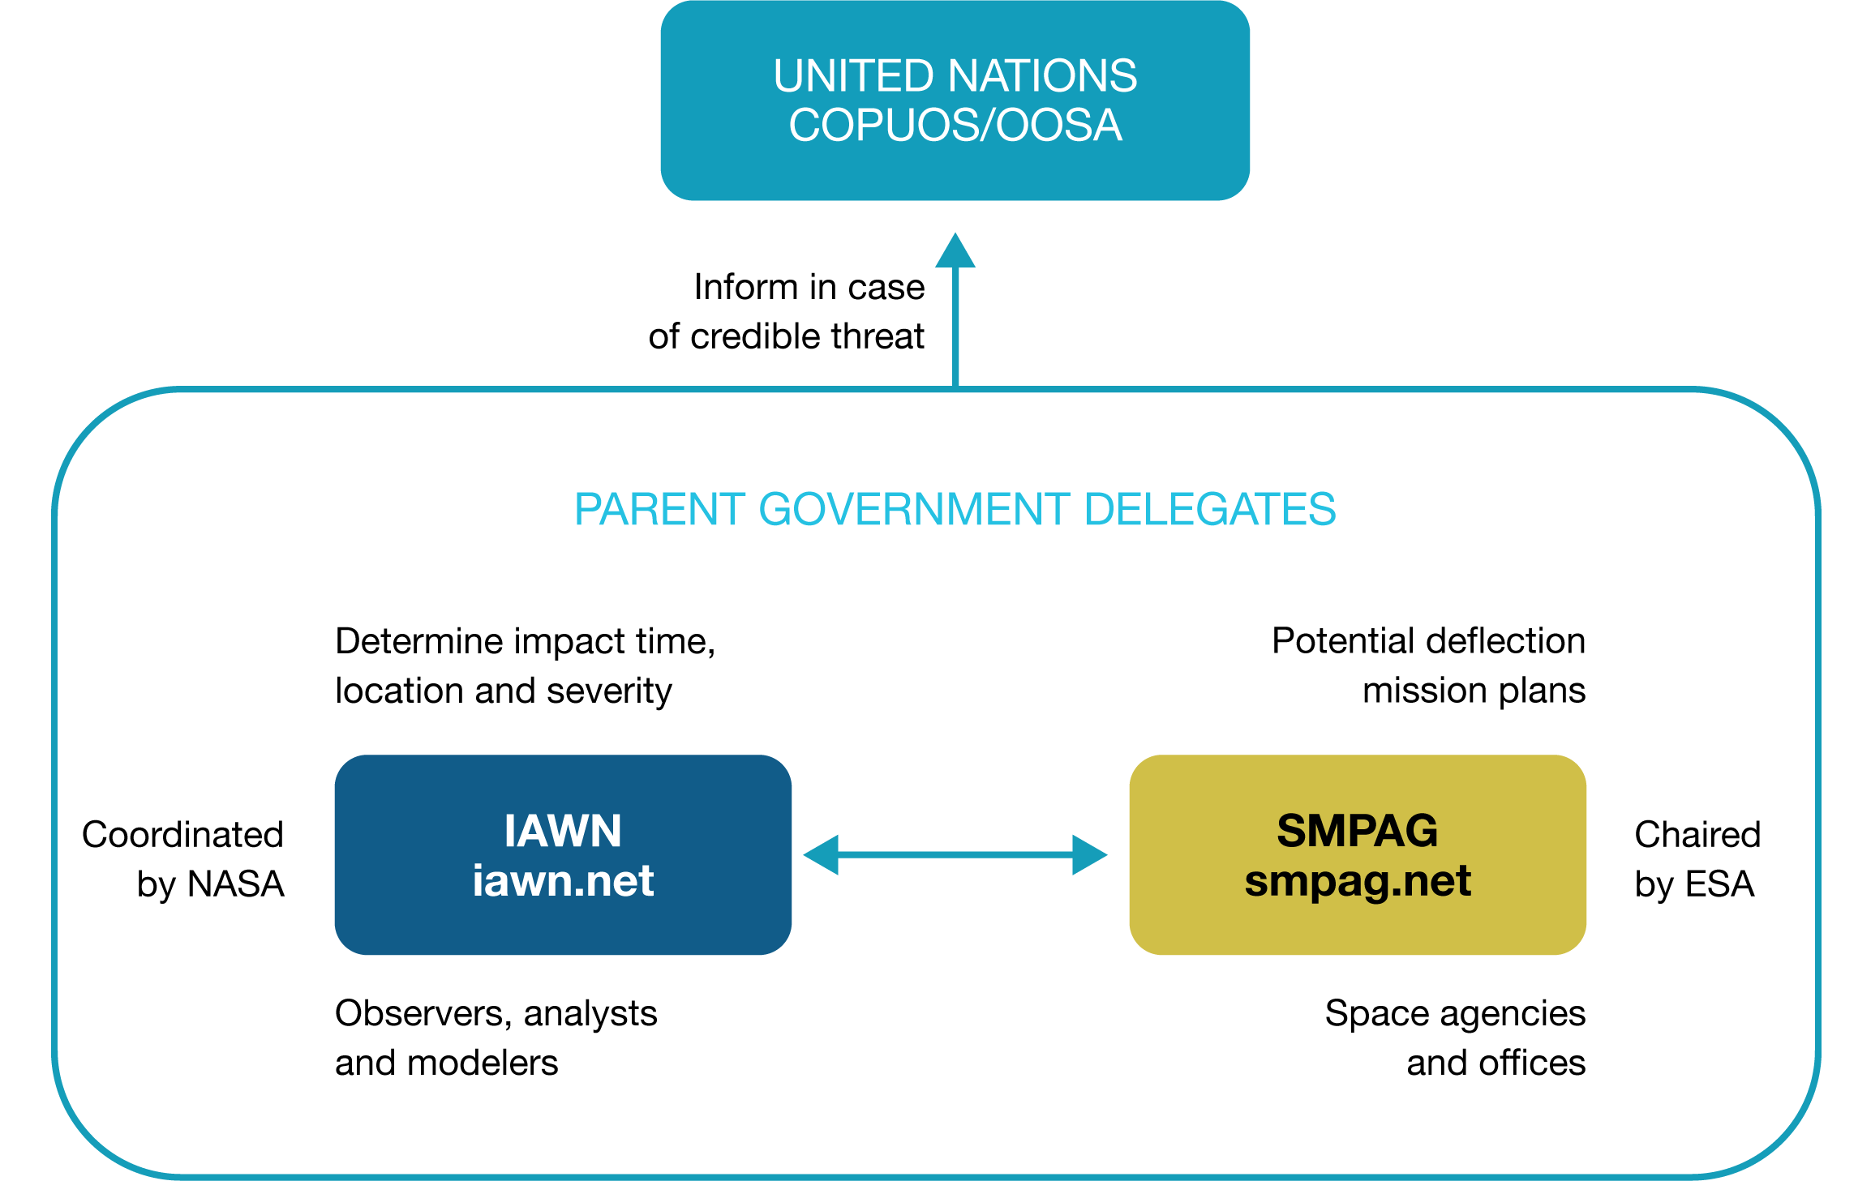
EXERCISE EXERCISE EXERCISE
Overview for NEO Threat Response
> 1 %
< 50 years
> 50 m
EXERCISE EXERCISE EXERCISE
36

Slide 37
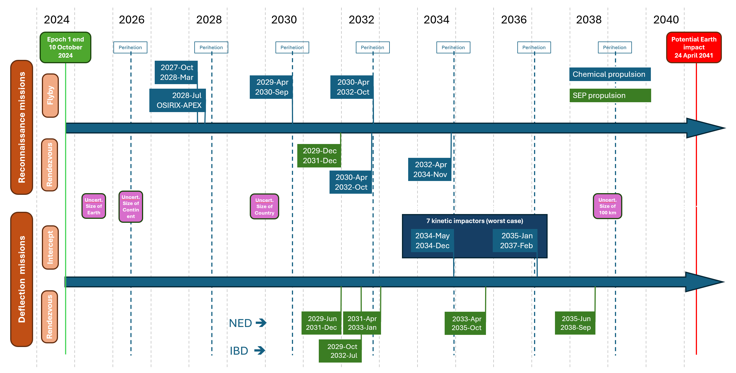
MISSION OPTIONS TIMELINE

Slide 38
Five SMPAG Recommendations
1 |  | Start, as soon as possible, the initial design phases (phases A/B) of a fast flyby reconnaissance mission.
2 |  | Consider re-tasking an already flying spacecraft to perform an early reconnaissance of the target asteroid.
3 |  | Start, as soon as possible, the initial design phases (phases A/B) of a solar electric propulsion (SEP) rendezvous reconnaissance mission, independently of the implementation of a flyby reconnaissance mission.
4 |  | Start, as soon as possible, the initial design phases (phases A/B) of in-space mitigation missions, based on the following concepts, including the risk assessment on each option: kinetic impactor (KI) and ion beam deflection (IBD).
5 |  | Perform detailed simulations assessing the possibility to disrupt an asteroid by an impulse transfer. The work should be done by several SMPAG delegations independently.

Slide 40
EXERCISE EXERCISE EXERCISE
It is October 2024
16.5 years until potential impact; 18% chance of impact
Potential impact
24 April 2041
Affected people among Earth-impacting scenarios
Possible asteroid sizes (m)
0
49%
>1K
43%
>10K
26%
>100K
10%
>1M
1%
50
Most likely size: 90–160
280
Rocky composition
Avg. affected population along potential impact regions
SMPAG Recommendations
Flyby Recon
Retask for Recon
Rendezvous Recon
In-Space Mitigation
Disruption Modeling

Slide 41
Participant Discussion
What did you learn during the panel?
What in the panelists’ comments aligned with your expectations? What surprised you?
Did your perspective on planetary defense change in any way after listening to the panelists? If so, how?
What are the implications of the panelists’ comments for your own work?
What concrete actions could be taken to make progress on the issues raised by the panelists?
If you could ask the panelists to elaborate on one specific point, what would it be?

Slide 42
Share Your Perspectives
Which recommendation about asteroid reconnaissance would you advocate that your government prioritize, given the current level of risk?
Fast flyby reconnaissance mission
Re-tasking already flying spacecraft for reconnaissance
Rendezvous reconnaissance mission
Which recommendation related to Earth impact prevention would you advocate that your government prioritize, given the current level of risk?
Initial design phases of in-space mitigation missions
Detailed simulations assessing the possibility of asteroid disruption

