Slide 1
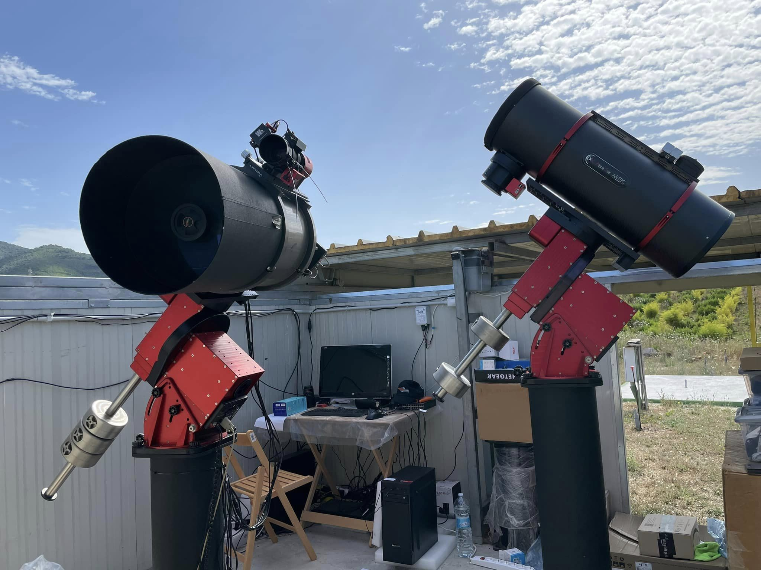
The Virtual Telescope Project
a unique resource in near-Earth object outreach and education
Gianluca Masi
Planetary Defence Conference 2025 – PDC2025

Slide 2
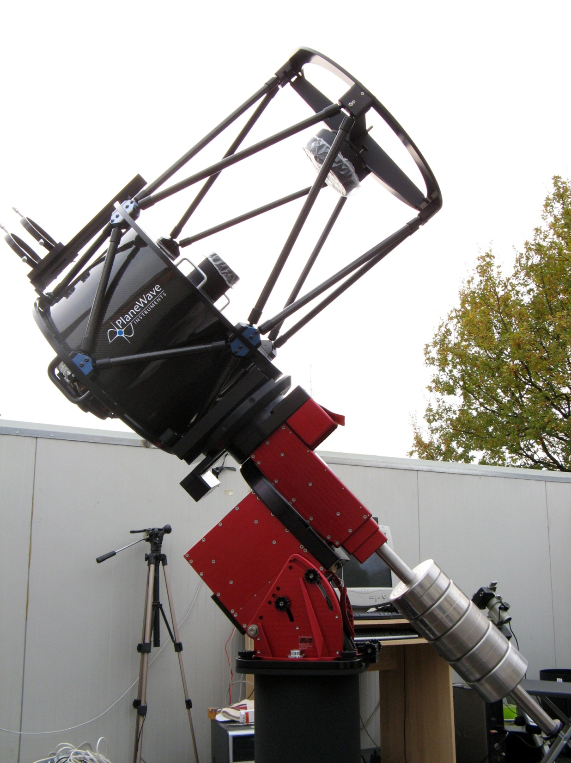
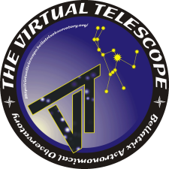
Virtual Telescope Project
unit #1
optics: PlaneWave 17” (432 mm-f/6.8)
- mount: Paramount MEII
instrument payload: 109 kg
PE: <3” peak-to-peak without PEC (!)
pointing accuracy: <8” RMS (!)
Tracking: any rate (!)
focuser: 3.5” Hedrick Focuser
CCD: SBIG STL-6303E, NABG
filters: LRGB; Ha, OIII, SII
software: TheSkyX Pro, Tpoint, Orchestate
SQM: 21.5
total remote control
“fully robotic” system

Slide 3
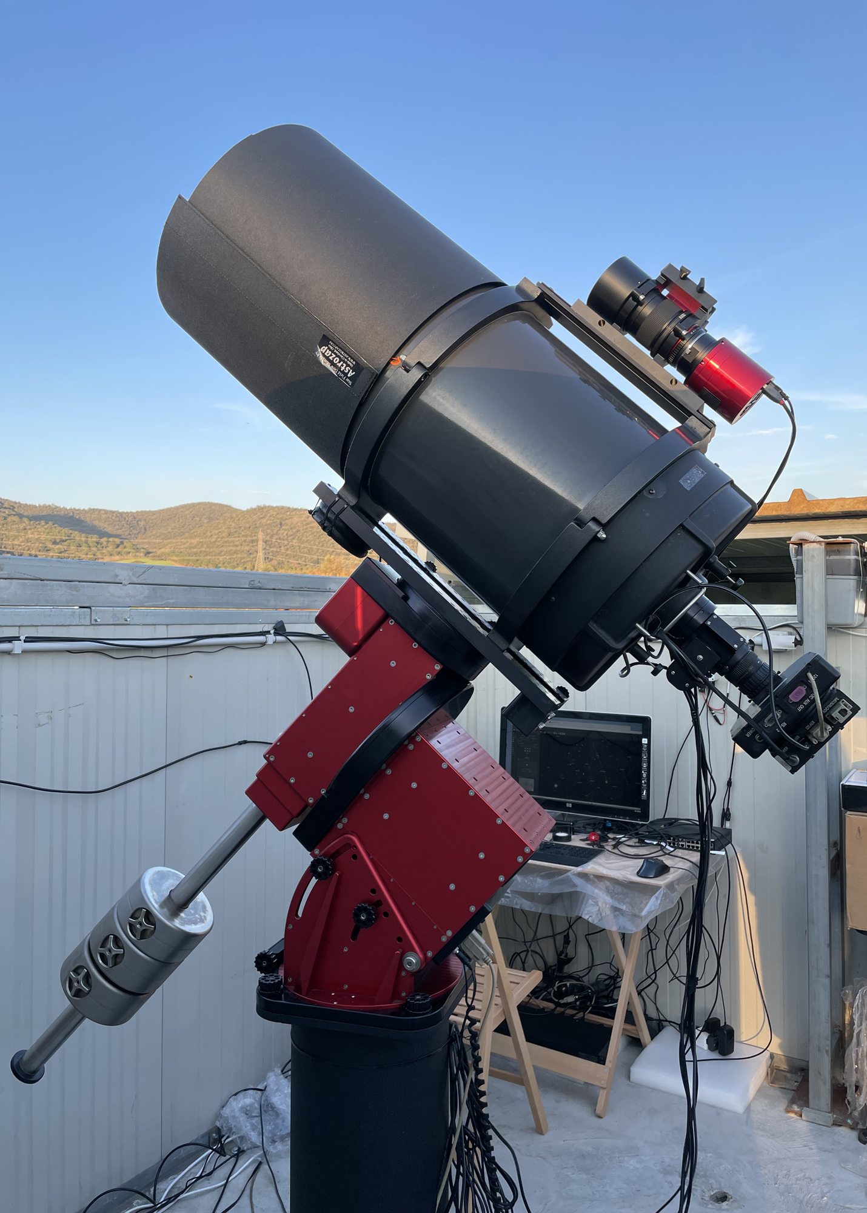
Virtual Telescope Project
unit #2
optics: C14 fastar (356 mm f/6.9)
mount: Paramount ME
payload: 68 kg
PE: 1.8”, peak-to-peak, without PEC (!)
pointing accuracy: 10” RMS (!)
tracking: any rate(!)
focuser: Optec TCF-S
CCD: SBIG ST-10XME, NABG, QE=90%
filters: RGB; B,V,R,I (Bessel); spectroscopy; Ha
software: TheSkyX Pro, Tpoint, Orchestate
SQM: 21.5
total remote control
“fully robotic” system

Slide 4
Virtual Telescope Project
unit #3
optics: 135mm-f/2
mount: Paramount ME
payload: 68 kg
PE: 1.8”, peak-to-peak, without PEC (!)
pointing accuracy: 10” RMS (!)
tracking: any rate(!)
focuser: ZWO focuser
CCD: ZWO ASI6200MC Pro
filters: One shot color
software: TheSkyX Pro, Tpoint, Orchestate
SQM: 21.5
total remote control
“fully robotic” system

Slide 5
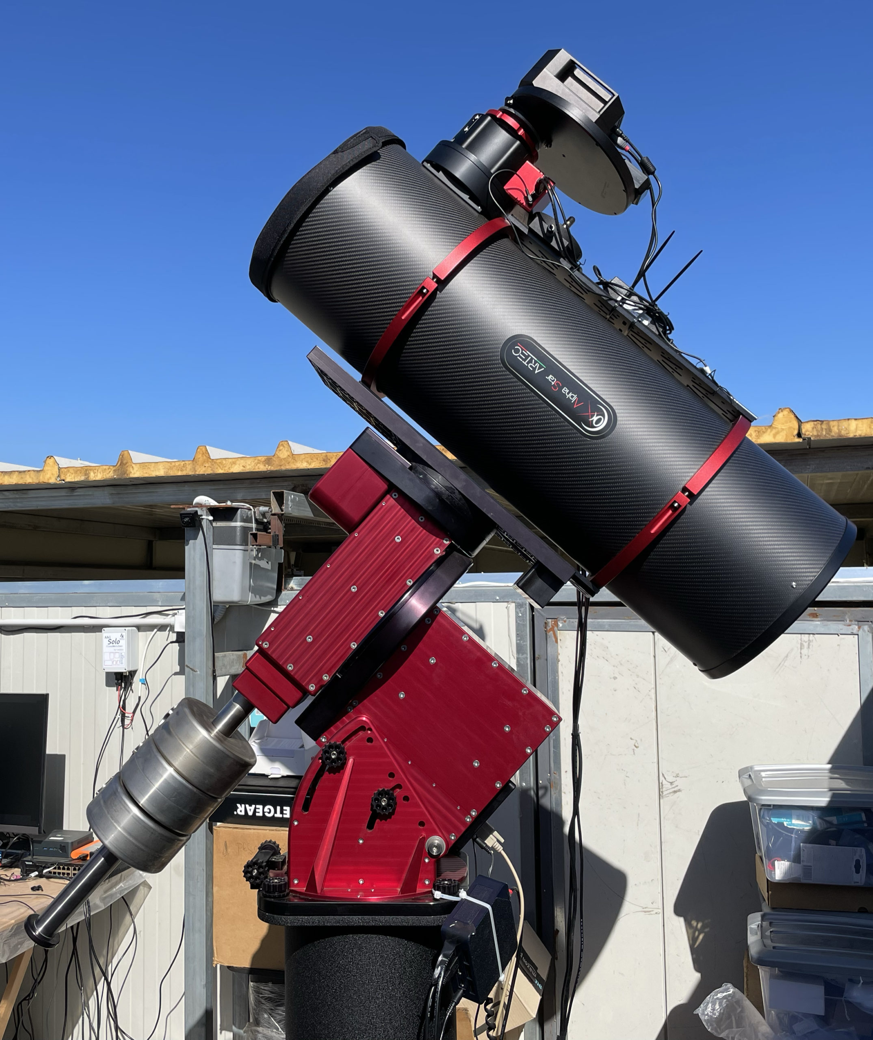
Virtual Telescope Project
unit #4
optics: 250mm-f/4.5
mount: Paramount ME
payload: 68 kg
PE: 1.8”, peak-to-peak, without PEC (!)
pointing accuracy: 8” RMS (!)
tracking: any rate(!)
focuser: Pegasus Prodigy
CMOS: Moravian C3-61000 PRO EC
filters: LRGB, Ha, OIII, SII
software: TheSkyX Pro, Tpoint, Orchestate
SQM: 21.5
total remote control
“fully robotic” system

Slide 6
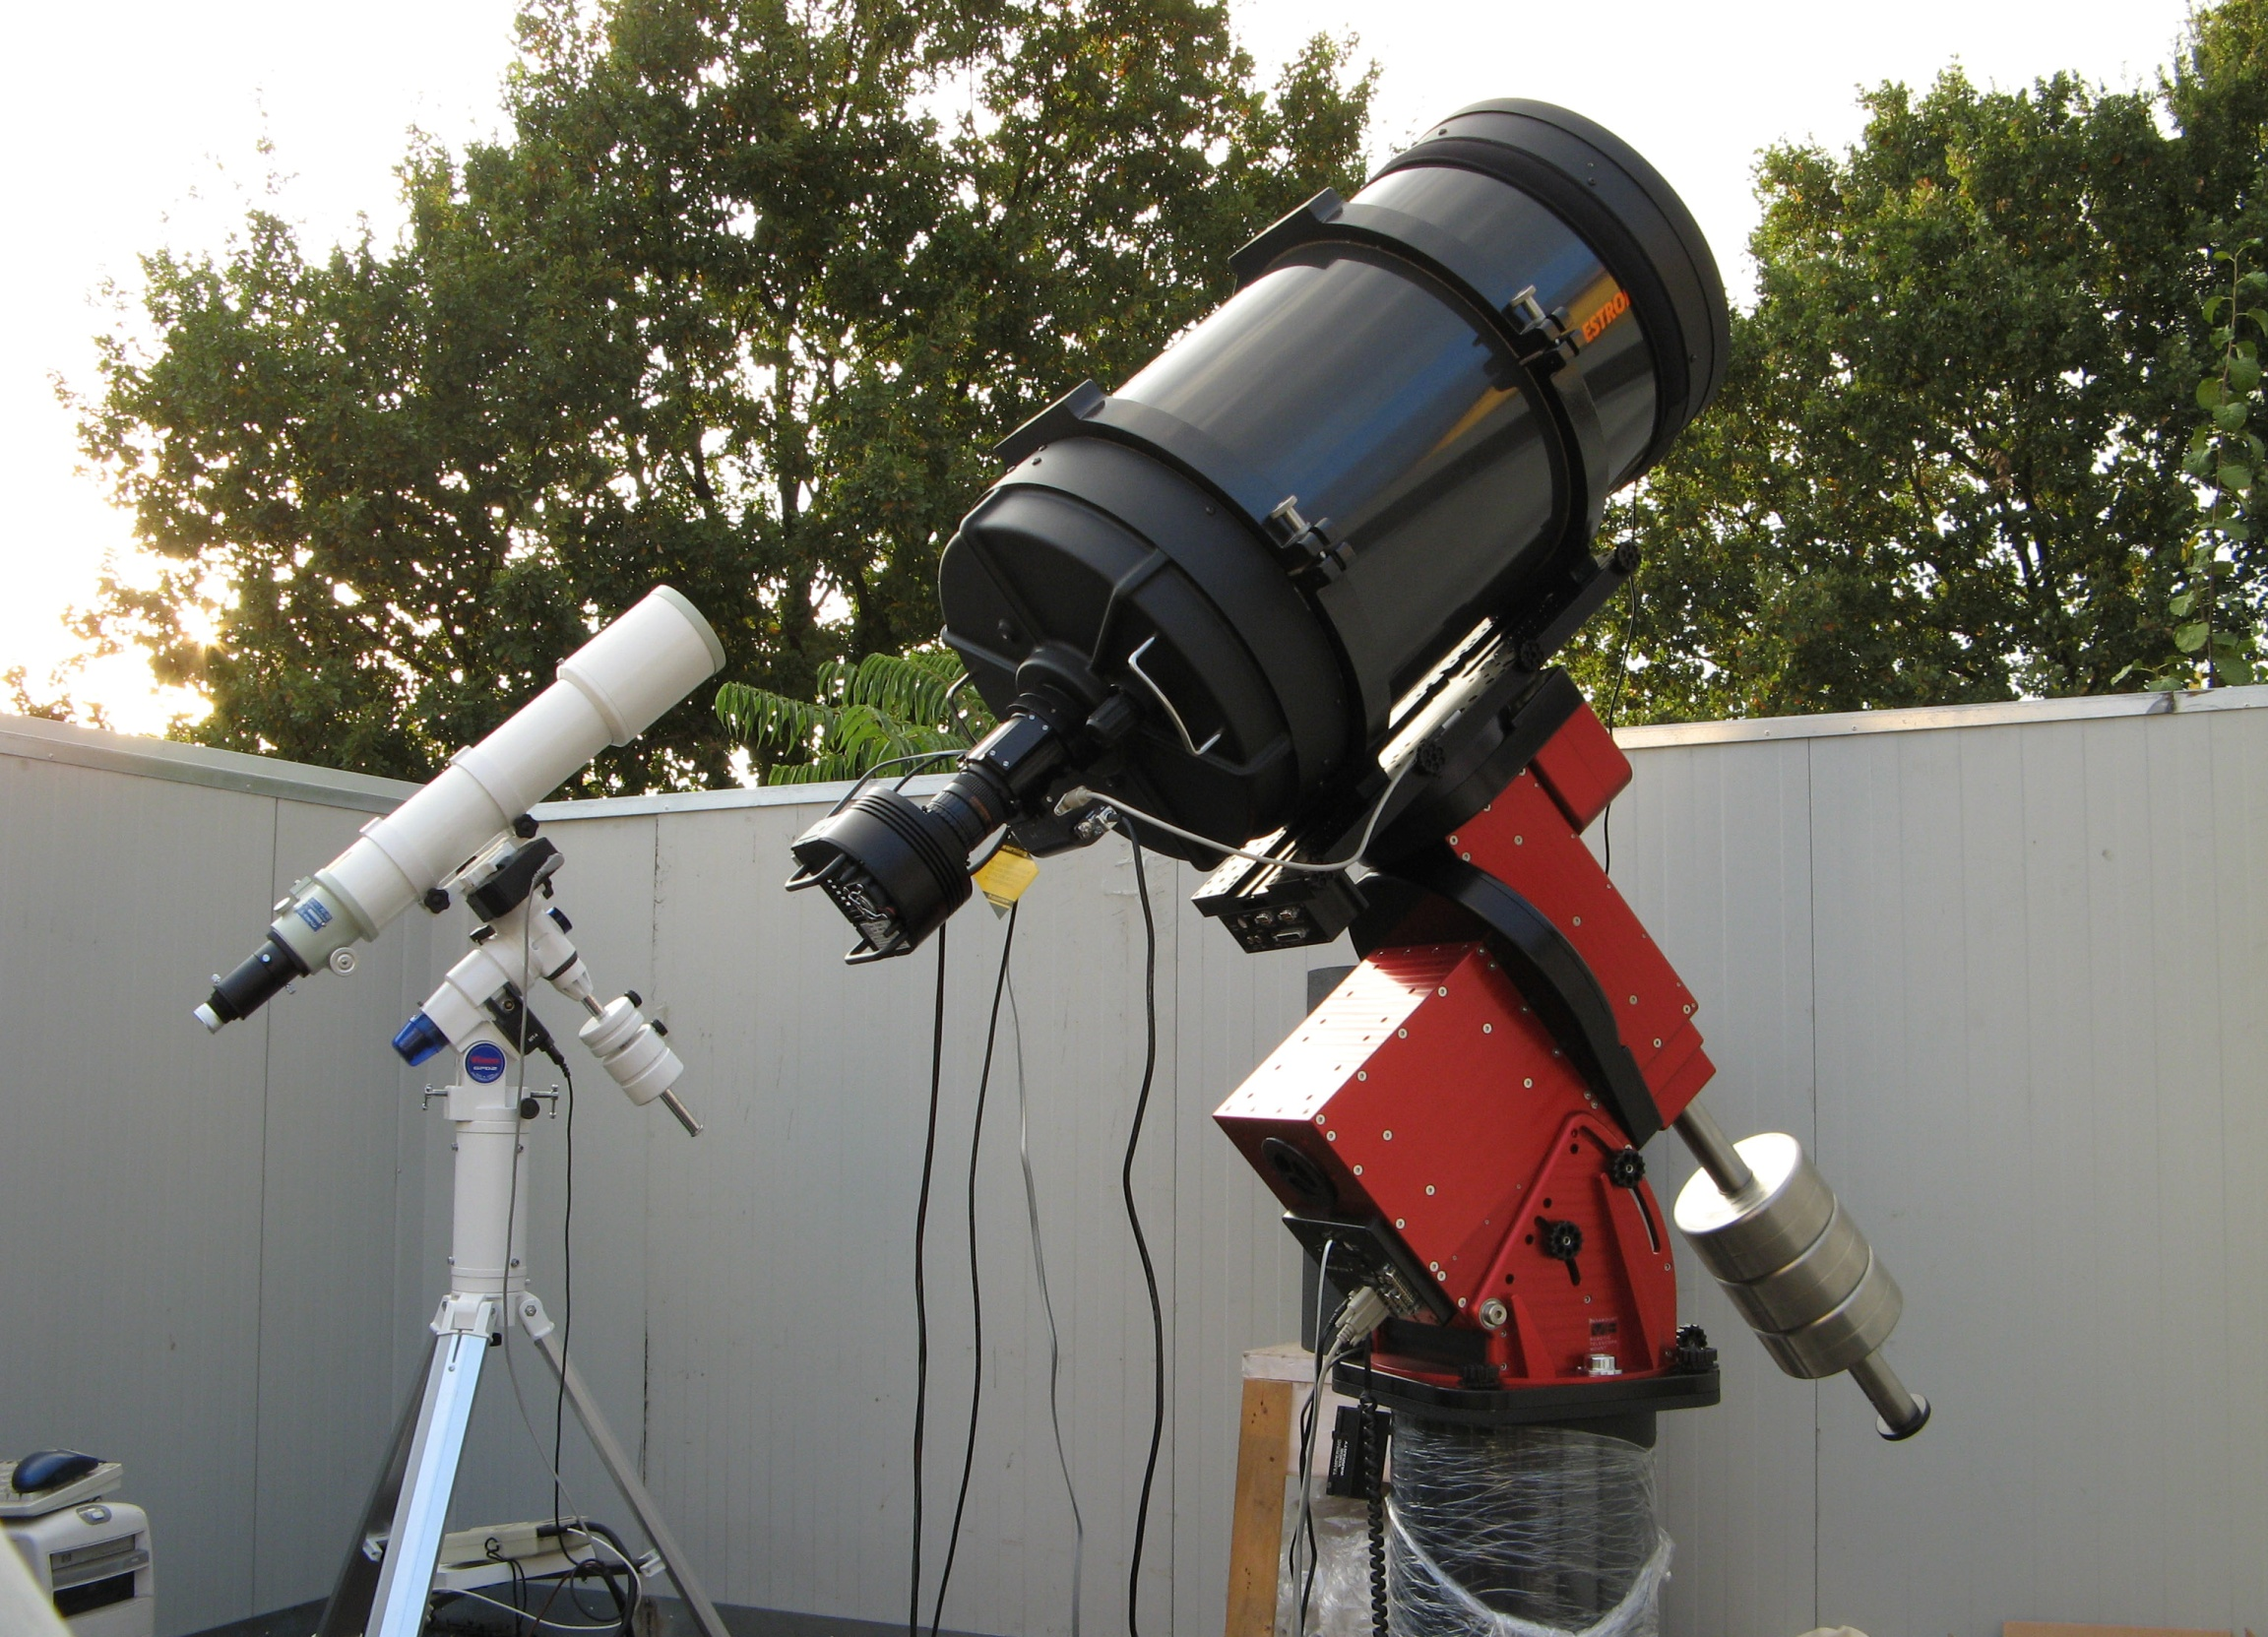

The Virtual Telescope Project
Quick facts
Active since 2006, a pioneer in live, online astronomy and observations (i.e.: IYA2009);
1.5 million web visitors per year on average;
more than 200 Countries involved;
almost 200 FREE online events over the last 4 years;
featured by the most important media, press and space agencies of the world;
member of IAWN.
Asteroid/Comet astrometry & photometry; exoplanets; variable stars, transients, spectroscopy.
Outstanding scientific results:
- discovery of blazar candidate VTP J004354.36+404634.0;
- discovery of a nova candidate in the Andromeda Galaxy;
- codiscoverer of ASASSN-15lh;
- codiscoverer of the XO-2b and XO-3b exoplanets;
- codiscoverer of many supernovae and variable stars.

Slide 7
The Virtual Telescope Project
Near-Earth asteroids have always been the major topic: 50% of the live events.
The most popular topic ever, the most successful events!
Strengths:
The VTP developed its own original format, significantly raising awareness on the importance of NEO science and planetary defense;
looking through a telescope, even if «virtual», is always mind-blowing;
sharing live images of NEAs dramatically increases engagement;
real observations, commented live, unveiling how science work;
the experience helps people understanding the need of a planetary defence program;
seeing THAT asteroid, the one everyone is talking about, is COOL: «I Was there!».

Slide 8
The Virtual Telescope Project
The Virtual Telescope Project revealed to be very precious for the international media.
Strenghts
Original images/footage/comments from a very reliable, professional source;
materials always made readily available;
coverage of many different astronomical events.

Slide 9
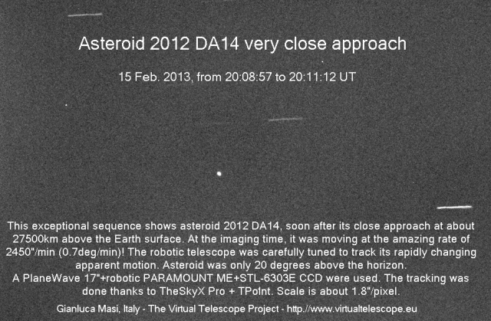

Slide 10
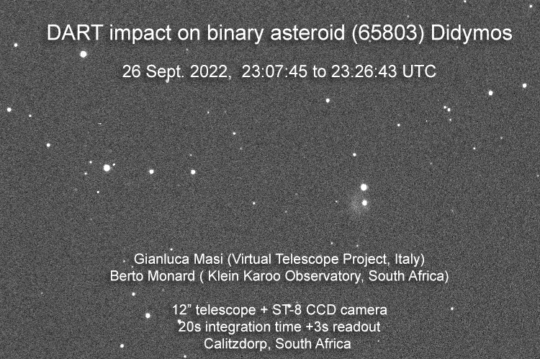

Slide 11
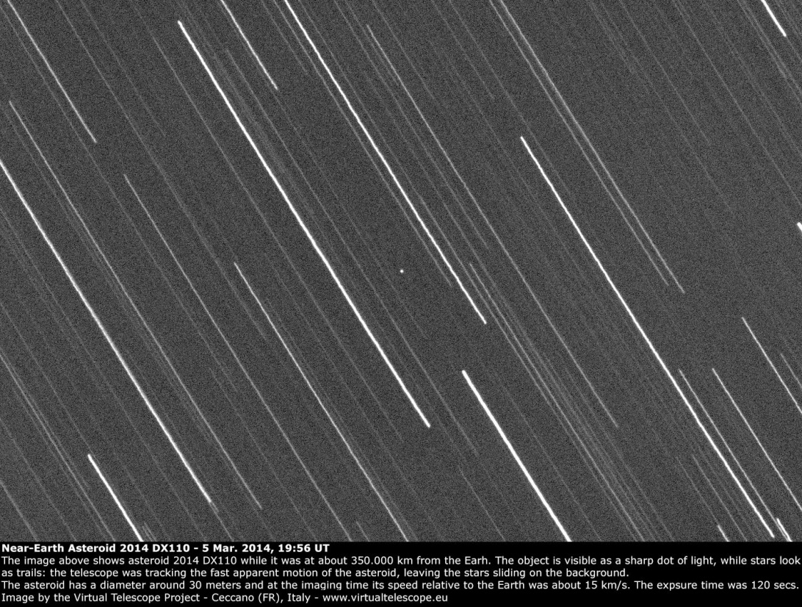
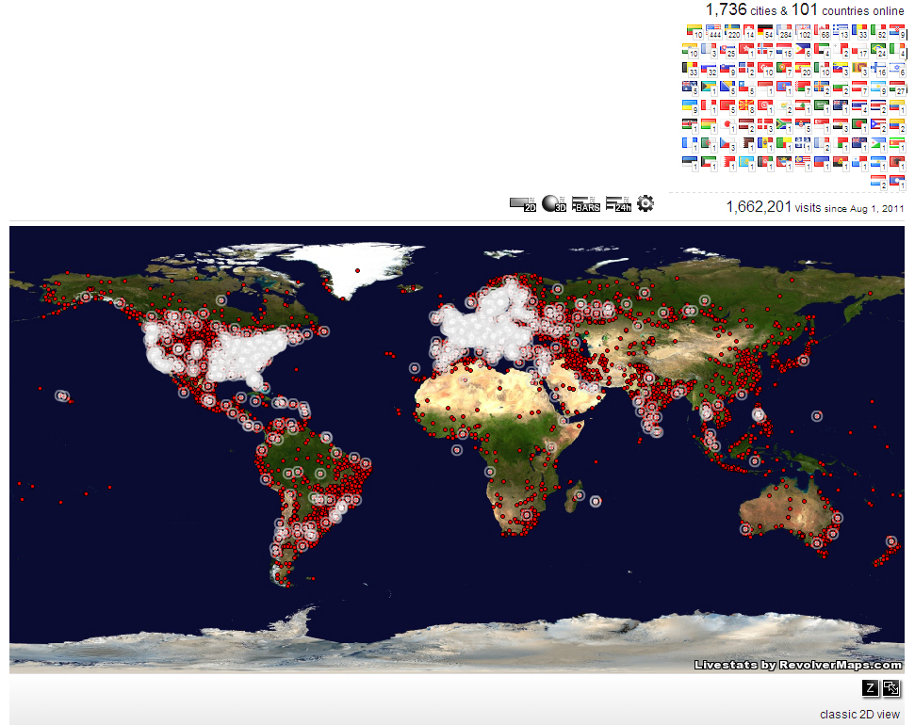

Slide 12
The Virtual Telescope Project
The future
We will continue covering and sharing live the most interesting close approaching asteroids (as well as other astronomical events);
In 2029, the Virtual Telescope Project will provide a complete coverage of Apophis;
We are working to install a mid-size telescope to do some survey work involving students.

Slide 13

Thank you for your attention
Technological Partners: Software Bisque, Seeweb, Telescope Live

