Slide 1





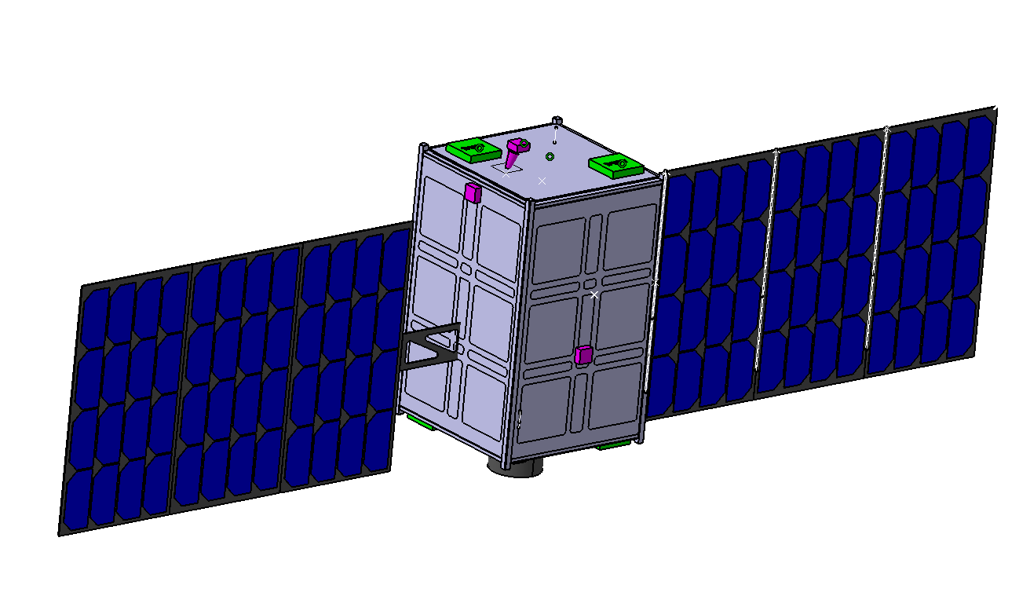
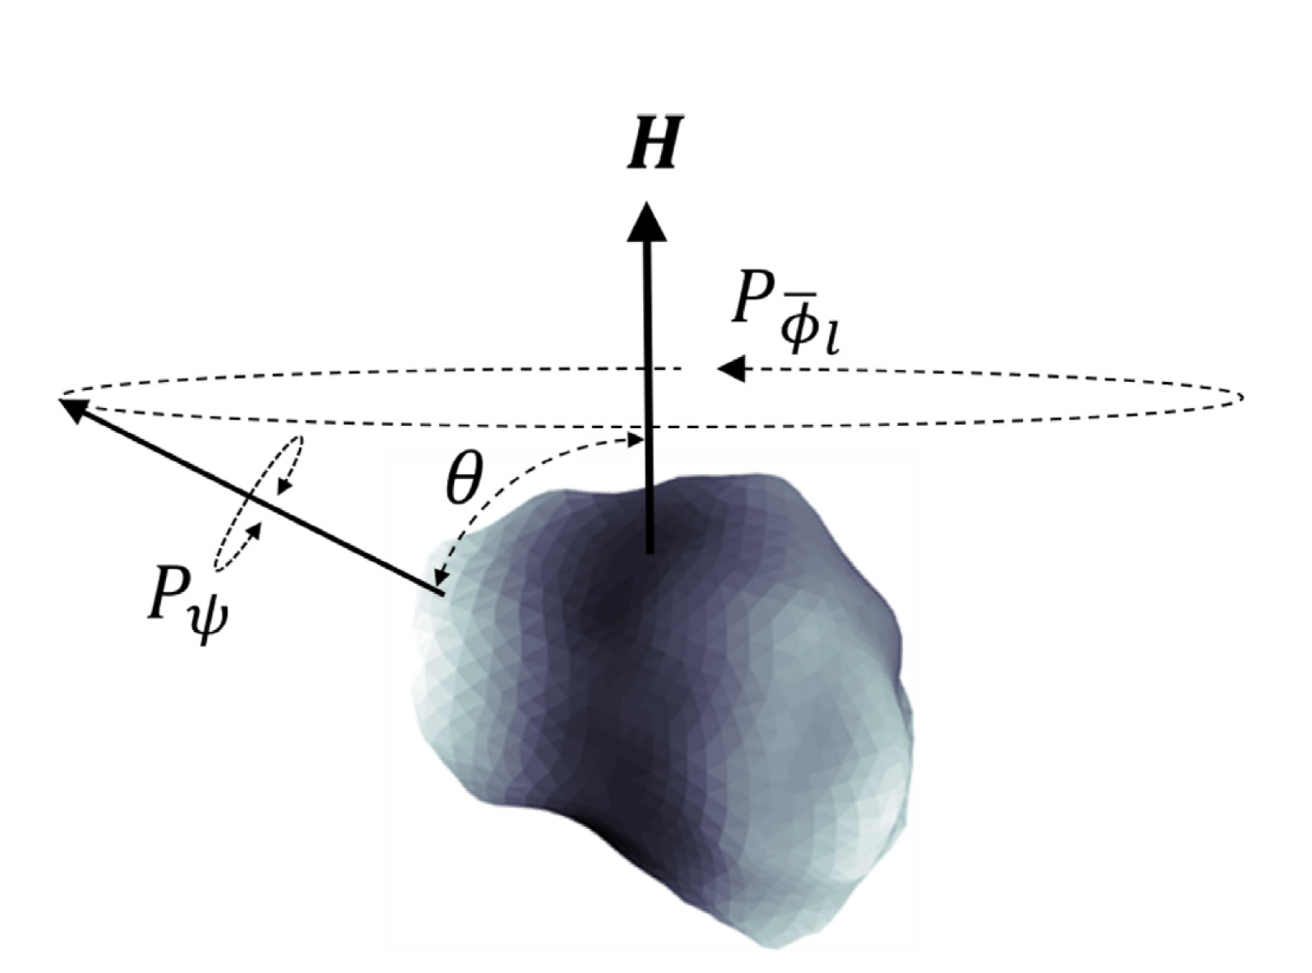
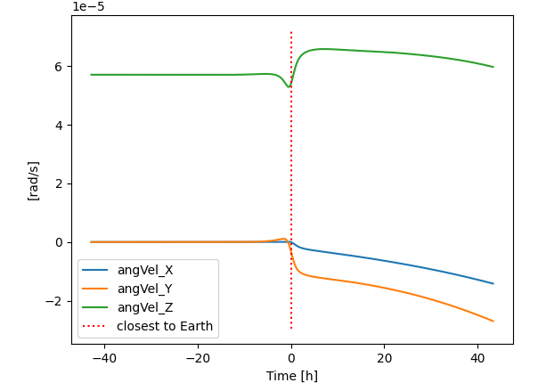
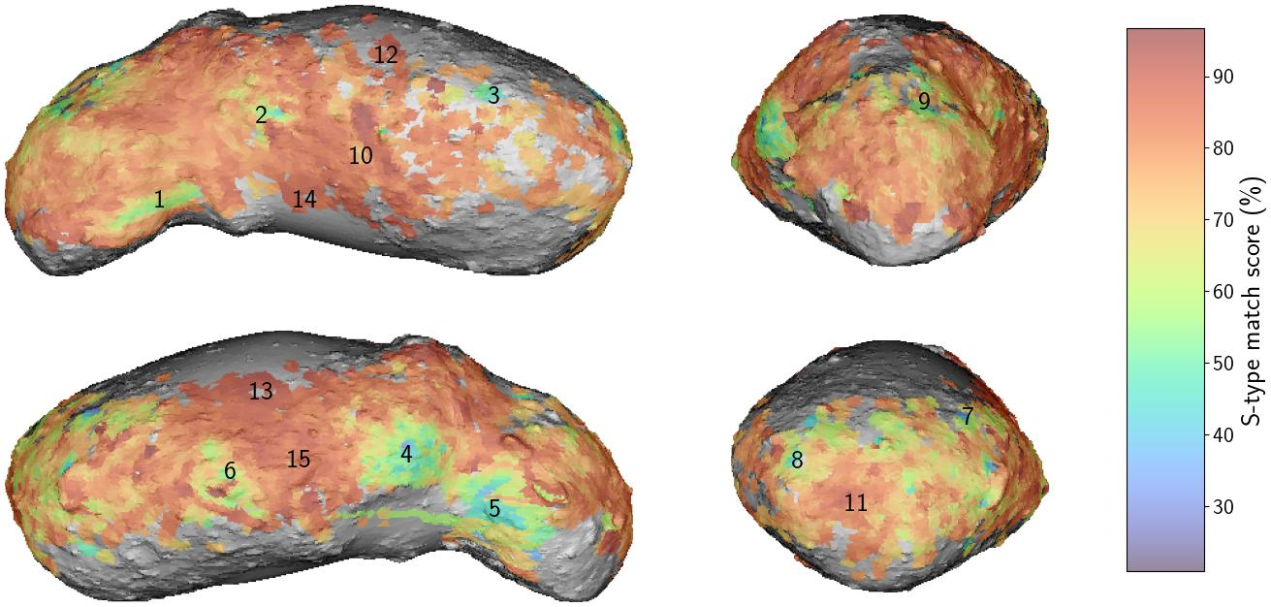
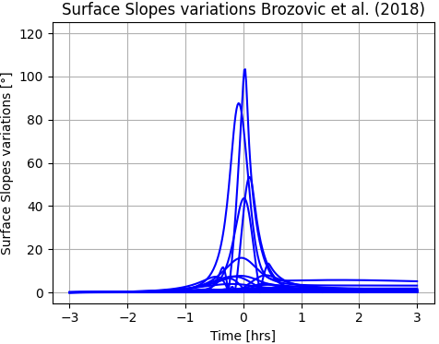
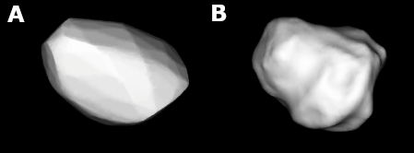
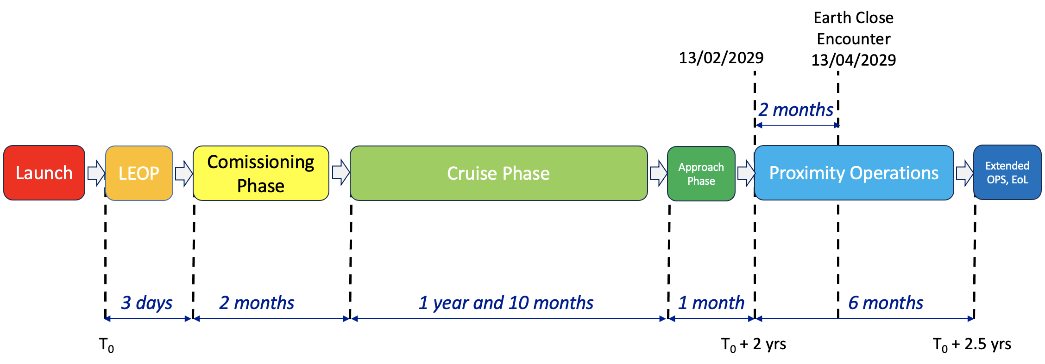
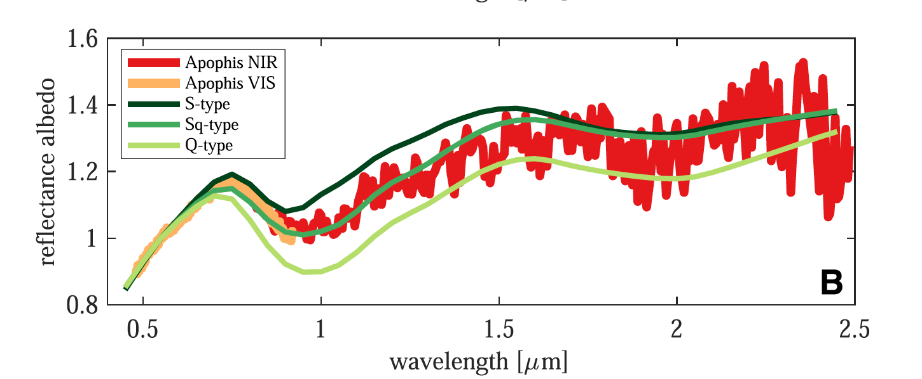
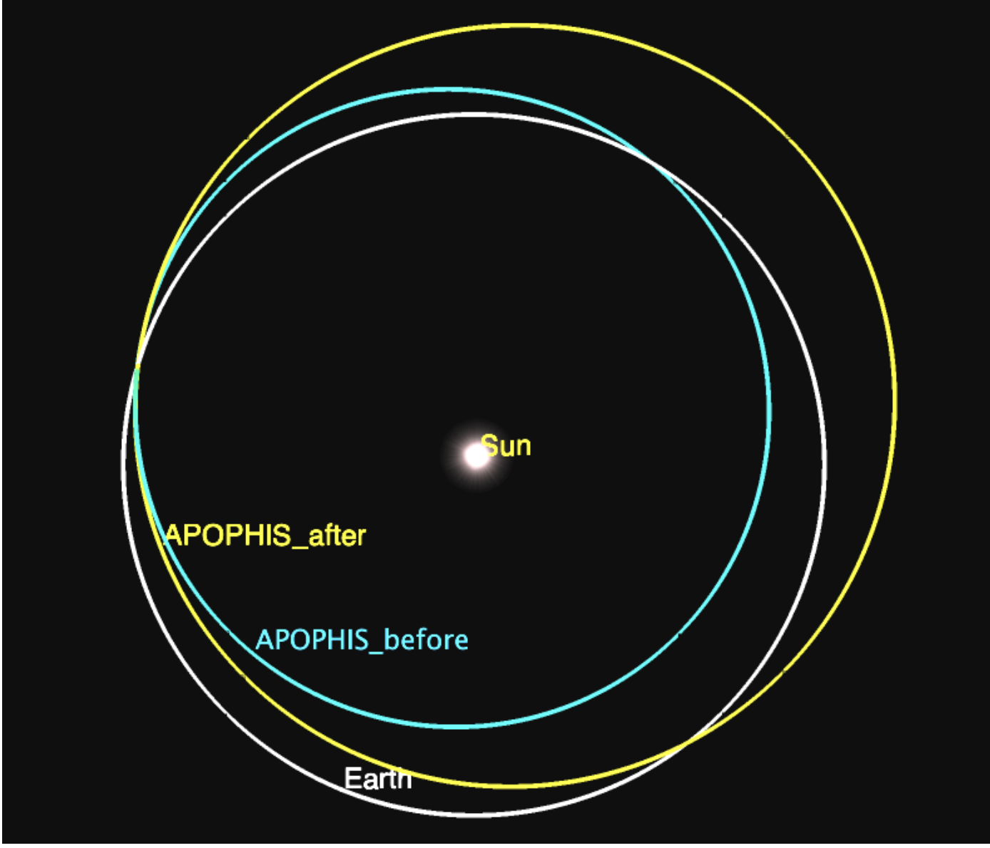
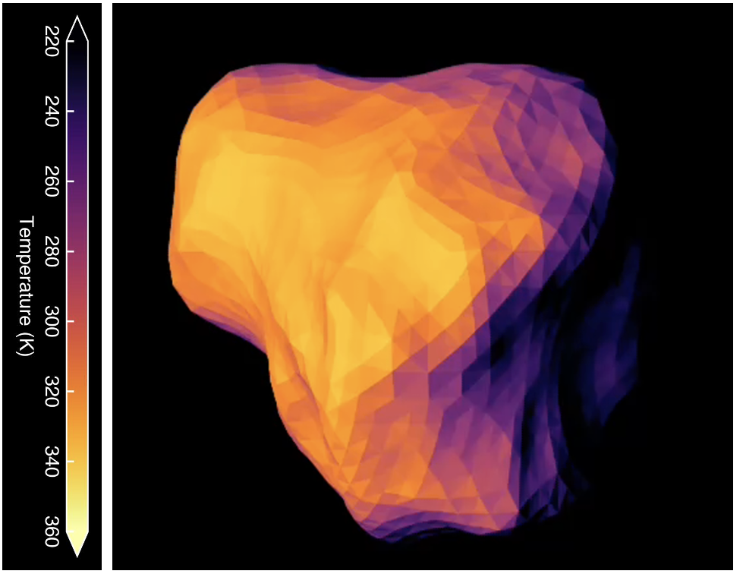
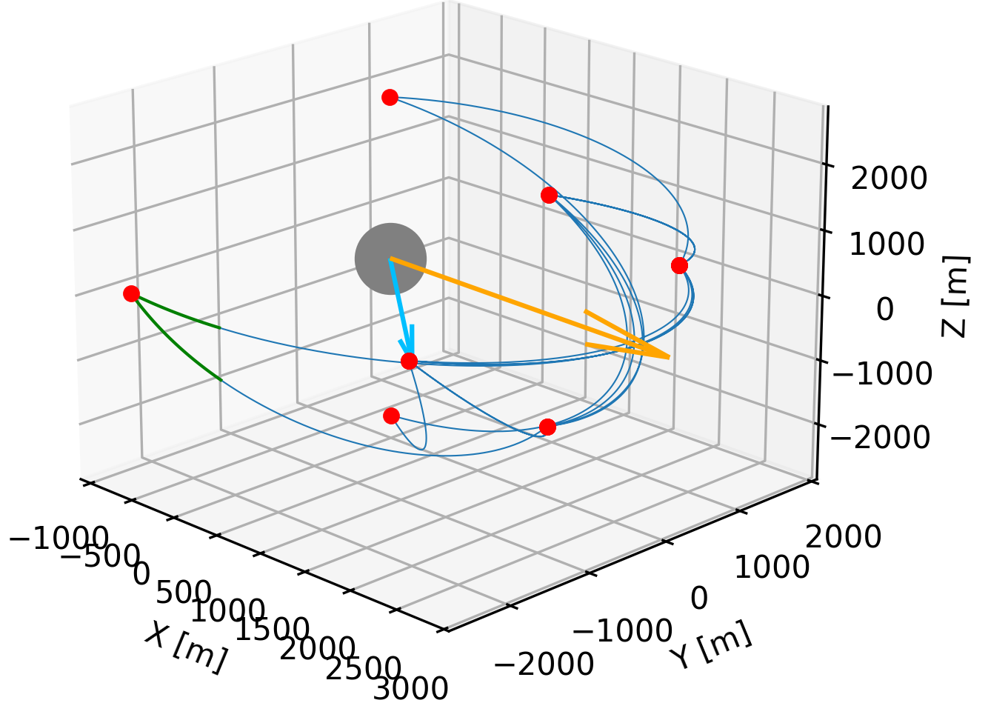
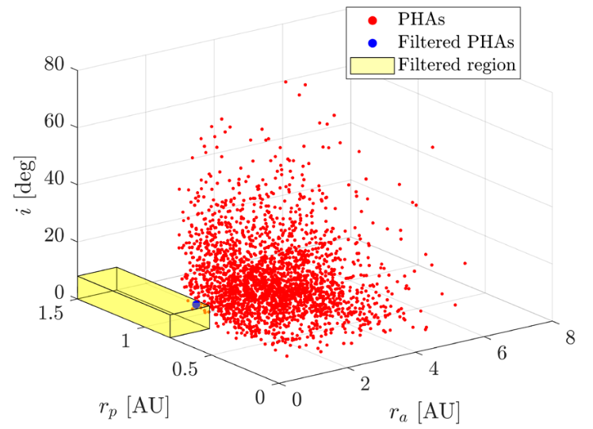
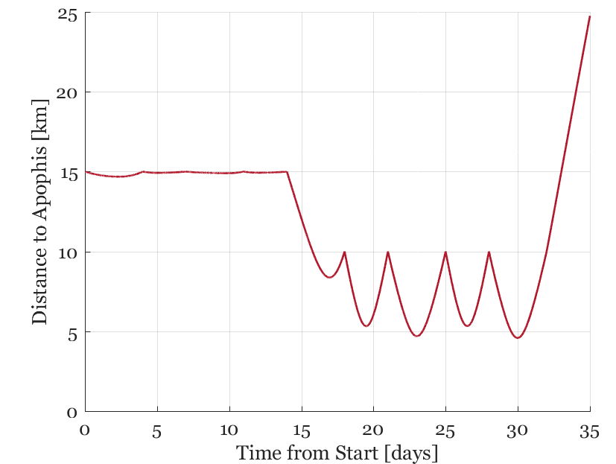
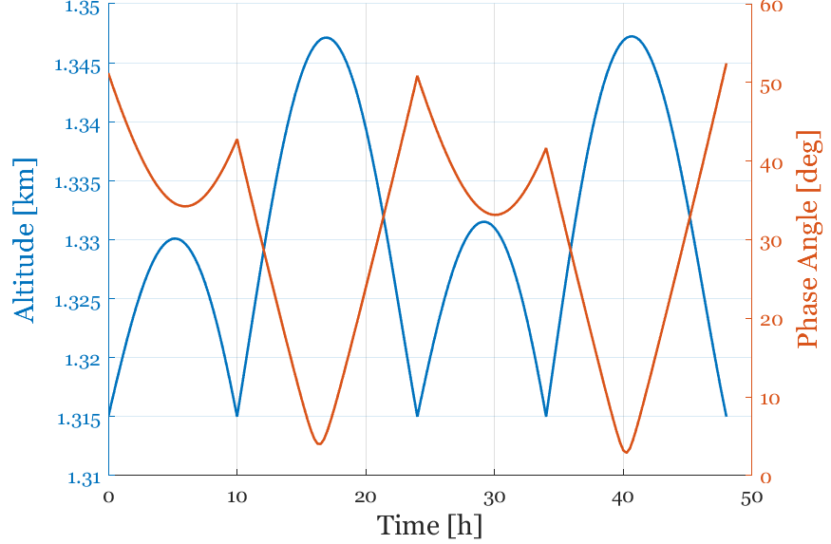
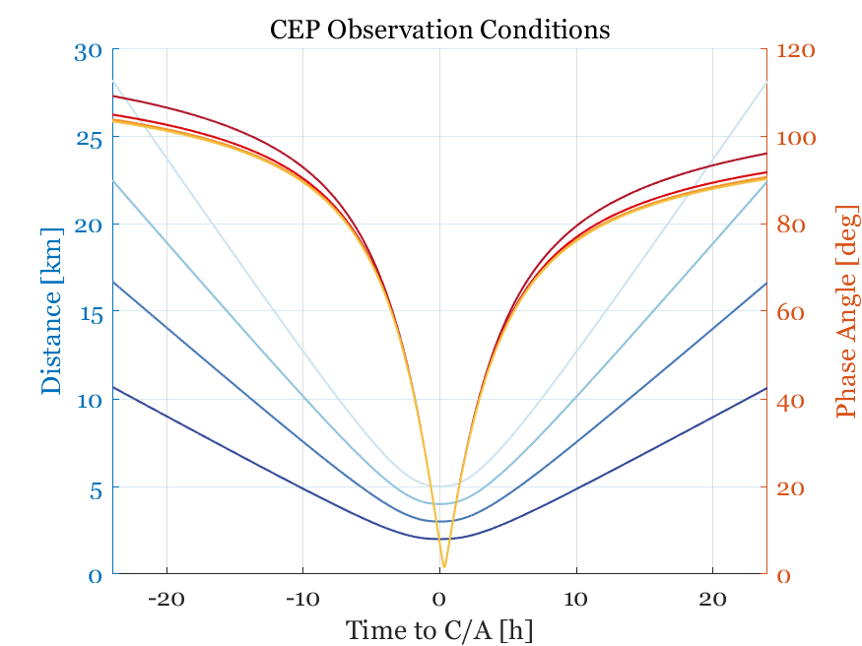
IAA-PDC-25-02-199
Satis: a fast-response ESA Planetary defence mission
Ö. Karatekin⁽¹⁾, B. Ritter ⁽¹⁾, B. Gundlach⁽²⁾, C. Güttler⁽²⁾, M. Patzek⁽²⁾, F. da Silva Pais Cabral⁽³⁾, D. Catisanu⁽³⁾, V. Fogliano⁽⁴⁾, P. Holster⁽⁴⁾, S. Simonetti⁽⁵⁾, R. Walker⁽⁵⁾, R. Moissl⁽⁵⁾
(1) Royal Observatory of Belgium, Brussels, Belgium (Ozgur.Karatekin@Observatory.be); (2) Institeute for Planetology, University of Münster, Germany; (3) GMV, Portugal; (4) Redwire Space, Belgium; (5) ESA – ESTEC, The Netherlands
Satis – an ESA planetary defense mission study
Science Objectives
The Satis Mission : Phase A
A stand-alone 12U-XL CubeSat
Fast response planetary defense mission
Launch on dedicated micro-launcher with kick stage
Ion Thruster Engine
thrust ~2 mN, SI ~3000-4000 s
Phase A study (finalized in Q4 2024):
Apophis rendez-vous prior to its Earth Close Encounter in 2029
Launch in 2027
Identified launch windows:
April/May
Oct./Dec. 2027
Direct insertion into the transfer orbit with an escape velocity of about 4km/s.
Primary payload:
Visible Camera (VIS)
Thermal Infrared Camera (TIR)
Radio Science (RS)
Secondary payload:
VIS-NIR spectrometer
Mission timeline:
By arriving several weeks before the Apophis flyby, shall monitor the response of Apophis on Earth’s gravitational forces.
Science Objective |  | Investigation | Measurement
Sci-1 | Internal properties | Density, mass, interior mass distribution | Gravity field, shape model, dynamical state
Sci-2 | Surface properties | Surface composition, cohesion, strength | Surface spectral reflection and absorption, grain size, potential movement of material
Sci-3 | Dynamical properties | Orbit and rotational state (+ thermal properties for Yarkowski/YORP effect) | Rotational dynamics, thermophysical properties
Satis spacecraft, 12U-XL CubeSat
Axis | Prior Period [hr]
P_{φl} Av. precession P | 30.56
𝑃_{𝜓} Long axis rot P | 263
Using flyby-induced changes in the observables:
Sci-1 The moment of inertia is a measure of internal mass redistribution and is directly linked to the conservation of angular momentum. Measuring the rotational states before and after the earth encounter allows to understand internal mass redistribution and any changes caused by the flyby to its interior.
Sci-2 Surface geophysical activities like avalanches, landslides or global shape deformation may occur due to external gravitational forces during the earth flyby. The observation (or non-detection) allows to estimate the cohesion of surface material which determines how asteroid surfaces respond to external forces and disturbances.
Sci-3: How will the gravitational interaction (+ thermal effects) affect the orbital evolution of Apophis and in general PHA.
Possible rotational changes of Apophis during Earth flyby, simulated with GUBAS. [1]
Left:
Simulated changes in the gravity surface slopes that could lead to landslide and expose fresh surface material. [2]
Bottom left:
Predicted changes in Apophis orbit. [3]
Bottom right:
Thermal modeling of Apophis. [4]
Low-thrust transfer [Ecliptic J2000]
Proximity Operations
Outlook
Phase | Sub-Phase | Timeline | Duration | Objectives
Pre-Encounter Phase (PREP) | Asteroid Characterisation Phase (ACP) | 13/02/2029-15/03/2029 | 4 weeks and 2 days | First two weeks @30-15km (TBC): Early characterization of the dynamical system Commissioning of the autonomous GNC system Detailed Characterisation @10km: Detailed Dynamical System Estimation First Scientific Tasks (Calibrations, etc) Approach and insertion for Phase COP
 | Close Observation Phase (COP) | 15/03/2029-12/04/2029 | 4 weeks | Reaching the required maximum scientific resolution and coverage when using the payload instruments. The distance from the asteroid surface will be decreased down to 1 km when flying the bow-tie trajectories.
Close Encounter Phase (CEP) | - | 12/04/2029-14/04/2029 | 2 days | Scientific Return Maximization Ensure SC safety under poorly known conditions Avoid bright objects (Sun, Earth, Moon) from FoVs of payload that might be affected The distance from the asteroid surface will be range between 2-5 km when flying the ballistic arcs.
Post-Encounter Phase (POSP) | Asteroid Characterisation Phase (ACP) | 14/04/2029-09/06/2029 | 4 weeks | Re-characterization of the dynamical system @ 10 km (TBC) Detailed Characterisation First Scientific Return Approach and insertion for Phase COP
 | Close Observation Phase (COP) | 09/06/2029-04/08/2029 | 12 weeks | Meet Scientific Resolution, Illumination and Coverage requirements The distance from the asteroid surface will be decreased down to 1 km when flying the bow-tie trajectories
Experimental Phase (EXP) | - | TBD | TBD | Observations extremely close to the surface, hovering, experiments in synergy with other spacecrafts, landing attempt.
End-of-Life Phase | - | TBD | TBD | Safely dispose of the spacecraft
Satis Phase B will start in 2025
General fast response planetary defence mission
NEA, PHA targets
Updated launch date
Focus on alternative PHA/NEA targets in reach with Satis concept
The Minor Planet Center (MPC) database contains > 1.3 million of objects
filtering on orbital parameters
~ 250 object including PHA
ACP
Hyperbolic arcs in 3-4 day cycles
COP
Bow-tie trajectories & hovering stations
CEP
Ballistic Arcs, 2-5 km
Filtered targets, study by Polimi
References
[1] Noiset, G. Tasev E. Karatekin O., EPSC 2022
[2] Tasev, E., Sert, H., Karatekin, O., EPSC 2024
[3] Doton et al. Apophis Specific Action (SAT) Team Report,
70238398, USGS Publications Warehouse, Astrogeology Science
Center 2022.
[4] KALAST thermal modeling code at Royal Observatory of Belgium, G. Henry et al., 2024
9th Planetary Defense Conference | 05 – 09 May 2025 | Stellenbosch, Cape Town | South Africa

